Slide 1
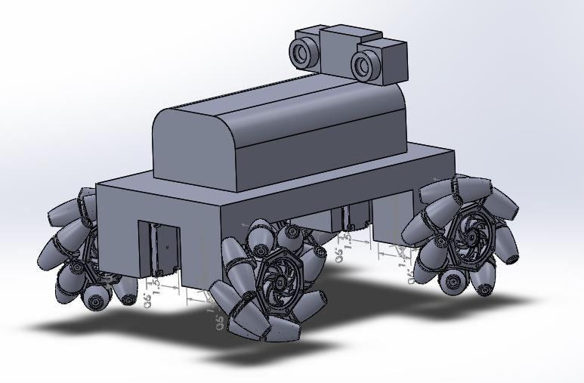
GROUP #4 Chris Carmichael Ismael Rivera Journey Sumlar Warayut Techarut
T-100 WATCHDOG

Slide 2
Project Goals
Autonomous Vehicle
System Integration
Motor Control
Computer Vision
Wireless Communication
Power Control

Slide 3
Requirements
Fully Autonomous
Object Detection within Range
Wireless Communication Capable
Utilize Thermal Camera

Slide 4
Specifications
Feature | Measurement
Dimension | 11” x 6”
Operating Range | 12 ft
Power Supply Voltage | 15 v
Maximum Weight | 20 lbs
Minimum Acceleration | 1 ft/s²
Maximum Speed | 3 ft/s
Battery Life | 3 hrs
Recharge Time | < 8 hrs

Slide 5
Block Diagram

Slide 6
System on Chip (SoC)

Slide 7
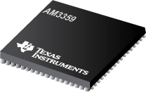

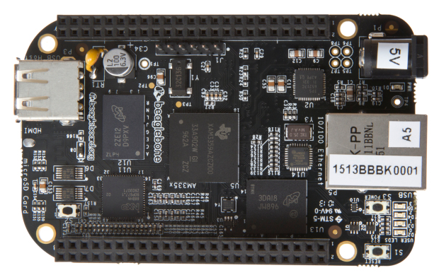
Microcontroller & Development Board
ARM Cortex A8
TI Sitara AM3359
BeagleBone Black

Slide 8
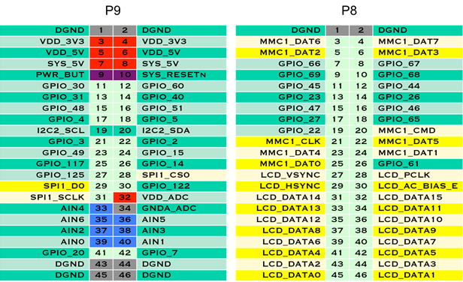
Microcontroller & Development Board

Slide 9



Operating Systems
Angstrom
Included onboard
ArchLinux|ARM
Most Lean
Windows Embedded
Most Integrated

Slide 10
Proximity Sensors

Slide 11
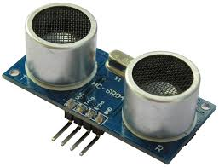
Proximity Sensors
HC - SR04
45 mm
Features | Measurement
Working Voltage | DC 5 v
Working Current | 15 mA
Working Frequency | 40 Hz
Max Range | 4 m
Min Range | 2 cm
15 mm

Slide 12
Object Avoidance

Slide 13
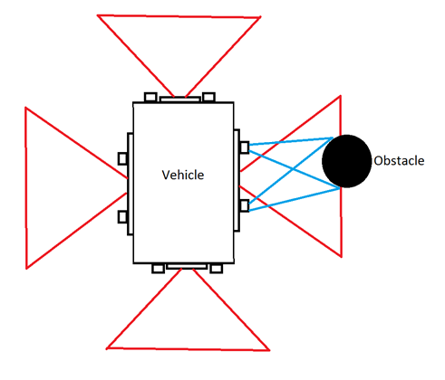
Object Avoidance

Slide 14
Wi-Fi

Slide 15
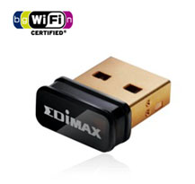
Wi-Fi
Edimax EW-7811Un
IEEE 802.11b/g/n
Compatible with Linux
Small size
Internal Antenna
WEP/WPA/WPA2/WPS Compatible
14.9 mm
7.1 mm
18.5 mm

Slide 16
Computer Vision - OpenCV

Slide 17
Computer Vision - OpenCV
Detect movement
Recognize and track a moving person
OpenCV 2.4.2
Optimized computer vision functions and algorithms
Built-in Object Detection and Tracking functions
ARM Support
Performance varies on functions being utilized.
Motion
Detect any movement
Works together with OpenCV

Slide 18
Computer Vision State Diagram

Slide 19
Server & Streaming

Slide 20
Server & Streaming
Node.js
Enable internet HTTP communication
Web GUI (Optional)
Lightweight on resources under load
TCP (Transmission Control Protocol)
JAVA Implementation (Android Compatible)
Always listening for incoming commands from mobile phone
Very lightweight on resources
Port specific

Slide 21
Server & Streaming
MJPEG Streamer
Streams images from a folder over the internet
Stream and Snapshot functions available
Android compatible stream
Low Resource

Slide 22
Streaming State Diagram

Slide 23
Difficulties
Port Forwarding not possible at UCF
Solution – Use No-IP for Dynamic IP. Overwrite client rule to utilize Local IP instead of External IP

Slide 24
Webcam

Slide 25
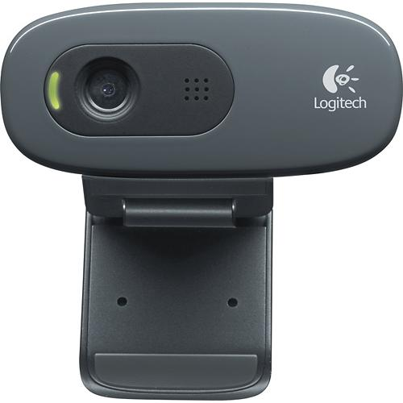
Webcam
8.3 cm
Logitech - HD Webcam C270
USB 2.0 Connectivity
Linux Compatible
Multiple picture/video resolutions available
5 - 15 cm
Notes:
Compare with others

Slide 26
Thermal Camera

Slide 27
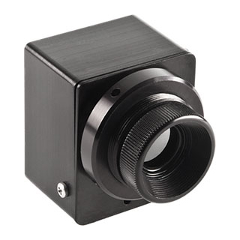
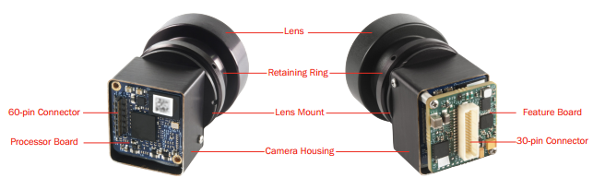

Thermal Camera
DRS Tamarisk 320
Automatic Image Calibration
320 x 240
40° Field of View (FOV)
Low Power (< 1.0 W)
Shock/Vibration Resistant
24 mm.
28 mm.

Slide 28
Difficulties
Analog Video Input
Solutions:
DRS BlackBox – requires a computer/laptop with special serial card and cable. Not compatible with our current setup.
Analog-to-USB frame grabber – convert the analog input to USB.

Slide 29
Analog-to-USB Frame Grabber

Slide 30
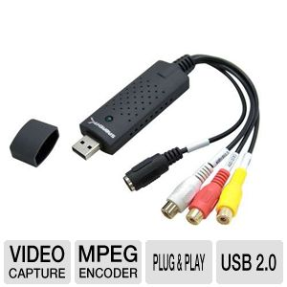
Analog-to-USB Frame Grabber
Sabrent USB-AVCPT
Converts Analog to USB
Compatible with the Thermal Camera
Low Cost
Picture quality is not affected
Size: 7 L x 1.2 W inches

Slide 31
Difficulties
Compatibility Issues - Linux recognizes device but picture is black with green lines at the bottom.
Solution- multiple beta drivers on GitHub, currently testing them.

Slide 32
Mobile Application

Slide 33
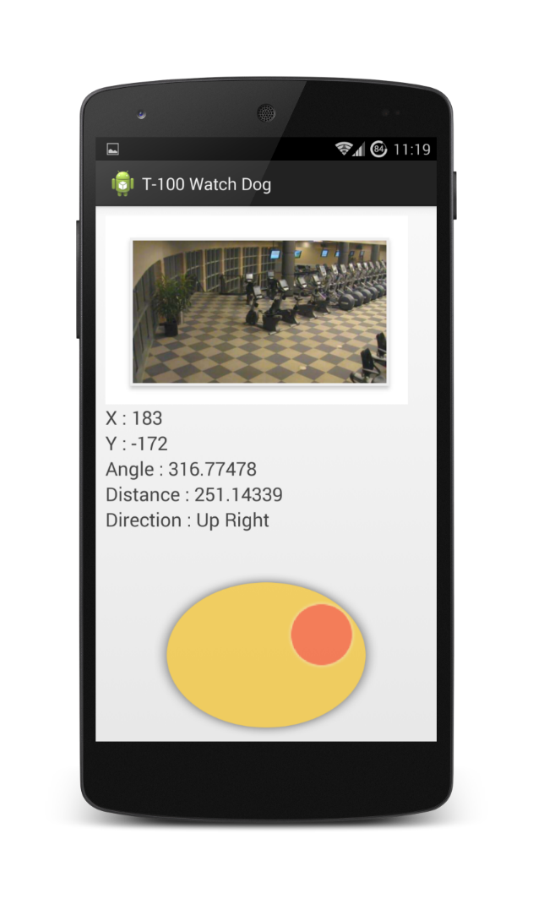
Mobile Application
Support Android 4.0 and newer versions
SQLite Database to store user credentials
Control vehicle remotely
View a live video feed
Store snapshot on the device
Ability to call 9-1-1

Slide 34
Mobile Application State Diagram

Slide 35
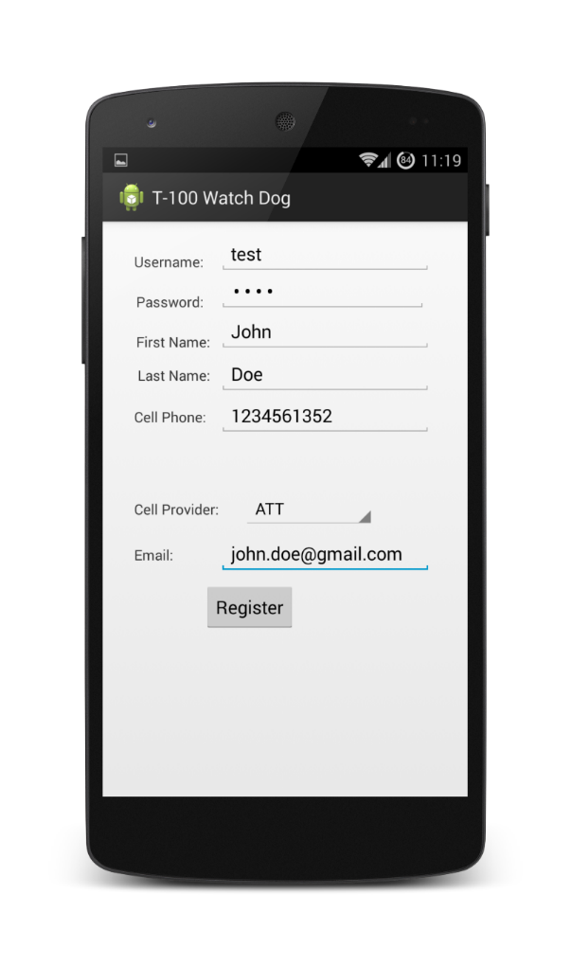
Mobile Application
Registration Section
Allow user to register a username/password combination.
Store cell phone for SMS and MMS alerts.
Supports: AT&T, Sprint, T-Mobile, Verizon, MetroPCS, Boost Mobile, Straight Talk.
Store email for email alerts.
Send SMS, MMS, and Email address to external server via PHP Post method.

Slide 36
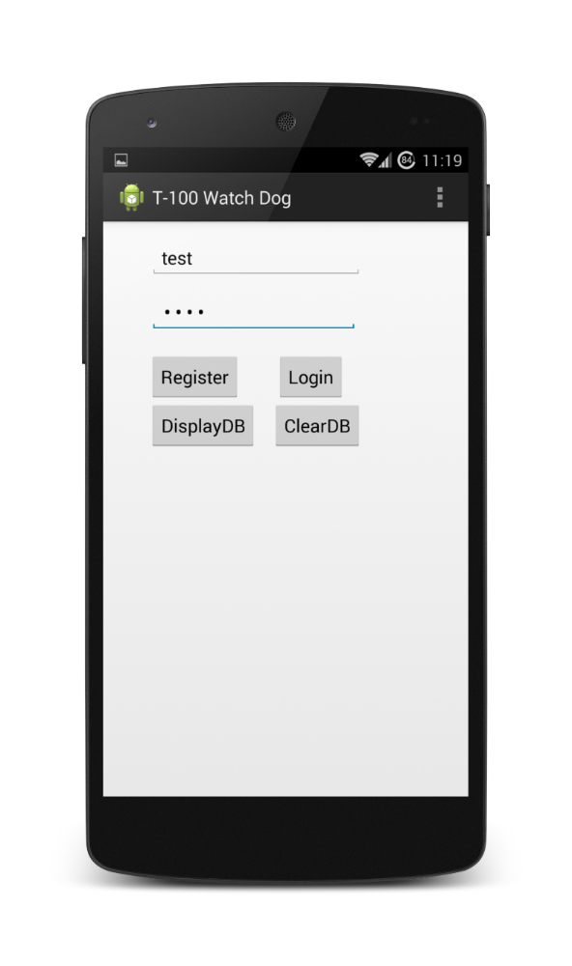
Mobile Application
Login Section
Allows user to register/login
Only authorized users will have access
Performs an Internet Check

Slide 37
Mobile Application
Control Section
View live video feed
Control robot with virtual joystick
Store snapshot
Call 9-1-1

Slide 38
Motor Controller, Motors, & Wheels

Slide 39
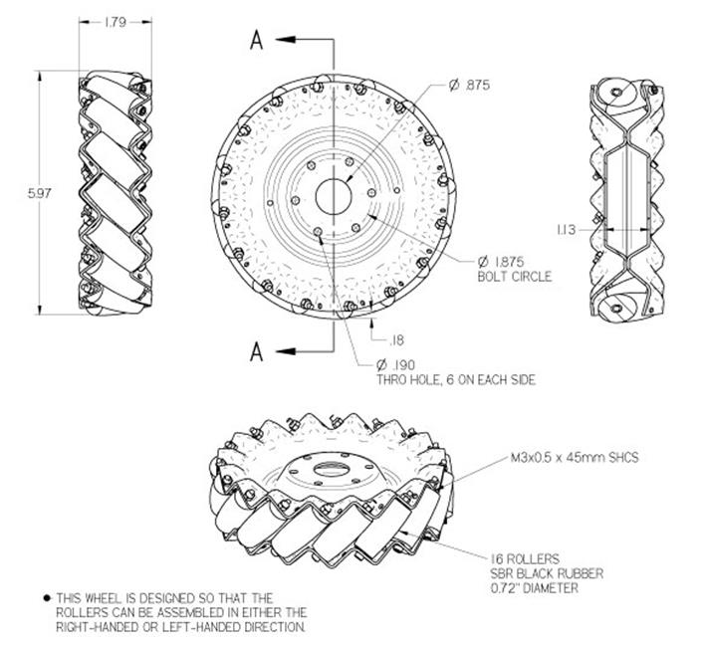
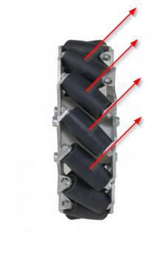
Mecanum Wheels
Notes:
Add Diagrams

Slide 40
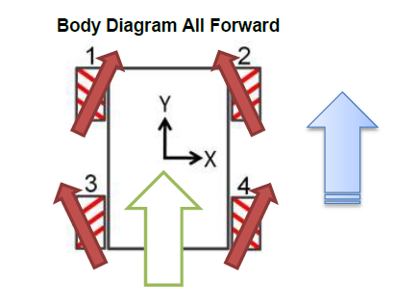
Mecanum Wheels
Notes:
Add Diagrams

Slide 41
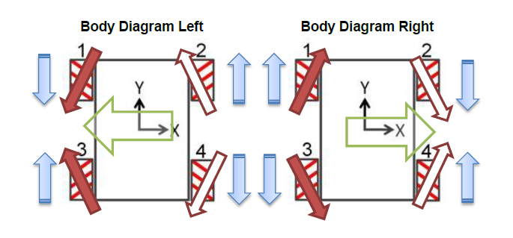
Mecanum Wheels
Notes:
Add Diagrams

Slide 42
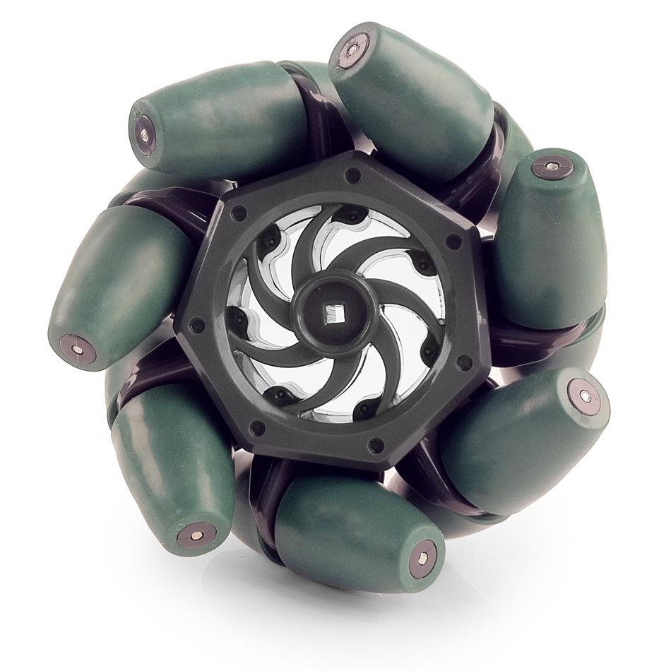
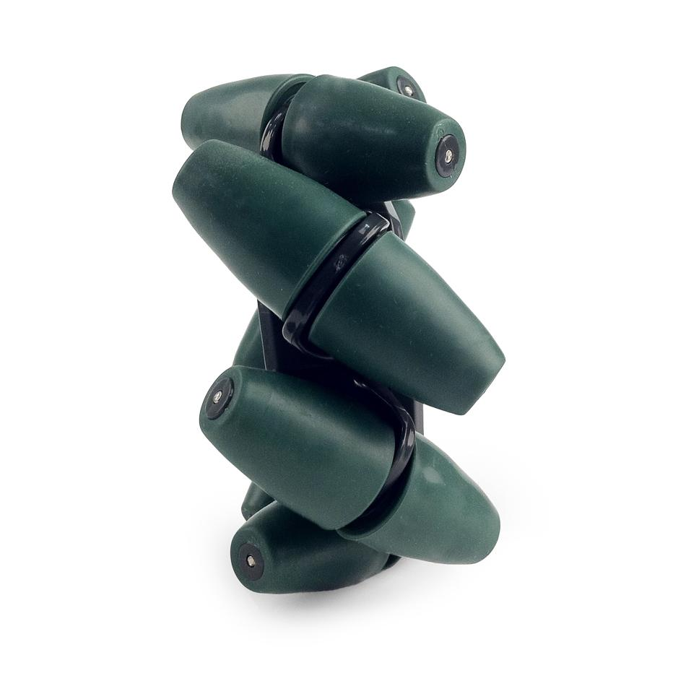
Mecanum Wheels
Vex Robotics Mecanum Wheels
Affordability
$59.99 4 pack
Diameter: 4 in.
Thickness: 2 in.

Slide 43
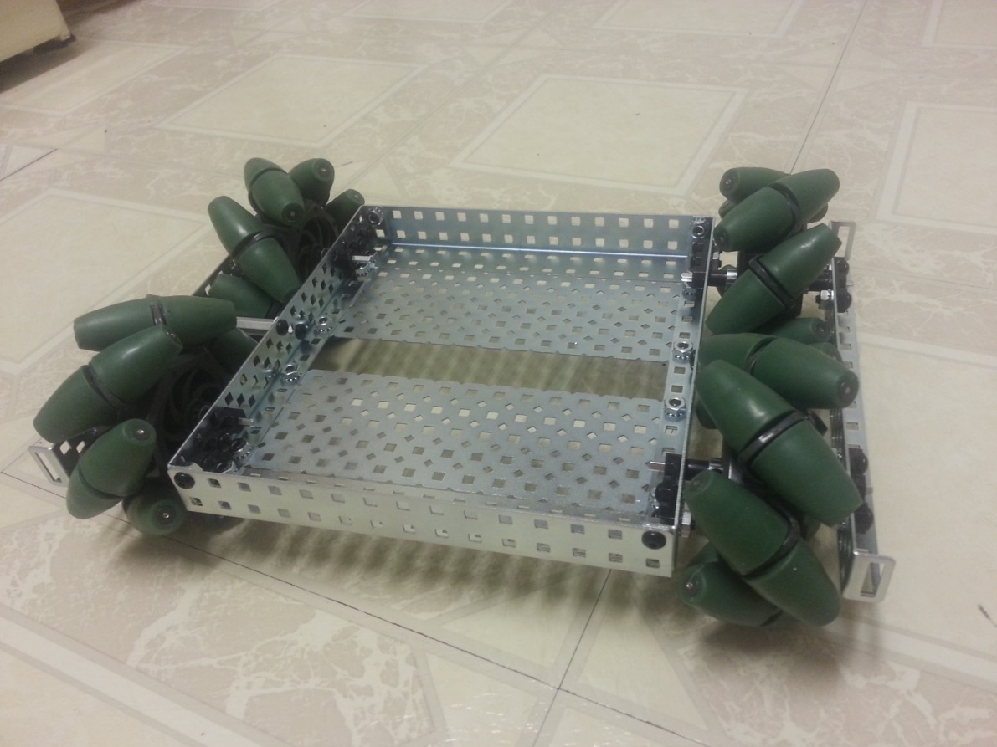
Platform
Perforated Aluminum – Lightweight
2 pounds with wheels included
Easily Adjustable
12 in.
8 in.

Slide 44
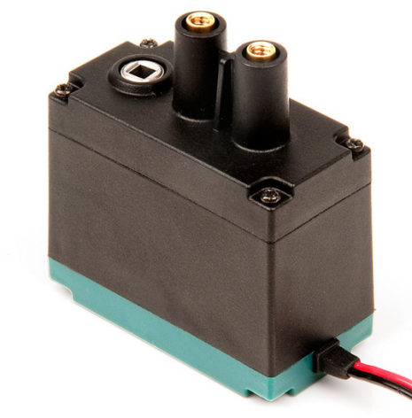
Motor
VEX 2-Wire motor 393 | Requirements | Specs-Low Speed | Specs- High speed
Price | < $20 | $14.99 | $14.99
RPM’s | 130 | 100 | 160
Torque | 1.3 Nm | 1.67 Nm | 1.04 Nm
Weight | < .5 lbs | .2 lbs | .2 lbs
Stall current |  | 4.8 A | 4.8A
Max Power | All measured at 7.2 V | 34.56 W | 34.56 W
2 in.
1.5 in.
1 in.
VEX 2-Wire motor 393

Slide 45
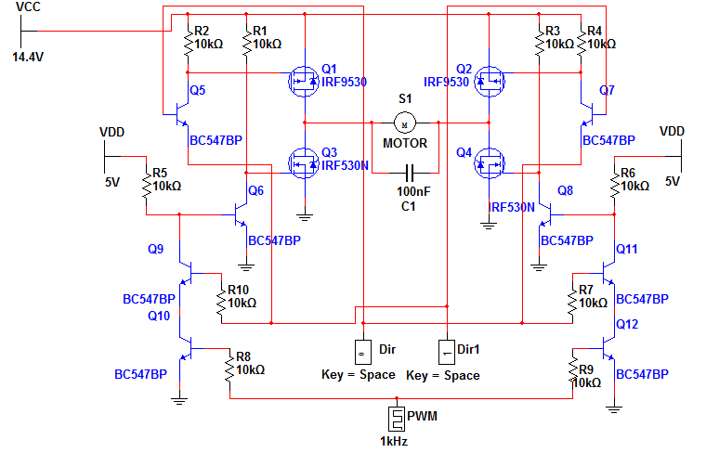
H-Bridge Circuit

Slide 46
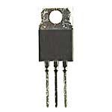
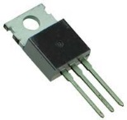
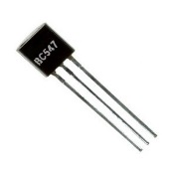
H Bridge Components
IRF 9530 P-Channel | IRF 530 N-Channel | BC547
100 Vds | 100 Vds | 47 V Breakdown
12 A | 14 A | 100 mA
$1.29 | $1.03 | $ 0.20
10 K OHM Current Limiting Resistors

Slide 47
Controller Budget
Component | How many | Price per unit | Total
MSP430G2552 | 4 | 2.79 | 11.16
IRF9530 | 8 | 1.29 | 10.32
IRF530 | 8 | 1.03 | 8.24
BC547 | 64 | 0.20 | 12.80
Capacitor(100nF) | 4 | .05 | 0.20
Resistor (10k) | 40 | .04 | 1.60
Total: (without pcb) |  |  | 44.32

Slide 48
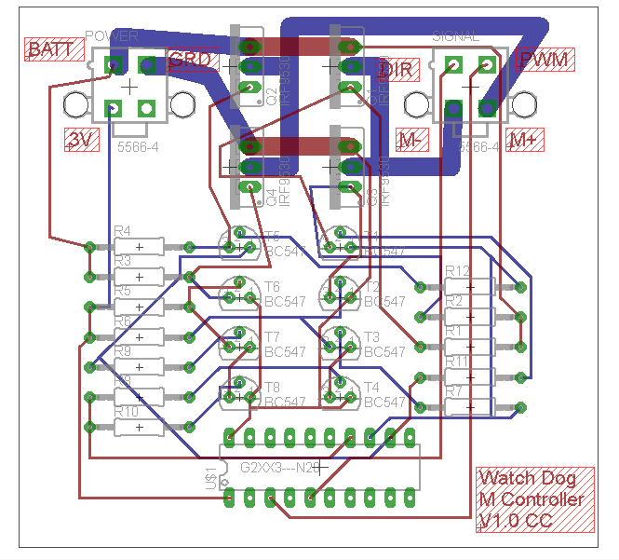
Motor Controller- PCB
Specifications
3”x3”
Thick Traces for high current lines
2 layer
$33- 60 square inches 4pcb.com

Slide 49
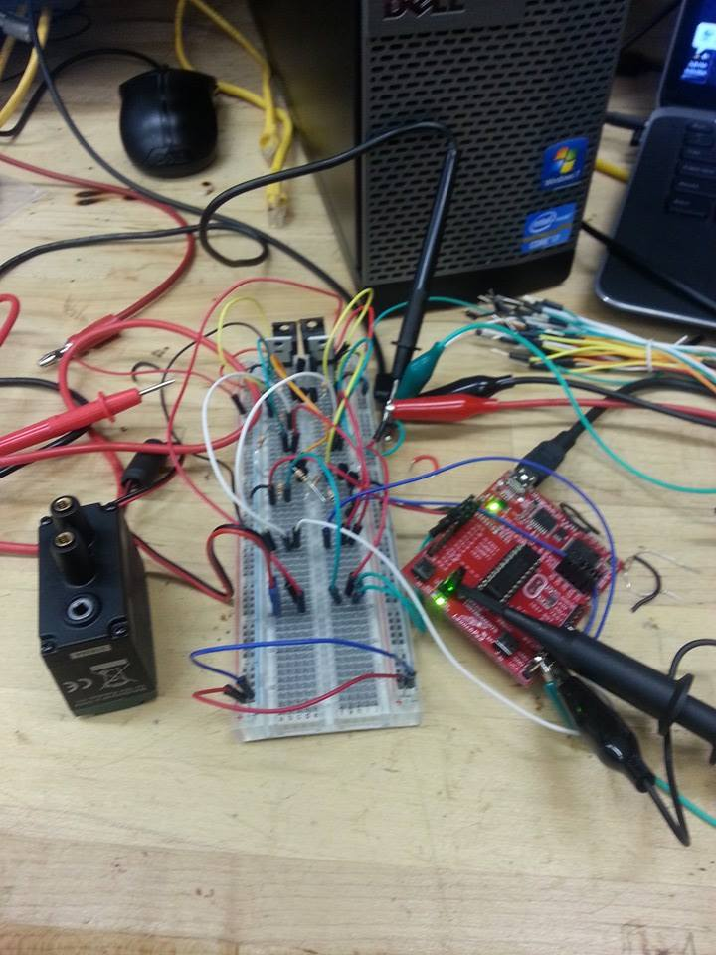
Testing
Tests
Digital Signal controls Motor Direction.
Analog signal from 0-3 V controls duty cycle of PWM from 0-100% in steps of 1.61%
3.6 A continuous through MOS-FET’s without noticeable heat production

Slide 50
Difficulties
Heat Dissipation with PCB
Solution-Add a heat sink if we have heat dissipation issues
Current Capabilities of PCB
Solution – remake PCB utilizing thicker traces

Slide 51
USB Power Hub

Slide 52
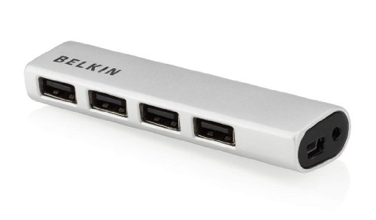
USB Power Hub
Beagle Bone Black only has 1 USB port
2.0 USB Ports
Input voltage is 3-5V
Constant power to each USB port
Weight 8 oz.
1 in.
.5 in.
6 in.

Slide 53
Power Management & Battery

Slide 54
Single Power Supply or Multi Power Supply?
Single power supply to power all components
Battery Characteristics
High discharge Rate
No/low Memory Effect
Light Weight
High Capacity
Price Effective
High Nominal Voltage

Slide 55
Battery Specifications
Top three candidates for batteries
Most important aspects are Capacity, Discharge Rate, and Voltage
Model | 31604 | 11427 | 18650
Brand | Tenergy | Tenergy | Supower
Capacity (mAh) | 1600 | 2000 | 2200
Voltage (V) | 7.4 | 9.6 | 7.4
Weight (Ib) | 0.2 | 0.52 | 0.2
Discharge Rate (C) | 20 (32 A) | 10 (20 A) | 2.5 (5.5 A)
Price ($) | 24.5 | 19.99 | 17.99
Chemistry | Lipo | NiMH | Li-on

Slide 56
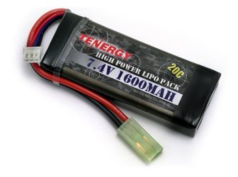
Battery Selection
Model | 31604 | 11427 | 18650
Brand | Tenergy | Tenergy | Supower
Capacity (mAh) | 1600 | 2000 | 2200
Voltage (V) | 7.4 | 9.6 | 7.4
Weight (Ib) | 0.2 | 0.52 | 0.2
Discharge Rate (C) | 20 (32 A) | 10 (20 A) | 2.5 (5.5A)
Price ($) | 24.5 | 19.99 | 17.99
Chemistry | Lipo | NiMH | Li-on
Tenergy 7.4V 1600mah
Two Lithium Polymer Ion Batteries in Series
Expected Battery Life needs to be at least 3 Hours

Slide 57
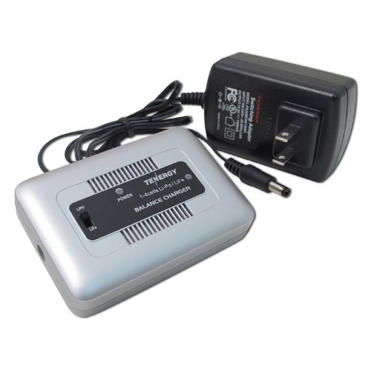
Battery Charger
Tenergy Airsoft Battery Charger
LIPO tends to overheat easily
Built in Balancer
Price $19.99
Powers both Lion and LIPO batteries.

Slide 58
Power Requirements
Items | Voltage input needed | Current input needed
BeagleBone Black | 5 V | 2 A
Motor Controllers | 12 V | 16 A
Thermal Camera | 3-5.5 V | <600 mA
Conventional Webcam | 3 V | <500 mA
Proximity Sensors | 4 V | 15 mA
MSP 430 | 3 V | .5 mA
Wi-Fi Adapter | 3 V | <500 mA
USB Power Hub | 3-5 V | 1.5 A

Slide 59
Voltage Regulator Motor Controllers
Needs to be able to provide 12V and 16A to power all four of the motor controllers
Provide 3.3 V to power the MSP 430
Name | Type of Regulator | Footprint | Efficiency | BOM Count | BOM Cost
LM27402 | Buck Controller | 419 | 97 | 28 | $3.81
TPS40304 | Buck Controller | 318 | 94 | 24 | $3.85
TPS40305 | Buck Controller | 305 | 98 | 24 | $4.35

Slide 60
Project Milestones

Slide 61
Work Breakdown
Task | Ismael Rivera | Warayut Techarut (Wye) | Journey Sumlar | Chris Carmichael
Motor Controller |  |  |  | X
Power Management |  |  | X
Server | X
OpenCV | X | X
Object Avoidance |  | X
Mobile Application | X

Slide 62


Budget & Finance
Part Name | Quantity | Price (each) | Total
HC-SR04 Proximity Sensor | 4 | $1.33 | $5.32
Tamarisc 320 | 1 | $0.00 | $0.00
Wi-Fi USB Adapter | 1 | $5.99 | $5.99
MicroSD Card | 1 | $7.99 | $7.99
USB Power Hub | 1 | $7.99 | $7.99
Motor | 4 | $14.99 | $59.96
Mecanum Wheels | 1 | $59.99 | $59.99
Drive shaft pack | 1 | $5.49 | $5.49
Shaft Collar 16 pack | 1 | $7.99 | $7.99
Motor Controller Parts | 4 | $20.00 | $80.00
PCB Motor Controller | 1 | $33.00 | $33.00
PCB Power | 2 | $33.00 | $66.00
Batteries and Charger | 1 | $80.00 | $80.00
Microcontroller | 1 | $45.00 | $45.00
 |  | Total | $464.72

Slide 63
Current Progress

Slide 64
GROUP #4 Chris Carmichael Ismael Rivera Journey Sumlar Warayut Techarut
Questions?

