Slide 1

Cody Burdette
Christopher Campbell
Pamela Caraballo Group 4
Sean Varela

Slide 2


Conception
Wanted to address:
Health
Energy Efficiency
Power awareness
Entertainment
The idea came from an project that combined 1200 bicyclists to provide power for a pregame show.

Slide 3

What is a ?
A CALBOX is an exercise station that allows the user to recapture the energy stored in chemical bonds within his body
The recaptured energy is stored for use
The user’s exercise statistics are recorded
The user can play an entertainment system using his recaptured energy, as a reward
The user can reduce his carbon footprint

Slide 4
Metrics of Achievement
Exercise
Provides adequate power
Provides a good source of exercise
Play
Acceptable “Work to Play” ratio
Provides ample play time from a full battery charge
Monitoring
Battery state of charge
Calorie expenditure
Session tracking

Slide 5
The Three Systems
Exercise
Generator
Play
DC/AC Inverter
Monitoring
μC
DC/DC Regulator
Generator protection
Over current protection
Load
Battery
Wireless data transmission
Software
GUI

Slide 6
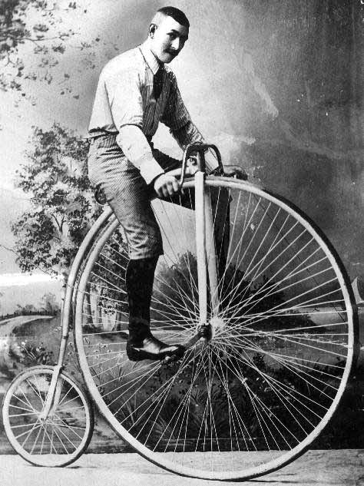
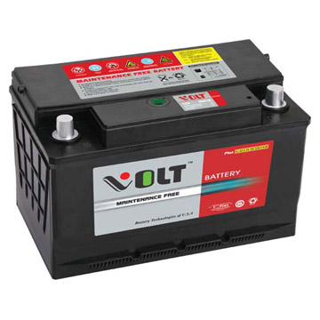
The System
DC/AC
XBOX
PC
GUI
µC
LCD
Generator
DC/DC

Slide 7
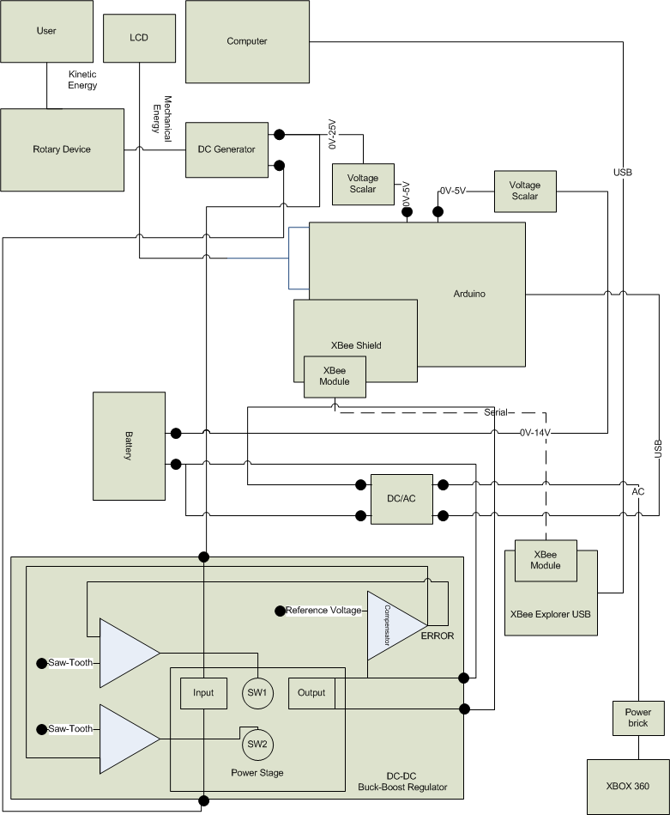
The big picture

Slide 8
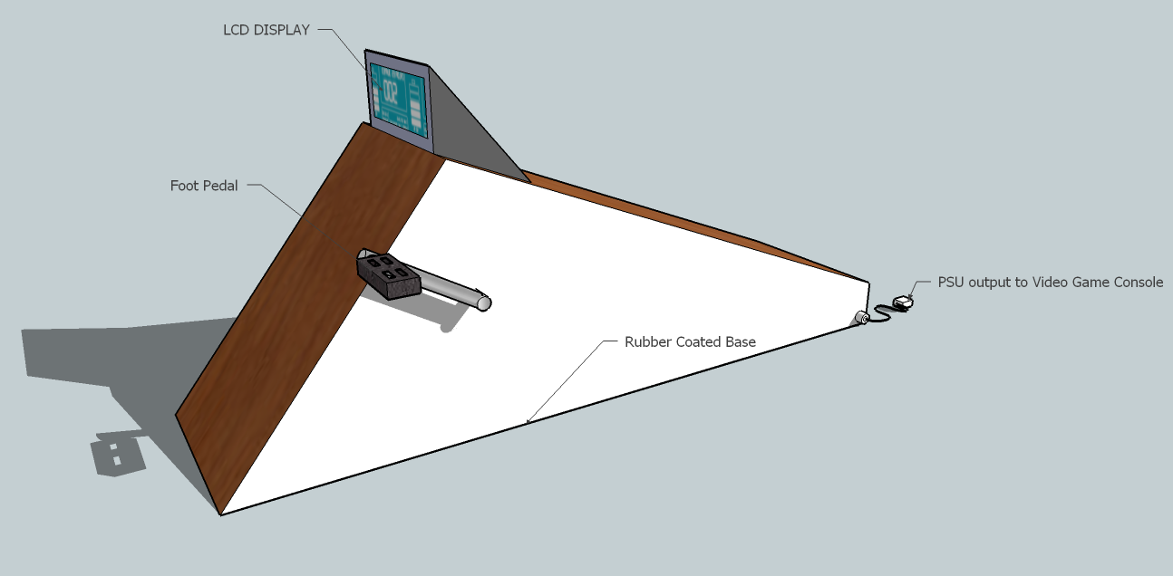
Artist’s rendering
Convenient design
Active display screen
Wireless data recording
Locked design
Comfort seat
Safety considerations

Slide 9
EXCERCISE

Slide 10
Generator
Options
Alternator
uses a rotating magnetic field to produce an AC electrical signal
cheaper
DC Motor
If it’s run backwards, it generates electricity instead
Brush Type - used in applications that are below 5,000 RPM
Brushless - can reach and exceed 60,000 RPM
Voltage rating selection
12V or 24 V motor

Slide 11
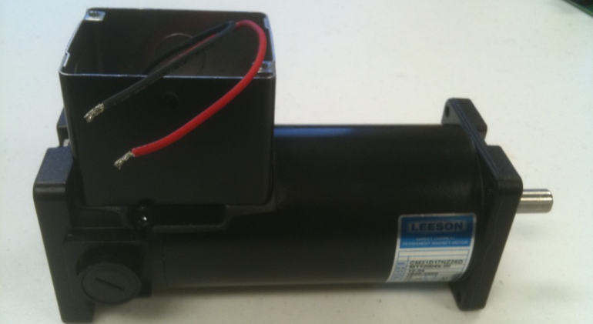
Leeson M1120046
To keep the generator from consuming power from the battery, a reverse current protection device must be introduced
Otherwise the pedals will spin and function as a motor
A high gear ratio between the generator and the bicycle must be achieved while not reducing torque input too low
If a rider can ride at 60 RPM, and a nominal 2400 RPM is set at the generator side, the gear ratio must be 1:40
The battery and related charging control electronics have current limits. If the user goes into a sprint that causes the generator to exceed the allowable currents for the charging circuit or the battery, this excess power must be dissipated
Light bank
Leeson M1120046
Item | DC Motor
Motor Type | Permanent Magnet
Enclosure | Totally Enclosed Non-ventilated
HP | 0.16
HP @ Higher Volts | 0.33
Nameplate RPM | 1800
“ RPM @ Higher Volts | 3900
Voltage | 12/24 VDC
Full Load Amps | 14
Full Load Torque (In.-Lbs.) | 5.875
NEMA/IEC Frame
Mounting | SQ. Flange
Thermal Protection | None
Insulation Class | F3
Bearings | DN
Ambient (C) | 25
Rotation | CW/CW
Overall Length (In.) | 9.45
Length Less Shaft (In.) | 7.88
Shaft Dia. (In.) | 0.468
Shaft Length (In.) | 1.5
Base Mounting O.C. (In.) | 7.42 x 2.00
Face Mounting O.C. (In.) | 3.16 x 2.88
Brush Type
RPM Range | 1800-3900
Standards | UL
Price | $178.88

Slide 12
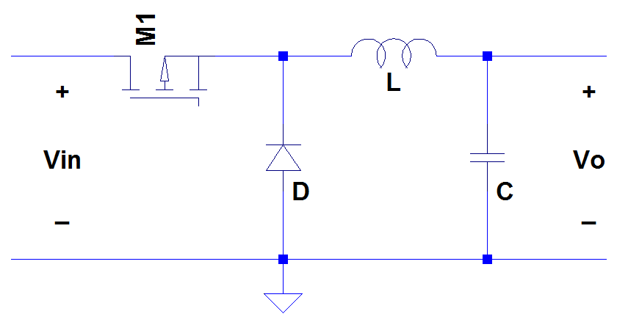
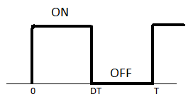
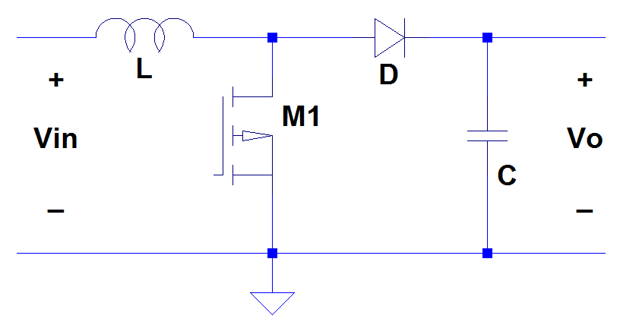
DC-DC Converter
The electrical design for the CALBOX encompasses outputting a constant voltage, while receiving a variable input voltage
The DC/DC converter will be used to regulate the voltage from the Generator, so the battery can be charged safely
The Duty Cycle (D) determines the rate at which the voltage will change
It represents a percentage of the period for which the switch is on
BUCK
BOOST
0 < D < 1

Slide 13
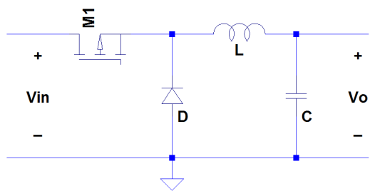
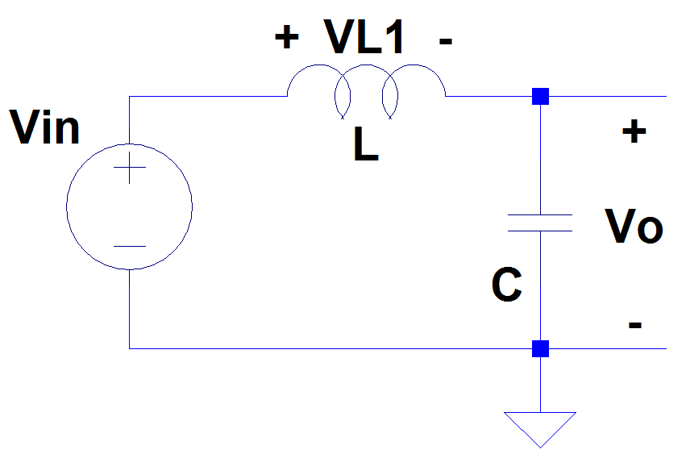
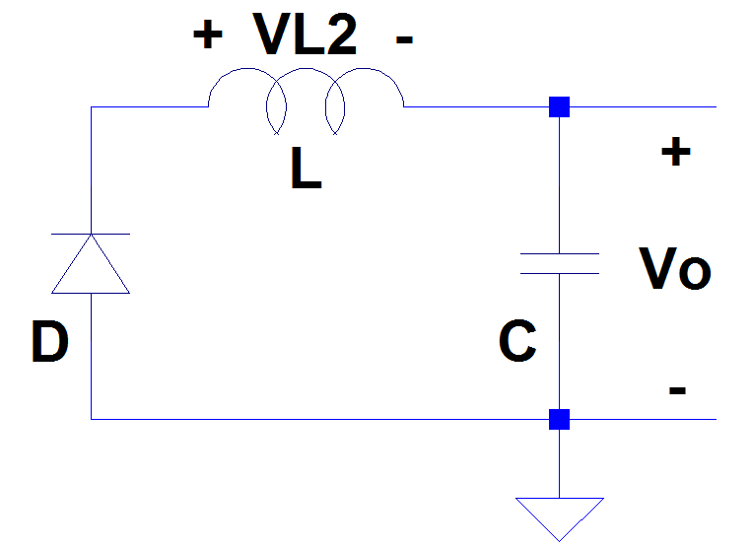

Buck Operating Mode
Mode 1: 0 < t < DT
Mode 2: DT < t < T
The average voltage across the inductor = 0 in steady state, or so:

Slide 14
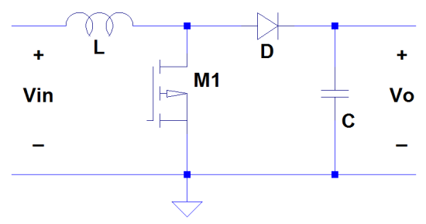
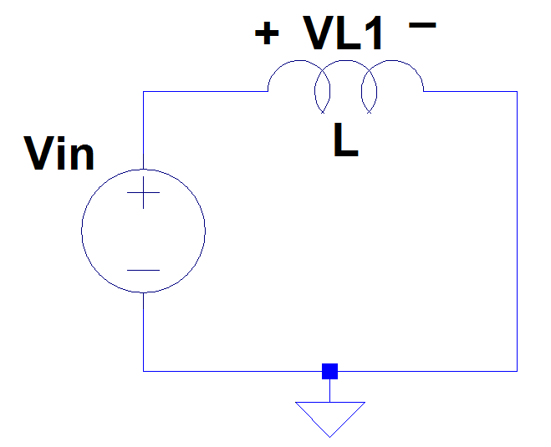
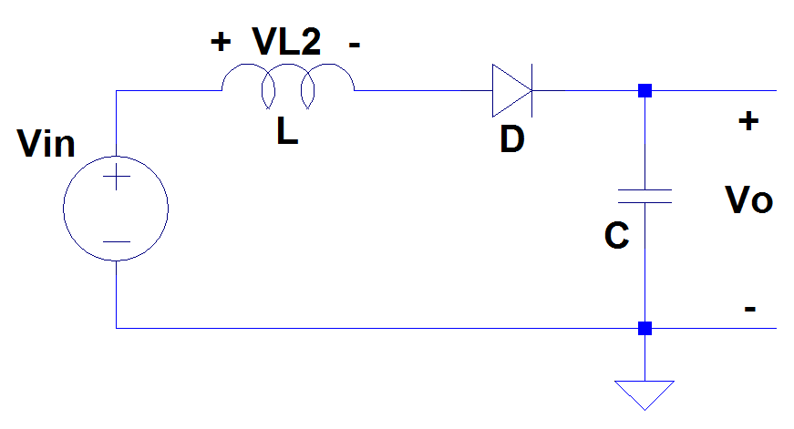

Boost Operating Mode
Mode 1: 0 < t < DT
Mode 2: DT < t < T

Slide 15
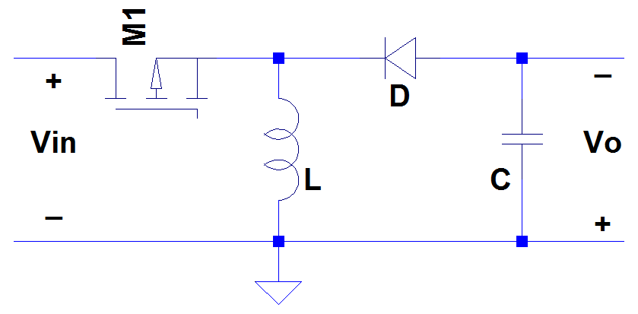
Basic Buck-Boost Converter
A converter that can either step-up or step-down input voltage to supply a load with a constant voltage source
Voltage levels ranging between 5 and 25 Volts will be accepted by the converter
This charge is supplied from the user’s energy exertion on the bicycle, driven through the DC generator
The system load (12 V battery) needs an average of 14.5 to 14.9 Volts to properly charge
The problem with this basic Buck-Boost model is that the voltage across the output is inverted, and therefore would not be accepted by the battery

Slide 16
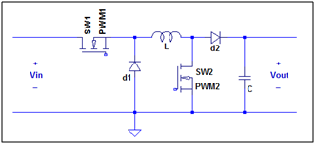
Non-Inverting Buck-Boost
Adding another switch and another diode along with repositioning the inductor leads to a system that is capable of powering the battery
This is because the current will now flow in a path that leads to a non-inverted output voltage
This system is a result of cascading a buck converter with a boost converter

Slide 17


System Design
Many values needed to be known in order to design a valid compensator
Some values were arbitrarily chosen
Others were solved for:
Minimum input voltage | V_{in,min} = 5 V
Maximum input voltage | V_{in,max} = 25 V
Voltage Oscillation | V_{osc} = 3 V
Minimum output current | I_{out,min} = 0.1 A
Maximum output current | I_{out,max} = 10 A
Power system inductor | L = 62 μH
Output capacitor | C = 280 μF
Open-loop resistance | R_{min} = 1.27 Ω
Closed-loop resistance | R_{max} = 148 Ω
Period | T = 2.5 μs
Crossover frequency | f_{c} = 40 kHz
Frequency of zeros | f_{z1} = f_{z2} = 8 kHz
Frequency of first pole | f_{p1} = 200 kHz
Phase margin | PM = 45°

Slide 18
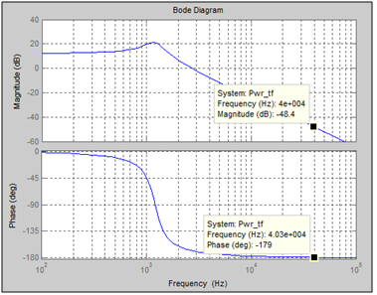



Power Stage
Using MATLAB, a Bode plot was constructed to measure the magnitude and phase of the power stage.
This excludes the feedback loop
These values determine the design of the PID compensator

Slide 19


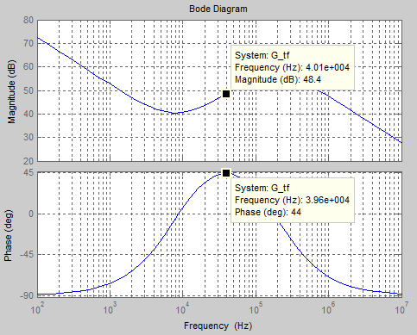
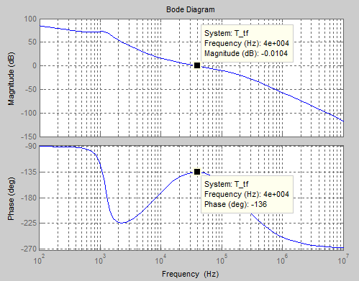
Compensator Design
The values for the gain(K) and the second pole are used to solve and plot the transfer function of the compensator:
Multiplying the transfer function of the power stage by that of the compensator yields the transfer function of the entire system:

Slide 20





Compensator Components
The values calculated for each extreme case of the system are used in a series of equations to solve for the most appropriate values for capacitors and resistors for the compensator
The two variables that were measured in each case were the second pole and the gain (K)
 | Maximum voltage input |  | Minimum voltage input
 | Open-loop | Closed-loop | Open-Loop | Closed-Loop
f_{p2} (kHz) | 187.055 | 204.44 | 187.055 | 204.44
K | 2.6515 x 10⁶ | 2.6420 x 10⁶ | 1.3289 x 10⁷ | 1.3242 x 10⁷
Solving the system of equations yields the following values, for which actual components are found
Resistance |  |  | Capacitance
Component | Calculated | Actual | Component | Calculated | Actual
R₁ | 1000 Ω | 1 kΩ | C₁ | 15.14 pF | 15 pF
R₂ | 54.751 kΩ | 54.9 kΩ | C₂ | 363.361 pF | 360 pF
R₃ | 44.679 Ω | 44.8 Ω | C₃ | 19.0435 nF | 20 nF

Slide 21
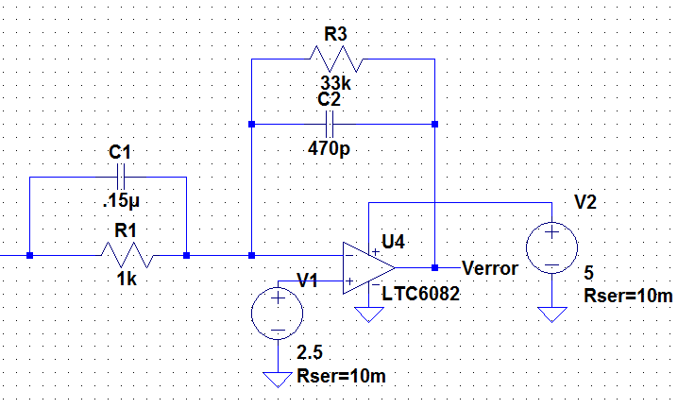
PID Compensator
Ensures stability in a closed-loop system
Compares V₀ against the reference voltage and determines an error voltage
To generate a modified square wave the V_{error} is compared to a saw-tooth wave dependant on the PWM driver change

Slide 22
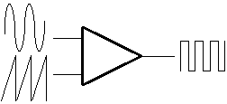
PWM Drivers
Two PWM drivers
both use saw-toothed pulses in conjunction with the V_{error} from compensator to output a modified square wave with an adjusted duty cycle
Recovery using switching
allows the system to stabilize at the desired output to correct overshoot and undershoot complications
Since there are two switches in the modified buck-boost, the switches must be controlled appropriately to get the corrected duty cycle into the power stage of the system

Slide 23
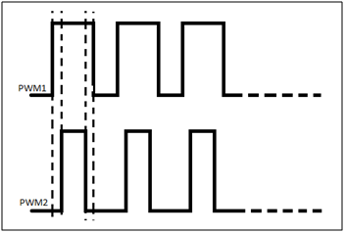
Switching
Four different phases must occur respectively between the switches controlled by PWM1 and PWM2 for the system to operate properly in all modes
The phases are listed in the table below:
Phases | SW1 PWM1 | SW2 PWM2 | Operating Modes
1 | OFF | OFF | Buck
2 | OFF | ON | n/a
3 | ON | OFF | Buck-Boost
4 | ON | ON | Boost
Phase 2 should never occur for the system to be stable because it does not comply with either of the buck-boost modes
The ideal switching should appear as:

Slide 24
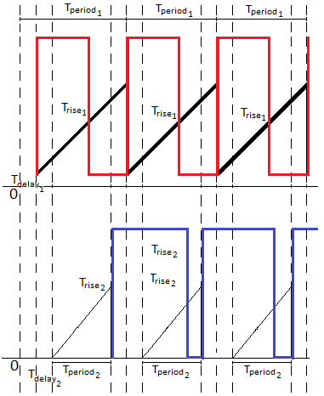
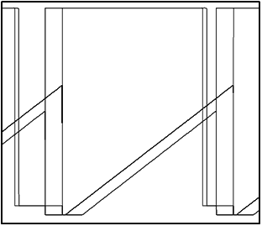
Switching
After establishing a relation between the saw-toothed wave and the newly generated PWM square wave depicted here, adjustments were made in terms of T_{period}, T_{delay}, T_{rise}, T_{fall} and T_{on} to simulate the correct relationship between both PWM signals as to obey all 4 phases respectively
The saw-toothed wave used for simulation purposes is a modified square wave with long rise time in comparison to the period and short fall time
The figure displayed to the right shows both PWM waves being generated correctly in LT simulations

Slide 25
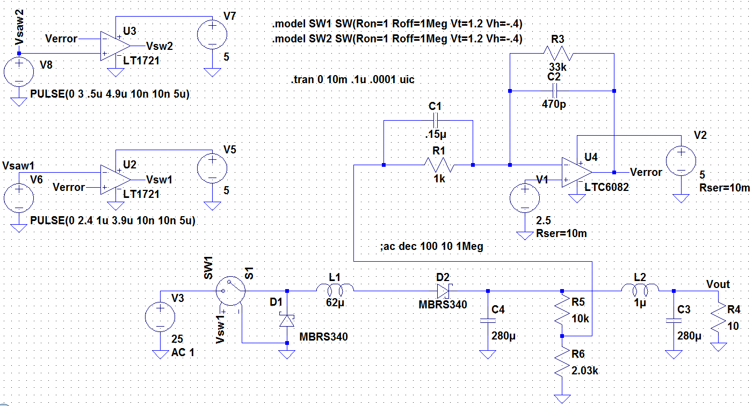
Closed Loop - Buck
In this representation of the circuit SW2 is opened therefore the circuit operates in buck mode. A 25 Volt input is used as the source for the scenario when the generator is outputting at maximum voltage. The generators maximum output is 24 V but the circuit was designed for 25 V as a security measure.

Slide 26
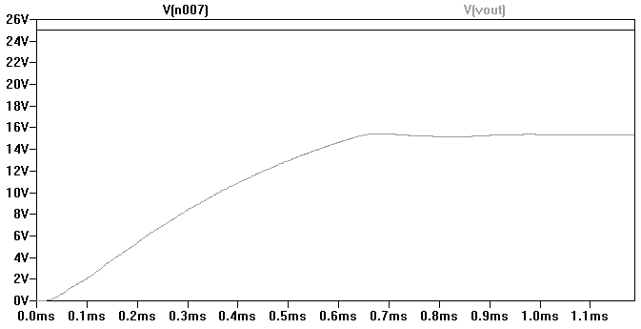
Buck simulation
The simulation of the buck circuit is displayed below and has results of the approximately 15 V output voltage necessary to charge the 12 V battery load.

Slide 27
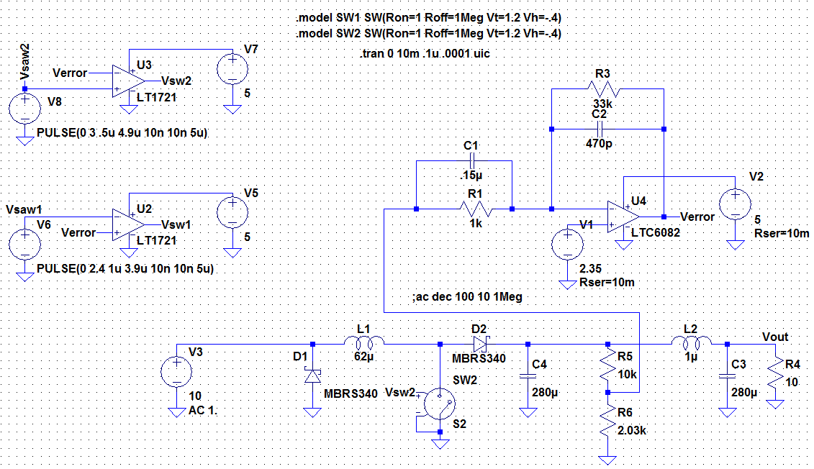
Closed Loop - Boost
This closed loop representation of the circuit shorts the usage of SW1 and the square wave generated from PWM1 which motivates it leaving the circuit operating in boost mode where it can be observed as a 10 Volt input and increased stabilized 14.8 V output seen on the next slide

Slide 28
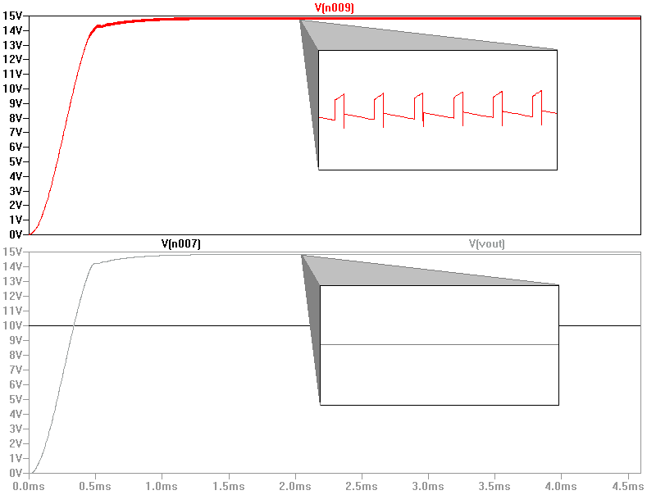
Boost simulation
The upper pane demonstrates the output voltage before passing through the additional RLC filter used to decrease the ripple
The lower simulation pane shows the 10 V input and the desired 14.8 V output

Slide 29
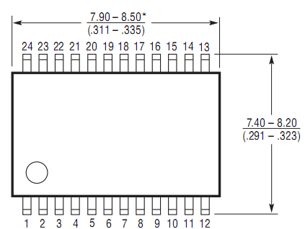
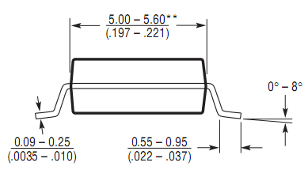
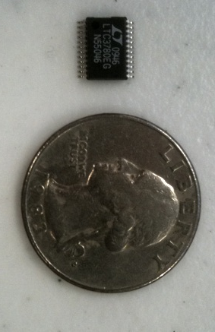
LTC3780 Option
The LTC3780 is a high performance buck-boost multi-switch non-inverting regulator exactly like the buck-boost designed and explained in previous slides
The chip is capable of a phase-lock frequency of up to 400kHz which our previously determined frequency falls perfectly into
Wide 4 V to 30 V input and output range making it ideal for a battery charging system
Meets the possibilities of the generator input
Although the circuit created by the designers meets the necessities of this project, the team is going to use the LT IC option to prevent unnoticed faults from happening that this chip accounts for

Slide 30
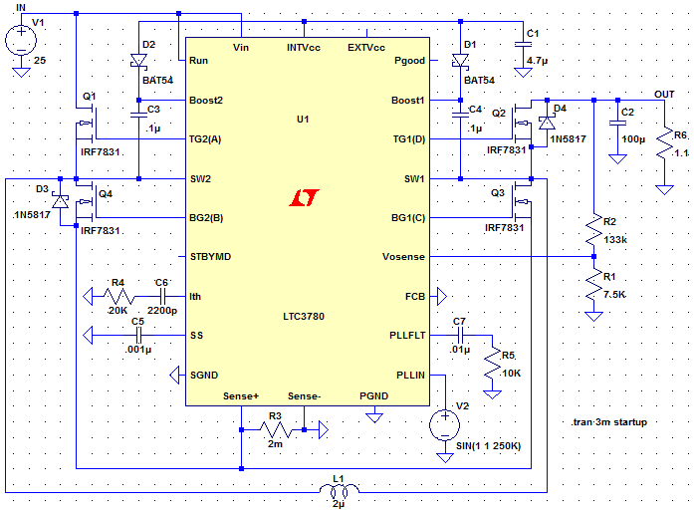
LTC3780 Schematic
Works for the same range of voltage the generator is capable of outputting
Battery load shown at the output, represented by its resistance 1.1 Ohm, shows the buck-boost system ready to be laid out and printed.

Slide 31
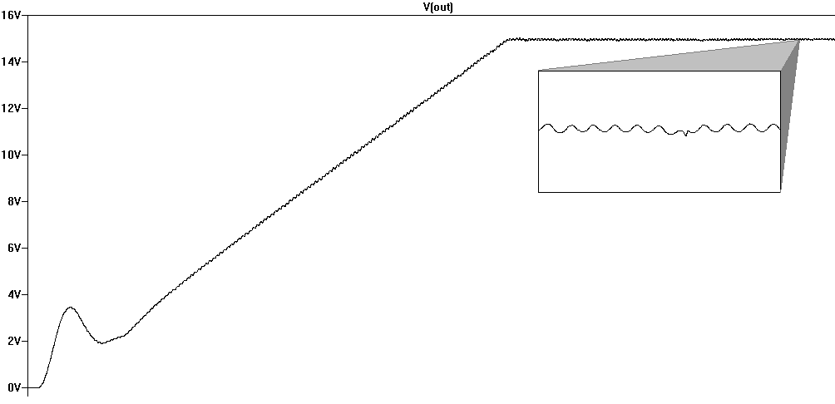
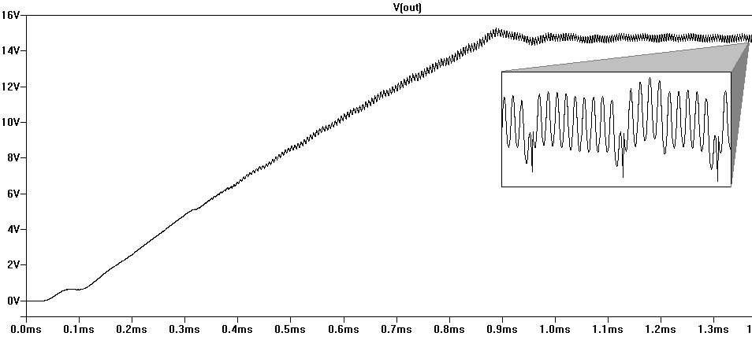
LTC3780 simulation
The figures below show the output voltage results from the LTC3780. The reason the output voltage ripple is greater for this case of bucking, is because ….
Buck simulation
25V to 14.8V
Boost simulation
5V to 14.8V

Slide 32
PLAY

Slide 33
Battery
Conventional battery technologies
Lead acid batteries are more suitable for the applications of the CALBOX
NiCd and NiMH would have required a very large battery bank
Li-ion is too expensive
Battery system | NiCd | NiMH | Li-ion
Average operating voltage (V) | 1.2 | 2.3 | 3.6
Energy density (Wh/I) | 90-150 | 160-310 | 200-280
Specific energy (Wh/Kg) | 30-60 | 50-90 | 90-115
Self-discharge rate (%/month) at 20°C | 10-20 | 20-30 | 1-10
Cycle life | 300-700 | 300-600 | 500-1000
Temperature range (°C) | -20 – 50 | -20 – 50 | -20 – 50
Lead acid batteries
 | Wet Cell | Gel | AGM
Cost | Least | Medium | Most
Maintenance | Some wet cell batteries need to be re-watered and their specific gravity checked with a hydrometer. | None | None
Cooling time | Yes | None | None
Lifetime | Longest | Shortest | Long
Charging sensitivity | Modest | Highest | High
High-temperature operation | Worst | Best | Moderate
Low-temperature operation | Worst | Best | Moderate
Safety | Electrolyte can spill and corrode | Safe | Safe
Venting | Must be vented or placed outside | None | None
Mounting | Upright only | Any | Any

Slide 34
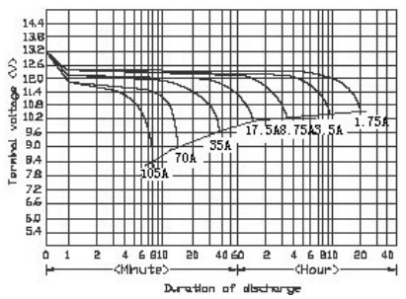
Universal Power Group UB12350
Absorbent glass mat battery
Deep cycle
Estimated 10 hours of play time for a 35 Ah charge
Characteristic | Value
Output Voltage | 12V
Amperage | 35Ah
Brand | UPG
Chemistry | Absorbent glass mat
Battery Size | Group U1
Length | 7.68”
Width | 5.16”
Height | 6.14”
Terminals | B2 internal threaded post
Model Number | 45976

Slide 35
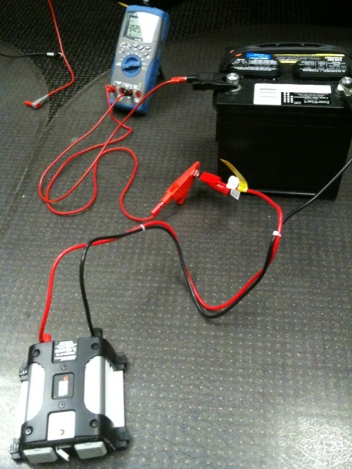
DC-AC Inverter
Black and Decker 400 W Power Inverter
Common inverters are available in 200W and 400W models
Chosen inverter has the capability of outputting currents upwards of 3.42A
XBOX 360 needs 2.5A during heavy gaming
200W inverters deliver insufficient current
Black and Decker model has a 5V USB output port
Will power Arduino microcontroller
Maximum Continuous Power: | 400 W
Surge Capacity: | 800 W
Input Voltage: | 12.8 V
Output Voltage: | Approximately 115 VAC RMS 60 Hz
Low Voltage Alarm: | < 11 VDC
Low Voltage Shutdown: | 10.8 VDC
Wave Form: | Modified Sine Wave
Maximum Output Current: | 3.42 A

Slide 36
MONITORING

Slide 37

Requirements
A system able to monitor and display relevant information locally:
Calorie expenditure
State of charge of the battery
A system able to record session data and observe it externally:
List of all recorded sessions
Graphically represent progress over time
FEEDBACK
Local
LCD
External
Computer Application

Slide 38
Components
Inputs from battery and generator (Voltage)
Core components consist of a microcontroller platform which is able to monitor voltages from the battery and generator and perform calculations related to calorie expenditure and battery charge
Display local to bike for providing user with battery and calorie information
Local Display
µC
Wireless Transmitter
Wireless transmitter/receiver for sending readings and calculations to an external computer
Windows application for presenting the user with statistical data about their sessions
A session database for holding all the data relating to sessions
Wireless Receiver
USB
PC
Session Database
Application

Slide 39
Calorie Calculations
Caloric intake
Caloric burn
Caloric surplus or deficit
1 LB of fat = 3500 calories: Being able to keep track of calorie intake versus calorie expenditure allows one to have goals for weight loss, eating habits, and excercise.
Use METs(Metabolic Equivalent of a Task) levels to relate pedaling intensity to caloric burn.
Voltage from the generator will be compared to this chart to provide the METs intensity level
METs Level | Pedaling Intensity
1 | No pedaling, at rest
2-3 | Low Intensity
4-5 | Low to Medium Intensity
6-7 | Medium Intensity
8-9 | High Intensity
10-12 | Very High Intensity
Notes:
2000 calorie intake – 2500 calories burned = 500 calorie deficit, = 1lb a week
Standing still = 1 METs, running = 10 METS
155lbs = 70 kg
9 * 3.5 * 70 * 60 / 200 = 660 calories burned

Slide 40
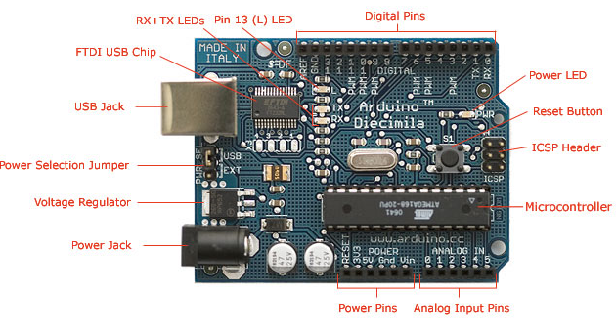
Microcontroller Platform
Arduino Physical Computer Platform
Features: low cost, open source, extensive libraries, development environment, I/O
Uses a Atmel AVR ATmega328P microcontroller
Modularity: Hardware support and software libraries for extendible modules such as LCDs, Wireless, and serial interfaces.
Programmability: C/C++ derivative, IDE, USB
 | Speed | Voltage | Flash | EEPROM | RAM
ATmega328 | 20Mhz | 1.8V-5.5V | 32KB | 1KB | 2KB
Allows us to measure voltages coming from battery and generator
Perform the calculations related to battery charge and caloric expenditure
Send wireless communications using a supported wireless module
Notes:
Less than $30, compared to $100’s for FPGAs
Open source = large community = extensive libraries means less writing code and more implementing features
I/O: USB, Support for external modules like wireless, LCDs, Analog Pins

Slide 41
Microcontroller Design: Inputs
Input from Generator:
Depending on intensity, pedaling will produce a voltage from 0-24V
Scale voltage using a voltage divider. Arduino analog pins can only read 0-5V with a resolution of 1024 bits. Each bit = .0049mV.
Sample voltage @ 1Hz and compare to a stored METs intensity chart.
Calculate calories burned for minutes passed in session based on returned METs value
Increment total calories burned as main program loops
Functions Name | Description | Returns (data type: description)
readV_gen(analog pin 0) | Read voltage from generator | float: Voltage from the generator
calcCalsBurned(metValue,time) | Calculate calories burned per minute | int: Calories burned per second
calcMets(genVolts) | Calculates a METs value from a given volts | int: METs value between 1 and 12
Notes:
Reading of 300 = 1.47 volts
Structure of a sketch
Initialize variables
Setup() : initalize libraries and pin modes
Loop() : main loop where bulk of code goes. Continually loops until Arduino powered off or reset.
if voltsRead < 4 && voltsRead > 3
metsValue = 9

Slide 42
Microcontroller Design: Inputs
Input from Battery:
Battery state of charge is determined through the voltage across the battery terminals. 0-13.2 VDC.
Scale voltage using a voltage divider and read on analog pin 1
Sample voltage @ 1Hz and compared to predetermined discharge levels given by manufacturer
Add voltage reading to a filter array that stores and averages the last 30 readings
Calculate battery charge percentage
Main program loops and continues to measure and filter voltages as well as updating the battery charge percentage
Percent Readout | Open Circuit Voltage (VDC) | Scaled Voltage (VDC) | Comments
100% | 12.3 -13.2 | 4.5 – 4.88 | Max voltage to be limited to 13.2VDC
90% | 12.1-12.3 | 4.48 – 4.55 | Linear voltage discharge range
80% | 12.0 – 12.1 | 4.44 – 4.48 | Nominal voltage
70% | 11.6 – 12.0 | 4.29 – 4.44
60% | 11.4 -11.6 | 4.22 – 2.29
50% | 11.2-11.4 | 4.15 – 4.22
40% | 11.0 – 11.2 | 4.07 – 4.15
30% | 10.8 - 11 | 4.0 – 4.07 | Estimated at max load 60 minutes remaining of game play
20% | 10.7 – 10.8 | 3.96 – 4.0
10% | 10.6 - 10.7 | 3.92 – 3.96
0% | 10.5 – 10.6 | 3.88 – 3.92 | Conservative shut-down voltage
Functions Name | Description | Returns (data type: description)
readV_batt(analog pin 1) | Read voltage from battery | float: Voltage from the battery
filterBattVoltage(battVolts) | Calculates the average voltage for the past 10 seconds. | float: Filtered voltage
calcBattPercent() | Calculates a State of Charge percentage from a given voltageReading | int: Battery Charge percentage

Slide 43
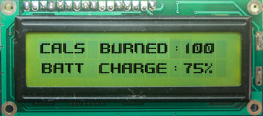
Microcontroller Design: Outputs
HD44780 Character LCD chipset:
16x2 (column x row) character display
Interfaces directly with Arduino power, and digital pins
Arduino supports the HD44780 with the LiquidCrystal library which allows an LCD to be manipulated in a high level programming language without having knowledge of the registers and machine instructions involved
Design:
Initialize pins and lcd object
lcd.clear screen at beginning of a session
Draw “CALS BURNED: “ and “BATT CHARGE: “ on the screen using lcd.setCursor and lcd.print
Draw the calories burned (int – 4 digits) and battery charge (int - percentage) using lcd.setCursor and lcd.print at certain refresh intervals
Notes:
“CALS BURNED:” = 12 Characters
“BATT CHARGE:” = 12 Characters
Set cursor at r
Initially the only two phrases will be drawn at the start of the session; “Cals Burned:” on row 0, starting at column 0 (rows and columns are initialized at 0) and “Batt Charge:” on row 1, starting at column 0. As “Cals Burned:” consists of 12 characters, to update the calories burned value as time passes, the setCursor() will appropriately start with row 0, column 13, giving 4 characters left to show the total calorie expenditure. The same practice follows with “Batt Charge”, although it will take in row 1, and column 12 as parameters.

Slide 44
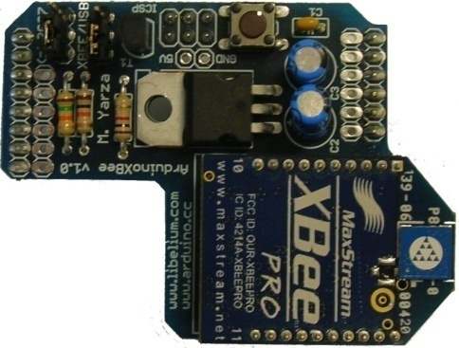
Wireless Communications
XBee Radio Module:
Zigbee derivative
(IEEE 802.15.4)
Considerations: Range, Power, Cost
Interfaces to the Arduino through the XBee Shield, providing power, and connections to the serial pins
Interfaces to the PC through USB
Configuration:
Operating in AT mode (Serial
Pass-through)
Personal Area Network
Coordinator vs. End Device
Configure Registers in X-CTU application
Xbee Radio Module Specifications
Indoor Range | 100 feet (30 meters)
Outdoor Range (line-of-sight) | 300 feet (100 meters)
Transmit Power | 1 mW
 | Xbee Registers (Arduino) |  | Xbee Registers (PC)
Name/Description | Default Value | New Value | Default Value | New Value
PAN ID | 3332 | 5249 | 3332 | 5249
MY: Source Address | FFFF | 10 | FFFF | 11
DL: Dest Address | 0 | 11 | 0 | 10
BD: Baud Rate | 3(9600) | 6(57600) | 3(9600) | 6(57600)
Notes:
Vs. Bluetooth:

Slide 45
Wireless Communications
Wireless Serial
Arduino
PC
XBee Shield
XBee USB Explorer
Packet
Total Session Calories | Total Session Time
XXXX | YYYY
Initialize serial connection on the Arduino using serial libraries
Accumulated values from calsBurned and sessionTime are padded with zeros
Resulting values are formatted into a single string packet. The resulting string is now ready for transmitting.
The string is then sent over serial using the serial print functions.
System goes idle and waits for next session to begin.

Slide 46

Software
Goals:
Provide the user with a GUI based application to see a list of all sessions over a period of time
Be physically untethered to the main system
Single user
Look nice
Session List
Graph/Chart of sessions

Slide 47
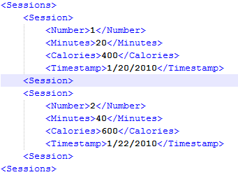
Software Platforms
Windows Presentation Foundation (WPF) + C#
Separates design (XAML)from functionality(C#,.NET)
Graphical Services: Many built in controls for buttons, list boxes, graphs/charts. Gradients, 3D, Animations
Data Binding: Important in able to update the GUI elements with data stores in the application dynamically and instantaneously.
Templates: Grants the ability to apply overall templates and inheritances, giving the GUI a uniformed looked that can be updated dynamically.
Layout: Provides layout controls for implementing organized layouts, allowing programmers to embed layouts within layouts.
XML files as database
Doesn’t require a SQL based server
Numerous libraries available for XML manipulation
XML
WPF

Slide 48
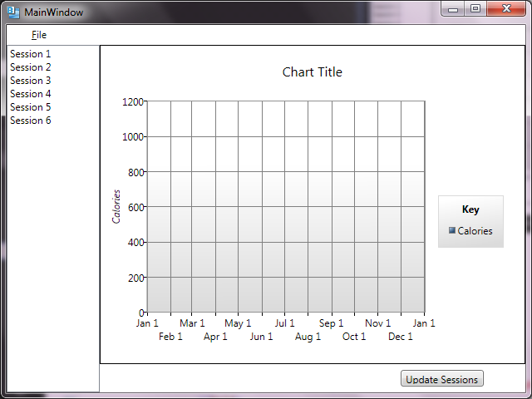
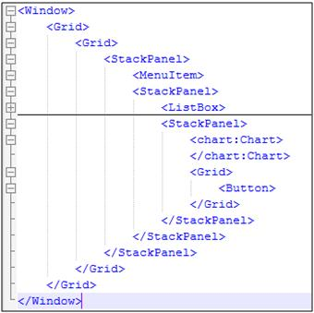
Prototype XAML

Slide 49
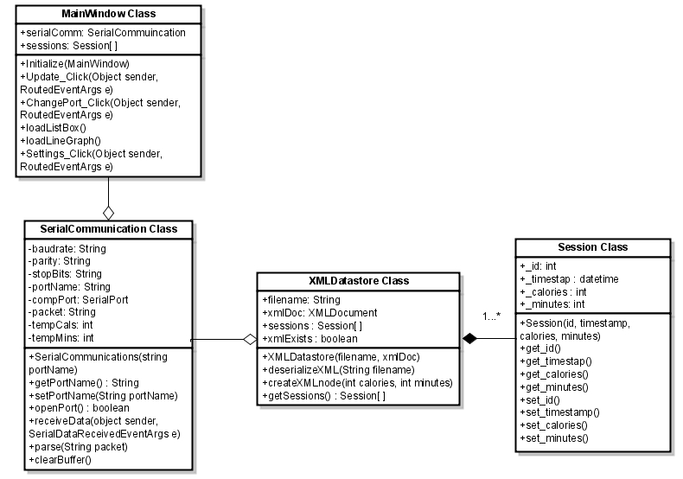
Classes
Initializes components
Class that communicates with hardware
Class to de-serialize XML database into instances of the Session class

Slide 50
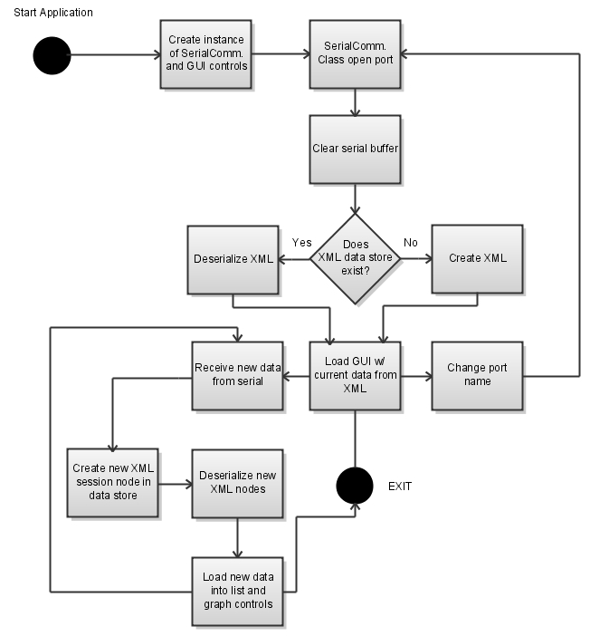
Activity Diagram

Slide 52
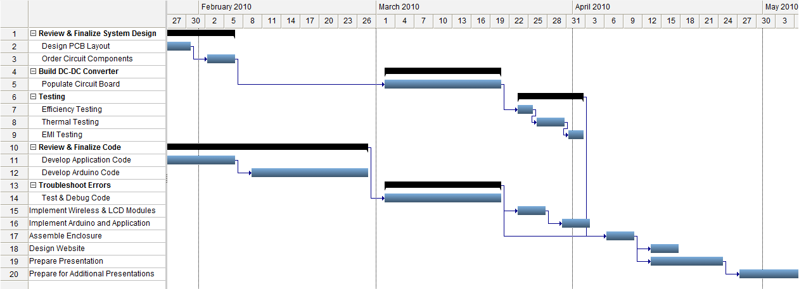
Milestone Chart

Slide 53
Budget & Financing
Component | Total Cost | Purchased
Leeson M1120046 DC Generator | $190 | Yes
12 V 35 Ah Lead Acid Battery | $100 | Yes
Black & Decker DC-AC Inverter | $50 | Yes
Arduino Duemilanove Microcontroller | $30 | Yes
Liquid Crystal Display | $12 | No
XBee Chips (2) | $46 | Yes
XBee Shield Kits (2) | $12 | Yes
XBee Explorer USB | $25 | Yes
Circuit Board Printing (3) | $100 | No
DC-DC Converter Components | $100 | No
Building Materials | $150 | No
Total Expenses | $815

Slide 54
System Status
Design
95% - complete by February 2
Ordering
70% - complete by February 15
Build
15% - complete by March 20
Testing
10% - complete by April 5

Slide 55
QUESTIONS?

