Slide 1

Cody Burdette
Christopher Campbell
Pamela Caraballo Group 4
Sean Varela

Slide 2


Conception
Wanted to address:
  Health
  Energy Efficiency
  Power awareness
  Entertainment
The idea came from an project that combined 1200 bicyclists to provide power for a pregame show.

Slide 3

What is a ?
A CALBOX is an exercise station that allows the user to recapture the energy stored in chemical bonds within his body
  The recaptured energy is stored for use
  The user’s exercise statistics are recorded
  The user can play an entertainment system using his recaptured energy, as a reward
  The user can reduce his carbon footprint

Slide 4
Metrics of Achievement
Exercise
Provides adequate power
Provides a good source of exercise
Play
Acceptable “Work to Play” ratio
Provides ample play time from a full battery charge
Monitoring
Battery state of charge
Calorie expenditure
Session tracking

Slide 5
The Three Systems
Exercise
Generator
Play
DC/AC Inverter
Monitoring
μC
DC/DC Regulator
Generator protection
Over current protection
Load
Battery
Wireless data transmission
Software
GUI

Slide 6
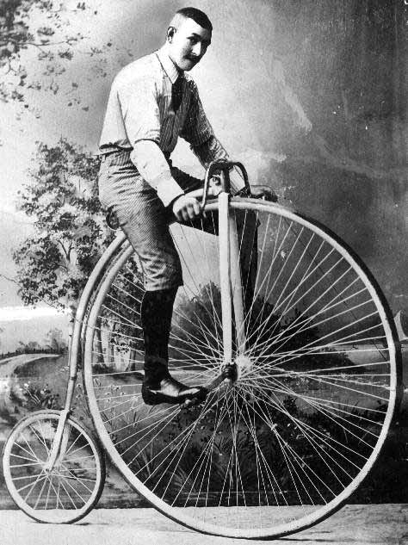
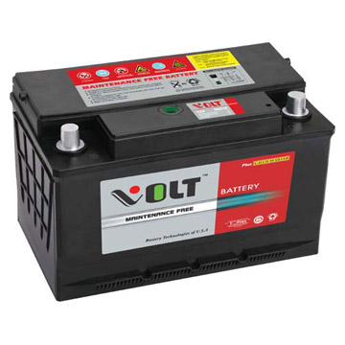
The Design
DC/AC
XBOX
PC
GUI
µC
LCD
Generator
DC/DC

Slide 7
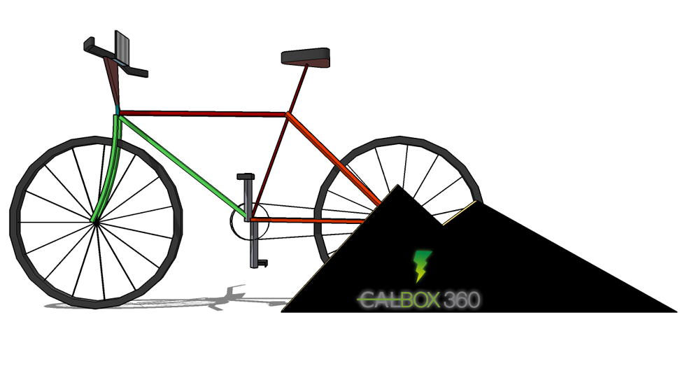
Artist’s rendering
Convenient design
Active display screen
Wireless data recording
Locked design
Comfort seat
Safety considerations

Slide 8
EXCERCISE

Slide 9
Generator
Options
  Alternator
    uses a rotating magnetic field to produce an AC electrical signal
    cheaper
  DC Motor
    If it’s run backwards, it generates electricity instead
    Brush Type - used in applications that are below 5,000 RPM
    Brushless - can reach and exceed 60,000 RPM
  Voltage rating selection
    12V or 24 V motor

Slide 10
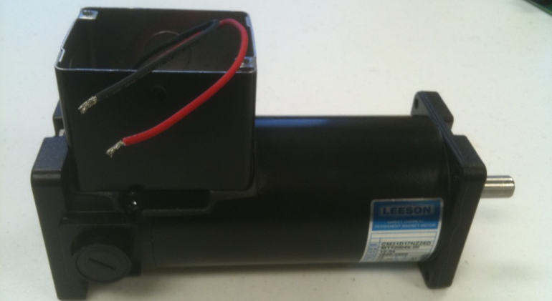
Leeson M1120046
To keep the generator from consuming power from the battery, a reverse current protection device must be introduced
  Otherwise the pedals will spin and function as a motor
A high gear ratio between the generator and the bicycle must be achieved while not reducing torque input too low
  If a rider can ride at 60 RPM, and a nominal 2400 RPM is set at the generator side, the gear ratio must be 1:40
The battery and related charging control electronics have current limits. If the user goes into a sprint the motor does not exceed the necessary limits of the circuitry
Leeson M1120046
Item | DC Motor
Motor Type | Permanent Magnet
Enclosure | Totally Enclosed Non-ventilated
HP | 0.16
HP @ Higher Volts | 0.33
Nameplate RPM | 1800
“ RPM @ Higher Volts | 3900
Voltage | 12/24 VDC
Full Load Amps | 14
Full Load Torque (In.-Lbs.) | 5.875
NEMA/IEC Frame
Mounting | SQ. Flange
Thermal Protection | None
Insulation Class | F3
Bearings | DN
Ambient (C) | 25
Rotation | CW/CW
Overall Length (In.) | 9.45
Length Less Shaft (In.) | 7.88
Shaft Dia. (In.) | 0.468
Shaft Length (In.) | 1.5
Base Mounting O.C. (In.) | 7.42 x 2.00
Face Mounting O.C. (In.) | 3.16 x 2.88
Brush Type
RPM Range | 1800-3900
Standards | UL
Price | $178.88

Slide 11
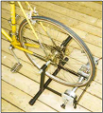
Wheel-Driven Option
Simple to place and remove bicycle from system
Requires custom built shaft to fit motor
Low efficiency
  Less wheel contact with shaft at high RPMs
  Heat release between rubber tire and metal shaft
Notes:
There are two options when looking to connect the bicycle to the generator, in order to produce power. The wheel driven option shown here makes it easy to integrate the CALBOX system into an already active lifestyle. Using this method, a cyclist has the constant option whether to cycle outdoors or on the system, as the bike can easily be positioned, as well as removed from the system. The bicycle need not be modified at all. Unfortunately, this method requires a custom built shaft to fit the motor so that it will be stable and useable with the bicycle wheel. Also, this method is somewhat low in efficiency, as the wheel makes less contact with the generator shaft as the cyclist increases speed. Heat release is also an issue as a byproduct of the rubber wheel being in direct contact with the metal shaft.

Slide 12
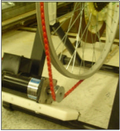
Drive Belt Approach
Rubber tire and inner tube are removed
Power Twist V-Belt provides custom fit
Increased efficiency at higher wattage outputs
  Due to higher deliverable torque into the system by the grips of the chain belt
Notes:
It is because of these reasons that the alternative, belt-driven approach has been chosen for this project. In this option, the rubber tire and inner tube are removed. A chain is then wrapped around the rear wheel, and the generator, as can be seen in the picture here. We used the Power Twist V-Belt, which provides a custom, tight fit to the system, as each link in the belt is removable. The generator in the system is mounted just below the wheel to minimize losses of the chain length. With the tight connection, efficiency is enhanced at higher wattage outputs. This is due to there being more torque delivered into the systems by the grip the belt has on it.

Slide 13
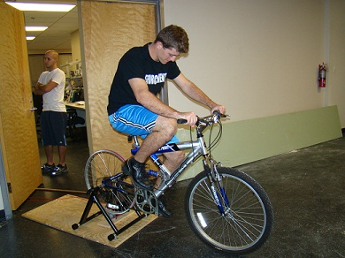
Gear Ratio
Testing generator with electronic load
  Current set at different levels to test voltage output
  Found that at higher mechanical gears, more power is created
Notes:
Before designing other components in the system, the basic setup is done to test how the generator will provide power to the system. A mountain bike with multiple gear settings is used as a cheap source of power for the system. Once the generator is safely mounted below the rear wheel, the output is connected to an Agilent DC load. This allowed us to set different current levels and gauge how much voltage we could produce. As you can see in the picture here, Sean is monitoring the load, while I am pedaling the bike. It was found rather quickly through testing, that as you cycle at higher gear levels, more power is generated. Of course, this makes the bike harder to pedal, but it is still very manageable. The highest gear is chosen as our standard for the system, but the user is able to change this at their leisure.
The power from the generator will feed the converter that Sean will now talk about.

Slide 14
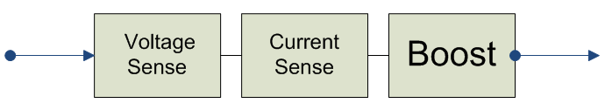
Boost Converter Functions
The board serves 3 basic functions:
  The variable generator voltage is scaled down to a less than 5V and 40mA signal using a simple resistor divider so that the microcontroller could take the reading via the analog pin 0 and reverse calculate the input voltage
  A highly accurate current sense circuit is used to provide the analog pin 2 of the microcontroller with a voltage to current relationship so that the input current could be calculated and used for the power calculations
  The rest of the circuit is responsible for boosting any variable input voltage greater than 8V and less than 23V to it’s 23V goal that is delivered to the smart charge controller for bucking and ultimately charging the 12V battery

Slide 15

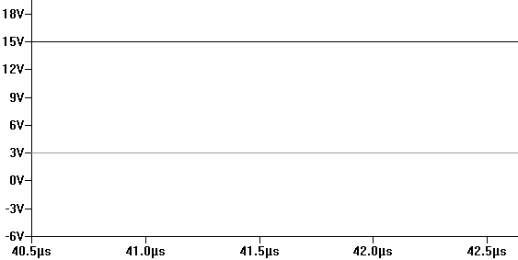
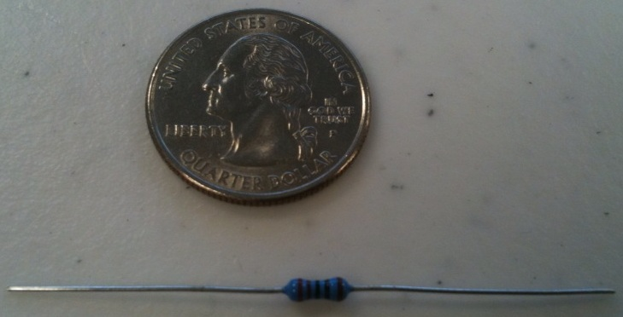
Voltage sense
Vsense
  The generator is capable of providing a maximum of 24V and 14A therefore in order to keep the analog pin of the microcontroller safe, 25V and 15A was considered for scaling purposes
    A high resistance divider allows the current to be dropped to (much) less than 40mA
    The values were chosen that would provide a maximum 5V signal to the pin
    To assure accuracy, 1% ¼ W Metal Film through hole resistors were used
    E.g. If the generator voltage is 15V, the Vgen pin will read 15/5.02 = 2.988

Slide 16
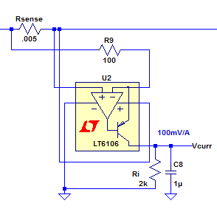
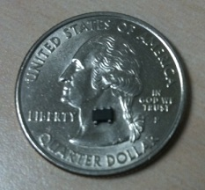
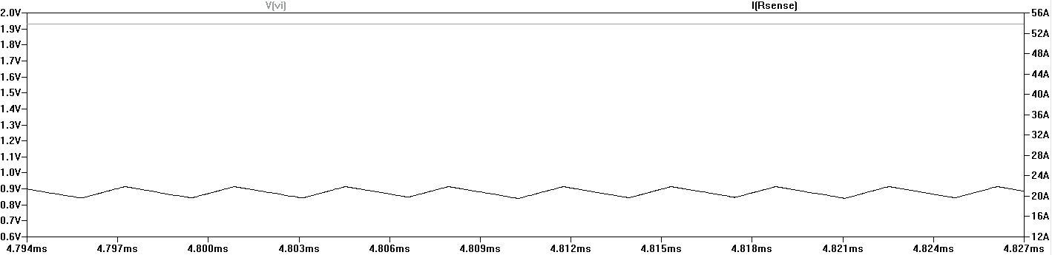
Current sense
LT6106 High Side Current Sense
  This sense amplifier monitors the current across an external sense resistor. This chip has a wide 2.7V - 44V input range making it ideal for the designer’s application.
    The sense resistor used is a .005 Ohm 2512 1W resistor
  The voltage to current relationship at the output of the LT6106 is a 100mV/A ratio
    For example purposes, If the current across the resistor is 20A, the analog pin 2 of the microcontroller would read approximately 2V which could be divided by .1 and equated to the original 20A input as shown below

Slide 17
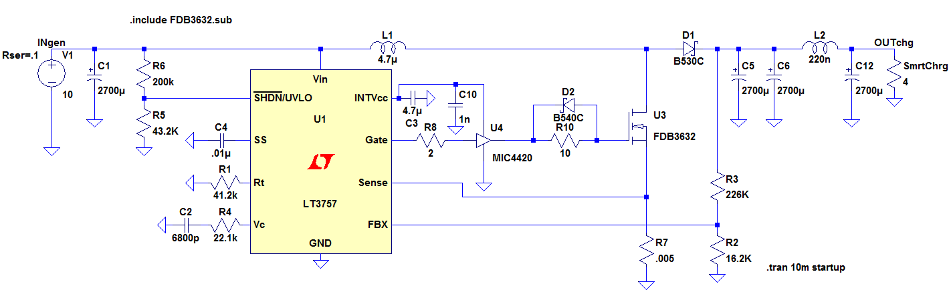
Switching Boost
LT3757 DC/DC controller
  The LT3757 handles all of the controls for the boosting in the circuit, it is capable of operating in both DCM and CCM modes as necessary and handles a 40V maximum input voltage
  The driving in the circuit is handled by an N-channel power MOSFET driven from an internal regulated supply of 7.2V therefore the specs the circuit was designed for ranges between 8V to 23V since our desired output is greater than 23V and less than 24V
  This chip provides the designer with internal shutdown and overload fault protections to maintain safety to the component
  For simulation purposes, the voltage source supplies the circuit with as much current as it finds necessary to boost the voltage high but in real life the current will vary based on the pedaling intensity. For this reason, certain lower voltage inputs will not boost to the 23V output but may instead increase to perhaps 18V which is more than enough for the CalBOX

Slide 18
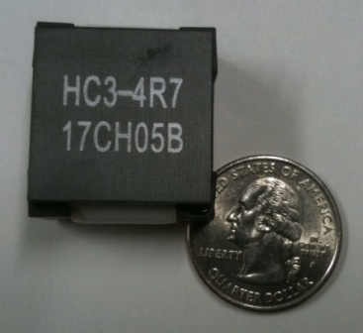
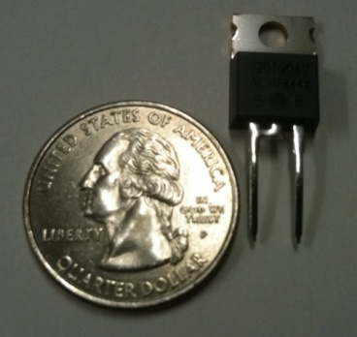
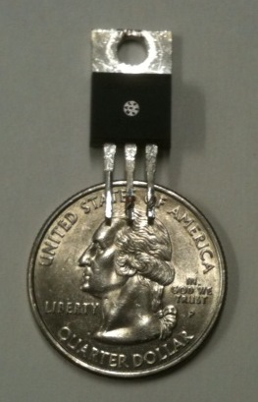
Power Components
HC3-4R7-R High Current Inductor
  Since the 4.7uH inductor undertakes all the current that source is capable of providing, a high current power inductor was chosen that met the specifications for the possibility of a high torque current spike
Schottky Diode 40V 20A
  A Schottky diode was chosen based on the current and voltage requirements and since there would be lots of current passing through this component, a TO220 package was used so that it could be heat-sinked
Fairchild FDP3632 N-channel MOSFET
  The component that handles all of the 300kHz switching is the NMOS by Fairchild. After analyzing the power loss in every component, it is known that the MOSFET was dissipating 9.3W which would be hazardous to the part. As a result of this power loss, a Micrel 4120 driver was used to decrease the power loss and more efficiently handle the switching for the MOSFET thus reducing stress on the part
    As a precaution, a TO220 package was acquired so that a heat sink could be used

Slide 19
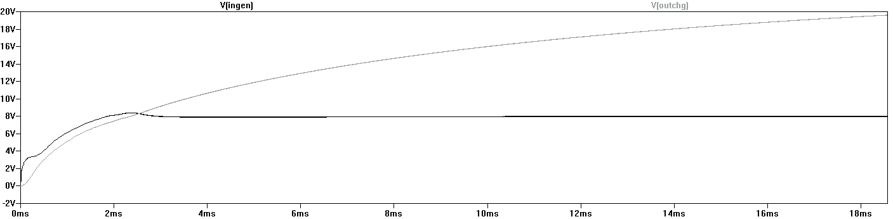
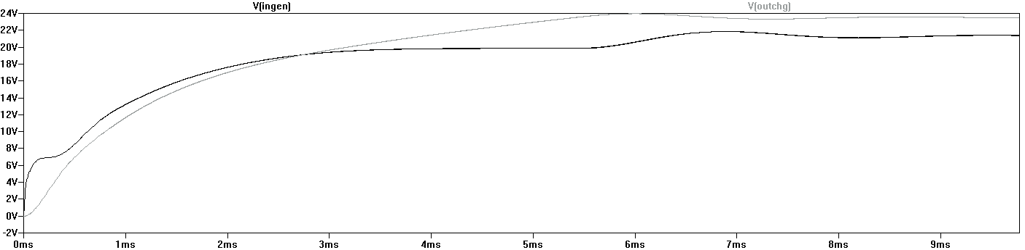
Switching Boost Simulations

Slide 20
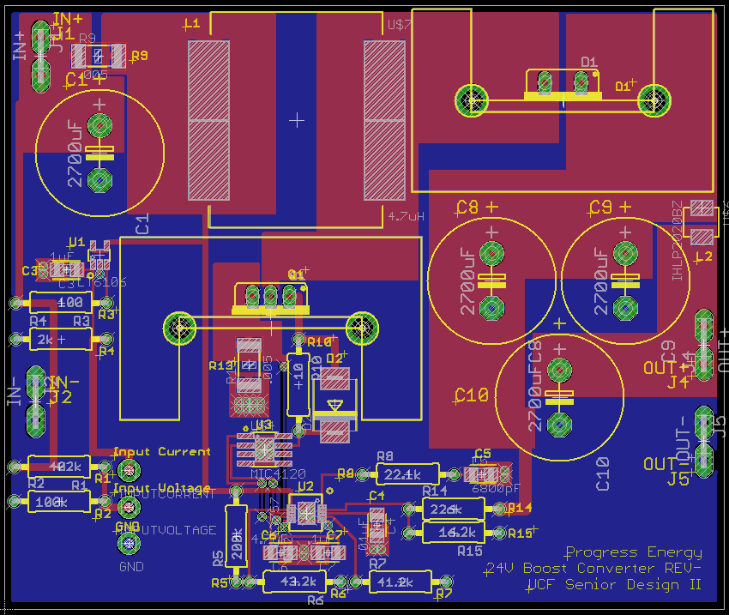
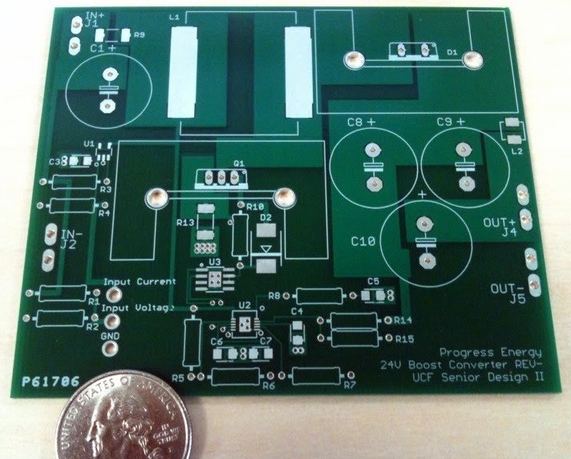
Layout
Eagle CAD
  For laying out the board, Eagle CAD was used. Eagle CAD has a huge following with help and tutorials found easily with little to no searching
  Large traces were used (constructed of polygons) for the high power lines and thermal relief was used for all the pads
  The student $33 special pricing for a 2 layer board including silk screen by Advanced Circuits (4pcb.com) allowed us to have the board printed affordably and in our possession within 5 days.

Slide 21
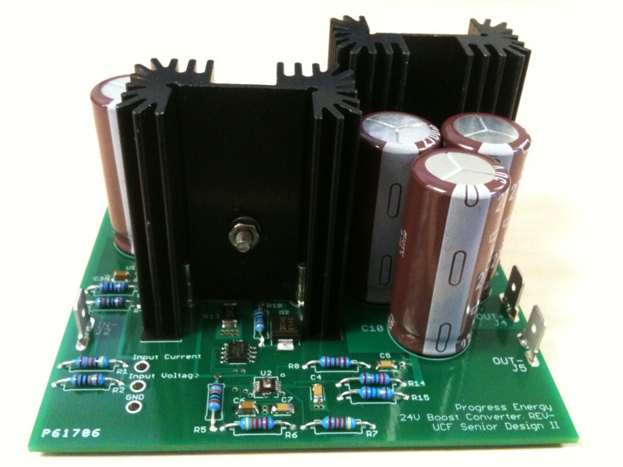
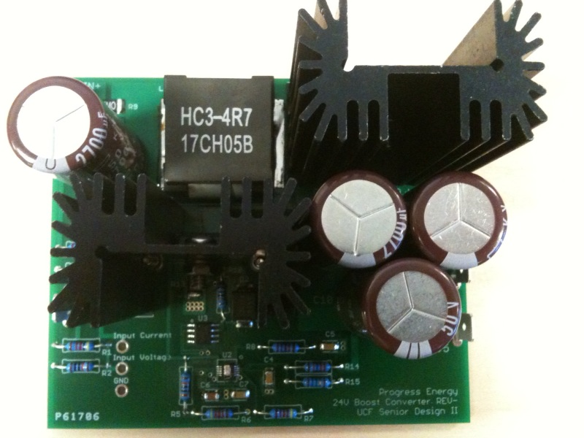
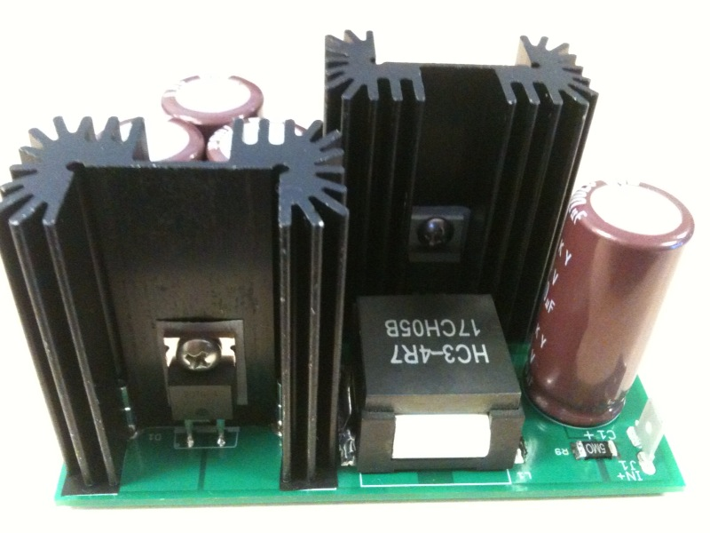
Populated Board

Slide 22
Smart Charge Controller
Morningstar Sunsaver-10
  100 % Solid State
    All switching done with FETs
    No mechanical relays
  PWM battery charging method
    Provides constant voltage battery charging
    True 0 to 100 % duty cycle is very fast and stable
  Built in temperature compensation
  Reverse current protection
Notes:
In order to charge the battery safely, a smart charge controller is employed between the Boost converter and the sealed lead-acid battery. The Morningstar Sunsaver-10 is specifically designed to charge a 12 V battery safely, and efficiently. It operates in solid state completely, as all switching is done by Field Effect Transistors. This allows there to be no mechanical relays, and thus no delay in the charging process. The 0 to 100 % duty cycle PWM signal used in this device provides constant voltage battery charging at a very fast and stable rate. Since the SunSaver prevents the battery from discharging theough the converter, there is no need for a blocking diode. All of these features lead to a longer battery life, and overall improved system performance.

Slide 23
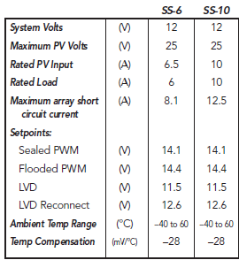
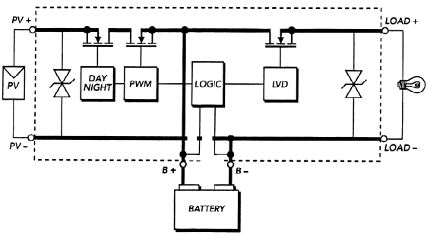
Morningstar SunSaver-10
Specifications
Block diagram
Notes:
The SunSaver is designed for use with solar panels, but the device fits perfectly into the CALBOX system. Looking at the collumn on the right in the specifications chart, it is seen that the model chosen accepts up to 25 V from the boost converter. Since the converter has been specifically designed based on this device, it is capable of providing a range of 12 – 24 V to the charge controller. The controller works perfectly with the battery chosen, as the battery can’t accept current greater than 12 A, and the SunSaver will not deliver any more current than this. Looking at the block diagram, it is seen that the PWM signal effectively charges the battery through the use of logic circuits. The diagram shows a load, which is directly driven by the controller, however the CALBOX does not require this. Another benefit of the SunSaver is that it minimizes switching noise and filters all noise output to extremely low levels.

Slide 24
PLAY

Slide 25
Battery
Conventional battery technologies
Lead acid batteries are more suitable for the applications of the CALBOX
  NiCd and NiMH would have required a very large battery bank
  Li-ion is too expensive
Battery system | NiCd | NiMH | Li-ion
Average operating voltage (V) | 1.2 | 2.3 | 3.6
Energy density (Wh/I) | 90-150 | 160-310 | 200-280
Specific energy (Wh/Kg) | 30-60 | 50-90 | 90-115
Self-discharge rate (%/month) at 20°C | 10-20 | 20-30 | 1-10
Cycle life | 300-700 | 300-600 | 500-1000
Temperature range (°C) | -20 – 50 | -20 – 50 | -20 – 50
Lead acid batteries
 | Wet Cell | Gel | AGM
Cost | Least | Medium | Most
Maintenance | Some wet cell batteries need to be re-watered and their specific gravity checked with a hydrometer. | None | None
Cooling time | Yes | None | None
Lifetime | Longest | Shortest | Long
Charging sensitivity | Modest | Highest | High
High-temperature operation | Worst | Best | Moderate
Low-temperature operation | Worst | Best | Moderate
Safety | Electrolyte can spill and corrode | Safe | Safe
Venting | Must be vented or placed outside | None | None
Mounting | Upright only | Any | Any

Slide 26
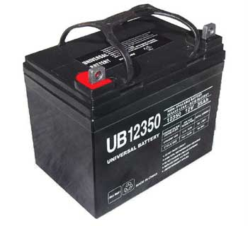
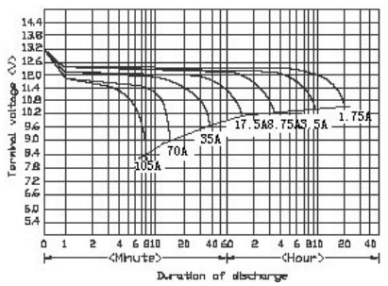
Universal Power Group UB12350
Absorbent glass mat battery
  Deep cycle
  Approximately 2 hours of play time for a 35 Ah charge
Characteristic | Value
Output Voltage | 12V
Amperage | 35Ah
Brand | UPG
Chemistry | Absorbent glass mat
Battery Size | Group U1
Length | 7.68”
Width | 5.16”
Height | 6.14”
Terminals | B2 internal threaded post
Model Number | 45976

Slide 27
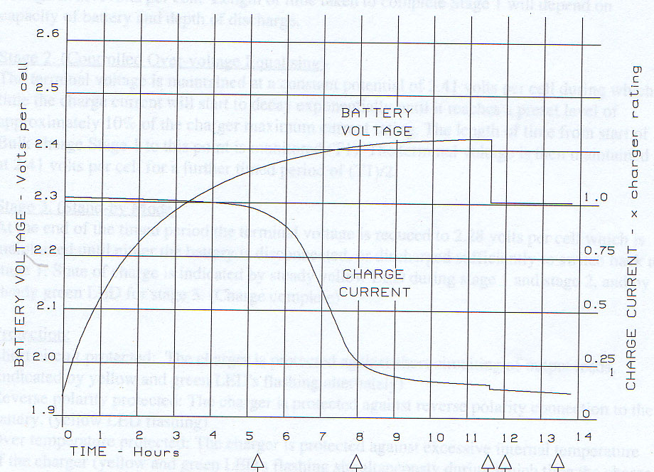
Resistance
The typical charge characteristic is inversely proportional between the voltage and the current
The current is directly proportional to how difficult it is to pedal the CalBOX
  If the battery is depleted, it is more difficult to pedal
    7-8 Amp demand
    12 V – generator side
  If the battery is fully charged, the current is greatly reduced, and the CalBOX is easier to pedal

Slide 28
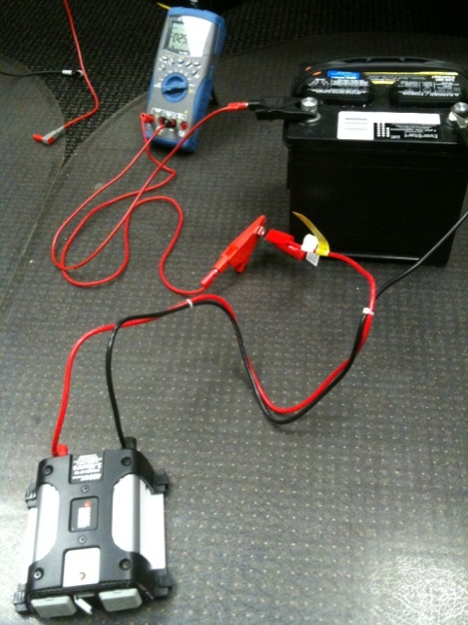
DC-AC Inverter
Black and Decker 400 W Power Inverter
Common inverters are available in 200W and 400W models
Chosen inverter has the capability of outputting currents upwards of 3.42A
XBOX 360 needs up to 1.7A during heavy gaming
  200W inverters deliver insufficient current
Black and Decker model has a 5V USB output port
  Will power Arduino microcontroller
Maximum Continuous Power: | 400 W
Surge Capacity: | 800 W
Input Voltage: | 12.8 V
Output Voltage: | Approximately 115 VAC RMS 60 Hz
Low Voltage Alarm: | < 11 VDC
Low Voltage Shutdown: | 10.8 VDC
Wave Form: | Modified Sine Wave
Maximum Output Current: | 3.42 A

Slide 29
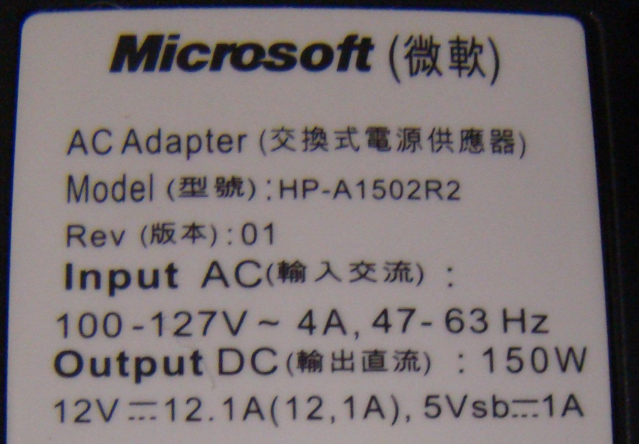
XBOX 360
Time (hh:mm) | Voltage (V) | Current (A) | Activity | Power (w)
8:51 | 12.27 | 9.97 | dashboard | 122.3
8:56 | 12.24 | 10.1 | dashboard | 123.6
9:02 | 12.21 | 10.14 | dashboard | 123.8
9:07 | 12.22 | 10.16 | movie | 124.2
9:12 | 12.14 | 10.16 | dashboard | 123.3
9:17 | 12.1 | 10.2 | dashboard | 123.4
9:22 | 12.09 | 10.21 | intro movie | 123.4
9:28 | 12.03 | 10.22 | dashboard | 122.9
9:32 | 12.02 | 10.22 | dashboard | 122.8
9:38 | 11.96 | 10.23 | dashboard | 122.4
9:45 | 11.92 | 10.24 | dashboard | 122.1
9:51 | 11.91 | 10.25 | dashboard | 122.1
9:59 | 11.83 | 10.31 | dashboard | 122.0
10:04 | 11.78 | 10.36 | dashboard | 122.5
10:11 | 11.71 | 10.42 | dashboard | 122.8
10:21 | 11.59 | 10.53 | dashboard | 122.4
10:27 | 11.53 | 10.67 | dashboard | 123.0
10:34 | 11.44 | 10.71 | dashboard | 122.6
10:39 | 11.35 | 10.76 | dashboard | 122.1
10:44 | 11.25 | 10.88 | dashboard | 122.4
10:49 | 11.12 | 10.97 | dashboard | 122.6
Final | 11.69
Typical discharge statistics for an Xbox on the CalBOX 360
  Rated for 150W
  Highest load while playing a video game
Power adapter encased inside of CalBOX to prevent user from running the console from wall outlet

Slide 30
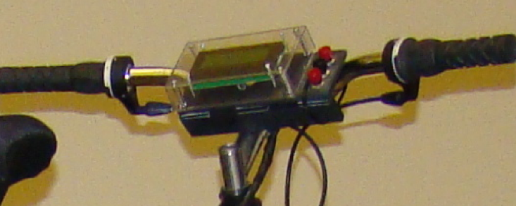
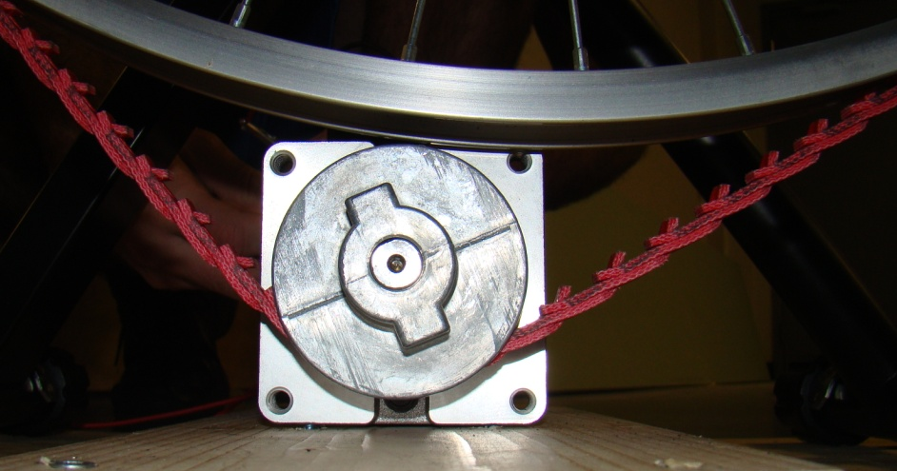
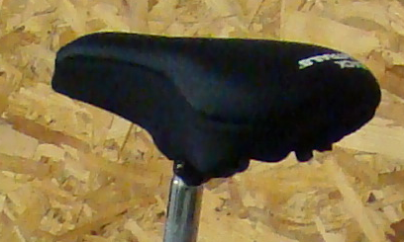
Final Build
Handlebar LCD with power on, session, and Xbox on buttons
Power twist v-belt ensures no slipping for power maximization
Comfort seat for extended workout

Slide 31
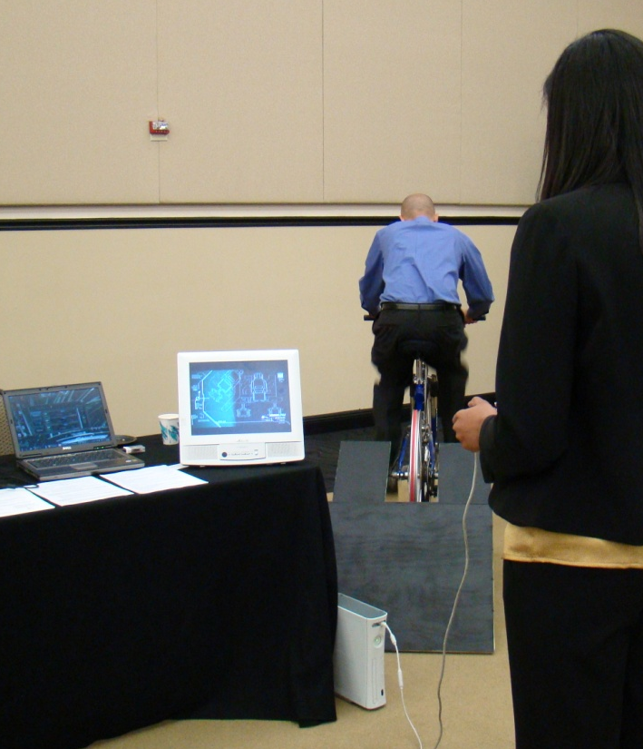
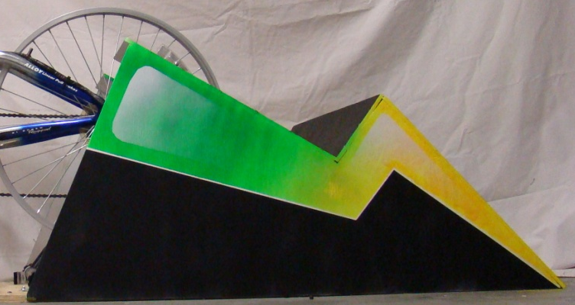
Final Build
The CalBOX 360 surpasses the original standards for build set as goals for the design
  Play and ride at the same time
  Power three devices
Attractive case for home use

Slide 32
MONITORING

Slide 33

Requirements
A system able to monitor and display relevant information locally:
  Calorie expenditure
  State of charge of the battery
A system able to record session data and observe it externally:
  List of all recorded sessions
  Graphically represent progress over time
FEEDBACK
Local
LCD
External
Computer Application

Slide 34
Components
Inputs from battery and generator (Voltage)
Core components consist of a microcontroller platform which is able to monitor voltages from the battery and generator and perform calculations related to calorie expenditure and battery charge
Display local to bike for providing user with battery and calorie information
Local Display
µC
Wireless Transmitter
Wireless transmitter/receiver for sending readings and calculations to an external computer
Windows application for presenting the user with statistical data about their sessions
A session database for holding all the data relating to sessions
Wireless Receiver
USB
PC
Session Database
Application

Slide 35
Calorie Calculations
Caloric intake
Caloric burn
Caloric surplus or deficit
1 LB of fat = 3500 calories: Being able to keep track of calorie intake versus calorie expenditure allows one to have goals for weight loss, eating habits, and excercise.
Use METs(Metabolic Equivalent of a Task) levels to relate pedaling intensity to caloric burn.
Voltage from the generator will be compared to this chart to provide the METs intensity level
METs Level | Pedaling Intensity
1 | No pedaling, at rest
2-3 | Low Intensity
4-5 | Low to Medium Intensity
6-7 | Medium Intensity
8-9 | High Intensity
10-12 | Very High Intensity
Notes:
2000 calorie intake – 2500 calories burned = 500 calorie deficit, = 1lb a week
Standing still = 1 METs, running = 10 METS
155lbs = 70 kg
9 * 3.5 * 70 * 60 / 200 = 660 calories burned

Slide 36
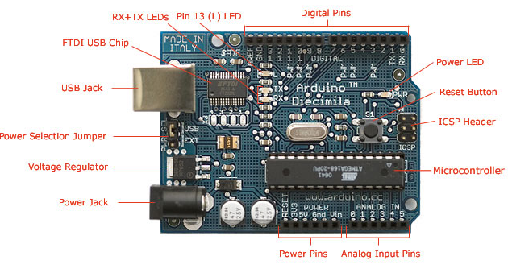
Microcontroller Platform
Arduino Physical Computer Platform
  Features: low cost, open source, extensive libraries, development environment, I/O
  Uses a Atmel AVR ATmega328P microcontroller
  Modularity: Hardware support and software libraries for extendible modules such as LCDs, Wireless, and serial interfaces.
  Programmability: C/C++ derivative, IDE, USB
 | Speed | Voltage | Flash | EEPROM | RAM
ATmega328 | 20Mhz | 1.8V-5.5V | 32KB | 1KB | 2KB
Allows us to measure voltages coming from battery and generator
Perform the calculations related to battery charge and caloric expenditure
Send wireless communications using a supported wireless module
Notes:
Less than $30, compared to $100’s for FPGAs
Open source = large community = extensive libraries means less writing code and more implementing features
I/O: USB, Support for external modules like wireless, LCDs, Analog Pins

Slide 37
Microcontroller Design: Inputs
Input from Generator:
  Depending on intensity, pedaling will produce a voltage from 0-24V
  Scale voltage using a voltage divider. Arduino analog pins can only read 0-5V with a resolution of 1024 bits. Each bit = .0049mV.
  Sample voltage @ 1Hz and compare to a stored METs intensity chart.
  Calculate calories burned for minutes passed in session based on returned METs value
  Increment total calories burned as main program loops
Functions Name | Description | Returns (data type: description)
readV_gen(analog pin 0) | Read voltage from generator | float: Voltage from the generator
calcCalsBurned(metValue,time) | Calculate calories burned per minute | int: Calories burned per second
calcMets(genVolts) | Calculates a METs value from a given volts | int: METs value between 1 and 12
Notes:
Reading of 300 = 1.47 volts
Structure of a sketch
Initialize variables
Setup() : initalize libraries and pin modes
Loop() : main loop where bulk of code goes. Continually loops until Arduino powered off or reset.
if voltsRead < 4 && voltsRead > 3
metsValue = 9

Slide 38
Microcontroller Design: Inputs
Input from Battery:
  Battery state of charge is determined through the voltage across the battery terminals. 0-13.2 VDC.
  Scale voltage using a voltage divider and read on analog pin 1
  Sample voltage @ 1Hz and compared to predetermined discharge levels given by manufacturer
  Add voltage reading to a filter array that stores and averages the last 30 readings
  Calculate battery charge percentage
  Main program loops and continues to measure and filter voltages as well as updating the battery charge percentage
Percent Readout | Open Circuit Voltage (VDC) | Scaled Voltage (VDC) | Comments
100% | 12.3 -13.2 | 4.5 – 4.88 | Max voltage to be limited to 13.2VDC
90% | 12.1-12.3 | 4.48 – 4.55 | Linear voltage discharge range
80% | 12.0 – 12.1 | 4.44 – 4.48 | Nominal voltage
70% | 11.6 – 12.0 | 4.29 – 4.44
60% | 11.4 -11.6 | 4.22 – 2.29
50% | 11.2-11.4 | 4.15 – 4.22
40% | 11.0 – 11.2 | 4.07 – 4.15
30% | 10.8 - 11 | 4.0 – 4.07 | Estimated at max load 60 minutes remaining of game play
20% | 10.7 – 10.8 | 3.96 – 4.0
10% | 10.6 - 10.7 | 3.92 – 3.96
0% | 10.5 – 10.6 | 3.88 – 3.92 | Conservative shut-down voltage
Functions Name | Description | Returns (data type: description)
readV_batt(analog pin 1) | Read voltage from battery | float: Voltage from the battery
filterBattVoltage(battVolts) | Calculates the average voltage for the past 10 seconds. | float: Filtered voltage
calcBattPercent() | Calculates a State of Charge percentage from a given voltageReading | int: Battery Charge percentage

Slide 39
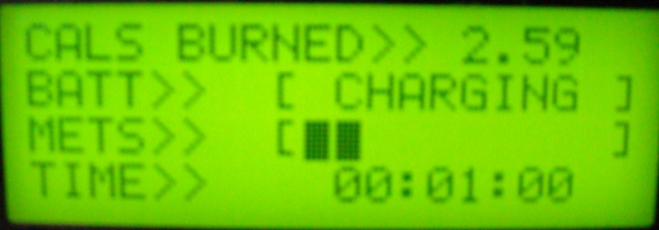
Microcontroller Design: Outputs
HD44780 Character LCD chipset:
  20x4 (column x row) character display
  Interfaces directly with Arduino power, and digital pins
  Arduino supports the HD44780 with the LiquidCrystal library which allows an LCD to be manipulated in a high level programming language without having knowledge of the registers and machine instructions involved
Design:
  Initialize pins and lcd object
  lcd.clear screen at beginning of a session
  Draw the text and meter brackets
  Update meters, calories burned, and increment timer every second
Notes:
“CALS BURNED:” = 12 Characters
“BATT CHARGE:” = 12 Characters
Set cursor at r
Initially the only two phrases will be drawn at the start of the session; “Cals Burned:” on row 0, starting at column 0 (rows and columns are initialized at 0) and “Batt Charge:” on row 1, starting at column 0. As “Cals Burned:” consists of 12 characters, to update the calories burned value as time passes, the setCursor() will appropriately start with row 0, column 13, giving 4 characters left to show the total calorie expenditure. The same practice follows with “Batt Charge”, although it will take in row 1, and column 12 as parameters.

Slide 40
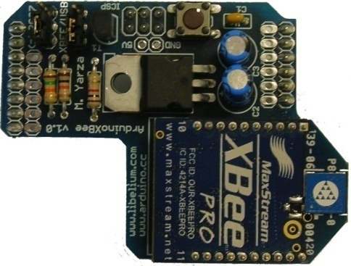
Wireless Communications
XBee Radio Module:
  Zigbee derivative
    (IEEE 802.15.4)
  Considerations: Range, Power, Cost
  Interfaces to the Arduino through the XBee Shield, providing power, and connections to the serial pins
  Interfaces to the PC through USB
Configuration:
  Operating in AT mode (Serial
  Pass-through)
  Personal Area Network
  Coordinator vs. End Device
  Configure Registers in X-CTU application
Xbee Radio Module Specifications
Indoor Range | 100 feet (30 meters)
Outdoor Range (line-of-sight) | 300 feet (100 meters)
Transmit Power | 1 mW
 | Xbee Registers (Arduino) |  | Xbee Registers (PC)
Name/Description | Default Value | New Value | Default Value | New Value
PAN ID | 3332 | 5249 | 3332 | 5249
MY: Source Address | FFFF | 10 | FFFF | 11
DL: Dest Address | 0 | 11 | 0 | 10
BD: Baud Rate | 3(9600) | 6(57600) | 3(9600) | 6(57600)
Notes:
Vs. Bluetooth:

Slide 41
Wireless Communications
Wireless Serial
Arduino
PC
XBee Shield
XBee USB Explorer
Packet
$ | Total Session Calories | . | Total Session Time
$calories.minutes
Initialize serial connection on the Arduino using serial libraries
Accumulated values from calories burned and session time are calculated.
Resulting values are formatted into a single string packet. The resulting string is now ready for transmitting.
The string is then sent over serial using the serial print functions.
When the push button that is connected goes low, we send the session data.

Slide 42
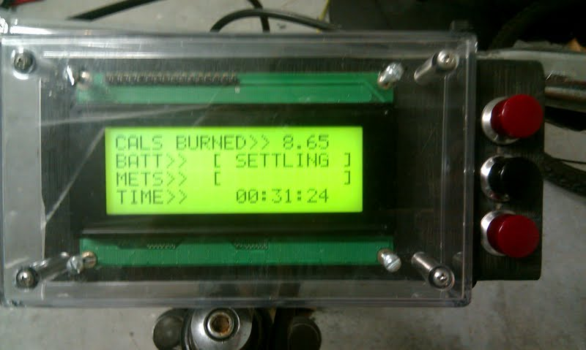
Handlebar Unit
Incrementing
Calories
Battery meter
METs intensity
meter
Session timer
Push button for transmitting session data

Slide 43

Software
Goals:
  Provide the user with a GUI based application to see a list of all sessions over a period of time
  Be physically disconnected from the main system
  Single user
  Look nice
Session List
Graph/Chart of sessions

Slide 44
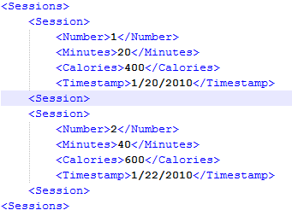
Software Platforms
Windows Presentation Foundation (WPF) + C#
  Separates design (XAML)from functionality(C#,.NET)
  Graphical Services: Many built in controls for buttons, list boxes, graphs/charts. Gradients, 3D, Animations
  Data Binding: Important in able to update the GUI elements with data stores in the application dynamically and instantaneously.
  Templates: Grants the ability to apply overall templates and inheritances, giving the GUI a uniformed looked that can be updated dynamically.
  Layout: Provides layout controls for implementing organized layouts, allowing programmers to embed layouts within layouts.
XML files as database
  Doesn’t require a SQL based server
  Numerous libraries available for XML manipulation
XML
WPF

Slide 45
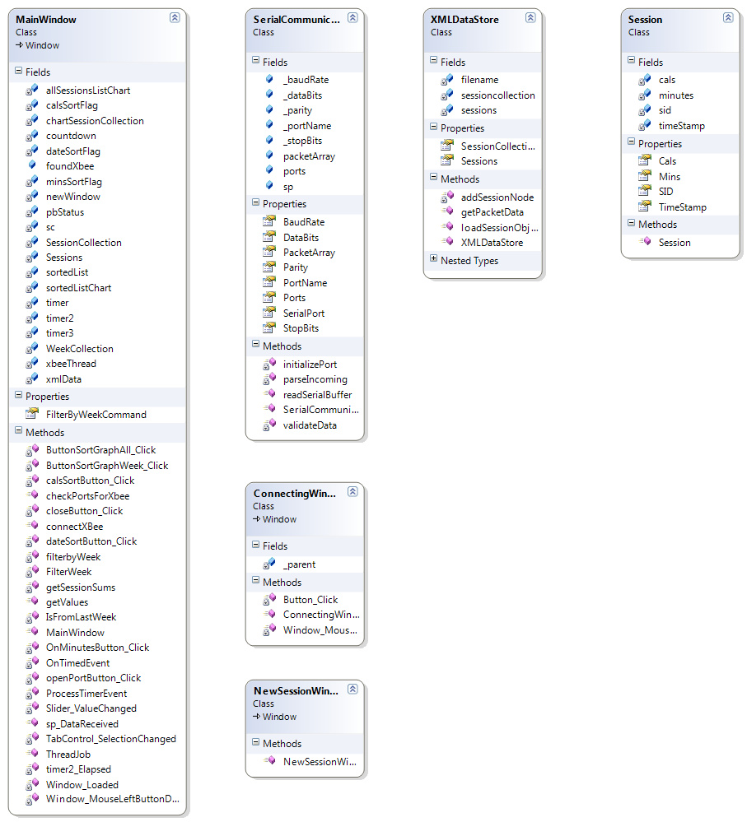
Classes
1…*
Initializes components
Class that communicates with hardware
De-serializes XML data, adds sessions to XML data, and instantiates the Sessions class and puts sessions into an observable collection.
Class to de-serialize XML database into instances of the Session class
Initializes serial port, talks with Xbee, receives session data, and initializes XMLDatastore class
Main, initializes all GUI controls, other misc. functions

Slide 46
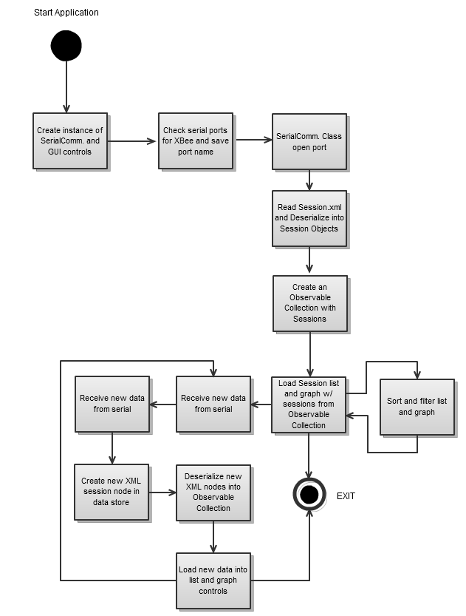
Activity Diagram

Slide 47
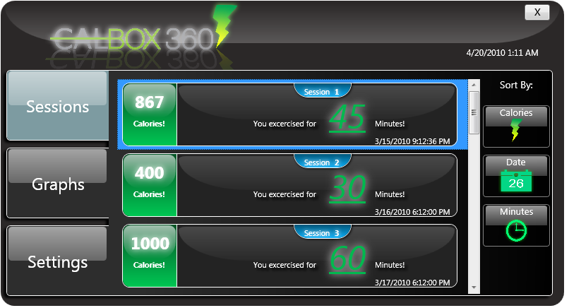
CalBOX App
List sessions and data
Show Calories burned
Show time of session in minutes
# of Session
Time stamp
Sort listed sessions:
Ascending/Descending calories
Ascending/Descending minutes
Latest/Oldest date
The user interface provides
  Calories
  Run timeDate
Multiple ways to view data
  Graphical charts
  Per session data
  Customize in settings
Notes:
Chris
The Windows Application runs on an external has a database that stores all sessions received by the main bike station. It lets the user track, organize, sort, and list all their sessions. We can look at these in list form or graphically over time. This is a great way for someone to keep interested in their health and exercise progress.

Slide 48
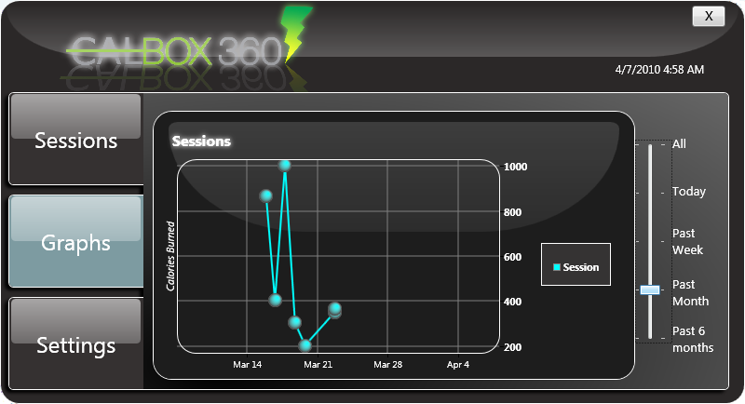
CalBOX App
X-Axis is time
Y-Axis calories
Show sessions by time span:
All Sessions
The current day
Past month
Past 6 months
Notes:
Chris
The Windows Application runs on an external has a database that stores all sessions received by the main bike station. It lets the user track, organize, sort, and list all their sessions. We can look at these in list form or graphically over time. This is a great way for someone to keep interested in their health and exercise progress.

Slide 50
Budget & Financing
Item | Unit Cost | Total Price
Leeson M1120046 DC Generator | $190 | $190
12V 35 Ah Lead Acid Battery | $100 | $100
Battery Charger (2) | $50 | $100
DC-AC inverter | $50 | $50
Arduino Duemilanove Microcontroller | $30 | $30
Liquid Crystal Display | $12 | $12
xBee Chips (2) | $23 | $46
xBee Shield Kits (2) | $6 | $12
xBee Explorer USB | $25 | $25
Circuit Board Printing (3) | $33 | $99
DC-DC Converter Components | $100 | $100
Indoor Trainer | $80 | $80
Power Twist V-belt | $80 | $80
Building Materials | $100 | $100
Totals |  | $1024
Notes:
As a whole, our system cost about $1100 to make. Thanks to the sponsorship of Progress Energy, these costs will be covered in full. The most expensive component of the system is the DC generator, which cost nearly $200 by itself. Two DC-AC inverters were purchased, as the first one experienced technical difficulties after an accident occurred. Other expenditures not listed here are encompassed in the miscellaneous section. Wires were purchased to connect the system. A lot of length was needed to connect all the pins from the LCD on the handlebars to the Arduino behind the rear wheel. Also, the wires for the toggle switches run this long as well. Wood was purchased to construct the platform and enclosure for the system.

Slide 51
QUESTIONS?

