Slide 1
Acoustic Pinger Locator Sponsor: Robotics Club at UCF
Group 19
Cassondra Puklavage
Jonathan Mohlenhoff
Zhen Cai
Critical Design Review
March 1, 2010
<footer>Group #19
<number><number>

Slide 2
AUVSI and ONR’s 13th International Autonomous Underwater Vehicle Competition
AUV must complete several missions
Path Planning
Obstacle Avoidance
Vision Tasks
Pinger Challenge
AUV Tasks
Facility and Competition Layout
<footer>Group #19
<number><number>
Notes:
AUVSI (Association for Unmanned Vehicle Systems International)
Host several student competition each year
Competitions include ground, air and water robots
ONR (Office of Naval Research)
Co-host several competitions with AUVSI
Provide military and industry judges for competitions
<number><number>

Slide 3
Robotics Club at UCF
Participation
Have entered AUVSI competitions for the past 10 years
Have entered the AUV competition for the past 6 years
2006 Fifth Place
2009 Fourth Place
Top 3 AUVs completed pinger challenge
History
Past UCF Vehicle
<footer>Group #19
<number><number>

Slide 4
Pinger Challenge
Locate single pinger in underwater environment
7ms pulse every 2 seconds
Frequencies range from 20KHz to 40KHz
Difficulties
Multiple Pingers in the water
Echoes
Signal interference and attenuation
Low-Power signal
<footer>Group #19
<number><number>

Slide 5
Group 19 Goals
Develop acoustic pinger locator system for AUV team
This component will be integrated into this year’s AUV
Black box approach
Acquires pinger location independently of AUV
Provides location information to host AUV computer
<footer>Group #19
<number><number>

Slide 6
Specifications
Provided by AUVSI competition rules and AUV Team
Pinger frequency selection from 20KHz to 40KHz
Powered through unregulated 22.2V Li-Po Batteries
Serial interface to AUV computer
Easy physical integration with AUV
7.5” diameter tube, allocated 6” length
Hydrophone array externally mounted
Actual AUV integration will depend on AUV Team
Heading accuracy to within 10 degrees of pinger location
<footer>Group #19
<number><number>

Slide 7
Technical Design
Analog
Digital
AUV Host
Analog
Filters for specific frequency
Amplifies hydrophone signals
Condition signal for A/D
Digital
A/D Capturing
Mathematics for acoustic localization
Control analog hardware: filters and amplifiers
Digital signal processing
AUV Host
Send commands to APL: pinger frequency
Queries pinger location
Connects to APL
<footer>Group #19
<number><number>

Slide 8
Analog Hardware Specifications
Incoming signal
Less than 10mV
Amplification
Needed for the ADC and digital processing
Voltage range from 0 to 3.3V for the ADC
Noise Removal
Filtering
Bandpass
Minimal distortion
Especially between hydrophones
Phase
<footer>Group #19
<number><number>

Slide 9
Analog Hardware
<footer>Group #19
<number><number>

Slide 10
Hydrophone: Reson TC4013
Decision
Meets all requirements
Previously acquired
Cost
<footer>Group #19
<number><number>

Slide 11
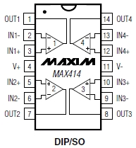
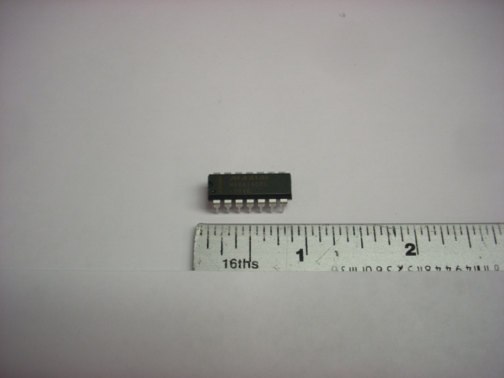
Pre-Amp Parts: MAX414
Quad Op-Amp
Used for initial low gain stage, separate signal
<footer>Group #19
<number><number>

Slide 12
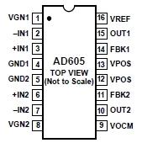
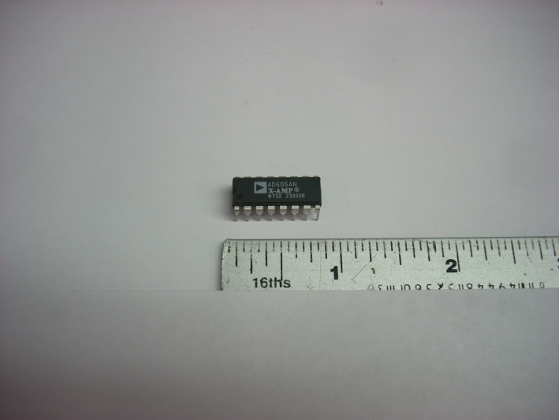
Pre-Amp Parts: AD605
Analog Controlled Variable Gain Amplifier
Used for first main gain stage
<footer>Group #19
Group #19
<number><number>
<number>

Slide 13
AD605 Configuration
<footer>Group #19
<number><number>

Slide 14
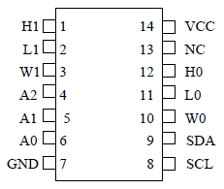
Pre-Amp Parts: DS1803
Digital Potentiometer
Controls the VGA through I2C implemented on the FPGA
<footer>Group #19
Group #19
Group #19
<number><number>
<number>
<number>

Slide 15
DS1803 Configuration
<footer>Group #19
<number><number>

Slide 16
Pre-Amp Stage Schematic
<footer>Group #19
<number><number>

Slide 17
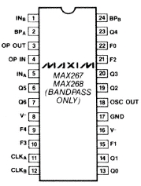
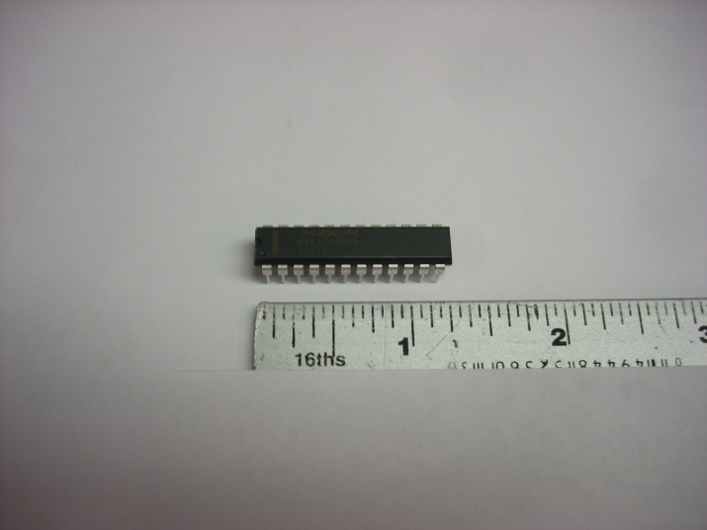
Filter Parts: MAX268
Programmable Filter
Controlled through clock line and pin settings
<footer>Group #19
Group #19
Group #19
Group #19
<number><number>
<number>
<number>
<number>

Slide 18
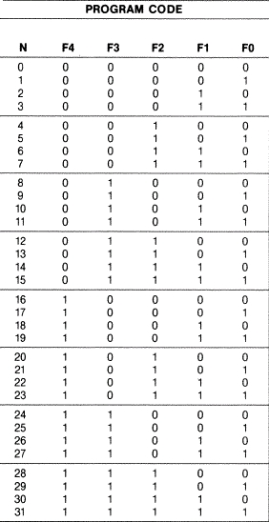
MAX268: Setting fo
Center Frequency Calculation
Based on fclk/fo ratio
32 steps
Higher ratios are more accurate
Equation: fclk/fo = pi(N+13)
N is set through Fo-F4 pins
Example: fo = 25kHz, large ratio
fclk = fo*pi(31+13) = 3455751
fclk should be 3.45MHz to set a fo of 25kHz
<footer>Group #19
<number><number>

Slide 19
MAX268: Set Q
BW and Q relationship
Q = fo/BW > BW = fo/Q
Higher Q results in smaller acceptance BW around fo for the bandpass filter
Filter will have Gain = Q
Chip allows for 128 Q steps
Provided Equation:
Q = 64/(128-N)
Q programmed through Q0-Q6 pins
Example: Set Q of 32 when fo = 25kHz
BW around fo = fo/Q = 781.25Hz
<footer>Group #19
<number><number>

Slide 20
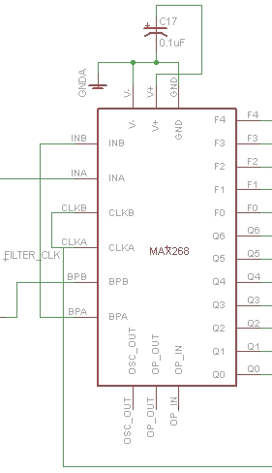
Filter Stage Schematic
Configuration
+5V
Pins set by FPGA
Output A fed into input B to create a 4th order filter bandpass filter
<footer>Group #19
<number><number>

Slide 21
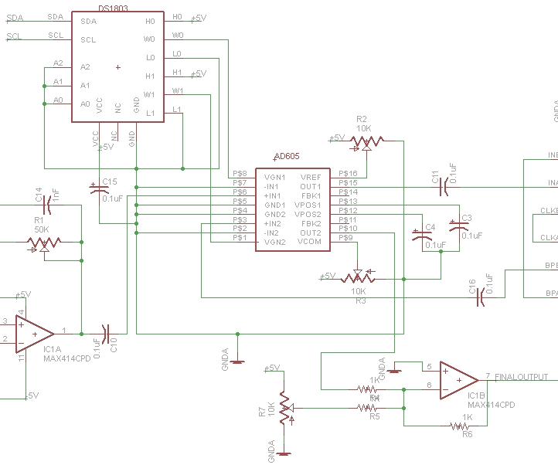
Signal Conditioning Stage Schematic
Final gain or attenuation stage using the same VGA and DP configuration
Use the MAX414 in an adder circuit to adjust the signal into the 0 to +5V range
Feed signal through a potentiometer to scale to 3.3V for the ADC
<footer>Group #19
<number><number>

Slide 22
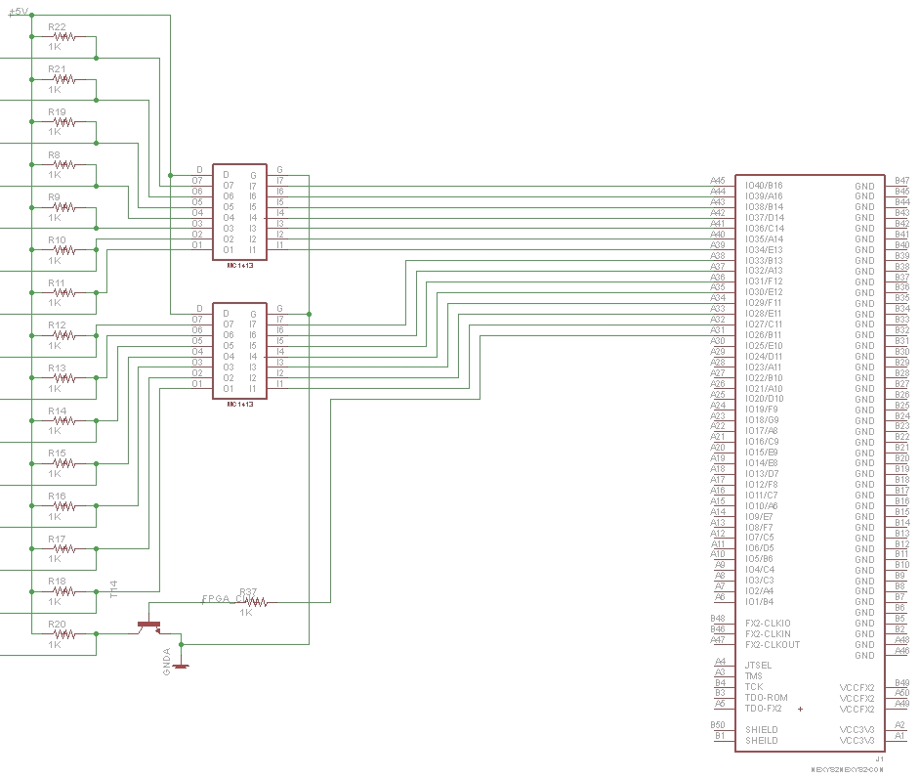
FPGA Control signals
FPGA Signal Output
0 to 3.3V
Filter Input Range
0 to 5V
NPN Transistor
Pull up resistor to 5V
Ground connected by transistor when logic on
Inverts logic
<footer>Group #19
<number><number>

Slide 23
Power Usage
<footer>Group #19
<number><number>

Slide 24
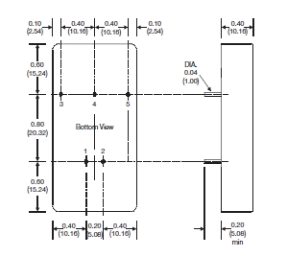
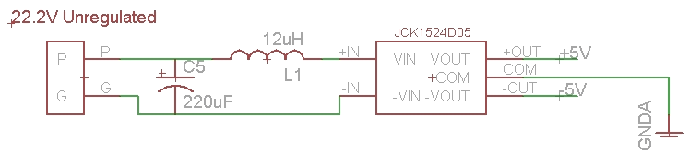
Voltage Regulator: JCK1524D05
Voltage Regulator
Provide power to the analog hardware board
<footer>Group #19
Group #19
Group #19
Group #19
Group #19
<number><number>
<number>
<number>
<number>
<number>

Slide 25
Single Signal
<footer>Group #19
<number><number>

Slide 26
Hydrophone Signal
Pre-Amplification
Filtering
Signal Scaling
Signal Conditioning
Post-Amplification
Signal Representation
<footer>Group #19
<number><number>

Slide 27
Full Schematic
<footer>Group #19
<number><number>

Slide 28
Digital System Overview
The digital hardware selection is an important stage of the project
Controls some of the analog hardware
Samples analog signals
Processes data
Various options to consider for our design
The analog signals need to be converted into a digital format to further be processed
The design needs to utilize the Nyquist Sampling Theorem to fully reconstruct the analog signal
<footer>Group #19
<number><number>

Slide 29
Digital System Specifications
Square wave PWM to select center frequency of analog filters, 500 KHz to 5 MHz
I2C Interface for controlling digital potentiometer
SPI for interfacing with high speed ADCs
UART for interfacing with AUV Host PC
Support large volume of data
4 Channels * 1.5 Bytes * 1 MSPS = 6 MB/S
<footer>Group #19
<number><number>

Slide 30
Hardware Choices
<footer>Group #19
<number><number>

Slide 31
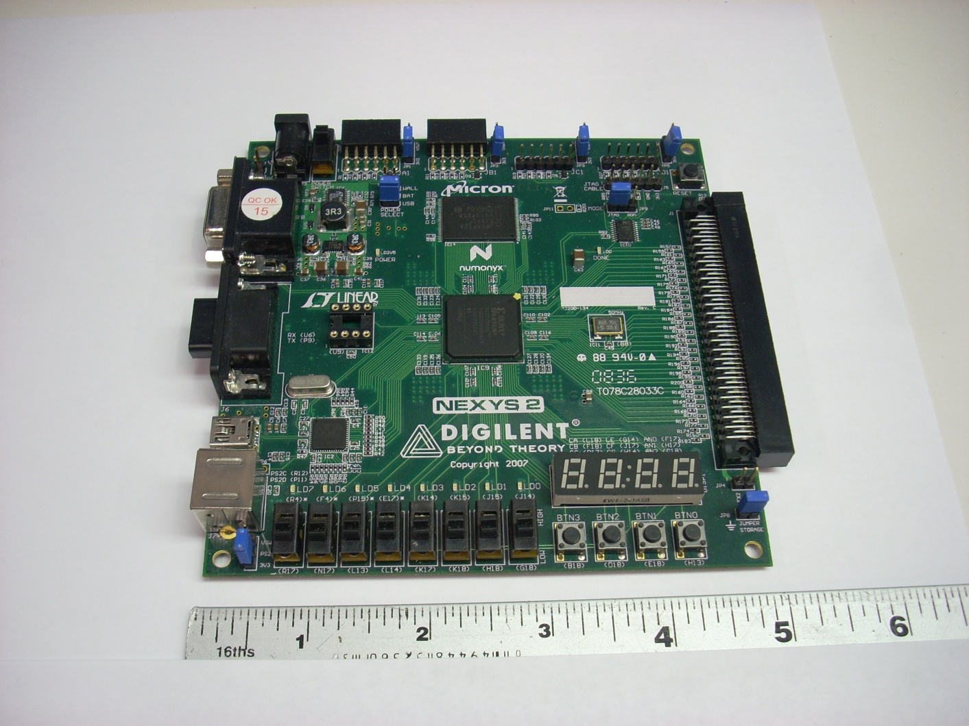
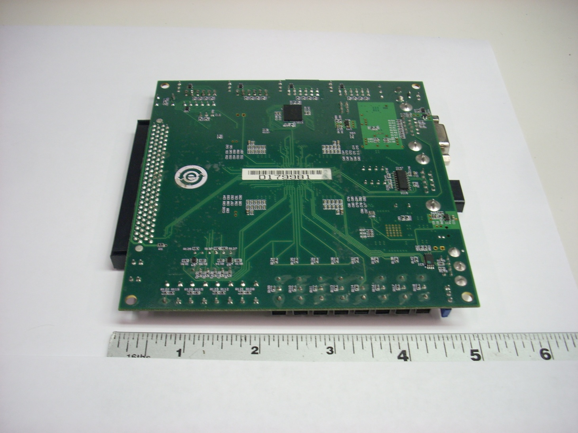
Digilent Nexys 2
Development board provides ease of prototyping and interface to FPGA
Built in programmer via USB
PMOD Digilent Standard interface
Size fits within requirements
100 pin connector for high speed I/O
Built in switches and buttons for user input
LEDs and 7 Segment Displays for user output
<footer>Group #19
<number><number>

Slide 32
A/D Converters
<footer>Group #19
<number><number>

Slide 33
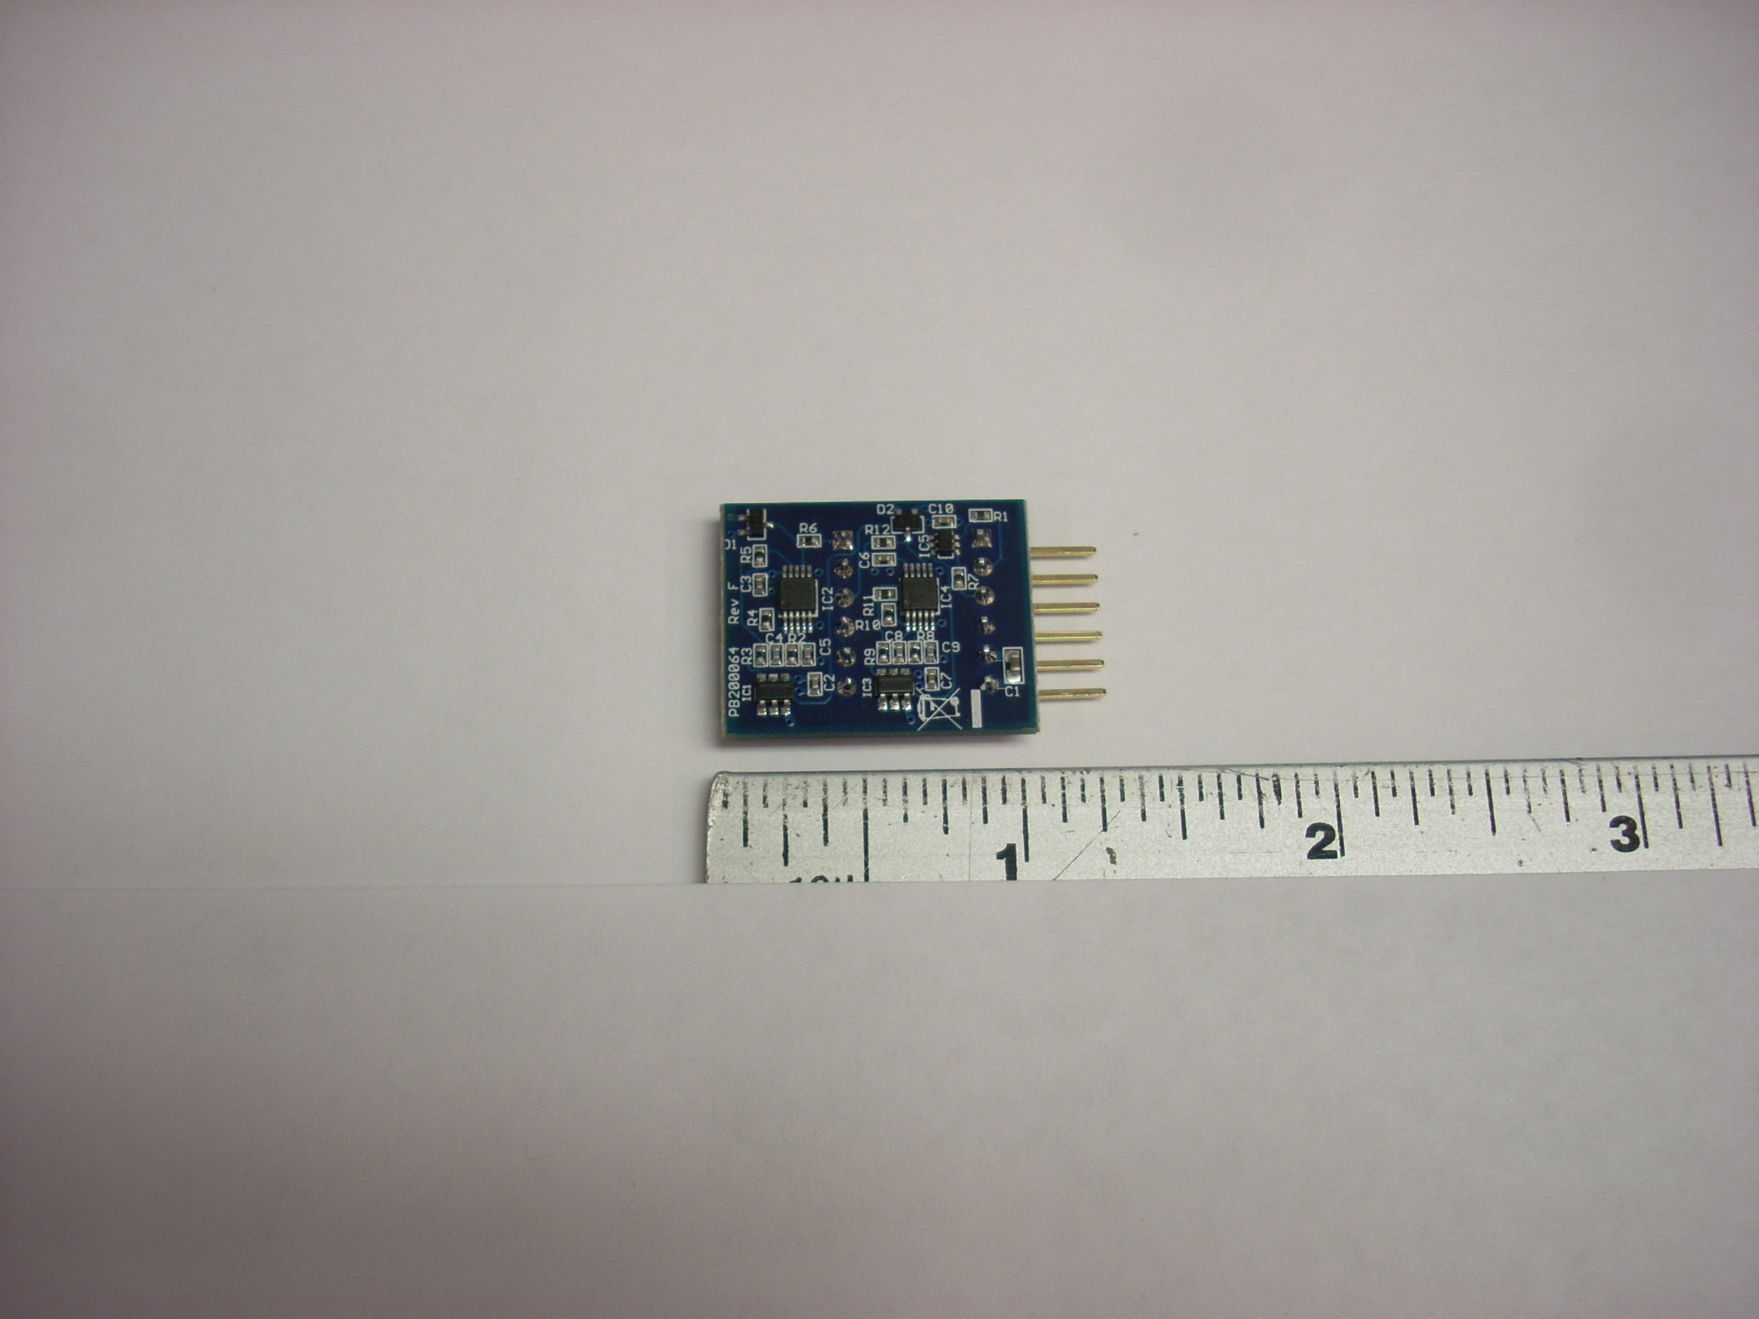
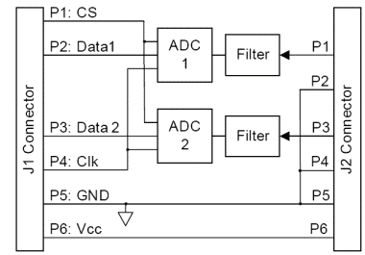
PmodAD1
Made by Digilent Inc.
2-Pole Sallen-Key Filters cutoff at 500 KHz for anti-aliasing
Two simultaneous A/D conversion channels using successive approximation
1 MSPS at 12 bits (0 to 4095)
Analog Input Range: 0V to 3.3V
Low power consumption:
3.3V @ 0.6mA ≈ 2 mW * 2 = 4 mW
Small Dimensions: 0.95” x 0.80”
SPI Interface over PMOD, VHDL Interface and sample code provided by Digilent
<footer>Group #19
<number><number>

Slide 34
Development Software
Xilinx ISE Design Software
Cost is free
Designed to be used with the Spartan 3E FPGA
Full featured for both VHDL and Verilog Hardware Descriptor Languages (HDL)
<footer>Group #19
<number><number>

Slide 35
VHDL on FPGA
Hierarchal Component Structure in FPGA
HydrophoneControl
ASampleComp
ChannelComp
Max268Comp
SampleFreqInterface
ArbiterComp
MCUPRT
dPotControllerInterface
rawDataInterface
pingTimerInterface
AD1RefComp
AD1RefComp
dcCalc
pkToPk
pingDectect
Adder x4
Pwm
RS232RefComp
ds1803Interface x2
Rs232RefComp
AD1RefComp
AD1RefComp
dcCalc
pkToPk
pingDectect
Adder x4
Pwm
RS232RefComp
ds1803Interface x2
Rs232RefComp
AD1RefComp
AD1RefComp
dcCalc
pkToPk
pingDectect
Adder x4
Pwm
RS232RefComp
ds1803Interface x2
Rs232RefComp
AD1RefComp
AD1RefComp
dcCalc
pkToPk
pingDectect
Adder x4
Pwm
RS232RefComp
ds1803Interface x2
Rs232RefComp
AD1RefComp
AD1RefComp
dcCalc
pkToPk
pingDectect
Adder x4
Pwm
RS232RefComp
ds1803Interface x2
Rs232RefComp
AD1RefComp
AD1RefComp
dcCalc
pkToPk
pingDectect
Adder x4
Pwm
RS232RefComp
ds1803Interface x2
Rs232RefComp
AD1RefComp
AD1RefComp
dcCalc
pkToPk
pingDectect
Adder x4
Pwm
RS232RefComp
ds1803Interface x2
Rs232RefComp
AD1RefComp
AD1RefComp
dcCalc
pkToPk
pingDectect
Adder x4
Pwm
RS232RefComp
ds1803Interface x2
Rs232RefComp
AD1RefComp
AD1RefComp
dcCalc
pkToPk
pingDectect
Adder x4
Pwm
RS232RefComp
ds1803Interface x2
Rs232RefComp
i2cComponet x2
i2cComponet x2
i2cComponet x2
i2cComponet x2
i2cComponet x2
i2cComponet x2
i2cComponet x2
i2cComponet x2
i2cComponet x2
i2cComponet x2
i2cComponet x2
i2cComponet x2
i2cComponet x2
i2cComponet x2
i2cComponet x2
i2cComponet x2
i2cComponet x2
i2cComponet x2
i2cComponet x2
i2cComponet x2
i2cComponet x2
i2cComponet x2
i2cComponet x2
i2cComponet x2
i2cComponet x2
i2cComponet x2
i2cComponet x2
i2cComponet x2
i2cComponet x2
i2cComponet x2
i2cComponet x2
i2cComponet x2
i2cComponet x2
i2cComponet x2
i2cComponet x2
i2cComponet x2
i2cComponet x2
i2cComponet x2
i2cComponet x2
i2cComponet x2
i2cComponet x2
i2cComponet x2
i2cComponet x2
i2cComponet x2
i2cComponet x2
i2cComponet x2
i2cComponet x2
i2cComponet x2
i2cComponet x2
i2cComponet x2
i2cComponet x2
i2cComponet x2
i2cComponet x2
i2cComponet x2
i2cComponet x2
i2cComponet x2
i2cComponet x2
i2cComponet x2
i2cComponet x2
i2cComponet x2
i2cComponet x2
i2cComponet x2
i2cComponet x2
i2cComponet x2
i2cComponet x2
i2cComponet x2
i2cComponet x2
i2cComponet x2
i2cComponet x2
i2cComponet x2
i2cComponet x2
i2cComponet x2
i2cComponet x2
i2cComponet x2
i2cComponet x2
i2cComponet x2
i2cComponet x2
i2cComponet x2
i2cComponet x2
i2cComponet x2
i2cComponet x2
i2cComponet x2
i2cComponet x2
i2cComponet x2
i2cComponet x2
i2cComponet x2
i2cComponet x2
i2cComponet x2
i2cComponet x2
i2cComponet x2
<footer>Group #19
<number><number>
Notes:
<number><number>

Slide 36

HydrophoneControl Logic Overview
Track max and min of analog signal
Adjust analog gain accordingly
Rx Commands from AUV Host PC
Perform directed action
Report status
Select filter frequency
<footer>Group #19
<number><number>

Slide 37
MCU Library
Microcontroller Unit Library supports messaging from an MCU to PC
Developed and maintained by the Robotics Club at UCF
Hosted on public server at SourceForge.net in the Zebulon Code Bank
Supports standard messages and allows expandability
Cross platform support on PC and architectures for MCU: ARMite, PIC, Rabbit
<footer>Group #19
<number><number>

Slide 38
MCU Packet Format
<footer>Group #19
<number><number>

Slide 39
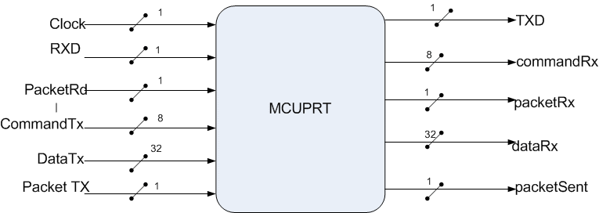
MCUPRT (Packet Rx and Tx)
Provides communication from FPGA to the Host AUV PC.
Includes a RS232RefComp component for using the RS232 Protocol. Encompasses all code to perform RS232 communications with simple interface.
<footer>Group #19
<number><number>

Slide 40
MCUPRT (cont.)
waitForStartBytes
If valid ->
processChecksum
Else ->
getHeader
RxProcess
Finite state machine for receiving a valid MCU Packet
Retrieves the Command and Data bytes and puts it on the external port
getDataByte3
getDataByte0
getDataByte2
getDataByte1
<footer>Group #19
<number><number>

Slide 41
MCUPRT (cont.)
waitForPacket
txChecksum
txStartByte1
TxProcess
Finite state machine for transmitting a valid MCU Packet that is placed on the components external ports
Encompasses start byte sequence and checksum calculations to module
txDataByte3
txStartByte2
txDataByte2
txCommand
txDataByte1
txDataByte0
<footer>Group #19
<number><number>

Slide 42
Supported Message Set
<footer>Group #19
<number><number>

Slide 43
FilterFreqSelect
Required to control the analog filter’s center frequency.
Must be a 50% duty cycle PWM wave at varying frequencies.
Simple interface for selecting appropriate frequency
Performs calculation to scale from 50 MHz FPGA clock to mapped frequency for filter.
<footer>Group #19
<number><number>

Slide 44
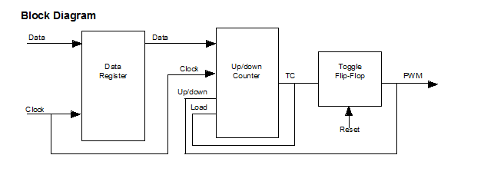
PWM (Attempt 1)
A data register is used to store the value for the counter
The Up/Down Counter is loaded with a new value from the data register when the counter reaches its terminal count;
When the data value is first loaded, the counter begins to count down from the data value to 0.
When the counter transitions through 0, the terminal count is generated and it triggers the Toggle Flip-flop to drive the PWM signal High
The data value is re-loaded and the cycle repeats.
*Counter direction is controlled by output signal:
count down when low / count up when high
<footer>Group #19
<number><number>

Slide 45
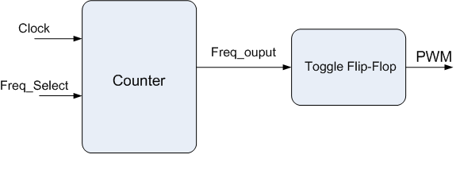
PWM
Designed PWM to meet the requirements of a continuous square wave with a varying frequency
Simple approach
F = 50 MHz / [2 * (1 + Input) ]
<footer>Group #19
<number><number>

Slide 46
ASignalInterface (VHDL)
Finite state machine for capturing the four channels simultaneously
Contains two AD1RefComp modules for interfacing with the two PmodAD1 over SPI
AD_done = 0
Wait for Conversion
AD1RefComp Interface
AD_done = 1
Start Conversion
Store Conversion
<footer>Group #19
<number><number>

Slide 47
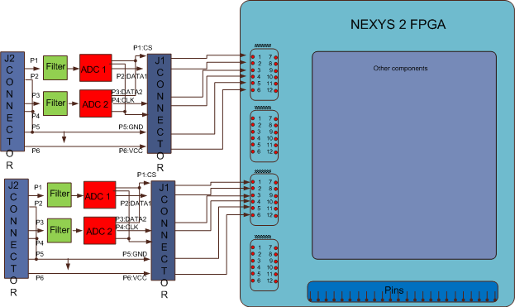
Hardware interface to PmodAD1
Physical connections made from Nexys2 FPGA to the PmodAD1 peripheral modules
<footer>Group #19
<number><number>

Slide 48
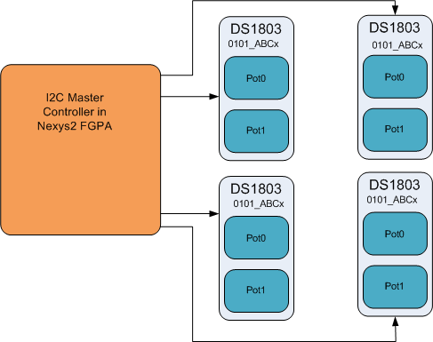
DS1803 Interface (VHDL)
The DS1803 is a digital potentiometer used for varying the gain in the analog system
Uses the I2C communication protocol
Allows multiple chips to be on the same bus, unique addresses
FPGA will act in master mode
DS1803 in slave mode
<footer>Group #19
<number><number>

Slide 49
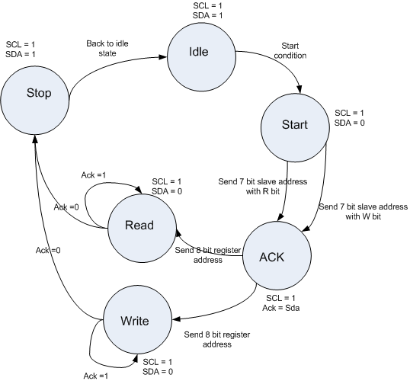
I2C
Custom I2C Module FSM
VHDL I2C Module will be utilized to conform to I2C Standard
Create our own simple I2C module
Use an open source module that implements full standard, more complicated
<footer>Group #19
<number><number>

Slide 50
Localization Techniques
Trilateration
Multilateration
Input / Output Data Mapping
All Require Timing Acquisition
Acquiring synchronized and accurate timing data from the hydrophones is necessary for acoustic localization of pinger.
Methods:
Counter Method
Frequency Domain Analysis
Cross Correlation
The different methods are used for differences in hydrophone distances
<footer>Group #19
<number><number>

Slide 51
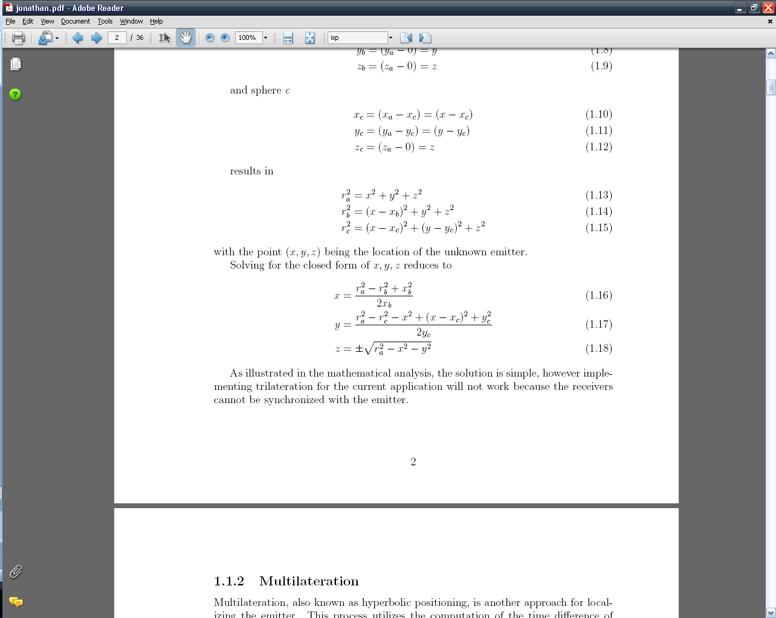
Trilateration
Time of Arrival (ToA) technique requires the receivers to be synchronized with the source
Solves the intersection of three spheres
Not applicable for our situation
<footer>Group #19
<number><number>

Slide 52
Multilateration
Hyperbolic positioning of Time Delay of Arrival (TDoA) using a reference receiver
Equations formed results in 3D hyperboloids
Intersection of 3D meshes is the solution, the pinger’s location
Nonlinear system, prone to input error
Initial simulations showed that input with < 1% error resulted in output error > 10%
Tolerances may not be achievable with the system
<footer>Group #19
<number><number>

Slide 53
Input / Output Data Mapping
Map data elements between two separate and distinct sets
Input pinger timing information from each hydrophone
Output pinger heading and distance information
A technique to attempt to linearize the system about some nonlinear function to reduce error within some specified tolerance
Pinger
Pinger
<footer>Group #19
<number><number>

Slide 54
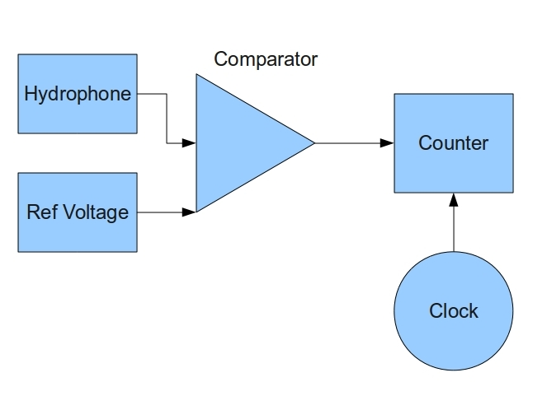
Counter Method
Requires high speed counter
Susceptible to noise
Compared to reference signal
Hydrophones need to be spread out as far as possible
<footer>Group #19
<number><number>

Slide 55
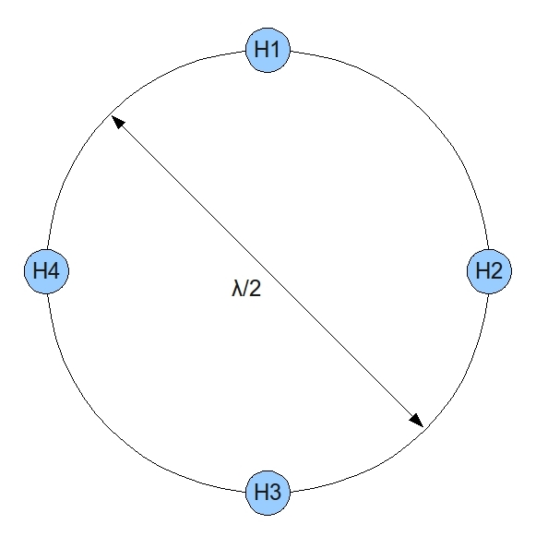
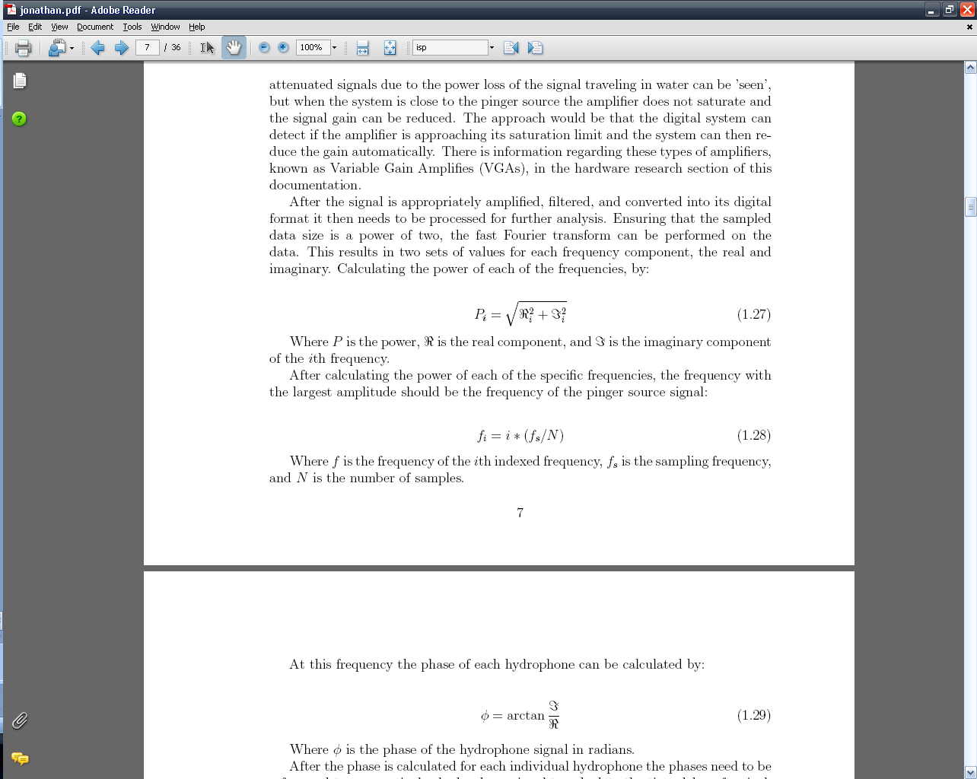
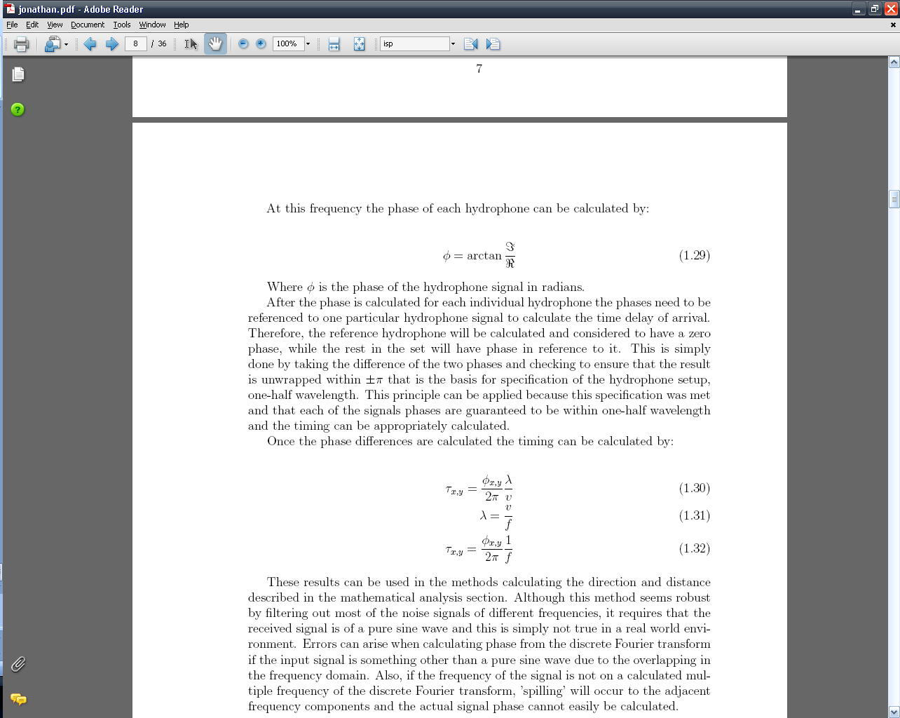

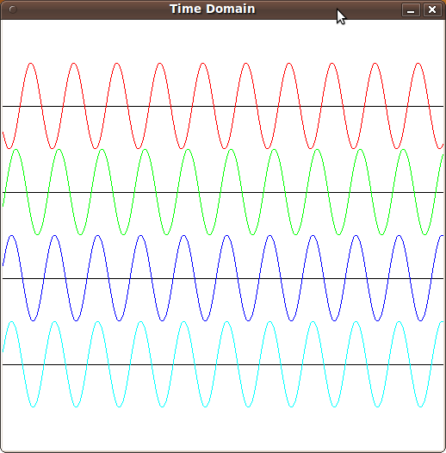
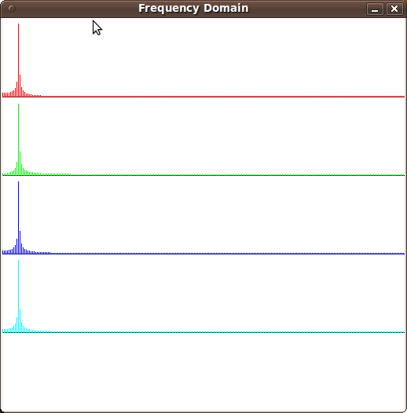
Frequency Domain Analysis (Relative Phase Shift)
Hydrophones have to be placed within half a wavelength
FFT is performed
Assumes pure sine wave
Error due to ‘spill over’ in DFT
Time Domain
Frequency Domain
<footer>Group #19
<number><number>

Slide 56
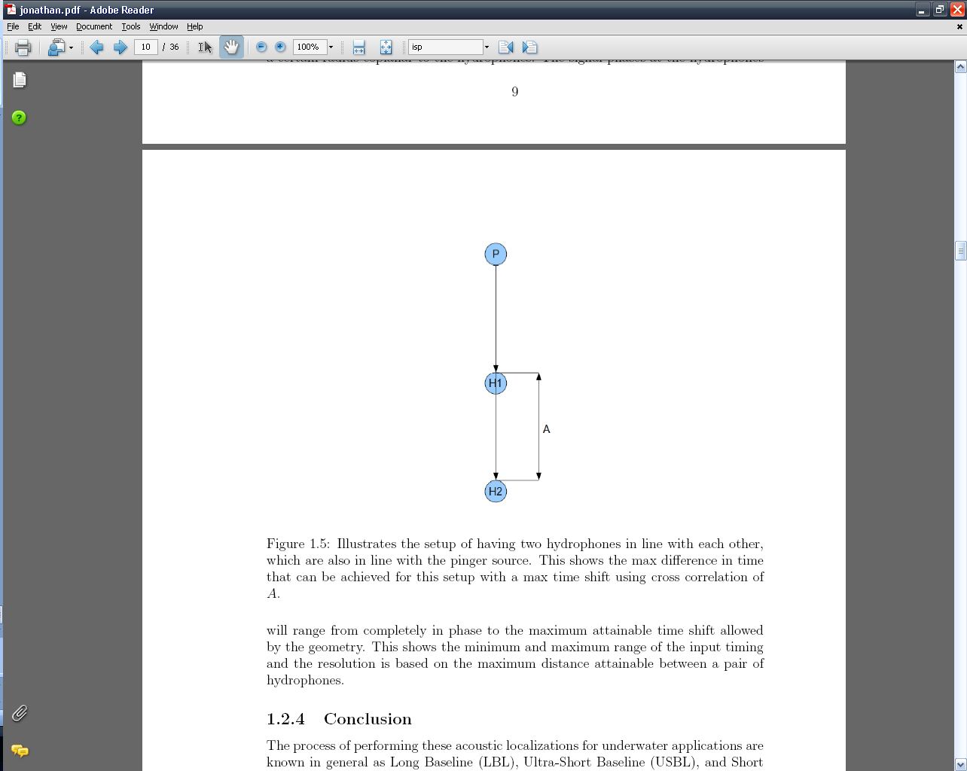
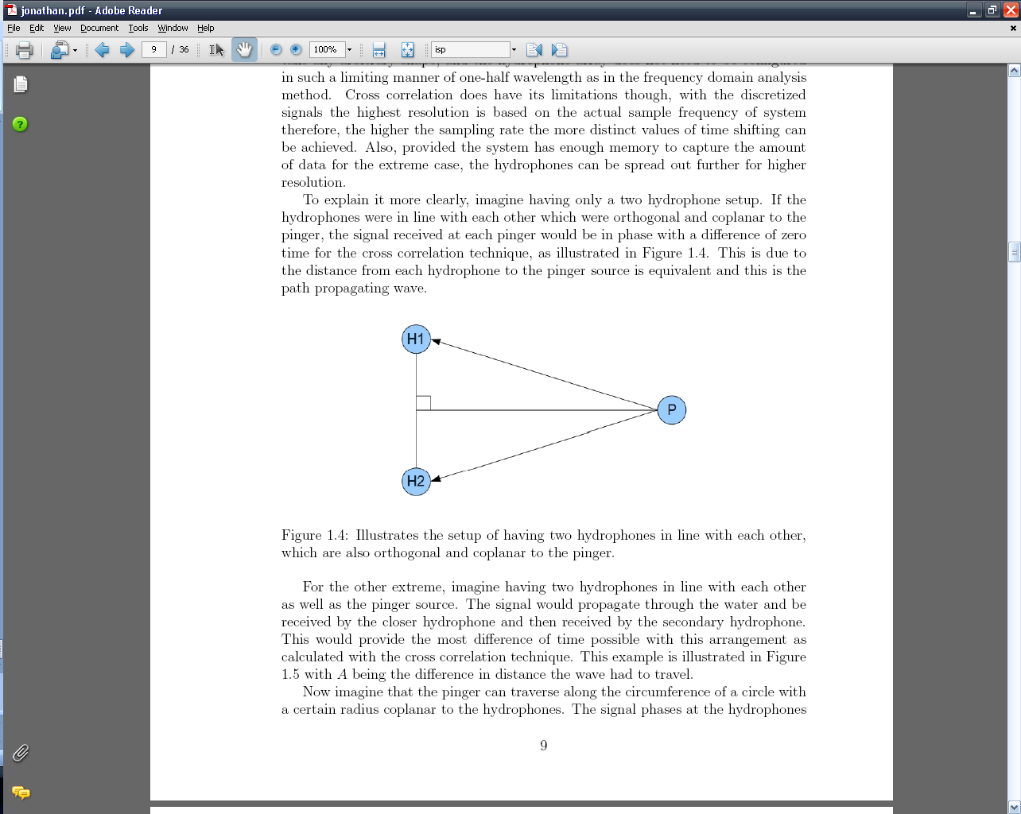
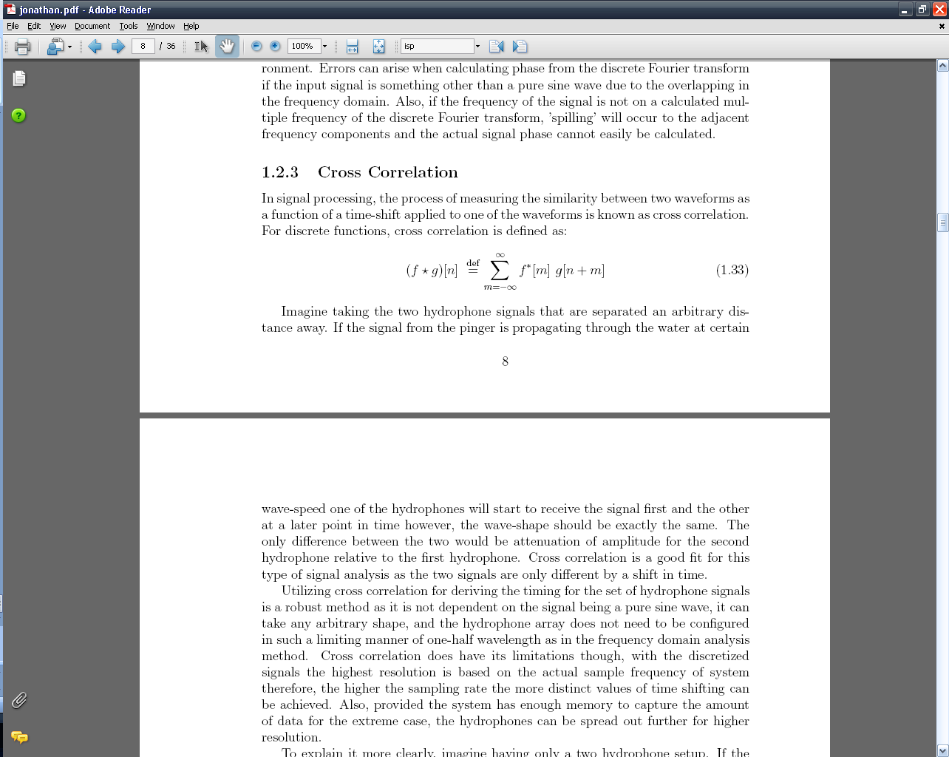
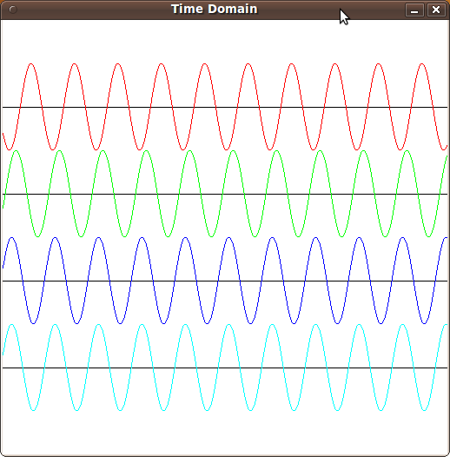
Cross Correlation
Measures the similarity between two waveforms as a function of time-shifting
Minimum and maximum range of input time and resolution is based on maximum distance between hydrophone pair
<footer>Group #19
<number><number>

Slide 57
Budget
<footer>Group #19
<number><number>

Slide 58
Budget
Total Cost: $6579.00
Total AUV Team Cost: $1385.92
Total Out-of-Pocket Expense: $0.00
Percent Purchased: 70%
<footer>Group #19
<number><number>

Slide 59
Progress
<footer>Group #19
<number><number>

Slide 60
Timeline
<footer>Group #19
<number><number>

Slide 61
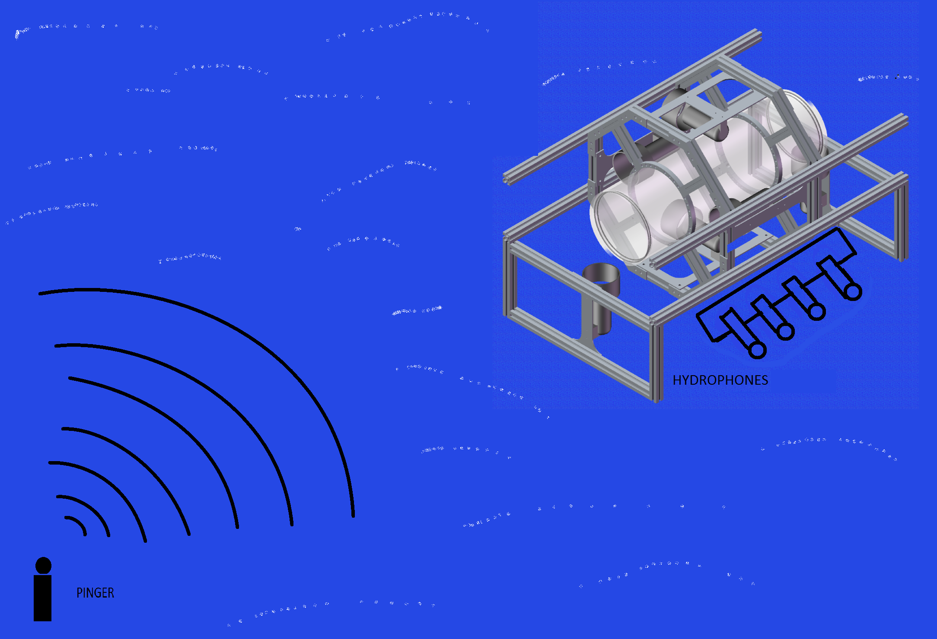
Questions?
<footer>Group #19
<number><number>

