Slide 1
The Electric Golf Cart Progress Energy
Group 5:
Nick Paperno Patrick Taylor
David Yeung Andrew Bridges

Slide 2
Introduction
Industries are becoming more focused on saving nonrenewable resources
There are two main ways of accomplishing this:
Use nonrenewable resources in a more efficient manner
Focus on using renewable resources
Our project focuses on applying these principles to an electric golf cart

Slide 3
Objectives & Goals
Allows Driver to change modes of operation from Display
Displays Current Speed, Current Battery Charge, and Current Mode of Operation
Can be charged by Solar Power from Solar Panels attached to the roof
Must implement a power control and saving system on an electric golf cart
Must have a power efficiency mode
Must have a high performance mode

Slide 4
Specifications and Requirements
Must have 6, 6V flooded lead acid batteries
Will go into a power saving mode at 15% charge remaining
The HUD must display the charge remaining within a 3% accuracy
The HUD must display the power usage of all components in the vehicle to a 3% accuracy

Slide 5
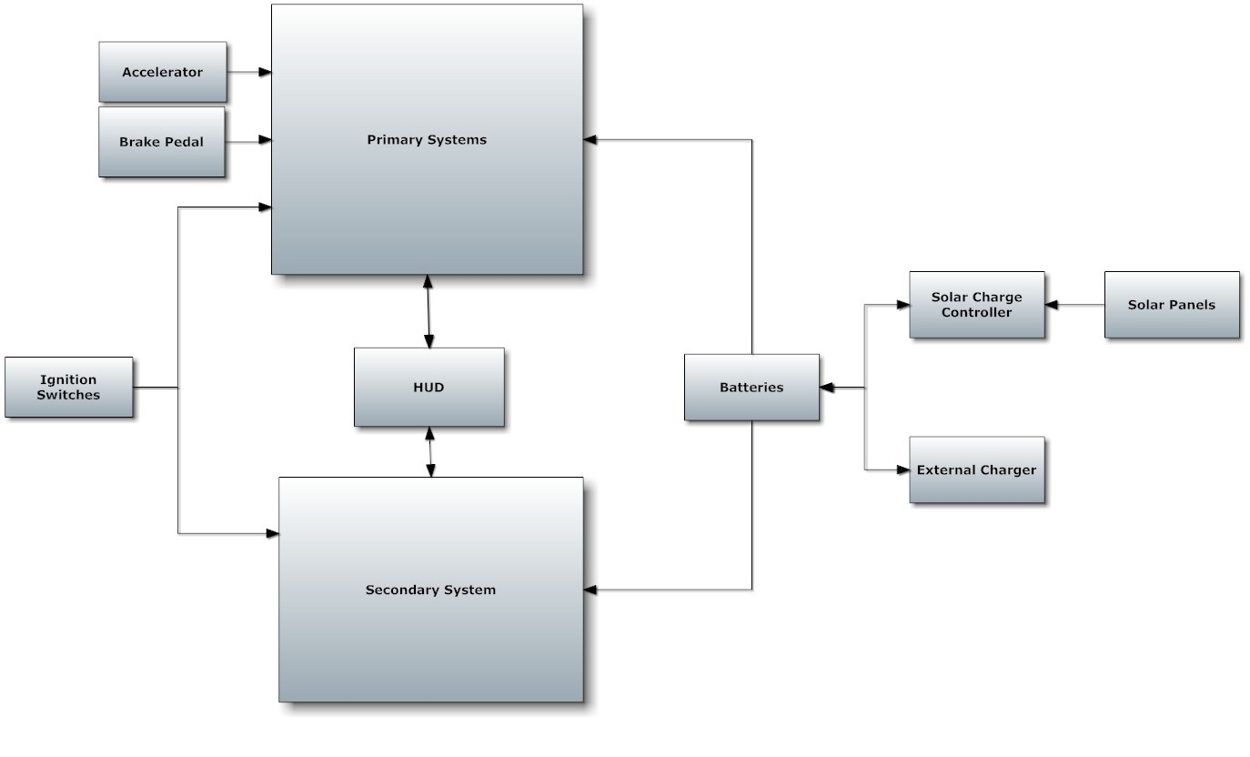
Project Block Diagram

Slide 6
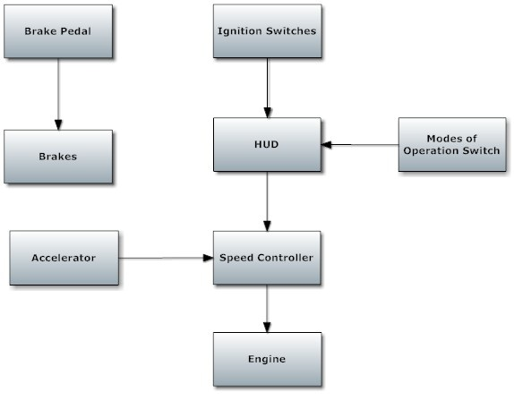
Primary System Block Diagram
Speed Controller
T, A

Slide 7
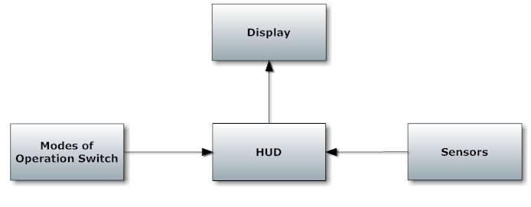
Secondary Block Diagram

Slide 8
Golf Cart

Slide 9
Battery consideration
Li-ion
Light weight, high energy density, consistent discharge voltage
High cost
NiCd
Moderate energy density, consistent discharge voltage
Lower cell voltage per cell
Lead Acid
Low cost, most battery found in golf carts
Lower energy efficiency, high weight

Slide 10
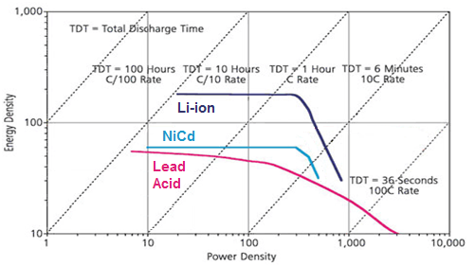
Energy Density vs. Power density

Slide 11
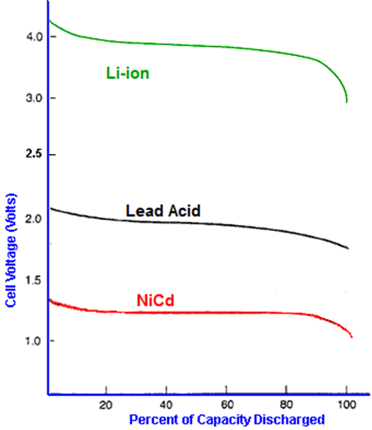
Cell voltage vs. Discharge

Slide 12

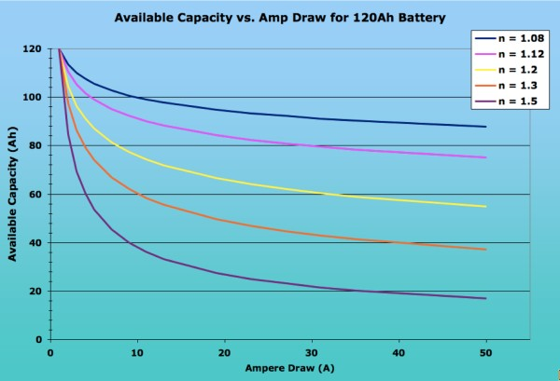
Peukert’s Equation:

Slide 13
Battery Comparison
Battery Type | Approximate Peukert Number | Cost Per Battery | Cost To Change
6V AGM | 1.08 | $329 | $1974
6V gel cell | 1.12 | $269 | $1614
6V wet Cell | 1.2 | $159 | $0

Slide 14
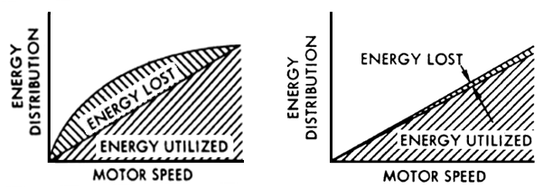
Resister vs. PWM speed control
PWM speed controllers are programmable and can support regenerative breaking.

Slide 15
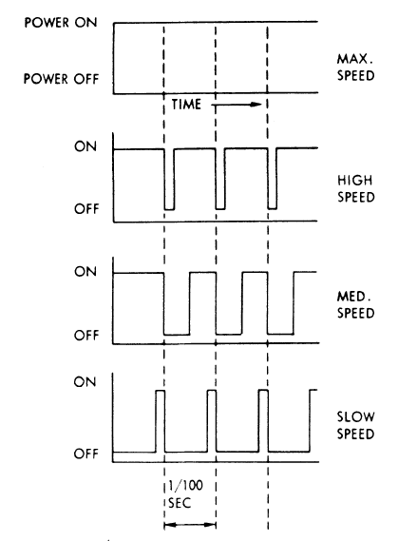
Pulse Width Modulation
PWM signal supplies positive gate voltage to an n-channel power MOSFET which drives the motor
Motor on when the PWM signal is high and off when the PWM signal is low
Decrease speed of the golf cart
Increases battery charge’s length

Slide 16
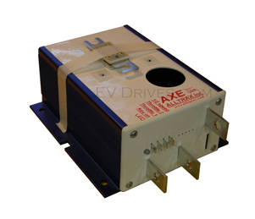
PWM controllers considered.
Integrated anodized heat sink
Fully encapsulated epoxy fill
Operating temperature -25ᵒC to 75ᵒC
Automatic shutdown at 95ᵒC
Can not adjust running mode without connecting to a computer
Adjustable via Controller Pro software allows
Armature current limit
Throttle acceleration
Altrax 8434

Slide 17
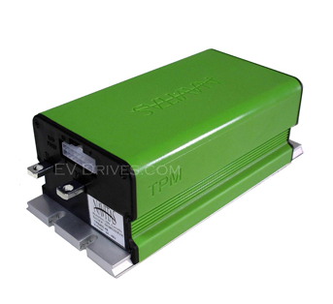
PWM controllers considered cont.
Regenerative breaking
Can not adjust running mode without connecting to a computer
Resistive or voltage throttle input
Battery over-discharge protection
Current limiting
Thermal limiting
TPM400

Slide 18
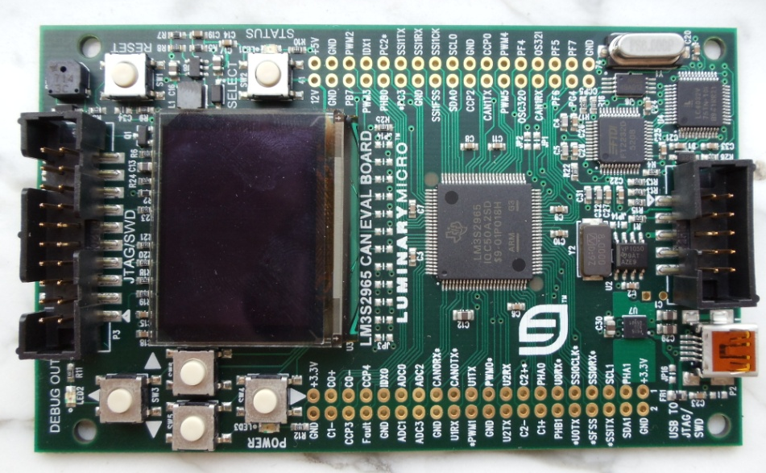
PWM controllers considered cont.
Complete control over PWM voltage output
Can switch to different modes while the golf cart is running, without connecting to a computer
Voltage and current sensing
Stellaris LM3S2965

Slide 19
Speed controller Comparison
Type | Variable current control | Voltage and current monitoring | Change of mode while running | Regenerative breaking | Cost
Alltrax 8434 | Yes | Yes | No | No | $387
TPM 400 | Yes | Yes | No | Yes | $695
Stellaris LM3S2965 | Yes | Yes | Yes | No | $250

Slide 20
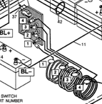
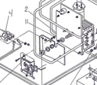
Implementing Speed controller

Slide 21
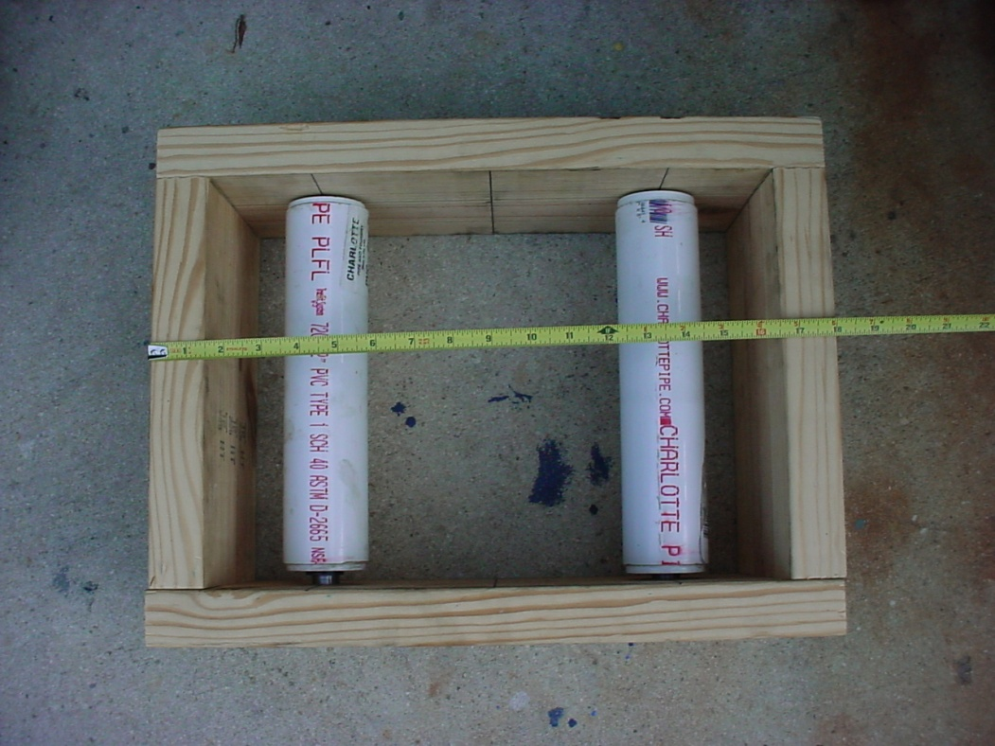
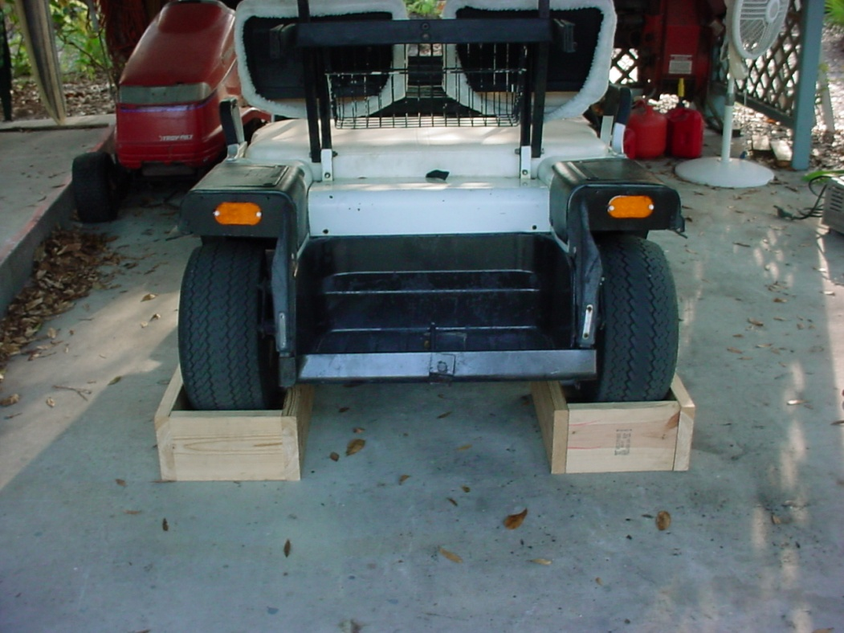
Testing the golf cart

Slide 22
Solar Panel

Slide 23
Solar Panel System
Needs to be able to charge 36 V battery bank.
Will be attached to the roof of the golf cart
Must be able to endure Elements and Floridian Humidity
Solar Panel System must have a kill-switch system
Must try to optimize charge
System must not drain the batteries
Temperature Coefficient is -0.5 %/°C and is for 80°F or 27°C

Slide 24
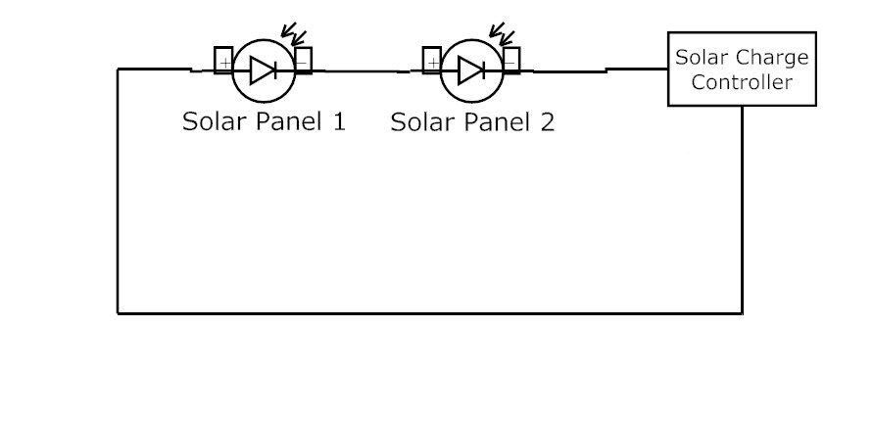
Solar Panel Setup
Will have 2 Polycrystalline Solar Panels connected in series
Will use a single Pulse Width Modulation Charge Controller
System will be connected in parallel to the Battery Bank

Slide 25
Solar Panel
Manufacturer | Canadian Solar
Model Number | CS6P-215-P
Cell Type | Poly-Crystalline
Power Rating | 215 W
Open Circuit Voltage | 36.5 V
Short Circuit Current | 8.01 A
Voltage at Pmax | 44 V
Current at Pmax | 29 V
Efficiency | 12%
Power Tolerance | +5 W
Vmax | 1000 V
Dimensions (HxWxD) | 64.5”x38.7”x1.57”
Weight | 44.1 lbs
Price | $406.35
Two Canadian Solar PV Module 215W B
(CS6P-215-B)
Connected in Series
Relativity cheap for the amount of Voltage and Wattage

Slide 26
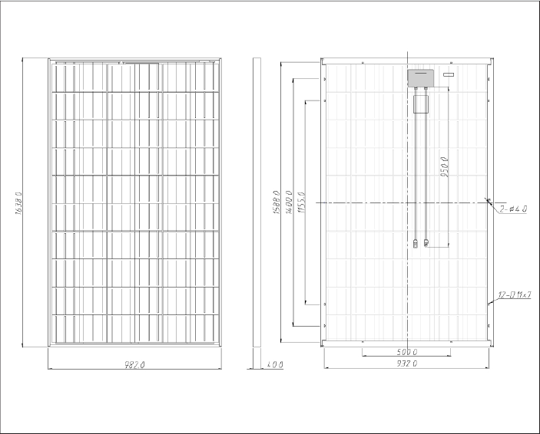
Solar Panel

Slide 27
Solar Power Charge Controller
Will use Pulse Width Modulation (PWD) charge controller
Cheaper price
High Efficiency
Switches off power to the batteries when batteries are full
Prevents power being drained from the batteries

Slide 28
Solar Power Charge Controller
One Morningstar TS-45
High Efficiency
Moderate Price
Manufacturer | Morningstar
Model Number | TS-45
Type | PWD
Max Battery Current | 45 A
Nominal System Voltage | 12 - 48 V
Peak Efficiency | 99%
Max Solar Voltage | 125 V
Self-Consumption (Controller) | <20 mA
Self-Consumption (Meter) | 7.5 mA
Dimensions | 10.3"x5"x2.8"
Weight | 3.5 lbs
Cost | 169.40

Slide 29
Solar Panel Roof Mount
Will replace old flimsy roof with new roof to mount solar panels on top
Made with treated plywood and metal support beams
Will attach to existing support beams
Problems Foreseen:
Too much weight
Slow cart down
Columns might not support roof and Solar Panels
Heat from solar panel
Solutions:
Use light and durable material
Have openings below the solar Panels

Slide 30
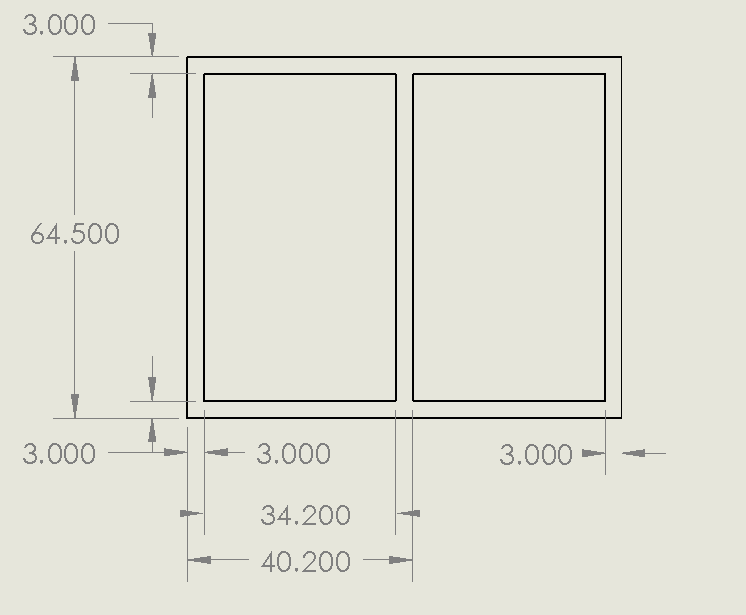
Solar Panel Roof Mount

Slide 31
Microcontrollers, Voltage Regulator, and Sensors

Slide 32
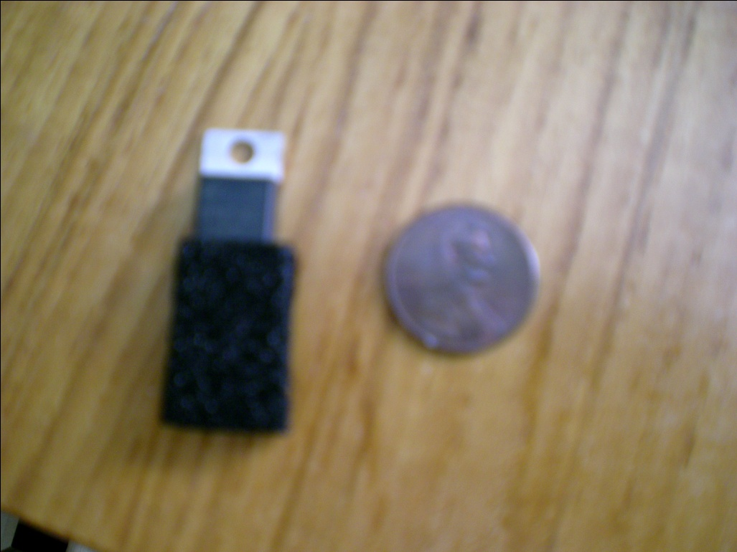
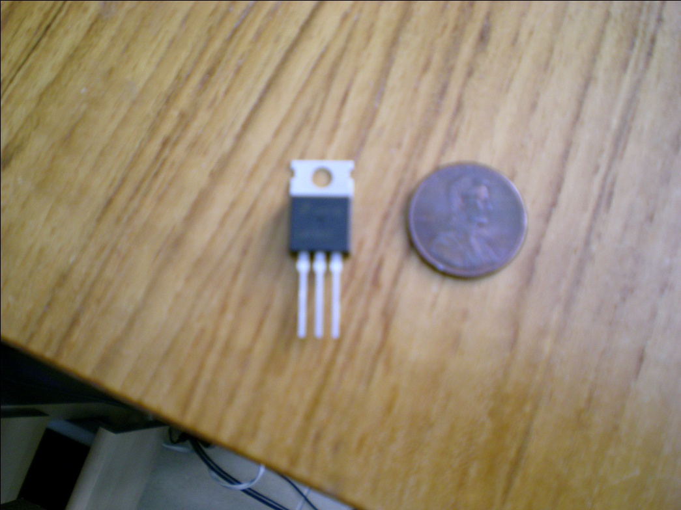
Voltage Regulators
Need to have 12V and 5V supply voltage for sensors and controllers
LM 2576 switching regulator and LM 7805 linear regulator
Originally going to use LM 117HV in place of 7805

Slide 33
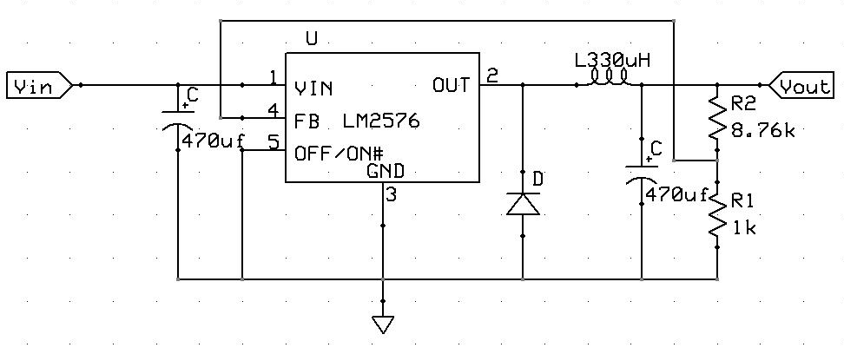
LM 2576 Adjustable Switching Regulator
Will drop voltage from 36V to 12V
Power speed sensor
Make easier to reduce voltage to 5V

Slide 34
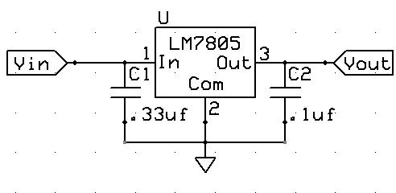
LM 7805 Linear Regulator
Drop voltage from 12V to 5V
Power Microcontroller, Display controller, current sensor, and provide voltage for switch

Slide 35
Microcontroller
Three controllers for whole system
Speed controller
Display controller
ATmega644

Slide 36
Sensors
Three quantities that need to be measured
Voltage across the batteries
Current output of batteries
Speed of golf cart
Devices that will be used
Voltage divider
CSLT6B100 Open-Loop Hall effect sensor
55110 Flange Mount Hall effect Sensor

Slide 37
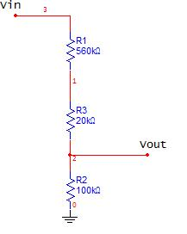
Voltage divider
Three resistors
560kΩ
20k Ω
100k Ω
Reduces input voltage to 5.29V

Slide 38
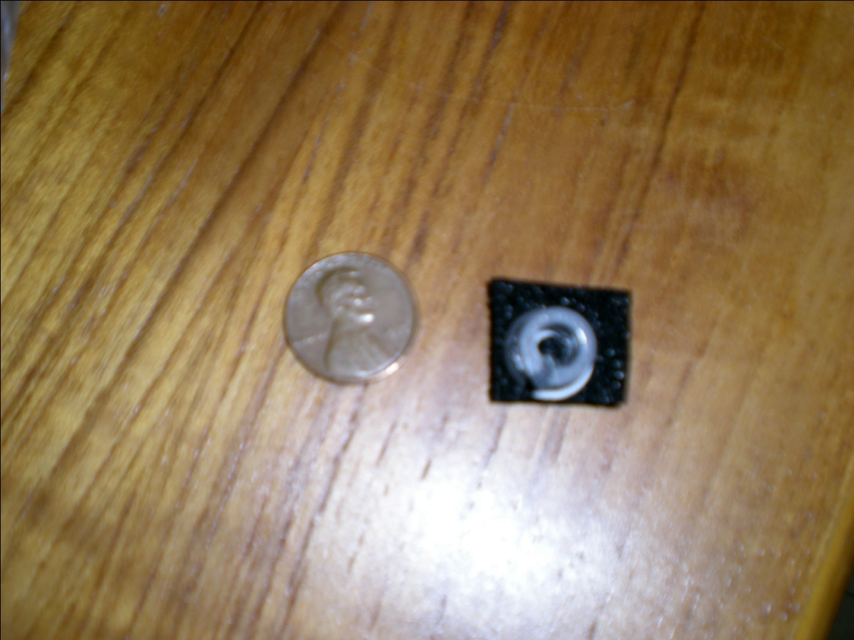
CSLT6B100 Open-Loop Hall effect sensor
Placed after ignition switch
Can sense up to 100A current
Gives output voltage

Slide 39
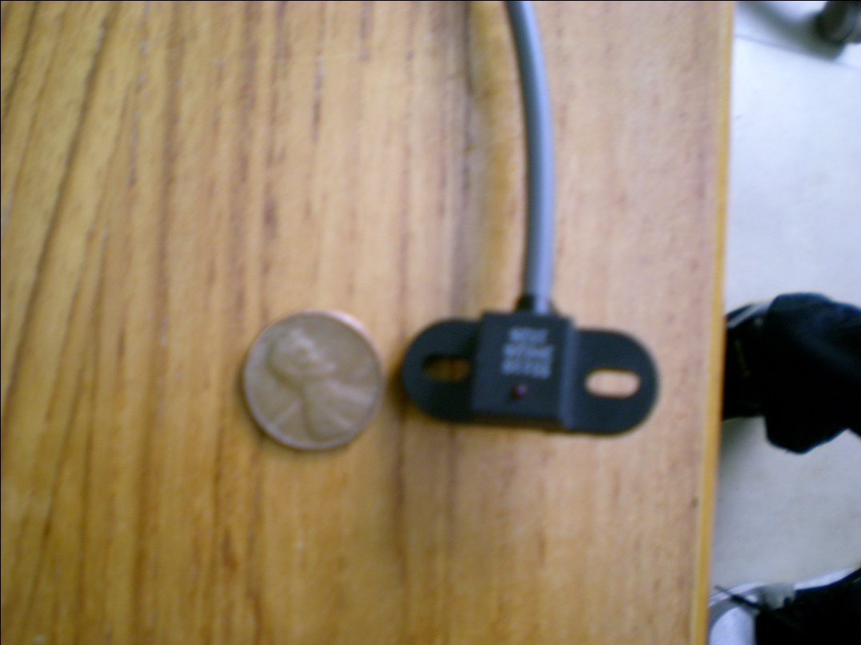
55110 Flange Mount Hall effect Sensor
Mounted near axel and connected to display controller
Voltage output
Durable housing
Originally going to use 55100

Slide 40
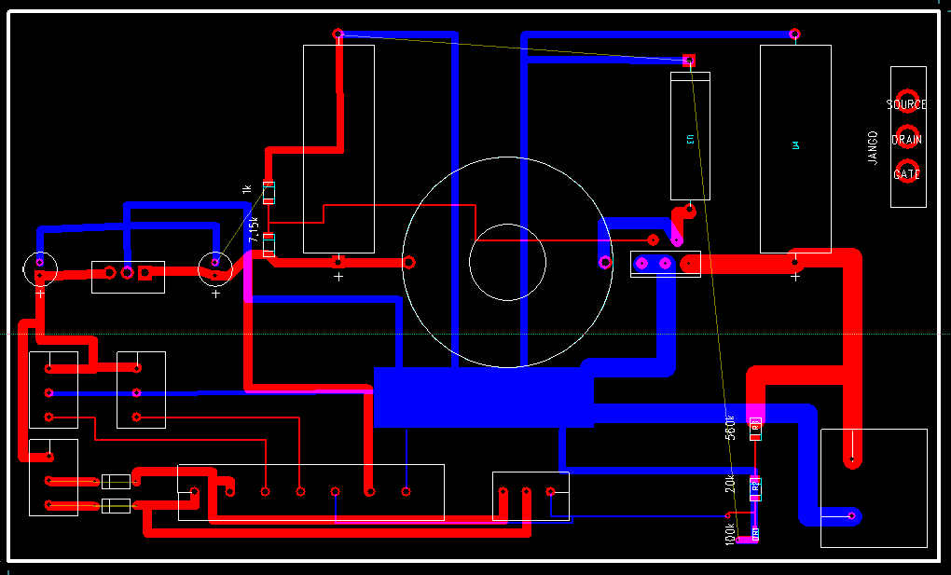
PCB Board

Slide 41
PCB Board
Steps voltage from 36 Volts to 10 Volts
Steps voltage from 10 Volts to 5 Volts
Parts | Value
R1 | 1kΩ
R2 | 7.15kΩ
C_{in} | 470µF
C_{out} | 470µF
L | 330µH

Slide 42
Human Interactive Display

Slide 43
Modes of Operation
Three modes of operation are available to provide a balance between performance and efficiency
A switch in the golf cart will allow the driver to change the modes of operation
Standard Mode | High Performance Mode | Efficient Mode
Uses typical golf cart settings before modifications | Top speed increases Acceleration increases Battery life decreases | Top speed decreases Acceleration decreases Battery life increases

Slide 44
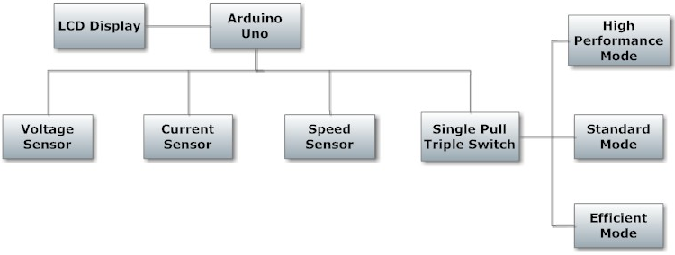
Human Interactive Display: Goals and Objectives
Provide the driver with information
Speed
Charge remaining
Current mode of operation
Allow the driver to switch modes of operation

Slide 45
Human Interactive Display: Requirements and Specifications
Switch for modes of operation
Display speed in MPH within 5% accuracy
Display charge remaining as percentage within 3% accuracy
Display charge remaining as time in the format HH:MM within 5 minute accuracy

Slide 46
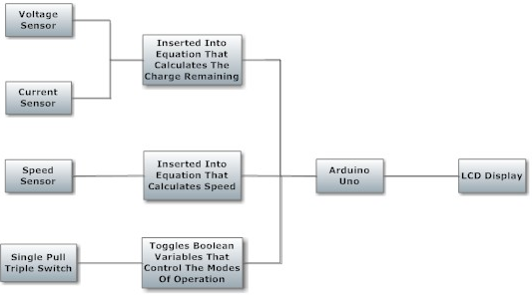
Human Interactive Display: Inputs to Display
Voltage and current sensors
Measures charge remaining
Speed sensor
Measures speed
Single pull triple switch
Change modes of operation

Slide 47
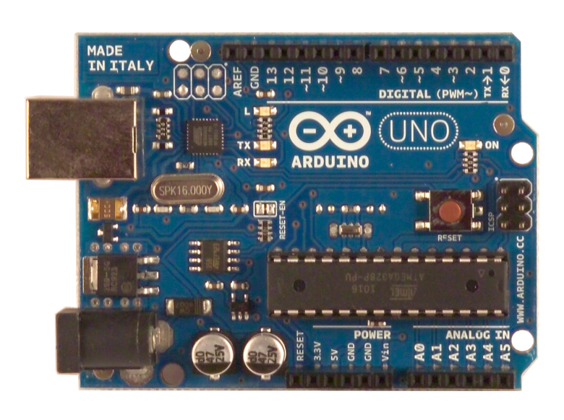
Arduino Uno Microcontroller
14 digital input/output pins
6 analog input pins
Performs the following functions:
Reads analog and digital signals from sensors
Controls the LCD display
Controls which PWM signal is sent to the motor

Slide 48
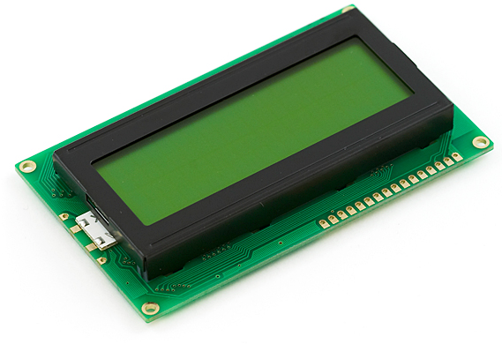
HD44780 Display
Text LCD
LED backlight
20 characters by 4 lines
Connected to the Arduino Uno
Displays the following:
Speed
Mode of operation
Charge remaining as time
Charge remaining as percent

Slide 49
Budget
Items | Actual Cost to date | Projected Cost
Golf Cart | $0 (Donated) | $400
Batteries | $0 (Donated) | $200
Solar Panels | $791.20 | $700
Solar Panel Controller | $150.00 | $200
Circuit Board and Sensors | $64.67 | $210
Speed Controller | $300.00 | $300
Human Interactive Displays | $66.65 | $200
Misc. Material | $590.06 | $250
Total | $1962.58 | $2360

Slide 50
Problems encountered
When donated the golf cart did not run (Fixed)
Right rear breaks were locked (Fixed)
Operational amplifier failed
Connection issues (Fixed)
Frame failed (Fixed)
Micro-switch on Pot-box failed (Fixed)

