Slide 1
Automatic Tensile Tester 4000
Group 6
Alan Beauchamp
Justin Ewing
Devon Jackson

Slide 2
Introduction
Material testing is a very expensive and exclusive exercise, from sending the material out to buying a specific test frame.
When the test frames are purchased for local use, they come with software that is cumbersome for the computers that use them, forcing them to use all of their memory.
This project enters with the goal to make a comparable test frame that is cost efficient and is autonomous, being able to function without a computer.

Slide 3
Introduction
This product is called the Automatic Tensile Tester 4000
A small scale test device for creep, creep-fatigue, and creep crack growth testing.
Creep is a deformation that occurs below the yield strength of a material at temperatures above 40% of the melting temperature.
Fatigue is the non-recoverable loss in strength that occurs when a material is subject to cyclic loading.
Often, the effects of creep and fatigue are idealized as damage. This device will be used to study those effects, because creep damage is the primary design consideration for steam and gas turbine OEM’s.

Slide 4
Goals
Low cost
Accurate
Portable
Work without a computer connection
Must be able to pause/re-edit/resume
Must be able to data dump to or read data from USB
Must be able to manually control entire experiment from box
Must be able to program experiment from computer connection
Control two material testers simultaneously
Interfacing accessible on web (Linux, Windows)
LCD must display status and cycle
Implement fat16 file system for data logging
Status light for experiment
Wall powered
Plug and play components
Software must be user friendly and open source

Slide 5
Specifications
Automatic command/data retrieval for 1 hour
Measure temperature accurate to ± 2º F
Rate temperatures from 0º F to 1000º F
Measure force accurate to ± .2%
Accurately measure strain gauge factor ± 10
Be able to hold and test loads up to 2000lb
Be able to run 3 tests (specified) for 15 minutes each
Control box 8”x 8” and weight no more than 10 pounds

Slide 6
Power Distribution
Justin Ewing

Slide 7
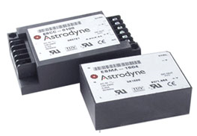
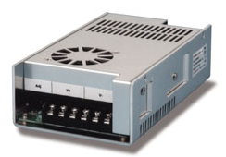
Power Requirements
Voltage needed by part:
Load Cell – up to 18V
LVDT – up to 18V
Microcontroller – 5V
INA 118 Instrumentation Amplifier - ±12V
LM741 Op-Amp - ±12V
LM339 Comparator – 5V
Linear Actuator – 12V, 20A for max power

Slide 8
Sensors and Control Power
All components and sensors will be powered by the MSCA-0303, a 15V, 2A power source.
A combination of regulators will be used to distribute power to all the components.

Slide 9
Sensors and Control Power
4 7812 Regulators
LCD Screen
INA118 Instrumentation Amplifier, 2 741 Op-Amps
555 Timer for Negative Rails
Load Cell and LVDT
2 7805 Regulators
H-Bridge
Microcontroller
1 LM317 Regulator
SD Card

Slide 10
Sensors and Control Power
The PCB is designed so that:
All of the common components are on the same side of the board.
Similar parts are next to each other
Located on the top is the voltage input and on the bottom is the H-Bridge.

Slide 11
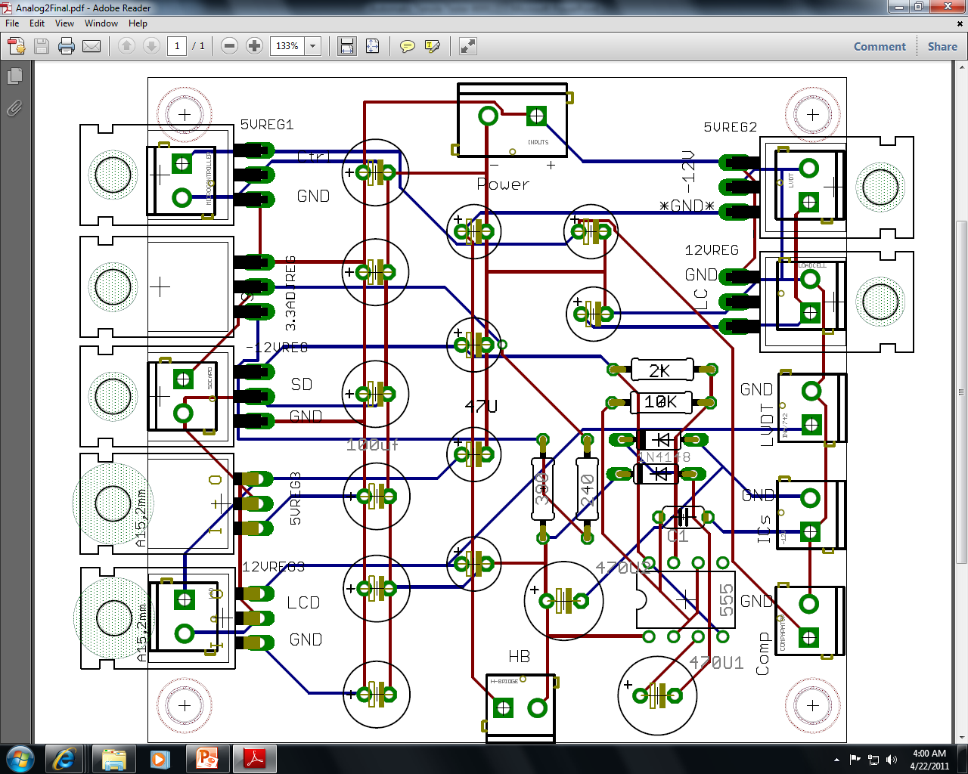
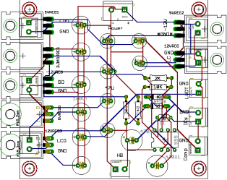

Slide 12
Actuator Power
For the Actuator’s power source, we chose the MMK320S-12.
Output of 300W (12V, 25A) at maximum output which will also power 2 small fans
Self-ventilating convection system.

Slide 13
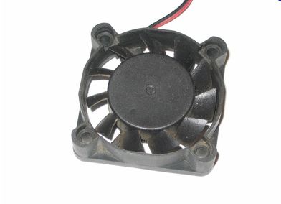
Actuator Power
The same power source will activate two cooling fans, that will provide air the rest of the components in the case and allow for convection cooling.

Slide 14
Power Control
Both power sources use wall power by means of stripped computer wire.
Main on/off will be the switch on the power strip.
Emergency shut off will take the positive outputs of both sources and the input to the devices they control.
Quick and easy installment.
Big Red Button is common sign for emergency

Slide 15
Sensors
Justin Ewing & Devon Jackson

Slide 16
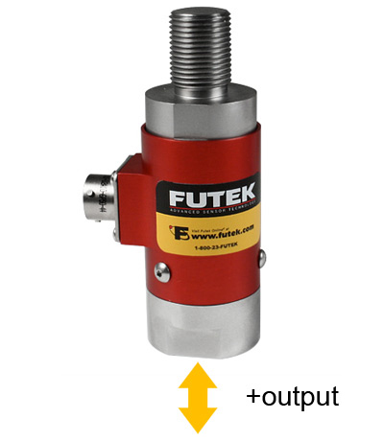
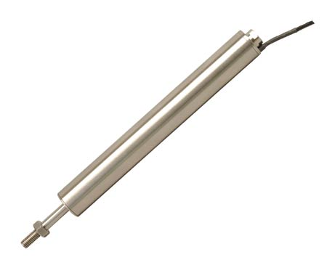
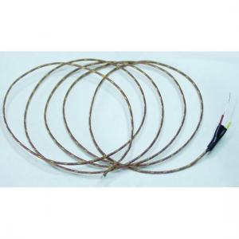
Sensors
For the tests performed, we will use the following sensors
Load Cell
Linear Variable Differential Transformer
Thermocouple

Slide 17
Load Cell
Two way load cell that detects both tension and compression
6 wire-receptacle
Positive and negative outputs at 2mV/V
Rated 2000 lbs.

Slide 18
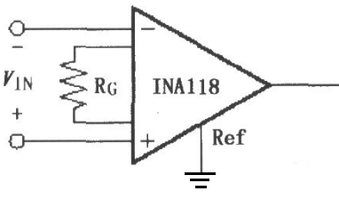
Load Cell (INA118)
Amplifies the difference between the terminals and outputs a voltage referenced to ground.
Amplification is:
A_{v} = 1 + 50K/R_{g}
Our application requires R_{g} to be 250Ω for a gain A_{v}≈200

Slide 19
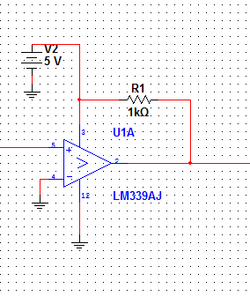
Load Cell (Tension/Compression Sensor)
Uses LM 339 Comparator (open-drain)
Tension (positive input) will yield LOW output
Compression (negative input) will yield HIGH output.
Output goes to the “sense” line in the MC

Slide 20
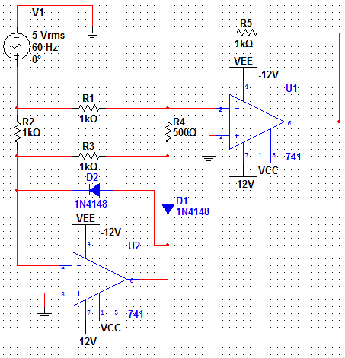
Load Cell (Full Wave Rectifier)
Designed as a precision rectifier that doesn’t have the loss of the diode version
Quick response to MC
Rejects ALL negative voltage, protects MC

Slide 21
Load Cell
The two previous circuits will take both of their inputs from the output of the INA118
Instead of using the datasheet to predict output values of the load cell, we will develop our own calibration system to more accurately determine the load applied.

Slide 22
Linear Variable Difference Transformer
Precise tool to measure displacement
4-wire interface
-1.5-11V output (0-10V functional)

Slide 23
LVDT
To reduce the output signal to the range of the MC, we used a voltage divider to reduce the output from 11V to 5V
Finally to eliminate the negative response, a diode was placed before the output to protect the microcontroller
Like the load cell, the LVDT will be calibrated so that the initial position will be the “Zero” and displacement will read from the “Zero” reference.

Slide 24
Temperature
Thermocouple
PID captures the signal
The data pulled and saved to a file
Specification

Slide 25
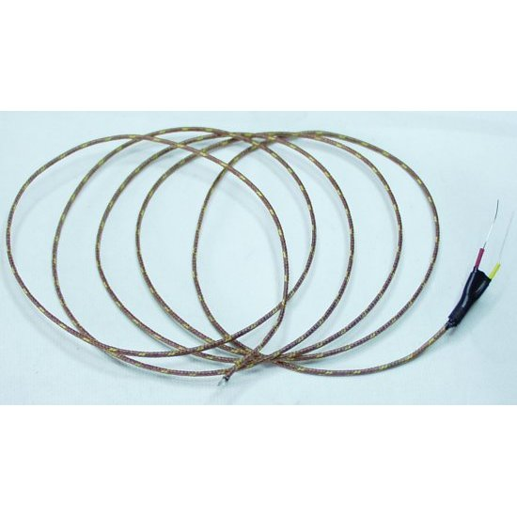
Thermocouple
Thermocouple has more range, sensitivity, more cost effective, and more ruggedness
36" high temperature Type-K Thermocouple with glass braid insulation.
Type-K Thermocouple (Ni-Cr)
30 gauge stripped and prepped wires
Thermocouple range : -270 to +1372C (-454 to +2501F)
Yellow + / Red –

Slide 26
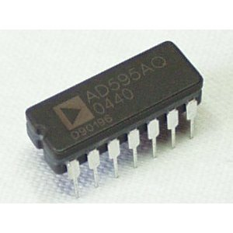
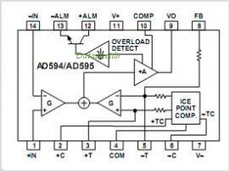
Thermocouple Amplifier AD595-AQ
•Analog Devices Thermocouple Type-K Amplifier.
•The 10mV/C analog output interfaces nicely with 10-bit ADCs found on many types of microcontrollers.
±3º C Accuracy
•5V-15V Power Supply

Slide 27
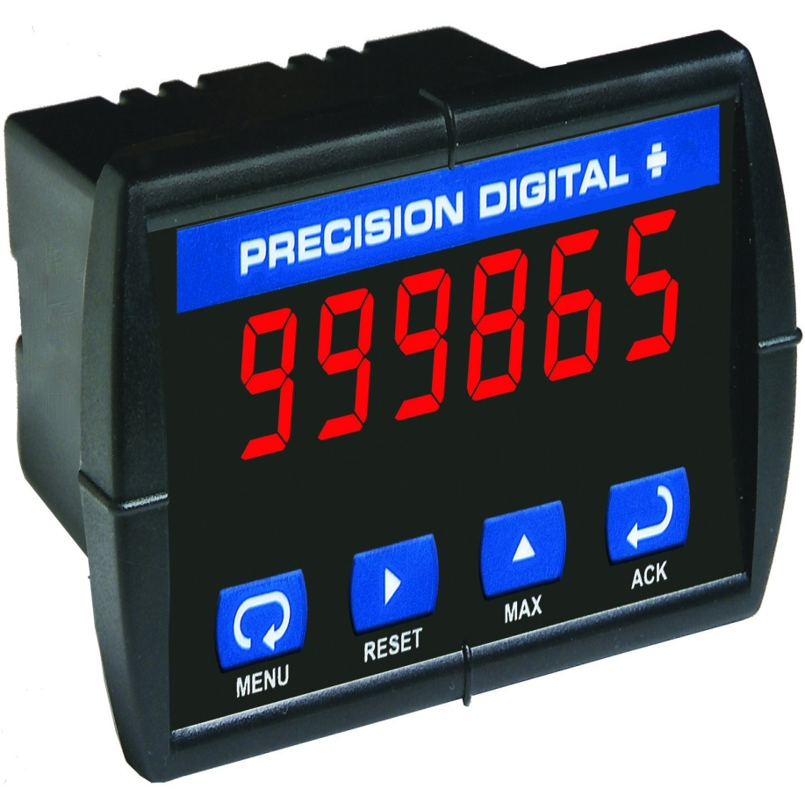
PID Controller
Trident and Trident X2 Digital Process and Temperature Panel Meter
A third party PID temperature controller captures signal from thermocouple
Temperature controller has an channel available for an analog input (i.e. remote set point)

Slide 28
Motor Control
Devon L. Jackson

Slide 29
Motor Control
Be able to control the motor manual
Be able to have the ability to go down, reverse, and stop
Be able to apply a certain amount of force as desired by the sponsor
Be able to apply a constant load

Slide 30
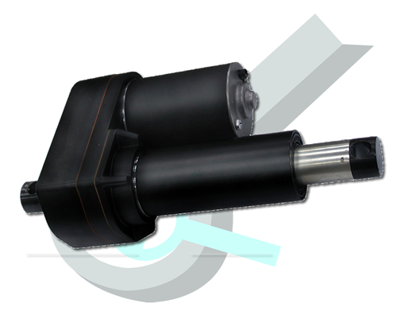
Actuator
Heavy Duty Linear Actuator (Stroke Size 12", Force 2000 Lbs, Speed 0.24"/sec)

Slide 31
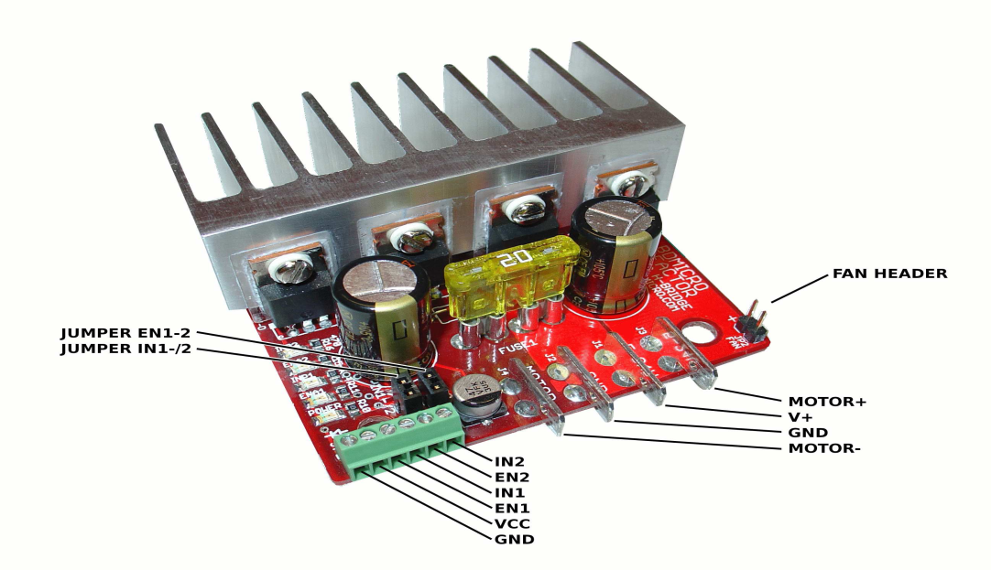
H-Bridge
An h-bridge is used to convert low-power control signals into high-power drive for motor control as well as other high power applications
The microcontroller connects to the h-bridge's logic level inputs, and the h-bridge converts those low power control signals into high power outputs suitable for driving the motor, controlling the motor's direction, and varying the motor's speed.

Slide 32
• With optional heat sink installed: 30 Amps continuous, 40 Amps peak
•With NO heat-sink installed: 10 Amps continuous
• 5 to 24 Volts (30V absolute max)
• High frequency PWM, frequencies to 100 kHz
• ATO style fuse on-board
•Status and power indicator LEDs
• Convenient FAST-ON blade type connectors
• Convenient screw terminals for control logic
• Locked anti-phase native control method
• Sign magnitude / synchronous rectification also possible
• Small size - 2.5 x 2.6 inches
• High quality 4-layer board, large ground and power planes
•Truth table for the possible control states:
EN1 | EN2 | IN1 | IN2 | MOTOR+ | MOTOR - | Description
0 | 0 | X | X | OPEN | OPEN | Bridge disabled, motor freewheels
1 | 1 | 0 | 0 | GND | GND | Motor leads break to GND
1 | 1 | 1 | 1 | V+ | V+ | Motor leads break to V+
1 | 1 | 0 | 1 | GND | V+ | Motor turns CW
1 | 1 | 1 | 0 | V+ | GND | Motor turns CCW

Slide 33
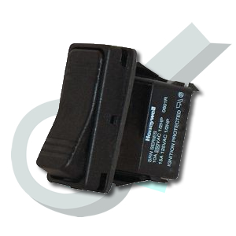
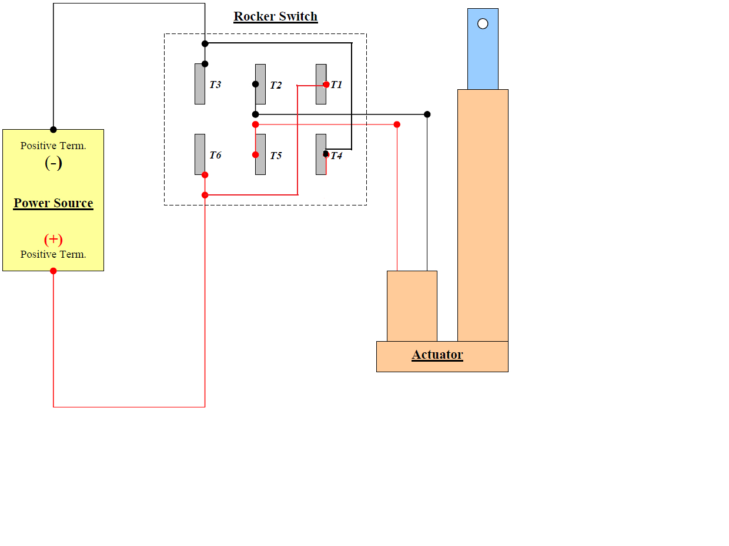
Rocker Switch
•Press a button and the actuator will fully extend and will stop once fully extended. Push a button in opposite direction and the actuator will fully retract. In addition, the switch has a middle position that can stop a linear actuator at any point.
•Specifications:
Switch Operation: 3 positions: On-Off-On
Can be used outdoors
Circuitry: DPDT
Switch Terminals: Quick Connect
Actuator / Cap Color: Black
Color: Black
Contact Current Max:10A
Leaded Process Compatible: Yes
Mounting Type: 0.187in Quick-Connect Tab
RoHS Compliant: Yes

Slide 34
System Control and Interface
Alan Beauchamp

Slide 35
PID control loop
The ATT 4000 uses a basic PID feedback control loop. The load is used to calculate the PWM percentage applied to the actuators motor which then to increase or decrease force to the test specimen.

Slide 36
PID Controller
PWM Signal = Motor Speed
= (Kp * P) + (Ki * I) + (Kd * D)
P = error
Desired Load – Load Cell Reading(Converted to number ranging from 0 to 1023)
I = Integral
I = (I * IDamp) + (error * Dt)
Sum of all the errors.
Controlled using a damping variable
Resets if error is close to zero
D = Derivate
Current error – previous error

Slide 37
System Logic

Slide 38
PID Constant Effect Table
Parameter | Rise time | Overshoot | Settling time | Steady-state error | Stability
K_{p} | Decrease | Increase | Small change | Decrease | Degrade
K_{i} | Decrease | Increase | Increase | Decrease significantly | Degrade
K_{d} | Minor decrease | Minor decrease | Minor decrease | No effect in theory | Improve if K_{d} small

Slide 39
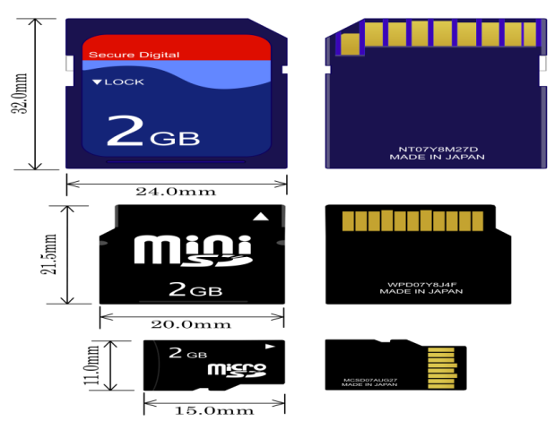
Data Storage Device
The A.T.T 4000 uses SD / MMC Card for data logging.
SD transfer rate of 80–160 Mbit/s
Capacity 4GB to 32GB
Small footprint. 24.0mm x 32.0mm max
File System: Fat 16
The SdFat V2 library is utilized on the data logging microcontroller to allow access Fat 16/32 partitions on the SD card.

Slide 40
Data Acquisition
The output file will consist of raw ADC conversion values from the microcontroller’s ADC pins.
The A.T.T 4000 logs data using the comma-separated file type. CSV is a simple format than is easily imported into a standard program such as excel or open office spreadsheet.
To the left we have the break up of each line of data in the CSV file.
Output | Type
Cycle | Unsigned long
Load | unsigned int
Error | unsigned int
Temp | unsigned int
Displacement | unsigned int
Motor Displacement | unsigned int
PWM | unsigned char
Seconds | Unsigned long
50 day count | Unsigned long

Slide 41
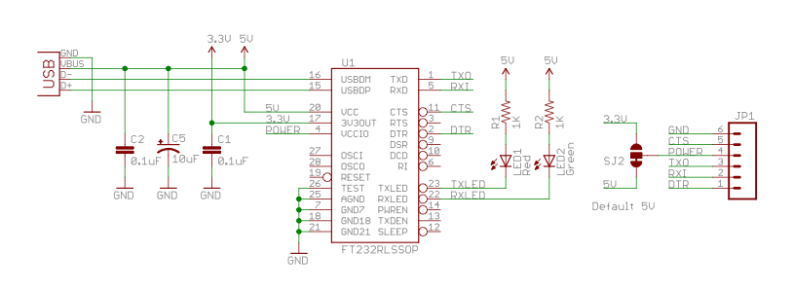
User & Communication Interface
Specification | GUI | Physical
Start | X | X
Stop | X | X
Pause | X | X
Resume | X | X
Temperature reading | X | X
Strain Gauge Reading | X | X
Motor PWM Status | X
Motor Control | X | X
Transfer Data | X
Set Constants | X
Load Input File | X
Load Setup File | X
The GUI a fully usable interface that can on control all aspect of the device.
The physical will be limited to viewing status, starting/stopping, pausing/resuming and position for setup of specimen.
The FTDI FT232RL allows the user to connect an USB mini cable to our devices when interfacing with the GUI on a PC. USB reliable, durable, and it’s usually plug and play. The alternative to using a USB to serial converter on the device side would be to use a serial to USB converter on the computer side.

Slide 42
Data Buffer
Atmega328
Byte array Data Buffer
PC GUI Interface
Op | Op Code | Data | Return
Get File | 0000 | Name of File on SD card you want to download | File
Load Input File | 0001 | Path of Input file on PC | File Load Success or Fail
Get Current Cycle Data | 0010 | NONE | Return 32 byte array with status
Stop | 0011 | NONE | Kill test
Start | 0100 | NONE | Run startup script
Pause | 0101 | NONE | Halt test
Data transferred to and from the GUI and the atmega328p we uses a byte array data buffer.
Example:
byte a[64] = Cycle/Strain/Load/Temp/Extra/….
The GUI will request information also using a byte array consisting of operation values and data values.

Slide 43
Event Name | External Stimuli | External Responses | Internal data and state
Application Opened | User opens application | Application GUI displays with main window. If experiment is currently running user directed to experiment status window. | System runs initialization script. System in Active state ready for user response
Initialize New Experiment | User selects option to start new experiment | User is directed to experiment configuration page, with require textbox inputs for configuration. | System is in stand by awaiting proper configuration data include experiment type, duration and other parameters.
Load / Confirm Experiment settings | User either submits initial experiment information or load old experiment configuration file | User is directed to main experiment status window /w Current status information available. | Query current experiment information. Goes back to Active state
Verify Input File | Use selects file verification or user try to start experiment | Application verification status bar appears | System checks each line of input file. Back to active state if no error, prompt user if error.
Run experiment | User hits play button | Application experiment status bar appears. User prompt for error or to start experiment | System initialize and a test all components of the system. Including creation of all necessary files. Go back to Active state
Pause experiment | User hits play button | User is directed main experiment status window. | System backups all current statuses and marks cycle position. Save all information to SD card.
Stop experiment | User select stop button or experiment is completed. | User is prompted with completion status then directed main experiment status window. | Verify all information is logged, save final status information. Return to active state
Application Closed | User closes application | Application prompted user to assure user want to exit | System is in Inactive state

Slide 44
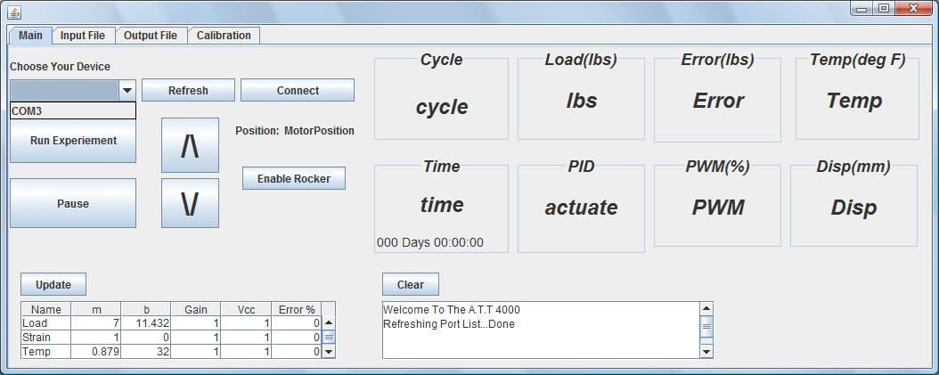
Main Interface
Once a user connects to the device if an experiment is currently running, receive real time statuses of the current running experiment. The user is also able to pause , resume and terminate a currently running experiment. The raw data is received from the microcontroller and converted into the proper measurements.
If an experiment is not running a user will be able to position the translating piece to secure a test specimen in place, using either the rocker switch or the button on in the interface. Once a experiment has started all motor controls will be disabled.

Slide 45
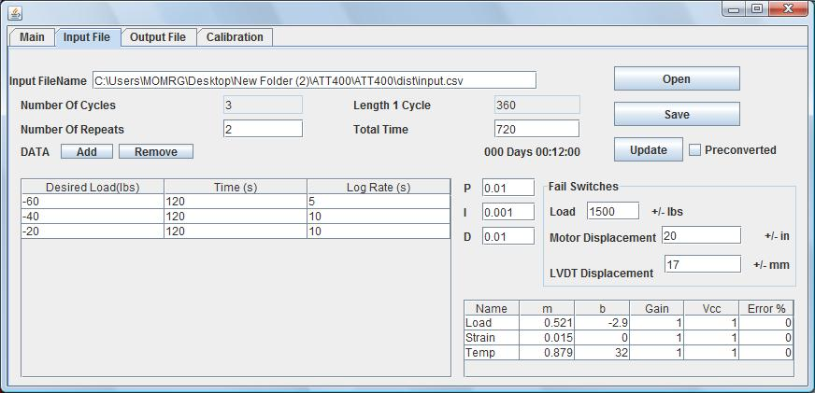
Input File
The input interface is used to defined the PID parameters, load per cycle, fail cases, and conversion factors for an experiment. The user friendly interface automatically calculates number of repeats or desired experiment time when either field is updated.
The user will be able to set fail switches for load, motor displacement , and L.V.D.T displacement. These fail switches will automatically stop the current running experiment if the specimen should fail before the total running time.
The conversion table variable are set to allow the microcontroller to convert load, strain , and temperature for PID control and LCD display.

Slide 46
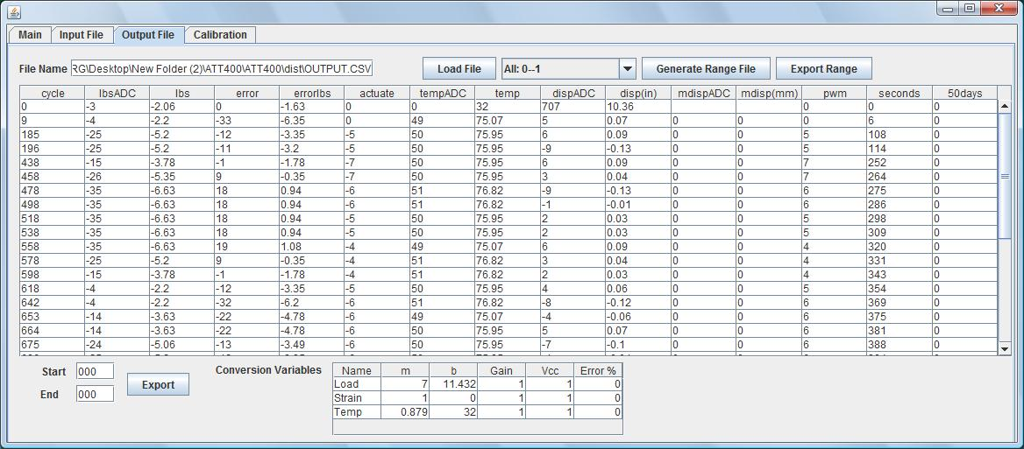
Output File
The raw data received from ATT 4000 is automatically converted using the value in the conversion table available on the bottom of the interface.
Once the output file is loaded the user may generate a range file using its corresponding input file. Once a range file is generated the user may export specific ranges and/or cycles; save and analysis the data in their preferred data analysis program.
The user may also export any range of data using the start and end fields.

Slide 47
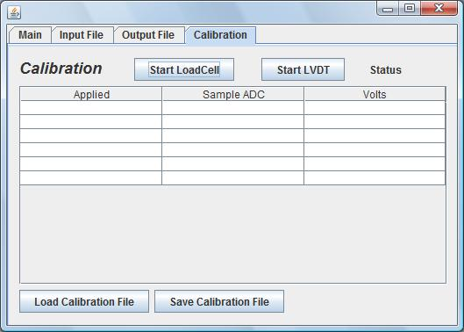
Calibration
This interface allow a user to calibration any load or L.V.D.T connected to the ATT 4000.Each sample is a average of 500 samples of the device being calibrated. This allow the user to have a analog to digital to Load or millimeter conversion and vise versa.
Skipping the middle conversion from pounds to volts to adc.

Slide 48
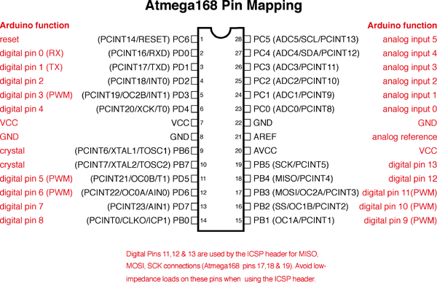
Atmega328P
The two atmega328p control the following aspect of the A.T.T 4000
Data logging
Serial communication to GUI
PID algorithm execution
Motor Control
Analog Readings
Fail condition algorithm
LCD output
Physical control interface
Specification
Operating Voltage 5V
Clock Speed 16 MHz
32 KiB Flash memory
1 KiB EEPROM
2 KiB SRAM
14 Digital I/O Pins (6 PWM)
6 ADC input pins

Slide 49
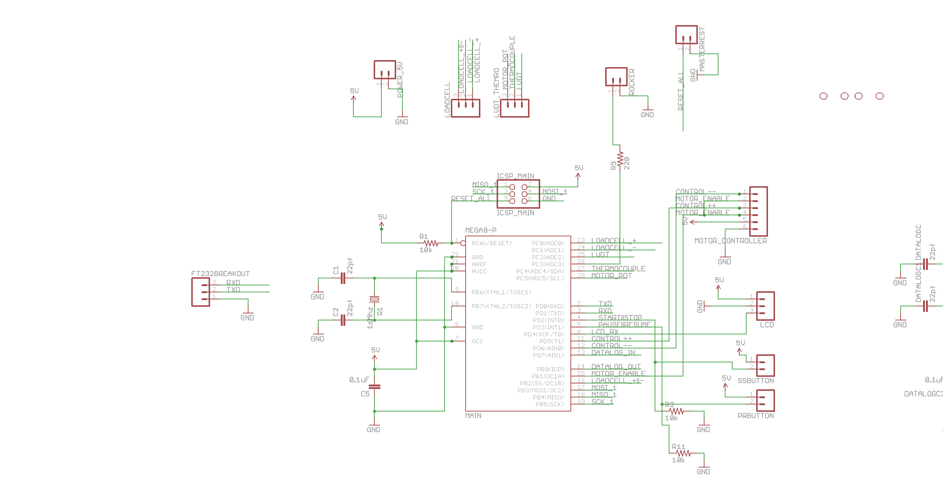
Analog devices to Atemga328P
The schematic to the left shows the configuration of the 3 analog devices and the atmega38p. The load cell and thermocouple outputs require amplification before they can be sent to the microcontroller, this allow the signal coming out to max out at 5 volts. The amplification circuit show is a black box representation of the actually circuit show in previous sections. ADC ports on the atmega328p 0, 2, 4 receive signals from the load cell, thermocouple and strain gain respectively.

Slide 50
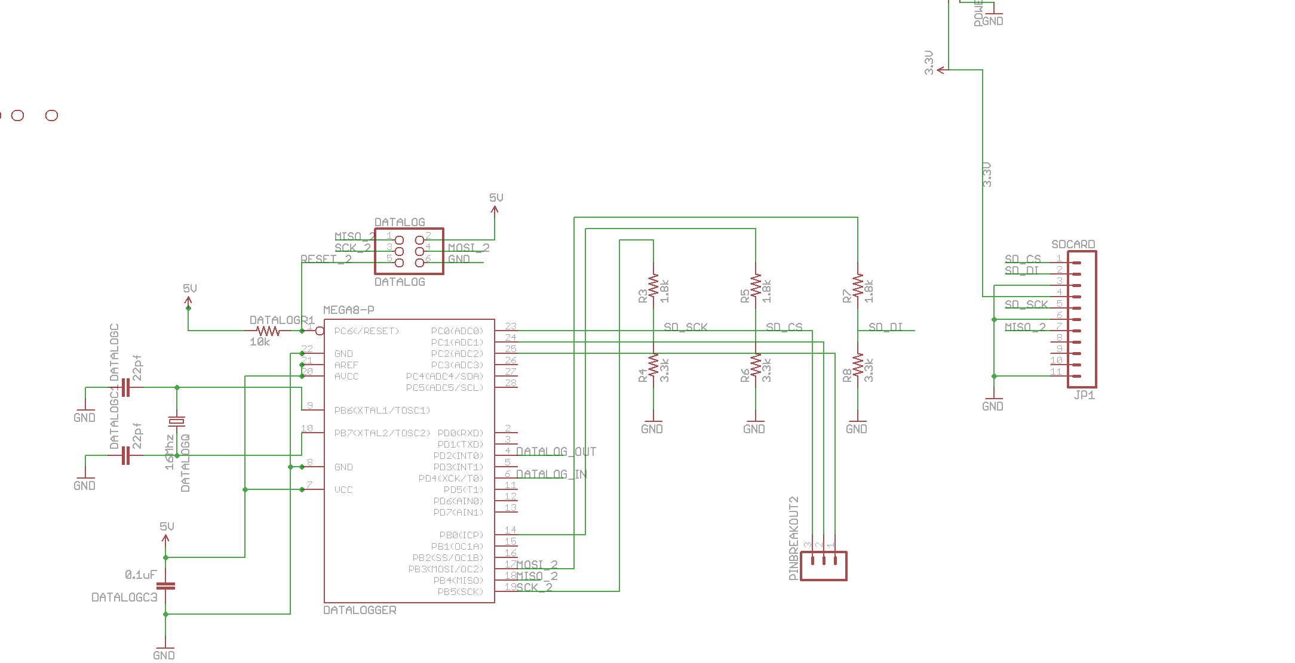
Micro SD Card – Atmega328p schematic
The SD card interfaces with the data logging microcontroller through the Serial Peripheral Interface Bus a 4-wire interface.
The micro SD card has a operating range of 2.6 – 3.6 volts because of this a voltage dividers circuits are used for communicating between the devices.
The data logging controller communicates with the main controller using a serial interface. Communicating at a baud rate of 9600.

Slide 51
Physical Interface
We incorporates a 20 by 2 rs232 alpha numeric display with a arcade style push button interface. This interface lets the user check the current status of all components of the system during a running experiment. While the device is either connected or disconnect for a PC.
The interface cycles 3 pages of information. The pages cycle every 3 seconds.
Page Format
Page 1
Cycle #
Time
Page 2
Load
Error
Page 3
Displacement
Temperature

Slide 52
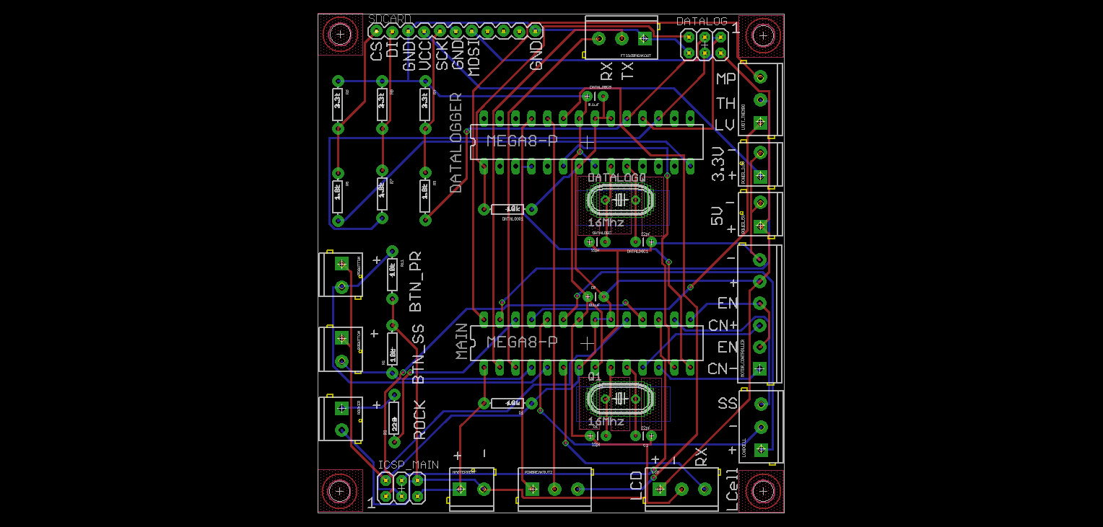
PCB Design

Slide 53
Conclusion
This project proves that it is feasible to create a test frame and interface for a fraction of the cost of a popular model.
MTS Frame ≈ $20,000
A.T.T. 4000 ≈ $1,500

Slide 54
Description | QTY | Cost | Total
Actuator Motor | 1 | $ 250.00 | $250.00
Atmega 328P | 2 | $ 4.30 | $8.60
H-Bridge | 1 | $ 120.00 | $120.00
5 Volt Regulator | 1 | $ 1.59 | $1.59
3.3 Volt Regulator | 1 | $ 1.95 | $1.95
Sparkfun Serial LCD | 1 | $ 12.95 | $12.95
Ethernet Shield | 1 | $ 45.95 | $45.95
Micro SD Card | 1 | $ 9.95 | $9.95
SD Breakout Board | 1 | $ 9.95 | $9.95
Load Cell | 1 | $ 475.00 | $475.00
Strain Gauge | 1 | $ 330.00 | $330.00
Thermocouple | 1 | $ 5.00 | $5.00
PCB | 1 | $ 121.00 | $121.00
10 nf Capacitors | 2 | $ 0.45 | $0.90
100 nf Capacitors | 2 | $ 0.35 | $0.70
FT245RL Breakout Board | 1 | $ 14.95 | $14.95
USB Cable | 1 | $ 5.00 | $5.00
12 AWG Wire | 1 | $ 10.00 | $10.00
Project Box | 1 | $ 6.99 | $6.99
Buttons | 4 | $ 0.50 | $2.00
Rocker Switch | 1 | $ 20.00 | $20.00
LED | 10 | $ 0.35 | $3.50
Op Amps | 2 | $ 1.99 | $3.98
Screw Terminals- 2pin | 20 | $ 0.95 | $19.00
Screw Terminals- 3pin | 2 | $ 0.95 | $1.90
Arduino | 1 | $ 29.95 | $29.95
Total |  |  | $1,510.81

