Slide 1
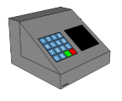
MTEC
Group 9
Francis Bato
Bishoy Botros
Erich Dondyk
Nghia Matt Nguyen

Slide 2
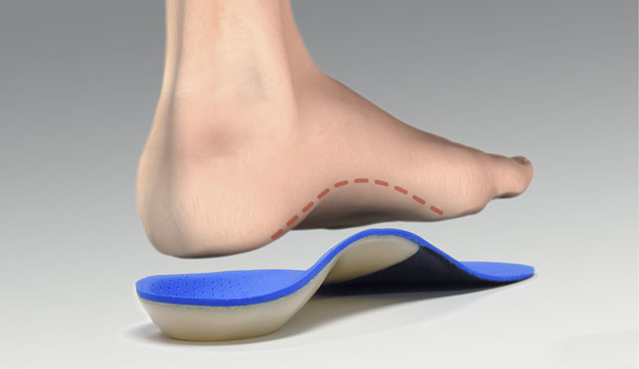

What is the MTEC?
MTEC
Material Testing Equipment Controller
Application
Material Testing for orthopedics of war veterans’
Sponsor
Dr. Gordon & MMAE

Slide 3

Goals & Objectives
Motor control to simulate the stepping motion of a human foot
User-friendly interface
Robust Hardware
Standalone device with data storage
Real-time data display
Compatible with Windows, Mac
2 Modes
Actuator/Load Cell (AL Mode)
Motor Control + Data Acquisition
Load Cell / Transducer (LT Mode)
Data Acquisition only

Slide 4




How does it work ?
GUI
MTEC

Slide 5
Specifications & Requirements
Dimensions
200.7 x 279.4 x 76.2 mm
Weight
< 5 lbs.
Microcontroller
> 20 I/O, > 10 ADC, 4 I/O ADC, 8 PWM
Operating voltage: 3.3V – 15V
Motor
Single actuator fits within a 1-1.5 in² area
Applied force of 25 lbs.
Sensors
Up to 8 load cells
Sustains 50 lbs. each
2 displacement sensors (transducer)
Threshold of 10-20 mm

Slide 6
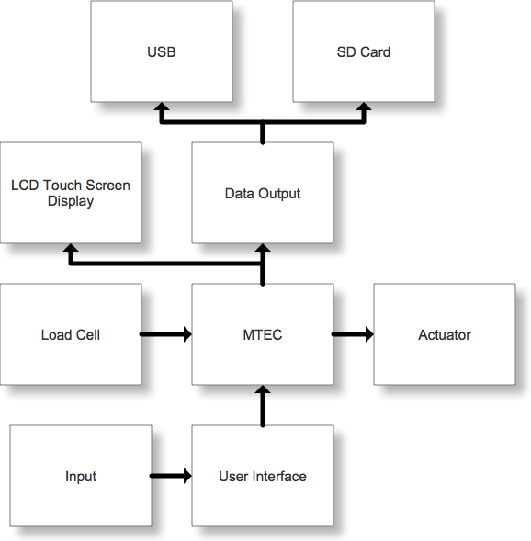
MTEC Block Diagram

Slide 7
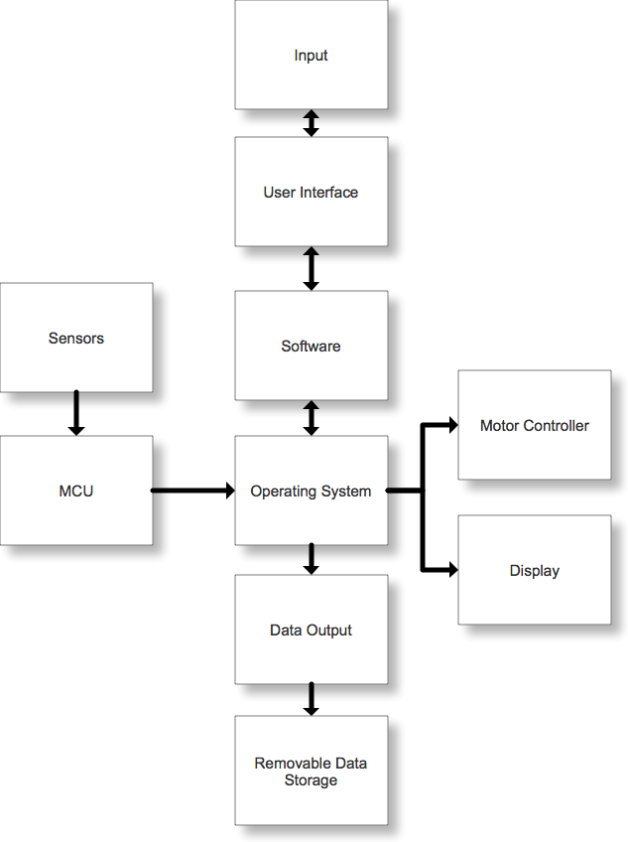
MTEC Software Diagram

Slide 8
Motor Control

Slide 9
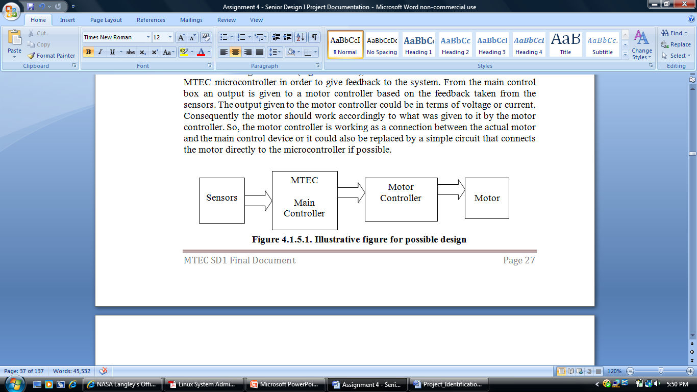
Motor Control
AC vs. DC vs. Servo vs. Stepper motors
Bidirectional motion
Speed control
Motion control ( pushing or pulling on the material)
Pulse Width Modulation for motion control

Slide 10
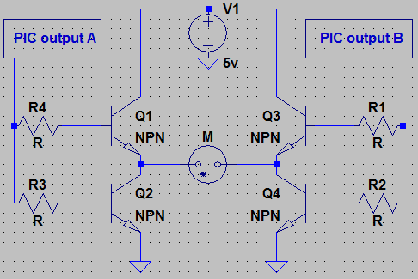
H-bridge
Allows for switching the voltage input for bidirectional movement.
CCP Vs. ECCP pins

Slide 11
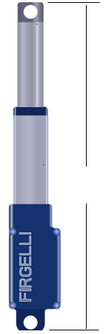
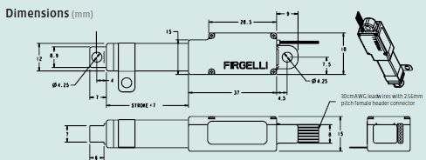
Linear Actuator
Model L12-50-210-06-I
50 is stroke length in mm
210 is gear ratio giving up to 150 N ≈ 33lb
06 is voltage
I is for microcontroller interface.
30 cm

Slide 12
Power Supply

Slide 13
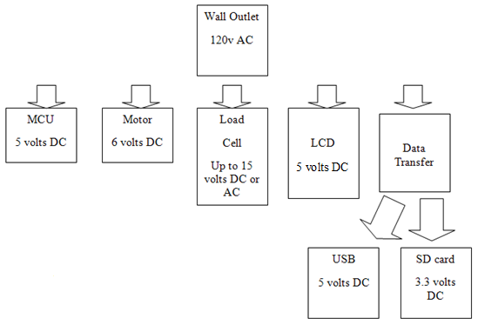
Power Distribution

Slide 14
Comparison
Linear Regulator | Switching Regulator
Excess voltage must be dissipated (Heat) | Efficient in conversion of electrical power (less heat)
Easier integration | Complex circuit integration
Inexpensive | A bit costly
Less efficiency | Much more efficient
Size and weight issues | Smaller size and lighter weight
LM 7805, 06 | LM2598, LM 2599 (error flag), LM2673 ( adjustable current limit) Output Range 1.23 – 37 volts

Slide 15
Sensors

Slide 16
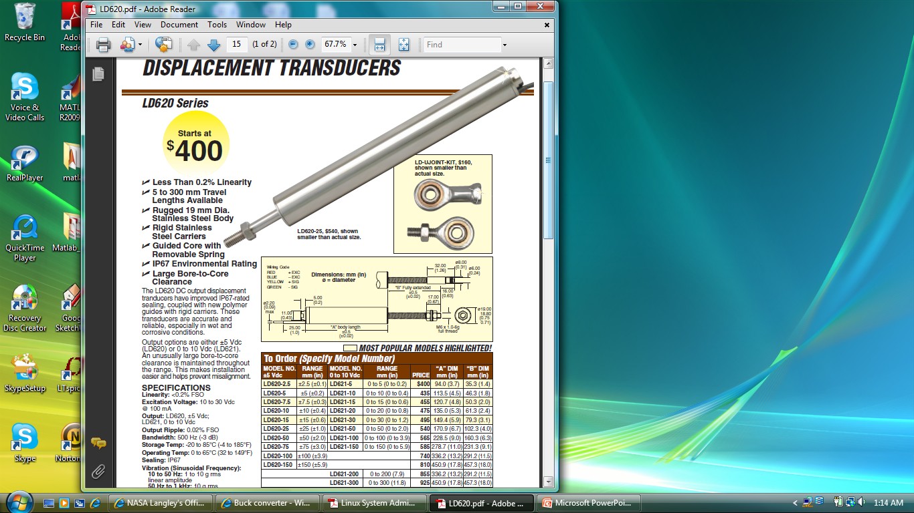
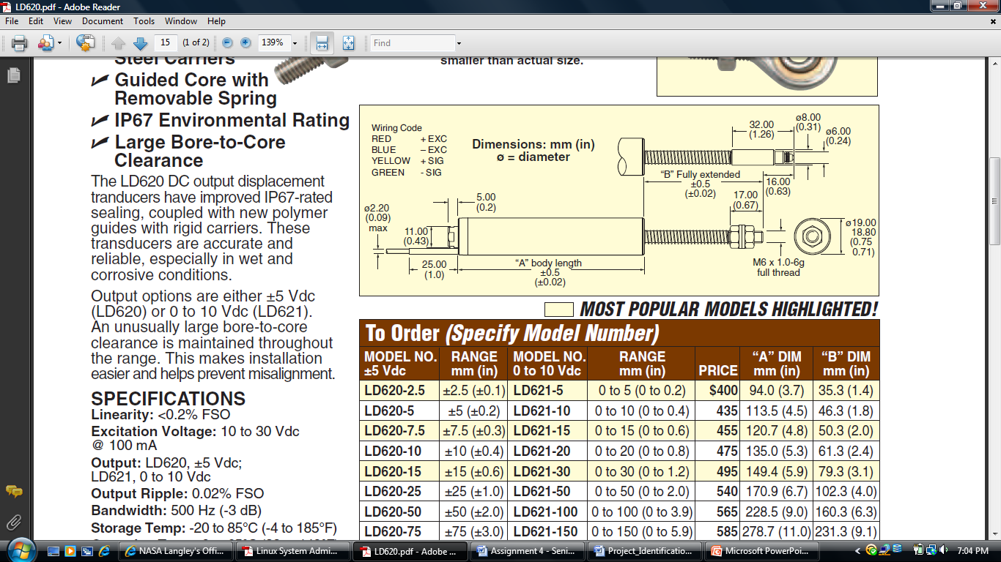
Displacement Transducer
LD 621 model.
Input DC voltage between 10-30 V at 100 mA.
Output 0 – 10 VDC
Linear relationship between voltage and displacement in mm.

Slide 17
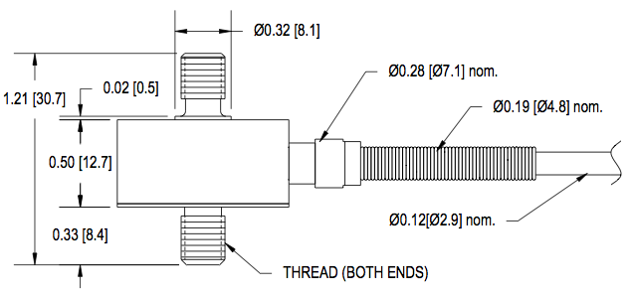
Load Cell
LCM 300
Rated Output: 2mV/V
Safe Overload: 150% of R.O.
Zero Balance: +/- 3% of R.O.
Excitation (VDC or VAC): 15 Max
Bridge Resistance: 700 ohms
Calibration Test Excitation: 10 VDC
Capacity: 250 lbs / 1112 N

Slide 18
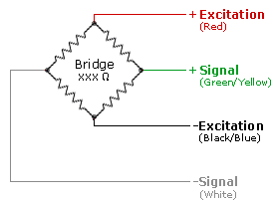
Wheatstone Bridge I
Load cell consists of a Wheatstone bridge circuit. 2 corners are used for voltage supply and 2 are output signal.
Voltage supplied in excitation will be 10V.

Slide 19
Wheatstone Bridge II
Load cell output is 2mv/V. With 10V excitation, the load cell output signal will be 20mV.
+ Output (Tension)
- Output (Compression)

Slide 20
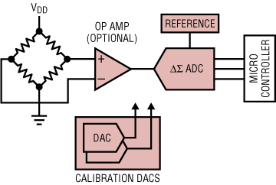
Op Amp
Needs to be amplified to about 5V for the microcontroller. 4096mV/20mV ~ 205x gain.
Load cell output signals connect to op amp for gain before being connected to A/D pin

Slide 21
Microcontroller

Slide 22
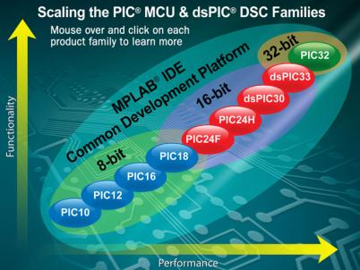
Microcontroller Selection
Decided PIC Microcontroller.
- Wide array of options
- Performance
- Programmable in C
Decided 8-bit technology.
- Fit for purpose
- Simplicity
Originally intended to use a PIC18F4550.
Due to requirement alterations, a MCU with 8 PWMs was necessary.
Only two PIC18 families met these requirements.

Slide 23
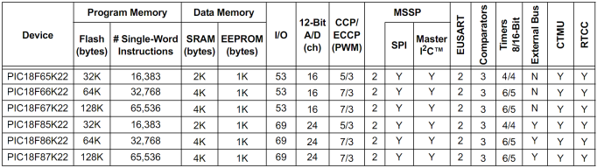
Microcontroller Selection
PIC18FXXK22 & PIC18FXXK90
- Identical in most aspects
- Package: TQFP (surface mounted)
PIC18FXXK90 has display controller incorporated.
- Unnecessary feature.
Selected most powerful version of the PIC18F87K22.
Device | Price
PIC18F65K22 | $2.39
PIC18F66K22 | DISCONTINUED
PIC18F67K22 | DISCONTINUED
PIC18F85K22 | $2.66
PIC18F86K22 | $2.97
PIC18F87K22 | $3.21

Slide 24
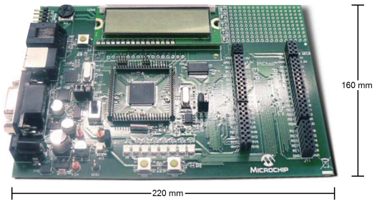
MCU Development Board
To program a surface mounted MCU it must be mounted on PCB with a ICSP circuit incorporated.
For prototyping purposes a development kit will be used.
PIC18 Development Kit. $165.00

Slide 25
Graphical LCD

Slide 26
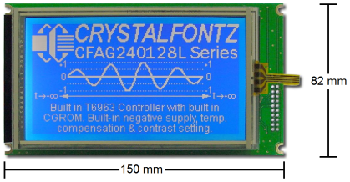
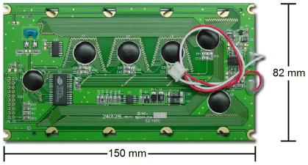
Graphical LCD Display Module
Model: CFAG240128L-TMI-TZTS
Manufacturer: Crystalfontz
Specifications:
Graphical LCD Display
240x128 Resolution
White Edge LED Backlight
STN Negative, Blue
Negative Voltage Generator
4-wire Resistive Touch Screen

Slide 27
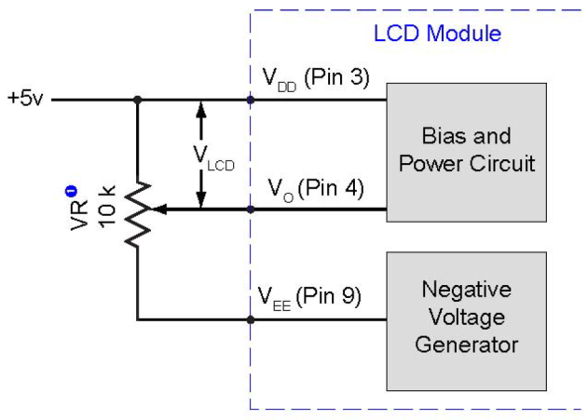
GLCD Display Controller
The CFAG240128L display module comes with a Toshiba T6963C display controller.
The T6968C has become an industry standard among small sized display modules.
Pin | Symbol | Type | Description | Specifications
1 | FG | Ground | Frame ground | 0V
2 | Vss | Ground | Ground | 0V
3 | Vdd | Power | Power supply. +5V | +5V
4 | V0 | Power | LCD contrast | V0= -8.1V for initial setting
5 | WR | Control Line | Data write | WR = L
6 | RD | Control Line | Data read | RD = L
7 | CE | Control Line | Chip Enable | CE = L
8 | C/D | Control Line |  | Command write: WR=L , C/D=H Data write: C/D=L Status read: RD=L, C/D=H Data read: C/D=L
9 | Vee | Power | Negative voltage output | -22V
10 | RESET | Control Line | Resets module | Normal = H ; Initialize T6963C = L
11 | DB0 | Data Line | Data bus | LSB
12 | DB1 | Data Line | Data bus
13 | DB2 | Data Line | Data bus
14 | DB3 | Data Line | Data bus
15 | DB4 | Data Line | Data bus
16 | DB5 | Data Line | Data bus
17 | DB6 | Data Line | Data bus
18 | DB7 | Data Line | Data bus | MSB
19 | FS | Control Line | Font select | 6 * 8 = H ; 8 * 8 = L
20 | RV | Control Line | Reverse | Reverse = H ; Normal = L
Electrical Requirements
Supply Voltage = +5V
Input High Voltage = +2.8V to +5V
Input Low Voltage = 0V to +0.8V
Supply Current = 28.2mA (typical)
Contrast Control
(Requires a negative voltage)

Slide 28
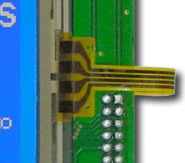
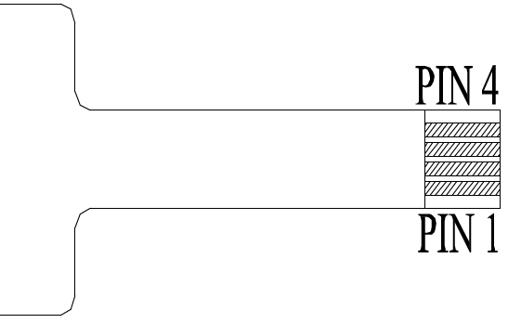
Resistive Touch Screen
The CFAG240128L display module has a 4 wire resistive touch screen.
- Durable, 5 million touches.
- Simple MCU integration.
- Enhances user interface.
The touch screen connects to digital/analog to digital pins.
Pin | Description | Specifications
1 | X1 | Digital/analog-to-digital pin
2 | Y1 | Digital/analog-to-digital pin
3 | X2 | Digital/analog-to-digital pin
4 | Y2 | Digital/analog-to-digital pin

Slide 29
GLCD/MCU Interface
The Graphical LCD display requires 15 digital pins.
The touch screen requires 4 digital/analog-to-digital pins.
GLCD |  | MCU
Pin | Symbol | Pin | Symbol
5 | WR | 54 | RB4/KBI0
6 | RD | 53 | RB5/KBI1/T3CKI/T1G
7 | CE | 52 | RB6/KBI2/PGC
8 | C/D | 47 | RB7/KBI3/PGD
10 | RESET | 46 | RC5/SDO1
11 | DB0 | 72 | RD0/CTPLS
12 | DB1 | 69 | RD1/T5CKI/T7G
13 | DB2 | 68 | RD2/PSP2/AD2
14 | DB3 | 67 | RD3/PSP3/AD3
15 | DB4 | 66 | RD4/SDO2/PSP4/AD4
16 | DB5 | 65 | RD5/SDI2/SDA2/PSP5/AD5
17 | DB6 | 64 | RD6/SCK2/SCL2/PSP6/AD6
18 | DB7 | 63 | RD7/SS2/PSP7/AD7
19 | FS | 62 | RJ0
20 | RV | 61 | RJ1/ALE
Touch Screen |  | MCU
Pin | Symbol | Pin | Symbol
1 | X1 | 79 | RH0/AN23
2 | Y1 | 80 | RH1/AN22
3 | X2 | 1 | RH2/AN21
4 | Y2 | 2 | RH3/AN20

Slide 30
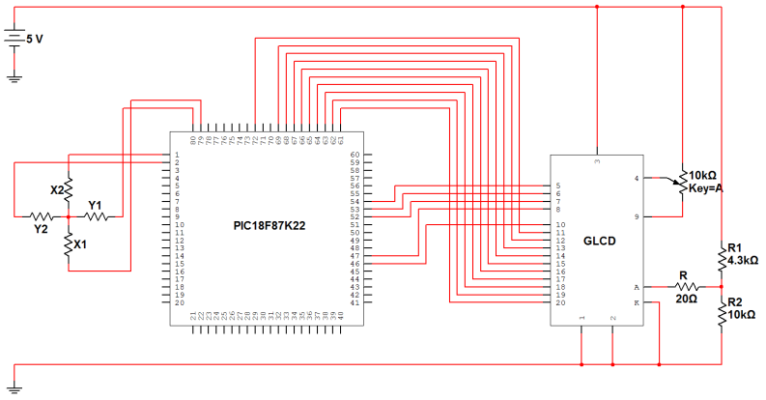
GLCD/MCU Schematic

Slide 31
Data Output

Slide 32
Data Output
Goal: Provide the user flexibility in performing data logging activities of extensive material testing through the use of multiple, reliable and portable output peripherals.
Master Synchronous Serial Port (MSSP)
2 Modes: SPI and I²C
Devices to consider:
Flash Memory
Universal Serial Bus
Wi-Fi

Slide 33
SPI
Designed for single Master-Slave protocol but can be used with multiple slave devices.
High throughput
Supports full duplex
No message limit
Supports higher data rates
More difficult to implement multiple slave systems because of no device addressing
Lower power requirements

Slide 34
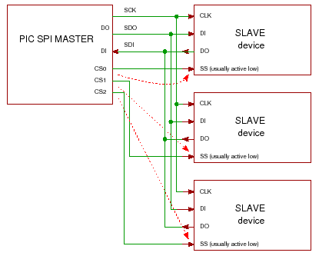
SPI & Slave Operation I
2 Different methods of implementing slave devices
Chip Select Method
Parallel configuration with independent slaves
Control each slave device through chip select
When slave is disabled, slave
goes into a high impedence
state that does not interfere
with active slave and ignores
data sent

Slide 35
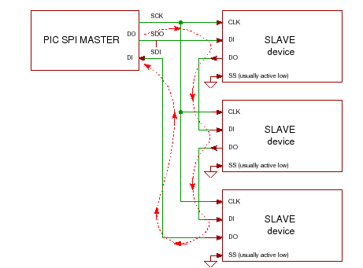
SPI & Slave Operation II
Daisy Chain Method
Data is cascaded through all the slave devices
Requires clock compatibility and same bit configuration among all slave devices
Clock polarity must be checked in order to determine edges of clock signal on which the data
is driven and sampled
Software implementation
heavy

Slide 36
MSSP: SPI
SPI using Slave Select was chosen
Familiarity
Ease of implementation
High throughput
Although I²C uses only two wires, additional complexity is added in handling the overhead of addressing and data acknowledgement
I²C can be inefficient when simple configurations and direct linking can be interfaced

Slide 37
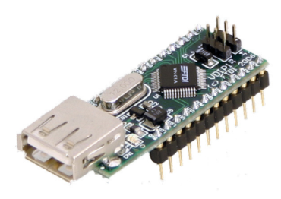
USB Interface
Future Technology Devices International, LTD.
VDIP1 Module
Utilizes FTDI’s VN1CL USB Host Controller IC
Handles USB protocol
Supports SPI interface with PIC18F
USB A Type Socket
$24.50

Slide 38
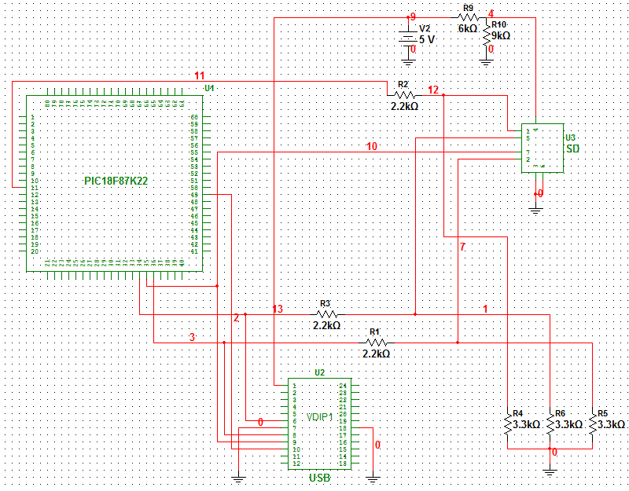
Data Output Schematic

Slide 39
Microchip’s MDD
Memory Disk Drive (MDD) Library
Free
Wide range of support
Provides method of interfacing files and directories
FAT12, FAT16, and FAT32
Most popular with SD cards and USB thumb drives

Slide 40
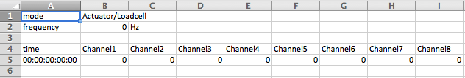
File Format
Input (TXT file)
mode
frequency
time0, force1,force2, force3, force4, force5, force6, force7, force8
time1, force1,force2, force3, force4, force5, force6, force7, force8
Output (CSV file)
mode,AL/LT
frequency,00,Hz
time,Channel1,Channel2,Channel3,Channel4,Channel5,Channel6,Channel7,Channel8
00:00:00:00:00,00.0,00.0,00.0,00.0,00.0,00.0,00.0,00.0

Slide 41
Graphic User Interface

Slide 42
GUI
Provide an interface for the user to control the MTEC on the touch screen
Display data and progress while MTEC running
Programmed in C
Graphics.h library provides functions to draw graphics on screen
Touch simulated using mouse-click functions in C

Slide 43
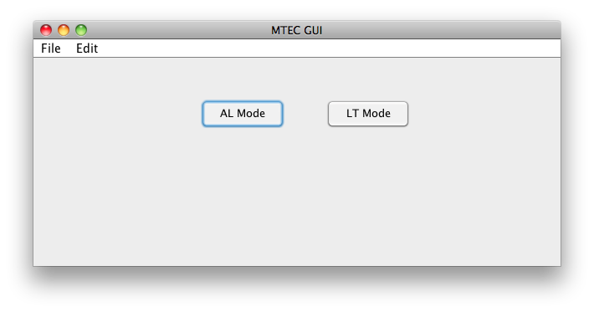
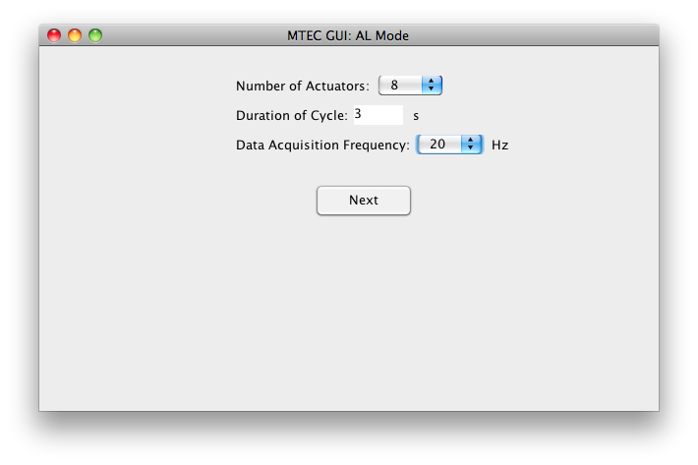
Instruction Input GUI

Slide 44
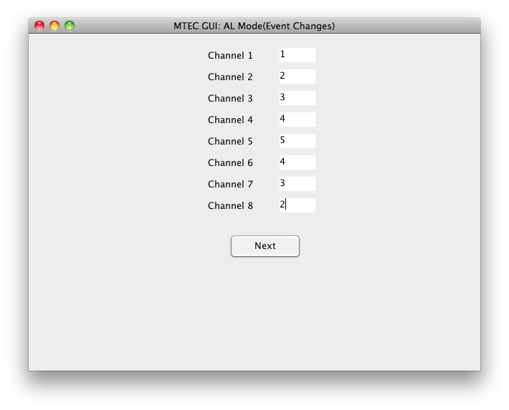
Instruction Input GUI II

Slide 45
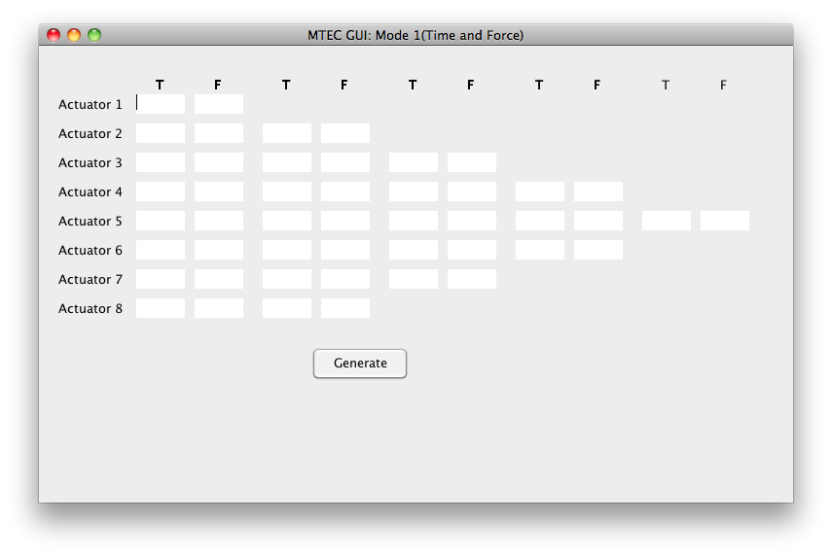
Instruction Input GUI III

Slide 46
Administrative

Slide 48
Budget
Component | Price | Qty | Projected | Actual | Acquired
MTEC Components
PIC18F Dev Kit | $165.00 | 1 | $103.00 | $165.00 | Y
GLCD w/ Touch Screen | $87.00 | 1 | $61.56 | $87.00 | N
USB VDIP1 Module | $24.50 | 1 | $23.42 | $24.50 | N
SD Card Socket | $9.95 | 1 | $9.95 | $9.95 | N
Breakboard | $9.95 | - | - | - | N
Pactec Enclosure | $28.20 | 1 | $28.20 | $28.20 | N
PIC18F87K22 Plugin Module | $25.00 | 1 | - | $25.00 | Y
Sub Total |  |  | $226.13 | $314.65
Rig Components
Futek LCM 300 FSH02632 Load Cell | $450.00 | 2 | $575.00 | $900.00 | Y
Linear Actuator Firgelli L12-50-210-06-I | $80.00 | 1 | $80.00 | $80.00 | Y
Transducer LD621-15 | $455 | 2 | - | $910.00 | N
Sub Total |  |  | $1230.00 | $1890.00
Grand Total |  |  | $1456.13 | $2204.65

Slide 49
Challenges
Acomodating the response time of the actuators.
Analog signal alterations created when modifying the sensor signals.
Programming the GUI of the GLCD.
Parallel implementation of the SD and USB.
Incorporating a surface mounted microcontroller.

