Slide 1
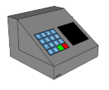
MTEC
Material Testing Equipment Controller
Group 9
Francis Bato
Bishoy Botros
Erich Dondyk
Nghia Matt Nguyen
Sponsored by Dr. Ali P Gordon

Slide 2

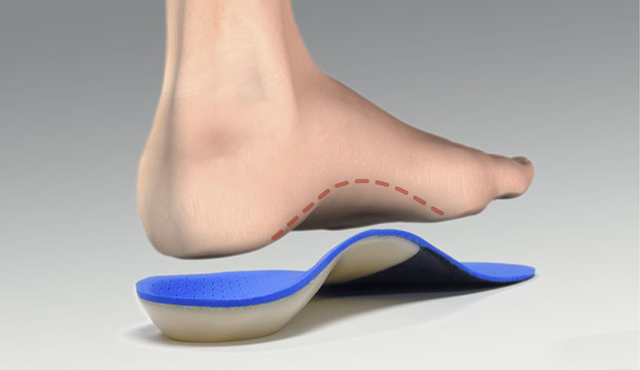
What is the MTEC?
MTEC
  Material Testing Equipment Controller
Application
  Material Testing for orthopedics of United States Military
Sponsor
  Dr. Gordon & Mechanics of Material Research Group (MOMRG)
Orthotics
Controller

Slide 3

Goals & Objectives
Motor control to simulate the static and dynamic pressure distribution of a human foot
User-friendly interface
Robust Hardware
Standalone device with data storage (detachable from computer)
Real-time data display
Compatible with Windows, Mac
2 Modes
  Actuator/Load Cell (Mode 1)
    Motor Control + Data Acquisition
  Load Cell / Transducer (Mode 2)
    Data Acquisition only

Slide 4
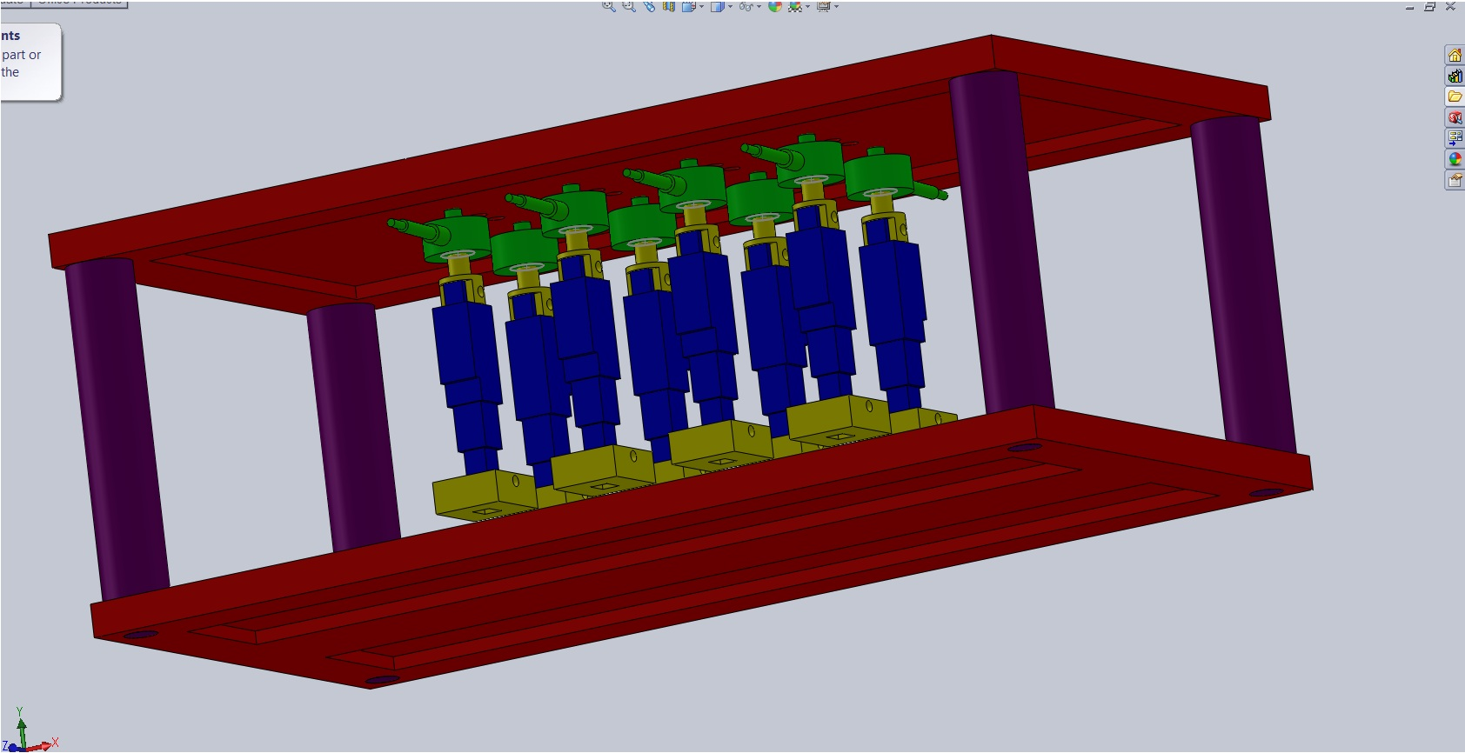
Mechanical Devices-I
Foot Simulator

Slide 5
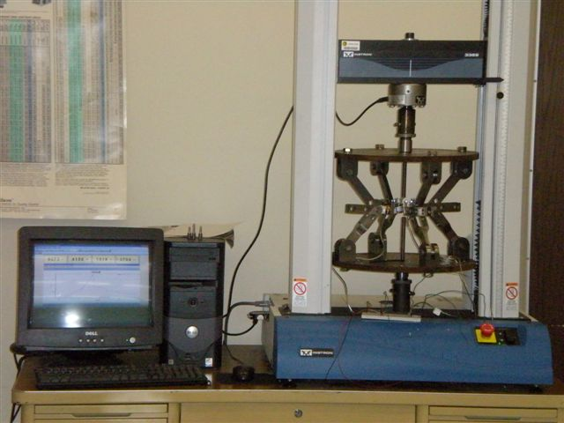
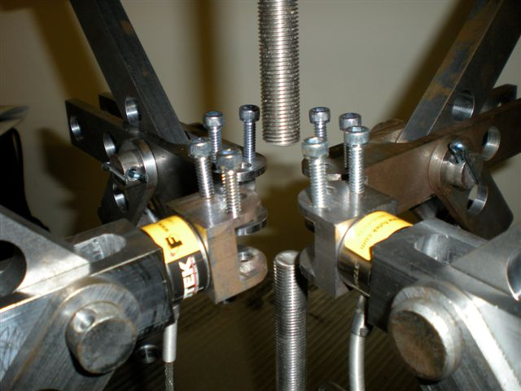
Mechanical Devices-II
Multi-axial Test Frame

Slide 6




How does it work ?
GUI
MTEC

Slide 7
Specifications & Requirements
Dimensions
  8.25 x 5.15 x 3.12 inches
Weight
  < 5 lbs.
Microcontroller
  > 20 I/O, > 10 ADC, 4 I/O ADC, >5 PWM
Operating voltage: 3.3V – 15V
Motor
  Single actuator fits within a 1-1.5 in² area
  Applied force of 30 lbs. (Total applied force must go to about 500 lbs.)
Sensors
  Up to 8 load cells
    Sustains at least 50 lbs. each
  2 displacement sensors (transducer)
    Measures up to 0.6 inches (~15 mm)

Slide 8
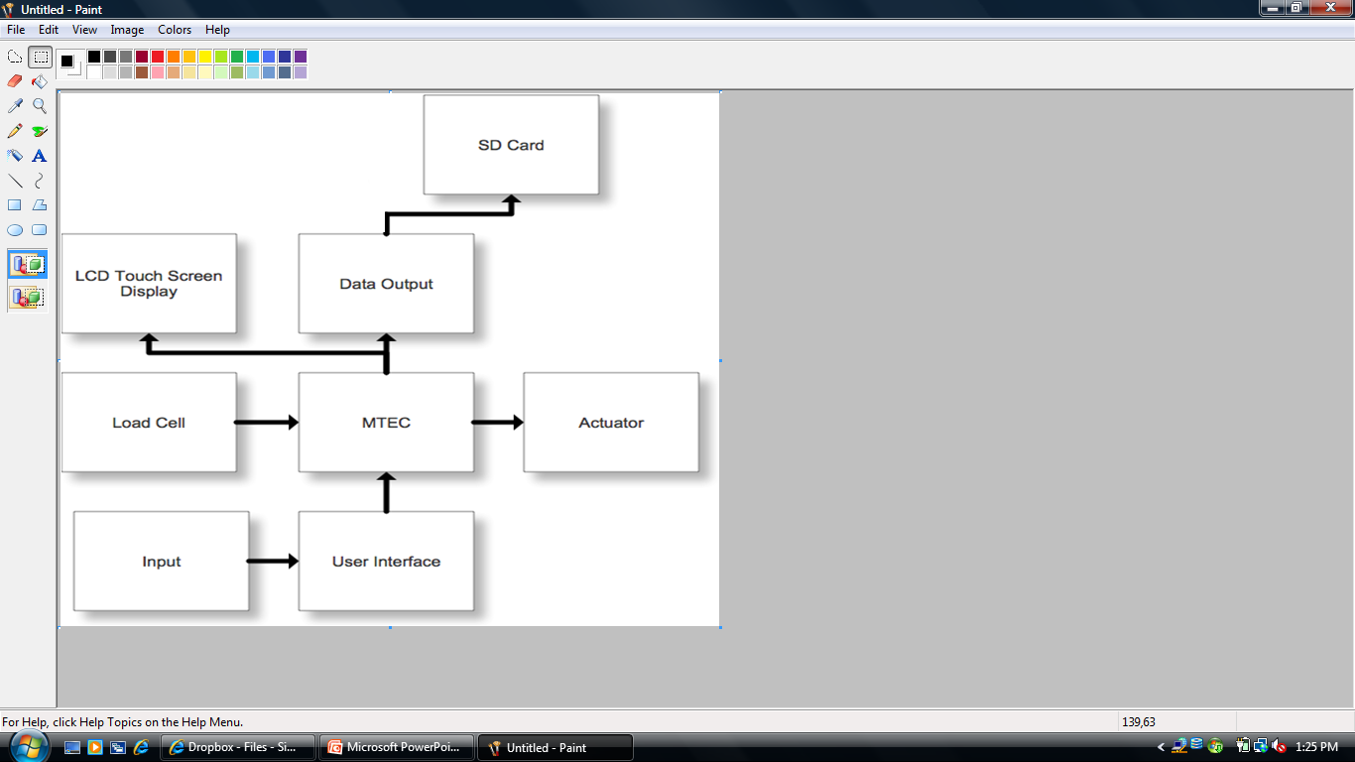
MTEC Block Diagram
Force History
Graphical

Slide 9
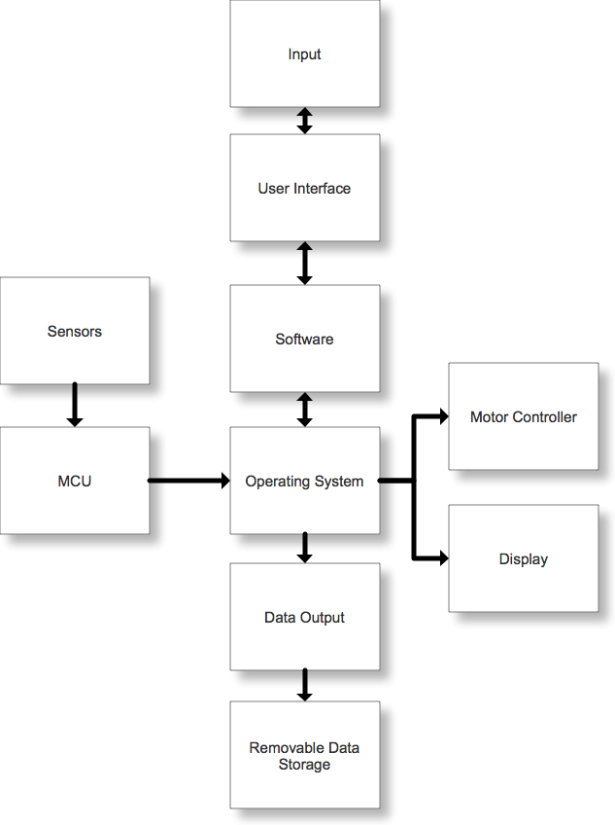
MTEC Software Diagram

Slide 10
Motor Control

Slide 11
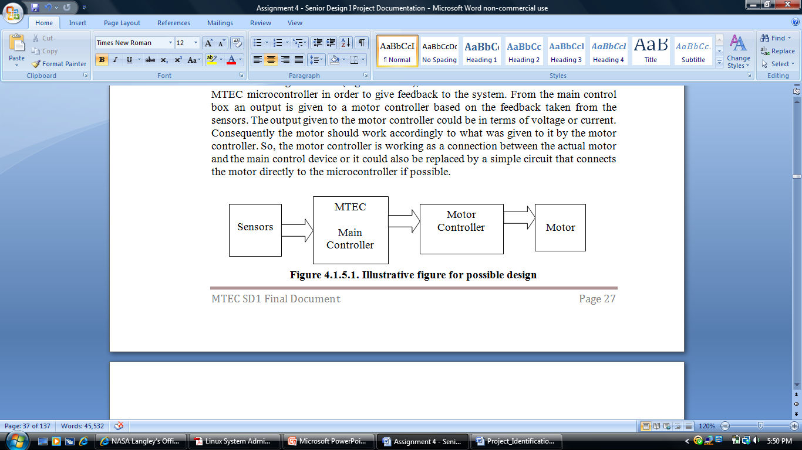
Motor Control
AC vs. DC vs. Servo vs. Stepper motors
Bidirectional motion
Speed control
Motion control ( pushing or pulling on the material)
Pulse Width Modulation for control

Slide 12
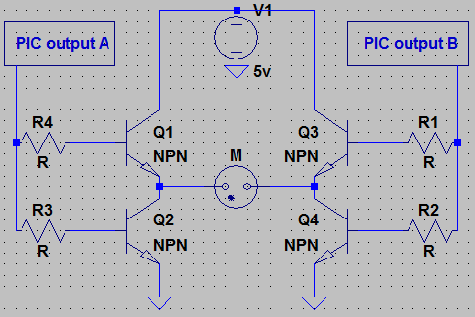
H-bridge
Allows for switching the voltage input for bidirectional movement.
CCP Vs. ECCP pins

Slide 13
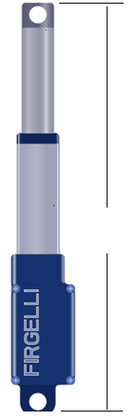
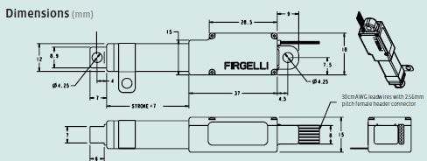
Linear Actuator
Model L12-50-210-06-I
50 is stroke length in mm
210 is gear ratio giving up to 150 N ≈ 33lb
06 is voltage
I is for microcontroller interface.
30 cm

Slide 14
Sensors

Slide 15
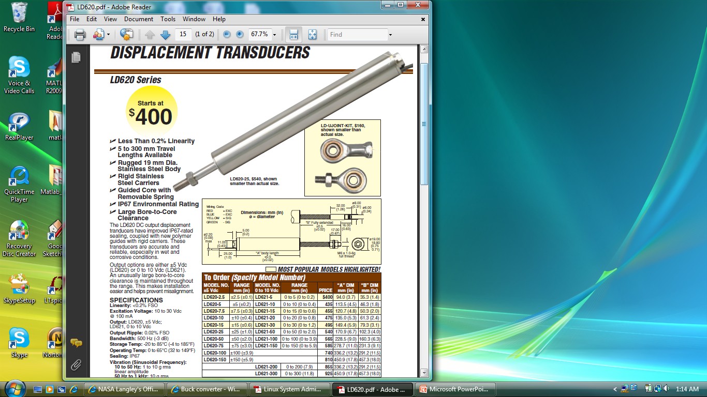
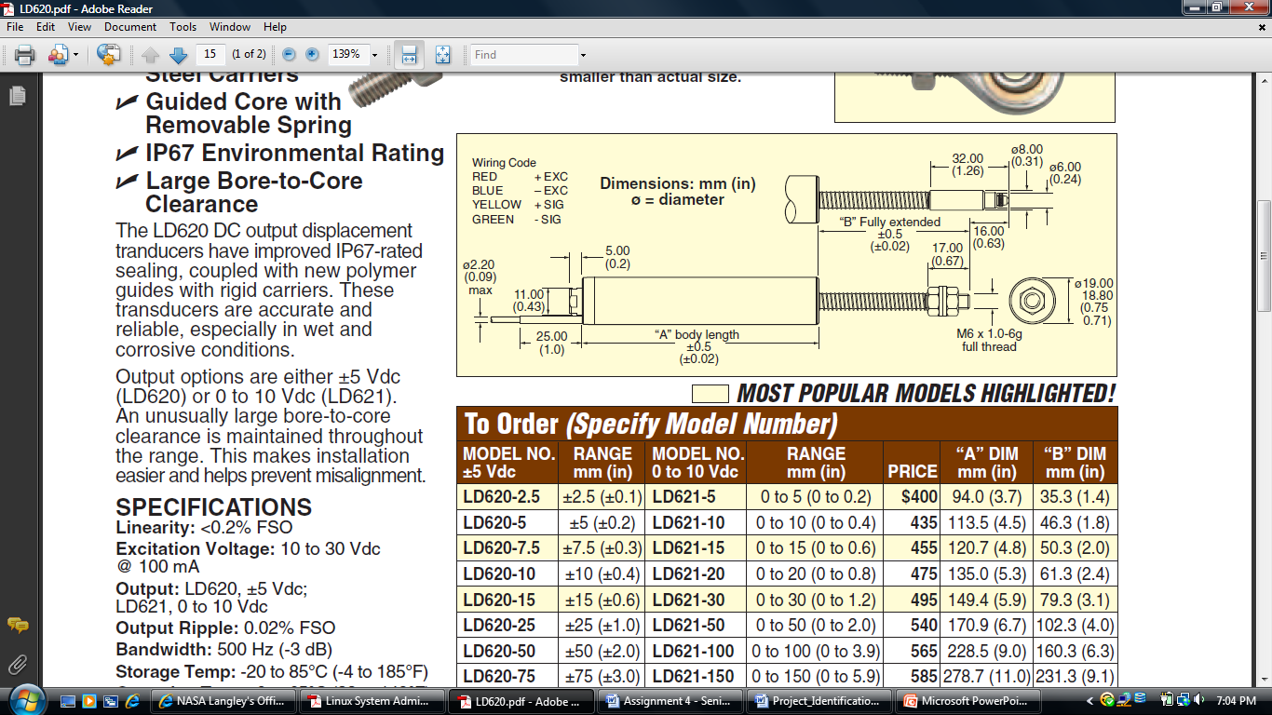
Displacement Transducer
LD 621 model.
Input DC voltage
between 10-30 V
at 100 mA.
Output 0 – 10 VDC
Linear relationship between voltage
and displacement in mm.

Slide 16
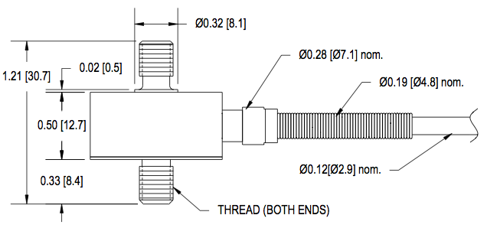
Load Cell
Excitation (VDC or VAC): 15 Max
Bridge Resistance: 700 ohms
Calibration Test Excitation: 10 VDC
Capacity: 250 lbs / 1112 N
LCM 300
Rated Output: 2mV/V
Safe Overload: 150% of R.O.
Zero Balance: +/- 3% of R.O.

Slide 17
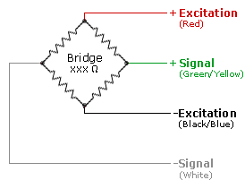
Wheatstone Bridge I
Load cell consists of a Wheatstone bridge circuit. 2 corners are used for voltage supply and 2 are output signal.
Voltage supplied in excitation will be 10V.

Slide 18
Wheatstone Bridge II
Load cell output is 2mv/V. With 10V excitation, the load cell output signal will be 20mV.
+ Output (Tension)
- Output (Compression)

Slide 19
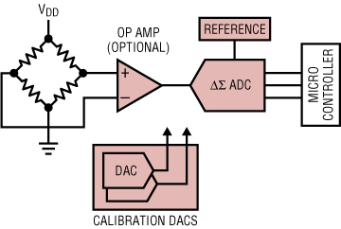
Op Amp
Needs to be amplified to about 5V for the microcontroller. 4096mV/20mV ~ 205x gain.
Load cell output signals connect to op amp for gain before being connected to A/D pin

Slide 20
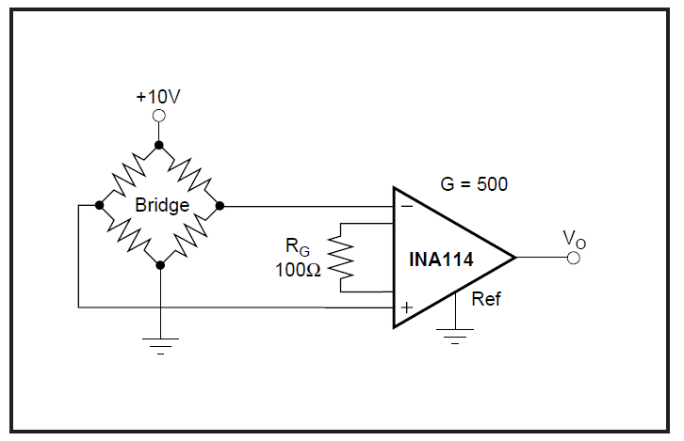
Amplifier Circuit
Gain used is 200 with a 250 ohm resistor giving amplification from 24 mV to 4.8 V.

Slide 21
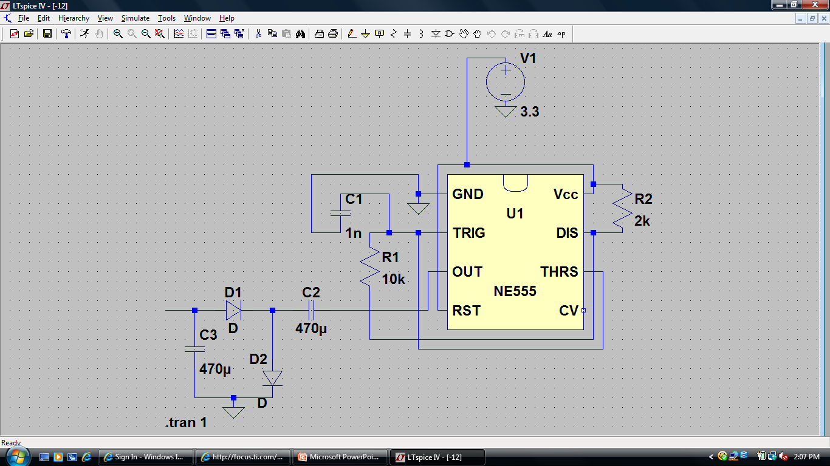
Generating (-12) volts using 555-timer

Slide 22
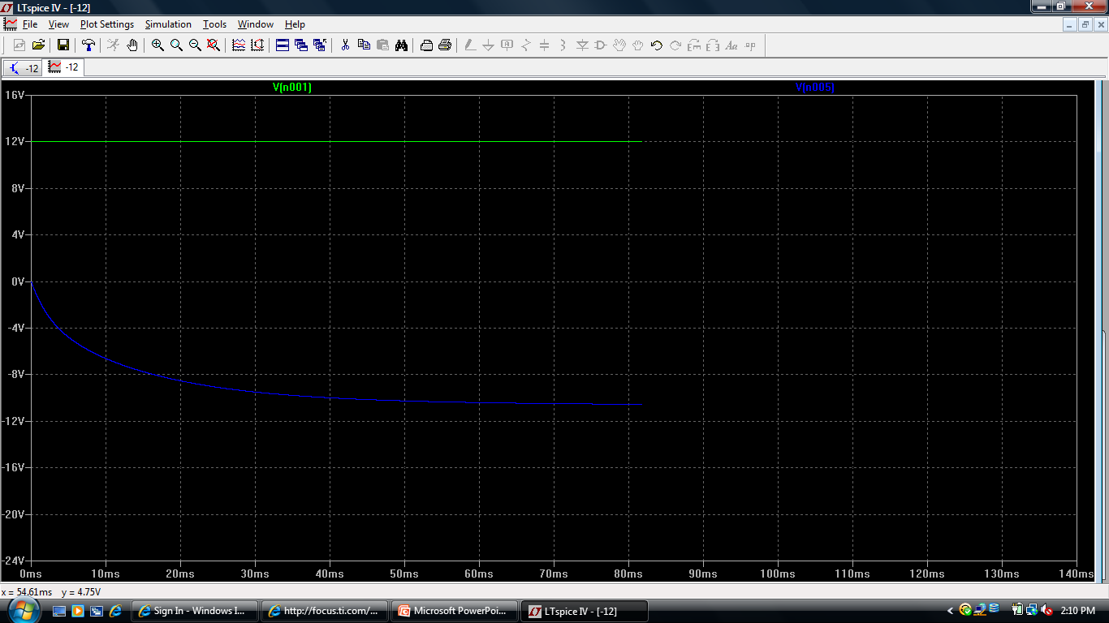
Simulation (-12 volts)
It takes about 25 milli-seconds to get a stable -12 volts out.

Slide 23
Testing LVDT
Displacement (inches) vs. Voltage (volts)

Slide 24
Testing Load Cell
Force (lbs) vs. Voltage (volts)

Slide 25
Microcontroller

Slide 26
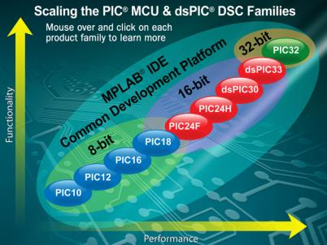
Microcontroller Selection
Decided PIC Microcontroller.
- Wide array of options
- Performance
- Programmable in C
Decided 8-bit technology.
- Fit for purpose
- Simplicity
Due to requirement alterations,
a MCU with several PWMs.
Only two PIC18 families met these requirements.

Slide 27
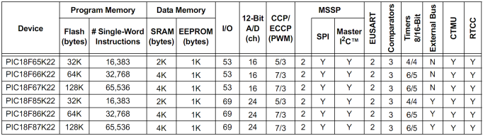
Microcontroller Selection
PIC18FXXK22 & PIC18FXXK90
- Identical in most aspects
- Package: TQFP (surface mounted)
PIC18FXXK90 has display controller incorporated.
- Unnecessary feature.
Selected most powerful version of the PIC18F87K22.
Device | Price
PIC18F65K22 | $2.39
PIC18F66K22 | DISCONTINUED
PIC18F67K22 | DISCONTINUED
PIC18F85K22 | $2.66
PIC18F86K22 | $2.97
PIC18F87K22 | $3.21

Slide 28
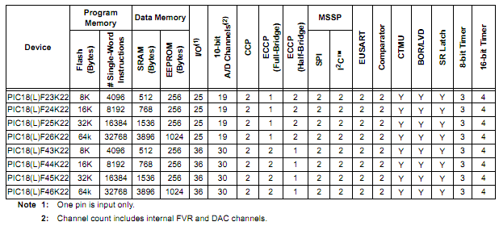
Microcontroller
PIC18LF46K22
High Performance
40 Dual Inline Package
Low Power
Device | Price
PIC18F25K22 | $2.39
PIC18F26K22 | $2.84
PIC18F45K22 | $3.28
PIC18F46K22 | $3.80

Slide 29
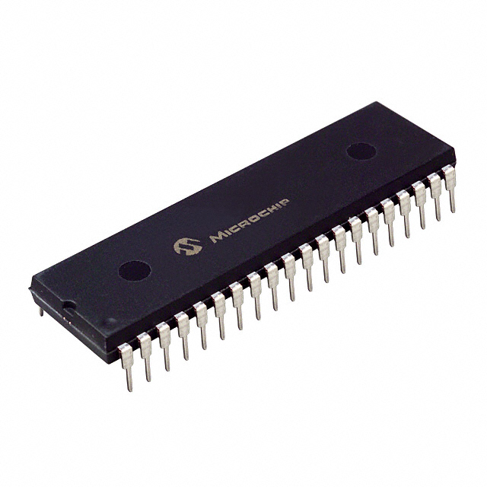
PIC18LF46K22
1.8V – 3.6V Operation
Self-Programmable under Software Control
In-Circuit Serial Programming (ICSP) Single-Supply 3V
PIC KIT 3 Compatible
MPLAB V8.66 Compatible
Extreme Low-Power Management
  Sleep mode: 100 nA typical
  Typical: 2.20 mA

Slide 30
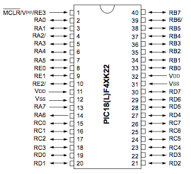
PIC18LF46K22 Features
Features
  35 I/O Pins
  Pulse Width Modulator (PWM)
    Two Capture/Compare/PWM (CCP modules)
    Three Enhanced CCP (ECCP Modules)
  Analog-Digital-Converter (ADC)
    30 external channels
    10-bit resolution
  Master Synchronous Serial Port (MSSP)
    3-wire SPI (all modes supported)
    I2C Master and Slave mode
  Memory
    32768 Single Word Instructions
    1024 EEPROM (bytes)
    64K Flash (Bytes)

Slide 31
Parallel LCD

Slide 32
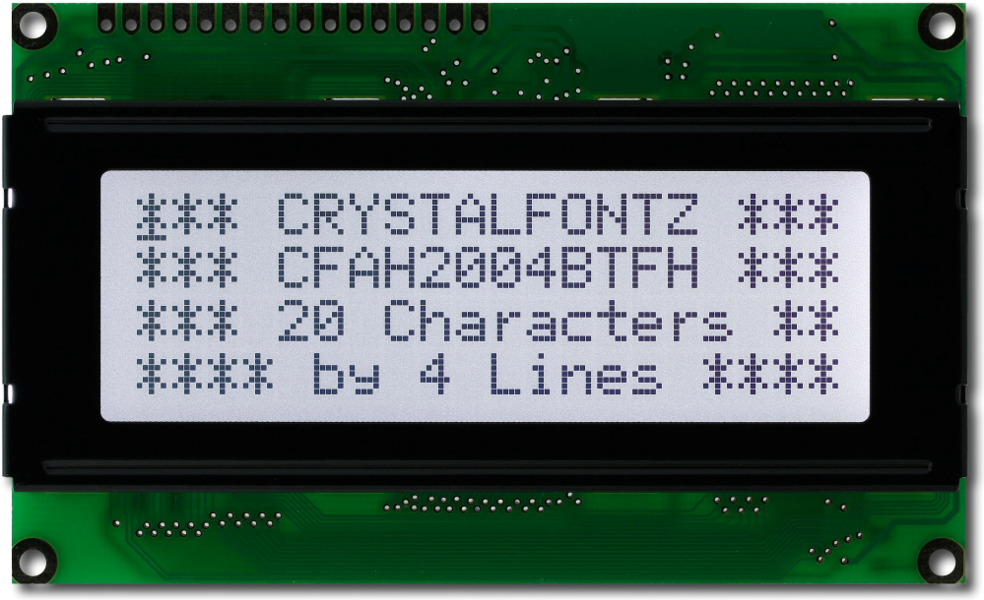
Parallel LCD Display Module
Model: CFAH2004B-TFH-ET
Manufacturer: Crystalfontz
Specifications:
Parallel LCD Display
40x4 Resolution
White Edge LED Backlight
STN Negative, White

Slide 33
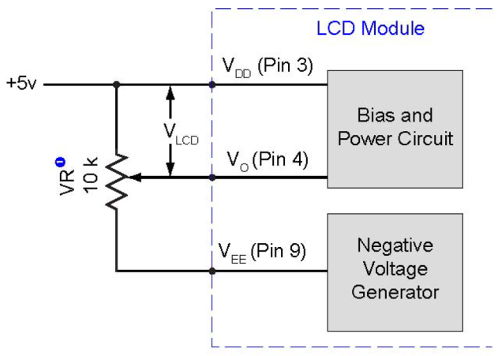
LCD Display Controller
The HD44780 display module comes with a Hiachi display controller.
The HD47780 has become an industry standard among small sized display modules.
Pin | Symbol | Type | Description | Specifications
1 | Vss | Ground | Ground | 0V
2 | Vdd | Power | Power supply. +5V | +5V
3 | V0 | Power | LCD contrast | V0= -8.1V for initial setting
4 | WR | Control Line | Data write | WR = L
5 | RD | Control Line | Data read | RD = L
6 | CE | Control Line | Chip Enable | CE = L
7 | C/D | Control Line |  | Command write: WR=L , C/D=H Data write: C/D=L Status read: RD=L, C/D=H Data read: C/D=L
9 | Vee | Power | Negative voltage output | -22V
10 | RESET | Control Line | Resets module | Normal = H ; Initialize T6963C = L
11 | DB0 | Data Line | Data bus | LSB
12 | DB1 | Data Line | Data bus
13 | DB2 | Data Line | Data bus
14 | DB3 | Data Line | Data bus
15 | DB4 | Data Line | Data bus
16 | DB5 | Data Line | Data bus
17 | DB6 | Data Line | Data bus
18 | DB7 | Data Line | Data bus | MSB
19 | FS | Control Line | Font select | 6 * 8 = H ; 8 * 8 = L
20 | RV | Control Line | Reverse | Reverse = H ; Normal = L
Electrical Requirements
Supply Voltage = +5V
Input High Voltage = +2.8V to +5V
Input Low Voltage = 0V to +0.8V
Supply Current = 28.2mA (typical)
Contrast Control

Slide 34
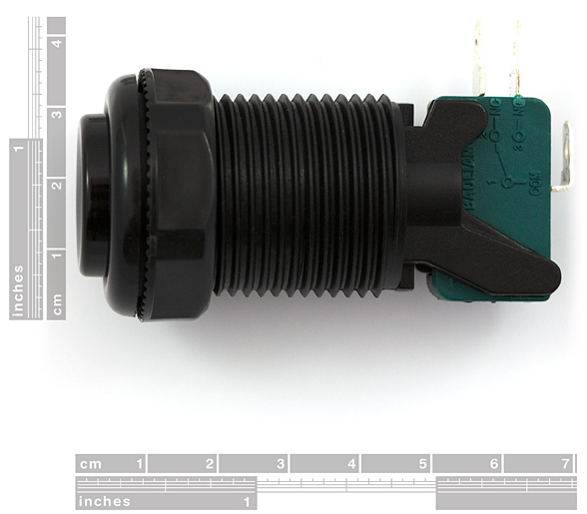
User Input
The display module will be used in conjunction with 3 momentary buttons.
- Durable
- Simple MCU integration.
- Enhances user interface.
The buttons connects to digital I/O pins.
Pin | Description | Specifications | Function
1 | B1 | Digital I/O Pin | Start/Pause
2 | B2 | Digital I/O Pin | Stop
3 | B3 | Digital I/O Pin | Mode Select

Slide 35
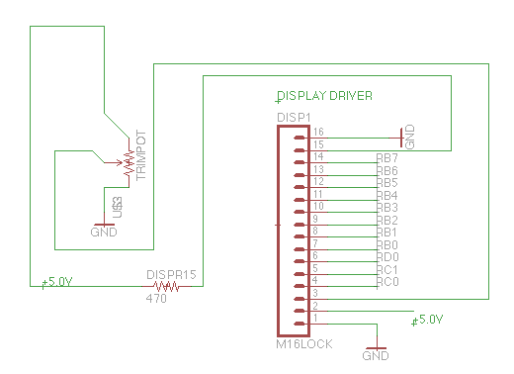
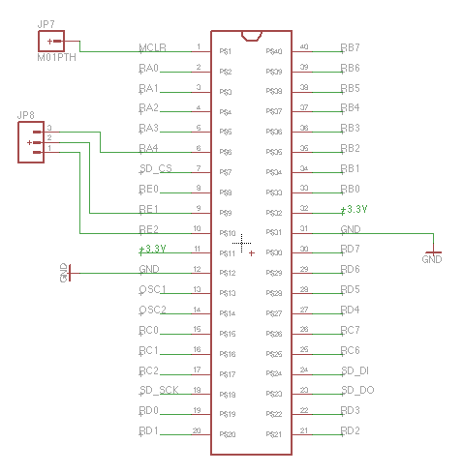
PLCD/MCU Schematic

Slide 36
Data Output

Slide 37
Data Output
Goal: Provide the user flexibility in performing data logging activities of extensive material testing through the use of multiple, reliable and portable output peripherals.
Master Synchronous Serial Port (MSSP)
  2 Modes: SPI and I²C
Devices to consider:
  Flash Memory
  Universal Serial Bus

Slide 38
SPI
Designed for single Master-Slave protocol but can be used with multiple slave devices.
High throughput
Supports full duplex
No message limit
Supports higher data rates
More difficult to implement multiple slave systems because of no device addressing
Lower power requirements

Slide 39
MSSP: SPI
SPI using Slave Select was chosen
  Familiarity
  Ease of implementation
  High throughput
  Although I²C uses only two wires, additional complexity is added in handling the overhead of addressing and data acknowledgement
  I²C can be inefficient when simple configurations and direct linking can be interfaced

Slide 40
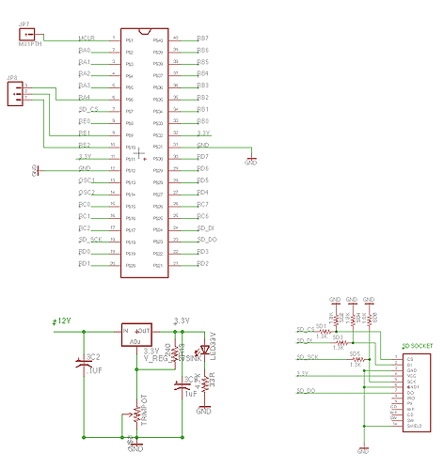
Data Output Schematic

Slide 41
Microchip’s MDD
Memory Disk Drive (MDD) Library
  Free
  Wide range of support
  Provides method of interfacing files and directories
  FAT12, FAT16, and FAT32
  Most popular with SD cards and USB thumb drives

Slide 42
Power Supply

Slide 43
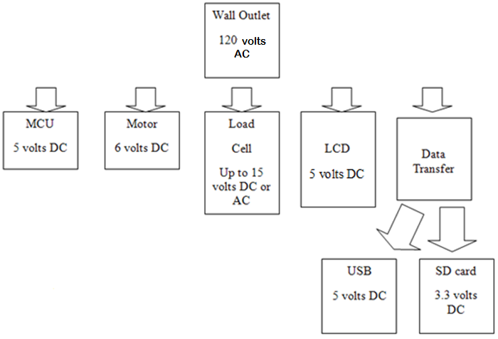
Power Distribution

Slide 44
Comparison
Linear Regulator | Switching Regulator
Excess voltage must be dissipated (Heat) | Efficient in conversion of electrical power (less heat)
Easier integration | Complex circuit integration
Inexpensive | A bit costly
Less efficiency | Much more efficient
Size and weight issues | Smaller size and lighter weight
LM 7805, 06 | LM2598, LM 2599 (error flag), LM2673 ( adjustable current limit) Output Range 1.23 – 37 volts

Slide 45
Power Calculations
 | Voltage | Current | Wattage
Microcontroller | 5 V | 5.5 mA | 1 W Max
SD | 3.3 V | 200 mA | 0.66 W
LCD | 5 V | 28.2 mA | 0.15 W
LVDT | 12 V | 100 mA | 1.2 W
Load Cell | ±12 V | 35 mA | 0.42 W
L12 Actuator | 6 V | 50 mA | 0.3 W
INA114 Op-Amp | ±12 | 2.5 mA | 0.03 W
Total Wattage: < 4W
Power Adapter used: 12V @ 1.2A

Slide 46
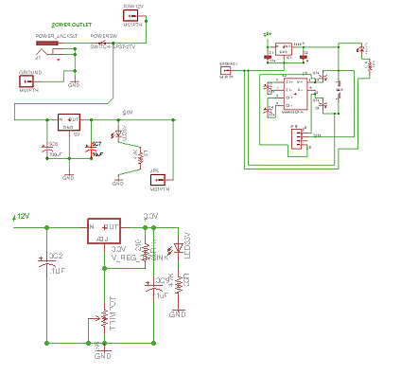
Power Supply Schematic

Slide 47
Printed Circuit Board

Slide 48
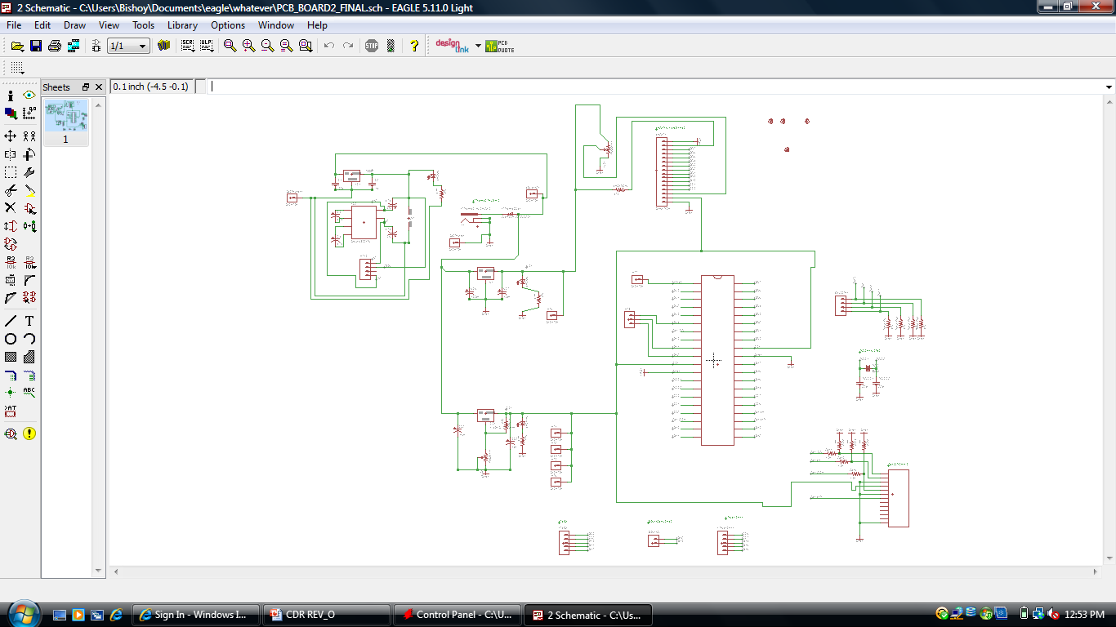
PCB Design (Digital)

Slide 49
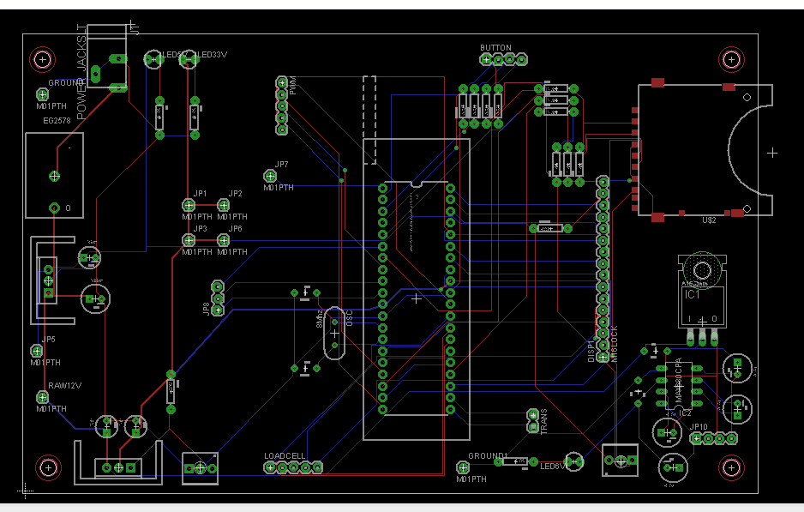
Board (Digital)

Slide 50
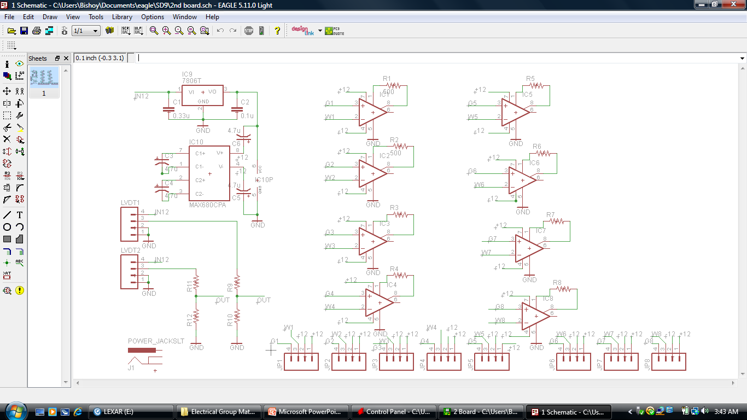
PCB design (Analog)

Slide 51
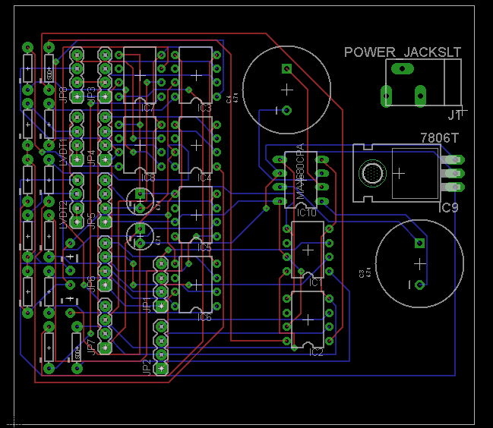
Board (Analog)

Slide 52
UML Case Diagrams

Slide 53
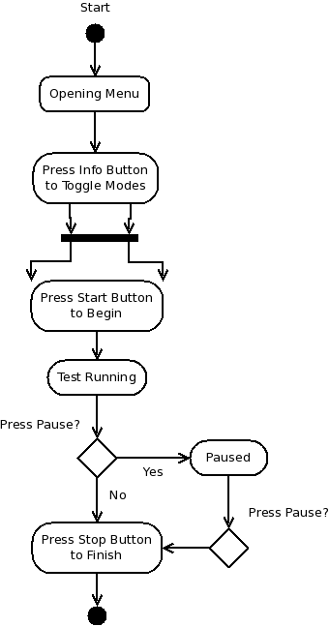
Button Diagram

Slide 54
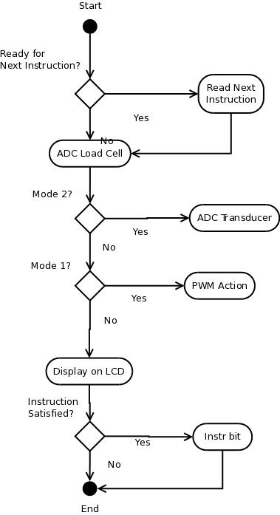
Main Loop Diagram

Slide 55
Graphic User Interface

Slide 56
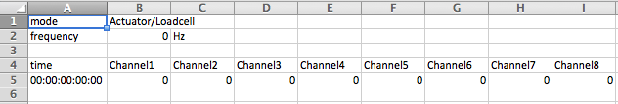
File Format
Input (TXT file)
mode
frequency
time0, force1,force2, force3, force4, force5, force6, force7, force8
time1, force1,force2, force3, force4, force5, force6, force7, force8
Output (CSV file)
mode,AL/LT
frequency,00,Hz
time,Channel1,Channel2,Channel3,Channel4,Channel5,Channel6,Channel7,Channel8
00:00:00:00:00,00.0,00.0,00.0,00.0,00.0,00.0,00.0,00.0

Slide 57
GUI
Provide an interface for the user to control the MTEC on the touch screen
Display data and progress while MTEC running
Programmed in C
Touch simulated using mouse-click functions in C

Slide 58
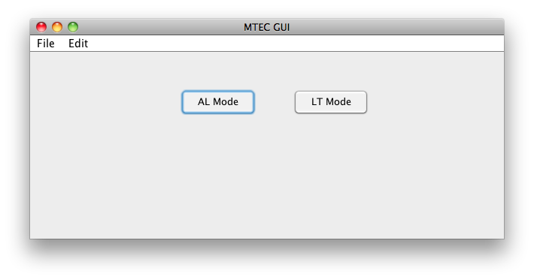
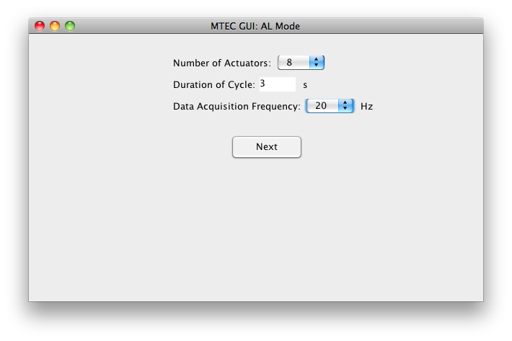
Instruction Input GUI

Slide 59
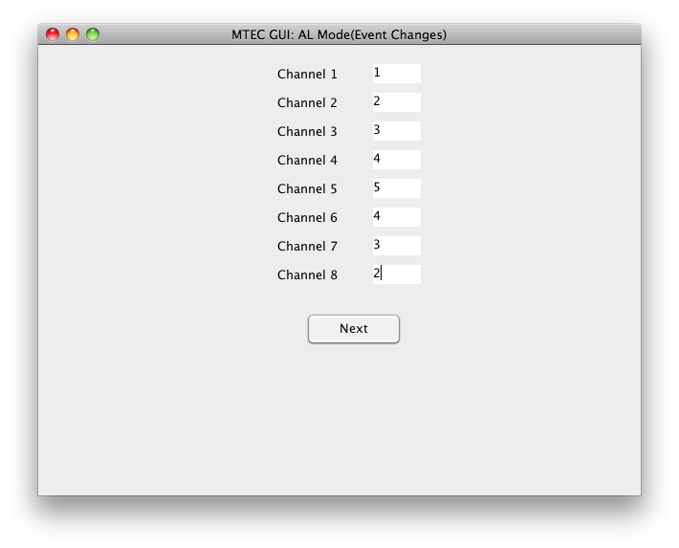
Instruction Input GUI II

Slide 60
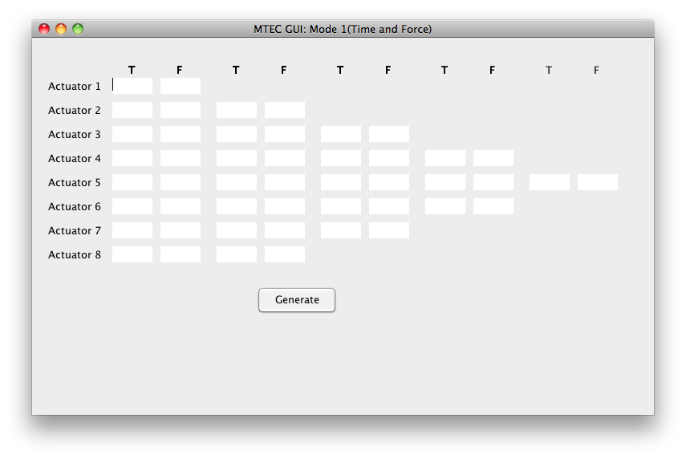
Instruction Input GUI III

Slide 61
Administrative

Slide 63
Budget
Component | Price | Qty | Projected | Actual | Acquired
MTEC Components
PIC18F Dev Kit | $165.00 | 1 | $103.00 | $165.00 | Y
PLCD | $87.00 | 1 | $61.56 | $87.00 | N
PCB | $185 | 1 | $100 | $185 | N
SD Card Socket | $9.95 | 1 | $9.95 | $9.95 | N
Breadboard | $9.95 | - | - | - | N
Pactec Enclosure | $28.20 | 1 | $28.20 | $28.20 | N
PIC18F87K22 Plug-in Module | $25.00 | 1 | - | $25.00 | Y
Sub Total |  |  | $226.13 | $500.15
Rig Components
Futek LCM 300 FSH02632 Load Cell | $450.00 | 2 | $575.00 | $900.00 | Y
Linear Actuator Firgelli L12-50-210-06-I | $80.00 | 1 | $80.00 | $80.00 | Y
Transducer LD621-15 | $455 | 2 | - | $910.00 | N
Sub Total |  |  | $1230.00 | $1890.00
Grand Total |  |  | $1456.13 | $2204.65

Slide 64
Few Insights
Sometimes it’s better to aim as far as you can reach.
Do what’s possible first and then step it up with a boost converter to do the impossible.
You’re more distinct if you perform well during stressful situations.

