Slide 1
Project Helios
Group 10
Michael Gannon
Michael Peffers
Muhammed Ali Khan
Ahmad Buleybel

Slide 2
Project Overview
Build a 12 Solar panel array outputting 3kW
To design a solar power monitoring system that will allow the client to conveniently check the optimization and output of there solar panel field.

Slide 3
Goals & Objectives
Build a 12 panel solar array
Monitor
Voltage
Temp
Current
Display data online in real time
Transmit data from field to web server wirelessly
System will sustain its own energy

Slide 4
Specifications
Voltage reading should be accurate to 10mV
Current reading should be accurate to 10mA
Temp reading should be accurate to .1 ºC
Wireless range should be 250 meters
Web data should be uploaded every 1 minute
Total power output of solar array should be 3kW

Slide 5
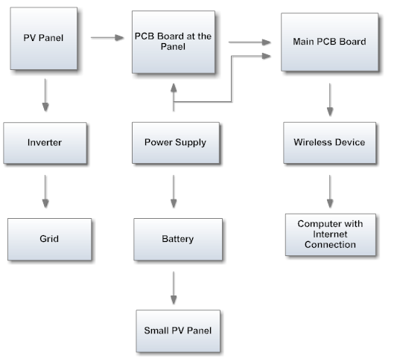
Block Diagram

Slide 6
Solar Panels and Components Selection
Ahmad Buleybel

Slide 7
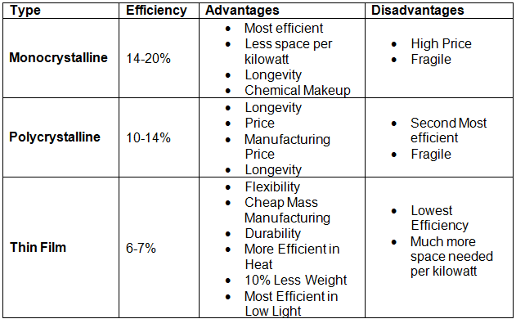
Solar Panel

Slide 8
Sharp Nu-U240f1
240W Monocrystalline panels
Panels will be connected in series
Mounted at a 28 degree angle
37.4V Open Circuit Voltage, 30.1V Maximum Power Voltage
8.65A Short Circuit Current, 7.98 Maximum Power Current
Panel Dimensions: 39.1” Wide, 64.6” Tall, 1.8” Thick
Weight: 44.1lbs/ 20.0 kg
Operating Temperature -40 to 194 degrees F

Slide 9
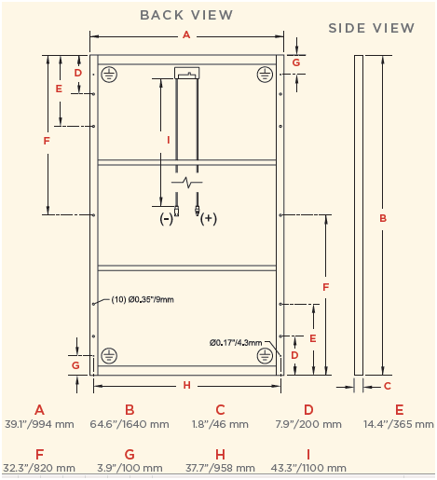
Panel Dimensions

Slide 10
12 Panels
The panels will be connected in series
3124 W
361.20 V
8.65 A

Slide 11
Inverter types
Off Grid Invertors
Grid Tie Invertors
Three phase

Slide 12
Choice of inverter
Fronius IG 4000 Inverter
Recommended PV power 3000-5000 W
Max. DC Input Voltage 500V, Operating DC Voltage 150-450V
Max. usable DC input current 26.1A
Inverter Dimensions: 16.5” Wide, 28.4” Long, 8.8” high
Weight: 42lbs/ 19kgs
Operating Temperature: -5 to 122 degrees F

Slide 13
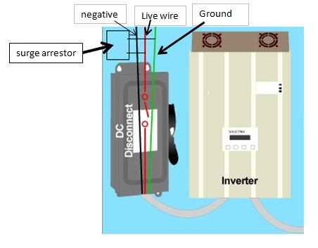
Array
Combiner Box
Surge Protector
Fuse and Fuse
Holder
MC4 Connectors

Slide 14
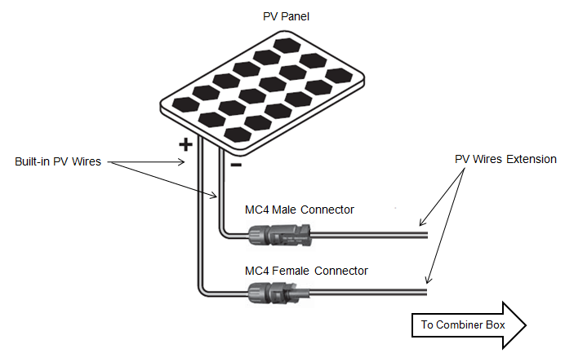
MC4

Slide 15
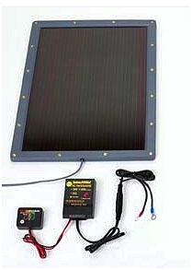
Power Supply
The charge controller is prevents battery discharge during darkness and low light conditions.

Slide 16
Power Supply
General Specifications
Input
16-24 volts DC solar power
Output
12 volts @ 333 mA
Charge Voltage
14.2 Vdc
Float Voltage
13.2 volts
Desulphation Pulse
3.33 mA @ 3.26 MHz
Float Current 5 mA – 150 mA² Size/Weight
3-3/4” L x 2-1/2” W x 1-1/2” H / 1 lb (without the panel)
Solar Panel Size/Weight
13-1/2” W x 19-1/2” H / 4.5 lbs

Slide 17
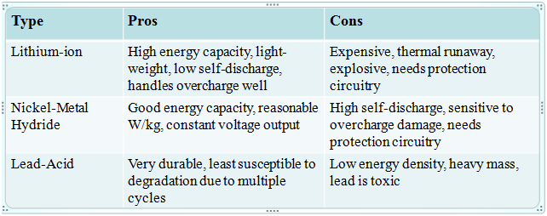
Batteries Options

Slide 18
Monitoring System Design
Michael Peffers & Michael Gannon

Slide 19
Working Block Diagram
Solar Panel
Secondary PCB
Voltage Sensor
Current Sensor
Temperature Sensor
4:1 Multiplexer
RJ45 Cable
Primary PCB
16:1 Multiplexer
PIC18F87J11

Slide 20
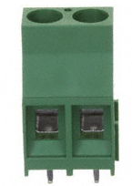
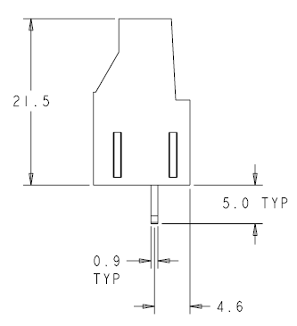
Secondary PCB
At the output of each solar panel the monitoring system will be connected in parallel using 2-Port terminal blocks.
This allows us to “Monitor” what is happening without effecting the output of the panels.
Figure 1:TERM BLOCK 2POSITION SIDE
Figure 2: Dimension (obtained from datasheet)

Slide 21
Voltage Sensor
100:1 Voltage Divider on each side of a panel lowers V_{IN}
Next, a Difference Amplifier will be used to take the difference of the two input voltages. V_{IN} will not be greater than ~.32V at this point.
The AD620 and LF351 Op-Amps are being investigated right now as the potential parts.
A gain of ten is desired on the Op-Amp to raise the output voltage to ~3.2V

Slide 22
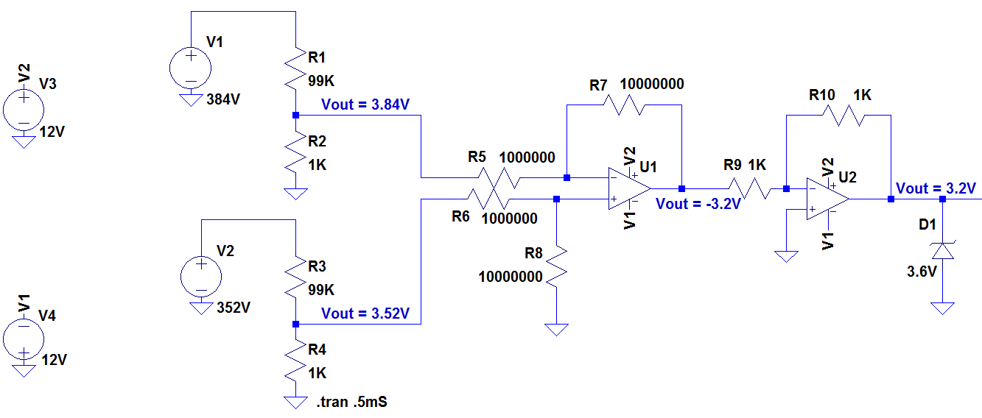
Physical Layout

Slide 23
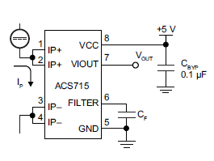
Current Sensor
The current sensor chosen is the surface mount IC part ACS715.
Designed for unidirectional input current from 0 to 30A.
Highly accurate and reliable: typical output error of 1.5%.
Operating Temperature between -40°C and 150°C
Figure 3: Pin Layout ACS715

Slide 24
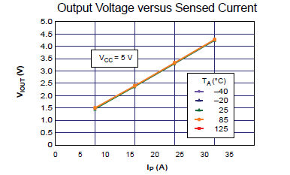
Current Sensor
The sensor requires 4.5-5 single input voltage and produces an analog output.
The ACS715 produces a linear analog voltage output that is proportional to 185mV/A with a 500mV offset voltage.
Figure 4: Output Graph

Slide 25
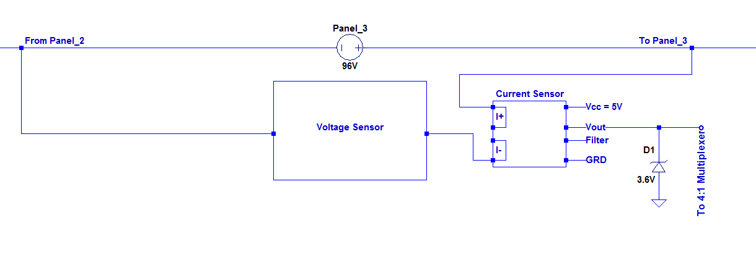
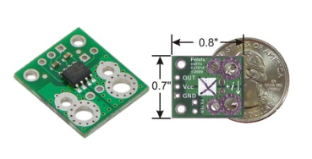
Physical Layout
Figure 5: ACS715 Breakout Board

Slide 26
Temperature Sensor
Temperature sensor chosen is the LM34 Precision Fahrenheit Sensor.
Typical Accuracy of ±1½°F
Temperature reading range from -50 to +300°F
The LM34 has a low output impedance and precise calibration which make it easy to work with.
Outputs a analog voltage that is linearly proportional the a Fahrenheit temperature
+10mV/°F

Slide 27
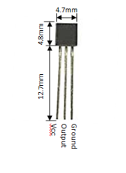
Temperature Sensor
Dimensions:
20 Gauge wire leads will be hand soldered to the leads of the sensor to provide the power and ground and to also retrieve the output.
These leads will be brought directly to the secondary printed circuit board from the sensor.
Figure 6: LM34 Dimensions

Slide 28
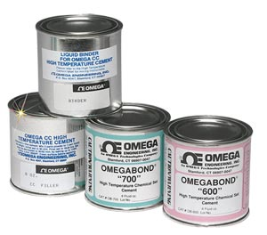
Temperature Sensor
The temperature sensor will be mounted directly to the back side of the solar panels via the thermal epoxy OMEGABOND 600.
“High Temperature Cement for Attaching and/or Insulating Thermocouples for Temperature Measurements”.
Figure 7: Omegabond 600
Accurate up to ±½°F

Slide 29
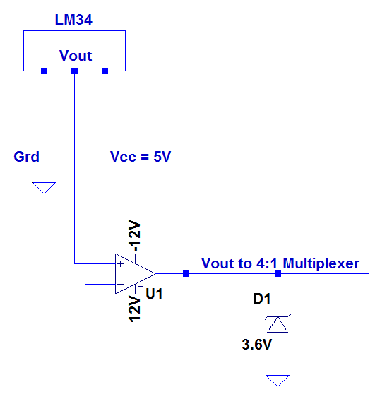
Physical Layout

Slide 30
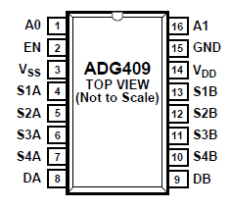
4:1 Multiplexer
The multiplexer that was chosen for this project was the ADG409 by Analog Devices.
This part is a analog multiplexer with four differential channels.
The ADG409 switches one of four differential inputs to a common differential output as determined by the 2-bit binary address lines A0 and A1.
An EN input on the device is used to enable or disable the device. When disabled, all channels are switched off.
Figure 8: ADG409 - 4:1 Multiplexer

Slide 31
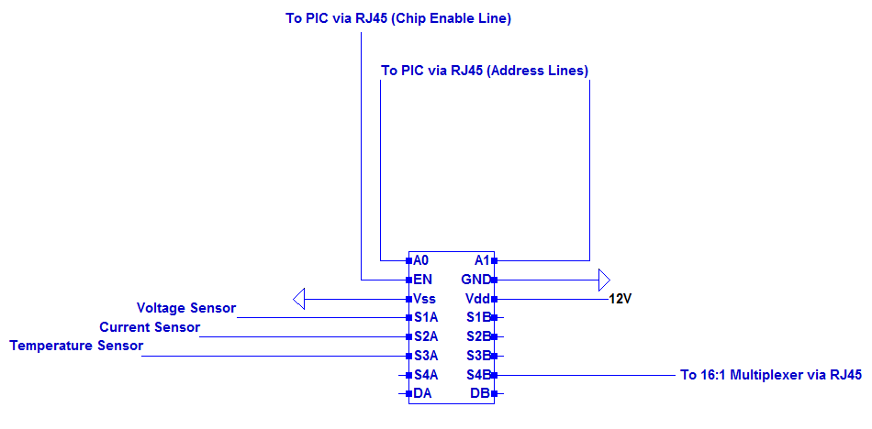
4:1 Multiplexer Physical Layout

Slide 32
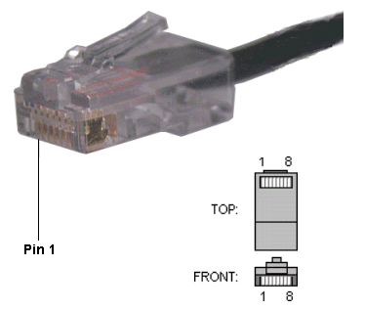
RJ45 – Cat5e Cable
We chose this form of connection because it easy to work with and the cable provides enough individual wires to handle multiple tasks in the same space and it cheap.
RJ45 Connection:
Figure 8: RJ45 Male Connector

Slide 33
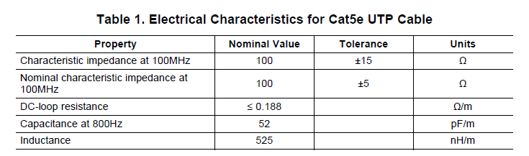
Electrical Characteristics for Cat5e
Attenuation has been a concern since choosing to use the Cat5e cable.
The typical impedance is measured as ≤0.188 Ω/m

Slide 34
Primary PCB
The data will be brought form the 12 individual monitoring systems via Cat5e to primary PCB.

Slide 35
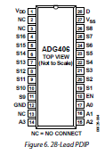
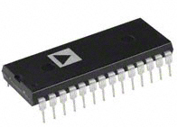
16:1 Multiplexer
The 16:1 multiplexer chosen for this project was the ADG406BNZ
This part is a analog multiplexer with 16 differential channels
Single supply operation
Wide range of supply voltage of +5V - +12V

Slide 36
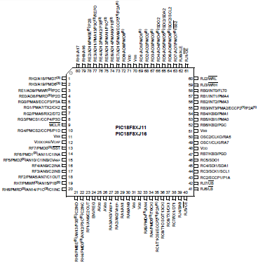
PIC18F87J11
80 Pin Device with 68 I/O pins
Programmable in C
15 10-bit Input A/D channels
128 Kbit RAM

Slide 37
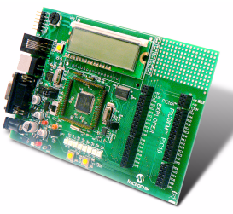
Explorer Board
Low cost demo board used for evaluating our PIC18F87J11 processor
Uses the PICkit 3 programmer debugger
Program to go
Multiple serial interface (USB, RJ11, RS232)
Emulator is MPlab

Slide 38
Problems
Water proof both of the PCB boards
Resistors for high wattage
Coding
Eagle

Slide 39
Wireless Communication
Muhammed Khan

Slide 40
Wireless Communication Options
We looked into three different wireless communication options:
Bluetooth: High data rate, Great delivery percentage, Hard to learn, Short range
WiFi: Great delivery percentage, Expensive, Short range
XBee: Easy to learn, Cheap, Good Range

Slide 41
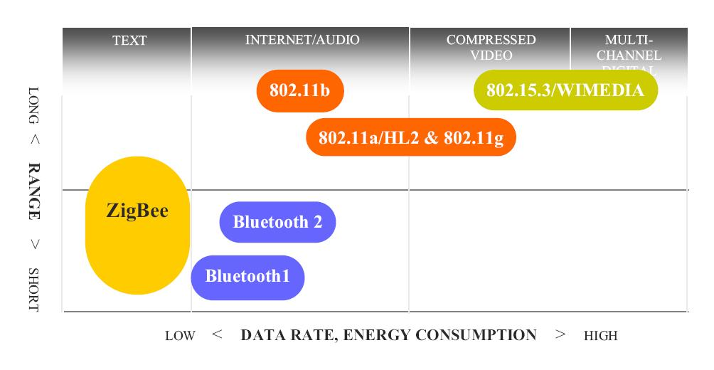
Technology Comparison

Slide 42
ZigBee
We decided to use ZigBee for our project for a number of reasons
Low power requirement
Compact size
Good range
Perfect for small data transfer
Relatively low complexity
Compatible with Microsoft Windows
Low cost

Slide 43
Personal Area Network 802.15.
Specializes in Wireless PAN (Personal Area Network) standards
802.15.1 – (Bluetooth)
802.15.2 – Deals with coexistence of Wireless LAN (802.11) and Wireless PAN
802.15.3 – High-rate WPAN standards (Wireless USB)
802.15.4 – (ZigBee) low-data rate, low-power networks

Slide 44
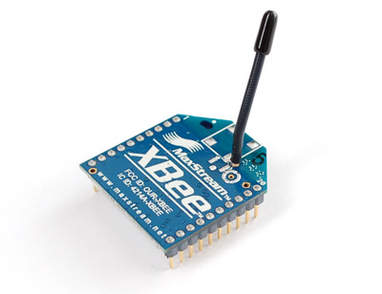
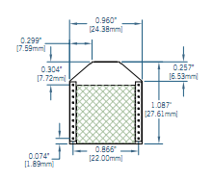
ZigBee ------> XBee Module
MaxStream OEM RF Module (802.15.4)

Slide 45
XBee Specifications
The XBee module costs $19.00 per unit.
It runs at 2.4 GHz.
Input voltage(operating voltage) is 3.3V.
The current:
when it is receiving data is 50mA,
while it is transmitting the current is 45mA
while it is in power-down mode it runs below 10µA.
Its sensitivity is at -92dBm.
The chips operating temperature has a range between -40* and +85*C

Slide 46
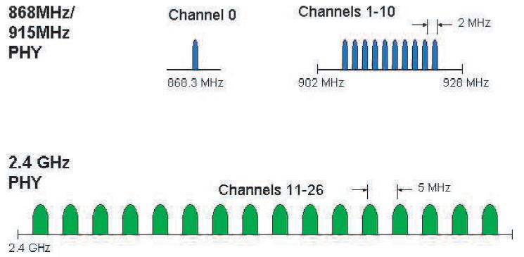
Channel Spacing
In the 2.4GHz band, each channel is about 3MHz wide

Slide 47
PIC and XBee
PIC 18 series have UART interface
The XBee module can be directly connected to the microcontroller.
For successful serial communication, the UART’s must be configured with the same baud rate, parity, start bits, stop bits, and data bits. On the microcontroller, pin 25 is for transmission and pin 26 is for receiving and are connected to pin 3 and pin 2 on the Xbee chip respectively.

Slide 48
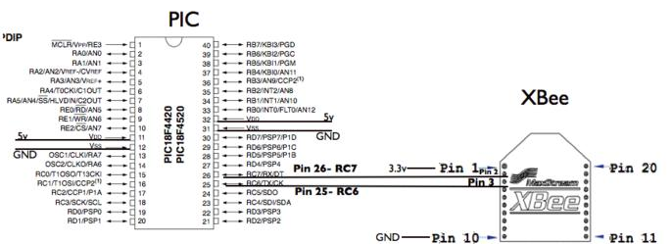
PIC and XBee connection
(Transmitter)

Slide 49
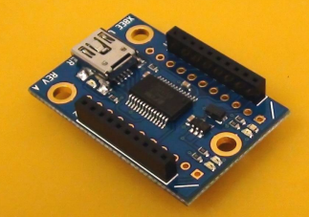
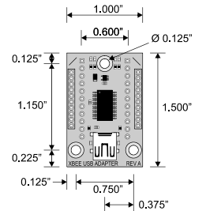
Problem
PIC Operates at 5V
XBee requires 3.3 V
Solution

Slide 50
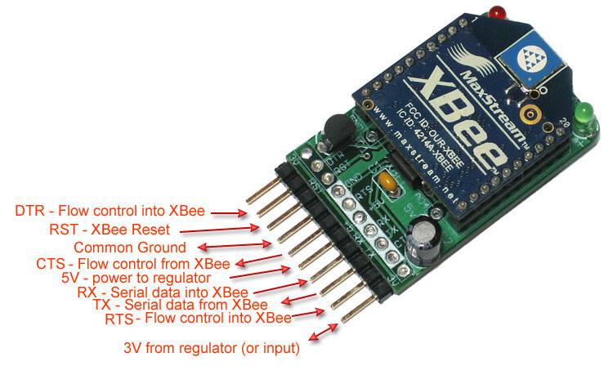
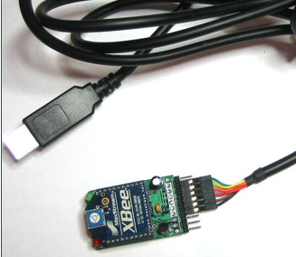
Receiver
FTDI Cable
Serial to USB interface

Slide 51
Configure
Update the modules using X-CTU
X-CTU can be downloaded for free
Configure the transmitter
Allows to read data in a certain way from PIC
Using the AT command mode is the how the XBee chip will be programmed.
AT commands deal with all things from setting the sleep mode to resetting the chip.
Assign a PAN ID for transmitter and receiver

Slide 52
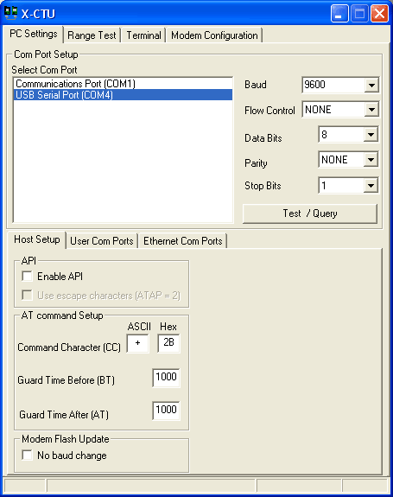
X-CTU

Slide 53
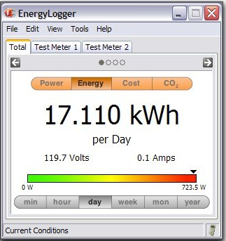
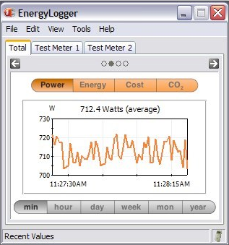
Data Display
Data collected from XBee can be translated
through “Python”
OR
We can use “Energy Logger”

Slide 54
Unresolved
Interface with PIC ( use “Stack” through “Zena”)
AT commands
Acquire the data from XBee to display on the base computer and to a website (Python Programming)
XBee range issue (Expand)

Slide 55
Budget
Parts List
Part | Cost
12 - Solar Panels | $7,344.00
1 - Inverter | $1,700.00
12 - Current Sensor | $56.76
12 - Temperature Sensor | $30.12
RJ45 Cable | $1.15/ft or $1.00/10ft
Microcontroller | $3.26
Wireless | $250.00
Solar power Charge Controller | $90.00
Battery | $10-30
Miscellaneous Parts | $200
PCB Boards | $500-800
Overall | $10,504.14

Slide 56
Progress

