Slide 1
Project Helios
Group 10
Michael Gannon
Michael Peffers
Muhammed Ali Khan
Ahmad Buleybel

Slide 2
Sponsored By
Dave Norvell of Energy and sustainability
Also Working with
Mechanical Engineers: Industrial Engineers:
Daniel Gould Amanda Longman
Connie Griesemer Joshua MacNaughton Ryan Lewis Andrew Wolodkiewicz
Jonathan Torres
Ryan Tribbey

Slide 3
Project Overview
Design a panel by panel monitoring system
  Monitoring system must be self sustaining
  Wirelessly transmit data
  Data will be collected every 5 minutes for duration of the day
Publish real time information online
  Data must be graphed for easy interpretation
  Publically accessible
UCF going 15% carbon free by 2020

Slide 4
Goals & Objectives
Monitor each panel for:
  Voltage
  Temp
  Current
Display data online in real time
Transmit data from field to web server wirelessly
System will sustain its own energy

Slide 5
Specifications
Voltage reading accuracy within 100mV
Current reading accuracy within 100mA
Temp reading accuracy within .1 ºC
Wireless range of at least 250 meters
Web data will be uploaded every 5 minutes
Total current consumed below 1.5A

Slide 6
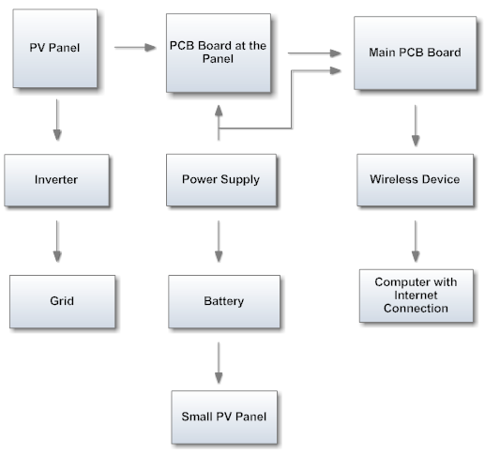
Block Diagram

Slide 7
Solar Panels and Components Selection
Ahmad Buleybel

Slide 8
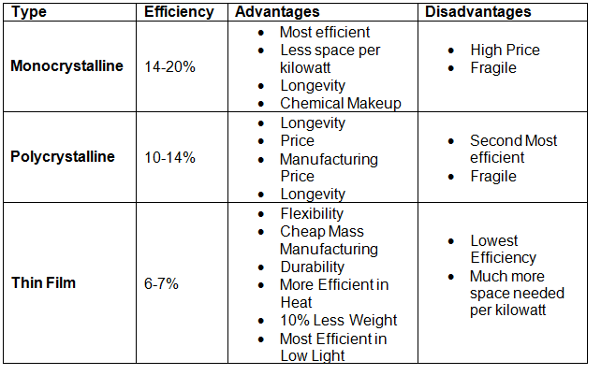
Solar Panel

Slide 9
Sharp Nu-U240f1
240W Monocrystalline panels
Panels will be connected in series
Mounted at a 28 degree angle
37V Open Circuit Voltage, 30V Maximum Power Voltage
8.5A Short Circuit Current, 8 Maximum Power Current
Panel Dimensions: 39.1” Wide, 64.6” Tall, 1.8” Thick
Weight: 44lbs/ 20.0 kg
Operating Temperature -40 to 194 degrees F

Slide 10
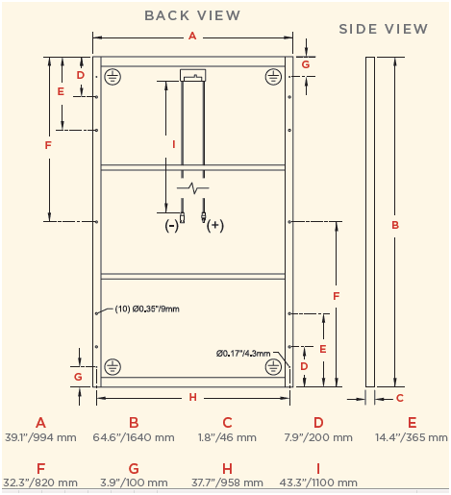
Panel Dimensions

Slide 11
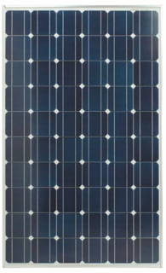
12 Panels
The panels will be connected in series
3124 W
361 V
8.5 A

Slide 12
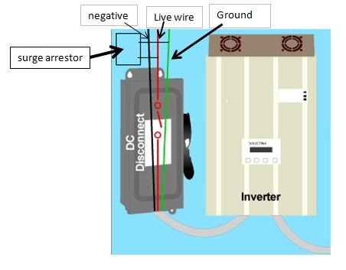
Array
Combiner Box
Surge Protector
Fuse and Fuse
Holder
MC4 Connectors

Slide 13
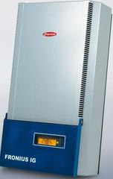
Inverter types
16.5”
Off Grid Inverters
Grid Tie Inverters
  Three phase
28.4”
8.8”

Slide 14
Choice of inverter
Fronius IG 4000 Inverter
Recommended PV power 3000-5000 W
Max. DC Input Voltage 500V, Operating DC Voltage 150-450V
Max. usable DC input current 26.1A
Weight: 42lbs/ 19kgs
Operating Temperature: -5 to 122 degrees F

Slide 15
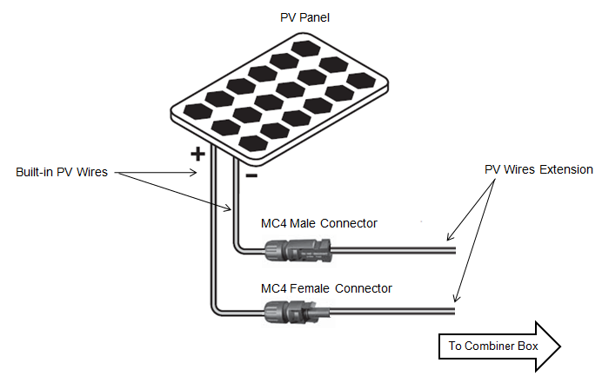
MC4

Slide 16
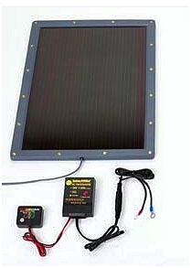
Power Supply
The charge controller is prevents battery discharge during darkness and low light conditions.

Slide 17
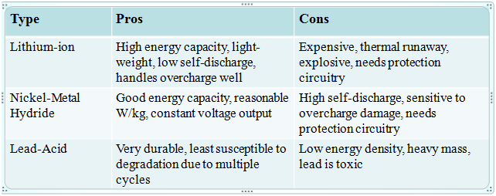
Batteries Options
The Batteries that were chosen were Power Sonic 12V/21 AH batteries

Slide 18
Monitoring System Design
Michael Peffers & Michael Gannon

Slide 19
Working Block Diagram
Solar Panel
Secondary PCB
Voltage Sensor
Current Sensor
Temperature Sensor
4:1 Multiplexer
RJ45 Cable
Primary PCB
16:1 Multiplexer
PIC18F87J11

Slide 20
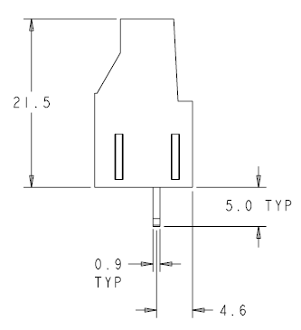
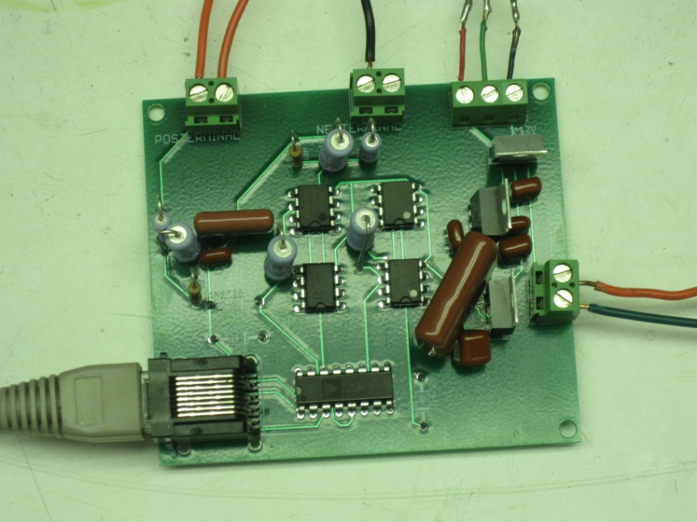
Secondary PCB
Will connected in parallel with Solar panel System
Board will consist of three separate sensors
Voltage, Current, and Temperature
All sensors are hardware designed to an accuracy at least ± 1.5%
Figure 2: Dimension (obtained from datasheet)

Slide 21

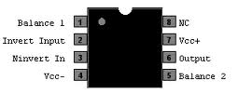
Voltage Sensor
100:1 Voltage Divider used to lower V_{IN}
An Instrumentation Amplifier was used in a difference mode to measure voltage
  Op Amp Used: AD620
Output of 620 will go through an Inverting op amp with a gain of 10
  Op Amp Used: LF351

Slide 22
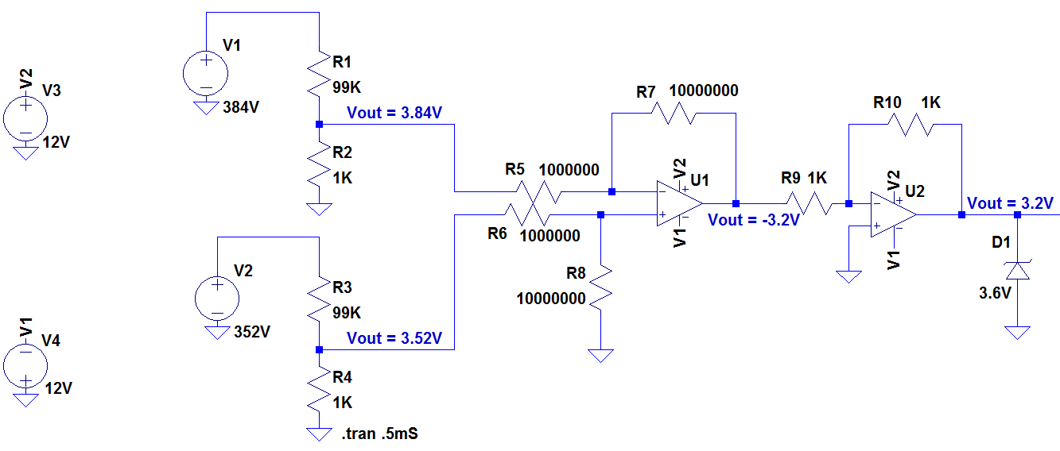
Physical Layout

Slide 23
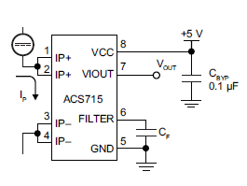
Current Sensor
The current sensor chosen was the ACS715.
Designed for unidirectional input current from 0 to 30A.
Highly accurate and reliable
Operating Temperature: -40°C and 150°C
Figure 3: Pin Layout ACS715

Slide 24
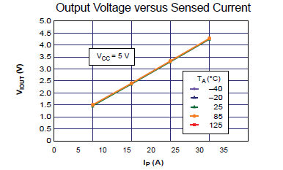
Current Sensor
The sensor requires 4.5-5 single input voltage and produces an analog output.
The ACS715 produces a linear analog voltage output that is proportional to 133mV/A with a 500mV offset voltage.
Figure 4: Output Graph

Slide 25
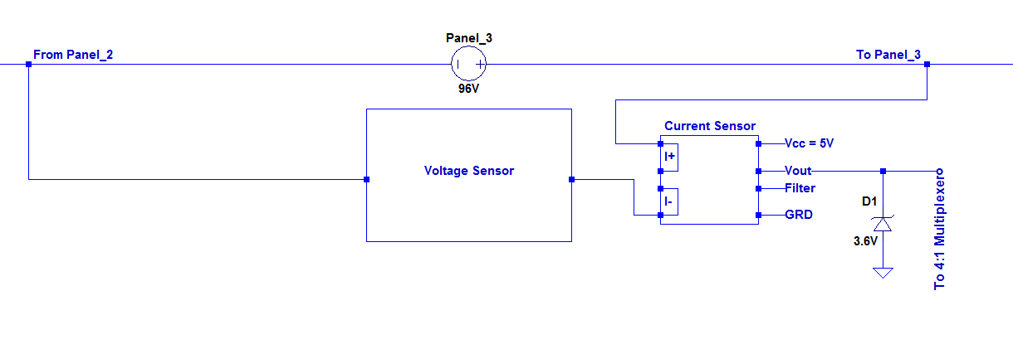
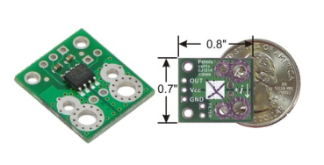
Physical Layout
Figure 5: ACS715 Breakout Board

Slide 26
Temperature Sensor
Temperature sensor chosen: LM34 Precision Fahrenheit Sensor.
Typical Accuracy of ±1½°F
Temperature reading range from -50 to +300°F
The LM34 has a low output impedance and precise calibration which make it easy to work with.
It outputs an analog voltage that is linearly proportional to the a Fahrenheit temperature
+10mV/°F

Slide 27
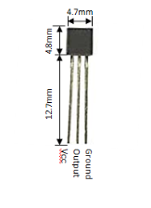
Temperature Sensor
Dimensions:
20 Gauge wire leads will be hand soldered to the leads of the sensor to provide the power and ground and to also retrieve the output.
These leads will be brought directly to the secondary printed circuit board from the sensor.
Figure 6: LM34 Dimensions

Slide 28
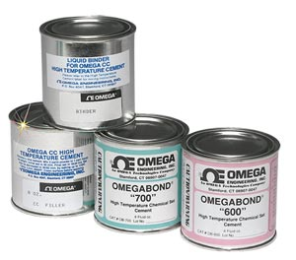
Temperature Sensor
The temperature sensor will be mounted directly to the back side of the solar panels via the thermal epoxy OMEGABOND 600.
“High Temperature Cement for Attaching and/or Insulating Thermocouples for Temperature Measurements”.
Figure 7: Omegabond 600
Accurate up to ±½°F

Slide 29
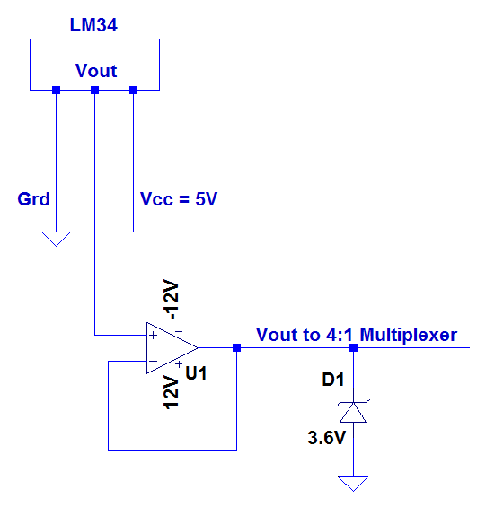
Physical Layout

Slide 30
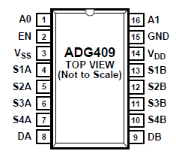
4:1 Multiplexer
The multiplexer that was chosen for this project was the ADG409 by Analog Devices.
This part is a analog multiplexer with four differential channels.
The ADG409 switches one of four differential inputs to a common differential output as determined by the 2-bit binary address lines A0 and A1.
An EN input on the device is used to enable or disable the device. When disabled, all channels are switched off.
Figure 8: ADG409 - 4:1 Multiplexer

Slide 31
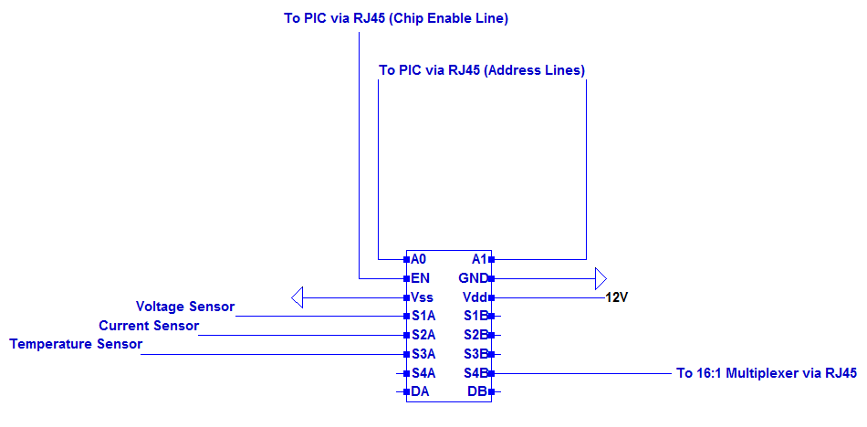
4:1 Multiplexer Physical Layout

Slide 32
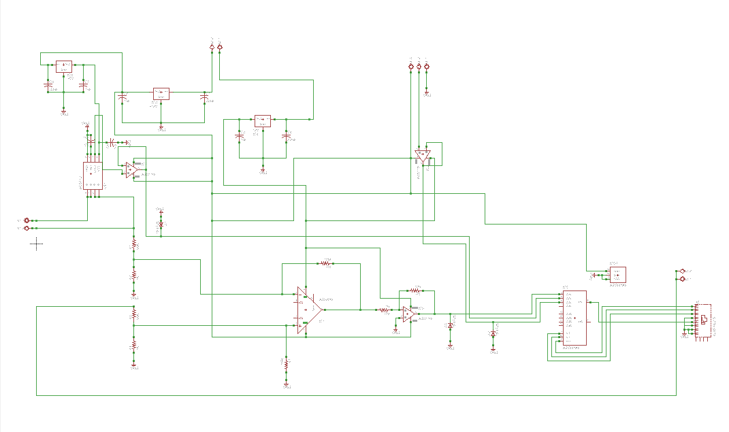
Secondary PCB Physical Circuit Layout
Current Sensor
Temperature Sensor
Differential Amplifier Circuit to Measure Voltage Between Panels

Slide 33
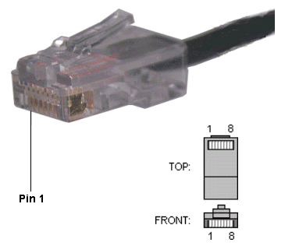
RJ45 – Cat5e Cable
We chose to use twisted pair RJ45 Cat5e cable because of it’s ability to cancel noise on the lines and it’s ease of implementation.
RJ45 Connection:
  Pin 1 – V_{CC} Data
  Pin 2 – Ground
  Pins 3-5 Address
  Select Lines for Mux
Figure 8: RJ45 Male Connector

Slide 34
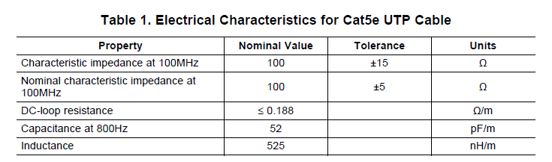
Electrical Characteristics for Cat5e
Attenuation has been a concern since choosing to use the Cat5e cable.
The typical impedance is measured as ≤0.188 Ω/m

Slide 35
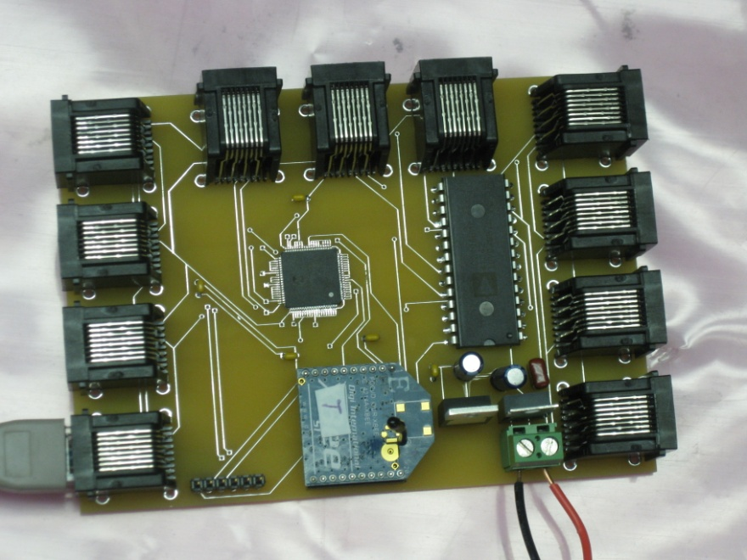
Primary PCB
Data Collection PCB
Will be connected to 11 secondary PCB boards through CAT5e cable
Wirelessly transmit data

Slide 36
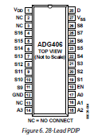
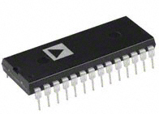
16:1 Multiplexer
The 16:1 multiplexer chosen: ADG406BNZ
Single supply operation
Wide range of supply voltage of +5V - +12V
Allows us to only you 1 A/D pin on PIC18F

Slide 37
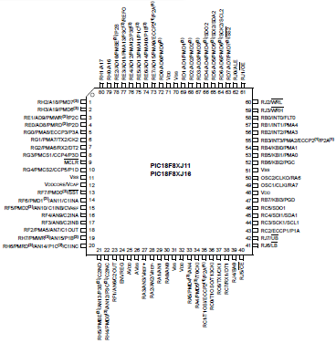
PIC18F87J11
80 Pin Device with 68 I/O pins
Programmable in C
15 10-bit Input A/D channels
128 Kbit RAM
Sleep mode uses nano watts
Very fast wake up time

Slide 38
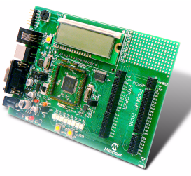
Explorer Board
Low cost demo board used for evaluating our PIC18F87J11 processor
Uses the PICkit 3 programmer debugger
Program to go
Multiple serial interface (USB, RJ11, RS232)
Emulator is MPlab

Slide 39
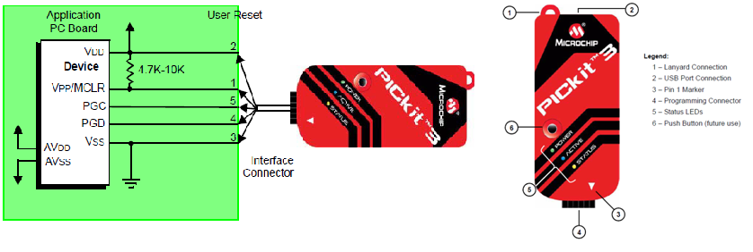
PICKIT 3

Slide 40
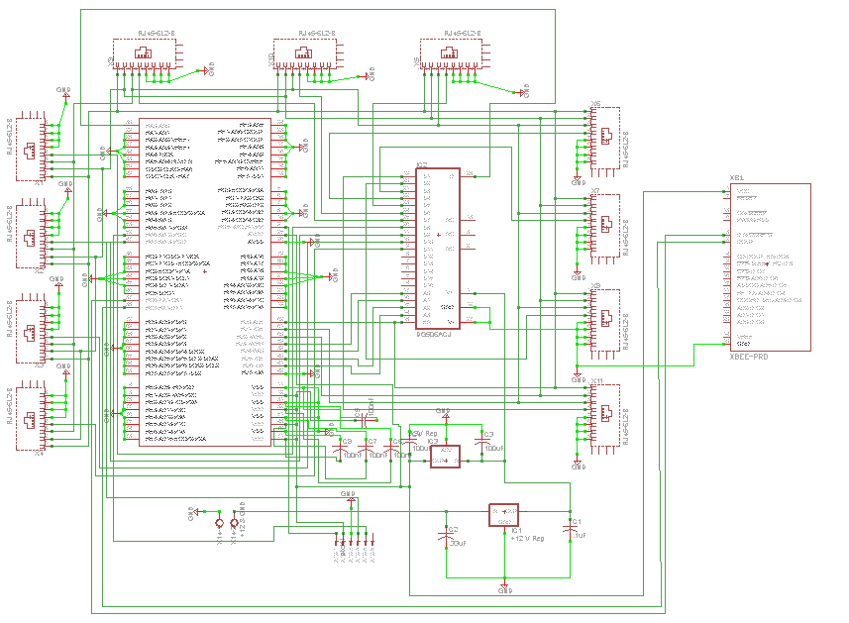
Primary PCB Physical Circuit Layout
16:1 Multiplexer
X-Bee
Pic18F87J11

Slide 41
Wireless Communication
Muhammed Khan

Slide 42
Wireless Communication Options
We looked into three different wireless communication options:
Bluetooth: High data rate, Great delivery percentage, Hard to learn, Short range
WiFi: Great delivery percentage, Expensive, Short range
XBee: Easy to learn, Cheap, Good Range

Slide 43
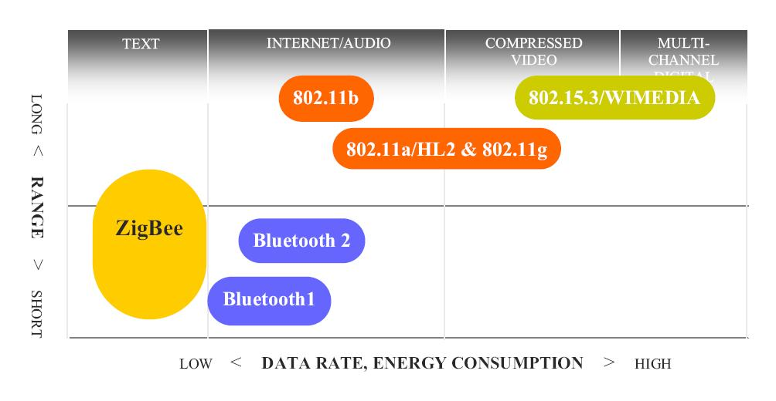
Technology Comparison

Slide 44
ZigBee
We decided to use ZigBee for our project for a number of reasons
Low power requirement
Compact size
Good range
Perfect for small data transfer
Relatively low complexity
Compatible with Microsoft Windows
Low cost

Slide 45
Personal Area Network 802.15.
Specializes in Wireless PAN (Personal Area Network) standards
802.15.1 – (Bluetooth)
802.15.2 – Deals with coexistence of Wireless LAN (802.11) and Wireless PAN
802.15.3 – High-rate WPAN standards (Wireless USB)
802.15.4 – (ZigBee) low-data rate, low-power networks

Slide 46
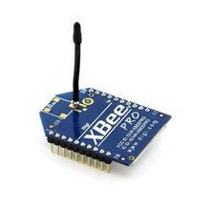
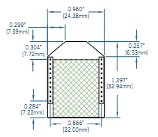
ZigBee ------> XBee Module
MaxStream OEM RF Module (802.15.4)

Slide 47
XBee Specifications
The XBee module costs $39.00 per unit.
It runs at 2.4 GHz.
Input voltage(operating voltage) is 3.3V.
The current:
    when it is receiving data is 50mA,
    while it is transmitting the current is 45mA
    while it is in power-down mode it runs below 10µA.
Its sensitivity is at -92dBm.
The chips operating temperature has a range between -40* and +85*C

Slide 48
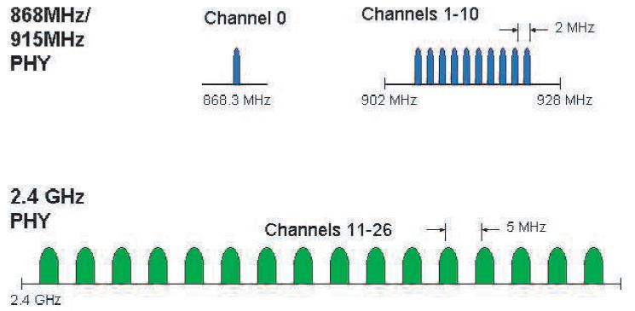
Channel Spacing
In the 2.4GHz band, each channel is about 3MHz wide

Slide 49
PIC and XBee
PIC 18 series have UART interface
The XBee module can be directly connected to the microcontroller.
For successful serial communication, the UART’s must be configured with the same baud rate, parity, start bits, stop bits, and data bits. On the microcontroller, pin 26 is for transmission and pin 27 is for receiving and are connected to pin 3 and pin 2 on the Xbee chip respectively.

Slide 50
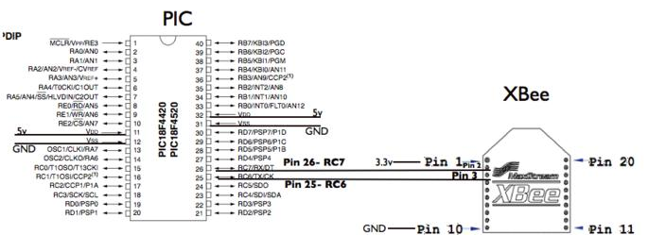
PIC and XBee connection
(Transmitter)

Slide 51
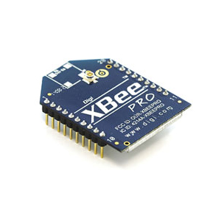
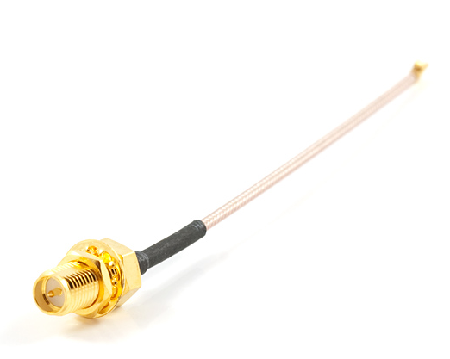
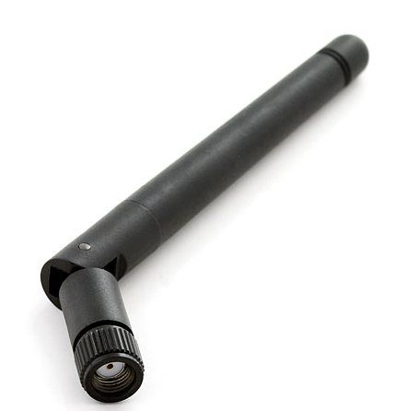
Xbee Transmitter
Transmitter connected to PIC18 microcontroller.
UFL RF to RP-SMA antennas
2.4GHz Duck Antenna 2.2dBi with Reverse Polarized - SMA RF connector

Slide 52
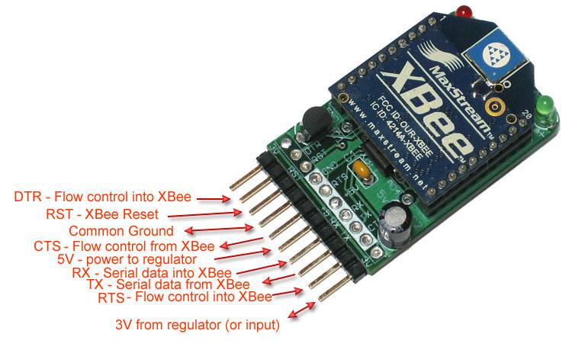
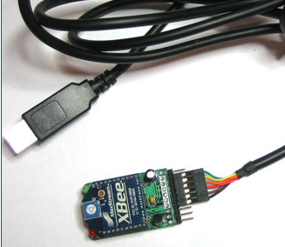
Receiver
FTDI Cable
Serial to USB interface

Slide 53
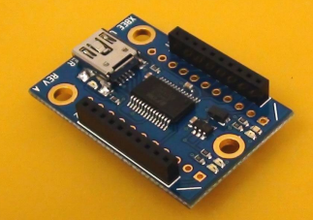
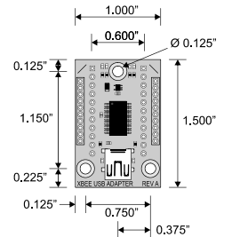
Problem
PIC Operates at 5V
XBee requires 3.3 V
Solution

Slide 54
Configure
Update the modules using X-CTU
X-CTU can be downloaded for free
Configure the transmitter
Allows to read data in a certain way from PIC
Using the AT command mode is the how the XBee chip will be programmed.
AT commands deal with all things from setting the sleep mode to resetting the chip.
Assign a PAN ID for transmitter and receiver

Slide 55
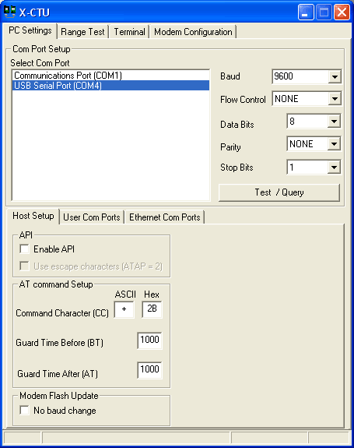
X-CTU

Slide 56
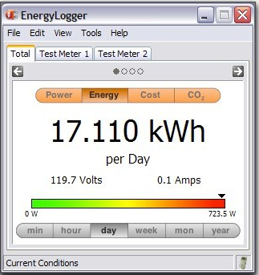
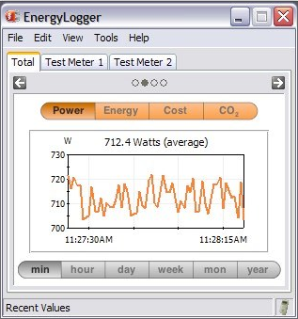
Data Display
Data collected from XBee can be translated
through “Python”
OR
We can use “Energy Logger”

Slide 57
Budget
Parts List
Part | Cost
12 - Solar Panels | $7,344.00
1 - Inverter | $1,700.00
12 - Current Sensor | $56.76
12 - Temperature Sensor | $30.12
RJ45 Cable | $1.15/ft or $1.00/10ft
Microcontroller | $3.26
Wireless | $60.00
Solar power Charge Controller | $150
2 - 12V 21AH Batteries | $85
Miscellaneous Parts | $400
PCB Boards | $660
Overall | $10,489.14

