Slide 1
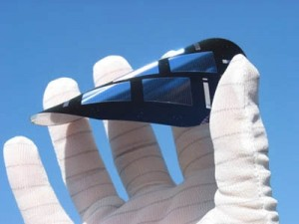


Low Concentration Thin Films with Solar Tracking
3rd Annual Senior Design Symposium - Renewable & Sustainable Energy
Friday, April 8, 2011
Amanda Klein, Jesse Trawick, Sean Murphy, Motiur Bhuiyan
Advisor: Dr. Samuel Richie
Notes:
Hi, good morning, pleased to have you. “title” Introduce team members. Let them know when you are available after grad. Add picture to the first slide

Slide 2



What is low concentration thin film with solar tracking?

Slide 3
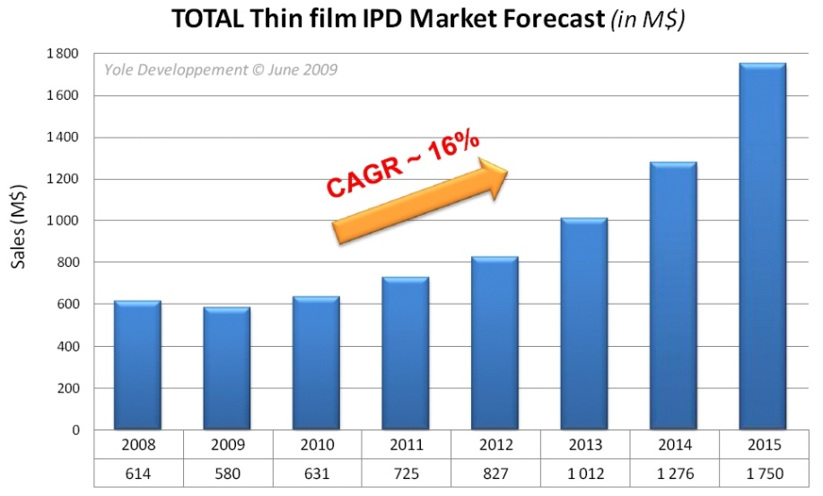
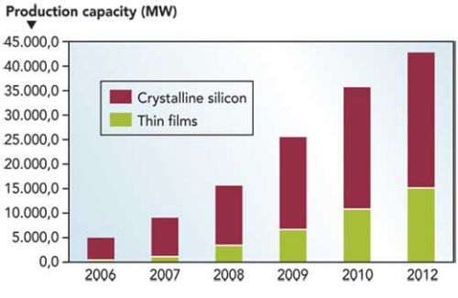
Outcomes & Benefits
To provide an alternative to roof mounted panels for people in apartments, leased homes or want clean, portable power.
Eliminating installation mounting and labor expenses.
To increase the efficiency of thin film solar panels using solar tracking and optical manipulation.
Consumer power monitoring interface.
Notes:
Talk about market. Images. Talk about installation costs. Put in the video of it moving. T

Slide 4
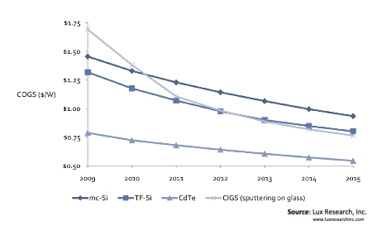
Crystalline Silicon PV vs. Thin Film PV
(PV – Photovoltaics)
Crystalline Silicon
Thick and bulky, rigid design.
Competing for materials with electronics market.
Lowest recorded production cost ~ $1.00/watt
Thin Films
Light, flexible material.
Maintains higher performance in cloudy conditions.
Lowest recorded production cost ~ $0.76/watt
Notes:
Show difference between silicon and thin films. Minimizing cost explanation/cost comparison. Find cost/efficiency graphs.

Slide 5
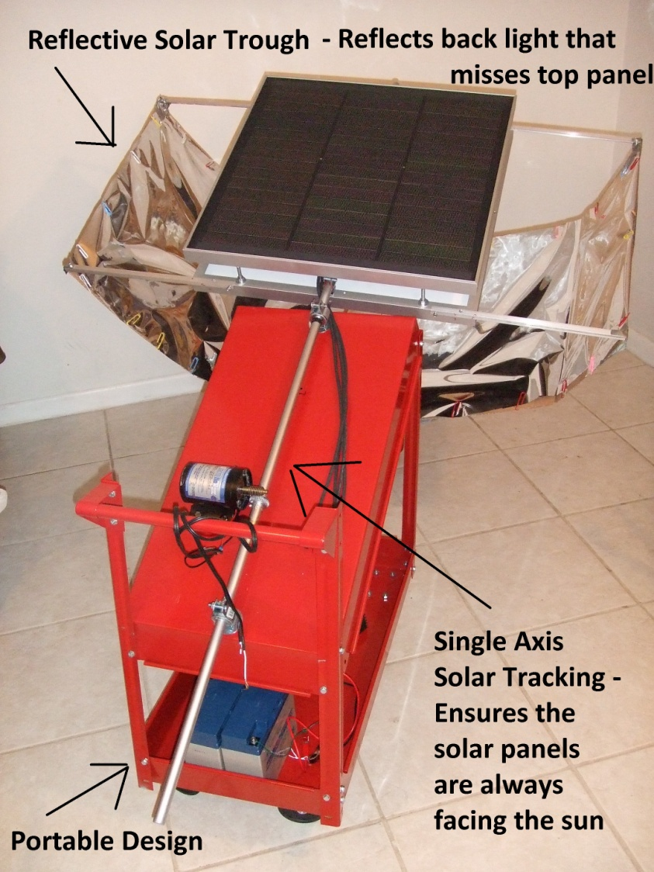
Design Features
Portable, fully functional design -No installation.
Single Axis Tracking – Panels follow sun across the sky.
Reflective Trough – Catches and reflects back light that misses panels.
Notes:
Label a picture of device before this slide.

Slide 6
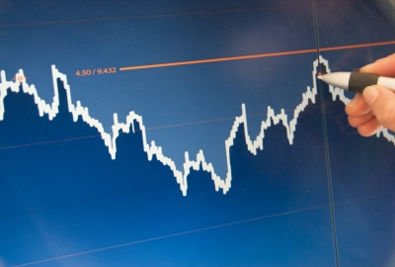
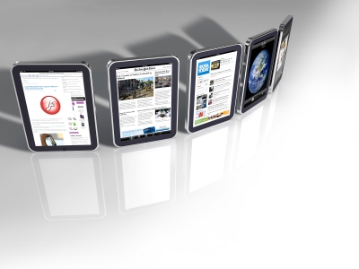
Consumer Power Monitoring
Real time power graphs will be accessible via the internet from any anyplace and any time of day.
The consumer can monitor how much he saves by using the product.
By giving the consumers this digital connection to their solar power system, interest in renewable energy increases.
They can share this information with friends, widening the market through word of mouth.
Notes:
Make one graph. Make sentences shorter and talk about it.

Slide 7
Future of Residential Solar
It appears thin films can become a less expensive to mass produce alternative to crystalline silicon panels.
Self-contained, portable modules can target an untapped market of apartment or leased home owners.
Solar tracking can reduce the space taken up by panels in a residential home, while still keeping efficiency high.
Interactive power data allows the consumer to connect with renewable energy, increasing its popularity.
Notes:
“Future of” Shorter sentences.

Slide 8
Special Thanks To!
Sponsors:
Advising:
Dr. Samuel M. Richie – EECS Associate Professor & Undergraduate Program Coordinator of EE and CpE
Dr. Arthur Weeks – Associate Professor, EECS
Dr. James E. Harvey – Associate Professor, Optics and ECE
Additional Thanks to:
Abner, Swiss Components – Metalworking
Sean Pagliari, FIT MSOE – Materials design

