Slide 1

OIL WELL MONITORING SYSTEM
Presented By:-
Louis Bengtson
Kaleb Stunkard
Jimit Shah

Slide 2
MOTIVATION
More than 27,000 oil wells permanently abandoned in the Gulf of Mexico.
Currently, there is no monitoring system available.
Four teams:
Buoy Team (Mechanical Engineering)
Bi-directional Turbine Team (Mechanical Engineering)
Sensor Team (Mechanical Engineering)
Electrical Team (Electrical Engineering)

Slide 3
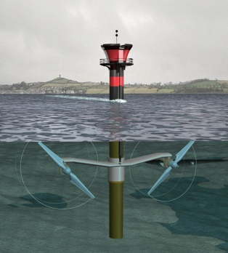
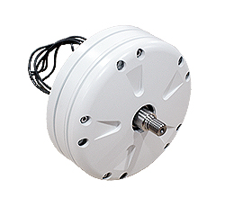
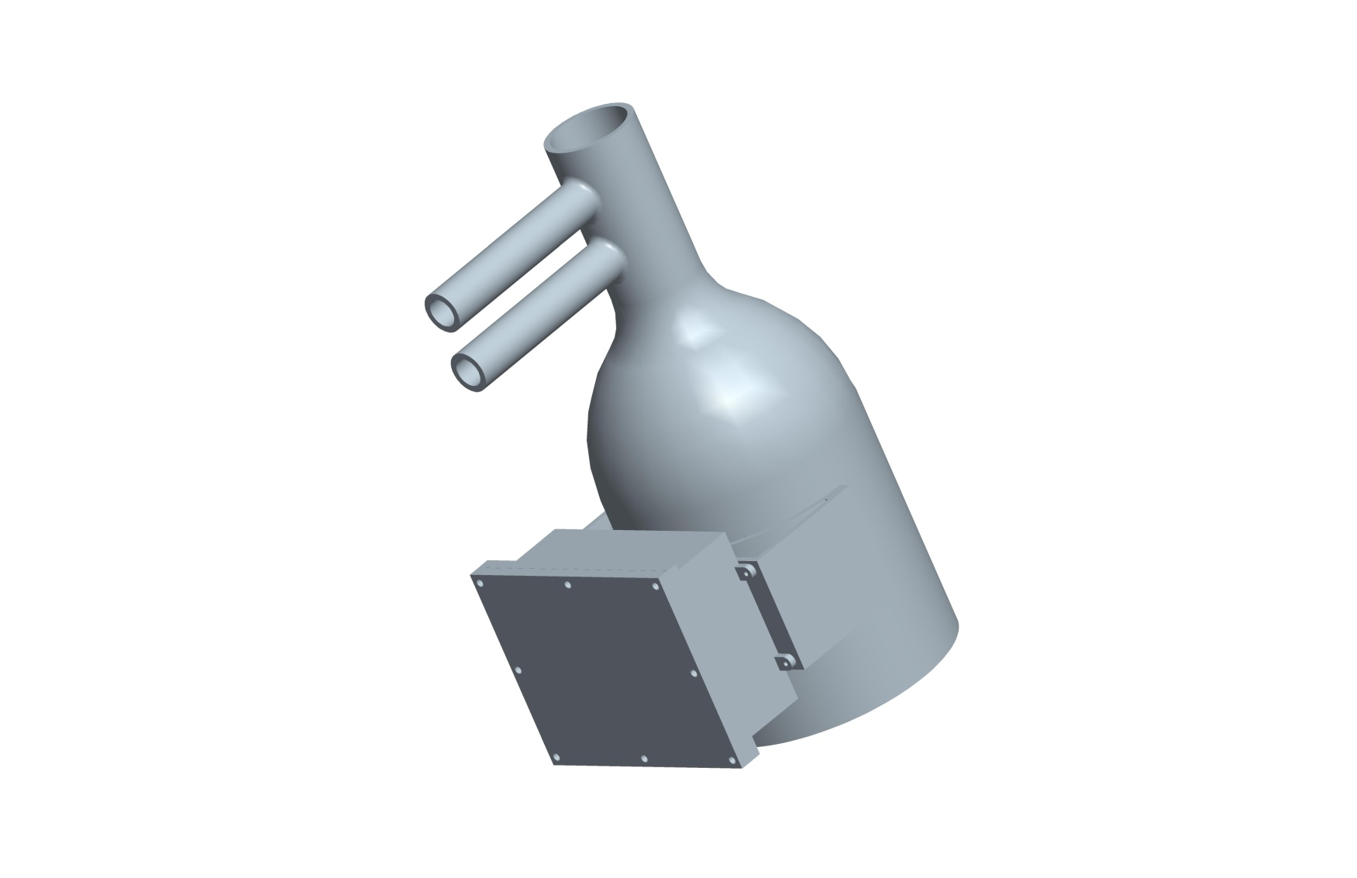
Turbine
Ginlong Generator
System Block Diagram
INPUT CIRCUIT
BOOST CONVERTER
(AC-DC Rectifier)
CONTROL
PROCESSOR
BUCK CONVERTER
Sensor
BATTERY CHARGING CIRCUIT
Electrical System

Slide 4
GOALS & OBJECTIVES
Efficiently convert varying AC voltage to steady DC voltage.
Be able to charge a battery that will supply the necessary output voltage to the sensors.
Must be self powered.
Must perform PFC on the AC signal.
Must be able to work in high and low pressure environment.
Must be suitable for dry and wet conditions.

Slide 5
SPECIFICATIONS
Input RPM range: 90 to 125 RPM
Input Voltage range: 20VAC to 30VAC
Output Current: 3A
Output Voltage: 12VDC
Cost: Less than $2,000
Efficiency: 85%
Operating Environments
Temperature: 25 to 110°F
Humidity: 100%

Slide 6
Input Circuit
- Kaleb Stunkard

Slide 7
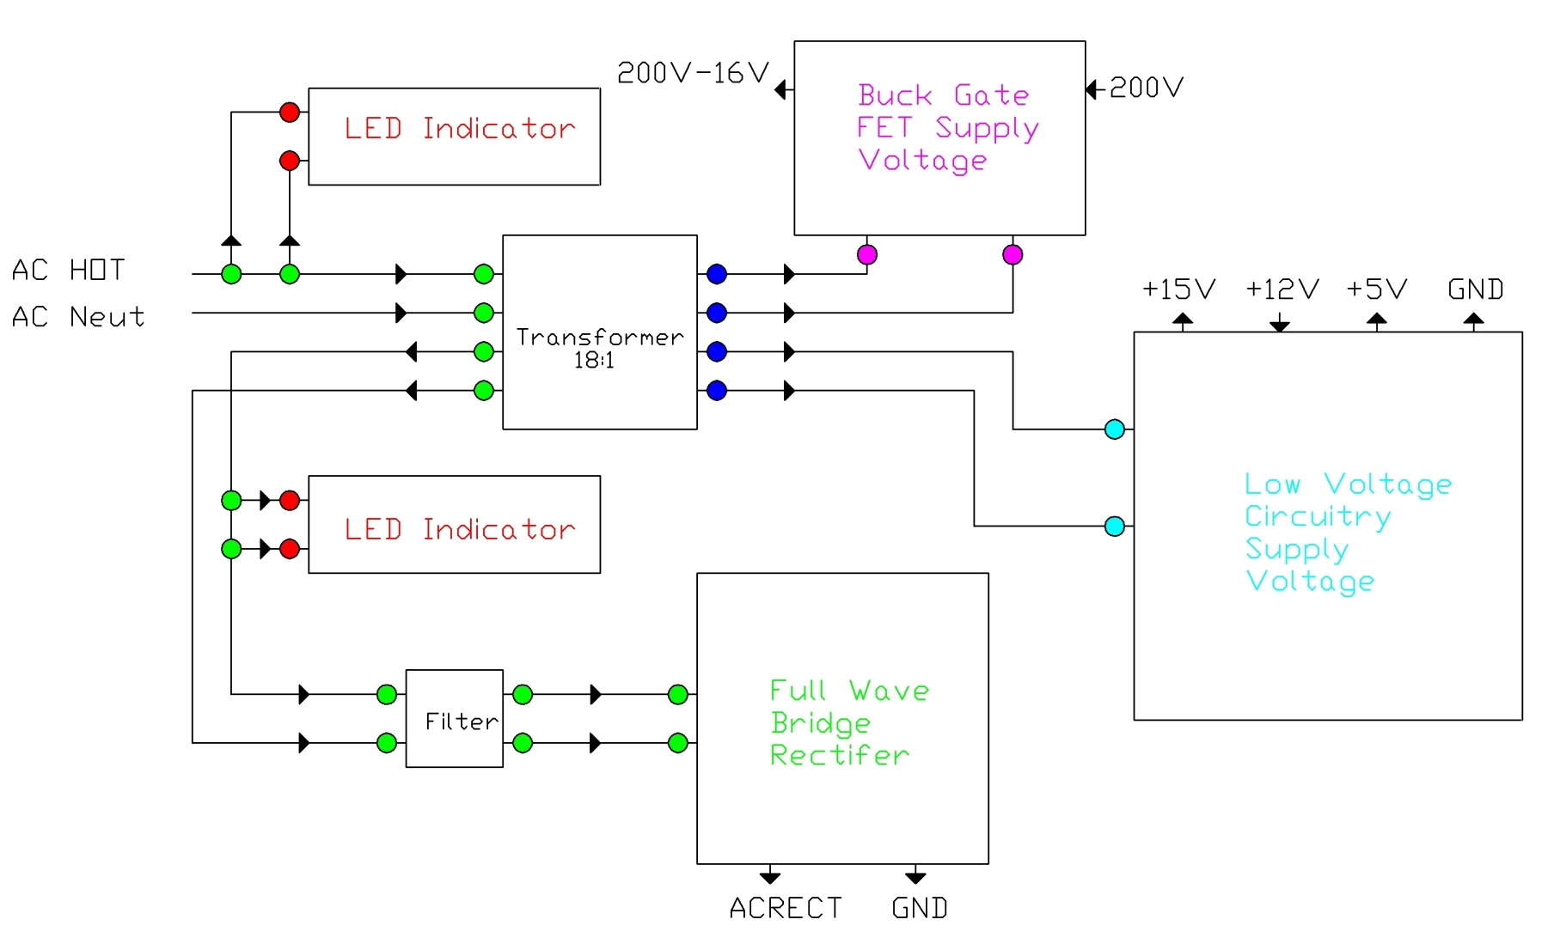
Input Power Block Diagram

Slide 8
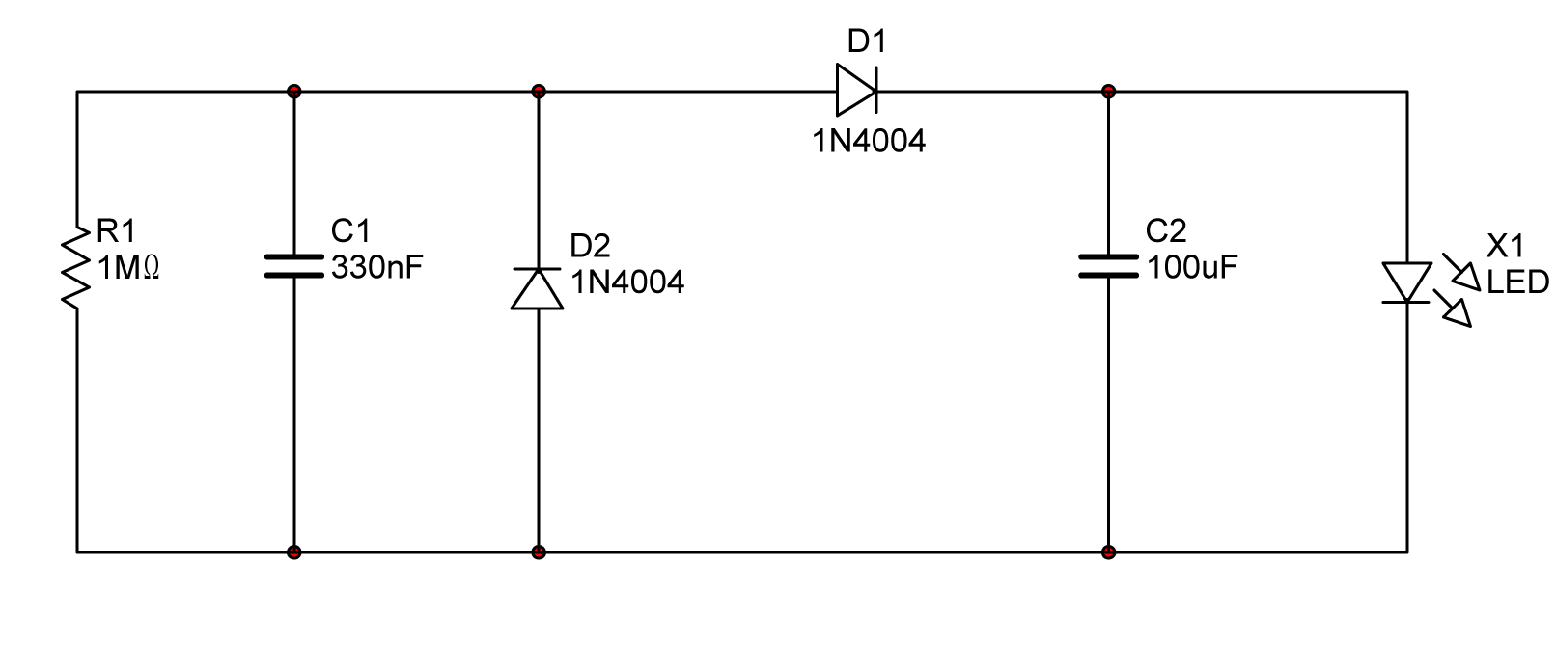
LED Indicator Schematic

Slide 9
Input Power Block Diagram

Slide 10
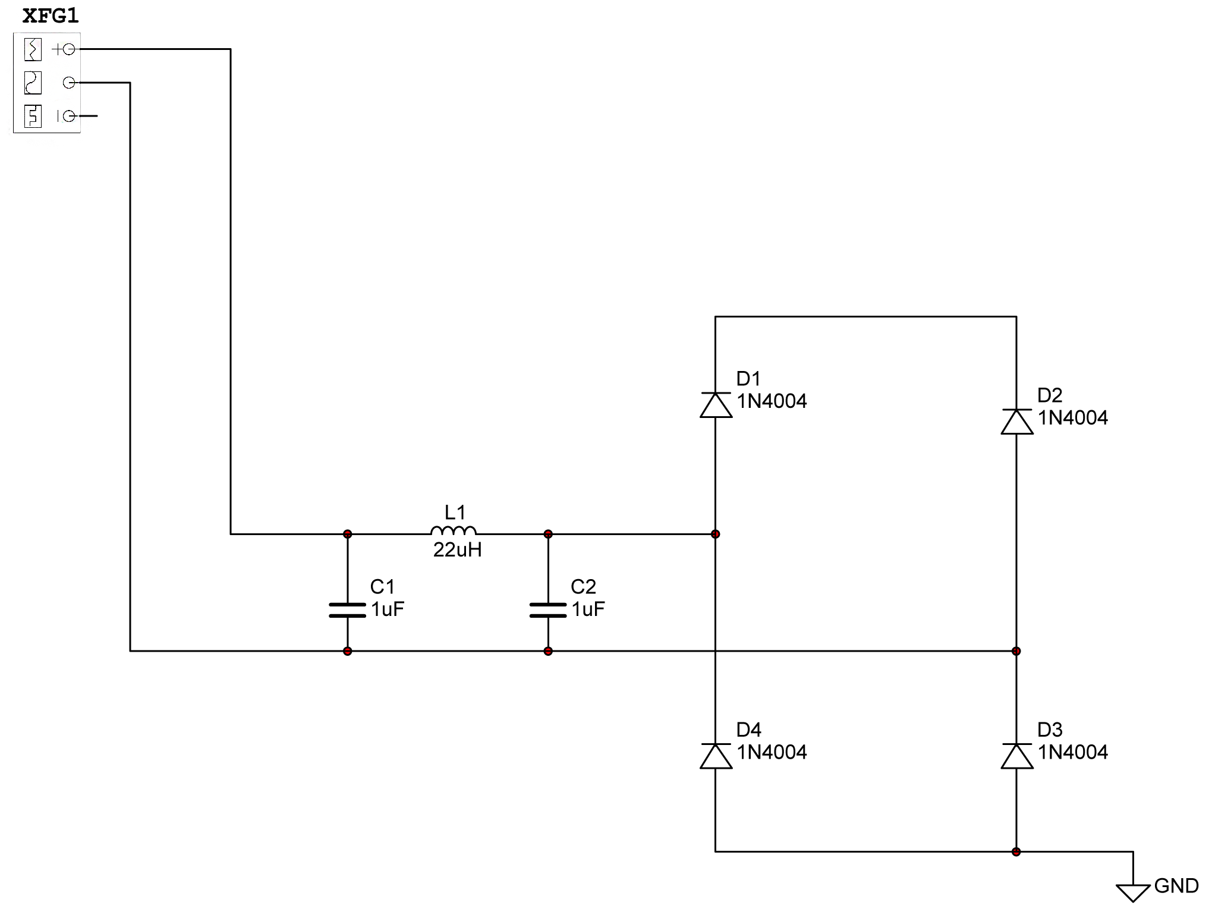
Full Wave Bridge Rectifier Schematic

Slide 11
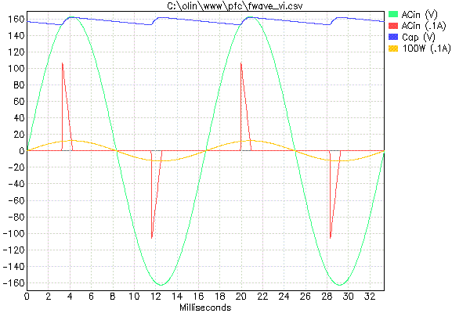
Why PFC?

Slide 12
Input Power Block Diagram

Slide 13
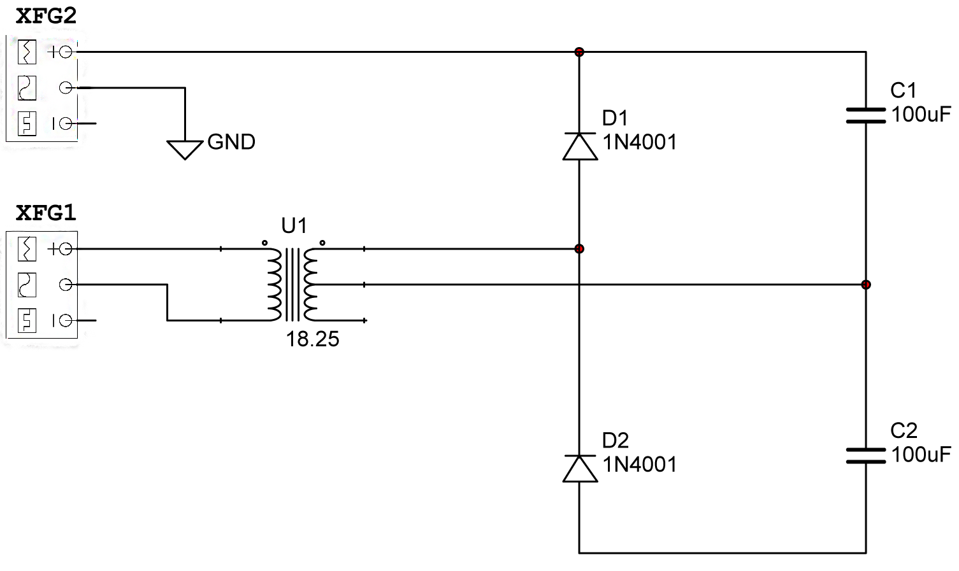
Buck Gate FET Supply Voltage Schematic

Slide 14
Input Power Block Diagram

Slide 15
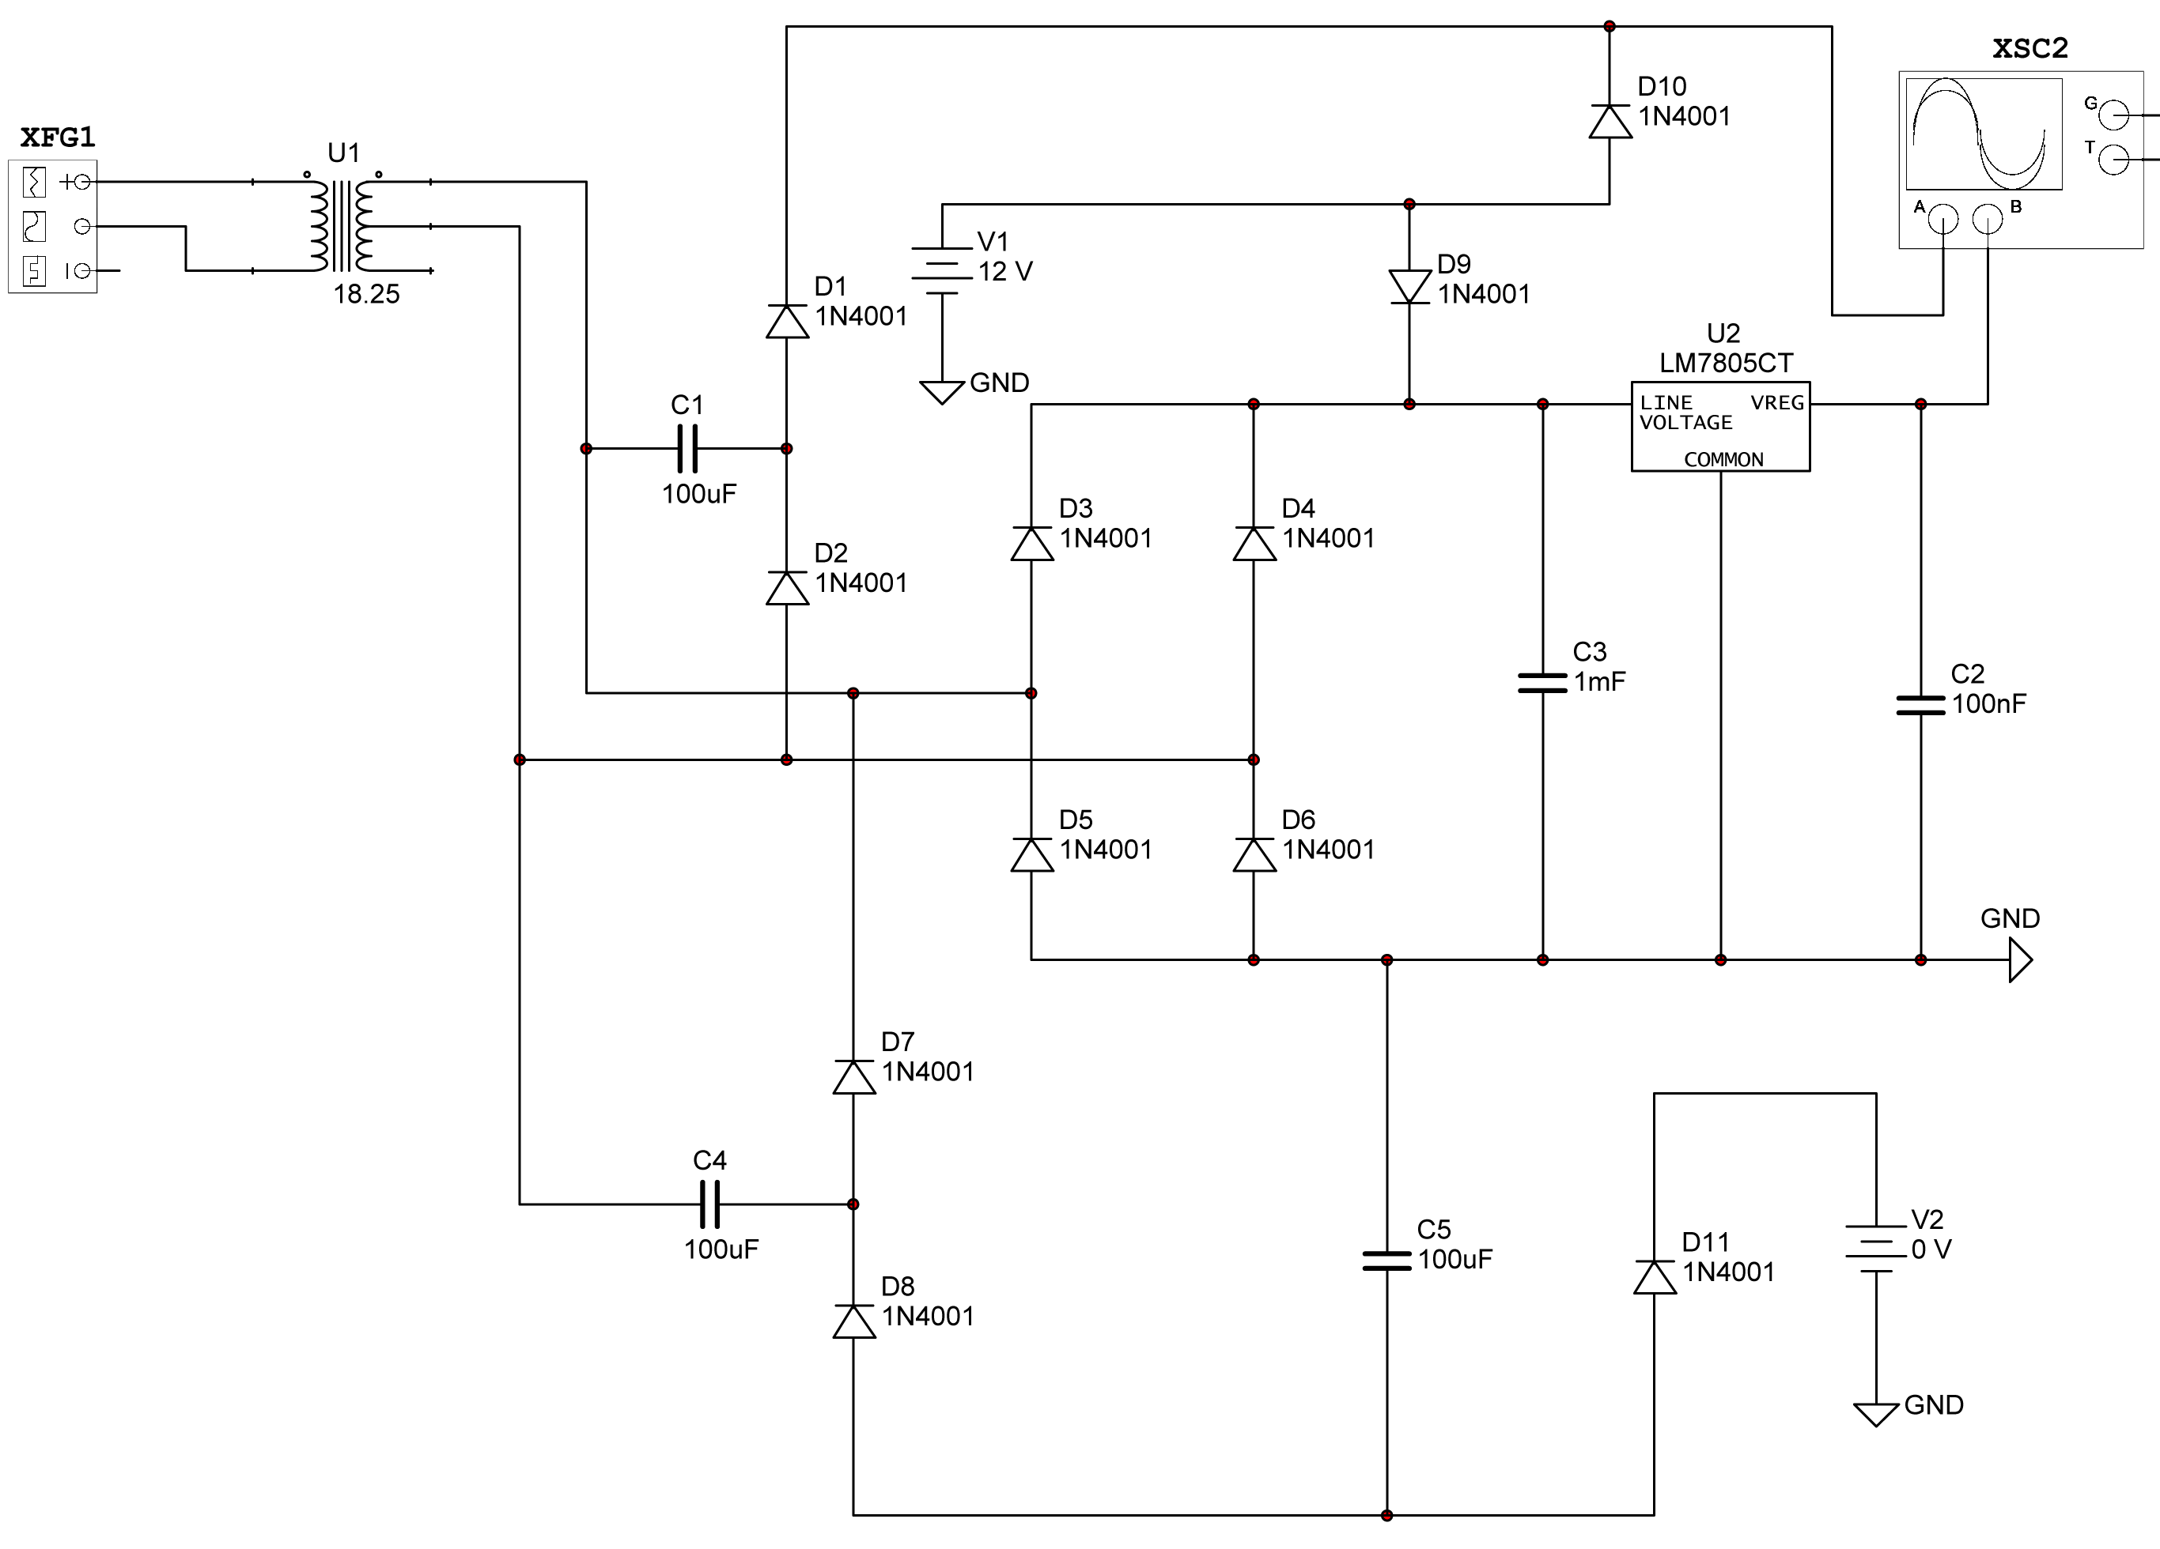
Low Voltage Circuitry Supply Schematic

Slide 16
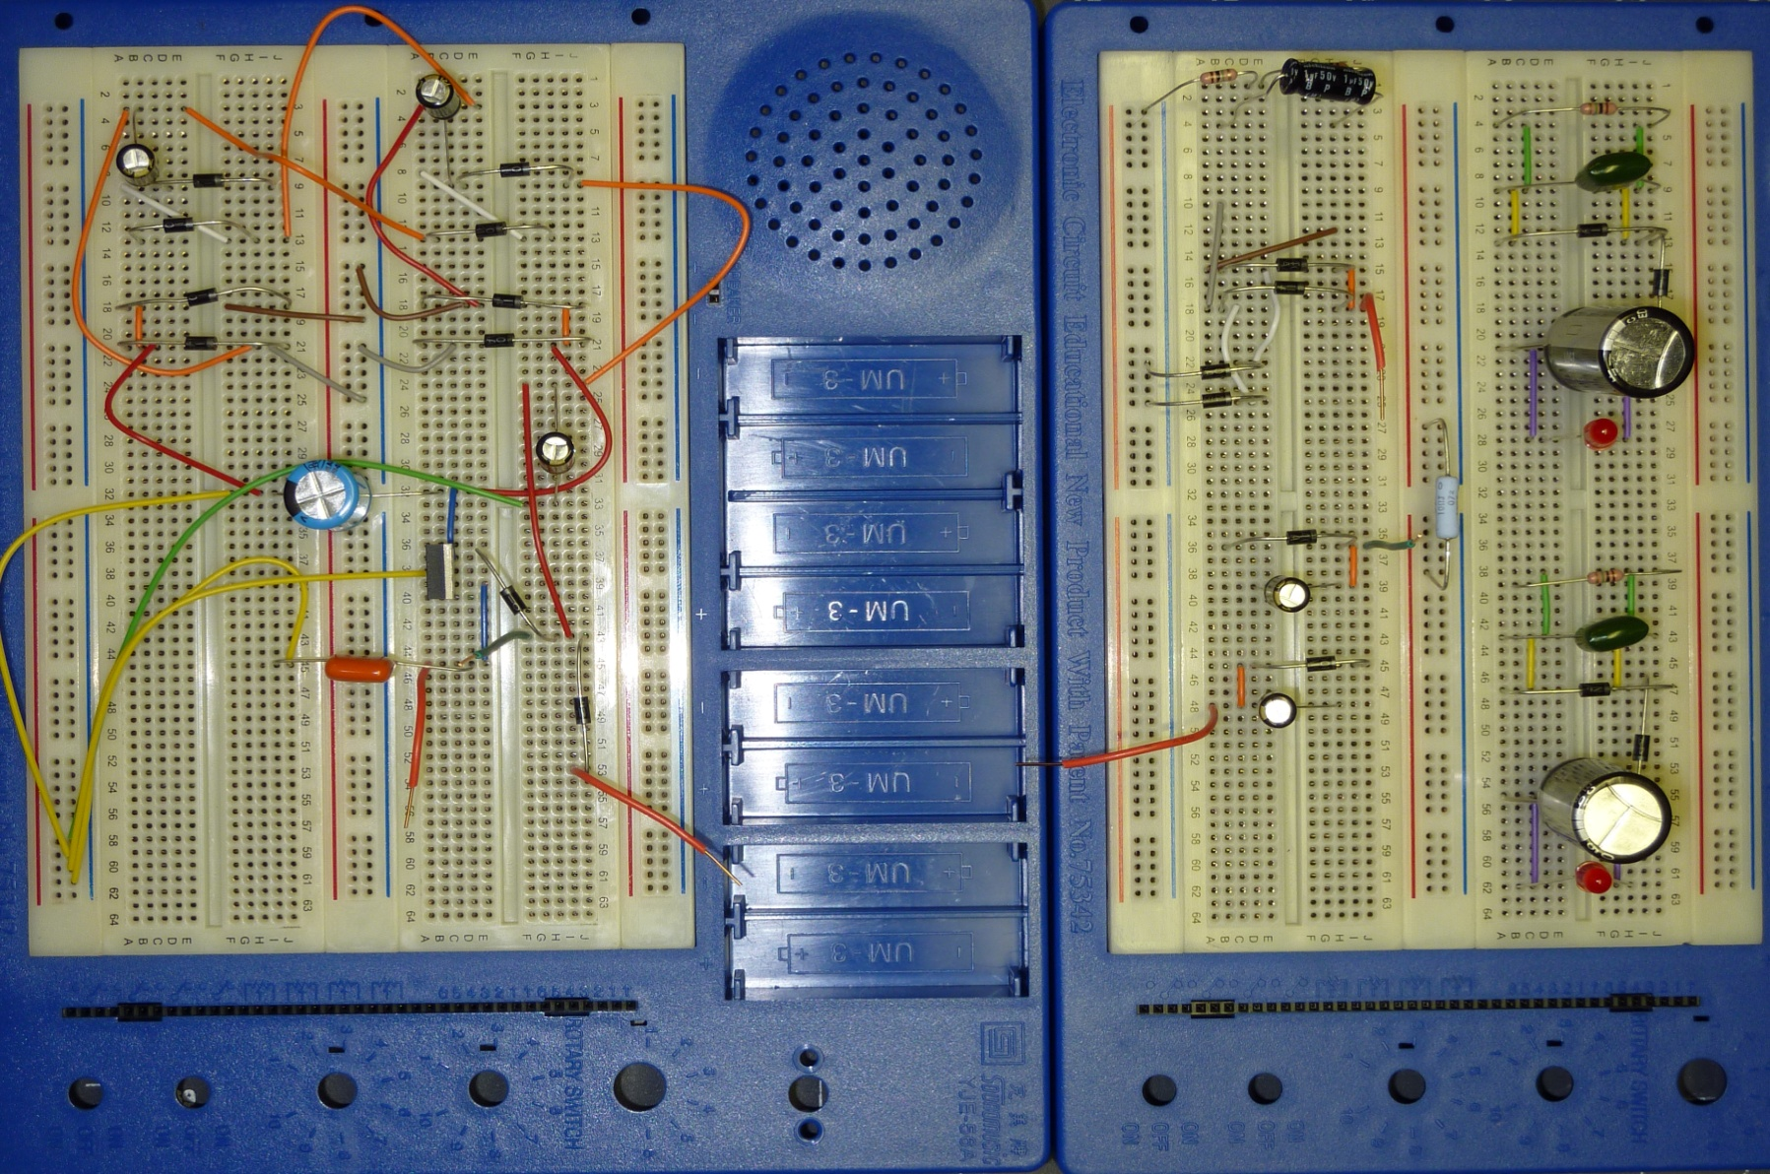
Input Power Prototype

Slide 17
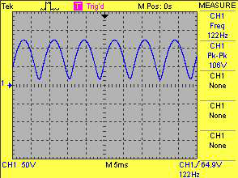
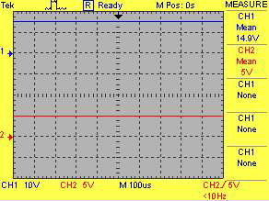
Results (Rectified AC and Low Power Outputs)

Slide 18
BOOST CONVERTER, BUCK CONVERTER & BATTERY CHARGING CIRCUIT
- Jimit Shah

Slide 19
Block Diagram
200V
ACRECT
200 - 16V
+5 V
BOOST
CONVERTER
BOOSTGATE
200V
BUCK
CONVERTER
BKPDONE
BUCKGATE
GND
12 V
BATTERY CHARGER
Vout
Input
Output
Output to Input Circuit
Output to Control Processor

Slide 20
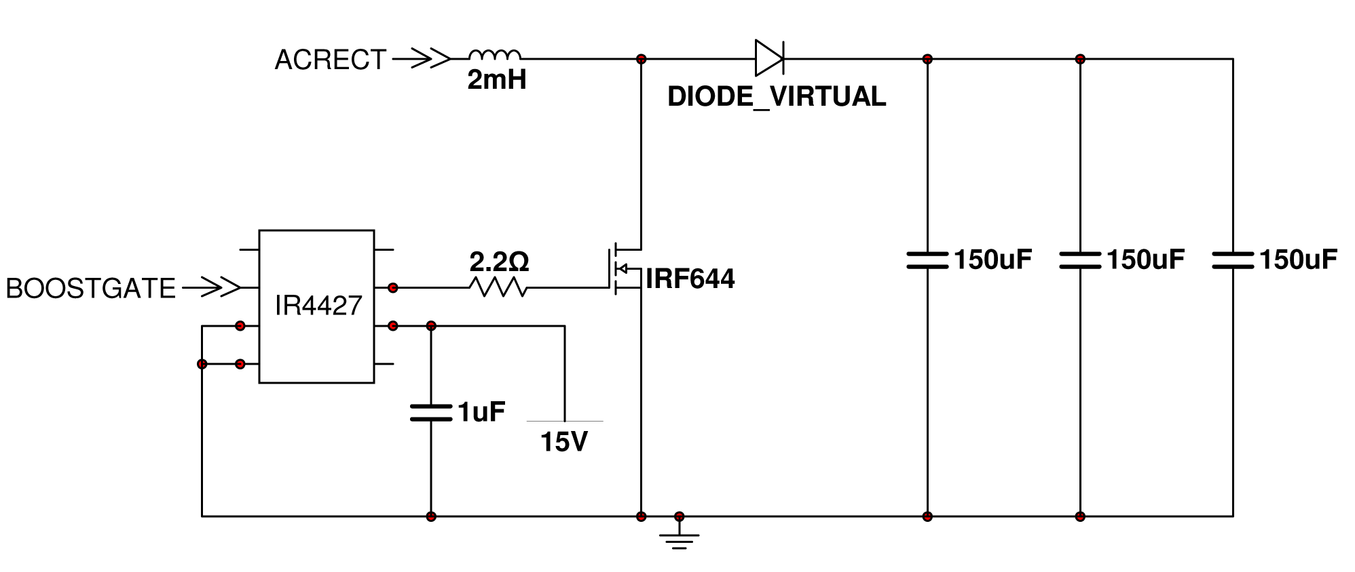
Boost Topology Schematic

Slide 21
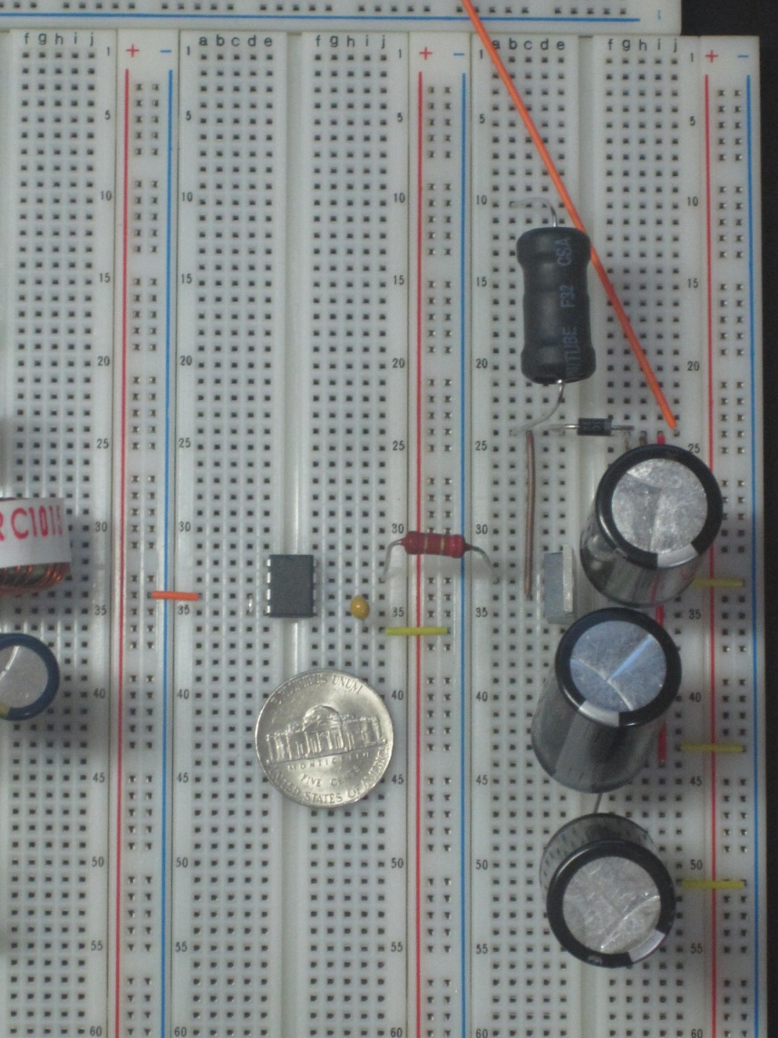
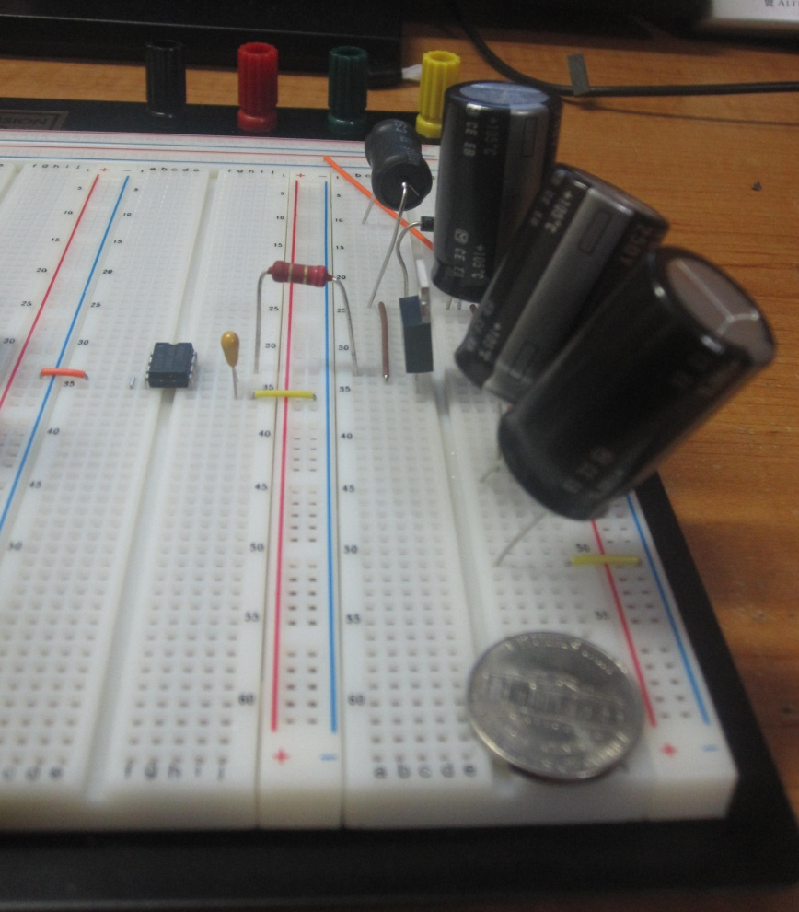
Top View
Side View

Slide 22
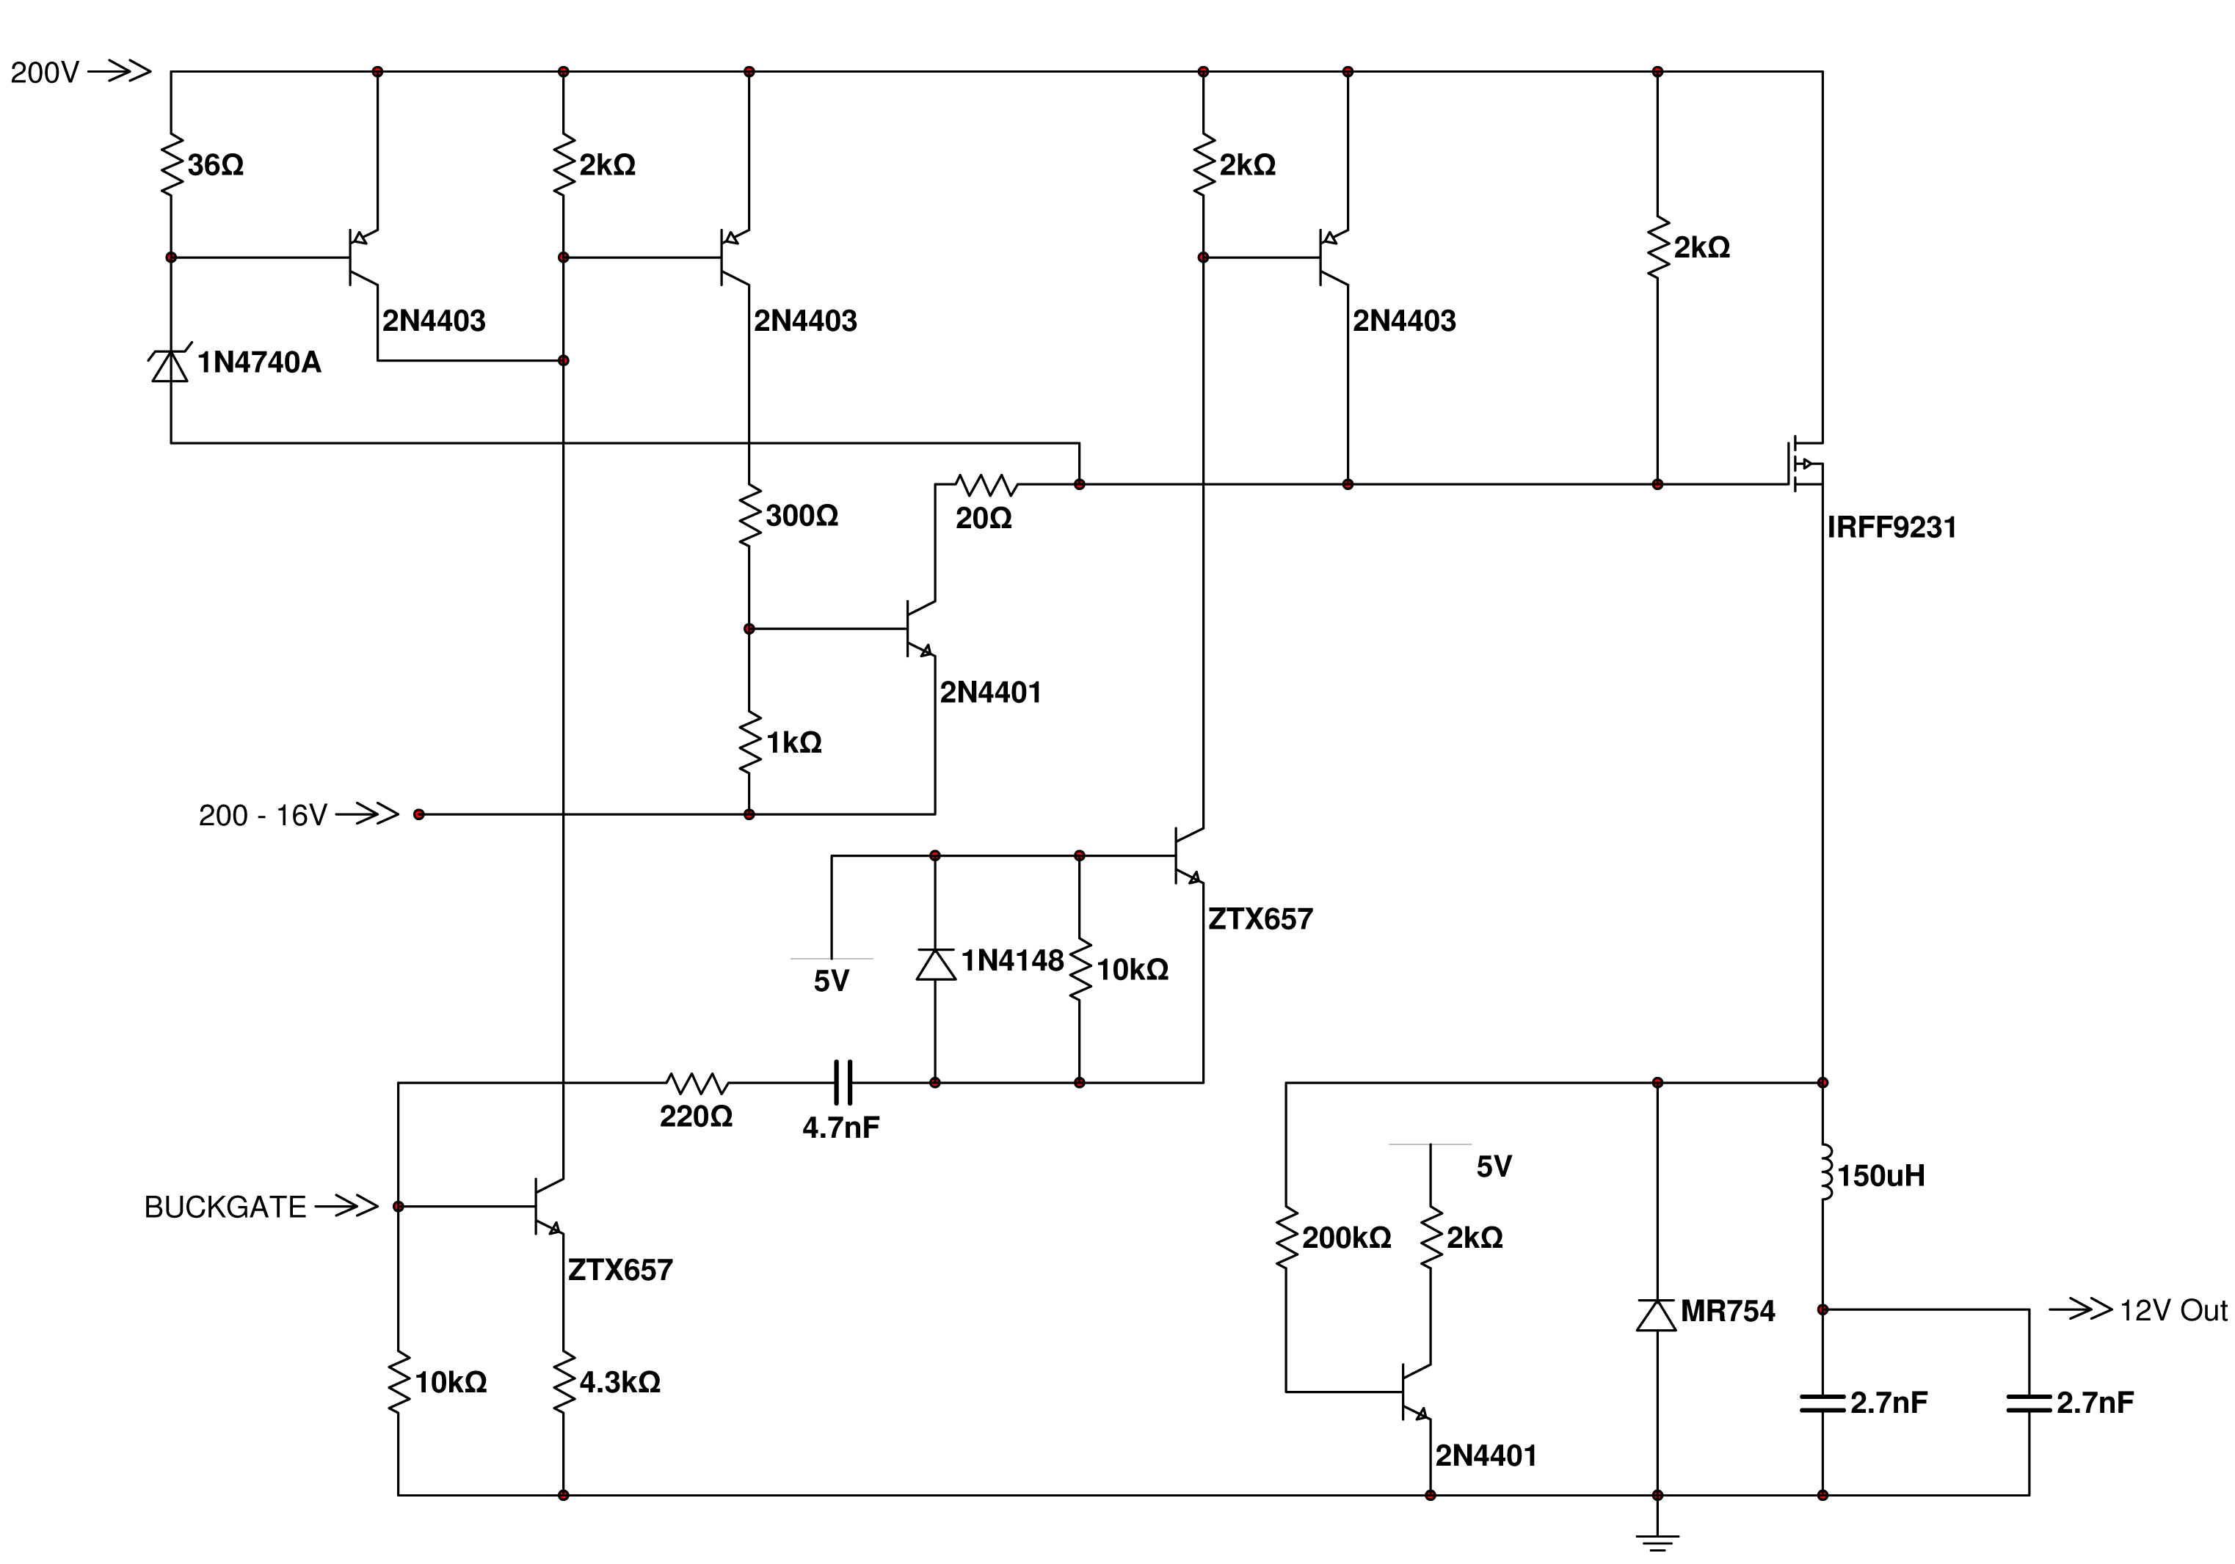
Buck Topology Schematic
← BKPDONE

Slide 23
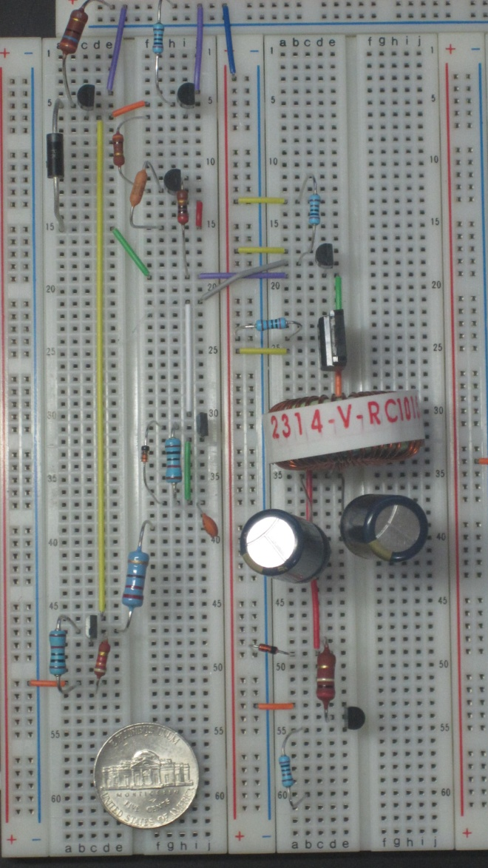
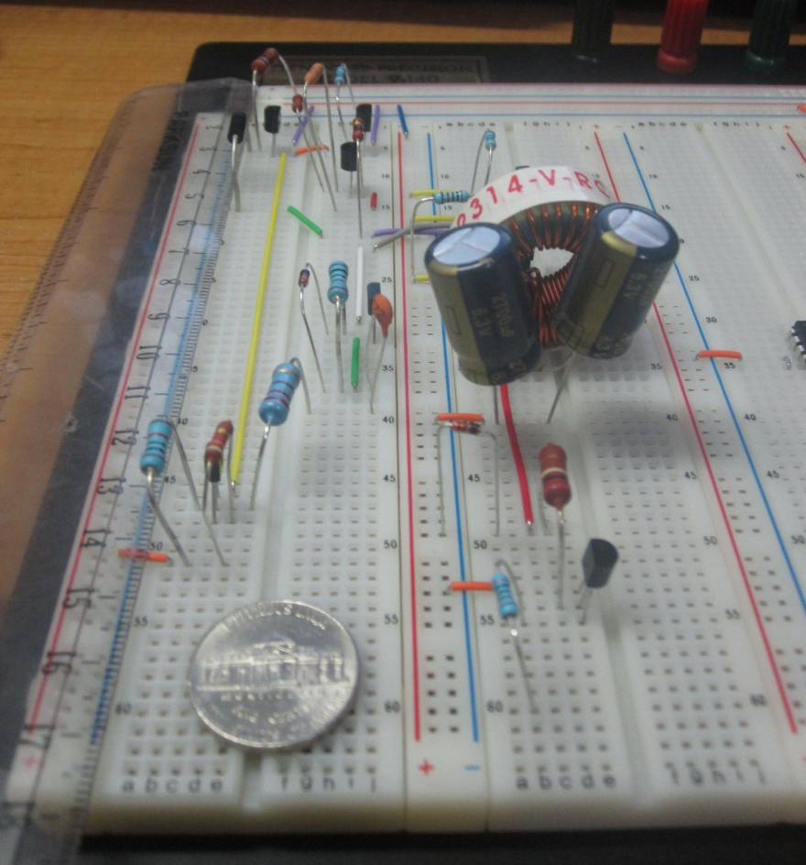
Top View
Side View

Slide 24
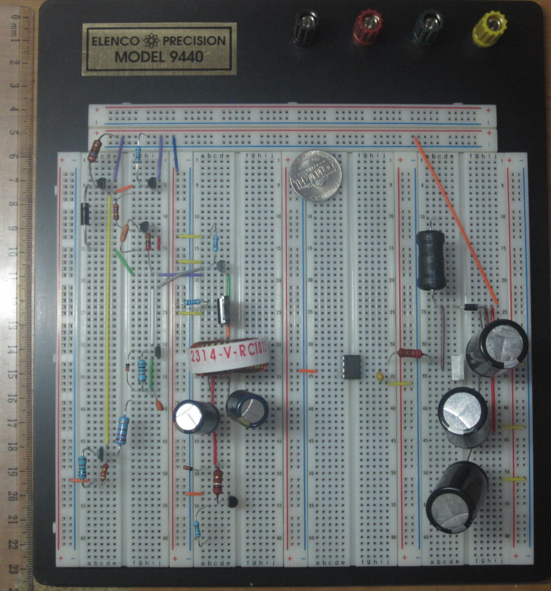

Slide 25
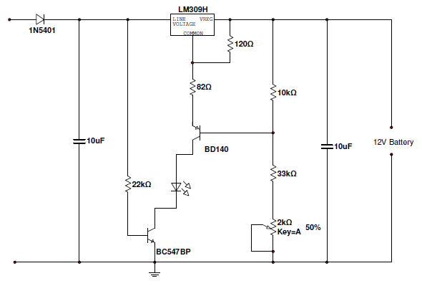
Battery Charging Schematic

Slide 26
Microcontroller
- Louis Bengtson

Slide 27
Advantages of dsPIC
Extensive available parameters
Inexpensive
Programmable in C
Compatibility with development tools
Allows use of PFC algorithm
Prospect of future improvements with digital control not possible with analog implementation

Slide 28
dsPIC30F4011 Specifications
Parameters | Values
Program Memory Type | Flash
Program Memory (KB) | 48
CPU Speed (MIPS) | 30
RAM Bytes | 2048
Internal Oscillator | 7.37 MHz, 512 kHz
nanoWatt Features | Fast Wake/Fast Control
Capture/Compare/PWM Peripherals | 4/4
Digital Communication Peripherals | 2-UART, 1-SPI, 1-I2C
Analog Peripherals | 1-A/D 9x10-bit @ 1000(ksps)
Timers | 5 x 16-bit, 2 x 32-bit
16-bit PWM resolutions | 16
Motor Control PWM Channels | 6
Temperature Range (deg C) | -40 to 125
Operating Voltage Range (V) | 2.5 to 5.5
I/O Pins | 30
Pin Count | 44
Volume Pricing | $4.02

Slide 29
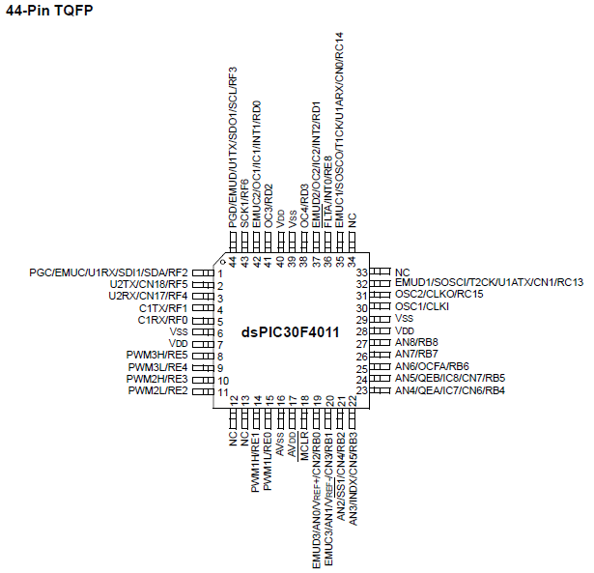

Slide 30
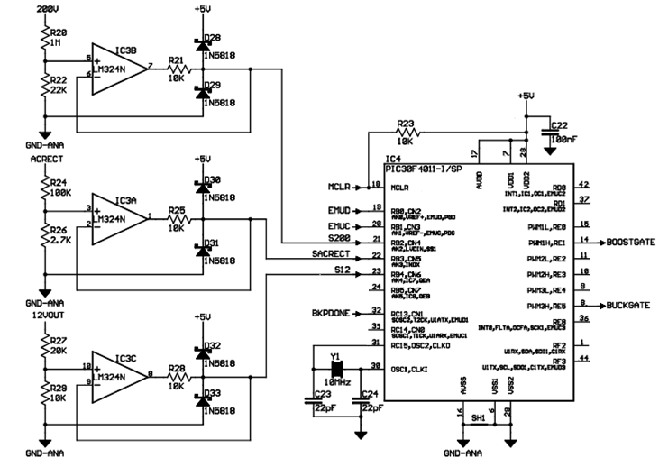

Slide 31
Microcontroller Functions
Control buck and boost FET gate drivers
Receive buck pulse done signal from buck converter to prevent new pulse while processing previous pulse
Interrupt and compute next period boost pulse width for power factor correction between pulses

Slide 32
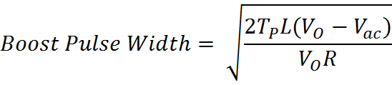
Boost Pulse Width Formula for PFC
T_{p} is the pulse period
L is the Boost inductance
R is the load resistance to the AC line
V_{o} is the Boost output voltage
V_{ac} is the instantaneous rectified AC voltage

Slide 33
Boost Pulse Width Algorithm
Add 200V internal supply reading with boost diode drop voltage to acquire effective boost switcher output voltage
Get rectified AC voltage reading and convert to 200V reading scale
Subtract AC rectified voltage from effective boost switcher output voltage to obtain boost difference voltage
If result is negative, clip at 0
Divide boost difference voltage by boost output voltage to obtain duty cycle
Take the square root to obtain scaled pulse width, and restore original scale
Compare computed duty cycle to maximum duty cycle
If computed duty cycle is out of range, set maximum duty cycle
Set boost switcher pulse width for the next PWM period

Slide 34
Anticipated Problems
Generator performance
GPS
Not being able to test Boost & Buck circuits
Programming the microcontroller
Integrating microcontroller chip into PCB
PCB layout

Slide 35
BUDGET
Item Description | Cost | % of Total Project Cost
Resistors | $5.56 | 0.70%
Capiators | $41.34 | 5.27%
Inductors | $31.92 | 4.06%
Diodes | $12.51 | 1.60%
Transistors | $15.35 | 1.95%
LEDs | $2.98 | 38.00%
Lead Acid Battery | $18.06 | 2.30%
Microcontroller | $31.90 | 4.06%
Blank MCU Cards | $56.60 | 7.20%
Breadboards | $64.89 | 8.26%
Breadboard Jumper Kits | $12.82 | 1.63%
Development Kit | $467.00 | 59.40%
Multimeter | $24.50 | 3.12%
 | $785.43

Slide 36
PROJECT TIMELINE
 | Tasks | 2010 |  |  |  |  | 2011
 |  | Aug | Sept | Oct | Nov | Dec | Jan | Feb | Mar | Apr | May
Phase I - Research | Obtain Specs Required for Design
 | Brainstorm Possible Solutions
 | Research Commercial Products
 | Analysis of Control Techniques
 | Analysis of Communication Protocols
Phase II - Design | Converter Topology Design and Simulation
 | Programming and Debugging
 | Communication and Protection Design
 | Prototype Building, Testing and Debugging
Phase III - Testing | Measurement + Tuning of Key Parameters
 | Packaging + Customizing
 | Final Budjet Report
 | Final Testing

Slide 37
MILESTONE CHART

Slide 38
QUESTIONS?

