Slide 1
Autonomous Mobile Payload Vehicle
(AMP-V)
GROUP 1
Kamal Ahmad
Francesco Buzzetta
Joshua Dixon
A Workforce Central Florida Funded Project
A Mike Felix Mentored Project

Slide 2
The Problem:
Transporting heavy objects over long distances
Limiting factors
  Physical stress
  Probability of human injury
  Labor costs

Slide 3
The Goal:
The goal is to reduce the amount of stress on the human body
  college students with books and/or electronics
  Major corporations utilizing human
  labor
  A passenger traveling in the airport
  carrying luggage.

Slide 4
The Solution:
To prevent the aforementioned problem, the use of an autonomous traveling assistant will be ideal in order to safely transport the user’s payload in a stress-free manner. This will be accomplished through the use of the AMP-V. AMP-V stands for “Autonomous Mobile Payload Vehicle.”

Slide 5
Goals and Objectives of AMP-V:
Follow the user autonomously
Mobility on various types of terrain
Avoid obstacles in its path
Self-sustaining capability
Transport a payload

Slide 6
Specifications of the AMP-V
Specification | Standards
Dimension | 25 in. x 25 in. x 25 in.
Range | 18 in. from user
Object Detection | Anything within 18 in.
AMP-V Speed | 0 mph - 3 mph
Operational Time | 1 hr
AMP-V Weight | ≤ 35 lb
Payload Weight | ≤ 25 lb
Photovoltaic Solar Panel | 50 W

Slide 7
Block Diagram
12 V
Battery
Charge Controller
Photovoltaic Cells
Infrared Receivers
Regulators
Ultrasonic Sensors
Microcontroller
Infrared Transmitter
Motor
Controller
5 V
Battery

Slide 8
Mobility Hardware

Slide 9
Chassis
AMP-V Chassis will consist of a Plexiglas structure and PVC piping
  Visibility of circuitry, structure, motors, etc.
Four main sections
  Payload Bay
  Hardware Bay
  Photovoltaic Mounting
  Tracks and Sprockets

Slide 10
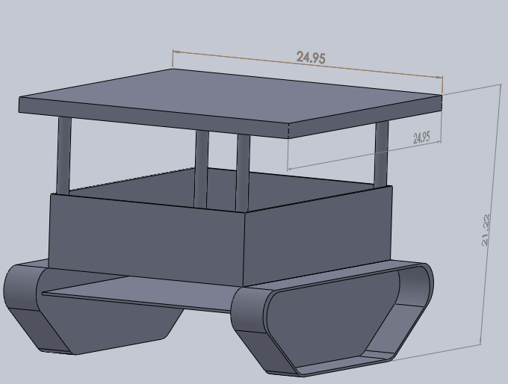
Chassis
5
Payload Bay
Hardware Bay
PV Mounting
Tracks/Sprockets
PV Cell
3
3
3
3
1
2
4
4

Slide 11
Motor Controls
The motor controls will consist of a dual
H-Bridge configuration
  Power MOSFETs handle high current from motors
  Combination of NPN transistors used to turn on MOSFET gates
    Voltage provided by Microcontroller GPIO pins
Motors set in Parallel in left, right sides
  Equal voltage and current pull per side

Slide 12
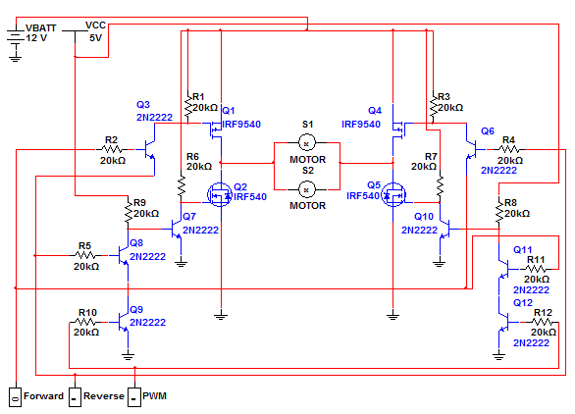
Motor Controls Schematic

Slide 13
Motor Controls Actions
Left Forward | Left Reverse | Left PWM | Left Motion
Low | Low | Low | Coasting
Low | Low | High | Coasting
Low | High | Low | Coasting
Low | High | High | Reverse
High | Low | Low | Coasting
High | Low | High | Forward
High | High | Low | Coasting
High | High | High | Active Braking
Right Forward | Right Reverse | Right PWM | Right Motion
Low | Low | Low | Coasting
Low | Low | High | Coasting
Low | High | Low | Coasting
Low | High | High | Reverse
High | Low | Low | Coasting
High | Low | High | Forward
High | High | Low | Coasting
High | High | High | Active Braking

Slide 14
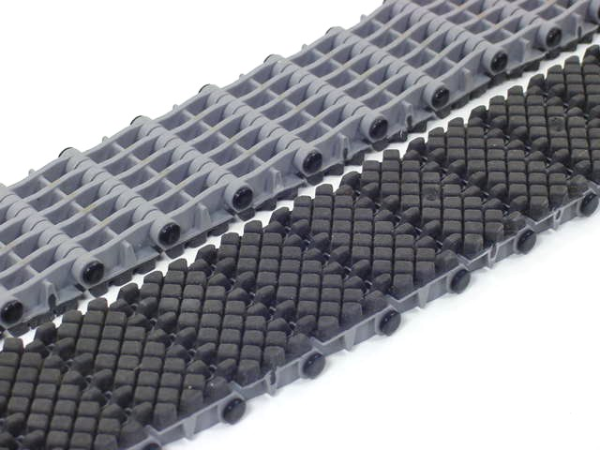
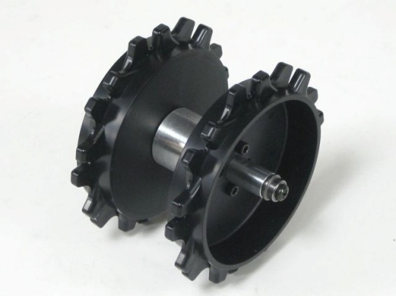
Tracks & Sprockets
Tracks
  3 inches wide, about 113 inches
    Rubber
    Provide high ground clearance
    All-terrain
Sprockets
  Will be used to define a trapezoid-like shape out of the tracks
    Motors
    Hub

Slide 15
Proximity System

Slide 16
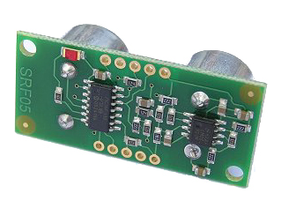
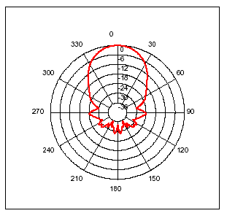
Ultrasonic Sensors
SRF05 Ultrasonic Ranger
  5 V, 4 mA
  Total of 4 sensors, one in each cardinal direction
    Radial area for pinging
  Trigger and Echo pin
  Returns a positive TTL level signal
    width proportional to distance of the object

Slide 17
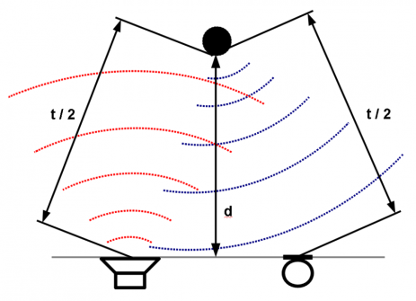

Object Detection
Sensors can detect up to 5 meters
  beam width of ±55° perpendicular to the surface
Only interested in objects ≥ 6 in. and ≤ 18 in.
  Threshold of 18 in.
    AMP-V will maintain a 18 in. distance from the user
    AMP-V will initiate collision avoidance

Slide 18
Collision Avoidance
Maneuvers conducted by the AMP-V to avoid collisions
  The AMP-V’s control systems will decide necessary movement
    Decision making
  Execute movements by sending the appropriate signals to the motor controls

Slide 19
Tracking System

Slide 20
Tracking System
Infrared technology
  IR transmitter
    Independent device
  4 IR receivers mounted at front of the AMP-V
    Determines orientation of AMP-V in relation to the transmitter

Slide 21
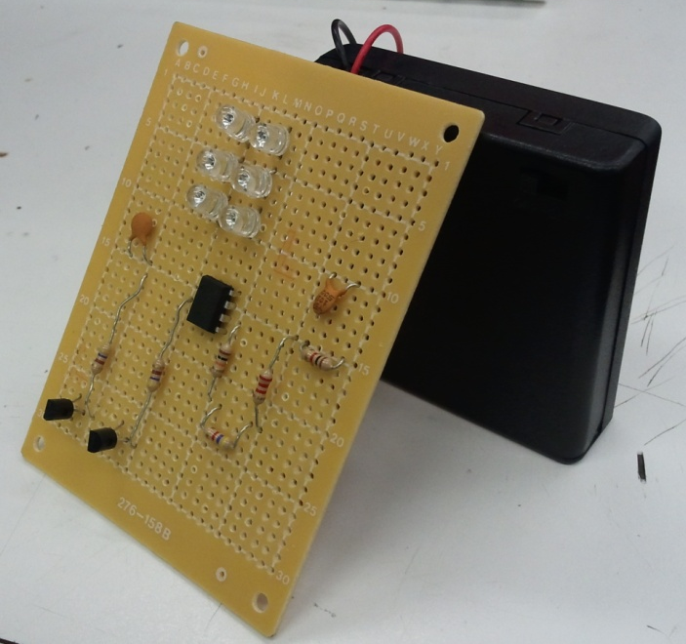
IR Transmitter
5V energy source required
  Four 1.5 V Batteries
IR oscillator circuit
  555 Timer: ICM7555
IR LED: TSAL6200
Circuit allows for IR LED to toggle on and off at 38 kHz frequency
  IR receivers will detect the 38 kHz IR wave ‘blinking’ and output it to MCU

Slide 22
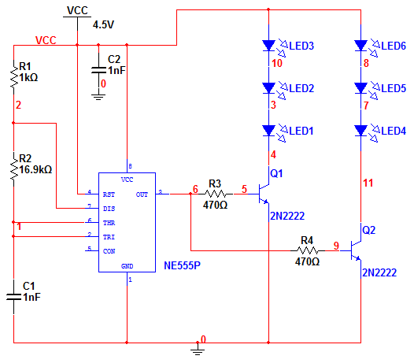
IR Transmitter Schematic

Slide 23
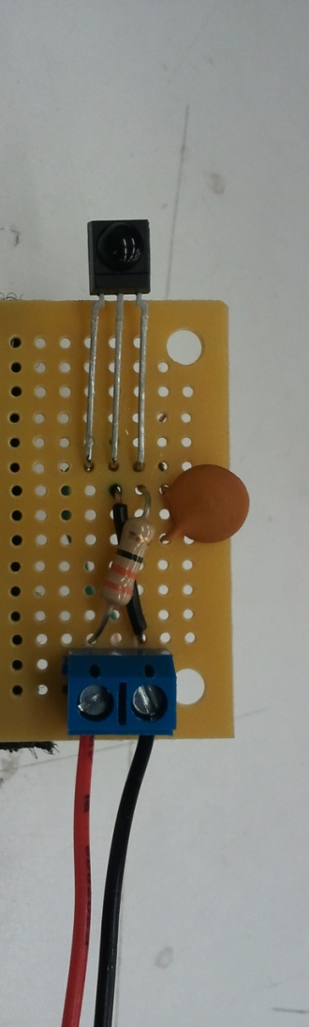
IR Receiver
IR Receiver Module
  Vishay TSOP34838
  38 kHz Infrared Measuring Sensor
  4 IR receivers mounted at front left and front right of the AMP-V
Analog output
  Read from detection angle of the Receiver

Slide 24
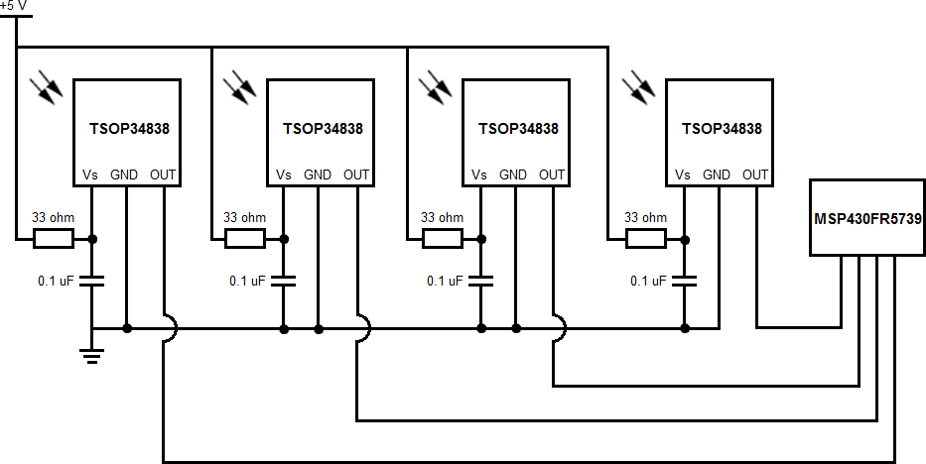
IR Receiver Schematic

Slide 25
Microcontroller

Slide 26
Microcontroller Choices
 | MSP430G2231 | MSP430FR5739 | ATmega168 | PIC24FJ256GB106
Voltage | 3.3V | 3.3V | 5V | 3.6V
GPIO | 10 | 32 | 14 | 52
Timers | 1 | 5 | 3 | 5
ADC | 8 | 12 | 6 | 15
Flash(kB) | 2 | 16 | 16 | 256
Language | C | C | Wiring | C
Price | $ 4.30 | $ 29.99 | $ 30.00 | $ 59.98

Slide 27
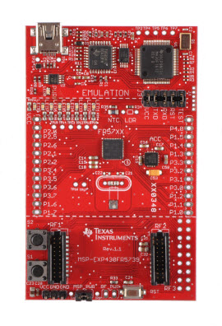
Microcontroller
MSP-EXP430FR5739
  24MHz
  2.0V - 3.6V 560uA
    Low power consumption
  32 I/O
    12 10-Bit ADC I/O
Pins for devices:
  Ultrasonic sensors – 8 GPIO - I/O
  Infrared receivers – 4 ADC - I
  H-bridges – 6 GPIO - O

Slide 28
Software
Clocking
  Timers
Interrupts
Sensors Interfacing
  Object Detection algorithms
Infrared Receiver Interfacing
  Tracking algorithms
Motor Control
  Movement & turning logistics
  Collision Avoidance algorithms
PWM

Slide 29
Functions
void ConfigClocks(void);
void IR_Receivers(void);
void IR_Read(void);
void Ultrasonic_Sensor_N(void);
void Ultrasonic_Sensor_S(void);
void Ultrasonic_Sensor_E(void);
void Ultrasonic_Sensor_W(void);
void Accelerate(void);
void Decelerate(void);
void Calculate(void);
void Turn(int time, int direction);
void SetPWM(int value);
void Rotate(void);
void Collision_Avoidance();
void Stop();
void Wait();
int get_pin(int byte);

Slide 30
Software Flowchart
Clock Configurations & Pin Set-Up
Turn On
Read IR Receivers
Turn?
Yes
No
Rotate
Decelerate
Yes
Rotate?
Turn
Ultrasonic Sensing
No
Collision Avoidance
Wait
Accelerate

Slide 31
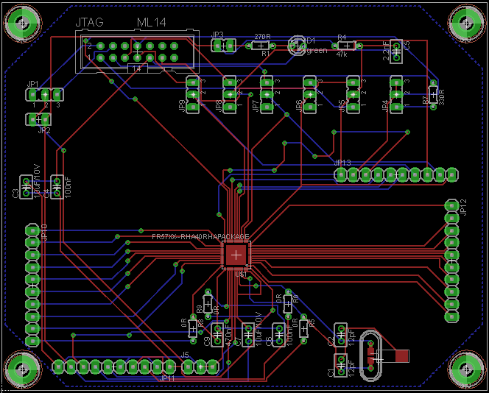
MCU PCB Board

Slide 32
Self-sustainability

Slide 33
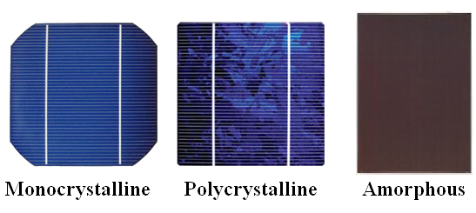
Photovoltaic Cells
Solar Panel | Voc | Imax | Dimensions | Weight | Cost
Monocrystalline | 21.6 V | 3.26 A | 24.00 in. x 16.57 in. x 1.25 in. | 8.8 lb | $139.99
Polycrystalline | 21.6 V | 3.2 A | 73 in. x 53 in. x 5 in. | 13.2 lb | $159.95
Amorphous | 20.7 V | 3.06 A | 33.5 in. x 17.3 in. x 0.098 in. | 5.51 lb | $294.75

Slide 34
Monocrystalline Solar Panel
Photovoltaic Cell Type: | Monocrystalline
Output Power: | 50 W
Maximum/Peak Voltage: | 17.1 V
Open Circuit Voltage: | 21.6 V
Maximum/Peak current: | 2.98 A

Slide 35
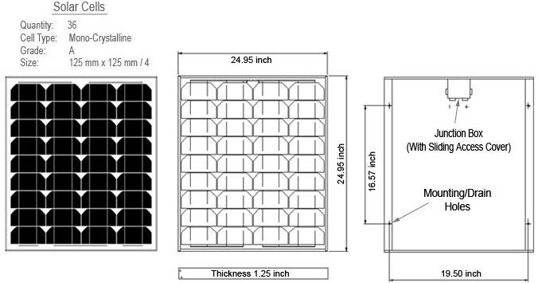
Monocrystalline Solar Panel

Slide 36
Monocrystalline Testing
Forcast | Temperature | Voltage
Sunny | 82-98 degrees | 17.1 Volts
Cloudy | 78-88 degrees | 14-16 Volts
Rainy | 70-88 degrees | 1-3 Volts
Indoors (Fluorescent) | 74-80 degrees | 5.76Volts

Slide 37
Power Distribution

Slide 38
Power Distribution Diagram
5 V
Battery
Photovoltaic Cells
Infrared Transmitter
Charge Controller
12 V
Battery
3.3V Regulator
5V
Regulator
Motor
Controller
Microcontroller
Ultrasonic Sensors
Infrared Receivers

Slide 39
Batteries
The AMP-V shall use four 12 V batteries
The batteries shall provide sufficient energy to
  4 Motors
  4 Ultrasonic sensors
  4 Infrared receivers
  Microcontroller
The batteries shall be rechargeable and sustain operation of the vehicle for at least one hour

Slide 40
Battery Requirements
 | Voltage |  | Current | Power
 | Min | Max |  | Pmin | Pmax
Photovoltaic Cells | 10V | 17.1V | 2.92A |  | 50W
Battery(4) - 3800mAh | 12V | 14.5V | <10A |  | 45.6W
Motor (4) | 6V | 12V | 1.5A | 9W | 18W
IR Receiver (4) | 2.5V | 5.5V | 3mA | 0.04W | 0.06W
Ultrasonic Sensor(4) |  | 5.0V | 4mA | 0.02W | 0.02W
MCU | 1.8V | 3.6V | 560uA | 1.01uW | 2.02mW
Accelerometer | 1.8V | 3.6V | 350uA | 0.64mW | 1.33mW
TOTAL |  |  |  | 36.08W | 72.08 W
(including all items)

Slide 41
Battery Specifications
Function | Nickel Metal hydride (NiMH) | Nickel Cadmium (NiCad) | Lithium Ion (Li-ion) | Rechargeable Alkaline (R-A)
Voltage | 1.25 | 1.25 | 1.75 | 1.5
Charge Capacity | 3800 mAh | 700 mAh | 400 mAh | 3000 mAh
Safety Needs | No | No | No | Yes
Recharge Cycles | 100’s | 100’s | >500 | 10’s
Charge Rate | 1.8 – 3.8 A | ~2A | 400 mA | N/A
Continuous Use Performance | Good | Good | Good | Poor
Weight | Light | Medium | Light | Heavy
Cost | Low | Medium | High | High

Slide 42
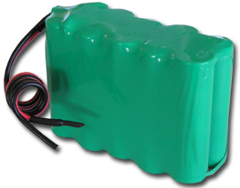
Battery
Nickel-metal hydride (NiMH)
12VDC 3800 mAh
  4 in parallel
Discharge rate: 3.8 A – 4.2 A
Charge rate: 1.8 A – 3.8 A
1.3 lb
3.3 in. x 1.3 in. x 2.6 in.
Charge Time of four Batteries in parallel from solar panel: Approximately 00.55.00 minutes[Sunny Condition]

Slide 43
Voltage & Charge Regulator
2 Voltage Regulators
  5 VDC – IR Receiver and Ultrasonic Sensors
  3.3 VDC – MCU
1 Charge Controller
  50W Solar Panel to 12VDC Battery

Slide 44
5 VDC Voltage Regulator
Powering IR Receivers and Ultrasonic Sensors
PT6653
Integrated Switching Regulator
Input Voltage = 9 – 28 V
Output Voltage = 5 V
Output Current = 5 A
Simple Implementation (2 capacitors)

Slide 45
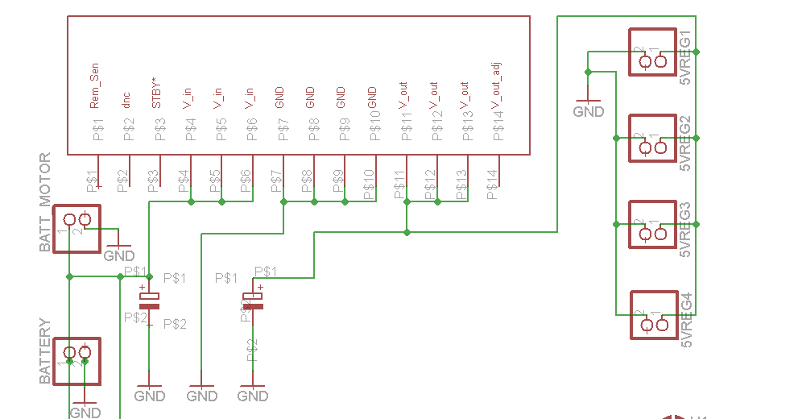
5 VDC Voltage Regulator Schematic

Slide 46
3.3 VDC Voltage Regulator
Powering MCU
PT6651
Integrated Switching Regulator
Input Voltage = 9 – 28 V
Output Voltage = 3.36V
Output Current = 5A
Simple Implementation (2 capacitors)

Slide 47
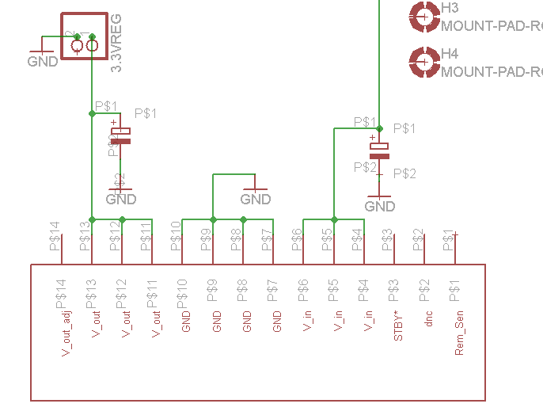
3.3 VDC Voltage Regulator
Powering MCU

Slide 48
Charge Controller
Provides max current of 2.92A
Charges four 12Vdc batteries in parallel in approximately 45-55minutes
Forcast | Temperature | Voltage from solar Panel | Current of charge controller
Sunny | 88-90Degrees | 17.1Volts | 2.98A
Cloudy | 70-88Degrees | 12V-16V | 1.07-2.45A
Rainy | 70-80Degrees | 1-3V | .5-.75A

Slide 49
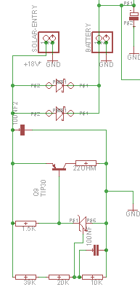
Charge Controller

Slide 50
Administrative Information

Slide 51
Budget & Financing
Part Type | Cost | Part Type | Cost
Ultrasonic Sensor | $ 121.56 | Track Fasteners | $ 3.95
Photovoltaic Cells | $ 149.99 | Motor Mounts | $ 29.90
Microcontroller | $ 17.20 | Plexiglass | $ 174.88
Battery | $ 159.80 | Overhead | $ 200.00
Motors | $ 87.80 | PCB | $ 200.00
Tracks | $ 233.70 | Infrared Receivers | $ 75.98
Track Sprockets | $ 79.60 | Infrared Diodes | $ 5.00
Charge Controller Parts | $ 25.00 | Accelerometer | $ 32.94
Connectors | $ 50.00 | Aluminum Bar | $ 7.50
Wire | $ 20.00 | Velcro | $ 20.00
Power Converter | $ 20.00 | Aluminum Dowel | $ 5.00
Passive Hub Extender | $ 59.80 | Heat Sinks | $ 1.00
Hub - motor to sprocket | $ 16.00
Total |  |  | $ 1,796.60
Final Workforce Central Florida Budgeting $1,927.98
$131.38 under budget

Slide 52
Work Distribution

Slide 53
END

