Slide 1
Autonomous Mobile Payload Vehicle (AMP-V)
GROUP 1 | Kamal Ahmad, Francesco Buzzetta, Joshua Dixon, David Snyder
Mentor: Michael Felix
Naval Air Warfare Center: Training Systems Division (NAWCTSD)

Slide 2
Motivation of AMP-V
The Autonomous Mobile Payload Vehicle (AMP-V) is the new means of transporting equipment in a low cost friendly solution.
The goal of AMP-V is to minimize the amount of stress on the human body
College students with tons of books and electronics being carried in their backpacks,
A major corporation using outside labor,
A passenger traveling in the airport with luggage or an airline carrier transporting cargo to airplanes.
Additionally, the project could be used for military purposes
Relocate items needed for troops and medical equipment. With this application, it is even possible to have multiple AMP-V’s follow in a train-like fashion.

Slide 3
Project Requirements
Transportation | Communication | Self-Sustainability
Maneuver to the user | Receive location information about the user | Sustain itself with photovoltaic cells and a rechargeable battery system
Capability to turn | Utilize sensor data to for collision avoidance | Accommodate to several power options
Operate on different terrain | Send signals to the transport system
Avoid obstacles within range
Ascend and descend stairs

Slide 4
Project Specifications
Dimensions are set to be 24’x18’x18’
Maintain a range of 24 inches from the user
Detect objects within 18 inches
The speed will not exceed 3 mph
Operate for 1 hour before losing complete charge
Will weigh no more than 25 lbs
Support a payload up to 20 lbs
Supply 91.2 watt-hours from 2 12V batteries
Utilize photovoltaic cells to provide 40 watt-hours
Motors (4) will operate at 7V

Slide 5
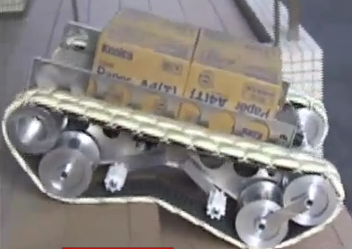
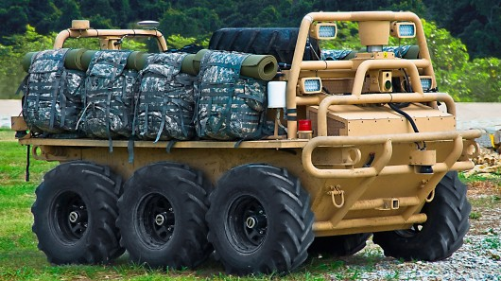
Similar Work
Stair Climbing Robot
Chiba Institute of Technology
Tokyo Institute of Technology
Various other stair climbing projects
Lockheed Martin’s SMSS Autonomous Vehicle
Squad Mission Support System (SMSS)

Slide 6
Project Milestones
November 21st – Research Phase
December 5th – End Preliminary Design
January 31st – End Prototype Assembly
February 29th – End Prototype Bugs Phase
March 31st – End Testing Phase
April 20th – Final Paper and Presentation

Slide 7
First meeting with Mentor
10/10/11: First Meeting with Mr. Michael Felix
Discussion of the Chassis
Motor types
Sensor beam-width
Climbing the stairs
Photovoltaic cells

Slide 8
Second Meeting with Mentor
11/17/11: Second Meeting with Mr. Michael Felix
Senior Design paper
RF wireless technology
Photovoltaic panel
Rechargeable battery
Preliminary Design Requirements

Slide 9
Work Accomplished
Requirements
Established three major functions of AMP-V
Research
Considered alternative methods to fulfill project requirements
Specifications
Modified functions to produce explicit design specifications
Design
Finishing design paper and ready to implement

Slide 10
Project Challenges
Wireless Communication
Deriving appropriate method (GPS, RF, Bluetooth, etc.)
Self-sustainable Energy Source
Determining total energy from photovoltaic solar panel required for AMP-V
Weight Ratio (Flexible vs Non-Flexible)
Stair Climbing
Tank-like tracks
Motor control

Slide 11
Distribution of Responsibilities
Kamal Ahmad
Photovoltaic Cells Motors Subsystem Stair Climb Function
Francesco Buzzetta
Wireless Control Chassis Motors Subsystem
Joshua Dixon
Microcontroller Sensors Sprockets and Tracks
David Snyder
Battery Source Voltage Regulators Charge Controller

Slide 12
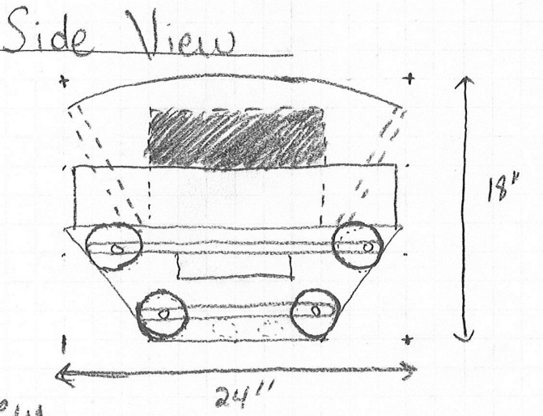
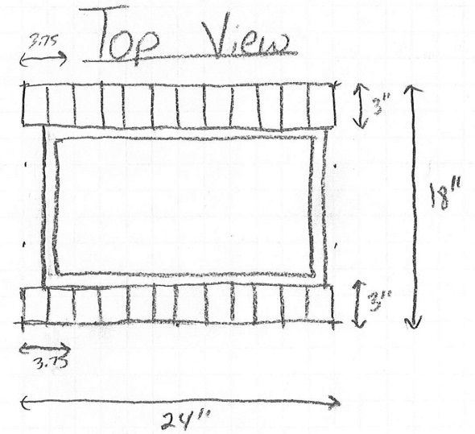
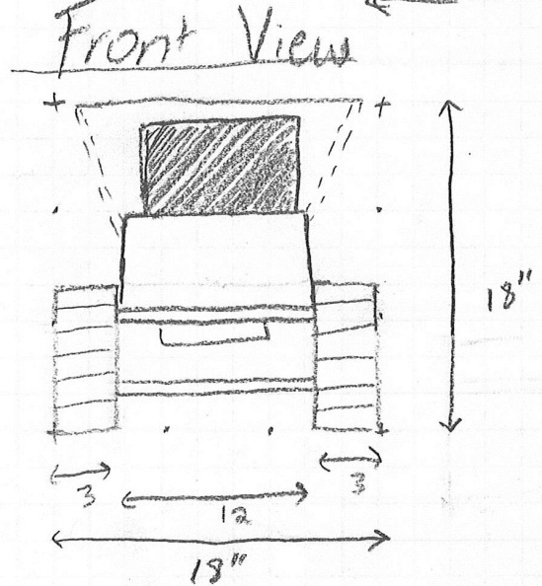
Expected Outcome
Build a robot that reduces human labor when transporting materials

Slide 13
Future Work with the AMP-V
Additional ideas that would go along with the development of the AMP-V are the following:
Create a multiple-AMP-V, wireless train system
Larger scale for carrying larger payloads
Wireless Human Transportation
Military-level applications
Transportation for arms and devices
Automated Human Deployment System

Slide 14
Thank You

