Slide 1
COLLIDE-3 AVM
Walter Castellon CpE & EE
Mohammad Amori CpE
Josh Steele CpE
Tri Tran CpE

Slide 2
Background
Planetesimal to Protoplanet to Planet is well understood
  Have gravitational forces
Prior to this stage is still unclear
  How do the particles stick together?
High velocity vs Low velocity impacts
  Do they hold the key?

Slide 3
Dr. Colwell
Planetary researcher since 1989
Multiple experiments already ran
  COLLIDE, COLLIDE-2, PRIME, Little Bang
    All dealing in low-velocity collisions
Current lab focuses on particle collisions in the 20-30 cm/s range in microgravity environments.

Slide 4
The Experiment
The COLLIDE-3 will be attached to a sub-orbital rocket
Upon entering micro-gravity LED’s and a Camera will be turned on to record the experiment
Next a spherical quartz object will be dropped onto JSC-1
The camera will record the results of the quartz object and JSC-1 in micro-gravity

Slide 5
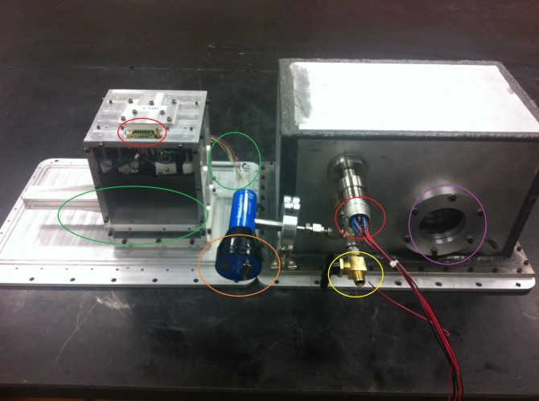
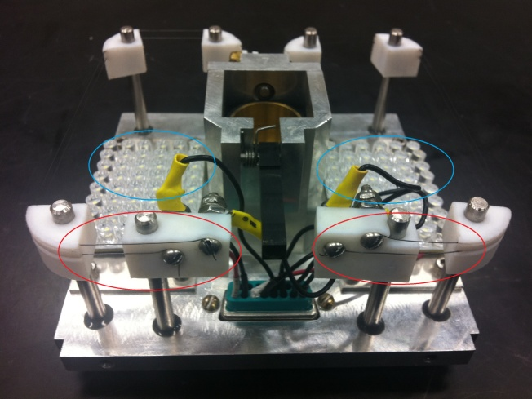
The Experiment
Notes:
Tri said keep talking explain in detail

Slide 6
The Problem
COLLIDE-3 scheduled to fly on private, experimental suborbital rocket
  This rocket had an AVM module which would control all of the functions of COLLIDE-3
Rocket thrusters failed upon re-entry, and the rocket was lost
  Dr. Colwell was left with an experiment, but no way to run it
  Needed a new AVM if he wished to utilize his experiment on a different rocket.

Slide 7
AVM (Avionics Module)
Brain of experiment
Manage hardware
Record results
Adaptable to future iterations of the experiment
Capable of withstanding atmospheric environments
Reliability is ESSENTIAL
  Failure could cost upwards of $250,000

Slide 8
AVM Components
2 Microcontrollers
Camera
LEDs
Solid State Drive
Accelerometer
User Input Module (UIM)
Stepper Motor
Micro-step driver
Muscle wire

Slide 9
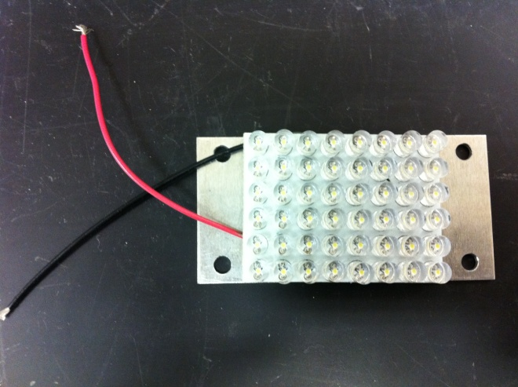
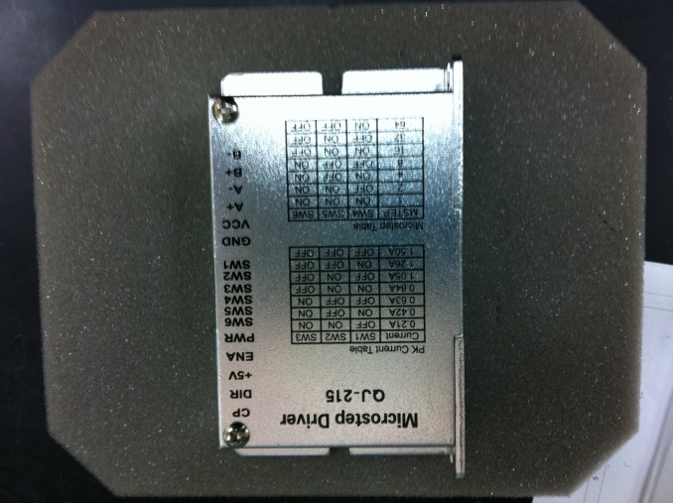
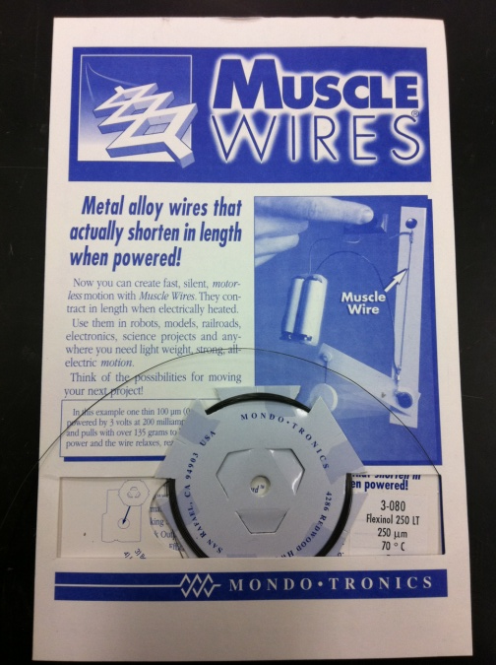
Standard Components
LEDs: 2 LED arrays each array has 48 LEDs
Micro-step driver: requires 12v, 5v, PWM
Muscle wire: 1 amp of current

Slide 10
Camera
AVM will be able to support both industrial and consumer cameras
Mikrotron “MotionBLITZ Cube2” and GoPro “HD Hero”
GoPro is a consumer camera used during initial experiments to reduce financial loss in case of rocket failure
Mikroton is an industrial camera that will be used more often in the long run

Slide 11
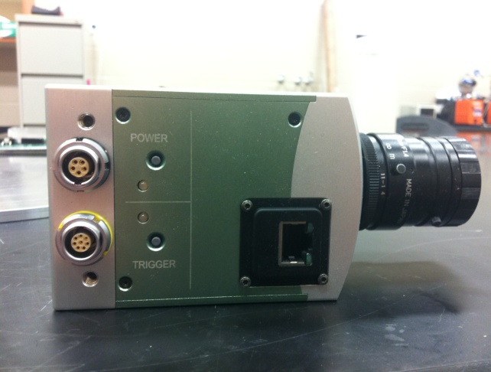
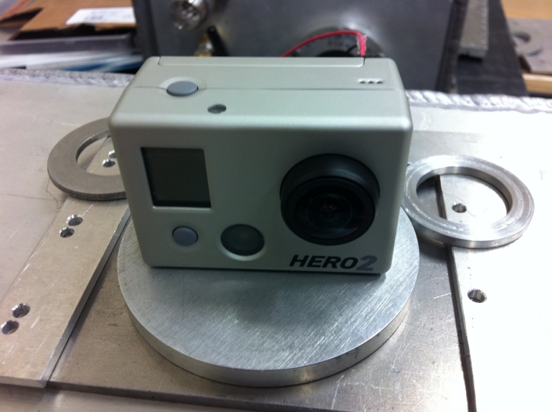
Mikrotron vs GoPro
Mikrotron | GoPro
500 FPS | 60 FPS
1280 x 1024 | 1280 x 720
Gigabit Ethernet | None

Slide 12
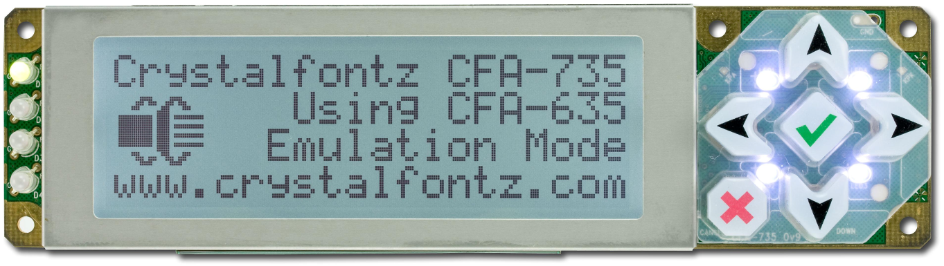
User Input Module (UIM)
Can use either serial or USB interface
Has EEPROM memory (to store the menu)
Will allow user to view current experimental variables
Or change them (start time, duration, etc)

Slide 13
UIM Menu
Main menu to choose which experimental variable to view/change
In submenu option to view or change will be proposed
If change is selected user will use arrows to increase or decrease current value

Slide 14
Data Storage
Data transfer will be ~ 100 MB/s
Patriot requires USB 3.0 for 120 MB/s rate
SanDisk is only 90 MB/s
SSD has best combination of speed, capacity, and durability
Brand | OCZ | Patriot | SanDisk
Series | VERTEX 3 | Supersonic Magnum | Extreme Pro
Interface | SATA III/II | USB 3.0/2.0
Capacity | 120 GB | 64 GB | 16 GB
Write Speed | 500 MB/s | 120MB/s | 90 MB/s
Price | $199.99 | $129.99 | $99.99

Slide 15
Solid State Drive
Using SATA II connection write speed is 260 MB/s
Shock Resistance is 1,500 G
Vibration Resistance 2.17G – 3.13G (Operating – Non-Operating)

Slide 16
Accelerometers
MMA7361 3-Axis Accelerometer Module
MMA7260QT 3-Axis Accelerometer Module
Hitachi H48C 3-Axis Accelerometer Module
First only sell in package
Second does not have a simple 0-g detection
Hitachi have a support base

Slide 17
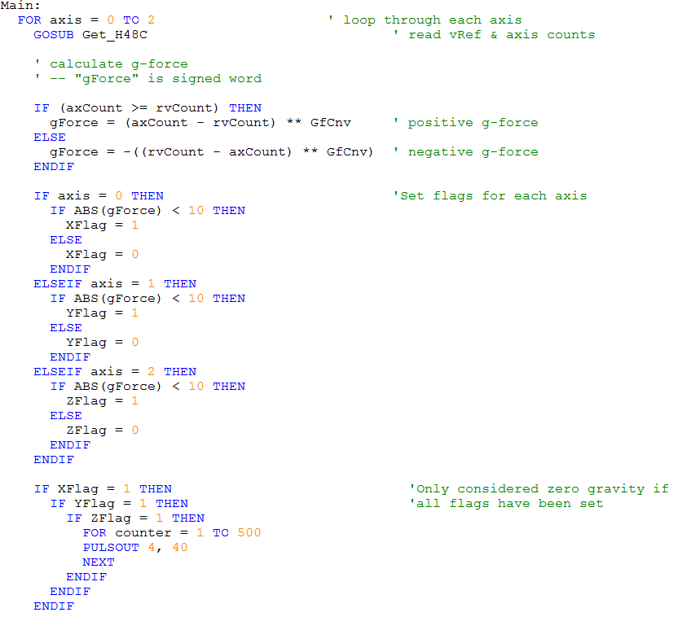
Accelerometer

Slide 18
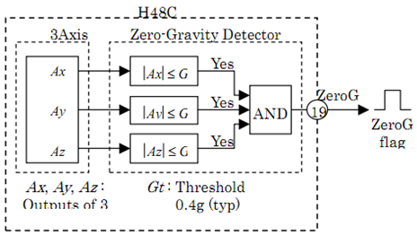
Zero-Gravity
Main draw of our accelerometer choice
  Has capability of detecting a zero gravity environment through a pin output
  Reduces chances of failure
    Essential for our needs

Slide 19
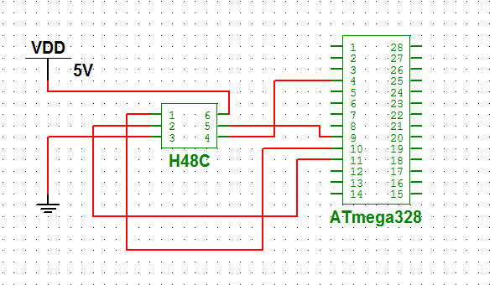
Accelerometer (H48C)
Pin | Label | Definition
1 | CLK | Synchronous clock input
2 | DIO | Bi-directional data to and from the host
3 | Vss | Power supply ground which is 0v
4 | Zero-G | “Free-fall” detection output; active-high
5 | CS\ | Chip select input; active-low
6 | Vdd | +5 vdc

Slide 20

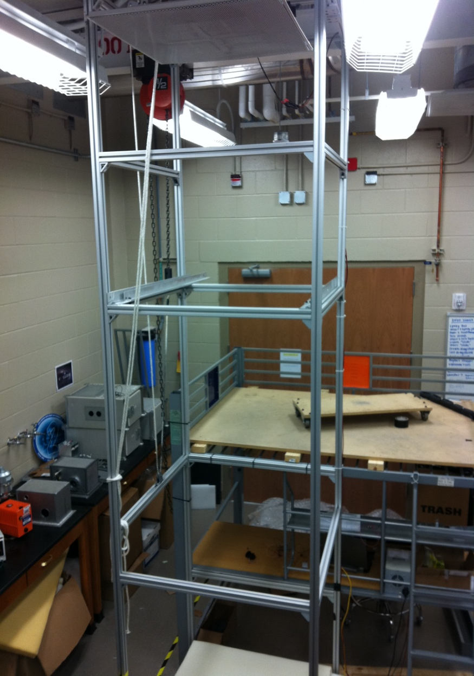
Testing Accelerometer

Slide 21
Accelerometer – False Positives
Zero-G pin can sometimes output false positives
Costly mistake that needs to be protected against
  Will have counter loop that continuously checks flag every .4ms
  If pin consistently reads zero gravity for set amount of time, it is not a false positive, and experiment can proceed

Slide 22
Primary Microcontroller
Will read inputs from the User Input Module
Uploads experimental variables and procedure to the secondary microcontroller
Communicates with the solid-state drive
Handles high speed image transfers from the camera

Slide 23
Primary Microcontroller
 | Hawkboard | Zoom L138 | TS-7800
Processor | TI OMAP-L138 | TI OMAP-L138 | 500 MHz ARM9
Memory | 128 MB DDR2 SDRAM | 128 MB DDR2 SDRAM | 128MB DDR-RAM
Interfaces | 1 x RS232 1 x Ethernet 2 x USB (1.1, 2.0) 1 x SATA II | 1 x RS232 1 x Ethernet 2 x USB (1.1, 2.0) 1 x SATA II | 2 x SD Card slots (1 micro, 1 full) 1 x Gigabit Ethernet 2 x SATA II 2 x USB (2.0) 10 x Serial
Software Supported | Linux | Linux/Windows Embedded CE/Ubuntu 10.04 | Linux/Eclipse IDE

Slide 24
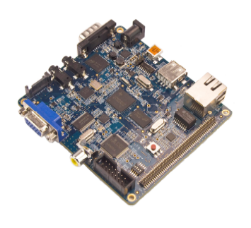
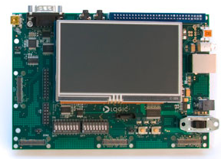
Hawkboard/Zoom
Hawkboard has instability issues
Updated version won’t be available till March,
TI rep suggested Zoom
Zoom cost is $500
Non-existent support from manufacturer

Slide 25
Primary Microcontroller (TS-7800)
Cost is $279
Excellent support
Available immediately
Faster Ethernet
More interface options
Great support for a processor

Slide 26
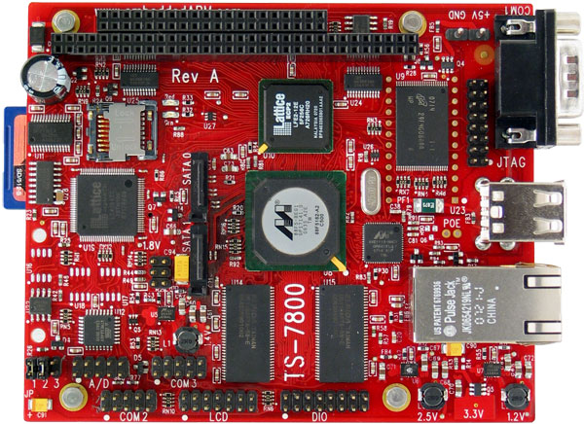
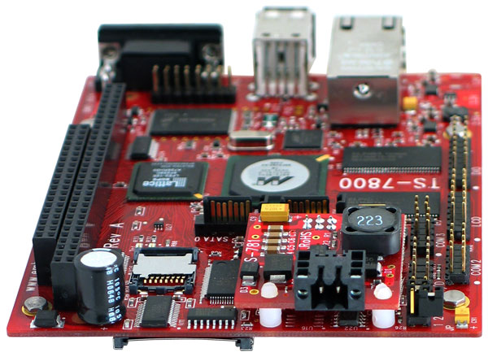
Primary Microcontroller (TS-7800)

Slide 27
Second Microcontroller
Stores experimental variables and procedure
Reads in microgravity mode from accelerometer
Powers on LED’s
Communicates with TS-7800 to power on camera
Activates both micro-step driver and muscle wire

Slide 28
Secondary Microcontroller
 | ATmega328 | ATmega644 | Parallax Propeller | PIC16C57
PINS | 28 PDIP/32 TQFP/ 32 QFN | 44 VQFN/ 44TQFP/40 PDIP | 40 DIP/44 QFN/44QFP | 28 DIP 28 SSOP
MAX I/O Pins | 23 | 32 | 32 | 20
FLASH MEMORY | 32 K | 64K | 32K | 72k
EEPROM | 1K | 2K | 64K | 2K
Price | $3.83 | $6.34 | $7.99 | $2.86

Slide 29
Issues
ATmega644: Extra features would not be taken advantage of
  Bigger size would take away board space
Propeller: same issue as ATmega644
PIC16C57: greater power consumption than the ATmega328

Slide 30
ATmega328
6 dedicated PWM lines
Small footprint
Meets basic requirements
  I/O pins
  Memory (RAM, EEPROM)
  Serial/USB pins
Larger support base
C language (all members familiar)
Familiarity

Slide 31
Hardware Flow Chart
SSD
UIM
TS-7800
CAMERA
SECONDARY
H48C
LEDs
MICROSTEP DRIVER
MUSCLE WIRE

Slide 32
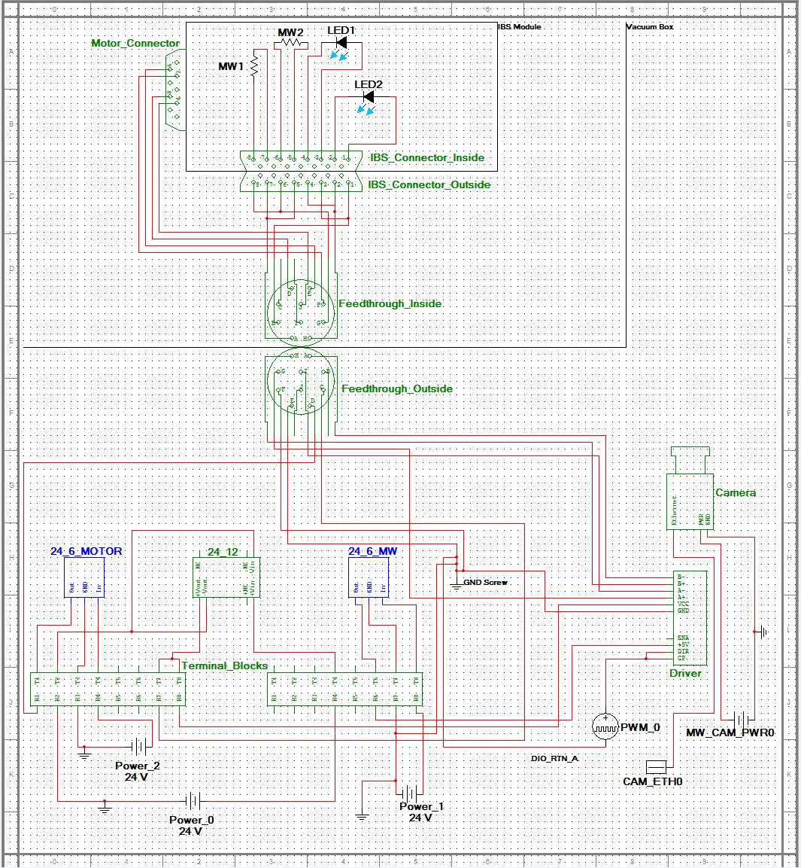
COLLIDE-3

Slide 33
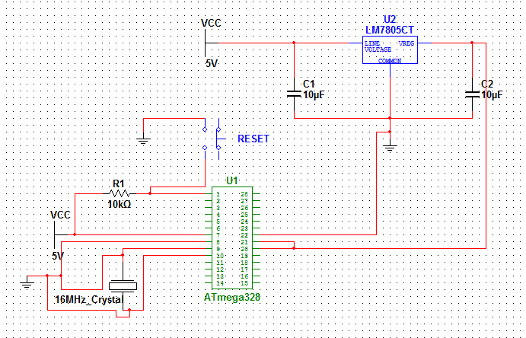
ATMega328 Board Layout

Slide 34
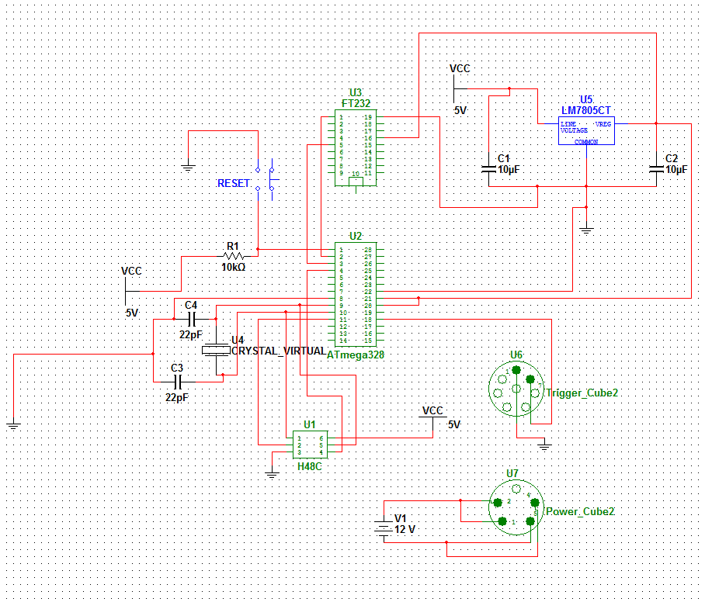

Slide 35
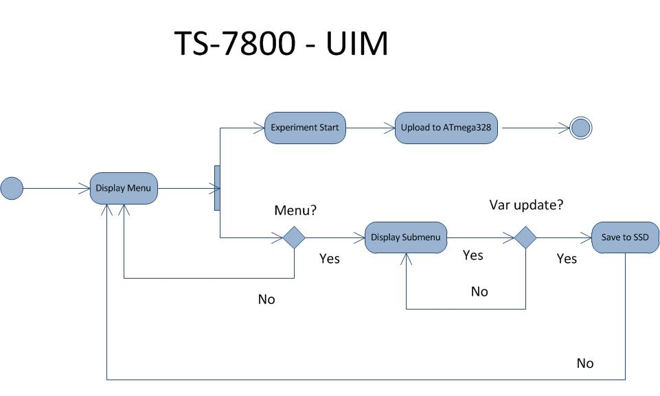
Software Flow Chart

Slide 36
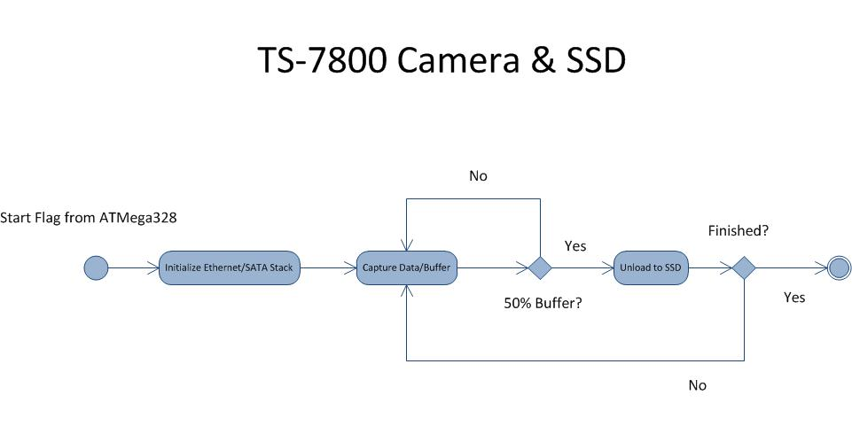
Software Flow Chart

Slide 37
Budget
Part | Cost | Part | Cost
Primary Microntroller | $269 | Power Connector | $65
ATmega328 | $3.83 | SSD | $199
Serial to USB converter | <$15 | Accelerometer (H48C) | $31.88
Voltage regulator | $2 | UIM | $83
Button | $1 | Relay | $100
Misc. Components | $5 | Breadboard | $12
PCB | <$150 | LEDs | Included
Muscle Wire | Included | Micro-step Driver | Included
Case | Included | Cameras | Included
 |  | Total | $936.71

Slide 38
Milestone
Date | Goal
10/10/2011 | First Meeting with Dr Josh Colwell
12/05/2011 | Finish all research
01/23/2012 | Order all main components
02/17/2012 | TS-7800 running fully functional
02/29/2012 | Secondary Microcontroller Complete
03/02/2012 | Progress Meeting with Dr, Josh Colwell
03/09/2012 | AVM ready for testing
04/01/2012 | All testing complete
04/09/2012 | Final Presentation

Slide 39
Work Progress

Slide 40
Project Issues
Handling high speed data transfers
SATA hardware integration
False positive readings from H48C
Communication protocol between TS-7800 and ATmega328

