Slide 1



Blood Pressure Tester
Sponsors:
Texas Instruments
Workforce Central Florida
Presenters:
Brandon Sbert (EE)
Raj Bose (EE)
Bianca Belmont (CPE)
Ricardo Wheeler (EE)
Mentor:
Herb Gingold (TI)

Slide 2
Project Description
Build an Automatic Blood Pressure Tester utilizing the Oscillometric Method (indirect)
Low Power
Wireless Display

Slide 3
Goals and Objectives
To be worn on upper arm
Battery powered
Simple user operation (one button device)
Integrate safe procedures into design
Implement wireless component
Calculate Blood Pressure reading (SYS DIA)
Transmit results wirelessly to display
Receive data from wireless module
Display Blood Pressure data
Error detection

Slide 4
Specifications
Power Supply 4 AAA rechargeable batteries (3v)
Power Life is 60 BP runs
Automatic using Micro motor (6V) / Micro Valve (6V)
Oscillometric
Accuracy of sensor plus or minus 3mmHg
Pressure range of 20mmHg to 280mmHg (cuff)
Adjustable cuff
Wireless range 1m <range> 2m
Display 138X110 grayscale, dot-matrix LCD

Slide 5
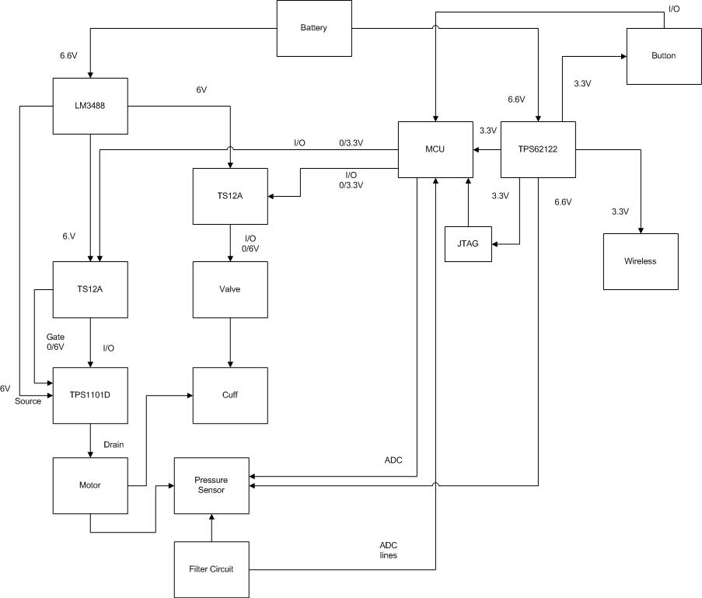
Hardware Block Diagram

Slide 6
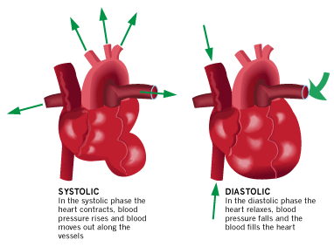
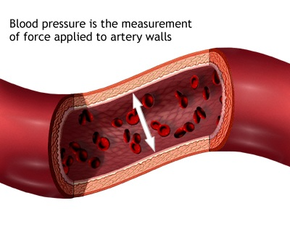
Blood Pressure Monitoring
BP = SYS (high pressure contracting) / DIA (low pressure relaxed)

Slide 7
Blood Pressure Monitoring
Many invasive and non invasive methods exist
Similarity of 3 non invasive methods
all 3 use an occlusion cuff
all 3 record pressure values upon the turbulent re-entry of
blood to lower arm
all 3 inflate cuff to about 30 mmHg above average systolic
pressure to cut off blood flow to the lower arm
Palpitation – touch – direct method
Auscultatory – hearing – direct method
Oscillometric – algorithmic – non direct
BP = SYS (high pressure contracting) / DIA (low pressure relaxed)

Slide 8
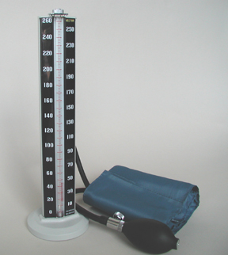
Auscultatory Method
Direct Method
Based on 5 auditory events
(sound / silence)
Heard with stethoscope or microphone
Record meter pressure at first and last event to obtain SYStolic and DIAstolic pressure values
BP = SYS / DIA

Slide 9
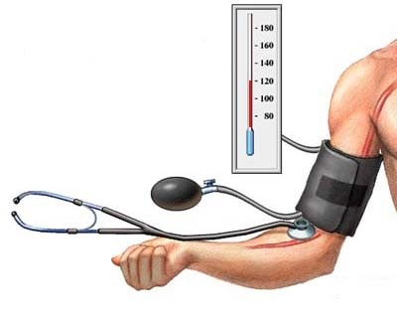
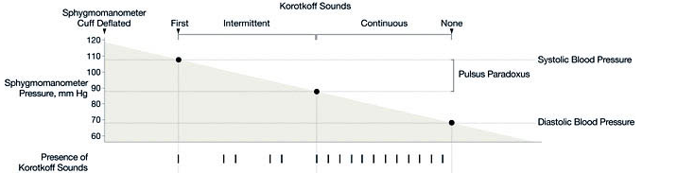
Auscultatory Method

Slide 10
Oscillometric Method
Utilized in our device
Indirect Method
Cuff wall assumed one with the skin
Movement of skin due to turbulent blood flow pulses upon re – entry
Creates air turbulence in cuff
Algorithm uses two sets of data:
Originating from a mixed signal obtained by a pressure sensor connected
to an occlusion cuff
Calculates a systolic pressure and diastolic pressure for a blood pressure reading
BP = SYS (high pressure contracting) / DIA (low pressure relaxed)

Slide 11
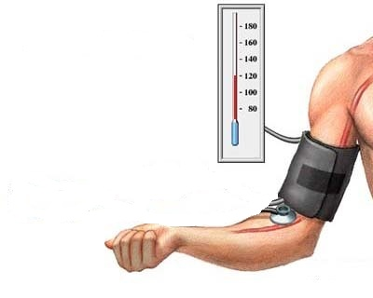
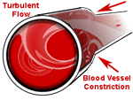
Oscillometric Method

Slide 12
Oscillometric Method
Data set 1
Cuff pressure vs. time
Data Set 2
Only MAP Mean Arterial Pressure obtained from signal
Average arterial pressure during one heart cycle
MAP = DIA + 1/3 (SYS – DIA)
MAP Mean Arterial Pressure PEAK amplitude of signal
Counterintuitive: MAP is the PEAK of a signal of re-entry pulses
SYStolic pressure is assumed to be the highest pressure in the heart cycle
SYStolic and DIAstolic points in time in relation to MAP

Slide 13
Mechanical

Slide 14
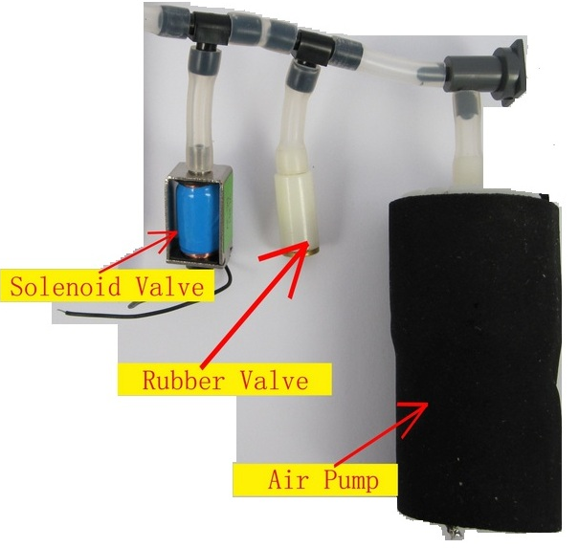
General Picture of the Mechanical Parts

Slide 15

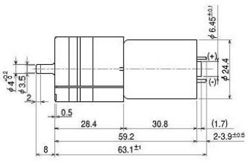
Motor
Model: P54A02R
Cylinders: 3
Rated Voltage: DC 6V
Flow (No Load): 1.8L/min
Current (No Load): 170mA
Max Current: 290mA
Max Pressure: 95kPa
Noise: 50dB

Slide 16
Cuff
Model: D-Ring
Upper Arm
Standard adult cuff which has a circumference between 9-13 inches
Used for home-monitoring and self-application environments
It provides great flexibility, and it is light

Slide 17
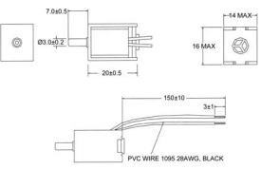
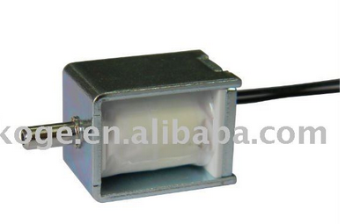
Solenoid Valve
Model: KSV05B
Rated voltage: DC 6V
Rated Current: 60mA/45mA
Exhaust time: Max. 6.0 seconds from 300mmHg reduce to 15 mmHg at 500CC tank
Leakage: Max. 3mmHg/min from 300mmHg at 500CC tank.

Slide 18
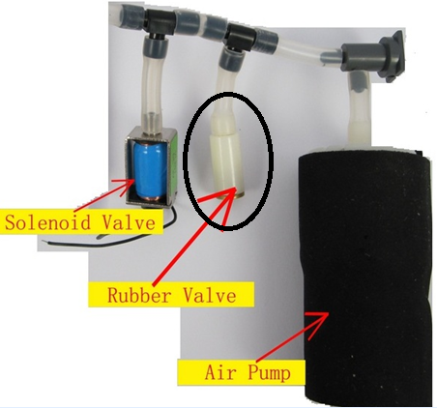
Mechanical Valve
Maintains a slower linear deflation rate
Optimal for pressure sensor sampling:
160 – 80 mmHg (Cuff Pressure)

Slide 19
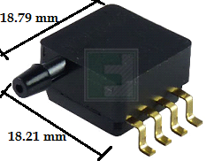
Pressure Sensor
Freescale MP3V5050GP
Internal amplification
Low pass output to avoid noise
Required
7mA constant current input
3.3 V input
Input Range 0 - 50 kPA ( 0 - 7.25psi)
Output Range 0.06 – 2.82 V out
Transfer Function
Vout = Vin * (0.018 * kPa + 0.04)
7.50061683 mmHg per 54 mV
BP = SYS / DIA = mmHg

Slide 20
Pressure Signal

Slide 21
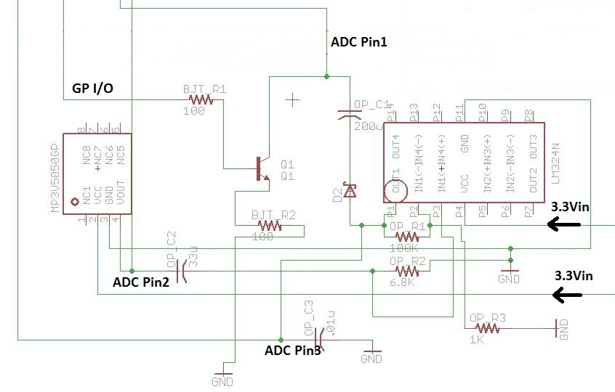
Pressure Signal

Slide 22
Oscillation Signal
Systolic
Point in time when signal is 55% of the MAP amplitude
Diastolic
When signal has decreased by 85% of MAP amplitude

Slide 23
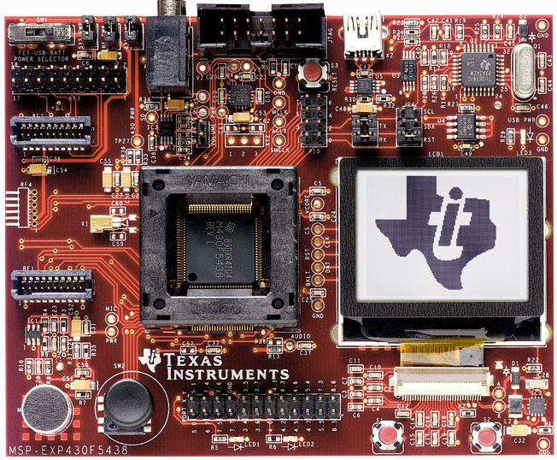
MCU

Slide 24
MSP430F5438A
MSP430F5438A Features:
16-bit Ultra-low power microcontroller
256KB Flash
16KB RAM
High performance 12-bit analog-to-digital (A/D) converter
Real-time clock module
Language: C
Implementation: Code Composer Studio v5.1
Schematics: TINA and WEBENCH Designer

Slide 25
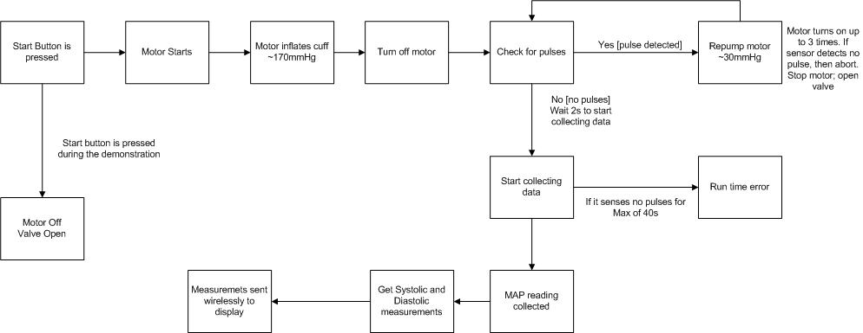
Software Diagram

Slide 26
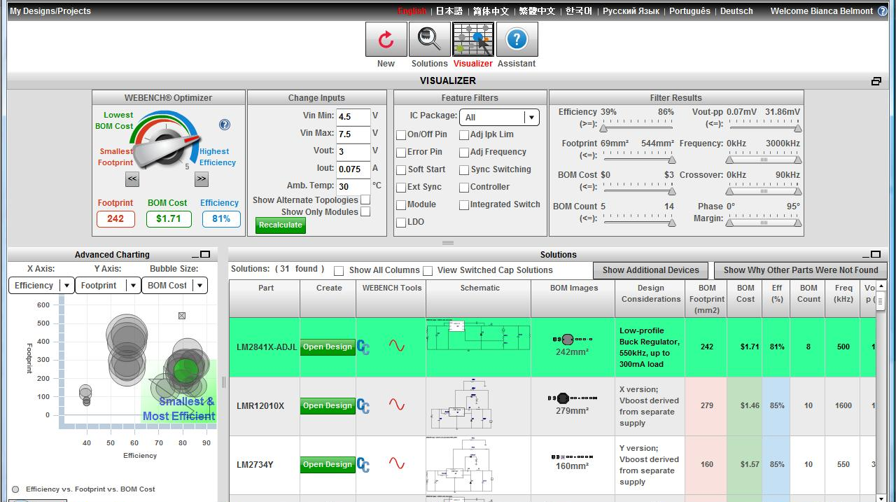
WEBENCH

Slide 27
Hardware Block Diagram

Slide 28

Wireless

Slide 29
Wireless Options
Data | CC1101 EM – Sub 1GHz radio | XBee 1mW Chip Antenna - Series 1 (802.15.4)
Power | 3.3V @34.2 mA | 3.3V @45 mA
Frequency | 868-915 MHz | 2.4 GHz
Protocol | RF | RF
Range | Short Range | Short Range
Antenna | Wire | Chip
Support | Little | A lot

Slide 30
XBee 1mW Chip Antenna - Series 1 (802.15.4)
Protocol: RF
Frequency: 2.4 GHz
Power: 3.3V @ 45mA
Range: 300ft (100m) range
Antenna: Chip Antenna

Slide 31
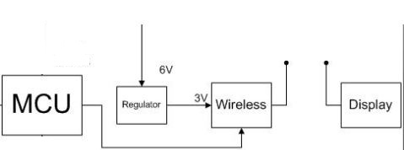
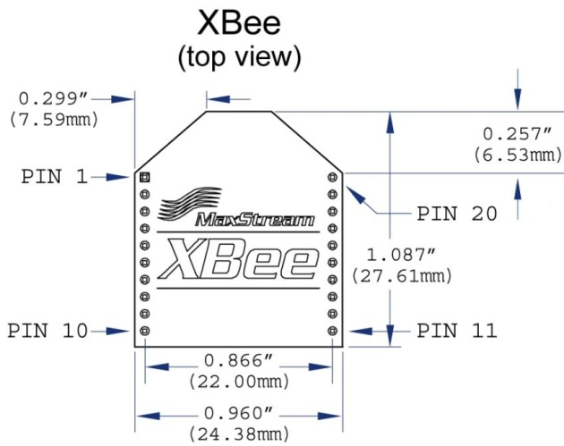
Wireless Block Diagram

Slide 32
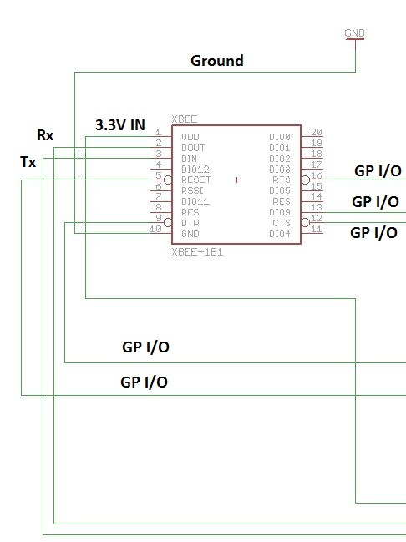
Wireless Design
Pin1: Vin at 3.3V
Pin2: Dout Connected to RX
Pin3: Din Connected to Tx
Pin10: Ground
Pin5: RESET
Pin9: Digital Input/Sleep Control
Pin12: Clear-to-send flow control
Pin13: Module Status Indicator
Pin16: Request-to-send flow control

Slide 33

Power Source

Slide 34
Battery
4x AAA batteries: 6V
Alkaline Batteries
Power life 60 BP runs

Slide 35
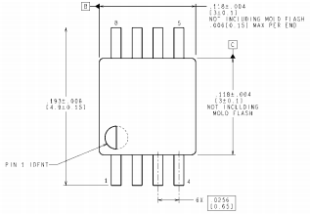
Power Regulator for the Motor/Valve
Model: LM3488
Efficiency: 80%
Switching Frequency (Max): 1000kHz
Switching Frequency (Min): 100kHz
Vin (Min): 2.95V
Vin (Max): 40V
Vout: 2.97V to 40V
It will be supplying the motor and the valve

Slide 36
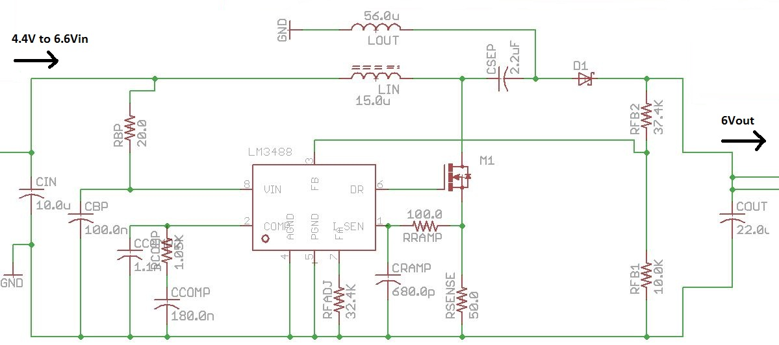
Schematic of the Power Regulator for the Motor/Valve

Slide 37
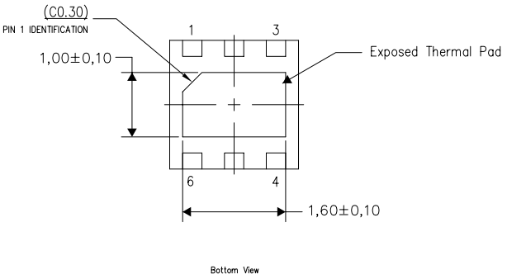
Power Regulator for the MCU/PS/Wireless
Model: TPS62122
Efficiency: 96%
Vin (Min): 2V
Vin (Max): 15V
Vout (Min): 1.2V
Vout (Max): 5.5V
It will supply the MCU, Pressure Sensor and Wireless

Slide 38
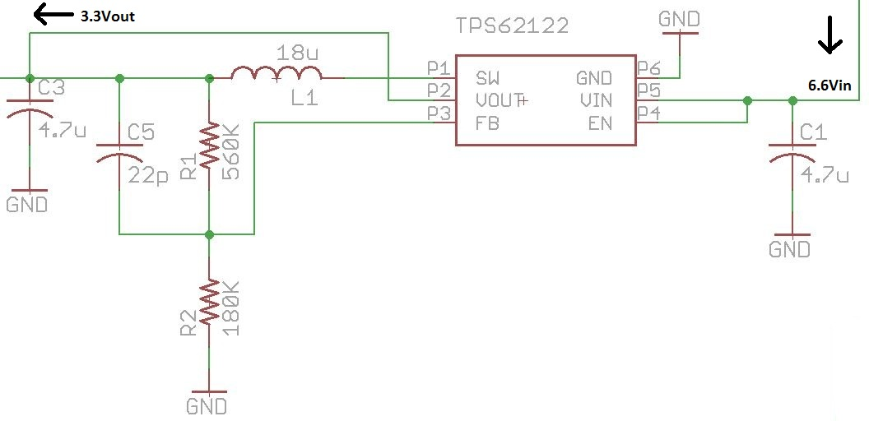
Schematic of the Power Regulator for the MCU/PS/Wireless

Slide 39
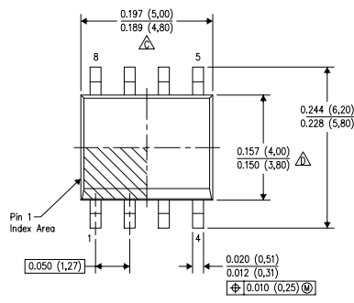
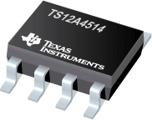
TS12A4514 - Switch
Single pole/single throw (SPST), low-voltage, single-supply CMOS analog
It is normally open (NO)
These CMOS switches can operate continuously with a single supply between 2 V and 12 V
Will be turned ON and OFF by the MSP430F5438 which will be sending 3.3 V (High)

Slide 40
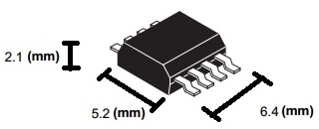
TPS1101PWR MOSFET
The TPS1101 is a single, P-channel, enhancement-mode MOSFET
It is a normally open (NO)
It is the ideal high-side switch for low-voltage, portable battery-management systems where maximizing battery life is a primary concern
It will supply enough current of 290mA to the motor
It operates under 6 V

Slide 41

Printed Circuit Board (PCB)

Slide 42
PCB Design
Data | Values
Software | EAGLE
Manufacturer's | PentaLogix, Inc. & ”Just In Time”
Size | 4” x 3”
Layers | 2
Components | 62

Slide 43
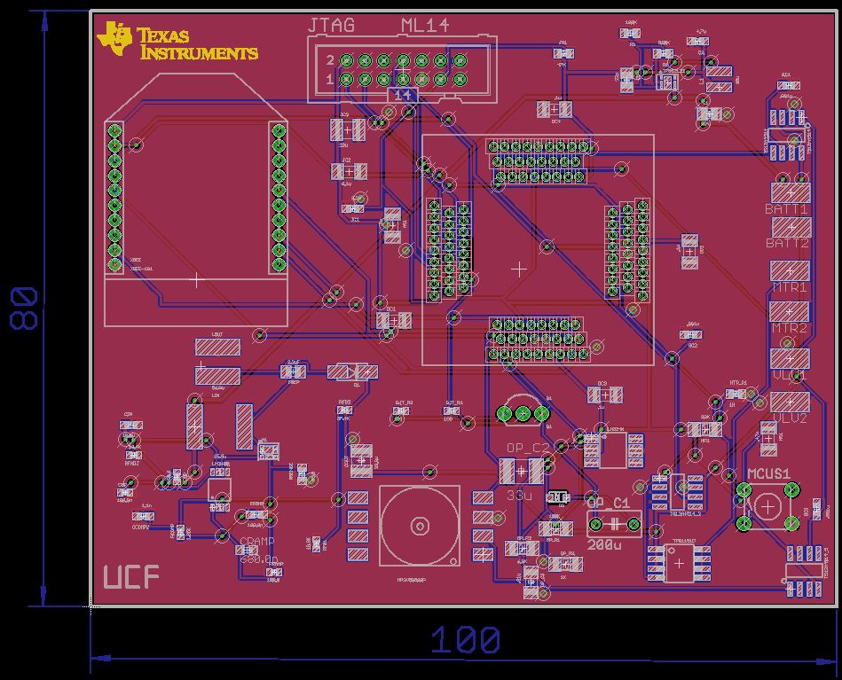
Eagle Designed PCB (Both Layers)
Dimensions are in mm

Slide 44
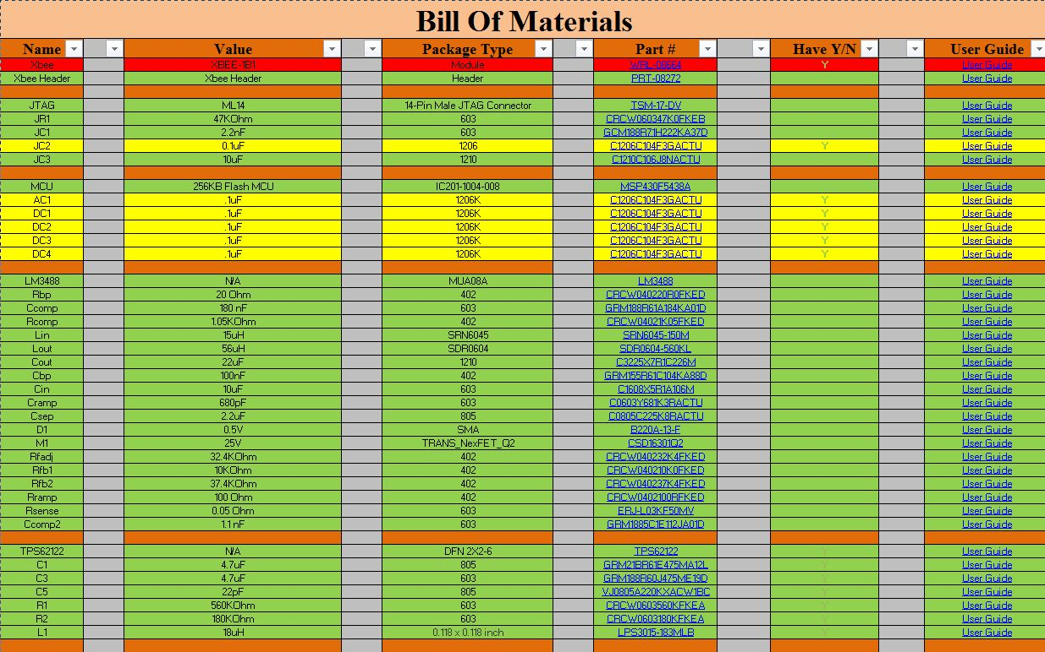
Bill OF Materials (BOM)

Slide 45
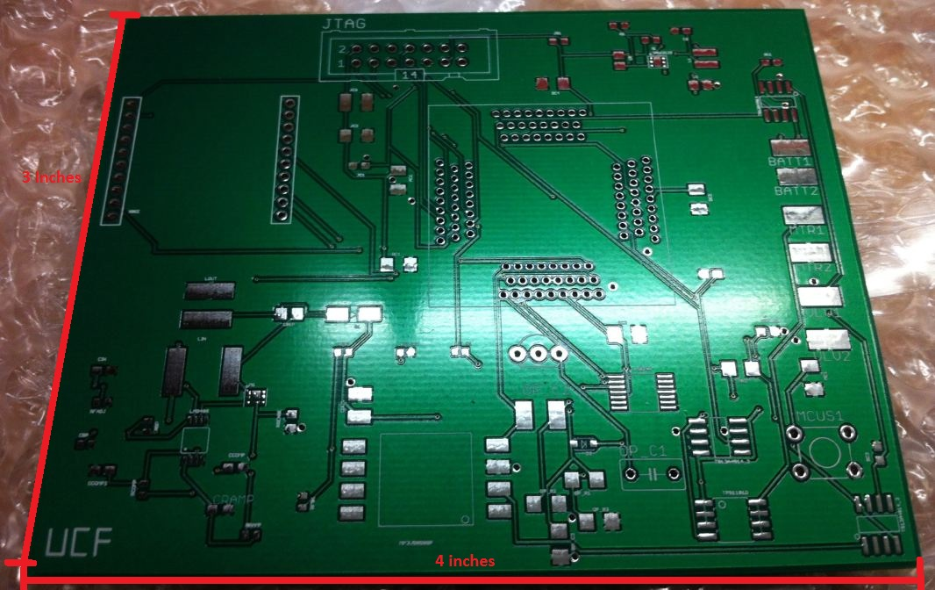
PCB Provided by PentaLogix

Slide 46
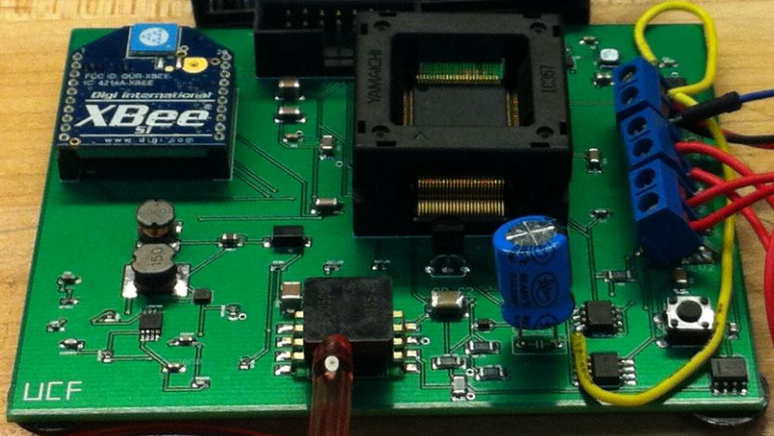
PCB Assembled by “Just In Time”

Slide 47
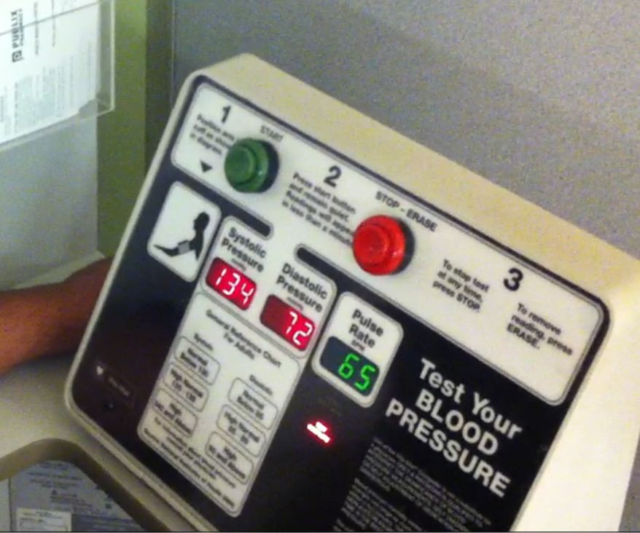
Testing
Brandon’s Test Run at Publix
Brandon’s Test Runs From Project
Test Runs
135/87
131/85
134/86
130/84

Slide 48
Work Distribution
Component | Brandon Sbert | Bianca Belmont | A. Raj Bose | Ricardo Wheeler
MCU/Coding | 5% | 80% | 10% | 5%
Power Design | 10% | 5% | 5% | 80%
Filter Design | 5% | 5% | 80% | 10%
Wireless Design | 80% | 10% | 5% | 5%
Schematic/PCB | 80% | 5% | 10% | 5%

Slide 49
WCF Budget
Component | Quantity | Total Price
Batteries | 8 | $20.00
BP Motor | 2 | $10.00
BP Pump | 3 | $30.00
BP Valve | 3 | $9.00
BP Cuff | 2 | $40.00
MCU | 3 | $3.00
Op-Amps | 5 | $10.00
Resistors | 10 | $7.00
Capacitors | 10 | $10.00
EXP Board/Display | 1 | $200.00
Pressure Sensor | 4 | $65.00
Wireless EM | 2 | $240.00
PCB Board | 1 | $55.00
Sub Total: | 54 | $699.00

Slide 50
Actual Budget
Component | Quantity | Total Price
Batteries | 20 | $15.00
BP Motor/pump | 2 | $25.00
BP Valve | 2 | $25.00
BP Cuff | 2 | $25.00
Components | 62 | $120.00
Tina Software | 1 | $89.00
PCB | 2 | $225
MSP430F5438 | 6 | FREE
Xbee Module | 2 | $50
MSP430F5438 Experimenter Board | 4 | FREE
CC1101DK868-915 | 1 | FREE
MSP-FET430U5X100 | 1 | FREE
Shipping | N/A | $100
Sub Total | 105 | $674

Slide 51
Problems
Testing LM Regulator
LM Regulator not working on original PCB

Slide 52
Questions?

