Slide 1
Solar Thermal Energy Generation
Group 7
Andy Bryan (EE), Beau Eason (EE), Rob Giffin (EE), Sean Rauchfuss (EE)
Funded by Progress Energy

Slide 2
Motivation
The world needs new reliable sources of energy
Current energy supply is based mainly on fossil fuels and natural gas which have a limited supply
Finding a new energy source which is renewable, such as solar, would be best
Because of this need, a lot of money can potentially made

Slide 3
Project Goals & Objectives
Utilize an energy source which is free and abundant
Be able to store the generated energy as electric potential
Prove that the concept can work with a functioning prototype

Slide 4
Specifications
The system is to weigh no more than 50 kilograms and is to occupy a volume no greater than 2 meter³
The system is to be capable of operating continuously under ideal conditions for at least a 2 hour period
A 12V supply battery will be able to properly power the control system
The generator output will be capable of efficiently and safely charging a 12V battery

Slide 5
Specifications
The tracking system will be able to keep the focal of the Fresnel lens precisely on the heat element of the Stirling engine as to avoid damage to other parts of the system and to maximize energy generation
Fresnel lens will be capable of producing focal point with enough heat to properly operate Stirling cycle engine

Slide 6
Specifications
A microcontroller will control the tracking system as well as be responsible for battery and charge control management
The system will utilize two 12V batteries that will be interchangeable in function. The microcontroller will be responsible for switching between battery functions
Switching regulators will be used to provide proper power for the microcontroller and tracking system motors from the 12V battery

Slide 7
General Overview

Slide 8
Charging Subsytem

Slide 9
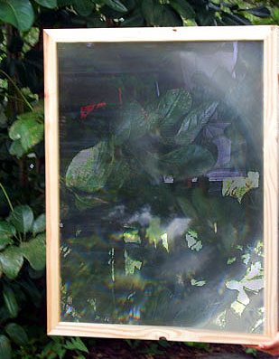
Fresnel Lens
Reach temperature of up to 2000 °F
Requires precise alignment of focal point
Chose a 40”x28” spot lens

Slide 10
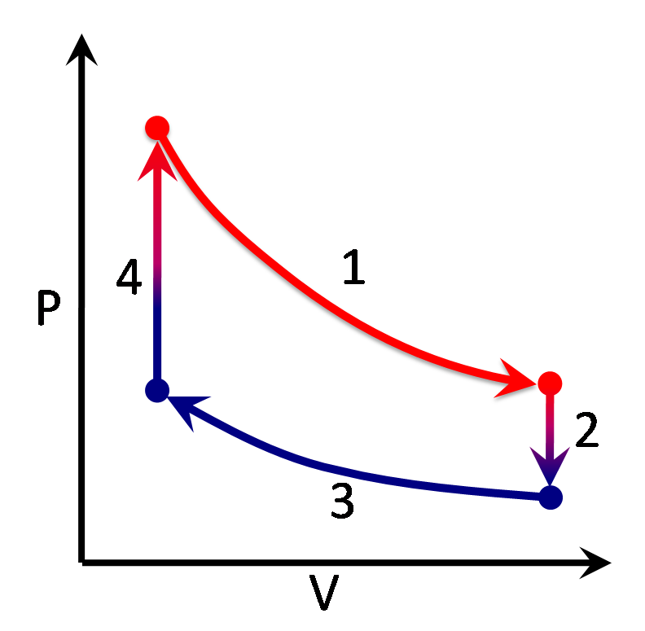
Stirling Engine
Based on Carnot cycle of
thermodynamics
2
3
1
4

Slide 11
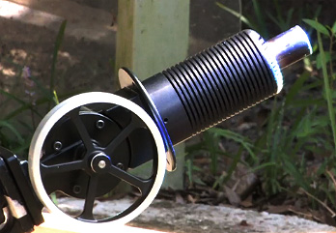
Stirling Engine Choice

Slide 12
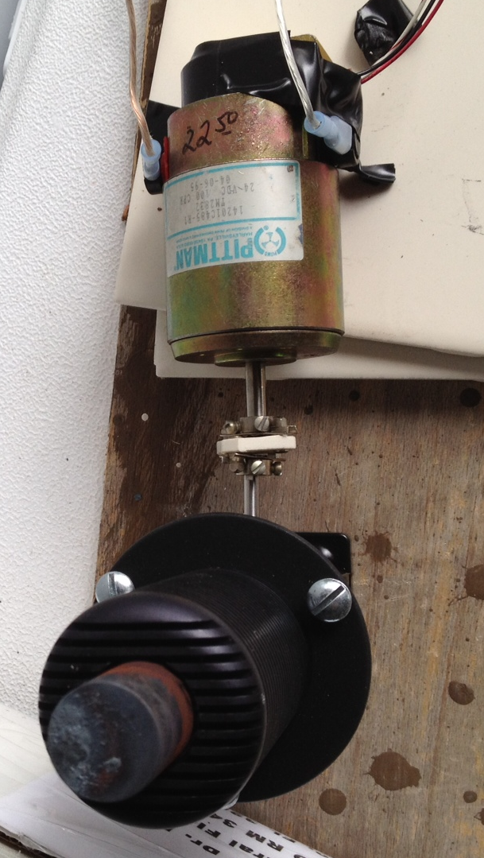
Generator
Rated up to 24 VDC
Low starting / running torque
Brush permanent magnet
Cost effective
Typically outputs 5-7VDC

Slide 13
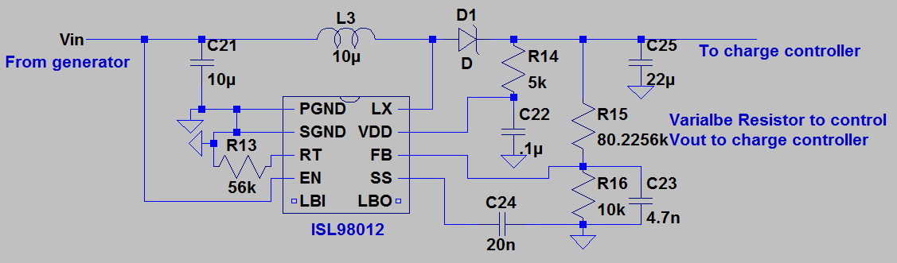
Boost Regulator
Used to step up 5-7VDC generator output to 12V needed to charge battery
Used ISL98012
Chosen for step up capabilities

Slide 14
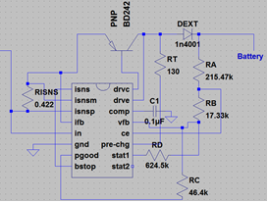
Charge Controller
BQ24450
12V charge controller
Max output voltage 13.8
High Efficiency
Safety
From boost
Regulator

Slide 15
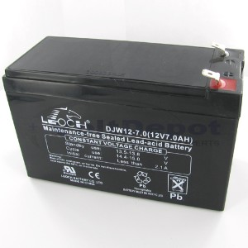
Charge Battery
Leoch LP12-6-FI
Chemistry: Lead Acid
Voltage: 12
Capacity: 7.00 Ah
Rating: 84 Whr
Cells: 6
2.6”
3.7”
6”

Slide 16
Control Subsystem

Slide 17
Dual Axis Solar Tracking
Meets accuracy need of lens and engine
Maintains central point where focal will always be
Altitude
Azimuth

Slide 18
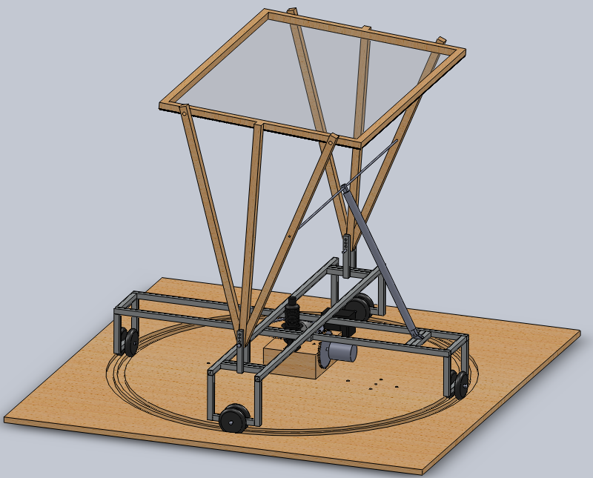
Hardware Design

Slide 19
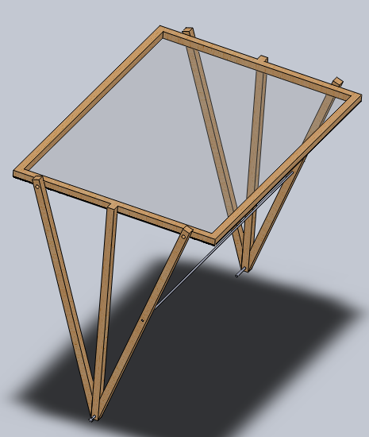
Lens Support Assembly
Contains Lens and Sensor Array
Rotates about Lens focal point (30° - 90°)
Interfaces with an actuator
Pins to Revolving Frame Assembly

Slide 20
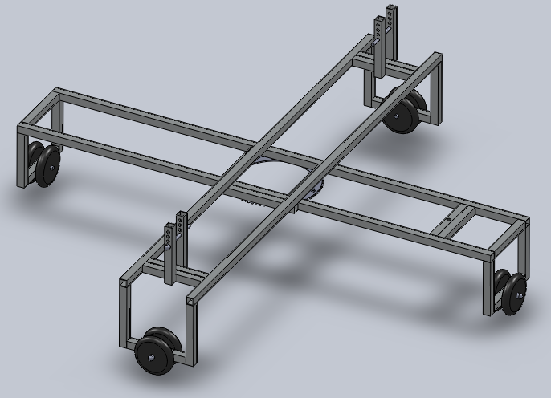
Revolving Frame Assembly
Contains Actuator bracket, LSA support arms, and wheels
Rotates about central axis (0° - 360°)
Interfaces with a geared stepping motor on base platform

Slide 21
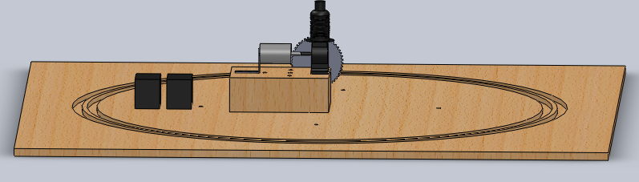
Base Platform Assembly
Contains Stirling Cycle Heat Engine, Generator, Stepper Motor, Batteries, Control Box
Raised inside platform which keeps wheels on RFA aligned properly

Slide 22
Solar Sensing
Sun
light
Photo detector
To control system
Block diagram of how sunlight is communicated to the control system
Altitude Up
Sensor A
Sensor B
Azimuth Left
Azimuth Right
Sensor C
Sensor D
Altitude Down
The finalized design of the solar tracking sensor array.

Slide 23
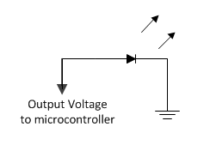
Using LEDs as Light Detectors
No input voltage required
Output
Direct sunlight=1.5V
Partial sunlight=0.6V
Ambient Light=.02V

Slide 24
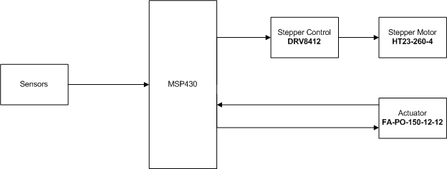
Control System Overview

Slide 25
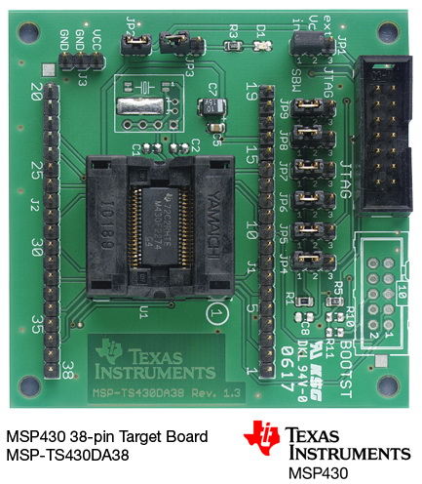
Microcontroller MSP430
This the target board being used
The particular MSP430 being used is the MSP430F2224
Chosen because of need for several I/O pins as well as analog to digital conversion

Slide 26
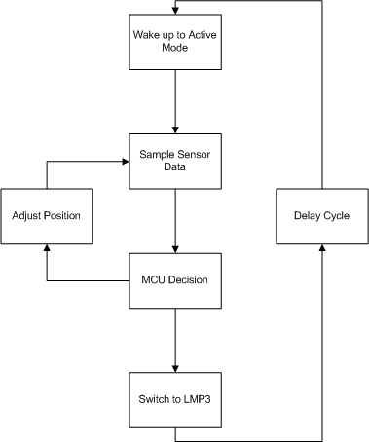
Software
During most of the operation cycle no control will be needed
This allows us to utilize the MSP430’s low power modes (LMPX)
An internal clock will be used for the delay between sensor reads

Slide 27
Low Power Modes
Mode | CPU | Mclock | SMclock | Aux. Clock | Oscillators
Active | Active | Active | Active | Active | Active
LMP0 | Off | Off | Active | Active | Active
LMP1 | Off | Off | Active | Active | Active (for LF oscillator and CLKIN as source, HF oscillator is mapped to LF oscillator as source)
LMP2 | Off | Off | Off | Active | Active
LMP3 | Off | Off | Off | Active | Active (for LF oscillator and CLKIN as source, HF oscillator is mapped to LF oscillator as source)
LMP4 | Off | Off | Off | Off | Off

Slide 28
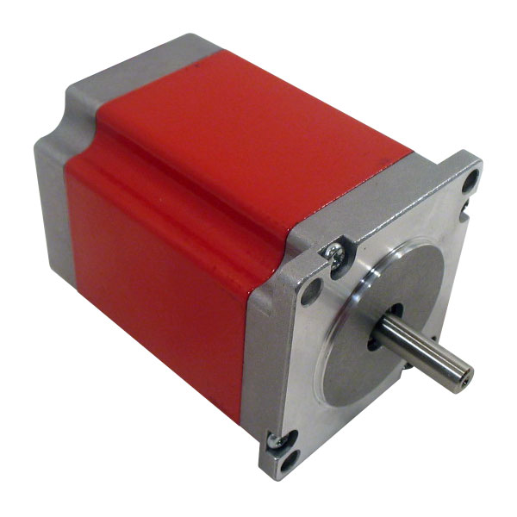
Stepper Motor
Used for azimuth angle adjustments
HT23-260-4
260 Oz In. Hybrid
1.8° /200 Steps Per Rev.
2.5 Amps Current Per Phase
4-wire Bi-polar

Slide 29
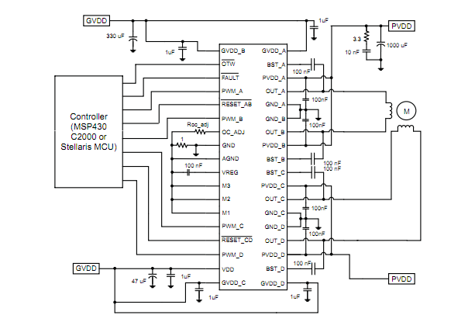
Stepper motor control
This shows TI’s DRV8412 configured to run a stepper motor
Utilizing this IC makes controlling the stepper motor much easier
Lots of application documentation available

Slide 30
Stepper motor issues
Problems with driver circuit on PCB
Spent over a week attempting to fix IC
Could never get necessary power to charge stepper motor windings
Eventually had to find a new solution to problem due to time issues

Slide 31
Resolution - HBridge
We constructed an Hbridge to power the stepper motor
After much testing the stepper motor we could still not operate the stepper motor
Solution was to change to a geared servo motor
A separate Hbridge is being used to control the actuator

Slide 32
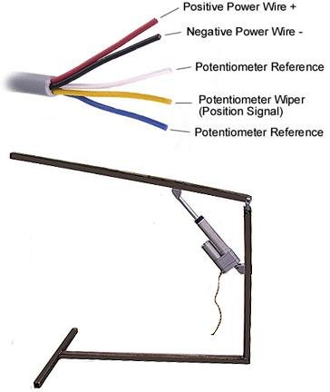
Actuator
Used for altitude angle adjustments
FA-PO-150-12-12
Built in limit switches (non moveable)
Aluminum case
Two clevis mount points, one on each end (uses our MB1 brackets)
10K ohm potentiometer built in

Slide 33
Supply Battery
Leoch LP12-6-FI
Same as charge battery
Function switchable by microcontroller
2.6”
3.7”
6”

Slide 34
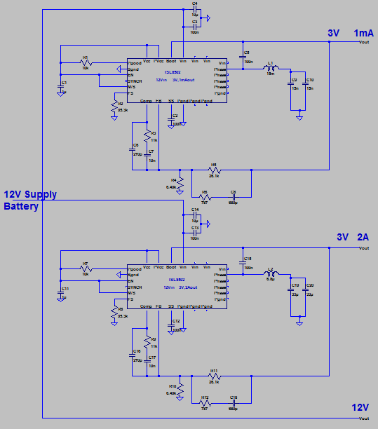
Tracking System Power
MSP430 - 3V
ISL8502 buck regulator
Actuator - 3V
ISL8502 buck regulator
Step controller - 12V
Straight from supply battery

Slide 35
Tracking System Power Issues
ISL8502 buck regulators operated correctly during initial testing
Burnt out during system testing and no longer produce useable voltage

Slide 36
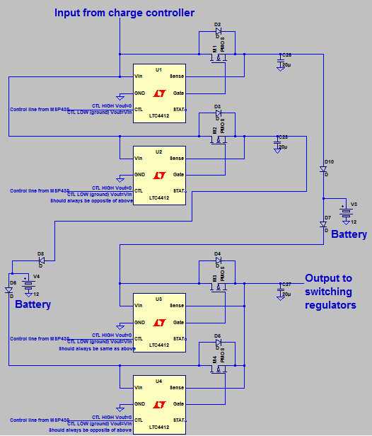
Battery Function Switching
Utilizes 4 LTC4412 low loss power path controllers
Function similarly to logic MUX and allow for safe switching of battery function

Slide 37
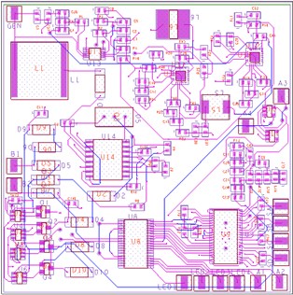
PCB Layout
Boost Regulator
Buck Regulators
Charge
Controller
Power
Switches
MSP430
Step Controller

Slide 38
Testing
Each component tested and operate correctly
Tracking system failed during system testing
Charging system operates correctly for 30 continuous minutes
Able to slowly charge the 12 V battery
Max power is 5 Watts

Slide 39
Administrative

Slide 40
Approved Budget
Item | Function | Price | Quantity | Total
PCB | Connecting subsystems | $ 33.00 | 1 | $ 33.00
Bright red LED | Solar Tracking | $ 1.60 | 4 | $ 6.40
½” Balsa wood | Solar Tracking | $ 2.00 | 1 | $ 2.00
¼” Balsa wood | Solar Tracking | $ 4.00 | 1 | $ 4.00
Hot glue | Solar Tracking | $ 2.90 | 1 | $ 2.90
Electrical Wire | Solar Tracking | $ 10.00 | 3 | $ 30.00
MSP 430 | Microcontroller | $ 4.30 | 2 | $ 8.60
Fresnel Lens | Concentrating Ligh Energy | $ 189.00 | 1 | $ 189.00
WBB236691 generator | Converting Engine output | $ 193.95 | 1 | $ 193.95
85BYGH450A-08 Stepper motor | Rotational Motion | $ 49.98 | 1 | $ 49.98
FA-PO-150-12-8 Linear Actuator | Lens Angle Adjustment | $ 138.00 | 1 | $ 138.00
LP12-6-F1 Leoch Battery | Energy Storage | $ 19.79 | 2 | $ 39.58
PST-DC/2812-8 Voltage Regulator | Energy Storage | $ 154.00 | 1 | $ 154.00
TAF10810N10G Coupler | Energy Storage | $ 18.95 | 1 | $ 18.95
SB1524iX Charger controller | Energy Storage | $ 249.00 | 1 | $ 249.00
Auto Darkening Helmet Powerweld PWH9843 | Eye Protection | $ 59.90 | 4 | $ 239.60
Aluminized Carbon Kevlar® Wool-Lined Gloves | Heat safety | $ 48.00 | 2 | $ 96.00
Kidde 1-A:10-B:C Fire Extinguisher | Fire safety | $ 17.97 | 2 | $ 35.94
misc hardware |  | $ 200.00 | 1 | $ 200.00
misc electronics |  | $ 200.00 | 1 | $ 200.00
 |  |  | Total | $ 1,890.90

Slide 41
Final Budget
Component | Cost
Fresnel Lens | 200.00
Stirling Engine | 316.00
Welding Goggles, Fire Extinguisher | 91.78
Wooden Lens Frame | 9.50
Kinkos Printing | 20.54
Generator and Stepper Gears | 41.48
Stepper Motor | 54.65
Actuator | 160.00
12V Batteries | 49.58
LEDs | 11.00
Aluminum Framing and Balsa wood | 50.13
PCB | 101.47
MSP430 Target Board | 150.00
Gear Motor | 25.00
Misc Components | 250.00
Total Spent | 994.66

Slide 42
Work Distribution

Slide 43
Project Challenges
Large amount of Mechanical Engineering to overcome
Aluminum welding was prohibitively expensive
Inexperience in PCB design
Inexperience in ordering parts
Power issues

Slide 44
Questions?

Slide 45
To do
Update budget
Update msp430 info
Add stirling cycle dimensions
Proofread

