Slide 1
Photovoltaic MPPT Charge Controller (PMC²)
Group 10
Amber Scheurer, EE
Eric Ago, EE
Sebastian Hidalgo, EE
Steven Kobosko, EE
Funded by Workforce Central Florida
Mentor: Alan Shaffer - Lakeland Electric

Slide 2
System Overview
MPPT Charge Controller
Inverter
Solar Array
Battery
LCD
Wireless
Wireless
We designed a charge controller that implements MPPT and demonstrates it in a fully functional stand-alone photovoltaic system.

Slide 3
Motivation and Value of Project
Maximize the cost return on investment for solar panels by using Maximum Power Point Tracking (MPPT) algorithms
LCD screen and wireless data transfer
Useful for testing, research, and maintenance
Potential for industrial scaling
Incorporate a charge controller system with one controller per panel
Notes:
- Save (as much) money on electricity (as possible) - Typical charge controllers just have LED lights Consulting with research engineer at the Florida Solar Energy Center (FSEC)

Slide 4
Goals
Charge controller has to be inherently low power
Utilize Maximum Power Point Tracking to increase efficiency
User/Researcher Friendly Design
LCD Screen
Wireless Data Transfer to Computer Station
Inexpensive

Slide 5
Specifications
Solar Panel delivers > 14 V
Total System Power Output > 200 W
12 V Battery with > 30 Ah
Wireless range > 20 m
Approximately 90% Efficient

Slide 6
Light
Sensor
PV Panel
Temp. Sensor
Charge Controller
LCD Screen
Current Sensor
Voltage Sensor
Micro Controller
XBee
XBee
Boost
Buck
MCU
Current Sensor
Voltage Sensor
Temp. Sensor
Battery
Inverter

Slide 7
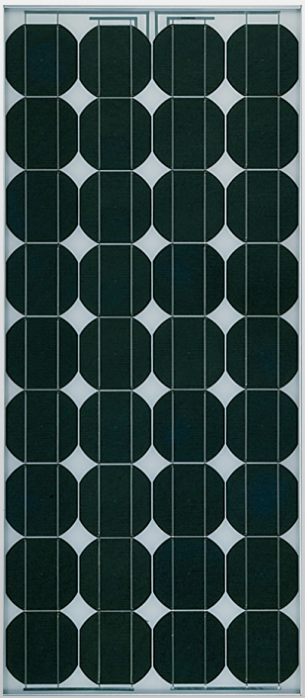
Solar Panel
Parameter | Siemens SP75
Rated Power | 75 W
Type | Single-Crystal
Rated Voltage V_{MPP} | 17.0 V
Rated Current I_{MPP} | 4.4 A
Open Circuit Voltage | 21.7 V
Short Circuit Current | 4.8 A
Provided by Florida Solar Energy Center
47.3 in
20.8 in

Slide 8
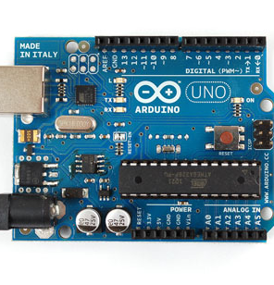
Microcontroller
ATmega328P
Parameter | Arduino UNO
Chip | ATmega328P
Digital I/O | 14 Pins
Analog Input | 6 Pins
PWM Output | 6 Pins
Communication Protocols | I2C, Serial
2.1 in
Arduino Bootloader
Open Source
2.7 in

Slide 9
Microcontroller Peripherals
Temperature Sensors
XBee
RX
SCL
SDA
TX
ATmega 328P
A3
Current Sensors
Irradiance Sensor
A2
D2
A1
A0
Voltage Sensors
PWM
LCD
PWM
TX (D4)
Buck-Boost Circuitry

Slide 10
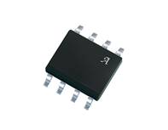
Current Sensor
ACS711ELCTR-12AB-T
Parameter | ACS711
Sensor Type | Hall Effect
Operating Voltage | 3 – 5.5 V
Current Sensing | -12 – +12 A
Operating Temp. | -40 – 85 °C
6 mm
4.9 mm

Slide 11
Voltage Sensor
Voltage Divider
Parameter | Voltage Divider
Source | PV panel
Sensor Type | Voltage Divider
Voltage Sense | 0 – 21 V
R1 | 2.7 kΩ
R2 | 10 kΩ
Output Voltage | 0 – 5 V
R2=10kΩ
R1=2.7kΩ
Vo

Slide 12
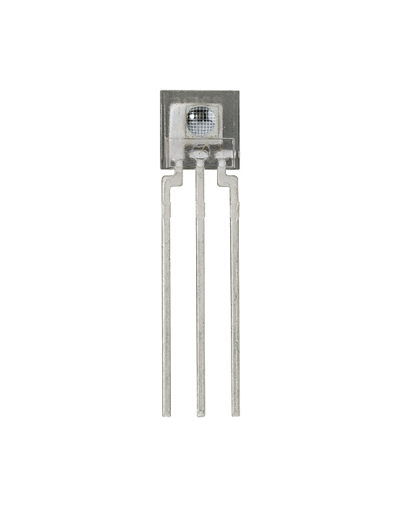
Irradiance Sensor
TSL235R-LF
Parameter | TSL235R-LF
Operating Voltage | 5 V
Output | Square wave 50% Duty Cycle
Operating Temp. | -25 – 70 °C
Light Wavelength Range | 320 – 1050 nm
Output Frequency | 200 – 1000 KHz
19.46 mm
4.6 mm

Slide 13
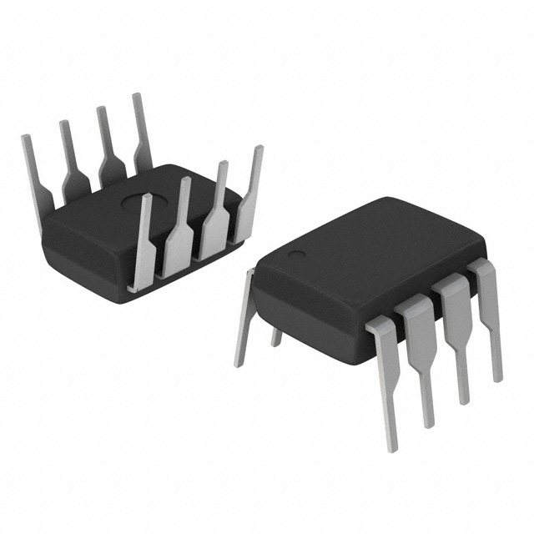
Temp Sensor
DS1624
Parameter | DS1624
Operating Voltage | 3 – 5V
Temp. Range | -55 – 125° C
Internal Memory E² | 256 Bytes
Protocol | I2C
8.5 mm
9 mm

Slide 14
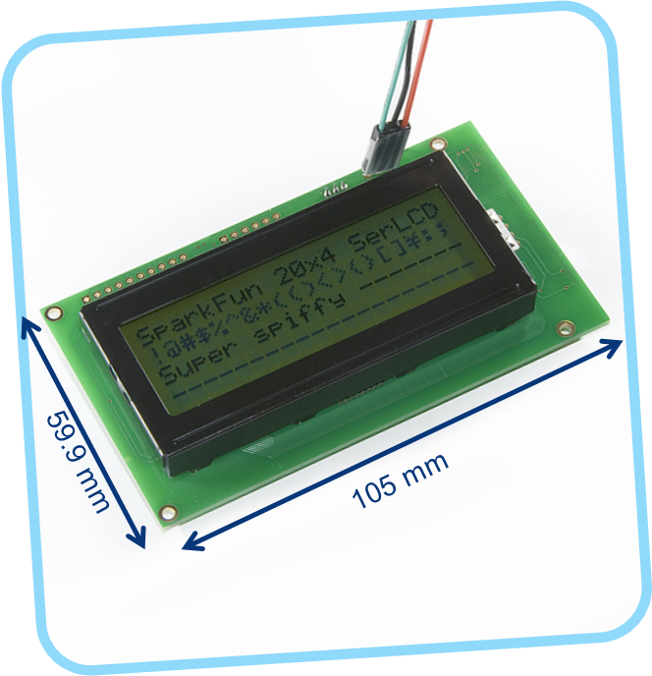
LCD Screen
Parameter | 20 x 4 LCD
Communication | Serial
Color | Black on Green
Operating Voltage | 5 V
Max Current | 60 mA
Notes:
105 x 59.9 mm

Slide 15
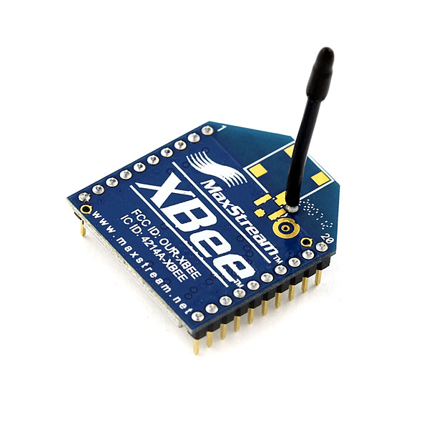
Wireless Module
Parameter | Xbee Series 1
Protocol | 802.15.4
Communication | Serial
Transmitting Power | 1 mW
Outdoor Range | 90 m
Frequency Band | 2.4 GHz
Operating Voltage | 3.3 V
24.3 mm
27.6 mm

Slide 16
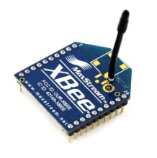
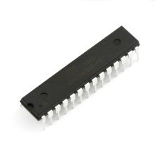
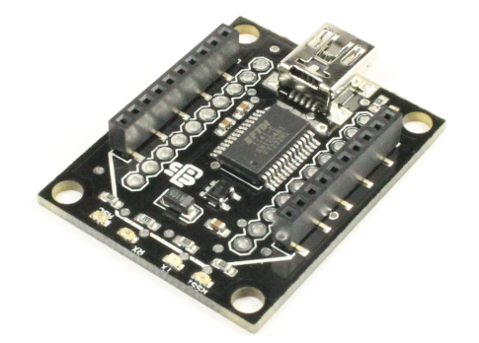
Wireless Subsystem
Sensor Data

Slide 17
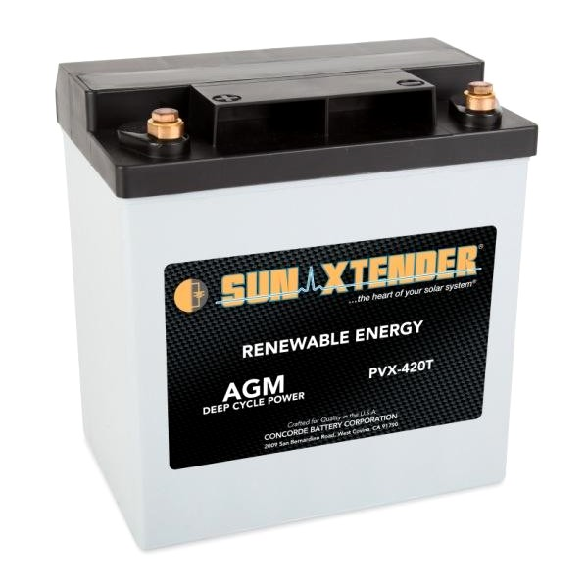
Battery
Sun Xtender PVX-420T
Parameter | Sun Xtender
Chemistry | AGM
Nominal Voltage | 12 V
Capacity | 42 Ah
CCA | 40 A
Number of Charges | 1000
8.05 in
5.18 in
7.71 in

Slide 18
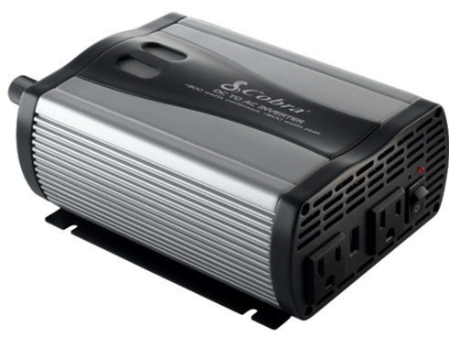
Inverter
Cobra CPI 880
Parameter | CPI 880
Output Power | 800 W
Surge | 1600 W
Wave output | Moderate Sine
Input Voltage | 12 V
Output Voltage | 109 – 120 VAC
AC Outlets | 2
USB | 1
3 in.
5.5 in
9 in.

Slide 19
H-Bridge Topology Buck-Boost DC/DC Regulator
Single Inductor Buck/Boost Architecture
Separate Buck and Boost Operating Modes
Synchronous 4-Switch Operation for Higher Efficiency
Wide Input Voltage Range: 4.5V to 40V
Wide Output Voltage Range: 12V to 15V

Slide 20
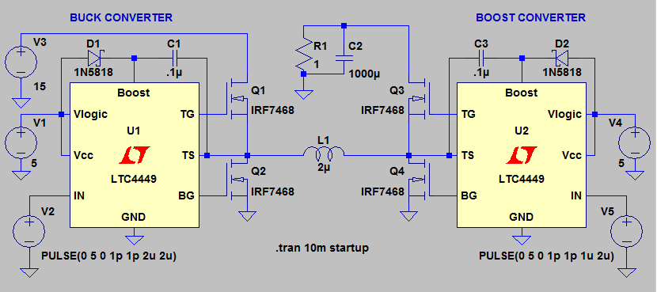
Boost Operation

Slide 21
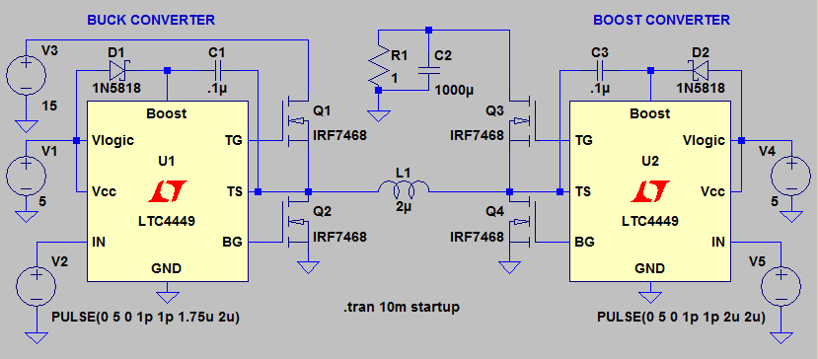
Buck Operation

Slide 22
MPPT Algorithms
 | Efficiency | Programming Difficulty | Potential for “error”
Incremental Conductance Method | Highest | Complex | Yes
Perturb and Observe Method | High | Average | Yes
Constant Voltage Method | Low | Low | No
Notes:
Going to do testing to determine the sampling rate and how often to perturb.

Slide 23
Perturb and Observe Method
MPP
P_{max}
Power
Voltage
V_{mp}
V_{OC}

Slide 24
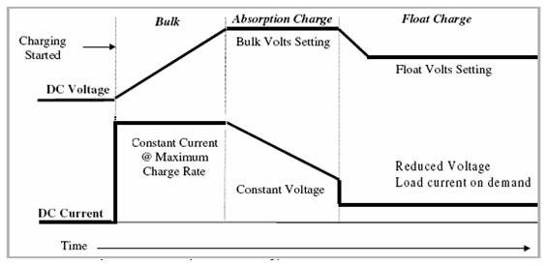
Battery Charging Stages
Bulk
Absorption
Float

Slide 25
LCD: LCD.print Xbee: Serial.write
Sensor Read: Battery Voltage
Bulk
Sensor Read: Battery Current
Start
Float or Absorption
I > I₀
I < I₀
Increase Voltage
Decrease Voltage
Adjust PWM
Regulated Power Delivered to Battery
Notes:
Software Diagram & User Interface

Slide 26
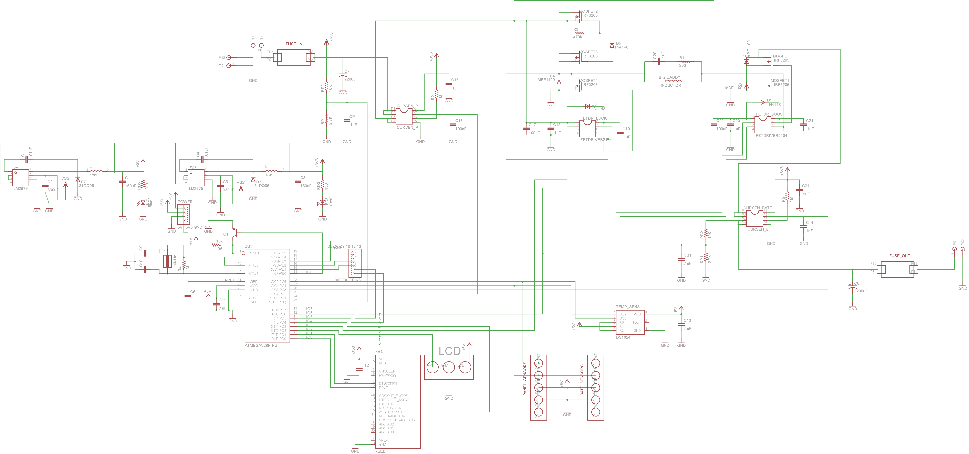
Printed Circuit Board Schematic

Slide 27
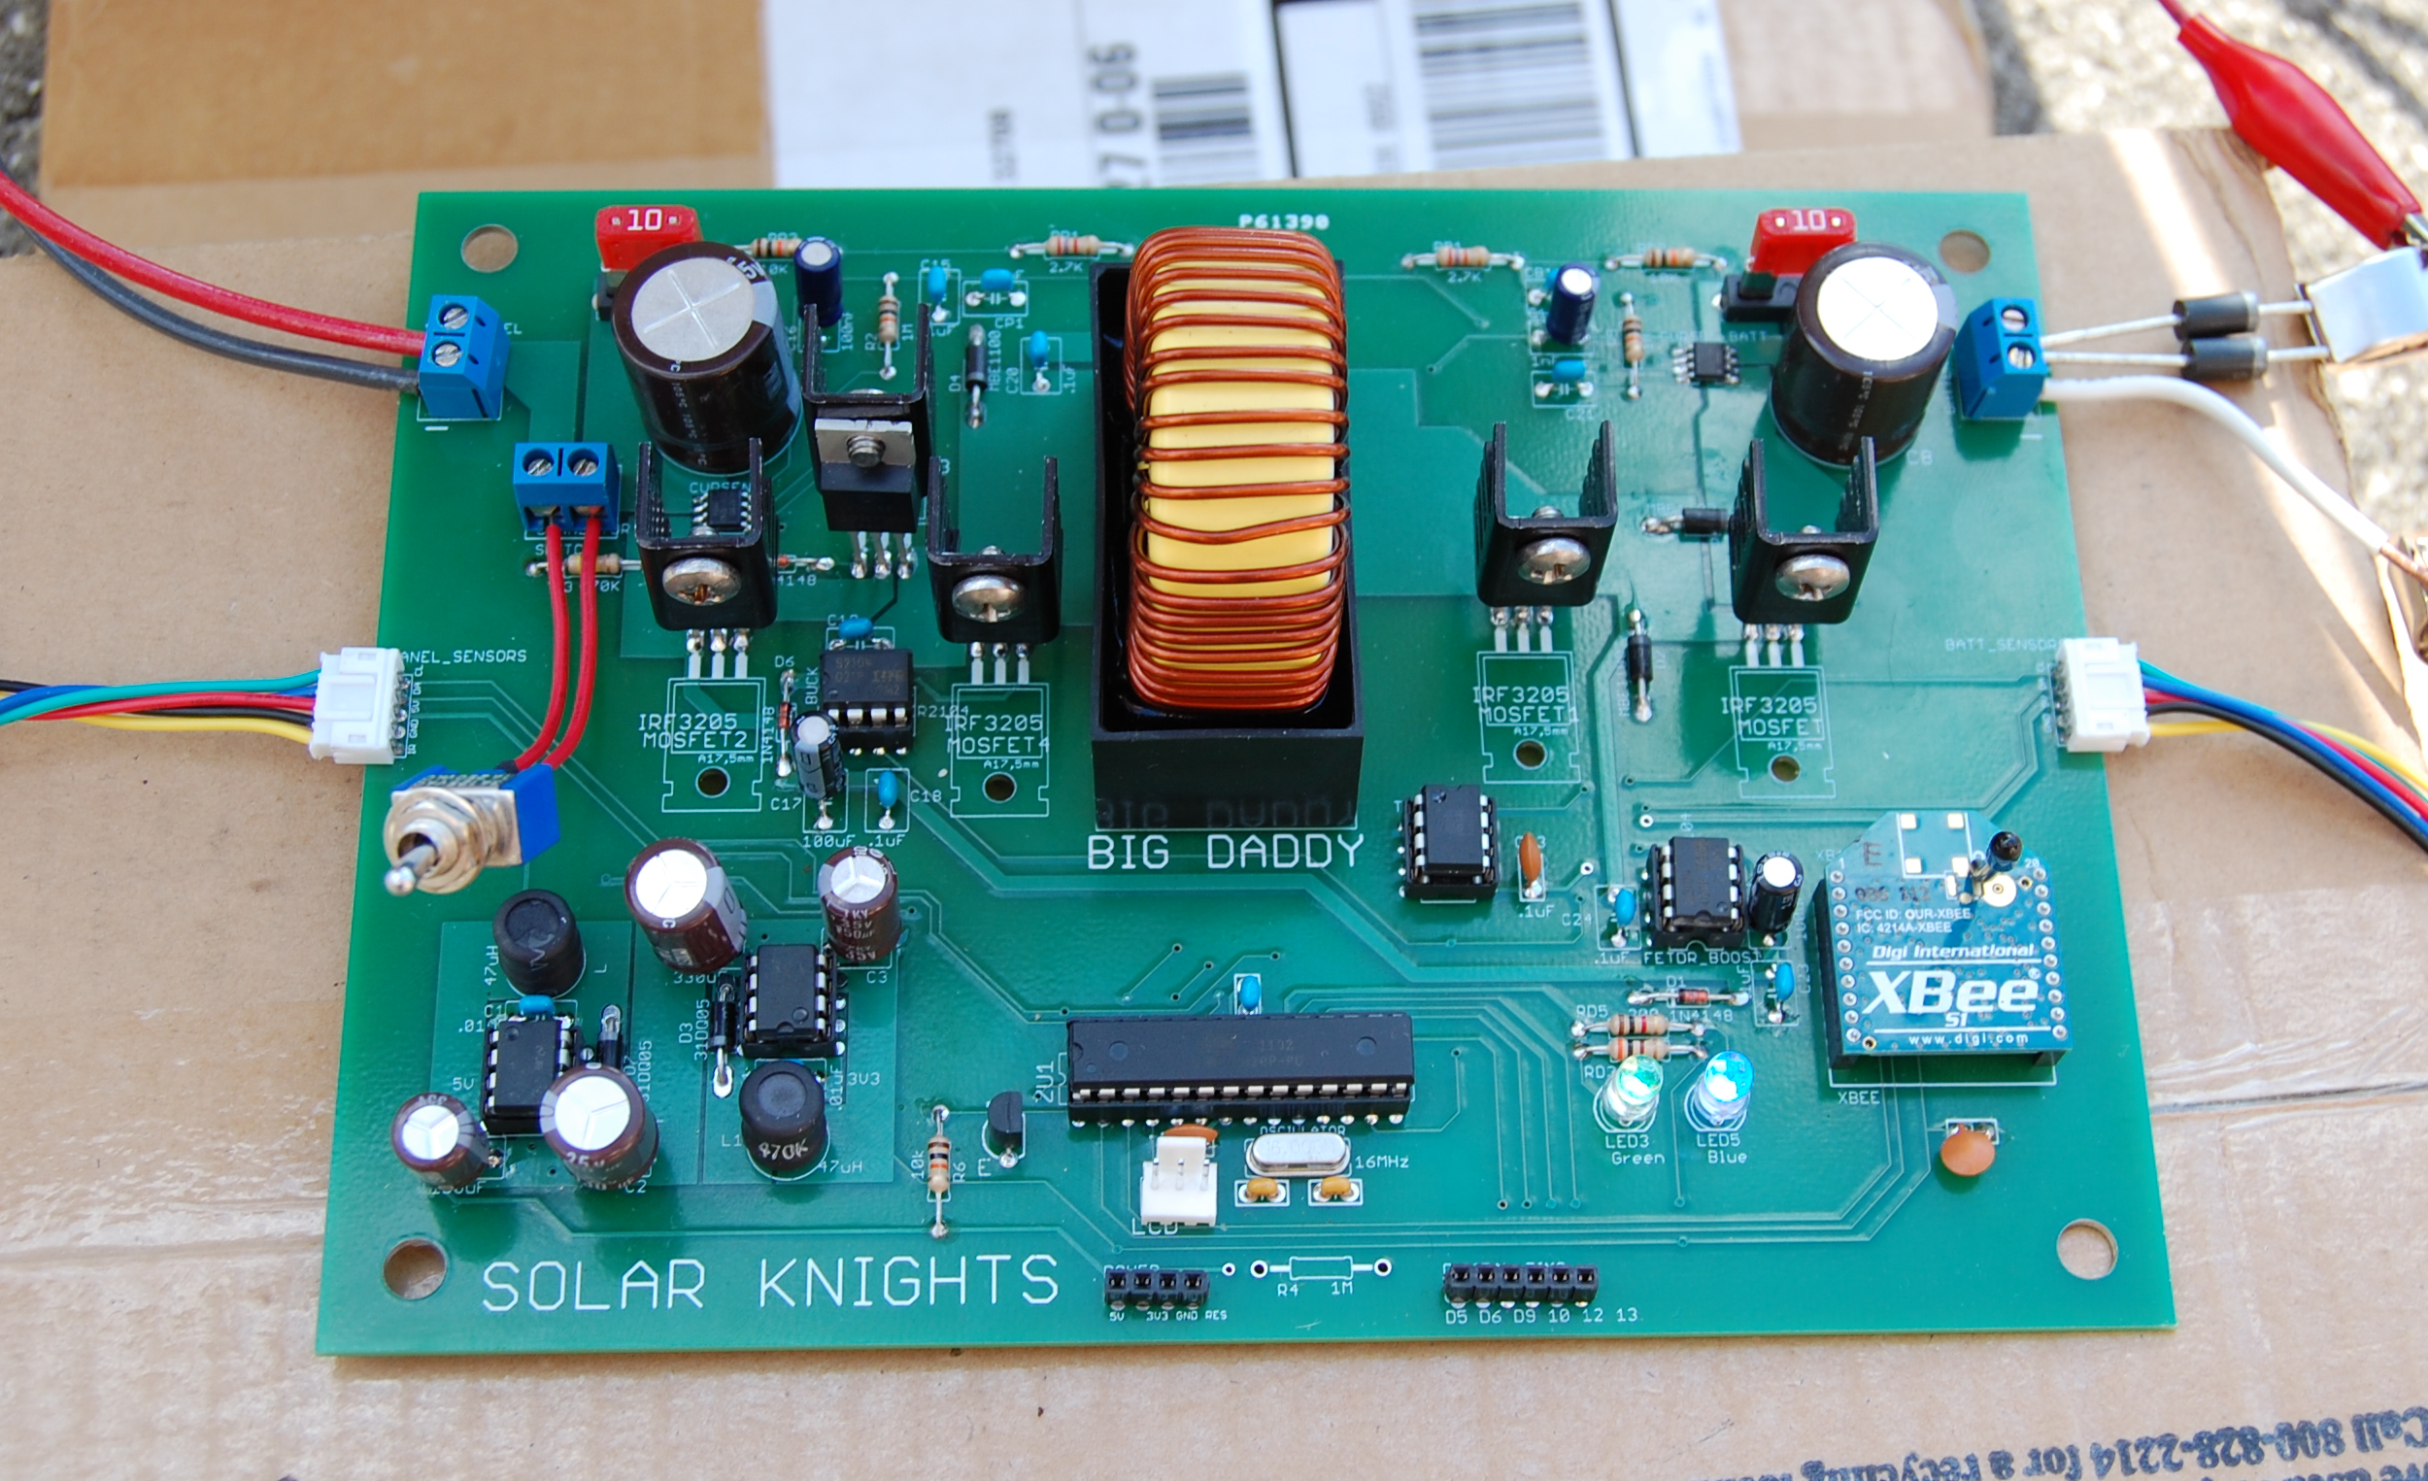
Notes:
Replace with a better picture of PCB, maybe show one of

Slide 28
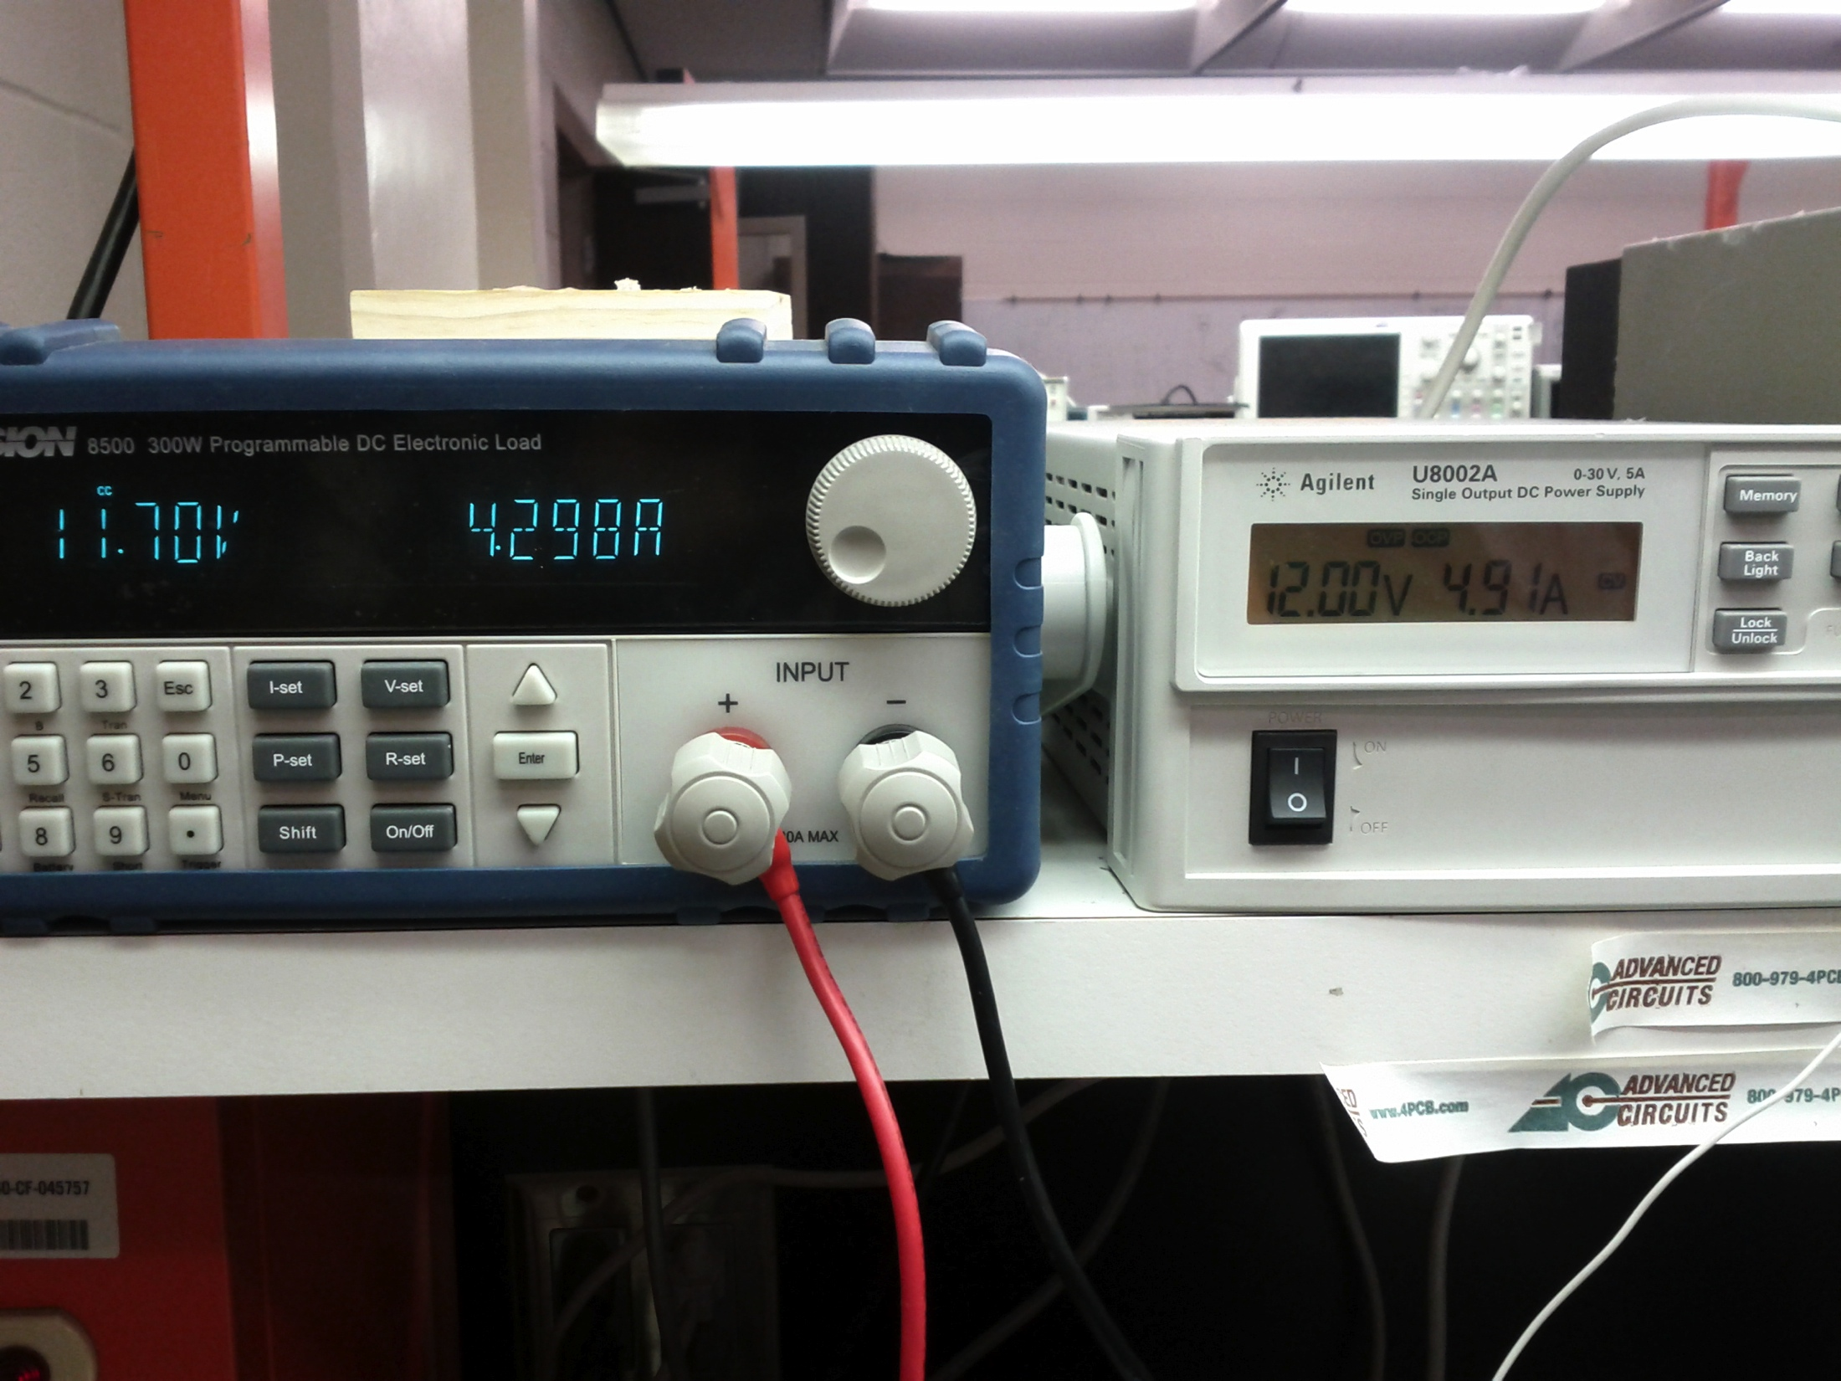
Testing: Drawing 4.29 A

Slide 29
17.3 V
12.5 V
3.4 A
2.0 A

Slide 30
Parts List | Cost per part | Number of parts | Total Cost
Solar Panel
Siemens SP75 75W Module | Loaned | 1 | $0.00
Charge Controller
Printed Circuit Board (Student Special) | $33.00 | 2 | $66.00
Serial Enabled 20x4 LCD - Black on Green 5V | $29.95 | 1 | $29.95
Sensors | $14.00 | 1 | $14.00
Electrical Circuit Components | $215.00 | 1 | $215.00
Misc Lab Supplies (Bread Board, wire, solder, etc.) | $48.00 | 1 | $48.00
Battery
Sun Xtender PVX-420T | $156.88 | 1 | $156.88
Inverter/Outputs
Cobra CPI 880 | $80.00 | 1 | $80.00
Microcontroller
Arduino Uno SMD (ATmega328) | $30.00 | 1 | $30.00
Wireless Components
Xbee Explorer Board | $24.00 | 1 | $24.00
Xbee Module | $26.00 | 2 | $52.00
Mounting
Misc Parts for Mounting (Aluminum, Wheels, etc.) | $108.00 | 1 | $108.00
 |  | Total: | $715.83
Notes:
Need to update and repaste

Slide 31
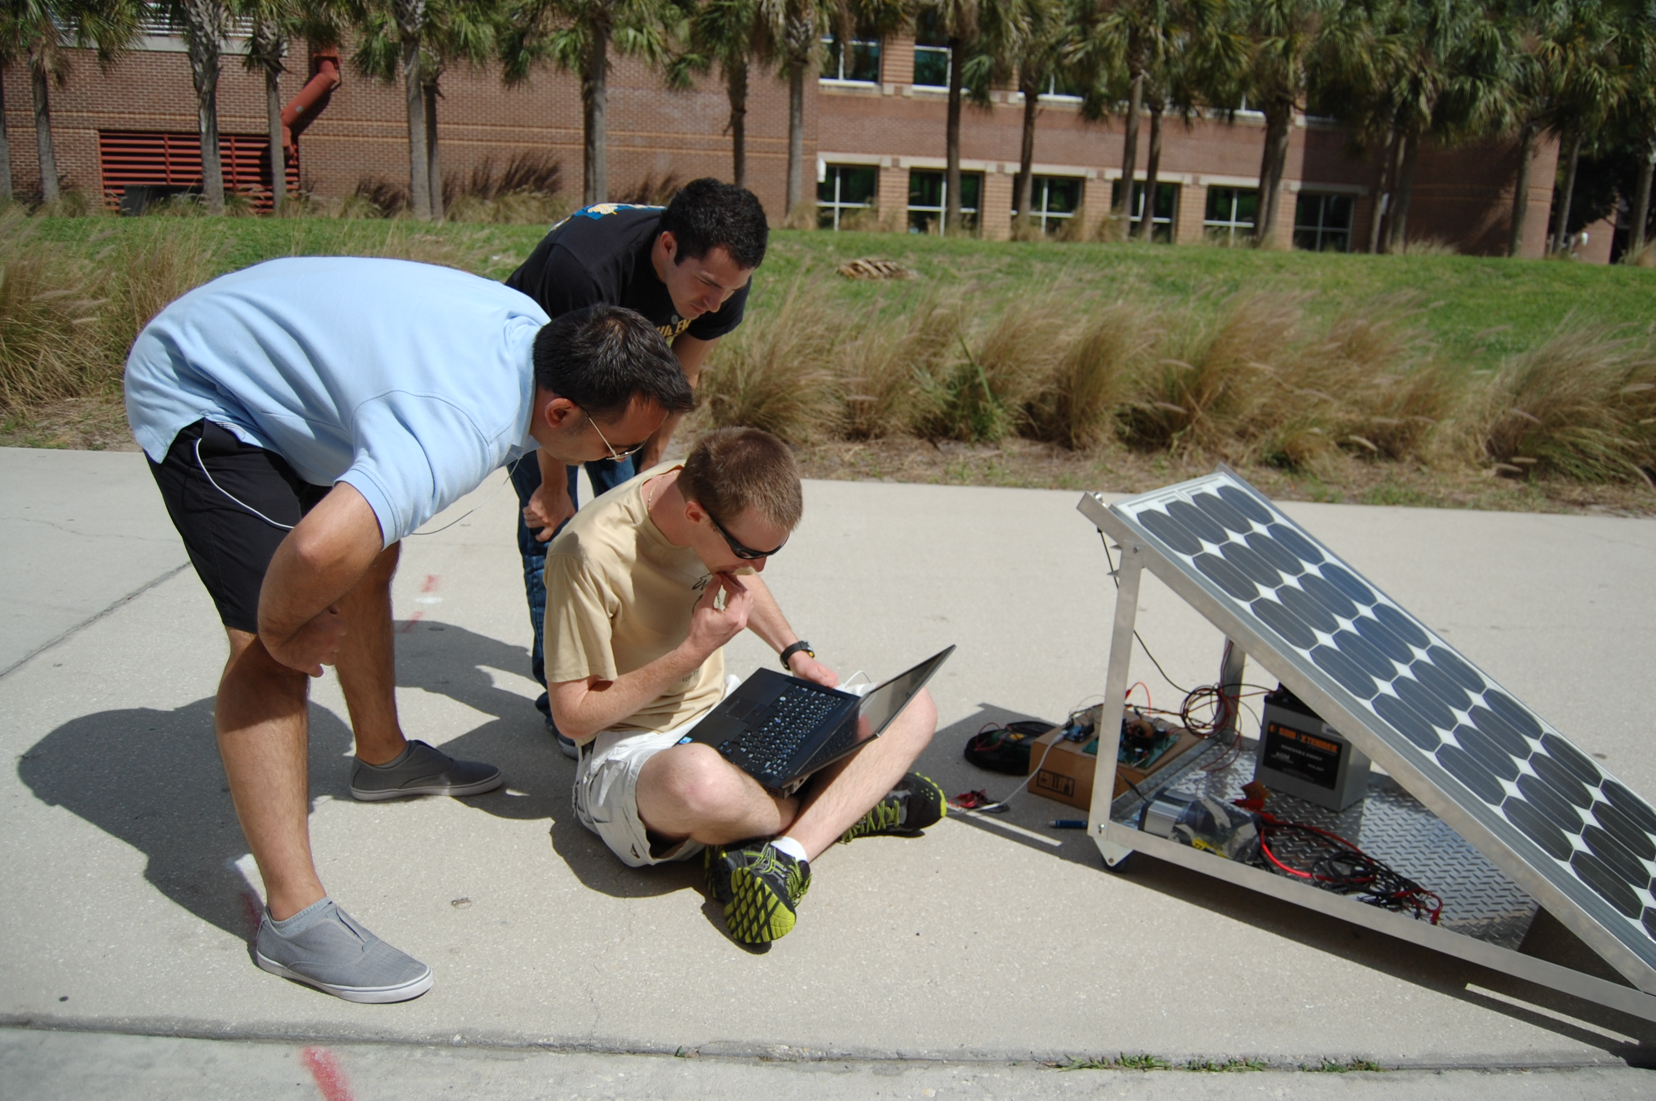

Slide 32
Questions?

