Slide 1
Remote Defense Turret
Group 11
Courtney Mann(EE)
Szu-Yu Fairen Huang (EE)
Brad Clymer (EE)
Mentor: Dr. Robert Muise, Senior Member, IEEE, Lockheed Martin
Sponsored by Workforce Central Florida

Slide 2
Motivation
Functional
Defense Turret for Sensitive Areas
Human Control
Operator Safety/Remote Operation
Intuitive/Easily Learned
Personal
Group Member Interest
Challenge and Feasibility
Logistical
Meets WCF Guidelines for Funding
Achievable in Two Semesters

Slide 3
Goals and Objectives
Fast, accurate targeting
Ease of use and learning
Compact design
Durability
Scalability
Solution: prototype a laser turret

Slide 4
Specifications and Requirements

Slide 5



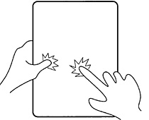
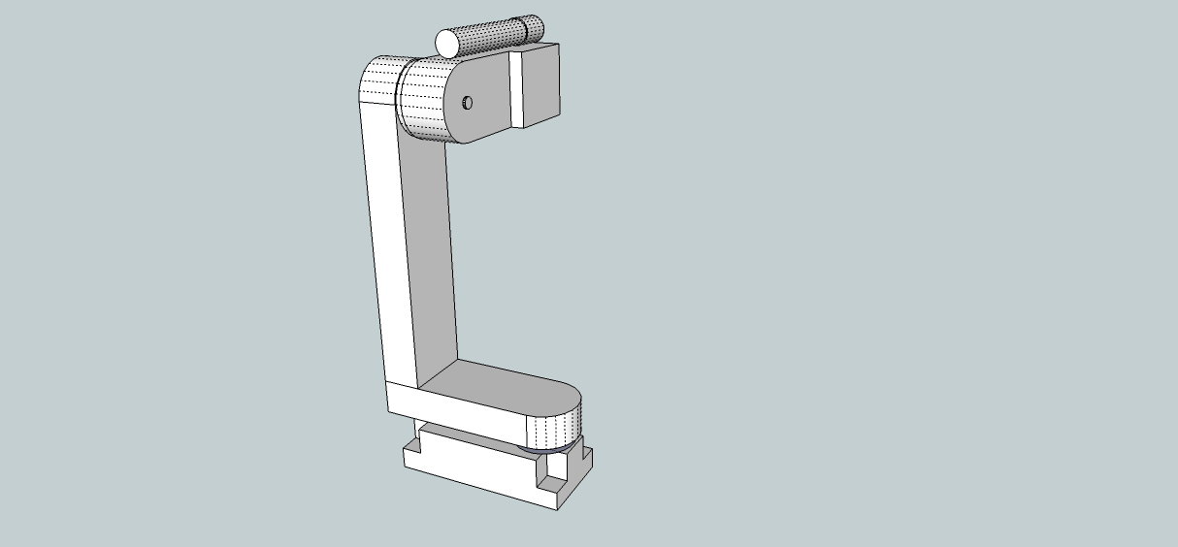
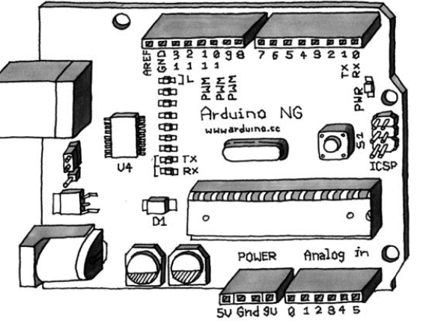
Overview
Target Presence
Image Capture and Transmission
Target Visualization,
User Input
User Interface Generation,
Target Acquisition
Aim Calculation
Aim and Fire Control
Aiming and Firing

Slide 6
Hardware Requirements
Easily transportable, robust to disturbance
Housing easily disassembled and inspected
Wirelessly independent of User-Interface tablet
Accurate over entire operating area
Able to track fast-moving human targets
User-Interface tablet light, visible, with long-lasting battery life for extended defense

Slide 7
Hardware Specifications
Component | Parameter | Specification
Wireless Module | Range Network Acquisition Time | 10 meters < 200ms
Servos | Sweep Speed Sweep Range | 60°/230ms 90°
Laser Pointer | Spread | <5cm at 30m
Camera | Frame Rate | >15fps
Complete System | Total Power Consumption Shooting Range | <12W peak 30m, 85°
Micro-controller | Serial Rate Power Consumption | 9600 baud <5W Nominal, <12W peak

Slide 8
Software Requirements
Can find accurate target coordinates, provide PWM signals to MCU
Continue tracking a moving object until it is out of view or new target chosen
Can also target single stationary point in field chosen by user
Use OpenCV libraries

Slide 9
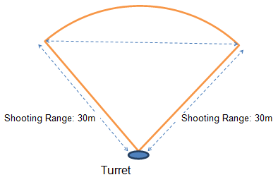
Software Specifications
Detect up to 3 moving objects within the field of view (up to 30m away from turret with an 85° viewing range)
Track a target moving at max speed of 9 m/s
Calculate target centroid and convert to x-y servo coordinates in <250ms
Notes:
Jon

Slide 10
Hardware Design

Slide 11
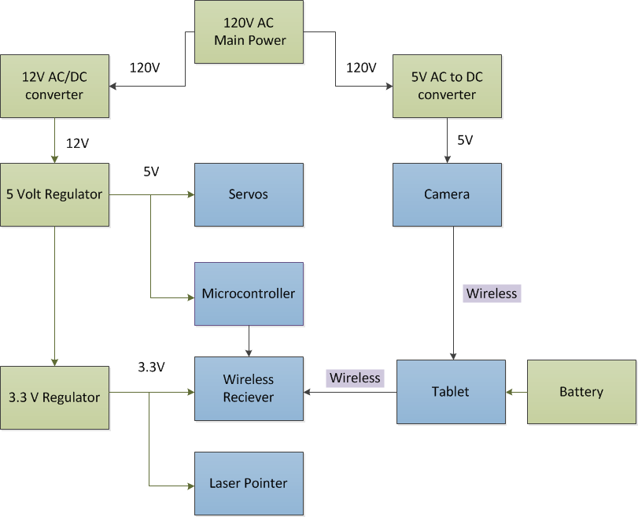
Hardware Block Diagram

Slide 12
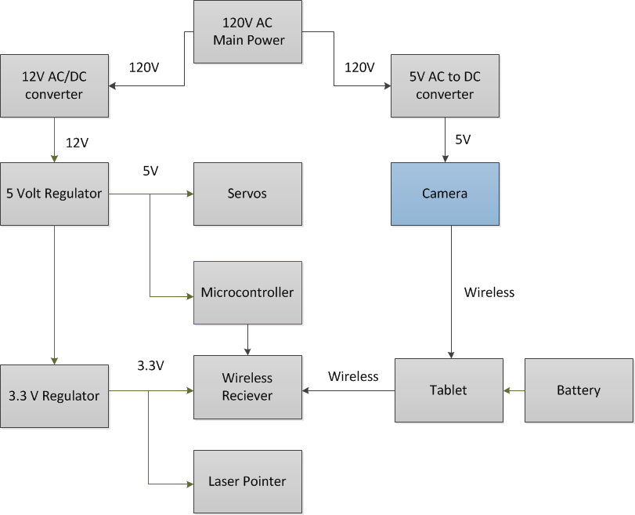
Hardware Block Diagram

Slide 13
Camera
High frame rate > 15 fps
Clear smooth movement
Moderate resolution: 640x480-1024x768
High enough to calculate target centroid
Too much data will limit speed

Slide 14
Camera Comparison
Model | Frame Rate (FPS) | Resolution | Wireless Protocol | Price (USD)
Logitech QuickCam Pro 4000 | 15 | 640x480 | None | Owned
Logitech QuickCam Orbit AF | 30 | 1600x1200 | None | 129.99
Edmund Optics NT56-567 | 100,000 | 768x494 | None | 1995.00
EasyN FS-613B-M166 | 25 | 640x480 | 802.11g | 66.99
Linksys WVC80N | 30 | 640x480 | 802.11n | 109.95
D-Link DCS-1130 | 30 | 640x480 | 802.11n | 149.00
AXIS M1031-W | 30 | 1280x800 | 802.11g/b | 248.00

Slide 15
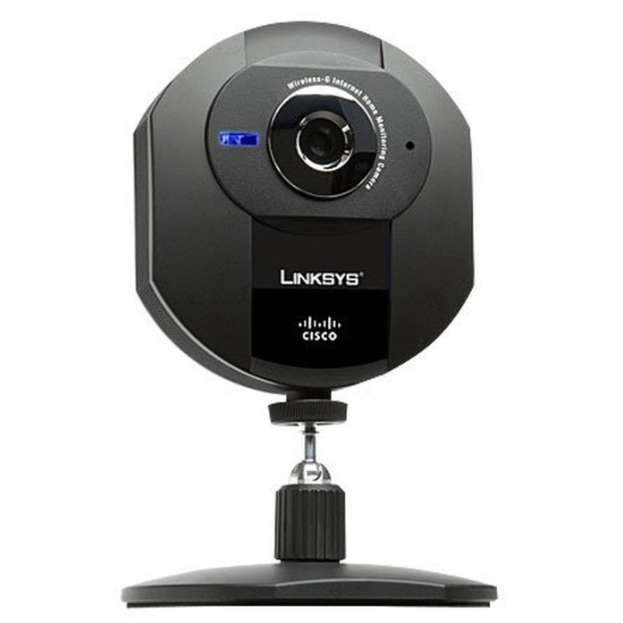
Camera
Cisco WVC80N
Mountable to Turret
Wireless-N Protocol
Specifications:
1-30 frames per second (selectable), allowing for sufficient refresh and target trajectory calculation
640x480 max resolution permits clear calculation of target position at range
Max power consumption of 5 watts (5V at 1A)

Slide 16
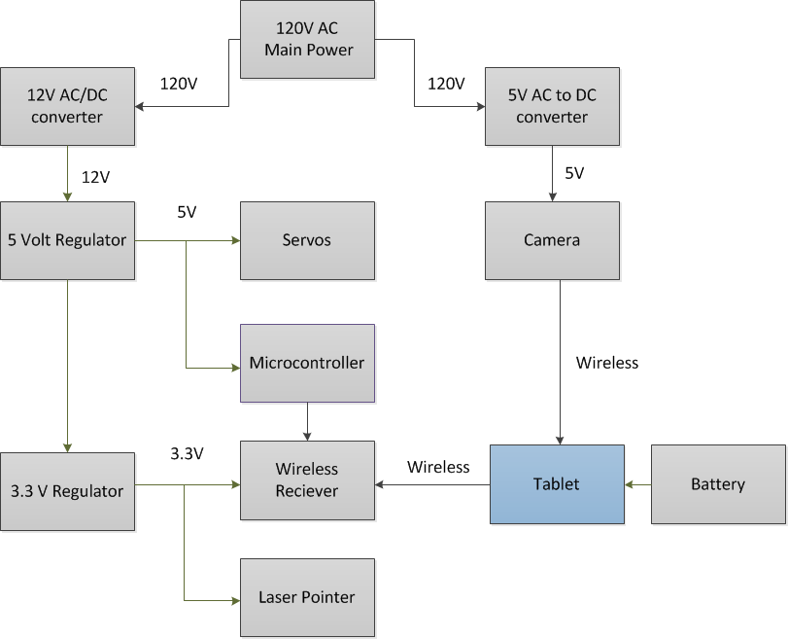
Hardware Block Diagram

Slide 17
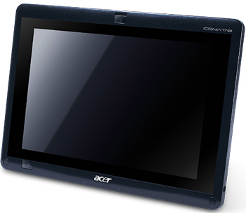
Tablet
Operating System: Windows
Compatibility with wireless cameras
Inclusion of USB port
Ease of integration of OpenCV and the UI
Budget < $700
Choice: $575 Acer Iconia

Slide 18
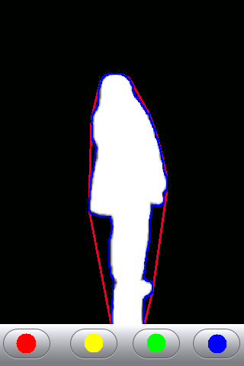
User Interface
Outline Targets
Button colors correspond to target outlines
Intuitively Indicate Operation
Inspired by Apple-Style simplicity
Run OpenCV in Visual Studio
Automated and Manual Modes

Slide 19
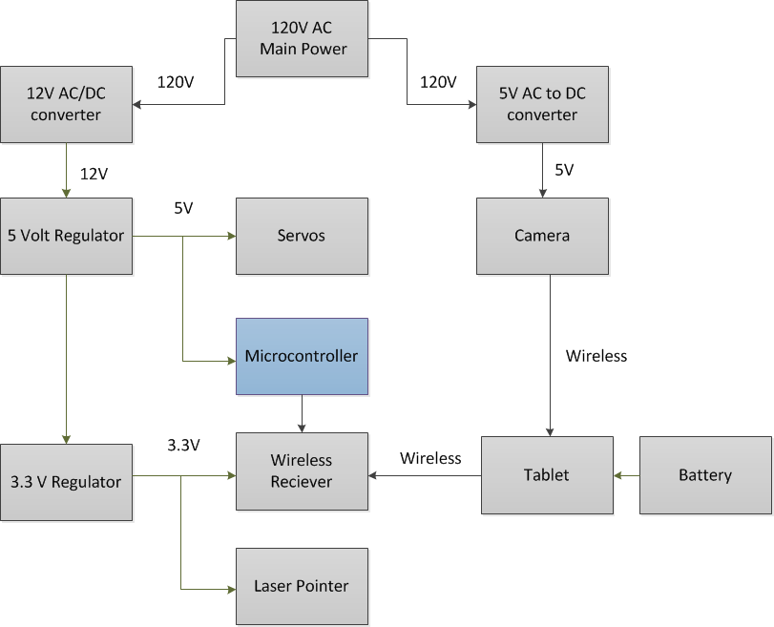
Hardware block diagram

Slide 20
Microcontroller
2 PWM outputs for servo motors
Digital output for laser pointer
Communicates with the computer via serial connection
Inexpensive
Easily programmable

Slide 21
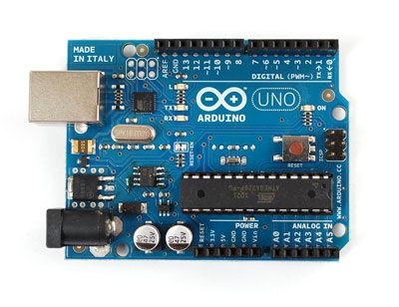
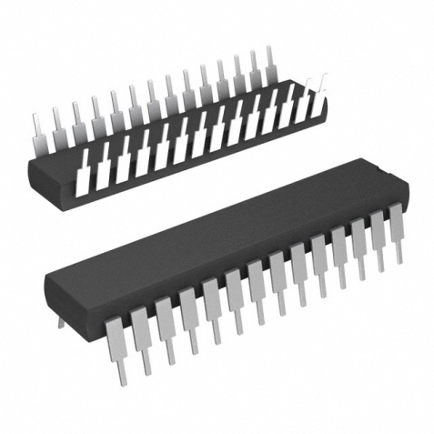
Microcontroller-ATmega 328
Inexpensive
14 digital I/O lines
6 PWM lines
6 Analog in lines
Programmable over serial using the Arduino bootloader
Arduino Uno for testing
3.5cm

Slide 22
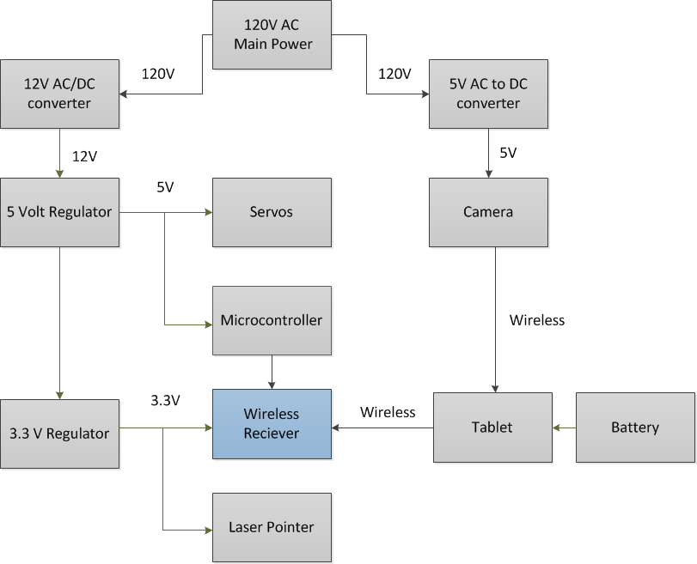
Wireless Communication

Slide 23
Wireless Communication
Low data rate between Arduino and the UI
Network Acquisition Time ≤ 200ms
Transmission range > 10 meters
Options: Wi-Fi, Bluetooth and RF

Slide 24
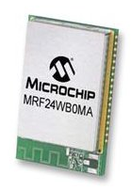
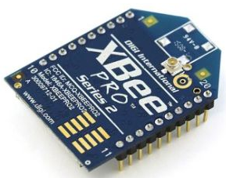
Wireless Communication
 | MRF24WB024 (Wi-Fi) | XBee Pro (RF)
Operating Voltage | 2.7V-3.6V | 3.3V
Transmission Range | Local WiFi coverage | 100m
Data Rate | 1000kbps | 250kbps
Configuration Complexity | High | Low
Quantity Needed | 1 | 2
Cost | $23.59/each | $25.95/each
2cm
3cm

Slide 25
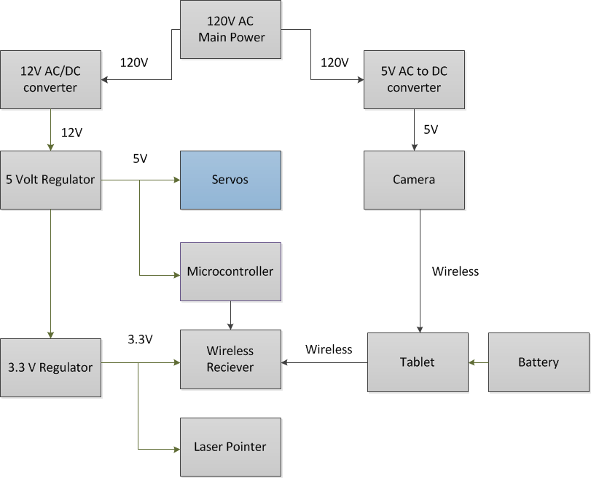
Servos

Slide 26
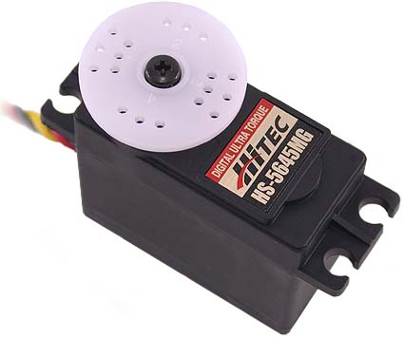
Servos
Model: Hi-Tec HS-5645MG
Readily Fit Turret Armature
Digitally Controlled
Desirable Specs:
400mA max current at 4.8V – usable with Arduino
PWM controllable: 0°-180° with 900μs-2100μs pulse
Fast enough to cover target range: 60°/230ms
Sufficient Torque: 10.3kg/cm
Size: 40.39 x 19.56 x 37.59mm

Slide 27
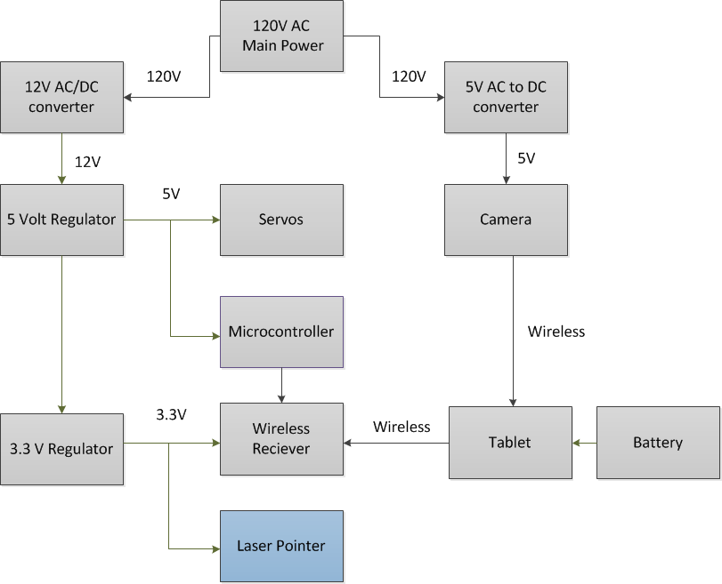
Hardware block diagram

Slide 28
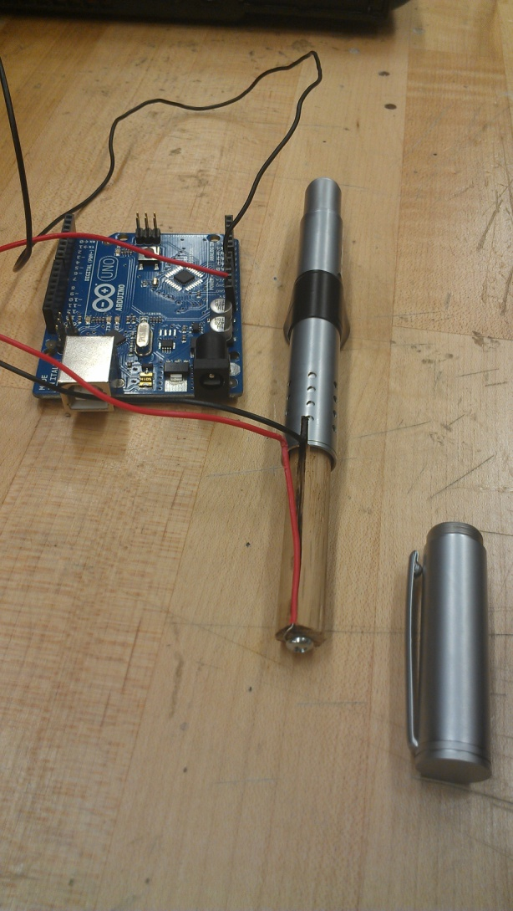
Laser Pointer
Instapark® Green Laser Pointer
Substitute for paintball gun
Will flash for .5s to indicate firing
Input voltage of 3.3V

Slide 29
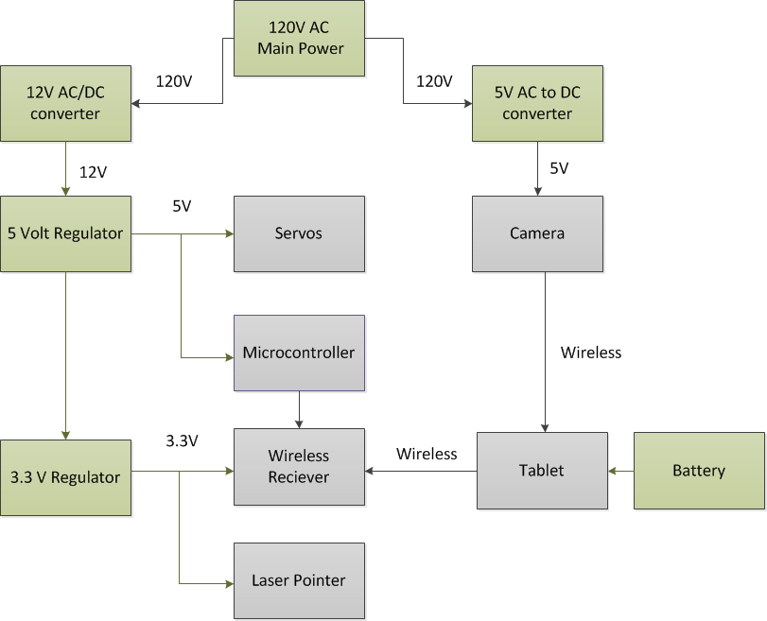
Power

Slide 30

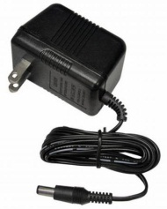
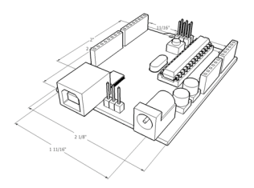
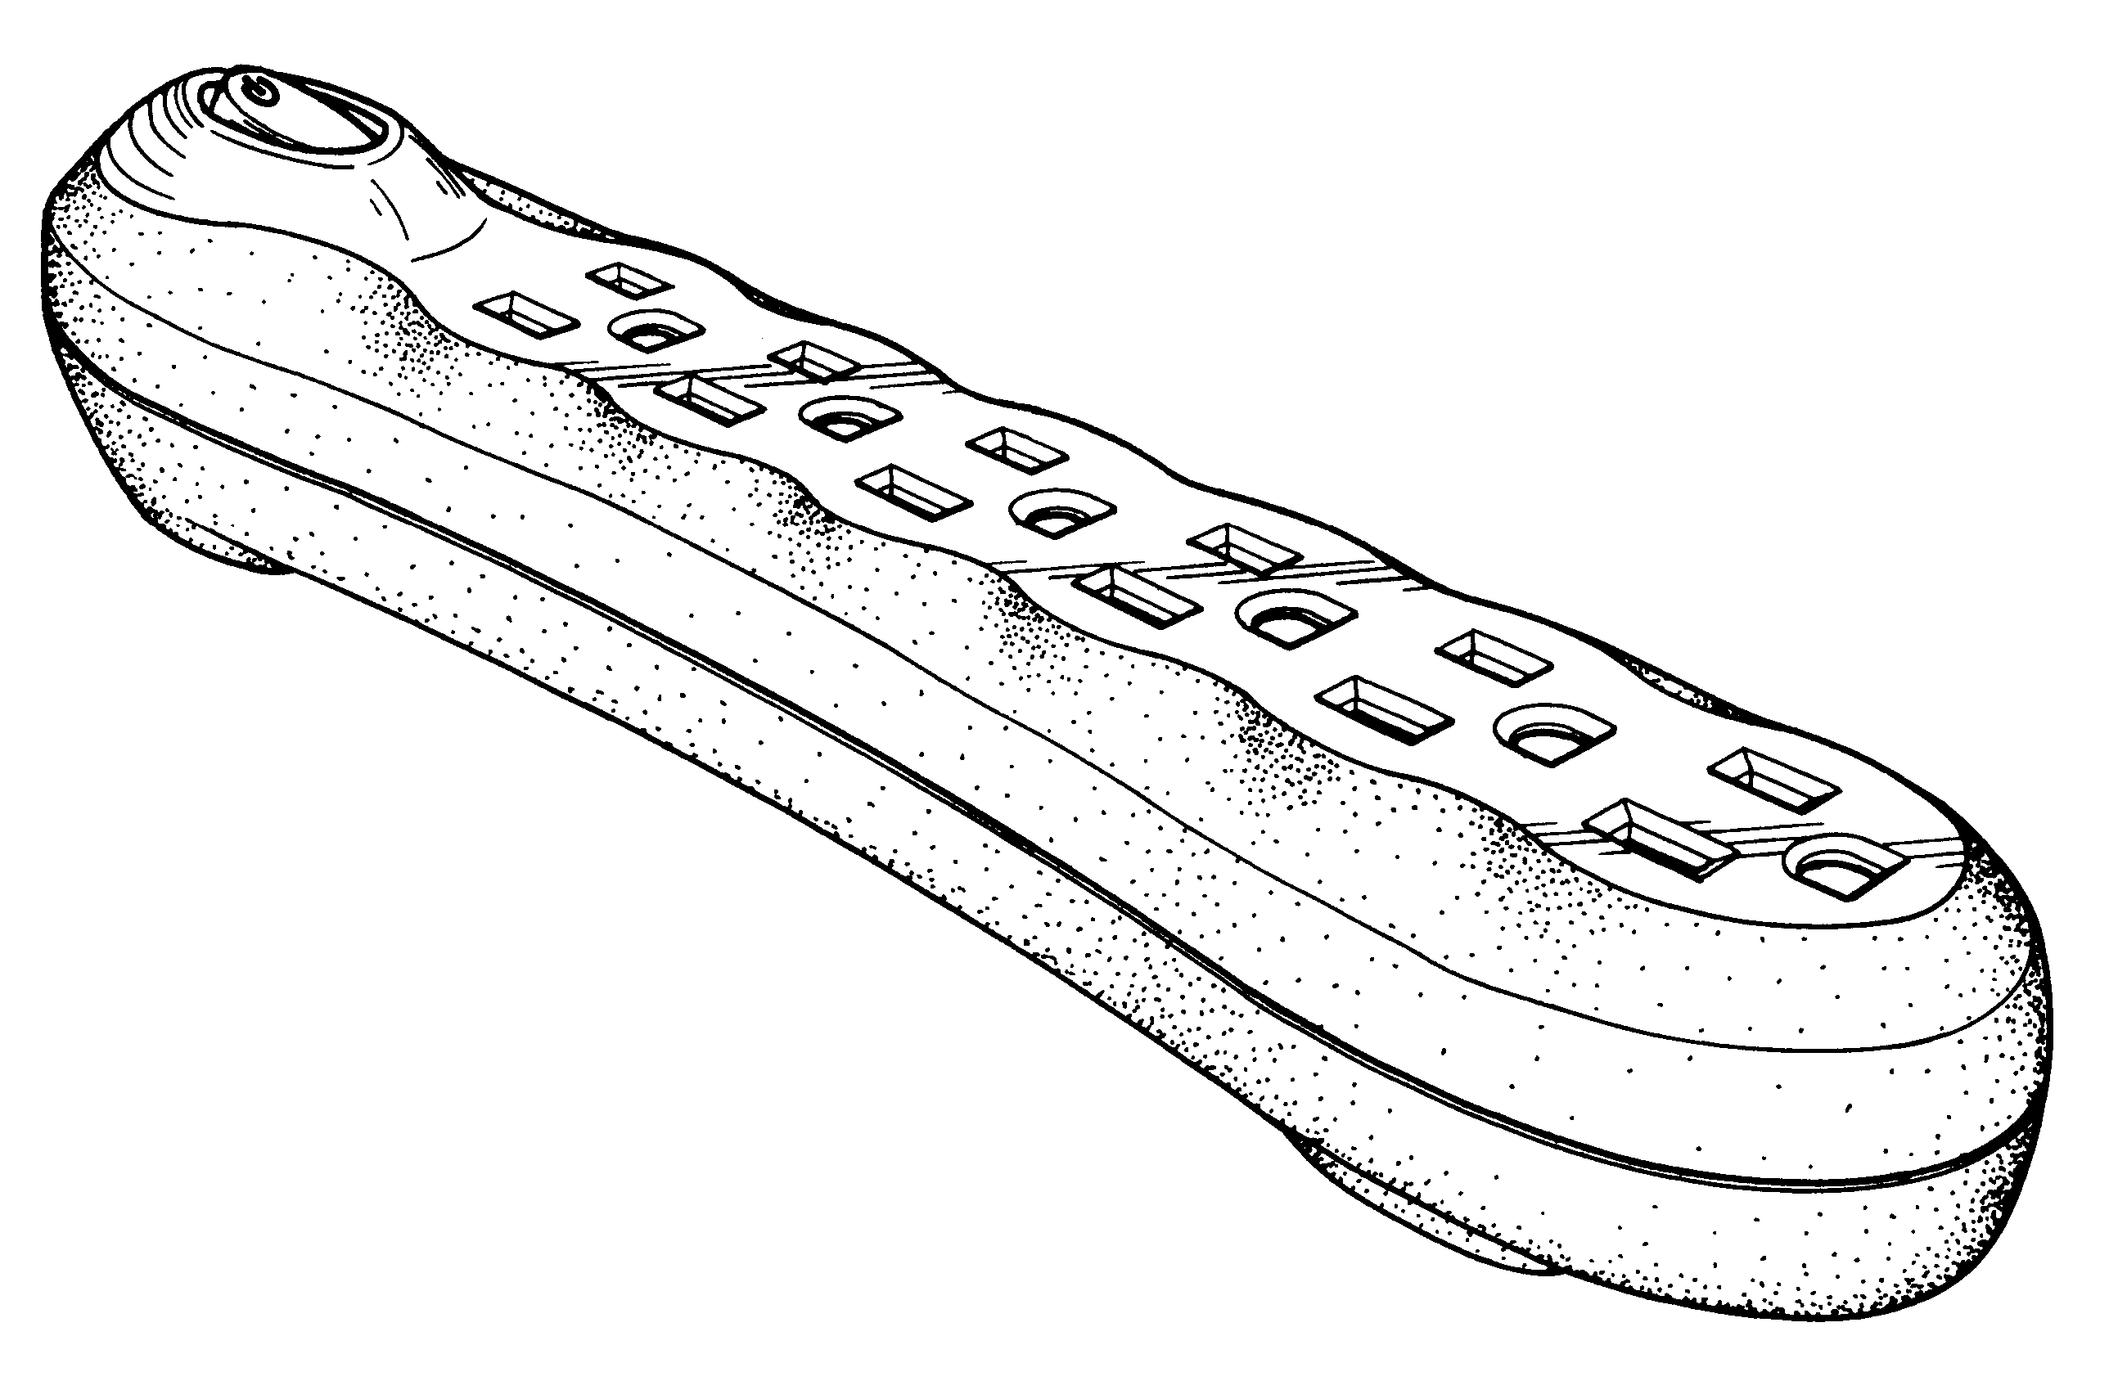
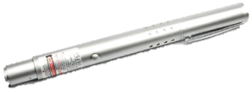
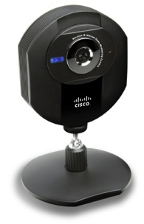
Power Flow
12V DC Power Adaptor
Custom Microcontroller Based Upon Atmega328 Processor
Digital Servos
Consumer-Grade Power Strip
Laser Pointer, 3V DC
5V DC Adaptor
Cisco WVC80N Camera

Slide 31
Regulators
3.3V regulator
LP2985 from TI
Output tolerance of 1%
Dropout of 280 mV @ 150-mA load current and 7 mV @ 1-mA load.
Used for wireless module and laser pointer
5V regulator:
NCP1117ST50T3G from On Semiconductor
Dropout of 1.2V @ 800mA over temperature (-55˚C to150˚C)
Used for servos and microcontroller

Slide 32
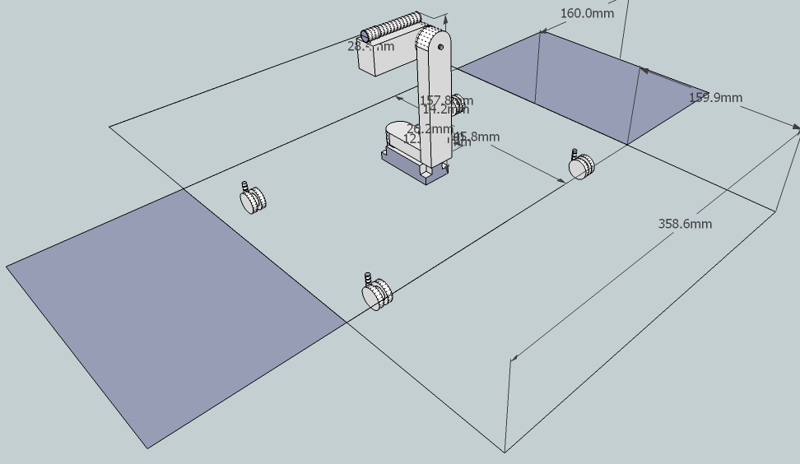
Hardware Housing
Plexiglas to allow observation of internal parts
Cotter-pinned construction for easy access to components
Casters for easy transport

Slide 33
Hardware Block Diagram
PCB

Slide 34
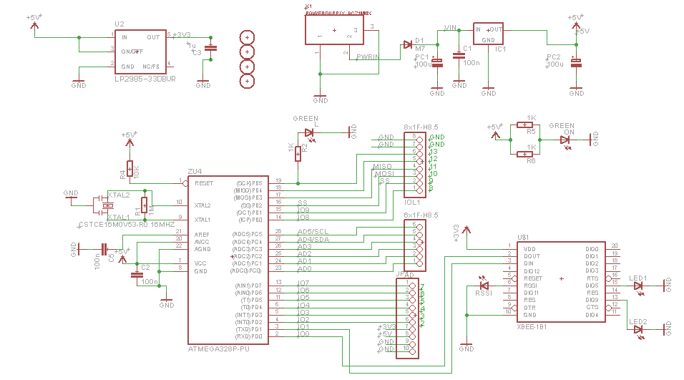
Schematic

Slide 35
Schematic
Atmega 328
XBee Wireless Module

Slide 36
Software Design

Slide 37
Target Acquisition
Detection: Background subtraction
Representation: Blob detection
Tracking: Centroid calculation

Slide 38
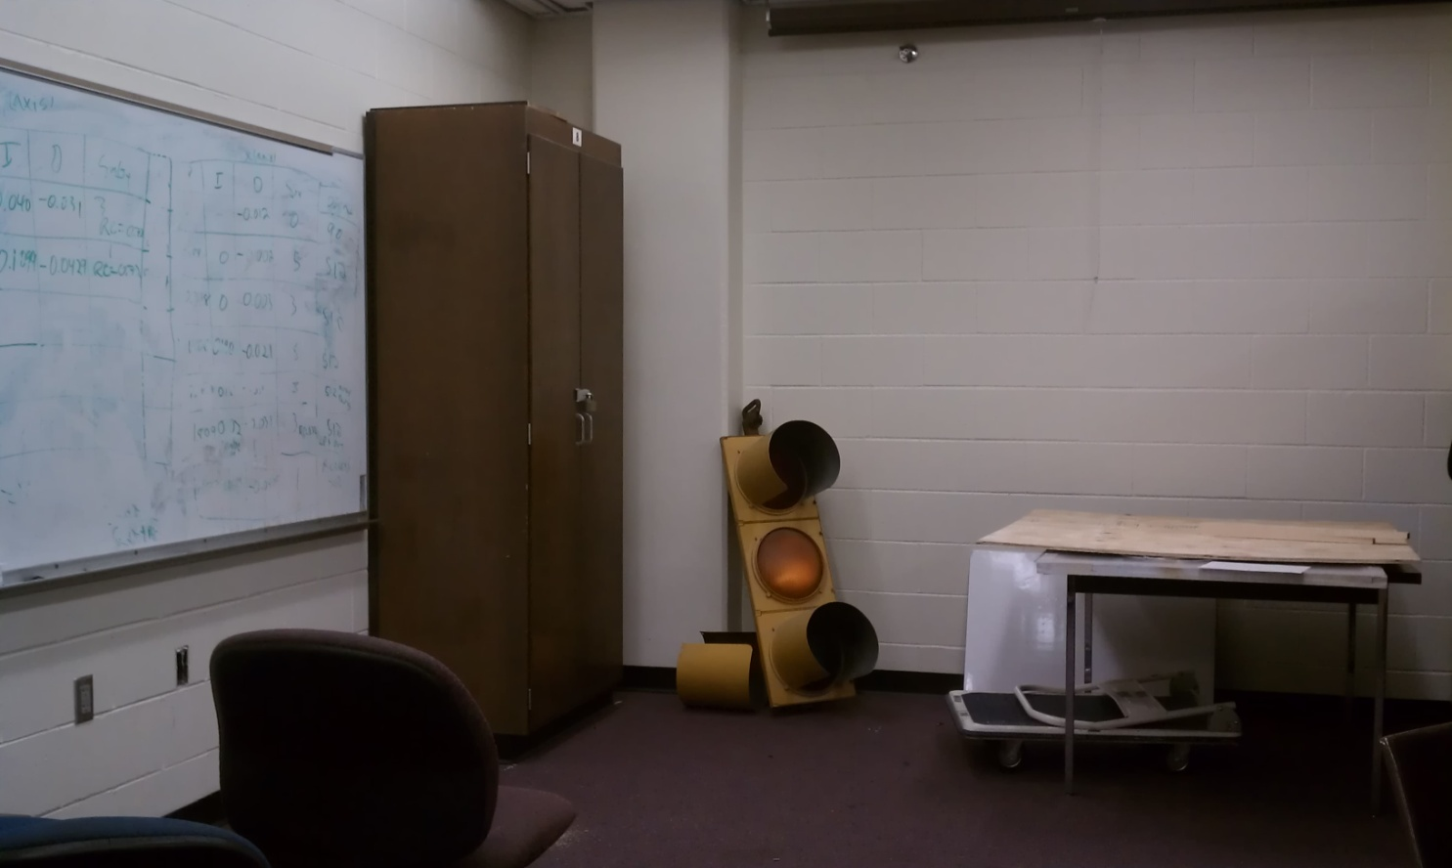
Detection
Reference frame will be stored containing average values for each pixel with specified tolerance

Slide 39
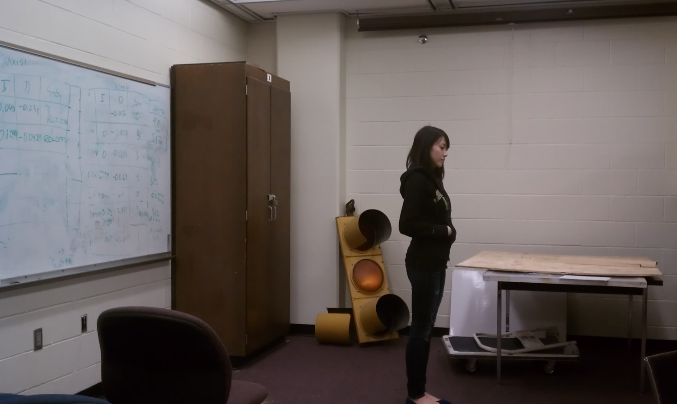
Background Subtraction
Compare new frames to the reference frame
Each pixel value from incoming frame compared to reference
Any pixel differences detected as potential targets

Slide 40
Representation
Detected object represented with colored rectangles
Find outermost points of object(closest points to each window edge )
These points will determine the border of the rectangle
Centroid calculation to determine coordinates

Slide 41
Tracking
Difference taken between current frame and past frames
Trajectory of centroid calculated for repeated fire
Chosen target will be tracked until out of frame or new target is chosen

Slide 42
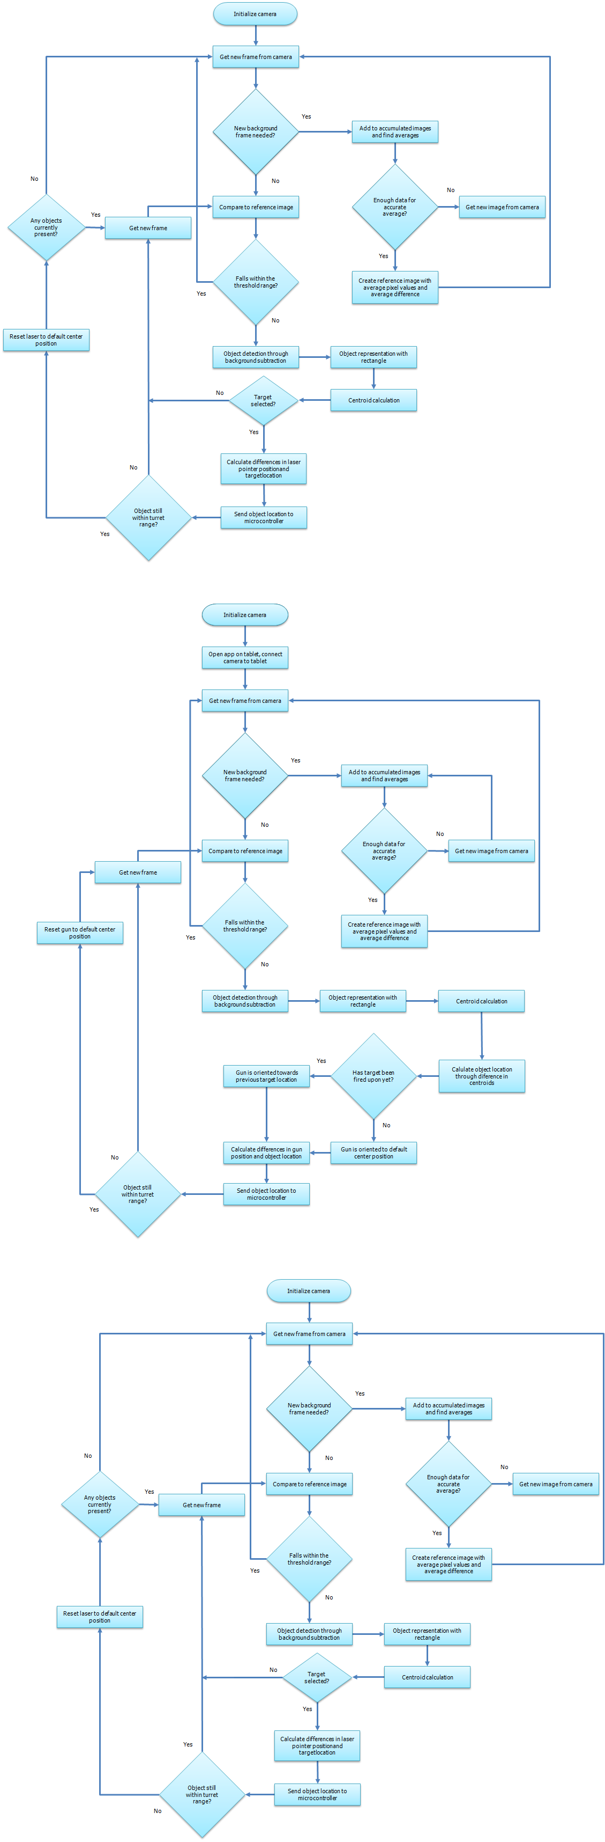
Target Acquisition Flow Chart

Slide 43
Target Acquisition Flow Chart

Slide 44
Target Acquisition Flow Chart

Slide 45
Target Acquisition Flow Chart

Slide 46
Target Acquisition Flow Chart

Slide 47
Target Acquisition Flow Chart

Slide 48
Administrative

Slide 49
Administrative

Slide 50

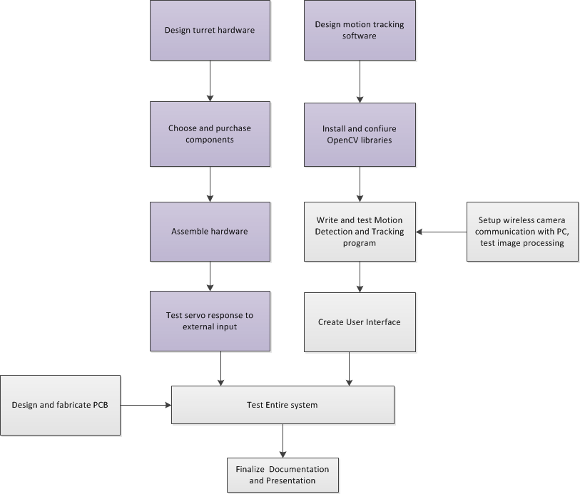
Progress
Complete
In Progress

Slide 51
Progress

Slide 52
Division of Labor
 | Brad | Fairen | Courtney
User Interface | X | X | X
Image Acquisition Software |  |  | X
Camera | X | X | X
Wireless Communication |  | X
Servo Control | X
PCB Design |  | X
Hardware Housing | X
Power | X
Arduino Programming |  |  | X

Slide 53
Budget: Original
Item | Qty | Unit Price | Total Price
Wireless Transmitter | 1 | $6.30 | $6.30
Arduino Uno | 1 | $25.00 | $25.00
Camera | 1 | $250.00 | $250.00
Wireless USB adapter | 1 | $129.95 | $129.95
Motor Controller | 1 | $59.99 | $59.99
Nitrogen tank | 2 | $49.95 | $99.90
RC switch | 1 | $24.00 | $24.00
Main pan/tilt mount | 1 | $199.00 | $199.00
Servo Extensions | 2 | $4.95 | $9.90
PCB Fabrication | 1 | $147.50 | $147.50
Misc. mechanical parts | 1 | $400.00 | $400.00
Misc. electrical parts | 1 | $150.00 | $150.00
Electronic Paintball Marker | 1 | $399.00 | $399.00
Paintball Hopper | 1 | $36.95 | $36.95
Basic parts, required by mount vendor | 1 | $49.00 | $49.00
Laser Rangefinder | 1 | $349.95 | $349.95
User Interface Tablet | 1 | $799.99 | $799.99
Pan-and-Tilt servos | 2 | $46.99 | $93.98
Laser Pointer | 1 | $39.70 | $39.70
Wifi Communicator Arduino Shield | 1 | $69.99 | $69.99
Panasonic 1024 Linear Image Sensor | 1 | $30.00 | $30.00
 |  | Total: | $3,370.10

Slide 54
Budget: Current
Item | Qty | Unit Price | Total Price
Arduino Uno | 1 | $25.00 | $25.00
Camera | 1 | $107.95 | $107.95
Main pan/tilt mount | 1 | $150 | $150.00
Misc. mechanical parts | 1 | $200.00 | $200.00
Misc. electrical parts | 1 | $150.00 | $150.00
Basic parts, required by mount vendor | 1 | $49.00 | $49.00
PCB Fabrication | 2 | $50 | $100
User Interface Tablet | 1 | $575.00 | $575.00
Pan-and-Tilt servos | 2 | $100.97 | $100.97
Laser Pointer | 1 | $39.70 | $39.70
Microchip Wifi Arduino Shield | 1 | $69.99 | $69.99
Xbee Transceivers | 2 | $30 | $60
 |  | Total: | $1627.61
Financed by Workforce Central Florida
Remaining Budget: 3370.10-1627.61= $1742.49

Slide 55
Issues
Wireless transmission from Arduino to tablet requires static IP address
Camera connection requires router access, which we do not have on campus
Programming is more complex than anticipated

Slide 56
Questions?
Notes:
That concludes our presentation. Are there any questions?

