Slide 1
Multi-User Touch Table
Planck
      Peter Oppold - CpE
      Hector Rodriguez - CpE
      Chris Sosa - CpE
      Enrique Roche - EE
      Mentors from NAVAIR;
      Ronald Wolff
      Dave Kotick
Group 14
Notes:
Enrique

Slide 2
Mission Statement
Create a multi-touch table with a novel touch and fiducial interface that recognizes gestures. These gestures will be used to manipulate a defense scenario application that requires the user to defend assets via the placement and management of military units.
Making a military scenario which is realized through computer graphics and controlled by non-traditional user inputs
Notes:
chris

Slide 3
Motivation of Project and explain value of project
Apple, Microsoft, Smart, Samsung, and Motorola gravitating towards touch interfaces
  Microsoft Surface
  iPhone/smart phone
  Smart board
Multi-touch can accommodate multiple users
  Design
  Simulation
  Business presentations
  Entertainment
  File Sharing
Notes:
Chris

Slide 4
Project Goals and Objectives
To remove the need for traditional input in favor of multi-touch gestures and real life objects
To create a tool set that is intuitive and natural and allows the user to learn through experience and not require lengthy instructions.
To facilitate collaborative work from simultaneous users
Be of sufficient size to accommodate multiple users simultaneously
To showcase the toolset with a battle simulator
Notes:
peter

Slide 5
Project Specifications and Requirements
Table shall enclose all hardware
Multi-touch surface will have a design resembling that of a smart-phone
The system shall have a maximum latency of 100ms
The internal temperature of the enclosure shall not exceed 35C
Usable system screen size shall be a minimum of 40 diagonal inches
The enclosure shall not be constructed with a height more than 3.5 feet
The enclosure shall be able to support up to 400lbs of weight
System shall recognize a minimum of 10 touch events simultaneously
System shall recognize fiducials at least as small as 2x2 inches
Notes:
Pete

Slide 6
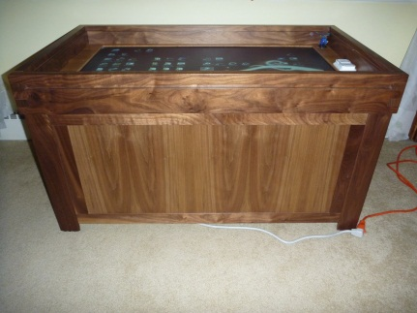
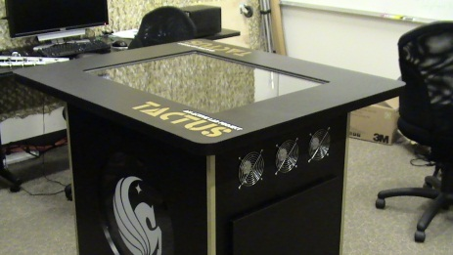
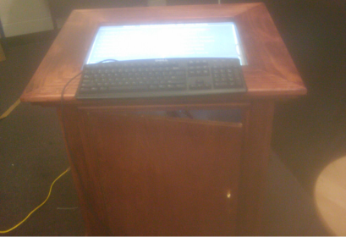
Prior Similar Work
Tactus – UCF FIEA
  FTIR
  Bespoke Vision library
  Surface Command
  Approx 48” display, 36” tall
Locus – Boston University
  DSI
  CCV 1.5
  Map Tools
  42” display, 19” tall
Multi Touch Poker Table (MTPT) - UCF
  FTIR
  TouchLib
  Texas Hold-em Poker
  39” tall
Notes:
Peter

Slide 7
Touch Technology considerations
Capacitive and Resistive touch are not very scalable to large screens nor capable of detecting fiducials.
Technology needed to be relatively cheap to implement on a large screen.
Ability to do more than traditional touch would be preferred.

Slide 8
Table of Touch Technologies
 | Frustrated Total Internal Reflection | Diffused Illumination | Diffused Surface Illumination | Force Sensitive Resistance | Optical Imaging
Sensor | Optical | Optical | Optical | Voltage | Optical
Touch Types | Touch Only | Touch and Objects | Touch and Objects | Touch and Pressure | Touch only
Difficulty to Implement | 2 | 3 | 4 | 1 | 5
Quality of Blobs | 5 | 1 | 3 | 4 | 2
Scalability (Cost vs Size) | 3 | 2 | 3 | 1 | 5
Cost | 4 | 3 | 2 | 1 | 5
5 = Best for project, 1 = Worst for project

Slide 9
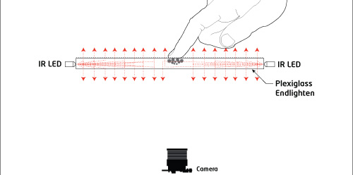
Diffused Surface Illumination
IR LEDs
Camera
Acrylic:
Active Layer
Diffusion Layer
Protective Layer

Slide 10
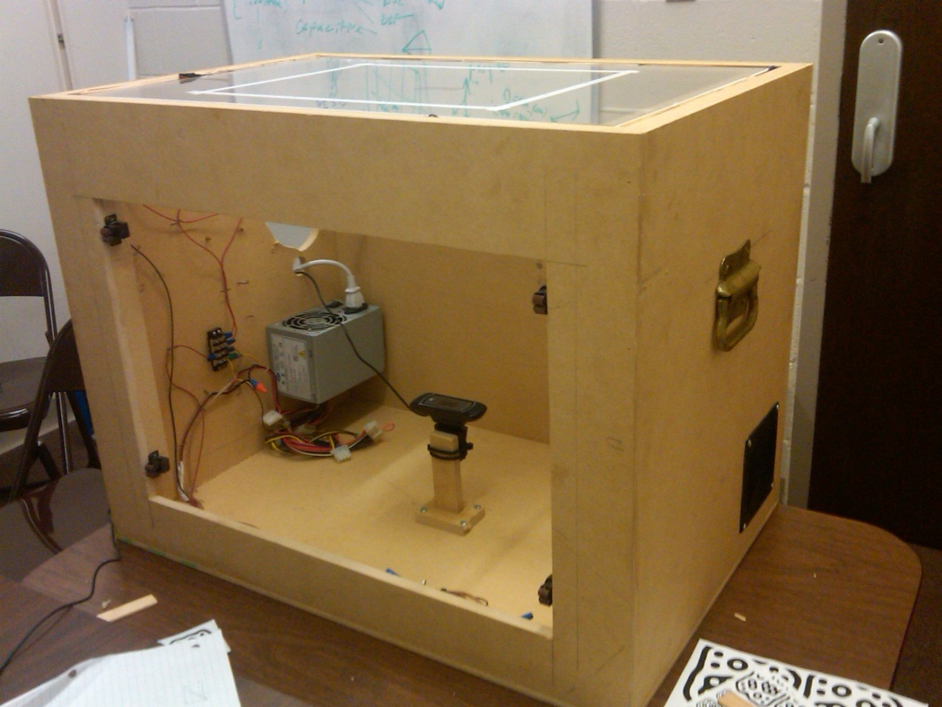
Hardware Block Diagram

Slide 11
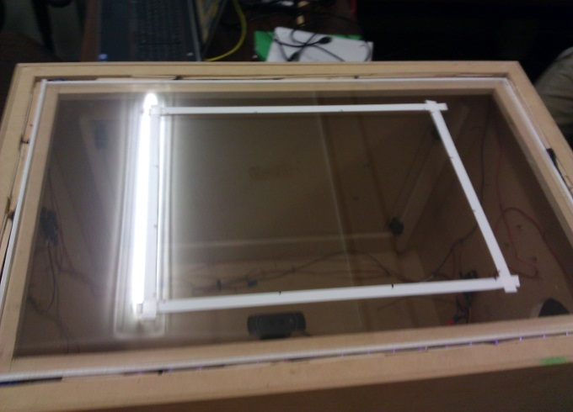
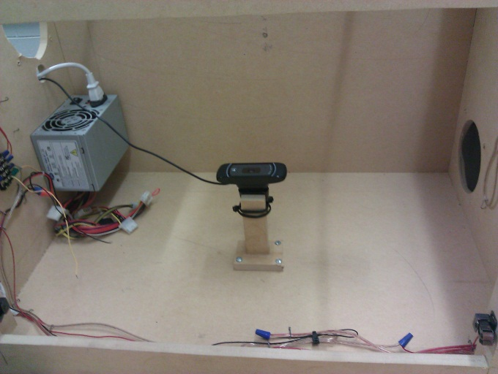
DevelopMENT Board (Prototype)
Provides platform essential to test our hardware and software
Polished acrylic edges
  LED light can penetrate deeper
Slim LED wooden Frame
  Flush fit
  Painted white for maximum deflection
Camera mount
  Allows for easy configuration

Slide 12
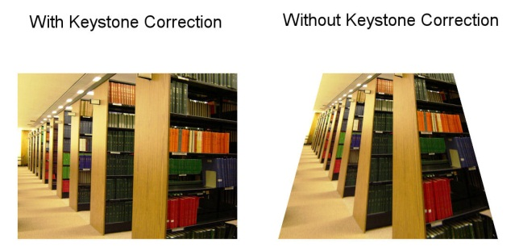
Final Design - Enclosure
46” Diagonal Display
36” Tall with Legs
  Capable of 24” tall (minus legs)
  Oak Veneer
Fluid Bearing enclosure Fans
  Bottom stealth mount
Projector tilt-mount
  Smallest achievable offset due to Keystone correction
Notes:
Pete

Slide 13
Design - Projector
Projector: Hitachi CP-AW250N Short Throw
  1280 x 800 (720p)
  46” diagonal image in just 19 ¾” distance
  3 LCD
Notes:
Pete

Slide 14
Computer System - Design
  Computer:
    CPU: 2nd Gen I7
    Hard drive: SandForce SF-2281 120gb SSD
    Memory: 8gigs DDR3
    Video Card: Nvidia Fermi DirectX 11
    700w power supply
      Power to LEDs and computer
Notes:
everyone

Slide 15
Design – LED Channel and Acrylic
Channel
  ~9.5mm deep
  15mm Tall
  against polished acrylic for maximum light penetration
Acrylic
  3 Layers Stacked
  Edge-Edge Acrylic Surface, Mirroring Smartphone surface
Notes:
Pete

Slide 16
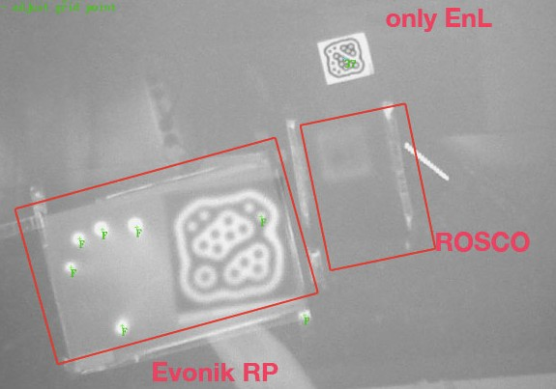
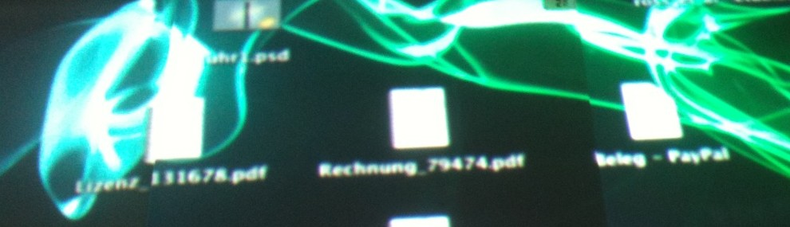
Rear Projection Acrylic
Diffuses light, but also diffuses infrared
Comes in two types, film and acrylic
Acrylic tends to give better quality.

Slide 17
Acrylic
EndLighten XXL 10mm
  91% Transmission, 39” penetration
7D006 Rear Projection Acrylic 5mm
  45% Transmission
  1.3 Gain (Lambertian)
  38 degree half angle
0A000 MR2 Mar Resistant Acrylic 3mm
  92% transmission, two sided coating

Slide 18
Camera
Resolution of at least 640x480
Frame-rate of at least 60 fps
Quality of picture in low light conditions
  Better quality picture in low light, less LEDs that would need to be used, less effect from noise.
Wide angle or replaceable lens
Full manual, or ability to disable “auto”

Slide 19
Camera
 | Logitech c910 | Firefly MV | Fire-i | PS3 Eye
Interface | USB | Firewire | Firewire | USB
Resolution | 640x480 60fps 1184x656 30fps | 752x480 60fps | 640x480 86fps | 320x240 120fps 640x480 60fps*
Total Cost per Camera (with wide angle lens) | $65 | $300 | $650 | $130
PS3 Eye may be slightly cheaper if we did the modifying ourselves. Stock lens is unable to focus at distance required. 640x480 60fps format uses full bandwidth of an entire USB bus and may not be obtainable based on hardware.
Firefly MV and Fire-I offer significantly better image quality.

Slide 20
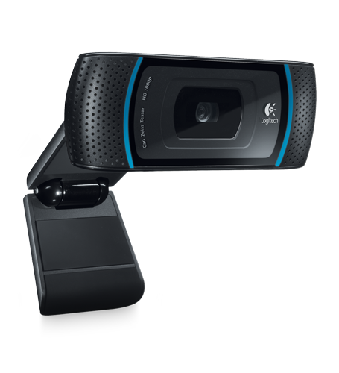
Camera
Logitech HD Pro C910 Webcam
Capable of YU12
60fps @ 640x480
30fps @ 1184x656
Wide Angle Lens
Easily removable IR filter
USB Video Device Class (UVC) capable
POI Zooming
$65 per Camera

Slide 21

LEDs
Requirements:
Shallow Angle
High Radiant Flux
Near Infrared (between 850 and 900 nm)
SFH4258
850nm
15 degree half angle
50mW Radiant Flux @ 100mA
1.5 V @ 100mA

Slide 22
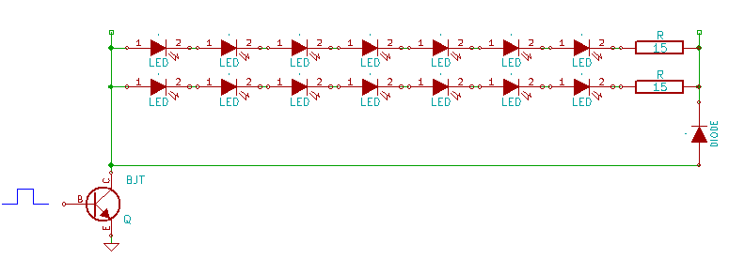
LED Arrays
7 LEDs + 1 Resistor in series per chain
42 total chains, totally 4.2A @ 12V

Slide 23
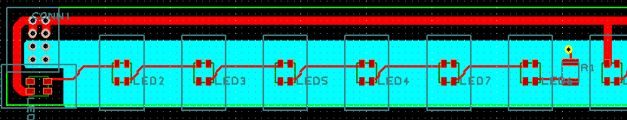
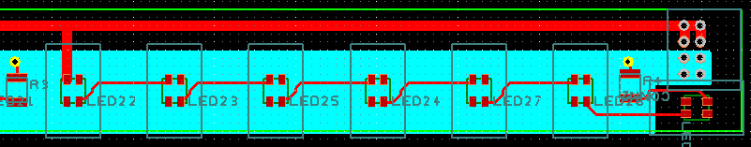
PCB LED Schematic

Slide 24
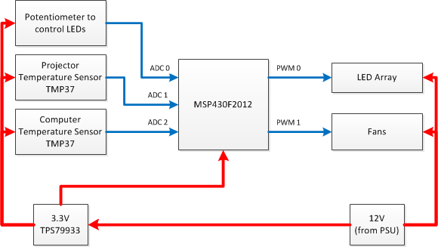
Microcontroller
MSP430F2012
10 Bit SAR ADC
Can be programmed by launchpad
TPS79933 Linear Regulator
3.3 V
TMP37 Temperature Sensors
Linear temperature sensor
20mV / °C

Slide 25
Software system

Slide 26
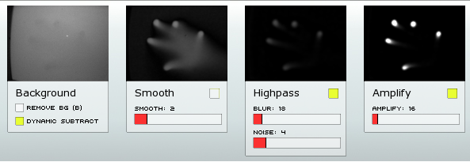
Software System overview
Two sub-systems in order to achieve multi-touch
  Touch and Fiducial Recognition System
    CCV 1.5 Vision Library
    GestureTracker input parsing and gesture software
  Showcase Application System
    weDefend Tower Defense Simulation Application
    XNA Graphics API renders interactive objects

Slide 27
Software Block Diagram

Slide 28
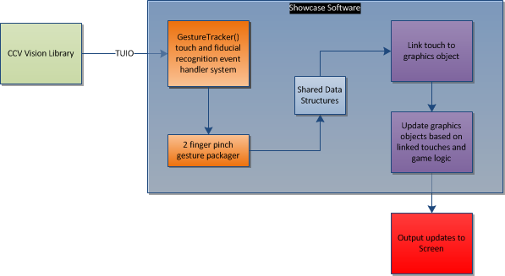
TFRS High Level BLOCK Diagram
CCV 1.5
(TUIO)
GestureTracker logic called as fingers and fiducials are added to surface
As objects are added to surface, linking of two touches to create a pinch gesture
Notes:
GestureTracking system is located within Showcase Software system

Slide 29
GestureTracker() Software
Use CCV to extract finger touch and fiducial information
CCV outputs single input touches. GestureTracker creates and packages gestures into 2 types
  1-finger drag
  2-finger pinch
CCV also outputs fiducial information.
Store and transmit touch, gesture, and fiducial information to Showcase Application program
Notes:
The TFRS is comprised of several parts. There’s software used to retreive touch and fiducial information. There’s a gesture recognition module that links gestures that are ‘close’ to one another, 1-finger drags, and fiducial gesture information. The last part of the system is a shared data structure that allows the showcase program to share its gesture information with other programs.
Before we get into all that, first I define what a fiducial is.

Slide 30
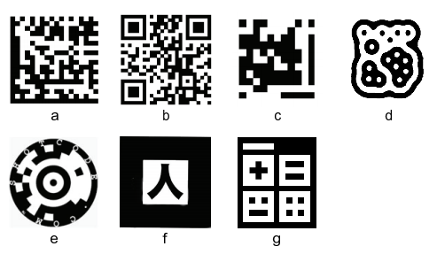
Fiducials
A Fiducial is a symbolic marker that has a specific meaning to our software
Position and orientation interpretation
Can be used to interact with Software Application
  Stamp out objects
  Trigger specific events
  Locate certain objects
  on screen
Examples:
  B. QR-code
  D. Amoeba
  G. d-touch fiducial
Notes:
Fiducials are symbols or markers.
Originally they were used in medical applications and later on in augmented reality applications

Slide 31
TFRS Vision Library decision
Vision library must
  Receive IR camera input
  Apply image noise filter, threshold filter, vision algorithms
  Perform within latency requirements
  Required to work with Diffused Surface Illumination technology
  Fiducial and touch information output (i.e. unique identification #, position, velocity, angle, time)
  CCV 1.5 chosen as the system’s vision library
Notes:
The vision library is in charge of receiving video input from the cameras, applying filters and computer vision algorithms to extract information about touches such as those listed here. It also has to find fiducials and distinguish these from touches by a unique ID number. The vision library must be able to work under our latency requirements and be able to work with DSI technilogy.
Table listed below shows how we arrived at CCV 1.5 decision.

Slide 32
TFRS/SAs Design

Slide 33
TFRS/SAs Design
Showcase application creates a thread instance of GestureTracker
GestureTracker keeps updating cursorList and objectList with new input information
List structures are shared via getCursorList and getObjectList methods
Touch-Input flow
  TuioCursor /Touch comes in as input
  Link 2 cursors together
  Update cursor information
  Update list with new objects

Slide 34
TFRS: Link Partner Algorithm
As a new touch arrives
Look at each touch and find a partner based on spatial locality within radius threshold
  Length<R
Threshold for linking based on size of on-screen object
Mitigate multi-user 2-finger gesture object
Limited usability of system due to spatial constraints

Slide 35
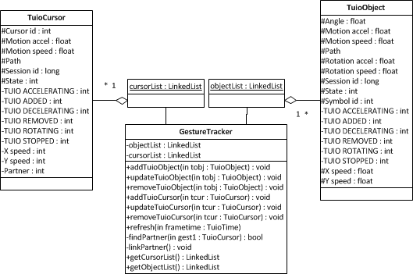
TFRS Class diagram

Slide 36
Showcase Application system
Creating a tower defense application capable of allowing teamwork between multiple users
Simple scenario where soldiers defend an area of the map from an opposing force
Three simple phases
  Tutorial: teaches user gestures
  Preparation mode: allows user to create, position and adjust soldiers
  Action mode: happens in real time and soldiers adjustment is restricted
Using XNA 4.0 in C# to draw to the screen
Graphics not as important as application logic.
  Uses 2D top-down view

Slide 37

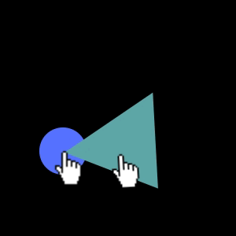
Gestures

Slide 38
Example Scenario

Slide 39
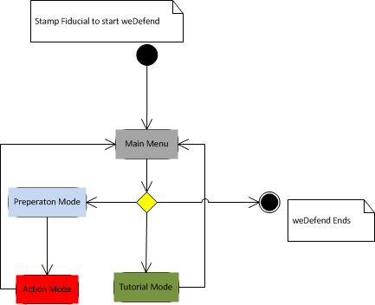
Sas state diagram

Slide 40
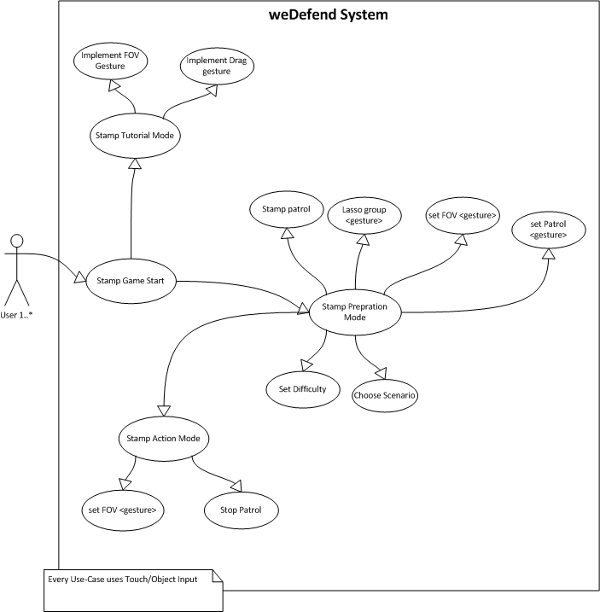
SAS USE-CASE diagram

Slide 41
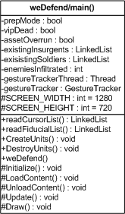
SAS application structure
Update methods for each graphics object
Draw methods draw the updated graphics object
Main Update and Draw methods in weDefend call object methods

Slide 42
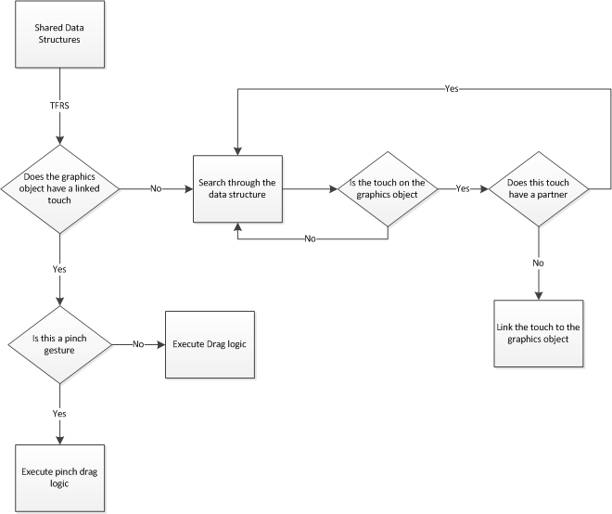
SASLinking
A graphics object must be linked to a touch in order to be acted upon
  Improper linking causes glitchy behavior
Touches that have partners are never eligible to be linked
Update checks if the linked touch has a partner or not.

Slide 43
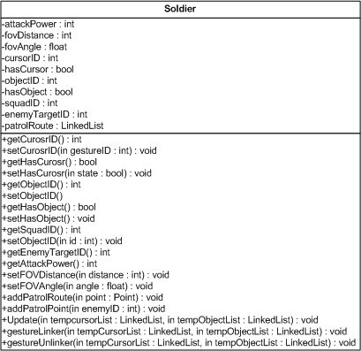
SAS interactive object
gestureLinker method links a graphics object to a touch/fiducial
gestureUnLinker method unlinks graphics objects from dead touches
Update method changes attributes of the graphics object
Draw method will graphically display the changes made in update

Slide 44
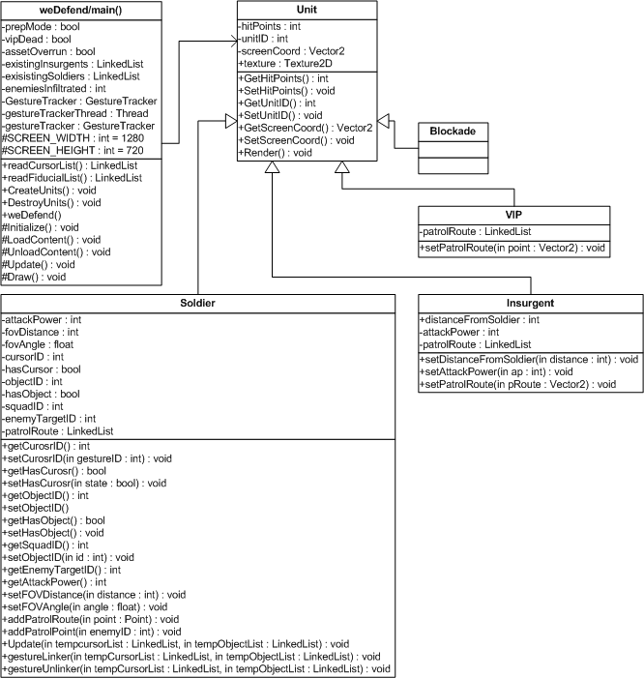
Class diagram

Slide 45
Current state of Hardware & software
Software
  Touches are being added, removed, updated, and linked successfully in the Touch and Fiducial Recognition System.
  Prototyping of graphics objects that can be manipulated via single and multi-touch gesture have entered testing.
    Dragging objects around the screen
    Resizing objects using two fingers
    Multiple objects being manipulated
Hardware
  Enclosure built and legs being designed and cut
  Parts are chosen, not completely ordered
  LED PCB schematics done
  Microcontroller still in testing phase before final schematic produced

Slide 46
Hardware Risks
Calibrating system to function in direct light
Small window for Testing/Calibration to be complete
Amoeba fudicials are very susceptible to noise from the camera
Floppy drive IR filters poor quality
Stitching of cameras has not been tested

Slide 47
Software Risks
Thread safety and atomicity
Fiducials can be mistaken for touches
Touches and fiducials can be linked to graphics objects at the same point in time could cause unpredictable behavior.
Wandering touches can possibly hijack graphical objects. This scenario has been tested and is being mitigated.
Creating an interactive tower defense application is large and complex. Timeline could prohibit all aspects of the application from being implemented.

Slide 48
Administration
Member roles and responsibilities
Budget and Parts
Life Cycle Model - SCRUM
Baselines
Subversion Control
Work Complete
Milestones/Deadlines

Slide 49
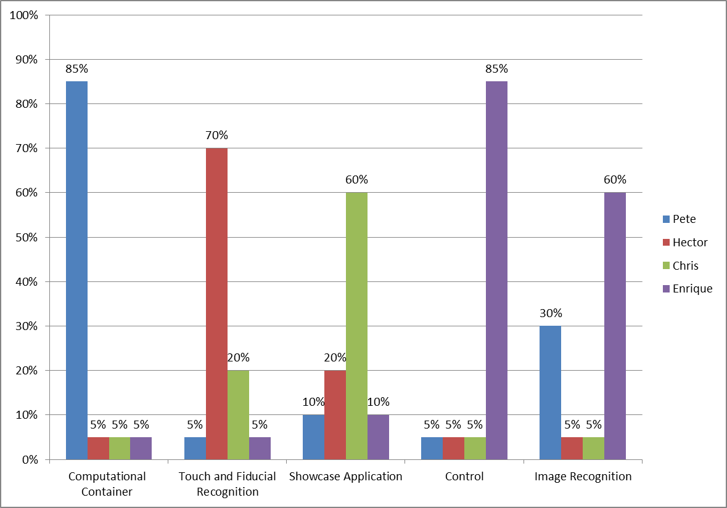
Member’s Design responsibilities
Computational Container System
  Peter Oppold
Image Recognition System
  Enrique Roche
Control System
  Enrique Roche
Touch and Fiducial Recognition System
  Hector Rodriguez
Showcase Application System
  Chris Sosa
Notes:
Pete

Slide 50
Member’s Roles
Pete Oppold: Project Manager
  Set milestones for the team
  Responsible for the creation of meetings
  Responsible for objectives and requirements being met
  Point of Contact for the team’s mentor and client
Hector Rodriguez: System Architect
  Senior Software System designer
  Assists in Software management
Chris Sosa: Scrum Master
  Manages the Software Systems
  Creates and assigns sprints
  Manages Defect Log
Enrique Roche: Senior Hardware Engineer
  Manage all electronics in the system
Notes:
Pete

Slide 51
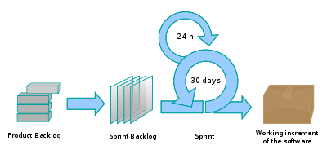

Life Cycle Model – Agile Methods Scrum
Documents
  Product Backlog
  Sprint
  System Integration
  Defects
Software development segmented into 4 baselines
Tortoise SVN
  Easy, free
  Prevents lost data and collisions

Slide 52
Baselines
Baseline 1.0 –
  Single Circle on non-graphical map. One gesture fully working with flag activation when Gesture recognized successfully.
Baseline 1.5
  Single Circle on non-graphical map. Both gestures fully working with flag activation when Gestures recognized successfully.
Baseline 2.0
  Multiple Circles on non-graphical map. Both gestures fully working with flag activation when Gestures recognized successfully. Gestures can be activated on all circles simultaneously.

Slide 53
Baselines
Baseline 2.5
  Use fiducials to stamp out graphical objects
Baseline 3.0
  Graphics improvement
  Addition of terrain
  Formal set of units, both allies and opponent
  Addition of Structures, such as buildings.
Baseline 4.0
  Creation of Game
  Rules
  Logic
  Game-play

Slide 54

Subversion control
Tortoise SVN
  Easy
  Free
  Prevents lost data and collisions
Ankh SVN
  Plugin for Visual Studio

Slide 55
Budget and parts
Work Force Central Florida Funded
  Waiting on half the funding
  Over budget on prototype 7%
  Under budget on camera by 58%
  Under budget on projector 5%

Slide 56
Work Complete

Slide 57
Parts
Acquired
Prototype
Enclosure
Cameras
Future(Priority)
IR Filter
Computer
LEDs
Acrylic
Projector

Slide 58
Milestones/Deadlines
2/13 – Baseline 2.0 Delivered
2/14-2/21 – in-class CDR
2/21 – CDR presentation
3/7 – Baseline 2.5 Delivered
3/12 – Soldering of PCBs complete
3/19 – Testing of hardware components complete
3/21 – 2nd Mentor Meeting
3/24 – Hardware components fully calibrated
3/25 – Baseline 3.0 Delivered
4/6 – Baseline 4.0 Delivered
4/9 – Final Presentation (tentative)

Slide 59
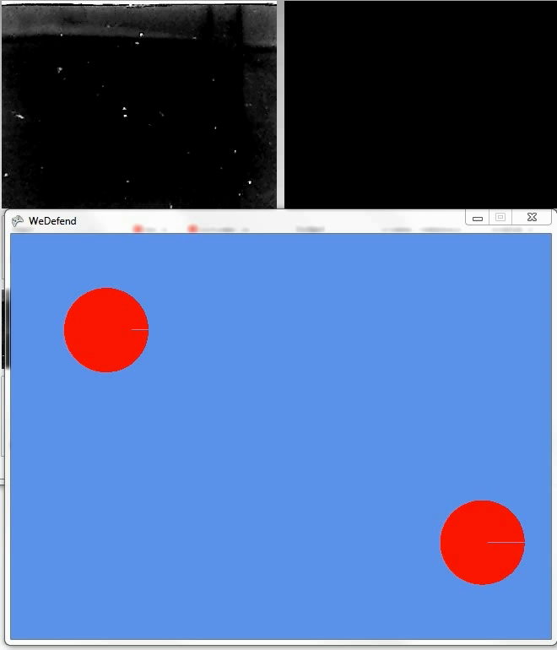
Questions?
Please enjoy this video of
our application while you
think of them.

Slide 60
Questions?

