Slide 1
Multi-User Touch Table
Planck
      Peter Oppold - CpE
      Hector Rodriguez - CpE
      Chris Sosa - CpE
      Enrique Roche - EE
      Mentors from NAVAIR;
      Ronald Wolff
      Dave Kotick
Group 14
Notes:
Enrique

Slide 2
Mission Statement
Create a multi-touch table with a novel touch and fiducial interface that recognizes gestures. These gestures will be used to manipulate a defense scenario application that requires the user to defend assets via the placement and management of military units.
Making a military scenario which is realized through computer graphics and controlled by non-traditional user inputs
Notes:
chris

Slide 3
Motivation of Project and explain value of project
Apple, Microsoft, Smart, Samsung, and Motorola gravitating towards touch interfaces
  Microsoft Surface
  iPhone/smart phone
  Smart board
Multi-touch can accommodate multiple users
  Design
  Simulation
  Business presentations
  Entertainment
  File Sharing
Notes:
Chris

Slide 4
Project Goals and Objectives
To remove the need for traditional input in favor of multi-touch gestures and real life objects
To create a tool set that is intuitive and natural and allows the user to learn through experience and not require lengthy instructions.
To facilitate collaborative work from simultaneous users
Be of sufficient size to accommodate multiple users simultaneously
To showcase the toolset with a battle simulator
Notes:
peter

Slide 5
Project Specifications and Requirements
Table shall enclose all hardware securely
Multi-touch surface will have a design resembling that of a smart-phone
The system shall have a latency similar to that of a Smartphone
The internal temperature of the enclosure shall not exceed 35C
Usable system screen size shall be a minimum of 40 diagonal inches
The enclosure shall not be constructed with a height more than 3.5 feet
The enclosure shall be able to support up to 400lbs of weight
System shall recognize a minimum of 10 touch events simultaneously
System shall recognize Fiducials
Notes:
Pete

Slide 6
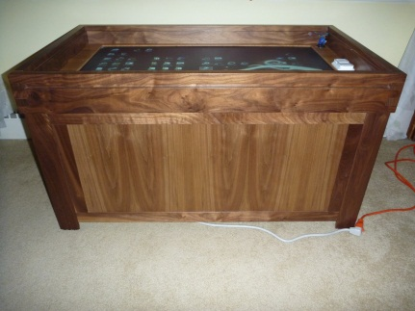
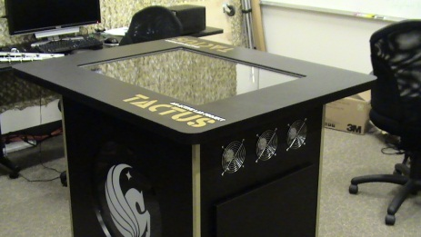
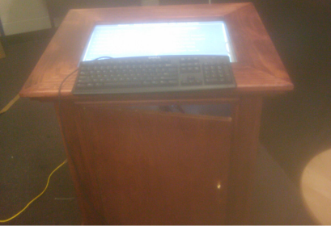
Prior Similar Work
Tactus – UCF FIEA
  FTIR
  Bespoke Vision library
  Surface Command
  Approx 48” display, 36” tall
Locus – Boston University
  DSI
  CCV 1.5
  Map Tools
  42” display, 19” tall
Multi Touch Poker Table (MTPT) - UCF
  FTIR
  TouchLib
  Texas Hold-em Poker
  39” tall
Notes:
Peter

Slide 7
Touch Technology considerations
Capacitive and Resistive touch are not very scalable to large screens nor capable of detecting Fiducials.
Technology needed to be relatively cheap to implement on a large screen.
Ability to do more than traditional touch would be preferred.

Slide 8
Table of Touch Technologies
 | Frustrated Total Internal Reflection | Diffused Illumination | Diffused Surface Illumination | Force Sensitive Resistance | Optical Imaging
Sensor | Optical | Optical | Optical | Voltage | Optical
Touch Types | Touch Only | Touch and Objects | Touch and Objects | Touch and Pressure | Touch only
Difficulty to Implement | 2 | 3 | 4 | 1 | 5
Quality of Blobs | 5 | 1 | 3 | 4 | 2
Scalability (Cost vs Size) | 3 | 2 | 3 | 1 | 5
Cost | 4 | 3 | 2 | 1 | 5
5 = Best for project, 1 = Worst for project

Slide 9
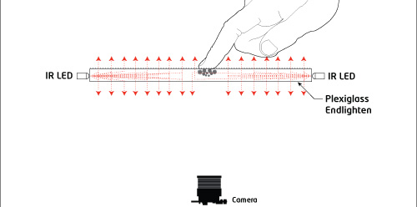
Diffused Surface Illumination
IR LEDs
Camera
Acrylic:
Active Layer
Diffusion Layer
Protective Layer

Slide 10
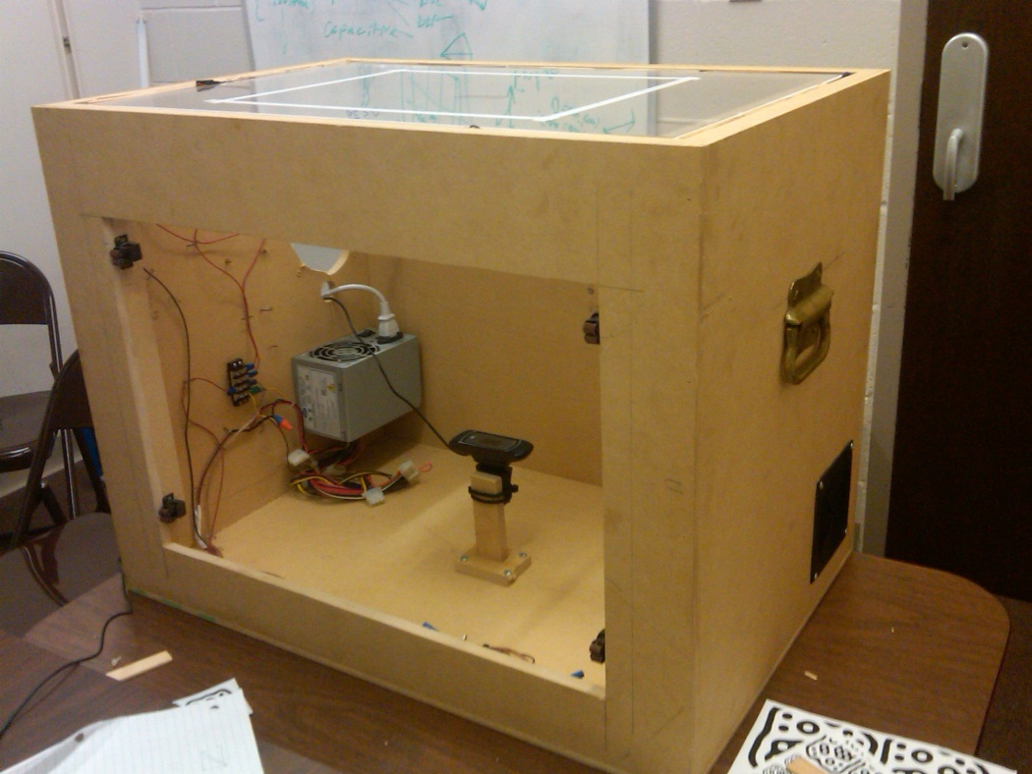
Hardware Block Diagram

Slide 11
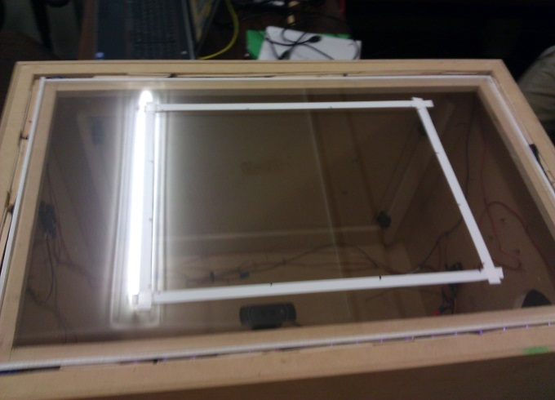
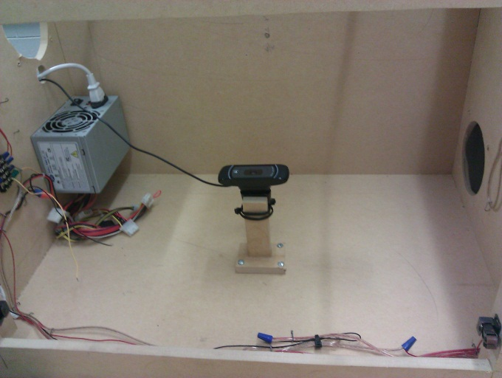
Development Board (Prototype)
Provides platform essential to test our hardware and software
Polished acrylic edges
  LED light can penetrate deeper
Slim LED wooden Frame
  Flush fit
  Painted white for maximum deflection
Camera mount
  Allows for easy configuration

Slide 12
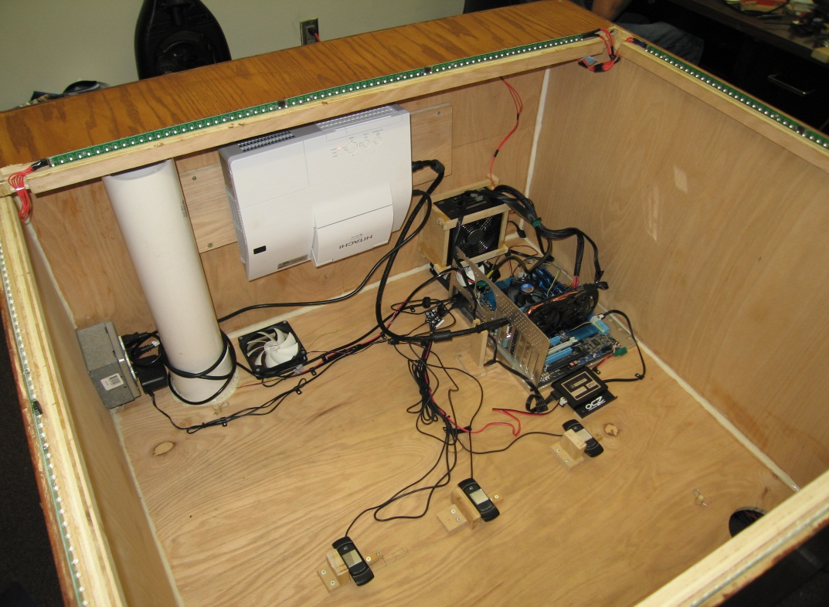
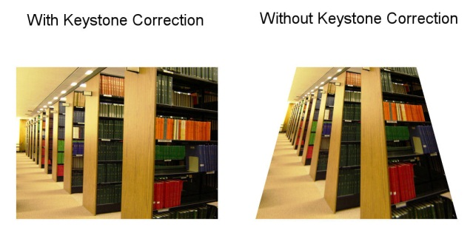
Final Design - Enclosure
45” Diagonal Display
36” Tall with Legs
  Capable of 24” tall (minus legs)
  Oak Veneer
Fluid Bearing enclosure Fans
  Bottom stealth mount
Projector tilt-mount
  Smallest achievable offset due to Keystone correction
Notes:
Pete

Slide 13
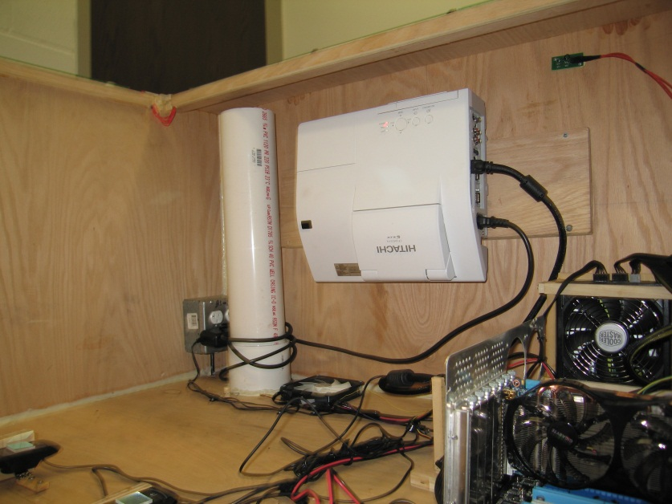
Design - Projector
Projector: Hitachi CP-AW250N Short Throw
  1280 x 800
  45” diagonal image in 0”
    Corrected with Zooming
  3 LCD
  Tilted to reduce vertical offset
Notes:
Pete

Slide 14
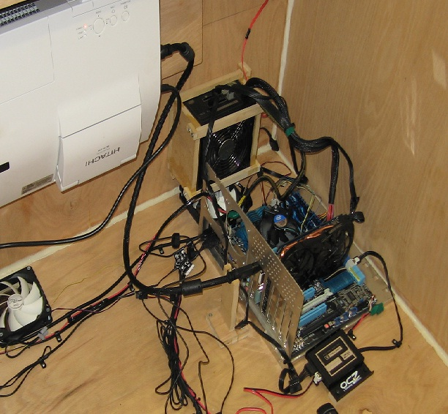
Computer System - Design
  Computer:
    CPU: 2nd Gen I7
    Hard drive: SandForce SF-2281 120gb SSD
    Memory: 8gigs DDR3
    Video Card: Nvidia Fermi DirectX 11
    700w power supply
      Power to LEDs and computer
Notes:
everyone

Slide 15
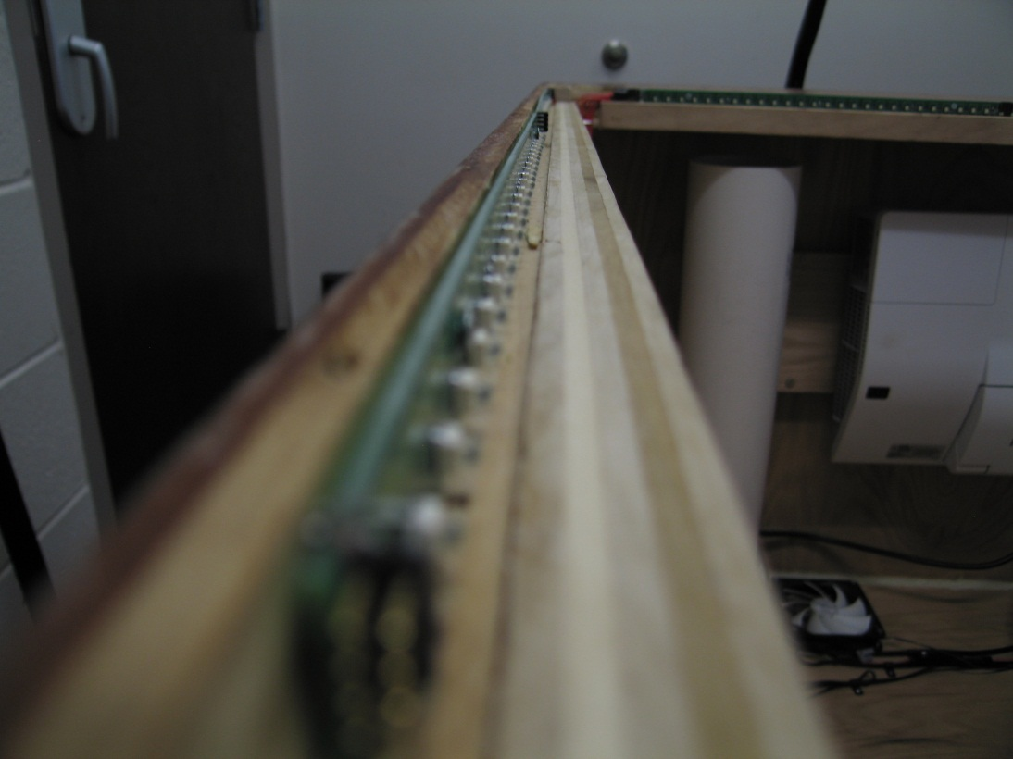
Design – LED Channel and Acrylic
Channel
  ~9.5mm deep
  15mm Tall
  against polished acrylic for maximum light penetration
Acrylic
  3 Layers Stacked
  Edge-Edge Acrylic Surface, Mirroring Smartphone surface
Notes:
Pete

Slide 16
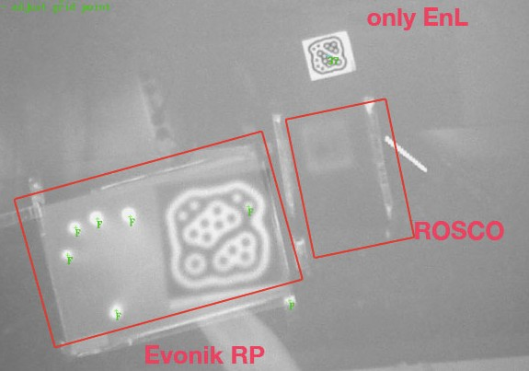
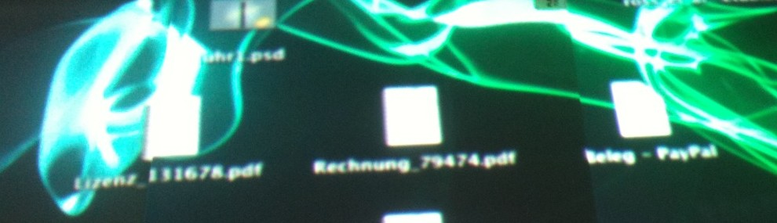
Rear Projection Acrylic
Diffuses light, but also diffuses infrared
Comes in two types, film and acrylic
Acrylic tends to give better quality.

Slide 17
Acrylic
EndLighten XXL 10mm
  91% Transmission, 39” penetration
7D513 Rear Projection Acrylic 3mm
  38.9% Transmission
0A000 MR2 Mar Resistant Acrylic 3mm
  92% transmission, two sided coating

Slide 18
Camera
Resolution of at least 640x480
Frame-rate of at least 60 fps
Quality of picture in low light conditions
  Better quality picture in low light, less LEDs that would need to be used, less effect from noise.
Wide angle or replaceable lens
Full manual, or ability to disable “auto”

Slide 19
Camera
 | Logitech c910 | Firefly MV | Fire-i | PS3 Eye
Interface | USB | Firewire | Firewire | USB
Resolution | 640x480 60fps 1184x656 30fps | 752x480 60fps | 640x480 86fps | 320x240 120fps 640x480 60fps*
Total Cost per Camera (with wide angle lens) | $65 | $300 | $650 | $130
PS3 Eye may be slightly cheaper if we did the modifying ourselves. Stock lens is unable to focus at distance required. 640x480 60fps format uses full bandwidth of an entire USB bus and may not be obtainable based on hardware.
Firefly MV and Fire-I offer significantly better image quality.

Slide 20
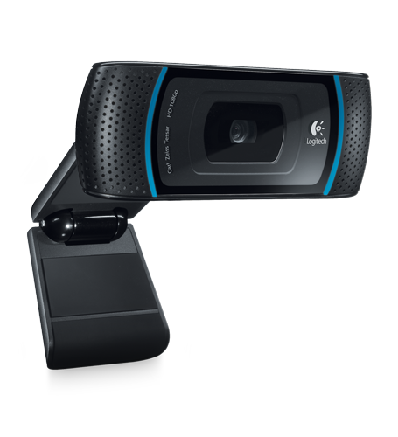
Camera
Logitech HD Pro C910 Webcam
Capable of YU12
60fps @ 640x480
30fps @ 1184x656
Wide Angle Lens
Easily removable IR filter
USB Video Device Class (UVC) capable
POI Zooming
$65 per Camera

Slide 21

LEDs
Requirements:
Shallow Angle
High Radiant Flux
Near Infrared (between 850 and 900 nm)
SFH4258
850nm
15 degree half angle
50mW Radiant Flux @ 100mA
1.5 V @ 100mA

Slide 22
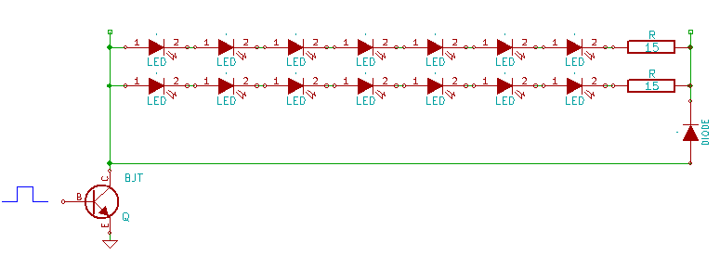
LED Arrays
7 LEDs + 1 Resistor in series per chain
42 total chains, totally 4.2A @ 12V

Slide 23
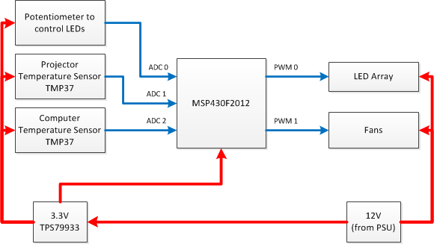
Microcontroller
MSP430F2012
10 Bit SAR ADC
Can be programmed by launchpad
TPS76133 Linear Regulator
3.3 V
TMP37 Temperature Sensors
Linear temperature sensor
20mV / °C

Slide 24
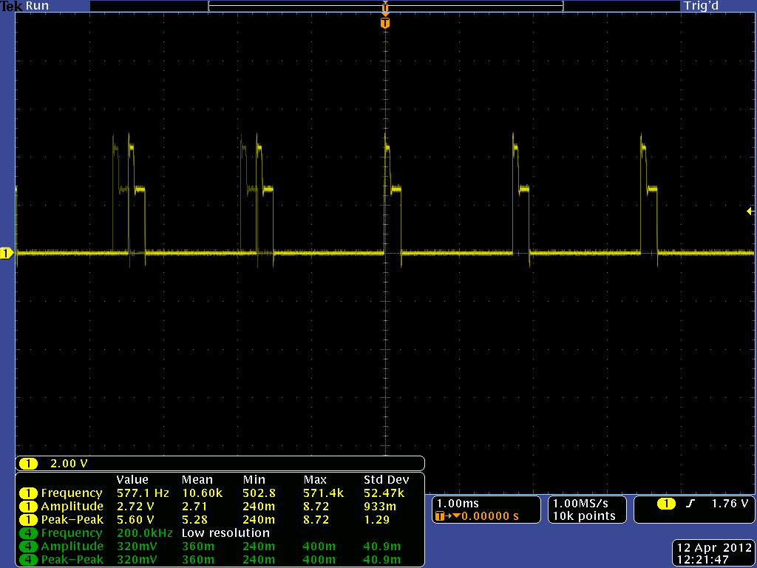
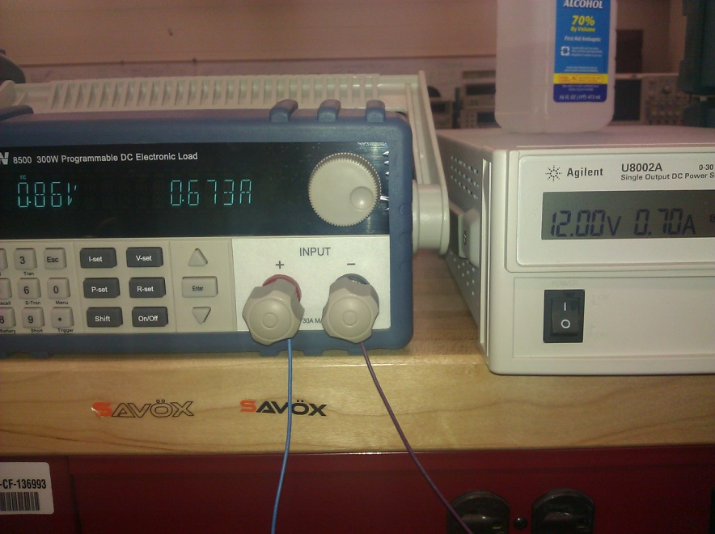
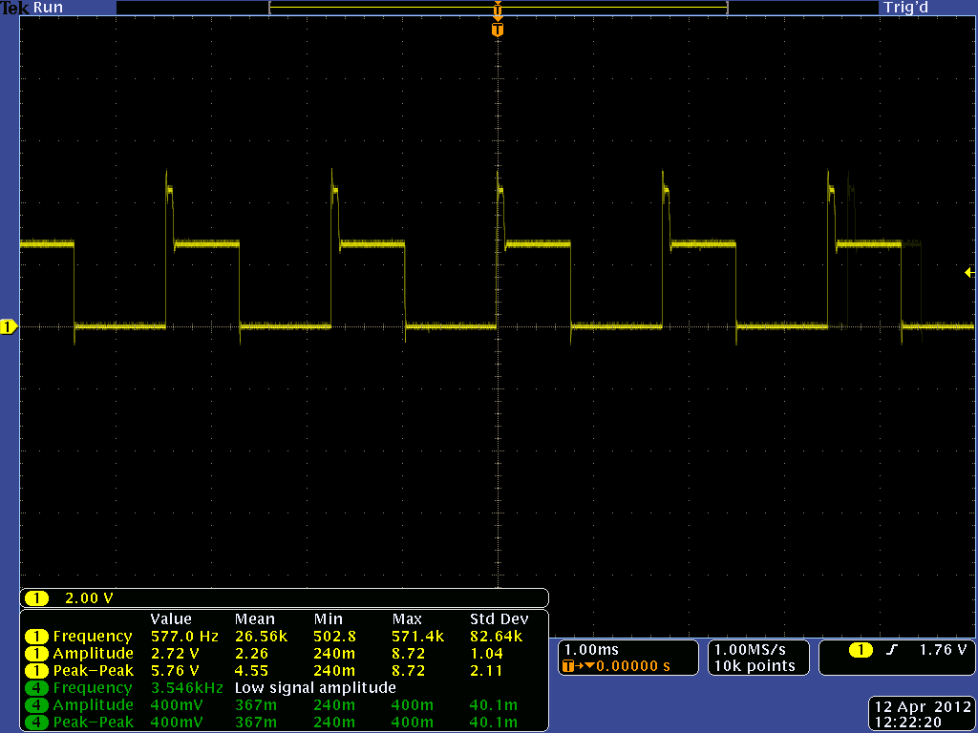
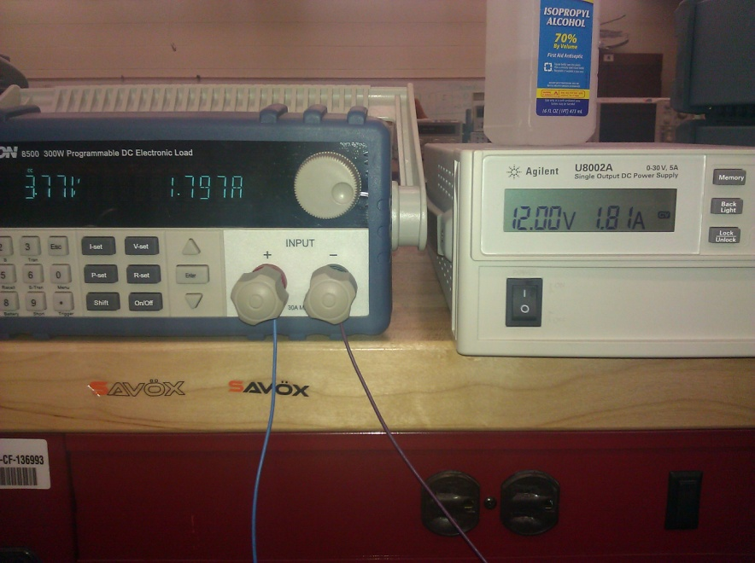

Slide 25
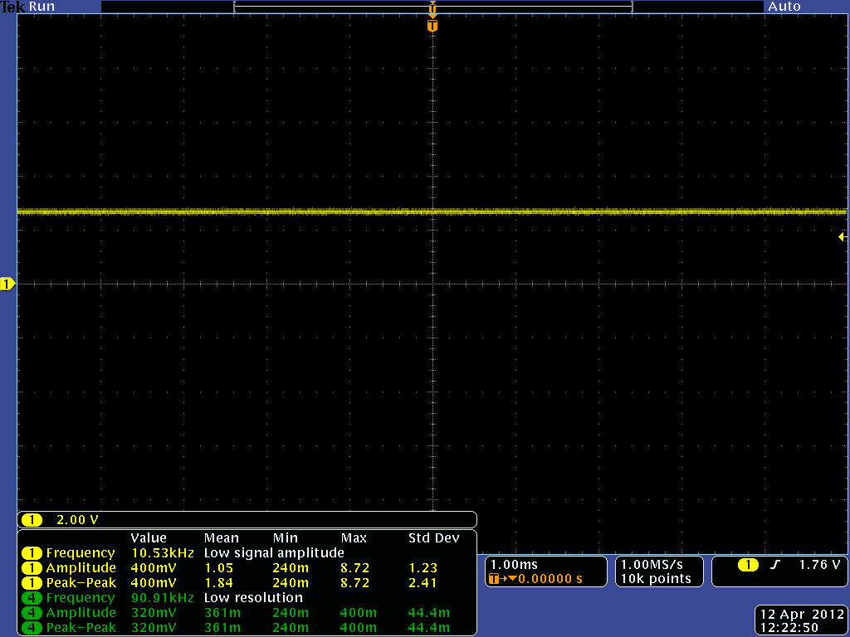
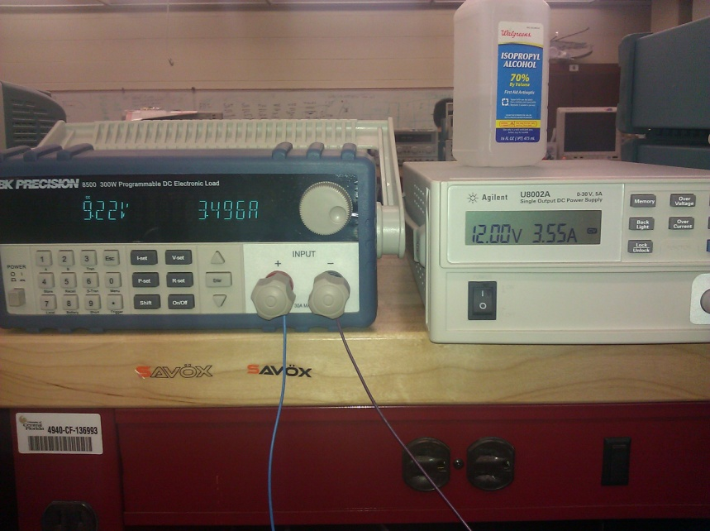
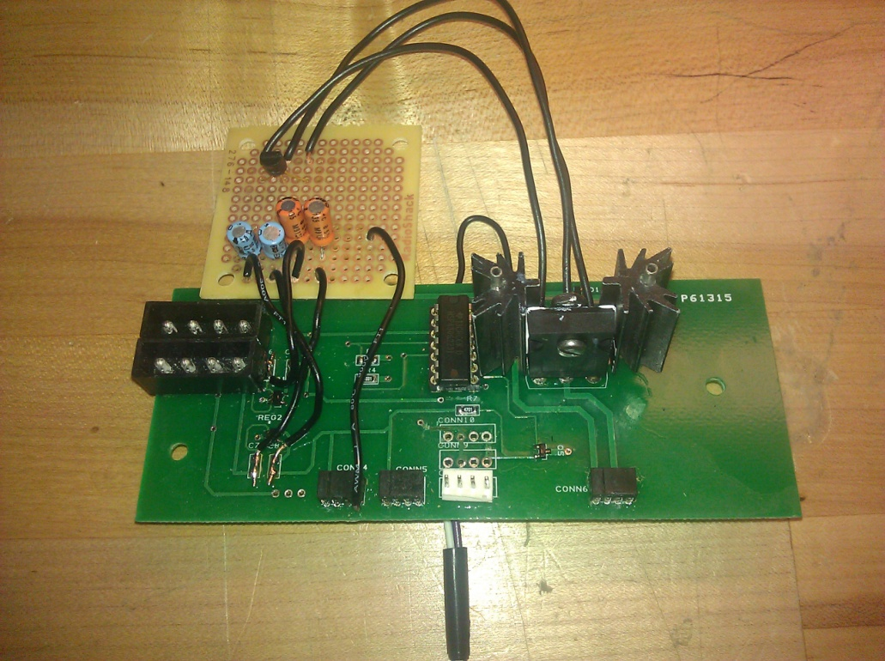

Slide 26
Control and Power System Testing
LED chain pulls 3.5A at 12V. Tested with power supply.
Original transistors did not supply enough amplification. Only outputted at about 30%. Tested with power supply.
Code ran at 577 Hz and modulated at 50 points between 1% and 100% power. Tested with oscilloscope.
Fans had 3 points of power. 20% in idle mode. 60% power when temperature rose above 25 C. 100% power when temperature rose above 35 C.
CCV was not capable of doing 60fps normally with directshow cameras. Code was edited to allow 60fps. This was verified working on prototype board with 1 camera. With multiple cameras, CCV would not properly set the 2nd and 3rd cameras resolution and framerate.

Slide 27
Software system

Slide 28
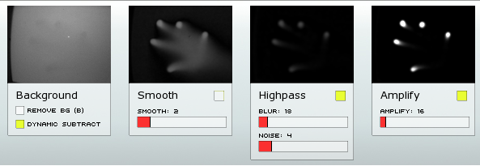
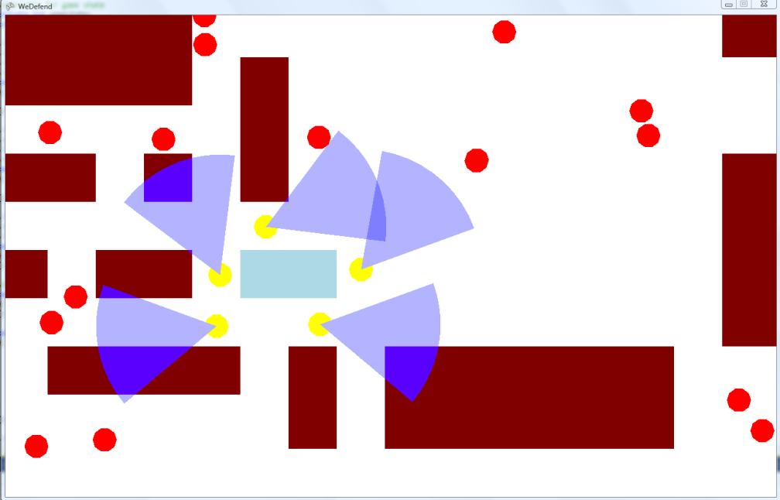
Software System overview
Two sub-systems in order to achieve multi-touch
  Touch and Fiducial Recognition Software System
    CCV 1.5 Vision Library
    GestureTracker input parsing and gesture software
  Showcase Application System
    weDefend Tower Defense Simulation Application
    Microsoft XNA Graphics API renders interactive objects

Slide 29
Software Block Diagram

Slide 30
TFRSS High Level BLOCK Diagram
CCV 1.5 outputs single input touches and Fiducial information via TUIO protocol.
GestureTracker packages touch input and Fiducials into shared list data structure
As fingers and Fiducials are added to surface and received from CCV
  GestureTracker logic called
  Objects are added, updated, and removed from shared data structures
Store and transmit touch, gesture, and Fiducial information to Showcase Application program
Notes:
GestureTracking system is located within Showcase Software system

Slide 31
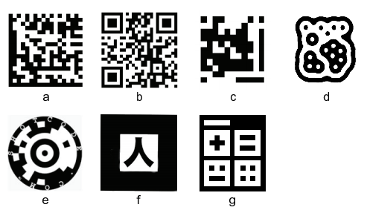
Fiducials
A Fiducial is a symbolic marker that has a specific meaning to our software
Position and orientation interpretation
Can be used to interact with Software Application
  Stamp out objects
  Trigger specific events
  Locate certain objects
  on screen
Examples:
  B. QR-code
  D. Amoeba
  G. d-touch Fiducial
Notes:
Fiducials are symbols or markers.
Originally they were used in medical applications and later on in augmented reality applications

Slide 32
TFRSS Vision Library decision
Vision library must
  Receive IR camera input
  Apply image noise filter, threshold filter, vision algorithms
  Perform within latency requirements
  Required to work with Diffused Surface Illumination technology
  Fiducial and touch information output (i.e. unique identification #, position, velocity, angle, time)
  CCV 1.5 chosen as the system’s vision library
Notes:
The vision library is in charge of receiving video input from the cameras, applying filters and computer vision algorithms to extract information about touches such as those listed here. It also has to find fiducials and distinguish these from touches by a unique ID number. The vision library must be able to work under our latency requirements and be able to work with DSI technilogy.
Table listed below shows how we arrived at CCV 1.5 decision.

Slide 33
TFRSS/SAs Design
Notes:
Showcase application creates a thread instance of GestureTracker
GestureTracker keeps updating cursorList and objectList with new input information
List structures are shared via getCursorList and getObjectList methods

Slide 34
TFRS/SAs Design
Showcase application creates a thread instance of GestureTracker
GestureTracker keeps updating cursorList and objectList with new input information
List structures are shared via getCursorList and getObjectList methods
Touch-Input flow
  TuioCursor /Touch comes in as input
  Link 2 cursors together
  Update cursor information
  Update list with new objects

Slide 35
TFRS: Link Partner Algorithm
As a new touch arrives
Look at each touch and find a partner based on spatial locality within radius threshold
  Length<R
Threshold for linking based on size of on-screen object
Mitigate multi-user 2-finger gesture object
Limited usability of system due to spatial constraints

Slide 36
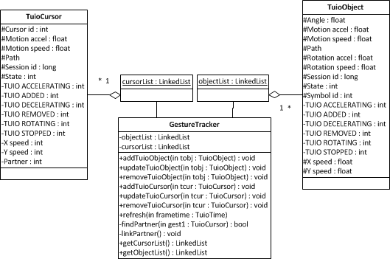
TFRSS Class diagram

Slide 37
Showcase Application system
Creating a tower defense application called weDefend capable of allowing teamwork between multiple users
Simple scenario where soldiers defend an area of the map from an opposing force
2 modes of operation
  Preparation mode: allows user to create, position and adjust soldiers
  Action mode: happens in real time and soldiers adjustment is restricted
Using XNA 4.0 in C# to draw to the screen
Uses 2D top-down view

Slide 38

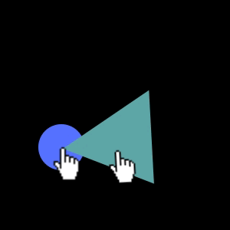
Gestures

Slide 39

Example Scenario

Slide 40
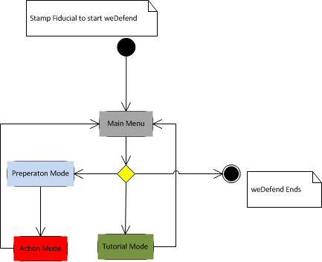
Sas state diagram

Slide 41
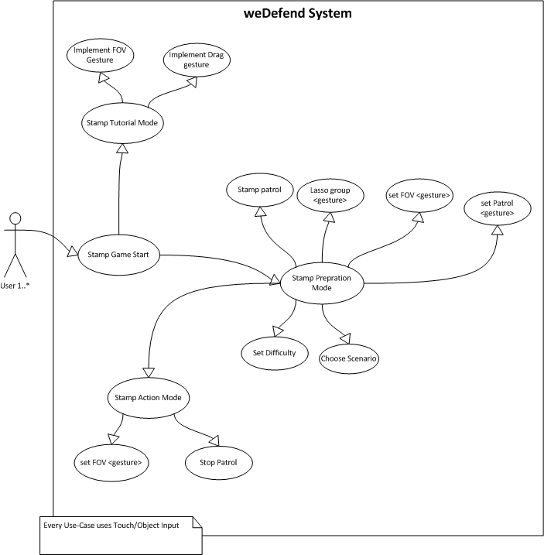
SAS USE-CASE diagram

Slide 42
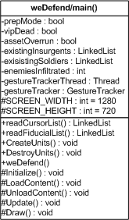
SAS application structure
Update methods for each graphics object
Draw methods draw the updated graphics object
Main Update and Draw methods in weDefend call object methods

Slide 43
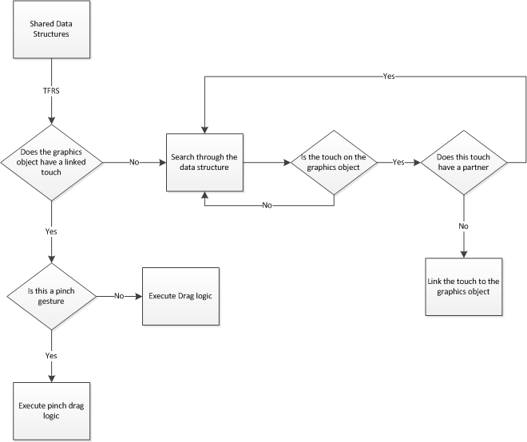
SAS Linking
A graphics object must be linked to a touch in order to be acted upon
Touches that have partners are never eligible to be linked
Update checks if the linked touch has a partner or not.

Slide 44
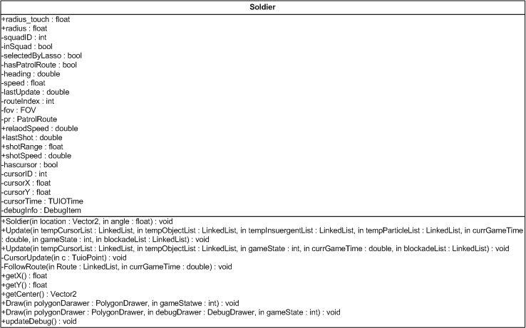
SAS interactive object
hasCursor and cursorID is used to link and update every call of weDefend Update()
Objects move as a touch moves based on the touches time stamp and last position
Update method changes attributes of the graphics object and runs the linking algorithm
Draw method will graphically display the changes made in update

Slide 45
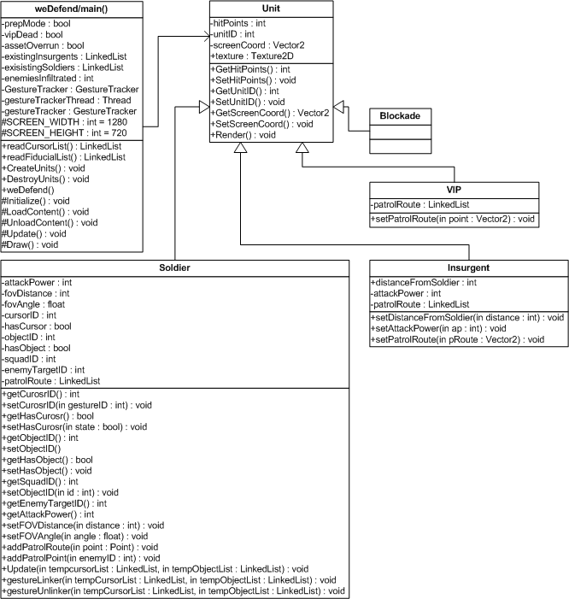
Class diagram

Slide 46
Current state of Hardware & software
Software
  Touches are being added, removed, updated, and linked successfully in the Touch and Fiducial Recognition System.
  Prototyping of graphics objects that can be manipulated via single and multi-touch gesture have entered testing.
    Dragging objects around the screen
    Resizing objects using two fingers
    Multiple objects being manipulated
Hardware
  Enclosure built and legs being designed and cut
  Parts are chosen, not completely ordered
  LED PCB schematics done
  Microcontroller still in testing phase before final schematic produced

Slide 47
Hardware Risks
Calibrating system to function in direct light
Small window for Testing/Calibration to be complete
Amoeba fudicials are very susceptible to noise from the camera
Floppy drive IR filters poor quality
Stitching of cameras has not been tested

Slide 48
Software Risks
Thread safety and atomicity
Fiducials can be mistaken for touches
Touches and fiducials can be linked to graphics objects at the same point in time could cause unpredictable behavior.
Wandering touches can possibly hijack graphical objects. This scenario has been tested and is being mitigated.
Creating an interactive tower defense application is large and complex. Timeline could prohibit all aspects of the application from being implemented.

Slide 49
Testing

Slide 50
HARDWARE testing
Tested weight holding ability of box
Configured and tested computer outside of box
Tested IR LED chains once soldered
Tested IR filters on cameras with prototyp
Tested stitching
Tested microcontroller

Slide 51
SOFTWARE Testing
weDefend was tested using a modified version of Agile Testing
Sprints contain testing descriptions, test delegate, and sprint test signatures
Tests are documented in the Master weDefend Test Sheet
Once a sprint is complete the test delegate tests according to the test description and decides whether or not the feature works according to the description
The SCRUM Master then double checks the test and approves the sprint as complete

Slide 52
System testing
Requirements
# | Requirement Description | Analysis | Demonstration | Test | Inspection | Done (pass/fail) | Performed by
1 | Table shall enclose all hardware securely |  |  | X |  | Pass | Group
2 | Multi-touch surface will have a design resembling that of a smart-phone |  |  |  | X | Pass | Group
3 | The system shall have a latency similar to that of a Smartphone |  |  | X |  | Pass | Group
4 | The internal temperature of the enclosure shall not exceed 35C |  |  | X |  | Pass | Hector Rodriguez
5 | Usable system screen size shall be a minimum of 40 diagonal inches |  |  |  | X | Pass | Hector Rodriguez
6 | The enclosure shall not be constructed with a height more than 3.5 feet |  |  |  | X | Pass | Hector Rodriguez
7 | The enclosure shall be able to support up to 400lbs of weight |  |  | X |  | Pass | Pete Oppold
8 | System shall recognize a minimum of 10 touch events simultaneously |  |  | X |  | Pass | Group
9 | System shall recognize Fiducials |  |  | X |  | Pass | Group

Slide 53
Administration
Member roles and responsibilities
Life Cycle Model - SCRUM
Budget and Parts
Milestones/Deadlines

Slide 54
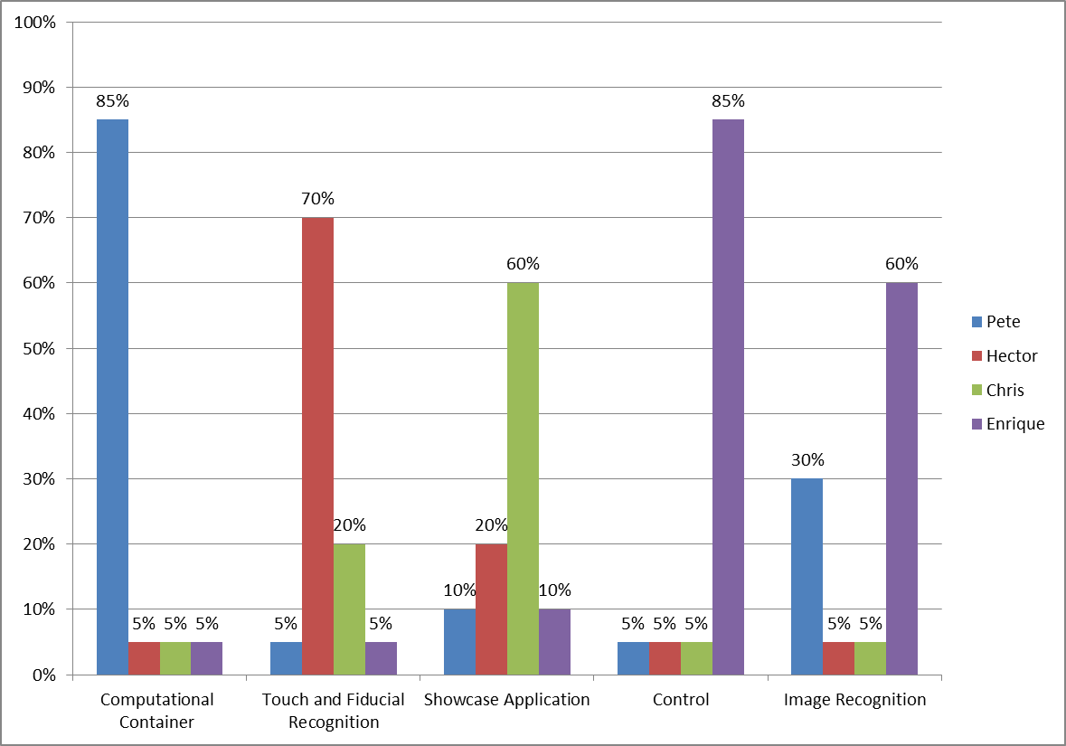
Member’s Design responsibilities
Computational Container System
  Peter Oppold
Image Recognition System
  Enrique Roche
Control System
  Enrique Roche
Touch and Fiducial Recognition System
  Hector Rodriguez
Showcase Application System
  Chris Sosa
Notes:
Pete

Slide 55
Member’s Roles
Pete Oppold: Project Manager
  Set milestones for the team
  Responsible for the creation of meetings
  Responsible for objectives and requirements being met
  Point of Contact for the team’s mentor and client
Hector Rodriguez: System Architect
  Senior Software System designer
  Assists in Software management
Chris Sosa: Scrum Master
  Manages the Software Systems
  Creates and assigns sprints
  Manages Defect Log
Enrique Roche: Senior Hardware Engineer
  Manage all electronics in the system
Notes:
Pete

Slide 56
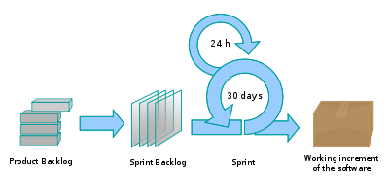

Life Cycle Model – Agile Methods Scrum
Documents
  Product Backlog
  Sprint
  System Integration
  Defects
Software development segmented into 4 baselines
Tortoise SVN
  Easy, free
  Prevents lost data and collisions

Slide 57
Budget and parts
Work Force Central Florida Funded
  Over budget on prototype 7%
  Under budget on projector 5%
  Over budget on:
    Cameras
    Acrylic
    Electroncis

Slide 58
Milestones/Deadlines
2/13 – Baseline 2.0 Delivered
2/14-2/21 – in-class CDR
2/21 – CDR presentation
3/7 – Baseline 2.5 Delivered
3/12 – Soldering of PCBs complete
3/19 – Testing of hardware components complete
4/3 – 2nd Mentor Meeting
3/24 – Hardware components fully calibrated
3/25 – Baseline 3.0 Delivered
4/6 – Baseline 4.0 Delivered
4/9 – Final Presentation

Slide 59
Questions?
Please enjoy the demonstration of
Planck and weDefend while you
think of them.

