Slide 1
Group 16 – Efficient HVAC System
Daniel Galarza – CpE
Chung Chien Hsia – EE
Marvin Fernandez – CpE
Kevin Ivy – EE
William Carson Sr. – Mentor, owner of Natural Air
Workforce Central Florida - Sponsor

Slide 2
Motivation – Natural Air Energy
Household energy consumption
Heating, Ventilation and Air Conditioning (HVAC)
Different needs for different climates
Humidity almost never considered

Slide 3
Project History
iTemp – First design
Did NOT work
Efficient HVAC System – Second design
Worked much better
Expensive, and excessive components
Stopped working later

Slide 4
Objectives
Improve upon previous projects
Make the project suitable for mass production
Make the project cheaper
Provide a layout for Internet connectivity

Slide 5
Specifications
Machine to Machine communication
A web server to relay information from HVAC system to web browser and mobile phone applications and vice versa
MySQL Database
Secure login
Website accessible by mobile and desktop web browsers
Application mimics touch screen interface
Create TCP/IP Stack software to allow Hardware to be able to communicate to internet

Slide 6
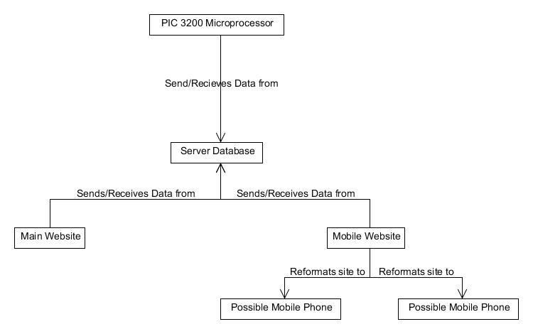
Block Diagram

Slide 7
Hardware

Slide 8
Processor Comparison
iTemp
Efficient HVAC System – Panda Board
Expensive, many features unused
Group 16 – PIC32
Significantly cheaper

Slide 9
Screen Comparison
iTemp
Efficient HVAC System –
Group 16 – Newhaven International Screen
Cheaper

Slide 10
Software

Slide 11
The Database
Will connect the control system hardware to the website in the Internet.
Ensures the data on both systems are accurate and consistent.
Updates any changes made on the data by either system.
Implemented on a hosting website given by the sponsor.

Slide 12
Mobile Software Comparisons
Android
iOS
SDK is free
Many different software programs available that supports Android
Primary language is Java
SDK is $100 roughly
Few other software programs are compatible with it
Primary language is Objective-C

Slide 13
Main Block Diagram (first version)

Slide 14
Website Application - Tools
Control and monitor a user’s HVAC system from a desktop or mobile web browser.
HTML and CSS – Basic building blocks
PHP – Allows web programming
SQL – Communication with Database
AJAX – Dynamic, automatic updating (later!)
Hype – HTML5 designer
Dreamweaver – hand coding PHP and SQL

Slide 15
The Website
Allows a user to get access to their home HVAC system.
Will closely follow the format of the control system.
Will have all the same functionalities of the control system.
Will obtain all of the consumer’s data from their specific entry within the database.

Slide 16
Main Page

Slide 17
User Settings

Slide 18
Scheduler

Slide 19
Administration

Slide 20
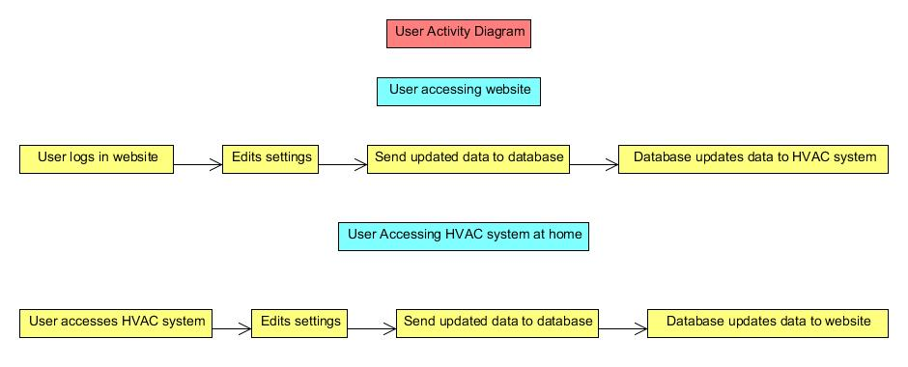
User Activity Diagram

Slide 21
Web Server
Core of the project
Stores web application and MySQL database
Accessible to mobile and desktop browsers
Accessible to the hardware (later!)

Slide 22
Progress of Project

Slide 23
Roles in the Project

Slide 24
Milestones

Slide 25
Budget and Financing
Part | Part Number | Price
Temp/Humidity Sensor (3) | SHT21 | $143.51
LM73-Digital Temperature Sensor |  | $.53
Personal Fan |  | $30.00
Mood Scent Dispenser |  | $15.00
VPack5.0V_AA |  | $11.95
Jumper 2 Pin (10) | PRT-09044 | $3.20
Basic LED (10) | COM-09592 | $3.20
Secondary PCB |  | $61.32
Main PCB (2) |  | $66.00
Electrical Test |  | $65.00
Wireless Router | N/A | $50.00
PIC32 USBII Starter Kit | DM320003-2 | $55.00
Fast 100 Mbps Ethernet PICTAIL Daughter Board | AC164132 | $50.00
ZEROG 802.11 Wi-Fi Board | AC164136-4 | $60.00
LCD TFT 7" 800X480 White Touch Panel | NHD-7.0-800480WF-CTXI#-T | $107.00
Graphics Controller PICtail Plus Epson S1D13517 Board | AC164127-9 | $119.99
Graphics Display Truly 7 800x480 Board | AC1641279 | $269.99
I/O Board Expansion | DM320002 | $72.00
Dreamweaver | N/A | $130.00
Shipping |  | $65.00
Total |  | $1378.69

Slide 26
Issues
Dealing with numerous changes to the project description and budget
PCB construction

Slide 27
Questions?

