Slide 1

Aquarium Lighting and Resource Monitor a.l.a.r.m.
Group 18
Kameron Lewis EE
Jeff Masson CpE
Britt Phillips CpE
Loren Robinson EE
Sponsored by: Progress Energy

Slide 2
Motivation
Salt water aquariums are one of the most popular hobbies world wide
A large portion of these aquariums use antiquated and inefficient lighting systems
Many systems have little to no automatic water quality monitoring
Poor water quality and temperature change are the main cause of fish deaths
Potential for power saving by utilizing controlled lighting schedules and power monitoring

Slide 3
Goals
Provide a higher quality and more stable environment for aquarium inhabitants
Allow user to control and monitor their aquarium remotely
Conserve power through alternate energy sources and controllability
Alert user of hazardous conditions to allow prompt response

Slide 4
Functional Requirements
Easy to operate
Monitor the pH, temperature, and any water leaks
Control and monitor power consumption of power heads, pumps, heater, and 2 auxiliary components
Control and provide suitable lighting system
User interface with front panel and website

Slide 5
Specifications
Poll temperature, current and pH every 10 seconds
Measure temperature within ± 1º C
Measure current up to 6A within ± 5%
Update web database every 10 seconds
Alert user of hazards within a minute of detection
Toggle relays within 10 seconds of update on website
PV panel that delivers 90% of lighting system power under ideal conditions

Slide 6
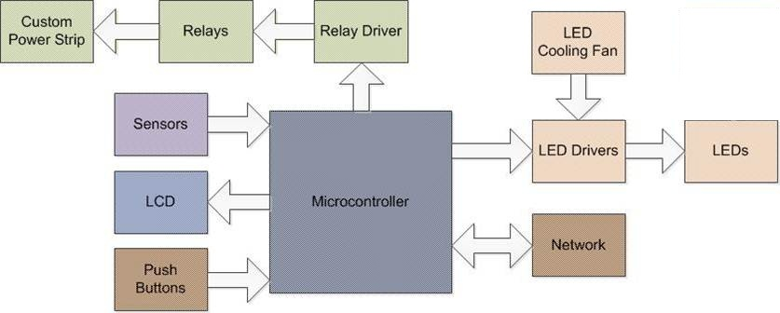
Overall Hardware Block

Slide 7
Main Sub-systems
Front panel
Sensors
LED lighting system
Custom power strip
Software

Slide 8
Front Panel

Slide 9
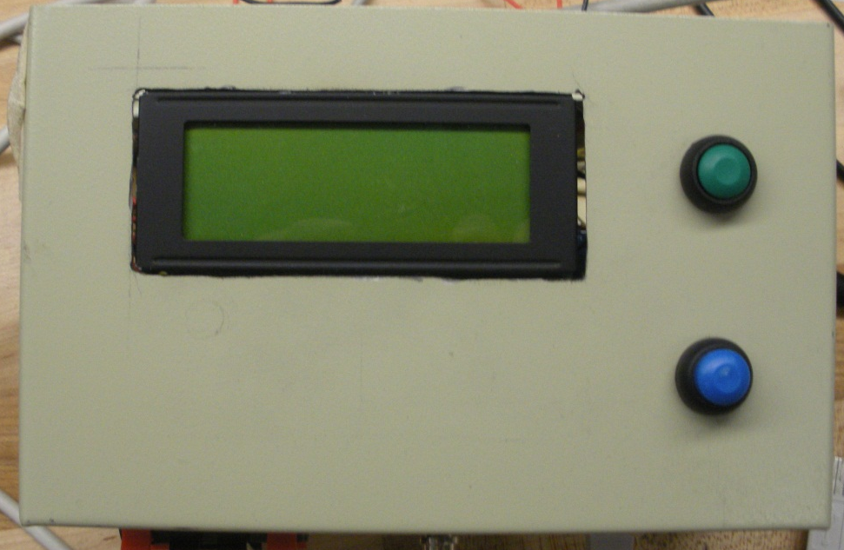
Front Panel
Shows the current condition of the tank via the LCD
Contains two push buttons
  Feed Mode
  Lighting Sequence
Houses microcontroller

Slide 10
Front Panel: LCD
Character display
Large enough to display water temp, pH, alerts, time and date
Low power consumption
Interfaces with microcontroller through 6 pins

Slide 11
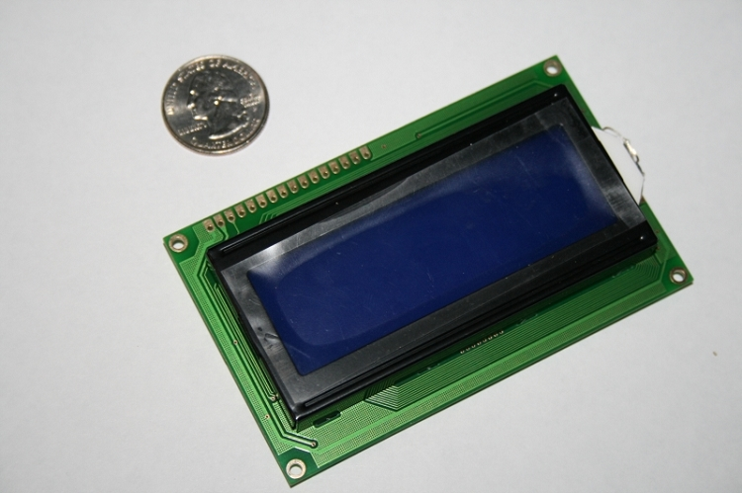
Front display: LCD
Futurlec 20X4 character display
LED Backlight
Hitachi HD44780 controller
Will be configured to use 7 digital lines
5VDC with typical current draw of 2.5mA
Large support base

Slide 12
Front Panel: Push Buttons
2 push buttons
  Feed Mode
    Turn off pumps and power heads for 5 minutes
  Lighting Sequence
    4 modes
      On- Both (100%)
      Dim- Both (50%)
      Off- Both(0%)
      Auto- Predefined Lighting Schedule

Slide 13
Sensors

Slide 14
Sensors
Current
  To measure the current which power the various components of the aquarium
Temperature
  To measure the water temperature
pH
  To measure the pH balance of the tank
Leak detection

Slide 15
Current Sensor
PART | CSLA2CD | INA193 | SI8512
Type | Hall Effect | Shunt | Inductive
Max Measurement | 72A | 10A | 10A
Input Voltage | 5.4V – 13.2V | 2.7V - 18V | 2.7-5.5v
Response Time | 3 μs | 2μs | 200 ns
Price | $22.21 | $3.29 | $1.22

Slide 16
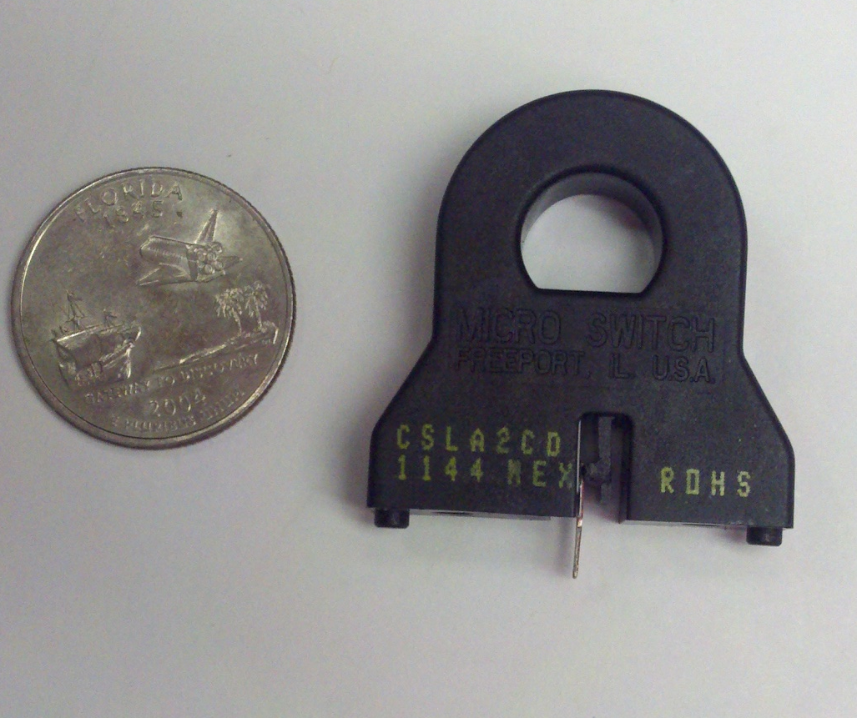
Honeywell CSLA2CD
Max Current Measured: 72A
Voltage Output: 0-12V (6V = 0A measured)
Adjusted Max Measured Current: 6A
Measured Current = (Voutput - 4.0) / 0.033

Slide 17
Temperature Sensor
PART | 10k Thermistor | DS18S20 | TMP 100
Temperature Range(°C) | -55 to +70 | -55 to +125 | -55 to 125
Accuracy(+/-°C) | 0.5 | 0.5 | 2
Programmable | No | Yes | Yes
Input Voltage | 3V | 3.0V to 5.5V | 2.7V to 5.5V
Response Time(max) | 400ms | 750ms | 300ms
Price | $0.99 | $3.95 | $3.11

Slide 18
Thermistor
Utilizes 10kΩ variable resistor which changes resistance with the temperature
Measure into ADC using another 10kΩ resistor as a voltage divider
Based on the Steinhart-Hart equation it is converted into degrees Fahrenheit

Slide 19
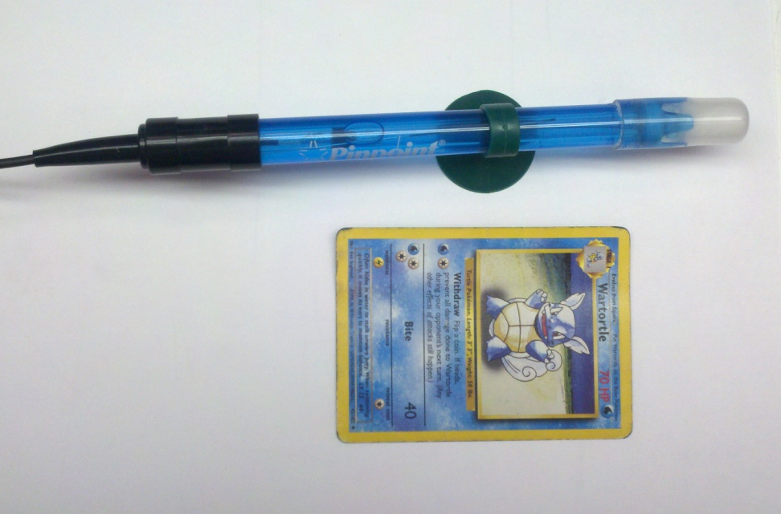
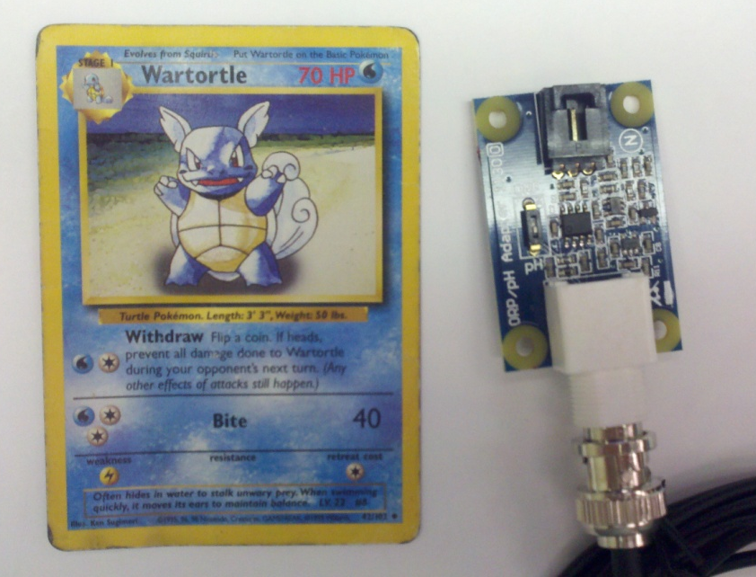

pH Sensor
Pinpoint pH probe
Phidgets 1130 adapter
  Input voltage 4.5VDC to 5.25VDC
Read into ADC changed into a pH value by the equation:
  $$pH=7−\frac{(2.5−\frac{Vin ∗200}{200})}{(.257179+ 0.000941468∗Temperature)}$$

Slide 20
Leak Detection Sensor
Resistor and 2 wire lead from Arduino 5V output is input into a digital pin
Water detected when the circuit is completed by conducting signal through the water
Sends interrupt to microcontroller to alert the owner

Slide 21
Lighting System

Slide 22
Lighting System
Supply lighting for the photosynthetic organisms
Low ambient air temp and heat transfer to the aquarium
Low power consumption and operating cost
Dimmable via PWM
Powered by PV panel

Slide 23
Lighting System
 | LEDs | Metal Halide | Power Compact
Power Consumption | Low | High | Medium
Efficiency | High | High | Low
Heat Dissipation | Low | High | Low
Controllable | Yes | No | No
Life Span | 10 years | 1 year | 6 months
Cost | High | Medium | Low

Slide 24
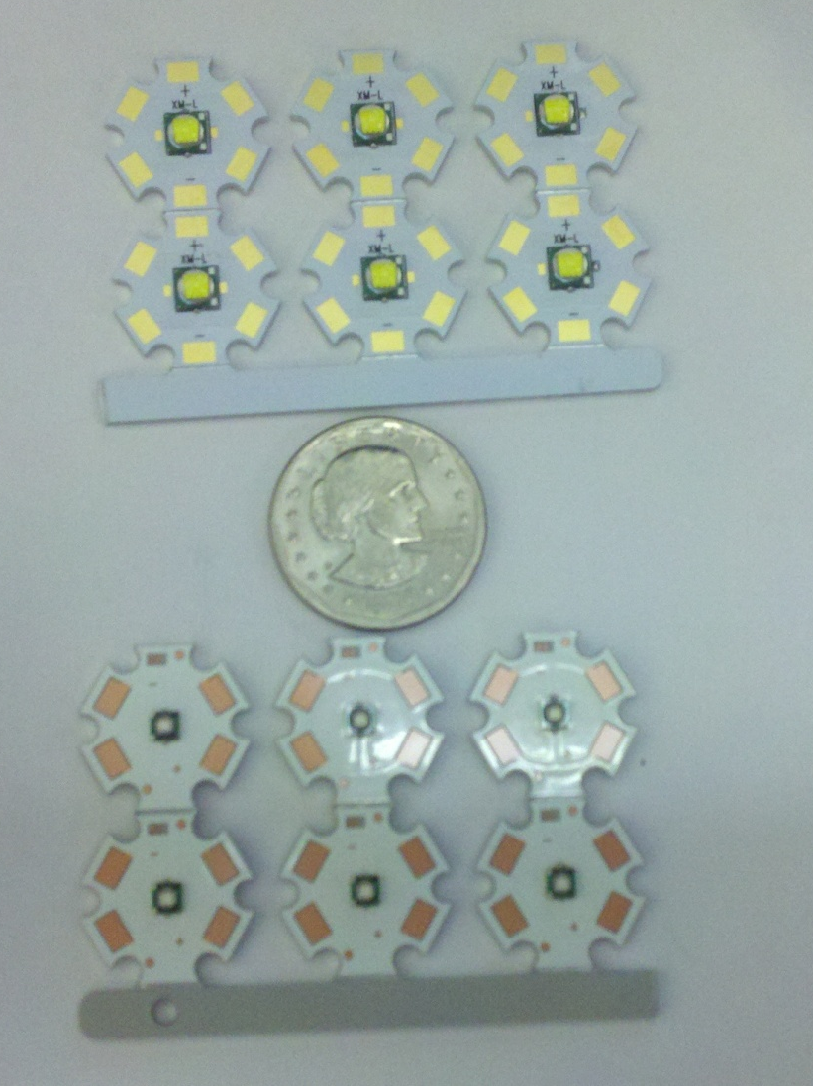
LED System: LEDs
6 Cree XML
  Cool White
  19.2V
6 Cree XPE
  Royal Blue
  20.4V

Slide 25
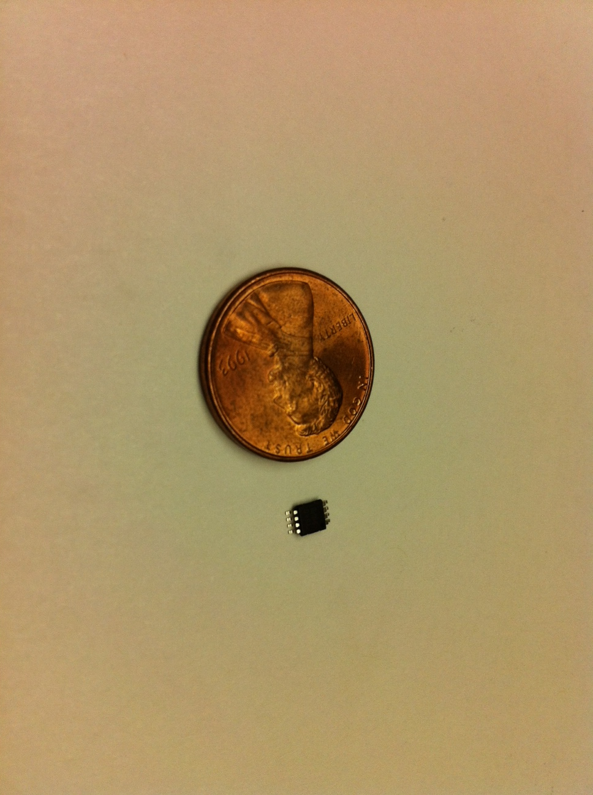
LED System: Drivers
1-LM3401 Driver IC
  Large Input voltage range 4.5-35V
  PWM input
  Requires simple circuitry
  Low cost

Slide 26
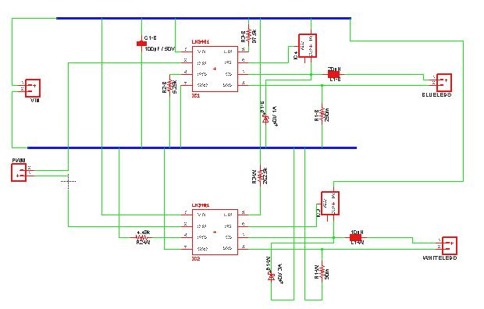
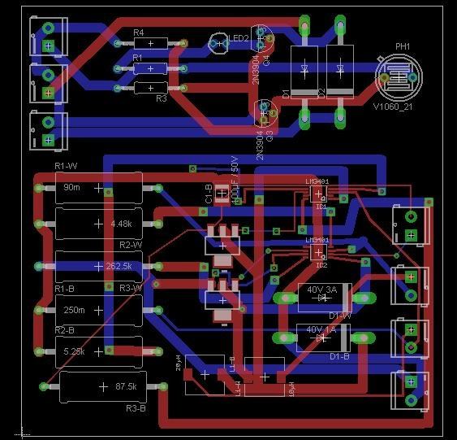
LED System: Driver PCB

Slide 27
Power Strip

Slide 28
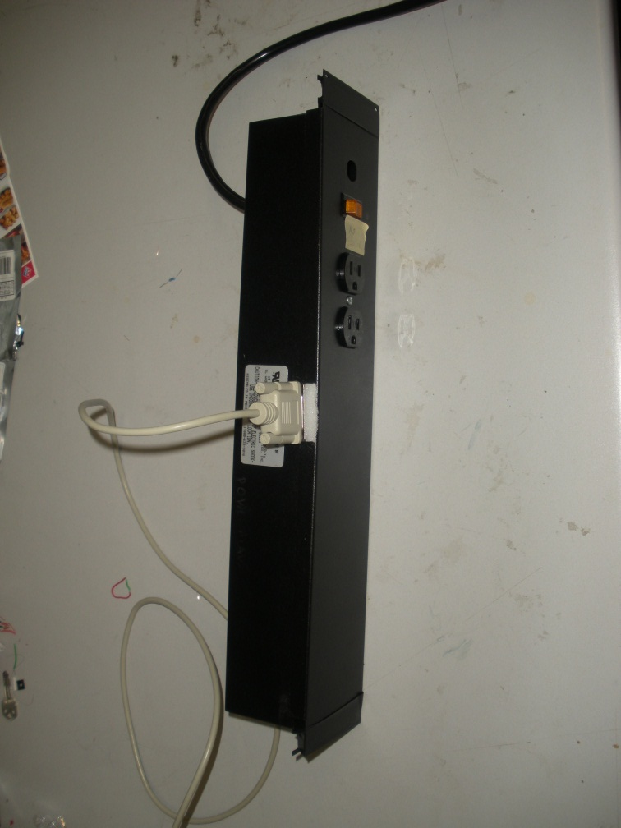
Custom Power Strip
Will function similar to a 6 plug power strip
Each component plugged into the power strip will be relay controlled
4 components will have their current monitored
Salt water aquariums have three main components that will be plugged in
  2 Power heads, 1 filter, and 1 heater
This will leave 2 plugs available for auxiliary components
  Protein skimmer, UV filter, dosing pump, etc.

Slide 29
Custom Power Strip: Relays
Need to handle 120VAC at 10A
Control with a 5VDC signal
PCB mountable

Slide 30
Custom Power Strip Components: Relays
Relays | Tyco ORWH-SF-1035H | Omron G5LE1 | Opto 22 120D10
Max Switching Voltage | 277VAC | 250VAC | 120VAC
Max Switching Current | 10A | 10A | 10A
Coil Voltage | 5VDC | 5VDC | N/A
Coil Current | 71.4mA | 79.4mA | N/A
Turn On Voltage | N/A | N/A | 5VDC
SPDT | Yes | Yes | No
PCB Mountable | Yes | Yes | Yes
Clicking Sound | Yes | Yes | No
Unit Price | $1.85 | $1.45 | $20.00

Slide 31
Custom Power Strip Components:
Relay Driver
Need a driver to increase current
ULN 2803A
  Uses Darlington pair transistors
  Can drive up to 8 relays
  Each channel can drive up to 500mA
  Built in blocking diodes

Slide 32
Power Strip PCB Components
G5LE1 Relays
ULN2803 Relay Driver
CSL2ACD current sensors
15 pin connector

Slide 33
Custom Power Strip Construction
Three 15A duplex outlets
Three junction Boxes
PCB
  Relays, relay driver, voltage regulator, current sensors

Slide 34
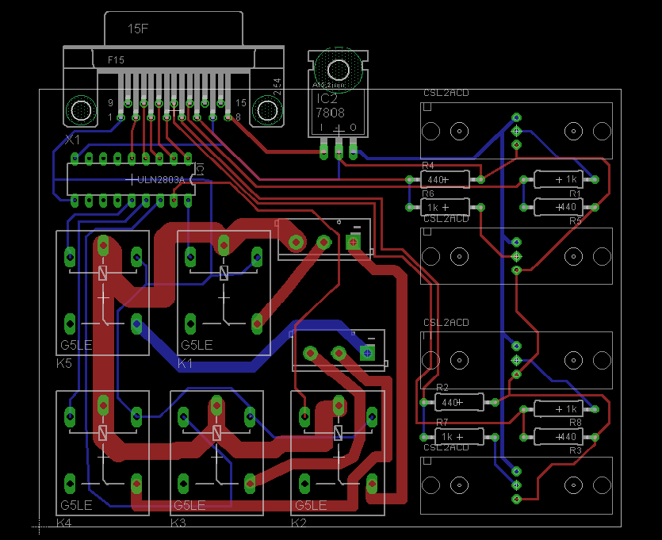
Power Strip PCB

Slide 35
Overall Hardware Block

Slide 36
Microcontroller Requirements
10 Digital IO pins
2 IO pins capable of PWM
8 analog input pins
8+ bit ADC
ICSP
Ethernet connectivity

Slide 37
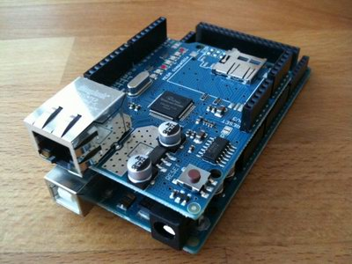
Arduino Mega 2560 with Ethernet Shield
54 Digital I/O pins
14 PWM capable pins
16 Analog Input pins
256 KB Memory
Ethernet with 10/100MB speed
Ethernet library

Slide 38
Software: Microcontroller
Sensor Input/database output
Control lighting system through custom lighting schedule
Web server polling
Interrupts

Slide 39
Software: Microcontroller
Programmed in Arduino language
One continuous main loop will run the main system
Interrupts will be used for physical interface

Slide 40
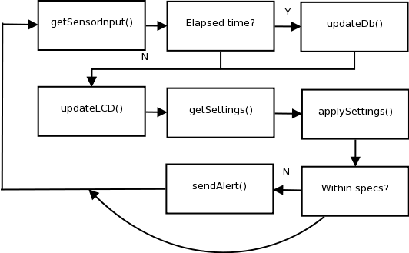
Software Main
Notes:
Gather input from temperature, ph , and power sensors
Continuously poll website for updated control information
Sends HTTP GET request to web server with sensor information and current device status
Control and monitor temperature of tank and LED heat sink
Control LED lighting system status

Slide 41
Software Interrupts
Leak detection – will alert user via text message if a water leak is detected around the perimeter of the aquarium
Feed Mode- Will turn off the pumps and filters for 5 minutes when the front button is pressed
Lighting Mode- Will allow user to change the state of the lighting system to 4 preset modes.

Slide 42
Website Database
MySQL database- open source, community support, easy interface with php.
Database contains 3 Tables – Users, Data, Settings
Users contains information about the user and their login information
Data contains data points for all of the sensor updates
Settings contains the current state of the relays and lighting system for each user

Slide 43
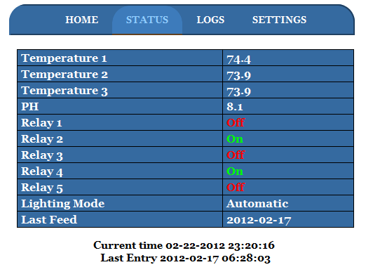
Website Status Page
Status page will be unique for each user
Displays the last update sent to the database
Shows temperature of the tank, ph, state of the relays

Slide 44
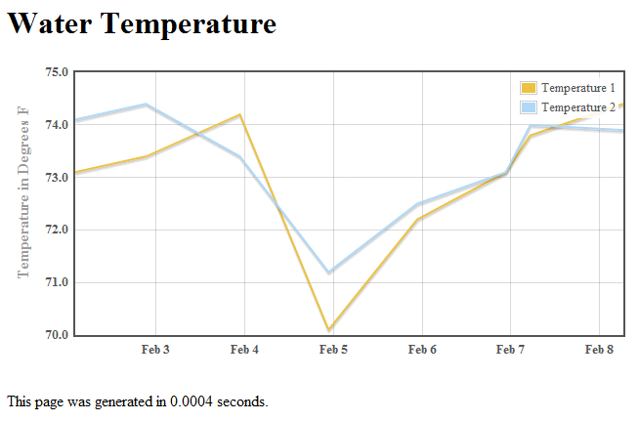
Website Logs Page
Shows the history of a users sensor input
Organized into different sections with variable time frames
Power usage (individual and combined)
Temperature (individual and average)
pH

Slide 45
Website Settings
Settings inputs for:
  Desired Temperature Range
  Desired pH range
  Custom lighting schedule
  Owners email
Submitting settings updates the Settings table in the database

Slide 46
Power
2 separate power systems
  LEDs
    Powered using PV panel and supplementary power supply
  Other components such as the microcontroller, sensors, display
    Powered using separate power supply

Slide 47
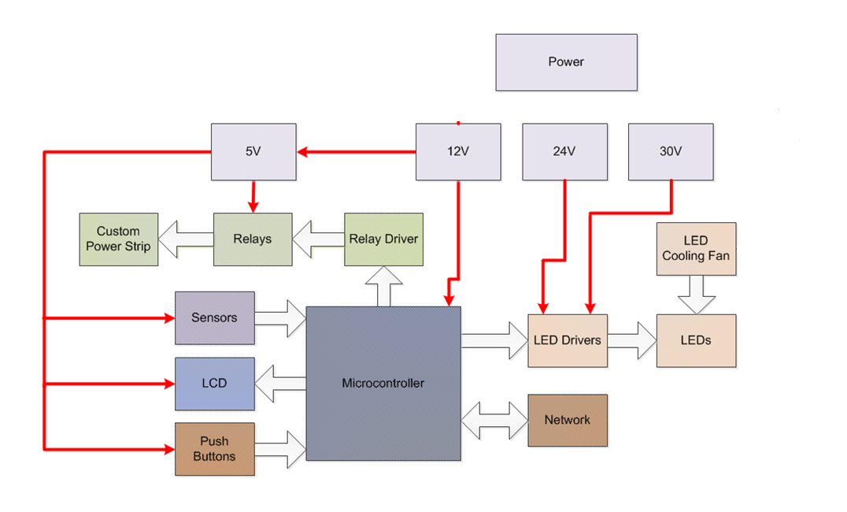
Power Block Diagram

Slide 48
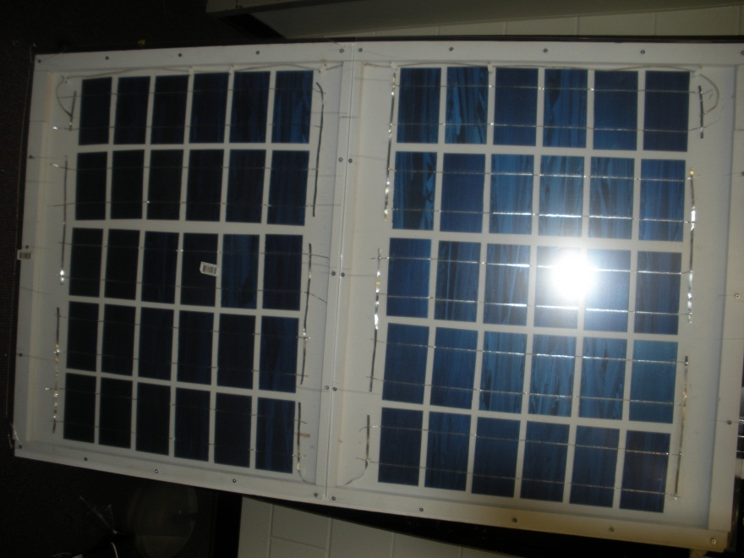
Power: LEDs
LM3401 LED Driver need at least 30.4V to provide necessary 2A drive current
Completely powered by solar panel under ideal conditions
Switch to grid power when solar panel voltage falls below 20.4V

Slide 49
Power: LEDs Solar Panel
 | Self built | SunWize SW-S55P 55 Watt Solar Panel | Kyocera 50W Solar Panel
Rated Voltage (Vmp) | N/A | 17.4V | 17V
Rated Current (Imp) | N/A | 3.15A | 2.95A
Rated Power (Watts) | N/A | 55W | 50W
Open Circuit Voltage (Voc) | 33 | 22.0V | N/A
Short Circuit Current (Isc) | 3A | 3.3A | N/A
Cost | $249.63 | $179.95 | $339.80
Quanity Needed | 1 | 2 | 2
Total Cost | $249.63 | $359.90 | $679.60
Type of Cells | Monocrystalline | Monocrystalline | Monocrystalline

Slide 50
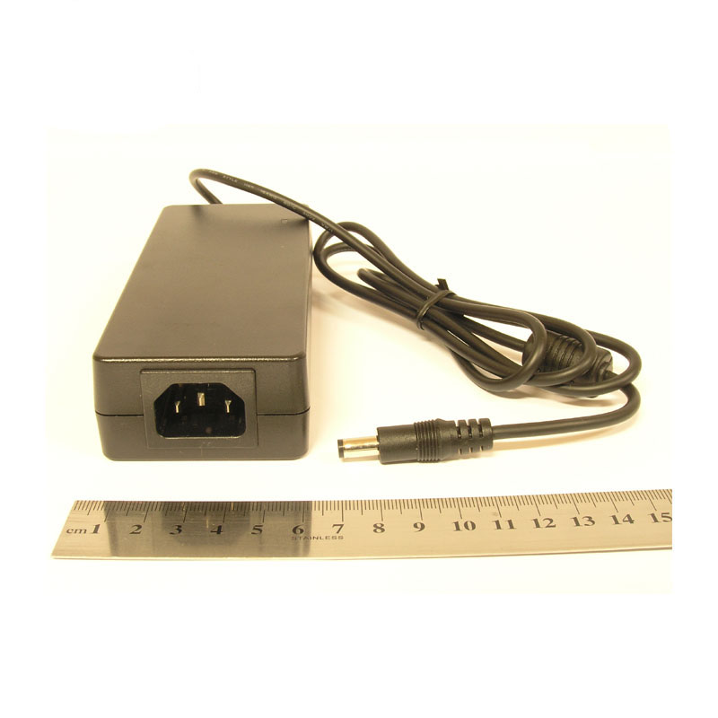
Power: LEDs Power Supply
Meanwell GS60A24 power supply
  Outputs 24VDC 2.5A
  short circuit, overload, overvoltage, over temperature protections

Slide 51
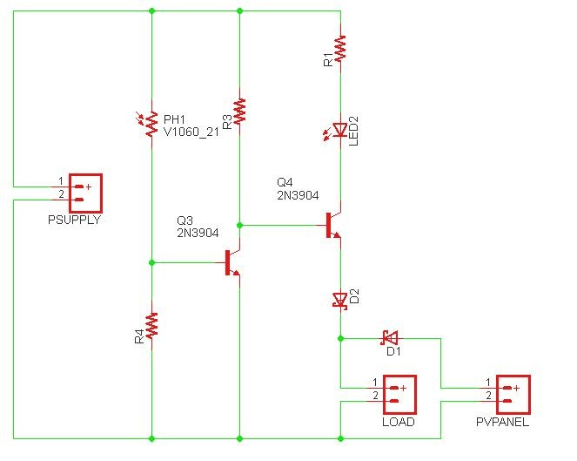
Power: LEDs Switching Circuit

Slide 52
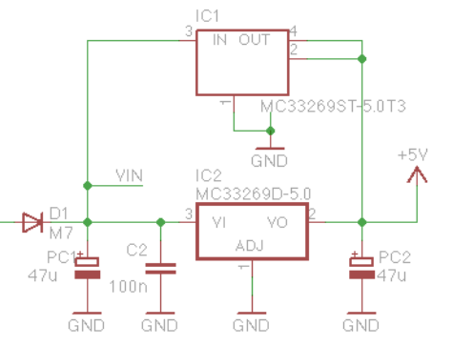
Power: 12V system
12V 1.5A power supply
12V
  Microcontroller
  Current sensors
5V
  LCD
  Relays/relay driver
  pH sensor
  Temperature Sensors

Slide 53
Budget
Part | Estimated Cost | Actual Cost
Junction Box | $1.77 | TBD
Duplex Outlet | $4.77 | $4.77
DB25 Connector | $8.99 | $3.00
LCD Display | $20.90 | $20.90
Arduino Mega2560 | $50.00 | Free(already owned)
Ethernet Shield | $49.95 | Free(already owned)
Circuit Components | $20.00 | $20.00
Testing Materials | $50.00 | $60.00
Construction Materials | $117.56 | $136.88
Shipping Costs | $100.00 | $75.00
Total Cost | $921.40 | $960.76
Part | Estimated Cost | Actual Cost
Relays | $1.85 | $9.25
Relay Driver | $1.49 | Sampled
LEDs | $97.80 | $71.88
LED Drivers | $13.93 | $5.58
Power Supplies | $60.49 | $44.49
Solar Cells | $80.00 | $80.00
Heat sink | $29.52 | $37.07
Cooling Fan | $18.95 | $10.00
Temperature Sensors | $14.14 | $6.43
pH Probe | $39.99 | $47.98
pH Adapter | $29.10 | $42.74
Current Sensors | $107.85 | $114.89
PCBs | $100.00 | $170.00

Slide 54
Work Distribution

Slide 55
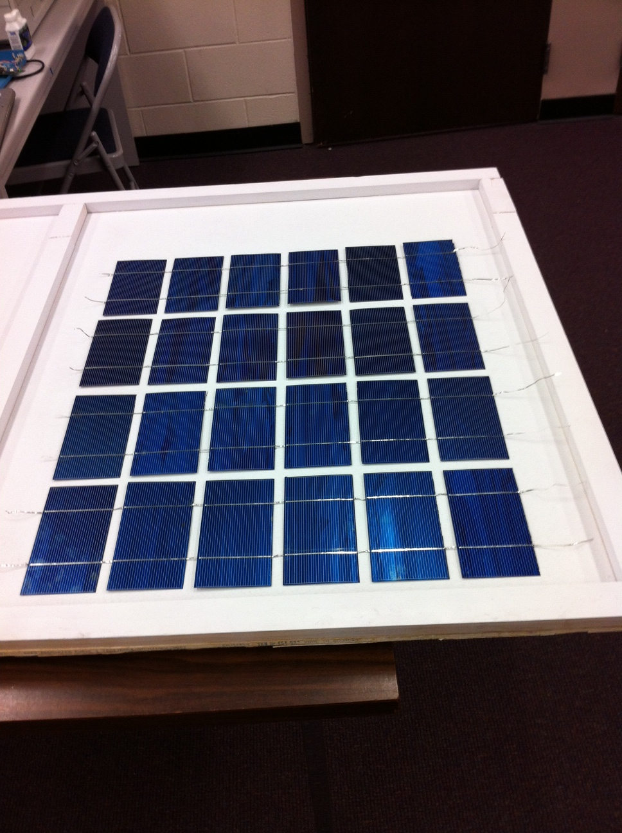
Questions???

