Slide 1

Team 1 – Sleep Management System
Anthony Bharrat
Facundo Gauna Ryan Murphy
Bartholomew Straka

Slide 2
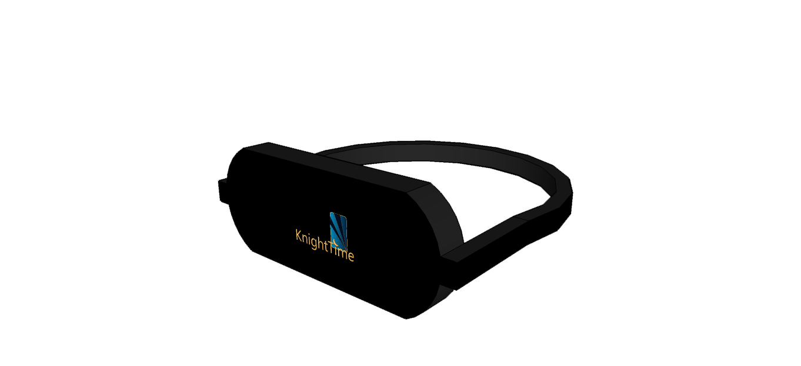
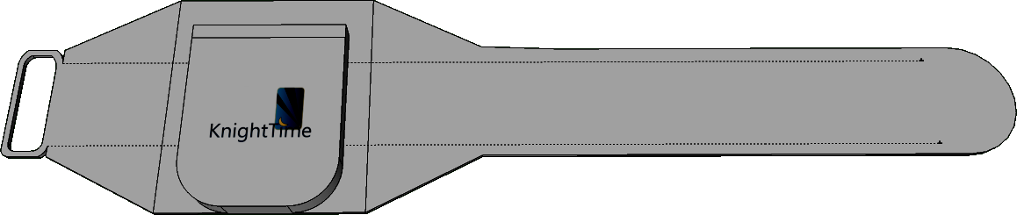
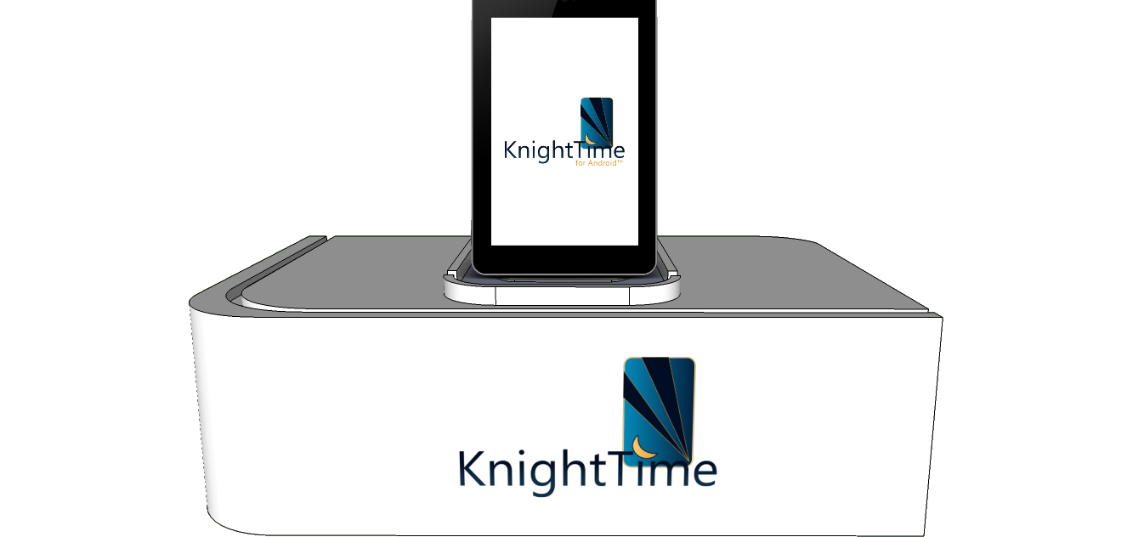
KnightTime attempts to monitor sleep cycles through the use of three peripherals.
The peripherals contain biomedical sensors.
They transmit data back to the mobile application.
Wristband
Mask
Base Station

Slide 3
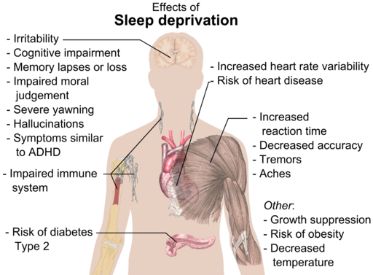
Motivation
To improve the quality of people’s sleep by informing them of their:
Movement
Heart rate
Ambient Measurements
Light
Humidity
Noise
Sleep Cycles
*Image by Mikael Häggström via Wikimedia Commons

Slide 4
Goals and Objectives
User-Friendly
Low-Cost
Modular
Power-Efficient
The system is:
Modular
User-Friendly
Low-Cost
Power-Efficient

Slide 5
Requirements
Be able to measure:
Skin Temperature
Body Movement
Ambient Temperature
Ambient Humidity
Heart Rate
Ambient Sound
Be able to sound an alarm at:
A particular time based on measured physiological cues.
At a user-defined time.

Slide 6
Specifications
Power Supply Voltage (Base Station) | Standard USB (5V DC, 1+ A best for charging)
Wearable Device Battery Life | 6 Hours+
Wearable Device(s) Weight | < 5 lbs.
Temperature Sensor Accuracy | ± 25%
Heart Rate Accuracy | ± 25% when acquired
Humidity Sensor Accuracy | ± 25%
Audible Alarm | 30+ dB
Functional Temperature Range | 5-35° Celsius (intended for indoor sleeping)
Minimum Wireless Range | 5 Feet
Battery Recharge Time | < 12 Hours for 100%

Slide 7
Concept of Operation

Slide 8
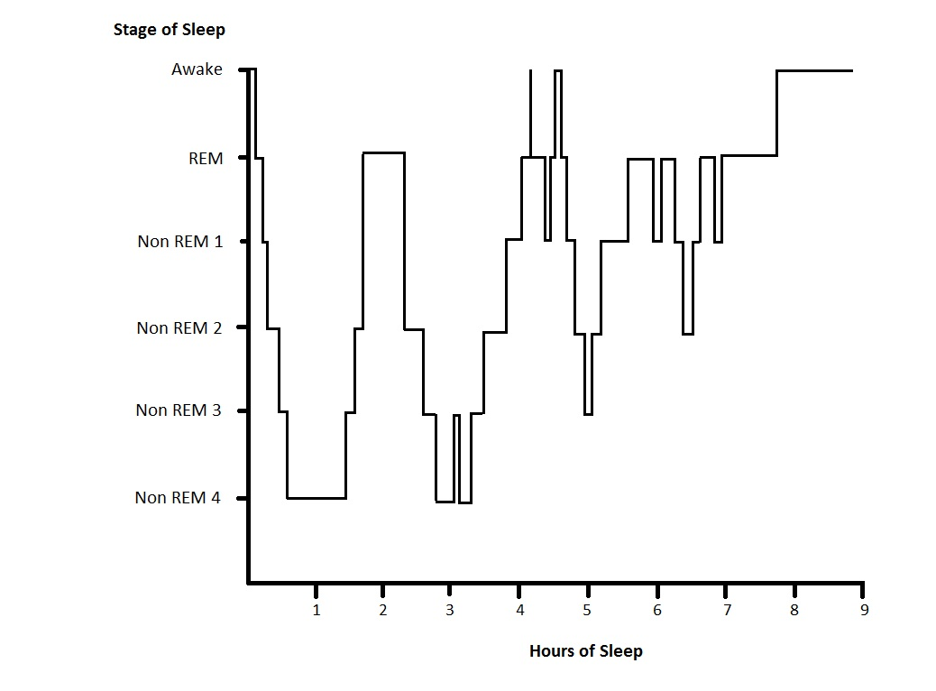
Smart Alarm
The system attempts to wake the user during a lighter stage of sleep. This reduces sleep inertia.

Slide 9
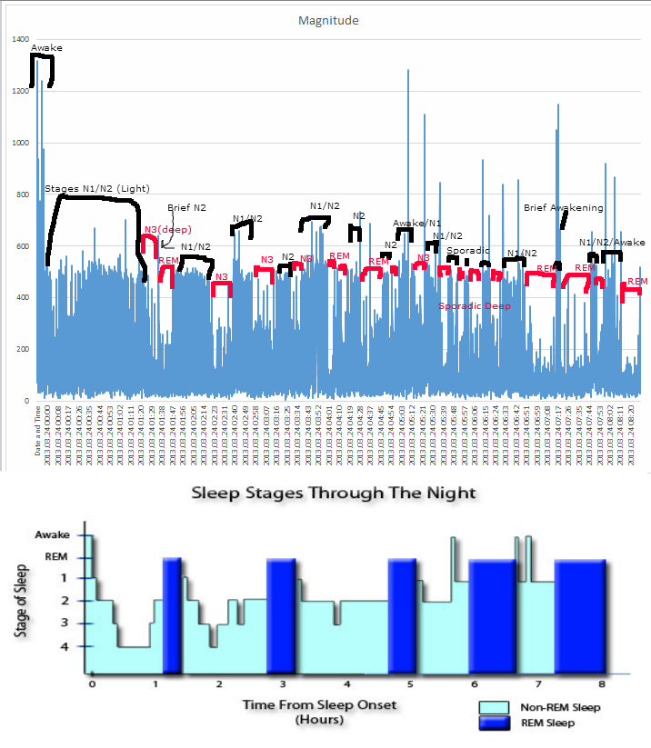

Slide 10
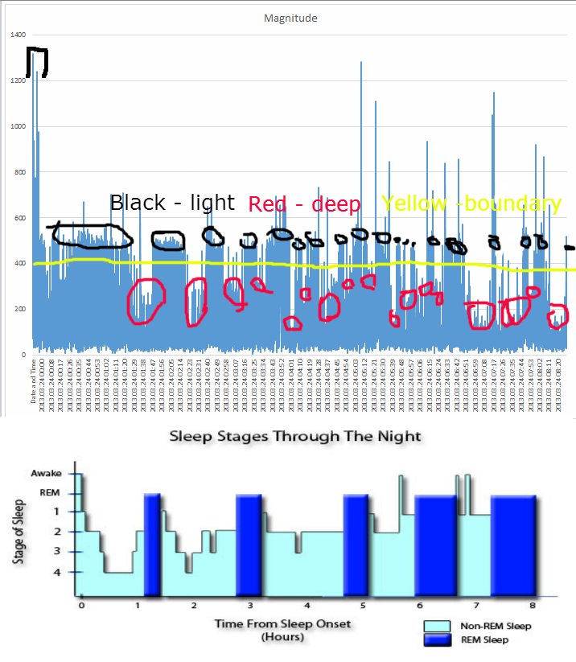

Slide 11
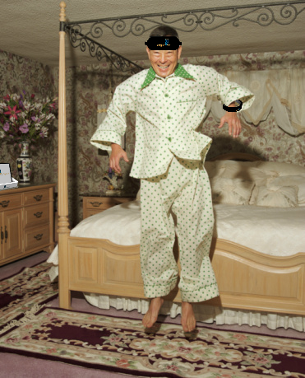
Smart Alarm
The peripherals allow the system to continue an alarm until the user shows significant signs of wakefulness such as a math problem.
Additional tasks may be added in the future.

Slide 12
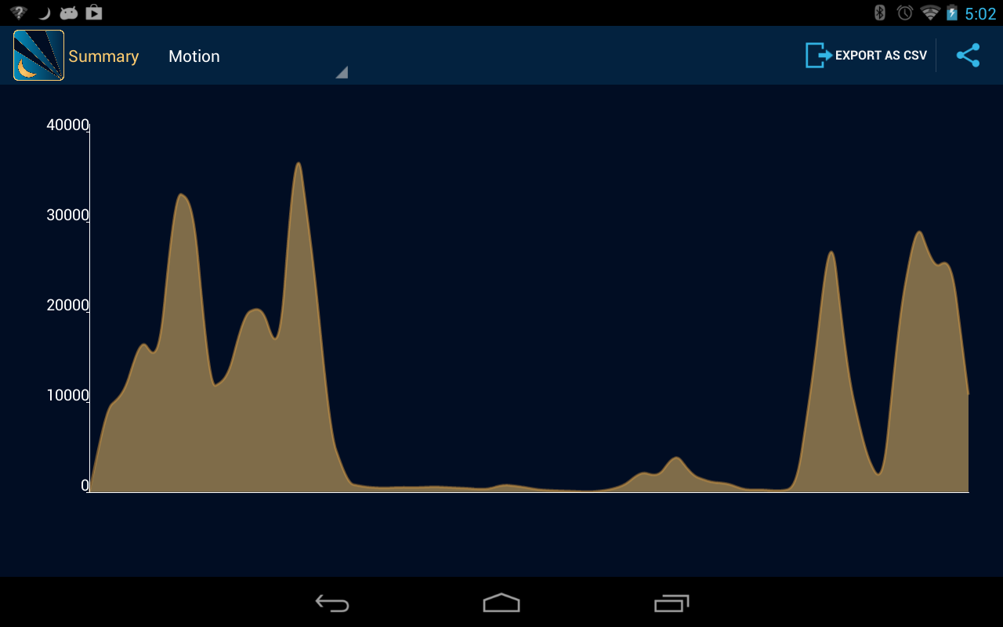
Data Review
After fully awake, the user can review the data collected throughout the night.
The user is able to see when the alarm was triggered.
They will be able to improve their sleep habits by reviewing the data.

Slide 13
Implementation

Slide 14
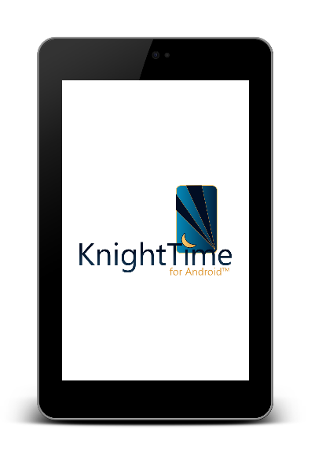

Vibrator
Pulse Oximeter
Skin Temperature
IMU
MSP430
Bluetooth Module
Bluetooth Module
MSP430
Light Array
Battery
Battery
Charging Module
Bluetooth Module
Hardware
Block Diagram
Wristband
Ambient Light
MSP430
Ambient Temp
Base Station
Headband
Ambient Noise
Ambient Humidity

Slide 15
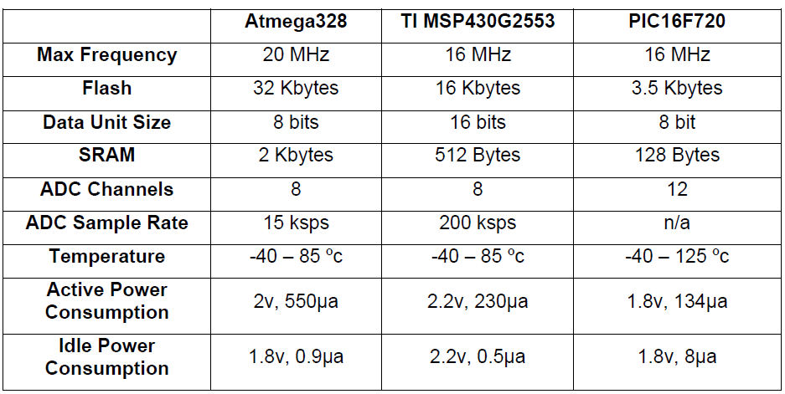
Microcontroller (MCU) Selection

Slide 16
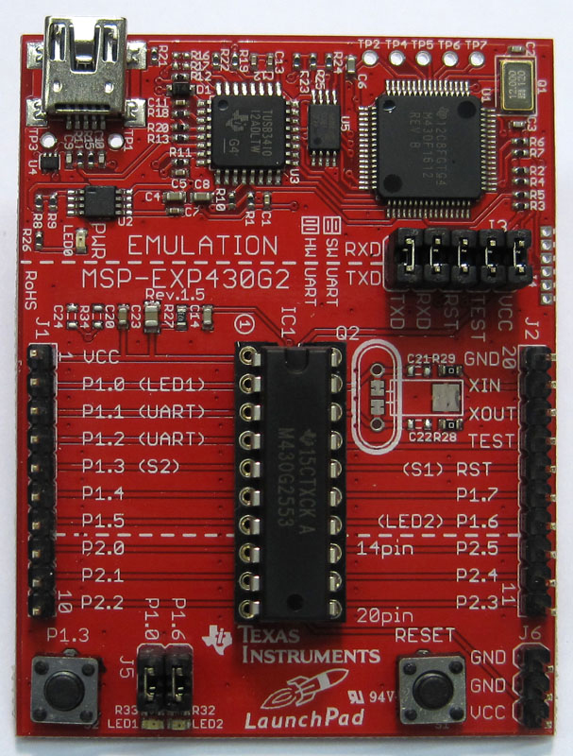
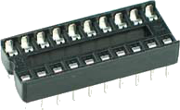
MSP430
MSP430 provides a good balance of features with low power consumption.
Useful for testing sensors in the same development environment.
MCU from board to socket
ICSP (In-Circuit Serial Programming) is easy: only 2 pins required.

Slide 17
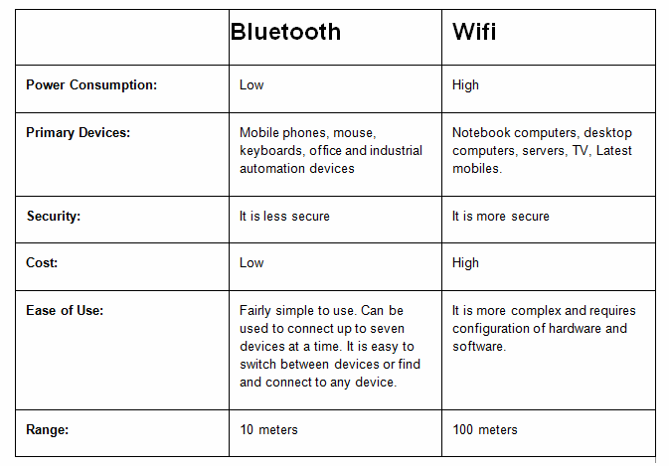
Communication Module Selection

Slide 18
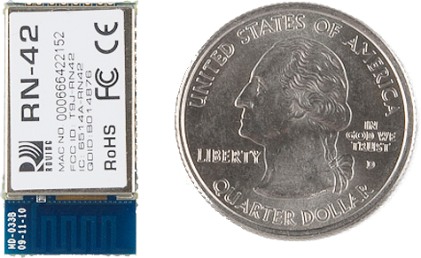
Bluetooth Module
The Bluetooth module chosen is the RN-42.
Features:
Easy to Configure
Readily available on cheap breakout boards
Auto discovery/pairing
Error correction
Integrated antenna
Small

Slide 19
Vibrator
Pulse Oximeter
Skin Temperature
IMU
MSP430
Bluetooth Module
Bluetooth Module
MSP430
Light Array
Battery
Battery
Charging Module
Bluetooth Module
Wrist Peripheral
Ambient Light
MSP430
Ambient Temp
Ambient Noise
Ambient Humidity

Slide 20
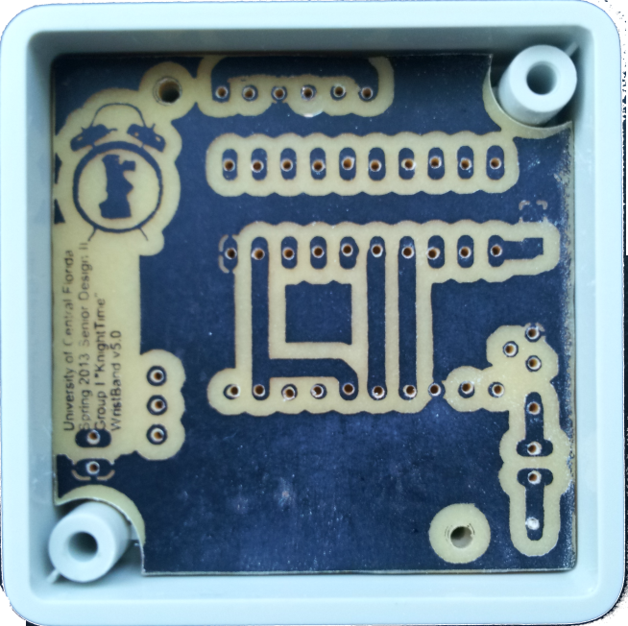
Wrist Peripheral
The wrist peripheral functions as an actigraph unit.
Actigraphy is a non-invasive way of monitoring rest and activity through measuring movement.
Offers high agreement with professional sleep studies.
The unit consists of:
MCU
Bluetooth Module
Battery
Vibration Motor
IMU (Inertial Measurement Unit)

Slide 21
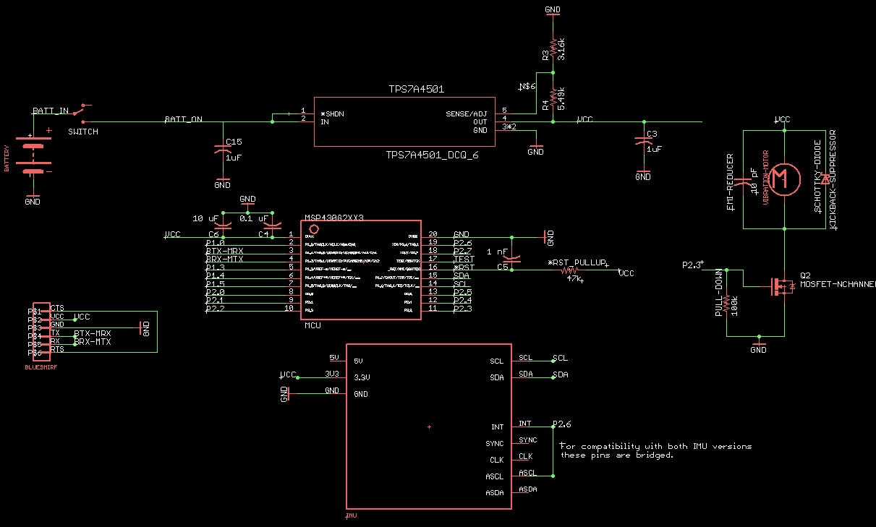
Wristband Schematic

Slide 22
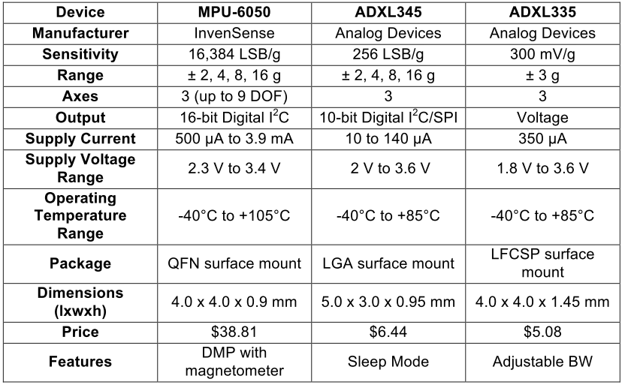
IMU (Inertia Measurement Unit)

Slide 23
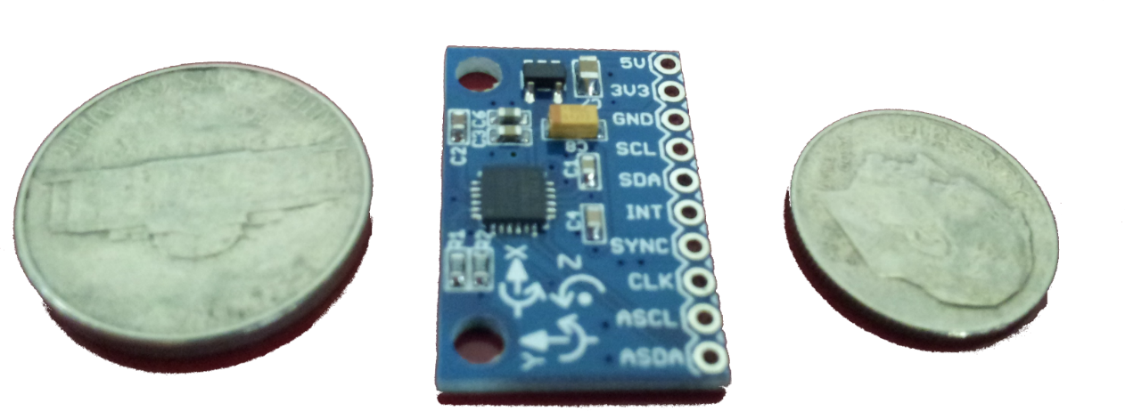
MPU 6050
Inexpensive breakout board (~$10)
Small size
Reasonable power draw
High sensitivity
16-bit Digital values over I²C (Inter-Integrated Circuit) Communication Protocol

Slide 24
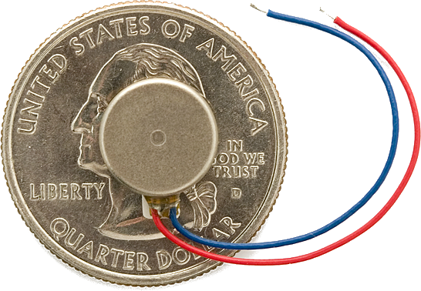
Vibration Motor
This is to help wake the user or notify them of such customizable event.
Precision Microdrives 310-101
Widely available and inexpensive: $4.95 from SparkFun
Powerful: 0.8 G Vibration Amplitude

Slide 25
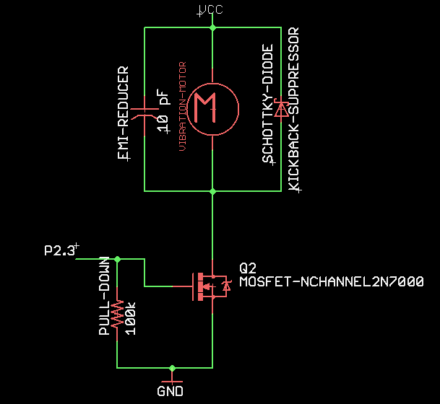
Vibration Motor Circuit
Pulse Width Modulation (PWM) from MCU to base of MOSFET controls vibration
Schottky ‘Flyback’ Diode prevents inductive kickback from motor
Capacitor reduces noise generated by motor

Slide 26
Vibrator
Pulse Oximeter
Skin Temperature
IMU
MSP430
Bluetooth Module
Bluetooth Module
MSP430
Light Array
Battery
Battery
Charging Module
Bluetooth Module
Mask Peripheral
Ambient Light
MSP430
Ambient Temp
Ambient Noise
Ambient Humidity

Slide 27
Mask Peripheral
The Mask peripheral will contain:
Skin temperature sensor
LED light array (to simulate sunrise)
Pulse rate monitor
Battery
Bluetooth Module
Buzzer alarm near ears

Slide 28
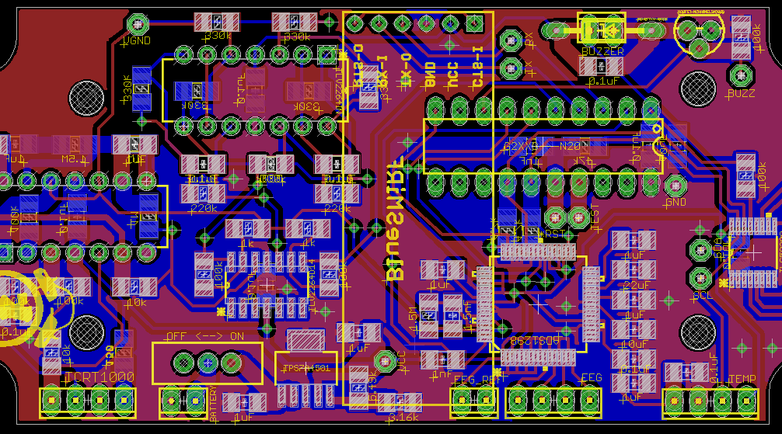

Slide 29
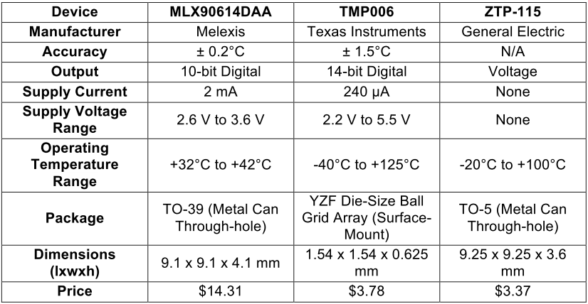
Selection of Skin Temperature Sensor

Slide 30
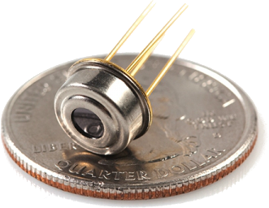
Skin Temperature: MLX90614DAA
Infrared thermometer for non contact temperature measurements.
DAA version intended for medical applications
Key features include:
17-bit ADC and powerful DSP
Power saving mode
Resolution of 0.02°C

Slide 31
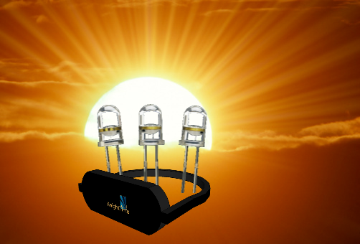
Light Array
An array of LEDs will gradually increase in brightness to simulate the sun rising
Exposure to light 30 min prior to waking reduces sleep inertia
Optional

Slide 32
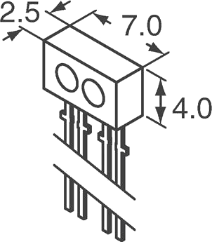
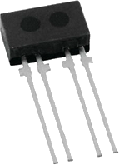
Heart Rate Sensor
Pulse is a helpful sleep indicator.
Forehead is a viable location.
Use reflectance of oxygenated blood cells (reflectance pulse oximetry)
Chosen: TCRT1000 Infrared Proximity Sensor
Sensor combines infrared LED with NPN phototransistor
Units in millimeters

Slide 33
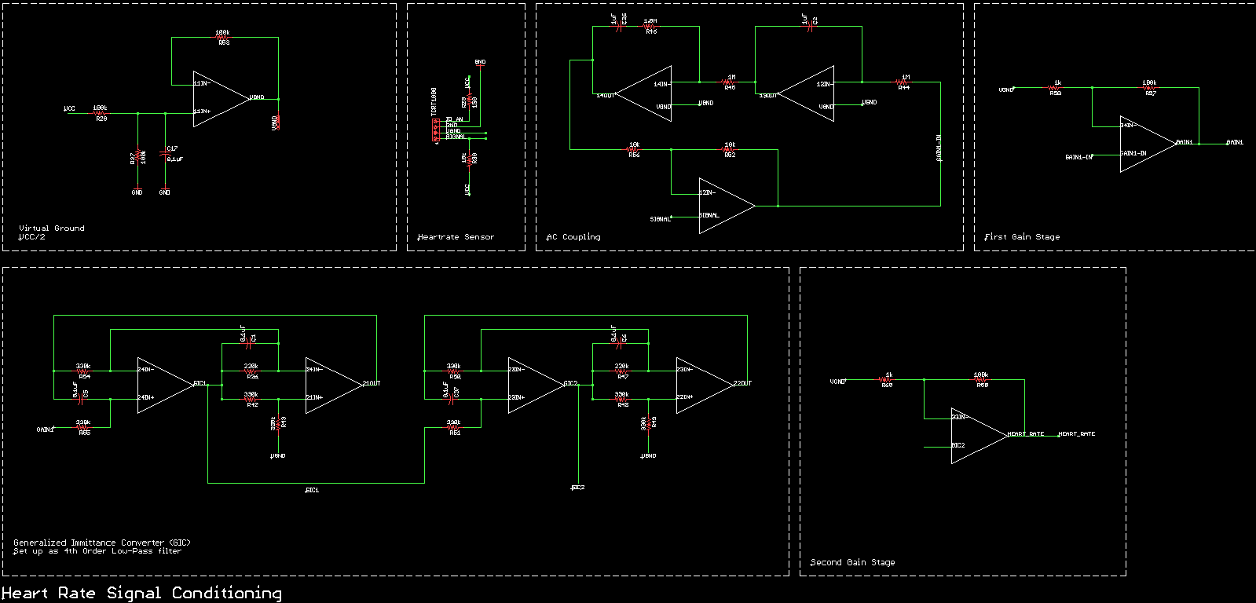
Signal Conditioning for Heart Rate

Slide 34
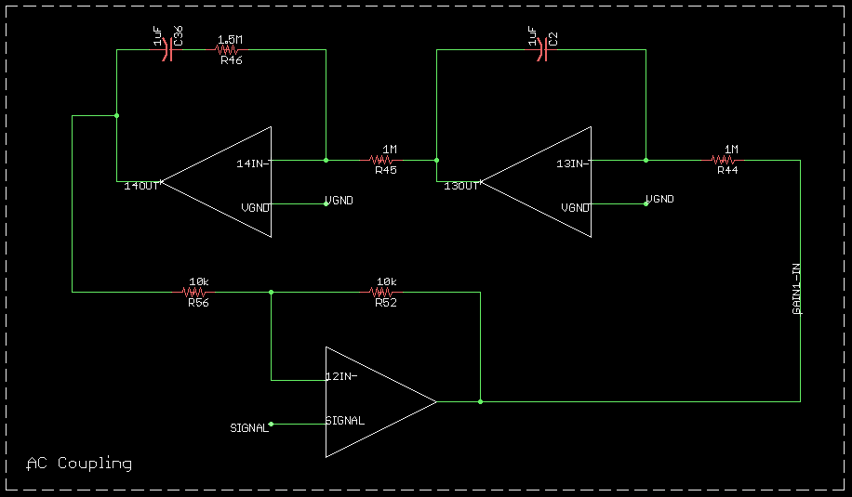
DC offset cancellation
“Servo feedback” technique without capacitor signal path
Actively removes DC component with 2nd order filters
Simplifies band-pass filter creation since frequencies of interest are very close (0-3 Hz)

Slide 35
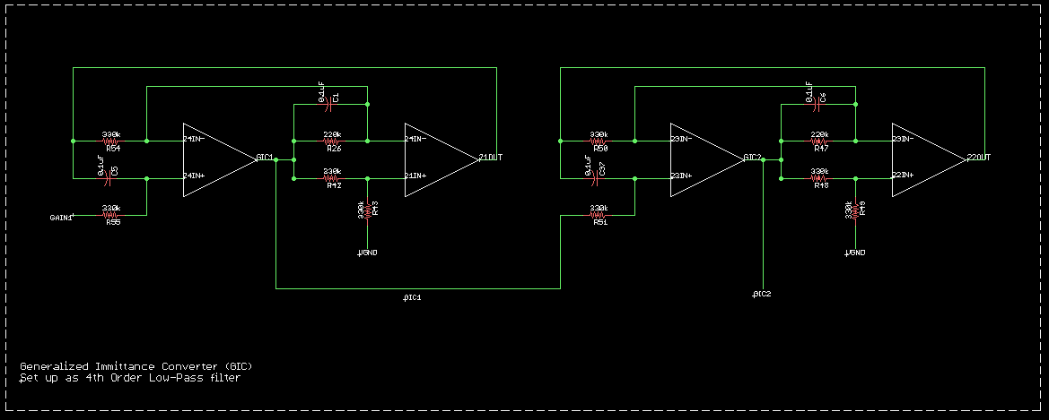
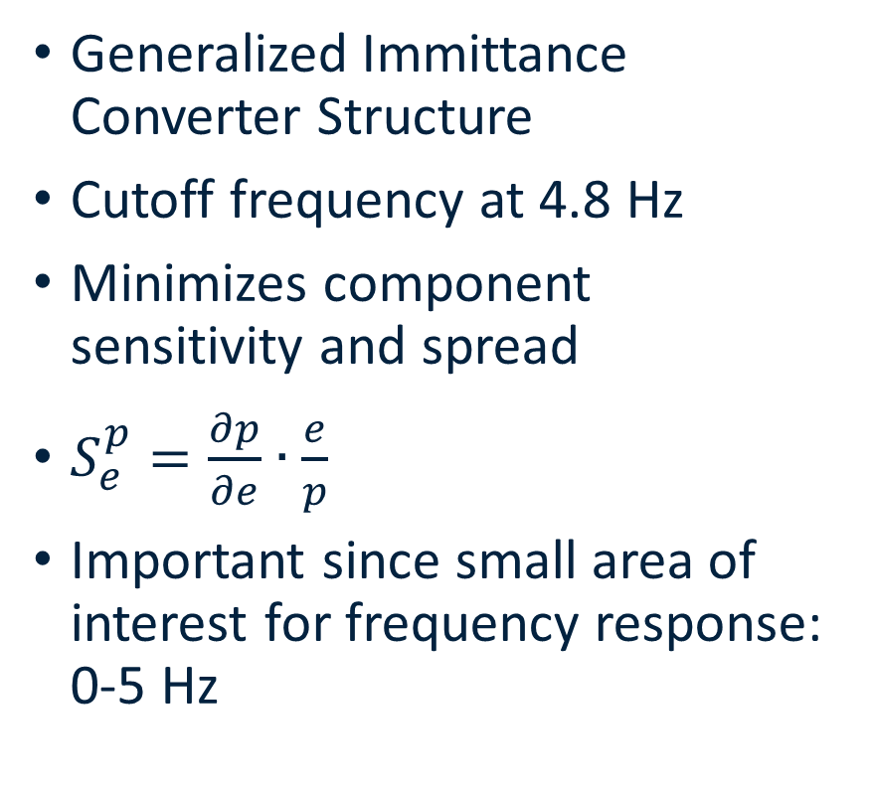
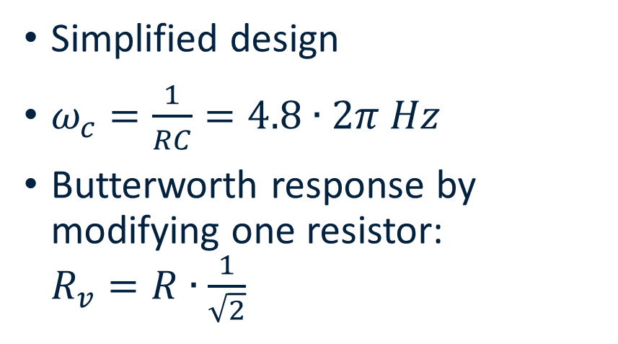
Low-Pass Filter
Simplified design
$ω_{c}=\frac{1}{RC}=4.8∙2π Hz$
Butterworth response by modifying one resistor: $R_{v}=R∙\frac{1}{\sqrt{2}}$
Generalized Immittance Converter Structure
Cutoff frequency at 4.8 Hz
Minimizes component sensitivity and spread
$S_{e}^{p}=\frac{∂p}{∂e}∙\frac{e}{p}$
Important since small area of interest for frequency response: 0-5 Hz

Slide 36
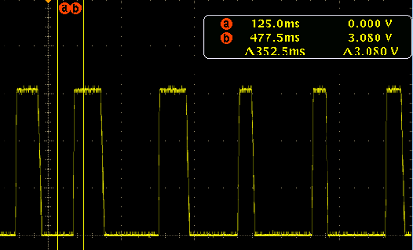
Heart Rate Prototyping
Excellent slew rate
Digital logic level response to detected pulse
Oscilloscope picture taken after heart rate acquired
Circuit takes a few minutes to adjust to the signal input due to active DC offset cancellation

Slide 37
Vibrator
Pulse Oximeter
Skin Temperature
IMU
MSP430
Bluetooth Module
Bluetooth Module
MSP430
Light Array
Battery
Battery
Charging Module
Bluetooth Module
Base Station
Ambient Light
MSP430
Ambient Temp
Ambient Noise
Ambient Humidity

Slide 38
Base Station
The base station will contain the following:
Ambient light sensor
Ambient temperature sensor
Ambient humidity sensor
Ambient noise sensor
Bluetooth Module
Charging Module for peripherals

Slide 39
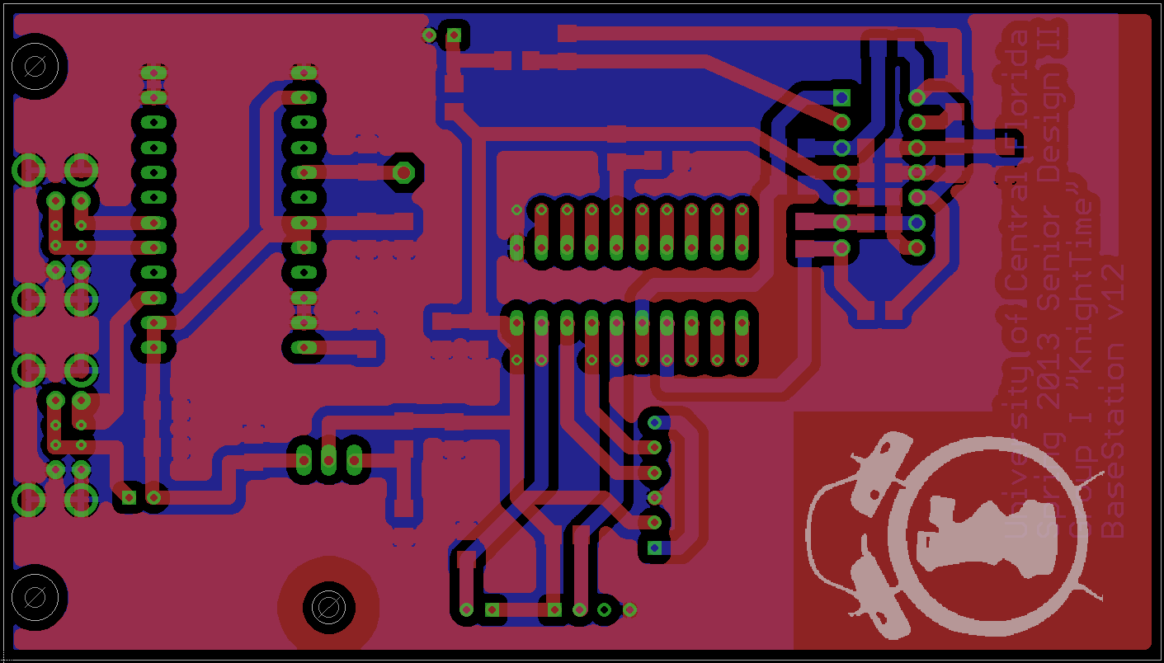

Slide 40
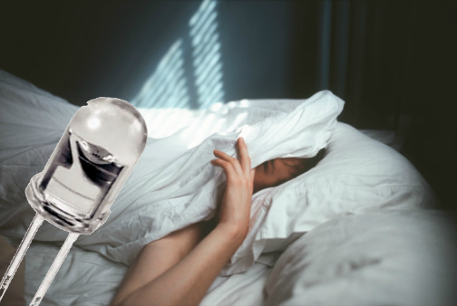
Ambient Light
An ambient light sensor was selected (Vishay TEPT5600)
Sensor is an NPN phototransistor adapted to human eye responsivity
User can compare quality of sleep to amount of light present.
Potential to kill lights, shut blinds, sound alarm, etc.

Slide 41
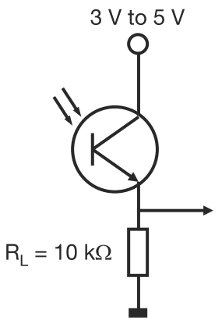
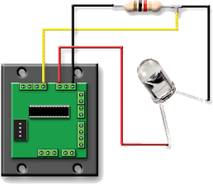
Ambient Light Circuit

Slide 42
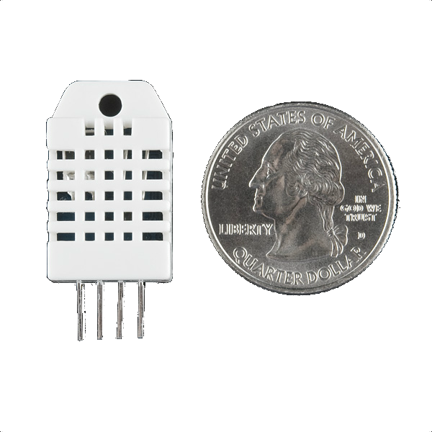
Ambient Temp and Humidity: RHT03
RHT03 is a low cost humidity and temperature sensor
Already calibrated - no external components
1-wire proprietary digital signal; code provided by manufacturer (MaxDetect)
Ambient temperature vs. body temperature
Sleep quality vs. environment

Slide 43
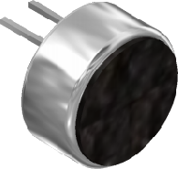
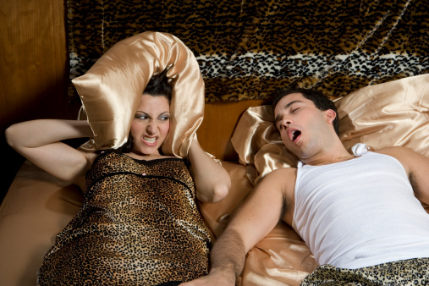
Ambient Noise: AOM-4544P-2-R
A microphone was selected to detect snoring.
Most snoring occurs at low frequencies: 20 - 500 Hz
AOM-4544P-2-R range from 20 Hz - 20 KHz
Chosen for low price, sensitivity, and omnidirection

Slide 44
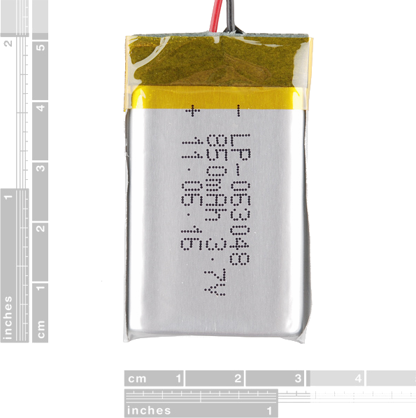
Battery
A polymer lithium-ion (LiPo) battery with 850mAh was selected
Higher energy density compared to standard lithium-ion batteries
Small size and decent capacity.
Rechargeable
Built-in over- and under-voltage protection

Slide 45
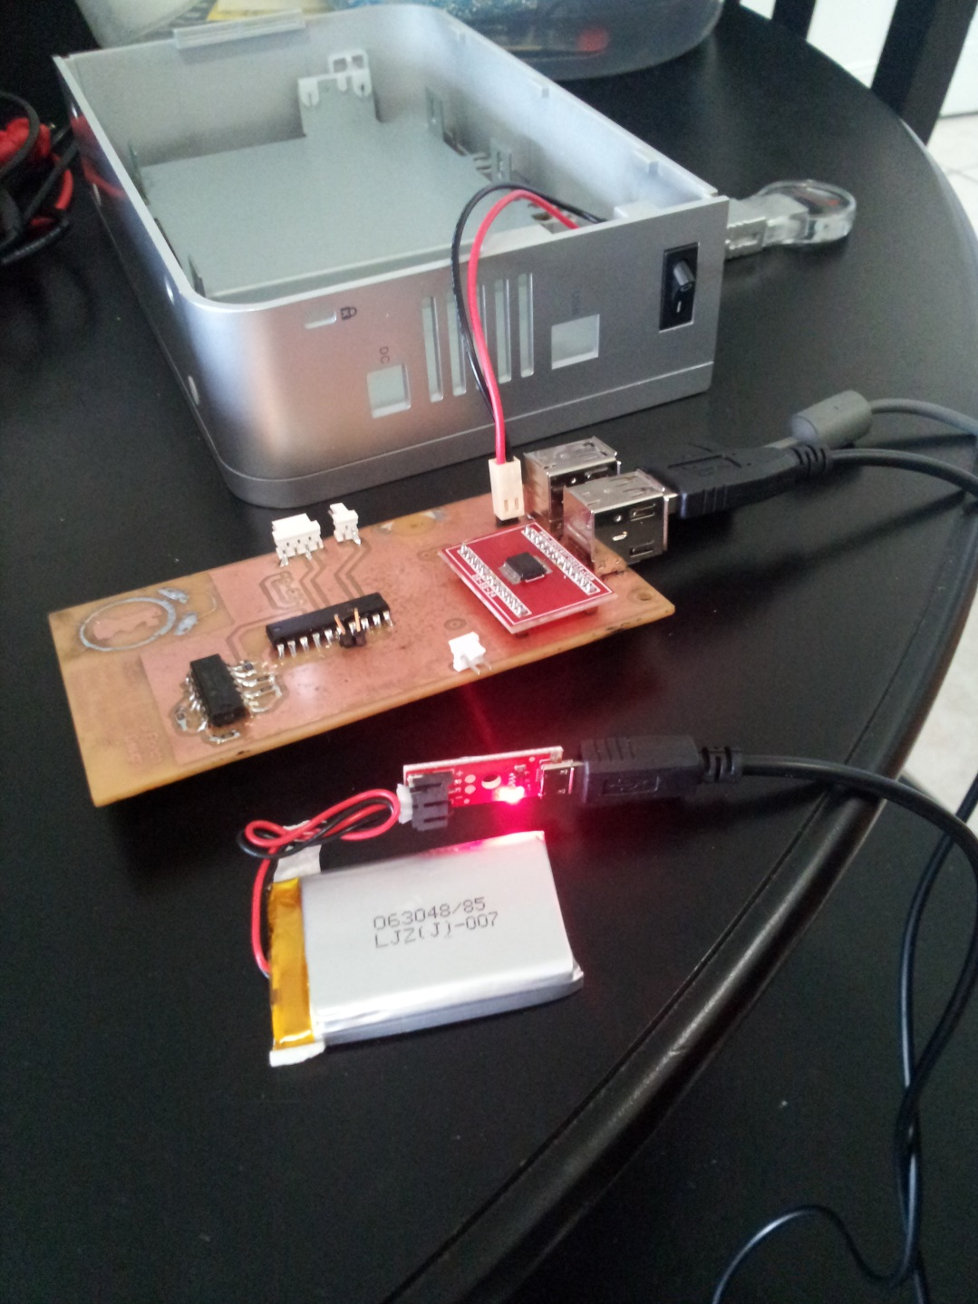
Charging and Power
Dock provides USB ports for peripheral charging
Uses Texas Instruments TPS2074 Four-Port USB Hub Power Controller
AC power supply also USB (5V 1A)
Each peripheral uses a LDO (low-dropout linear regulator)

Slide 46
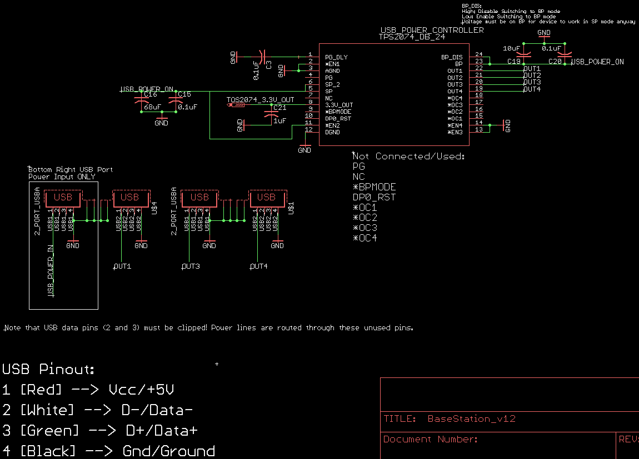
TPS2074 USB Power Controller Setup

Slide 47
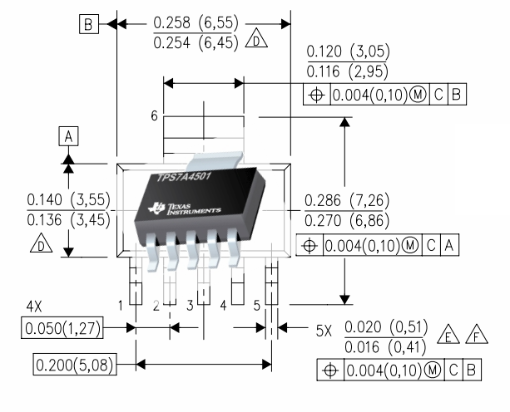
Charging and Voltage Regulator
TPS7A4501 Low-Dropout Regulator
Can supply up to 1.5 A with a dropout voltage of 300 mV
Much lower dropout at lower current: 85 mV at 100 mA, 170 at 500 mA
Adjustable

Slide 48
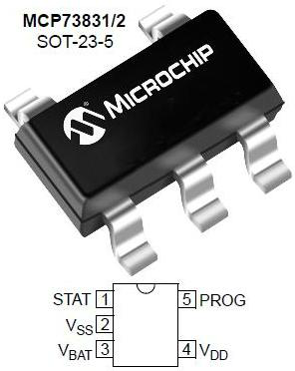
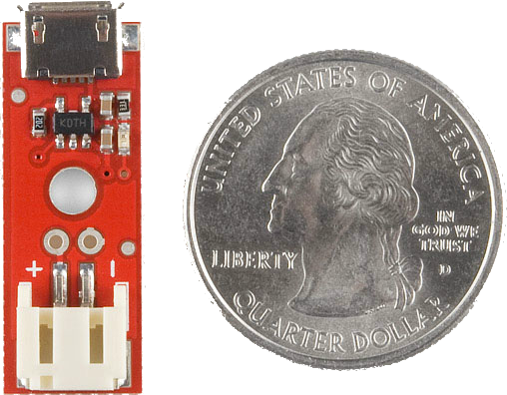
Charging and Voltage Regulator
MCP73831 Li-Polymer Charge Management Controller
500 mA charger
Chosen for price and ease of use
Available on convenient breakout module
Not placed on peripheral PCBs to reduce footprint

Slide 49
Vibrator
Pulse Oximeter
Skin Temperature
IMU
MSP430
Bluetooth Module
Bluetooth Module
MSP430
Light Array
Battery
Battery
Charging Module
Bluetooth Module
Mobile App
Ambient Light
MSP430
Ambient Temp
Ambient Noise
Ambient Humidity

Slide 50
Mobile Application
The application will implement the:
Monitoring Algorithm
Network Messaging System
A database to store acquired data
It was developed using Mono for Android™ framework.
It allows the developer the use of C#/.NET and Visual Studio™
It links the assemblies to Java binaries
C#

Slide 51
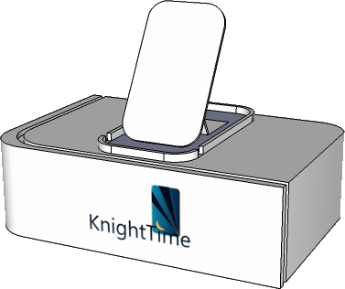
Messaging System
1
3
2

Slide 52
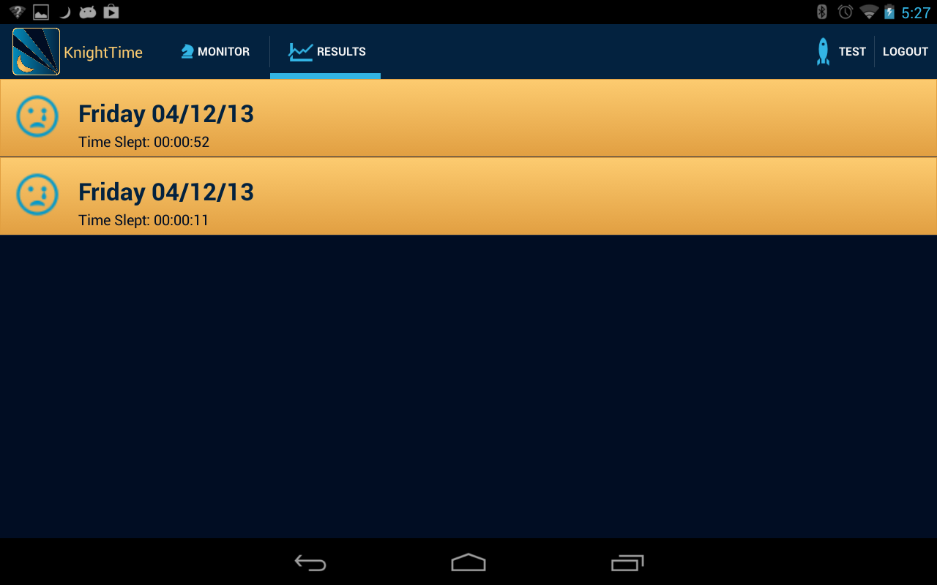
Data Presentation
The mobile application presents collected data by:
Graphing the collected data
Sorting stored data by run
Real-time
Provides real-time plotting for movement messages

Slide 53
Administrative Content

Slide 54
Distribution of Work
Facundo (CpE)
Embedded Software
Mobile App
Anthony (CpE)
Embedded Software
Wireless
Bart (EE)
Power
Sensors/PCBs
Ryan (EE)
Power
Sensors/PCBs

Slide 55
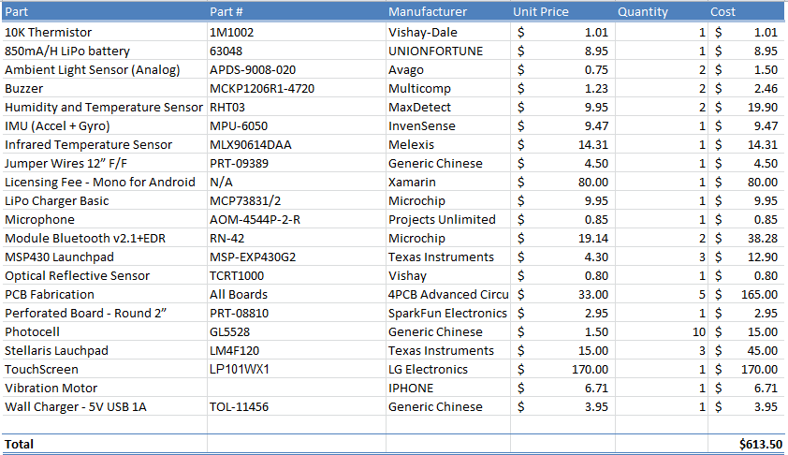
Bill of Materials

Slide 56
Questions?

