Slide 1

Team 1 – Sleep Monitoring System
Anthony Bharrat
Bartholomew Straka
Facundo Gauna
Ryan Murphy

Slide 2
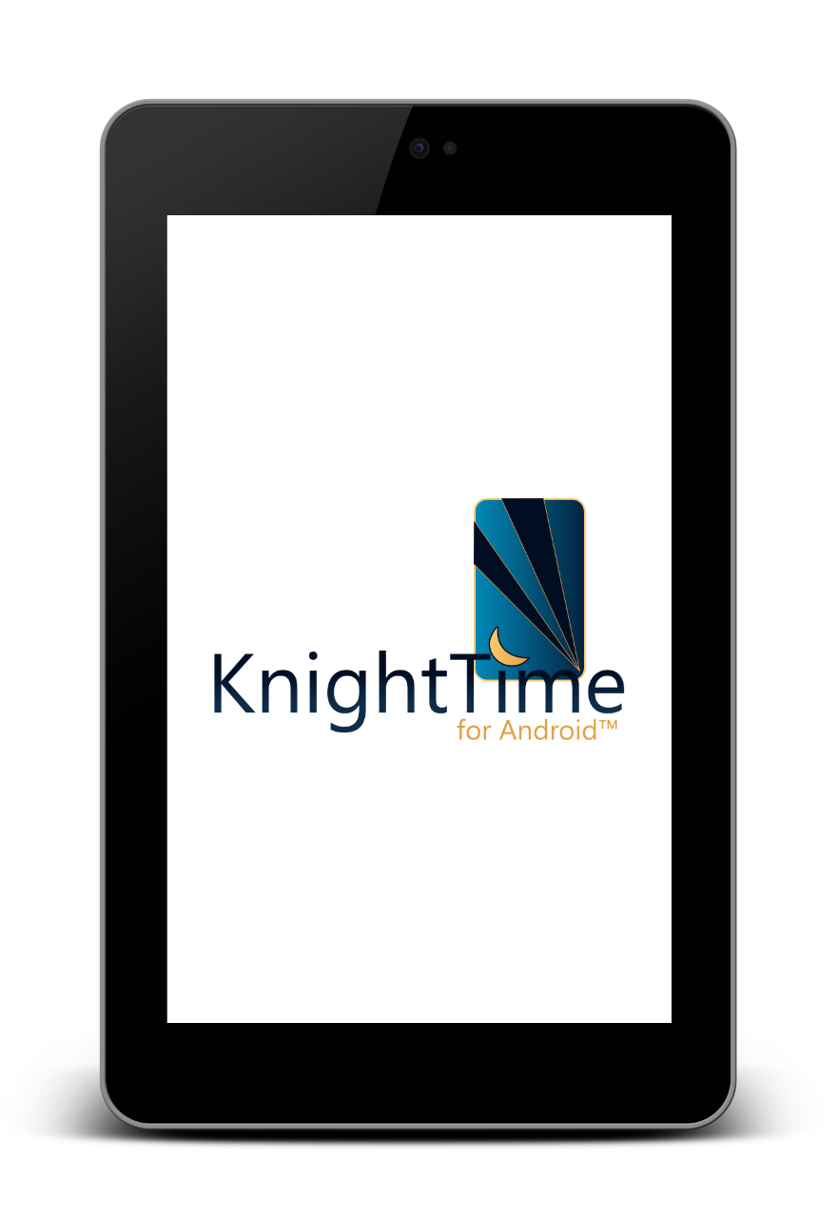
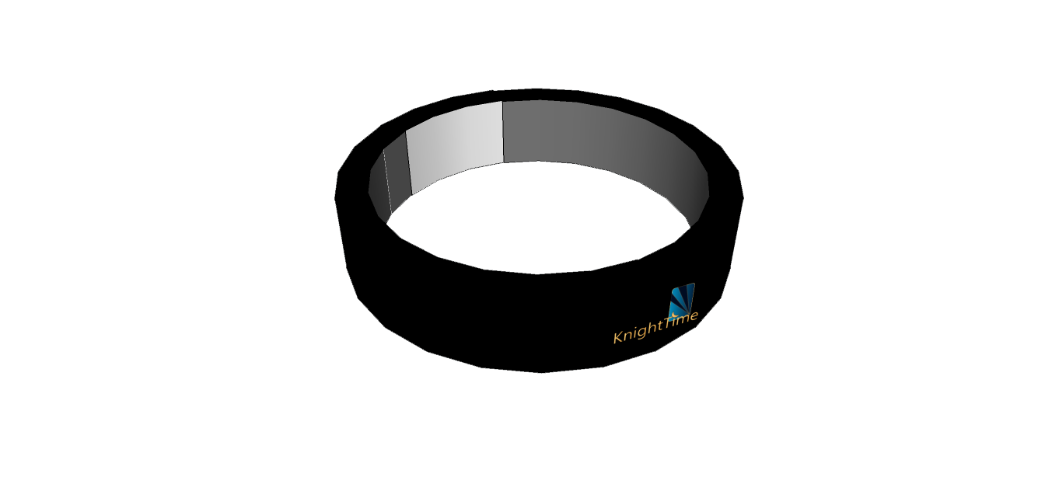
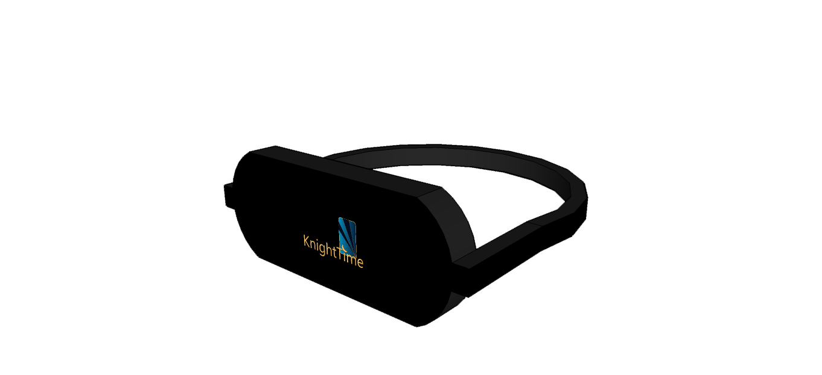
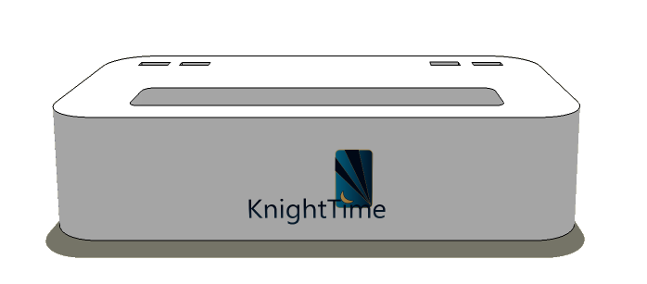
KnightTime monitors sleep cycles through the use of three peripherals.
The peripherals contain biomedical sensors.
They transmit data back to the mobile application.
Wristband
Mask
Base Station

Slide 3
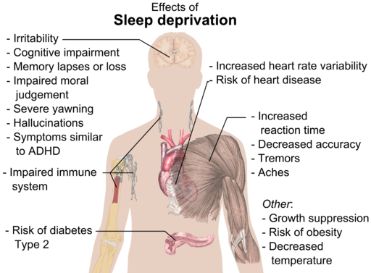
Motivation
To improve the quality of a person’s sleep by informing them of their:
  Movement
  Heart rate
  Ambient Measurements
    Light
    Humidity
    Noise
  Sleep Cycles
*Image by Mikael Häggström via Wikimedia Commons

Slide 4
Goals and Objectives
User-Friendly
Low-Cost
Modular
Power-Efficient
The system should be:
  Modular
  User-Friendly
  Low-Cost
  Power-Efficient

Slide 5
Requirements
Be able to measure:
  Body Temperature
  Body Movement
  Ambient Temperature
  Ambient Humidity
  Heart Rate
  Ambient Sound
Be able to sound an alarm at:
A particular time based on measured physiological cues.
At a user-defined time.

Slide 6
Specifications
Power Supply Voltage | AC 110-230 V
Wearable Device Battery Life | 6 Hours+
Wearable Device(s) Weight(total) | < 5 lbs.
Temperature Sensor Accuracy | ± 25%
Pulse Oximetry Accuracy | ± 25%
Humidity Sensor Accuracy | ± 25%
Audible Alarm | 30-90 dB
Functional Temperature Range | 5-35 Celsius°
Minimum Wireless Range | 5 Feet
Battery Recharge Time | < 24 Hours from 100%

Slide 7
Concept of Operation

Slide 8
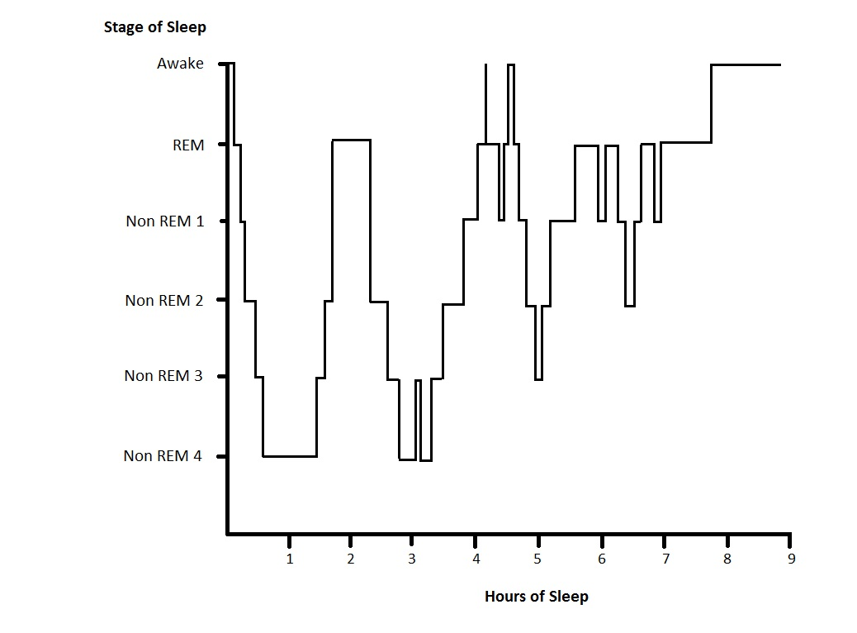
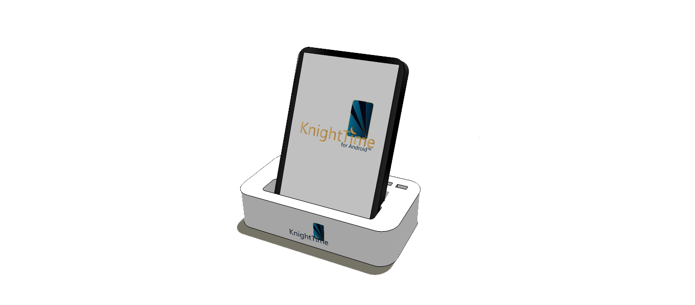
Smart Alarm
The system tracks the user's stage of sleep to wake them at the best time.

Slide 9
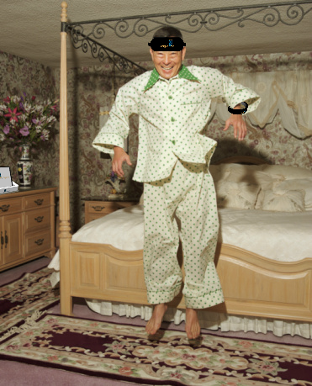
Smart Alarm
The peripherals allow the system to continue an alarm until the user shows significant signs of wakefulness such as high movement or heart rate.

Slide 10
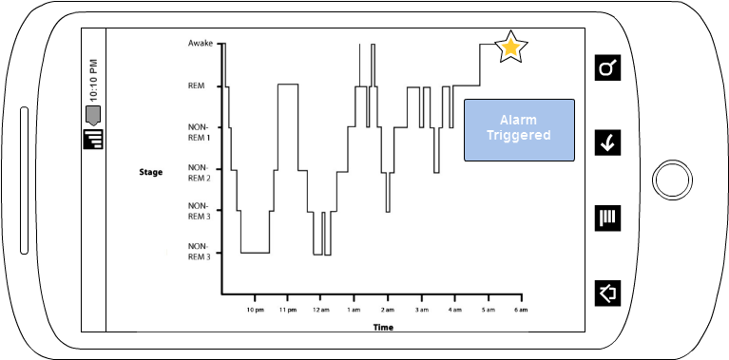
Data Review
After fully awake, the user can review the data collected throughout the night.
The user will be able to see when the alarm was triggered.
They will be able to improve their sleep habits by reviewing the data.

Slide 11
Implementation

Slide 12
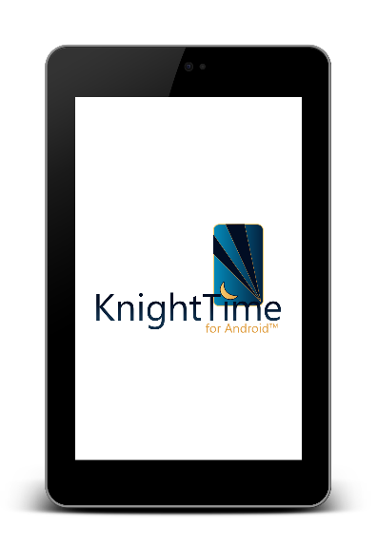

Vibrator
Pulse Oximeter
Skin Temperature
IMU
MSP430
Bluetooth Module
Bluetooth Module
MSP430
Light Array
Battery
Battery
Charging Module
Bluetooth
Module
Hardware
Block Diagram
Ambient Light
MSP430
Ambient Temp
Ambient Noise
Ambient Humidity

Slide 13
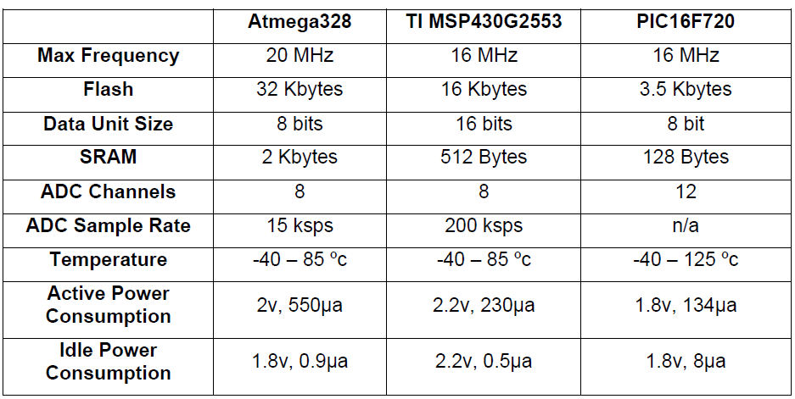
Micro Controller Selection

Slide 14
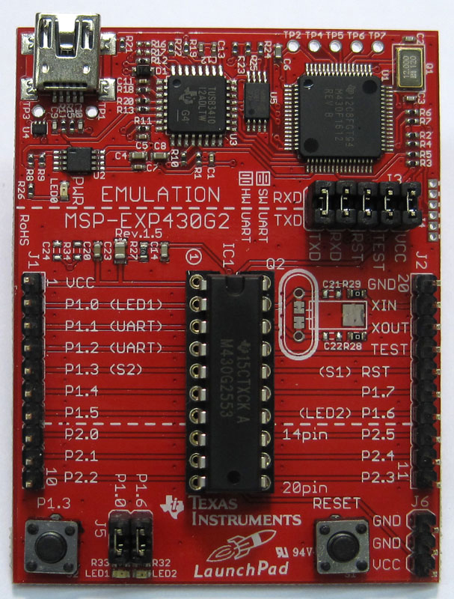
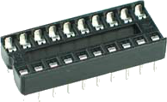
MSP430
MSP430 provides a good balance of features with low power consumption.
Useful for testing sensors in the same development environment.
No ICSP required. MCU from board to socket

Slide 15
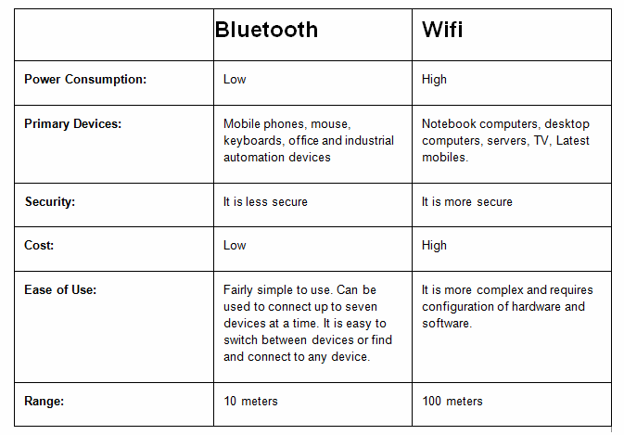
Communication Module Selection

Slide 16
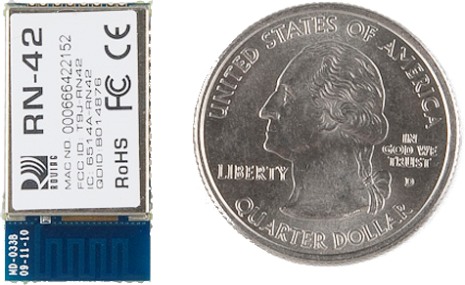
Bluetooth Module
The Bluetooth module chosen is the RN-42.
Features:
  Easy to Configure
  Auto discovery/pairing
  Error correction
  Integrated antenna
  Small

Slide 17
Vibrator
Pulse Oximeter
Skin Temperature
IMU
MSP430
Bluetooth Module
Bluetooth Module
MSP430
Light Array
Battery
Battery
Charging Module
Bluetooth
Module
Wrist Peripheral
Ambient Light
MSP430
Ambient Temp
Ambient Noise
Ambient Humidity

Slide 18
Wrist Peripheral
The wrist peripheral functions as an actigraph unit.
Actigraphy is a non-invasive way of monitoring rest and activity through measuring movement.
Offers high agreement with professional sleep studies.
The unit consists of:
  MCU
  Bluetooth Module
  IMU
  Battery
  Vibration Motor

Slide 19
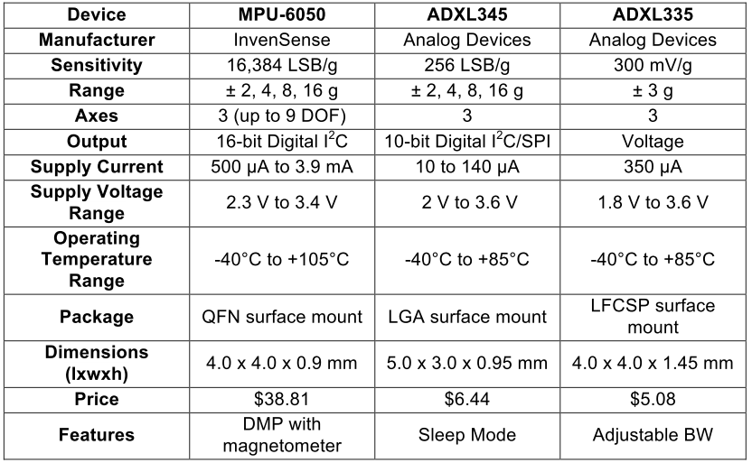
IMU (Inertia Measurement Unit)

Slide 20
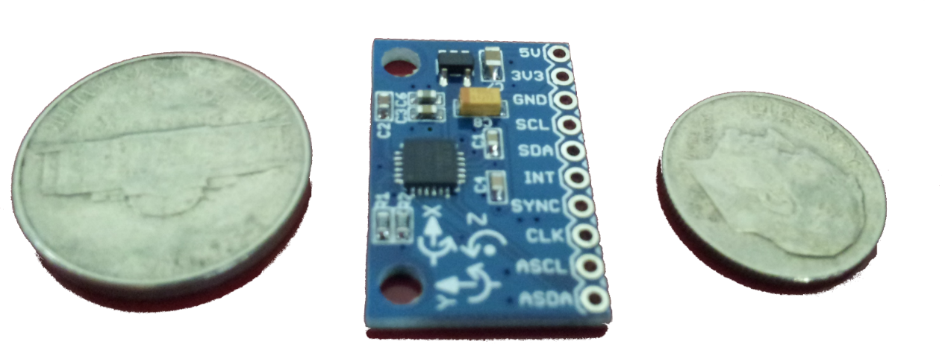
MPU 6050
Inexpensive breakout board (~$10)
Small size
Reasonable power draw
High sensitivity
16-bit Digital values (over I2C)

Slide 21
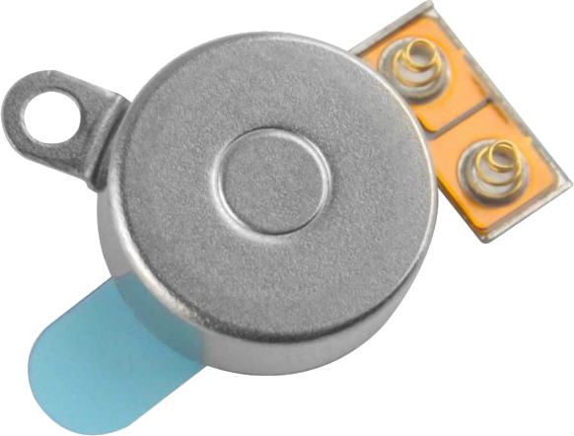
Vibration Motor
This is to help wake the user or notify them of such customizable event.
iPhone 4S Vibration Motor
Widely available + cheap

Slide 22
Vibrator
Pulse Oximeter
Skin Temperature
IMU
MSP430
Bluetooth Module
Bluetooth Module
MSP430
Light Array
Battery
Battery
Charging Module
Bluetooth
Module
Mask Peripheral
Ambient Light
MSP430
Ambient Temp
Ambient Noise
Ambient Humidity

Slide 23
Mask Peripheral
The Mask peripheral will contain:
  Skin temperature sensor
  LED light array (to simulate sunrise)
  Pulse rate monitor
  Battery
  Bluetooth Module
  Buzzer alarm near ears

Slide 24
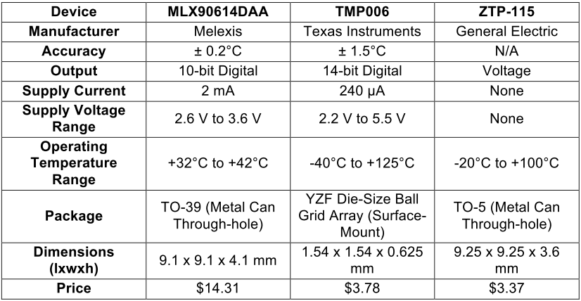
Selection of Skin Temperature Sensor

Slide 25
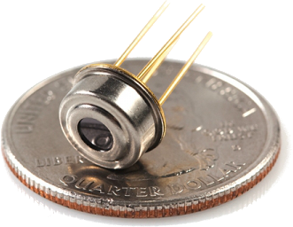
Skin Temperature: MLX90614DAA
Infrared thermometer for
non contact temperature
measurements.
Key features include:
  17-bit ADC and powerful DSP
  Power saving mode
  Resolution of 0.02°C

Slide 26
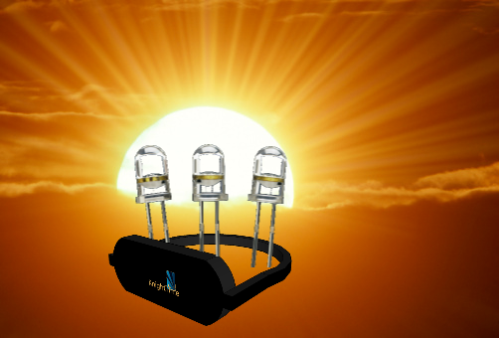
Light Array
An array of LEDs will gradually increase in brightness to simulate the sun rising.
Exposure to light 30 min prior to waking reduces sleep inertia.
Optional.

Slide 27
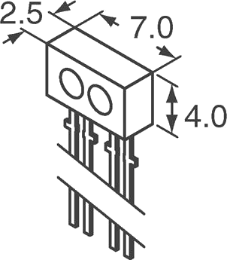
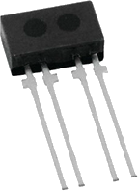
Heart Rate Sensor
Pulse is a helpful sleep indicator.
Forehead is a viable location.
Similar to pulse oximetry
Use reflectance of oxygenated blood cells
Chosen: TCRT1000
Infrared Proximity Sensor

Slide 28
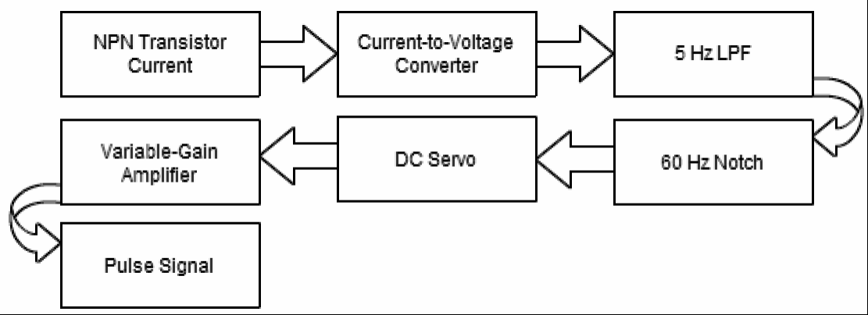
Signaling Condition for Heart Rate

Slide 29
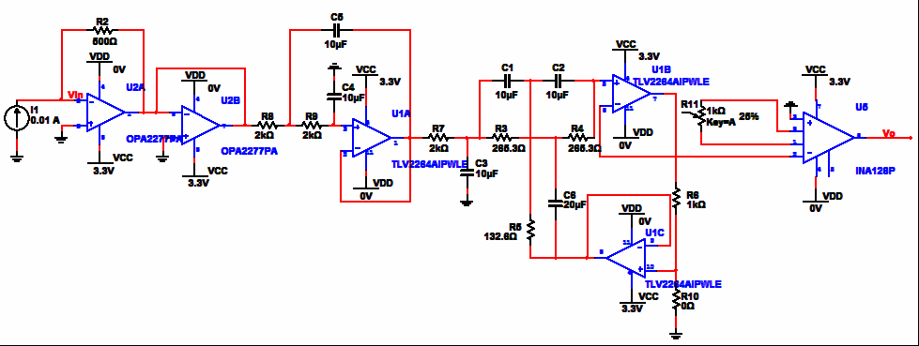
Heart Rate Schematic

Slide 30
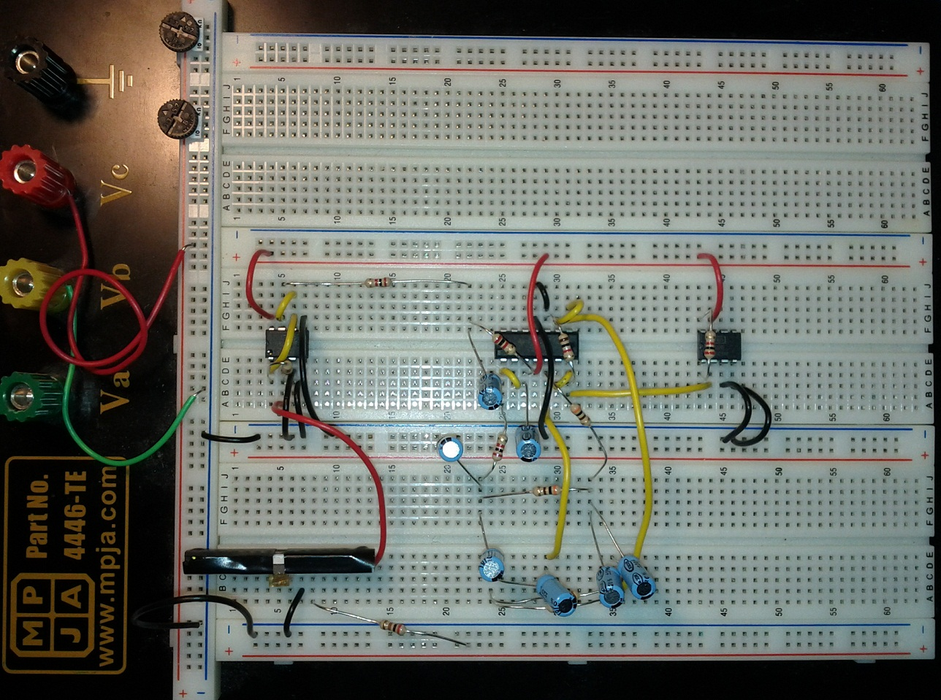
Heart Rate Prototyping

Slide 31
Vibrator
Pulse Oximeter
Skin Temperature
IMU
MSP430
Bluetooth Module
Bluetooth Module
MSP430
Light Array
Battery
Battery
Charging Module
Bluetooth
Module
Base Station
Ambient Light
MSP430
Ambient Temp
Ambient Noise
Ambient Humidity

Slide 32
Base Station
The base station will contain the following:
Ambient light sensor
Ambient temperature sensor
Ambient humidity sensor
Ambient noise sensor
Bluetooth Module
Charging Module for peripherals

Slide 33
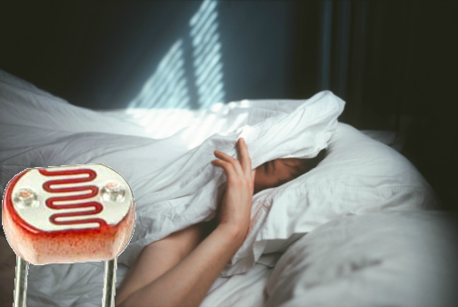
Ambient Light
A photoresistor was selected to detect ambient light in the room.
User can compare quality of sleep to amount of light present.
Potential to kill lights, shut blinds, etc.

Slide 34
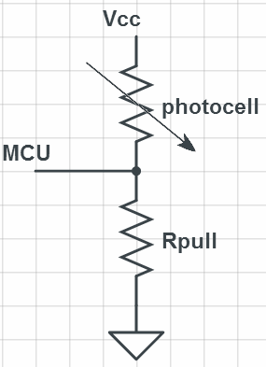
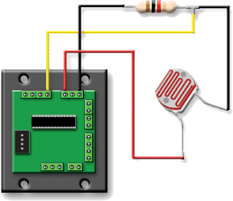
Ambient Light Circuit + Equation

Slide 35
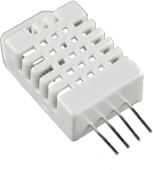
Ambient Temp and Humidity: RHT03
RHT03 is a low cost humidity and temperature sensor
Already calibrated - no external components
Ambient temperature vs. body temperature
Sleep quality vs. environment

Slide 36
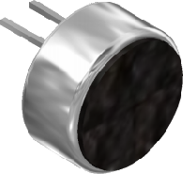
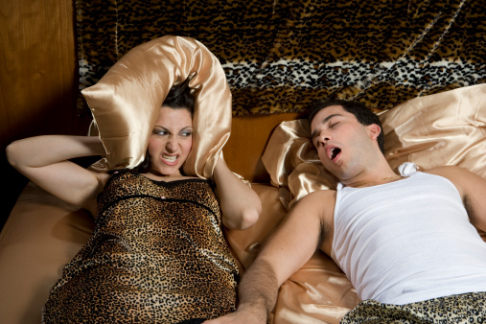
Ambient Noise: AOM-4544P-2-R
A microphone was selected to detect snoring.
Most snoring occurs at low frequencies: 20 - 500 Hz
AOM-4544P-2-R range from 20 Hz - 20 KHz
Chosen for low price, sensitivity, and omnidirection

Slide 37
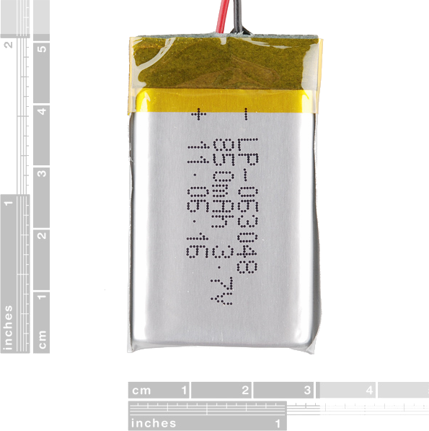
Battery
A polymer lithium-ion (LiPo) battery with 850mAh was selected.
Higher energy density compared to standard lithium-ion batteries.
Small size and decent capacity.
Rechargeable.

Slide 38
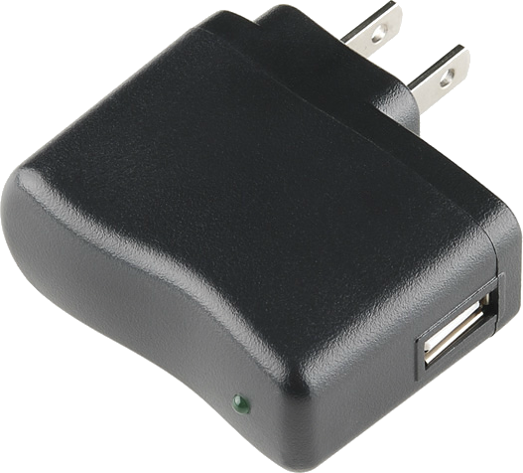
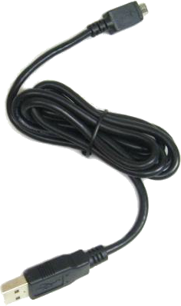
Charging and Power
Dock provides USB ports for peripheral charging
AC power supply also USB (5V 1A)
Regulator and charger IC's

Slide 39
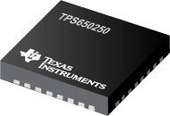
Charging and Voltage Regulator
TPS650250 Power Management IC for Li-Ion Powered Systems
3.7 V battery, 5 V USB --> 3.3 V Step-down converter
97% efficiency, up to 1.6A

Slide 40
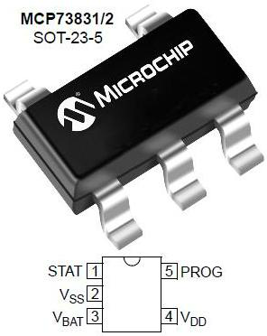
Charging and Voltage Regulator
MCP73831 Li-Polymer Charge Management Controller
500 mA charger
Chosen for price and ease of use

Slide 41
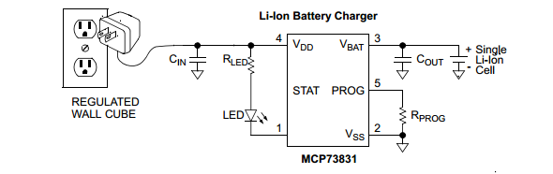
Charging and Voltage Regulator
MCP73831 Li-Polymer Charge Management Controller
500 mA charger
Chosen for price and ease of use

Slide 42
Vibrator
Pulse Oximeter
Skin Temperature
IMU
MSP430
Bluetooth Module
Bluetooth Module
MSP430
Light Array
Battery
Battery
Charging Module
Bluetooth
Module
Mobile App
Ambient Light
MSP430
Ambient Temp
Ambient Noise
Ambient Humidity

Slide 43
Mobile Application
The application will implement the:
  Monitoring Algorithm
  Network Messaging System
  A database to store acquired data
It is being developed using Mono for Android™ framework.
  It allows the developer the use of C#/.NET and Visual Studio™
  It links the assemblies to Java binaries
  Provides very little overhead and performance hit.
C#

Slide 44
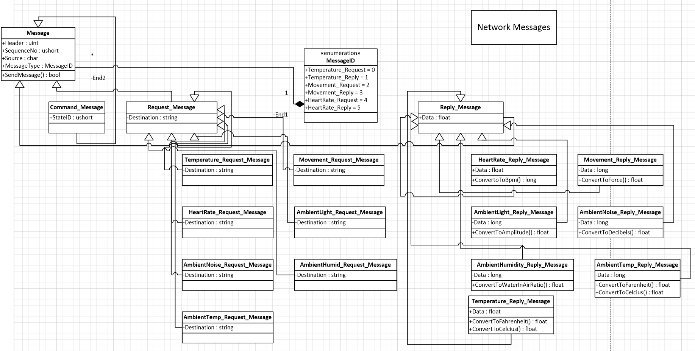
Messaging System

Slide 45
Administrative Content

Slide 46
Performance

Slide 47
Distribution of Work
Facundo (CpE)
Embedded Software
Mobile App
Anthony (CpE)
Embedded Software
Wireless
Bart
(EE)
Power
Sensors/PCBs
Ryan
(EE)
Power
Sensors/PCBs

Slide 48
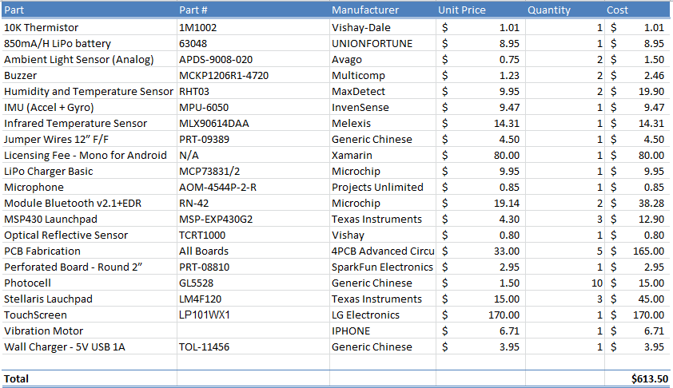
Bill of Materials

Slide 49
Problems
TI I2C library did not work with MPU 6050
How to package in while keeping the device small/comfortable
Full system tests could take up to 10hrs.
We must provide power for at least 8 hrs. with minimal battery size.
Initially the base station was going to implement the Monitoring Algorithm.
    The Bluetooth connection (Master/Slave) complicated the chain of command.

Slide 50
Questions?

