Slide 1
Dynamic Animation Cube II
Group 5
Timothy Foard, EE
Adam Heeren, CpE
Sommer Marsh, EE
Brian Zei, EE

Slide 2
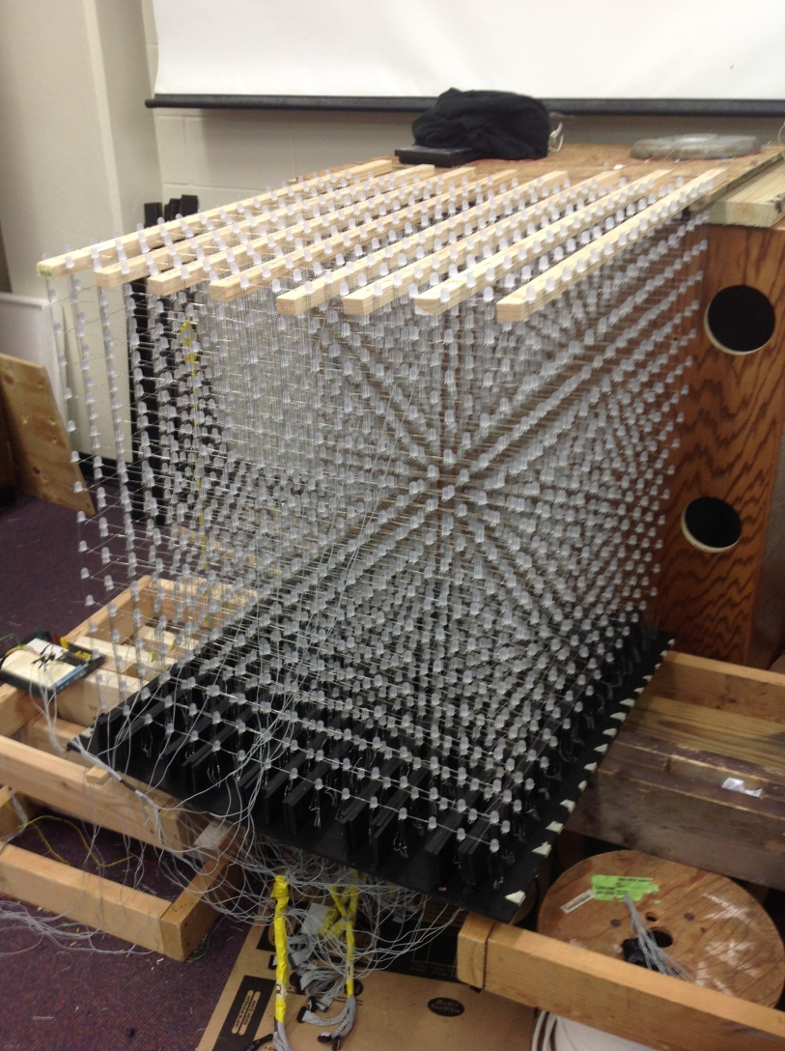
Brief Overview
The Dynamic Animation Cube was commissioned by a previous senior design group
16 x 16 x 16 RGB LED Cube
Main application was animations
Project had many flaws and oversights during design
29.5”

Slide 3
Motivations Goals
Possibility of funding for project
Allure of having our project on display for future engineering students
LED Cube was already constructed
Multiple user interactive applications w/ use of Wii Nunchuck
  Rubik’s Cube
  Game of Life
  1 player Pong
  Tetris
Professional end product that will be structurally sound
Display product at the University

Slide 4
Specifications
Cube size:
Visible sides:
LED type:
Pixel Resolution:
Base Construction:
Case Construction:
Working Temperature:
Refresh rate:
Working Voltage:
Application’s:
3.5’ x 3.5’ x 4.5’
5 sides
RGB
16 x 16 x 16 = 4,096
Wood
Transparent acrylic
50 – 104 ºF
120 Hz
AC 110-230V
Rubik’s Cube

Slide 5
Milestones
Structure
  Base
  Internal Frame
LED Cube
  Testing
  Re-construction
PCB Design
Software
  Addressing
  Wii Nunchuck Interface

Slide 6
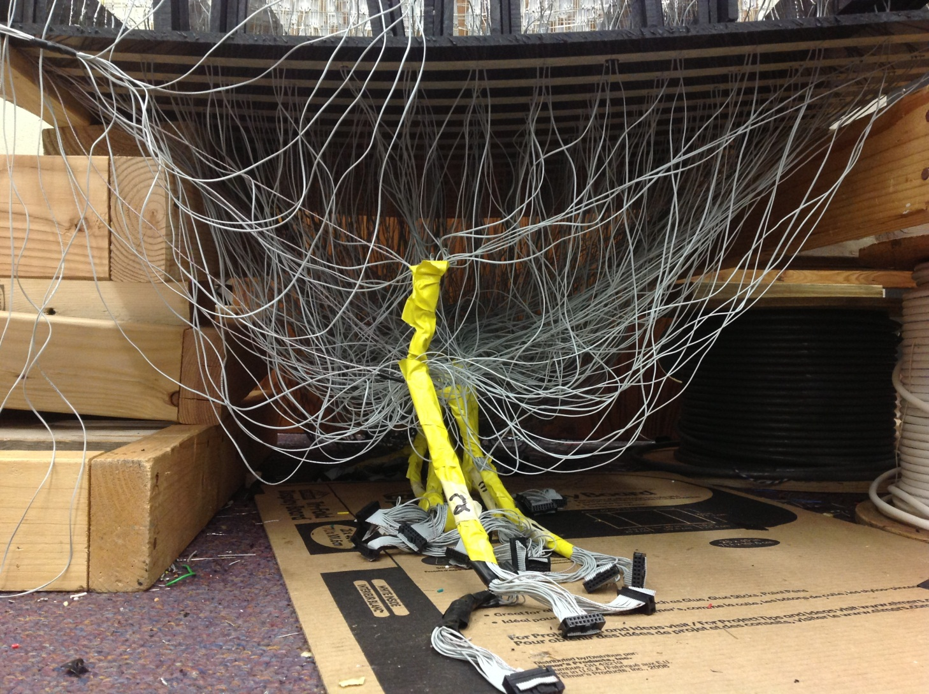
Structure: Base
Previous group’s design

Slide 7
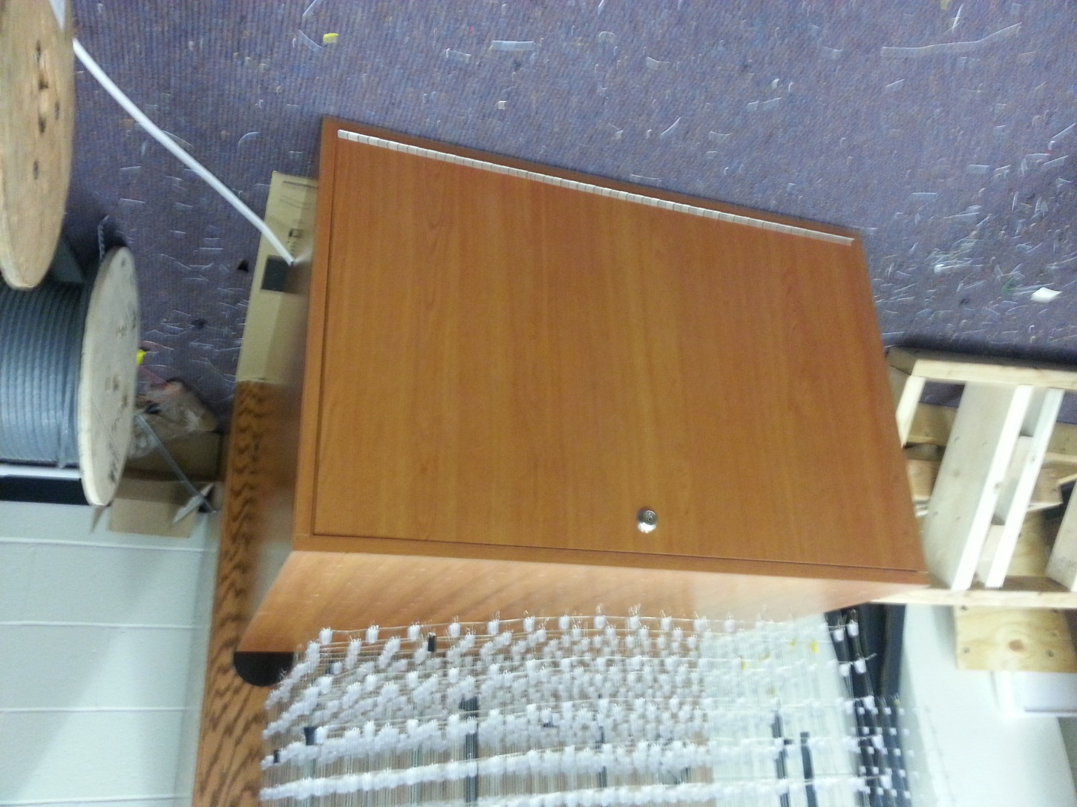
Structure: Base (cont.)
33”
Group 5’s design

Slide 8
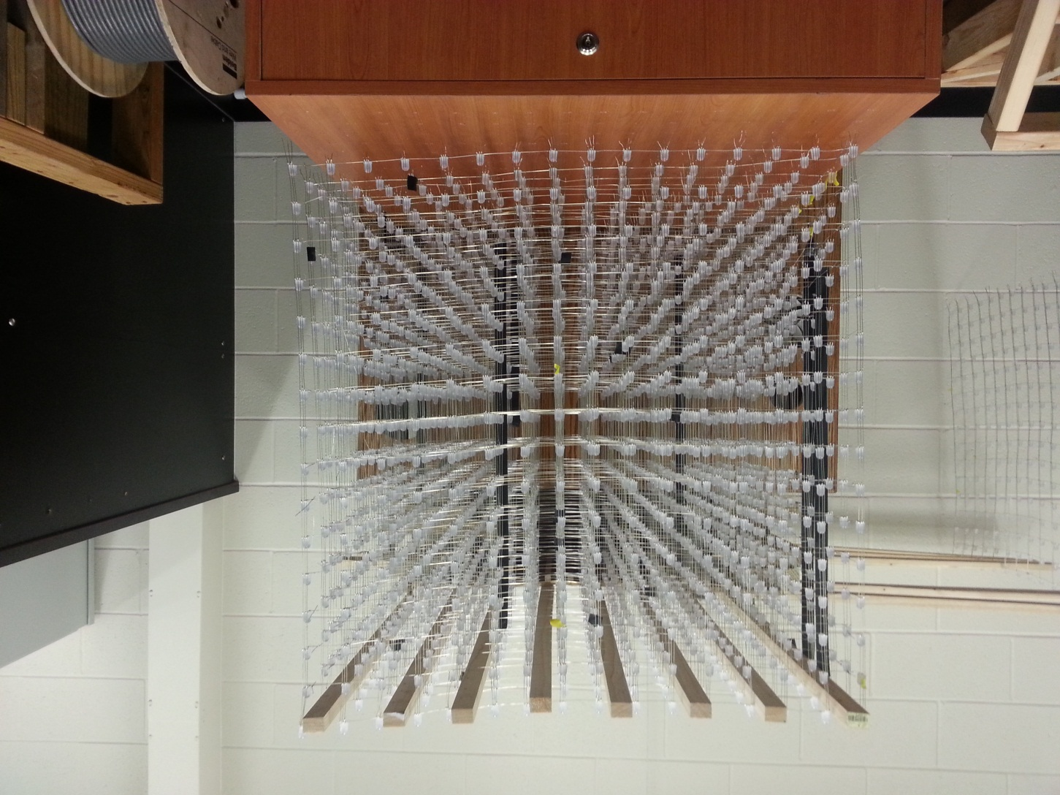
Structure: Internal Frame
33”

Slide 9
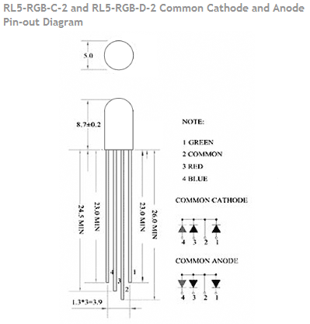
LED’s
Cube is comprised of more than 4,000 LED’s.
SPECS
  RGB
  Common Anode
  20 mA – 50 mA
  100 mW Power Dissipation
2”

Slide 10
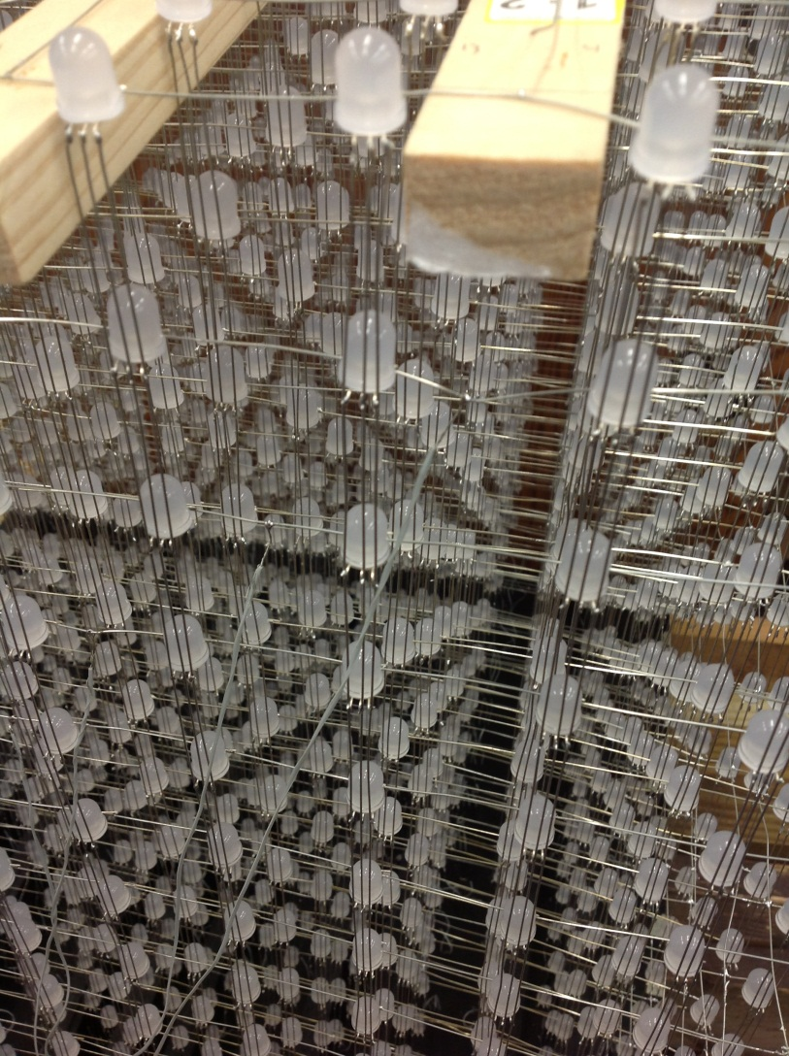
LED Array
Previous group was unable to get every single LED to light
Soldering effort included more than 17,000 individual solder connections
It fell on us to test each LED and it’s solder connections
2”

Slide 11
Power Supply Unit
Triad Magnetics
5V DC input
4A max current
20W power capabilities
Wall adapter plug

Slide 12
LED Drivers
STP24DP05
Controls 8 columns of LED’s per chip
Maximum 20V and 80mA output
25MHz clock frequency
30ns internal delay
Serial Peripheral Interface (SPI)
Pulse width modulation application that will allow us to control the intensity of each LED.

Slide 13
LED Drivers (cont.)
Error detection mode
  Checks if commands are flowing correctly
Temperature detection
  Turns off driver is temperature rises too high
Preset shift registers
  Changes order of colors displayed

Slide 14
Decoders
74HTC154
4-to-16 bit
Rated for -0.5 to 7V Vcc input and 20mA current
Contains enable gates for eliminating bugs
Decoders will be used for two purposes
  2, 4-to-16 decoders will be used to select which LED Driver will be active
  1, 4-to-16 decoder will be used to select which layer of the cube will be active

Slide 15
Decoders (cont.)
Internal propagation delay (70ns)
  Limits errors and missed latches
Transition time (32ns)
  Makes sure commands are read in the correct order
Power dissipation for system safety
High immunity to noise

Slide 16
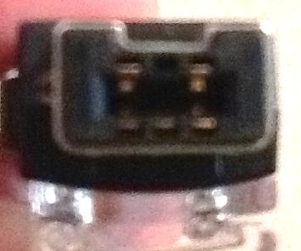
Wii Nunchuck
Inputs
  2 Buttons
  Joystick
  Accelerometer
Communication Protocol
  Two Wire Interface (TWI)
Data
  6 Bytes
SCL
GND
+3.3
SDA

Slide 17
Microcontroller
Atmel AT32UC3C2512
66 MHz processing speed
Memory
  512 kB Flash
  64 kB SRAM
  Single cycle access for both
45 GPIO
Supports SPI and TWI
Atmel’s community

Slide 18
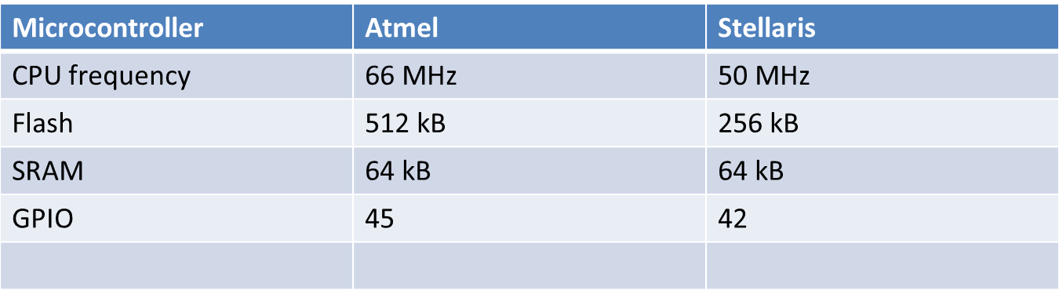
Microcontroller Comparison

Slide 19
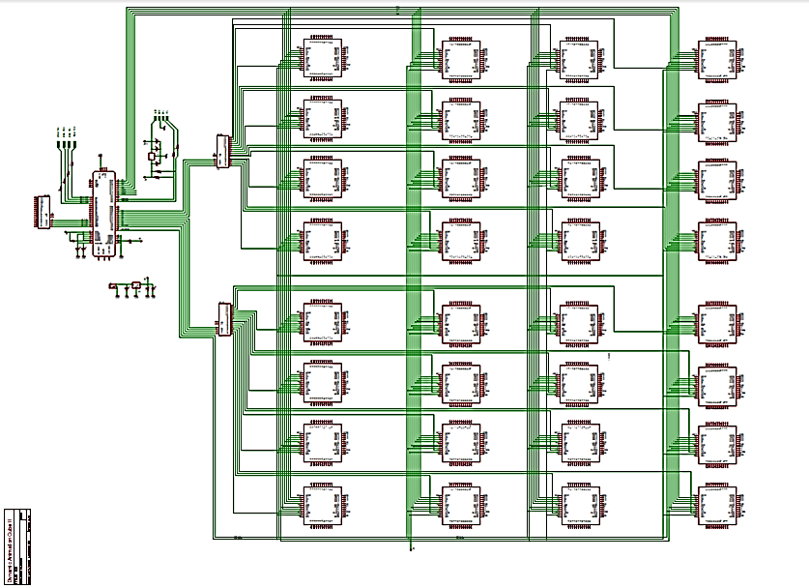

Slide 20
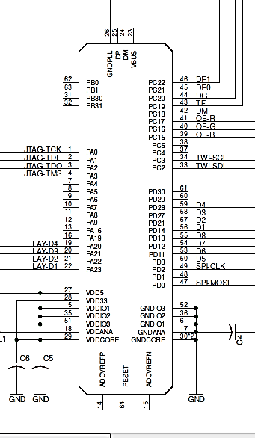
Microcontroller
Wiring
Programming
  JTAG
Layer addressing
LED driver addressing
Driver Communication
  SPI
Nunchuck Communication
  TWI

Slide 21
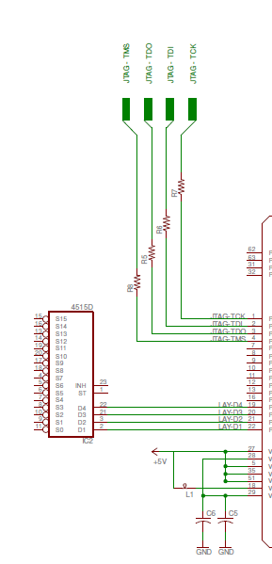
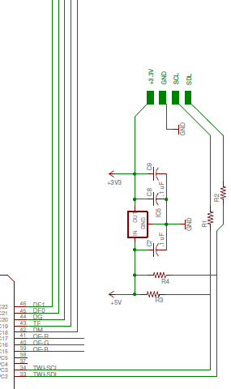

Slide 22
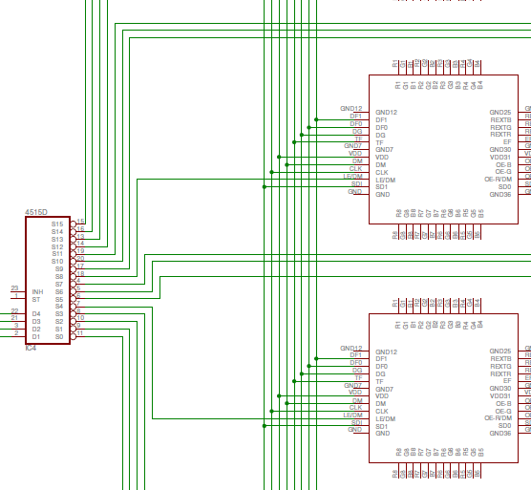

Slide 23
Software
Written in C
Compiled using Atmel Studio 6
Runs the Atmel Software Framework (ASF) library

Slide 24
Physical Interfaces
Joint Test Action Group (JTAG) for writing the software to the MCU
Serial Peripheral Interface (SPI) for communicating with the LED drivers
Two Wire Interface (TWI) for receiving input from the Wii Nunchuck

Slide 25
Planned Applications
Rubik’s cube
Conway’s Game of Life
1 player Pong
Tetris

Slide 26
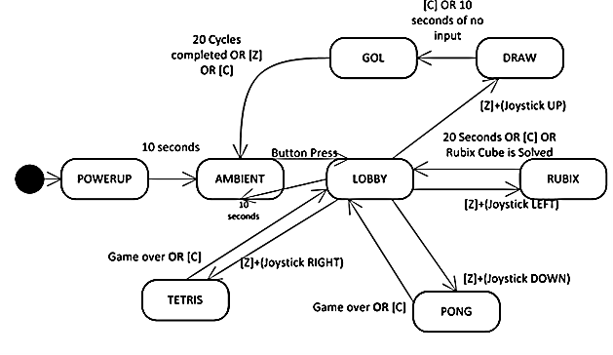
Software Flowchart

Slide 27
Cube Output
Cube will be stored as a [16][16][3] array of integers named ‘CUBE’
If CUBE[A][B][C]=X, X_{N} represents the Nth bit of the Ath vertical layer of the Bth layer. C represents the color (0,1,2 correspond to red, green, and blue, respectively.
Each bit represents an LED being lit (1) or dark (0)
Space (1 cube): 1.5kB
Time to update cube: 698 microseconds (1/1.432 kilohertz)

Slide 28
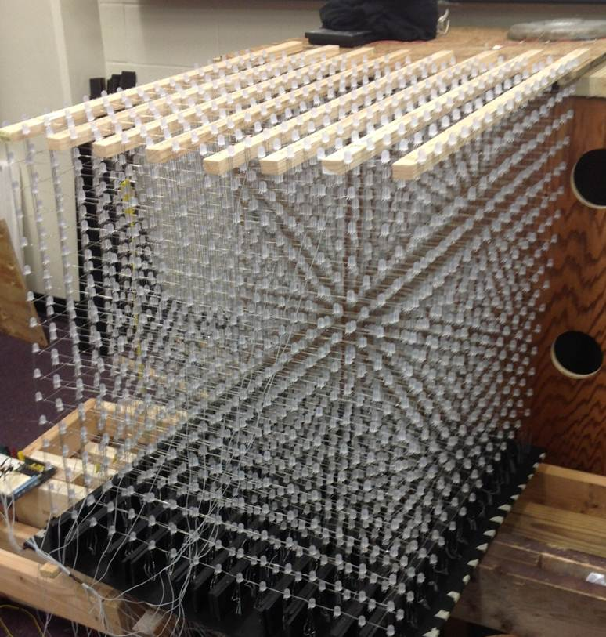
Example: [0][3][2] = 1168
29.5”

Slide 29
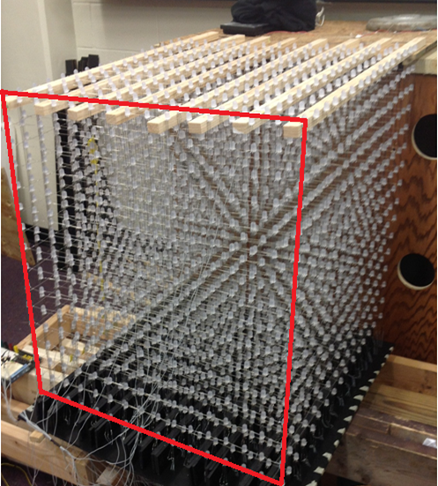
Example: [0][3][2] = 1168
29.5”

Slide 30
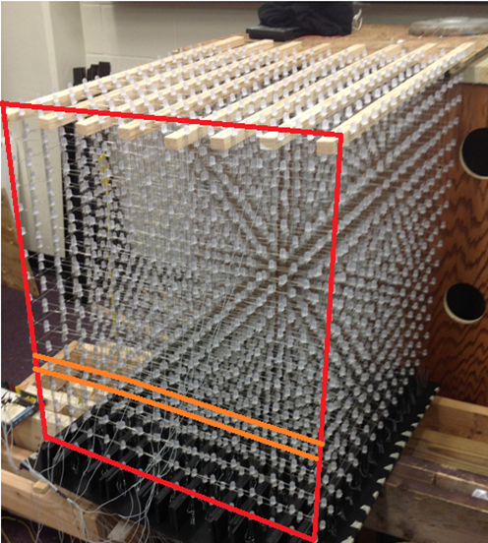
Example: [0][3][2] = 1168
29.5”

Slide 31
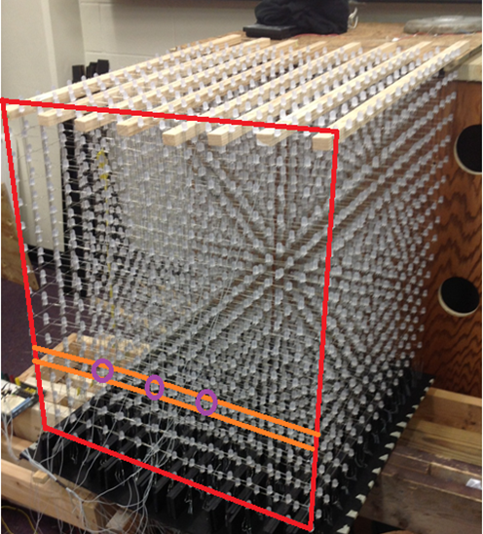
Example: [0][3][2] = 1168 = 0000010010010000
29.5”

Slide 32
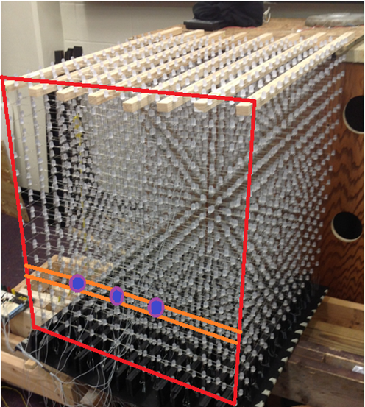
Example: [0][3][2] = 1168
29.5”

Slide 33
Nunchuck Input
Received through TWI
The TWI will be accessed using the TWI interface software provided in the ASF

Slide 34
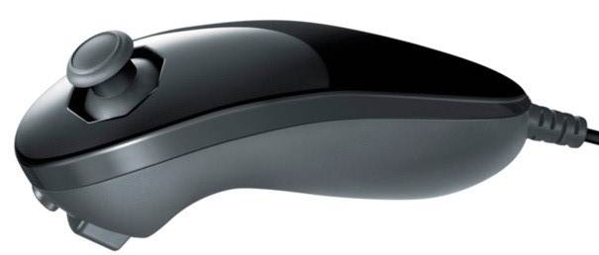
Joystick X |  |  |  |  |  |  |  | Byte 0
Joystick Y |  |  |  |  |  |  |  | Byte 1
Accelerometer X[9:2] |  |  |  |  |  |  |  | Byte 2
Accelerometer Y[9:2] |  |  |  |  |  |  |  | Byte 3
Accelerometer Z[9:2] |  |  |  |  |  |  |  | Byte 4
Acc. Z[1] | Acc. Z[0] | Acc. Y[1] | Acc. Y[0] | Acc. X[1] | Acc. X[1] | C-butt. | Z-butt. | Byte 5

Slide 35
Cube Output Pseudo code
for(each vertical layer X)
{
for(each horizontal row Y)
{
output Y to the layer select;
output X to the driver decoder;
output the lower 8 bits of CUBE[X][Y][0],CUBE[X][Y][1], and
CUBE[X][Y][2] to the drivers and latch them;
raise the red, green and blue signals separately;
output 24 zeroes to the drivers and latch them;
output X +1 to the driver decoder;
output the upper 8 bits of CUBE[X][Y][0], CUBE[X][Y][1], and
CUBE[X][Y][2] to the drivers and latch them;
raise the red, green and blue signals separately;
output 24 zeroes to the drivers and latch them;
}
}

Slide 36
Finances
Total Budget: $1500.00 (Sponsorship from the College of EECS)
To-date Financing:
$200 replacement LED’s
$50 AVR Dragon
$180 Base
$75 wire & connectors
$13 power supply
$25 solder materials
$7 drill bits
Future Financing:
$40 acrylic rods
$250 acrylic sheets
$17 Weld-on #4 acrylic cement
$33 PCB printing
$20 Microcontroller
$110 LED Drivers
$100 miscellaneous hardware
We are on track to come in well under budget, at around $1100 if all goes according to plan

Slide 37
Current Progress

Slide 38
Immediate Plans
Replace burnt out LED’s or poor solder connections
Start building internal support frame
Get LED array put back together over new frame
Complete PCB design and get it ordered
Verify software approach is compatible with hardware
Integrate hardware with software and begin the testing/debugging phase

