Slide 1
B.R.A.V.O.
Bring Reliability to Autonomous Vehicle Operation
Group 11
Christopher Cox
Mirazam Usmanov
Douglas Akinola
Henry McWhorter

Slide 2
Objectives
Create an autonomous vehicle that is able to navigate a course with various paths and obstacles
Demonstrate a robust A.I. that is able to determine and follow particular routes as well as make appropriate decisions regarding obstacle avoidance
Demonstrate a smooth motor control system
Ideally demonstrate image processing and autonomous navigation between two cars

Slide 3
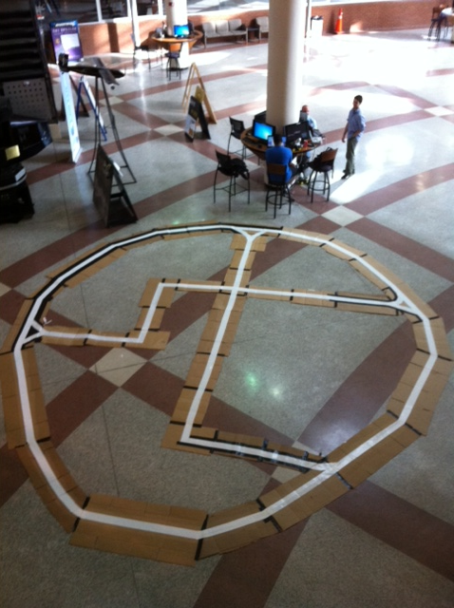
Pre-Constructed Course

Slide 4
System Design Flow

Slide 5
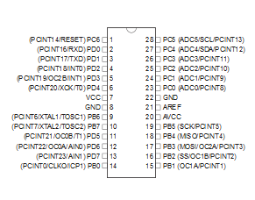
Microcontroller: Atmel Atmega 328P
Features | Atmel Atmega 328P
Clock Frequency | 20MHz
Flash Memory | 32KB
On-Chip Ram | 1 KB EEPROM / 2 KB SRAM
PWM | 6 Channels
Analog Support | 6 Pins
Support | Arduino Uno Scripts

Slide 6

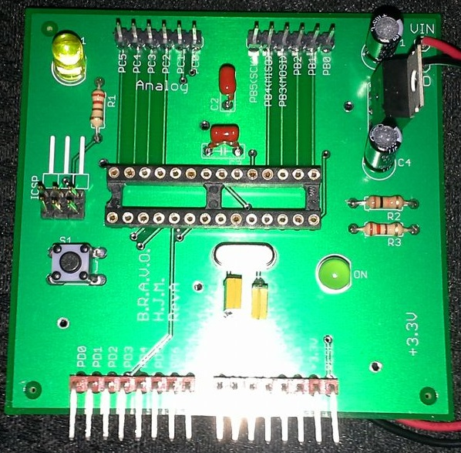
Printed Circuit Board
Atmel Atmega328P
LM7805 Fixed +5V Regulator
“On” LED
16MHz Oscillator
Reset Switch
Potential for ICSP

Slide 7
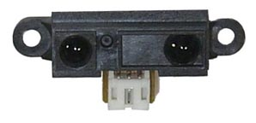
Sharp IR Proximity Sensor
Detecting distance between
10cm - 80cm
Operating voltage of 5V
Average dissipation current
30mA
Returns an analog voltage.
Closer proximity = greater analog value

Slide 8
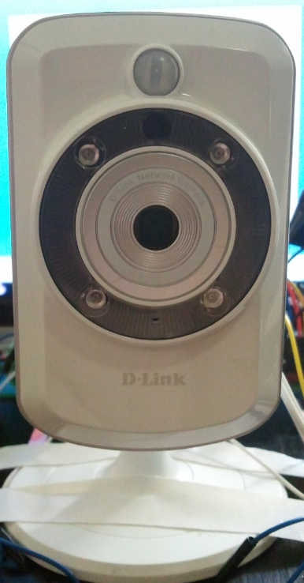
Camera
D-Link Wireless IP camera:
Real Time Streaming Protocol (RTSP)
5V @ 1.2 A
320x240 resolution
30 frames per second

Slide 9

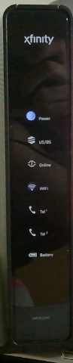
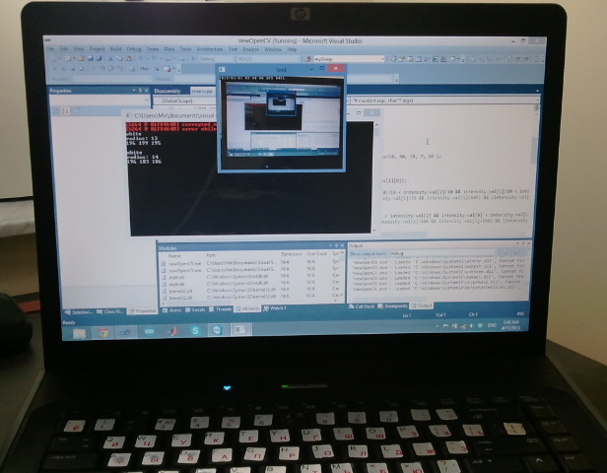
Video Feed Transmission

Slide 10
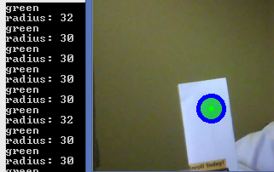
Computer Vision and Sign Detection
OpenCV Library:
Gaussian Blur
Canny Edge Detection
Hough Circle Transform
Color Filter
Output

Slide 11

Road Sign Representation
ON/OFF Ramp STOP Right Turn Left Turn

Slide 12
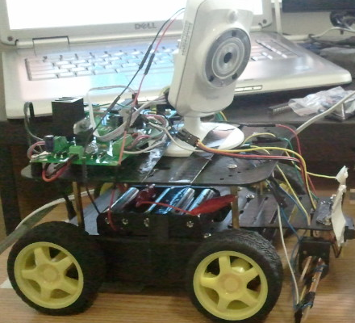
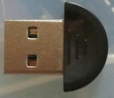
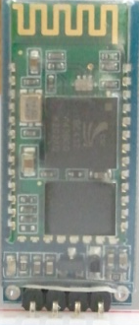
Data Extraction and Transmission
Detected Signs
JY-MCU Bluetooth Module:
40mA @ 5V
9600 bps (default)
30 ft range
UART interface

Slide 13
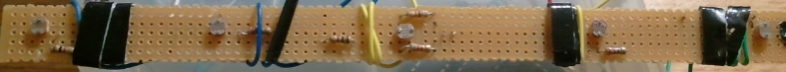
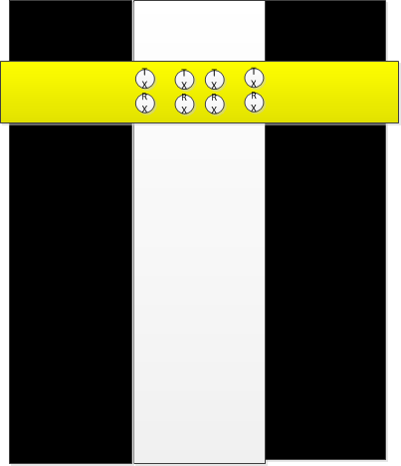
Line Sensor Array
Series of photoresistors

Slide 14
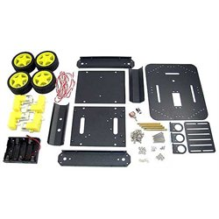
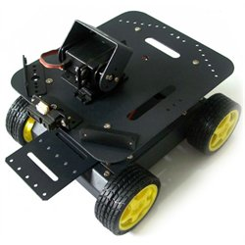
Vehicle Platform

Slide 15
Features
Aluminum based 4WD robot chassis
4 motors/gearboxes and internal battery storage compartment.
Dual level mounting platforms.
Motors are rated 4.5V-6V with a no load current of 71mA and a stall current of 470mA.

Slide 16
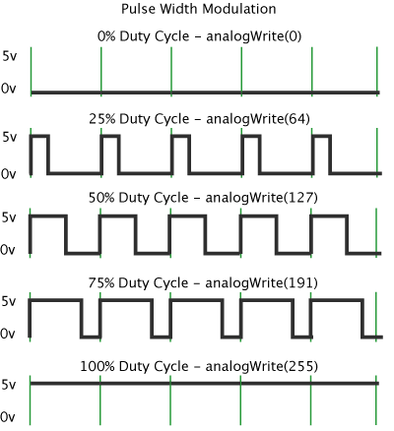
Operation
Signals are sent from the microcontroller to the motor controller based on the need to turn, accelerate, stop or reverse the vehicle.

Slide 17
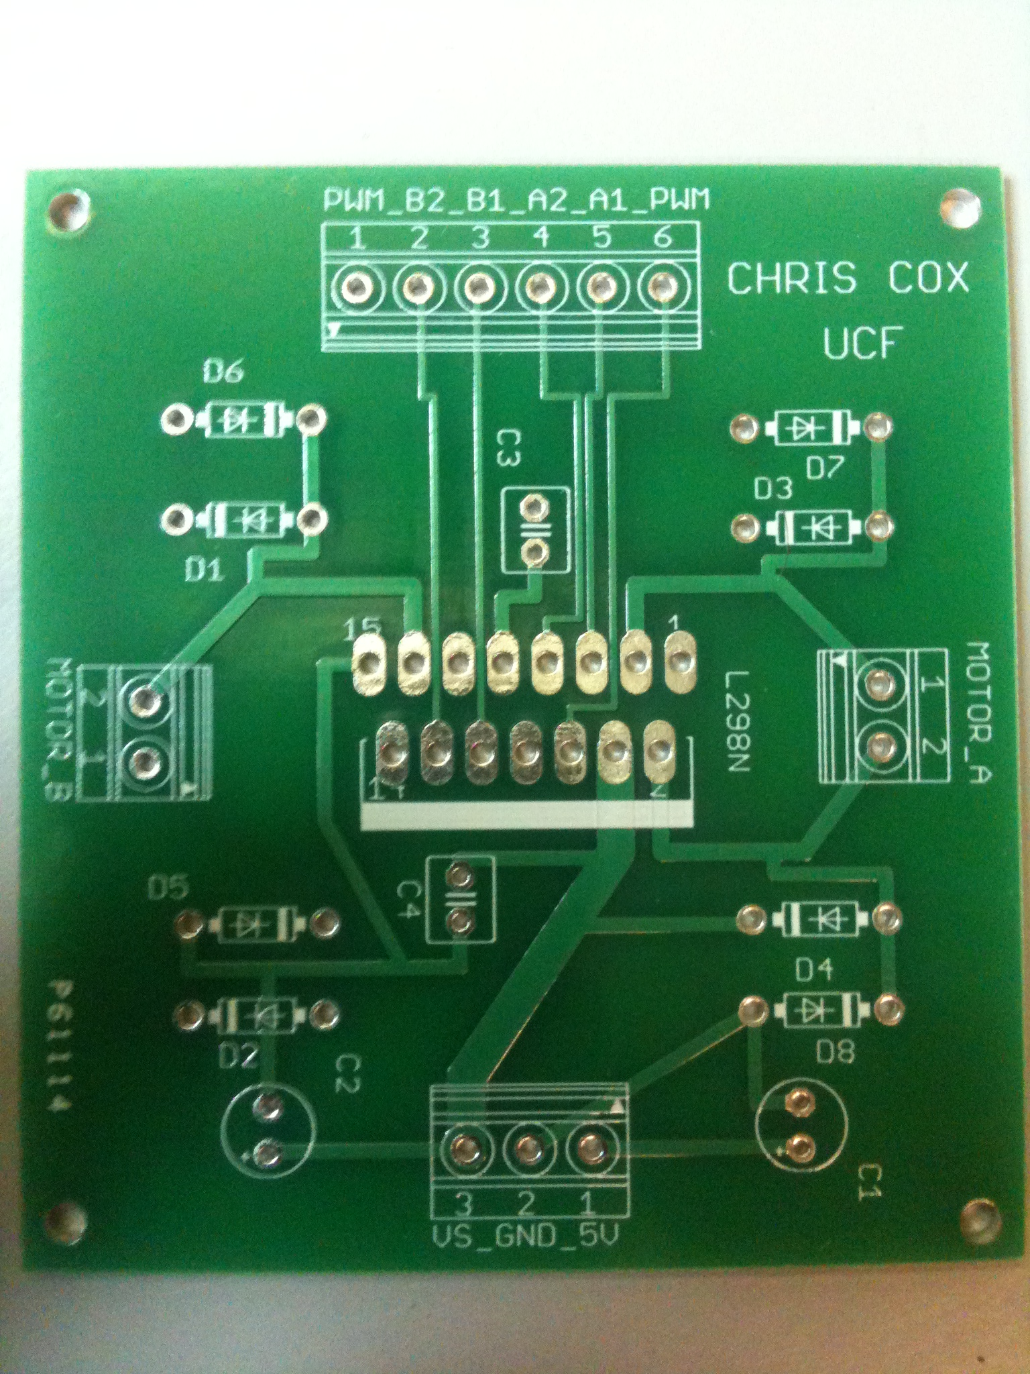
Motor Control

Slide 18
Functions of the IC
The primary function of the motor control circuit is to convert signals from the microcontroller into movement of either the drive or steering motors. To control brushed DC and servo motors, polarity changes and pulse width modulation are used to regulate their respective power outputs.

Slide 19
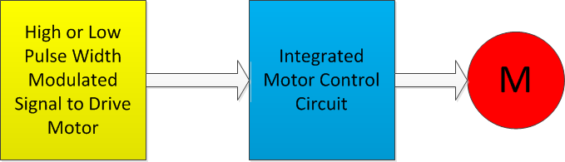
Operational Flow

Slide 20
IC Operation
The following slides illustrate a simple H-Bridge and how high and low signals can control the transistors and thus reverse the motor polarity.
A PWM signal regulates the duration that the transistors are turned on.

Slide 21
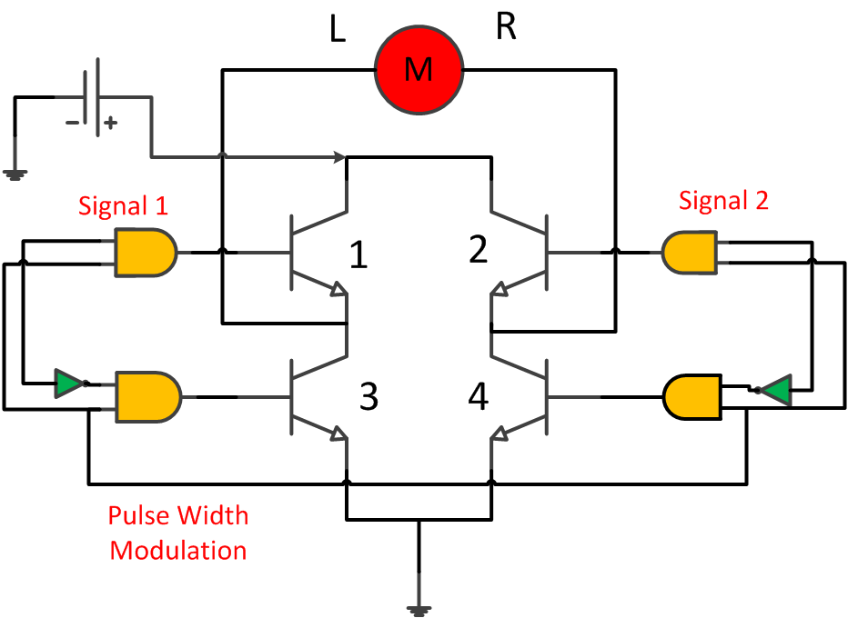
Integrated Motor Control Circuit

Slide 22
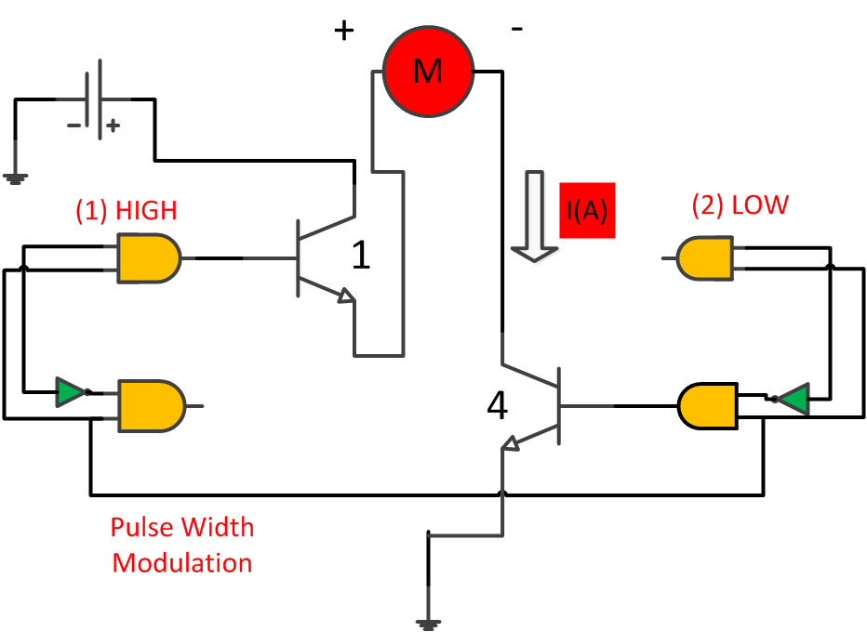
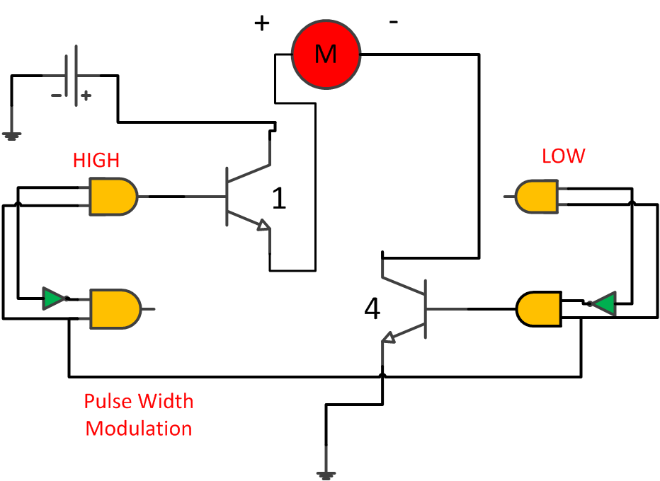
1 = HIGH and 2 = LOW

Slide 23
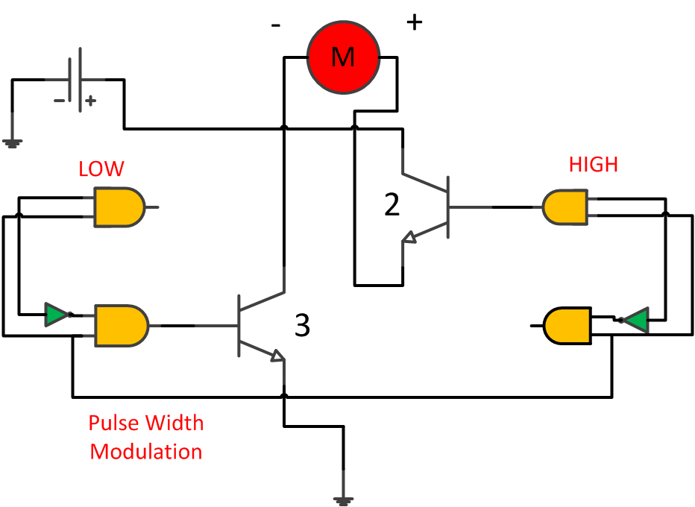
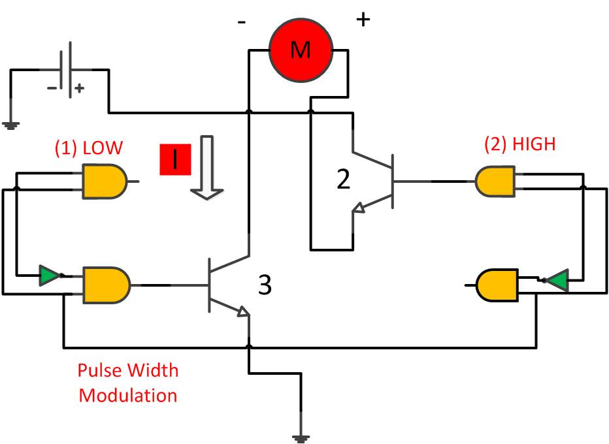
1 = LOW and 2 = HIGH

Slide 24
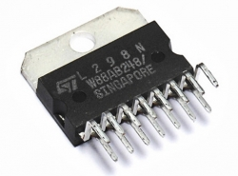
IC Selection
The ST Micro L298n Integrated Motor Controller features surface or test-board mount (shown) options and an exposed heat-sink rail for additional heat distribution according to project specs.

Slide 25
Features
SUPPLY VOLTAGE UP TO 46 V
TOTAL DC CURRENT UP TO 4 A
LOW SATURATION VOLTAGE
OVERTEMPERATURE PROTECTION
LOGICAL "0" INPUT VOLTAGE UP TO 1.5 V
(HIGH NOISE IMMUNITY)

Slide 26
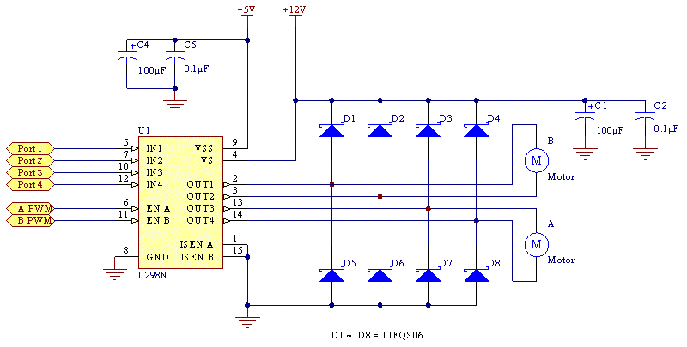
L298N Schematic

Slide 27
Diodes are added between the supply and ground nodes to protect the integrated circuit from reverse voltage from the induction motors.
Pulse width modulated signals from the microcontroller are used to control the current through the motors and thus the velocity of the vehicle.

Slide 28
PWM and Current Curve
V(out-3)
V(out-4)
I(Motor-b)
8.0V
1.6A
7.2V
1.4A
6.4V
1.2A
5.6V
4.8V
1.0A
4.0V
0.8A
3.2V
0.6A
2.4V
0.4A
1.6V
0.2A
0.8V
0.0V
0.0A
-0.8V
-0.2A
0ms
10ms
20ms
30ms
40ms
50ms
60ms
70ms
80ms
90ms
100ms

Slide 29
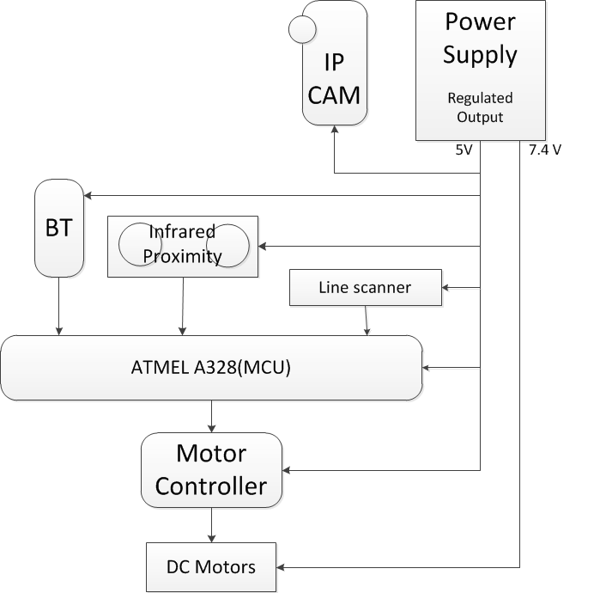
Power

Slide 30
Power Overview
Device | Voltage | Current
DC Motors | 7.4 V | 2 A
AtMega328 | 4.5-5 V | 200mA
Motor Controller | 5 V | 25 mA
IP Camera | 5 V | 1.2 A
Bluetooth | 5 V | 8mA
Infrared Proximity Sensors | 5 V | 30 mA
Line Scanner | 5 V | 40mA

Slide 31
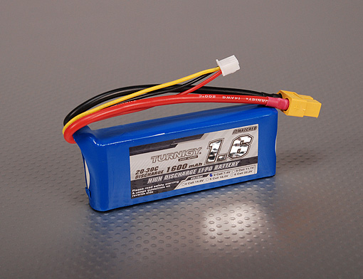
Primary Power Supply
Turnigy Lithium Polymer Battery (2x)
7.4 V at 1600 mAh
106 x 32 x 13 mm
97 grams
Light Weight
High Energy Density
Very efficient
Safe to Use

Slide 32
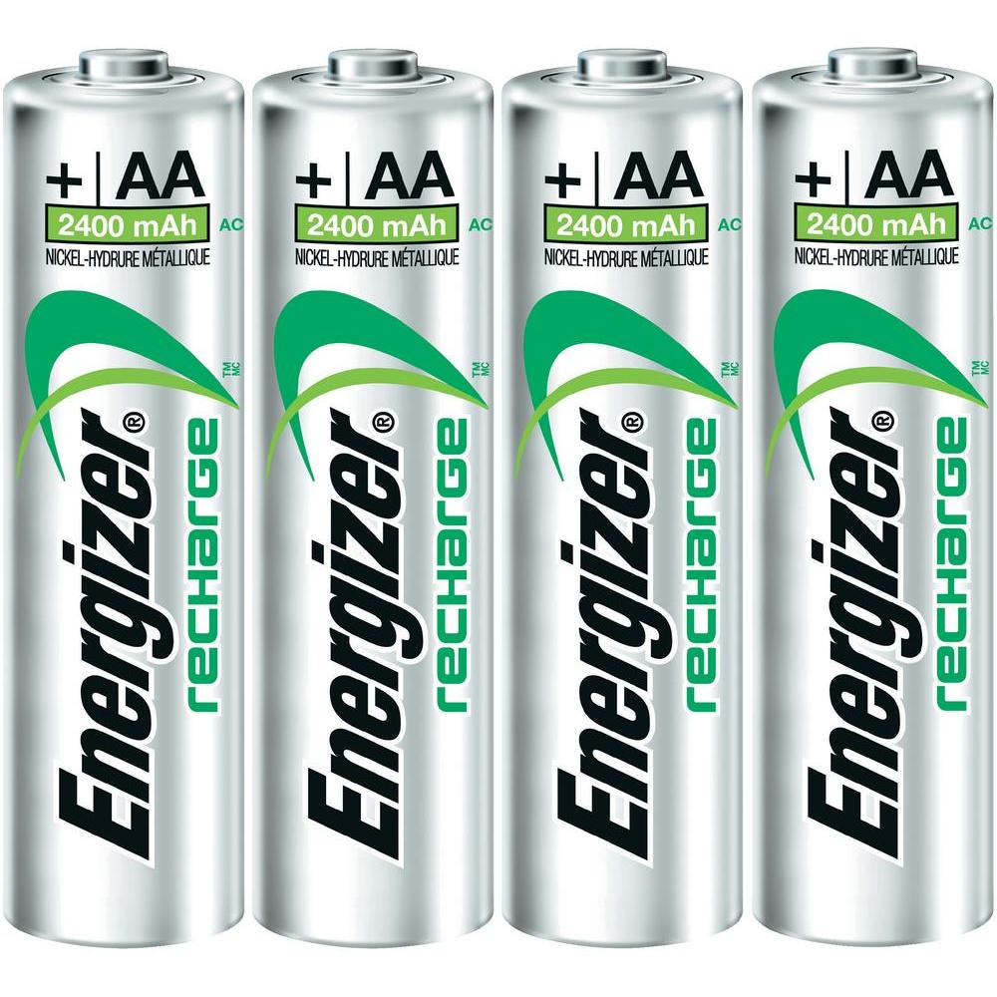
Secondary Power Supply
Energizer NiMh Battery (4x)
4.8 V at 2400mAh
14 mm x 50.5 mm
Power for IP Camera

Slide 33
Budget
 | Item | Qty. | Price($)
1 | Vehicle Platform | 2 | 105.98
2 | Motor Controller | 2 | 5.99
3 | 2.125" ALUMINUM HEX SPACER, F-F, 6-32 | 24 | 7.8
4 | 6/32x.25" Button Socket Head Screws (25 pk) | 16 | 11.04
5 | 20 AWG Solid Wires (Different Colors) 25' | 6 | 9.78
6 | BUTT CONNECTOR, RED-(50 pk) | 2 | 3.05
7 | Printed Circuit Board/Motor Control | 2 | 105.00
8 | Miscellaneous Electrical Parts (diodes,capacitors etc) | 1 | 60.00
9 | 1600mAh 2S 20C Lipo Battery | 2 | 8.05
10 | 2S 3S Balance Charger. Direct 110/240v | 1 | 11.61
11 | JY-MCU Bluetooth Module | 2 | 20.99
12 | Infrared Proximity Sensor | 2 | 25.95
13 | DSL Wireless IP camera | 2 | 230.35
14 | Photoresistors | 10 | 16.22
15 | Microcontroller PCB | 2 | 86.00
16 | Voltage Regulators | 2 | 3.00
 | TOTAL COST |  | 763.81

Slide 34
Questions?

