Slide 1
Project AUGI
UCF Augmented Navigation System

Slide 2
Motivations
To develop an improved and more open navigation experience.
Make it accessible to a broad audience through Android devices.
To improve upon traditional 2D maps and voice turn-by-turn navigation.
Notes:
*Introduce yourself, Project Name
*Current navigation aids require the user to be able to read a map, match what they see to the map (cross streets, landmarks)
* Better to just provide a virtual line for them to follow to their destination.

Slide 3

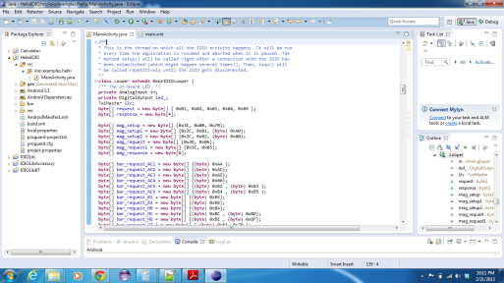
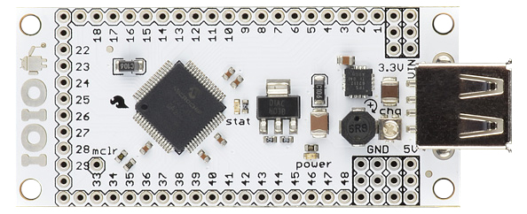
What is Project AUGI?
Android based augmented reality navigation application.
  Includes:
    Android Application
    Hardware/Software Interface
    Expansion Sensor board
Notes:
*Three main focus areas to this project: Software application, Sensor Board, hardware/software communication layers
*

Slide 4

Platform Choices
iOS vs. Android vs. Windows Phone 8
Which platform is the most open and familiar to the team?
  SDK features
  Programming Language familiarity
  Interfacing with Hardware
  Map Features

Slide 5
Base Development Platform
Panda Board ES vs Beagle Board-xM
 | Panda Board ES | Beagle Board-xM
CPU | Dual-Core ARM A9 1.2 Ghz | Single Core ARM Cortex A8 1.0 Ghz
RAM | 1 GB | 512 MB
Video | Imagination SGX540 | Texas Instruments DM3730
Connectivity | WLAN bgn, Bluetooth, 10/100 Ethernet | 10/100 Ethernet
Video out | DVI-D, HDMI | DVI-D
Price | $162 | $149

Slide 6
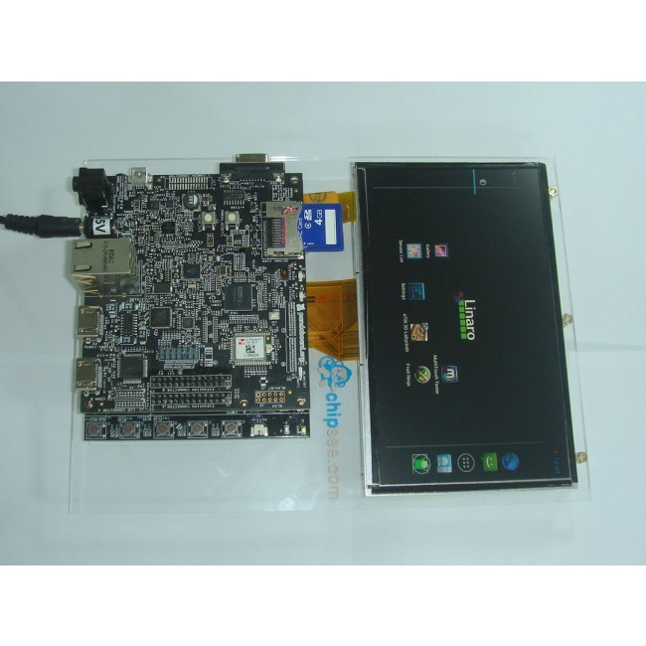
Base Development Platform
Panda Board ES + Chipsee Expansion
7 inch LCD 800 x 400
5-point Capacitive Touch
5 User Keys (useful for Android OS)
Linaro Android OS 4.0.3

Slide 7
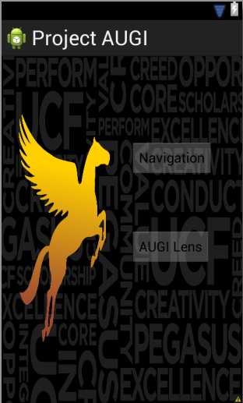
Application
2 Basic parts to the Application:
Navigation Activity
  Basic Google Maps functionality
  Some custom functionality
AUGI Lens Activity
    Augmented Landmark detection
  Augmented Navigation
Notes:
Adam

Slide 8
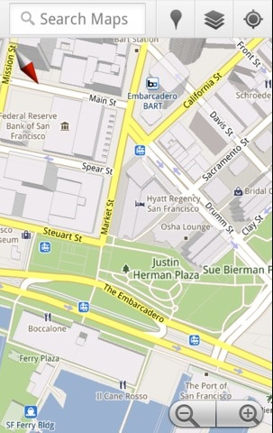
Navigation
Basic Google Maps GPS based functionality:
  Landmark Searching
  Destination Routing
  Zooming and panning
Added functionality:
  Custom landmark creation
  (locally stored)
  Bounded by UCF’s campus limits
Sensor Polling:
GPS (location)
Notes:
Adam
-Search Queries will be performed across both Google’s DB and local custom landmarks

Slide 9
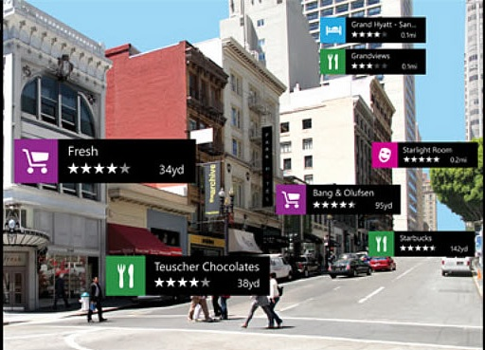
AUGI Lens
Augmented Landmark Layer:
Going to detect, in real time, the landmarks that you are facing using the camera preview.
Ability to detect landmarks through
obstruction and display name
preview.
If a landmark is selected,
Augmented navigation will
initiate.
Sensor Polling:
GPS (location)
Gyroscope (orientation)
Magnetometer (find North)
Notes:
Adam

Slide 10
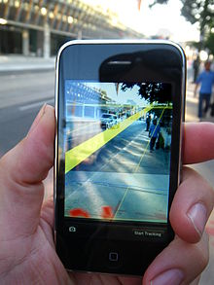
AUGI Navigation
Augmented Navigation Layer:
Initiated within AUGI Lens activity
User will be navigated to selected
landmark via augmented on-screen
route lines.
Sensor polling:
GPS sensor(location)
Magnetometer (find North)
Gyroscope (orientation)
Barometric sensor (altitude)
Notes:
John

Slide 11
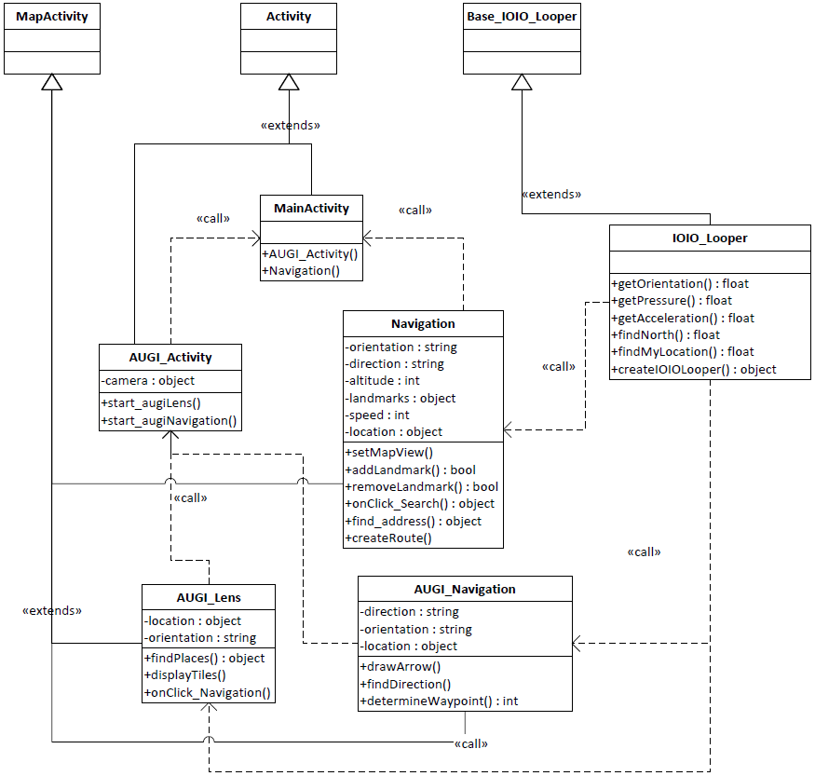
Class Diagram
Notes:
John

Slide 12

Controller Software Interface
Java code Libraries integrate with Eclipse
Plug and Play Android Driver
I2C Communication Protocol
Sensor Loop Class

Slide 13
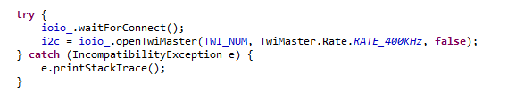
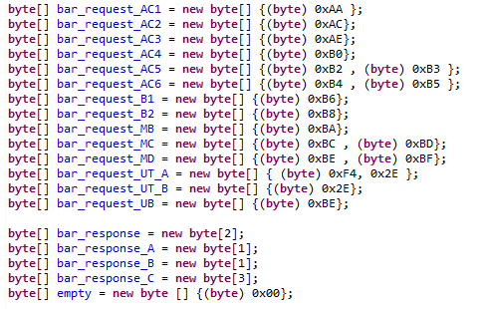
IOIO Software Interface
Establish Connection
Data Packet Format

Slide 14
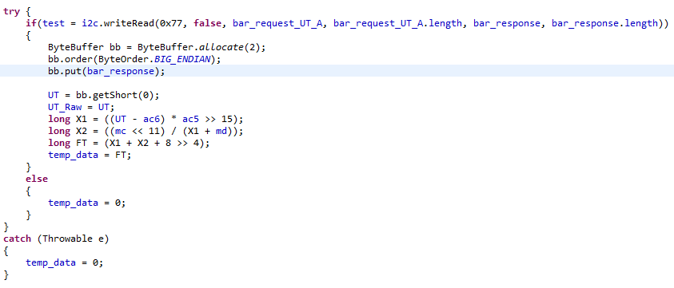
IOIO Software Interface
Send, Receive, Process

Slide 15
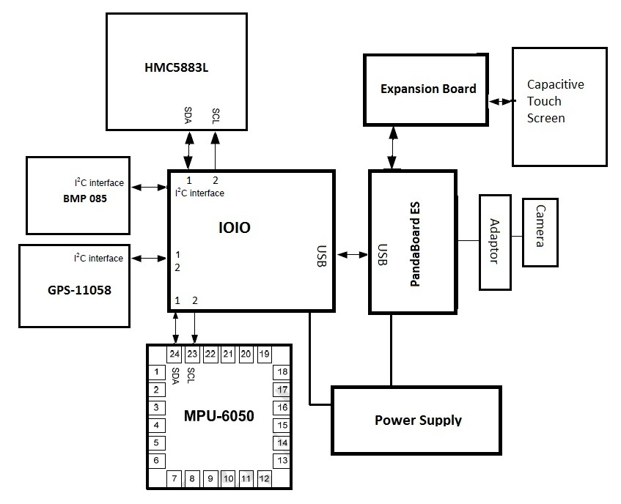
Hardware Diagram
Custom Board

Slide 16
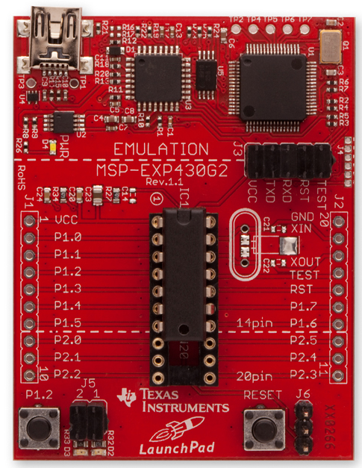
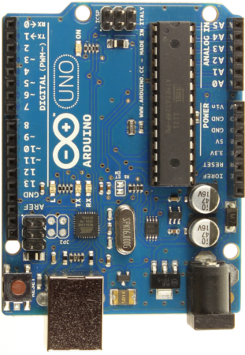
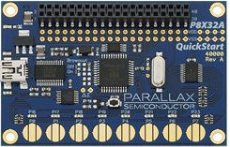
Microcontroller Selection
Parallax Propeller:
Advantages:
EIGHT PROCESSERS(COGS)
MSP430
Advantages:
CHEAP
Arduino:
Advantages:
WELL DOCUMENTED

Slide 17

Winner: IOIO Board (Yo-Yo)
Provides robust connectivity to an Andriod device via a USB/bluetooth connection.
Fully controllable from within an Android application using a simple and intuitive Java API
Talks to the PandaBoard ES via USB Directly!

Slide 18
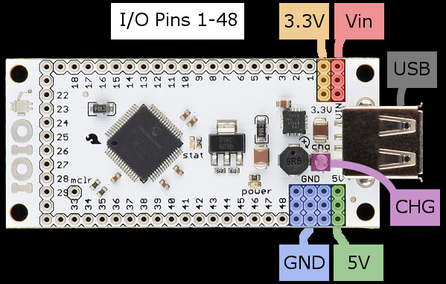
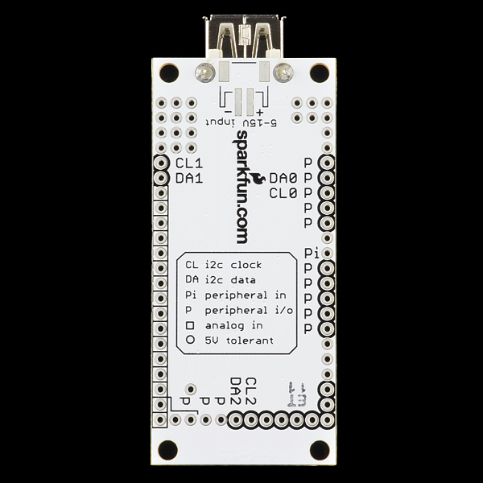
IOIO Pin Out
Based on PIC24 Chipset with 48 pins
Analog input/output
Digital input/output((3.3v or 5v open drain mode)
I2C (3 module), UART, SPI
Supplies 3.3v and 5V

Slide 19
IOIO Connections
UART TX
UART RX
GPS
Magnetometer
I2C data
I2C clock
Barometer
GND
3.3v
Battery
IMU
USB
PandaBoard ES

Slide 20
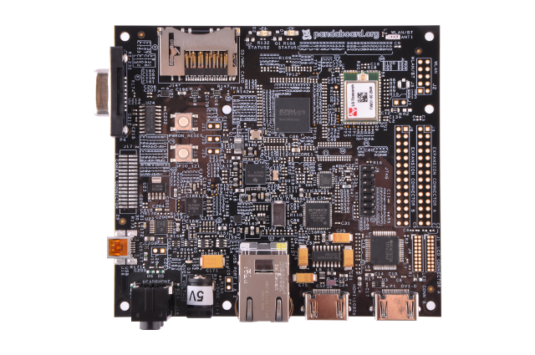
Power Supply Requirements
Pandaboard ES 5v
IOIO Board 5 – 15v

Slide 21
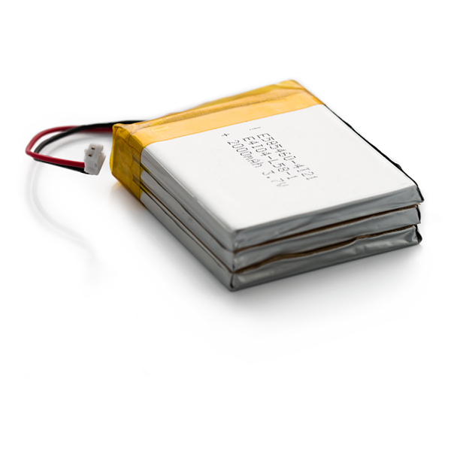
Battery
Polymer Lithium Ion Battery
Output: 3.7v
6000mAh (Long Battery Life)

Slide 22
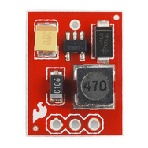
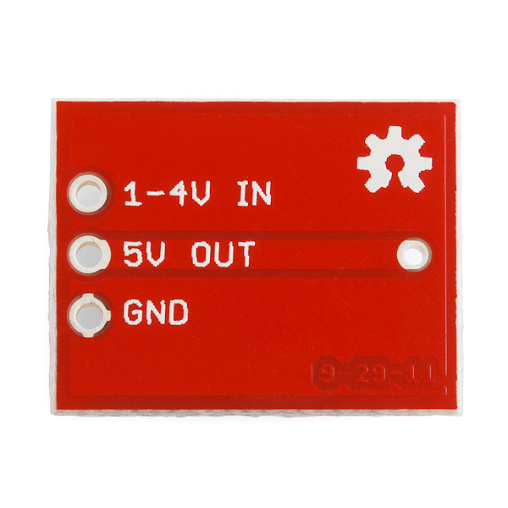
Step Up
Input: 1 – 4 v
Output: 5v or 3.3v
Max Current: 200 mA.

Slide 23
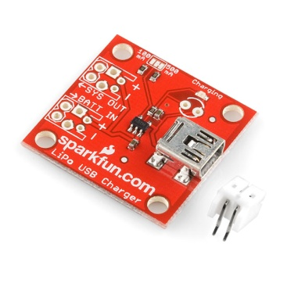

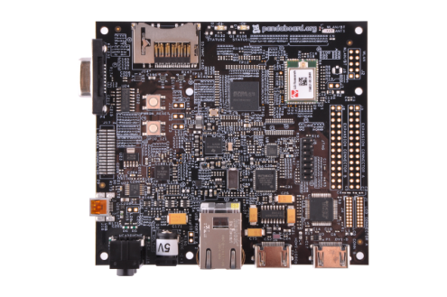
Power Diagram
START HERE
3.7v
3.7v
Step-up 1-4v to 5v
Battery Charger
Polymer Lithium Ion Battery
3.7v, 6000mAh
5v
5v
IOIO Board
PandaBoard ES

Slide 24
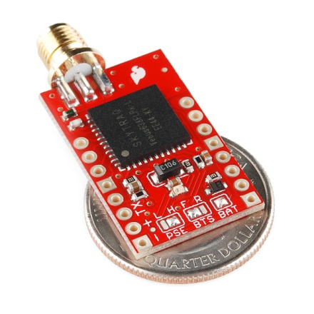
GPS-11058
Features:
Up to 20Hz update rate
-165dBm tracking sensitivity
3.5 second TTFF with AGPS
1 second hot start
2.5m accuracy
Multipath detection and suppression
Jamming detection and mitigation
67mW full power navigation
Works directly with active or passive antenna
Single 2.7-3.3V supply

Slide 25
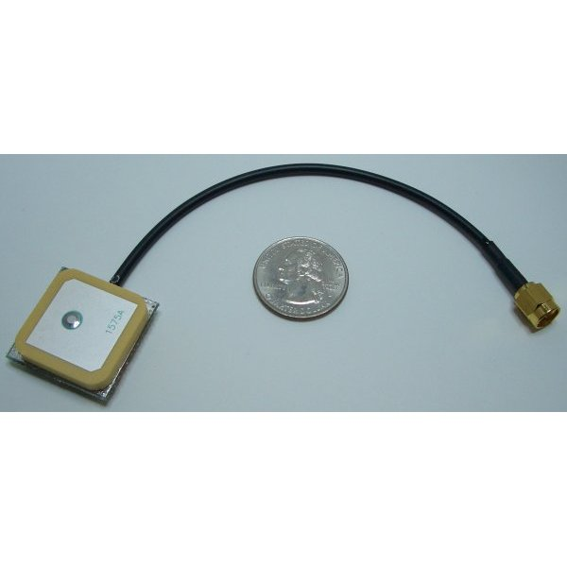
Antenna GPS Embedded SMA
Features:
Gain 26dB
VSWR <2.0
Voltage 3.3V +/- 0.5V
Current 12mA
Weight 18g

Slide 26
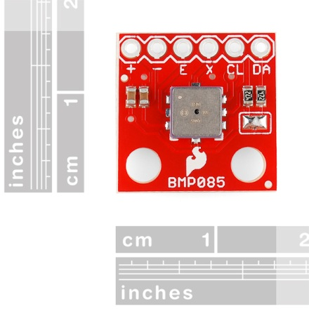
Barometric Pressure Sensor - BMP085
Features:
Digital two wire (I²C, TWI, "Wire") interface
Wide barometric pressure range
Flexible supply voltage range (1.8V to 3.6V)
Ultra-low power consumption
Low noise measurements
Factory-calibrated
Includes temperature sensor
Low-profile with a small footprint

Slide 27
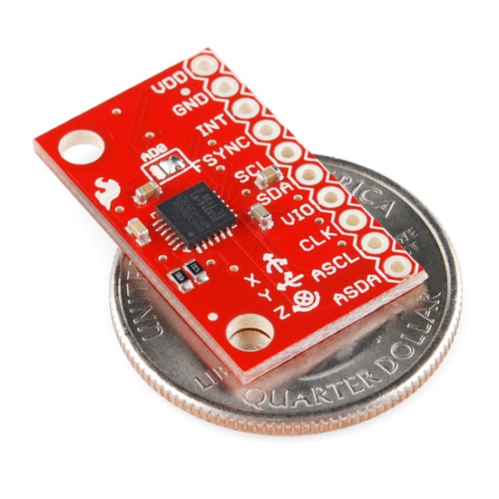
Accelerometer & Gyro
MPU-6050 IMU
Features:
I2C Interface
Input Voltage: 2.3 - 3.4V
Tri-Axis angular rate sensor (gyro) with full scale range ±250dpi to ±2000dpi
Tri-Axis accelerometer with a programmable full scale range of ±2g, ±4g, ±8g and ±16g
Digital Motion Processing™ (DMP™) engine offloads complex MotionFusion, sensor timing synchronization and gesture detection
Embedded algorithms for run-time bias and compass calibration. No user intervention required

Slide 28
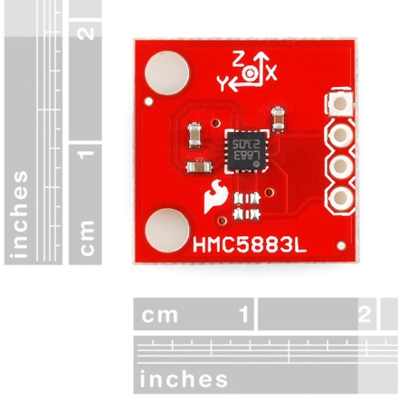
Triple Axis Magnetometer HMC5883L
Features:
Simple I2C interface
2.16-3.6VDC supply range
Low current draw
5 milli-gauss resolution

Slide 29

Project Sponsor and Budget
Item | Cost
Panda Board ES | $162
Panda Expansion Board | $250
5MP Camera + Adapter | $100
IOIO Board | $50
CY8CKIT PSOC | $100
Propeller Chip | $8
Step-Up | $6
GPS + Antenna | $62
Sensors | $80
Battery | $40
Shipping | $54
Total | $912
U.S. Army Simulation and Training Technology Center: DARPA Cell
Total Allotted Budget: $2,000
Expenses to date: $912

Slide 30
Work Allocation and Progress
25%
25%
February 22, 2013
Application Sensor
Writing Software
Group Member | Project Task
Jonathan Pedrosa : BSPE | Primary: Sensor Board Software Interface Secondary: Augi Application Development, Tablet Housing
Adam Ilter : BSPE | Primary: Augi Application Development Secondary: Sensor Board Software
Phillip Lee : BSEE | Primary: Sensor Board Circuit Design and Manufacture Secondary: Sensor Integration with IOIO
Zulkafil Ahamed : BSEE | Primary: Sensor Integration with IOIO Secondary: Sensor Board Circuit Design
50%
33%
Sensor Project
Board Total

Slide 31
Questions?

