Slide 1
Project AUGI
UCF Augmented Navigation System

Slide 2
Motivations
To develop an improved and more open navigation experience.
Make it accessible to a broad audience through Android devices.
To improve upon traditional 2D maps and voice turn-by-turn navigation.
Notes:
*Introduce yourself, Project Name
*Current navigation aids require the user to be able to read a map, match what they see to the map (cross streets, landmarks)
* Better to just provide a virtual line for them to follow to their destination.

Slide 3

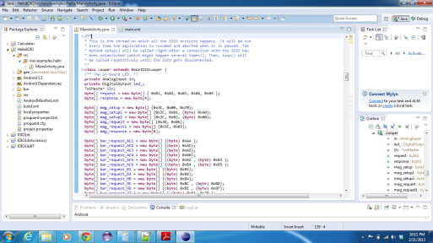
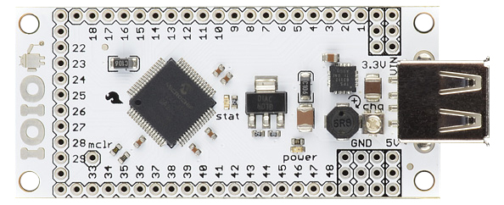
What is Project AUGI?
Android based augmented reality navigation application.
  Includes:
    Android Application
    Hardware/Software Interface
    Expansion Sensor board
Notes:
*Three main focus areas to this project: Software application, Sensor Board, hardware/software communication layers
*

Slide 4

Platform Choices
iOS vs. Android vs. Windows Phone 8
Which platform is the most open and familiar to the team?
  SDK features
  Programming Language familiarity
  Interfacing with Hardware
  Map Features

Slide 5
Base Development Platform
Panda Board ES vs Beagle Board-xM
 | Panda Board ES | Beagle Board-xM
CPU | Dual-Core ARM A9 1.2 Ghz | Single Core ARM Cortex A8 1.0 Ghz
RAM | 1 GB | 512 MB
Video | Imagination SGX540 | Texas Instruments DM3730
Connectivity | WLAN bgn, Bluetooth, 10/100 Ethernet | 10/100 Ethernet
Video out | DVI-D, HDMI | DVI-D
Price | $162 | $149

Slide 6
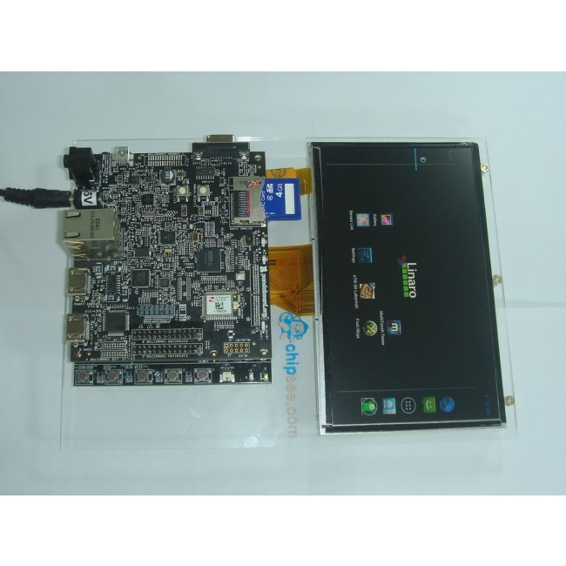
Base Development Platform
Panda Board ES + Chipsee Expansion
7 inch LCD 800 x 400
5-point Capacitive Touch
5 User Keys (useful for Android OS)
Linaro Android OS 4.0.3

Slide 7
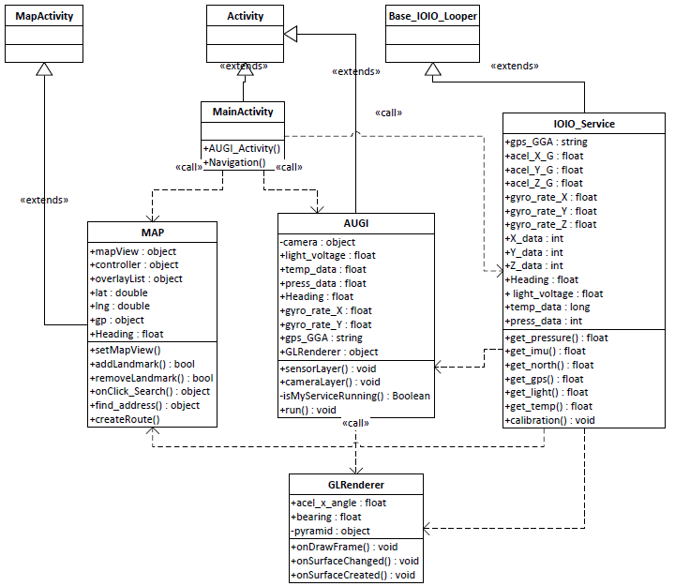
Class Diagram
Notes:
John

Slide 8
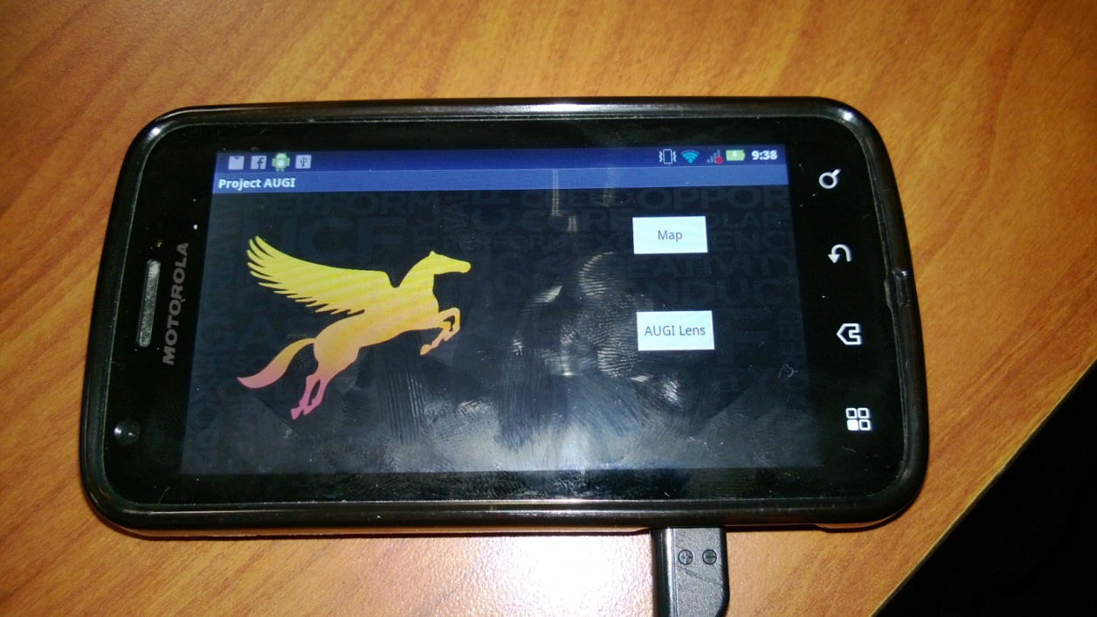
Application
Two Basic parts to the Application:
MAP Activity
  Basic Google Maps functionality
  Some custom functionality
AUGI Activity
  Augmented Navigation
Notes:
Adam

Slide 9
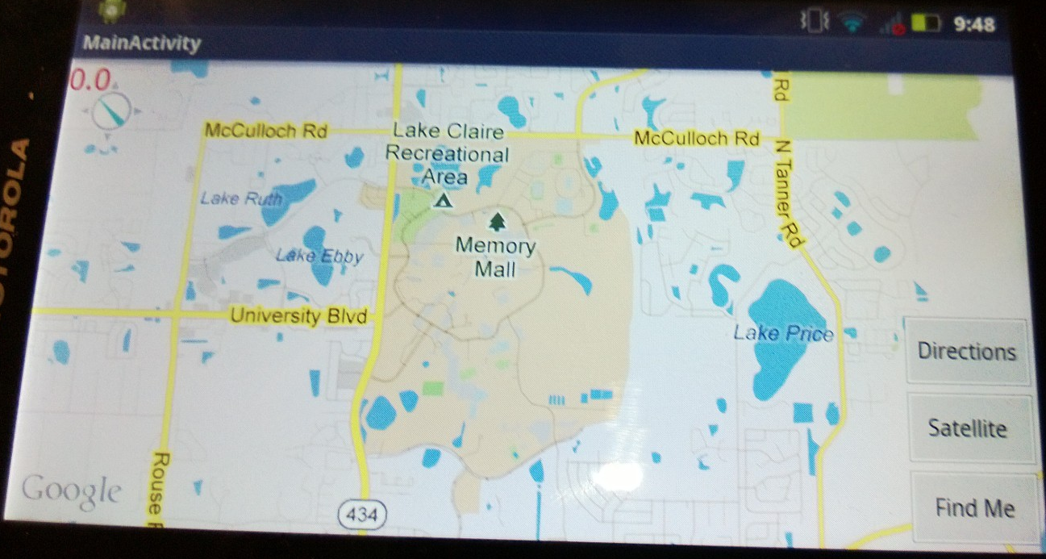
MAP
Basic Google Maps GPS based functionality:
  Landmark Selection (Spinner)
  Zooming and panning
  Destination Routing (Google Maps)
Added functionality:
  Custom landmark creation (locally stored)
Sensor Polling:
GPS (location)
Notes:
Adam
-Search Queries will be performed across both Google’s DB and local custom landmarks

Slide 10
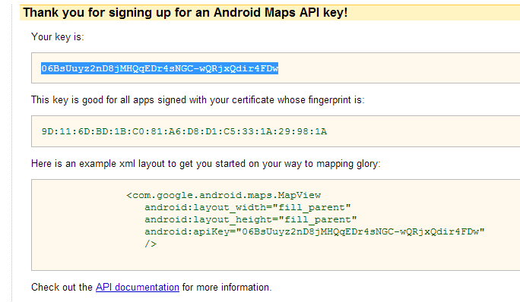
MAP Challenges
Implementing MapView:
  MD5 Keys Creation and Registration
  GUI Overlay and Layering
  Route Plotting (Google Maps)
    Waypoint Retrieval
    Communicating with Google servers (JSON)
Notes:
Adam
-Search Queries will be performed across both Google’s DB and local custom landmarks

Slide 11
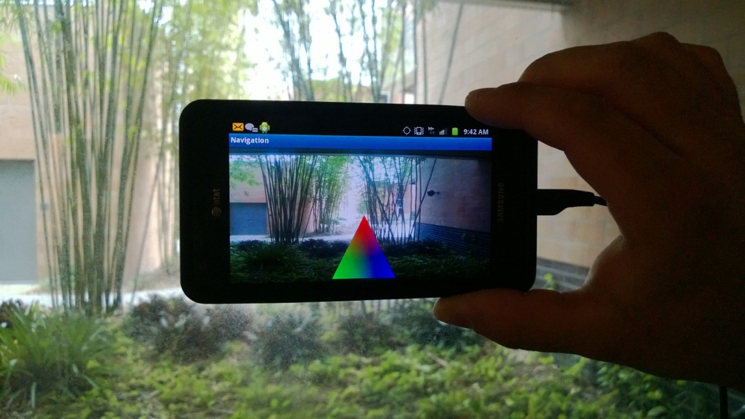
AUGI
Augmented Navigation Layer (GLRenderer):
Initiated within AUGI Activity
User will be navigated to selected
landmark via augmented on-screen visual guide
Sensor polling:
GPS sensor(location)
Magnetometer (find North)
Gyroscope (orientation)
Barometric sensor (altitude)
Notes:
John

Slide 12
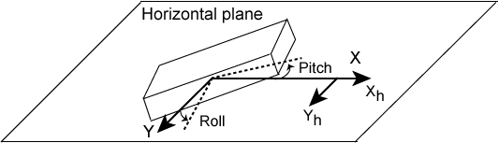
AUGI Challenges
Augmented Navigation Layer (GLRenderer):
Interface Overlay and Layering
OpenGL Graphics
Calculating Heading and Bearing to Waypoint
  Tilt Compensated Compass
Notes:
John

Slide 13

Controller Software Interface
Java code Libraries integrate with Eclipse
Plug and Play Android Driver
I2C Communication Protocol
Sensor Loop Class

Slide 14
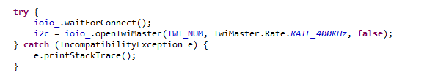
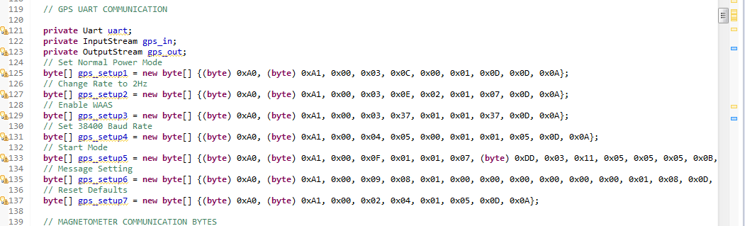
IOIO Software Interface
Establish Connection
Data Packet Format

Slide 15
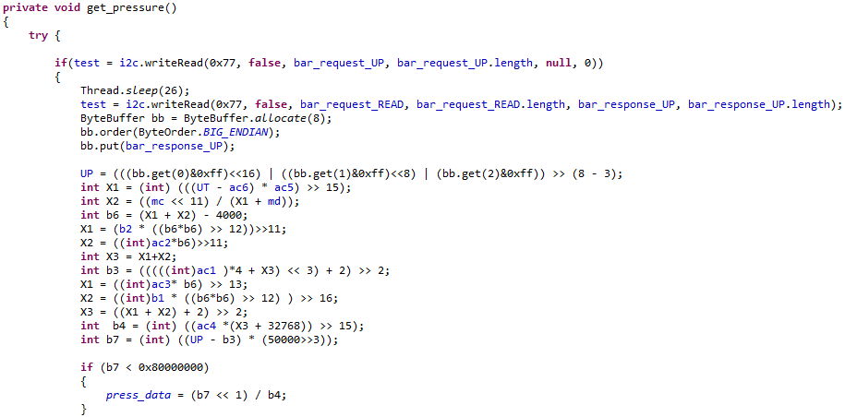
IOIO Software Interface
Send, Receive, Process

Slide 16
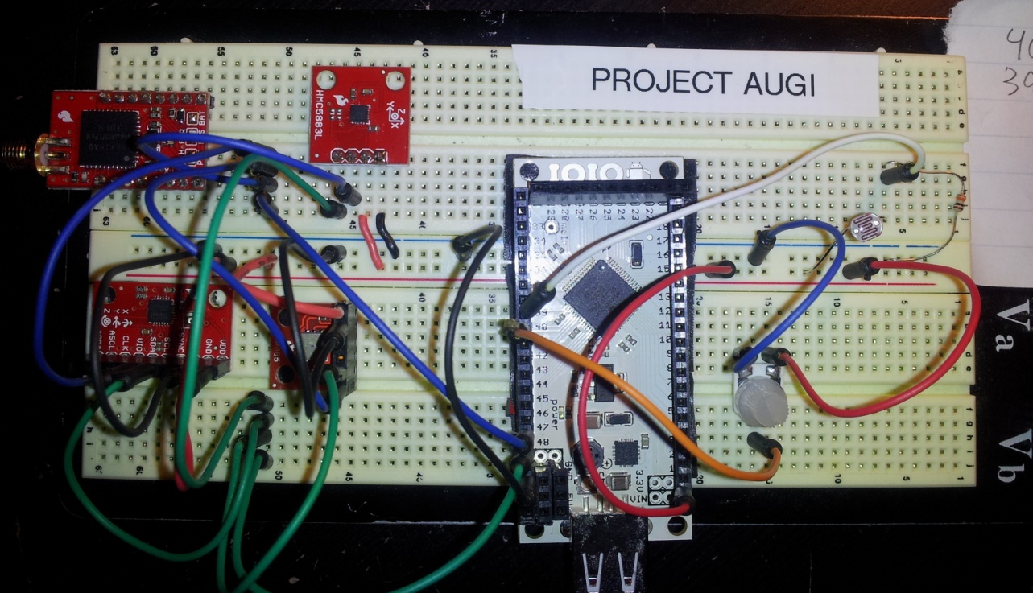
IOIO Software Challenges
Send, Receive, Process
Studying Sensor Data Sheet
IOIO Microcontroller Code integration
Post Processing Calculations
Creating a running Android Service

Slide 17
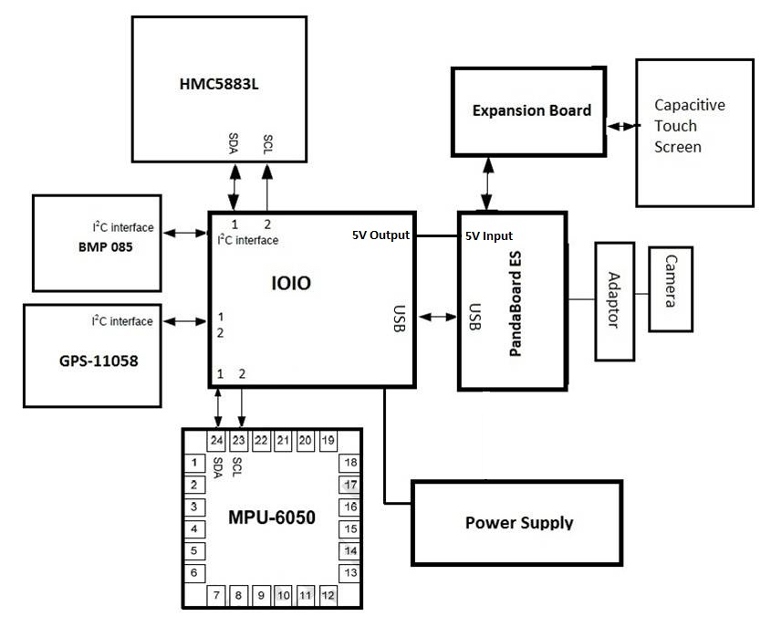
Hardware Diagram
Custom Board

Slide 18
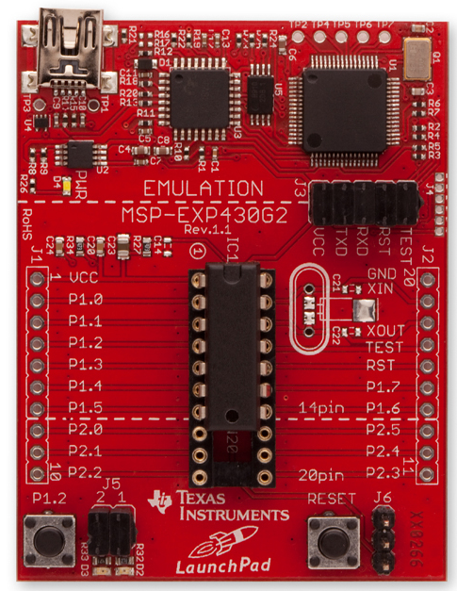
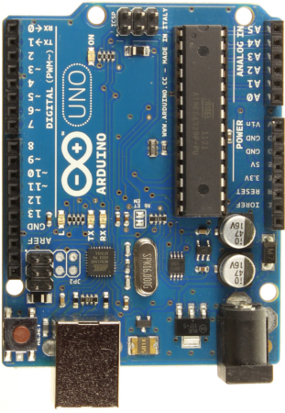
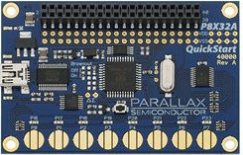
Microcontroller Selection
Parallax Propeller:
Advantages:
EIGHT PROCESSERS(COGS)
MSP430
Advantages:
CHEAP
Arduino:
Advantages:
WELL DOCUMENTED

Slide 19

Winner: IOIO Board (Yo-Yo)
Provides robust connectivity to an Andriod device via a USB/bluetooth connection.
Fully controllable from within an Android application using a simple and intuitive Java API
Talks to the PandaBoard ES via USB Directly!

Slide 20
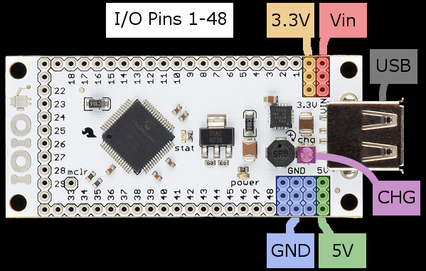
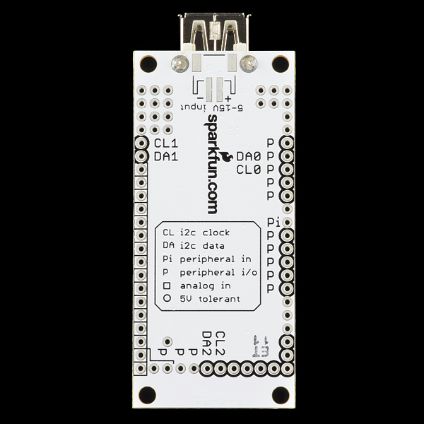
IOIO Pin Out
Based on PIC24 Chipset with 48 pins
Analog input/output
Digital input/output((3.3v or 5v open drain mode)
I2C (3 module), UART, SPI
Supplies 3.3v and 5V

Slide 21
IOIO Connections
UART TX
UART RX
GPS
Magnetometer
I2C data
I2C clock
3.3 V
Barometer
GND
7.4 V
Battery
IMU
USB
PandaBoard ES

Slide 22
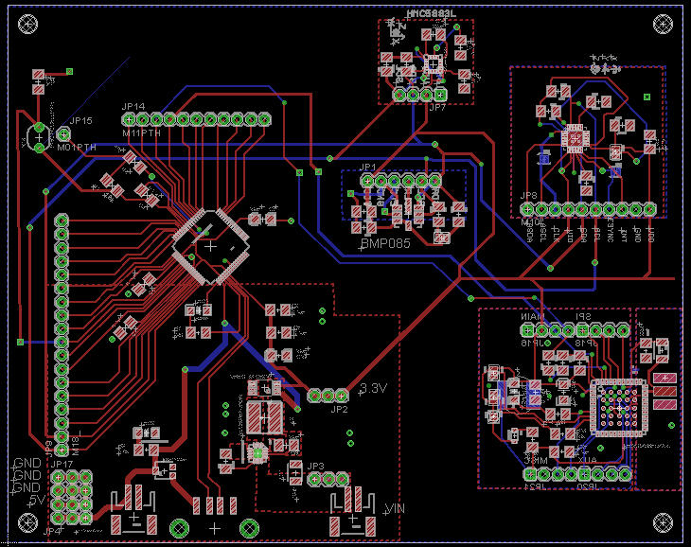
EAGLE CAD
Photo Resistor
Compass
IMU
PIC24
PWR REG
GPS

Slide 23
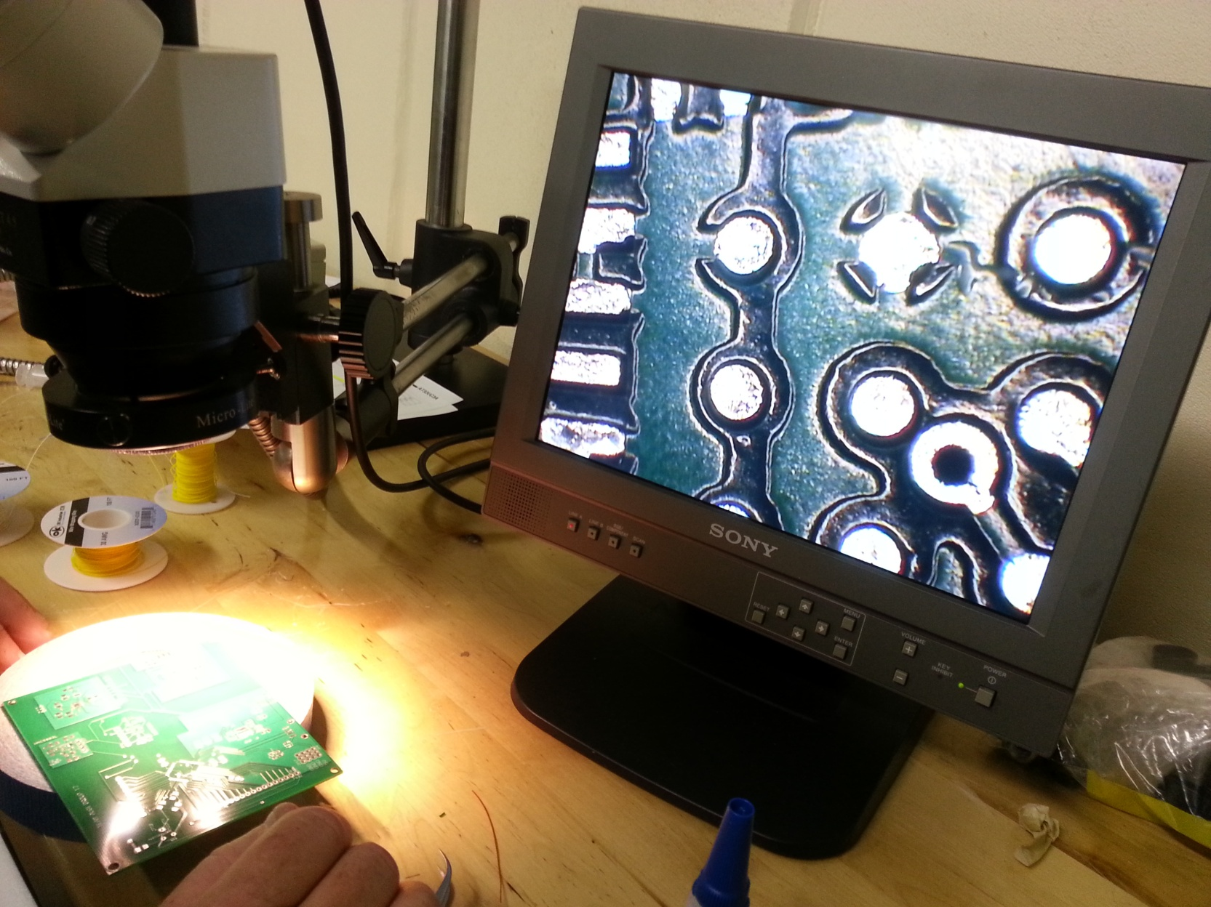
Board Debugging Challenges

Slide 24
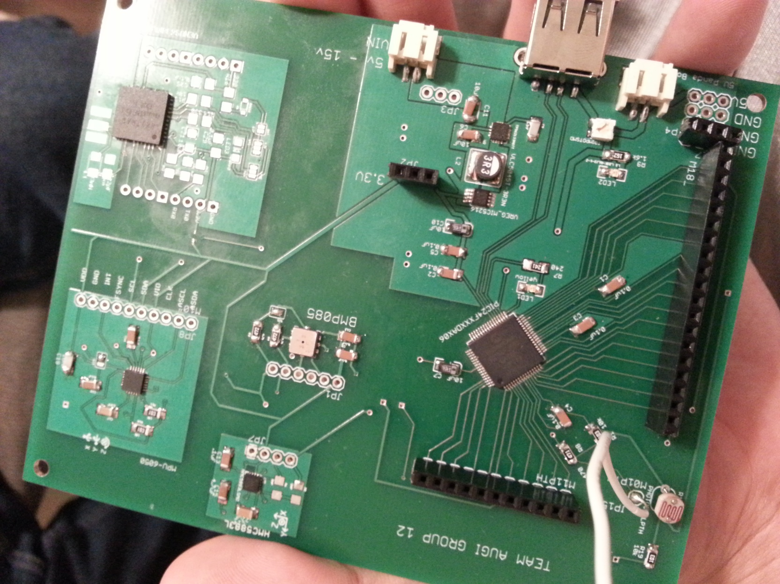
Final Board

Slide 25
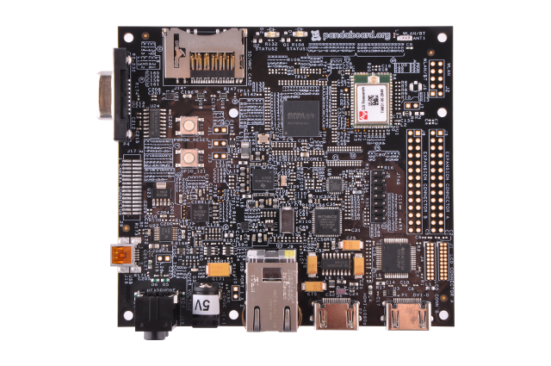
Power Supply Requirements
Pandaboard ES 5v
IOIO Board 5 – 15v

Slide 26
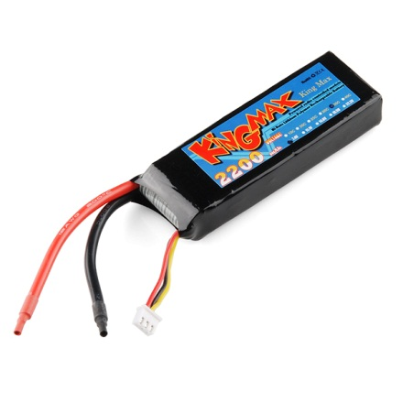
Battery
Features:
7.4V 2-cell pack
2200mAh of charge
30C continuous discharge rate
JST-XH charge plug

Slide 27
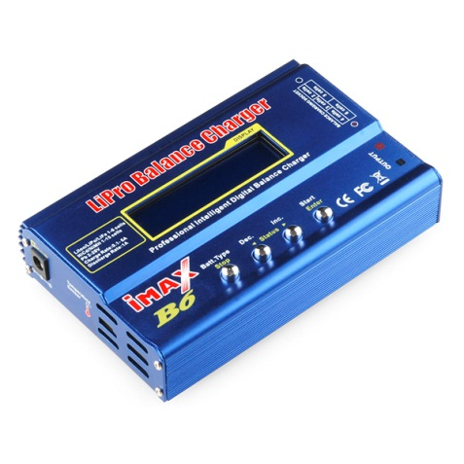


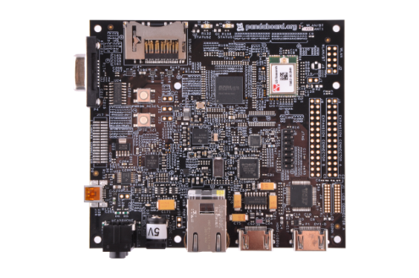
Power Diagram
START HERE
7.4 v
7.4 v
Polymer Lithium Ion Battery
7.4 v, 22000mAh
Battery Charger
5v
5v
PandaBoard ES
IOIO Board

Slide 28
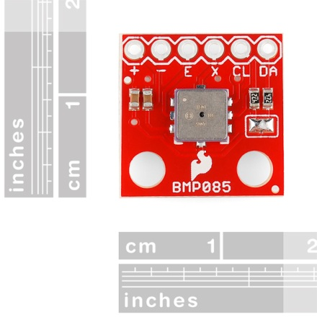
Barometric Pressure Sensor - BMP085
Features:
Two wire I²C interface
Wide barometric pressure range
Includes temperature sensor
Flexible supply voltage range (1.8V to 3.6V)
Ultra-low power consumption
Factory-calibrated

Slide 29
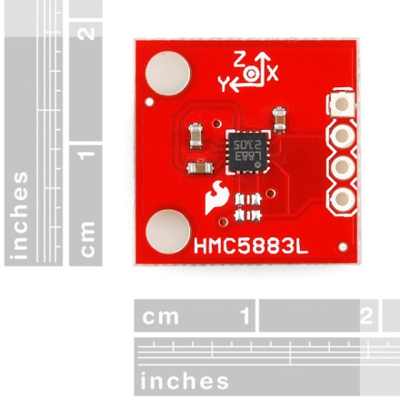
Triple Axis Magnetometer HMC5883L
Features:
Simple I2C interface
2.16-3.6VDC supply range
Low current draw
5 milli-gauss resolution

Slide 30
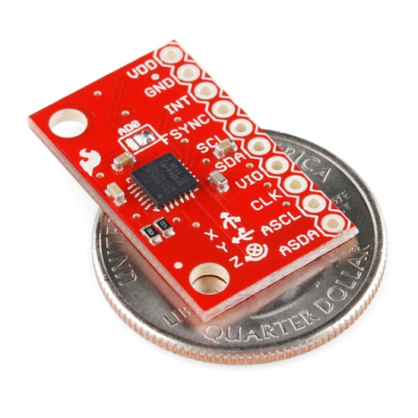
Accelerometer & Gyro
MPU-6050 IMU
Features:
I2C Interface
Input Voltage: 2.3 - 3.4V
Tri-Axis angular rate sensor (gyro) with full scale range ±250dpi to ±2000dpi
Tri-Axis accelerometer with a programmable full scale range of ±2g, ±4g, ±8g and ±16g
Embedded algorithms for run-time bias and compass calibration. No user intervention required

Slide 31
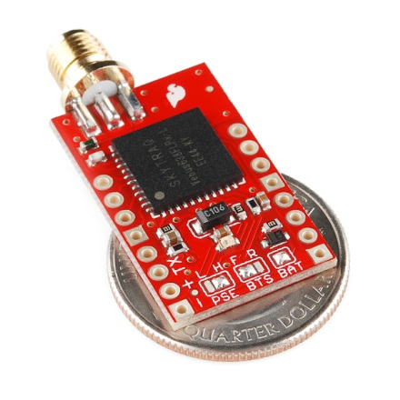
GPS-11058
Features:
Up to 20Hz update rate
-165dBm tracking sensitivity
3.5 second TTFF with AGPS
2.5m accuracy
Multipath detection and suppression
Jamming detection and mitigation
Works directly with active or passive antenna
Single 2.7-3.3V supply

Slide 32
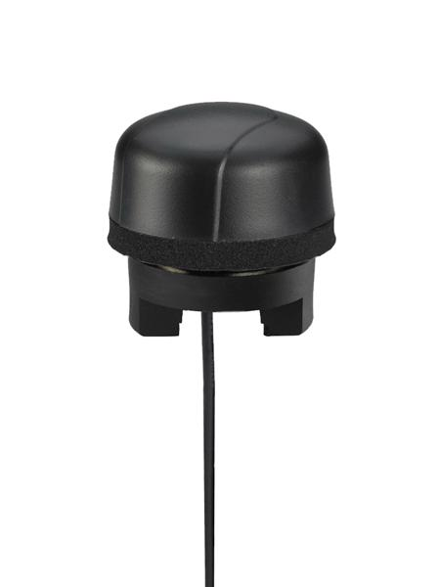
Antenna GPS Embedded SMA
Features:
Active Antenna
Gain 30dB
VSWR MAX 2.0
Voltage 1.8V - 5.5V
Current 12mA
Weight 18g

Slide 33
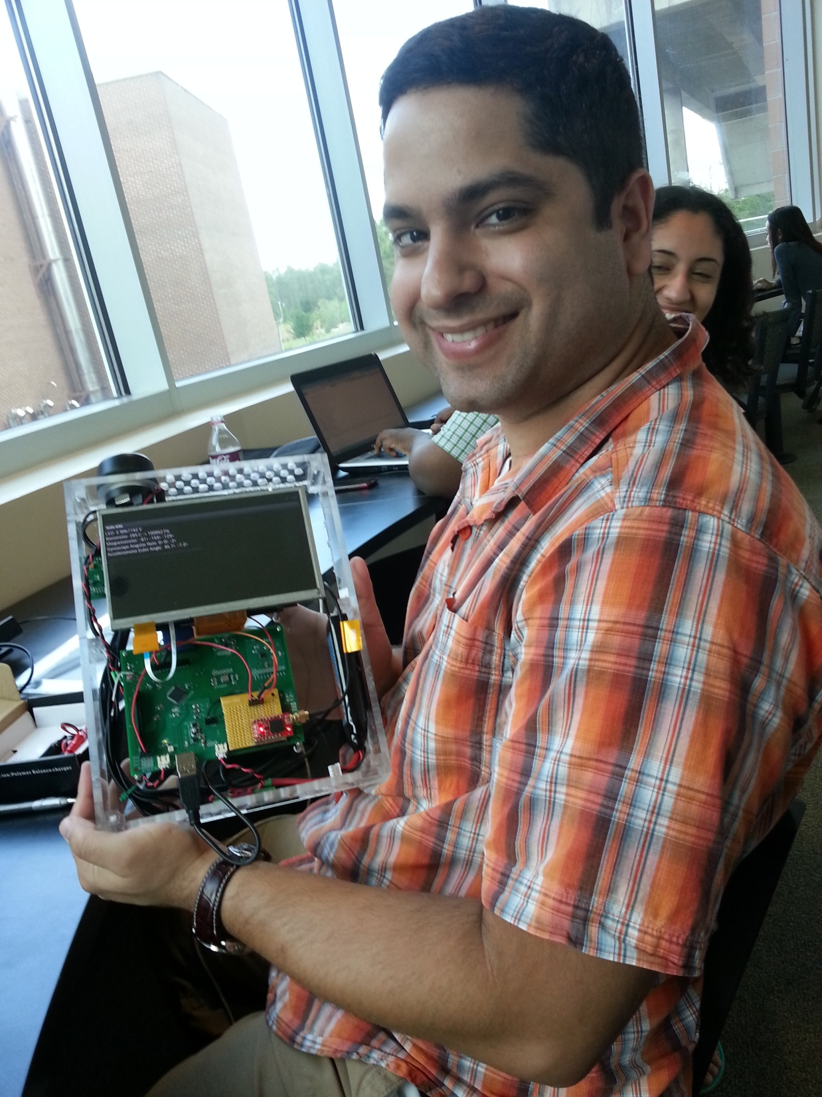
Tablet Housing
Features:
PlexiGlass Construction (¼ in.)
Holds all circuit boards and power units
Ventilation Holes
Android Control Buttons

Slide 34

Project Sponsor and Budget
Item | Cost
Panda Board ES | $162
Panda Expansion Board | $250
5MP Camera + Adapter | $120
Micro Controllers | $354
GPS + Antenna | $50
Sensors | $120
Board Construc | $457
Battery | $70
Shipping | $200
Total | $1,783
U.S. Army Simulation and Training Technology Center: DARPA Cell
Total Allotted Budget: $2,000
Expenses to date: $1,783

Slide 35
Work Allocation
Group Member | Project Task
Jonathan Pedrosa : BSPE | Primary: Sensor Board Software Interface Secondary: Augi Application Development, Tablet Housing
Adam Ilter : BSPE | Primary: Augi Application Development Secondary: Sensor Board Software
Phillip Lee : BSEE | Primary: Sensor Board Circuit Design and Manufacture Secondary: Sensor Integration with IOIO
Zulkafil Ahamed : BSEE | Primary: Sensor Integration with IOIO Secondary: Sensor Board Circuit Design

Slide 36
Questions?

