Slide 1



The A.U.M. Device (pronounced “Ohm”)
By
B. Löwen Gruseck (EE)
Gardy Lacombe (EE)
Michael Sriprashad (EE)

Slide 2
Motivation
To save energy
Energy sustainability
Reduce Phantom Power
Unwanted Carbon dioxide emissions
Saving money

Slide 3
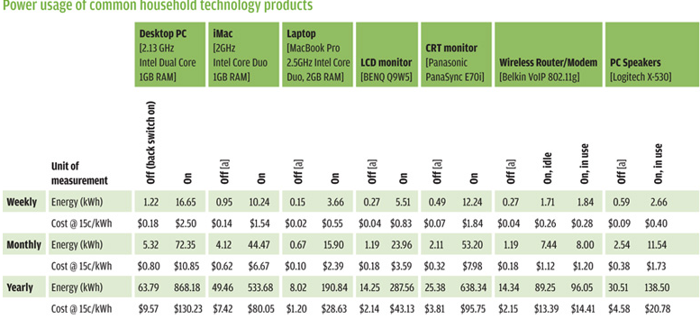
Common Appl. Power Use

Slide 4
Goals and objectives
Eliminate standby power
Overall device to be energy efficient
Different modes of operations
User controlled onboard
User controlled wirelessly
Accurately calculate power usage

Slide 5
Specifications
3 outlets
120V(RMS) AC 60Hz power input and output
Measures 5 to 8A, 120V
75% savings on stand by power
5V DC power for internal devices
Calculate power with at most +/- 5% error
At least10 bit wide ADC for power calculations
2 user interface inputs
100m wireless control

Slide 6
Block Diagram
Motion Sensor
Screen
Wireless
Communication
Power Supply
Microcontroller
Wall (120V AC)
Current Sensor
Relay
Appliance Device

Slide 7
MicroController Duties
Needs to be low power (under 3 Watts)
Easy user interfacing
Readily control exterior devices
Compatibility with touch screen
Compatibility with Wireless App
Analog to Digital Conversion
Power calculation
Readily programmable with multiple resources

Slide 8
Comparing microcontrollers
MCU | MSP430F551x | Atmega328 | Atmega324p
Clock speed | 0-25MHz | 0-20MHz | 0-20MHz
Touch Support | N/A | Q-Touch Library | Q-Touch Library
Pin number | 80-100 | 32 | 40
Programming support | TI E2E community | Spaces, avrfreaks | Spaces, avrfreaks
Programming Language | Assembly, C, C++ | Assembly, C, C++ | Assembly, C, C++
Low power Active Mode (8MHz) | 6.96mW | 2.88mW | 5.76mW
UART | 3 | 1 | 2

Slide 9
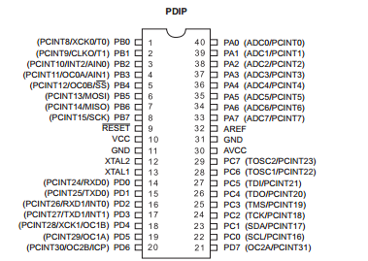
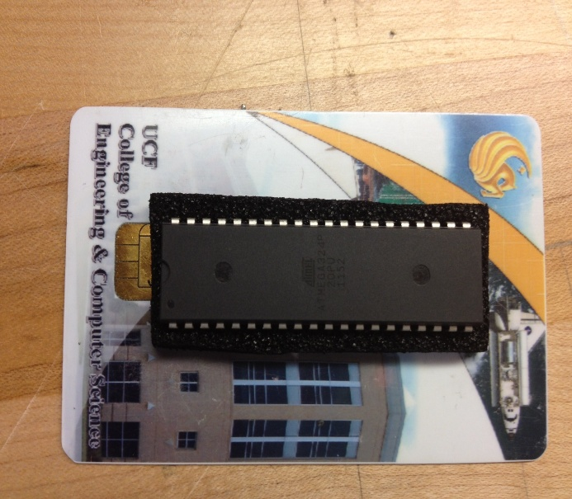
AtMegega324p
Pin Layout

Slide 10
Block Diagram
Touch Screen
Atmega324p

Slide 11
Touch Screen
Needs to be low power
Display on coming info from the microcontroller as well sending commands to it.
Big enough for buttons and features
Compatibility with microcontroller

Slide 12
Comparing screens
Screens | uLcd-32wptu | MK-CY-043 | DT028ATFT-TS
Manufacturer | 4D systems | Amulet Technologies | Displaytech
Type | Resistive | Capacitive | Resistive
Diagonal | 3.5 in | 4.3 in | 2.8 in
Interface | Serial, 12C, UART | RS-232, UART, USB | Parallell, RGB
Module size | 95.4 mm x 49.6 mm x 15.9 mm | 78.4 mm x 111 mm x 17 mm | 50 mm x 69.2 mm x 2.85 mm
Operating current | 20 mA | 22 mA | 18.5 mA
Supply voltage | 4 – 5.5 V | 5 V | 2.8 V
Price | $89.00 | $338.00 | $30.00

Slide 13
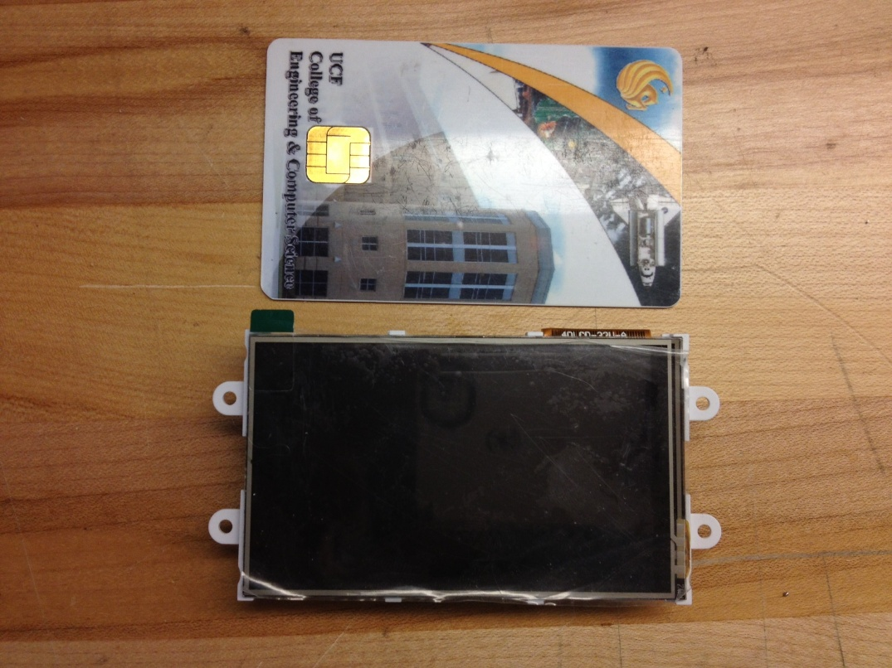

Slide 14
Block Diagram
uLcd-32wptu
Wireless
Communication
Atmega324p

Slide 15
Wireless Communication
Simple User Interface
Smartphone compatible
Bluetooth or Wifi
Readily programmable
UART communication with MCU

Slide 16
Bluetooth
Feature | Bluetooth Mate Gold | BlueSMiRF RP-SMA
Class | 1 | 1
UART connection | Yes | Yes
FCC certified | Yes | No
Power consumption | 25mA | 25mA
Operating Voltage | 3.3-6V | 3.3-6V
Operating Temperature | -40 to 70˚C | -40 to 70˚C
Antenna | Built-in | Compatible
Hopping Scheme | Hardy | Hardy
Serial communications | 2400-115200bps | 2400-115200bps
Connection Encrypted | Yes | No
Serial Connection | 6-pin Arduino layout | 6-pin FTDI layout

Slide 17
Block Diagram
Motion Sensor
uLcd-32wptu
Bluetooth
Atmega324p

Slide 18
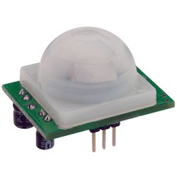
Motion sensor
Must detect up to 20 feet
Must be able to detect if people are present in the room
Be able to set length of time for system shut down
For this design we chose PIR sensor
Parralax 555-28027
Pir sensor Rev B
Up to 30 feet range in high sensitivity mode
Dimensions 1.41 x 1.0 x 0.8 in

Slide 19
Block Diagram
PIR
uLcd-32wptu
Bluetooth
Atmega324p
Wall (120V AC)
Relay
Appliance Device

Slide 20
Relay - Solid State vs Electromechanical
Long life and reliability
High switching frequency
No contact arcing and bounce
No electrical mechanical noise
Low input current
High switching speed

Slide 21
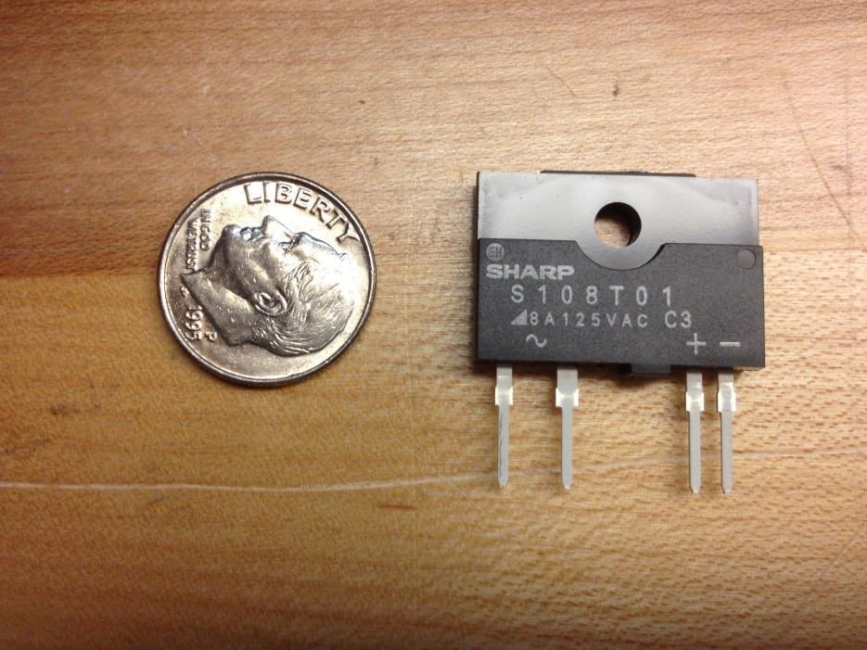
Relay-Sharp S116S01
Always off state
On State Voltage 1.5V
RMS On-Current 16A
Isolation Voltage 4kV
Turn on time 1ms
Turn off time 1ms

Slide 22
Block Diagram
Motion Sensor
uLcd-32wptu
Wireless
Communication
Microcontroller
Wall (120V AC)
Current Sensor
S116S01
Appliance Device

Slide 23
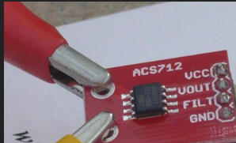
Current Sensor – acs712
Hall Effect Based
Closed Loop
Supply Voltage 5V
Maximum Current 5A
Output is a proportional voltage with a sensitivity of 185 mV/A

Slide 24
Block Diagram
Motion Sensor
uLcd-32wptu
Wireless
Communication
Power Supply
Microcontroller
Wall (120V AC)
Acs712
S116S01
Appliance Device

Slide 25
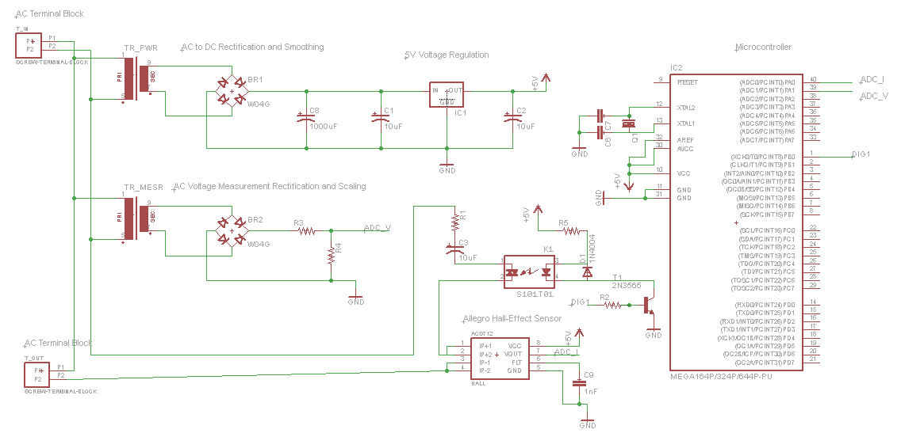
Circuit Design
Main Power Circuit

Slide 26
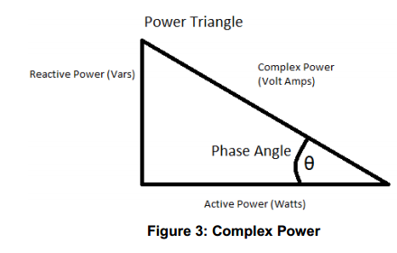
calculating power
Goal is to calculate real power
Real power is 𝑃 = 𝑉(𝑅𝑀𝑆) ∗ 𝐼(𝑅𝑀𝑆) ∗ 𝑐𝑜𝑠(𝜃).
The current sensor will report the current to the microcontroller
Incoming voltage transformer and voltage divider

Slide 27
Circuit Design
Voltage Divider Circuit

Slide 28
Modes of operation

Slide 29
Software Design
Power Calculations
Standby mode
Master-slave Mode
Motion Sensor Mode
Timer Mode
User Interface

Slide 30
Stand by Mode
Automatically turns outlets on or off depending on whether the appliance is in standby mode or not.
Takes a sample with outlet on and reiterates 8192 times, incrementing counter
Logical shifts left, 13 places, effectively dividing by 8192 (2^13)
If there was no change in average from last run, check if new current is less than or equal to .75 the current avg. (False if first run)
Check if new avg. is greater or equal to 1.25 times the current avg. (True if first run)
Set current avg. to new avg., and set change counter to true(01)
Set new avg. to zero and reiterate to find next new avg.
Since change is true, check if new average is greater or equal to 1.25 the current avg. If it is, the outlet is in use, and the new avg. is set as current avg. and the change counter is set back to false. If its not, the outlet is not in use and the outlet is turned off.
The new avg. is reset, and the sampling reiterates again.

Slide 31
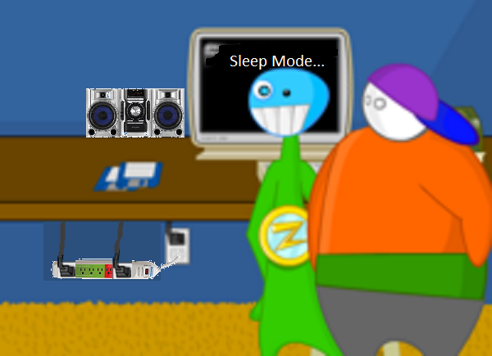

Stand By mode

Slide 32
Standby Mode Flowchart
Current_avg=0;
Current_new=0;
Change=0;
i=0;
Outlet_on();
Current_new+=current_current();
i++;
Yes
Outlet_off();
i<8192?
Current_new=0;
Change=0?
No
No
Yes
No
Current_avg= Current_new;
Change=0;
Yes
Current_new=Current_new>>13;
i=0;
(LShiftLeft=current_new/8192)
Current_new>= 1.25*Current_avg?
Outlet_off();
Current_avg=Current_new;
Change=1;
No
Current_new<= .75*current_avg?
Yes

Slide 33
Leader-Follower mode
One Outlet set as the Leader
All other outlets follow its lead
If Leader is off, Followers are off
If the Leader turns on, Follower turns on
Same applies for Motion Sensing and Stand by modes

Slide 34
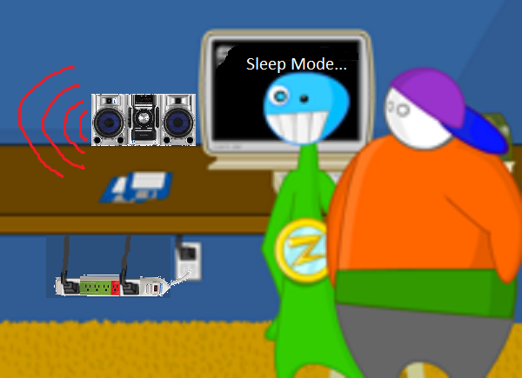
Leader-follower mode

Slide 35
Motion Sensor Mode

Slide 36

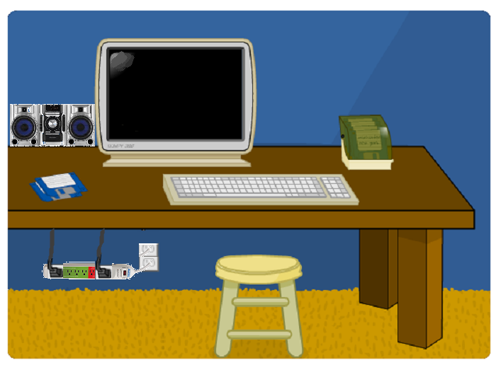
Motion sensing Mode

Slide 37
User Interface

Slide 38
Touch Screen Menu
Home Menu
Home Screen menu
Modes
Time/date
Toggle Switches
December 5, 2012
3:34 P.M
Leader/Follower
Motion Sensing
On/Off
Estimating power and cost used

Slide 39
Touch Screen Menu
Leader/Follower Mode
Set devices to be either
to leader, follower or off.
Leader/Follower Mode
Outlet 1
Outlet 2
Outlet 3
Leader
Leader
Leader
Follower
Follower
Follower
Off
Off
Off

Slide 40
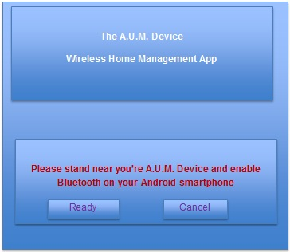
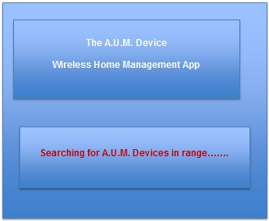
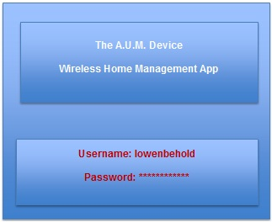
Bluetooth Menu

Slide 41
Work Distribution
Tasks | Group member
Power | Gardy Lacombe
LCD | Michael Sriprashad
Bluetooth | Benjamin Gruseck
Microcontroller | Benjamin Gruseck
Motion sensor | Michael Sriprashad
Current sensor | Gardy Lacombe
Relay | Gardy Lacombe

Slide 42
Budget
Item | Quantity | Cost(in dollars)
Atmega324p | 3 | $21.48
CSLT Honeywell open loop current sensor | 5 | $25.56
Sharp S116S01 solid state relay | 5 | $27.75
VSK-S1 Power Supply | 2 | $34.90
Printed Circuit Board | 3 | $75.00
uLCD32pt resistive touch screen | 1 | $90
Parallax motion sensor | 2 | $24.12
Watt meter | 1 | $26.90
EagleCad Software | 1 | $50
Bluetooth mate gold | 1 | $66.95
PCB components | 1 | $50
Misc. components | 1 | $100
Total |  | $592.66

Slide 43

Overall project progress

Slide 44
DIFFICULTIES(PROBLEMS)
Soft power-down

Slide 45
Questions?

