Slide 1
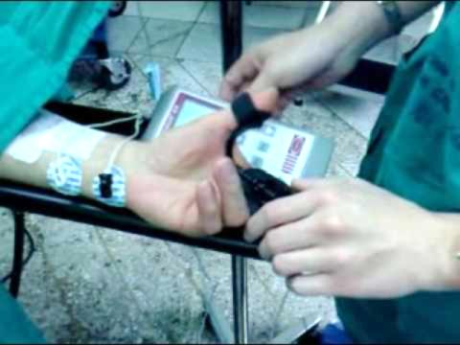
Paralytic Twitch Sensor
Group 14
Kelly Boone
Ryan Cannon
Sergey Cheban
Kristine Rudzik
Sponsored by: Dr. Thomas Looke and Dr. Zhihua Qu

Slide 2
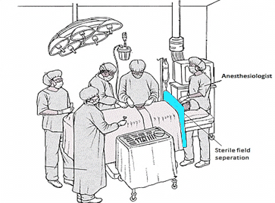
Motivation
Techniques for evaluating levels of muscle response today are not reliable.
Anesthesiologist as the sensor: by touch or by sight
Other methods require patients arms to be restrained
Problems: if restrained wrong it could lead to nerve damage in the patient or false readings
Seeing first hand when we shadowed
Dr. Looke individually
Trying to find a way to not let the
blue shield that separates the sterile
field create an inconvenient way to
measure the twitches.

Slide 3
Medical Background
Anesthesia
Nobody is really sure how it works; all that is known about these anesthetics:
Shuts off the brain from external stimuli
Brain does not store memories, register pain impulses from other areas of the body, or control involuntary reflexes
Nerve impulses are not generated
The results from the neuromuscular blocking agents (NMBAs) are unique to each individual patient. Therefore there is a need for constant monitoring while under anesthesia.

Slide 4
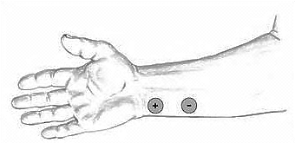
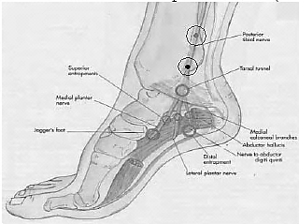
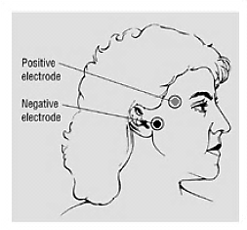
Medical Background
Different types of measuring:
The thumb (ulnar nerve)
Most popular site for measuring
The toes (posterior tibial nerve)
If ulnar nerve isn’t available this is
an accurate alternative
Difficult to reach
The eye (facial nerve)
Not an accurate way to measure
Results in an eyelid twitch

Slide 5
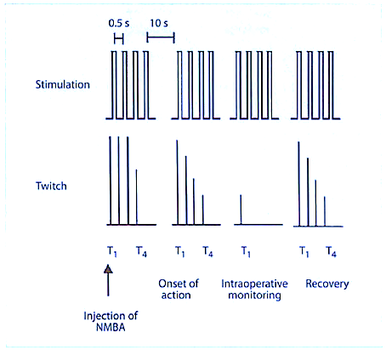
Medical Background
Pattern of electrical stimulation and evoked muscle response before and after injection of neuromuscular blocking agents (NMBA).
Train-of-Four (TOF) Twitch

Slide 6
Goals
Sensor that is relatively accurate
An interactive LCD touchscreen
Minimal delay between the sensed twitch and the read out
Train of four (ToF), single twitch and tetanic stimulation patterns
Safe to use in the operating room
Any part that touches the patient needs to either be easily cleaned or inexpensive enough to be disposed of after each use

Slide 7
Specifications
A maximum current of at least 30mA
Maximum charge time of 0.5 seconds in order to have a reliable train of four
Minimum sampling frequency of 100Hz
Consistent sensor readout accuracy of ±25%

Slide 8
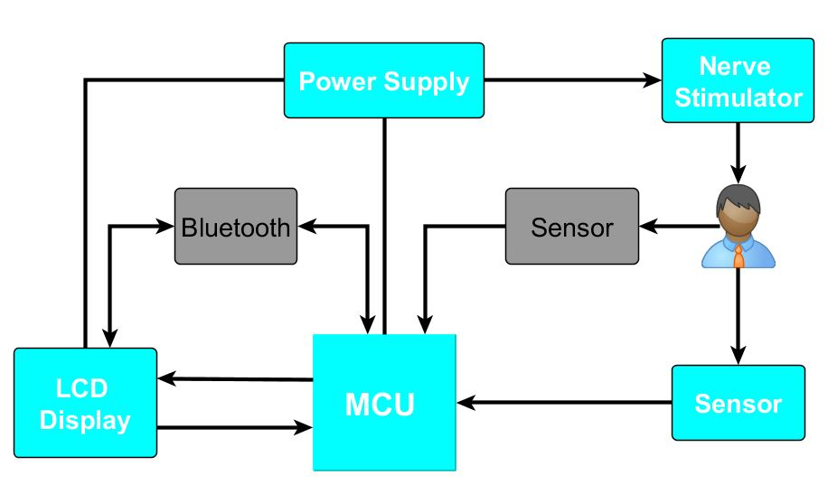
High Level Block Diagram

Slide 9
Nerve Stimulator

Slide 10
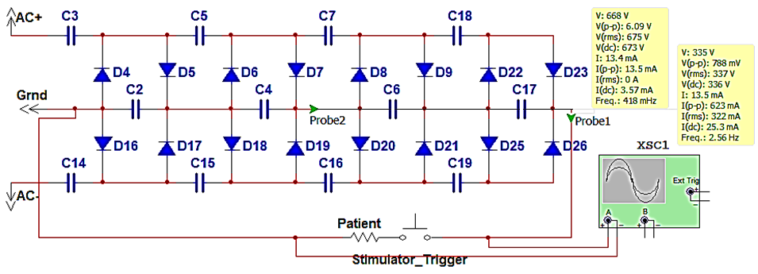
Voltage Multiplier
Built using a full wave Cockcroft–Walton generator
Every pair of capacitors doubles the previous stages’ voltage
Vout = 2 x Vin(as RMS) x 1.414 x (# of stages)

Slide 11
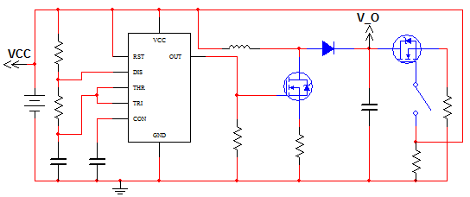
Inductive-Boost Converter
Uses the inductor to force a charge onto the capacitor
555 timer provides reliable charging
Microcontroller triggered delivery

Slide 12
Sensors

Slide 13
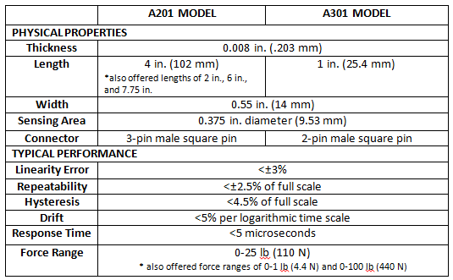

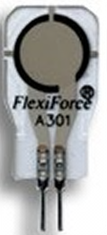
Force-Sensitive Resistors (FSRs)
4 in.
A201 Model
0.55 in.
1 in.
A301 Model

Slide 14
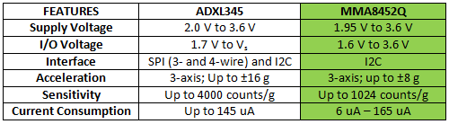
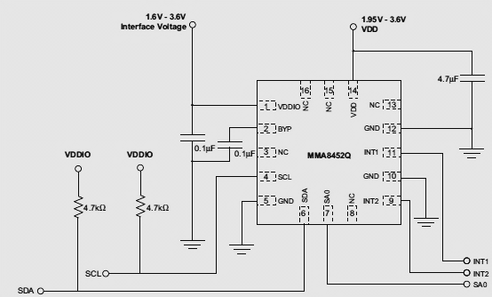
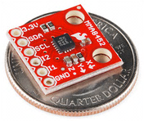
Accelerometers
MMA8452Q

Slide 15
LCD Display

Slide 16
LCD Display
4d-systems uLCD-43-PT
Itead Studio ITDB02-4.3
4.3” display
Easy 5-pin interface
Built in graphics controls
Micro SD-card adaptor
4.0V to 5.5V operation range
~79g
Has already been used in medical instruments
~$140.00
4.3” display
16bit data interface
4 wire control interface
Built in graphics controller
Micro SD card slot
~$40.00
Not enough information

Slide 17
4D-Systems uLCD-43-PT
Delivers multiple useful features in a compact and cost effective display.
4.3” (diagonal) LCD-TFT resistive screen
Even though it’s more expensive than the other screen we know that this screen works and it has already been used in medical devices.
It can be programmed in 4DGL language which is similar to C.
4D Programming cable and windows based PC is needed to program

Slide 18
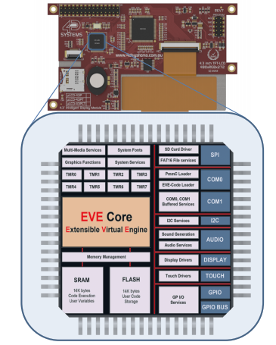
PICASO-GFX2 Processor
Custom Graphics Controller
All functions, including commands that are built into the chip
Powerful graphics, text, image, animation, etc.
Provides an extremely flexible method of customization

Slide 19
MCU

Slide 20
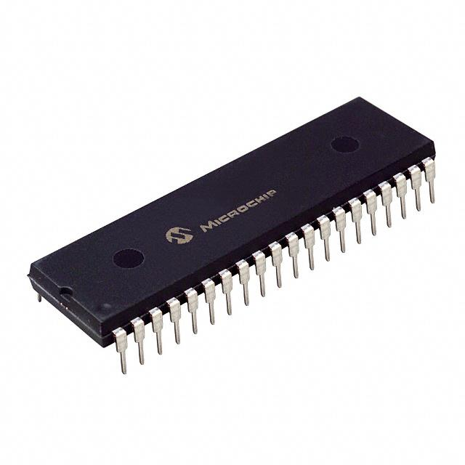

Microcontroller
Important Features
Low cost
Large developer support
Enough FLASH memory
Libraries Available
Works with our LCD display
Preferably through-hole package

Slide 21
Microcontroller
Features | MSP430F5438A | PIC32MX150 | ATmega328
Architecture | 16-Bit RISC | 32-Bit RISC | 8-Bit AVR
Flash Memory | 256 KB | 128 KB | 32 KB
Frequency | 25 MHz | 50 MHz | 20 MHz
RAM | 16 KB | 32 KB | 2 KB
I2C Bus | 4 | 2 | 1
AD Converter | x16, 12-bit | x10, 10-bit | x8, 10-bit
Power Usage | 1.8 – 3.6V | 2.3 – 3.6V | 1.8 – 5.5V
I/O Pins | 87 | 21 | 23
Package | SMD | 28DIP | 28DIP
Size | 14.6 x 14.6 x 1.9 mm | 34.6 x 7.2 x 3.4 mm | 34.7 x 7.4 x 4.5 mm

Slide 22
Bluetooth

Slide 23


Bluetooth
Important Features
Built-in antenna
Low power consumption
Easy to setup
Automatic pairing preferably
Relatively low cost

Slide 24
Wireless
Features | SPBT2632C2A.AT2 | PAN1325A
Size | Small 11.6 x 13.5 x 2.9 mm | Very small 9.5 x 9 x 1.8 mm
Data Rate | 1.5 Mbps Max Data Rate | 2.1 Mbps
Encryption Type | 128-bit Encryption | 8-to-128 Bit Encryption
Integrated Antenna | Yes | Yes
Power Consumption | 2.1 – 3.6 V | 1.7 – 4.8 V
Certifications | CE, IC, FCC, Bluetooth | FCC, CE, NCC, Bluetooth
Program Memory | 256 KB | None

Slide 25
Power Supply

Slide 26
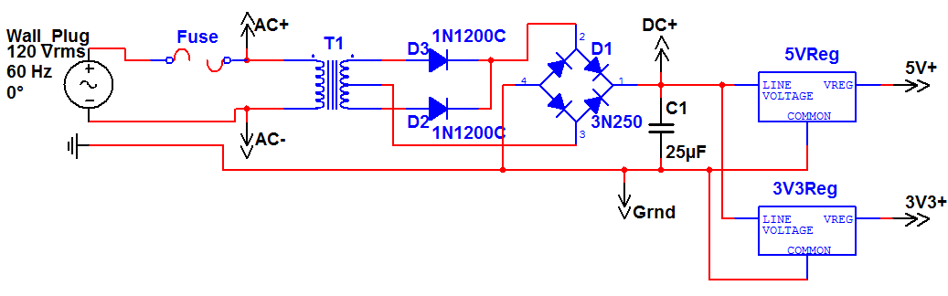
Power Supply
Initial power from Wall Plug, used for Voltage Multiplier
Converted to 5V and 3.3V for use with ICs
Backup: modified laptop charger

Slide 27
Administrative Content

Slide 28
Budget
Part | Price (projected)
PCB Board | $150
Batteries | $50
Microcontroller/Embedded Board | $125
Wiring | $20
Display | $140
Accelerometer | $15
Flexion Sensor | $15
Piezoelectric Sensor | $15
Force Meter | $45
Display Housing | $100
Electrodes | $38
Experimenter Board | $149
Bluetooth Evaluation Kit | $99
USB Debugging Interface | $99
Total | $1,060

Slide 29
Budget
Part | Price Paid | Actual Price
LCD Display (TFT LCD) | $159.44 | $159.44
4D-Programming Cable | $26.04 | $26.04
PIC32MX150 | FREE | $4.10
Arduino Uno-R3 | 33.64 | 33.64
Sensors
TekScan Flexiforce Sensor | FREE | $16.25
Flexiforce Sensor | $16.74 | $16.74
Pressure Sensors | $20.00 | $64.70
Triple Axis Accelerometer | $13.64 | $13.64
TOTAL | $269.50 | $334.55

Slide 30
Current Progress

Slide 31

Next Steps
Start programming and testing the screen with the controller
Testing and narrowing sensor selection
Build and modify the nerve stimulator design

Slide 32
Issues
Testing and demonstrating the final product
Generating the appropriate voltage (upwards of 1000VDC)
Picking an accurate enough sensor

Slide 33
Issues
Testing and demonstrating the final product
Generating the appropriate voltage (upwards of 1000VDC)
Picking an accurate enough sensor
Kelly’s stress levels!!! ☺

Slide 34
Questions?

