Slide 1
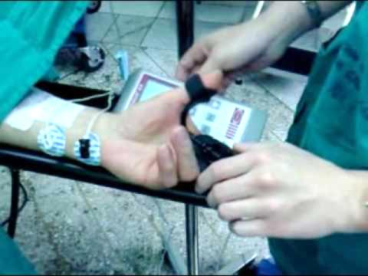
Paralytic Twitch Sensor
Group 14
Kelly Boone
Ryan Cannon
Sergey Cheban
Kristine Rudzik
Sponsored by: Dr. Thomas Looke and Dr. Zhihua Qu

Slide 2
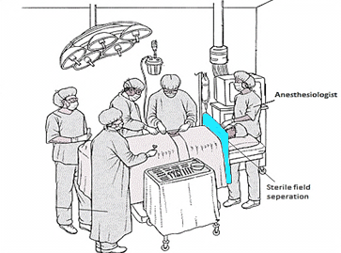
Motivation
Techniques for evaluating levels of muscle response today are not reliable.
Anesthesiologist as the sensor: by touch or by sight
Other methods require patients arms to be restrained
Problems: if restrained wrong it could lead to nerve damage in the patient or false readings
Seeing first hand when we shadowed
Dr. Looke individually
Trying to find a way to not let the
blue shield that separates the sterile
field create an inconvenient way to
measure the twitches.

Slide 3
Medical Background
Anesthesia
Nobody is really sure how it works; all that is known about these anesthetics:
Shuts off the brain from external stimuli
Brain does not store memories, register pain impulses from other areas of the body, or control involuntary reflexes
Nerve impulses are not generated
The results from the neuromuscular blocking agents (NMBAs) are unique to each individual patient. Therefore there is a need for constant monitoring while under anesthesia.

Slide 4
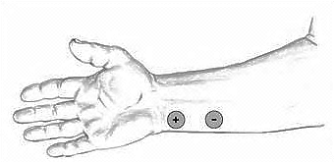
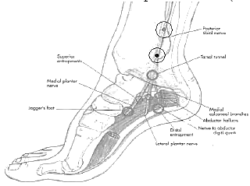
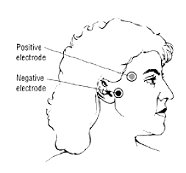
Medical Background
Different types of measuring:
The thumb (ulnar nerve)
Most reliable and accurate site
Easy to access
The toes (posterior tibial nerve)
Fairly accurate alternative
Difficult to reach
The eye (facial nerve)
Not an accurate way to measure

Slide 5
Medical Background
3 main stimulation patterns that need to be included in the design:
Tetanic
Single-Twitch
Train-of-Four (TOF)

Slide 6
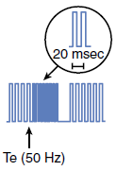
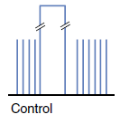
Medical Background
Tetanic Stimulation
The concept of using a very rapid delivery of electrical stimuli at maximum current.
Used once patient is unconscious, before the induction of anesthesia, to obtain a baseline measurement.
Frequency impulse commonly used is 50 Hz for a maximum duration of 5 seconds.

Slide 7

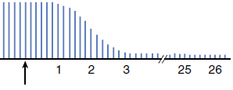
Medical Background
Single-twitch Stimulation
Injection
of NMBA
The simplest form of nerve stimulation; the concept of using a single electrical stimulus at a constant frequency.
Used to view the onset of the neuromuscular block up until muscle response is first detected.
Stimulation frequency varies between 1 Hz (equivalent to one stimulation every second) and 0.1 Hz (i.e., one stimulus every 10 s).

Slide 8
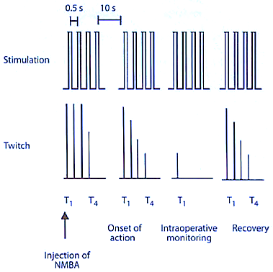
Medical Background
Train-of-Four (TOF) Stimulation
Involves four successive stimuli to the target motor nerve.
Stimulation occurs every 0.5 seconds, resulting in a frequency of 2 Hz, and a 10-second delay between each TOF set.
Used once muscle response is detected.
TOF Ratio: assesses the degree of neuromuscular recovery
T₄/T₁
Pattern of electrical stimulation and evoked muscle response before and after injection of neuromuscular blocking agents (NMBA).

Slide 9
Goals
Sensor that is relatively accurate
An interactive LCD touchscreen
Minimal delay between the sensed twitch and the read out
Train-of-Four (TOF), single twitch and tetanic stimulation patterns
Safe to use in the operating room
Any part that touches the patient needs to either be easily cleaned or inexpensive enough to be disposed of after each use

Slide 10
Specifications
A maximum current of at least 30mA
Maximum charge time of 0.5 seconds in order to have a reliable train of four
Minimum sampling frequency of 100Hz
Consistent sensor readout accuracy of ±25%
The sensor readout is within 5% of the actual value

Slide 11
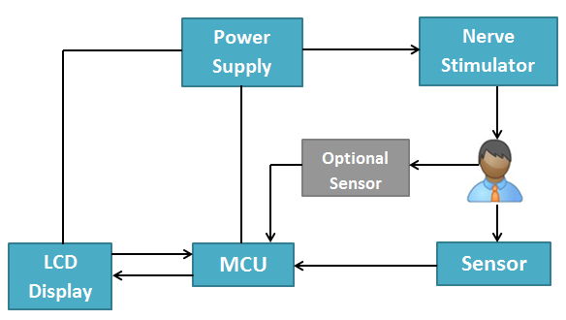
High Level Block Diagram

Slide 12
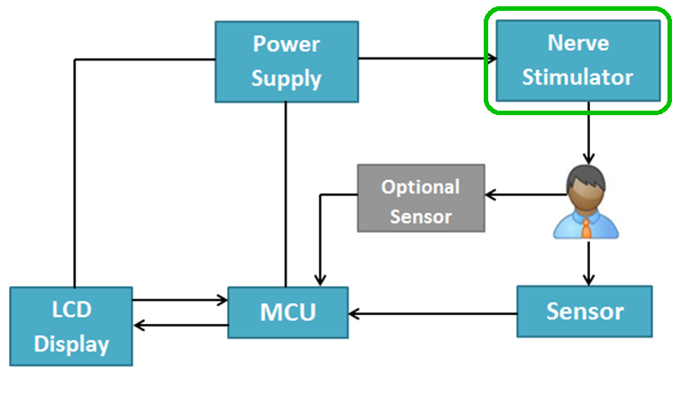
Nerve Stimulator

Slide 13
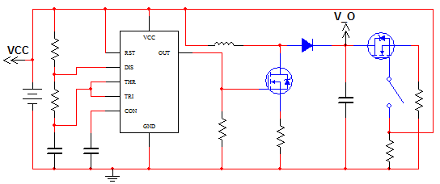
Inductive-Boost Converter
Uses the inductor to force a charge onto the capacitor
555 timer provides reliable charging
Microcontroller triggered delivery

Slide 14
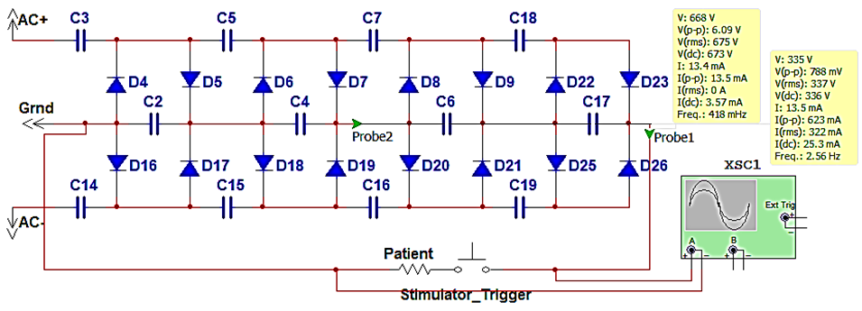
Voltage Multiplier
Built using a full wave Cockcroft–Walton generator
Every pair of capacitors doubles the previous stages’ voltage
Vout = 2 x Vin(as RMS) x 1.414 x (# of stages)

Slide 15
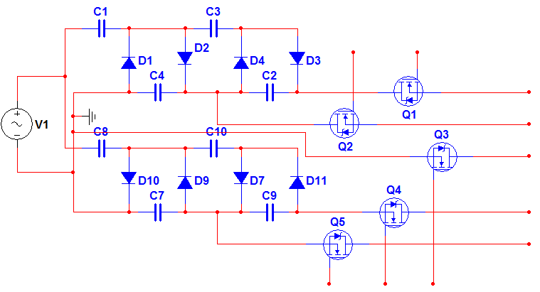
Voltage Multiplier
To reduce sag in the multiplier, positive and negative biases were added to the previous circuit.

Slide 16
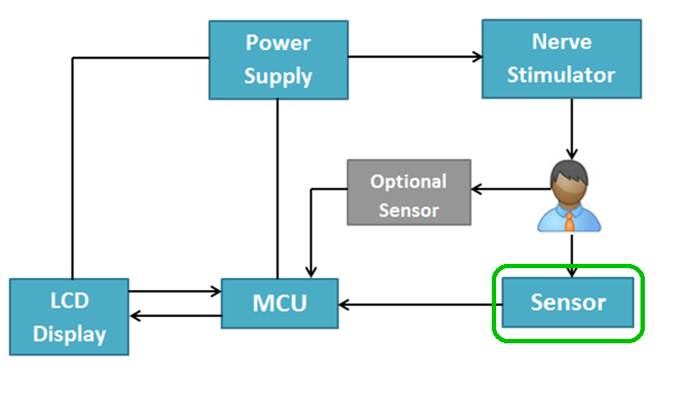
Sensor

Slide 17
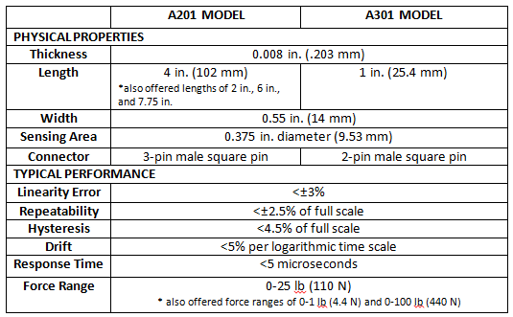

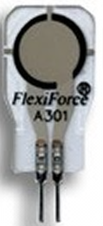
Force-Sensitive Resistors (FSRs)
4 in.
A201 Model
0.55 in.
1 in.
A301 Model

Slide 18
Pressure Sensor
Requirements
Gauge pressure sensor
Only measures a positive input range
Small accuracy error
Quick response time
Notes:
Only positive input range because we will never be measuring less than atmospheric pressure

Slide 19
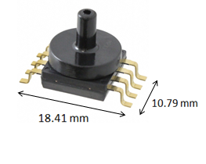
Pressure Sensor
Freescale MPXV5010GP
Internal amplification
Low pass output to avoid noise
Quick response time, t_{R}, of 1.0 msec
Required
5 V input
5 mA constant current input
Input Range: 0 – 10 kPa (0 – 1.45 psi)
Output Range: 0.20 – 5.00 V
Transfer Function
Vout = Vin * (0.09 * P + 0.04) ± ERROR
where P = pressure in kPa
Notes:
Quick response time important for TOF stimulation where there is little time between each pulse in the set.

Slide 20
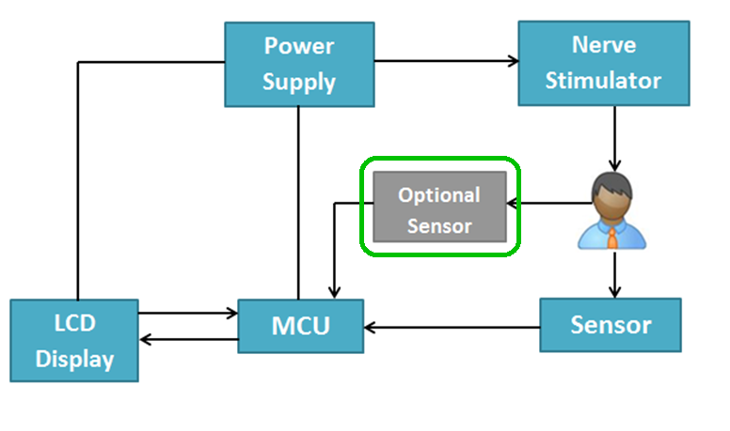
Optional Sensor

Slide 21
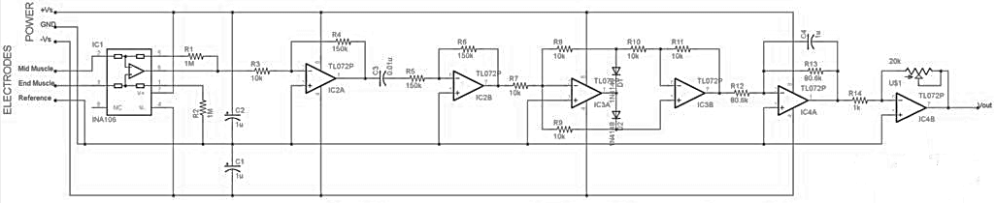
Electromyography (EMG) Sensor
Optional method of monitoring if preferred by the anesthesiologist.
EMG records the electrical activity of a muscle at rest and during contraction.
EMG sensor indirectly measures neuromuscular blockades by finding the compound action potentials produced by stimulation of the peripheral nerve
Notes:
Optional method although emphasis of this project is to use the pressure sensor system

Slide 22
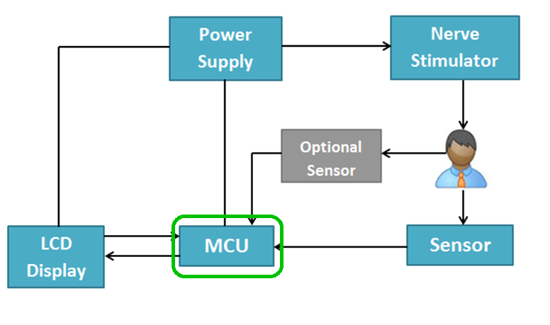
MCU

Slide 23
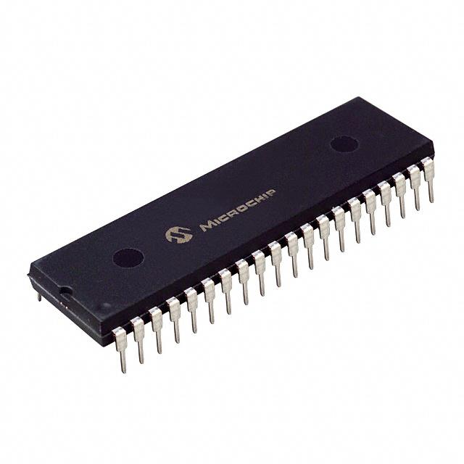
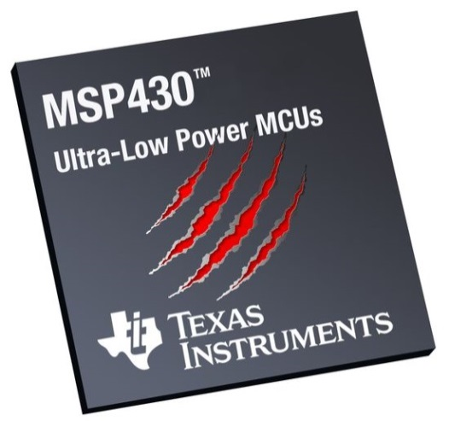
Microcontroller
Important Features
Low cost
Large developer support
Enough FLASH memory
Libraries Available
Works with our LCD display
Preferably through-hole package

Slide 24
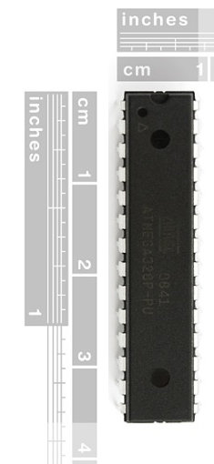
Microcontroller
Features | MSP430F5438A | ATmega328P | PIC32MX150
Architecture | 16-Bit RISC | 8-Bit AVR | 32-Bit RISC
Flash Memory | 256 KB | 32 KB | 128 KB
Frequency | 25 MHz | 20 MHz | 50 MHz
RAM | 16 KB | 2 KB | 32 KB
I2C Bus | 4 | 1 | 2
AD Converter | x16, 12-bit | x8, 10-bit | x10, 10-bit
Required Voltage | 1.8 – 3.6V | 1.8-5.5V | 2.3-3.6V
I/O Pins | 87 | 23 | 21
Package | SMD | 28DIP | 28DIP
Size | 14.6 x 14.6 x 1.9 mm | 34.7 x 7.4 x 4.5 mm | 34.6 x 7.2 x 3.4 mm

Slide 25
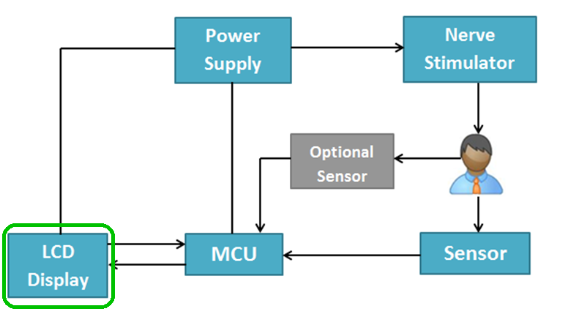
LCD Display

Slide 26
LCD Display
4d-systems uLCD-43-PT
Itead Studio ITDB02-4.3
4.3” display
Easy 5-pin interface
Built in graphics controls
Micro SD-card adaptor
4.0V to 5.5V operation range
~79g
Has already been used in medical instruments
~$140.00
4.3” display
16bit data interface
4 wire control interface
Built in graphics controller
Micro SD card slot
~$40.00
Not enough information

Slide 27
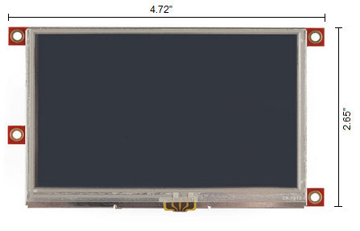
4D-Systems uLCD-43-PT
Delivers multiple useful features in a compact and cost effective display.
4.3” (diagonal) LCD-TFT resistive screen
Even though it’s more expensive than the other screen we know that this screen works and it has already been used in medical devices.
It can be programmed in 4DGL language which is similar to C.
4D Programming cable and windows based PC is needed to program

Slide 28
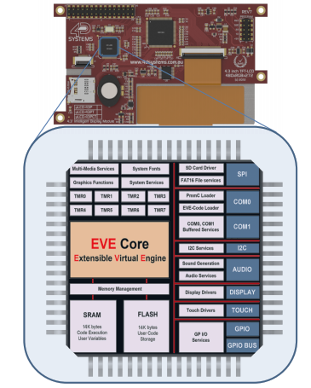
PICASO-GFX2 Processor
Custom Graphics Controller
All functions, including commands that are built into the chip
Powerful graphics, text, image, animation, etc.
Provides an extremely flexible method of customization

Slide 29
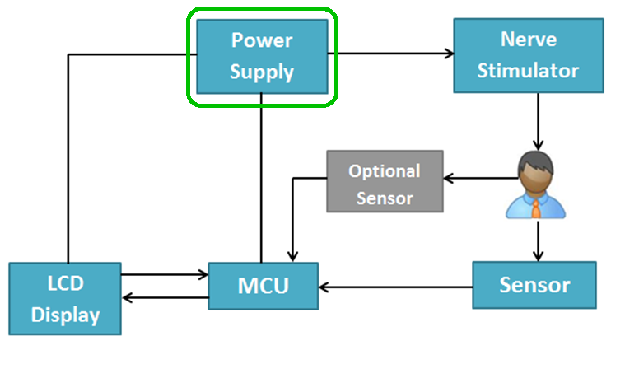
Power Supply

Slide 30
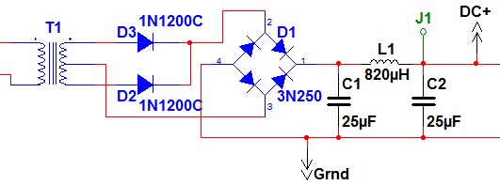
Power Supply
Initial power from Wall Plug, used for Voltage Multiplier
Converted to 5V and 3.3V for use with ICs
Backup: modified laptop charger

Slide 31
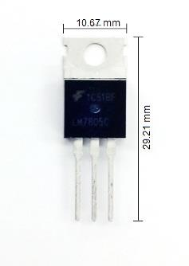
Voltage Regulators
LDO vs. Switching
Both got up to almost 200˚
Decided to go with LDOs for simplicity
because power was not an issue.
LM7805 and LM7812
Notes:
We chose ldo over switching
-not worried about?

Slide 32
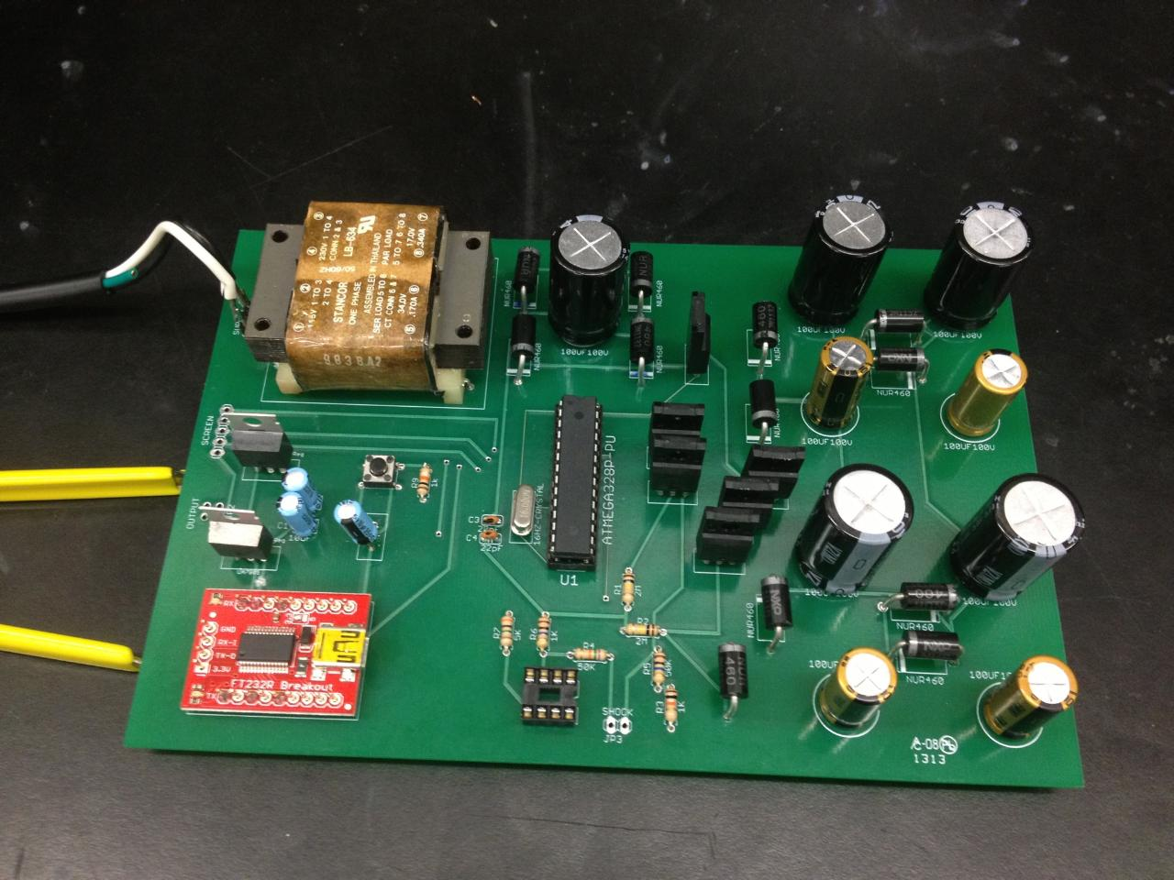
PCB

Slide 33
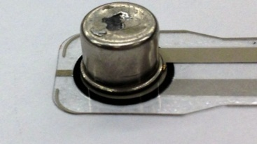
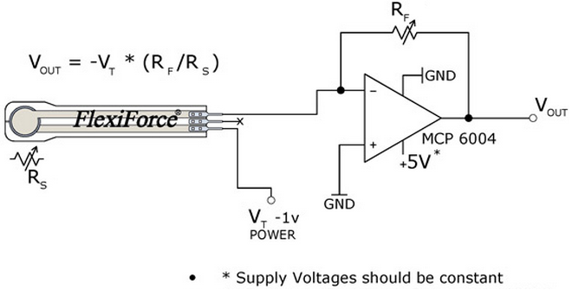
Testing: FlexiForce Sensor
Per instruction by Tekscan’s website:
Tested sensor on a flat, hard surface.
Calibrated the sensor with 110% of the maximum load until steady output was maintained.
Used a shim between the sensing area and load to ensure that the sensor captures 100% of the applied load since the thumb is larger than the 0.375-inch sensing area.
Used the recommended circuit shown, with reference resistance, R_{F}, varying between 10kΩ and 1MΩ.
Metal shim with a 0.325-inch diameter.
Recommended circuit provided by Tekscan.
Notes:
Calibration is supposed to help improve repeatability but still had too much range

Slide 34
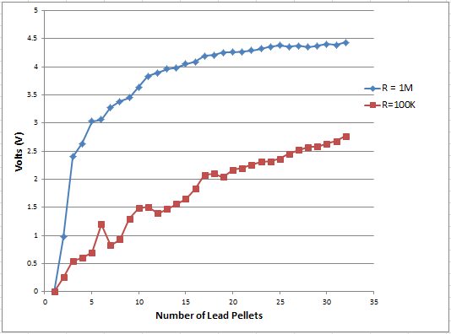
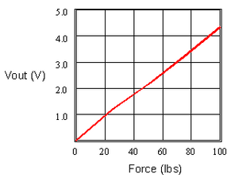
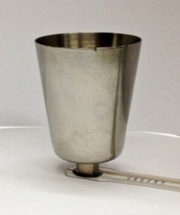
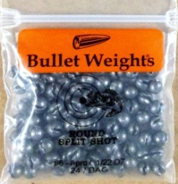
Testing: FlexiForce Sensor
Attached the shim to the bottom of the center of the metal shot glass.
Added lead bullet weights to the shot glass in increments of 3 and saw how the output changed with the increasing load.
Shim attached to Lead bullet weights
shot glass
Notes:
Not linear enough for TOF monitoring
Top graph: our results
Bottom graph: graph on Tekscan spec sheet

Slide 35
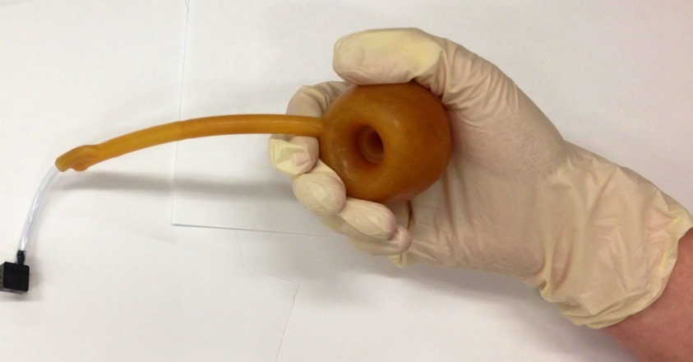
Testing: Pressure Sensor
The pressure sensor is connected to an inflatable pessary which is placed in the patient’s hand
The pressure sensor will measure the strength of the muscle response by how much air pressure results from the squeeze of the pessary.

Slide 36
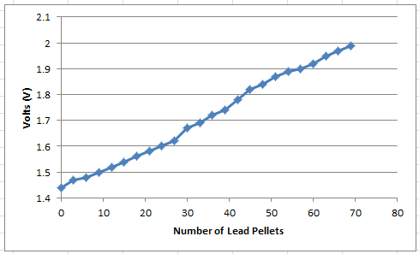
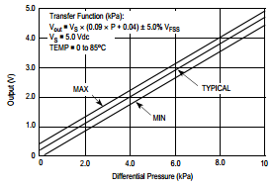
Testing: Pressure Sensor
Used a flat surface on top of the pessary to evenly distribute the force applied on the pessary
Tested MPXV5010GP pressure sensor in a similar way to the FlexiForce:
Measured with a constant force by adding the lead pellets, which were applied evenly over the pessary
Incremented the force applied to the pessary at a constant rate
Measurements showed a more linear result than the Flexiforce
Important for TOF ratio

Slide 37
Testing: EMG Sensor

Slide 38
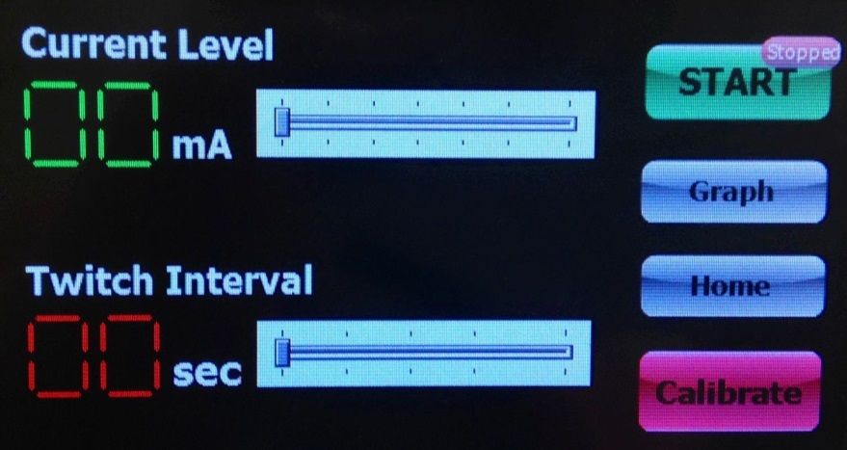
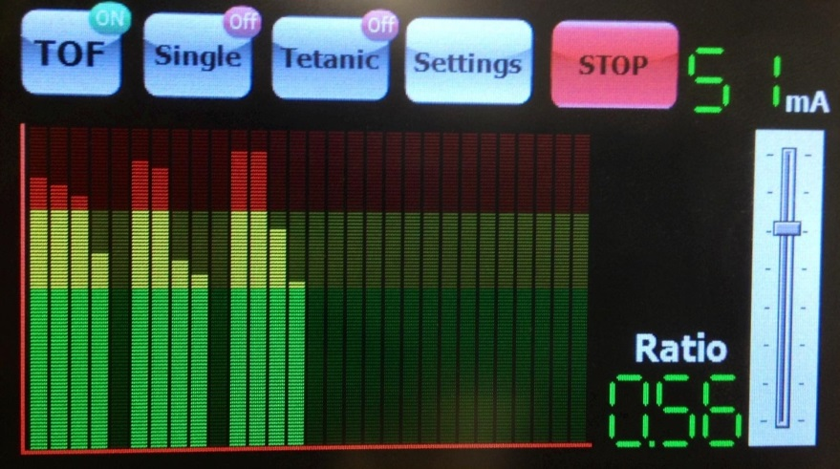
User Interface/ testing
Top:
Screen for adjusting the current level and the interval of the twitches (for single twitches and groups of TOF)
Bottom:
Choosing which nerve stimulation type
Graph of the outputs
TOF ratio
Notes:
Pick name…figure out what to say and then put stuff on the slide

Slide 39
Issues
Testing and demonstrating the final product
Generating the appropriate voltage
Picking an accurate enough sensor
Inaccurate information on the datasheet
The screen pulled 260 mA of current when the datasheet said it would only pull a maximum of 150 mA
Notes:
Needs to be with testing

Slide 40
Administrative Content

Slide 41
Budget
Part | Price (projected)
PCB Board | $150
Batteries | $50
Microcontroller/Embedded Board | $125
Wiring | $20
Display | $140
Accelerometer | $15
Flexion Sensor | $15
Piezoelectric Sensor | $15
Force Meter | $45
Display Housing | $100
Electrodes | $38
Experimenter Board | $149
Bluetooth Evaluation Kit | $99
USB Debugging Interface | $99
 | $1,060

Slide 42
Budget
Part | Quantity | Price Paid | Actual Price
Screen
LCD Display | 1 | $159.44 | $159.44
4D-Programing Cable | 1 | $26.04 | $26.04
SD-Card | 2 | $16.47 | $16.47
USB Cable | 1 | $15.90 | $15.90
Sensors
TekScan Flexiforce Sensor | 4 | $25.81 | $42.06
Pressure Sensors | 24 | $67.19 | $270.13
Flex Sensor | 1 | $16.76 | $16.76
Triple Axis Accelerometer | 1 | $13.64 | $13.64
Breakout board (FT232RL) | 4 | $63.71 | $63.71
ACS712 low current sensor breakout | 2 | $29.52 | $29.52
Circuitry
ATmega328P | 1 | $0.00 | $3.16
Arduino Uno | 1 | $33.64 | $33.64
Caps, Diodes, Resistors |  | $176.30 | $176.30
Transformer | 2 | $0.00 | $27.88
PCB
Advanced Circuits PCB | 1 | $358.32 | $505.60
Solder Board | 4 | $21.59 | $21.59
Miscellaneous (wire, headers, ect.) |  | $177.49 | $177.49
Total |  | $1,201.82 | $1,599.33

Slide 43
Questions?

