Slide 1
Boy Scout Pinewood Derby
Track Detection System
Group 19
Mohammad Rehawi
Mike Reyes
Julia Williams
Rodney Brewer

Slide 2
Project Motivation
Community Involvement (Boy Scouts of America)
Technical Problem Solving Challenges
Utilization of a Wireless Communication Protocol
Reproducible for other Scout Packs
Partially funded by the Boy Scouts
Plain Old Fun!!!

Slide 3
Project Description
With the Pinewood Derby Track Detection System project we would like to take a manually operated track and convert it to a fully automated track for the Boy Scouts of America. The track consists of four main components integrated into one: Starting Gate, Sensors, Finish Gate, and Communication. The starting gate is responsible for the initiation of the race that will be achieved using Servo Motors. The sensors will gather a variety of data that will be used by other components. The finish gate will display most of the data gathered during the race using interactive lighting and display systems. The communication consists of a computer controlled software program that transmits and receives information from and to different points on the track using Bluetooth wireless communication and microcontrollers.

Slide 4
Project Objectives
Integration of Bluetooth Wireless Communication
Detection of Instantaneous Velocity
Automated Starting Gate
Race Sequencing and Display Automation
Automated Sensor Calibration
Power Management
MCU and Main Application Software

Slide 5
Project Design Overview
Boy Scouts Pinewood Derby
Track Detection System
Software
Sensor
& Servo
Software
Application
Software
Hardware
Start Gate Assembly
Display
Software
Finish Gate Assembly
Power Supply
Displays
Systems
Sensors

Slide 6
Project Design Overview
Boy Scouts Pinewood Derby
Track Detection System
Software
Sensor
& Servo
Software
Application
Software
Hardware
Start Gate Assembly
Display
Software
Finish Gate Assembly
Power Supply
Displays
Systems
Sensors

Slide 7
Gate Mechanism
Push / Pull Solenoids
  High voltage = 12+ V
  Low cost
Stepper Motor
  Low voltage = 5+ V
  Slow speed
  Low cost
Servomotor [HS-5055MG x 4]
  Small in size
  Low voltage = 5V
  Low cost
  Easy to mount
  Fully automated
  High speed

Slide 8
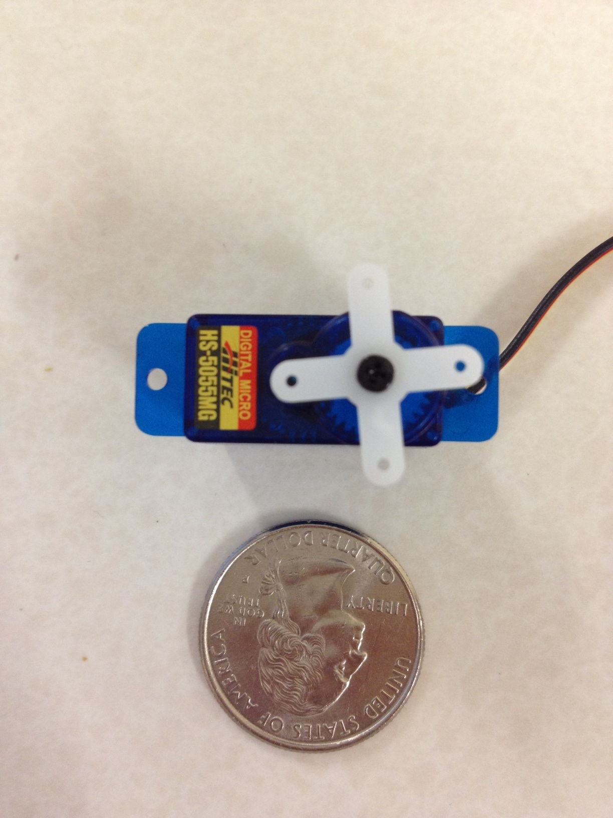
Project Design Overview (Hardware)
Start Gate Assembly
  Automated Start and Reset
    PWM Servo Controller
    Digital Start Signal w/
    Automatic Reset

Slide 9
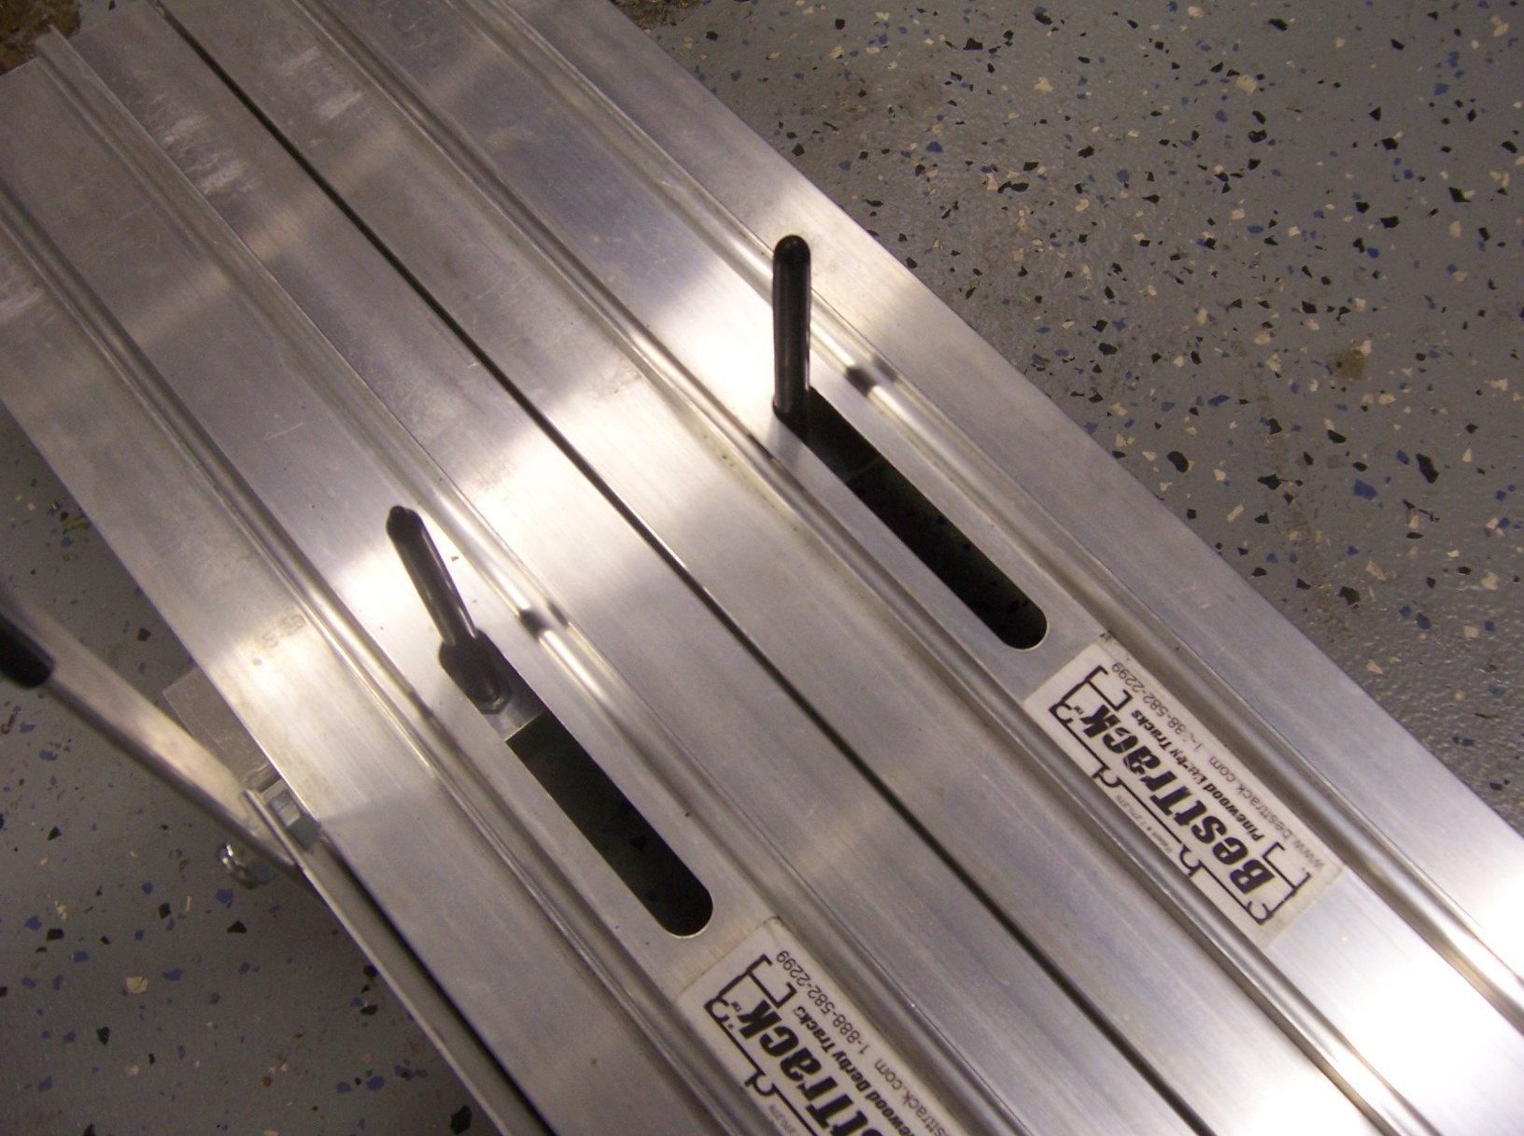
Servo Motor Installation

Slide 10
Microcontroller Selection
AT89C51
  40 Pins
  Large Footprint
PIC16F628A
  18 Pins
  Large Footprint
CC2540 / AT8051
  Small Footprint
  Bluetooth Communication
  Level Shifter Needed
PIC12F683
  Small Footprint
  PWM Enabled
  Internal Oscillator
  No Level Shifter Needed
    Vout = Vin = 5 V
  Programmer is available
  (meLab Epic Processor)

Slide 11
Communication Options
RS - 232
  Wired
  Low cost
  Range is about 150 ft
433MHz Transceiver
  Cost vs # of modules needed
  Large in size
Wireless [ 802.11 ]
  Multiple IP addresses for different sensors
  A router might be needed
  High cost
Bluetooth [ 3.2 GHz ]
  CC2540 [ Sampled via TI ]
  System on a chip
  TI donated the development kit to the group
  Range is about 50 ft
RN-41 Bluetooth Dongle
  Low Cost
  Mounted on the main finish gate board
  Requires only Transmission and Receiver I/O pins from main processor

Slide 12
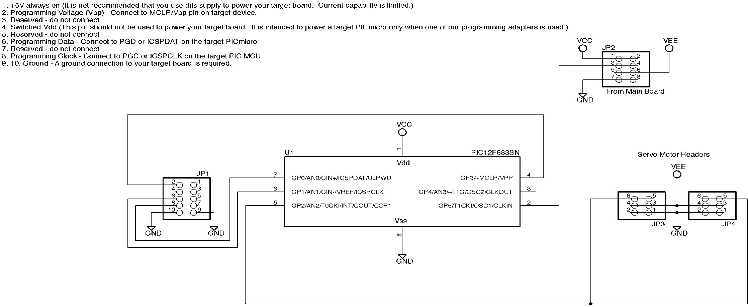
Starting Gate Schematic

Slide 13
Project Design Overview
Boy Scouts Pinewood Derby
Track Detection System
Software
Sensor
& Servo
Software
Application
Software
Hardware
Start Gate Assembly
Display
Software
Finish Gate Assembly
Power Supply
Displays
Systems
Sensors

Slide 14
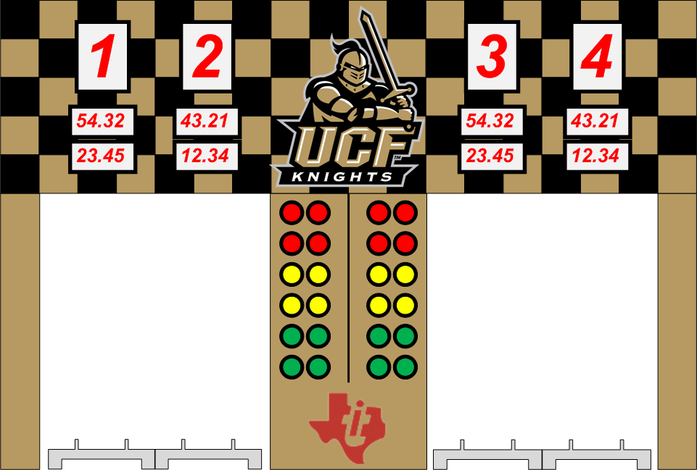
Project Design Overview (Hardware)
Finish Gate Assembly
  Bluetooth Enabled Comms
  Main Processor
    PIC18F87J11
      2 SPI Buses
      2 UARTS
      68 I/O Pins
      Internal Oscillator
      Programmer is
      available (meLab)

Slide 15
Main Processor Responsibility
Lane Detection Interrupts
  IR Curtain System
  Lane/Track Lockout Latching
Poll Tree Light (Starting Tree)
  SPI Bus 1 to LED Driver
Display
  SPI Bus 2 to Display’s Pic processor
Connections to RN – 41
  RS 232
Position Sensors Interrupt
  via Port Expander
  SPI Bus 2 to Port Expander
Speed Sensors
  SPI Bus 2 to Speed Sensors’ PIC processor

Slide 16
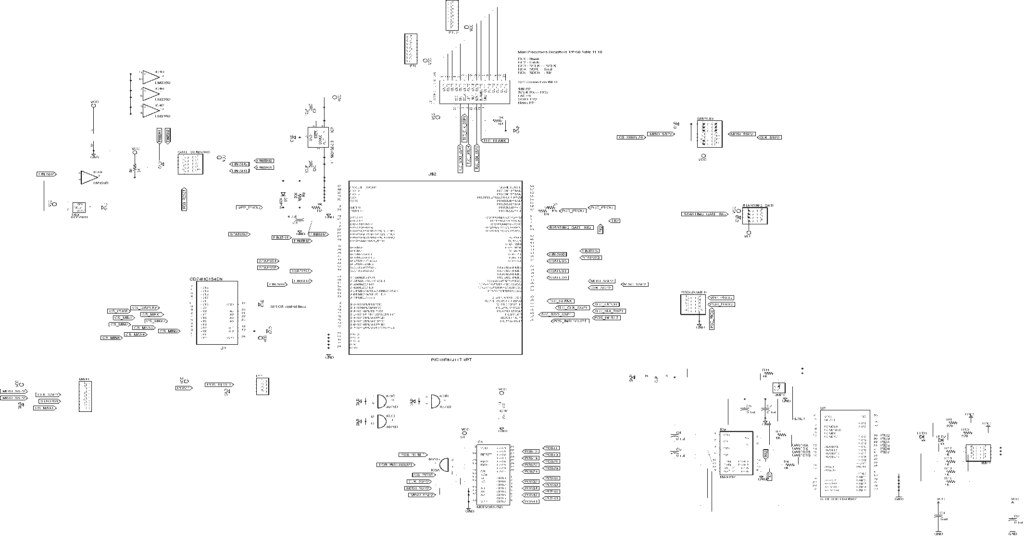
Finish Gate Main Board

Slide 17
Poll Tree Light Sequencing
Colors | State 0 | State 1 | State 2 | State 3 | State 4
Red | OFF | ON | ON | ON | ON
Yellow | OFF | OFF |  | OFF | OFF
Yellow | OFF | OFF |  | OFF | OFF
Yellow | OFF | OFF | OFF | ON | OFF
Green | OFF | OFF | OFF | OFF | ON
Green | OFF | OFF | OFF | OFF

Slide 18
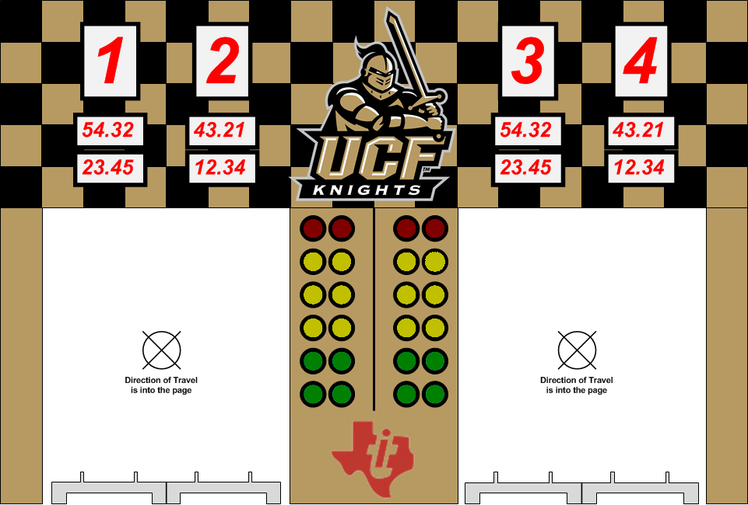
Pole Tree Light

Slide 19
Poll Tree Light Drivers
8-bit Shifter Register – 74HC164
  1 LED lights at a time
  Resistors required
CMOS Buffer – CD4049
  Resistors required
  6 output pins
  Drives up to 20mA
LED Driver – TLC59281
  No resistors required
  Sampled via TI
  16 output pins
  Drives up to 40mA/output

Slide 20
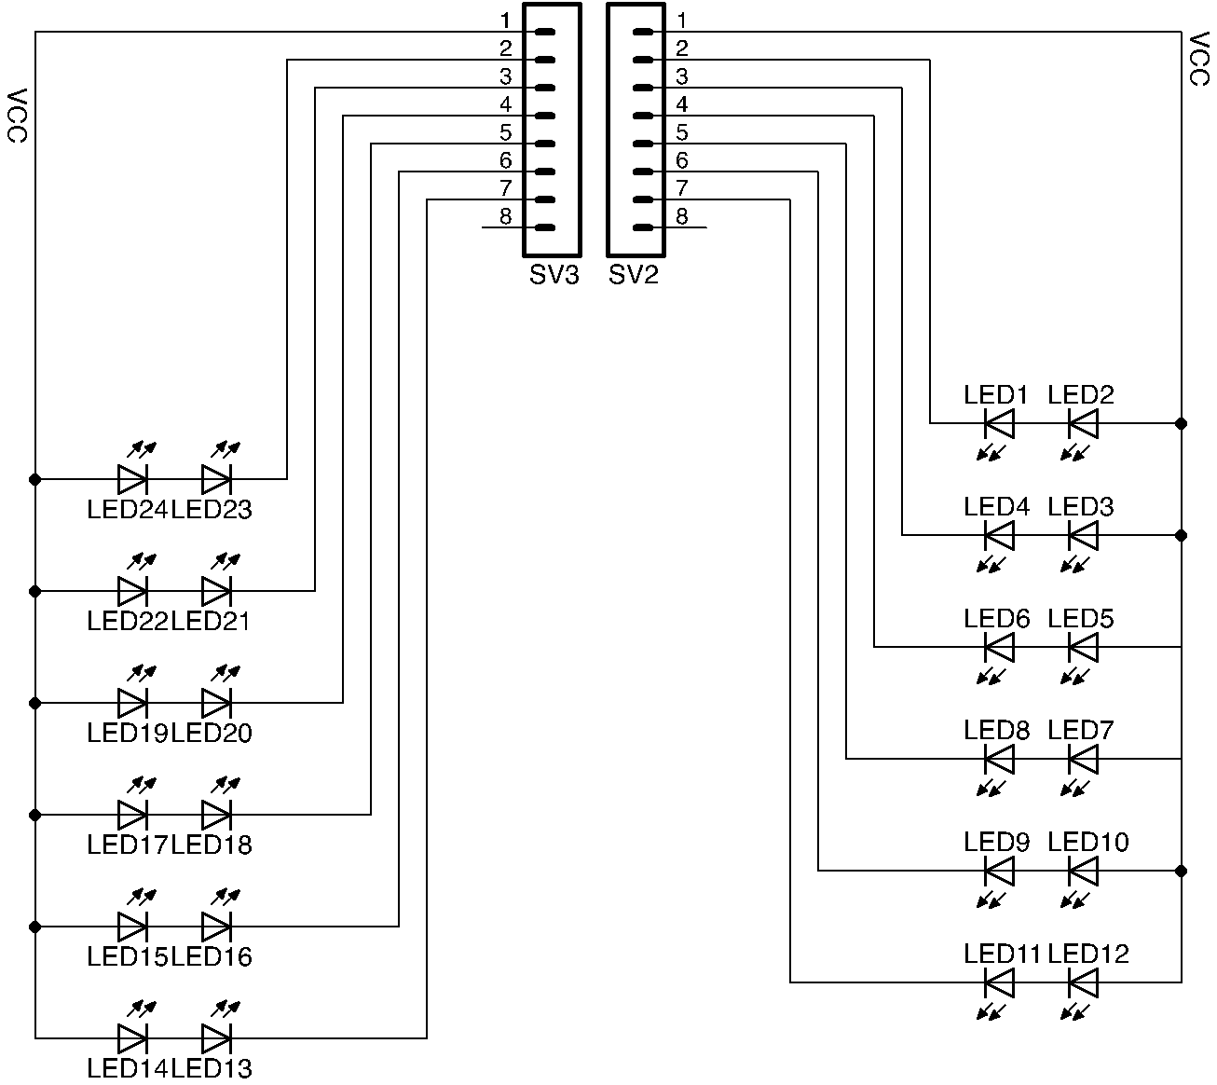
Poll Tree Light Schematic

Slide 21
Starting Gate Signal Path
Main Application
(PC Computer)
Starting Gate
Controller
(PIC12F683)
Finish Gate
Controller
(PIC18F87J11)
Poll Tree Light
(TLC59281)

Slide 22
Project Design Overview
Boy Scouts Pinewood Derby
Track Detection System
Software
Sensor
& Servo
Software
Application
Software
Hardware
Start Gate Assembly
Display
Software
Finish Gate Assembly
Power Supply
Displays
Systems
Sensors

Slide 23
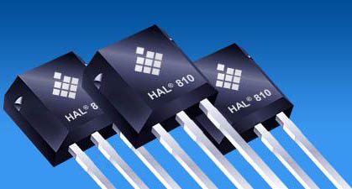
Sensors Options
Ambient Light Sensors
  Sensitive to changes in room light
Hall Effect Sensors
  Additional hardware required
Infrared Sensors
  Better Choice

Slide 24
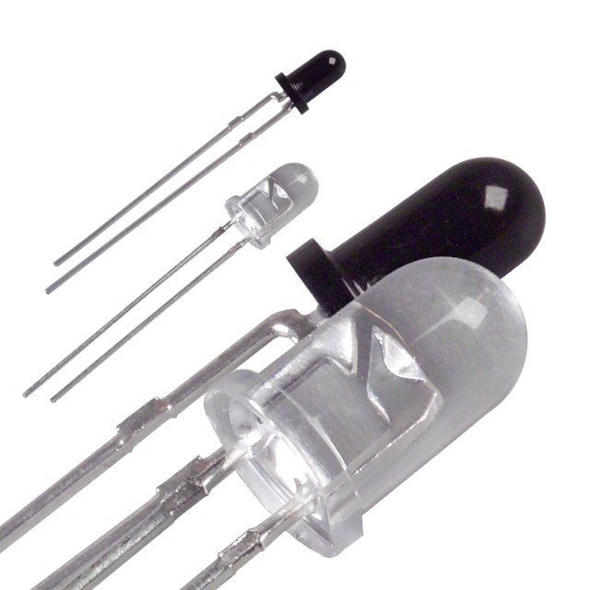
IR Sensor Options
Photo-Transistor
  Response Time: Microseconds
Photo-Diode
  Response Time: Nanoseconds
Photo-Resistor
  Response Time: Milliseconds

Slide 25
Sensor Types
Speed Sensors
  Instantaneous speed
  Start total time
  First row of position sensors
Position Sensors
  Cars current position on the track
Finish Gate Sensors
  Finish total time
  Last row of position sensors
  Determine winner

Slide 26
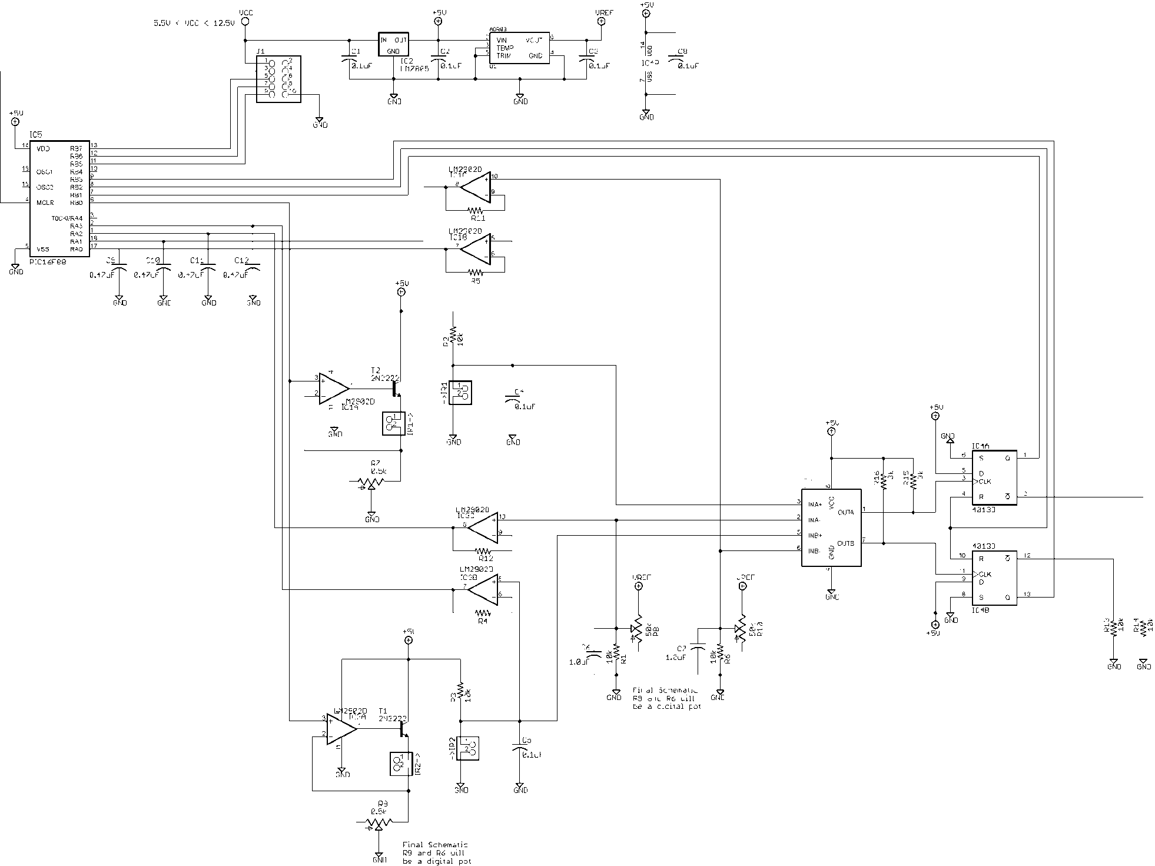
Complete Photo Detection
Schematic

Slide 27
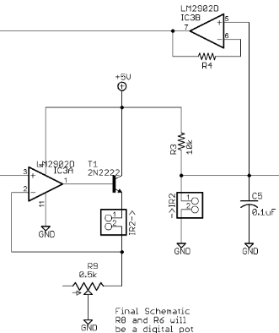
IR Driver Circuit

Slide 28
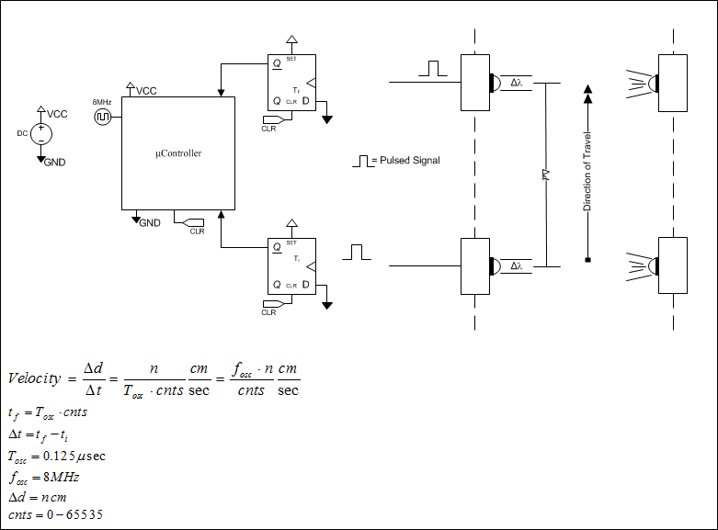
Speed Sensor Design Concept

Slide 29
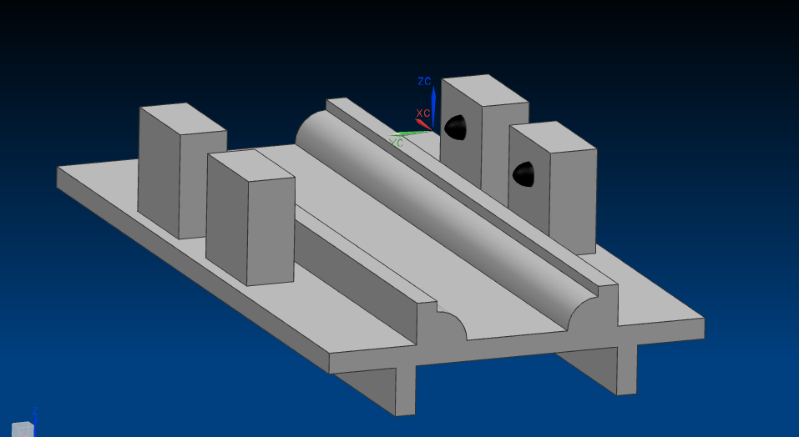
Mounting of Speed Sensors

Slide 30
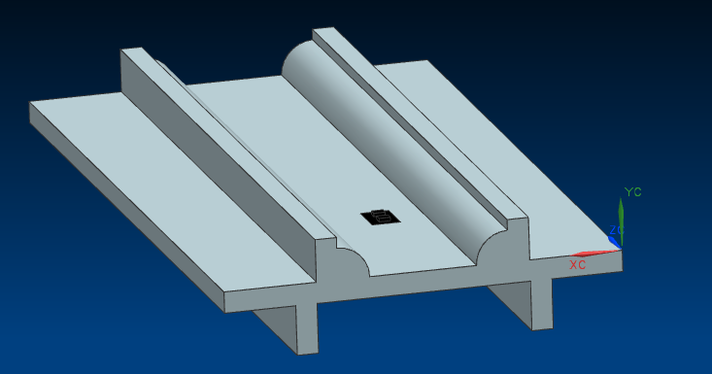
Mounting of Position Sensors

Slide 31
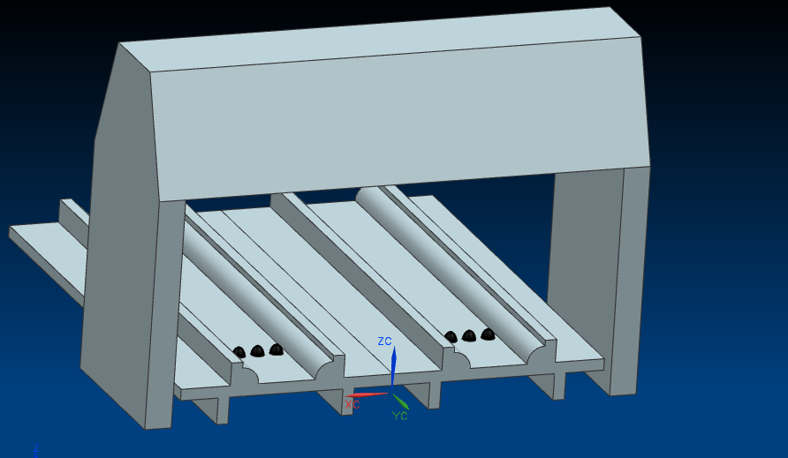
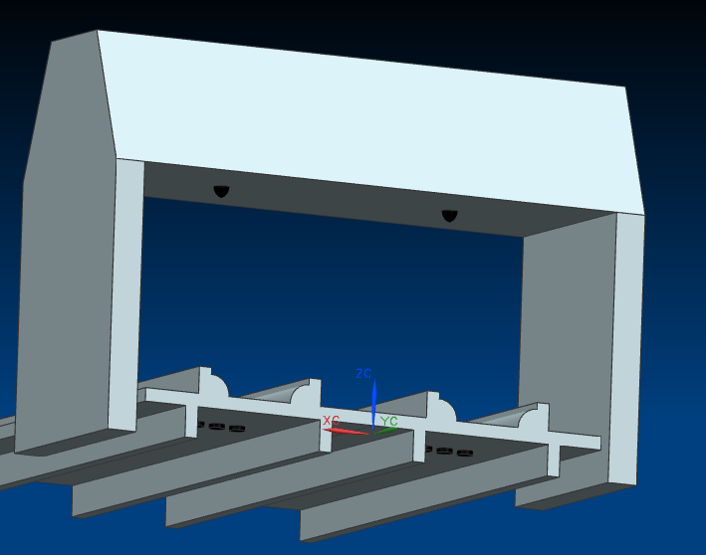
Mounting of Finish Gate Sensors

Slide 32
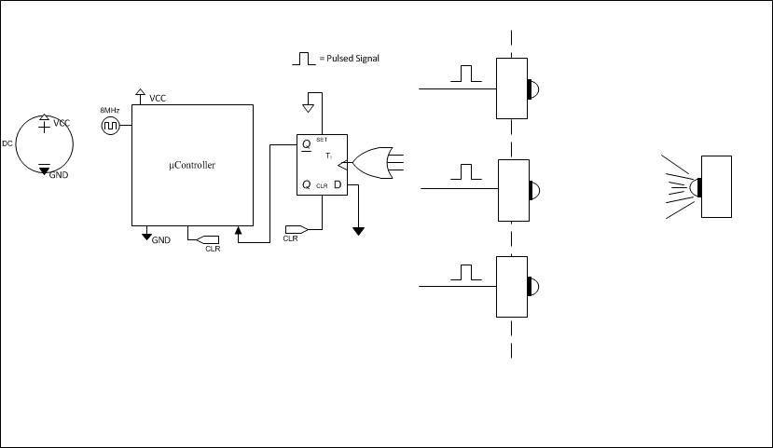
Finish Gate Sensors Design Concept

Slide 33
Sensor Specs
Specification | Amount
Number of IR Emitters | 28
Number of IR Detectors | 36
Maximum Emitter Current | 50 mA
Photo-Transistor Output Range (Tested) | About 4 V
Maximum Distance (Tested) | 8 Inches
Wavelength | 900nm
Maximum Collector-Emitter Voltage | 35V
Half Angle | 12 degrees
Response Time(Tested) | 4µs

Slide 34
Calibration
Ensures optimum readings by the detector.
Will only be implemented on Speed and Finish Gate Sensors.
Automatic at every startup.
May be manually executed.
No additional sensors necessary.
Automated calibration process

Slide 35
Calibration Process
A combined amount of IR from the IR Emitter and ambient light will be recorded by the detector.
25% decrease in IR will be calculated.
This value will be used as the trigger point for the sensors.

Slide 36
Calibration Components
Analog – to – Digital Convertor
  MAX11632
    16 Channel convertor
    12 bits
    SPI interface
    Internal Reference
    0 – 4 Voltage Input Range
Processors
  PIC16F88
    18 pins
    SPI Interface (x1)
    Internal Oscillator
    Programmer Available
    (meLab)
Digital – to – Analog Convertor
  MAX528
    8 Channel convertor
    8 bits
    SPI interface
    Internal Reference
    0 – 4 Voltage Input Range

Slide 37
Project Design Overview
Boy Scouts Pinewood Derby
Track Detection System
Software
Sensor
& Servo
Software
Application
Software
Hardware
Start Gate Assembly
Display
Software
Finish Gate Assembly
Power Supply
Display
Systems
Sensors

Slide 38
Project Design Overview (Hardware)
Display System
  SPI Communication
  Displays Track Parameters
    Total Race Time
    Maximum and Average Speed
    Lane Pole Position
    Strobe Lane Lights

Slide 39
Finish Gate Display Design Decisions
Displays considered were LED’s and LCD screen displays.
Chose LED Display because of cost and best visibility at a distance.
Considered 3 different design approaches for the display data, a port-expander or a secondary processor devoted to display data only or a serial latch that behaves much like a port expander.
Chose a combination of the two, a secondary processor that drives a serial bus display driver.
Chose this approach due to it’s versatility and it’s independent functionality, while conserving some I/O on the processor.

Slide 40
Finish Gate Display Design Decisions (continued)
Processors considered were the MSP430, the ATMELXXX and the PIC24F series processors.
Chose PIC processor because of cost and the software team member’s familiarity with the processor.
The team has prior experience with this microcontroller and access to a development board.

Slide 41
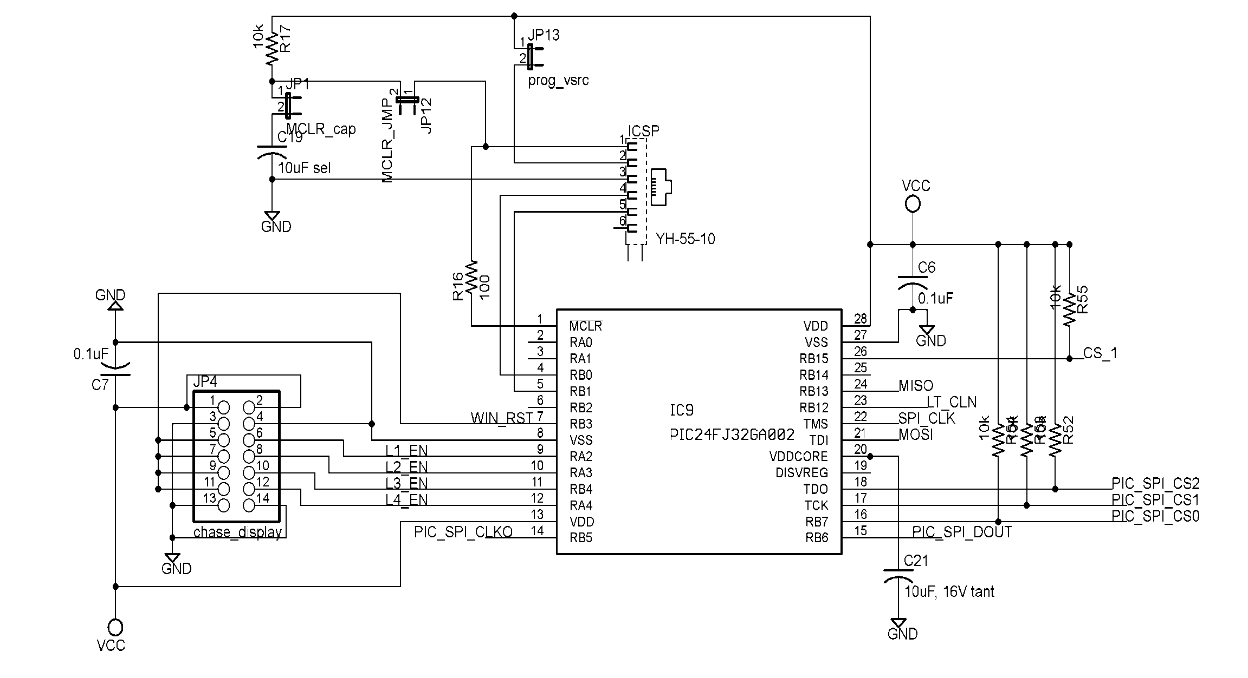
Display Processor Schematic

Slide 42
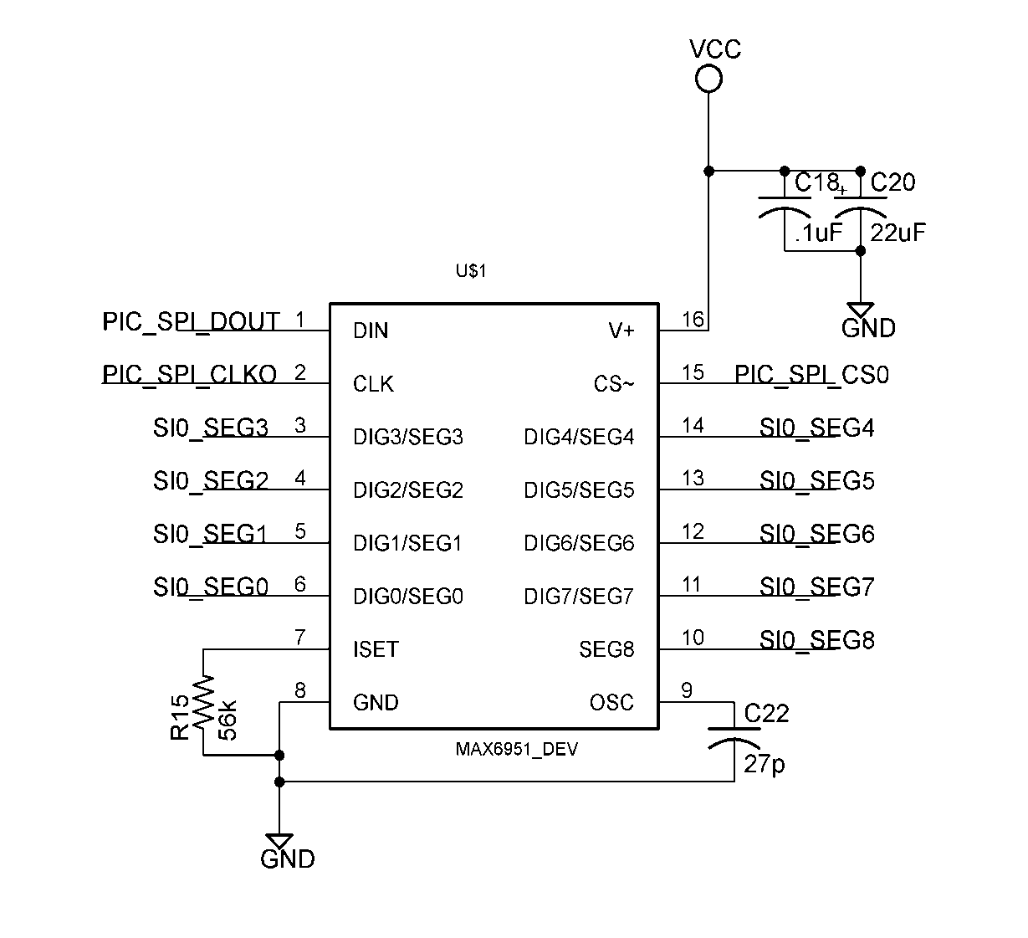
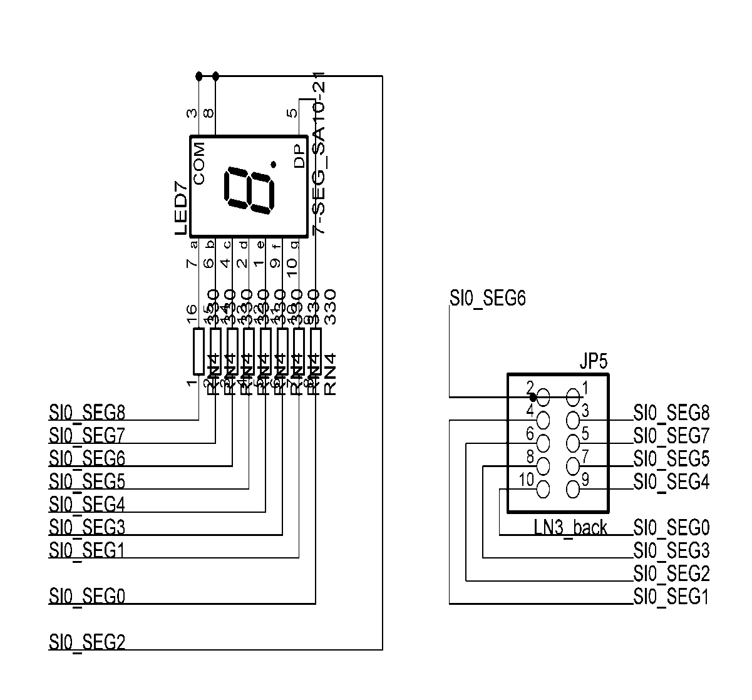
Finish Gate Display Driver

Slide 43
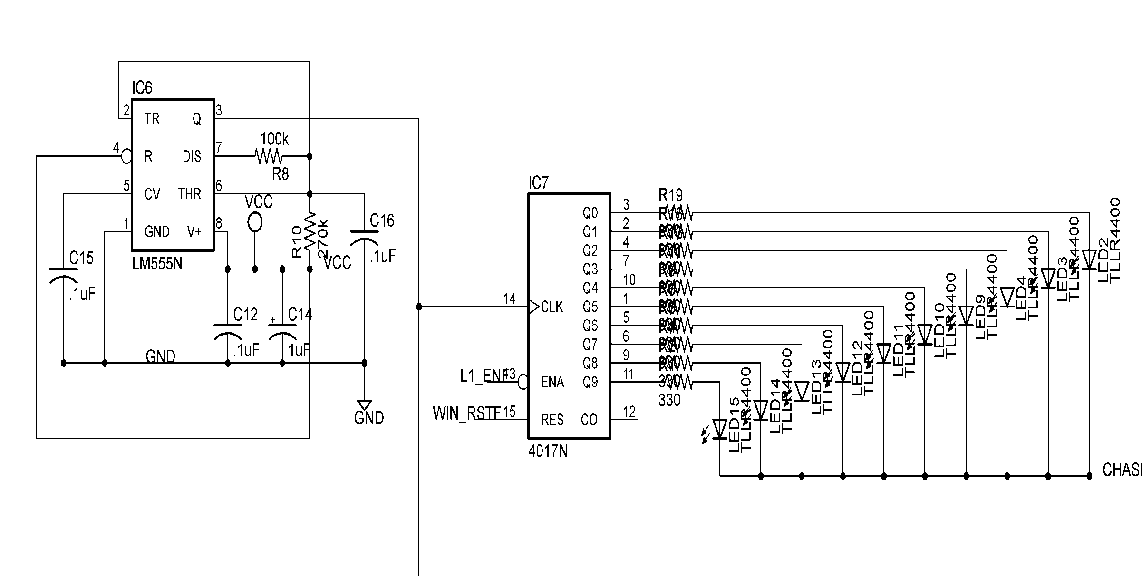
Chasing Light Schematic

Slide 44
Project Design Overview
Boy Scouts Pinewood Derby
Track Detection System
Software
Sensor
& Servo
Software
Application
Software
Hardware
Start Gate Assembly
Display
Software
Finish Gate Assembly
Power Supply
Displays
Systems
Sensors

Slide 45
Chose an Existing Power Supply
The supply is UL listed, with no safety issues, important for use by and around children.
All output voltages and power ratings are within our project’s requirements.

Slide 46
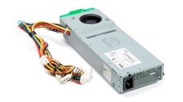
Project Design Overview (Hardware)
Pure power 2.0 350W power supply.
  Tested simultaneous 5V, 12V and 5VSB lines with (worst case) electronic load simulation and met requirements.
  Assembled for project.

Slide 47
Project Design Overview
Boy Scouts Pinewood Derby
Track Detection System
Software
Sensor
& Servo
Software
Application
Software
Hardware
Start Gate Assembly
Display
Software
Finish Gate Assembly
Power Supply
Displays
Systems

Slide 48
Project Design Overview
Boy Scouts Pinewood Derby
Track Detection System
Software
Sensor
& Servo
Software
Application
Software
Hardware
Start Gate Assembly
Display
Software
Finish Gate Assembly
Power Supply
Displays
Systems
Sensors

Slide 49
Starting Gate Software (Servo Control)
Power Up
(Reset)
Not
Received
Wait for Start Trigger
Wait 6 Sec
Received
Actuate Servo
To 90º
Return Servo to Home
Reset
Starting Gate
PWM

Slide 50
Speed Sensor Software
Power Up
and Cal.
Not
Received
Not
Received
Wait for IRQ1 Trigger
Wait for IRQ2 Trigger
Received
Start Timer
Received
Compute Velocity
Transmit Velocity
Reset Sensor

Slide 51
Finish Gate Sensor Software
Power Up
and Cal.
Not
Received
No
Wait for IRQ Triggers
Position Counter > Lane Count
Yes
Wait For Race Reset
Received
Clear All Display and Reset
Determine
Track
Obtain Race Parameters
Update Display
& Increment
Position Counter

Slide 52
Project Design Overview
Boy Scouts Pinewood Derby
Track Detection System
Software
Sensor
& Servo
Software
Application
Software
Hardware
Start Gate Assembly
Display
Software
Finish Gate Assembly
Power Supply
Displays
Systems
Sensors

Slide 53
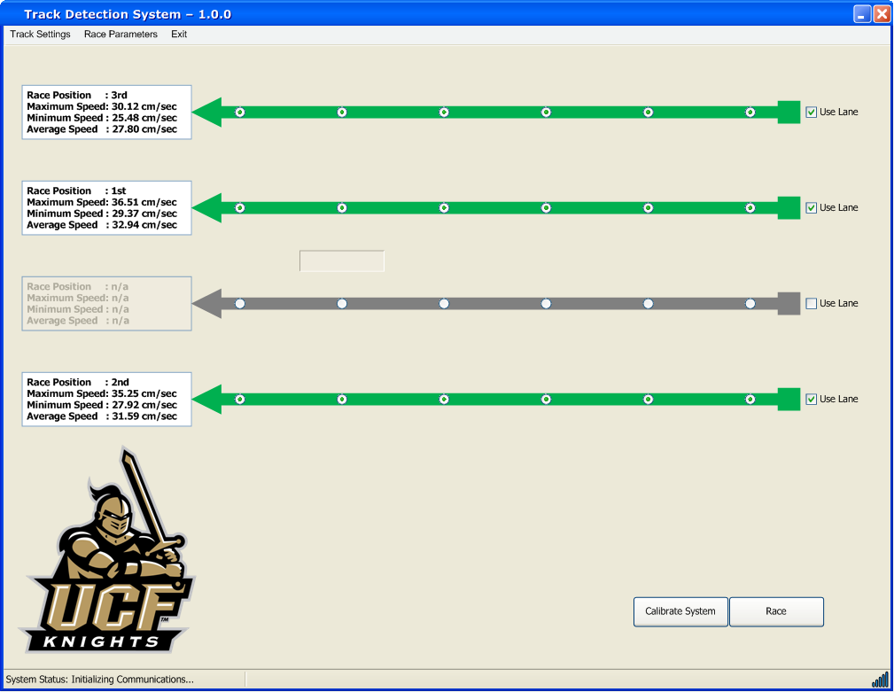
Application Software
Up to 4 Selectable Lanes
Race Parameter Display
Stores and Tracks Each Race
Auto/Manual Calibration of Primary Sensors (Speed and Gate Sensors)
Bluetooth Enabled Communication and Signal RSSI Strength

Slide 54
Project Design Overview
Boy Scouts Pinewood Derby
Track Detection System
Software
Sensor
& Servo
Software
Application
Software
Hardware
Start Gate Assembly
Display
Software
Finish Gate Assembly
Power Supply
Displays
Systems
Sensors

Slide 55
Display and Lane Indication Software
Utilize the SPI Bus to receive race data:
  Lane Ranking
  Lane Elapsed Time
  Avg & Max Speed
Sends SPI data to drivers
  Currently acts as a data router only but retains an element of expandability to the board.

Slide 56
Display Software
Power Up.
Init & Clr displays
Not
Received
Wait for Data
Race reset?
Clear All Displays and Reset
Received
Yes
No
Determine
Track/Data-type
Update Display
Memory Location
Rx’d All Data?
No
Yes
Send to Displays

Slide 57
Project Administration

Slide 58
Budget
Mainly Self funded project and Boy Scouts donated $100
Projected each team member contribute approximately $125.00 to total $600.00.
  Actually Spent $2213.39.
Severely over-budget due to two main factors.
    Failing to itemize quantity of PC boards and corresponding cost in the planning phase and PC board rush request due to re-design.
    Price Increase in Hardware Material (Acrylic Glass, Ethernet Cable, … )

Slide 59
Conclusion
We are sorry to report that aren’t prepared to demonstrate our product today.
  All sub-assemblies currently work independently and we can show you videos this, but we would rather schedule the complete demonstration at a later time, we apologize again for this inconvenience.
  Currently wrapping up the communications between the main application software and the track Bluetooth chip.
  Establishing communications between the finish gate processor and the display unit.

Slide 60
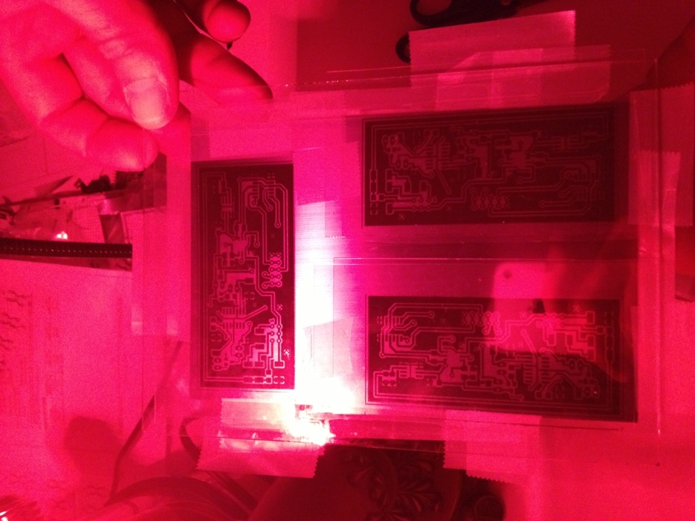
Main Reasons for Delay
Manufacture own boards
  4PCB wanted to charge more for Speed Sensors and Position Sensors
    Position Sensors (x16) + Logic Circuit (x8)
    Speed Sensors (x8)
    Servo Boards (x1)
    Poll Tree Light (x1)
Underestimated the Required
Mechanical Installation and Fabrication

Slide 61
Questions?

Slide 62
Lessons Learned
Avoid:
Do not ignore drop dead dates for design approaches.
Avoid the need to rush external venders, will cause budget issues.
Start software efforts early, and simulate, simulate, simulate……
Budget in an ‘incidentals’ pad.
Successes:
Original prototypes were completed early.
Had a well laid out back up plan if original design had problems.
Team members were versatile and complimentary of one another’s talents.
Utilized support avenues well.

