Slide 1

Gesture Recognition Interface Device
Group 22

Slide 2
Group 22 Members:
Martin Rodriguez- EE
Landon Splitter- CE
Evianis Cruz- EE
Pamela Garcia- EE

Slide 3
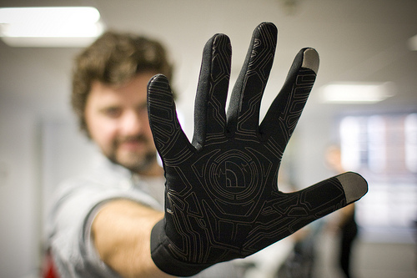
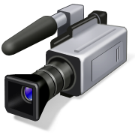
Project Introduction

Slide 4
Motivation and Goals
Motivation- To provide the user with a natural and less restrictive way to communicate with the computer.
Goal – To design an intuitive device with high responsiveness to make the experience continuous, as opposed to fragmented.

Slide 5
Project Requirements and Specifications
Operating Range: up to 20ft.
Weight < 250g
Battery Life > 10 hrs
FPGA: Real Time Image Processing (30 fps)
Response Time/Gesture Recognition < 2 sec
Low Cost < $400.00

Slide 6
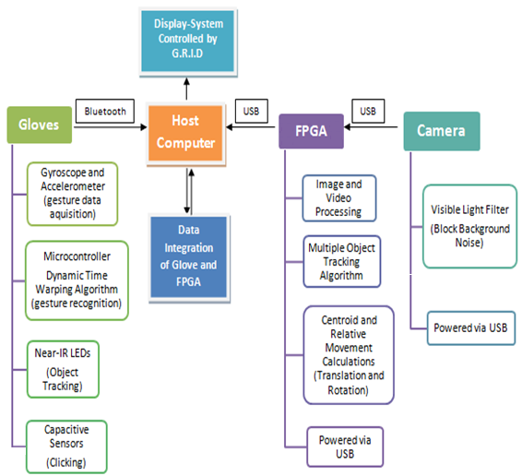
Design Overview
SS4
SS2
SS1
SS3

Slide 7
SS1: Camera
SS4
SS2
SS1
SS3

Slide 8
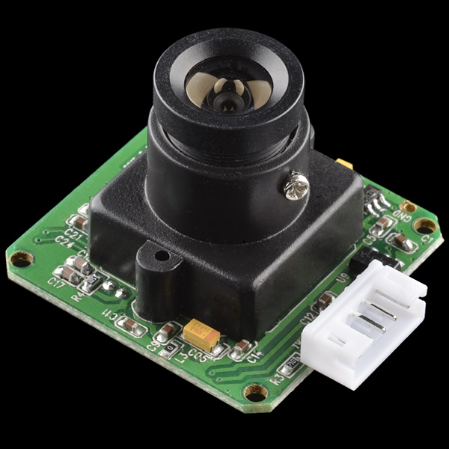
SS1: Camera
Module size: 32mm x 32mm
Image sensor: CMOS 1/4 inch
Output format: Standard JPEG/M-JPEG
Frame speed: 30fps
Resolution: 640*480
Monitoring distance: Up to 15m
Operating voltage: 5V
Communication: TTL

Slide 9
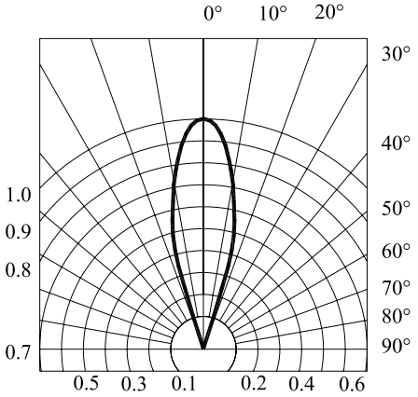
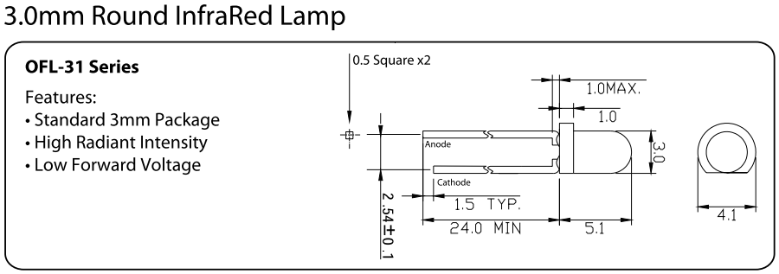
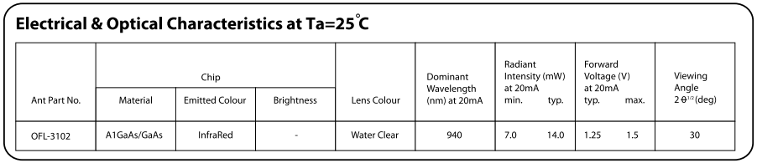
Near-IR LED Multicomp

Slide 10
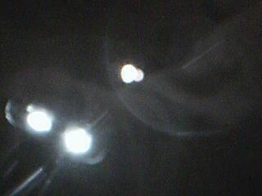
SS1: Visible Light Filter
Goal:
Block background noise (visible light) and allow
the near-IR wavelengths to reach the camera
sensor.
Approach:
Install visible light (magnetic
disk of a floppy disk or film).

Slide 11
SS2: FPGA
SS4
SS2
SS1
SS3

Slide 12
SS2: FPGA vs. DSP Processor
Characteristic | FPGA | DSP
Performance | X
Parallelism | X
Power Consumption | X
Reliability and ease of maintenance | X
Low Cost | X
Development Software |  | X

Slide 13
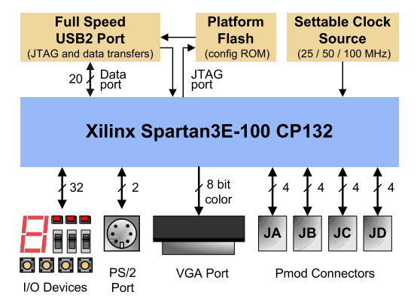
SS2: Image Acquisition via FPGA Basys2- Xilinx Spartan 3E
100,000 Logic Gates
Full-speed USB2
Flash ROM to store FPGA configurations
User-settable clock (25/50/100MHz)
Socket for a 2nd clock
Four expansion connectors
ESD and short circuit expansion on all I/O signals

Slide 14
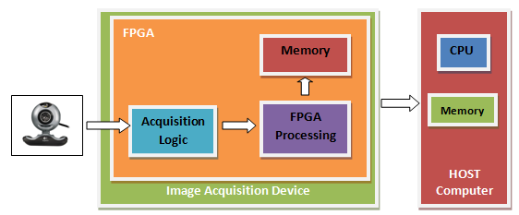
SS2: Image Acquisition FPGA Pre-processing
Stream video from camera through FPGA
Calculate location of LED 1 (cursor location)
If a second LED comes on calculate centroid between the two points.
Does the movement
correspond to a gesture?
FPGA outputs frame
coordinates to host
computer

Slide 15
SS2: Image Processing Output of FPGA
RGB
Image
Gray Scale Conversion
Output
Median Filter
Thresholding
Geometry Calculations
Object Identification
Development Software: Simulink & HDL Coder

Slide 16
Image Acquisition System
Success
Difficulties
Stream Video
Test FPGA functionality
Test a Simulink model with some filtering
Interfacing the camera with FPGA
HDL coder from a Simulink model
FPGA Logic Gates
Clock Speed

Slide 17
SS3: Host Computer
SS4
SS2
SS1
SS3

Slide 18
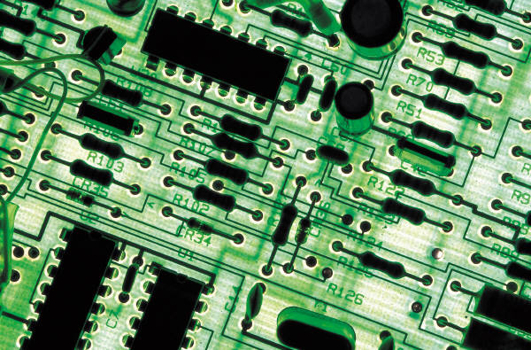
SS3: Host Computer
Requirements:
Current consumer grade PC with Windows OS
Free USB/Serial ports
Goals:
Plug N Play style system
All heavy computing not on PCs CPU

Slide 19
SS3: Driver
Coding in C++
Takes input from two I/Os
Handles movement and gestures

Slide 20
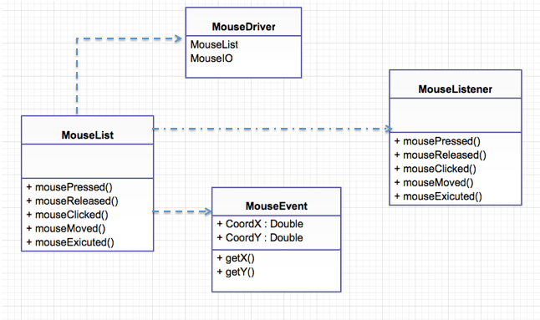
Class Diagram Mouse Driver

Slide 21
Host Computer
Success
Difficulties
Integrate driver with USB ports
Read in and modify information from I/O ports
Listening to two ports simultaneously
Integrating gestures that will flag different commands

Slide 22
Design Overview
SS4
SS2
SS1
SS3

Slide 23
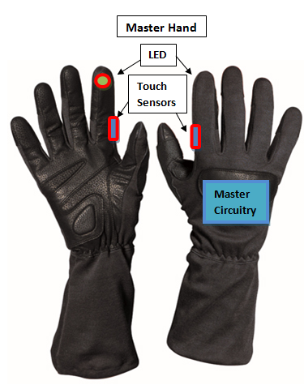
SS4: Gloves
Master Hand
Bluetooth Module
Gyroscope and Accelerometer: MPU-6050 by InvenSense
Microcontroller: Stellaris LM4F120
Near-IR LED (940nm & 30˚ viewing angle)
Touch sensor
Battery and Voltage regulating circuit

Slide 24
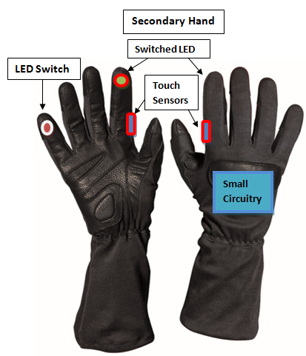
SS4: Gloves
Secondary Hand
Near-IR LED (940nm & 30˚ viewing angle)
Touch sensor
Battery

Slide 25

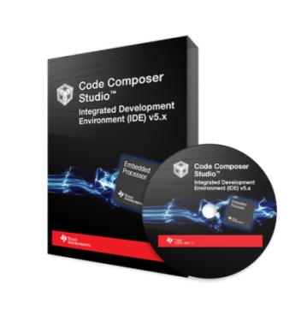
Development Environment
Code Composer Studio
Arduino IDE
C/C++ and Assembly
More Debugging options.
Direct access to control registers
Flexible clock system, Low power options, interrupt friendly
Limited support
Free (Code limited)
Arduino wiring language
Simple and easy to use, but limited Debugging options
Fixed Clock speed and no power options
Wealth of user support and existing code libraries
Free

Slide 26
Development Environment
Code Composer Studio
Arduino IDE
C/C++ and Assembly
More Debugging options.
Direct access to control registers
Flexible clock system, Low power options, interrupt friendly
Limited support
Free (Code limited)
Arduino wiring language
Simple and easy to use, but limited Debugging options
Fixed Clock speed and no power options
Wealth of user support and existing code libraries
Free

Slide 27

MCU
MSP430g2553
Stellaris LM4F120
Arduino UNO
3.3V
16 MHz
UART, I2C, SPI
4.30$
DIP
3.3V
80 MHz
UART, I2C, SPI
12.99$
LQFP
5v
16 MHZ
UART, I2C, SPI
29.95$
DIP

Slide 28
MCU
MSP430g2553
Stellaris LM4F120
Arduino UNO
3.3V
16 MHz
UART, I2C, SPI
4.30$
DIP
3.3V
80 MHz
UART, I2C, SPI
12.99$
LQFP
5v
16 MHZ
UART, I2C, SPI
29.95$
DIP

Slide 29
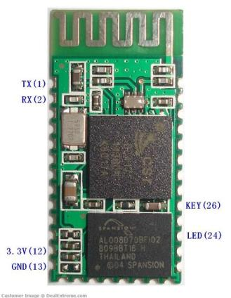
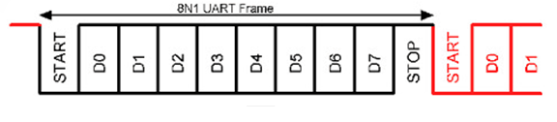
Bluetooth TTL transceiver module
Bluetooth V2.0
3.3V input voltage
8mA once connected
UART w/ Baud rate up to 115200
Low cost. 10$
2 wires RXD, TXD.

Slide 30
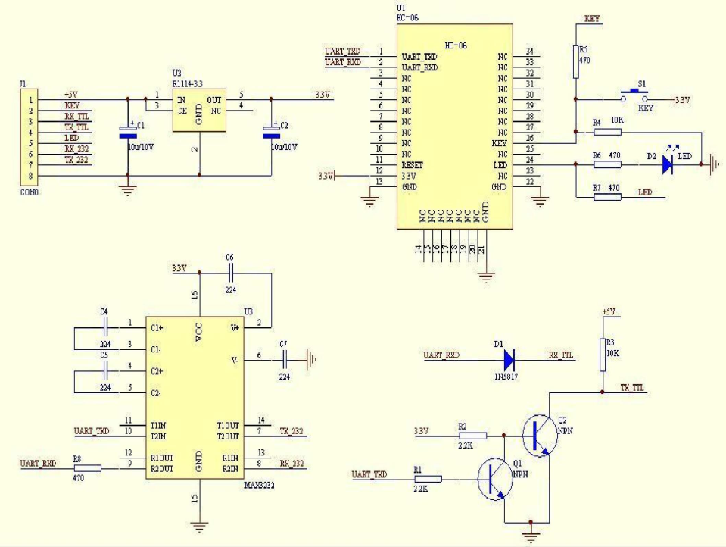

Slide 31
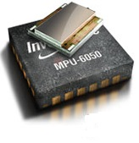
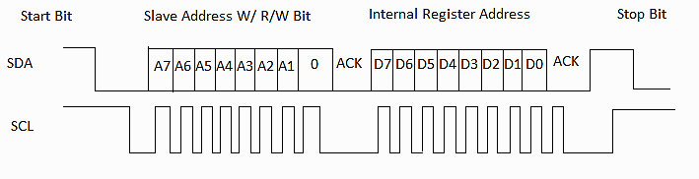
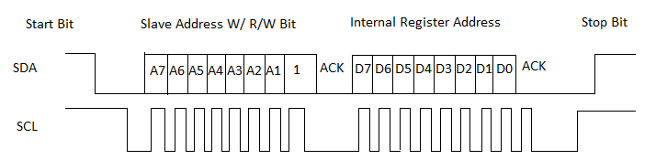
MPU-6050
Tri-Axis gyroscope and accelerometer
3.3V input voltage
3.8 mA (Gyro + Accel No DMP)
Programmable interrupts
Fast I2C communications (400kHz)

Slide 32
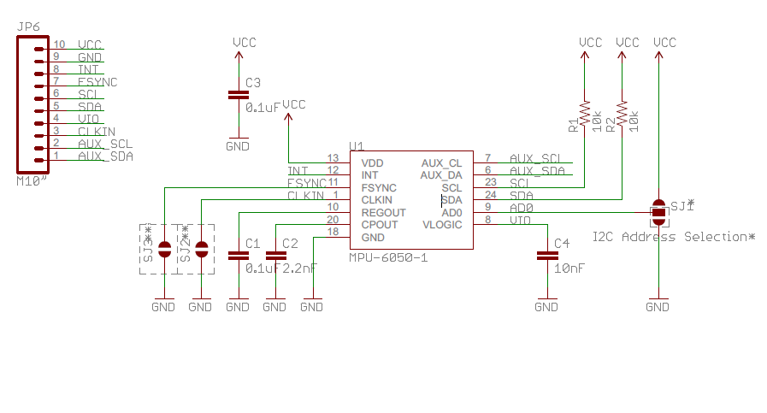

Slide 33
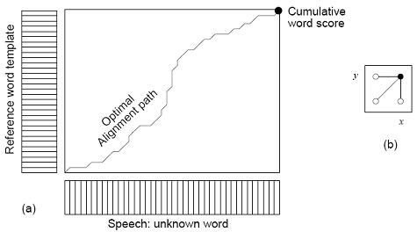
Dynamic Time Warping
Compare two time-signals with variable speeds.
Algorithm is of O(n²)
Modifications to better perform in MCU RISC structures.
Note: During algorithm execution the Stellaris’ Master clock is ramped up to 80MHz.

Slide 34
Gloves
Success
Difficulties
Dynamic time warping algorithm ported to C language
Interface with Bluetooth module
Configuring MPU’s basic functions
Inconsistent results with I2C.
Testing the efficiency of DTW algorithm on Gyro data
Optimize code for low power

Slide 35
Stellaris Power Requirements
Power Reqs for Stellaris LM4F
3.3v Vcc
Run mode 1 (Flash loop): nominal 50 mA w/ all peropherals ON and System clock = 80 MHz
Sleep mode: 4.5 mA
Power source:
3.7v Lithium-ion battery.
Buck (step-down)-Boost(step-up) Converter

Slide 36
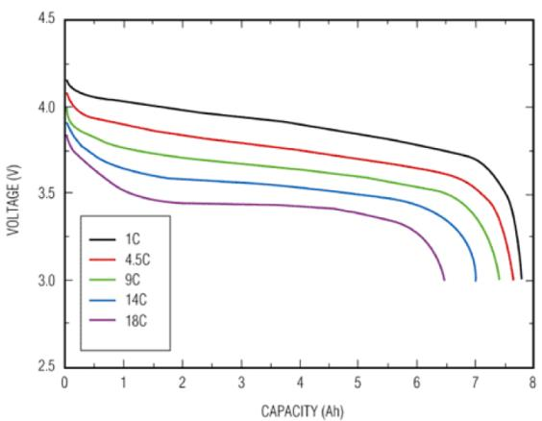
Li-ion Battery characteristics
Variable voltage throughout battery discharge cycle
Can drop below regulated voltage

Slide 37
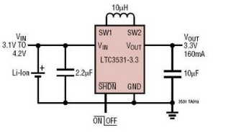
Voltage regulation
LTC3531 - 200mA Buck-Boost Synchronous DC/DC Converters Features:
Regulated Output with Input Above, Below or Equal to the Output
Single Inductor
Up to 90% Efficiency
VIN Range: 1.8V to 5.5V

Slide 38
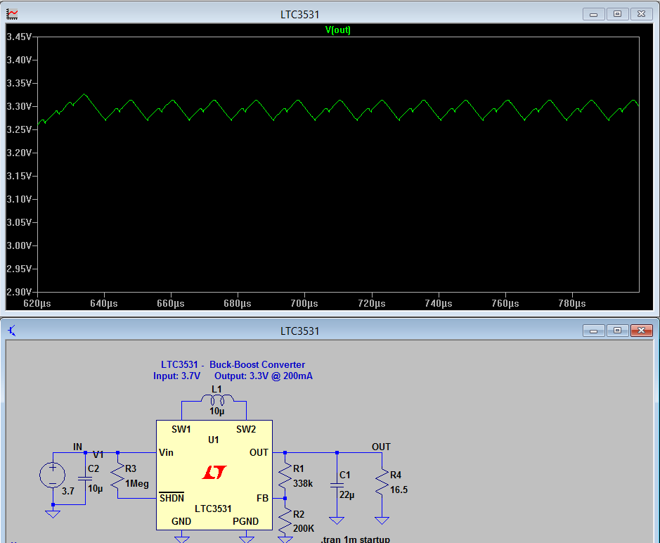

Slide 39
Budget and Financing
Date | Name | Part | Price
Sep 3 | Pamela G./Martin R. | MPU 6050 x 2 | $21.00
Sep 3 | Evianis Cruz | Bluetooth Module r2232 | $11.96
Nov 18 | Pamela Garcia | Basys2 | $58.89
Oct 5 | Martin R./Landon S. | Stellaris Launchpadx2 | $4.78
Jan 20 | Martin Rodriguez | MPU 6050 | $12.86
Nov 18 | Pamela Garcia | Near-IR LEDs | $9.92
Jan 20 | Evianis Crus. | Li-Ion Battery | $13.95
Jan 21 | Martin Rodriguez | LTC1147-3.3 | $5.25
Jan 21 | Martin Rodriguez | EEPROMs | 7.98
 |  | Other | $50.00
 |  | Total: | $196.59
Total Spent so Far: $196.59 Expected Budget: $400.00
Self-Funded: $100 per member

Slide 40
Project Progress

Slide 41
Questions?

