Slide 1

Gesture Recognition
Interface Device
Group 22:
Martin Rodriguez
Landon Splitter
Evianis Cruz
Pamela Garcia

Slide 2
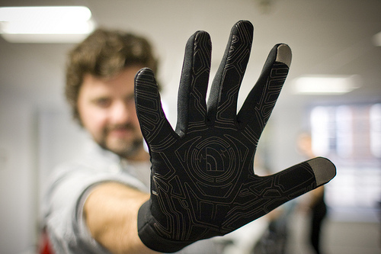
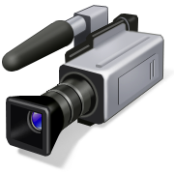
Project Introduction

Slide 3
Motivation and Goals
Motivation- To provide the user with a natural and less restrictive way to communicate with the computer.
Goal – To design an intuitive device with high responsiveness to make the experience continuous, as opposed to fragmented.

Slide 4
Project Requirements and Specifications
Camera Operating Range: up to 15ft.
Weight < 250g
Battery Life > 10 hrs
Response Time/Gesture Recognition < 2 sec
Low Cost < $400.00

Slide 5
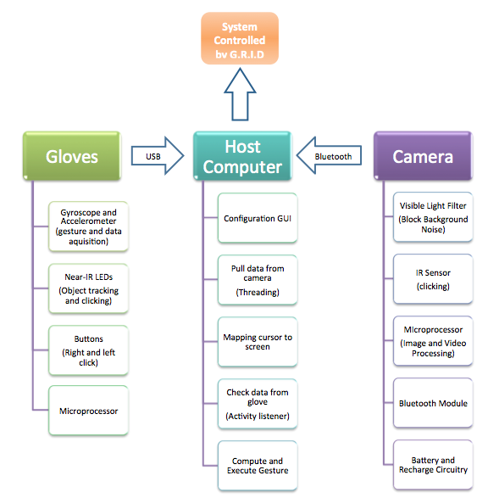
Design Overview
SS3
SS2
SS1

Slide 6
SS1: Camera
SS3
SS2
SS1

Slide 7
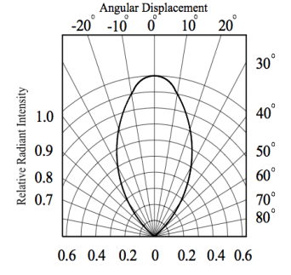
Near-IR LED
Digi-Key
Description | Size | Dominant Wavelength (nm) at 50 mA | Forward Voltage (V) | Viewing angle (deg)
Side Face IR-LED | 1.5 mm | 940 | 1.2 | 60

Slide 8
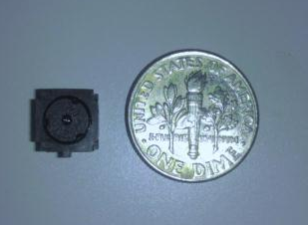
SS1: IR Sensor
Resolution: 1024x768
Operating voltage: 3.3V
Communication: TTL
Near-IR LED tracking
Tracking LED at 500 kHz

Slide 9
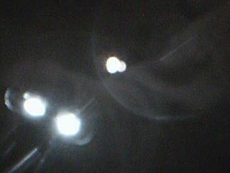
SS1: Visible Light Filter
Goal:
Block background noise (visible light) and allow
the near-IR wavelengths to reach the camera
sensor.
Approach:
Install visible light filter

Slide 10
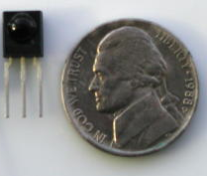
SS1: IR-Receiver
Left Click – 38 kHz for 600 μs
Right Click – 38 kHz for 1.2 ms

Slide 11
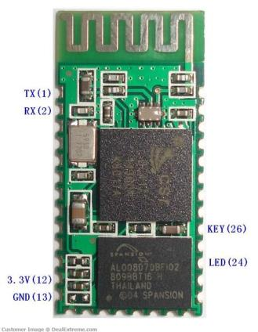
Bluetooth TTL transceiver module
3.3V input voltage
8mA once paired
UART w/ Baud rate up to
115200
2 wires (RXD & TXD)
Low cost
39.8 mm

Slide 12
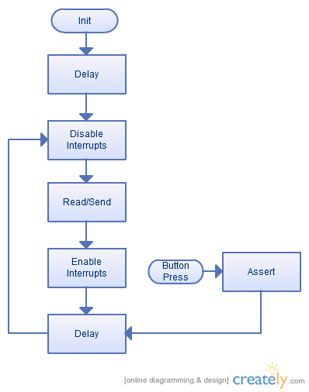
SS1: MCU

Slide 13
SS2: Host Computer
SS3
SS2
SS1

Slide 14
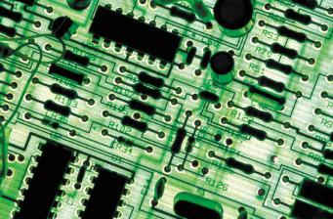
SS2: Host Computer
Requirements:
Current consumer grade PC with Windows OS
Open USB/Serial ports
Goals:
Plug N Play style system
All heavy computing not on PCs CPU

Slide 15
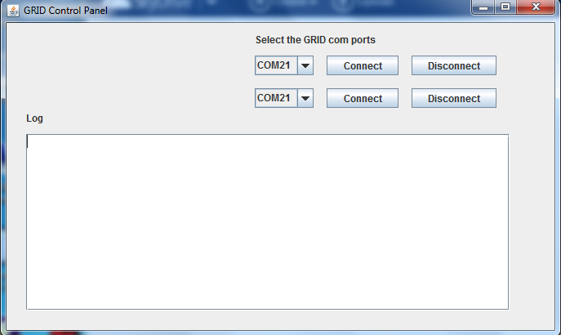
SS2: Driver
Coding in Java
Takes input from two I/Os
Handles movement and gestures

Slide 16
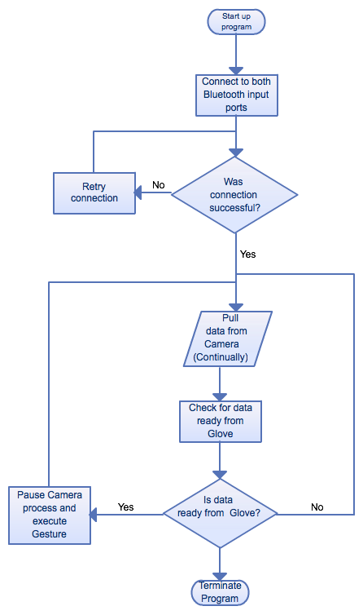
Driver Flow Chart

Slide 17
Gesture Library
Clicking
Zooming in and out
Rotation
Swiping in any direction
Refresh
Multimedia Gestures:
  Play
  Fast-Forward
  Rewind
  Pause

Slide 18
Host Computer Difficulties
Mouse movement smoothing
Developing gestures to be cross platform
Developing gestures for universal use

Slide 19
Design Overview
SS3
SS2
SS1

Slide 20
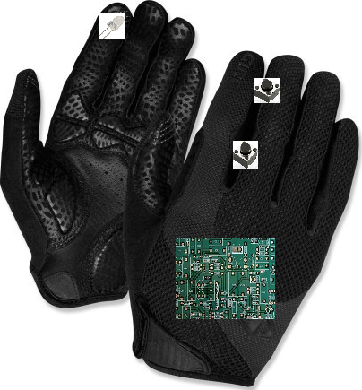
SS3: Gloves
Gyroscope and Accelerometer: MPU-6050 by InvenSense
Microcontroller: Stellaris LM4F120
Near-IR LED (940nm & 30˚ viewing angle)
Buttons

Slide 21
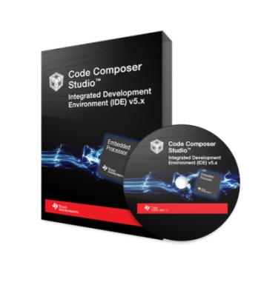
Development Environment
Code Composer Studio
  C/C++ and Assembly
  More Debugging options.
  Direct access to control registers
  Flexible clock system, Low power options, interrupt friendly
  Limited support
  Free (Code limited)

Slide 22
MCU
Stellaris LM4F120
  Low power
  80 MHz
  UART, I2C, SPI
  LQFP

Slide 23
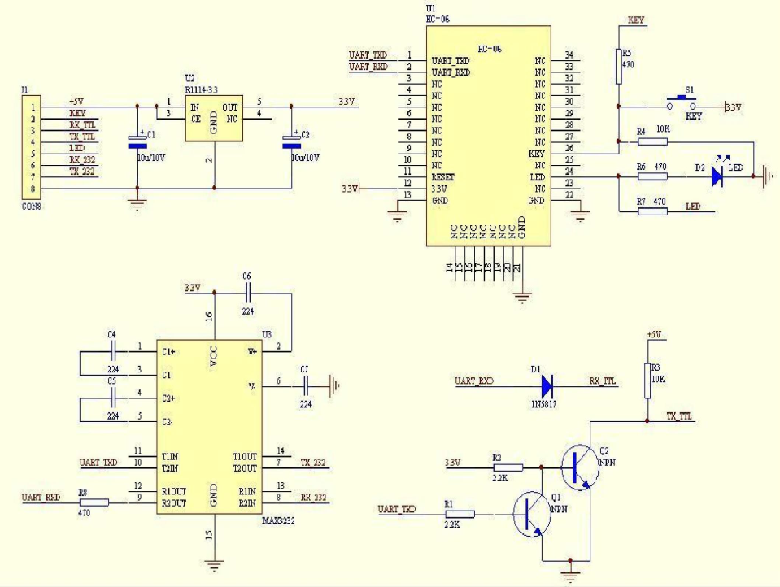

Slide 24
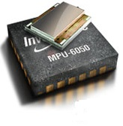
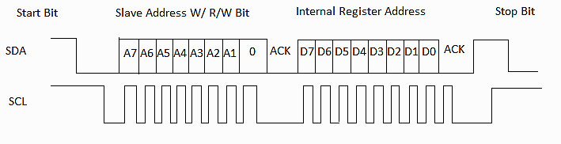
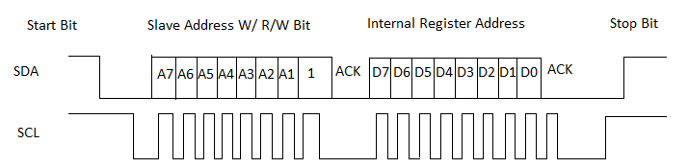
Tri-Axis Gyroscope and Accelerometer
InvenSense-MPU-6050
Low Power Consumption
Programmable interrupts
Fast I2C communications (400kHz)

Slide 25
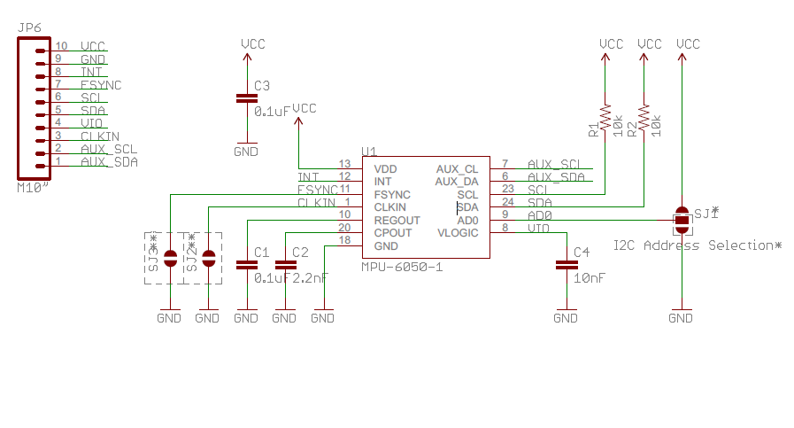

Slide 26
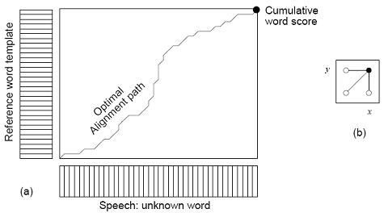
Dynamic Time Warping
Compare two time-signals with variable speeds.
Algorithm is of O(n²)
Modifications to better perform in MCU RISC structures.
Note: During algorithm execution the Stellaris’ Master clock is ramped up to 80MHz.

Slide 27
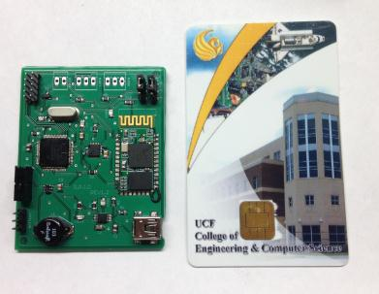
Glove Difficulties
Bluetooth Module
Testing the efficiency of DTW algorithm on Gyro data
Optimize code for low power
Gesture Recognition Accuracy
PCB

Slide 28
Glove Power Requirements
  Stellaris Current Usage:
  50 mA (all peripherals on and system clock @ 80 MHz)
  Sleep mode: 4.5 mA
  Power source: Input Voltage: 5V (USB)
Device | Input Voltage Range
Stellaris | 3.1V - 3.6V
MPU 6050 | 2.3V – 3.4V
LED | 1.2V – 1.5V

Slide 29
Camera Power Requirements
Device | Input Voltage
MSP430 | 1.8V – 3.6V
Pixart IR Sensor | 3.3V
Bluetooth Module | 3.3V
Battery Charger | 2.5V and 5.5V
Charge Controller | 5V
Power Source: Battery and Recharge Circuitry

Slide 30
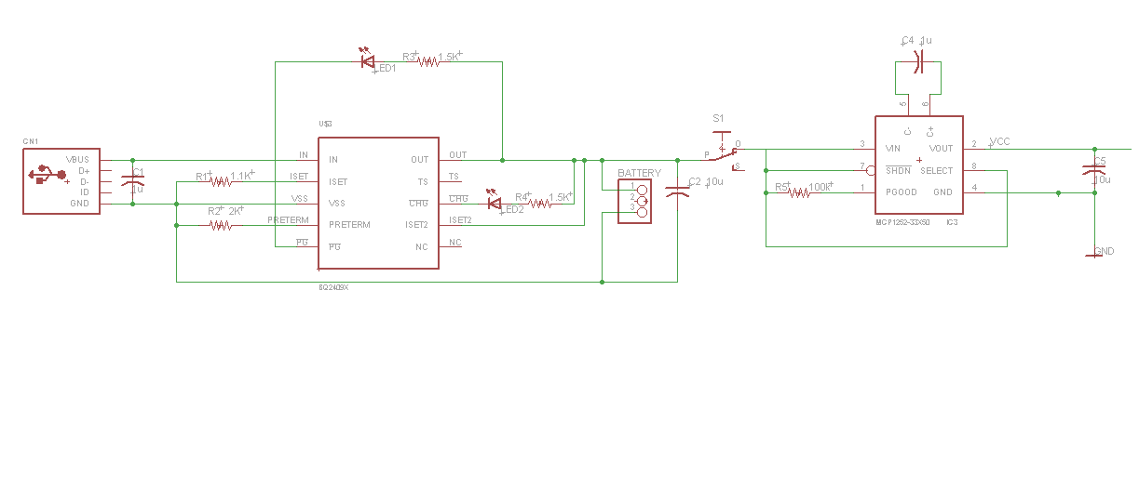
Camera Power Supply
USB Power Supply
(5V)
BQ24090
Battery Charger
Li-Ion
Battery (3.7V)
SPDT
Switch
MCP1252
Charge Controller
Output regulated to 3.3V

Slide 31
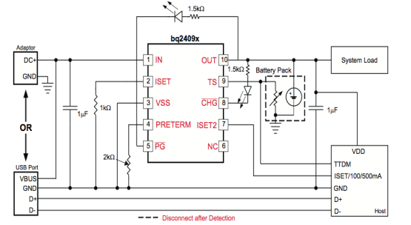
Battery Charger
Texas Instrument-BQ24090
Single cell Li-Ion and Li-Pol Battery charger
1% Charge Voltage Accuracy
10% Charge Current Accuracy
Status Indication:
  Input Voltage is good (Green)
  Charging in
  process (Red)

Slide 32
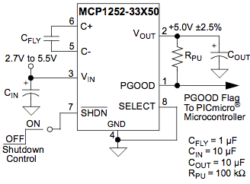
Charge Controller
Microchip- MCP1252
Positive-regulated charge pump DC/DC converters
Inductorless design
Vin range: 2.5V and 5.5V
Regulated fixed voltage: 3.3V
Output Current: Up to 120mA
Efficiency: 90%

Slide 33
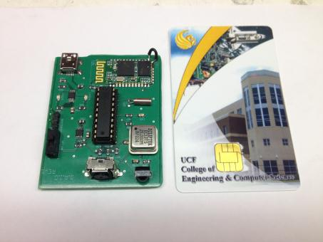
Camera Printed Circuit Board (PCB)
Dimensions: 2" X 2.5"
2 layer lead free PCB of .062 thickness
Traces contain a standard 1 oz of copper
  Withstand a maximum current of 75 mA

Slide 34
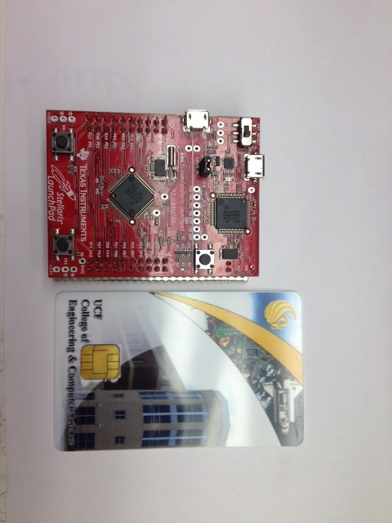
Glove Printed Circuit Board (PCB)
Dimensions: 2" X 2.5"
Proto board
Stellaris Launchpad

Slide 35
Budget and Financing
Part | Price
MPU 6050 x 2 | $21.00
Bluetooth Module r2232 x5 | $59.80
Stellaris Launchpad x2 | $26.00
MPU 6050 | $12.86
Near-IR LEDs | $9.92
Li-Ion Battery x2 | Donation
IR Sensor | Donation
LTC1147-3.3 | $5.25
EEPROMs | $7.98
SMT Resistors, Capacitors, and LEDs | $15.00
Battery Charger | Sample
Charge Controller | Sample
PCBs | $100.00
Other | $100.00
Total: | $357.81
Self-Funded: $100 per member Expected Budget: $400.00

Slide 36
Questions?

