Slide 1

ABEC
Autonomous Brilliantly Engineered Cooler
Marc Bianco
Andrew Boyles
Chris Echanique
Garrett Lee
Sponsored By
Group #23

Slide 2
Description
ABEC is, in essence, an autonomous cooler on wheels that addresses the common tailgating issues such as transporting heavy loads across long distances
It features a GPS tracking system to track the user’s smart phone and directs its path according to the user’s position
It uses motion sensors to handle object interferences by rerouting the station’s path
Its sustainable energy framework uses a solar panel to provide renewable energy to the vehicle

Slide 3
Requirements
Shall sync with phone via Bluetooth
Shall track user through cell phone and onboard GPS
Shall follow user autonomously
Shall be able to switch to remote control via mobile application
Shall avoid obstacles as necessary
Shall recharge battery using solar panels or wall outlet

Slide 4
Specifications
Carry up to 130 lbs.
Move at least 2 mph
Must detect obstacles at least 3 feet away
Max range of up to 50 feet from user
GPS tracking accurate to 15 feet
Operate for up to 6 hours on one charge

Slide 5
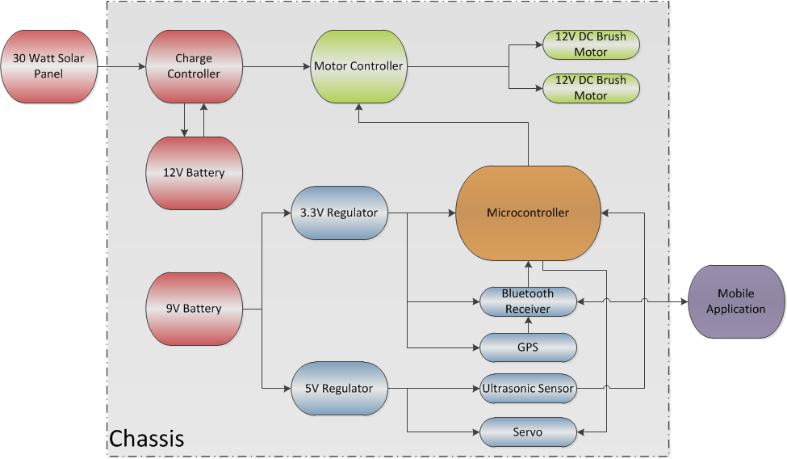
Block Diagram

Slide 6
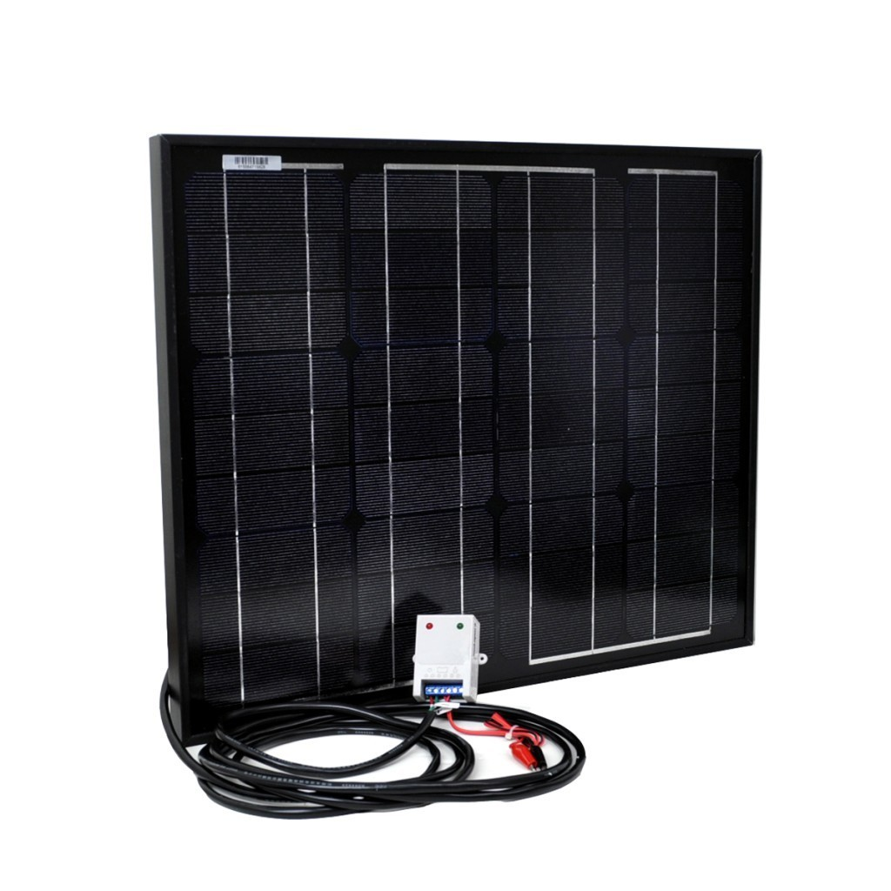
Power Supply For Motors
Uses 30 watt mono-crystalline solar panel
12V sealed lead acid battery
9.5 Ah capacity
Responsible for supplying power to motors and motor controller

Slide 7
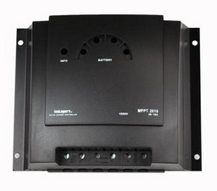
Charge Regulation
Solarix MPPT 2010 charge controller
A charge controller will be used in the solar panel interface to charge the battery more efficiently
Monitors batteries voltage
Controls the charging process
Controls connection of loads connected to the load output

Slide 8
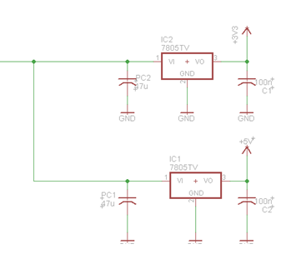
Voltage Regulators
LM7805 5V regulator
Max Vin: 15V
Max Vout: 5V
LD117V33 3.3V regulator
Max Vin: 15V
Max Vout : 3.3V

Slide 9
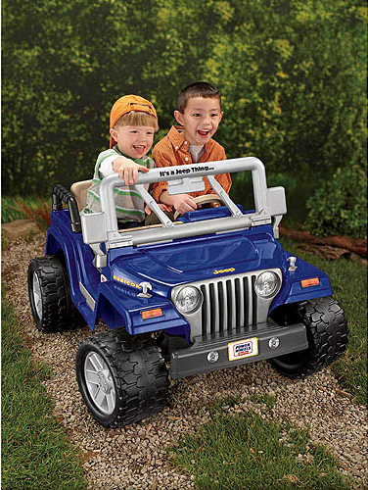
Chassis
A Fisher Price Power Wheels will be used as the chassis.
130 pound weight limit.
5 mph max speed
45”L x 33”W x 28”H

Slide 10
Advantages of Power Wheels
Save a considerable amount of time by not having to build it ourselves.
Guarantee a sturdy chassis, which has a specified weight limit.
The Power Wheels came with motors, which are already mounted on the back wheels.
Comes with a 12 volt battery and charger.

Slide 11
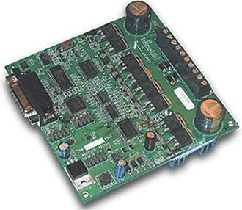
Motor Controller
 | AX1500 | SDC 2130 | RB-Dfr-207
Manufacturer | Roboteq | Roboteq | Infineon
Operating Voltage | 12 to 40 Volts | 7 to 30 Volts | 4.8 - 35 Volts
Max Current | 2 x 30 Amps | 2 x 20 Amps | 2 x 15 Amps
R/C Control | Yes | Yes | No
Serial Control | Yes | Yes | Yes
Datasheet/User Manual | Both | Both | Datasheet
Additional Features | RoboRun Software | - | -
4.2”L x 4.2”W x 1.5”H

Slide 12
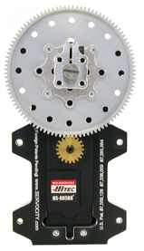
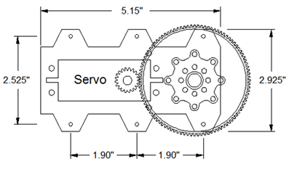
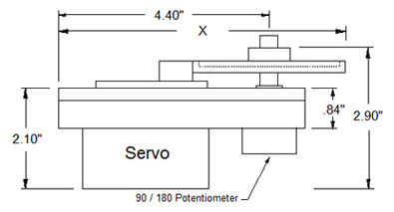
Servo System
SPG805A Standard Rotation Servo
Can produce 1,375 oz-in. of torque operating at 5V
Arduino Servo Library used to generate servo control signals

Slide 13
Servo Issues and Solution
Problems with servo rotating when it hits resistance
When servo cannot reach its limit it spins freely in the other direction
Solution was to rotate the wheels at different speeds
Motor controller allows each motor to be controlled independently

Slide 14
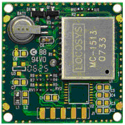
On board GPS
A GPS module will be used in conjunction with a digital compass to obtain the position of the vehicle
The positioning data will be transferred to the microcontroller and the user for tracking
30mm x 30mm
GPS Receiver

Slide 15
GPS Receiver
 | LS20031 | VPN1513 | IT430
Manufacturer | Locosys | Parallax | Fastrax
Channels | 66 | 20 | 48
Time to First Fix | 35 seconds | 42 seconds | 35 seconds
Operating Voltage | 3 to 4.3 Volts | 4.5 to 12 Volts | 1.8 Volts
Interface | TTL Serial | Serial | I2C, SPI, UART
Position Acuracy | 3 m | 10 m | 2.5 m
Position Information | 5 times a second | 1 time per second | 1 time per second

Slide 16
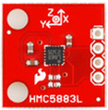
3-Axis Digital Compass
15 Dollars
Operating voltage = 2.16 to 3.6 volts
Low Power Consumption: 100 μA
I2C Serial Interface
Arduino example code available
HMC5883L
17.78mm x 17.78mm

Slide 17
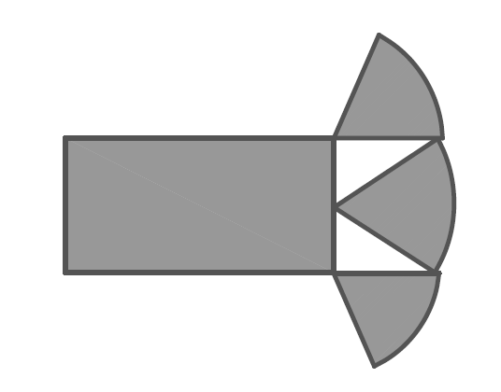
Obstacle Detection
Work Outdoors
45 degree viewing angle
Front Range at least 5 feet

Slide 18
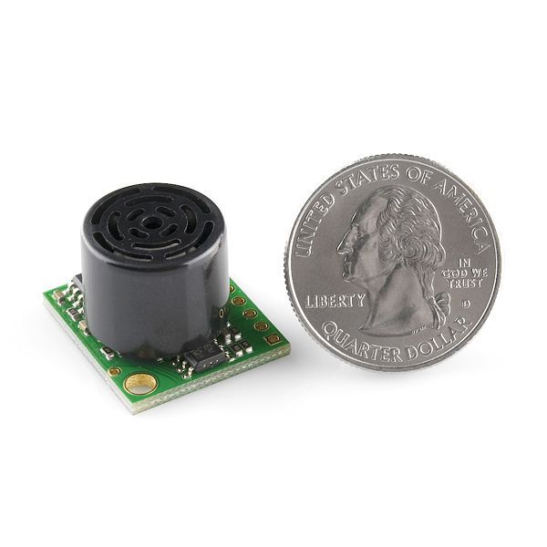
Ultrasonic Sensor
 | LV-EZ1 | SRF04
Manufacturer | Maxbotix | Devantech
Price | $24.95 | $29.50
Range | 0-256in. | 1.18in.-118in.
Sensitivity | 0.25 in. | 1.18 in.
Current | 2mA | 30mA
Interface | Analog, PWM, Serial | PWM

Slide 19
Bluetooth Receiver
Bluetooth generally uses less power
Bluetooth is cheaper
Bluetooth is effective at short ranges
Range: Class 1(300 ft.) vs. Class 2(50-60 ft.)

Slide 20
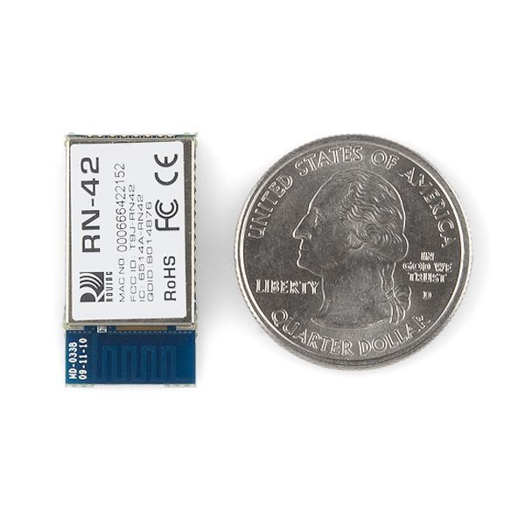
Bluetooth Receiver
 | RN-42 | WT12
Manufacturer | Roving Networks | Bluegiga
Price | $16 | $25
Version | 2.1 | 2.1
Data Rate | 300Kbps-3Mbps | 2-3Mbps
Interface | UART,USB | UART,USB,PCM
Operating Voltage | 3.3 Volts | 3.2 – 3.4 Volts

Slide 21
Microcontroller Comparison
 | MSP430G2553 | Atmega328
Manufacturer | TI | Atmel
Price | Free | $2.88
Memory | 16k | 32k
GPIO | 16 | 28
Analog Inputs | 8 | 8
DC Current | 220uA | 40mA
Interface | 1(I2C/UART/SPI) | 2(SPI), 1(I2C/UART)
Operating Voltage | 1.8 – 3.6V | 1.8 – 5.5V

Slide 22
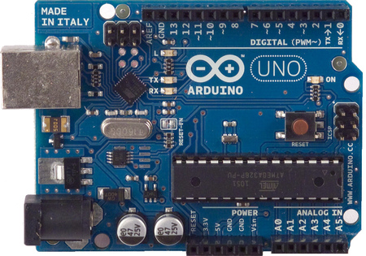
Arduino Uno
ATmega328P-PU microcontroller was chosen
Used Arduino Uno for programming and testing the microcontroller and individual subsystems
Utilizes C based programming language

Slide 23
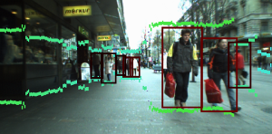
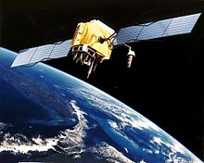
User Tracking
Infrared Sensors
Vision-Based Tracking
GPS Tracking
Notes:
Vision based tracking

Slide 24
GPS-Based User Tracking
Easy to implement
Can be done using mobile application
Additional features can be incorporated
  Remote control feature
No limit on distance between devices
Notes:
Not as complex as vision based tracking

Slide 25
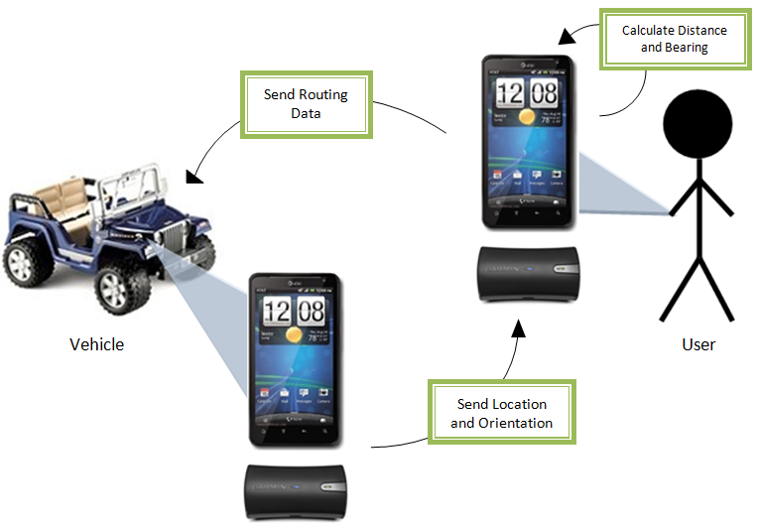
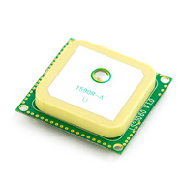

GPS-Based User Tracking
Bluetooth Connection
Notes:
GPS chip on the vehicle

Slide 26

Android Application
Java programming language
Abundance of APIs and open source code
No start up costs for SDK
a b e c
CONNECT BLUETOOTH
FORWARD
REVERSE

Slide 27
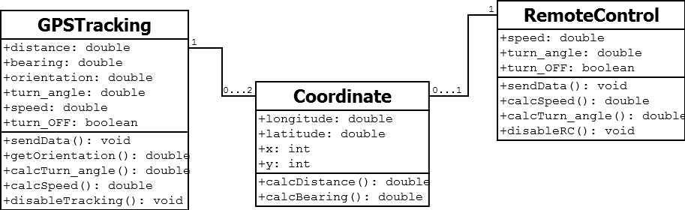
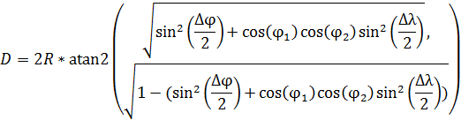
Software Design
Distance and Bearing Equations

Slide 28
Tracking Error
U_{GPS}
U_{real}
r_{e}
3 m
Expected Path
Calculated Path
V_{real}
After Tracking
r_{e}
V_{real}
3 m
Distance Error (<6m)
U_{GPS}
V_{GPS}
V_{GPS}
U_{real}

Slide 29
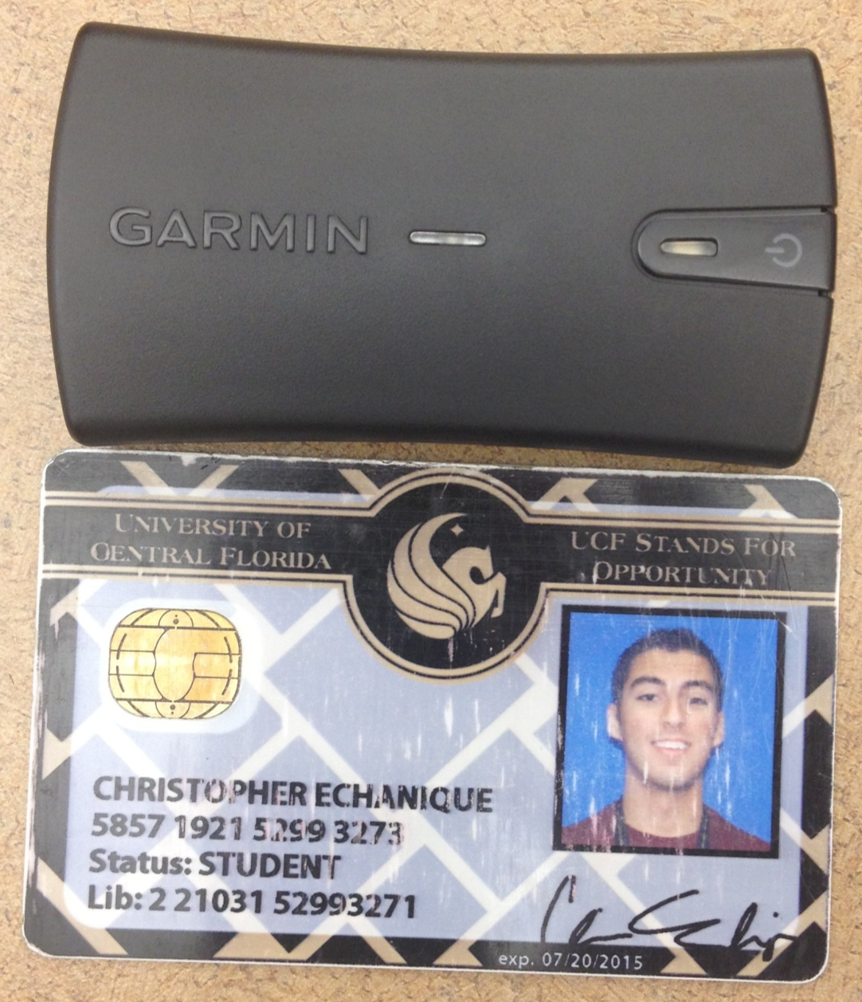
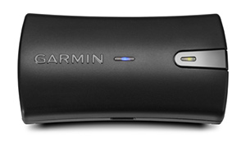
Garmin GLO
Garmin GLO™ Specifications
Unit Size WxHxD | .70" x 1.65" x 3.04" (1.78 x 4.19 x 7.72 cm)
Weight | 2.12 oz (60.1 g)
Receiver technology | GPS+GLONASS
WAAS | Yes
Update Rate | 10 Hz
Accuracy | 3 meters (9.54 feet)
Battery Capacity | 1100 mAh
Battery Life | 12 hours
Hot Start Time | 3-5s
Warm Start Time | 35s
Cold Start Time | 60s

Slide 30
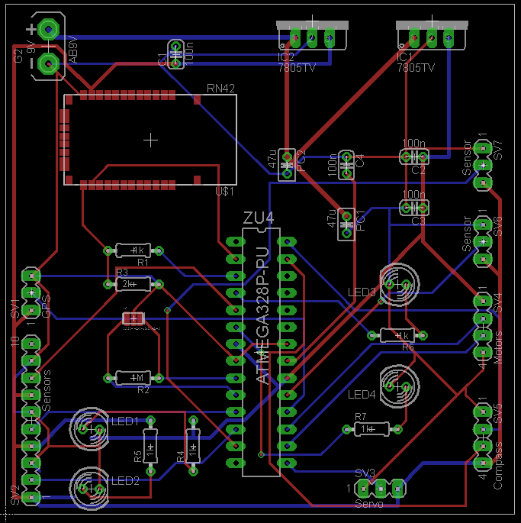
PCB
Created using Eagle PCB CAD software
Manufactured by Advanced Circuits
3” x 3” two layer board

Slide 31
Major Issues
Steering the vehicle with the SPG805 gearbox
Bluetooth on PCB could not send and receive data through the pins it was traced to
Integrating GPS tracking and remote control on one mobile application
GPS accuracy

Slide 32
Division of Labor
Power System/Steering Servo/PCB
  Marc Bianco, EE
Motor Control/Chassis/PCB
  Andrew Boyles, EE
Obstacle Avoidance/Integration/PCB
  Garrett Lee, EE
Mobile Application/GPS Tracking
  Chris Echanique, CE

Slide 33
Budget
Part | Projected Cost | Actual Cost
Motor Controller | $350 | $300
Solar Panels | $500 | $179
LED's | $10 | $9.65
Batteries | $75 | $50.13
Charge Controller | $200 | $92.5
Bluetooth | $20 | $16
Power Wheels | $250 | $360.49
Garmin Glo | $100 | $100
GPS & Compass | $100 | $80
Ultrasonic Sensors (3) | $75 | $75
ATMega328P | $5 | $2.88
Servo | $200 | $116
PCB | $66 | $105
Total | $1951.00 | $1486.65

Slide 34
Questions?

