Slide 1



Slide 2
Motivation
Medium Range Security for Protecting Assets
Off Grid Operation
Tactical Advantage Over Wired Systems
Quick Deployment and User Friendly

Slide 3
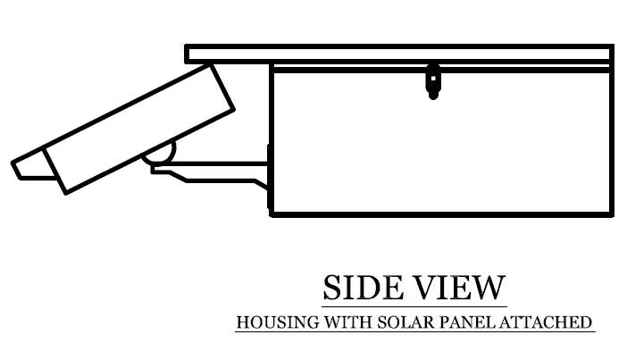
Goals and Objectives
Solar-Sufficient
Wi-Fi data transmission
Remote Desktop access
Remote Smartphone access
Self-contained weather resistant housing
Portable

Slide 4
Specifications
System | Parameter | Design Specification
Camera | Resolution | 0.3 Mega Pixel
Camera | Frame Rate | 30 fps
WIFI | Range | 20 m
WIFI | Encryption | WEP 128 or above
Applications | Platform | Android 2.2+
Solar Panel | Power output | 50 Watts
Battery | Life | 20+ Hours
Housing | Weather Resistant | Protected From Elements

Slide 5
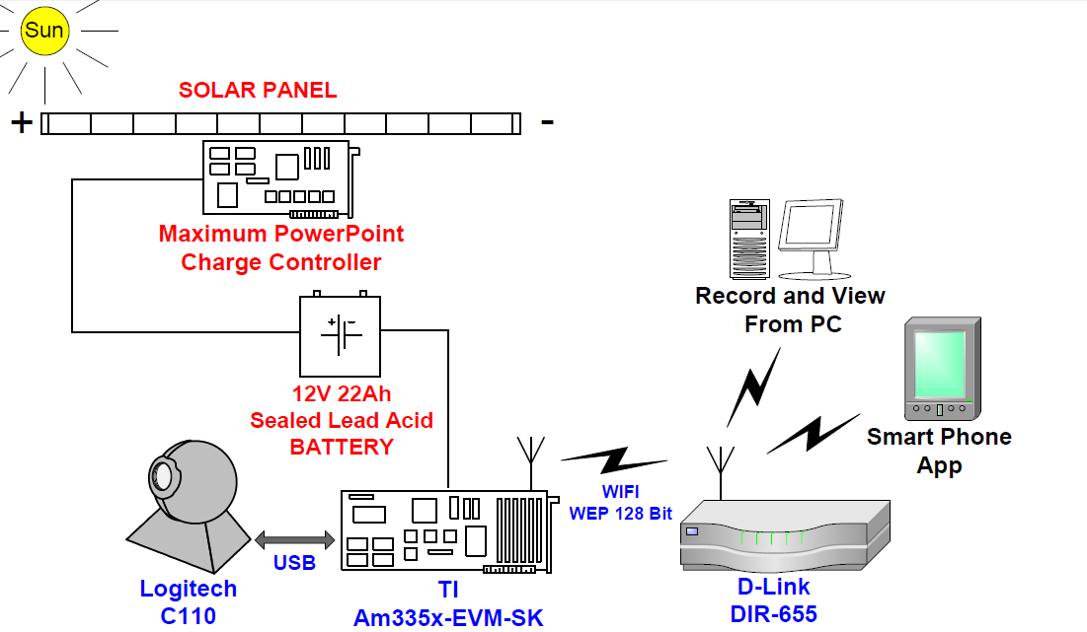
System Block Diagram

Slide 6
System Block Diagram

Slide 7
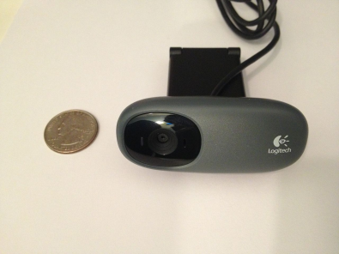
Camera
Logitech C110 Features
Supported by Linux Kernel
UVC Compliant (USB)
640 x 480p (30 fps)
68° Viewing Angle
Extremely Inexpensive
Low Power Consumption

Slide 8
TI Cortex-A8 Processor
Specifications Starter Kits
Linux Compatible
720 MHz (32b)
Capable of transcoding video
Power efficient
AM335X SK
BeagleBone
PandaBoard

Slide 9




Operating System
Linux Distributions
Android
Camera Compatibility
Windows CE
Steep Learning Curve
iOS
Not Freeware

Slide 10
Video Encoding
Saving Formats Streaming Options
MPEG4
Mjpeg
Can’t save in video format
FLV
High Memory Cons.
AVI
MJPEG
Broad client support
MPG4
Processor strain
Real Media
Real player required
QuickTime

Slide 11
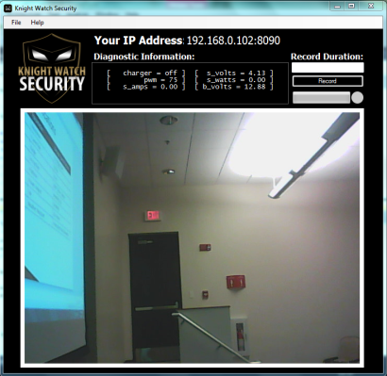
Video Streaming
MJPEG Streamer
Constantly refreshing stream of Jpeg images
Played through Firefox and Chrome
Preserves Video Quality (640x480 at 30 fps)
Simplifies Networking
Light on the CPU

Slide 12
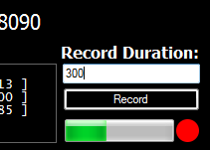
Saving Video
MPEG-4 Format
After transmitted, converted to MPEG-4
Saved on ‘home’ PC
Playable through QuickTime, Windows Media Player, VLC, etc.

Slide 13
System Block Diagram

Slide 14
Am335x Development
Ubuntu Linux Host Machine
TI Code Composer Studio
TI Am335x Development Suite
Cross Compiler
Board Development Features
Boot over LAN functionality
Angstrom Embedded Linux

Slide 15
Mjpg-Streamer
MJPG-streamer is a command line application to stream JPEG files over an IP-based network
OPEN SOURCE
Includes a small but powerful server to stream video
Streams well on our hardware at 640x480 resolution
Light on the CPU
Needed to be Cross Compiled for Arm

Slide 16
Saving Frames To SD Card
Using Mjpg-streamer and an 8GB memory card we save .jpg frames at 5Hz
Stores frames in a loop allowing for 2+ hours of record time
Leaving the frames uncompressed and separate keeps the processor demands low
With lower processor demands we use less power
Expandable to up to 12+ hours of recording

Slide 17
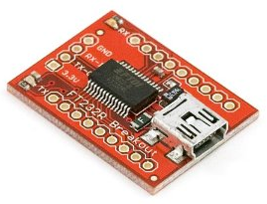
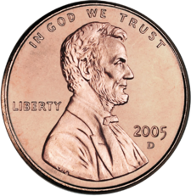
Solar Data Collection
A Linux script polls the Charge Controlling Circuit
The diagnostic data is read in through the USB every 2 seconds
Once the data is read in it is converted to a text file
The text file is then output to the web server where it can be read in by the user applications

Slide 18
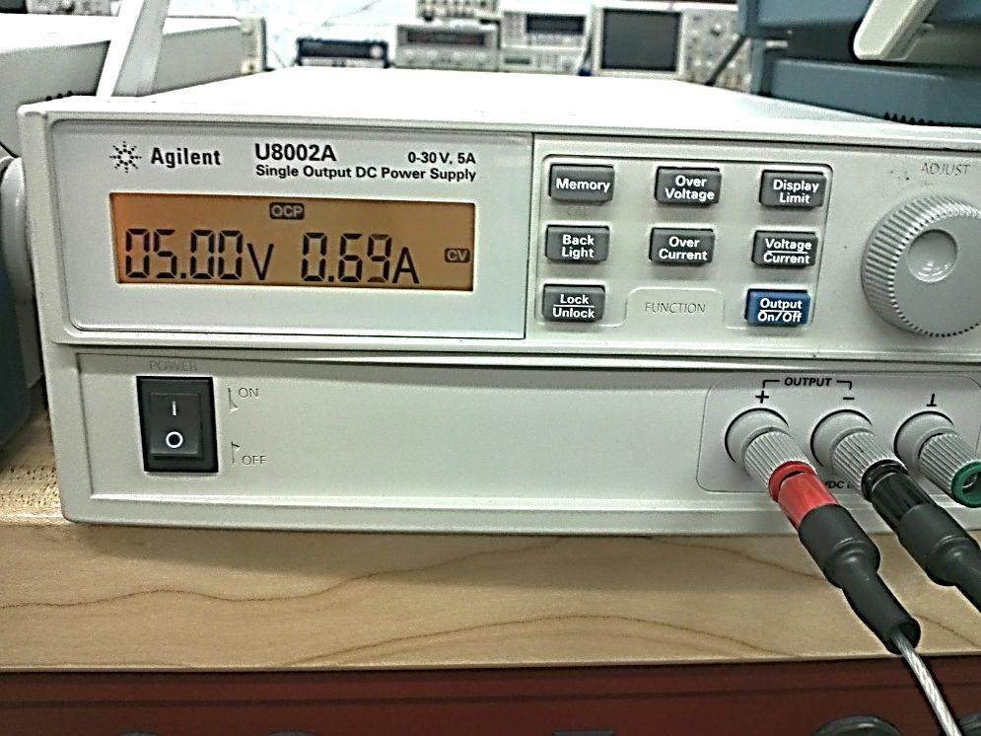
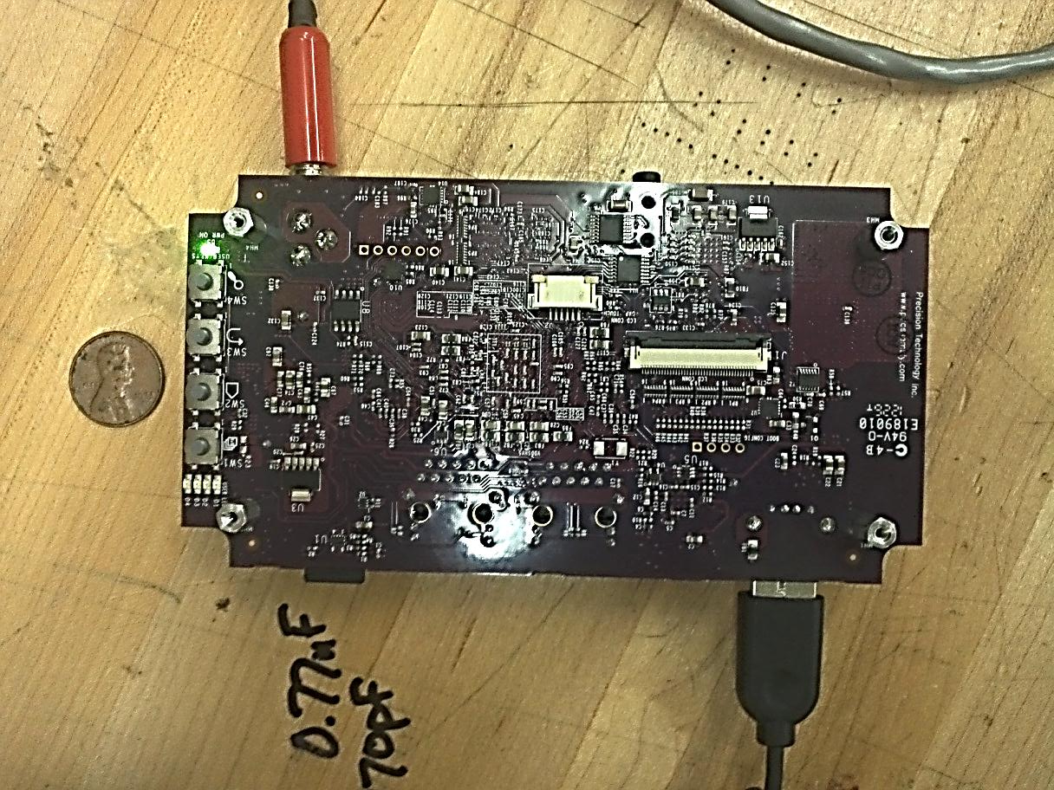
Reading taken while Streaming & Storing with WIFI enabled

Slide 19
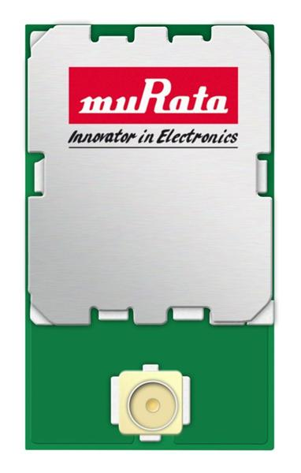
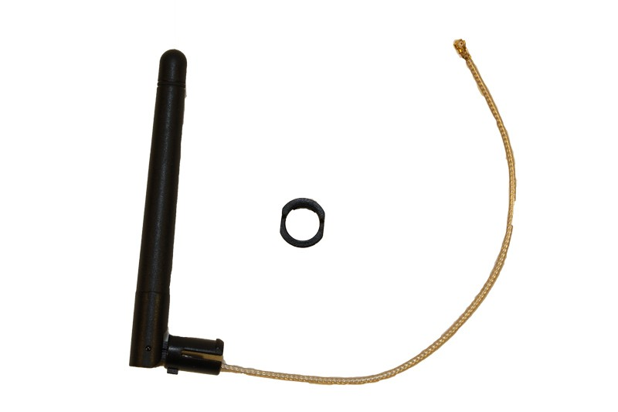

WIFI Link
The Am335x has an onboard LBEE5ZSTNC-523
The Wi-Fi card has a UFL port allowing us to add a 3 dBi external antenna
Link will be encrypted with WEP 128
17mm
10mm

Slide 20
System Block Diagram

Slide 21
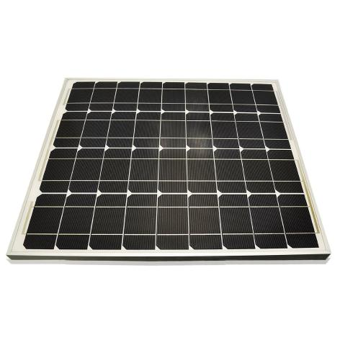
Solar Panel
50W Mono-crystalline
Low-cost and Efficient
Weight: 9.5lb
Dimensions: 24.4 x 25.3 x 1 inches

Slide 22
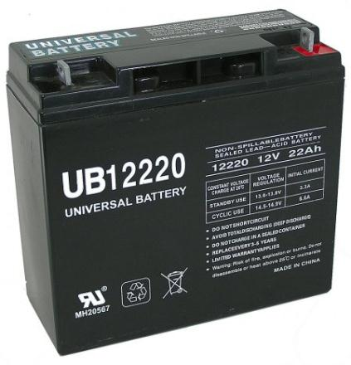
Battery
12V Sealed Lead Acid
Lightweight compared to other models (13lbs)
22 Ah sufficient for overnight functionality
Dimensions: 7.1 x 3 x 6.6 inches

Slide 23
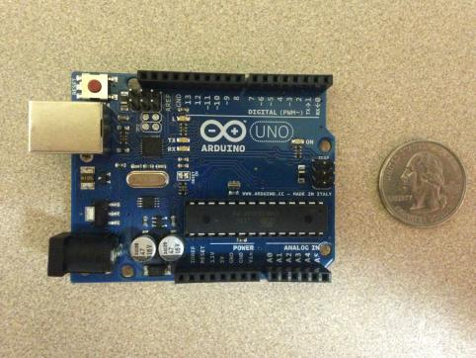
Charge Controller Prototype
Arduino Uno R3
Open sourced hardware platform based on Atmel ATmega328 microcontroller
Programmed with the MPPT algorithm

Slide 24
Charge Controller Circuit
DC/DC converter in buck configuration controlled by programmed Arduino MPPT algorithm
Prototype built on top of Arduino Protoshield
Designed to form fit on top of Arduino Uno development board
Brings all signals from Arduino Uno to prototype space

Slide 25
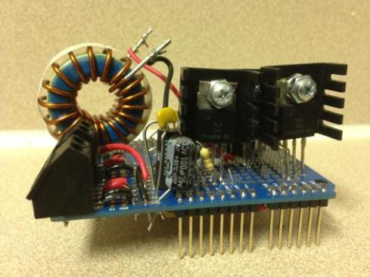
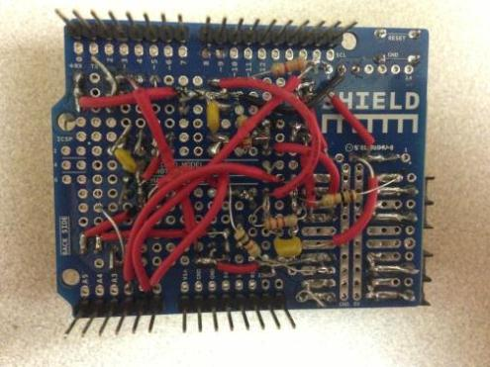
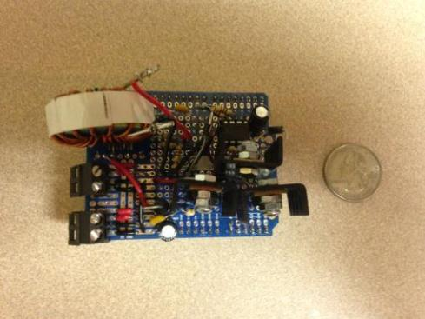
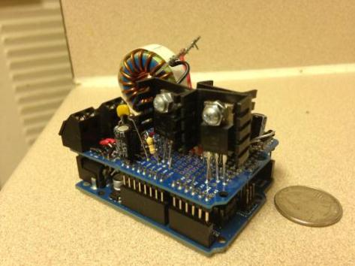

Slide 26
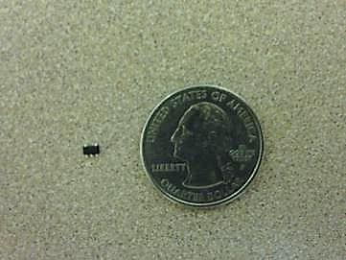
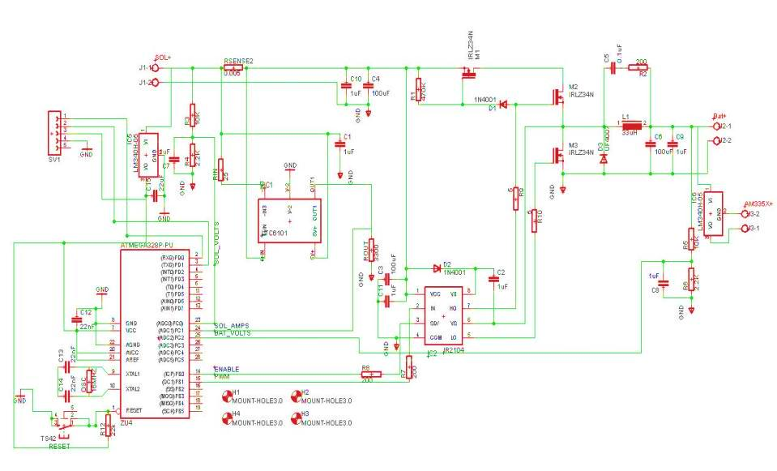
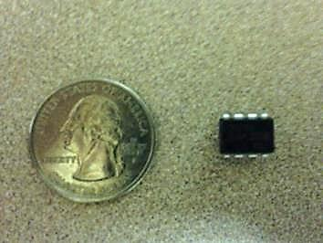
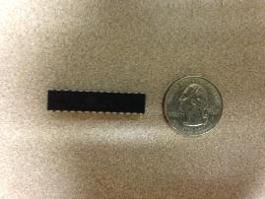
Charge Controller Eagle Schematics
Manufacturer | International Rectifier
Part No. | IR2104
Function: | MOSFET Driver
Price: | $2.68
Pin Count: | 8
Manufacturer | Linear Techonology
Part No. | LTC6101HV
Function: | Current Sense Amplifier
Price: | $4.84
Pin Count: | 5
Supply Voltage: | 5 to 100V
Manufacturer | Atmel
Part No. | ATmega328p
Function: | Microcontroller
Price: | $3.16
Pin Count: | 32
Supply Voltage: | 1.8 to 5.5V

Slide 27
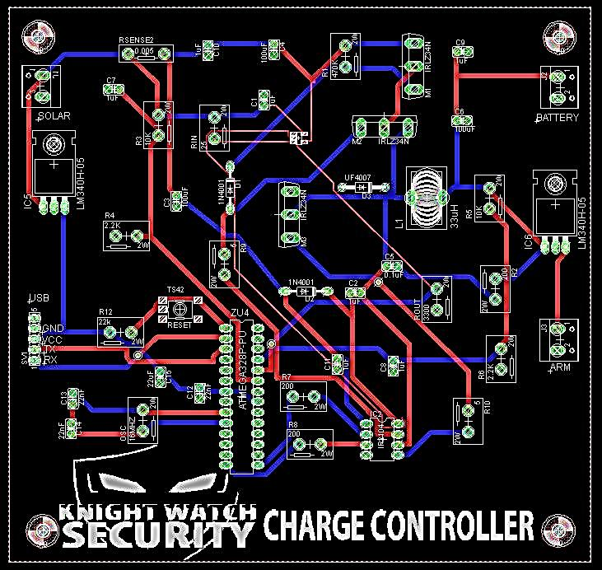

Slide 28
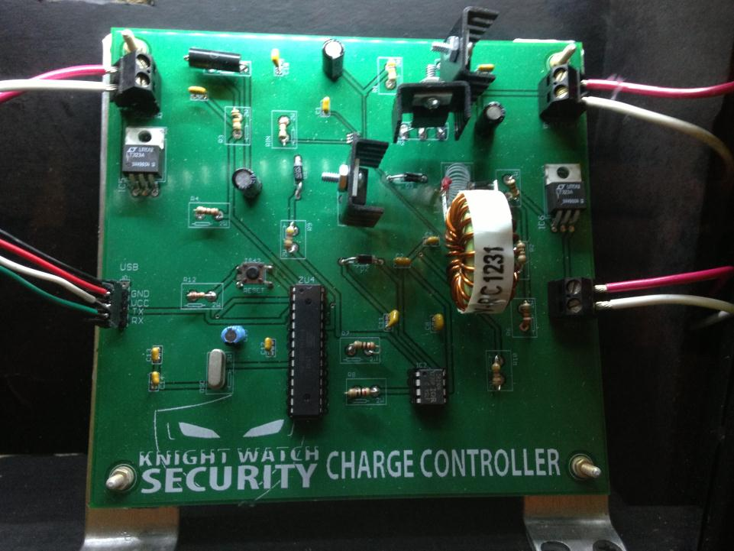

Slide 29

MPPT Algorithm
MPPT algorithm implemented to optimize peak performance
Programmed using Arduino software 1.0.3
Easy to implement and use (Free)
Programmed in C

Slide 30
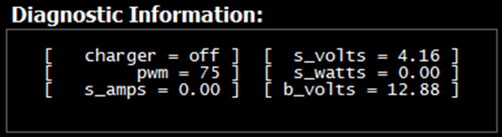
Algorithm Serial Output

Slide 31
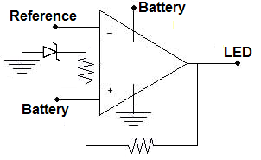
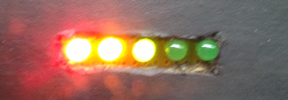
Analog Battery Status
Reads battery voltage and outputs to LEDs
Voltage Level | LED Color
9 | Red
10 | Yellow
11 | Green
12 | Green
13.5 | Green

Slide 32
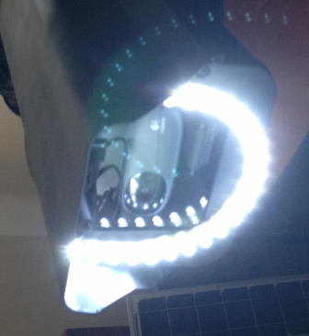
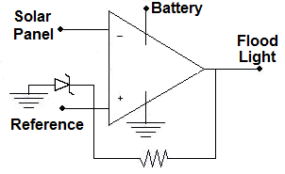
Automatic Flood Light
Reads battery voltage and solar voltage
When solar voltage drops below 5v the flood light is activated

Slide 33
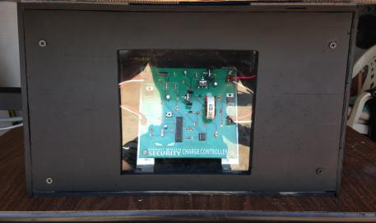
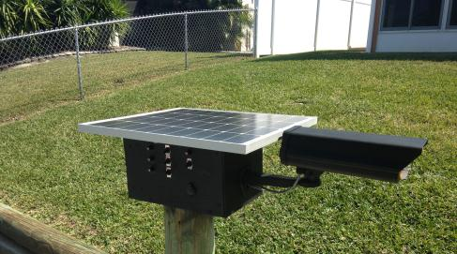
Housing
The equipment housing is secure and weather resistant
Incorporated a Plexiglas window
Allows viewing of battery status indicator
Allows viewing of PCB

Slide 34
System Block Diagram

Slide 35
Remote Monitoring
Objective:
Ability to view video stream
Access from anywhere
Simple and easy

Slide 36
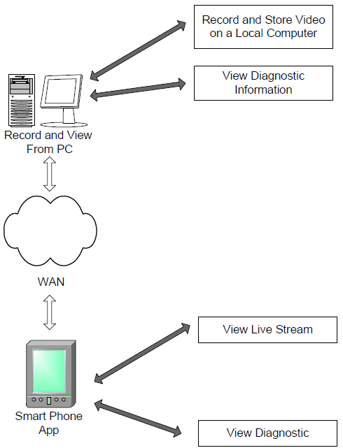
User Interface
Three ways to view video stream:
Internet Browser
Desktop Application
Android Application
Notes:
Add internet browser.
Remove view diagnostic info?
Change from “possible motion detection” to “motion detection”

Slide 37
Web Browser
Design:
Video access from anywhere with network access
Features:
User types IP address in address bar
Views video stream from browser.

Slide 38



Web Browser Requirements
 | Internet Explorer | Mozilla Firefox | Google Chrome
MJPEG Support | No | Yes | Yes
Loading Speed | Low | Moderate | High
Preference | Low | High | High
Desktop App Support | Yes | Yes | No

Slide 39
Desktop Application
Design:
A user-friendly base station application usable within the network.
Features:
View video stream
Record video stream
View Diagnostic Information

Slide 40
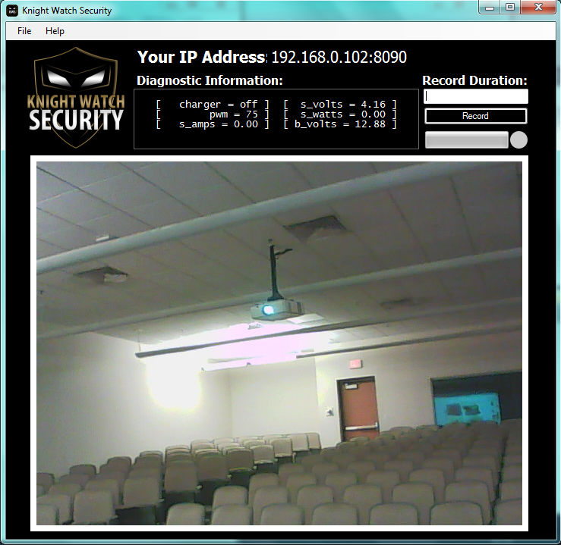

Slide 41
Desktop Application Development
Microsoft Visual Studio 2010 (C++)
Excellent for development and debugging
Great for GUI development
VLC Media Player
Open-Source cross-platform media player and streaming media server.
Supports many compression formats and streaming protocols
Stream over computer network
Transcode multimedia files

Slide 42
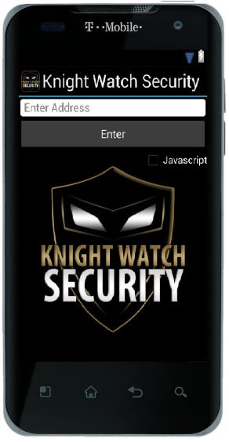
Android Application
Design:
An app that allows remote monitoring from an Android smartphone
Features:
View live video stream
View diagnostic information
Capture snapshot

Slide 43
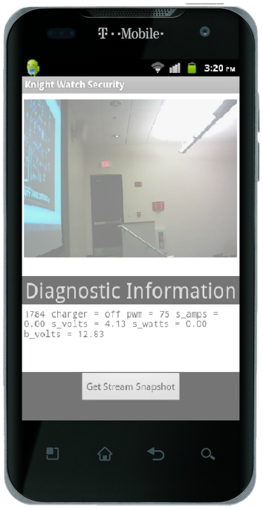

Slide 44

Android App Development
Development environment:
Android SDK
Android Development Tools (ADT) Plugin
Eclipse

Slide 45
Android App Development
Android Operating System
Lowest level: API 8-Android 2.2 (Froyo)
Highest Level: API 17-Android 4.2 (Jelly Bean)
Android Testing Devices
Android Virtual Device
LG-P999 (2.3.4)
Asus Eee Pad Transformer TF101 (4.0)

Slide 46
Administrative Content

Slide 47
Work Distribution
Name | Video Streaming/Recording | Video Processing | Power | PCB Design | Remote Monitoring & UI
Dan | r |  | r
Joe | r | r |  | r
Mike |  |  | r | r
Sarah |  | r |  |  | r

Slide 48
 | KWS Project Budget
 | Iteam | Price |  | Money Allotted
 | Digi Key Order | $64.76 |  | $1,378.00
 | Dev Board | $199.00
 | Solar FETS & Etc | $61.41 |  | Remaining
 | Housing | $25.00
 | Camera | $18.51 |  | $217.32
 | Ink | $30.51
 | Battery | $41.45
 | Router | $79.99
 | Solar Panel | $144.99
 | Wifi Antenna | $7.95
 | Led Strip | $11.98
 | Atmega328 Kit | $10.90
 | FT232RL USB to Serial | $14.95
 | Atmega328 Kit_2 | $10.90
 | FT232RL USB to Serial_2 | $14.95
 | 4PCB | $151.19
 | Solar FETS & Etc (2) | $28.33
 | Housing | $243.91
 | Total Spent | $1,160.68

Slide 49
Questions?

