Slide 1
eMpower
Solar Powered Mobile Device Charger
With Remote Control
Group 32
Bernard “Bernie” Feeser
Anjanett “Anjie” Exum
Kellman “Kell” Pryor
Stephen “Stephen” Sheldon

Slide 2

Water Missions International is a nonprofit Christian engineering ministry providing long lasting safe water and sanitation solutions for people in developing countries and disaster areas.
They provide access to safe water for over 2 million people throughout the world.
WMI has served 49 different countries on 5 different continents

Slide 3
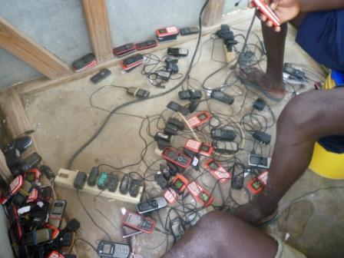
Motivation
Safe, Scalable product that has expandable features that can be deployed on WMI’s and many other renewable energy project sites

Slide 4
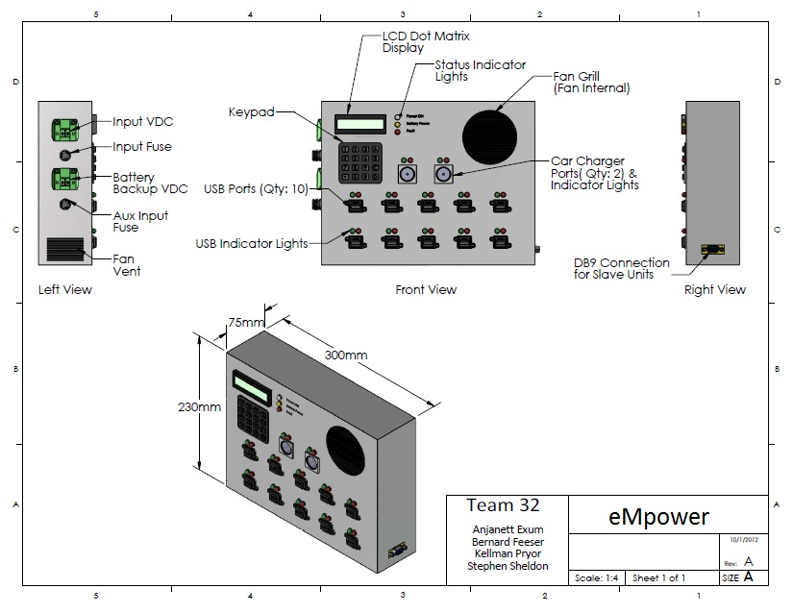
Solution

Slide 5
System Block Diagram
Additional Slave Units
External Account Management
Master Control Board
Port Control Board
Port Control Board
Power Source
Power Supply Unit
Power Supply Unit
Master Unit
Slave Unit #1

Slide 6
Master Control Board
Additional Slave Units
External Account Management
Master Control Board
Port Control Board
Port Control Board
Power Source
Power Supply Unit
Power Supply Unit
Master Unit
Slave Unit #1

Slide 7
Main Control Board Overview
4x4 Keypad
SD Card
ATMega2560 Controller Board
20x4 LCD Screen
GSM Module

Slide 8
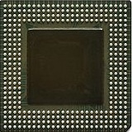
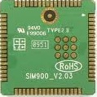
GSM Modules Considered
Main deciding factors
  Price point
  Community support
Module | Technology | Manufacturer | Form Factor | Speed | Price
Sim900 | GPRS | Simcom | Board-to-Board Connector | 85.6 kbps | $17.50 USD (Avnet Express Asia)
GE865 | GPRS | Telit | LGA Mount | 85.6 kbps | $37.90 USD (Verical)
Notes:
- Explain community support

Slide 9
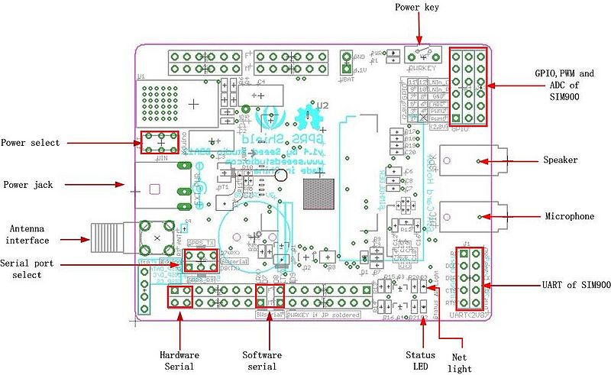
Seeed Studio GPRS Module

Slide 10
Microcontroller Selection
Microcontrollers Considered
Parameter | PIC18F872 | MSP430F2619 | P8X32A-Q44 | ATmega328P-PU | ATmega2560-AU
Operating Voltage | 4.2-5.5 V | 1.8-3.8 V | 2.7-3.6 V | 1.8-5.5 V | 4.5-5.5 V
Data Bus Width | 8 bit | 16 bit | 32 bit | 8 bit | 8 bit
Programmable I/O Lines | 70 | 48 | 32 | 23 | 86
Flash Memory | 128 KB | 120 KB | 32 KB | 32 KB | 256 KB
EEPROM | 1 KB | NA | NA | 1 KB | 4 KB
SRAM | 4 KB | 4 KB | 32 KB | 2 KB | 8 KB
Max Clock Speed | 40 MHz | 16 MHz | 80 MHz | 16 Mhz | 16 Mhz
Cost | $14.53 | $13.15 | $11.53 | $2.24 | $14.21
Notes:
- Explain why we picked the atmega 2560

Slide 11
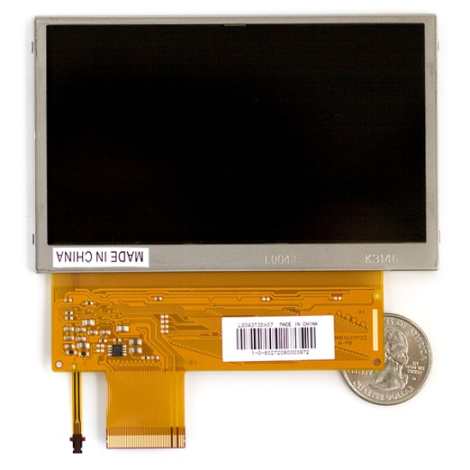
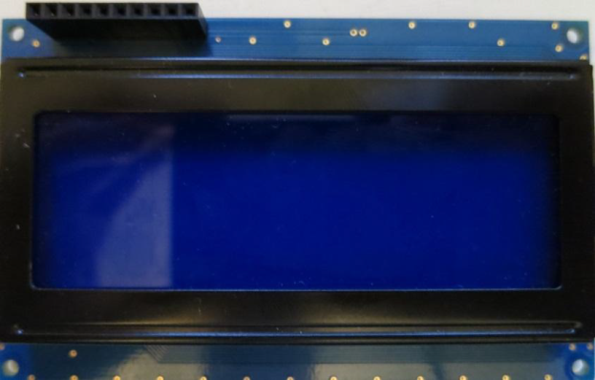
LCD Selection
Sharp TFT-LCD
  Required too much computational power
Longtech Optics LCD
  Requires less computational
  Lower price point
2.690”
5.50”
Notes:
Explain why longtech fit our application better
Sharp TFT-LCD requires greater processing power and higher price point
Longtech Optics used serial interface thus only having to utilize either one digital I/O port for software UART or hardware UART

Slide 12
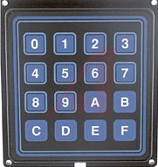
Keypad selection
Requirements
Flange-mount
Splash resistant
4.490”
2.690”
Grayhill 88 Series 4x4 Keypad
Notes:
Explain why we chose keypad
Because they’re all the same?

Slide 13
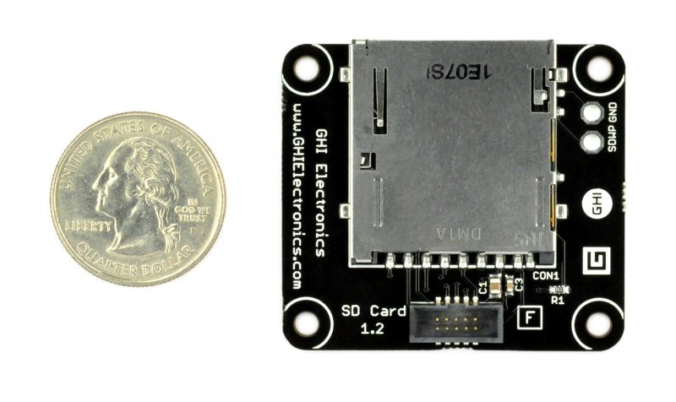
Choosing On-Board Memory
EEPROM
  Limited to 4Kb EEPROM
Internal storage
  Limited space due to ATMega2560 having only 256Kb on board flash
SD/MicroSD card
  Cards are easily replaced or upgraded
  Cards come in various sizes and form factors
Seeed Studio SD Card Module
Item | Value
Voltage | 2.7V -3.6V
Current | 0.159 mA – 200 mA
Supported Card Type | SD card(<=2G); Micro SD card(<=2G); SDHC card(<=16G);

Slide 14
User Workflow
Water Missions Side
  Account Setup
Device Side
  Client to device actions

Slide 15

Account Setup
Client Pays Water Missions on Location
Water Missions USA updated
Name: Bernard Feeser
Unique Key: 0115555555
Pin Number: 1234
Minutes Added: 100
Minutes Used: 12377
Average Use/month:345
Solar Charger ID: 0001
Device Updated by SMS
New Accounts Added
Old Accounts Updated

Slide 16
Account Setup
Client Pays Water Missions on Location
Water Missions USA updated
Name: Bernard Feeser
Unique Key: 0115555555
Pin Number: 1234
Minutes Added: 100
Minutes Used: 12377
Average Use/month:345
Solar Charger ID: 0001
Device Updated by SMS
New Accounts Added
Old Accounts Updated

Slide 17
Account Setup
Client Pays Water Missions on Location
Water Missions USA updated
Name: Bernard Feeser
Unique Key: 0115555555
Pin Number: 1234
Minutes Added: 100
Minutes Used: 12377
Average Use/month:345
Solar Charger ID: 0001
Device Updated by SMS
New Accounts Added
Old Accounts Updated

Slide 18
Account Setup
Client Pays Water Missions on Location
Water Missions USA updated
Name: Bernard Feeser
Unique Key: 0115555555
Pin Number: 1234
Minutes Added: 100
Minutes Used: 12377
Average Use/month:345
Solar Charger ID: 0001
Device Updated by SMS
New Accounts Added
Old Accounts Updated

Slide 19
Account Setup
Client Pays Water Missions on Location
Water Missions USA updated
Name: Bernard Feeser
Unique Key: 0115555555
Pin Number: 1234
Minutes Added: 100
Minutes Used: 12377
Average Use/month:345
Solar Charger ID: 0001
Device Updated by SMS
New Accounts Added
Old Accounts Updated

Slide 20
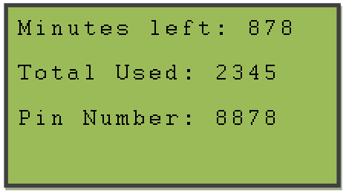
Account Setup
Text sent to client
  Number minutes on Account
  Stats on Account usage
  Pin number
Client now ready to use eMpower

Slide 21
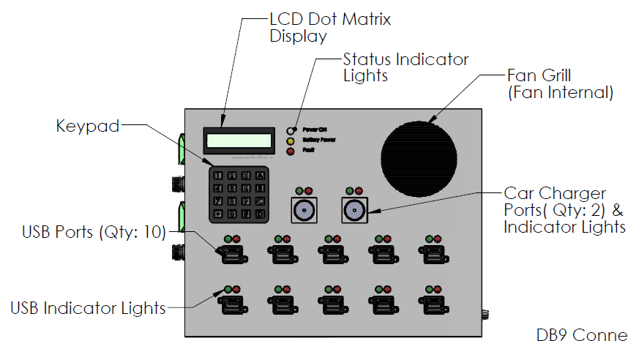
Device Side (Client)
Enters phone number
Enters pin
Main menu

Slide 22
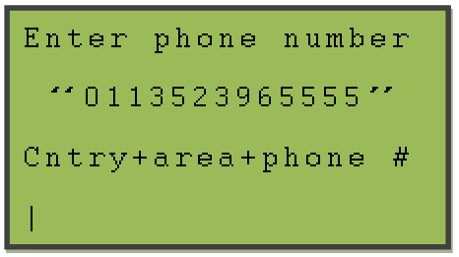
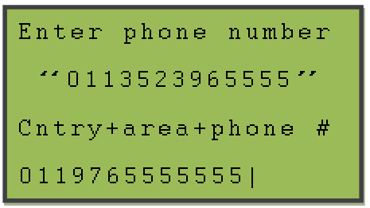
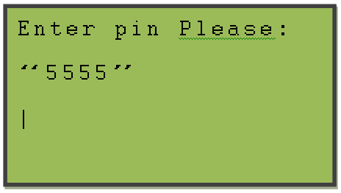
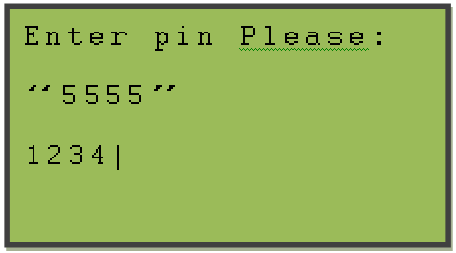
Device Side (sign on)

Slide 23
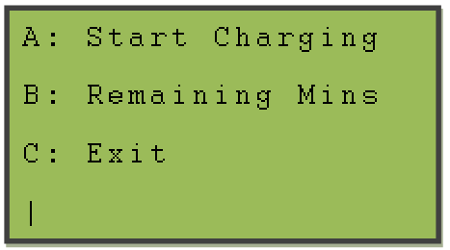
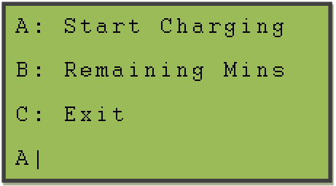
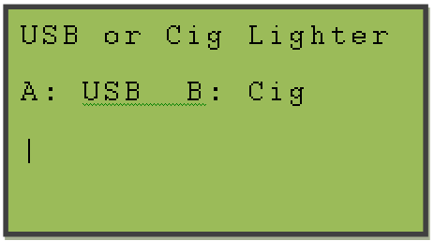
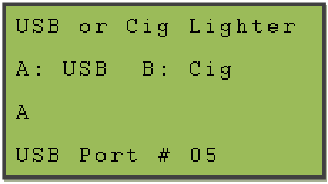
Device Side (Menu)

Slide 24
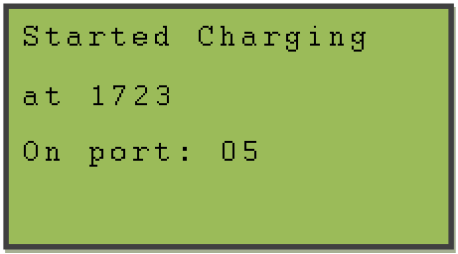
Device Side
Light turns on for that port
  Red LED flash
Client plugs in
  Timer starts
  Green LED on
Client unplugs
  Timer stopped
  Account updated
  Text sent to client

Slide 25
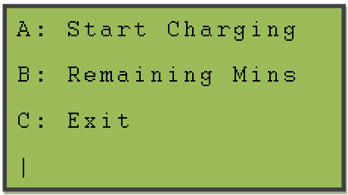
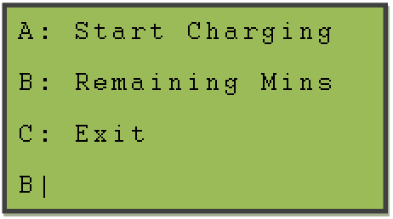
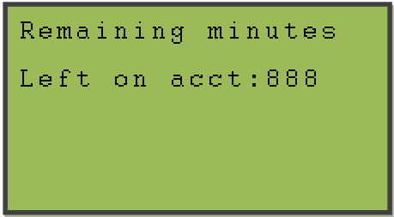
Device Side (Menu)

Slide 26
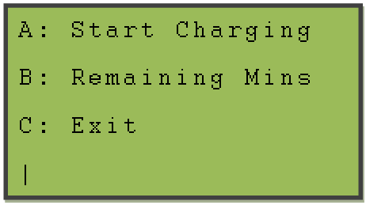
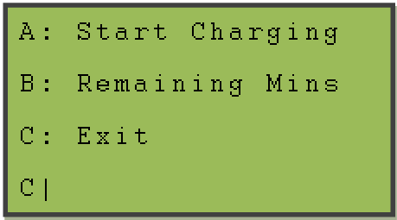
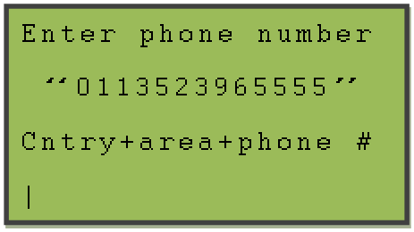
Device Side (Menu)

Slide 27
Communication
Master Control Board to Port Control
I2C
String of Flags (14 bits)
“0BBBBBBBBBBBB0”
Slave ID for if more slave units are attached
Master Update
Bit
Slave Unit ID
Bit
Ports 1-12

Slide 28
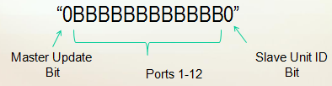
Communication
Master Control to Port Control
1st bit notates a change
  “1” slave will parse for port changes
    “A” turn on that port
    “B” turn off that port
    Change back to “0” once read
  “0” slave will ignore

Slide 29
Communication
Port Control to Master Control Board
I2C
String of Flags (14 bits)
“0BBBBBBBBBBBB0”
Slave ID for if more slave units are attached
Port Control Update
Bit
Slave Unit ID
Bit
Ports 1-12

Slide 30

Communication
Port Control to Master Control Board
1st bit notates a change
  “1” Master will parse to insure port is on
    Start timer for port
    Change 1st bit to “0”
    Reset to help a new client

Slide 31
Port Control Board
Additional Slave Units
External Account Management
Master Control Board
Port Control Board
Port Control Board
Power Source
Power Supply Unit
Power Supply Unit
Master Unit
Slave Unit #1

Slide 32
Charging Port Control Board
Interface of eMpower to user’s mobile devices
Facilitates Master Control Unit’s control of power to individual ports
Provides ten (10) USB Charging ports and two (2) 12vDC Outlets per Unit
Reports port use status to Master Control Unit
Provides power conditioning and circuit protection to charging ports

Slide 33
Charging Port Control Board
Overview
Power Supply
Power Regulator/Circuit Protection
(x 12) Typical per port
Charging Port Controller
Enable/Disable
Current Sensing Device
Master Control Unit
Board Control Unit
Interface Port (USB)
I2C Comm. line
User Supplied Charging Cable
Mobile Device

Slide 34
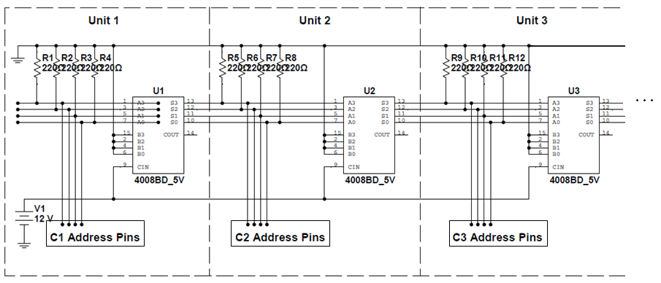
I2C Addressing
Each Charging port controller will be a individual “slave” node on the I2C line
4-bit addresses will be assigned sequentially with 1 being connected first in line, and unit 15 (max permissible) the furthest daisy-chained from the MCU
0000 1111
Address:
0000 0001
0000 0010
0000 0011

Slide 35
Microcontroller Requirements
Function | Input/output | Qty.
Port Control | Output | 12
Port Status | Input | 12
Port Indication (LED) | Output | 12
Unit Power Indication | Output | 1
I2C Communication | I/O | 2
I2C Addressing | Input | 4
43 I/Os
Minimal Cost
  Board target cost is $33
Availability
  Wide vender base
  Not near “end of life”, requiring redesign
Large user base
  Guaranteeing customer will be able to find servicer to upgrade/re-design for future revisions
I2C communication support

Slide 36
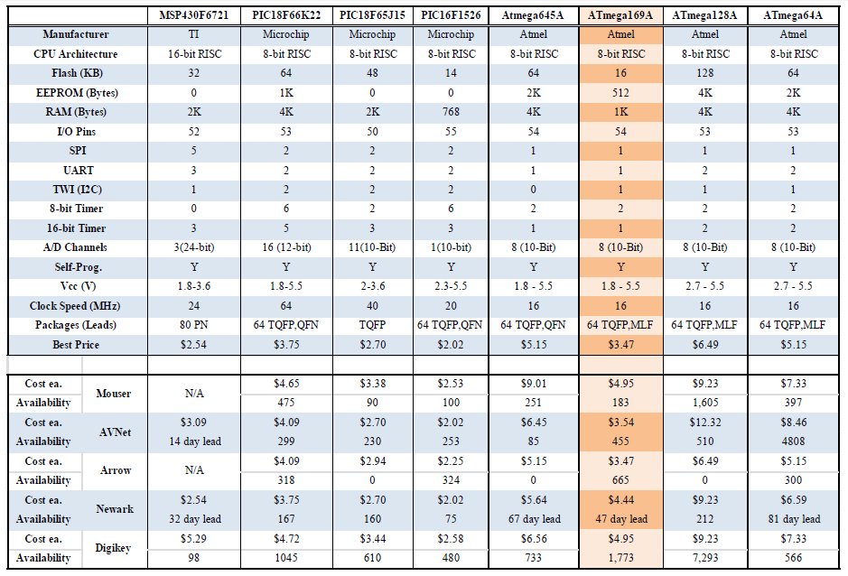
Microcontroller Selection

Slide 37
Charging Ports
Universal Serial Bus (USB, type A)
  Standard mobile device charging interface
    Required feature of all mobile devices in China (2007)
    Standard supported by GSM Association (2009)
    Standard supported by International Tele. Union (2009)
  Power requirements
Port type | Support USB Comm. | Min. Current Supply to Device
Standard downstream port/USB 2.0 (SDP) | Yes | 500 mA
Standard downstream port/USB 3.0 (SDP) | Yes | 900 mA
Charging downstream port (CDP) | Yes | 1500 mA
Dedicated charging port (DCP) | No | 1500 mA

Slide 38
Device Charger Handshaking
  Used by device to determine power availability in order to charge at maximum rate
  Without this handshaking protocol, many devices fail to charge
Several handshaking schemes:
  Divider DCP
    Apple devices
    2.7 vdc/2.0 vdc or 2.0 vdc/2.7vdc on D+/D- lines
  USB 2.0 BC1.2 DCP
    Most devices (Motorola,HTC,Sony)
    <200 ohm short D+/D-
  1.2 vdc/1.2vdc
    Many Samsung devices
    1.2 vdc/1.2vdc on D+/D-

Slide 39
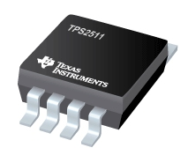
TPS2511
Automatically Switch D+/D- Lines to suit connected device
  BC1.2 DCP, Divider DCP, 1.2/1.2
  USB 2.0, USB 3.0
Provides “Enable” pin for port control by microcontroller (compatible with TTL and CMOS
Provides “Current Sense” pin for activating fly-back circuit to address voltage loss during high current draw
Programmable current limiting
Operating range 4.5 to 5.5 Vdc
MSOP, 8-pin package
5.5mm
3.1mm

Slide 40
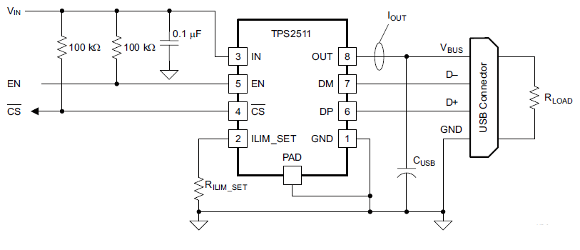


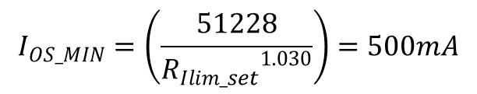

TPS2511 Circuit Calculations
$$I_{OS_MIN}=\left(\frac{51228}{{R_{Ilim_set}}^{1.030}}\right)=500mA$$
$$R_{Ilim_set}=73.2149kΩ$$
$$C_{USB}=22µF (min⁡)$$
Per Data sheet
$R_{Ilim_set}=\frac{73.2149kΩ}{1.01}=72.4899kΩ$*
*To account for 1% resistor tolerance

Slide 41
Power Supply
Additional Slave Units
External Account Management
Master Control Board
Port Control Board
Port Control Board
Power Source
Power Supply Unit
Power Supply Unit
Master Unit
Slave Unit #1

Slide 42

Power Regulation Specification
Wide input voltage of 30 VDC– 300 VDC
Battery Input of 12 VDC – 24 VDC
Output voltage to devices of 12 VDC

Slide 43
Power Regulation
Primary Stage
Secondary Stage
Converts an input from 30 VDC – 300 VDC to the a 30 VDC Output that is provided to the secondary stage
Decides the input source (Primary Stage or Battery)
Converts the source to the necessary 12 VDC
Secondary Power
12 VDC to
24 VDC
Secondary
Stage
12 VDC OUT
Primary Stage
30 VDC OUT
Primary Power
30 VDC to
300 VDC
Power Supply

Slide 44
Power Topologies
Fly back Converter
  Galvanic Isolation
  Switching Mode
  Low Power Applications
Buck-Boost Converter
  Output Greater or Less than Input
  Constant output voltage
  No Galvanic Isolation

Slide 45
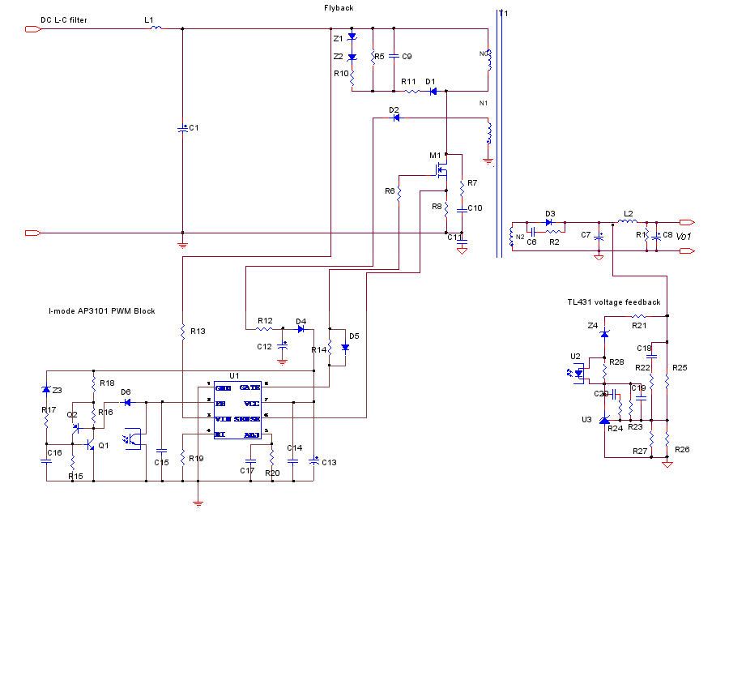
Primary Stage Schematic

Slide 46
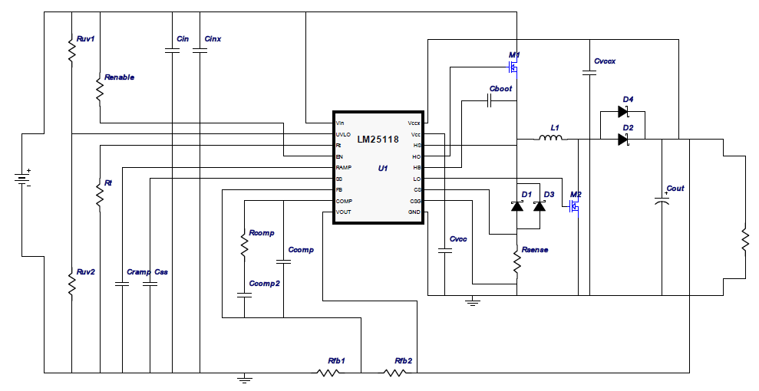
Secondary Stage Schematic

Slide 47
System Block Diagram
Additional Slave Units
External Account Management
Master Control Board
Port Control Board
Port Control Board
Power Source
Power Supply Unit
Power Supply Unit
Master Unit
Slave Unit #1

Slide 48
Distribution of Work
 | Power Regulation | Master Control | Port Control | Code Master Unit | Code Port Control | Documentation
Kell |  |  | X |  | X | X
Stephen |  | X |  | X |  | X
Anjie | X |  |  |  | X | X
Bernie |  | X |  | X |  | X

Slide 49

Budget/Financing
* Financed by Progress Energy for $2281.97

Slide 50
Progress

Slide 51
Problems
EMF noise from adding more peripherals
Port Charging
  Voltage drop across current sensor
Message buffering between master and port control units

Slide 52


