Slide 1
eMpower
Solar Powered Mobile Device Charger
With Remote Control
Group 32
Bernard “Bernie” Feeser
Anjanett “Anjie” Exum
Kellman “Kell” Pryor
Stephen “Stephen” Sheldon

Slide 2

Water Missions International is a nonprofit Christian engineering ministry providing long lasting safe water and sanitation solutions for people in developing countries and disaster areas.
They provide access to safe water for over 2 million people throughout the world.
WMI has served 49 different countries on 5 different continents

Slide 3
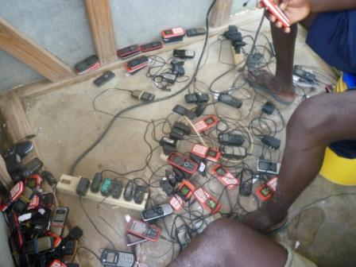
Motivation
Safe, Scalable product that has expandable features that can be deployed on WMI’s and many other renewable energy project sites

Slide 4
Objectives
Primary
Secondary
Provide mobile device charging interface (USB).
Provide account management interface.
Local Management
Remote Management (SMS)
Minimal Cost complete unit.
Provide a wide input power supply.
Provide an expandable mobile device charging interface.
Provide mobile device charging interface (12V ports)
Diagnostic Features

Slide 5
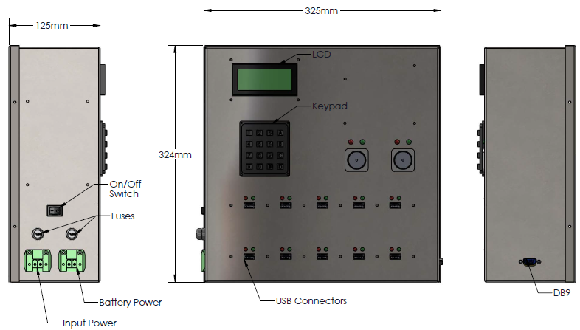
Solution

Slide 6
System Block Diagram
Additional Slave Units
External Account Management
Master Control Board
Port Control Board
Port Control Board
Power Source
Power Supply Unit
Power Supply Unit
Master Unit
Slave Unit #1

Slide 7
Master Control Board
Additional Slave Units
External Account Management
Master Control Board
Port Control Board
Port Control Board
Power Source
Power Supply Unit
Power Supply Unit
Master Unit
Slave Unit #1

Slide 8
Main Control Board Overview
4x4 Keypad
SD Card
ATMega2560 Controller Board
20x4 LCD Screen
GPRS Module

Slide 9
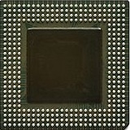
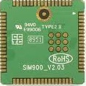
GPRS Modules Considered
Main deciding factors
Price point
Community support
Module | Technology | Manufacturer | Form Factor | Speed | Price
Sim900 | GPRS | Simcom | Board-to-Board Connector | 85.6 kbps | $17.50 USD (Avnet Express Asia)
GE865 | GPRS | Telit | LGA Mount | 85.6 kbps | $37.90 USD (Verical)
Notes:
- Explain community support

Slide 10
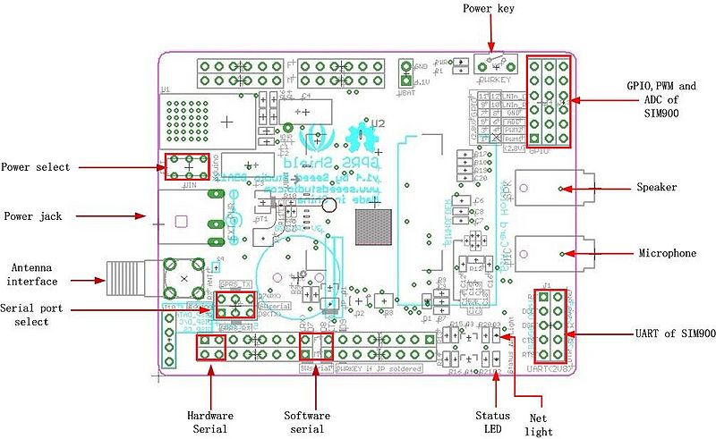
Seeed Studio GPRS Module

Slide 11
Microcontroller Selection
Microcontrollers Considered
Parameter | PIC18F872 | MSP430F2619 | P8X32A-Q44 | ATmega328P-PU | ATmega2560-AU
Operating Voltage | 4.2-5.5 V | 1.8-3.8 V | 2.7-3.6 V | 1.8-5.5 V | 4.5-5.5 V
Data Bus Width | 8 bit | 16 bit | 32 bit | 8 bit | 8 bit
Programmable I/O Lines | 70 | 48 | 32 | 23 | 86
Flash Memory | 128 KB | 120 KB | 32 KB | 32 KB | 256 KB
EEPROM | 1 KB | NA | NA | 1 KB | 4 KB
SRAM | 4 KB | 4 KB | 32 KB | 2 KB | 8 KB
Max Clock Speed | 40 MHz | 16 MHz | 80 MHz | 16 Mhz | 16 Mhz
Cost | $14.53 | $13.15 | $11.53 | $2.24 | $14.21
Notes:
- Explain why we picked the atmega 2560

Slide 12
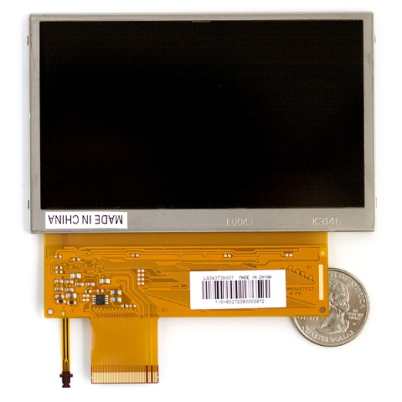
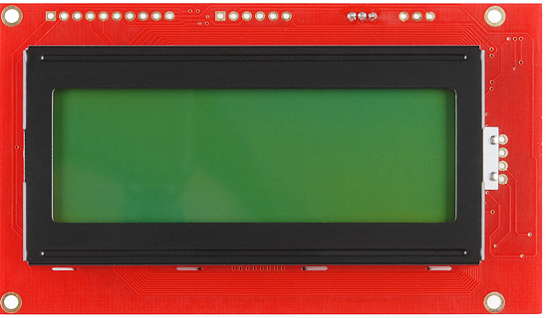
LCD Selection
Sharp TFT-LCD
Required too much computational power
Sparkfun LCD-09568
Serial Enabled
20x4 character display
2.690”
5.50”
Notes:
Explain why longtech fit our application better
Sharp TFT-LCD requires greater processing power and higher price point
Longtech Optics used serial interface thus only having to utilize either one digital I/O port for software UART or hardware UART

Slide 13
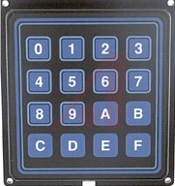
Keypad selection
Grayhill 88Series
Flange-mount
Splash resistant
4x4 keypad
4.490”
2.690”
Notes:
Explain why we chose keypad
Because they’re all the same?

Slide 14
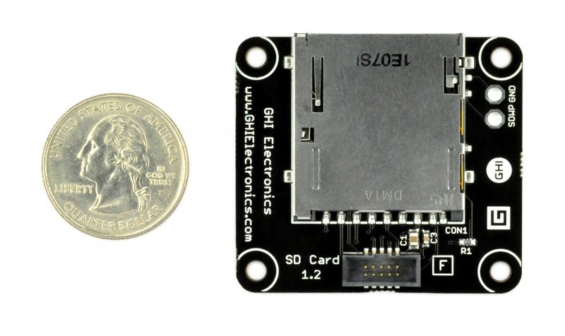
Choosing On-Board Memory
EEPROM
Limited to 4Kb EEPROM
Internal storage
Limited space due to ATMega2560 having only 256Kb on board flash
SD/MicroSD card
Cards are easily replaced or upgraded
Cards come in various sizes and form factors
Seeed Studio SD Card Module
Item | Value
Voltage | 2.7V -3.6V
Current | 0.159 mA – 200 mA
Supported Card Type | SD card(<=2G); Micro SD card(<=2G); SDHC card(<=16G);

Slide 15
User Workflow
Water Missions Side
Account Setup
Device Side
Client to device actions

Slide 16

Account Setup
Client Pays Water Missions on Location
Water Missions USA updated
Phone Number: 0115555555
Unique Key: 1234
Minutes Balance: 100
Device Updated by SMS
New Accounts Added
Old Accounts Updated

Slide 17
Account Setup
Client Pays Water Missions on Location
Water Missions USA updated
Phone Number: 0115555555
Unique Key: 1234
Minutes Balance: 100
Device Updated by SMS
New Accounts Added
Old Accounts Updated

Slide 18
Account Setup
Client Pays Water Missions on Location
Water Missions USA updated
Phone Number: 0115555555
Unique Key: 1234
Minutes Balance: 100
Device Updated by SMS
New Accounts Added
Old Accounts Updated

Slide 19
Account Setup
Client Pays Water Missions on Location
Water Missions USA updated
Phone Number: 0115555555
Unique Key: 1234
Minutes Balance: 100
Device Updated by SMS
New Accounts Added
Old Accounts Updated

Slide 20
Account Setup
Client Pays Water Missions on Location
Water Missions USA updated
Phone Number: 0115555555
Unique Key: 1234
Minutes Balance: 100
Device Updated by SMS
New Accounts Added
Old Accounts Updated

Slide 21
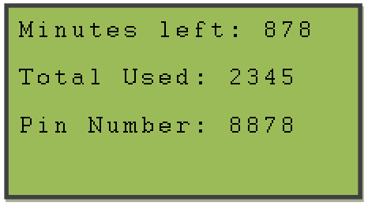
Account Setup
Text sent to client
Number minutes on Account
Stats on Account usage
Pin number
Client now ready to use eMpower

Slide 22
Device Side (Client)
Enters pin
Enters phone number
Main menu

Slide 23
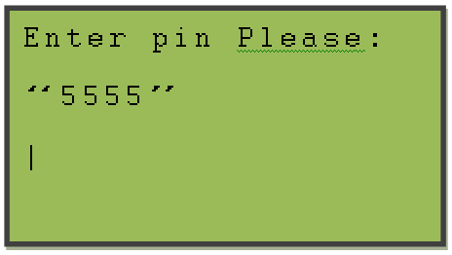
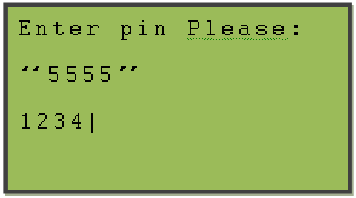
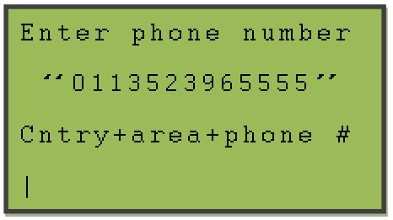
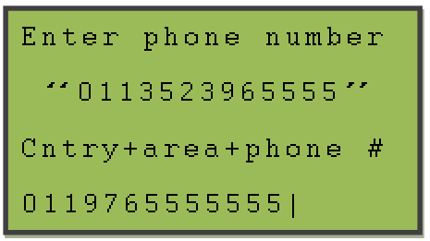
Device Side (sign on)

Slide 24
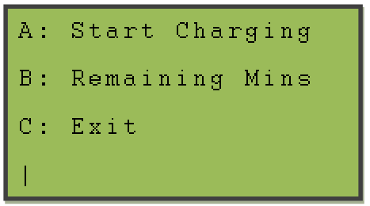
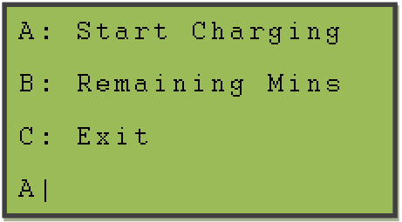
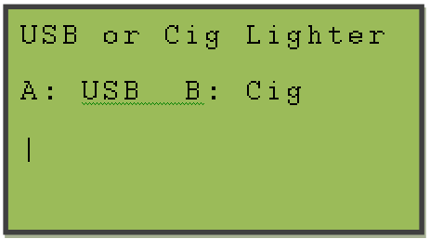
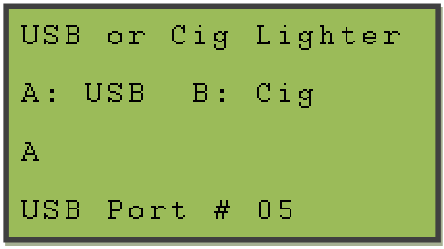
Device Side (Menu)

Slide 25
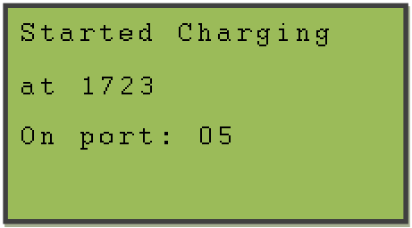
Device Side
Light turns on for that port
Red LED flash
Client plugs in
Timer starts
Green LED on
Client unplugs
Timer stopped
Account updated
Text sent to client

Slide 26
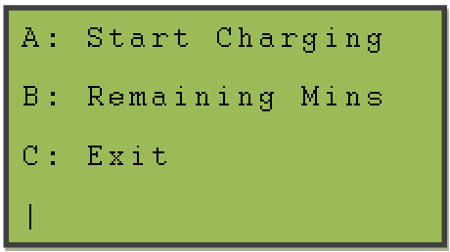
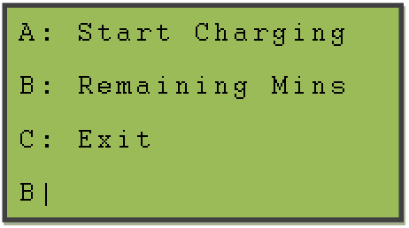
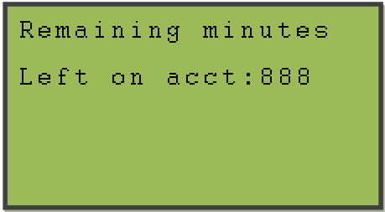
Device Side (Menu)

Slide 27
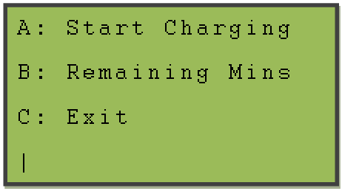
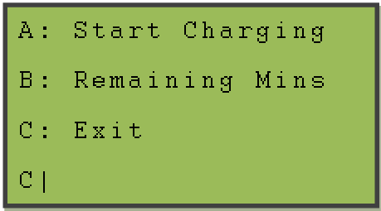
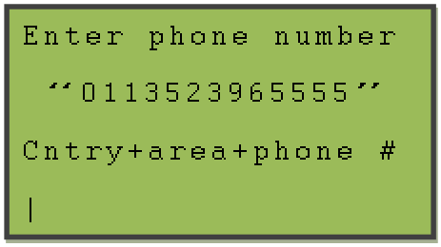
Device Side (Menu)

Slide 28
Communication Master Control Board to Port Control
I2C
Communication String (12 characters)
“000100011000”
Ports 1-12

Slide 29
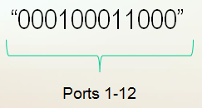
Communication Master Control to Port Control
Characters 1 thru 12
“1” indicates request to turn on port
“0” indicates request to turn off port

Slide 30
Communication Port Control to Master Control Board
I2C
Communication String (12 characters)
“000100011000”
Ports 1-12

Slide 31
Communication Port Control to Master Control Board
Characters 1 thru 12
“1” indicates port is turned on
“0” indicates port is turned off

Slide 32
Port Control Board
Additional Slave Units
External Account Management
Master Control Board
Port Control Board
Port Control Board
Power Source
Power Supply Unit
Power Supply Unit
Master Unit
Slave Unit #1

Slide 33
Charging Port Control Board
Interface of eMpower to user’s mobile devices
Facilitates Master Control Unit’s control of power to individual ports
Provides ten (10) USB Charging ports and two (2) 12vDC Outlets per Unit
Reports port use status to Master Control Unit
Provides power conditioning and circuit protection to charging ports

Slide 34
Charging Port Control Board
Overview
Power Supply
Power Regulator/Circuit Protection
(x 12) Typical per port
Charging Port Controller
Enable/Disable
Current Sensing Device
Master Control Unit
Board Control Unit
Interface Port (USB)
I2C Comm. line
User Supplied Charging Cable
Mobile Device

Slide 35
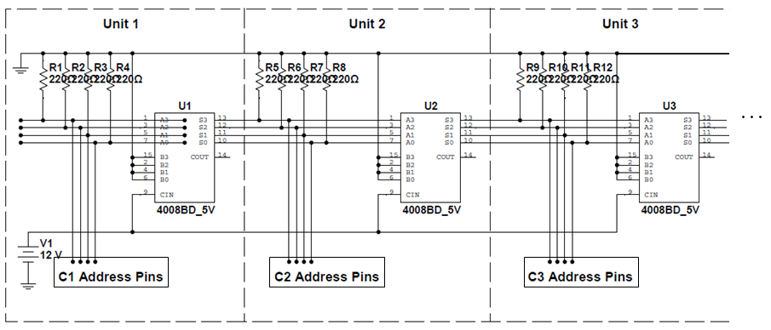
I2C Addressing
Each Charging port controller will be a individual “slave” node on the I2C line
4-bit addresses will be assigned sequentially with 1 being connected first in line, and unit 15 (max permissible) the furthest daisy-chained from the MCU
0000 1111
Address:
0000 0001
0000 0010
0000 0011

Slide 36
Microcontroller Requirements
Function | Input/output | Qty.
Port Control | Output | 12
Port Status | Input | 12
Port Indication (LED) | Output | 12
Unit Power Indication | Output | 1
I2C Communication | I/O | 2
I2C Addressing | Input | 4
43 I/Os
Minimal Cost
Board target cost is $33
Availability
Wide vender base
Not near “end of life”, requiring redesign
Large user base
Guaranteeing customer will be able to find servicer to upgrade/re-design for future revisions
I2C communication support

Slide 37
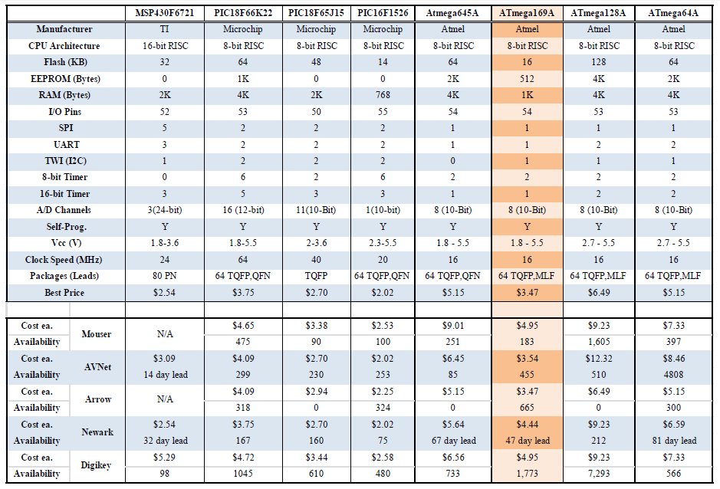
Microcontroller Selection

Slide 38
Charging Ports
Universal Serial Bus (USB, type A)
Standard mobile device charging interface
Required feature of all mobile devices in China (2007)
Standard supported by GSM Association (2009)
Standard supported by International Tele. Union (2009)
Power requirements
Port type | Support USB Comm. | Min. Current Supply to Device
Standard downstream port/USB 2.0 (SDP) | Yes | 500 mA
Standard downstream port/USB 3.0 (SDP) | Yes | 900 mA
Charging downstream port (CDP) | Yes | 1500 mA
Dedicated charging port (DCP) | No | 1500 mA

Slide 39
Device Charger Handshaking
Used by device to determine power availability in order to charge at maximum rate
Without this handshaking protocol, many devices fail to charge
Several handshaking schemes:
Divider DCP
Apple devices
2.7 vdc/2.0 vdc or 2.0 vdc/2.7vdc on D+/D- lines
USB 2.0 BC1.2 DCP
Most devices (Motorola,HTC,Sony)
<200 ohm short D+/D-
1.2 vdc/1.2vdc
Many Samsung devices
1.2 vdc/1.2vdc on D+/D-

Slide 40
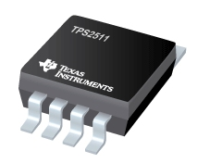
TPS2511
Automatically Switch D+/D- Lines to suit connected device
BC1.2 DCP, Divider DCP, 1.2/1.2
USB 2.0, USB 3.0
Provides “Enable” pin for port control by microcontroller (compatible with TTL and CMOS
Provides “Current Sense” pin for activating fly-back circuit to address voltage loss during high current draw
Programmable current limiting
Operating range 4.5 to 5.5 Vdc
MSOP, 8-pin package
5.5mm
3.1mm

Slide 41
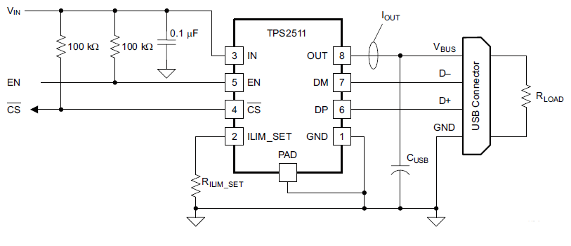


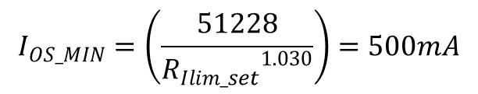

TPS2511 Circuit Calculations
$$I_{OS_MIN}=\left(\frac{51228}{{R_{Ilim_set}}^{1.030}}\right)=500mA$$
$$R_{Ilim_set}=73.2149kΩ$$
$$C_{USB}=22µF (min⁡)$$
Per Data sheet
$R_{Ilim_set}=\frac{73.2149kΩ}{1.01}=72.4899kΩ$*
*To account for 1% resistor tolerance

Slide 42
Power Supply
Additional Slave Units
External Account Management
Master Control Board
Port Control Board
Port Control Board
Power Source
Power Supply Unit
Power Supply Unit
Master Unit
Slave Unit #1

Slide 43

Power Regulation Specification
Wide input voltage of 30 VDC– 300 VDC
Battery Input of 12 VDC – 24 VDC
Output voltage to devices of 12 VDC, 5.3 VDC, 5VDC

Slide 44
Power Regulation
Primary Stage
Secondary Stage
Converts an input from 30 VDC – 300 VDC to the a 30 VDC Output that is provided to the secondary stage
Decides the input source (Primary Stage or Battery)
Converts the source to the necessary 12 VDC
Secondary Power
12 VDC to
24 VDC
Secondary
Stage
12 VDC, 5.3 VDC,
5VDC
OUT
Primary Stage
30 VDC OUT
Primary Power
30 VDC to
300 VDC
Power Supply

Slide 45
Power Topologies
Fly back Converter
Galvanic Isolation
Switching Mode
Low Power Applications
Buck-Boost Converter
Output Greater or Less than Input
Constant output voltage
No Galvanic Isolation

Slide 46
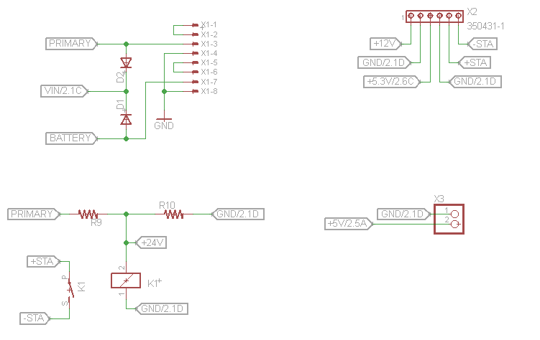
Input Power

Slide 47
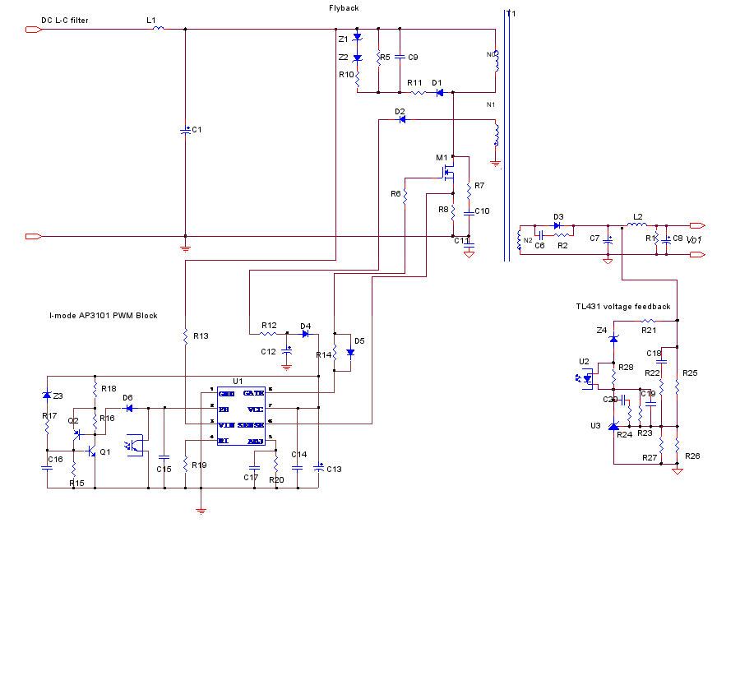
Primary Stage Schematic
30VDC Out
6 A Max

Slide 48
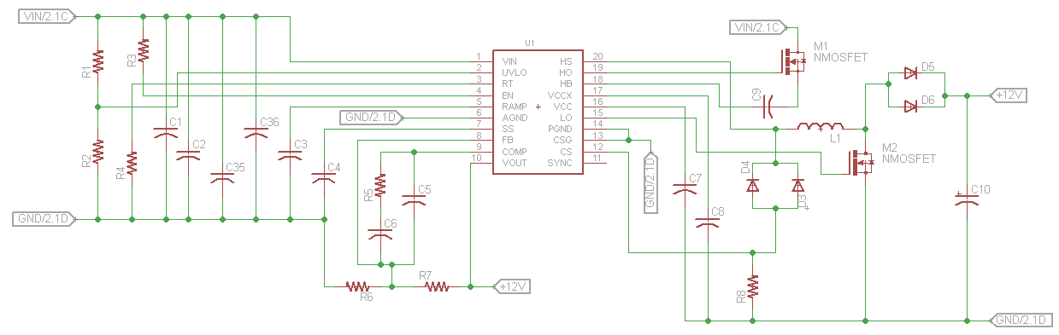
Secondary Stage Schematic(1)
12VDC Out
LM25118
12VDC Out
4 A

Slide 49
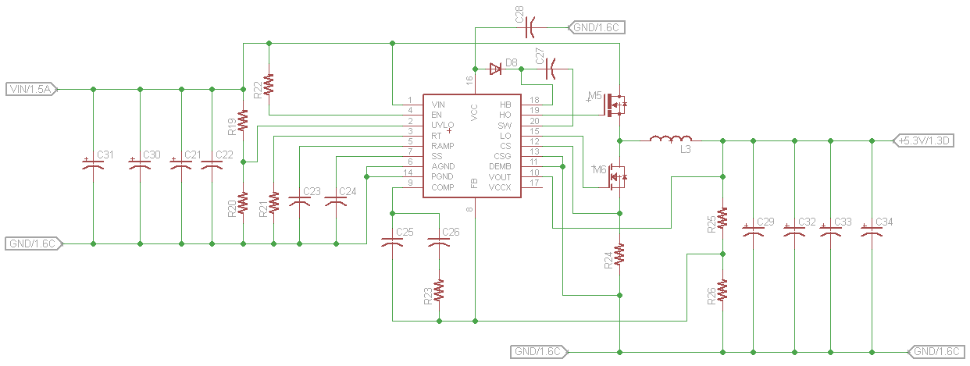
Secondary Stage Schematic (2)
5.3VDC Out
LM25116
5.3VDC Out
15 A

Slide 50
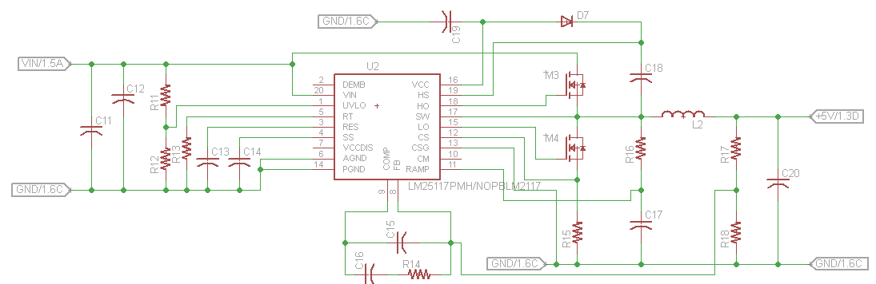
Secondary Stage Schematic (3)
5VDC Out
LM25117
5VDC Out
5 A

Slide 51
System Block Diagram
Additional Slave Units
External Account Management
Master Control Board
Port Control Board
Port Control Board
Power Source
Power Supply Unit
Power Supply Unit
Master Unit
Slave Unit #1

Slide 52
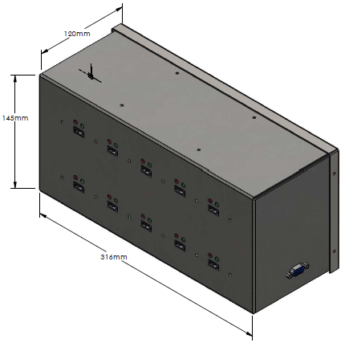
Slave Unit Solution

Slide 53
Distribution of Work
 | Power Regulation | Master Control | Port Control | Code Master Unit | Code Port Control | Documentation | Enclosure
Kell |  |  | X |  | X | X
Stephen |  | X |  | X |  | X
Anjie | X |  |  |  | X | X | X
Bernie |  | X |  | X |  | X

Slide 54
Projected Cost Of Units *
Master Unit
Port Control Board | $ 54.80
Main Control Board | $22.37
Peripherals | $ 75. 77
Enclosure | $ 30.00
Total | $182.94
Slave Unit
Port Control Board | $ 54.80
Enclosure | $20.00
Total | $74.80
* Prices based on Qty: 500 Units

Slide 55
Achievements
Primary
Secondary
Provide mobile device charging interface (USB).
Provide account management interface.
Local Management
Remote Management (SMS)
Minimal Cost complete unit.
Provide a wide input power supply.
Provide an expandable mobile device charging interface.
Provide mobile device charging interface (12V ports)
Diagnostic Features

Slide 56

Thank you to our sponsor:

