Slide 1
Striker
Autonomous Air-Hockey Gaming Experience
Group 8:
Brian Thomas, EE
Efrain Cruz, EE
Loubens Decamp, EE
Luis Narvaez, EE

Slide 2
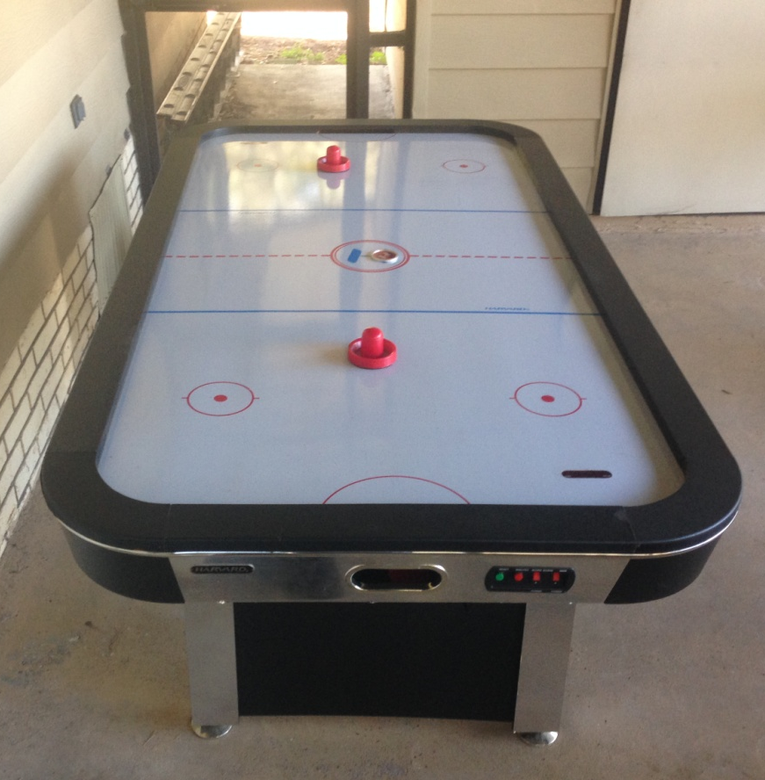
Project Description
Autonomous robotic air hockey opponent
Android application user interface
Optional manual control of robotic arm
Audio effects and video replay
Automatic puck-return

Slide 3
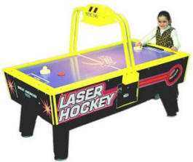
Motivation and Purpose
Majority of air hockey tables require a second person in order to play
Create an air hockey experience in which one person can enjoy
Create a unique twist to previous robotic air hockey tables
I’m so bored, I wish I had someone to play against…

Slide 4

Goals and Objectives
Fast reacting robotic arm
Wireless communication
Android user interface
Convenient and user friendly environment
Interactive, customizable, and engaging

Slide 5
Overall System Overview

Slide 6
Main System Controller
Our choice of microcontroller was based on these basic criteria:
Microcontroller should be open source (C/C++ based)
Should have enough memory to support our design (RAM)
High frequency
At least 10 Digital I/O and at least 1 Analog I/O channel
Low voltage ( operating voltage 3-5V )
Affordable (<$10.00)
Should have the necessary interfaces (USB port, I2C, UART/SPI/ADC)

Slide 7
MSP430FG4618 and ATmega328
Features | MSP430FG4618 | ATmega328
Data Bus (core size) | 16 bit | 8bit
Speed | 8MHz | 20MHz
Storage | 16KB | 32KB
RAM | 8KB | 2KB
Digital I/O | 80 | 14
Analog I/O | 12 | 6
Supply voltage | 1.8- 3.6V | 1.8- 5.5V
I2C, UART,SPI & ADC | yes | yes
Price /chip | $8.35 ( from TI) | $2. 84 (Digi-Key)

Slide 8
Advantages of Both
MSP430FG4618
The MSP430 is known as an ultra low voltage device (1.8-3.6v).
Significant amount of I/O pins (80)
Built-in LCD interface
Low price
ATMEGA328
The ATmega328 very easy to program (code are very short and simple).
Open-source (significant amount of software examples)
Support 5V for operation
High frequency (20MHz)
Low price

Slide 9
Our Decision
Due to the complexity of our project we decided to go with the ATmega328.
Our project is mainly tested by an Arduino Uno development board which uses the ATmega328.
It is an open source environment (C/C++)
It is very affordable
It interfaces with I2C, UART & SPI
High frequency (20MHz)

Slide 10
Hardware Interface

Slide 11
Robot Arm
Design Goals:
Structurally sound and appealing
Dedicated Microprocessor
Has to be portable/removable
Have the ability to be manually controlled or automatically controlled by processor
End-Effector has tilt and propulsion
Needs to cover entire width of playing area
Must have fast reaction time (real-time)

Slide 12
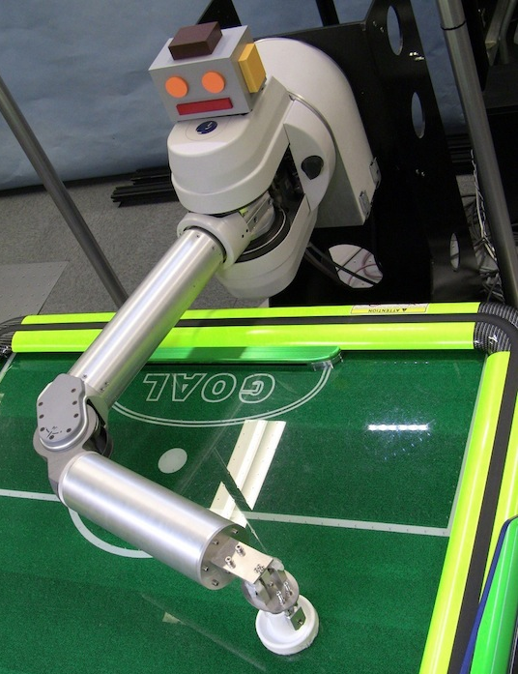
Robot Arm Mechanical Design
Build by Hand!
Originally thought of revolute, revolute, revolute (RRR) design – (too difficult, not M.E.)
Ultimately decided on going with linear motion (guarding the goal)
Linear motion could be achieved via ACME rod, ANSI chain, (A.K.A. bicycle chain), rack & pinion gear drive, or pulley system.

Slide 13
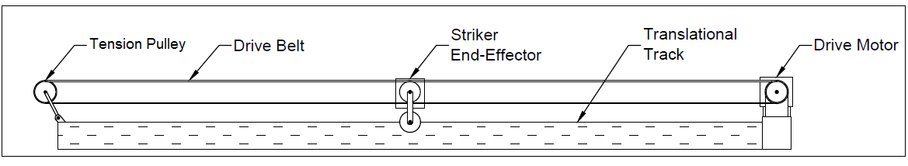
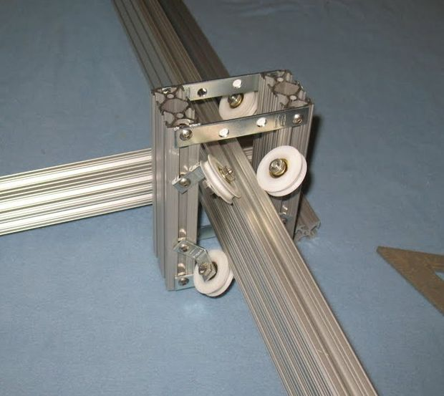
Pulley system
Driven by single Stepper Motor
Motion achieved by timing belt/pulley system
Build using T-Slots aluminum extrusions

Slide 14
Robot Arm Motor Specification
Attribute | Specification
RPM | __ rpm
Position Accuracy | ± 50 mm
Time to change direction | __ ms
Supply Voltage | 9-30 Vdc
Max Torque | __ ft·lb
Output Power | __ W (__ hp)

Slide 15
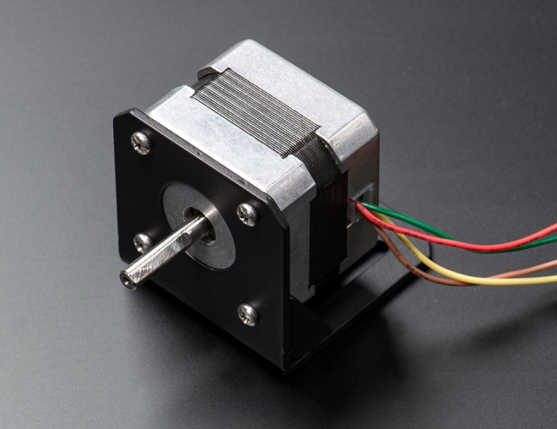
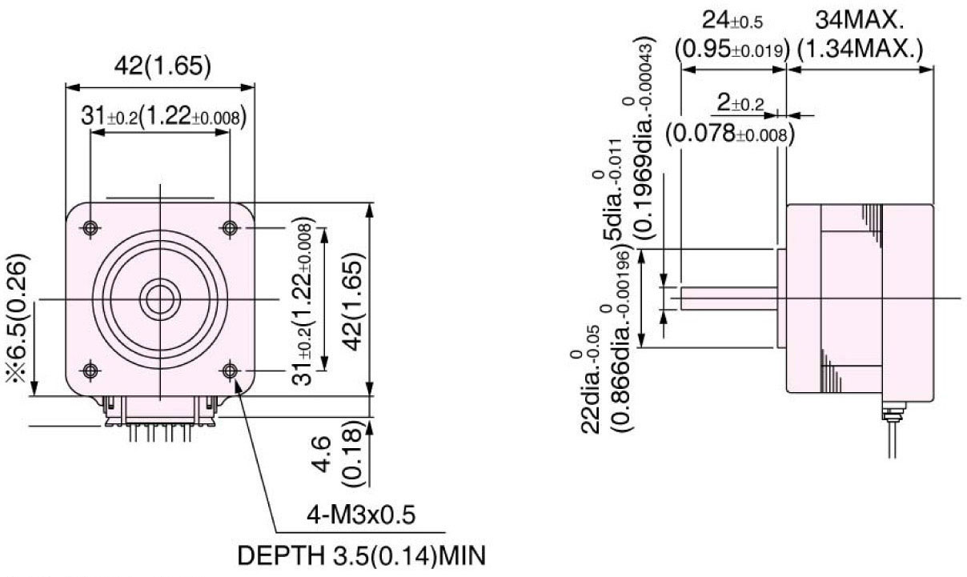
Motor Selection
NEMA 17 size Stepper Motor from Adafruit Industries (Part ID 324)
Specification | Value
Deg/step | 1.8
Input Voltage | 12Vdc
Max Input Current | 350 mA
Holding Torque | 0.2 N·m
No. of Poles/Phases | 2

Slide 16
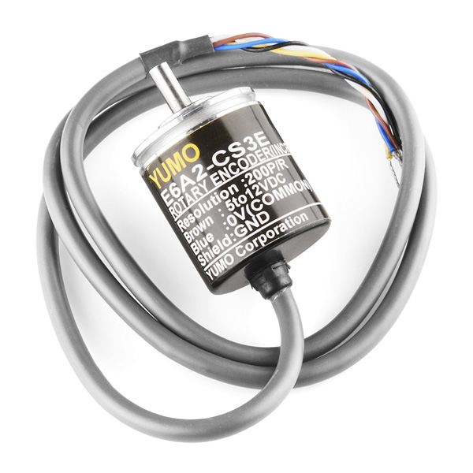
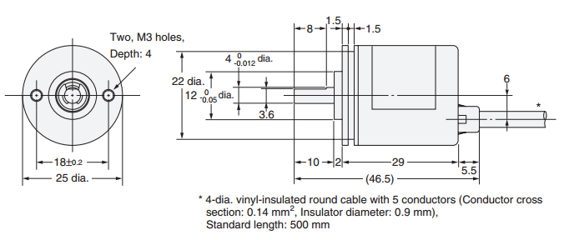
Robot Arm Position Feedback
In order for the MCU to move to next predicted position, it needs to know its current position and take the difference
One option for feedback was Potentiometers, however have limited rotation
A linear transducer would have to have a 3’ stroke
Rotary Encoder provides feedback for continuous rotation, thus making it ideal for our design
E6A2-CS3E Encoder Specifications
Supply Voltage | 5-12 Vdc
Current Consumption | 30 mA max
Resolution (Pulses/Rev.) | 200 PPR
Output configuration | Voltage Output
Starting torque | 0.001 N•m max

Slide 17
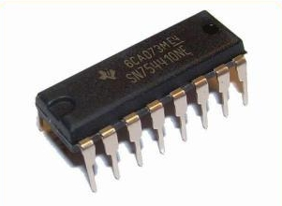
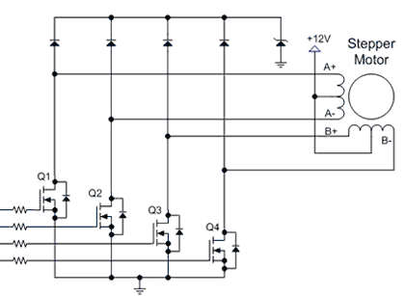
Motor Control: t.i. SN754410NE
Features:
Bi-directional motor control for steppers, solenoids and inductive loads
Supply voltage range for motor: 4.5V to 36V
Minimal power dissipation

Slide 18
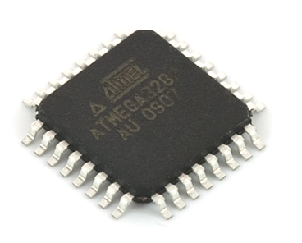
Robot Arm Microcontroller selection
Since Main system controller is Atmel’s ATmega328, we decided to use the same for the striker arm.
Small amount of Digital IO being used => perfect for application
High-speed, works well with t.i. H-Bridge driver
Easy to program using Arduino’s boot loader and IDE

Slide 19
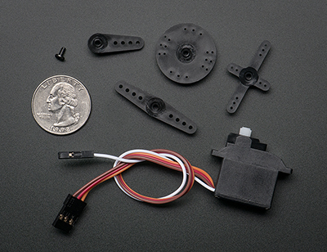
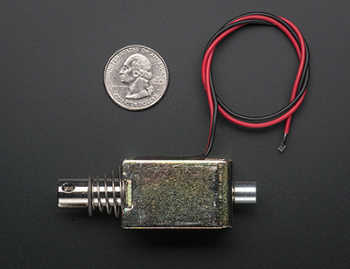
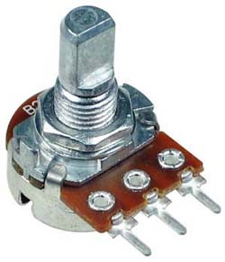
Robot End-Effector
Small servo motor to pan the Mallet towards the user’s goal
Solenoid for Mallet propulsion
Potentiometer for Servo feedback to MCU
Servo Motor
Solenoid
Potentiometer

Slide 20
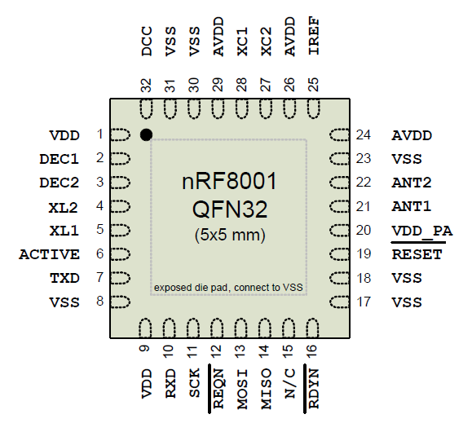
Robot Arm Control – Wireless!
Communicate via Bluetooth 4.0 BLE
Using nRF 8001D Bluetooth Module
RedBear BLE shield for development and testing
Interface via ACI for parallel transmission
Small footprint: 5mm x 5mm

Slide 21
Robot Arm System Schematic

Slide 22
Robot Arm Software

Slide 23
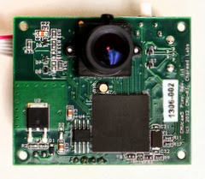
Tracking System
Specification | Value
Processor | 204 MHz dual core
Image Sensor | 1280x800
Frame Rate | 50 Hz
Field of View | 75° Horizontal 47° Vertical
Nominal Current Consumption | 140 mA
RAM | 264 Kb
Flash | 1 Mb
Data Output | UART, SPI, I2C, USB, digital, analog
Dimensions | 2.1” x 1.75” x 1.4”
PIXY ( CMUcam 5)

Slide 24
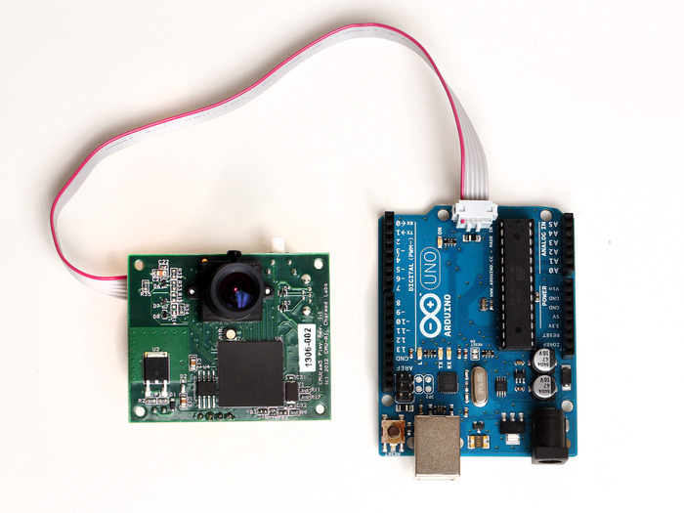
Benefits of Pixy
Easy to interface with Arduino Uno
CMUcam makes Arduino Interface libraries
Functions such as trackColor() already built in

Slide 25
Tracking System Software

Slide 26
Audio/Video/Lighting Objective
Provide video replay of goals scored against striker
Display replays on a 15.6” monitor located above Striker
Employ a separate camera that is directed at Striker for goals scored
Audio effects
LED lighting aesthetics

Slide 27
Video/Audio Replay Specifications
Video resolution 720p @ 30 fps
H.264, MPEG 4 codecs
DSP core that operates between 250 MHz and 300 MHz
Adequate documentaiton

Slide 28
Video/Audio Processing Choices
Spartan 3E FPGA by Xillinx
Parallel processing
Configurability
Bug issues are easier to resolve
DM365 by Texas Instruments
Built in H.264, MPEG 4 codecs
Less expensive than FPGA
Detailed support documentation

Slide 29
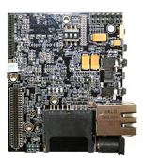
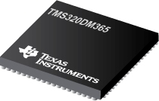
DM365 Video/Audio Controller
Leopardboard 365 for development
Arm 9 processor w/ 270 MHz clock rate
Audio codecs: MP3, WMA, AAC, Audio Echo Canceler (AEc)
HD video codecs: H.264, MPEG-4, M-JPEG, WMV9/VC1, MPEG-2

Slide 30
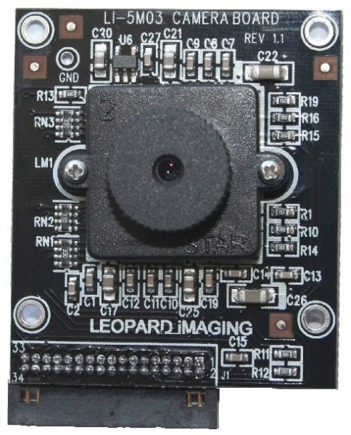
Camera Selection
Easily interfaces with Leopardboard 365
Sensor: Aptina 1/2.5” CMOS Sensor MT9031
Max Resolution: 5 Mega-pixels (2592x1944 pixels, 14 fps)
Data output format: RGB
Pixel Size: 2.2µm x 2.2µm
Support 720p @ 60 fps and 1080p @ 31 fps

Slide 31
LED Lighting Objective
Fully Addressable
Have many color variations
Adds visual appeal to the gaming experience

Slide 32
LED Comparison
Specifications | HL 1606 | WS2801 | LPD8806
Color Choices | 8 | 16,777,216 | 2,097,152
Control Method | SPI | PWM | PWM
Addressable | Yes | Yes | Yes
Cost (5m) | $65 | N/A | $95

Slide 33
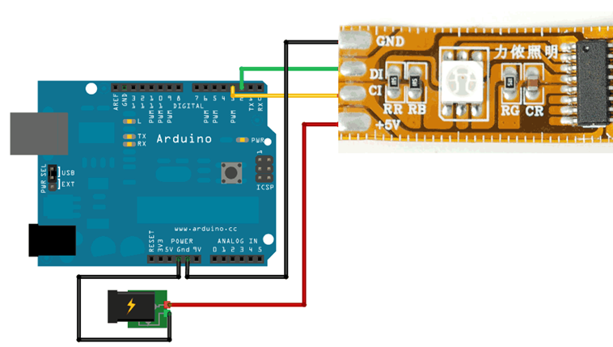
LED Selection
LPD8806 programmable LED
3 channels
7 bits per channel resulting in 2,097,152 color options
Programming using the Arduino language
Controlled with PWM at a frequency of 500 Hz via an atmega 328
Development using an Arduino Uno

Slide 34
LED Programming for Tracking Puck

Slide 35
LED Programming Design for Goal Score

Slide 36
System Communication
Wanted to have wireless transmission between Tracking system and Robot arm.
Wireless communication has to communicate to tablet wirelessly
Fast data rate ( >1Mbps)
SPI Interface preferred

Slide 37
System Comparisons
Specification | Bluetooth | Wi-Fi | Zigbee
Data Rate | 2-25 Mbps | 100 Mbps | 250 kbps
Range | 10cm-100m | 20-100m | 40 m
Baud Rate | 115200 bps | 115200 bps | 115200 bps
Operating Freq. | 2.4-2.48 GHz | 2.4 GHz | 2.4 GHz
Complexity | Moderate | High | Low
Power Consumption | ~2.5 mW | ~500 mW | 1.25 mW
Interfacing Method | UART, SPI, I²C | UART, SPI, SDIO, I²C, USB | UART, SIP I²C, PWN, DIO, ADC

Slide 38
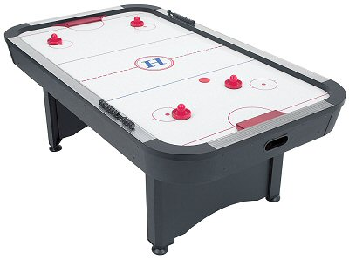


And the winner is…Bluetooth!
Striker!
Easier to implement
Fast data rates (1 Mbps)
Low power
Small footprint on PCB
Allows control and connectivity via Tablet or Smartphone

Slide 39
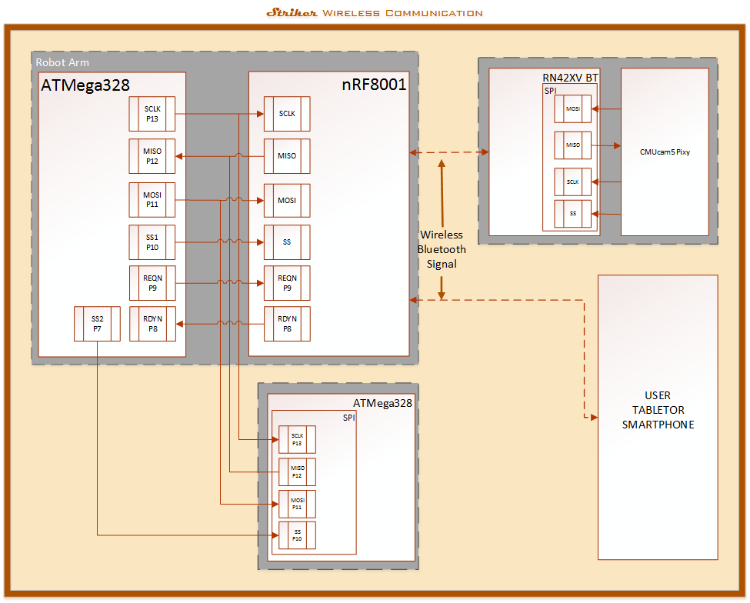

Slide 40
Puck Return
Has to return puck on command
Has to provide enough friction to transport the puck
Puck must be returned to player in approximately 5 to 10s
Powered by 9V DC
System controlled through Arduino Uno
Sensor must have the ability to detect the Puck
Closed loop system

Slide 41
Puck Return Control Diagram

Slide 42
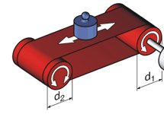
Puck Return Conveyor System
Parameter | Value
Belt Widths | 4 inches
Belt Lengths | 18 ft.
Belt Type | PVC (Black)
Drive | DC Motor (9V)
Drive Pulley | 2
Conveyer roller (d_{1,} d₂) | 2 (4-7/8”each)
Drive shaft | 1 (6”)
Calculations based on data collected:
Table total length is 82 inches
1”= 0.0254m (U.S.I)
82”= 2.0828m
t=5s
V = d/t → V = .417m/s or 16.4 in/s
Conveyor system goes underneath of the table

Slide 43
Power Supply
Power supply is divided in two parts: the first must be able to supply enough voltage to supply the motors, solenoids and encoder. The second must supplied the sub-systems.
Use a wall receptacle to power up the air hockey table (120V AC, 60 Hz)
Design of a system to supply 5V DC to our sub-systems ( Audio, LEDs, Puck Tracking, Cameras and Puck return mechanism)

Slide 44
Power Supply Wiring Diagram

Slide 45
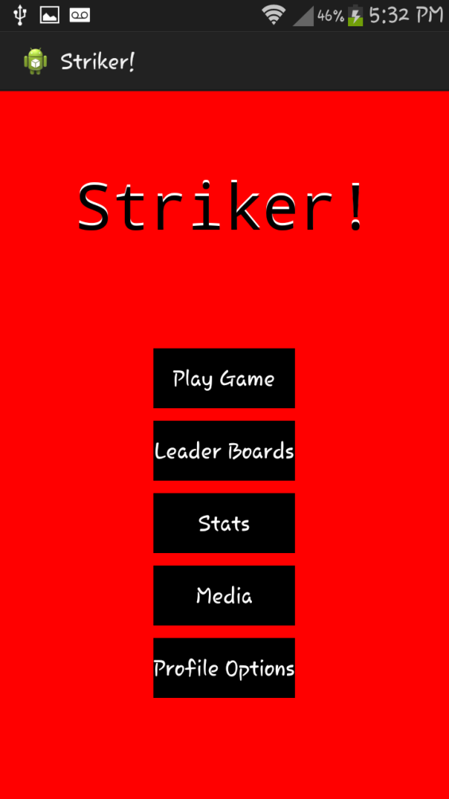
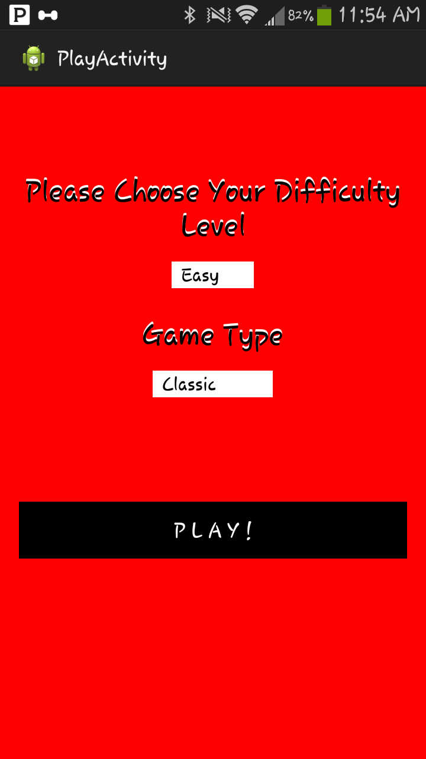
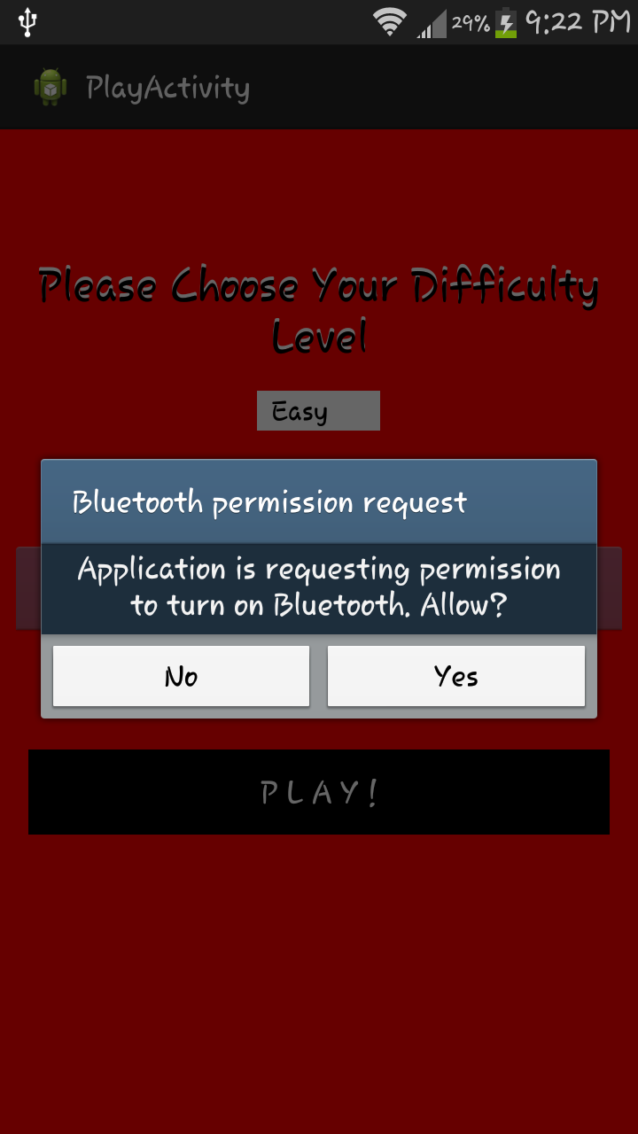
User Interface (App)
Home Screen
Play Game Screen
Enabling Bluetooth

Slide 46
Application Software

Slide 47
Main System Software Overview

Slide 48
Projected Budget
Part Description | Budgeted Amount ($) | Current Expense ($)
Air Hockey Table | 170.00
Microcontroller/PCB | 200.00
Visual Effects | 120.00
Communications | 60.00
Robot Arm | 100.00
Servo Motor | 60.00
Tracking Cam | 20.00
Playback Cam | 20.00
Sensors | 20.00
Manufacturing | 60.00
Puck Return | 100.00
Shipping | 70.00
Total Budget | 1000.00

Slide 49
Project Distribution
 | Brian | Efrain | Loubens | Luis
A/V & Effects
Main Controller
Power
Puck Return
Puck Tracking
Robot Arm
Wireless Comm.
Software/App

Slide 50
Timeline & Goals

Slide 51
Progress

Slide 52
Issues and Concerns
Linux environment for developing video/audio control
Pixy has been delayed in production. Possibly using CMUcam4 instead.
Bluetooth pairing and connectivity issues.

Slide 53

Questions?

