Slide 1
Striker
Autonomous Air-Hockey Gaming Experience
Group 8:
Brian Thomas, EE
Efrain Cruz, EE
Loubens Decamp, EE
Luis Narvaez, EE

Slide 2
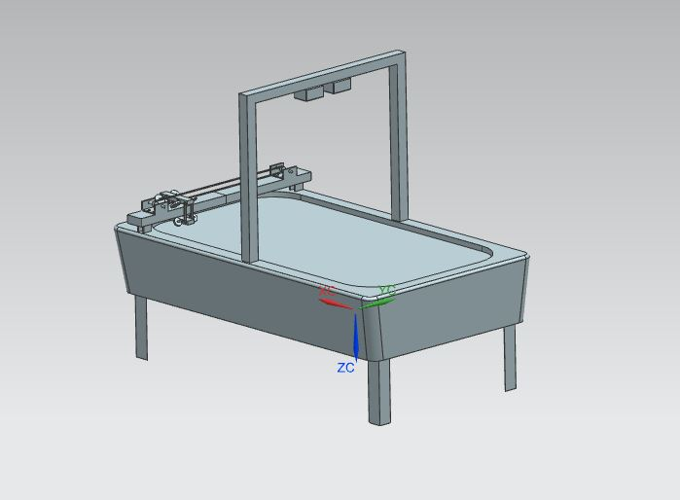
Project Description
Autonomous robotic air hockey opponent:
Puck-return
Visual Effects
Visual Tracking
End-effector
Dedicated regulated power supply

Slide 3
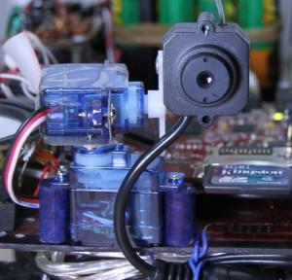
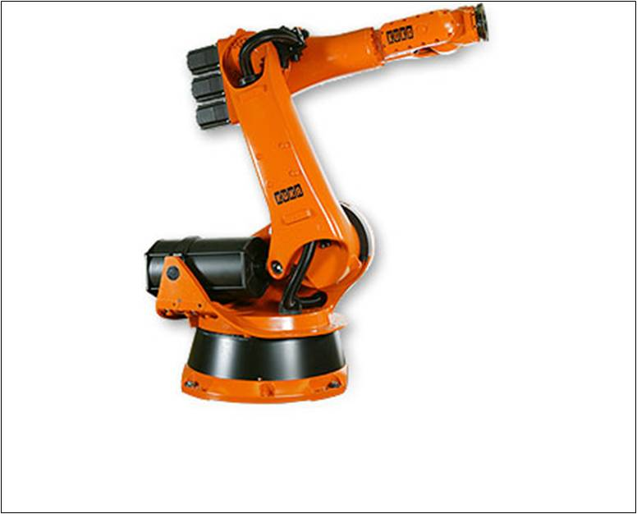
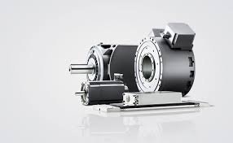
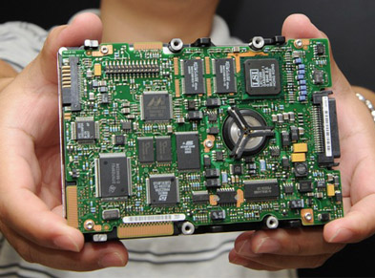
Motivation and Purpose
Desire to gain experience with:
Computer vision
Autonomous robotics
Motion control
Software proficiency
Hardware design
PCB Design

Slide 4

Goals and Objectives
Autonomous robotic arm
‘Real time’ game play
Desire of a “puck-return” system
Visual object tracking
Accurate trajectory predictions
Design our own power supply
Visual lighting effects
Convenient and user friendly environment

Slide 5
Requirements & Specifications
Specification | Value
Puck Return run-time | ≤ 20s
Autonomous Striker | ≤ 20 ms
Visual Tracking frequency | ≥ 60 fps
Visual Tracking resolution | ≤ VGA - 640x480
Voltage Regulation | 24V, 12V & 5V DC
Trajectory Prediction Accuracy | ≤ 3”
Linear Velocity of Robot Arm | ≥ 80 in/s
End-effector stroke | -
Microcontroller processing speed | ≥ 8 MHz

Slide 6
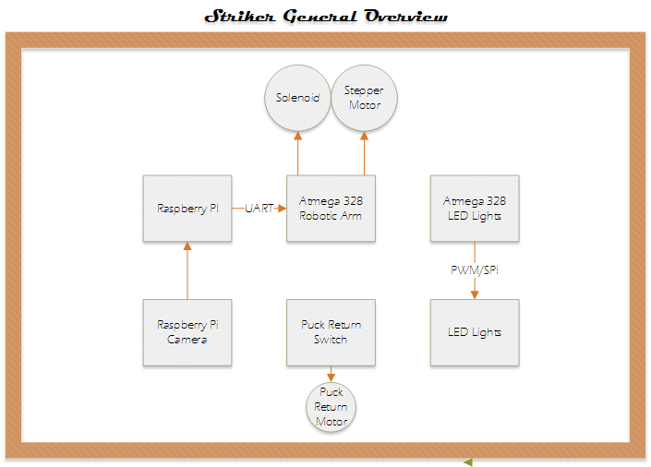
Overall System Overview

Slide 7
Microcontrollers
Our choice of microcontroller was based on these basic criteria:
Microcontroller should have descriptive reference documentation available
Simple development environment
Processing frequency higher than 8 MHz
Digital, Analog and PWM pins available
Low voltage ( operating voltage 3-5V )
Affordable (<$10.00)
Should have the necessary communication protocols – UART & SPI
Must have ability to control Striker arm.

Slide 8
MSP430FG4618 vs. ATmega328P
Features | MSP430FG4618 | ATmega328P-PU
Data Bus (core size) | 16 bit | 8 bit
Speed | 8MHz | 8MHz
Storage | 16KB | 32KB
Memory | 8KB | 2KB
Digital I/O | 80 | 14
Analog I/O | 12 | 6
Supply voltage | 1.8 - 3.6V | 1.8 - 5.5V
UART & SPI | yes | yes
Price /chip | FREE (LQFP) | FREE (DIP)

Slide 9
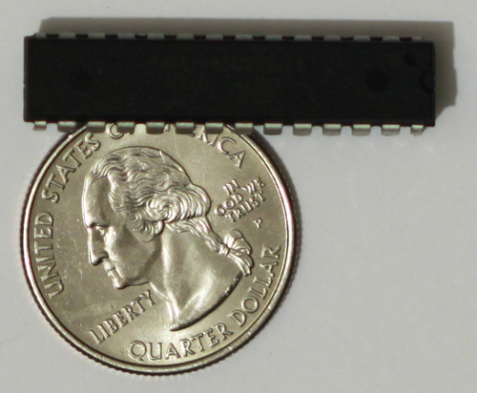
Microcontroller Decision
The Atmega328P met our requirements:
Testing can be easily implemented using Arduino Uno and Sketch IDE
Open source and abundance of support
Atmel offers free samples
Communicates through UART, SPI & I2C
High frequency (up to 20MHz with external clock)
Contains Analog, PWM & digital IO

Slide 10
Hardware Interface

Slide 11
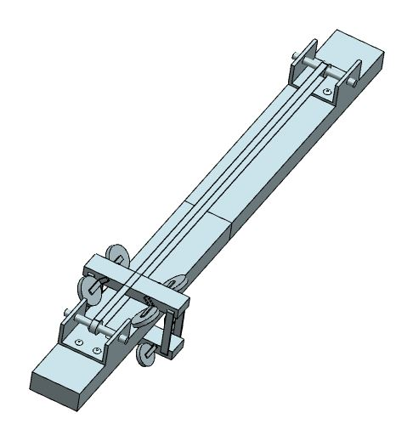
Robot Arm
Design based on the following criteria:
Hand crafted
Prismatic motion
Dedicated Microprocessor
Linear set-points no more than 2” apart
Must intercept puck’s motion towards goal
End-effector to have Propulsion with stroke no less than 1/4”
Needs to cover entire width of playing area

Slide 12
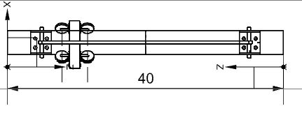
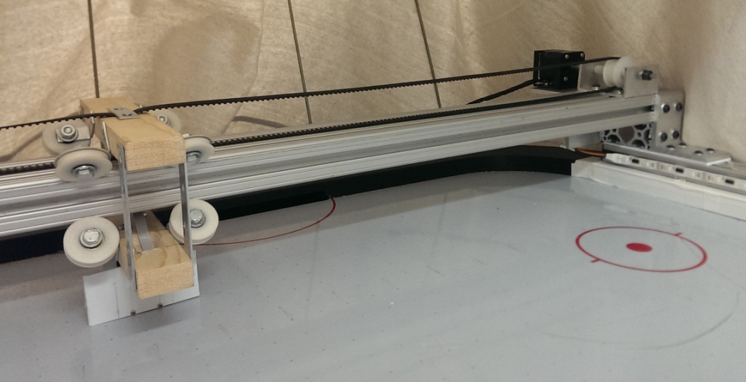
Prismatic Design
Driven by 2-phase bipolar Stepper Motor
Motion achieved by timing belt/pulley system
Built using T-Slots aluminum extrusions
End-effector gondola weight of 4.2 lbs

Slide 13
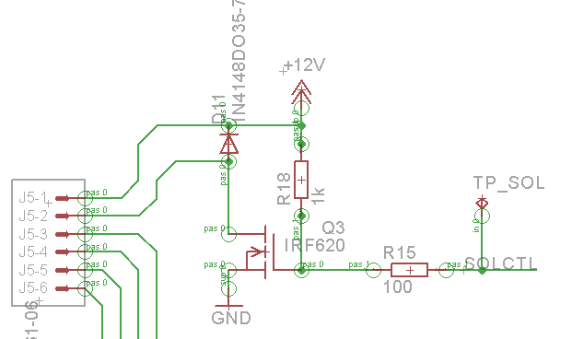
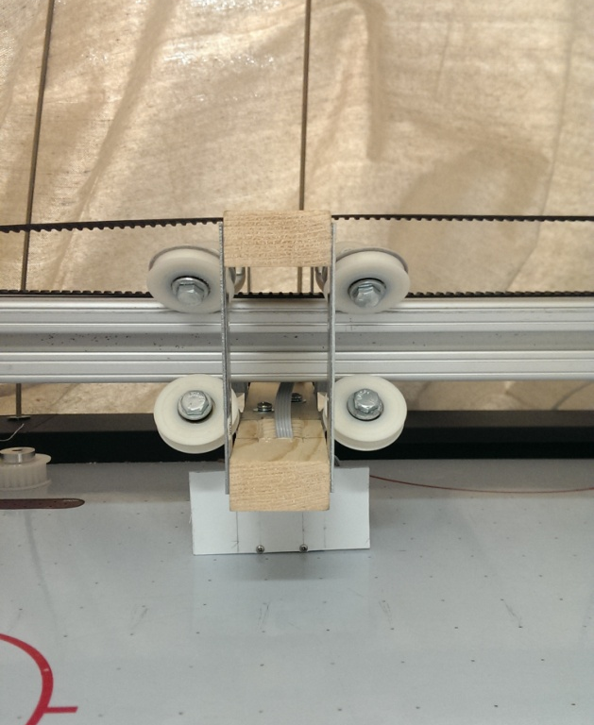
End-Effector
Pull type solenoid allows for propulsion of puck
Aligned so propulsion is parallel to side walls of playing surface
IRF620 allows for logic control of solenoid through TTL from Atmega328P

Slide 14
Stepper Motor Requirements
Attribute | Specification
RPM | 800 rpm
Position Accuracy | ± 50 mm
Steps per revolution | 200
Holding Torque | 46 oz-in
Operating Voltage | 24VDC
Shaft Diameter | 6 mm
Attribute | Specification
Inertia of Load | 46.072 oz-in²
Inertia of Pulley | 1.7957 oz-in²
Inertia of Belt | 8.9283 oz-in²
Total Inertia | 57.091 oz-in²
Total Torque | 46.165 oz-in

Slide 15
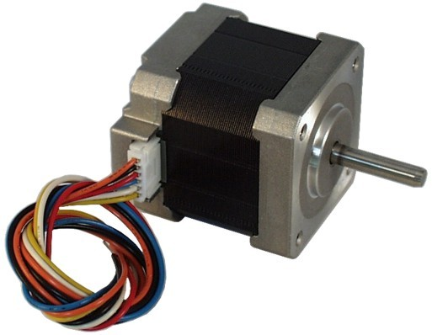
Motor Selection
STP-42DB3018
Specification | Value for bipolar
Rated Voltage | 8.8 V DC
Rated Current | 0.62 A / Phase
Rated Holding Torque | 66 oz-in
Shaft Diameter | 5mm
Dimensions (LxWxH) | 42x42x44 mm

Slide 16
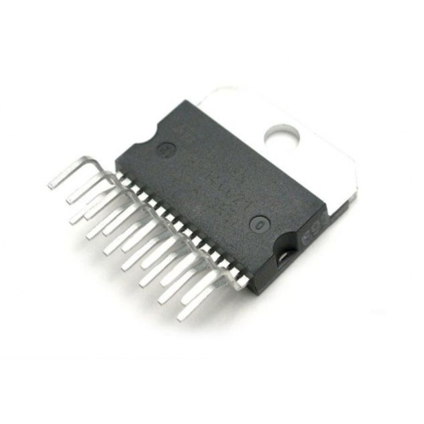
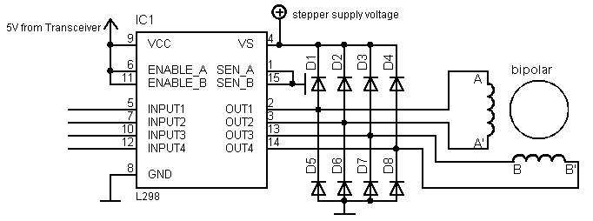
Motor Driver: L298N
Dual full H-Bridge allows for control of bidirectional
Stepper Motor
Clamping diodes, 1N5822 used to protect against
voltage spikes from ‘back EMI.’
Features:
Bi-directional motor control for steppers and solenoids
Supply voltage range for motor: 2.5 - 46V DC
Peak output current for DC operation: 2.5A
Logic supply: 4.5 – 7V DC

Slide 17
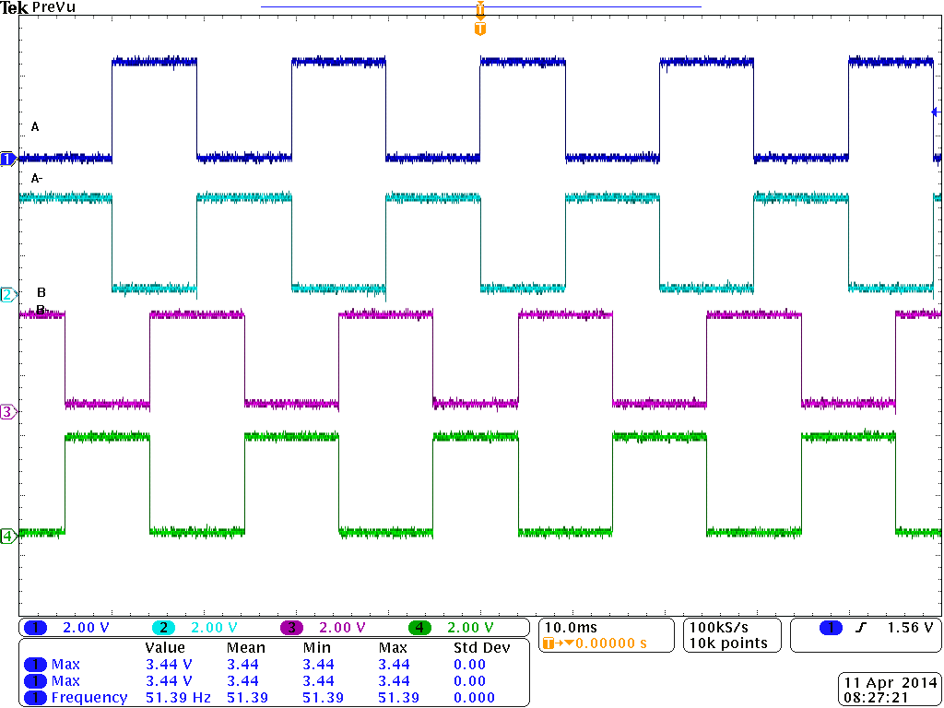
Stepper Motor Control
Stepper Motor is Permanent Magnet motor that requires pulsed signals to move rotor.
Timing sequence is Full-step to achieve maximum Torque.
A | A⁻ | B | B⁻
1 | 0 | 1 | 0
0 | 1 | 1 | 0
0 | 1 | 0 | 1
1 | 0 | 0 | 1
Full Step Timing Sequence from PCB

Slide 18
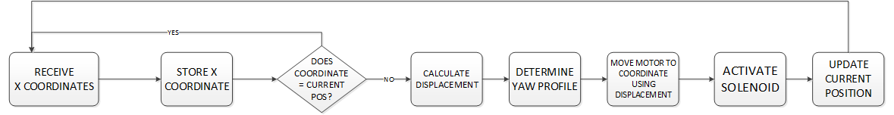
Robot Arm Software

Slide 19
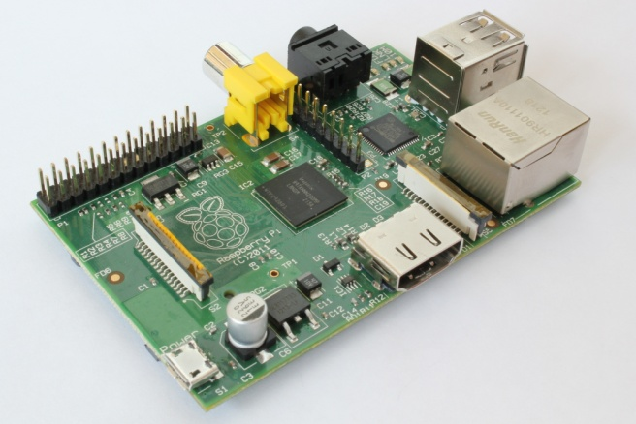
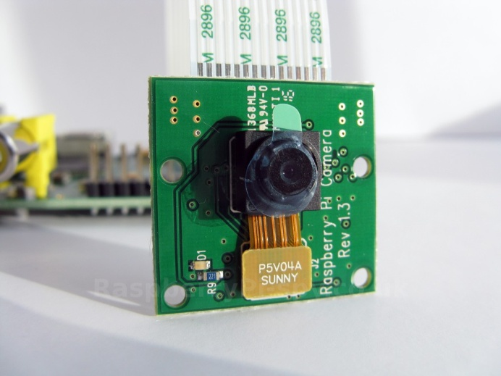
Tracking System
Raspberry Pi
Specification | Value
Processor | 700 MHz dual core
RAM | 512 MB
Communication Protocols | UART, SPI, I2C
Image Sensor | Omnivision 5637
Max. Resolution | 5 MP
Frame Rate | 90 frames/second
Field of View | 54° Horizontal 41° Vertical
Computer Language | Python & OpenCV
Lens | 0.4x Super Wide Angle 140 ͦ
Raspberry Pi Camera Module

Slide 20
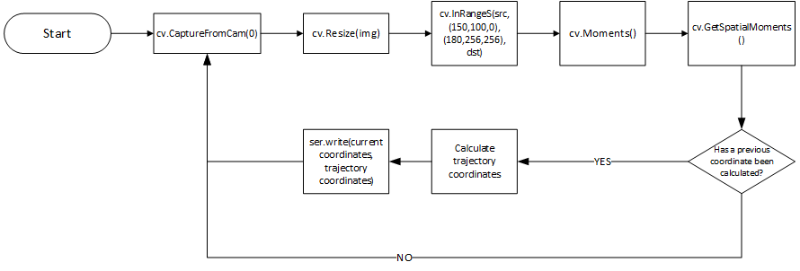
Tracking System Software

Slide 21
Centroid Calculation Test Data
IMG | Calculated Centroid |  | Actual Centroid |  | Pixel Error (%) |  | Actual Error
# | X | Y | X | Y | X | Y | X | Y
1 | 12.14 | 14.22 | 12.25 | 14 | 0.906096 | 1.547117 | 0.22289476 | 0.37125
2 | 8.77 | 14.778 | 9 | 15.25 | 2.622577 | 3.193937 | 0.46605268 | 0.7965
3 | 12.29 | 3.82 | 12.5 | 3.5 | 1.708706 | 8.376963 | 0.42552636 | 0.54
4 | 5.18 | 6.83 | 5.5 | 6.75 | 6.177606 | 1.171303 | 0.64842112 | 0.135
5 | 14.3 | 18.89 | 13.75 | 19.5 | 3.846154 | 3.229222 | 1.1144738 | 1.029375
6 | 14.4 | 6.96 | 14.25 | 6.75 | 1.041667 | 3.017241 | 0.3039474 | 0.354375
7 | 17.23 | 7.82 | 17 | 7.5 | 1.334881 | 4.092072 | 0.46605268 | 0.54
8 | 13.775 | 3.97 | 14.75 | 4 | 7.07804 | 0.755668 | 1.9756581 | 0.050625
9 | 16.82 | 12.814 | 16.5 | 12.5 | 1.902497 | 2.450445 | 0.64842112 | 0.529875
10 | 11.38 | 14.1 | 11.5 | 14.25 | 1.054482 | 1.06383 | 0.24315792 | 0.253125

Slide 22
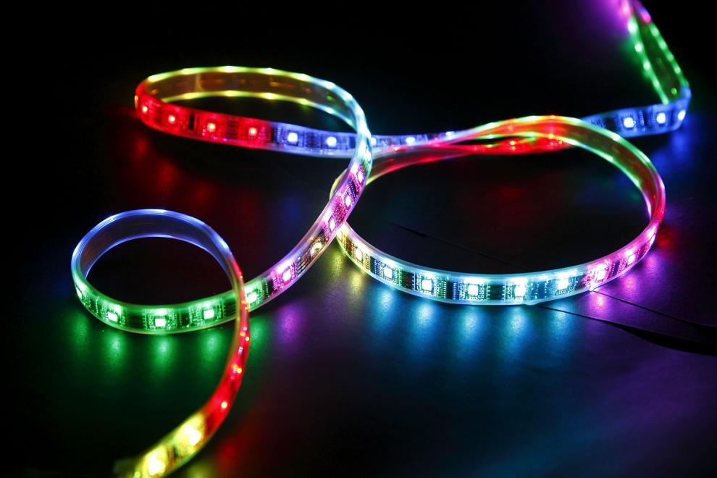
LED Lighting Objective
Fully Addressable
Have many color variations
Adds visual appeal to the gaming experience

Slide 23
LED Comparison
Specifications | HL 1606 | WS2801 | LPD8806
Color Choices | 8 | 16,777,216 | 2,097,152
Control Method | SPI | PWM | PWM
Addressable | Yes | Yes | Yes
Cost (5m) | $65 | N/A | $95

Slide 24
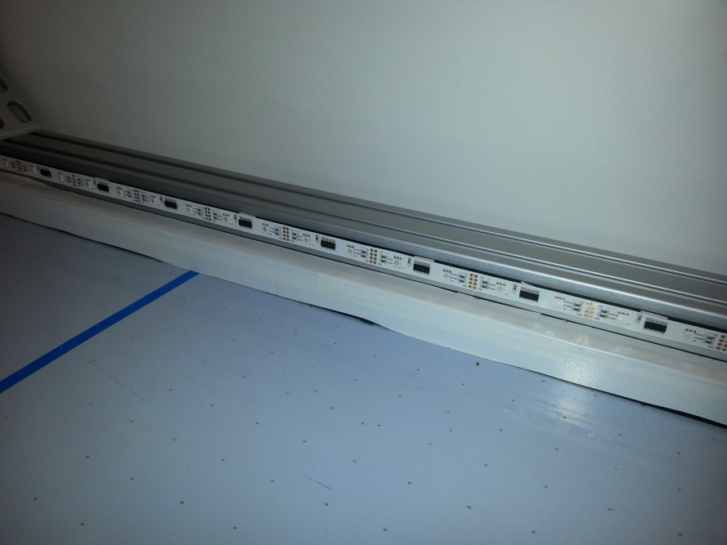
LED Selection
LPD8806 programmable LED
3 channels
7 bits per channel resulting in 2,097,152 color options
Programmed using a derivation of C language called Wired
Controlled with PWM at a frequency of 1.2 MHz via an Atmega 328

Slide 25
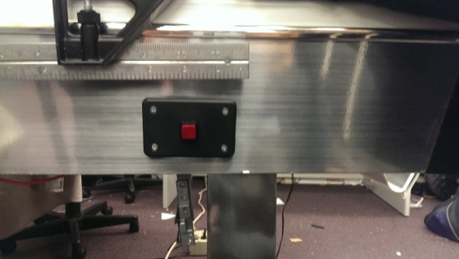
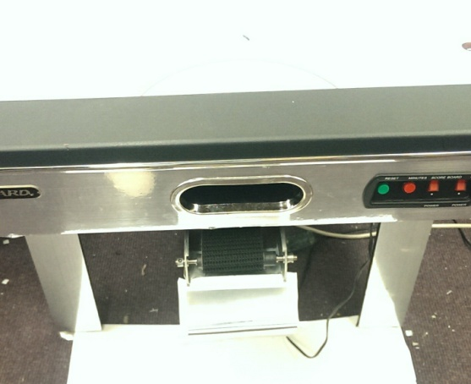
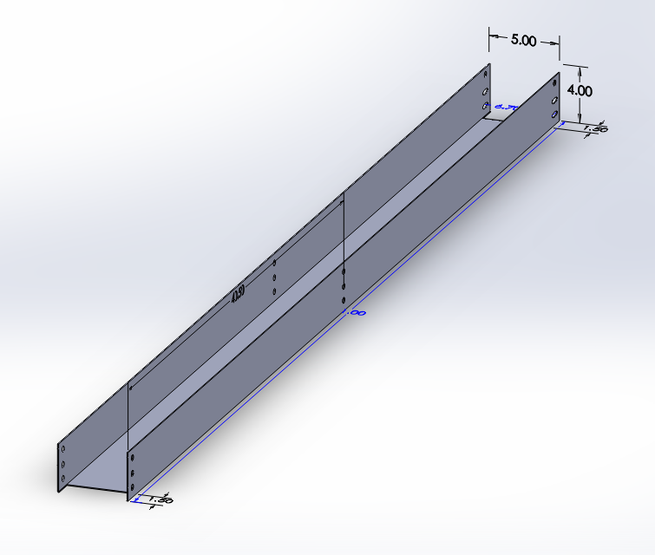
Puck Return
Return puck on demand via toggle push button
Puck must be returned to player in less than 20 seconds
Powered by separate 24V, 72W power supply

Slide 26
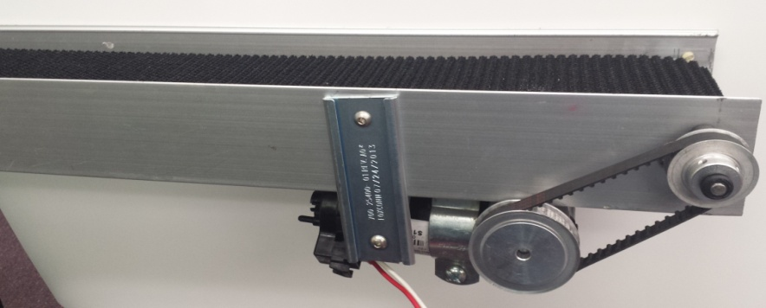
Puck Return Conveyor System
Parameter | Value
Belt Widths | 4 inches
Belt Lengths | 18 ft.
Belt Type | PVC (Black)
Drive | DC Gear Motor (12-24V@1.2A)
Drive Pulley | 2 @ .25mm bore
Conveyer roller | 5@ (4-7/8”each)
Aluminum Track | 82”x5”x 3”
Calculations based on data collected:
Table total length is 82 inches
1”= 0.0254m (U.S.I)
82”= 2.0828m
t=16s
V = d/t → V = .13m/s or 5.125in/s
Conveyor system goes underneath of the table

Slide 27
Power Supply
Uses wall receptacle to power up the air hockey table (120V AC, 60 Hz)
Power supply is divided in two parts:
24V @3A adjustable use to power up the Motors
Linear Regulated Power supply (LRPS) to supply our Electronic sub-systems. The LRPS provides 12V for our Solenoid, 5V for LEDs and Logic.

Slide 28
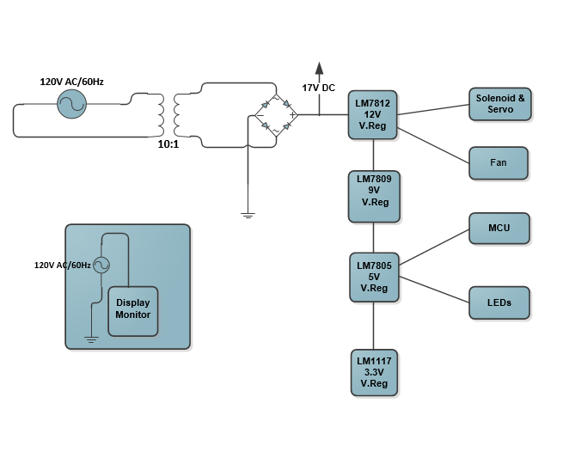
Power Supply Wiring Diagram

Slide 29
Power supply load calculation
P2 = 17V*2A = 34 W ( maximum load )
P_{Max =} 34 Watts
P_{system}= ΣPi, 1≤i≤5
P_{system} = P_{stepper} + P_{LEDs} + P_{MCU} + P_{Com} +P_{sol}
P_{system} = 12V*1A + 5V*.25A + 5V*.212A +3.3V*.03A + 12V* 1A
P_{system} = 26.409Watts (
77.7% of the available supply is used to feed our design.

Slide 30
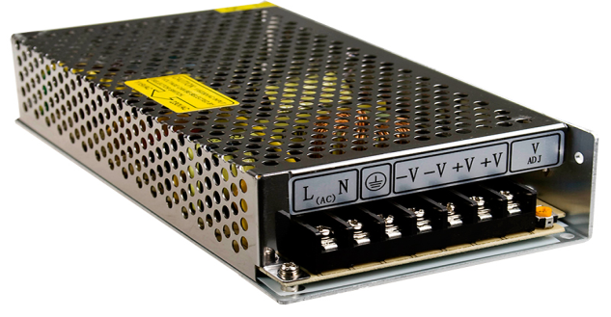
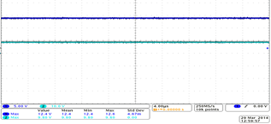
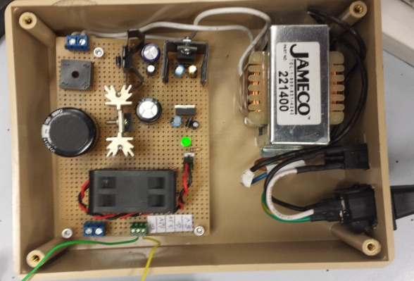
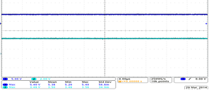
Power Supply – Motor & System
24 V/3A Adjustable Power Supply
Linear Regulated Power supply( 12V, 9V, 5V & 3.3V)
12v and 9V DC signal
5V and 3.3V signal

Slide 31
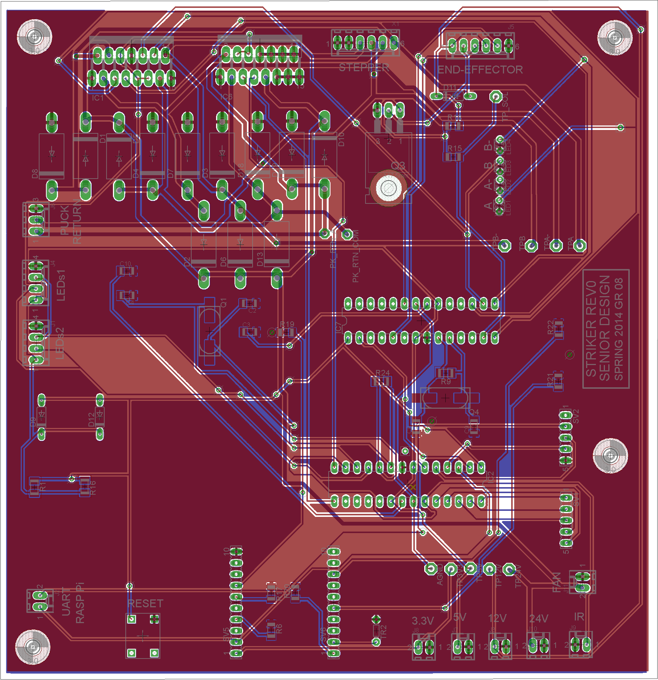
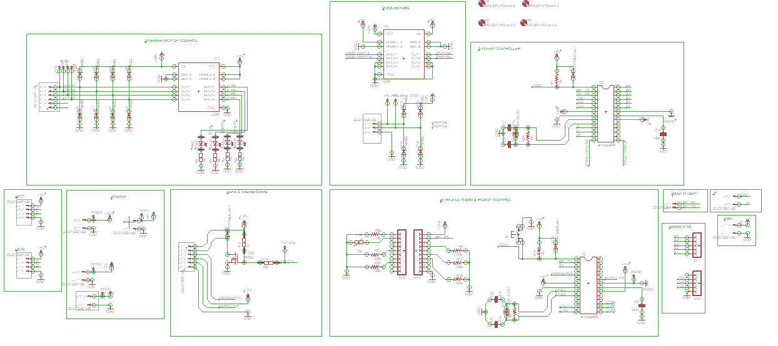
PCB Design
Designed using EagleSoft

Slide 32
Projected Budget
Part Description | Budgeted Amount ($) | Current Expense ($)
Air Hockey Table | 170.00 | 50.00
Microcontroller/PCB | 200.00 | 168.90
Visual Effects | 120.00 | 189.99
Communications | 60.00 | 50.94
Robot Arm | 100.00 | 213.76
Servo Motor | 60.00 | 12.95
Tracking Cam | 20.00 | 69.00
Playback Cam | 20.00 | 70.00
Sensors | 20.00 | 4.00
Manufacturing (Overhead Support) | 60.00 | 60.00
Puck Return | 100.00 | 61.05
Shipping | 70.00 | 141.84
Total Budget | 1000.00 | 1092.43

Slide 33
Project Distribution
 | Brian | Efrain | Loubens | Luis
Main Controller
Power
Puck Return
Puck Tracking
Robot Arm
Software
PCB/ Circuit design
Lighting
Mechanical Build

Slide 34
Adversity
PCB Design Errors
Mechanical Issues with Translation track
Automatic Puck Return
Goal Scoring LED lighting
Audio/Visual System
User Interface
Wireless Communication

Slide 35
Features omitted from final design
Audio/ Video Instant replay
Wireless Communication via Bluetooth
Android Application
LED Puck tracking
Automatic Puck Return

Slide 36


Acknowledgments
Manufacturing Support:
UCF Machine Lab
Mid Florida Tech
Quality Manufacturing Services
Faculty Support:
Dr. Richie
Dr. Gong
Dr. Wasfy
Dr. DeMara
Sponsors:

Slide 37

QUESTIONS?

