Slide 1
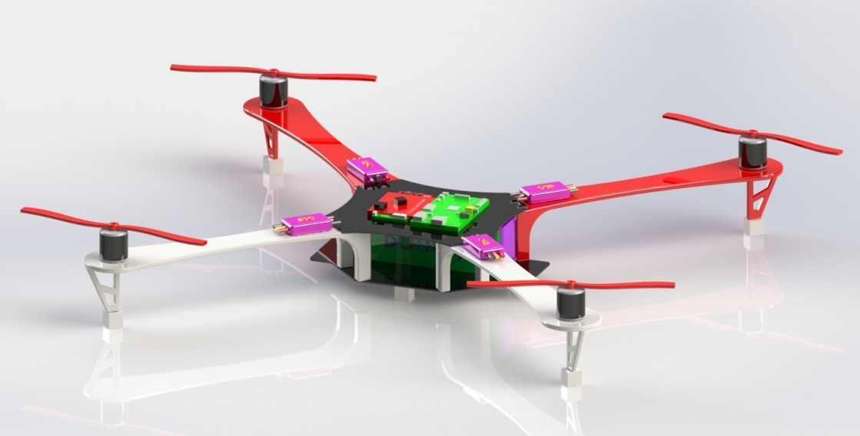
Knight’s Intelligent Reconnaissance Copter KIRC EEL 4915 - Spring 2014 - Group 14
Nathaniel Cain, EE
James Donegan, EE
James Gregory, EE
Wade Henderson, CpE
Notes:
Donegan

Slide 2
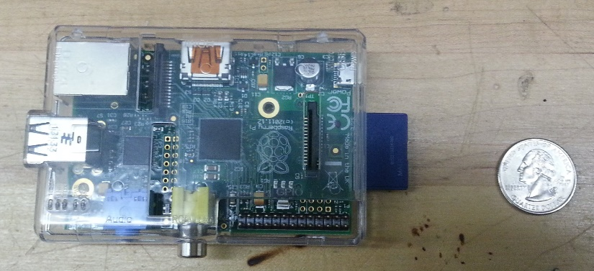
Project History and Motivation
This is an unofficial NASA sponsored project
Team was provided a budget of $1,000
Tasked to create two Unmanned Aerial Vehicles (UAV) working together to image an area autonomously
The objective is to test Delay Tolerant Networking (DTN) protocol useful in applications which tend to have long delays or disruptions
Future applications include NASA missions such as the Pavilion Lake Research Project in Canada and other Earth science missions
Notes:
*consider condensing
Cain

Slide 3
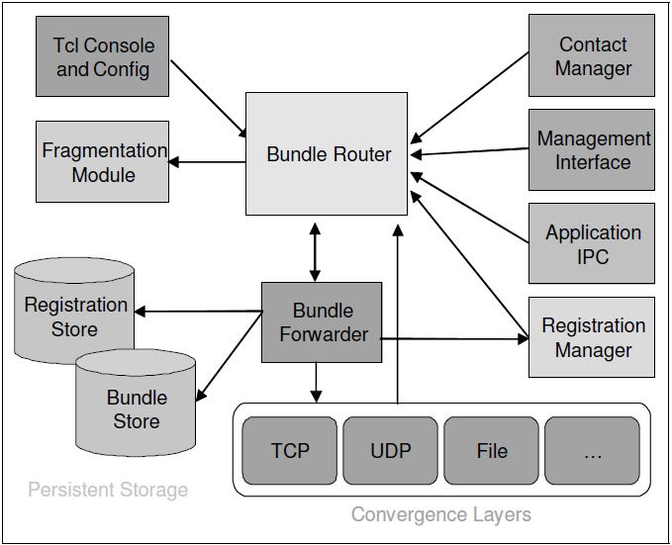
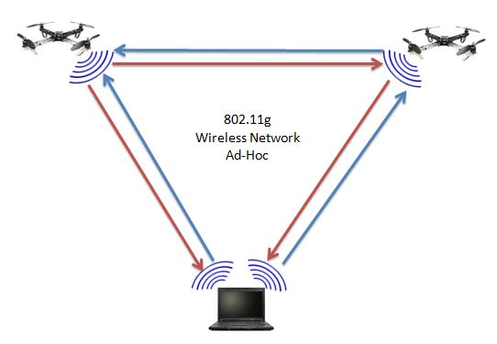
DTN Network
DTN “Delay Tolerant Network” will be used on the project, as it is one of NASA’s requirements
DTN is a networking protocol that resides as a virtual transport layer for computer communication networks, it is used to transmit and receive data over networks that are prone to delays and disruptions
DTN2, a version of DTN is an open source version of this software available online and runs on linux
Both quadcopters as well as our ground station will have DTN2 installed as part of the KIRC software
Notes:
Cain

Slide 4
Goals
Demonstrate the main features of DTN: data hopping over a mesh network, store and forward, and bundle handling
Build a foundation for software that can be reconfigurable on a mission-by-mission basis as well as having the flexibility to integrate into other UAVs
Create flexible software, implement a Real Time Operating System (RTOS) on an ARM processor, and use digital control loops to provide compensation to motors
Use an image stitching software that can stitch together a composite image from multiple coordinate stamped images
Notes:
Cain

Slide 5
Project Objectives
Lightweight
Durable
Adequate flight time
Dynamically stable flight
Ease of manual flight control
Consistent, accurate, and stable autonomous flight
Small lightweight mounted imaging camera with reasonable clarity
Ability to receive commands over a mesh network
Notes:
Cain

Slide 6
Autonomous Flight Objectives
We will program the quadcopters to take commands from a user at the ground station terminal to perform the following functions without human intervention:
Fly to a location
Take a snapshot at a location
Image an area (by a single quadcopter)
Cooperatively image an area (by two quadcopters)
Fail safe functions
Return home (ability to easily set home location)
Hover
Land Quadcopter
Directly or indirectly relay information to the other quadcopter or the ground station (DTN software)
Notes:
* Input to 3.) and 4.) will be 4 coordinates- quadcopter(s) will image area bounded by 4 coordinates
* For 5.) i.) the home location will be set every flight
All commands will be bound into a program stored on the ground computer
CAin

Slide 7
Project Specifications and Requirements
Requirement | Specification
Flight Time | > 10 minutes
Durability | Durable to 3 ft drop
Stability | ≤ 5 mph winds
Camera | ≥ 5 megapixels
Weight Limit | < 5 pounds
Altitude | > 100 ft
Time to Reach Min Altitude | < 30 seconds
Notes:
Donegan

Slide 8
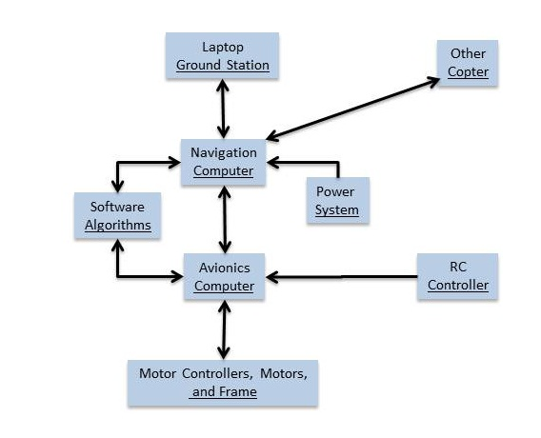
Overall Project Block Diagram
Notes:
Donegan

Slide 9
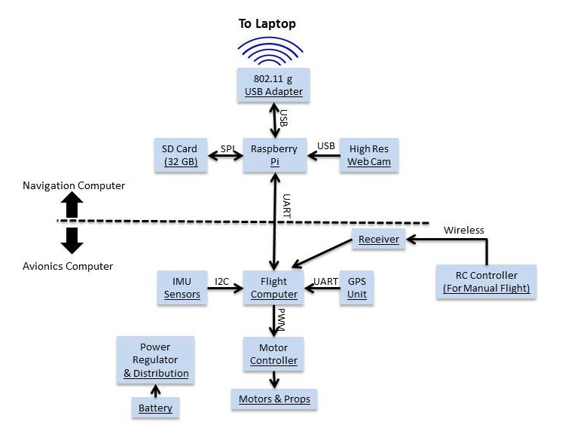
Subsystem Block Diagram
Notes:
Donegan

Slide 10
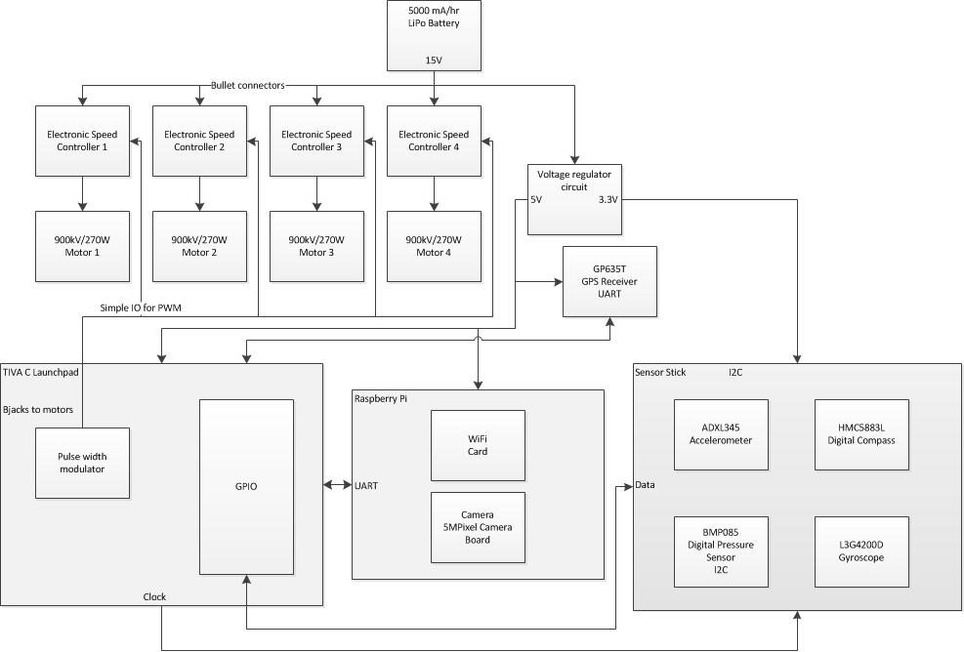
Prototype Block Diagram
Notes:
Note that although the camera module is physically separate from the Raspberry Pi (mounted on the bottom of the quadcopter with a ribbon cable running to the Raspberry Pi) but nevertheless apart of the same subsystem
Gregory

Slide 11
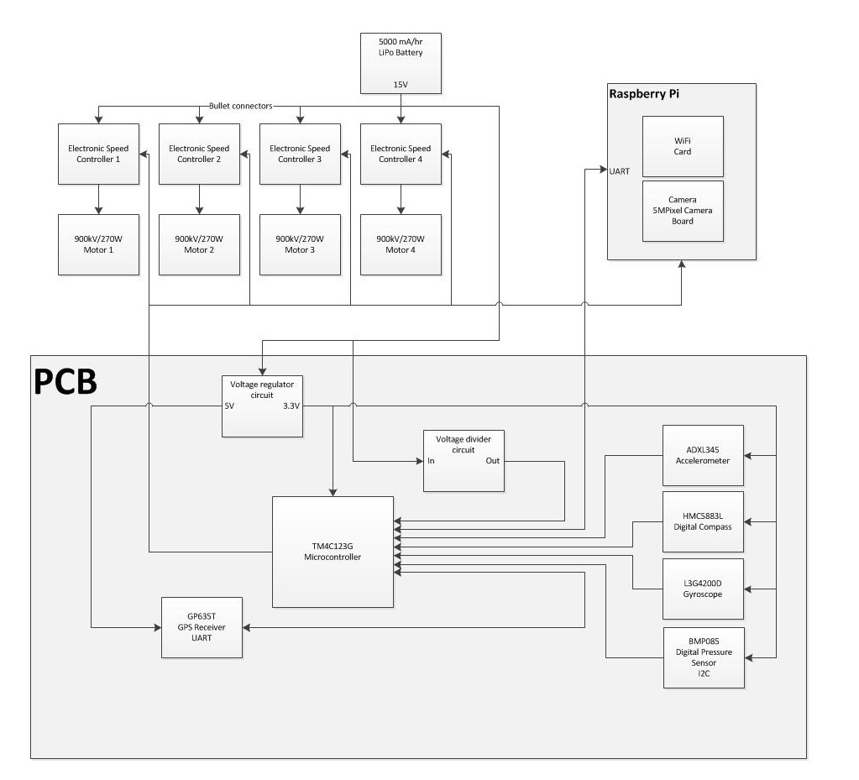
Final Block Diagram
Notes:
Gregory

Slide 12
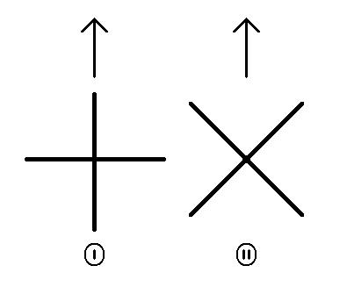
Significant Design Decisions
We chose a four rotor design over a single or six rotor design
Stability high altitudes (wind interference)
Power consumption
Large propeller force needed for fast cruising speed
We chose orientation II over orientation I
Faster movement response
Greater Stability
More challenging in terms of programming
Notes:
Consider adding 3d coordinate with roll pitch yaw
Gregory

Slide 13
Significant Component Decisions: μC
Our microcontroller had to meet some performance criteria
Must have a floating point unit to support control algorithm calculations
Must have multiple UART port for serial communication for with GPS and Raspberry Pi
Must have I2C ports for reading IMU
Must have multiple PWM channels for motor control output
Must have an A/D converter
Must support a Real Time Operating System (RTOS)
At least a 32 bit processor with fast clock rate for control functions
Must have a Launchpad as well as surface mount IC available
Name | Vendor | Processor | RTOS Support | Availability | Price
UNO32 | Digilent | PIC32MX320F128 | No | Launchpad, Standalone | $26.95
Piccolo Launchpad | Texas Instruments | F28027F | Yes | Launchpad, Standalone | $17.00
Stellaris Launchpad | Texas Instruments | EK-LMF120XL | Yes | Launchpad only | $13.49
Tiva C Launchpad | Texas Instruments | TM4C123GH6PMI | Yes | Launchpad, Standalone | $12.99
Notes:
*Change to Bullet Form
*Re-type the table and re-paste for a consistent format
The Tiva ™ C is a very capable microcontroller with a 32 bit, 80MHz, ARM Cortex M4 Processor. It has plenty of flash ROM to hold the RTOS, with 256KB. It also has enough RAM to support any amount of data or variable necessary for the control algorithms, with 32KB available. The microcontroller also has support for multiple UART, I2C, SPI, PWM, A/D, and GPIO ports in hardware. One very attractive feature of this microcontroller is its available RTOS from Texas Instruments. The TI RTOS can be specifically optimized for this microcontroller. The microcontroller is also low power, drawing only 45mA in nominal mode according to the datasheet.
Cain

Slide 14
Significant Component Decisions: μC
Our microcontroller had to meet some performance criteria
Must have a floating point unit to support control algorithm calculations
Must have multiple UART port for serial communication for with GPS and Raspberry Pi
Must have I2C ports for reading IMU
Must have multiple PWM channels for motor control output
Must have an A/D converter
Must support a Real Time Operating System (RTOS)
At least a 32 bit processor with fast clock rate for control functions
Must have a Launchpad as well as surface mount IC available
Name | Vendor | Processor | RTOS Support | Availability | Price
UNO32 | Digilent | PIC32MX320F128 | No | Launchpad, Standalone | $26.95
Piccolo Launchpad | Texas Instruments | F28027F | Yes | Launchpad, Standalone | $17.00
Stellaris Launchpad | Texas Instruments | EK-LMF120XL | Yes | Launchpad only | $13.49
Tiva C Launchpad | Texas Instruments | TM4C123GH6PMI | Yes | Launchpad, Standalone | $12.99
Notes:
*Change to Bullet Form
*Re-type the table and re-paste for a consistent format
The Tiva ™ C is a very capable microcontroller with a 32 bit, 80MHz, ARM Cortex M4 Processor. It has plenty of flash ROM to hold the RTOS, with 256KB. It also has enough RAM to support any amount of data or variable necessary for the control algorithms, with 32KB available. The microcontroller also has support for multiple UART, I2C, SPI, PWM, A/D, and GPIO ports in hardware. One very attractive feature of this microcontroller is its available RTOS from Texas Instruments. The TI RTOS can be specifically optimized for this microcontroller. The microcontroller is also low power, drawing only 45mA in nominal mode according to the datasheet.
Cain

Slide 15
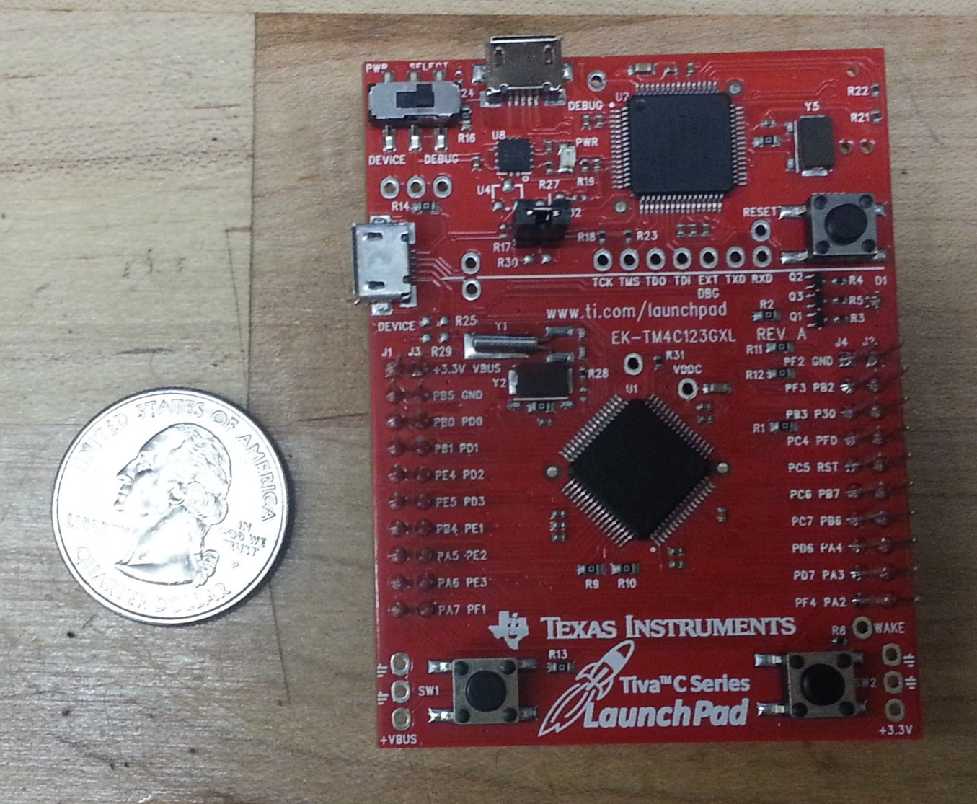
Tiva C Launchpad μC
Notes:
*Change to Bullet Form
*Re-type the table and re-paste for a consistent format
The Tiva ™ C is a very capable microcontroller with a 32 bit, 80MHz, ARM Cortex M4 Processor. It has plenty of flash ROM to hold the RTOS, with 256KB. It also has enough RAM to support any amount of data or variable necessary for the control algorithms, with 32KB available. The microcontroller also has support for multiple UART, I2C, SPI, PWM, A/D, and GPIO ports in hardware. One very attractive feature of this microcontroller is its available RTOS from Texas Instruments. The TI RTOS can be specifically optimized for this microcontroller. The microcontroller is also low power, drawing only 45mA in nominal mode according to the datasheet.
Cain

Slide 16
Significant Component Decisions: IMU
Our IMU must meet the following criteria
Must be less than $100 (preferably less than $50)
Must be I2C compatible
Have accelerometer, gyroscope, altimeter, and magnetometer
Must work on 3.3V power and low current
Must fit on through-hole mounting shield of size less than the microcontroller
All on board sensors must be available individually from at least one vendor so that they can be incorporated into the PCB design
We decided to choose a 10 DoF sensor stick because of size and satisfaction of our needs
Notes:
Add picture
Cain

Slide 17
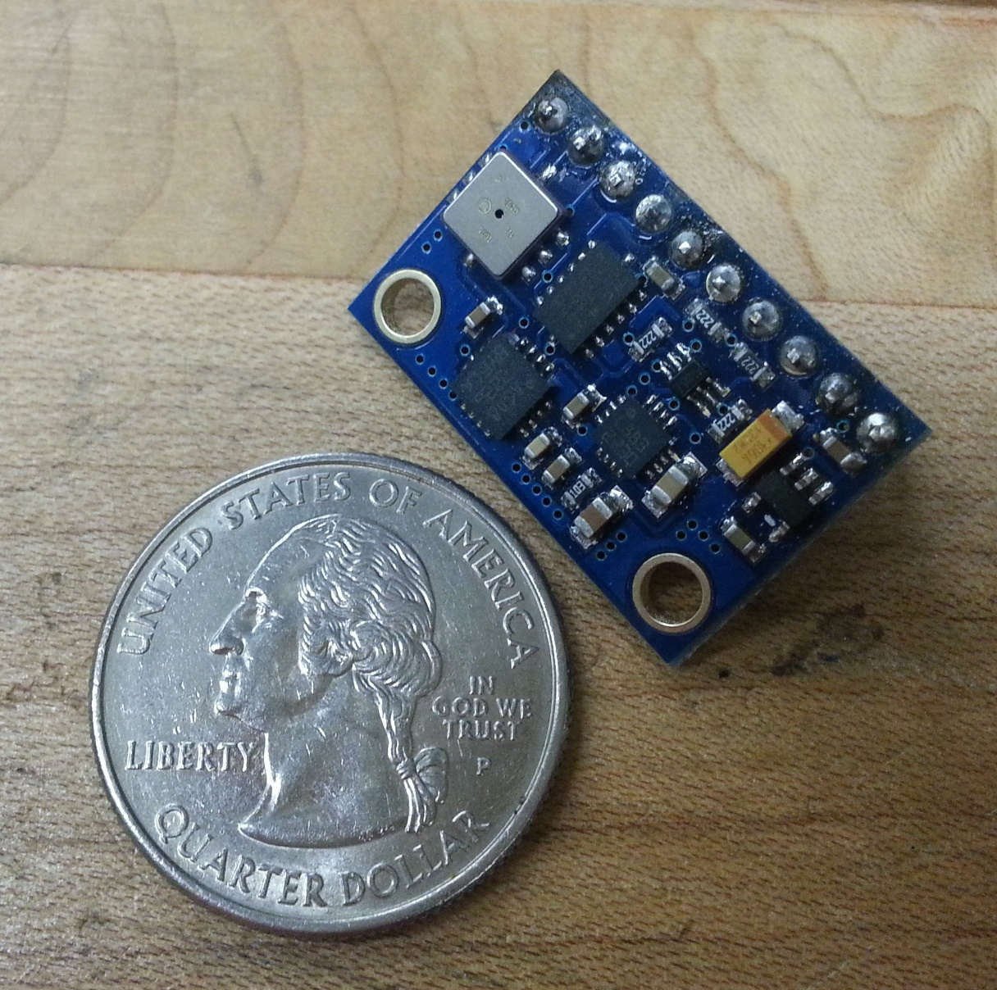
10DoF IMU
Notes:
*Change to Bullet Form
*Re-type the table and re-paste for a consistent format
The Tiva ™ C is a very capable microcontroller with a 32 bit, 80MHz, ARM Cortex M4 Processor. It has plenty of flash ROM to hold the RTOS, with 256KB. It also has enough RAM to support any amount of data or variable necessary for the control algorithms, with 32KB available. The microcontroller also has support for multiple UART, I2C, SPI, PWM, A/D, and GPIO ports in hardware. One very attractive feature of this microcontroller is its available RTOS from Texas Instruments. The TI RTOS can be specifically optimized for this microcontroller. The microcontroller is also low power, drawing only 45mA in nominal mode according to the datasheet.
Cain

Slide 18
Significant Component Decisions: GPS
Our GPS must meet the following criteria
Must have large enough signal strength to overcome motor EMI
Sensitivity under -160dBm for tracking and navigation
Fast start up time; TTFF or time to first fix under 30s
At least 50-channel (possible number of satellites that can be used at one time)
Name | Vendor | Power | Number channels | TTFF (seconds) | Sensitivity (dBm) | Price ($)
GS407 | S.P.K. Electronics Co. | 3.3V@75mA | 50 | 29 | -160 | $89.95
GP635T | ADH Technology Co. | 5V@56mA | 50 | 27 | -161 | $39.95
D2523T | ADH Technology Co. | 3.3V@74mA | 50 | 29 | -160 | $104.00
Notes:
Instead of Bold, have two identical slides with the second slide highlighting the chosen component
The GP-635T produced by ADH Technology Co. Ltd. is not only slim and easily implementable, it is also cost effective at $39.99 each, accurate to -161dBm with a UART default baud rate of 38400 bps, and the implementation of digital I/O. Environmentally, this unit can maintain operational status between -40 and +85 degrees Celsius and less than 500 Hz of vibration, less than the amount expected under the worst of conditions.
We sacrificed a small bit of battery life for the precision of such a component with 4.75 to 5.25 power supply needs with max of 56 mA current, which in comparison to the rest of the system will be close to nothing. As packaging goes this component only sits at 8x35x6.55 mm, this assists in keeping the payload of the quad-copter compact. At the price and precision of this component and its ease of implementation made it a clear choice for KIRC.
Cain/Gregory

Slide 19
Significant Component Decisions: GPS
Our GPS must meet the following criteria
Must have large enough signal strength to overcome motor EMI
Sensitivity under -160dBm for tracking and navigation
Fast start up time; TTFF or time to first fix under 30s
At least 50-channel (possible number of satellites that can be used at one time)
Name | Vendor | Power | Number channels | TTFF (seconds) | Sensitivity (dBm) | Price ($)
GS407 | S.P.K. Electronics Co. | 3.3V@75mA | 50 | 29 | -160 | $89.95
GP635T | ADH Technology Co. | 5V@56mA | 50 | 27 | -161 | $39.95
D2523T | ADH Technology Co. | 3.3V@74mA | 50 | 29 | -160 | $104.00
Notes:
Instead of Bold, have two identical slides with the second slide highlighting the chosen component
The GP-635T produced by ADH Technology Co. Ltd. is not only slim and easily implementable, it is also cost effective at $39.99 each, accurate to -161dBm with a UART default baud rate of 38400 bps, and the implementation of digital I/O. Environmentally, this unit can maintain operational status between -40 and +85 degrees Celsius and less than 500 Hz of vibration, less than the amount expected under the worst of conditions.
We sacrificed a small bit of battery life for the precision of such a component with 4.75 to 5.25 power supply needs with max of 56 mA current, which in comparison to the rest of the system will be close to nothing. As packaging goes this component only sits at 8x35x6.55 mm, this assists in keeping the payload of the quad-copter compact. At the price and precision of this component and its ease of implementation made it a clear choice for KIRC.
Cain/Gregory

Slide 20
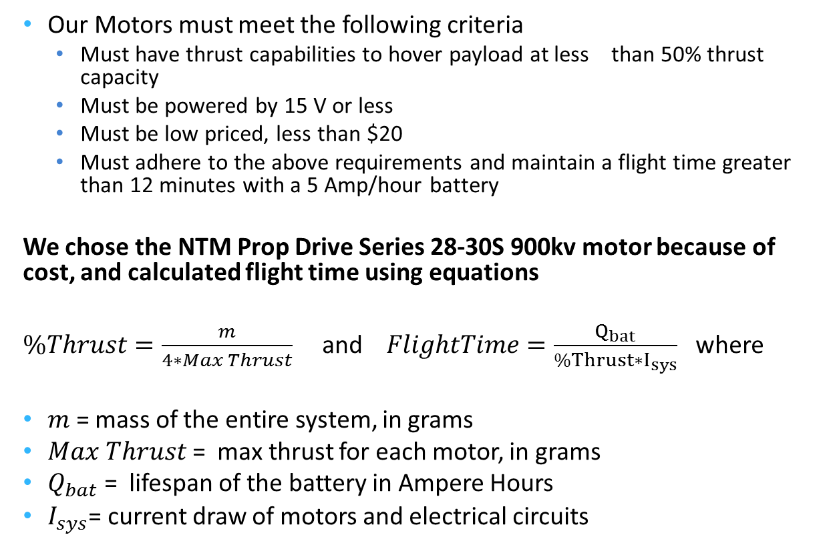
Significant Component Decisions: Motor
Our Motors must meet the following criteria
Must have thrust capabilities to hover payload at less than 50% thrust capacity
Must be powered by 15 V or less
Must be low priced, less than $20
Must adhere to the above requirements and maintain a flight time greater than 12 minutes with a 5 Amp/hour battery
We chose the NTM Prop Drive Series 28-30S 900kv motor because of cost, and calculated flight time using equations
$\%Thrust=\frac{m}{4∗Max Thrust}$ and $FlightTime=\frac{Q_{bat}}{\%Thrust∗I_{sys}}$ where
$m$ = mass of the entire system, in grams
$Max Thrust$ = max thrust for each motor, in grams
$Q_{bat}$ = lifespan of the battery in Ampere Hours
$I_{sys}$= current draw of motors and electrical circuits
Notes:
Add picture
Gregory/Donegan

Slide 21
Why do we need an RTOS?
Time sensitive application
Tasks
Memory Management
Multitasking
Clock/Timers
Preemption
Notes:
Henderson

Slide 22
Peripheral priorities
IMU
Receiver
Altimeter
Raspberry Pi
GPS
Notes:
Henderson

Slide 23
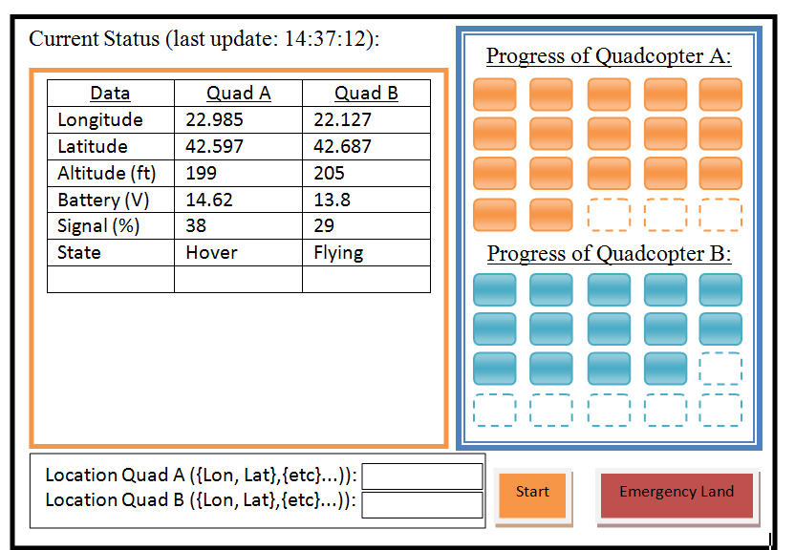
Ground Station User Interface
Notes:
Henderson

Slide 24
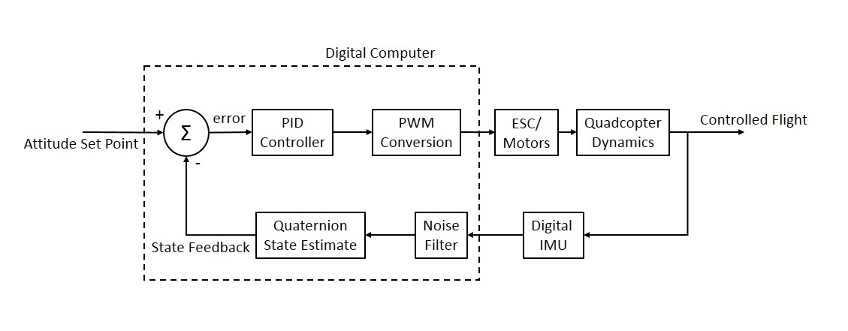
Control System
The quadcopters must be dynamically stabilized in flight in order to produce controllable flight
Attitude control will be done digitally using classical PID (Proportional Integral Derivative) feedback controllers for each axis (shown below)
The compensated output of the PID controller is sent to a PWM conversion matrix, and the respective PWM signals are sent to the ESCs and motors
Input to this control system will be from an RC controller (shown in next slide)
Notes:
Cain

Slide 25
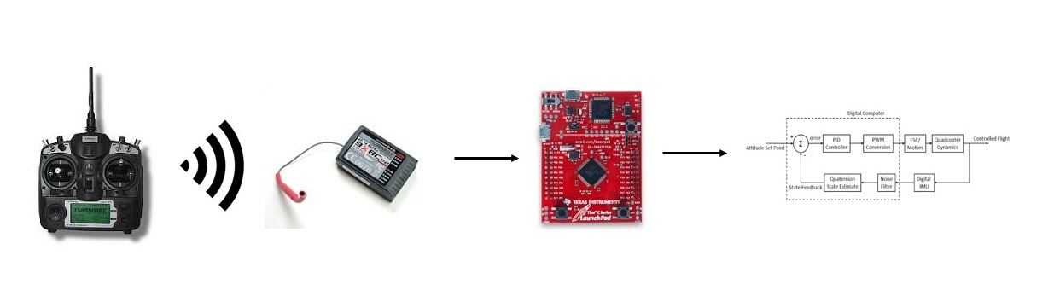
Control System (Cont’d)
Input from the RC controller is done in multiple steps:
Controller transmitter sends signal to receiver (2.4GHz)
Receiver converts signal to PWM for each channel
PWM signals are sent to microcontroller
Interrupt driven program on microcontroller decodes PWM signals into duty cycle calculations
Each signal is translated into control input for attitude control system
Notes:
Cain

Slide 26
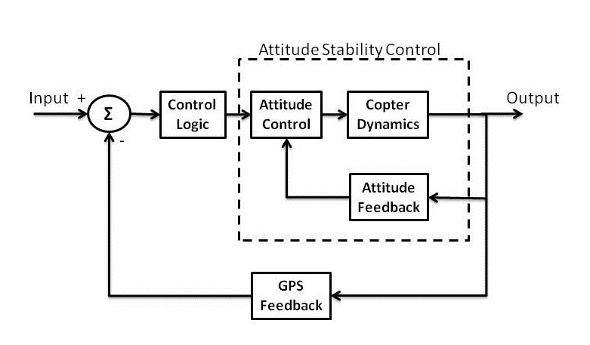
Navigation & Guidance System
The navigation control system, essentially the workhorse of the autonomous part of the project, will operate alongside the attitude control system
The navigation control system will use GPS, magnetometer, and altimeter sensors for position, heading, and altitude feedback
Most of this computing will be done on the Raspberry Pi, but the Tiva C will be reading the sensors and relaying the navigation information to the Pi
Notes:
Cain

Slide 27
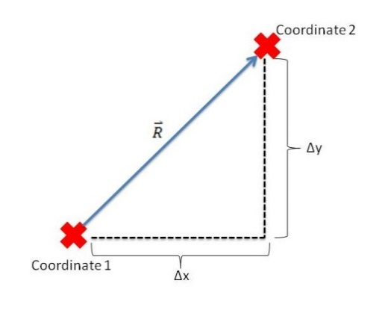
Navigation & Guidance System (Cont’d)
The navigation control algorithms will be slightly different than the attitude control system
The quadcopter will essentially have a series of “way points” to fly to
Since civilian GPS has error to within a few meters, each way point will be described as a “bubble”, where within this bubble the quadcopter will be considered to be at the destination
The autonomous control of the quadcopter will be achieved using a state machine that describes to the flight computer exactly what actions to take and when to do them
Notes:
CAin

Slide 28
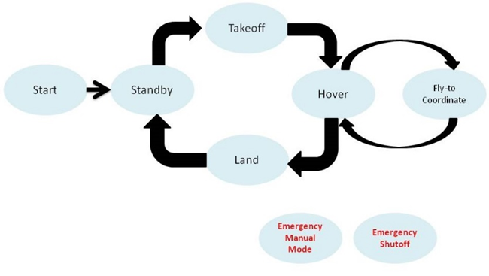
Navigation State Machine

Slide 29
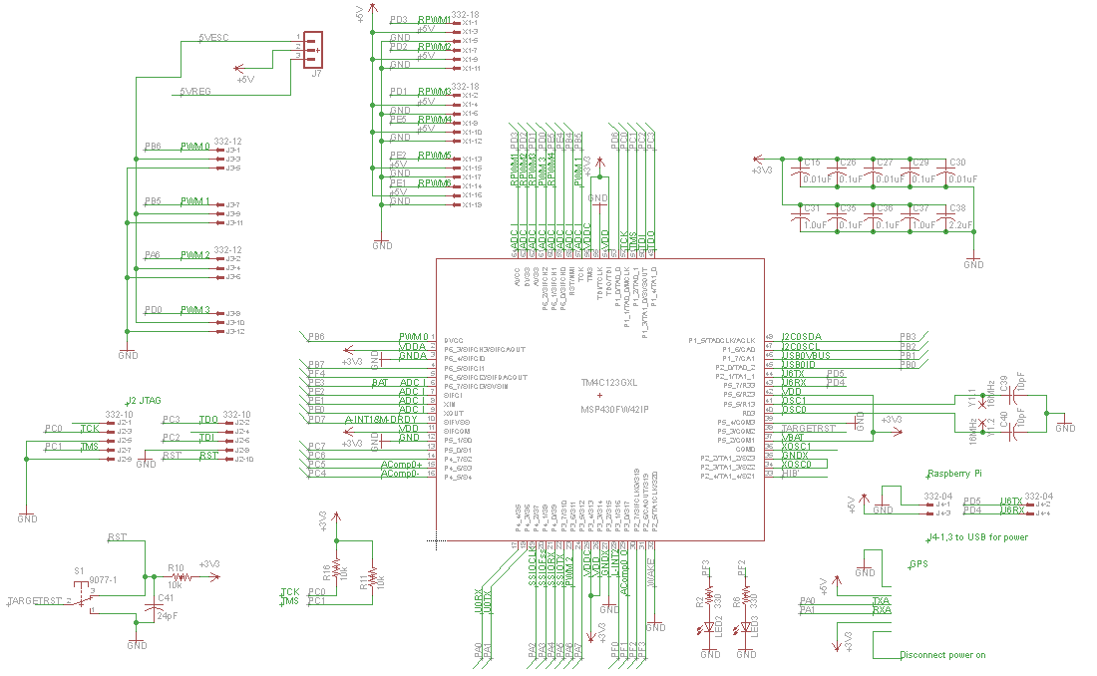
PCB Schematic: μC
Notes:
Gregory

Slide 30
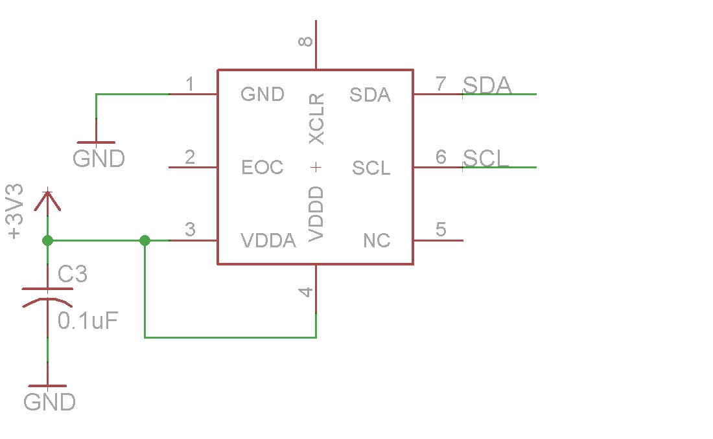
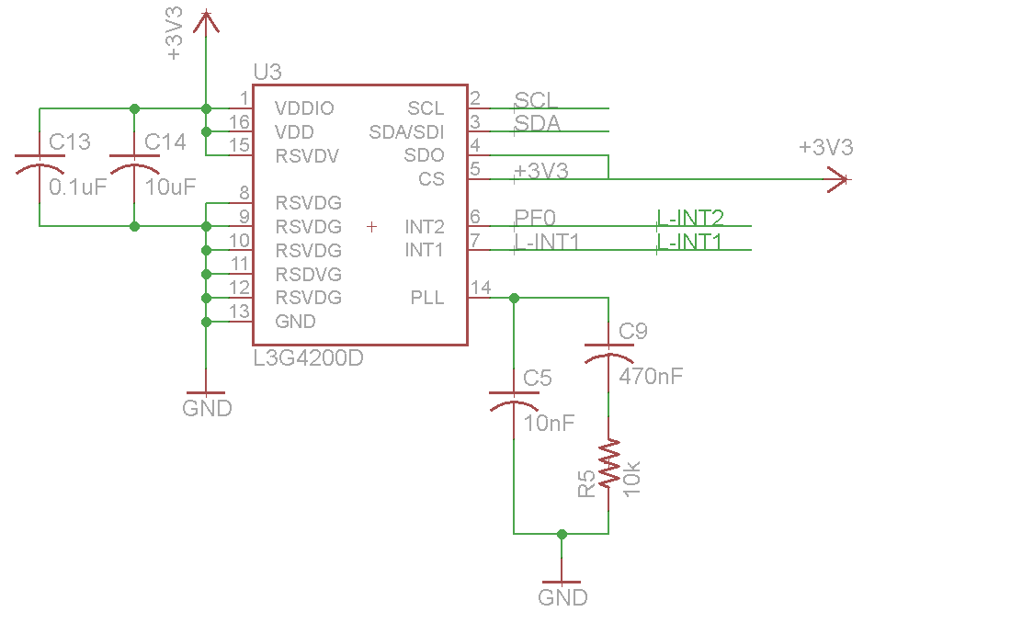
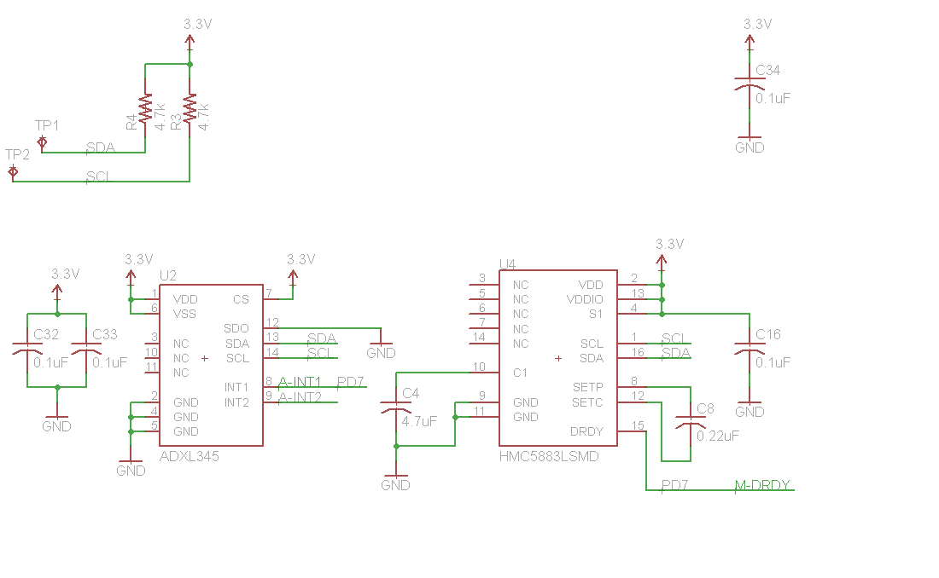
PCB Schematic: IMU
Notes:
Gregory

Slide 31
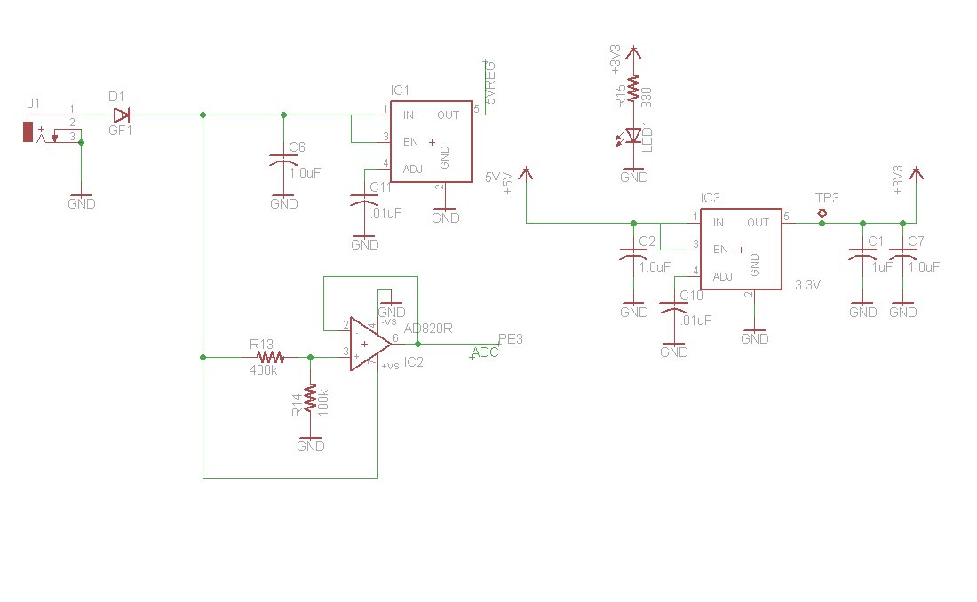
PCB Schematic: Power Circuit
Notes:
Gregory

Slide 32
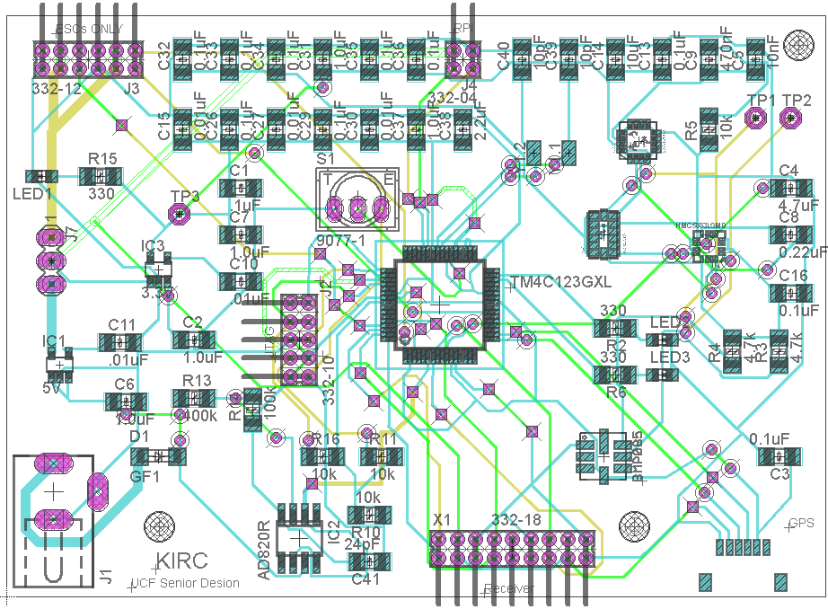
PCB Layout Manufactured by OSH Park
Notes:
Longways 3.3
2.5 wide
Insert bar
Gregory

Slide 33
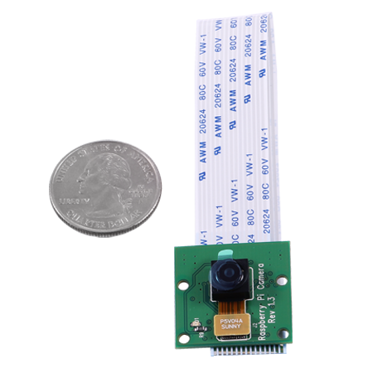
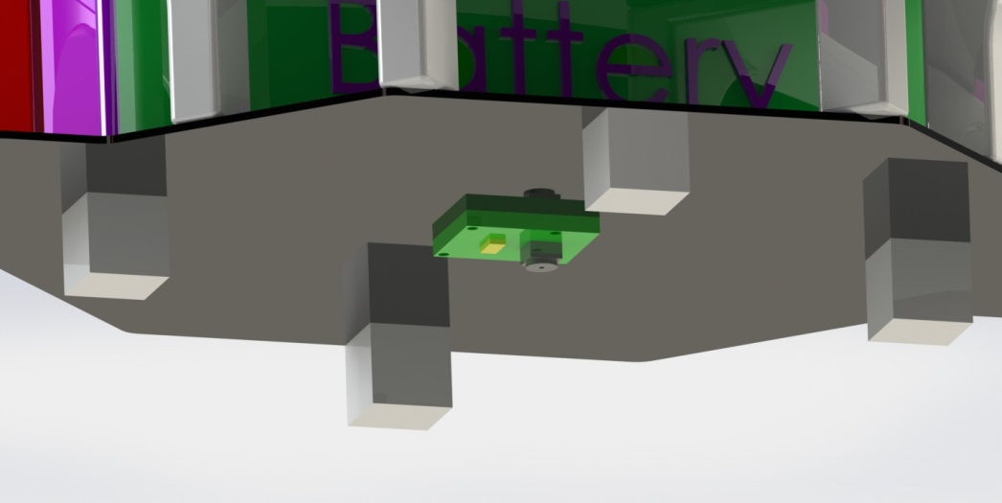
Mounted Camera
Raspberry Pi Camera Module
5 Megapixel imaging

Slide 34

Stitching Software
The software will have locations of the positions of each pictures, and overlap neighboring pictures based on position
In figure (a) below, we have an input of 4 pictures in red, blue, green, and yellow which are equally spaced
In figure (b) below, the output picture overlaps every input picture by 50%
(a)
(b)
Notes:
Henderson

Slide 35
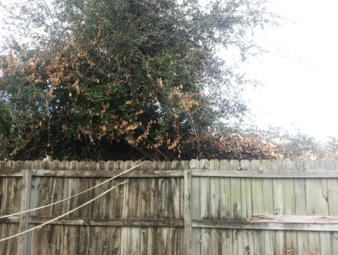
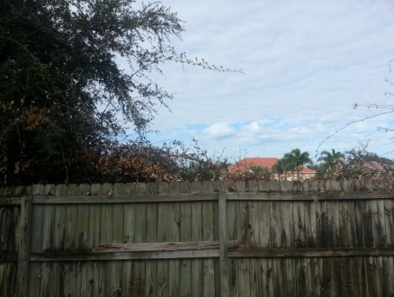
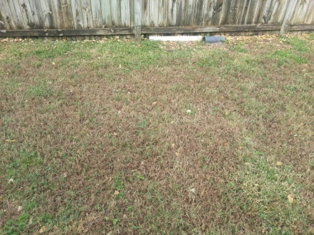
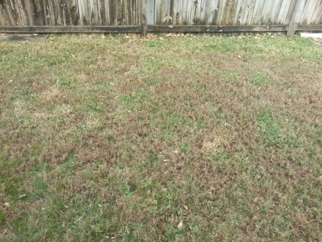
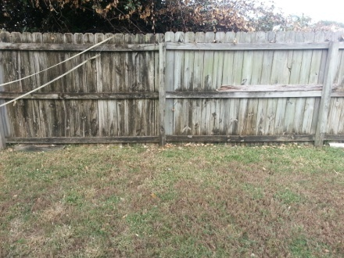
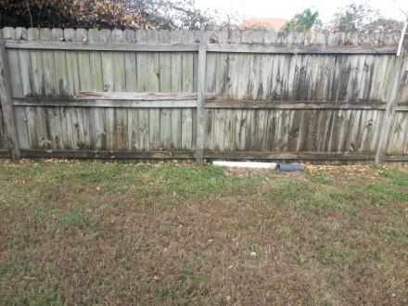
Stitching Software Example
(a)
(b)
(c)
(d)
(e)
(f)
Notes:
Henderson

Slide 36
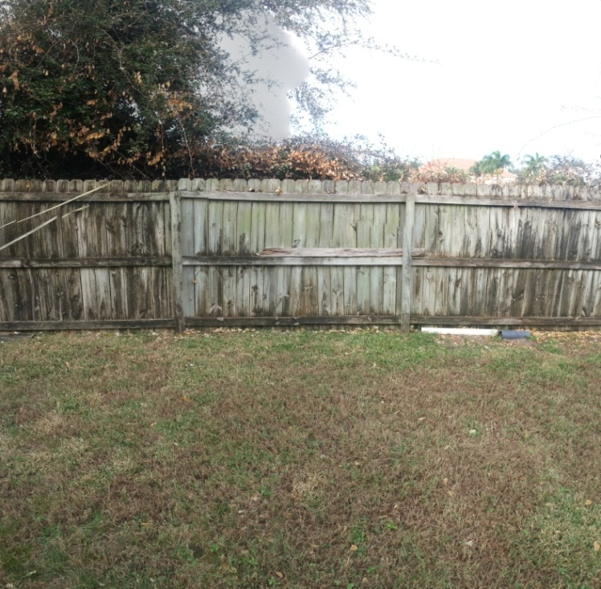
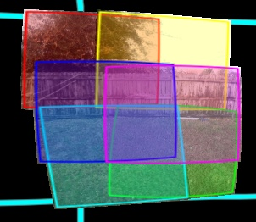
Stitching Software Application
In our implementation, each photo taken by the quadcopter will have associated GPS coordinates, which will be used in the stitching software
(a)
(b)
Notes:
Henderson

Slide 37
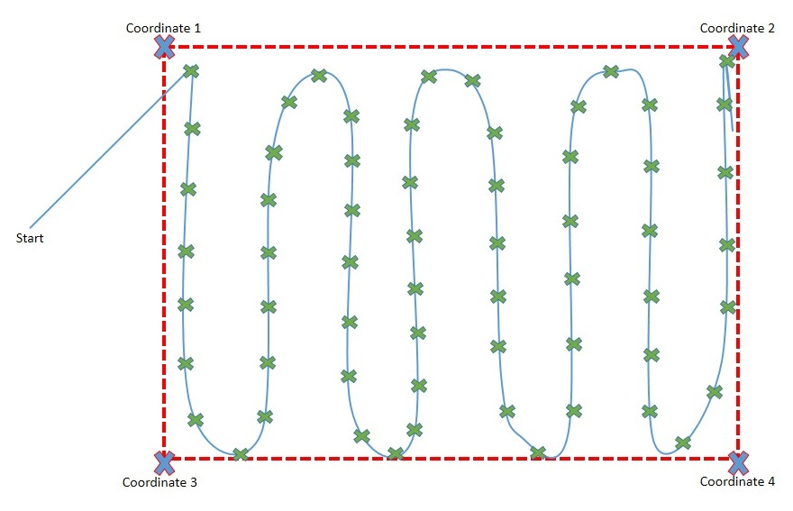
Area Imaging Flight Path
The figure below shows one possible way a single quadcopter will image an area
Notes:
A group member should explain if there are two quadcopters, the area will be divided in half, and each quadcopter’s flight path will appear similar to this figure but will be in half
(consider creating a figure which shows two quadcopter’s paths in imaging the same area)
Donegan

Slide 38
Team Organization/Work Distribution
Name | Role
Nathaniel Cain | Team Lead, NASA liaison, Control Systems Lead
James Donegan | Power System Lead and PCB Backup
James Gregory | Control Systems Backup, Schematic Design and PCB
Wade Henderson | Software Lead
Notes:
-Each member can go a little more in depth as to what their roles have evolved to (especially Wade and Nate because) however this should be a brief slide

Slide 39
Project Budget and Financing
Category | Item | QTY | Price Ea. ($) | Total $ | Status
Quad:ControlSys
… | Microcontroller Launchpad | 2 | $15.00 | $30.00 | Acquired
… | IMU Sensor Unit | 2 | $25.00 | $50.00 | Acquired
… | GPS Unit | 2 | $50.00 | $100.00 | Acquired
Quad:FlightSys
… | Speed Controller | 8 | $10.00 | $80.00 | Acquired
… | Motors | 8 | $20.00 | $160.00 | Acquired
… | Props | 12 | $4.00 | $48.00 | Acquired
… | Frame | 2 | $15.00 | $30.00 | Acquired
… | Li-Po Battery (4-5 A-h) | 2 | $40.00 | $80.00 | Acquired
… | RC Controller & Reciever | 1 | $50.00 | $50.00 | Acquired
Quad:GuidSys
… | Embedded Linux Processor | 2 | N/A |  | Acquired
… | Power Cable | 2 | N/A |  | Acquired
… | SD Cards | 2 | N/A |  | Acquired
… | 802.11G Wireless Card | 2 | N/A |  | Acquired
… | High Resolution Webcam | 2 | $50.00 | $100.00 | Acquired
Ground:GndStat
… | Laptop | 1 | N/A |  | Acquired
Quad:PCBHardW
… | Microcontroller Standalone | 2 | $10.00 | $20.00 | To be acquired
… | Accelerometer | 2 | $5.00 | $10.00 | To be acquired
… | Gyroscope | 2 | $5.00 | $10.00 | To be acquired
… | Magnetometer | 2 | $5.00 | $10.00 | To be acquired
… | Altimeter | 2 | $5.00 | $10.00 | To be acquired
TOTALS | All |  |  | $788.00 | N/A
Notes:
Donegan

Slide 40
Project Successes
So far the group has completed the following tasks
1.) Use RC controller to drive Motor through ESC
2.) Completed design of PCB
3.) Pieced together the hardware of the first quadcopter (frame, mounted motors, mounted ESCs)
4.) Successfully implemented image stitching software
5.) Successful input and calibration of Real Time IMU data
6.) RTOS Implementation including I2C and UART
7.) Significant progress on the control algorithm
Notes:
Donegan

Slide 41
Current Progress of the group
Overall Completion at 50%
Current Progress
% Completed | 5 | 10 | 15 | 20 | 25 | 30 | 35 | 40 | 45 | 50 | 55 | 60 | 65 | 70 | 75 | 80 | 85 | 90 | 95 | 100
Research
Design
Prototype
Software
Testing
Overall Completion
Notes:
Overall Completion: 49%

Slide 42
Project Difficulties
1.) Dealing with acquiring parts during the Government Furlough in 2013 (NASA budget)
2.) Dealing with lengthy shipping time for parts ordered from foreign countries
3.) Learning how to implement embedded software (drivers) into RTOS
4.) Learning to use software interrupts, hardware interrupts, and tasks
Notes:
Whoever needs

Slide 43
Plan for Completion
1.) Control Algorithm Tuning
2.) Test first working prototype with manual control
3.) Add Raspberry Pi with guidance software
4.) Test autonomous navigation
5.) Test PCB
6.) Final Testing
Notes:
Whoever needs

Slide 44
Questions or Suggestions?
Thanks for listening!

