Slide 1
N.O.M.S.
Group 18
Nakiesa Faraji-Tajrishi
Tim Miller
Jared Wach

Slide 2
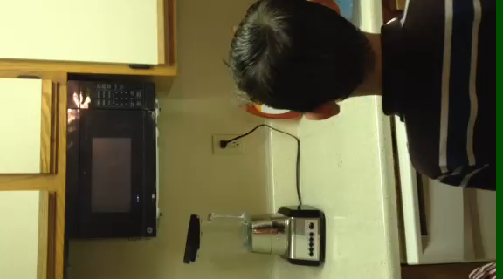
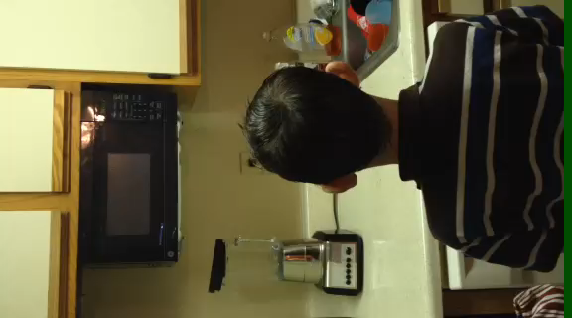
How Many Times Has This Happened to You?

Slide 3
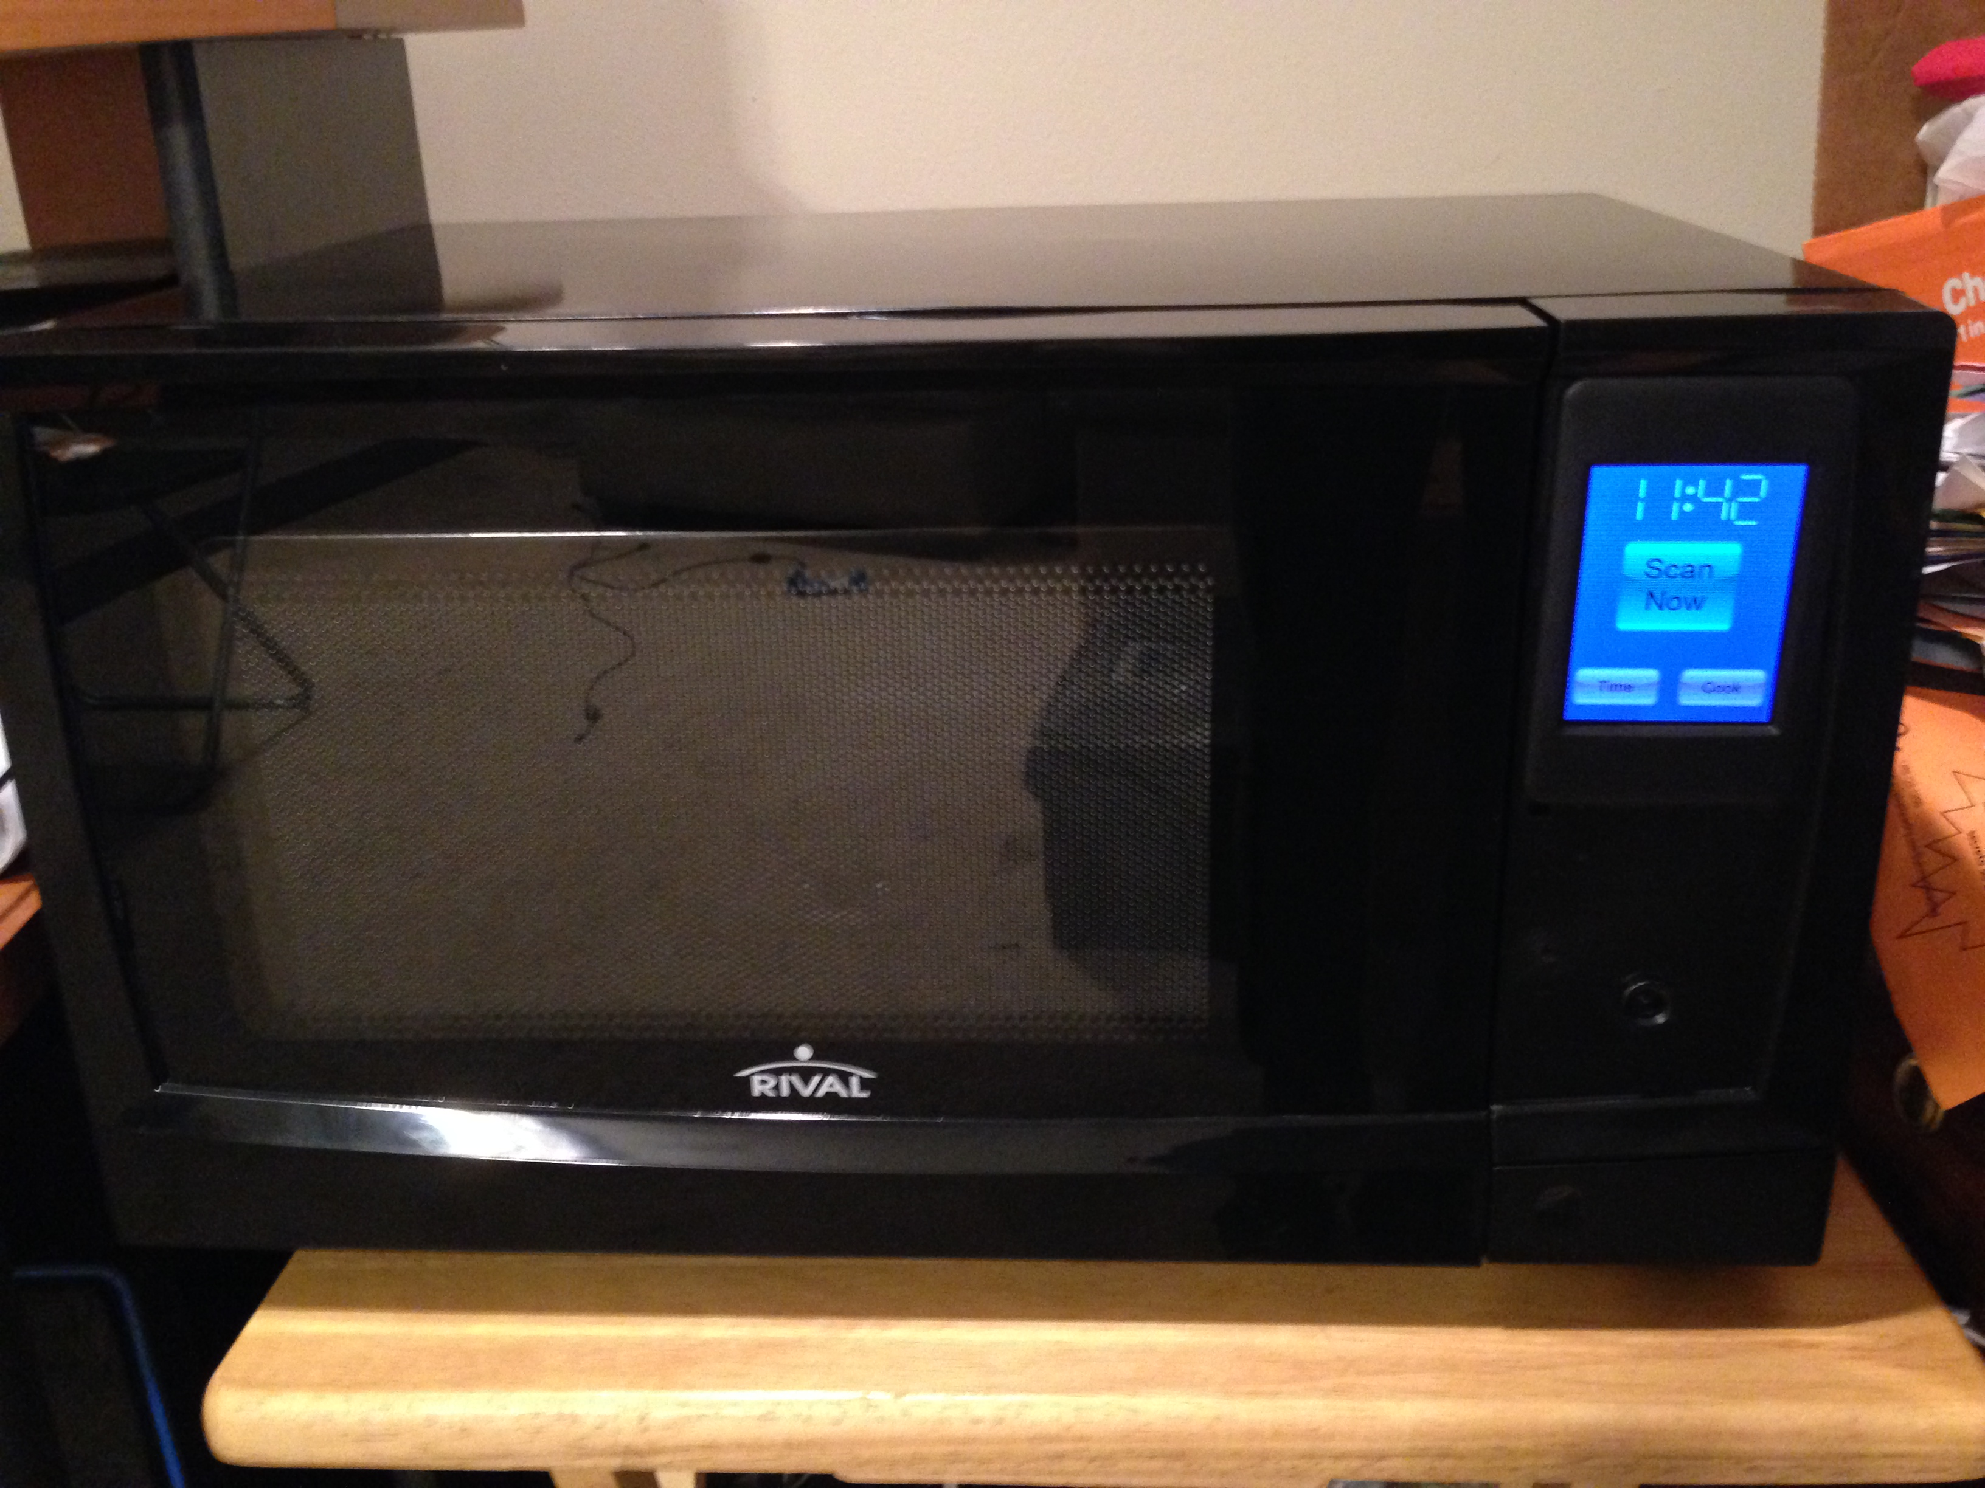
Project Goals and Objectives
Simplify the microwave experience
Touch screen user interface
Bar code scanning
Internet connected
More consistent cooking results
Varied cooking times and temperatures
Optimized instructions by wattage
Push advertising to microwave user
Notes:
Microwave picture

Slide 4
Project Specifications and Requirements
Requirement | Value
LCD Display Must Fit Panel | Less than 60 mm x 80 mm
Wi-Fi Protocol | 802.11b
Camera Frame Rate | Greater than 10 frames/sec
Camera Resolution | At least 640 x 480 pixels
Microcontroller GPIO | At least 5 GPIO
Microcontroller Communications | I2C, SPI, RS422
Onboard Storage | At least 100 Mb
Maximum Allotted Wattage Use | Less than 1680 W, 120 V power base

Slide 5
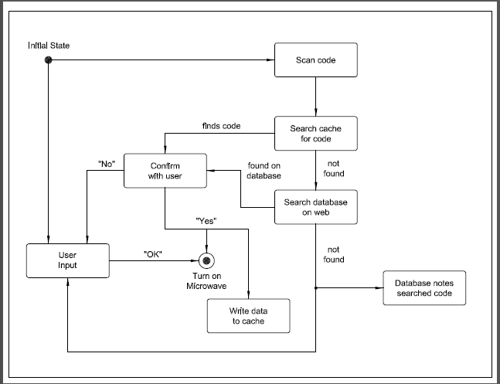

Slide 6
Design Approach and Implementation
Camera
LCD
Wi-Fi
Microcontroller
Database
Power Management

Slide 7
Design Approach and Implementation
CAMERA
LCD
Wi-Fi
Microcontroller
Database
Power Management

Slide 8
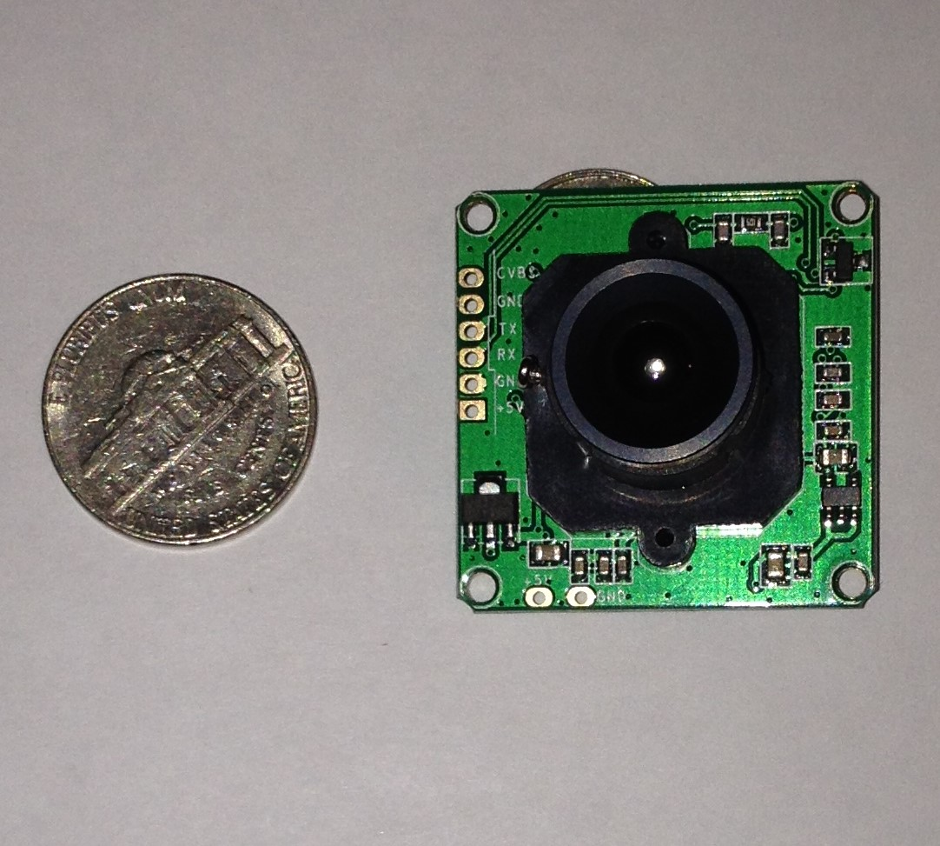
Camera
PTC-08 Serial Camera
Specifications
Module Size: 32mm x 32mm
Frame Speed: 640 x 480 @ 30 fps
Viewing Angle: 60 degrees
Baud rate: 38400
Current Draw: 75mA
Operating Voltage: DC +5V
Communication: 3.3V TTL

Slide 9
Camera Features
NTSC video output to allow the user to align the UPC code so that the microcontroller can decode it.
Once UPC code is aligned, JPEG output allows it to be captured digitally for “easy” processing by the microcontroller.
Multiple image sizes allow us to adapt the captured image for both decoding and output to the user.
Simple UART communication between the camera and the microcontroller.

Slide 10
Design Approach and Implementation
Camera
LCD
Wi-Fi
Microcontroller
Database
Power Management

Slide 11
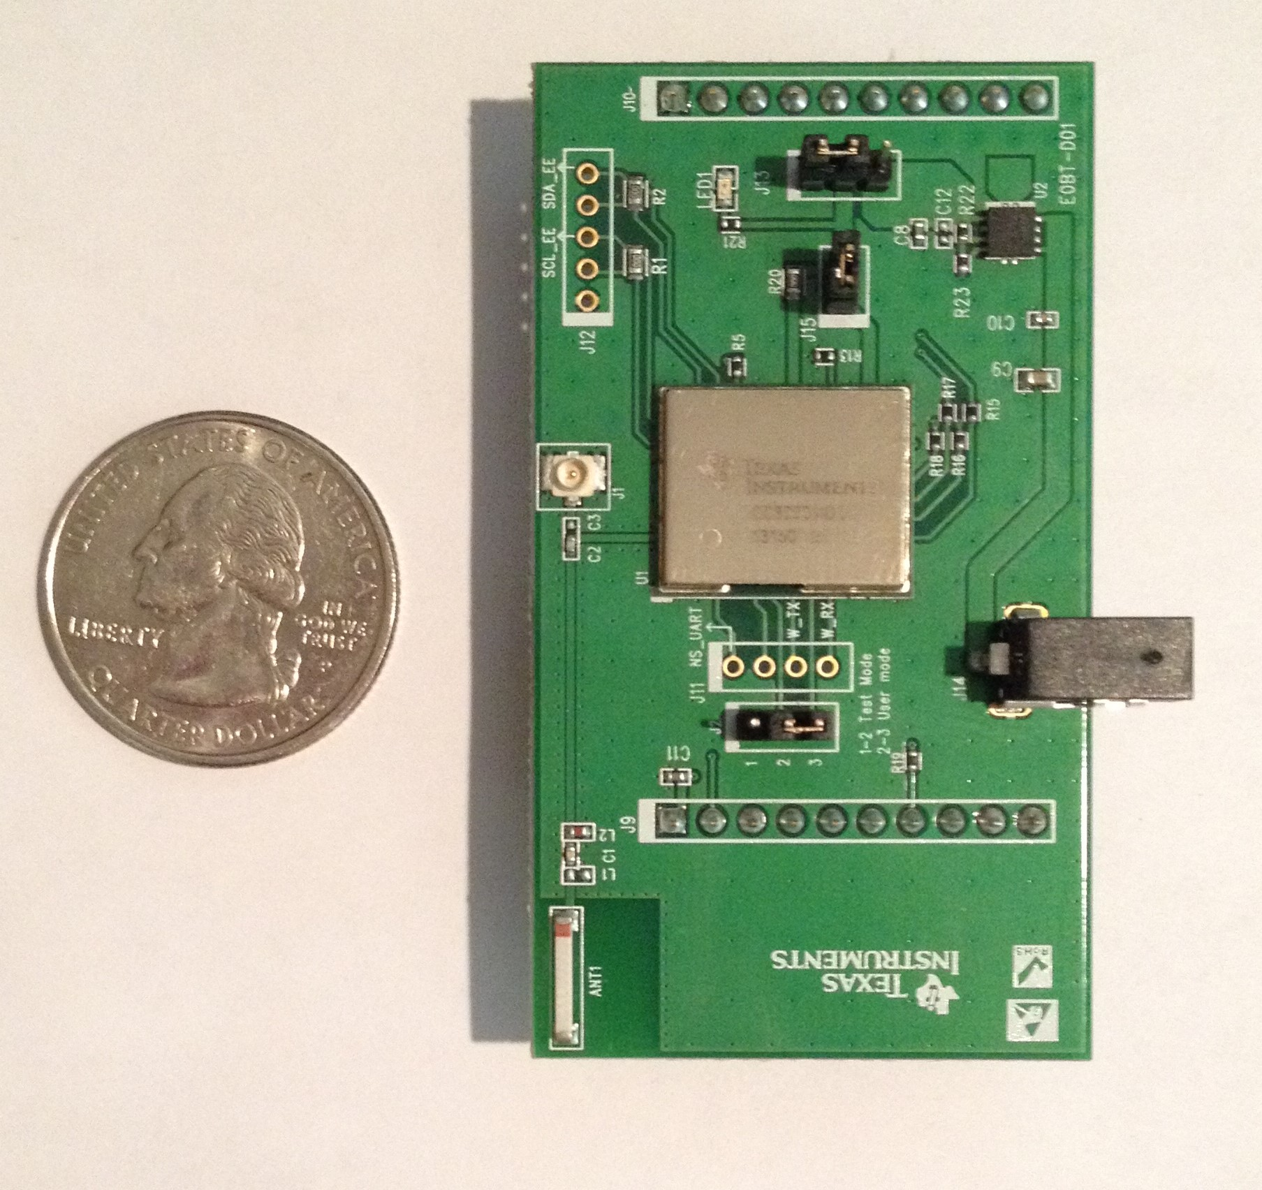
Wi-Fi
TI CC3000
Specifications
802.11 b/g integrated radio, modem, and MAC
Supports all Wi-Fi security modes
Integrated IPv4 TCP/IP stack
SPI interface
Typical current draw of 260 mA
3.3V DC

Slide 12
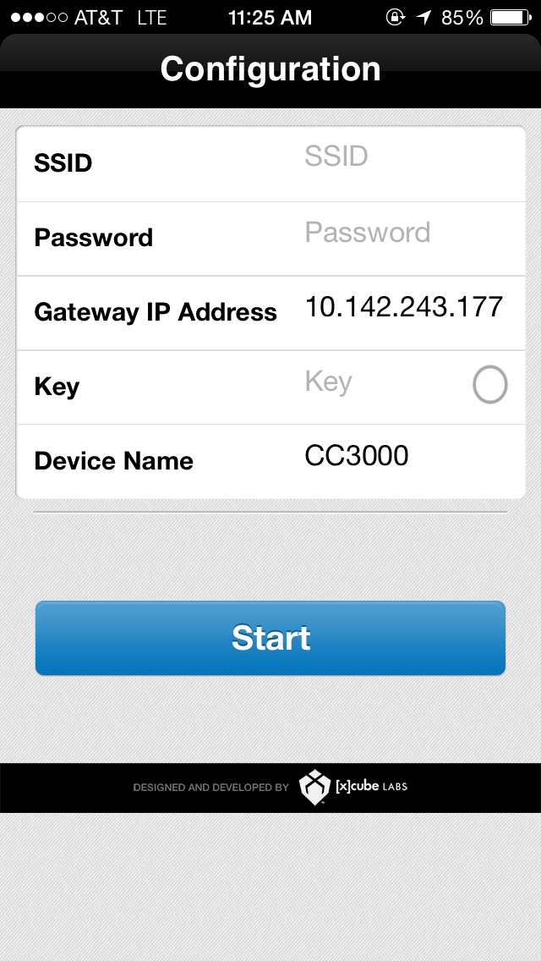
Wi-Fi Features
Industry standard chip for embedded Wi-Fi applications.
Allows for simple ad-hoc (point-to-point) wireless configuration.
PC or mobile software available for configuration.
Onboard protocol stack implemented allowing simple SPI communication between device and microcontroller.
Heavily supported by Texas Instruments.

Slide 13
Design Approach and Implementation
Camera
LCD
Wi-Fi
Microcontroller
Database
Power Management

Slide 14
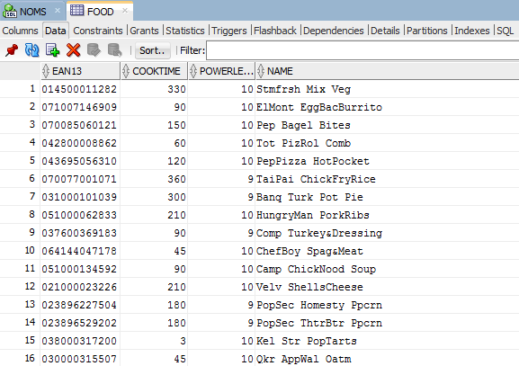
Database
Features
Relational Database that uses a single field as the key to the table
Designed for high traffic use (future)
Highly used and documented for simplicity of use in the design process
Free for trial use

Slide 15
Design Approach and Implementation
Camera
LCD
Wi-Fi
Microcontroller
Database
Power Management

Slide 16
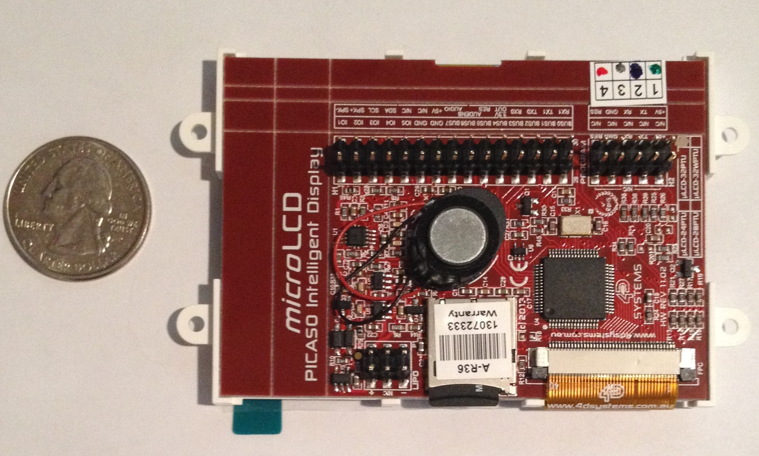
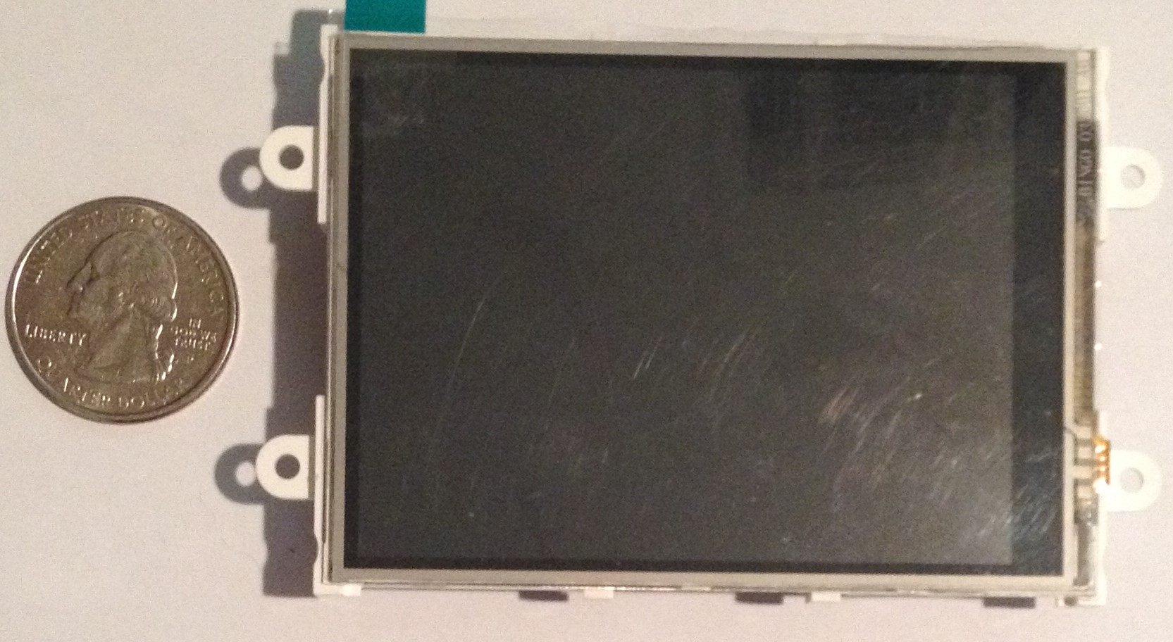
LCD
4D Systems 32PTU
Specifications
3.2” LCD-TFT display
240 x 320 with integrated 4-wire resistive Touch Panel
2 Serial and 1 I2C interfaces
13 GPIO
On-board SD
On-board audio amplifier and speaker
155 mA Current Draw
5V DC

Slide 17
LCD Features
Onboard processing system allows the user interface operation to be separate from the microcontroller.
Onboard compact flash allows generous storage space for advertisements, user profiles, and custom cooking instructions.
Robust set of development tools, including a visual development environment.
Touch screen allows for intuitive, simple user interface.

Slide 18
User Interface
The user interface will provide the following functions:
Display the time while on home screen
Provide a method whereby a UPC code can be scanned
Provide a method for manual cooking by setting the power level and cook time instructions
Display product and status information while cooking

Slide 19
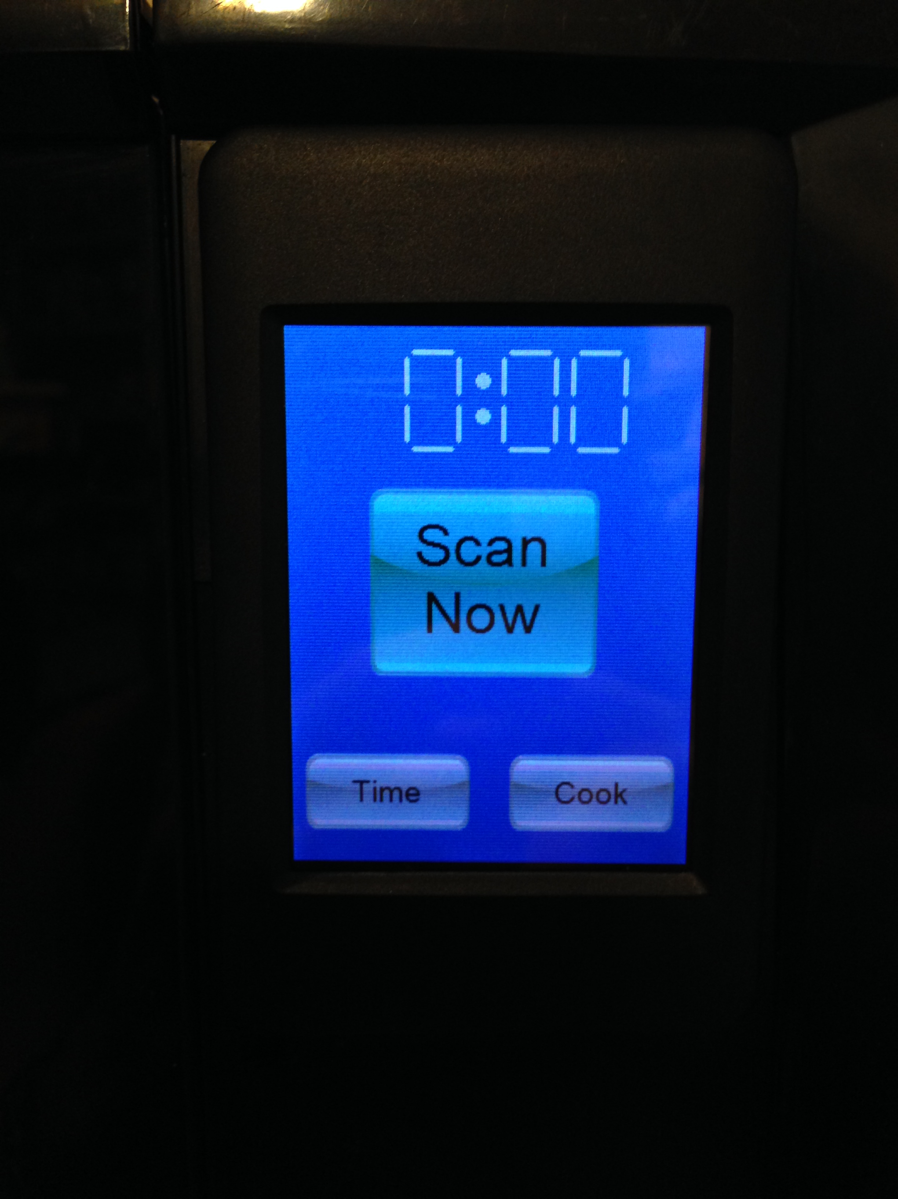
User Interface Design
Home Screen
Default screen, user decides between automatic or manual cooking instructions
Ability to access settings
Time display

Slide 20
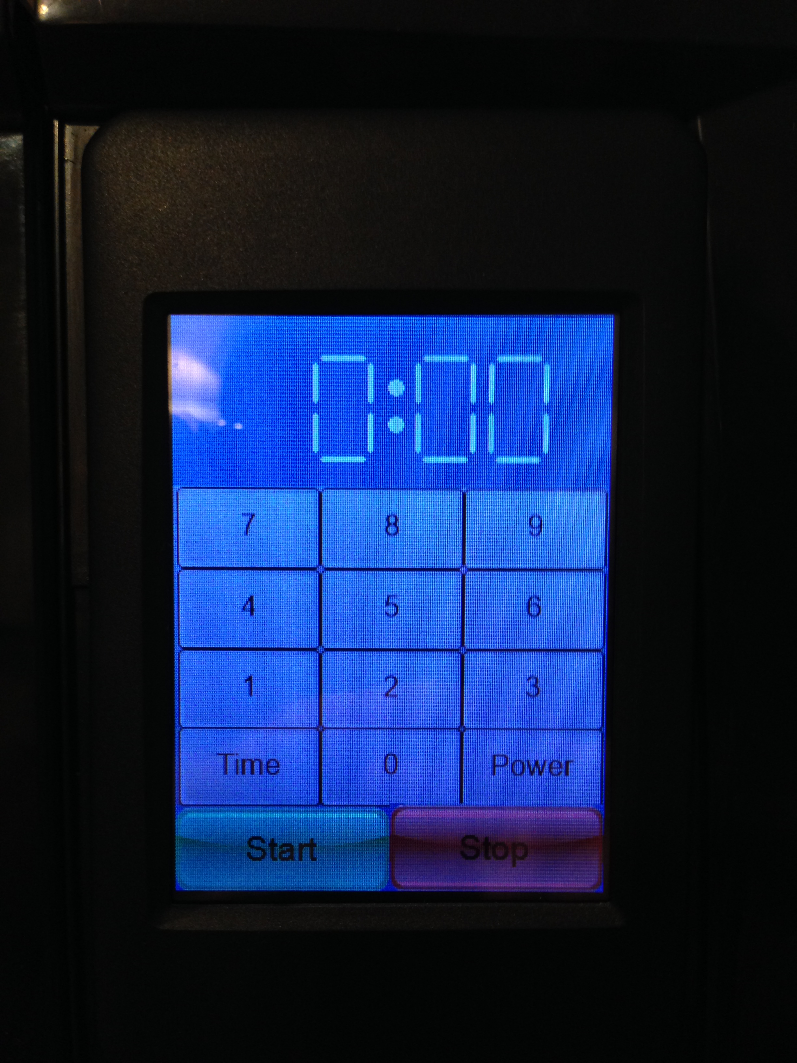
User Interface Design
Manual Entry
Allows user to set required cooking power, as designated on package
Allows user to input cooking time
Home Screen button to return home
Back button to return to previous screen
“Traditional Microwave Screen”

Slide 21
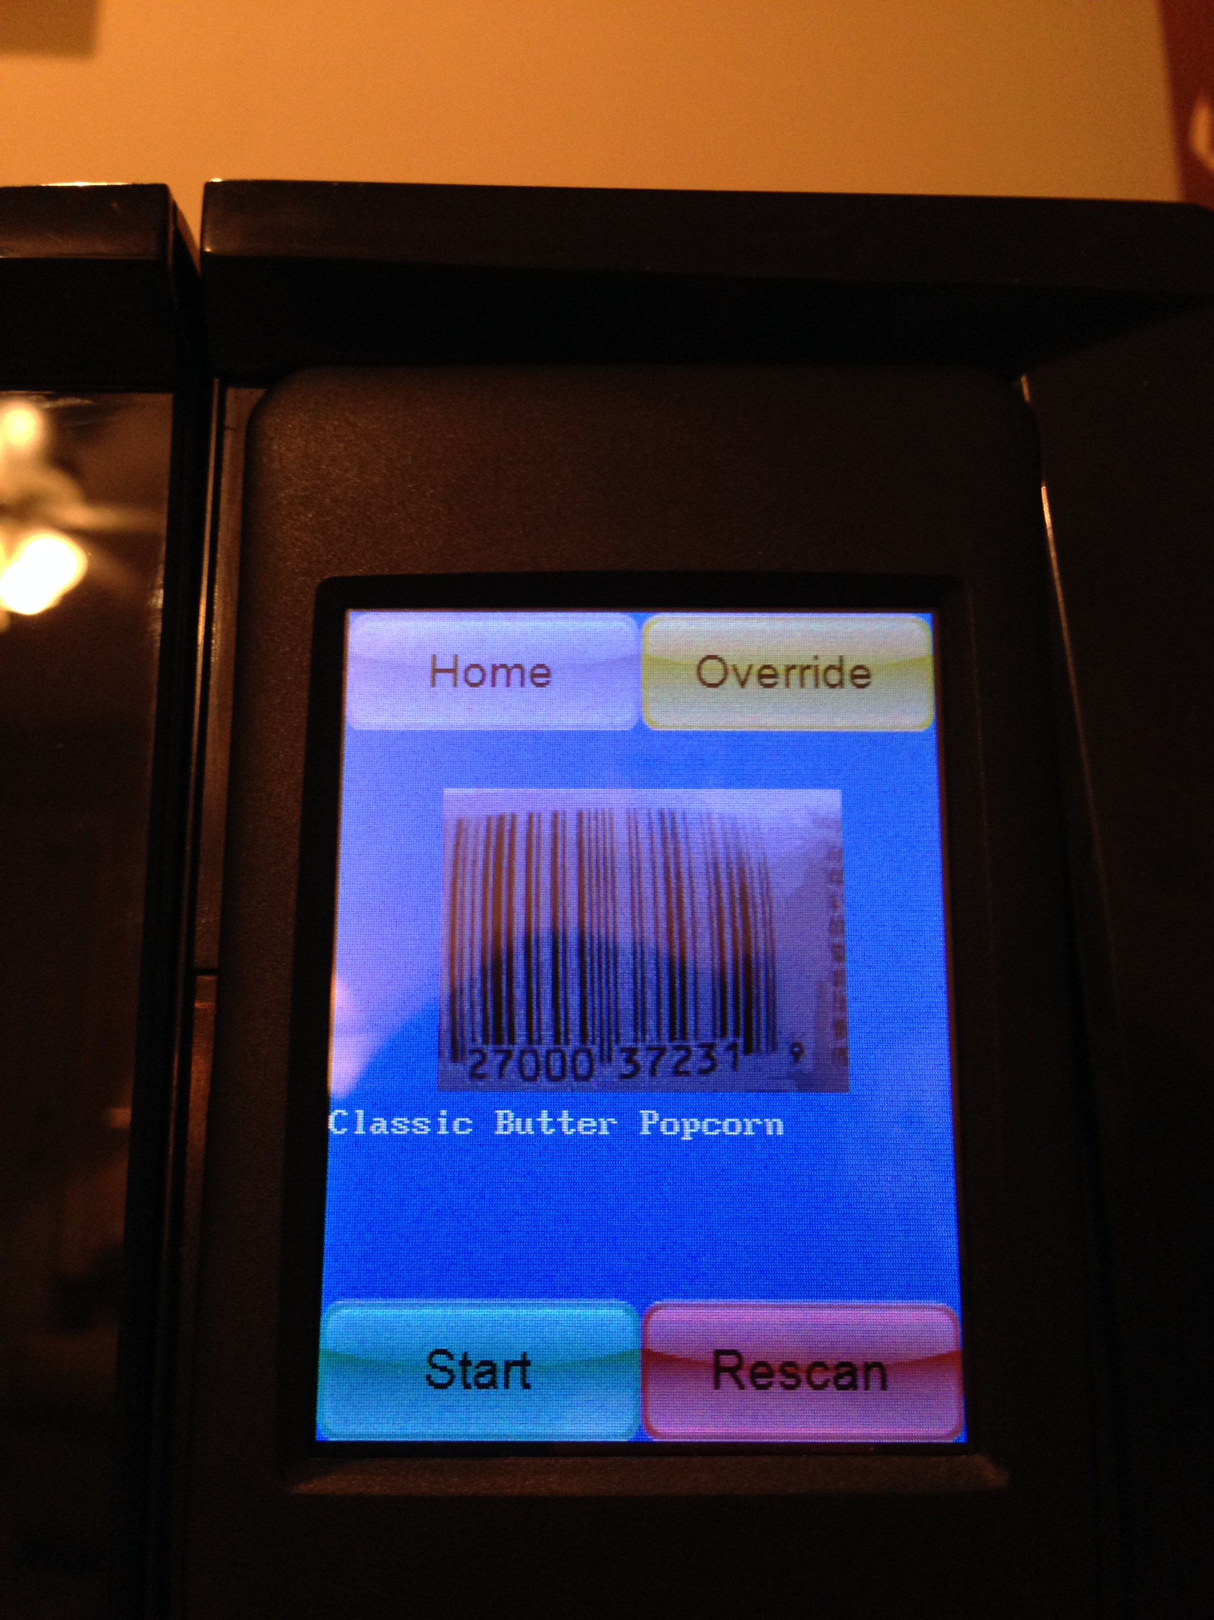
User Interface Design
Automatic Entry
User holds item up to camera to scan barcode
Video feedback provided to help with alignment
Once object identified, description appears on screen
Start to commence cooking
Override to customize cooking instructions

Slide 22
User Interface Design
Advertising Screen
The system allows for product advertisements from manufactures
Allows relevant coupons to reach consumers
Provides entertainment while food is cooking
Video and image options, audio possibility

Slide 23
User Interface Design
Push to Fitness Platform
Food data will be collected on user profile
Ability to push this data to fitness/food tracker
Allows users to generate accurate food consumption data

Slide 24
Design Approach and Implementation
Camera
LCD
Wi-Fi
Microcontroller
Database
Power Management

Slide 25
AC Vs. DC Power Components
AC | DC
Magnetron | Microcontroller
Turntable | Camera
Fan Motor | LCD Touchscreen
Lights/ Buzzer | Relay
Low voltage components will not exceed 5V DC.
We will use existing microwave components (i.e. magnetron, turntable, fan motor)

Slide 26
Power Consideration
Component | Volts | Amps | Power Consumption
Magnetron | 4.1 kV | 0.171 amps | 1000 W
Fan | 120 V | 0.7 amps | 39 W
Light | 240 V | 0.0833 amps | 20 W
Turntable | 120 V | 0.025 amps | 3 W
Buzzer | 10 V | 0.010 amps | 0.1 W
Controller | 5 V | 0.255 Amps | 1.28 W
Camera | 0.7 | 0.0429 Amps | 0.03 W
Touch Screen | 5 V | 0.155 Amps | 0.76 W
Total: |  | 1.412 Amps | 1064.17 W
All small appliances must be designed to operate within 15amp circuit.
Total power consumption must be less than 1800 watts.
Notes:
Can microwave handle additional requirements? Considerations show components identified, have additional load calculated. We have ample margin of error to add components and still not overload the wiring

Slide 27
Design Approach and Implementation
Camera
LCD
Wi-Fi
Microcontroller
Database
Power Management

Slide 28
Design Decisions : Microcontroller
 | MSP430x5xx | TM4C123x | F28M3x
Operating Frequency | 25 MHz | 80 MHz | 100 MHz
SPI | 2 (shared) | 4 | 4
I²C | 1 (shared) | 6 | 2
Serial | 1 (shared) | 8 | 5
GPIO | 29-87 | 12 | 88
Flash | 512 KB | 256 KB | 256-512 KB(x2)
Ram | 66 KB | 32 KB | 16 KB(x2)
Floating Point | No | Yes | Yes

Slide 29
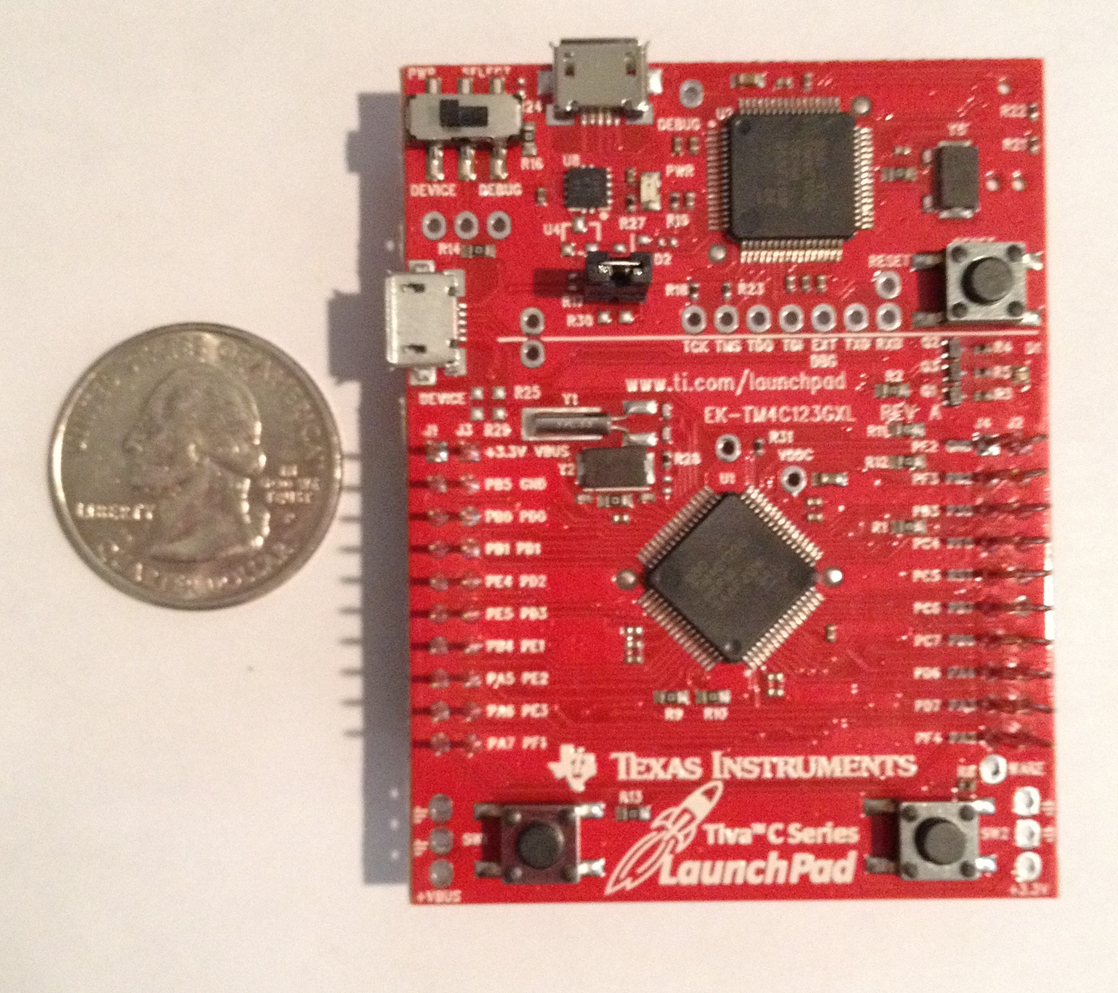
Microcontroller
TI TM4C123G
Specifications
ARM Cortex M4 based chip
256 KB Flash
32 KB SRAM
4 SSI, 4 I2C, 8 UARTs
43 GPIO
45 mA current draw
3.3V DC

Slide 30
Microcontroller Requirements
The system incorporates a centralized system controller. This handles several functions:
Control the microwave magnetron.
Manage and control microwave light, turntable motor, and fan.
Uses a database table of food items.
Communicates with the user interface module.
Monitor system power

Slide 31
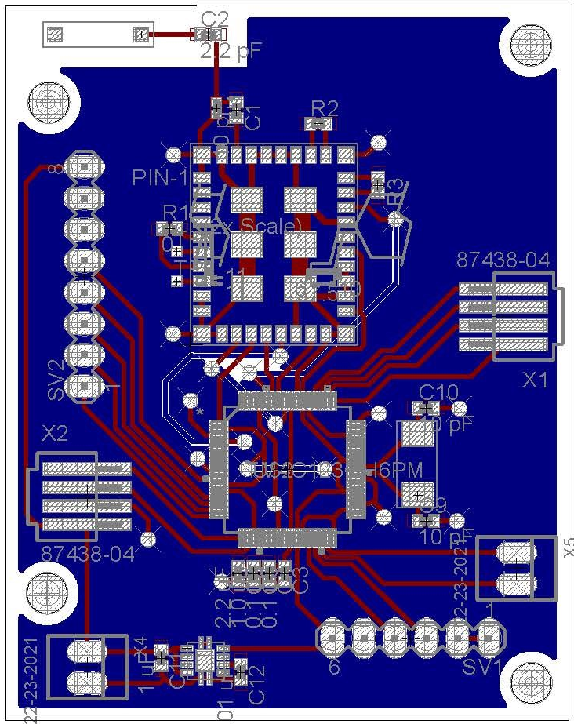
PCB Design
Reference Designation | Subsystem
J1 | Power Connection
J2 | Door Switch
J3 | JTAG Header
J4 | Camera Header
J5 | LCD Header
Table of mainboard connections

Slide 32
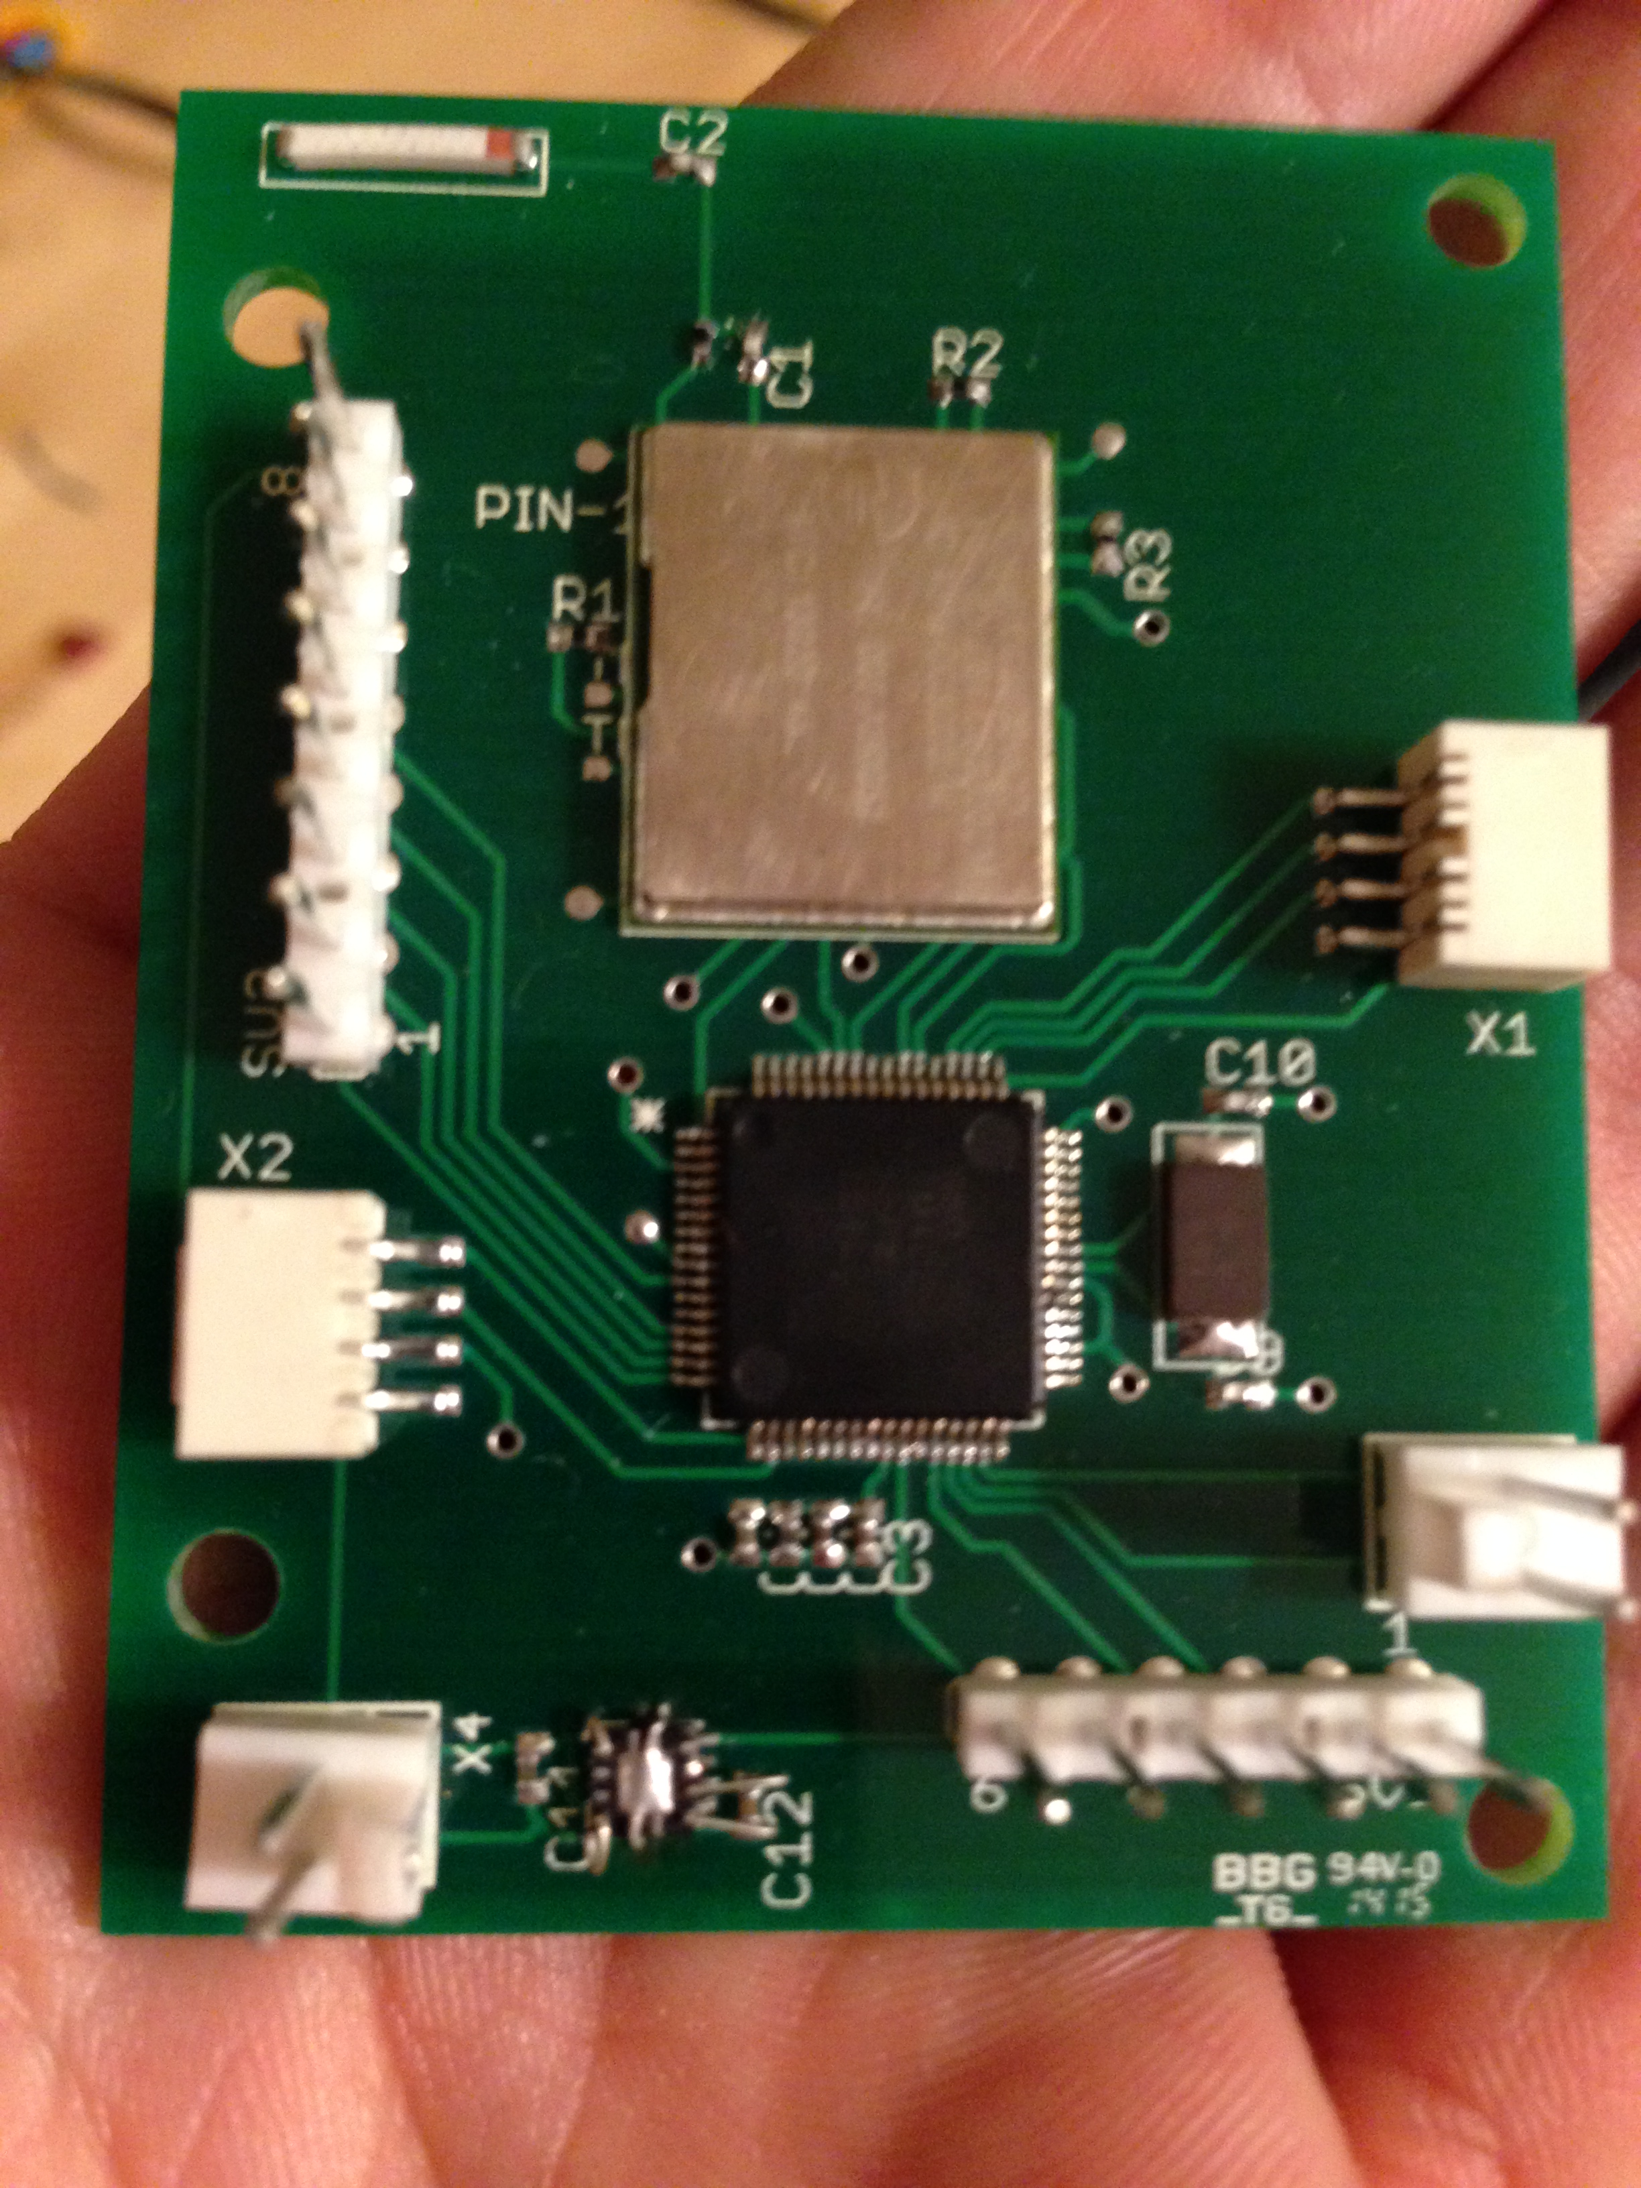
PCB Design
To control cost and signal integrity all analog systems, primarily high voltage management would remain off board
2 layer PBC design
Backplane is primarily used for ground plane
Most signals on top plane
To control high voltage components, external relay assembly used
Board includes 5 connection headers for subsystems

Slide 33
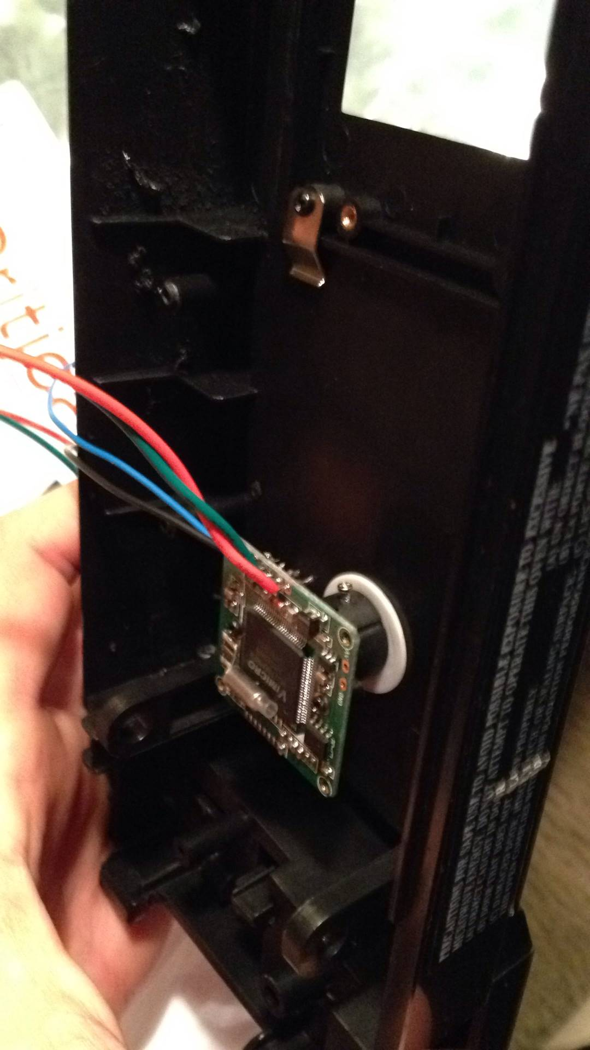
Software: Camera Host Driver
Originally written for Arduino in C++
Extensive adaptation required for use
Camera itself had various bugs that had to be overcome

Slide 34
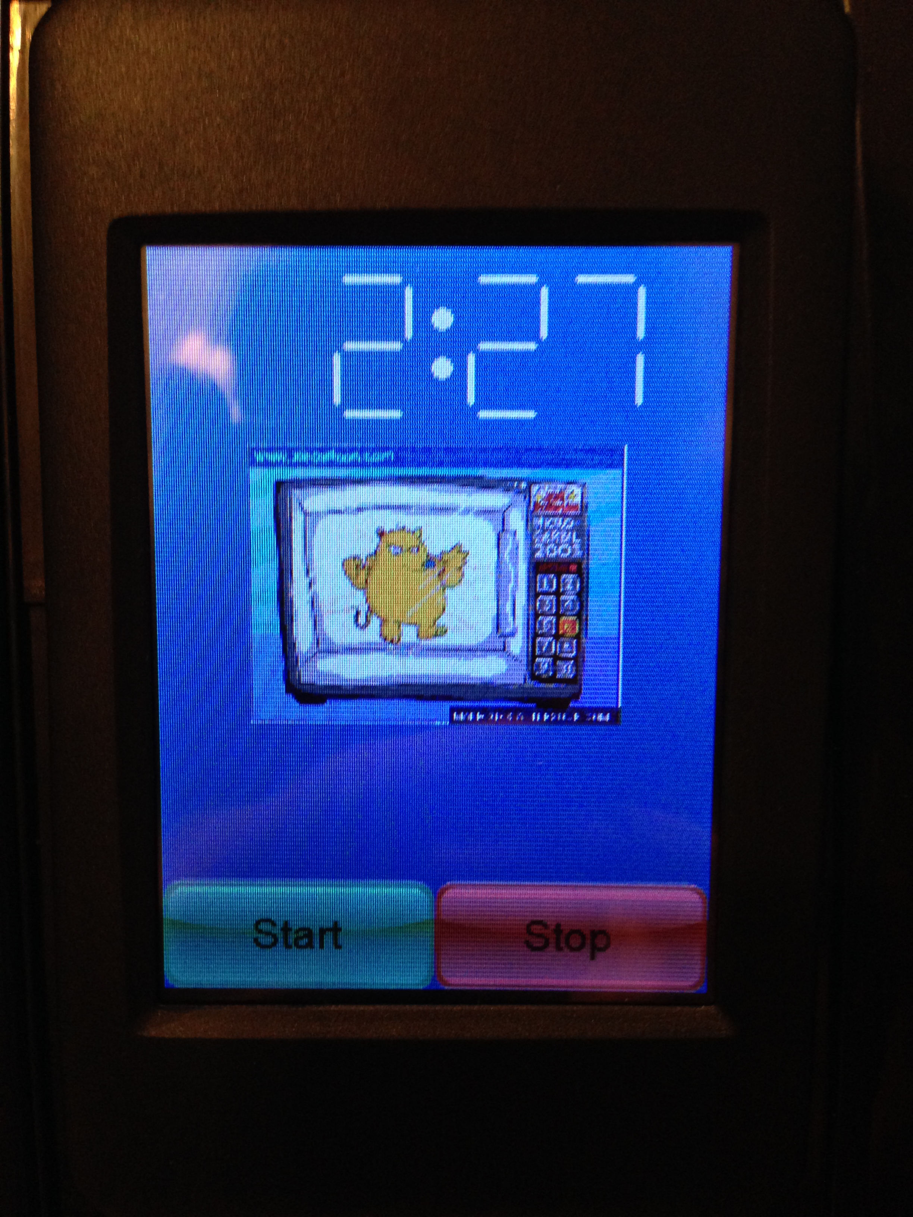
Software: LCD Host Driver
No Code Provided
Written from the ground up using 4DGL
Visi Genie underpowered dev. environment.

Slide 35
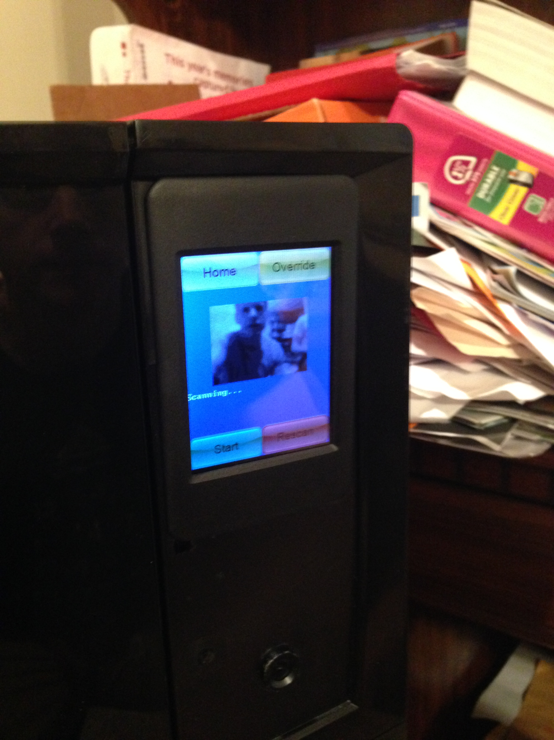
Software: JPEG stream decoder
Zbar relies on libjpeg
Exceeded available memory
Microcontroller severely restricted resolution
Wrote lightweight stream decoder

Slide 36
Software: Barcode Scanner
Zbar required high resolution
No known available solutions
Scanner written from the ground up

Slide 37
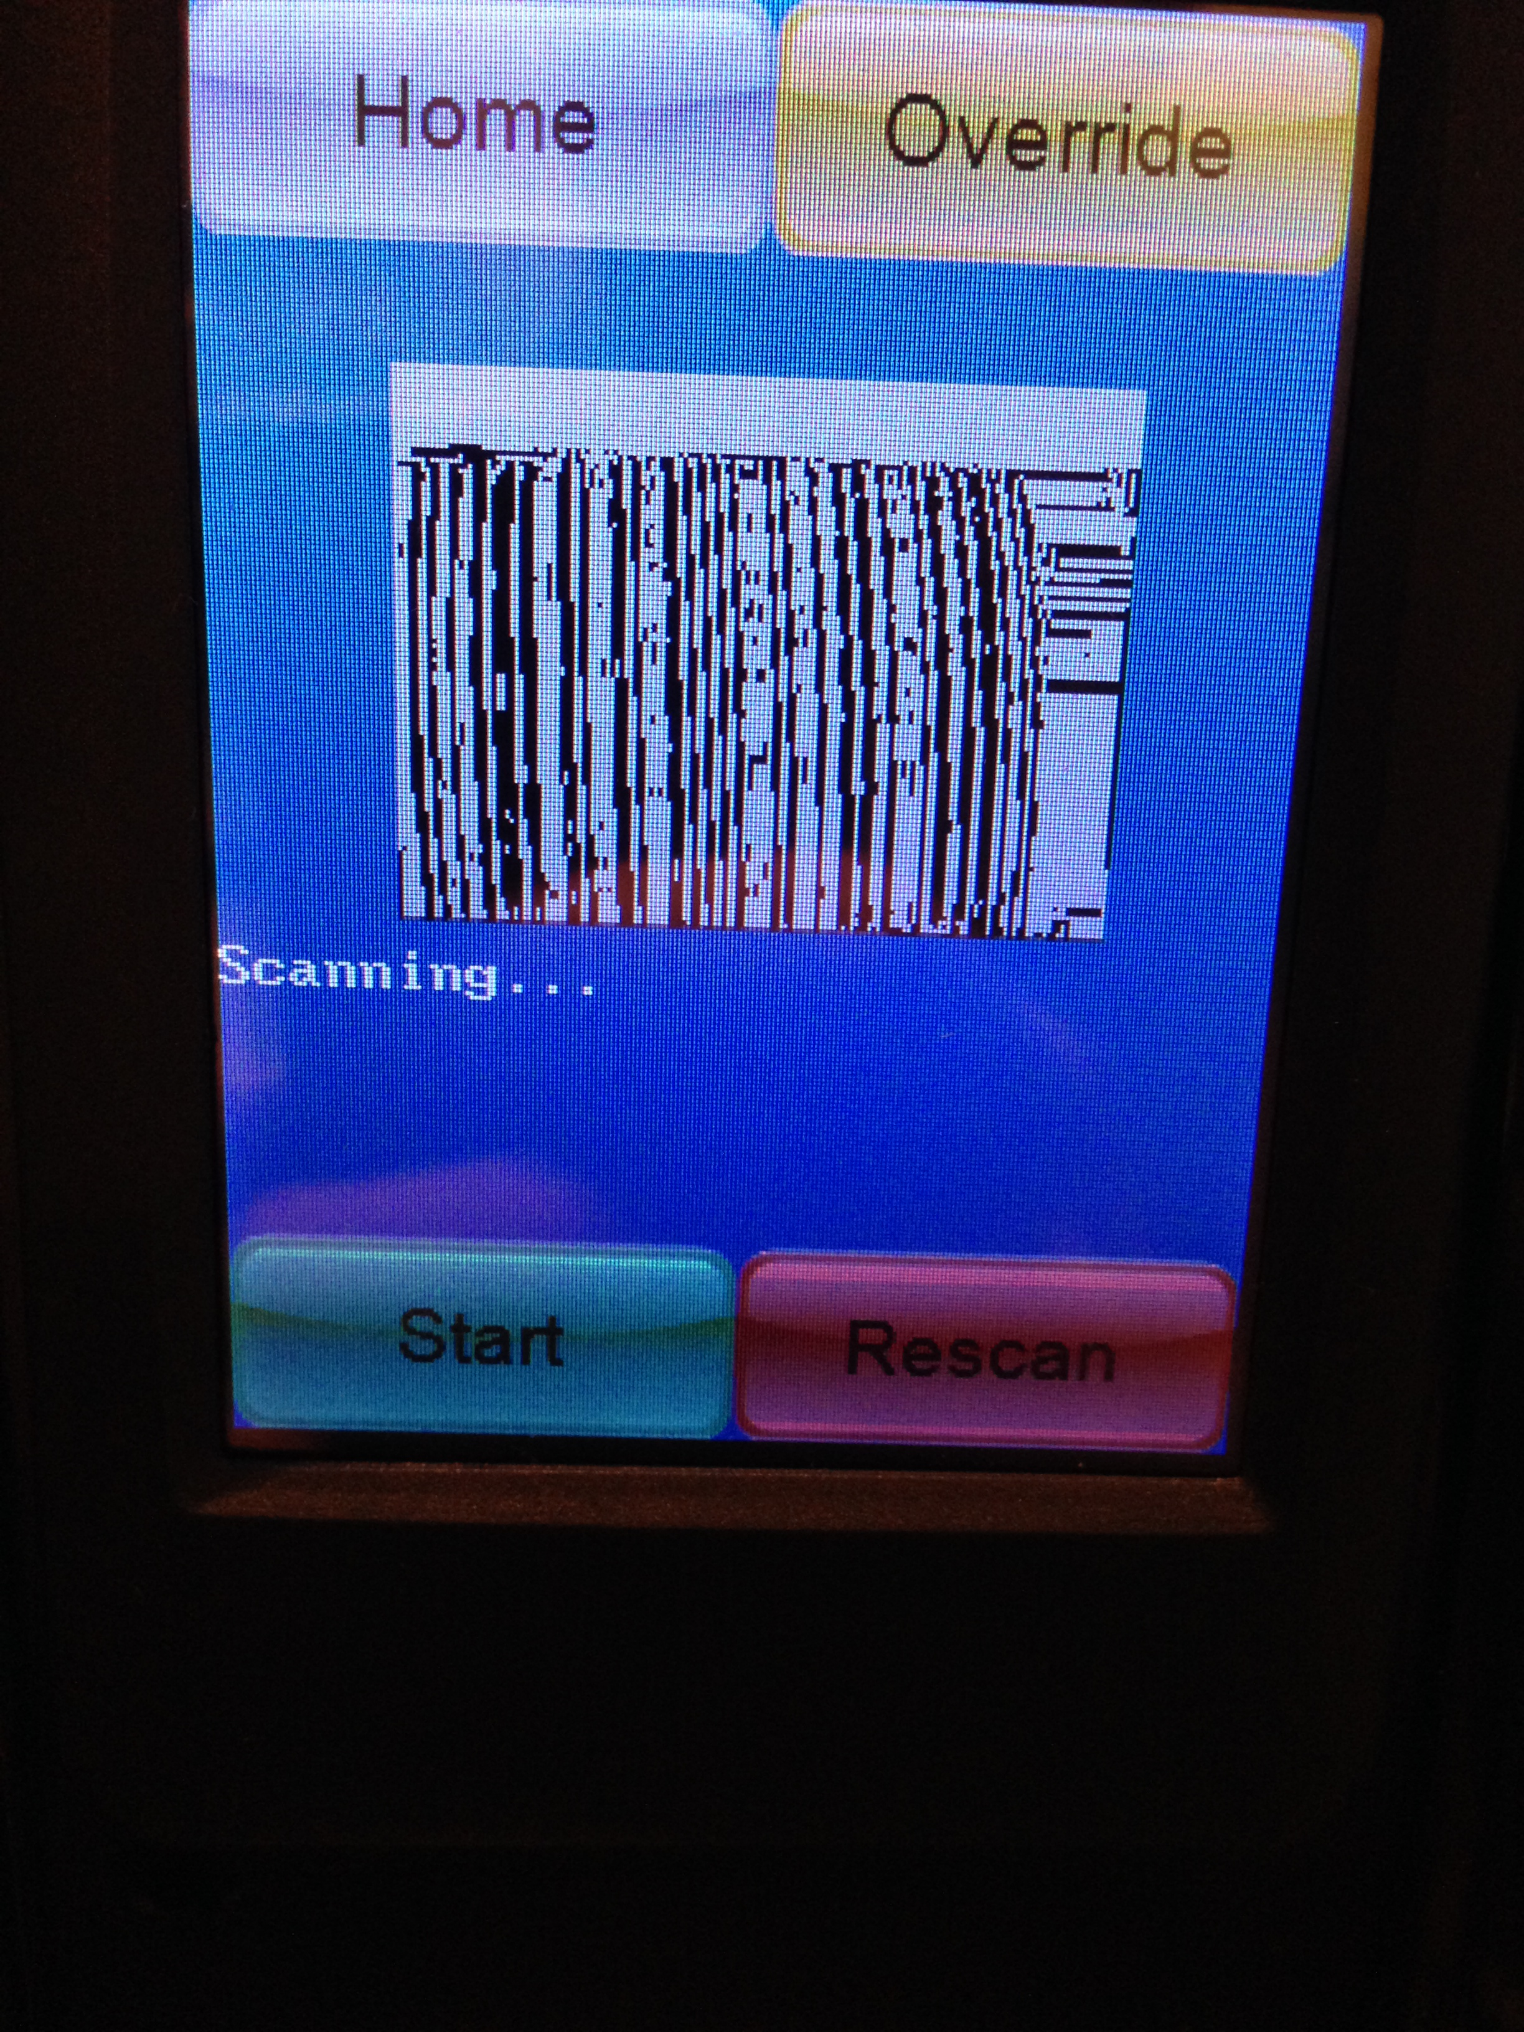
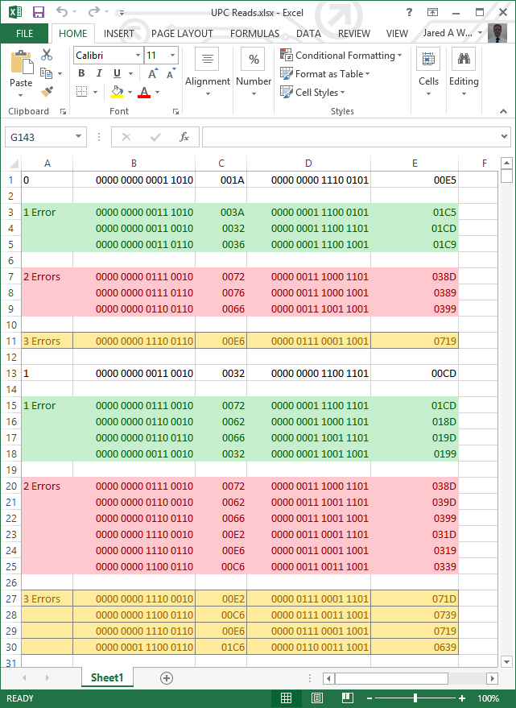
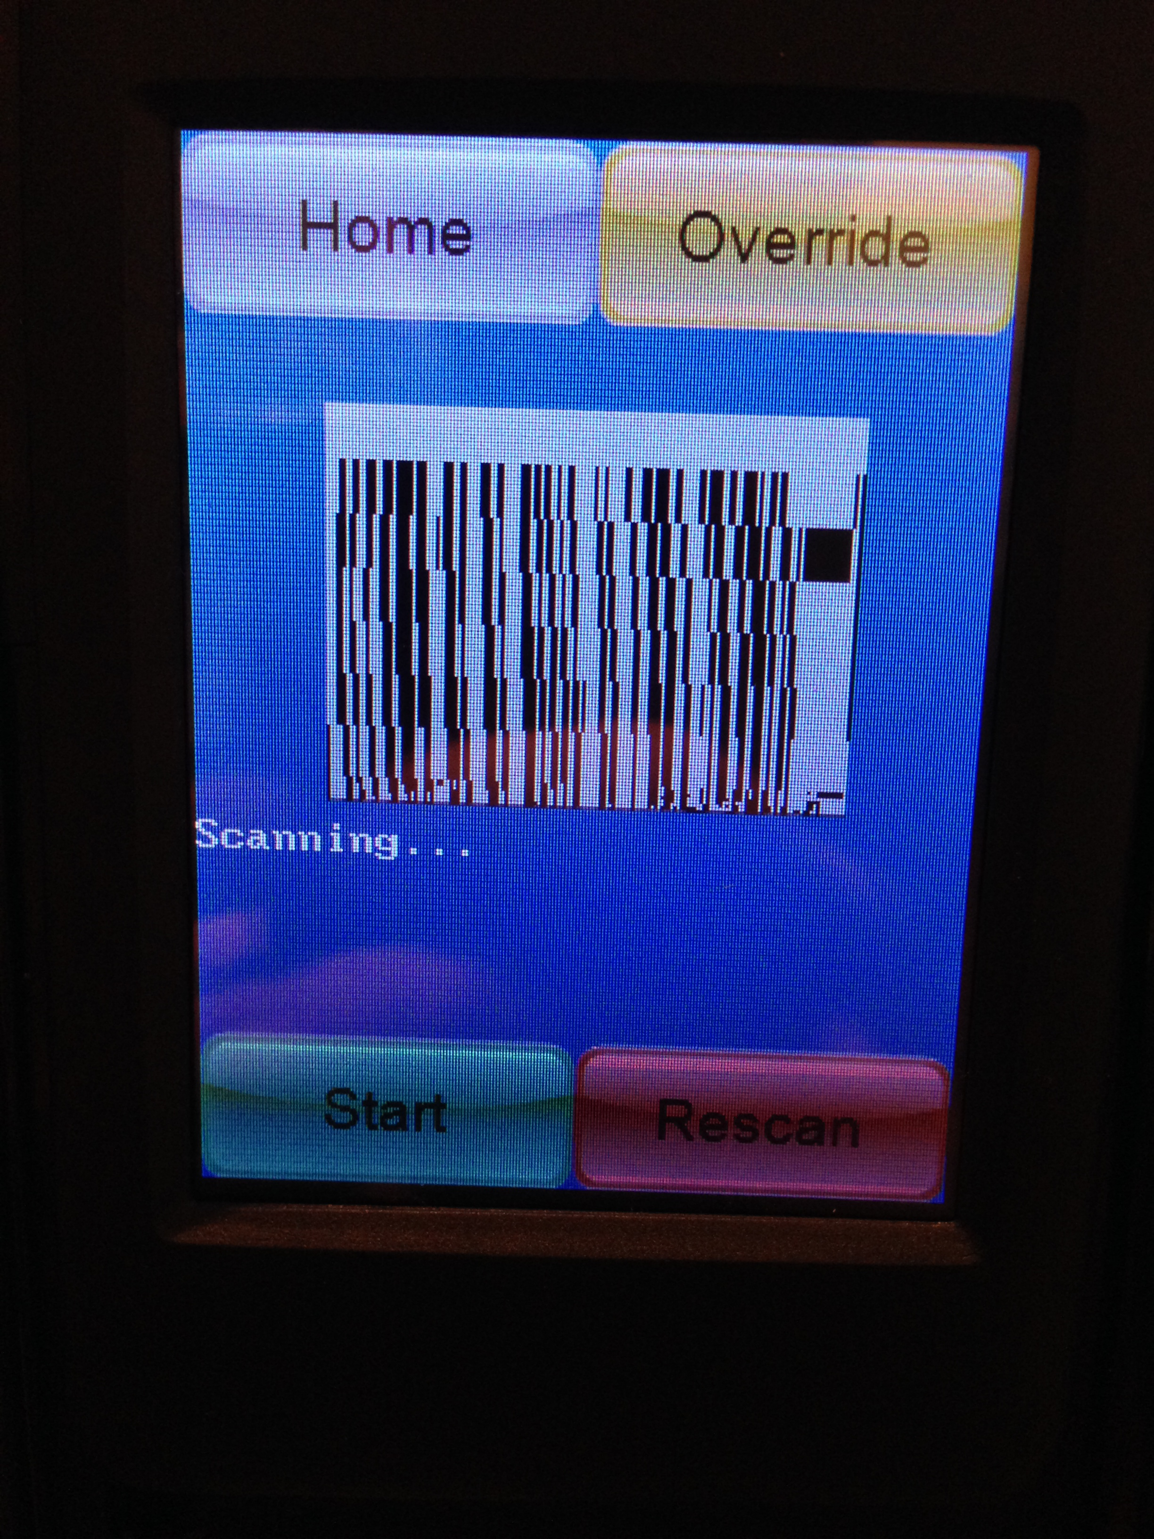
Software: Barcode Scanner
Edge Detection
Band Averaging
Error Detection and correction

Slide 38
Administration Content : Budget
Item | Estimated Cost | Actual Cost
uLCD-32 PTU | $80 | $106
TI CC3000 | $40 | $36
PTC-08 Serial Camera | $20 | $40
PCB Fabrication | $70 | $40
Microwave | $250 | $50
Misc. Project Needs | $75 | $145
TM4C123 Microcontroller | $25 | $13
SMAKN AC 110/220 V DC Power Switching Supply | $20 | $20
Bezel | $20 | $42
Total: | $600 | $505 Under budget ☺

Slide 39
Responsibilities
Nakiesa | Tim | Jared
Programming 4DGL (LCD) | Programming System Controller | Programming System Controller
Power Management | Database Management | PCB Design
Camera Test | Wi-Fi Management | Systems Integration

Slide 40
Progress

Slide 41
Challenges
Lost group member, had to appropriately redistribute work and downscale.
Inexperience with Eagle schematic capture, board design, and fabrication.
Learning curve for new programming language (4DGL).
Mounting new microwave case due to redesign.
Connect to database via Wi-Fi without client operating system.
Project ultimately presented major software engineering problems.

Slide 42

Questions?

