Slide 1

Charge Spot
Group 20
Ryan Johnson
Theophilus Essandoh
Emelio Watson

Slide 2
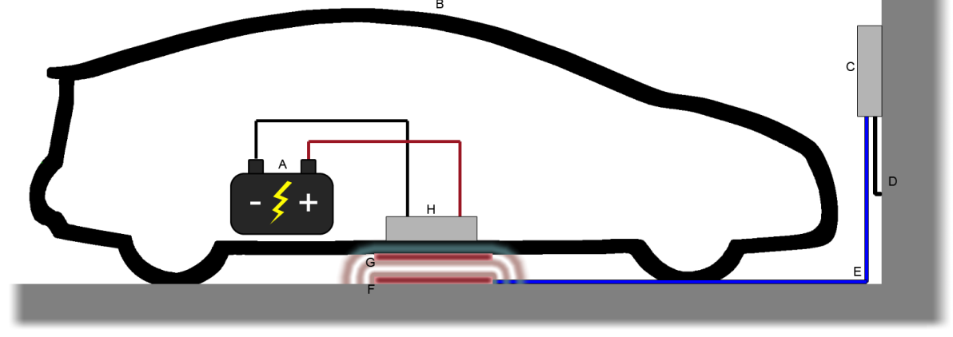
Introduction
Increased push for wireless technology
Autonomous Charging System for residential use
Resonant frequency charging system

Slide 3
Goals and Objectives
Design and implement a wireless charging system
No physical connectivity between the car and system
User friendly with very little user interaction
System Shuts down automatically when battery is fully charged
A fail safe manual over ride shutdown switch
Receiving coil must be properly concealed and not interfere with the normal safe operation of the vehicle
Visual guidance system for proper alignment

Slide 4
Specifications
Car detected 15 Ft minimum from control panel
Proximity sensor range 5 Ft. minimum
Copper coils less than 2 lbs. each
Measure and display battery temperature to within + 1°C accuracy
Charge current greater than 3 Amps
Battery 12V 18AH
Oscillator resonant frequency > 500 kHz
Battery fully charged within 8Hrs
Efficiency > 40%

Slide 5
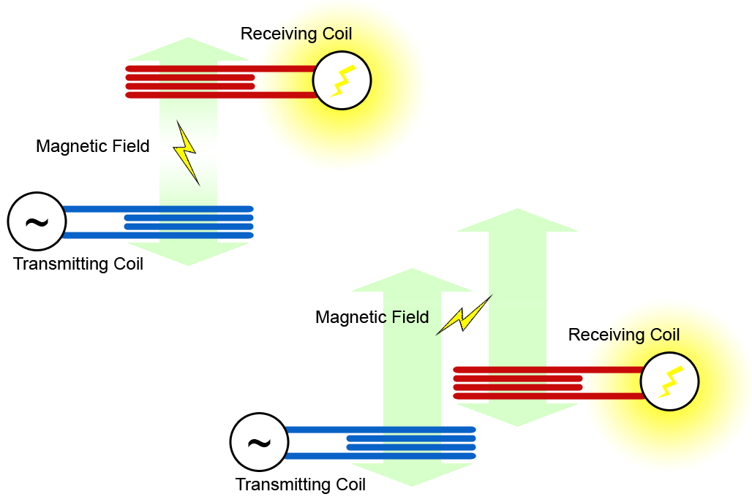
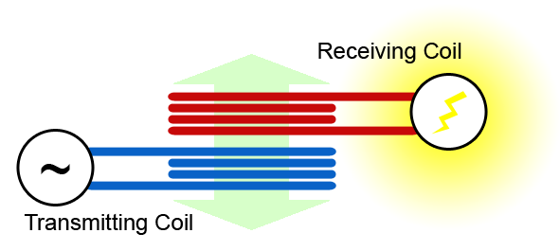
Why We Chose Magnetic Resonance
Inductive Coupling
Requires more power
Coils must be properly aligned for maximum efficiency
Shorter range
Magnetic Resonance
Inductive Coupling

Slide 6
PARTS

Slide 7
Microcontrollers
Easy to use/implement
Cheap (including development board)
18 pin minimum of programmable I/O
5 pins on Car System
2 Digital, 3 Analog
18 pin on Ground System
16 Digital, 0 Analog

Slide 8
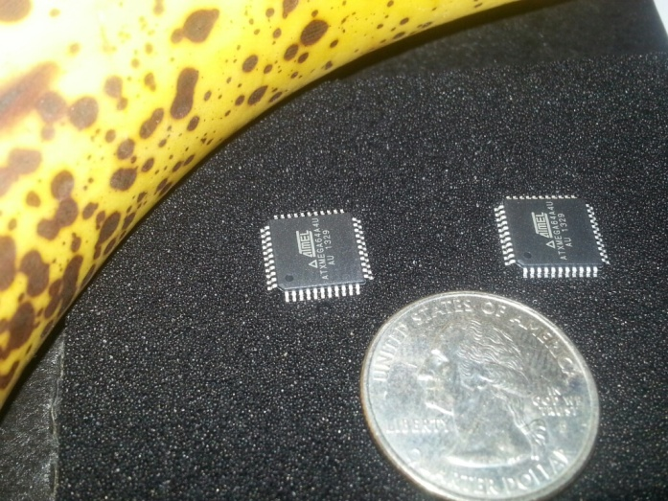
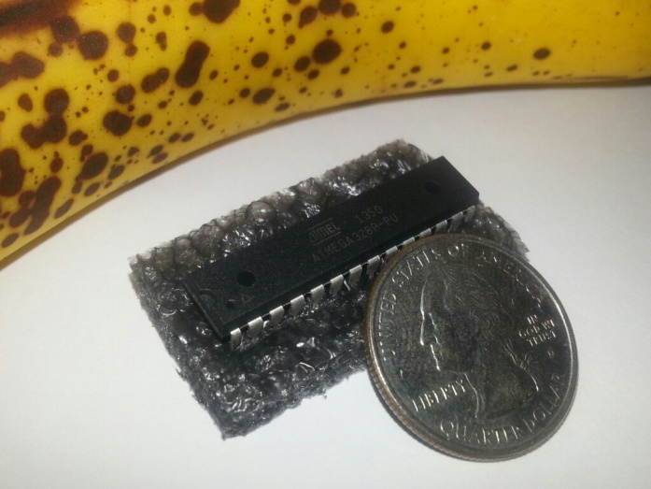
Microcontrollers
TI MSP430 / Launchpad (Code Composer)
128KB memory, 63 pins, 1.8V-3.5V
ATMega328p / Arduino Uno (Atmel Studio or Arduino IDE)
32KB memory, 23 pins, 4.5V-5.5V
ATXMega64 / STK600 (Atmel Studio)
64KB memory, 34 pins, 1.6-3.5V

Slide 9
Microcontrollers
TI MSP430 / Launchpad (Code Composer)
128KB memory, 63 pins, 1.8V-3.5V
ATMega328p / Arduino Uno (Atmel Studio or Arduino IDE)
32KB memory, 23 pins, 4.5V-5.5V
ATXMega64 / STK600 (Atmel Studio)
64KB memory, 34 pins, 1.6-3.5V

Slide 10
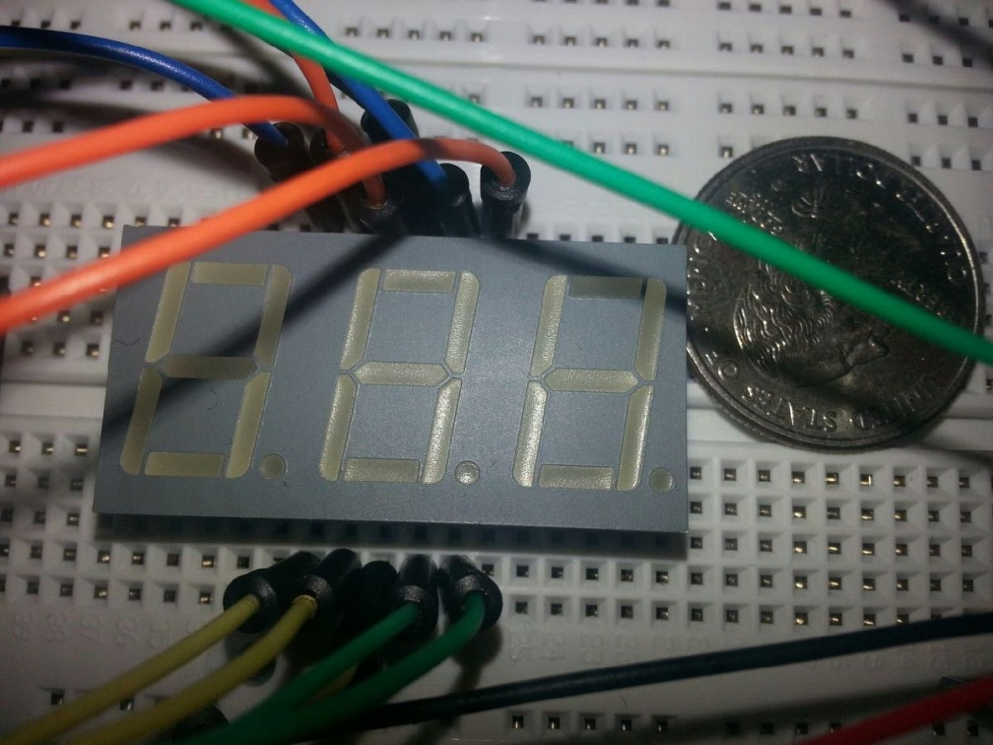
LED 7-segment
The largest and cheapest we can find
At least 3 characters ( ##°C )
Kingbright BC56-12SRWA

Slide 11
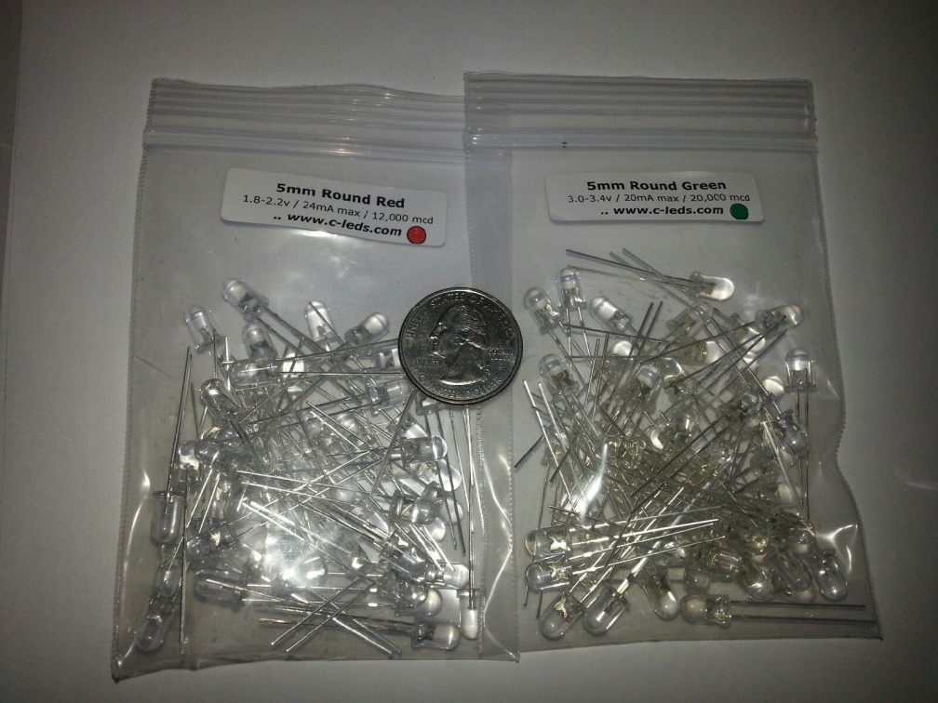
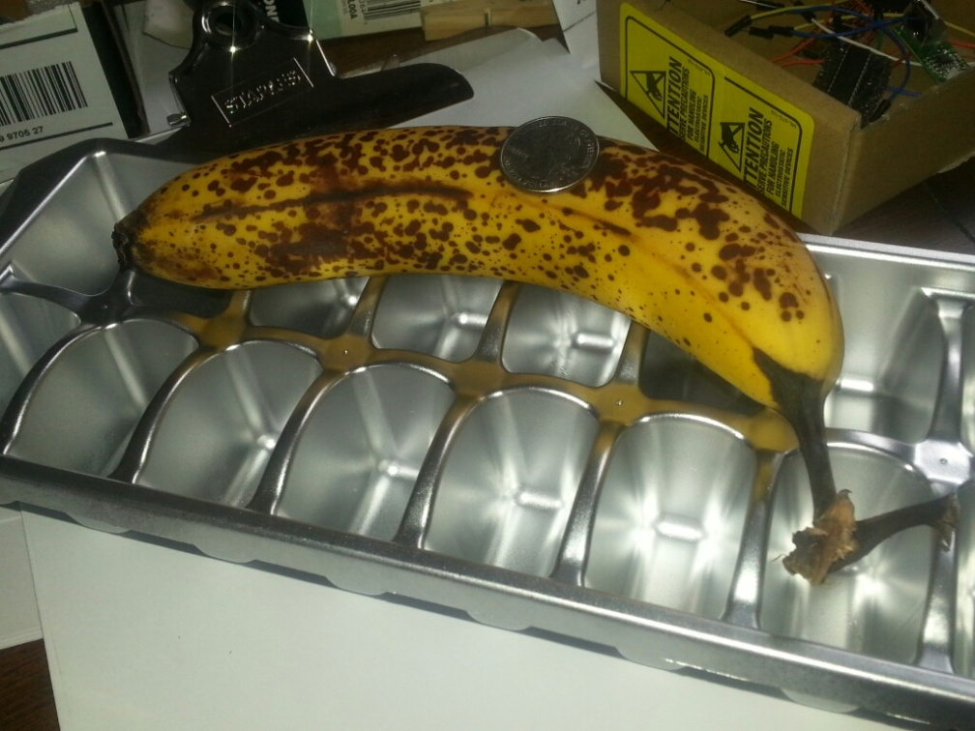
LED Bar Display
Big enough to read from a distance
8 bars (for simple 4:16 decoder implementation)
At least 2 LEDs per bar (5mm green/red)

Slide 12
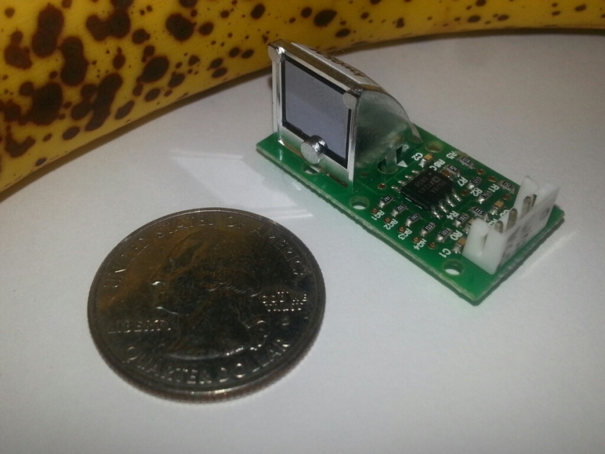
Temperature Sensor
Touching Sensor (Thermistors)
Non-touching Sensor (Infrared, Laser)
Range of 0C – 99C (for battery reading)
Optimal battery operating range (-25C to 30C)
GE ZTP-115M

Slide 13
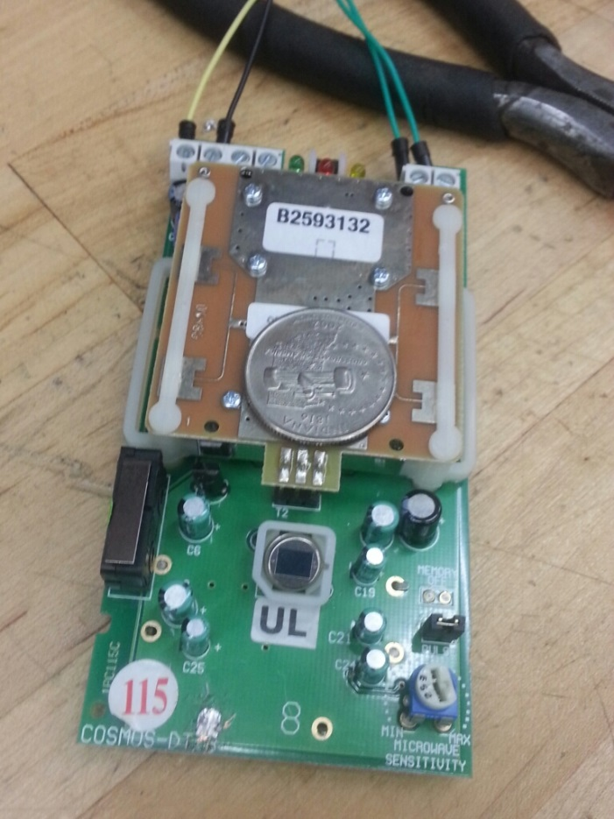
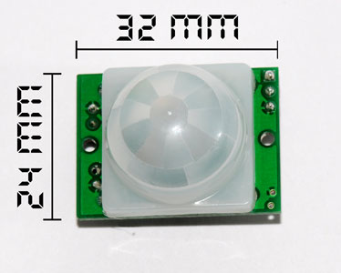
Motion Sensor (PIR)
Range >15ft
Low current consumption
ROKONET PIR
HC SR501

Slide 14
Motion Sensor (PIR)
Range >15ft
Low current consumption
ROKONET PIR
HC SR501

Slide 15
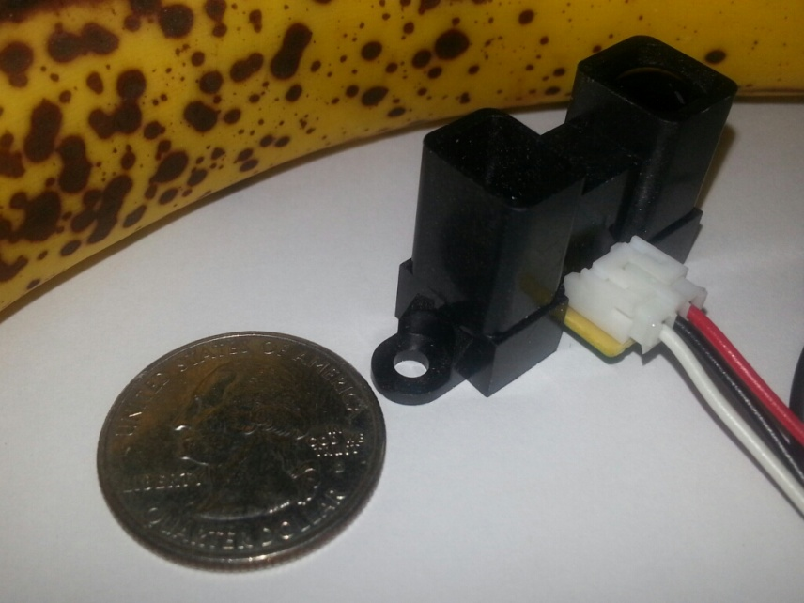
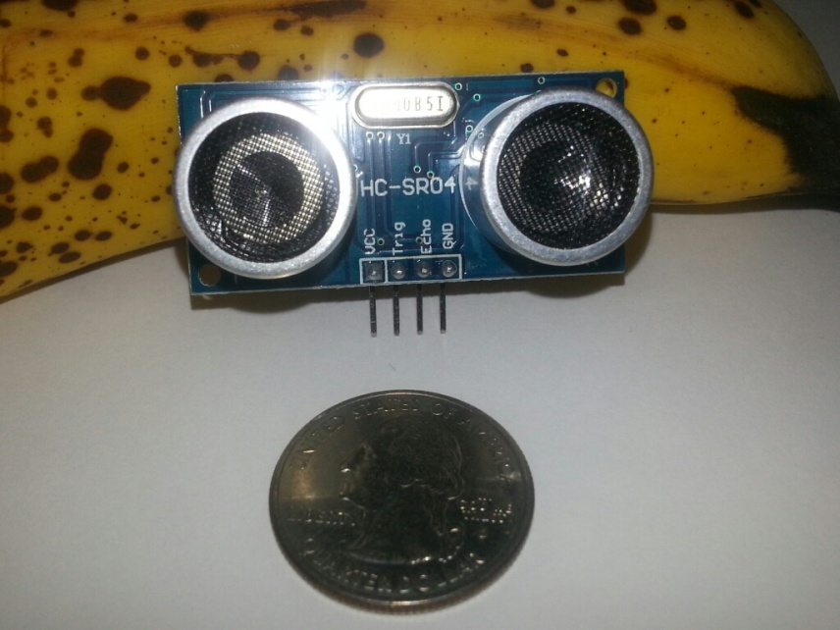
Proximity Sensor
Either Infrared, Ultrasonic, Laser
Ideal range of 60in
Sharp IR Distance Sensor (Left)
SainSmart Ultrasonic Ranging Detector (Right)

Slide 16
Proximity Sensor
Either Infrared, Ultrasonic, Laser
Ideal range of 60in
Sharp IR Distance Sensor (Left)
SainSmart Ultrasonic Ranging Detector (Right)

Slide 17
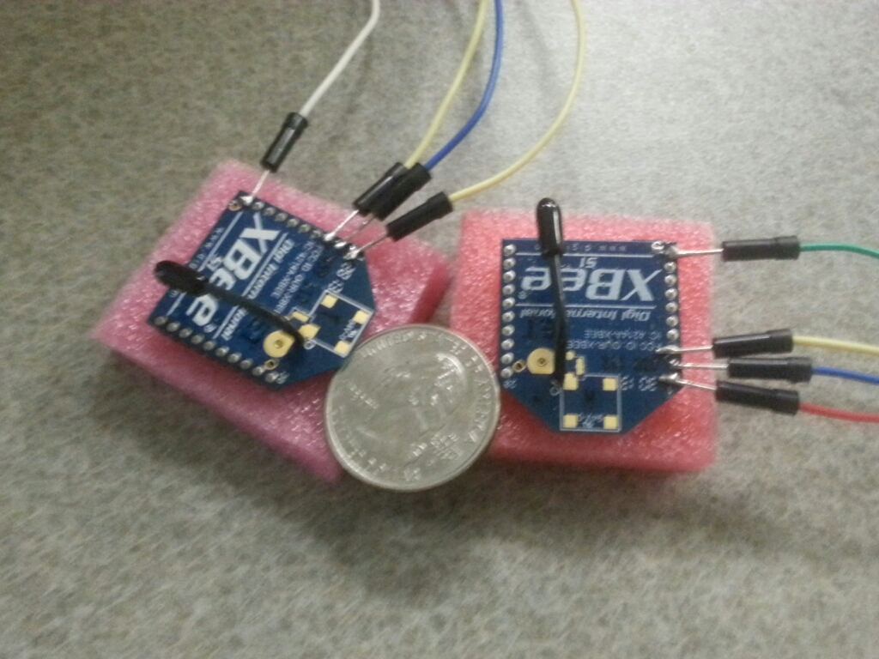
Wireless Communication
XBee Series 1 (1mW antenna)
300ft max range (clear condition)
Easy sync and communication between 2 XBees
3.3VDC

Slide 18
Charge Controller
6V, 12V and 24V
Life span optimized
Overvoltage protection
Monitored battery performance
BTY79
Silicon- controlled rectifier
Operating Temperature 0C to 125C
Reverse- blocking Thyristors

Slide 19
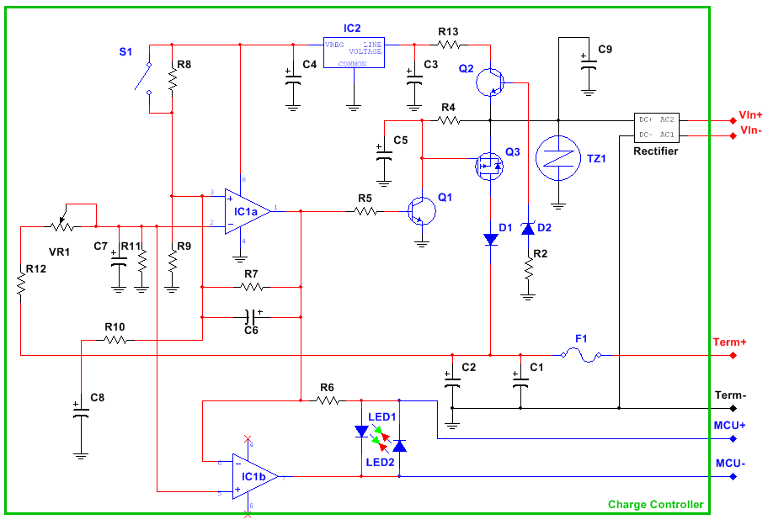
Charge Controller

Slide 20
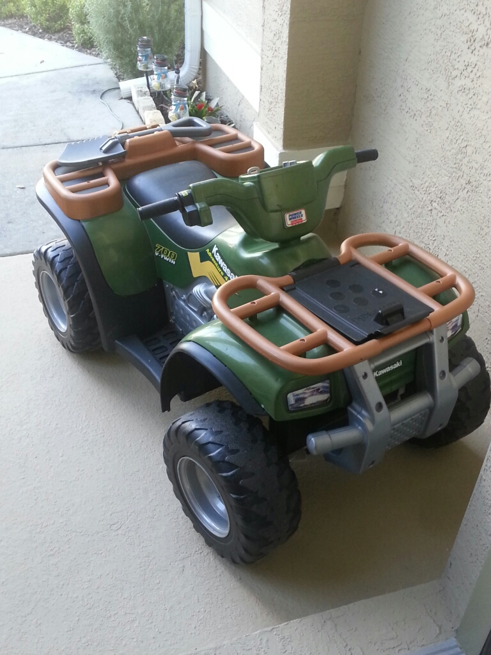
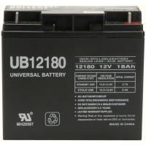
Vehicle and Battery
Power wheel, golf cart or go-cart
Price range <$150
12V 18AH Battery

Slide 21
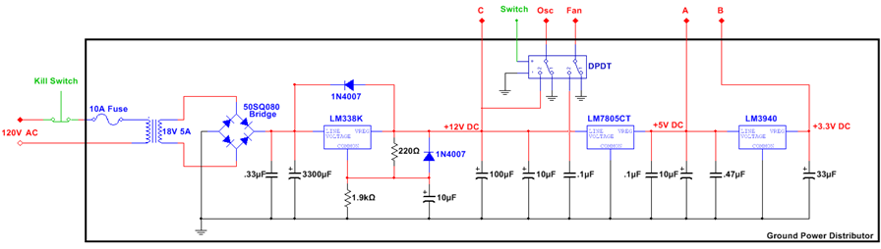
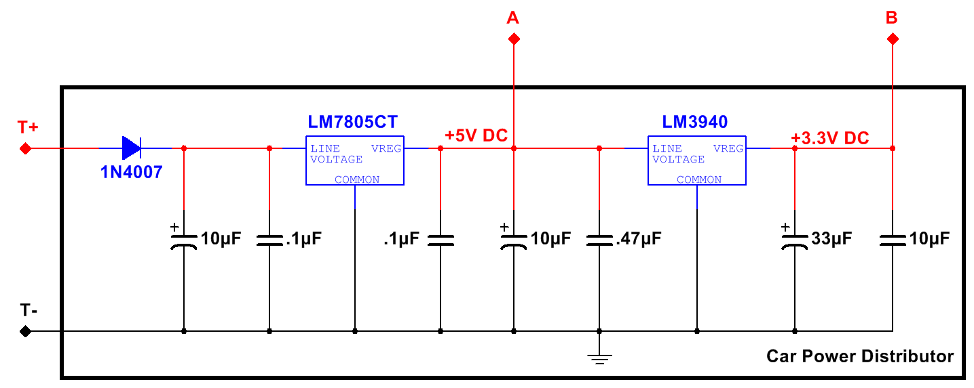
Power Supply and Distribution

Slide 22
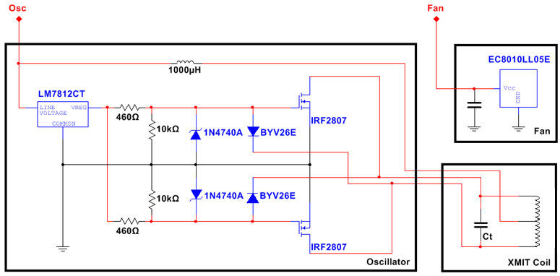
Oscillator Circuit
Initially Colpitts
Chose ZVS since it handles more power
Stronger Magnetic field

Slide 23
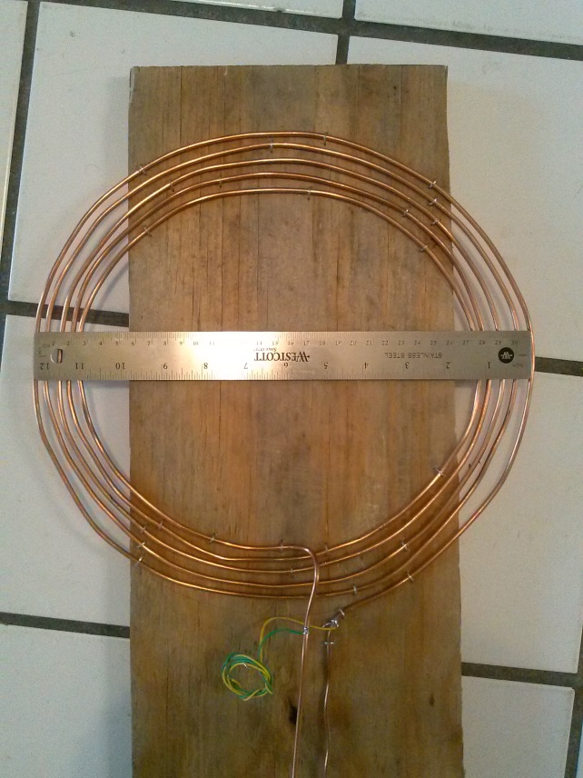
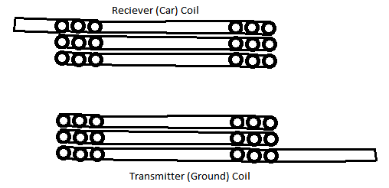
Coils
Flat spiral chosen over cylindrical design
Made of 10 AWG Copper wire
Approx. 12 inches in diameter
Covered with Plexiglas for safety

Slide 24
DESIGNS

Slide 25
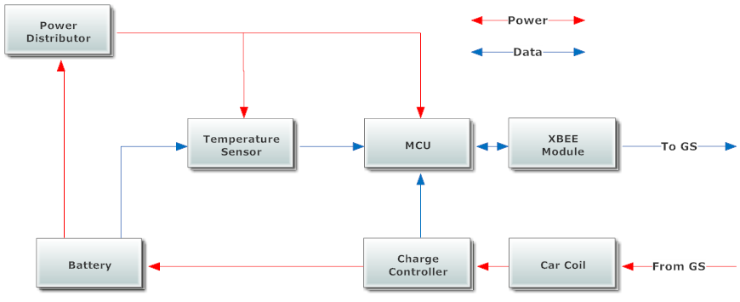
Car System – Block Diagram

Slide 26
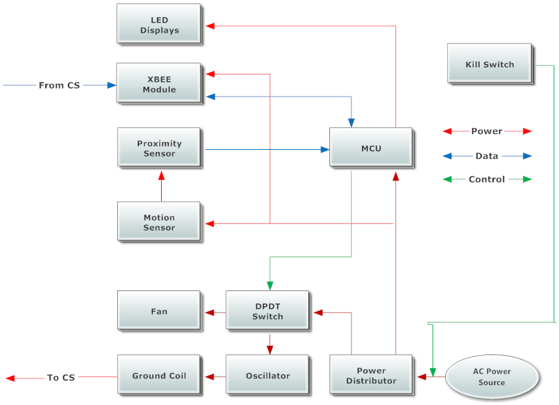
Ground System – Block Diagram

Slide 27
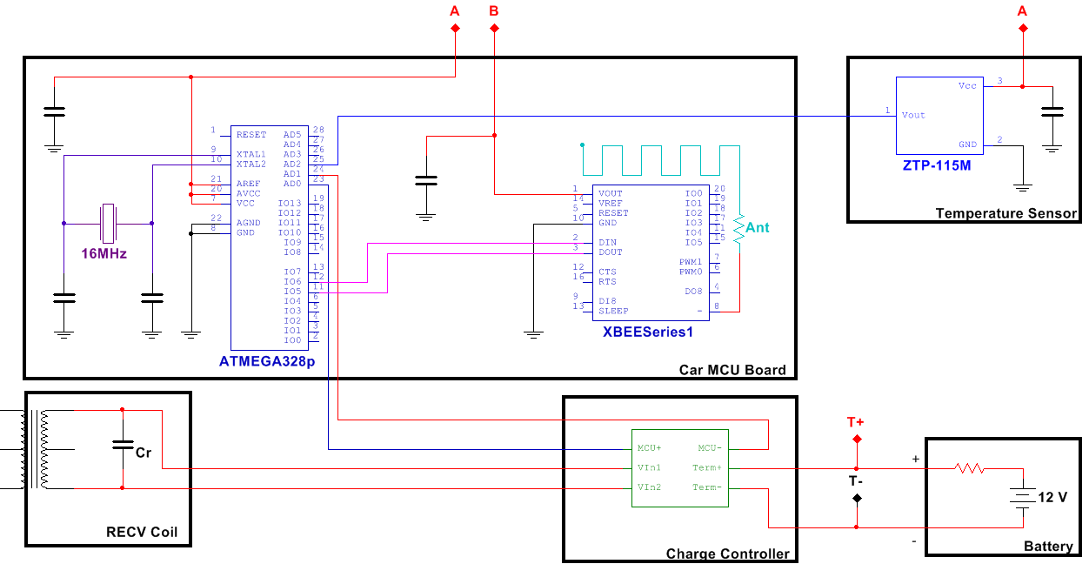
Car System - Schematics

Slide 28
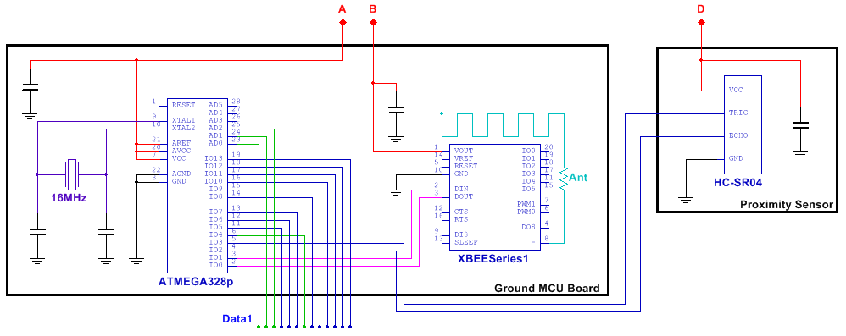
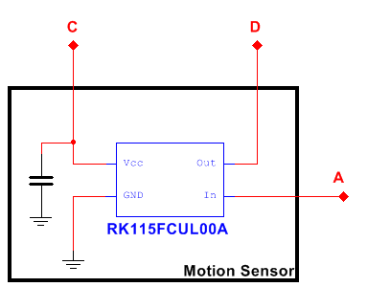
Ground System - Schematics

Slide 29
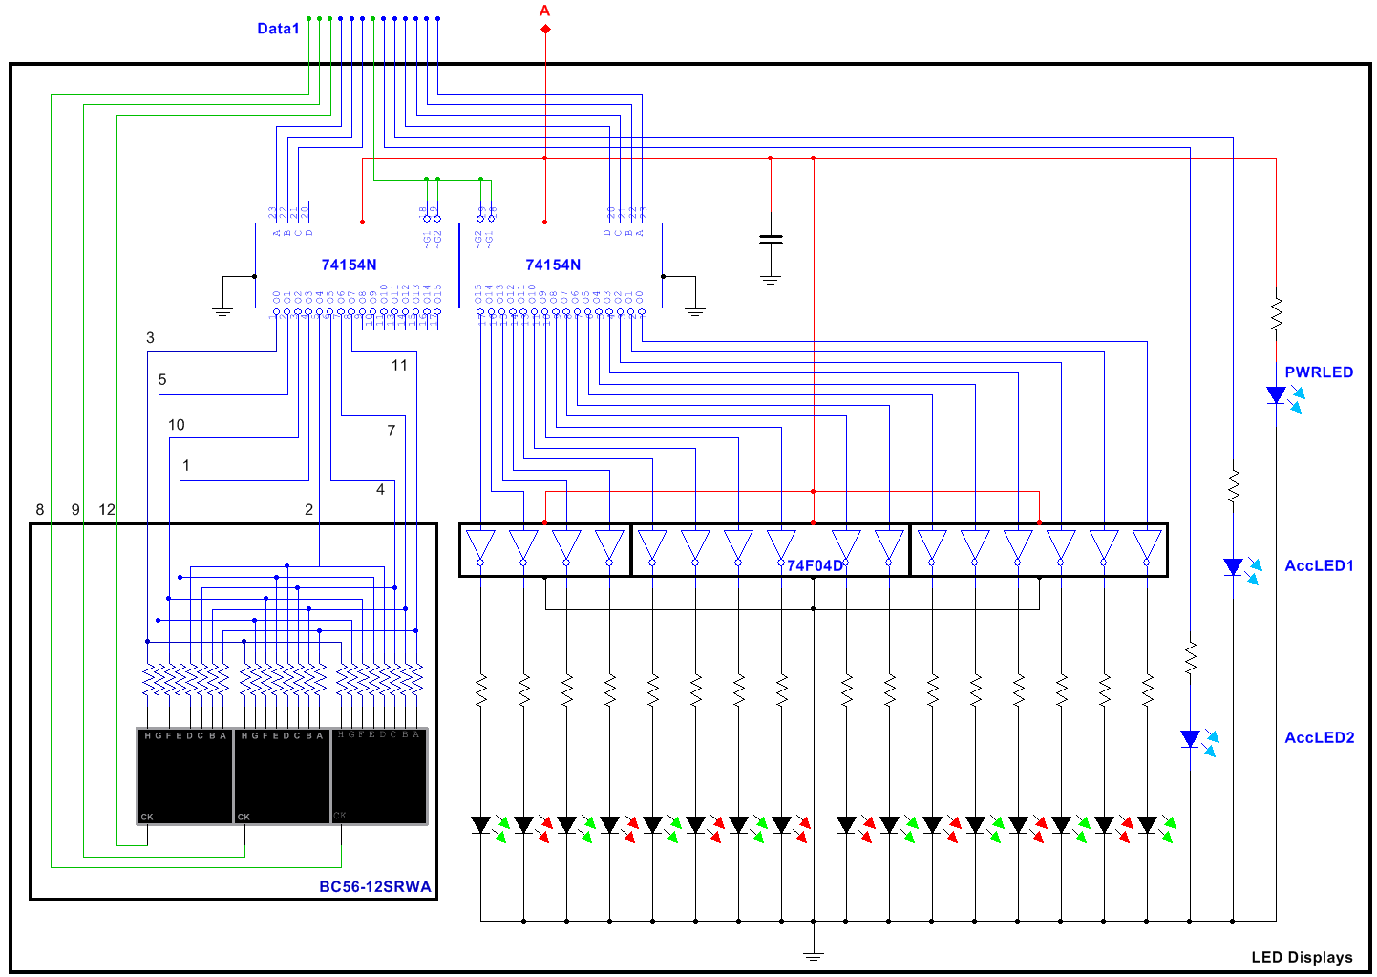
Ground System – LED Displays

Slide 30
Ground System – LED Displays

Slide 31
Ground System – LED Displays

Slide 32
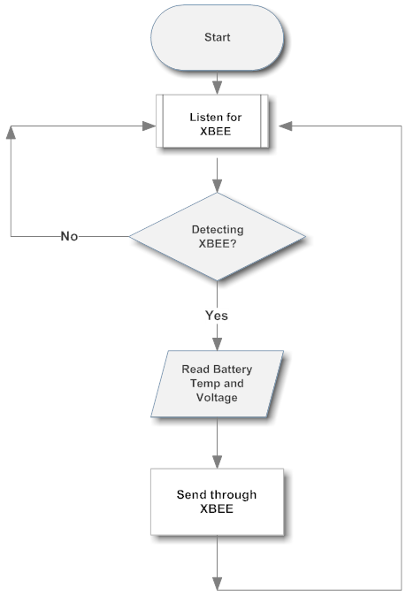
Logic Flow – Car System

Slide 33
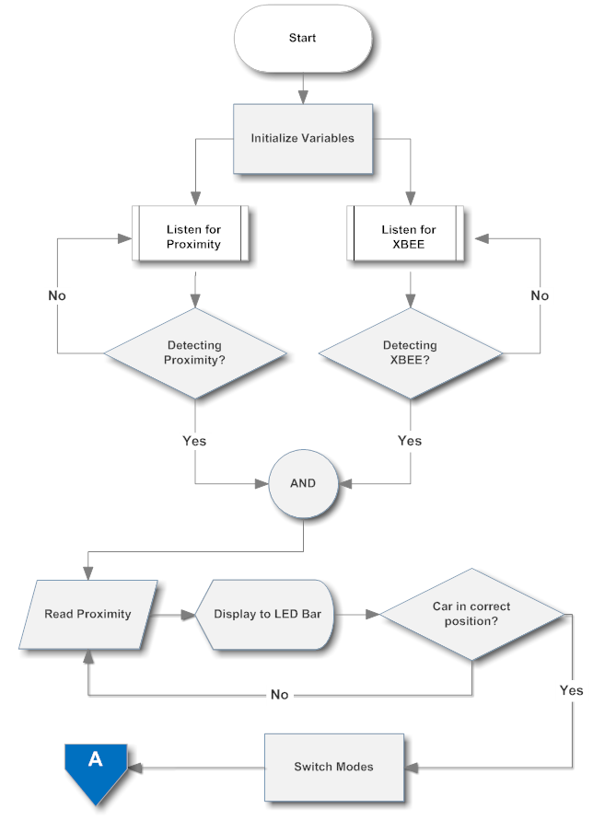
Logic Flow – Ground System

Slide 34
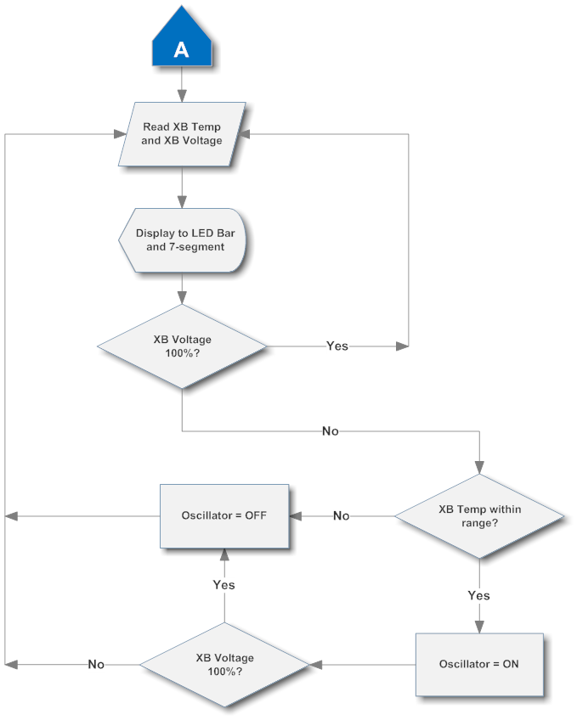
Logic Flow – Ground System

Slide 35
PCB/ Assembly
4PCB
Price
Turn-around Time
Eagle files completed by March 1
Ground System MCU Board
Microcontroller, XBEE, LED circuitry
Ground System Power Supply Board
Power Distribution, Oscillator
Car Systems Board
Microcontroller, XBEE, Power Distribution, Charge Controller

Slide 36
Budget/Finance
Component | Cost | Budget | Difference
Metal Box | $5.00 | $30.00 | $25.00
Proximity Sensor | $22.95 | $10.00 | ($12.95)
Motion Sensor | $0.00 | $10.00 | $10.00
LED Displays | $26.95 | $30.00 | $3.05
Kill Switch | $5.38 | $5.00 | ($0.38)
Fan | $0.00 | $5.00 | $5.00
Power Distributor | $54.03 | $30.00 | ($24.03)
Charge Controller | $32.63 | $30.00 | ($2.63)
Vehicle/Battery | $119.99 | $150.00 | $30.01
Temperature Sensor | $11.88 | $20.00 | $8.12
Microcontroller | $29.39 | $20.00 | ($9.39)
Wireless Module | $45.90 | $20.00 | ($25.90)
Oscillator | $8.82 | $30.00 | $21.18
Wires, Conduit, and Mounting | $43.32 | $60.00 | $16.68
Services | $51.94 | $150.00 | $98.06
TOTAL | $458.18 | $600.00 | $141.82

Slide 37
Progress

Slide 38
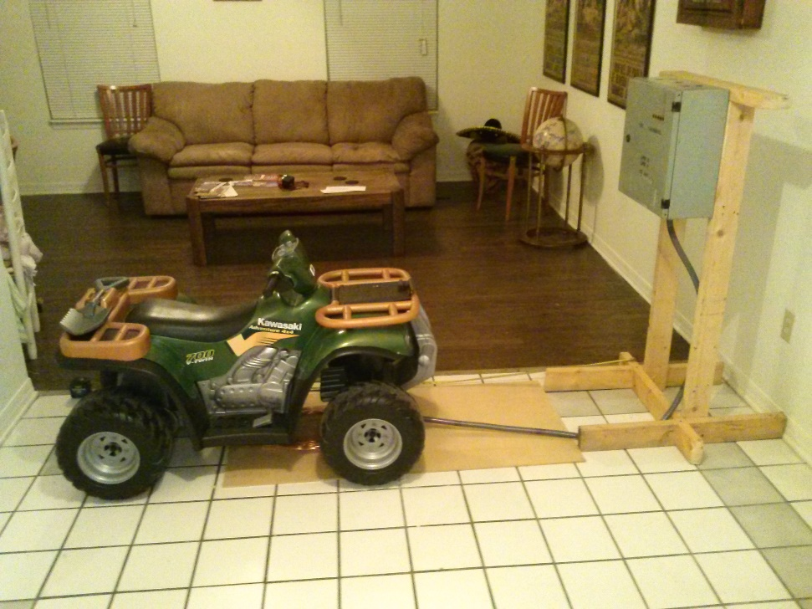
Progress
Acquired and tested power supply
Most sensors tested and programed
Built and tested coils
Most parts ordered
Working Prototype by March 1st
Finalized design by April 1st

Slide 39
Responsibilities
 | Emelio | Ryan | Theo
Power Distribution | x
Oscillation Circuitry | x
Coils/Winding | x
Charge Controller |  |  | x
Wireless Communication |  |  | x
Motion/Proximity Sensors |  |  | x
Temperature Sensor |  | x
Microcontrollers |  | x
LED Displays |  | x
Prototype Construction | x
Schematics/PCB |  | x
Programming |  | x
Budget |  |  | x

Slide 40
Project Issues
Learning the PCB software
Maintaining fixed coil dimensions
Measure battery capacity while charging

Slide 41

QUESTIONS?

