Slide 1

ChargeSpot
Senior Design II – Spring 2014
Group 20
Theophilus Essandoh
Ryan Johnson
Emelio Watson

Slide 2
Introduction
To Wireless Power Transfer through High Resonant Frequency

Slide 3
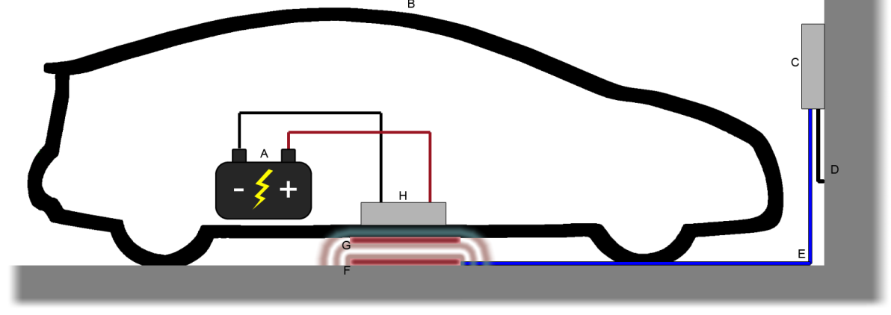
Increased push for wireless technology
Autonomous Charging System for residential use
Utilize High Resonant Frequency

Slide 4
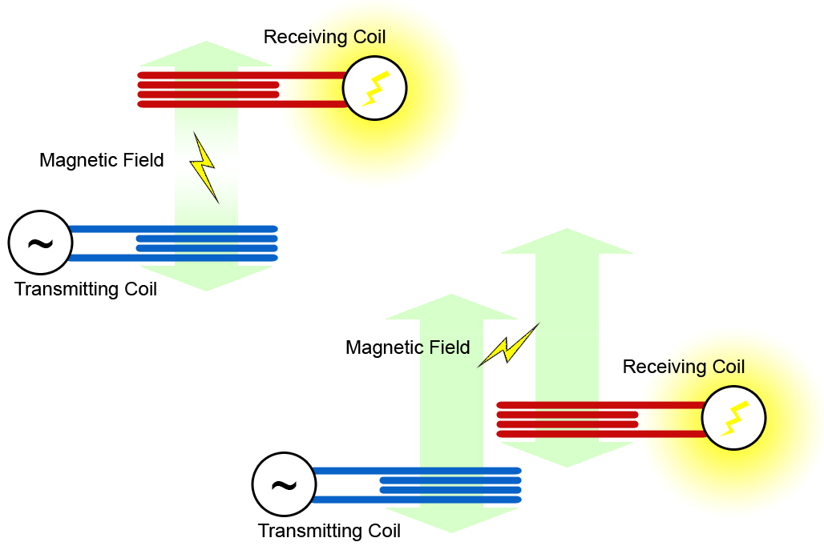
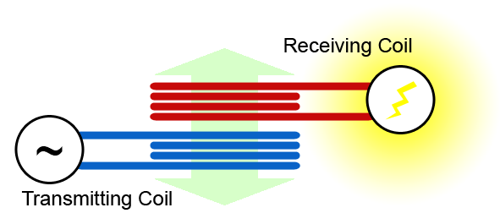
Why We Chose Magnetic Resonance
Inductive Coupling
Magnetic Resonance
Requires more power
Coils must be properly aligned for maximum efficiency
Shorter range
Potentially more efficient
Coils can have greater alignment tolerance for high efficiency
Larger range
Inductive Coupling
Magnetic Resonance

Slide 5
Goals and Objectives
Design and implement a wireless charging system
No physical connectivity between the car and charging system
User friendly with very little user interaction
System shuts down automatically when battery is fully charged or temperature is not ideal
Include a fail safe manual override shutdown switch
Receiving coil must be properly concealed and not interfere with the normal safe operation of the vehicle
Visual guidance system for proper alignment

Slide 6
Specifications
Wireless XBee link 50 Ft from control panel
Proximity sensor range 5 Ft. minimum
Copper coils less than 2 lbs. each
Measure and display battery temperature to within + 1°C accuracy
Charge current greater than 1A
Battery 12V 18AH
Battery fully charged within 8Hrs
Efficiency > 20%

Slide 7
Overview
Of Systems

Slide 8
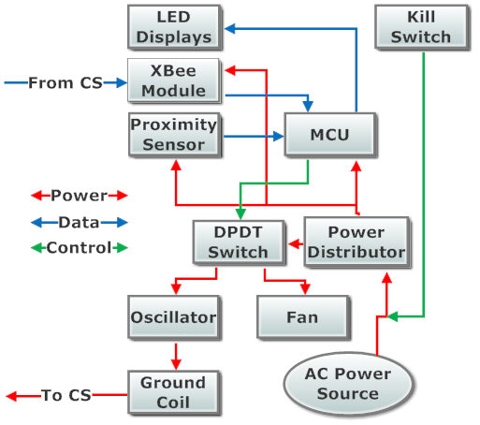
Ground Systems Block Diagram
Kill Switch implemented at power source
Power is rectified and converted to 24V, 12V, 5V, and 3.3V and supplied to corresponding systems
The MCU controls the oscillator system via a switch that controls the wireless power transfer
Data is sent to the MCU via the XBee and relevant data is displayed via the LED displays

Slide 9
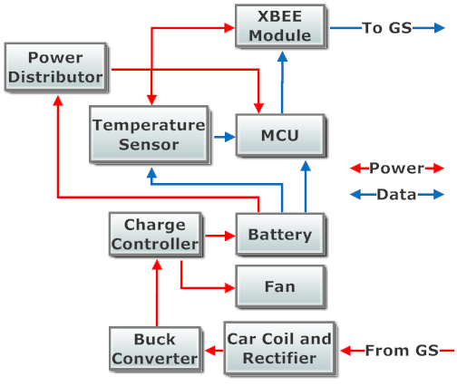
Car Systems Block Diagram
Power comes from the receiving coil and is rectified
The buck converter brings the voltage down for the charge controller to charge the battery
The battery powers the car MCU and other related systems
Temperature and voltage data from the battery are sent through the Xbee to the ground MCU

Slide 10
Designs of Systems
And Hardware

Slide 11
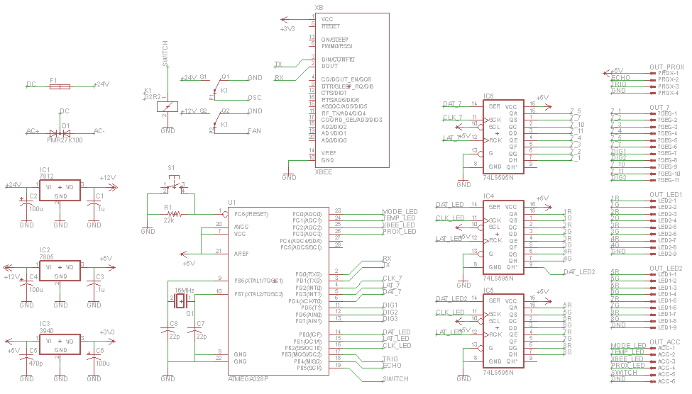
Ground Systems on EAGLE

Slide 12
Ground Systems on EAGLE
Power System

Slide 13
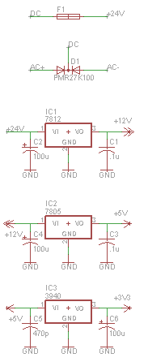
Power System for Ground
Power comes from the transformer and is rectified through a PMR27K100, outputting 24VDC.
A 250VAC/5A fuse is used for overcurrent protection.
24VDC goes to the Relay, it is also regulated to 12VDC with a LM7812.
12VDC goes to the Relay, it is also regulated to 5VDC with a LM7805.
5VDC powers most of the ICs, it is also regulated to 3.3VDC with a LM3940.
3.3VDC powers the XBee Module.

Slide 14
Power System for Ground
Power comes from the transformer and is rectified through a PMR27K100, outputting 24VDC.
A 250VAC/5A fuse is used for overcurrent protection.
24VDC goes to the Relay, it is also regulated to 12VDC with a LM7812.
12VDC goes to the Relay, it is also regulated to 5VDC with a LM7805.
5VDC powers most of the ICs, it is also regulated to 3.3VDC with a LM3940.
3.3VDC powers the XBee Module.

Slide 15
Power System for Ground
Power comes from the transformer and is rectified through a PMR27K100, outputting 24VDC.
A 250VAC/5A fuse is used for overcurrent protection.
24VDC goes to the Relay, it is also regulated to 12VDC with a LM7812.
12VDC goes to the Relay, it is also regulated to 5VDC with a LM7805.
5VDC powers most of the ICs, it is also regulated to 3.3VDC with a LM3940.
3.3VDC powers the XBee Module.

Slide 16
Power System for Ground
Power comes from the transformer and is rectified through a PMR27K100, outputting 24VDC.
A 250VAC/5A fuse is used for overcurrent protection.
24VDC goes to the Relay, it is also regulated to 12VDC with a LM7812.
12VDC goes to the Relay, it is also regulated to 5VDC with a LM7805.
5VDC powers most of the ICs, it is also regulated to 3.3VDC with a LM3940.
3.3VDC powers the XBee Module.

Slide 17
Power System for Ground
Power comes from the transformer and is rectified through a PMR27K100, outputting 24VDC.
A 250VAC/5A fuse is used for overcurrent protection.
24VDC goes to the Relay, it is also regulated to 12VDC with a LM7812.
12VDC goes to the Relay, it is also regulated to 5VDC with a LM7805.
5VDC powers most of the ICs, it is also regulated to 3.3VDC with a LM3940.
3.3VDC powers the XBee Module.

Slide 18
Ground System on EAGLE
DPDT Relay

Slide 19
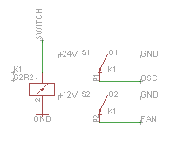
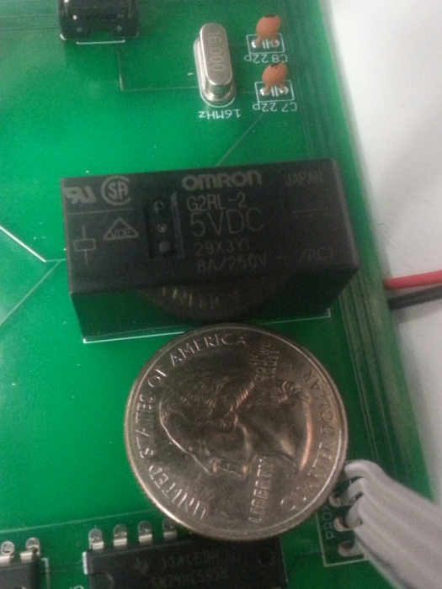
DPDT Relay for Ground
Omron G2R2 5VDC Relay
  Low coil voltage for our microcontroller
  Current rating of 8A
The Relay takes the 24VDC and 12VDC lines and powers the Oscillator System and Cooling Fans.
The “SWITCH” control line comes from the Microcontroller.

Slide 20
Ground System on EAGLE
Microcontroller

Slide 21
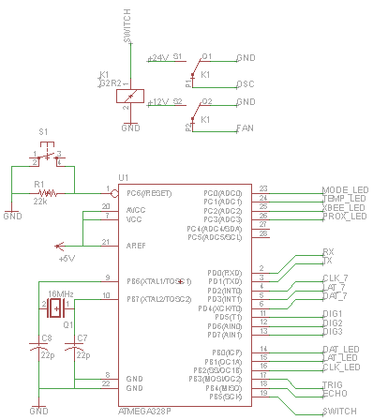
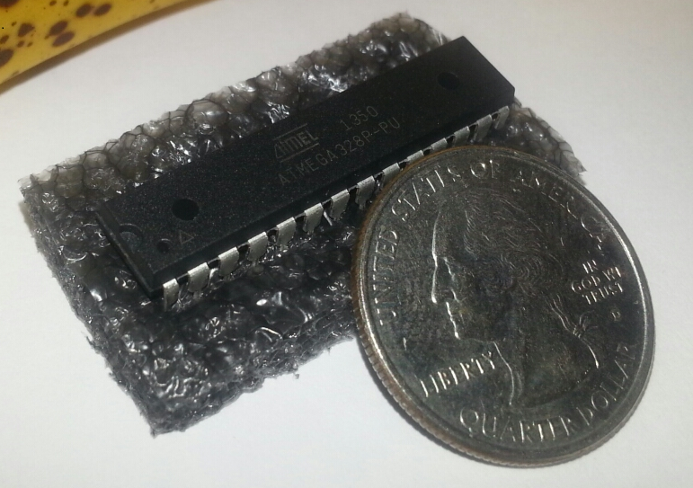
Microcontroller for Ground
Atmel ATMega328p
  Arduino Uno development board
  Arduino IDE
  32KB memory, 23 pins, 5VDC
The ground MCU controls the main logic flow of the systems and the LED displays.
18 Digital I/O pins used

Slide 22
Ground System on EAGLE
XBee Module

Slide 23
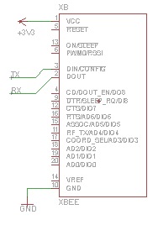
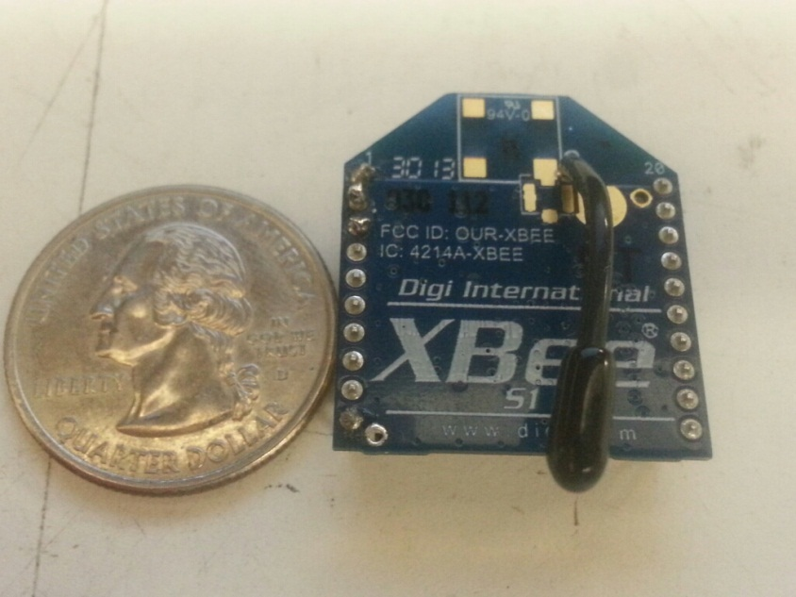
XBee Modules
XBee Modules used for Wireless communication because of its compatibility with the ATMega328p.
X-CTU used for programming (to set private channel and optional coordinator/slave)
1mW antenna (300ft max range)

Slide 24
Ground System on EAGLE
Header Pins
Shift Registers

Slide 25
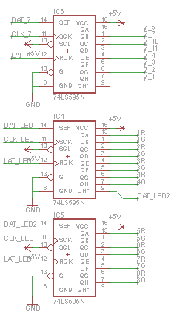
LED Displays
Three 8-bit shift registers needed to drive LED displays (595s). Old design used inverters and 3:8 decoders.
  One 595 is used for our 7-segment display.
  Two 595s are used to drive our LED bar display.

Slide 26
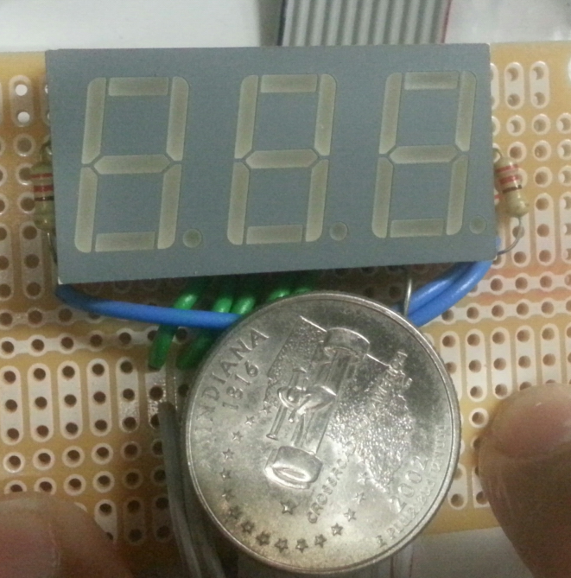
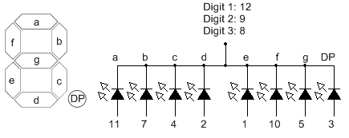
LED Displays
The 7-segment display is a Kingbright BC56-12SRWA 3-digit display.
Displays numbers upside-down, so we can use the DP as a degree symbol.
This particular display uses a common anode configuration, and is connected as shown below:

Slide 27
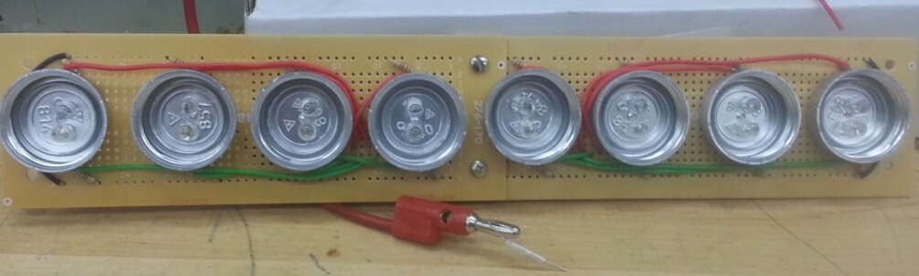
LED Displays
For our LED bar display, nothing we found online suited our requirements and budget, so we made our own.
Initially an ice cube tray, we used bottle caps as our LED housing.
This display shows the distance of the vehicle until proper alignment. Once charging begins, it shows the voltage level of the battery.

Slide 28
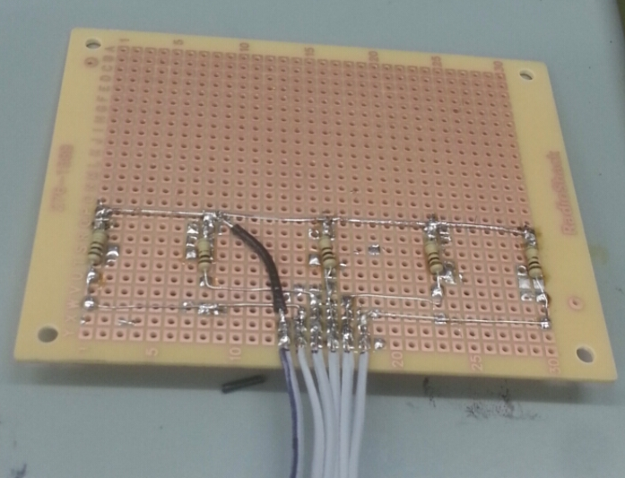
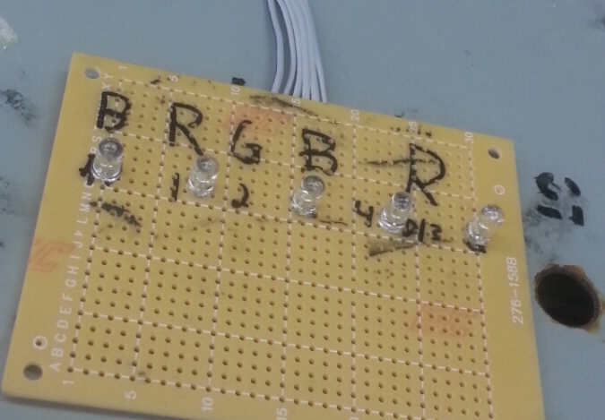
LED Displays
In addition to our LED displays, we also have accessory LEDs for additional notifications of systems’ status.
They indicate:
  Charging mode.
    Is the system is the right mode for charging?
  Temperature error.
    Is the battery too hot or cold for charging?
  XBee connectivity.
    Is data being communicated wirelessly?
  A met proximity condition.
    Is the vehicle in position?
  Charging status.
    Is the oscillator system on, sending power through the coils and thus charging the battery?

Slide 29
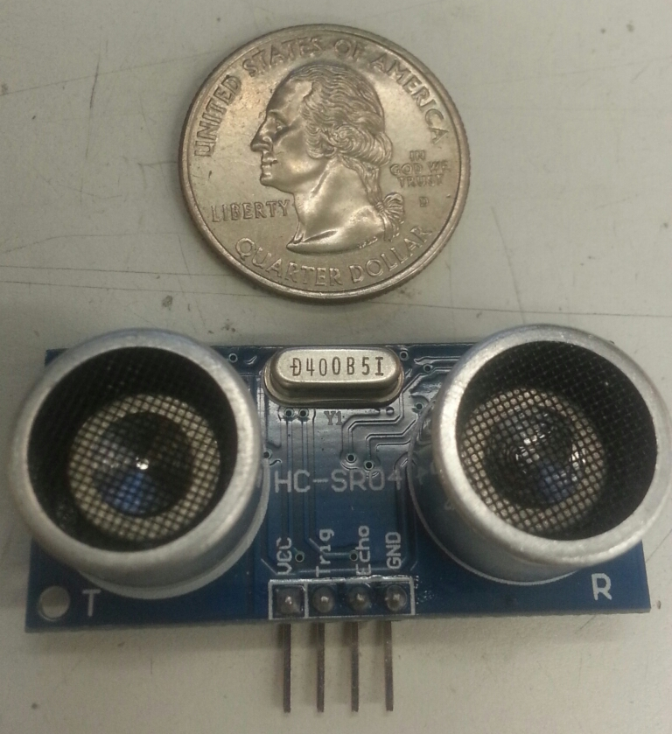
Proximity Sensor for Ground
  Initially we used an infrared proximity sensor, but its range was far too short. We switched to this ultrasonic proximity sensor by SainSmart.
  It has a maximum range of 80 inches; powered by 5VDC.
  It is used to determine the vehicle’s distance from the ideal position for proper alignment for optimal efficiency.
  It is also used to determine if the vehicle leaves in order to shut the system down.

Slide 30
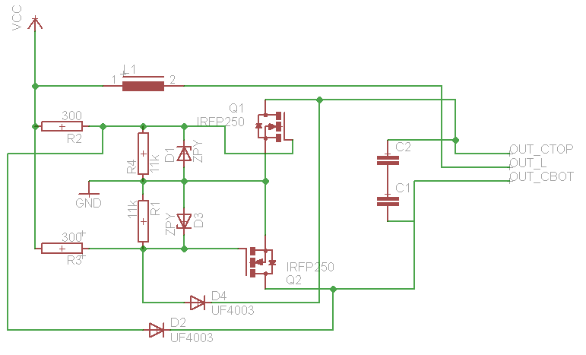
Oscillator System on EAGLE

Slide 31
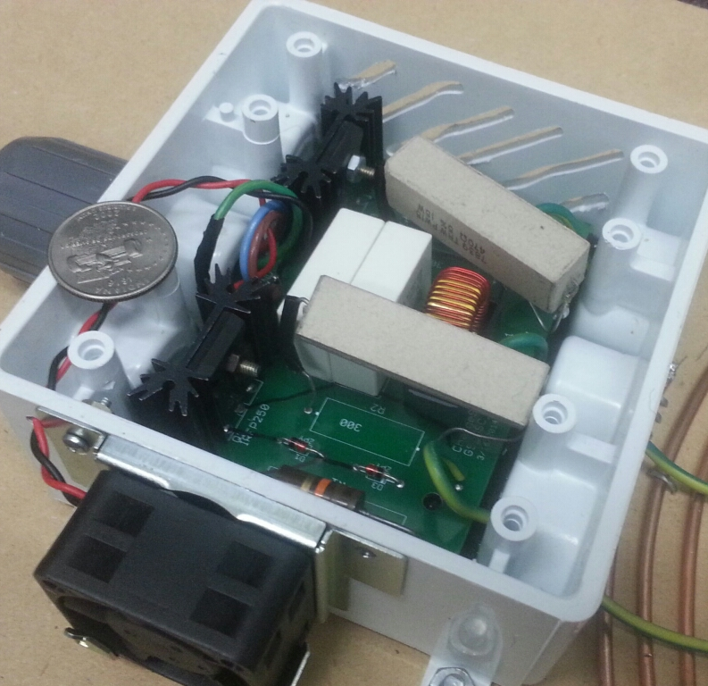
Oscillator System
VCC is the 24VDC coming from the Ground Systems’ Relay.
Researched variations of Hartley and Colpitts oscillators, but eventually came across the zero voltage switching (ZVS) driver oscillator
Our variation of the ZVS oscillates at 100kHZ.

Slide 32
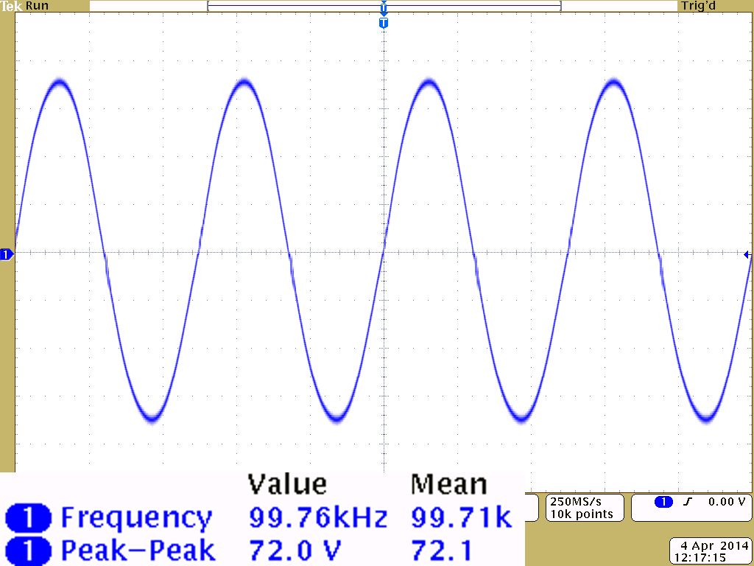
Oscillator System

Slide 33
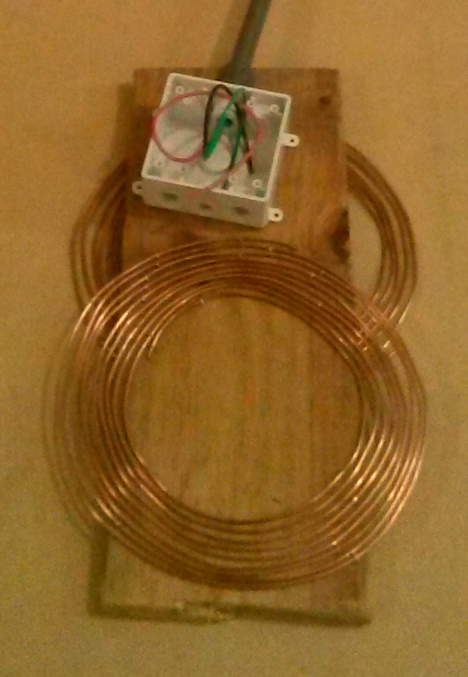
Transmitting and Receiving Coils
Pictured are coil designs we went through. We finalized our design with 3+3 turns for the transmitting coil (center-tapped) and 5 turns for the receiving coil.
Final coils are made from 10 AWG solid copper and measure 12in and 11in in diameter.

Slide 34
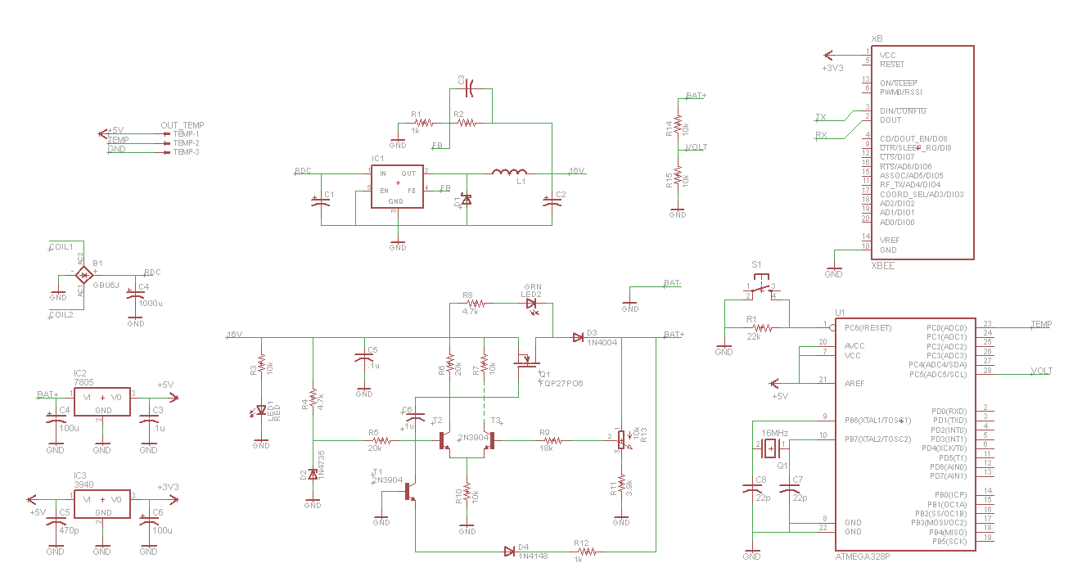
Car Systems on EAGLE

Slide 35
Car Systems on EAGLE
Power System

Slide 36
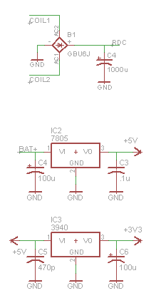
Power System for Car
Power comes from the receiving coil and is rectified through a GBU6J bridge rectifier, outputting unregulated DC.
The unregulated DC feeds into the buck converter.
The BAT+ is regulated to 5VDC with a LM7805.
5VDC powers most of the ICs, it is also regulated to 3.3VDC with a LM3940.
3.3VDC powers the XBee Module.

Slide 37
Power System for Car
Power comes from the receiving coil and is rectified through a GBU6J bridge rectifier, outputting unregulated DC.
The unregulated DC feeds into the buck converter.
The BAT+ is regulated to 5VDC with a LM7805.
5VDC powers most of the ICs, it is also regulated to 3.3VDC with a LM3940.
3.3VDC powers the XBee Module.

Slide 38
Power System for Car
Power comes from the receiving coil and is rectified through a GBU6J bridge rectifier, outputting unregulated DC.
The unregulated DC feeds into the buck converter.
The BAT+ is regulated to 5VDC with a LM7805.
5VDC powers most of the ICs, it is also regulated to 3.3VDC with a LM3940.
3.3VDC powers the XBee Module.

Slide 39
Car Systems on EAGLE
Buck Converter

Slide 40
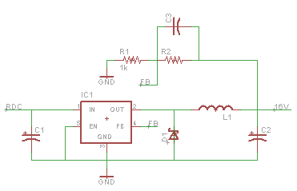
Buck Converter for Car
Unregulated DC feeds the buck converter and outputs an adjustable output; we adjusted for an output of 16VDC.
The 16VDC feeds the charge controller.
Our design is based around the LM2596 Simple Switcher chip.

Slide 41
Car Systems on EAGLE
Charge Controller

Slide 42
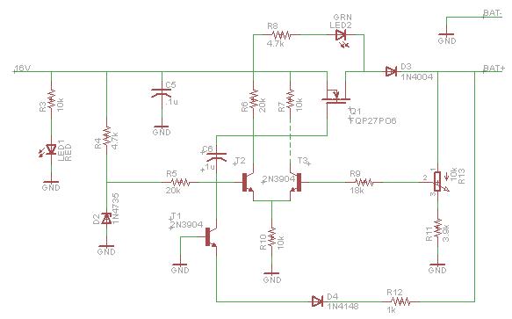
Charge Controller for Car
Purpose for the charge controller:
  Life span optimized
  Overvoltage protection
  Monitored battery performance
16VDC from the buck converter feeds the charge controller.
Output adjusted to 14VDC.
Maximum power dissipation is 16W

Slide 43
Car Systems on EAGLE
Microcontroller

Slide 44
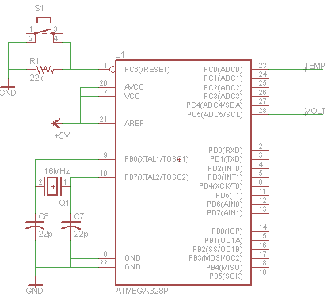
Microcontroller for Car
Same ATMega328p as Ground System
In the Car System, the MCU is reading TEMP and VOLT; voltage from the temperature sensor and voltage from the voltage divider circuit to determine battery’s voltage level.

Slide 45
Car Systems on EAGLE
XBee Module

Slide 46
Car Systems on EAGLE
Voltage Divider
Header Pins

Slide 47

Voltage Divider for Car
This simple voltage divider is used to read the battery’s voltage without damaging the 5V microcontroller.

Slide 48
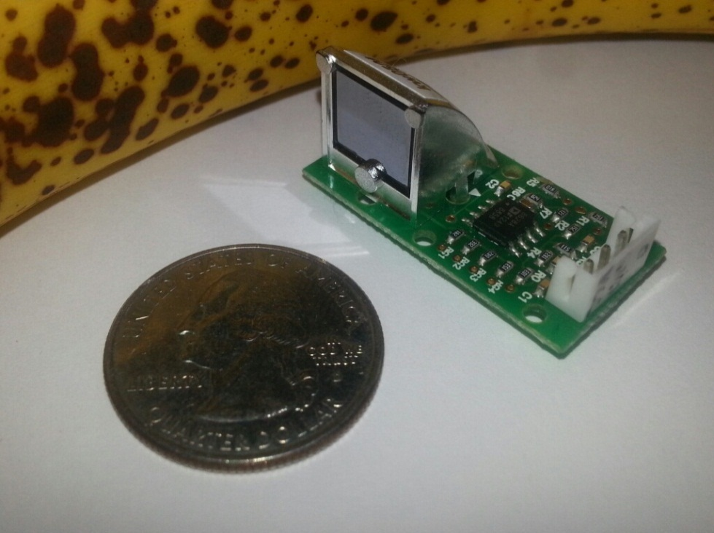
Temperature Sensor for Car
This ZTP-115M temperature sensor module is an infrared non-contact sensor.
Versatile and easy-to-use with an acceptable range of -40C to 145C and 1C accuracy at room temperature.
However, following its given sensitivity curve, we were getting inaccurate readings, so we had to calibrate.

Slide 49
Software
And Logic

Slide 50
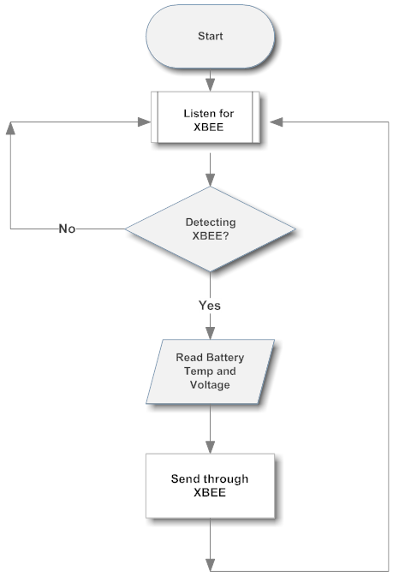
Logic Flow Diagram for Car MCU

Slide 51
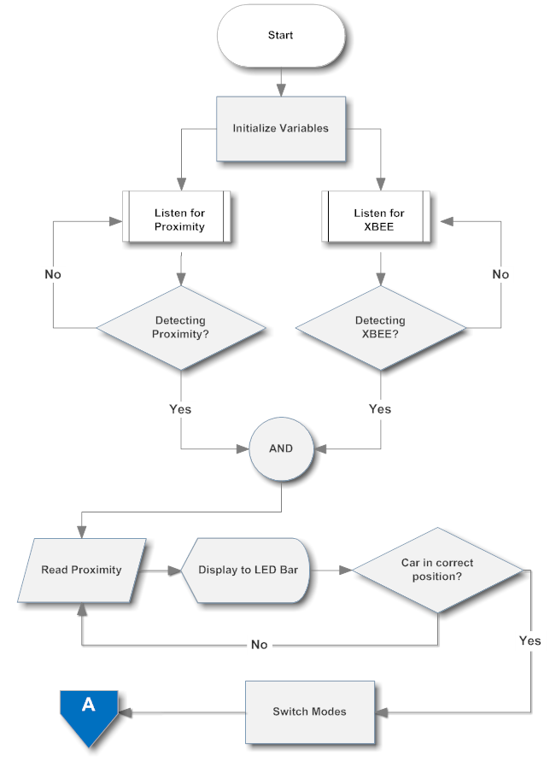
Logic Flow Diagram for Ground MCU

Slide 52
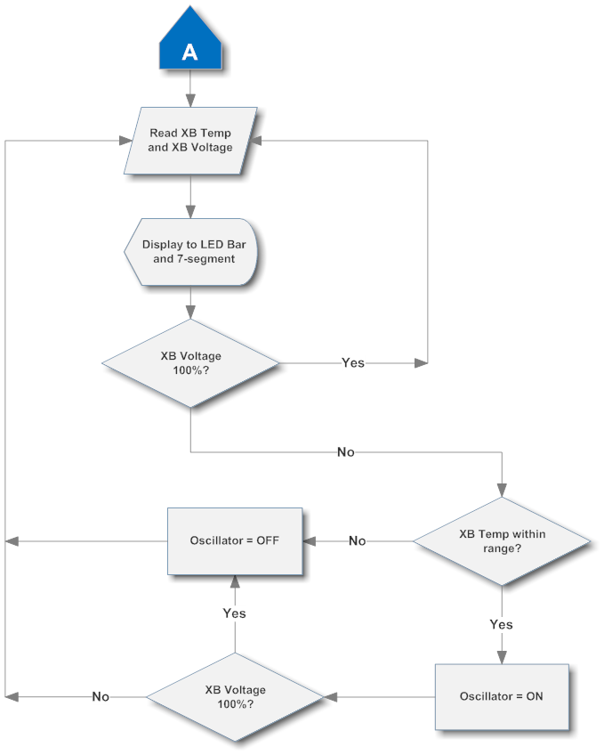
Logic Flow Diagram for Ground MCU

Slide 53
Project Testing
And Administration

Slide 54
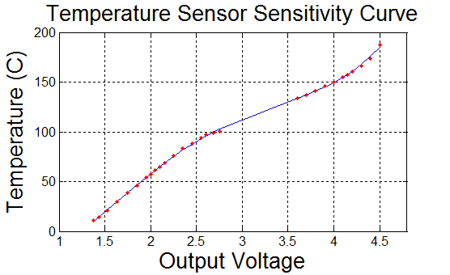
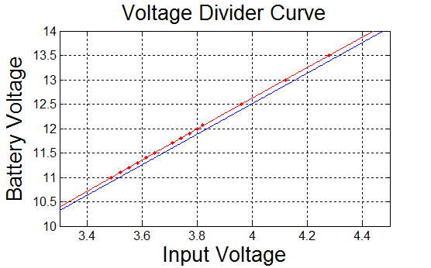
Sensors Calibration
Temperature Sensor
  Red points represent data points taken from stove top measurements using DMM temperature sensor as reference; blue line represents best fit curve.
Voltage Divider
  Red points and line represent collected data from voltage divider of 10k and 4.7k; blue line represents voltage divider equation.

Slide 55
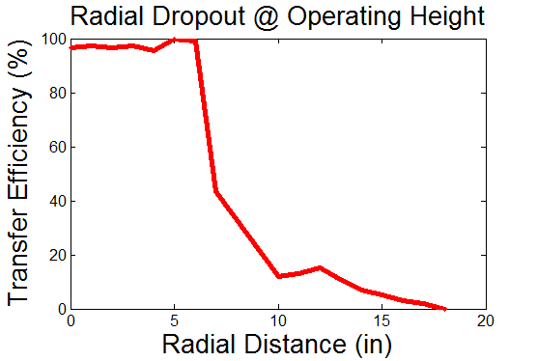
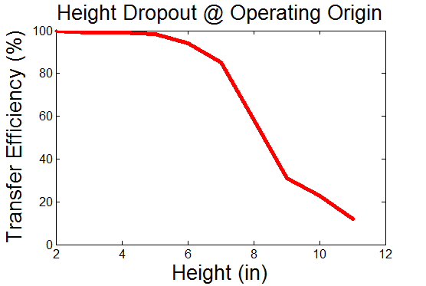
Wireless Power Transfer Efficiency Tests
Horizontal Misalignment Test
  Used to determine distance from origin where wireless power transfer efficiency fades.
Vertical Displacement Test
  Used to determine height from transmitting coil where wireless power transfer efficiency fades.

Slide 56


Integrated System Power Efficiency Test
Measurement Point | Voltage | Current | Power
Ground Systems (Oscillator Off) | 23.8V | 0.12A | 2.86W
Ground Systems (Oscillator On) | 21.8V | 1.32A | 28.78W
Oscillator | 21.6V | 1.30A | 28.08W
Car System at Charge Controller Output | 14.0V | 0.48A | 6.72W
Temperature Sensor
  Red points represent data points taken from stove top measurements using DMM temperature sensor as reference; blue line represents best fit curve.
Voltage Divider
  Red points and line represent collected data from voltage divider of 10k and 4.7k; blue line represents voltage divider equation.
  $$Power Efficiency=\frac{Power Received}{Power Transmitted}∗100\%$$
  $$\frac{6.72W/0.9}{28.08W}∗100\%=26.59\%$$

Slide 57
Budget
Category | Cost | Budget
Metal Box | $5.00 | $30.00
Proximity Sensor | $22.95 | $10.00
Motion Sensor | $0.00 | $10.00
LED Displays | $29.47 | $30.00
Kill Switch | $5.38 | $5.00
Fans | $0.00 | $5.00
Power Distributor | $54.03 | $30.00
Charge Controller | $76.98 | $30.00
Vehicle/Battery | $119.99 | $150.00
Temperature Sensor | $11.88 | $20.00
Microcontroller | $70.30 | $20.00
Wireless Module | $45.90 | $20.00
Oscillator | $50.11 | $30.00
Wires and Mounting | $76.94 | $60.00
PCB and Boards | $103.04 | $100.00
Services | $152.82 | $50.00
TOTAL | $824.79 | $600.00

Slide 58
Project Issues
Proximity sensor had feedback interference due to mis-angled reflections from non-uniform surfaces.
  Vehicle had to be retrofitted with a uniform surface.
Charge controller MOSFET failures due to circuit sensitivity.
Heat issues; oscillator, voltage regulators, and rectifiers.
  System had to include heat sinks and cooling fans.
Mounting circuit boards to the panel door.
Microcontroller Serial buffer used to sense XBee connectivity.
  Used a timer to determine length of disconnection.

Slide 59

QUESTIONS?

