Slide 1
Flashback Group 22
Marlon De La Cruz (EE)
Rene Martinez (CpE/EE)
Trenton Reed (EE)
Marlon Smith (CpE)

Slide 2
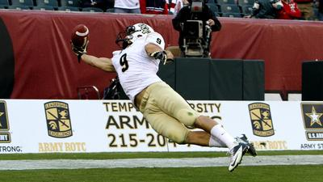
What is Flashback (Patent Pending)

Slide 3
Goals and Motivation
Patent Pending
Gain Experience
ARM / Linux Development
Qt / C++ GUI
Set Top Box Application
PCB Design
To Enhance the Viewing Experience
Graduation

Slide 4
Requirements
Process videos of at least 24 frames/sec
Accurate video and audio syncing
MPEG-2 support
Event controller
Non-Invasive user interface
Two channel video playback
Process OTA Transmitted Channels

Slide 5
Software Specifications
Commercial Detection < 1.0 s
GUI Responses < 0.5 s
Channel Switching < 3.0 s
Live TV lag < 5.0 s

Slide 6
Hardware Specifications
512 MB of Ram
1 GHz clock
16 GB storage device
TV Tuners process 6 MHz bandwidth channels
38.8 Mbps Data throughput
Standard Definition Video Filter Gain > 6 dB
Audio SNR > 72 dB

Slide 7
Hardware Peripherals
10/100 Ethernet
Two USB 2.0 Type A
USB Mini Type B
Digital Visual Interface Digital Only (DVI-D)
Composite Video
Right and Left Audio Channel
Power Supply
7-Segment Display
Overo TidalStorm
MicroSD
Fan
Infrared Sensor

Slide 8
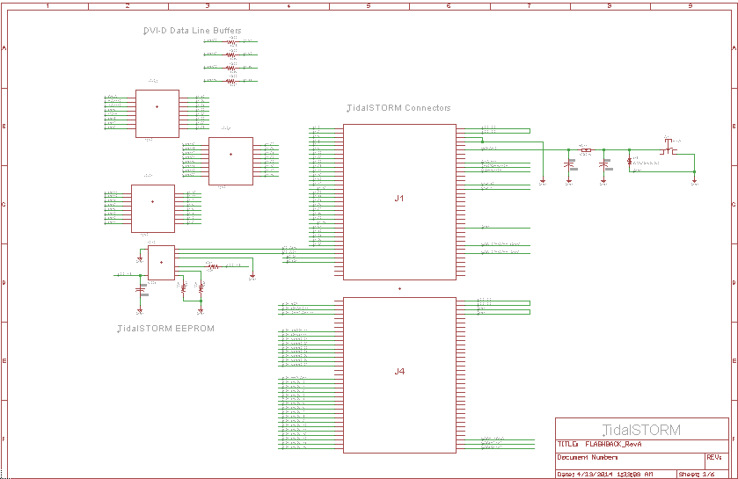
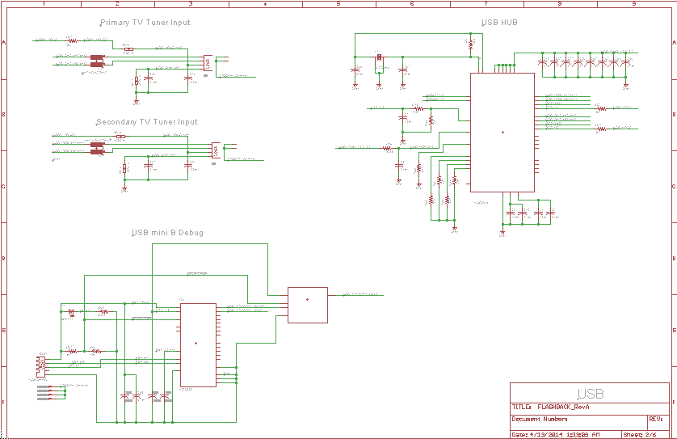
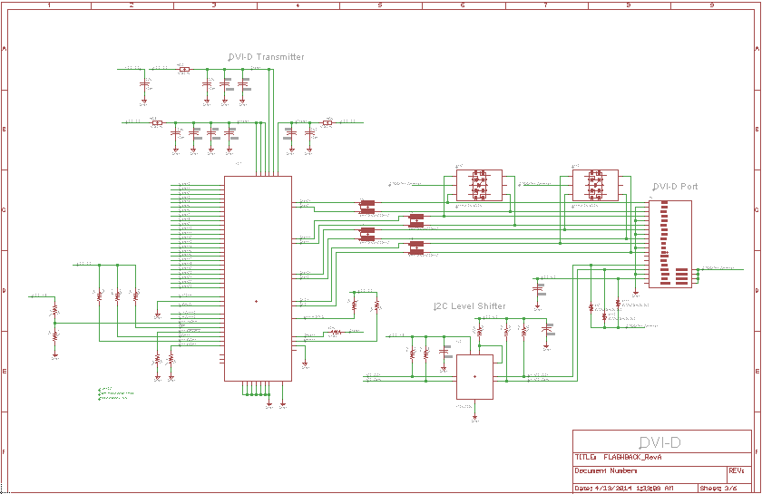
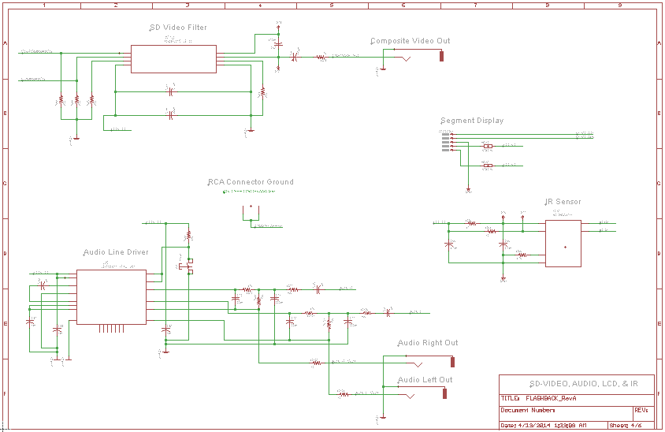
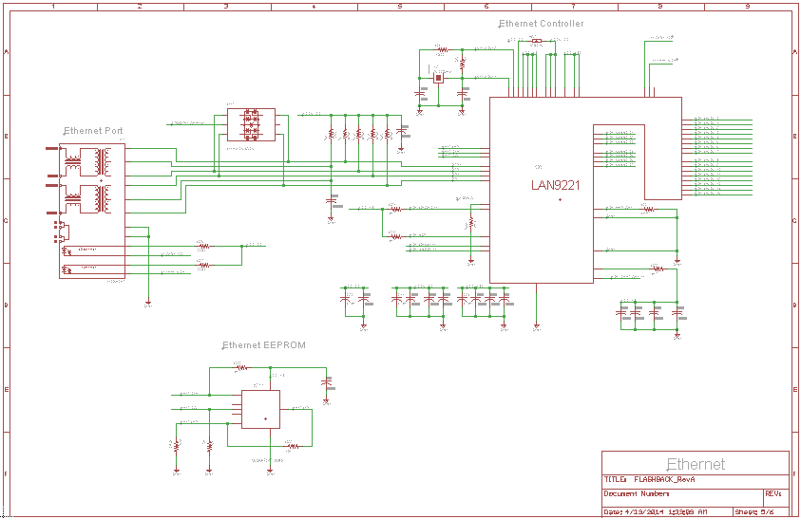
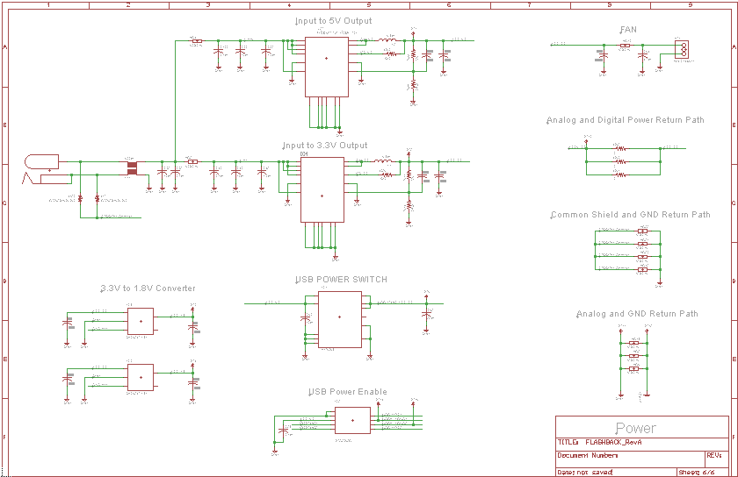
Schematic Overview

Slide 9
Processor Implementation
OMAP4470
TMS320DM8168 (DaVinci)
ARM1176/BCM2835
AM335x
DM3730

Slide 10
Microprocessor
Name | Cost | Specs | GPIOs Available | Sufficient Documentation
TMS320DM8168 | $149.00 | -ARM Cortex A8 -up to 1.35 GHz -2 GB RAM | 1031 | Yes
ARM1176JZF-S BCM2835 | N/A | -up to 1 GHz -JTAG debug support | 21 | No
AM355x | $34.00 | -up to 1 GHz -Linux, Android and Windows Embedded CE -2 USB OTG ports -ARM Cortex A8 | 67 | Yes
DM3730 | $46.00 | -ARM Cortex A8 -up to 1 GHz -Linux, Android and Windows Embedded CE -Multiple USB OTG ports | 140 | Yes

Slide 11
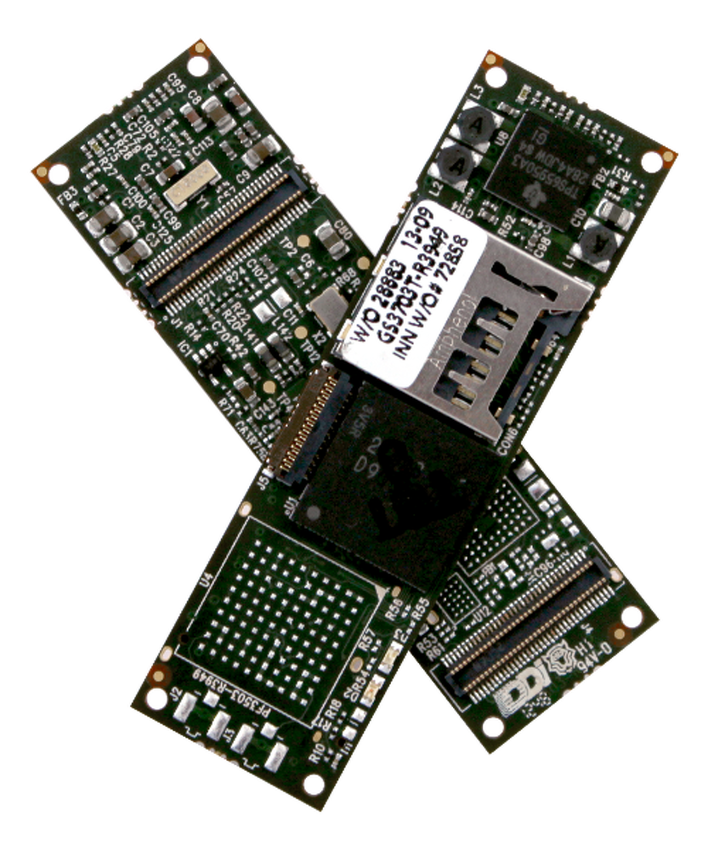
Dev Boards
Raspberry Pi
BeagleBone Black
OVERO TidalSTORM

Slide 12
TidalSTORM Connectors

Slide 13
TV Tuner

Slide 14
TV Tuners: USB-A Input

Slide 15
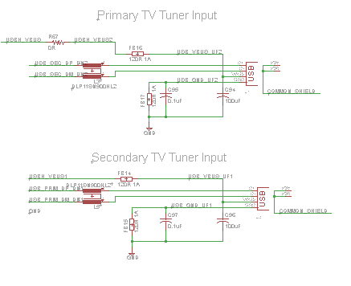
TV Tuners: USB-A Input

Slide 16
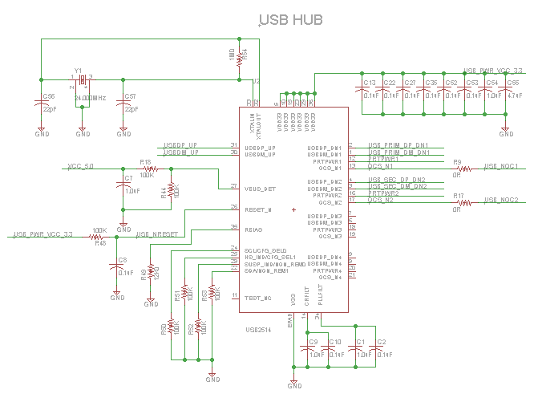
TV Tuners: USB Control

Slide 17
TV Tuners: USB Hub
USB2514 by SMSC
USB 2.0 Compatible
4-Port Hub
Enhanced EMI rejection and ESD protection

Slide 18
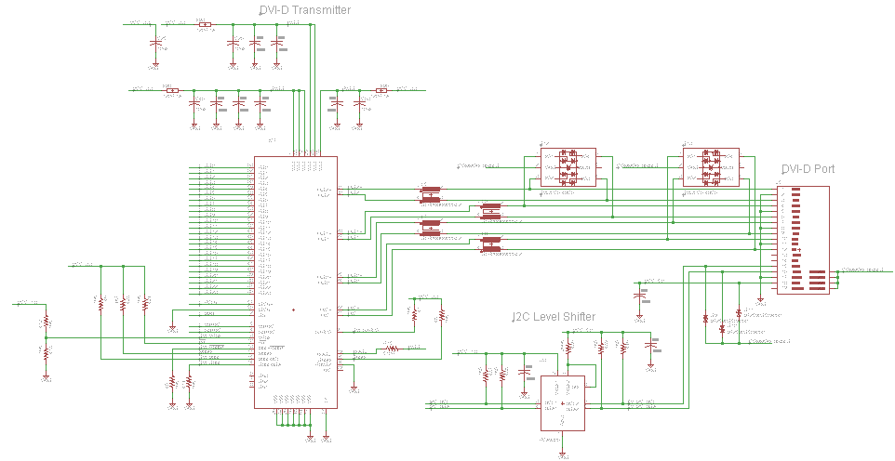
DVI-D

Slide 19
DVI-D
Texas Instruments: TFP410
I²C Interface
Enhanced PLL Noise Immunity
No HSYNC Jitter Anomaly
Negligible Data-Dependent Jitter
24-bit True Color Pixel Format

Slide 20
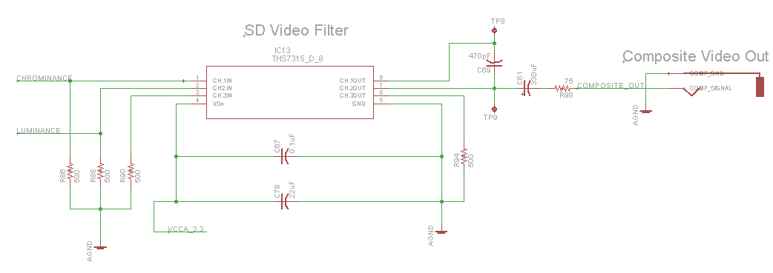
SD Video Filter

Slide 21
SD Video Filter
Texas Instruments: THS7315
Butterworth 5th Order LPF 8.5 MHz (-3dB)
14.3 dB Gain
Supports Composite and S-Video Output

Slide 22
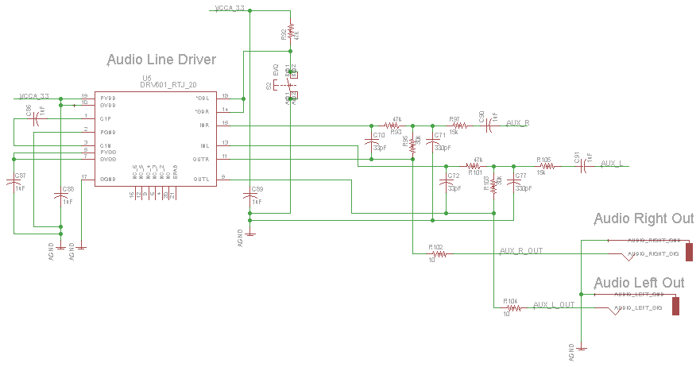
Audio

Slide 23
Audio
Texas Instruments: DRV601
SNR 105 dB
Low Noise and Total Harmonic Distortion
Pop Reduction Circuitry

Slide 24
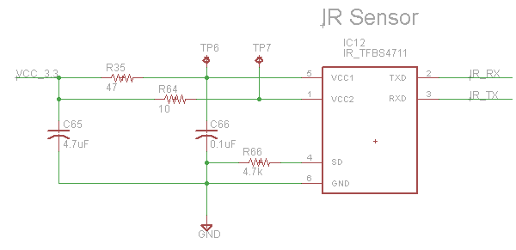
IR Receiver

Slide 25
IR Receiver
TFBS 4711
Supports data rates up to 115.2 kbit/s
Distance up to 8 m
Max Power Dissipation 250 mW
6 mm
3 mm

Slide 26
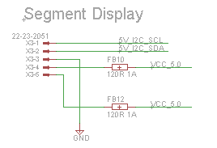
7-Segment Display
1.2” 7-Segment Display
I²C Interface
Requires 5V

Slide 27
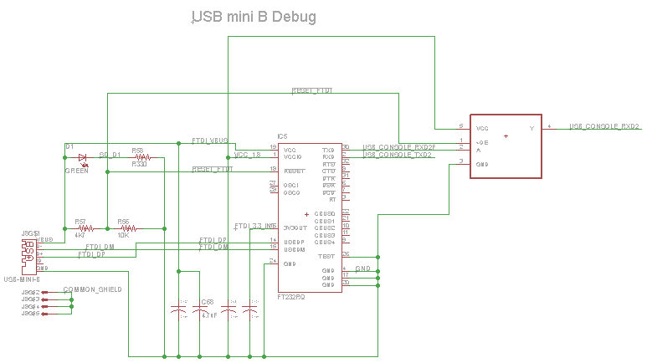
USB Mini-B

Slide 28
USB Mini-B
Communicate via UART
Kernel Load and Debug
FTDI’s FT232RQ USB UART IC
USB to Asynchronous Serial Data Transfer Interface
USB Protocol on Chip
USB 2.0 Full Speed Compatible

Slide 29
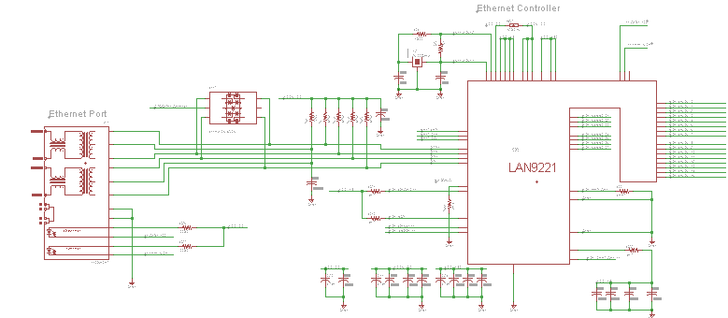
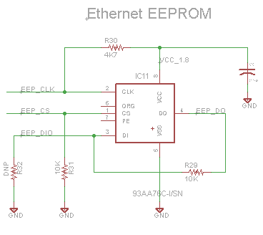
Ethernet

Slide 30
Ethernet
Load Flashback to Board
Debug Flashback Functionality in Real-Time
SMSC’s LAN9221 Ethernet Controller
Integrated Ethernet MAC and PHY
10BASE-T and 100BASE-TX support

Slide 31
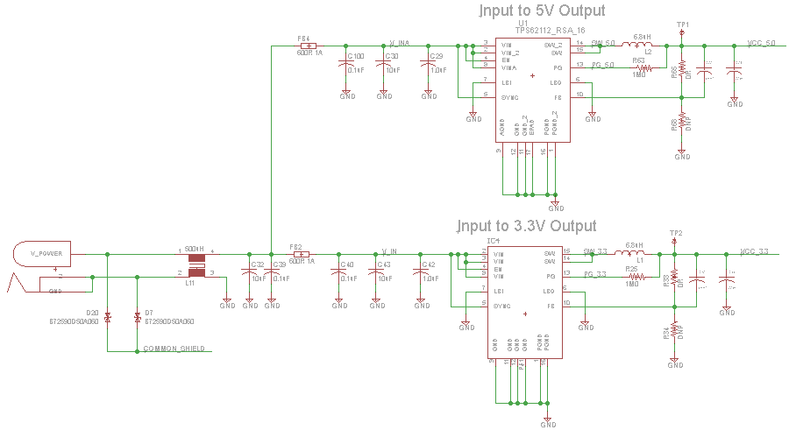
Power: 6V to 5V and 3.3V

Slide 32
Power: 5V and 3.3V
TI’s TPS6211x Step Down Converter
3.1V to 17V Input Range
Up to 1.5A Output Current
TPS62111 Fixed Output 3.3V
TPS62112 Fixed Output 5V
Over-temperature and Over-current Protection

Slide 33
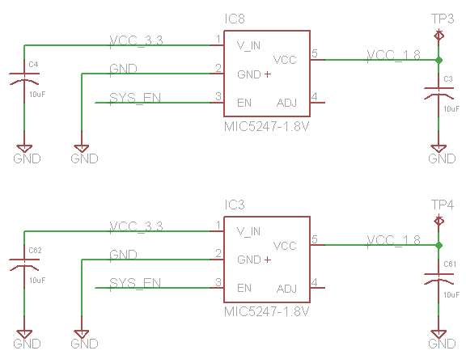
Power: 3.3V to 1.8V

Slide 34
Power: 3.3V to 1.8V
MICREL’s MIC5247 Linear Regulator
Output Voltage 1.8V
150mA Output Current
Thermal Shutdown

Slide 35
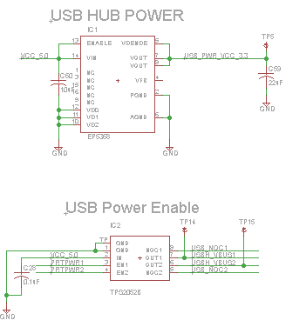
Power: USB

Slide 36
Power: USB
USB Hub Power: ENPIRION’s EP5368QI
Synchronous Buck Converter
2.4V to 5.5V Input Voltage
700mA Output Current
3.3 V Output
Short Circuit and Over Current Protection
USB Power Switch: TPS2052B
Power Distribution Switch
2.7V to 5.5V Input and Output Range
500mA Output Current
Thermal and Short-Circuit Protection

Slide 37
Linaro Ubuntu 12.10 LTS
Linux Kernel v3.2+
Desktop Environment
Qt Support
FFMPEG
OpenCV
Community Support
Familiarity

Slide 38
Software Development (IDE)
Qt Creator

Slide 39
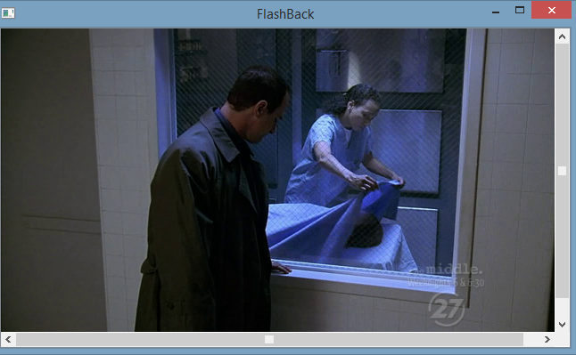
QtCreator
Cross Platform Compatible
Programming Language: C++
GUI development forms
OpenCV and FFMPEG compatible

Slide 40
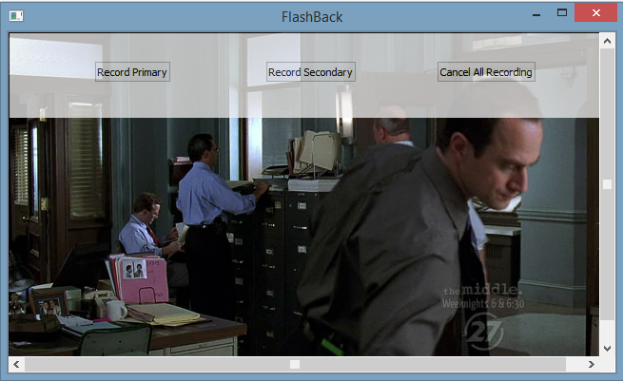
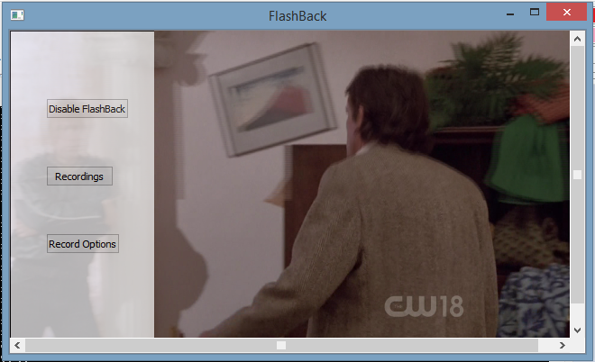
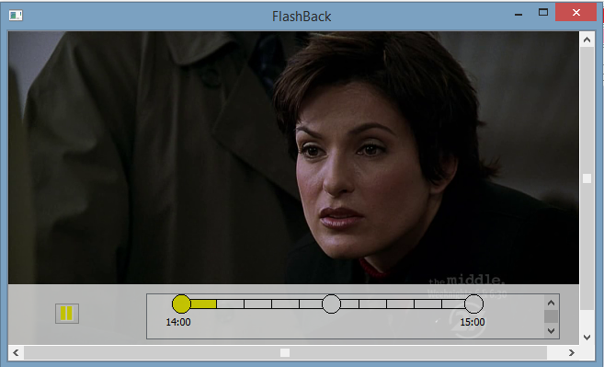
GUI Design

Slide 41
OpenCV and FFMPEG
We elected to use OpenCV and FFMPEG.
Extensive documentation on OpenCV and FFMPEG.
Easier to create our implementation of a media player with more control over the audio and video streams.
Cross platform and compliable on different architectures

Slide 42
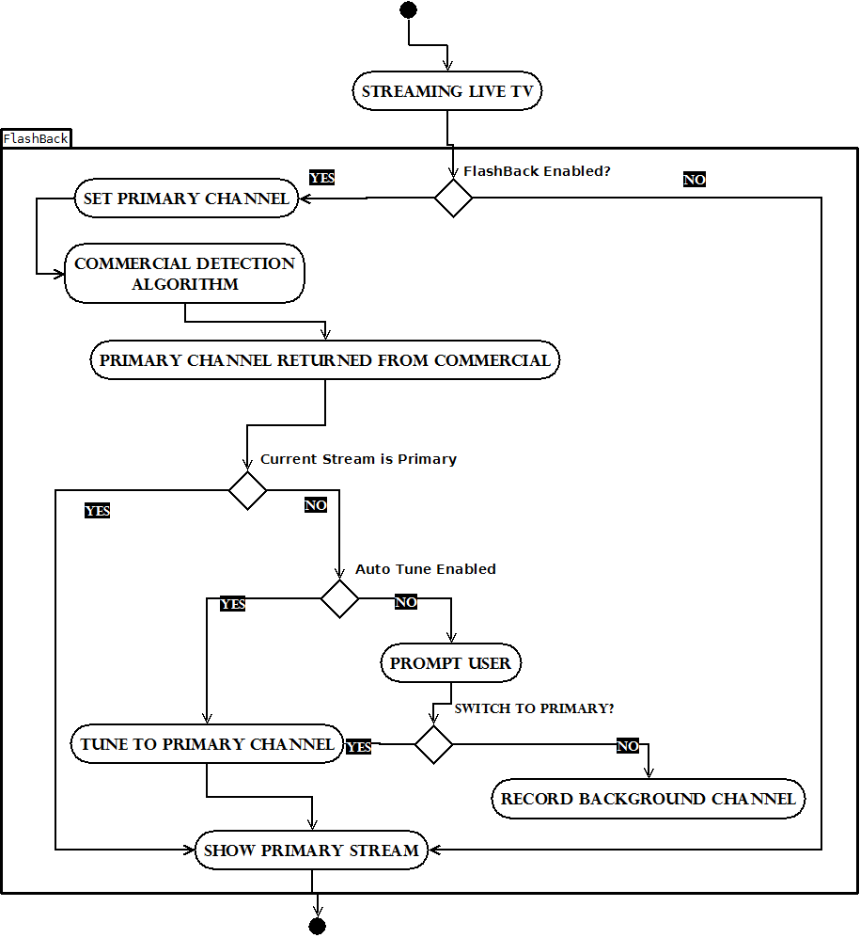

Slide 43
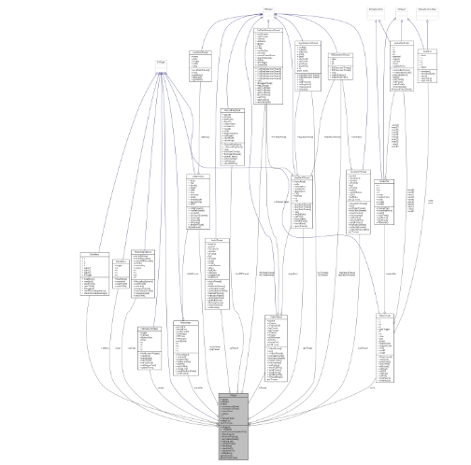
Software Class Diagram

Slide 44
Class Interaction

Slide 45
Class Interaction

Slide 46
Class Interaction

Slide 47
Detection Algorithms
Black Screen
Logo absence detection
High Cut Rate detection

Slide 48
Black Screen Detection
Black Screen: Pixel value threshold of 200,000
Algorithm samples every 100 Frames
Location of logo is omitted from analysis

Slide 49
Logo Absence Detection
A database of known station logos with their coordinates will be stored in memory.
Each logo will be accessed by key value.
Using OpenCV, the image is normalized and then the difference is taken
Sum >115,000, no logo
Sum < 115,000 Logo

Slide 50
High Cut Rate Detection
Cut Rate - difference in pixel density between two or more frames
High cut rates indicate rapid change in pixel densities between frames.
Using the standard deviation between the pixel densities we can determine commercial breaks.

Slide 51
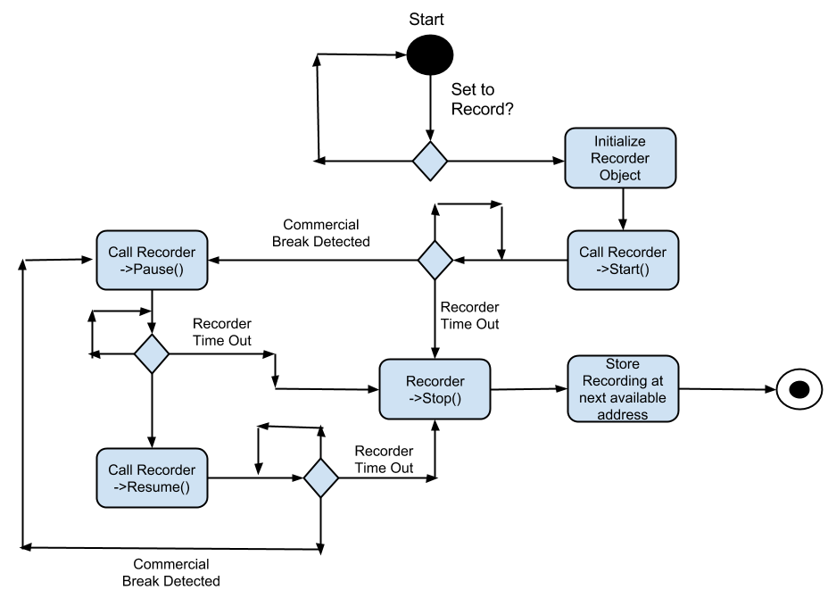
Recording

Slide 52
Work Distribution: Hardware
PCB Design and Layout (per component)

Slide 53
Work Distribution: Software

Slide 54
Budget
Components | Description | Quantity | Cost
Development Board | Tidal Storm, EEPROM, and Connectors | 3 | $ 144.98
HDMI | IC's and Connector | 3 | $ 2.70
LCD | Screen and Connector | 1 | $ 19.45
PCB | PCB | N/A | $ 356.58
Power | IC's, Connector, and Inductors | 10 | $ 17.06
RCA | IC's and Connector | 3 | $ 2.51
Summit Prototype Board | Summit Prototype Board | N/A | $ 49.00
TV Tuner | Two Tuners, IC's, Crystal, and USB-A Connectors | 4 | $ 160.24
Debug | Ethernet and USB mini B | 7 | $ 23.15
Eagle License | Eagle License | N/A | $ 169.00
Fan | Fan and Connector | 1 | $ 15.77
Capacitors | Capacitors | 96 | $ 20.51
Choke Filters | Choke Filters | 6 | $ 2.54
ESD | ESD | 9 | $ 4.24
Ferrite Beads | Ferrite Beads | 21 | $ 0.75
IR | IR | 1 | $ 4.32
LED | LED | 1 | $ 1.13
Resistors | Resistors | 84 | $ 7.02
Switches | Switches | 2 | $ 1.45
Total |  | 252 | $ 1,002.39
Budget |  |  | $ 1,000.00

Slide 55
Questions

