Slide 1
Flashback Group 22
Marlon De La Cruz (EE)
Rene Martinez (CpE/EE)
Trenton Reed (EE)
Marlon Smith (CpE)

Slide 2
What is Flashback (Patent Pending)

Slide 3
Goals and Motivation
Patent Pending
DVRs are costly
Gain Experience
ARM / Linux Development
Qt / C++ GUI
PCB Design
Graduation

Slide 4
Requirements
Process videos of at least 30 frames/sec
Accurate video and audio syncing
MPEG-2 support
H.264 support
IR remote control
Non-Invasive user interface
Memory Management Unit (MMU)
Two channel video capture
Process OTA Transmitted Channels

Slide 5
Software Specifications
Commercial Detection < 0.5s
GUI Responses < 0.5s
Channel Tuning < 3s
Live TV lag < 5s

Slide 6
Hardware Specifications
512 MB of Ram
1 GHz clock
16 GB storage device
TV Tuners function between 42 – 866 MHz
38.6 Mbps Data throughput
Standard Definition Video Filter Gain > 6 dB
Audio SNR > 72 dB

Slide 7
Hardware Peripherals
10/100 Ethernet
USB 2.0 and up
MicroSD
HDMI
Component Video/Audio

Slide 8
Processor Implementation
OMAP4470
TMS320DM8168 (DaVinci)
ARM1176/BCM2835
AM335x
DM3730

Slide 9
Microprocessor
Name | Cost | Specs | GPIOs Available | Sufficient Documentation
TMS320DM8168 | $149.00 | -ARM Cortex A8 -up to 1.35 GHz -2 GB RAM | 1031 | Yes
ARM1176JZF-S BCM2835 | N/A | -up to 1 GHz -JTAG debug support | 21 | No
AM355x | $34.00 | -up to 1 GHz -Linux, Android and Windows Embedded CE -2 USB OTG ports -ARM Cortex A8 | 67 | Yes
DM3730 | $46.00 | -ARM Cortex A8 -up to 1 GHz | 140 | Yes

Slide 10
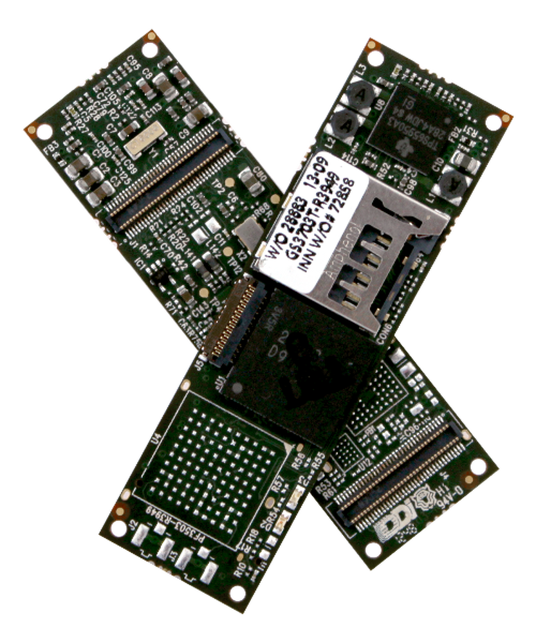
Dev Board Considerations
Raspberry Pi
BeagleBone Black
Gumstix OVERO

Slide 11
TV Tuner

Slide 12
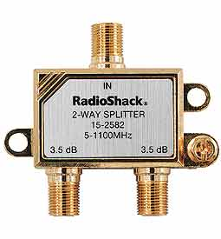
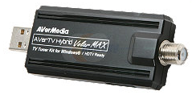
TV Tuners
TV Antenna
PCB

Slide 13
IR Receiver
Receiver: TSOP38238

Slide 14
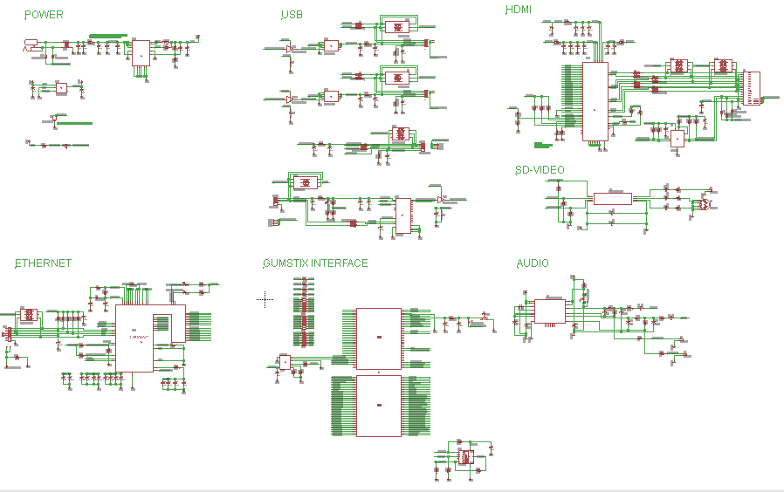
Schematic Overview

Slide 15
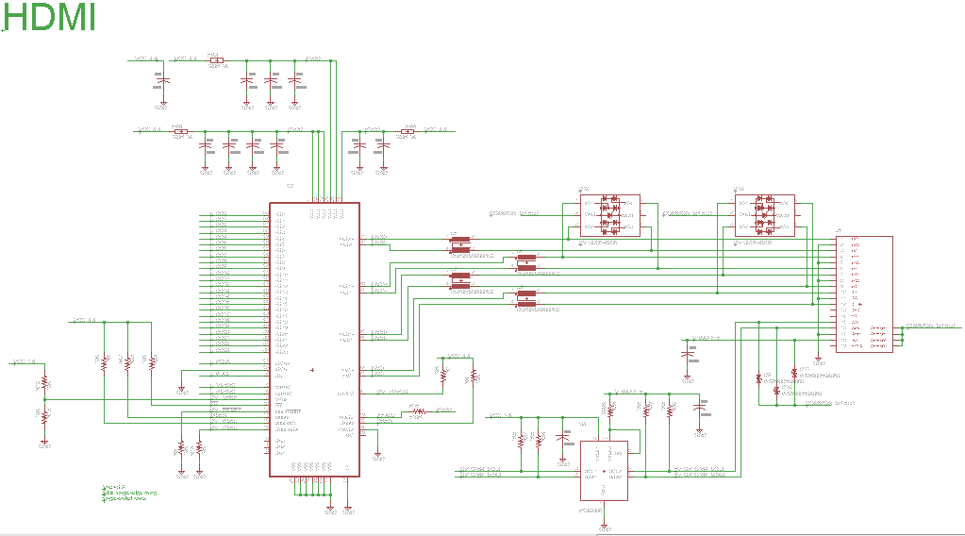
HDMI

Slide 16
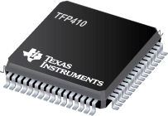
HDMI
Texas Instruments: TFP410
I²C Interface
Enhanced PLL Noise Immunity
No HYSYNC Jitter Anomaly
Negligible Data-Dependent Jitter
24-bit True Color Pixel Format
11 mm x 11 mm 64-Pin Package
Free Samples
11mm
11mm

Slide 17
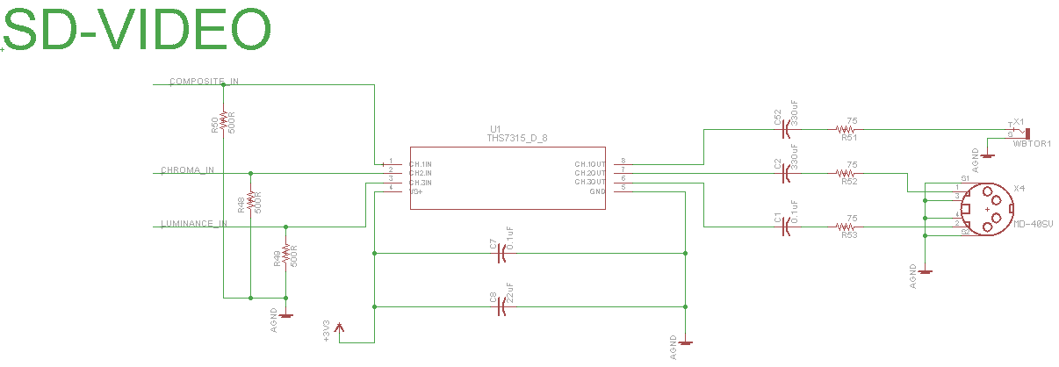
SD Video Filter

Slide 18
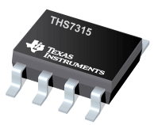
SD Video Filter
Texas Instruments: THS7315
Butterworth 5th Order LPF 8.5 MHz (-3dB)
14.3 dB Gain
Supports Composite and S-Video Output
3 Channels
5 mm x 6.2 mm 8-Pin Package
Free Samples
5 mm
6.2 mm

Slide 19
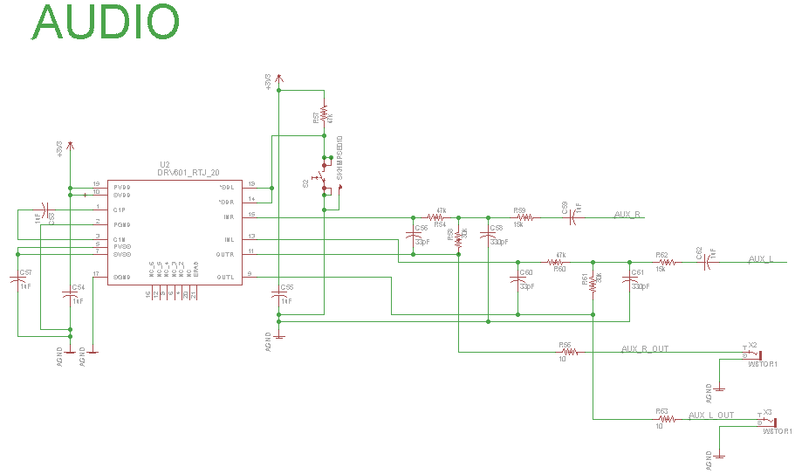
Audio

Slide 20
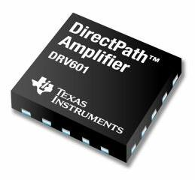
Audio
Texas Instruments: DRV601
SNR 105 dB
Low Noise and Total Harmonic Distortion
Pop Reduction Circuitry
4 mm x 4 mm 20-Pin Package
Free Samples
4 mm
4 mm

Slide 21
Operating Systems Considerations
Ubuntu
ArchLinux
Angstrom

Slide 22
Ubuntu 12.04 LTS
Linux Kernel v3.2+
Desktop Environment
Qt Support
Community Support
Familiarity

Slide 23
Software Development (IDE)
Qt Creator
Microsoft Visual Studio

Slide 24
QtCreator
Cross Platform Compatible
Programming Language: C++
GUI development forms
OpenCV and FFMPEG compatible

Slide 25
Visual Studio
Programming Language: C, C++, C#, .NET
Target Platform: Windows
Qt Plug Ins and Qt SDK for Cross Compilation
OpenCV and FFMPEG compatible

Slide 26
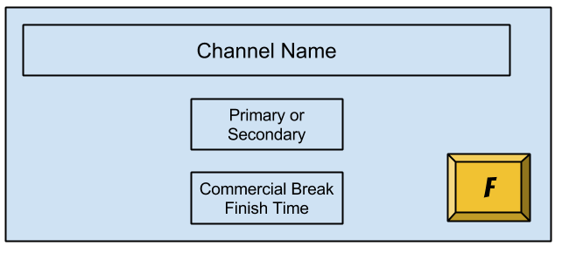
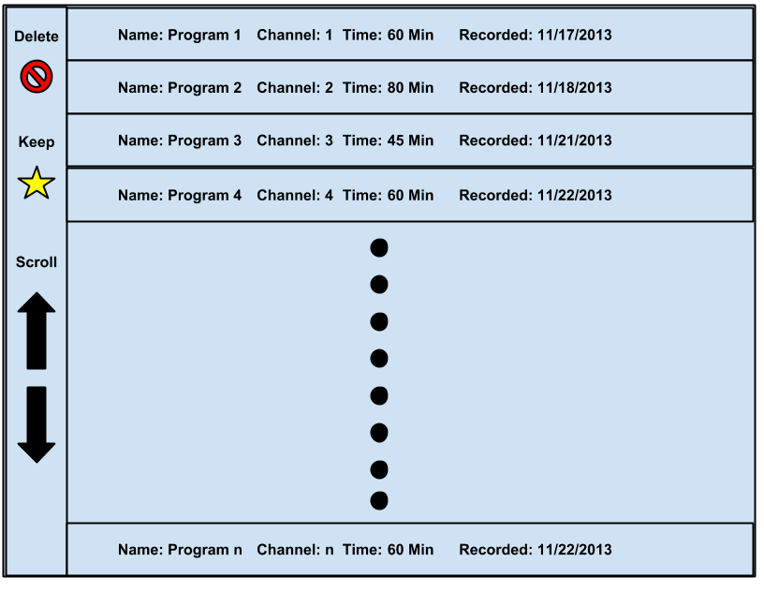
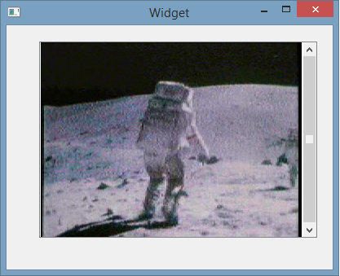
GUI Design

Slide 27
Qt Media Encoding Library
Third party media encoding library specifically for Qt.
Library wraps OpenCV and LibAV from FFMPEG.
Target Platform: Windows

Slide 28
OpenCV
Open Source Computer Vision cross platform library.
Available on multiple languages and development environments.
Streamlined fashion of accessing pixels in a given video frame.
Only supports processing on images.

Slide 29
FFMPEG
Cross platform audio and video streaming, decoding, encoding, and recording library.
Available on multiple languages and development environments.
Used in many video streaming applications.

Slide 30
QtMEL Vs OpenCV and FFMPEG
We elected to use OpenCV and FFMPEG.
More documentation on OpenCV and FFMPEG than QtMEL.
Easier to create our implementation of a media player with more control over the audio and video streams.
Above all QtMEL is only available on Windows devices

Slide 31
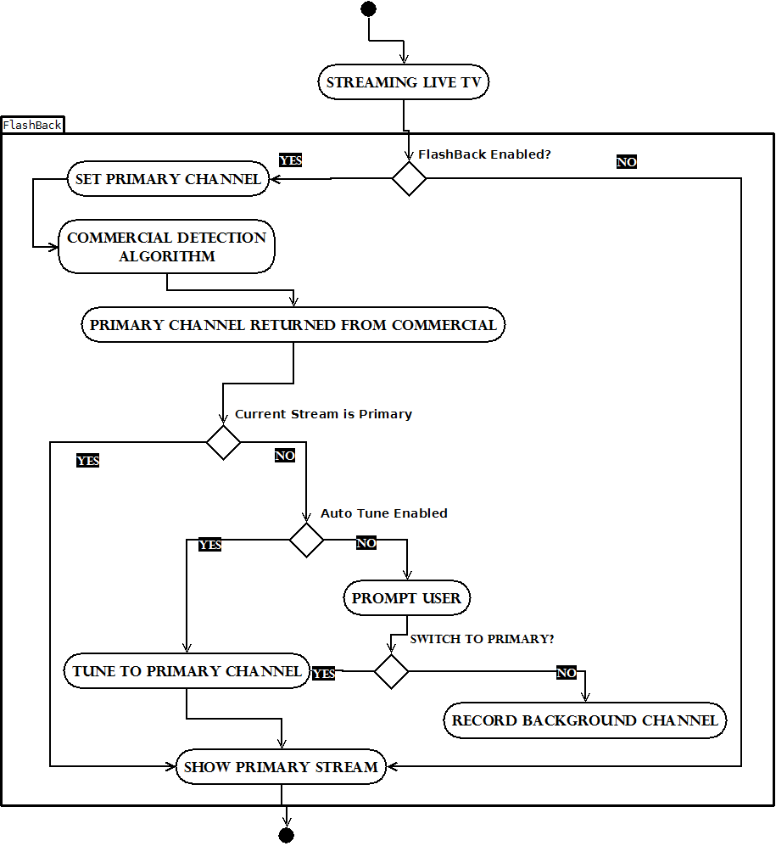

Slide 32
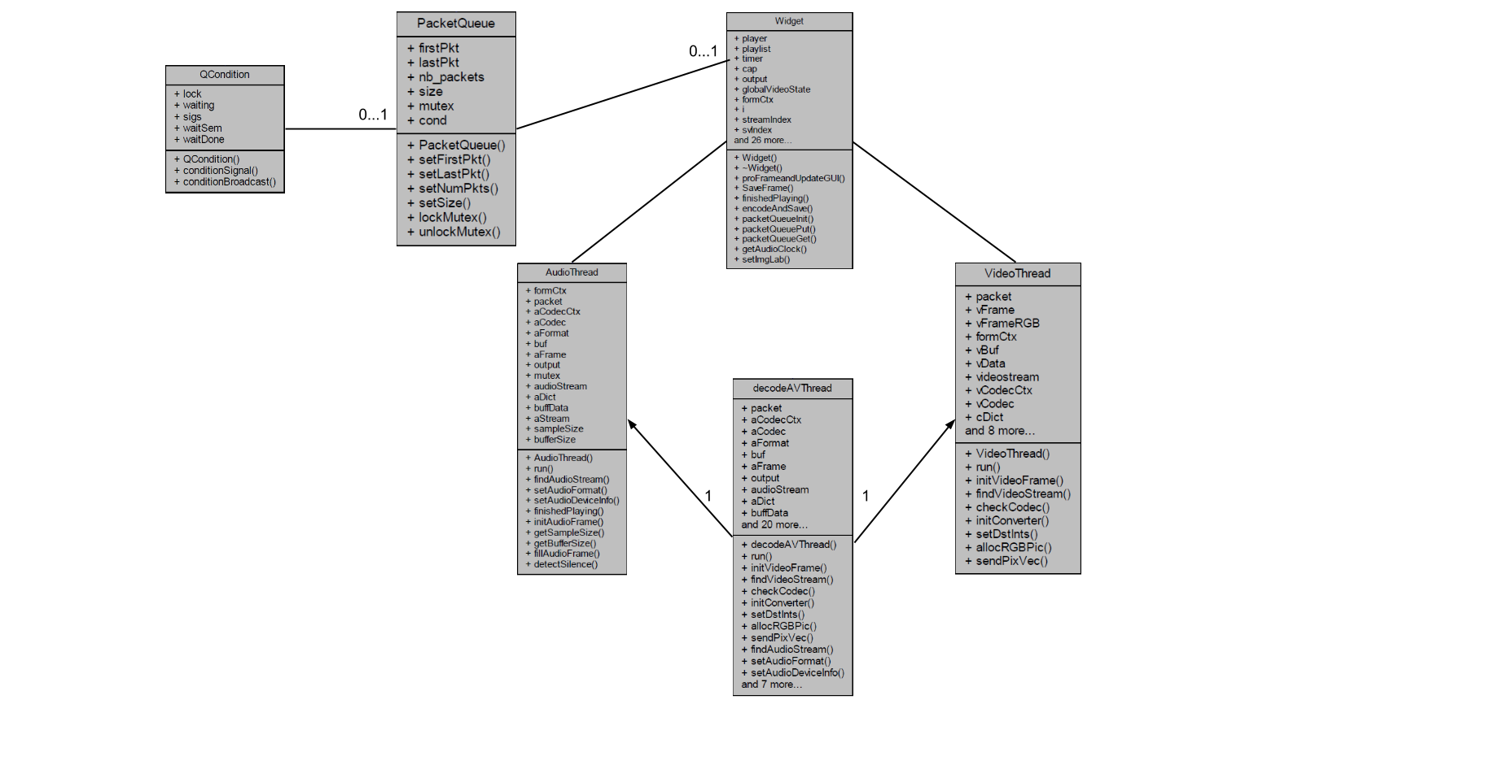
Software Class Diagram

Slide 33
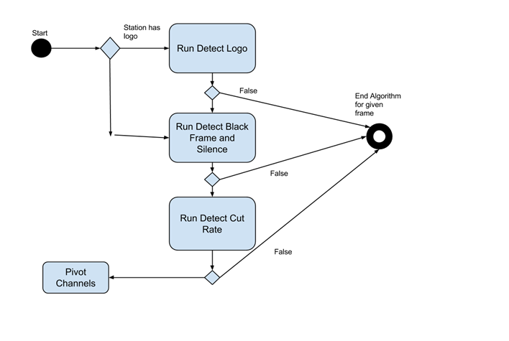
Detection Algorithms
Silence and Black Screen
Logo absence detection
High Cut Rate detection

Slide 34
Silence and Black Screen
Silence Detection: If the Standard Deviation of audio frames is above the threshold, this is determined to be silence
$$σ=\frac{{\left(ΣF_{n}−Mean\right)}^{2}}{Total Frames}$$
Black Screen: All the pixel values of a given frame will be 0 if it is a black frame in relation to RGB bit scheme.

Slide 35
Logo Absence Detection
A database of known station logos with their coordinates will be stored in memory.
Each logo will be accessed by key value.
Using OpenCV, the difference of the images will be taken.
If a zero is produced the current stream isn’t on commercial

Slide 36
High Cut Rate Detection
Cut Rate - difference in pixel density between two or more frames
High cut rates indicate rapid change in pixel densities between frames.
Using the standard deviation between the pixel densities we can determine commercial breaks.

Slide 37
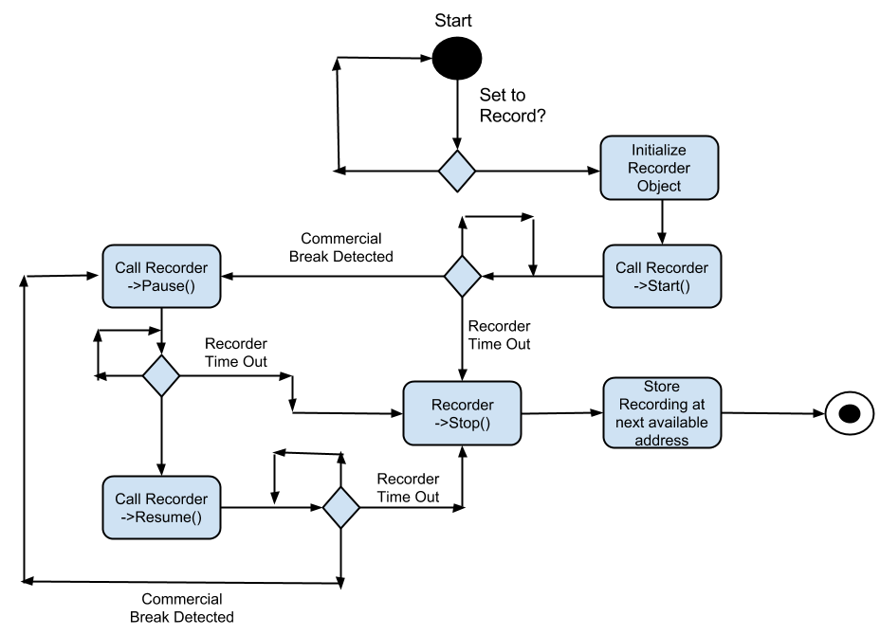
Recording

Slide 38
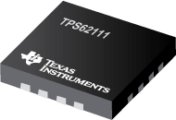
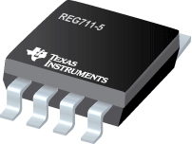
Power
CUI PJ1-022 Power Jack
TI’s TPS62111 Step-Down Converter
TI’s REG711 Converter
4.8 mm
4 mm
2.75 mm
4.8 mm
0.65 mm
6 mm

Slide 39
Work Distribution
Marlon De La Cruz
PCB Layout and Design
IR Design and Implementation
Power Management
Trenton Reed
PCB Layout and Design
Hardware Peripheral Design
Processor Implementation

Slide 40
Work Distribution
Rene Martinez
Media Streaming
GUI Development
Commercial Detection Algorithm/Analysis
Marlon Smith
Systems Integration
Eagle Library Modification
Qt Environment Execution

Slide 41
Budget
Product | Description | Quantity | Price (per unit) | Total Price
Overo® TidalStorm | DM3730 Development Board | 1 | $139.00 | $139.00
Summit | Prototype Board | 1 | $49.00 | $49.00
AVerTV H826 | TV Tuner | 2 | $44.99 | $89.98
74AHC1G126DBVRE4 | Buffer and Line Driver | 4 | $0.28 | $1.12
DRV601 | Audio Line Driver | 1 | FREE | FREE
USBLC6-2P6 | High Speed Interface Protection | 2 | $0.92 | $1.84
DLP0NSN900HL2L | Common Mode Filters | 12 | $0.44 | $5.28
DVIULC6-4SC6 | ESD Protection | 4 | $1.26 | $5.04
MC1411B | 7 Segment LCD | 2 | $0.35 | $0.70
REG711 | DC-DC Converter | 2 | FREE | FREE
Connectors | Various | 8 | $50 | $50
PCA9306 | I²C Bus | 1 | FREE | FREE
TPS2051B | Power Distribution Switch | 1 | FREE | FREE
THS7315 | Video Amplifier | 1 | FREE | FREE
TFP410 | DVI Transmitter | 1 | FREE | FREE
TPS62111 | Step-Down Converter | 1 | FREE | FREE
RLC | Various | TBD | $20 | $20
Shipping |  | TBD | $100 | $100
PCB | 6 Layers | 1 | $220.50 | $220.50
Total | $682.46
Budget | $1000

Slide 42
Progress

Slide 43
Current Struggles
PCB Routing Constraints
Eagle Libraries
TV Tuner driver API
Potential A/V Syncing

Slide 44
Questions

