Slide 1
POV Bicycle
Group 29
Matthew Egan
Sean Schindzielorz
Gian Thomas
Nancy Zanaty

Slide 2
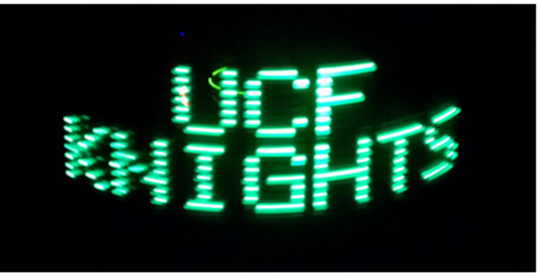
Background
Persistence of vision to create optical illusions
Lights spinning at rapid, consistent pace form images
Using bicycle wheels and LEDs to produce images using POV

Slide 3
Project Overview
Bicycle with wireless transceiver to which user can transmit images
Bicycle receives and processes images, delivers to LED display on wheel
When bicycle wheels are rotating due to pedaling, images are formed from the LEDs
Can charge your phone!

Slide 4
Objectives
Mobility: The system must be light enough not to affect the usability of the bike. It should also be self contained to avoid tangling cables. The electronics should be weather resistant.
Endurance: The system must be capable of displaying a message for an extended period of time without recharging because the intended purpose of this project is as a mobile billboard.
Range: The system should allow for remote uploading of images and text to the display so the bike does not need to be manually connected to a PC to change messages.
Compatibility: The client software must be compatible with a common office computer and user friendly.

Slide 5
Specifications
Component | Parameter | Design Specification
LEDs | Number/Type | 48 RGB- Diffused
Battery | Discharge Time | 4 hours
Battery | Charge Time | 5 hours
Wireless | Range | No less than 15 feet
RPM Sensors | Accuracy | Accurate to +/- .5 RPM
Handlebar Display | Update Time | < .5 seconds
Handlebar Display | Accuracy | +/- .1 MPH
User to POV Display | Transfer Time | Max 2 minutes

Slide 6
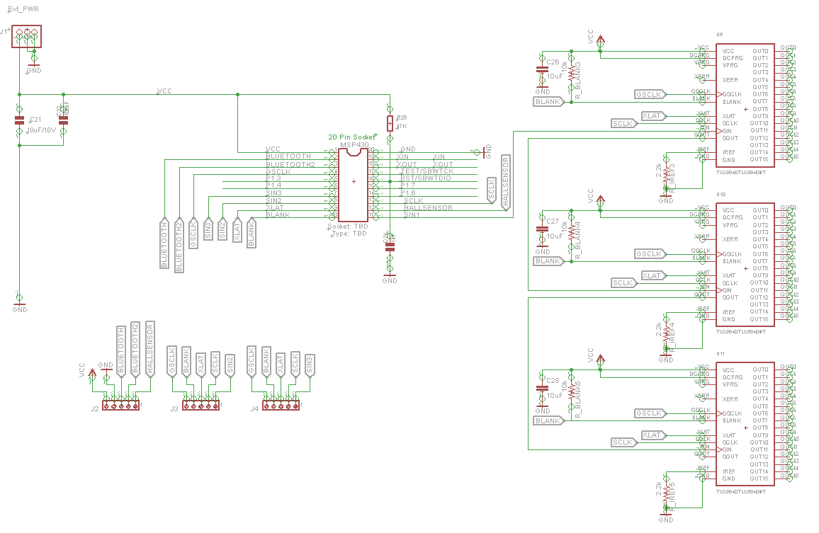
PCB Schematic

Slide 7
Microcontollers
Microcontroller | Maximum Frequency | General Purpose I/O | Ram | Flash | Cost
MSP430g2553IN20 | 16 MHz | 16 | 0.5 KB | 16KB | < $3.00
PIC32MX340F512H | 80 MHz | 51 | 32 KB | 256 KB | < $6.00
ATtiny2313 | 20 MHz | 18 | 128 B | 2KB | < $3.00
ATMega8515 | 16 MHz | 35 | 0.5KB | 8KB | < $7.00
Minimum Required: | 16 MHz | 8 | .5 KB | 6 KB | < $50.00

Slide 8
Microcontollers
Microcontroller | Maximum Frequency | General Purpose I/O | Ram | Flash | Cost
MSP430g2553IN20 | 16 MHz | 16 | 0.5 KB | 16KB | < $3.00
PIC32MX340F512H | 80 MHz | 51 | 32 KB | 256 KB | < $6.00
ATtiny2313 | 20 MHz | 18 | 128 B | 2KB | < $3.00
ATMega8515 | 16 MHz | 35 | 0.5KB | 8KB | < $7.00
Minimum Required: | 16 MHz | 8 | .5 KB | 6 KB | < $50.00

Slide 9
LED Controllers
Chip | TLC5940NT | LT3746 | TLC 5947 | HT16D724
Manufacturer | Texas Instruments | Linear Technologies | Texas Instruments | HOLTEK
Price | <$6.00 | <$8.00 | $1.95/1000 Unit | <$3.00/ 10 units
No. of Channels | 16 | 32 | 24 | 16
Input voltage | 3-5.5V | 6-55V | 3-5.5V | 3.3-5V
Data Input | Serial | Serial | Serial | Serial
Data Transfer rate | 30MHz | 30MHz | 30MHz | 25MHz
Ability to Cascade | Yes | Yes | Yes | Yes
Constant Current Sink | 0-120mA | 30mA | 30mA | 3-45mA
PWM Grayscale control | Yes 12-bit | Yes 12-bit | Yes 12-bit | No
DOT correction | Yes 6-bit | Yes 6-bit | No | No
Special features | Error Notification | Full Diagnostic and Protection | Thermal Shutdown | No

Slide 10
LED Controllers
Chip | TLC5940NT | LT3746 | TLC 5947 | HT16D724
Manufacturer | Texas Instruments | Linear Technologies | Texas Instruments | HOLTEK
Price | <$6.00 | <$8.00 | $1.95/1000 Unit | <$3.00/ 10 units
No. of Channels | 16 | 32 | 24 | 16
Input voltage | 3-5.5V | 6-55V | 3-5.5V | 3.3-5V
Data Input | Serial | Serial | Serial | Serial
Data Transfer rate | 30MHz | 30MHz | 30MHz | 25MHz
Ability to Cascade | Yes | Yes | Yes | Yes
Constant Current Sink | 0-120mA | 30mA | 30mA | 3-45mA
PWM Grayscale control | Yes 12-bit | Yes 12-bit | Yes 12-bit | No
DOT correction | Yes 6-bit | Yes 6-bit | No | No
Special features | Error Notification | Full Diagnostic and Protection | Thermal Shutdown | No

Slide 11
LEDs
Small size to eliminate streaking- 5mm
RGB for color mixing
Small driving current (~20mA)
Common anode

Slide 12
RPM Sensor
Sensor | Description | Sensory type | Size | Power Used | Accuracy | Cost
LED | Uses visible light sensors to detect LED light emissions | Visible Light | Small | Low | Moderate | Low
Infra-Red (IR)LED | Uses infra-red detecting sensors to pick up the IR light | Infra-red Light | Small | Low | Moderate | Low
Hall | Uses change in magnetic field to pick up flux dense areas | Magnetic | Small | Low | Moderate | Low
Laser | Uses intense light to gauge speed | Light | Moderate | High | High | High
Relay Switch | Uses a mechanical switch to detect movement | Mechanical | Moderate | Low | Moderate to low | Low

Slide 13
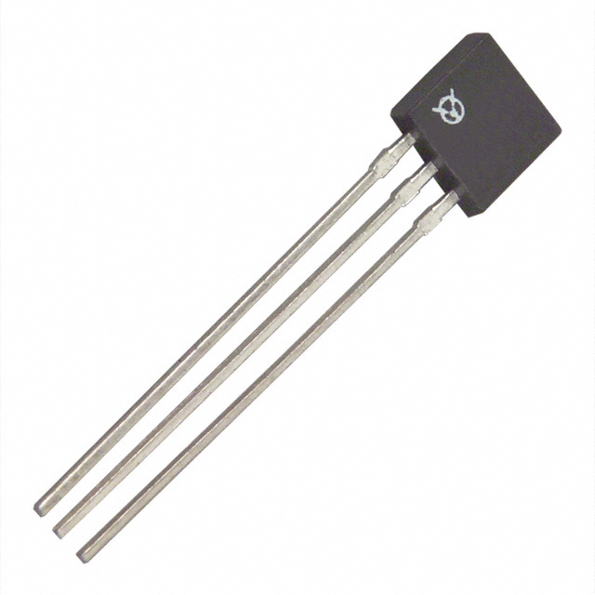
Hall Effect Sensor
OPTEK Technology OH090U
Acts as Reed Switch
In presence of magnetic field it switches LOW

Slide 14
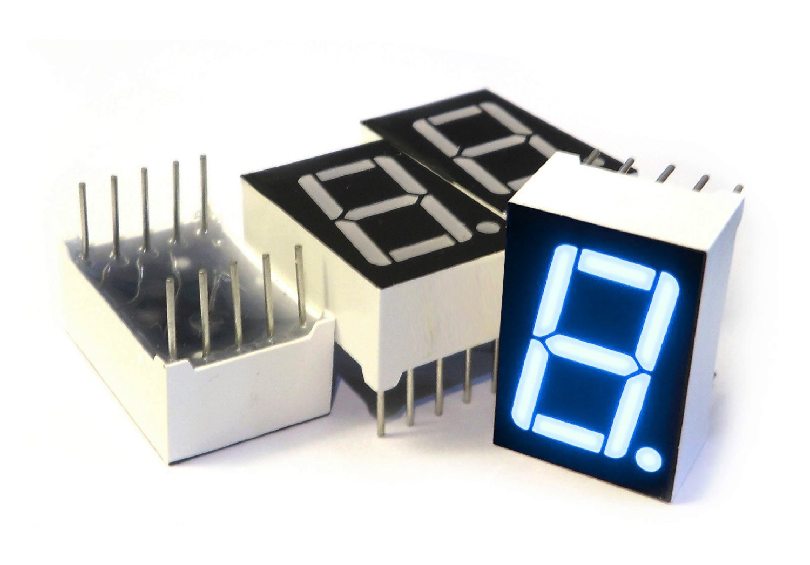
7-Segment Display
LCDs, CRTS, and Plasma displays were all briefly considered for use on the handle bar display, but a 7-segment suits the role best.
7-segments are very low power, very low cost easily visible in direct sunlight, and easy to implement.

Slide 15
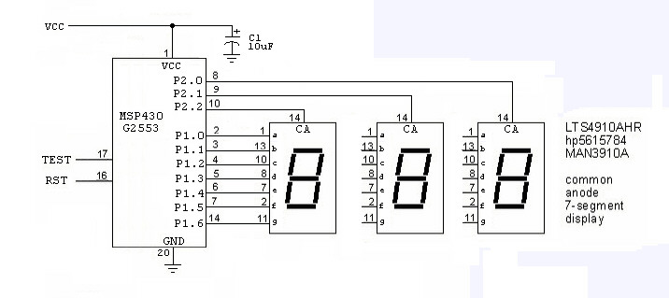
7-Segment Schematic

Slide 16
Batteries
Battery Type | LiNiMnCo / NMC | LiMnNi / NMC | LiFePO₄ / LFP
Voltage (Working) | 7.2V | 7.4V | 6.4V
Capacity | 7.2Ah (51.84Wh) | 8.8Ah (59.2Wh) | 5.0Ah (30Wh)
Cycle Life | ≈750 cycles | ≈1000 cycles | ≈ +1000 cycles
Price | $54.45 | $51.99 | $45.00
Dimensions (LxWxH) | 133mm(5.25") x 64mm (2.5") x 29 mm (1.13") | 73mm(2.87") x 37mm (1.45") x 65 mm (2.55") | 70mm ( 2.76") X 47mm (1.85") x 101mm (3.98")
Weight | 430 grams (0.95 lbs.) | 397 grams (0.875 lbs.) | 370grams (0.82 lbs.)
Protection | YES (8A PCB) | YES (8.8A PCB) | YES (10A PCB)
Charging rate | 4.0 A (max) | 4.0A (Max) | 2.5A (Max)
Charge time | @1.2 Amps ≈7Hrs | @1.2 Amps ≈11hrs | @1.2Amps ≈5.9Hrs

Slide 17
Secondary Batteries
Battery Type | LiCO₂ / LCO | LiMnNi / NMC | LiFePO₄ / LFP
Voltage (Working) | 7.4V | 7.4V | 6.4V
Capacity | 4.4Ah (32.6Wh) | 4.4Ah (32.6Wh) | 2.4Ah(15.36Wh)
Cycle Life | _ | ≈1000 cycles | ≈+1000 cycles
Price | $19.95 | $29.45 | $29.95
Dimensions (LxWxH) | 0.735 x 2.86 x 2.86 inches | 59mm(2.3") x 30mm (1.2") x 75 mm (3.0") | 75mm(3.0") x 72mm (2.8") x 21mm(0.8")
Weight | 198.5 grams (0.45 lbs.) | 181.4 grams (0.4 lbs.) | 145 grams (0.32 lbs.)
Protection | YES (PCB & polyswitch) | Yes (5.5A PCB) | Yes (5A PCB & polyswitch)
Charging rate | 3.0 (max) | 4.4A (max) | 1.2A (max)
Charge time | @1.2A ≈5.5hrs | @1.2A ≈ 5hrs | @1.2A ≈3.6hrs

Slide 18
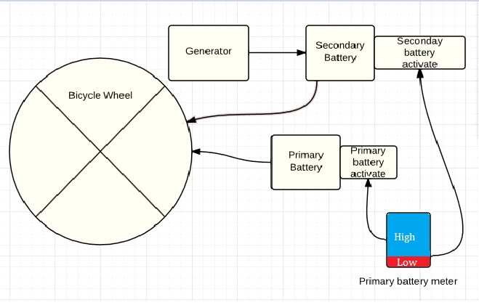
Power- Generator
Pedal Operated Generator produces power as you ride
Charges the secondary battery.

Slide 19
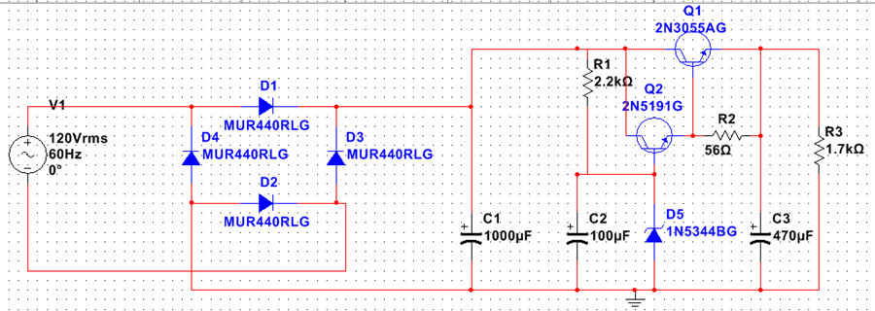
AC to DC Charger
Regulated DC voltage
High output current about 2.5A
No transformer.

Slide 20
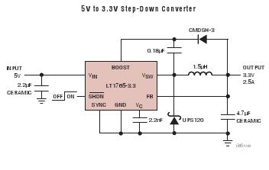
Switching Voltage Regulator
3V to 25V operating range
High switching efficiency and frequency
0.5-3A output current
1.8-5V output Voltage
Thermal Shutdown

Slide 21
Wireless Technologies
Type | Wi-Fi | Bluetooth
Frequency | 2.4, 3.6, 5 GHz | 2.4 GHz
Latency | 150ms | 200ms
Cost | High, around $50 | Low, under $10
Bandwidth | 11 mbps | 800 Kbps
Range | 32 meters indoors,95 meters outdoors | 5-30 meters
Power Consumption | High | Low
Complexity | High | Low

Slide 22
Bluetooth- Modules
Module | HC-06 | RN-42 | PAN1315
Range | 10m | 20m | 10m
Max Bandwidth | 2.1Mbps | 2Mbps | 2Mpbs
Voltage | 3.3V | 3.3V | 3.3V
Price | $12 | $24 | $25

Slide 23
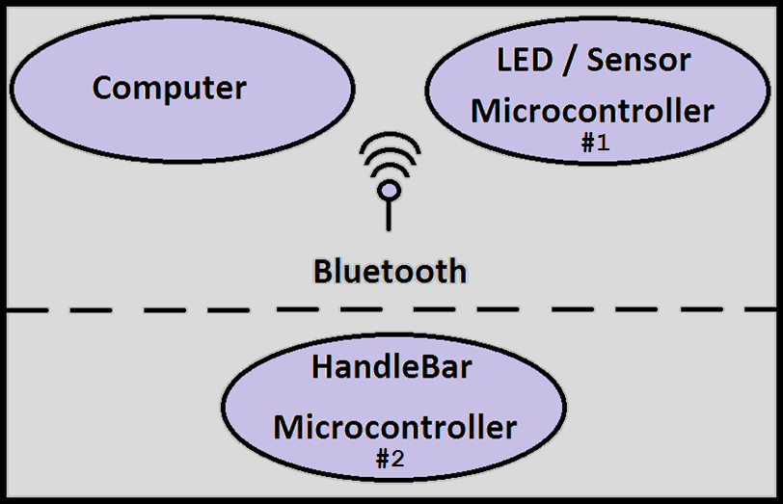
High level Software Block Diagram

Slide 24
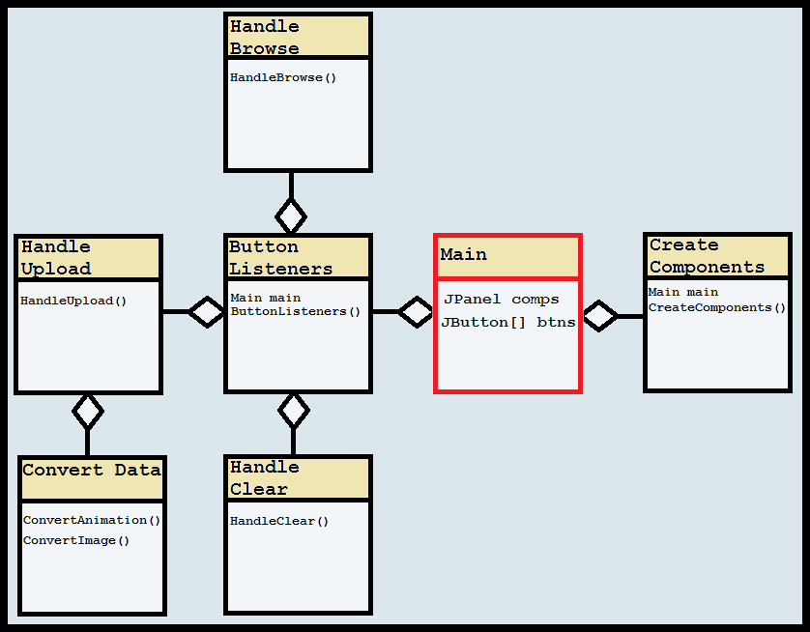
Software - Computer

Slide 25
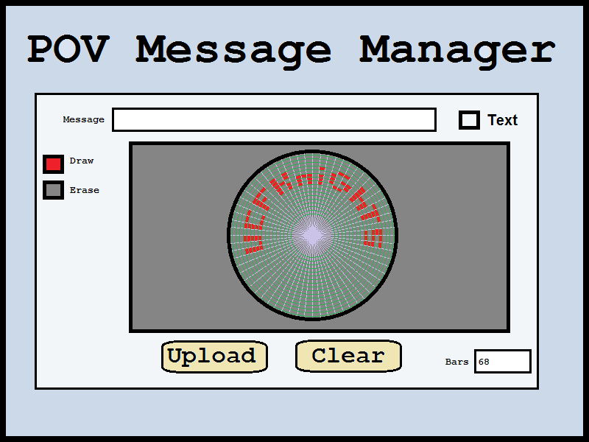
Software - Computer

Slide 26
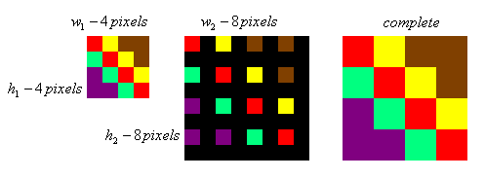
Image Scaling Algorithms
Nearest Neighbor Scaling:
Produces a new image by creating a scaled up array and filling the blank spaces with the same color values as their nearest neighbors.
It’s fast but produces VERY jagged ugly images.

Slide 27


Image Scaling Algorithms (Continued)
Bilinear Interpolation:
Functions similarly to nearest neighbor, but instead of copying neighbors to obtain color values, the neighbors are averaged. Bilinear Interpolation does this average in both the x and y direction for each missing pixel.
Produces relatively sharp images quickly.
Linear Interpolation Example:
Pixel Y is defined as the weighted average of it’s two nearest neighbors, A and B:

Slide 28
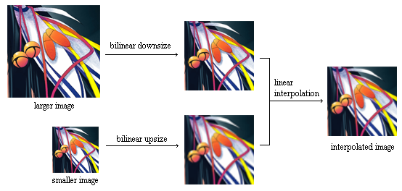
Image Scaling Algorithms (Continued)
Trilinear Interpolation:
Modified form of bilinear scaling. It results in an even sharper image, takes a lot of time. Since the display has so few LEDs, this was overkill.

Slide 29
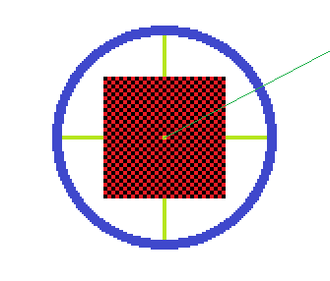
Radial Image Conversion
After scaling the normally rectangular images will be split into n polar arrays, by using the equation of a line through the center of the image. Each array will have 16 slots, each corresponding to an LED.
When the line doesn’t cut cleanly, the pixels will be averaged using linear interpolation.

Slide 30
Primary Microcontroller
OBJECTIVES:
Receive Bluetooth Data
Receive Sensor Data
Control TLC5940

Slide 31
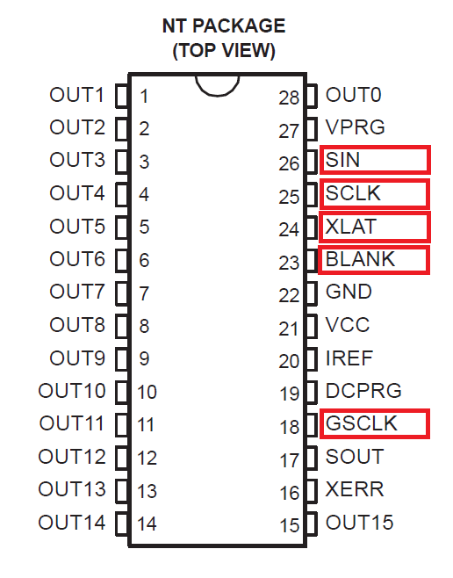
Software – LED Array
TLC5940

Slide 32
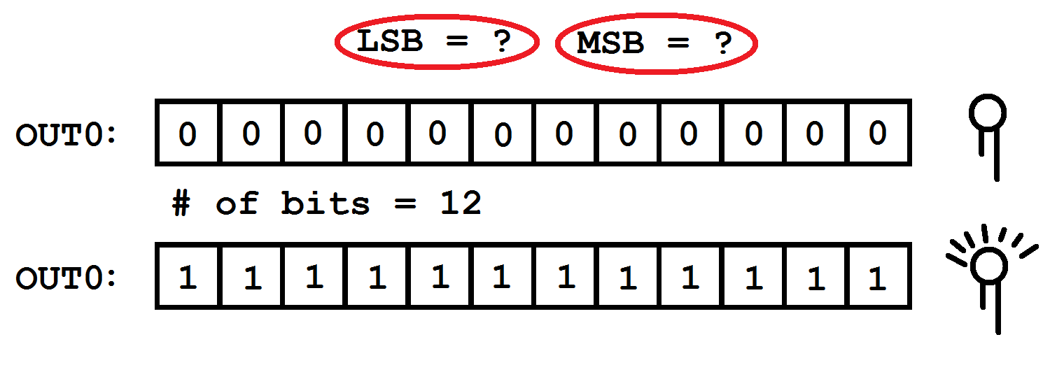
Software – LED Array

Slide 33
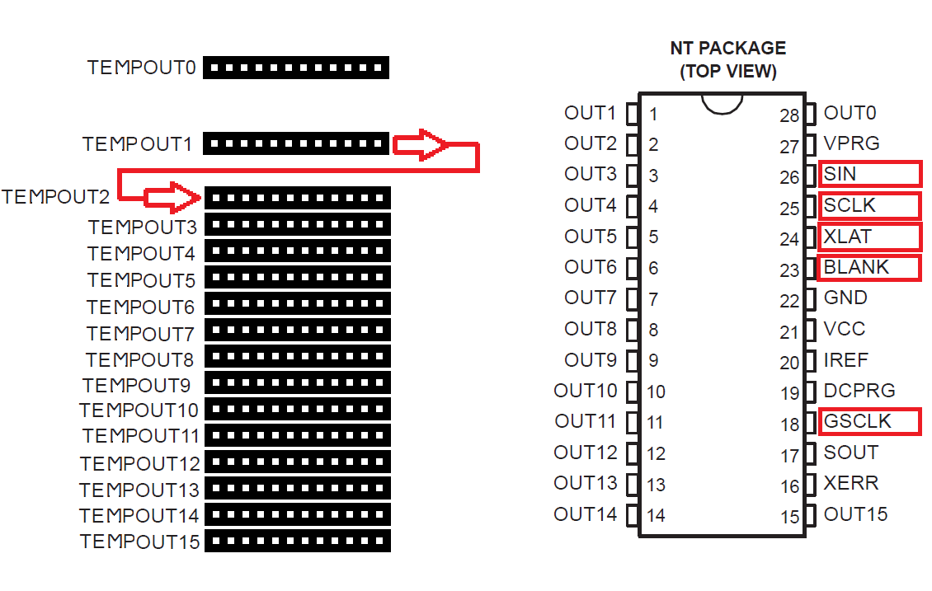
Software – LED Array

Slide 34
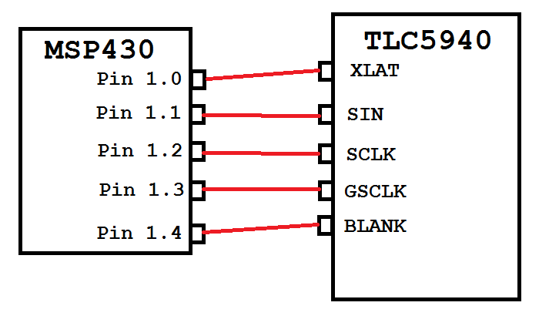
Software – LED Array
FOR EACH BIT
SET PIN 1.1 = (1 or 0)
PULSE PIN 1.2
DO THIS 4098 TIMES
PULSE PIN 1.3
SET PIN 1.4 HIGH
PULSE PIN 1.0
SET PIN 1.4 LOW

Slide 35
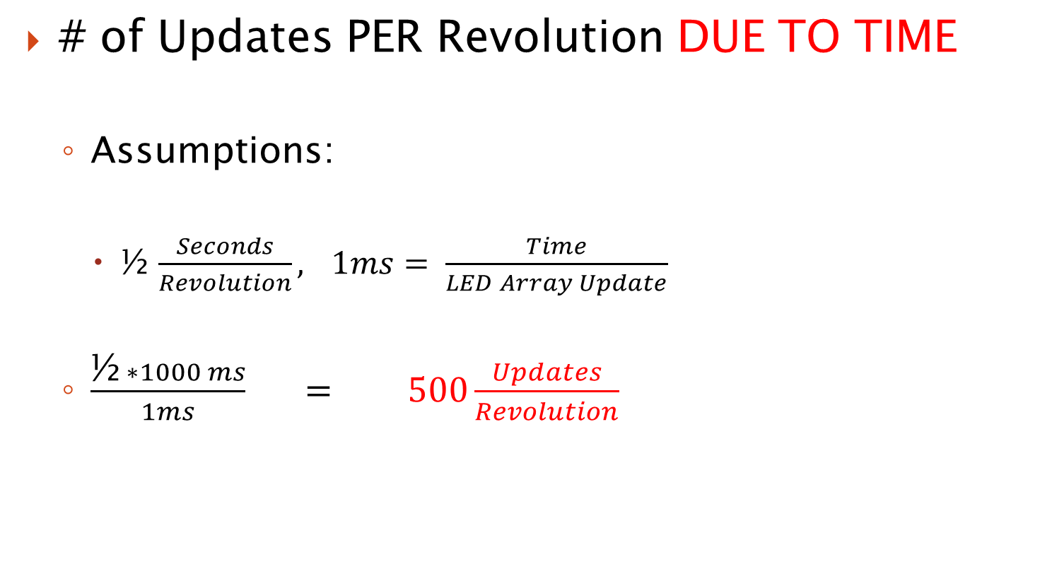
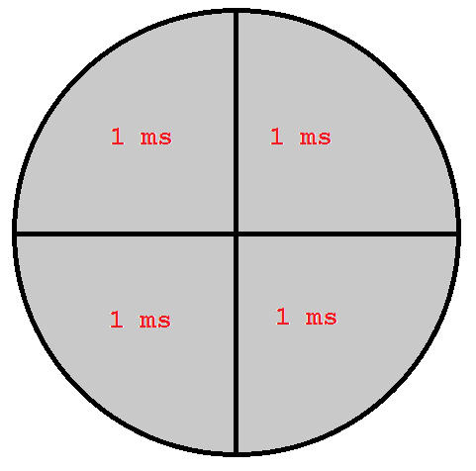
Software – LED Array

Slide 36
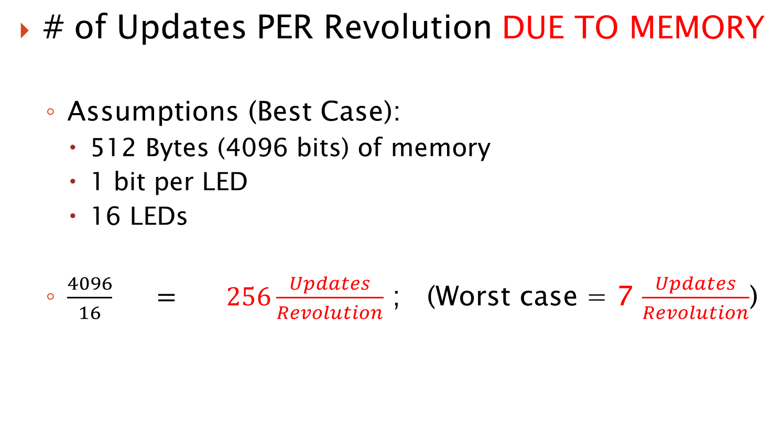
Software – LED Array

Slide 37
Secondary Micrcontroller
Wheel rotation, in RPM, will be measured using Hall Effect sensors, mounted on the wheel. The following will be calculated and displayed:
Velocity(Km/h) = Wheel Circumference(m) *60/1000
Distance(Km) = Revolutions*Wheel Circumference(m)/1000
An analog to digital converter will measure the voltage across a small resistive load. The estimated remaining battery life is then:
% Charge = V_{Load}/V_{Battery}

Slide 38
Division of Labor
 | Matt | Sean | Gian | Nancy
Software Development | X | X
PCB Development |  |  | X | X
Power |  |  | X | X
Mechanical Design | X | X | X | X
Testing | X | X | X | X

Slide 39
Budget
Item | Quantity | Cost (each $) | Cost (total $)
LEDs | x100 | 00.15 | 15
LED Controllers | x5 | 05.00 | 25
Power Supply | x1 | 70.00 | 70
Bike | x1 | 00.00 | 0
Micro-controller | X2 | 50.00 | 100
PCB | x1 | 200.00 | 200
Bike RPM Sensor | X2 | 40.00 | 80
Bluetooth Module | x1 | 30.00 | 30
Battery | X2 | 40.00 | 80
Generator | X1 | 60.00 | 60
7-segment modules | X1 | 5.99 | 5.99
Mounting hardware |  | 20.00 | 20.00
Wiring |  | 10.00 | 10.00
 |  | Total: | 675.99

Slide 40
Progress

Slide 41
Questions?

