Slide 1
POV Bicycle
Group 29
Matthew Egan
Sean Schindzielorz
Gian Thomas
Nancy Zanaty

Slide 2
Background
Persistence of Vision: human eye’s ability to retain images for fractions of a second
Optical illusions- Lights spinning at rapid, consistent pace form images
Using bicycle wheels and LEDs to display images using POV

Slide 3
Project Overview
Mobile advertising platform for small businesses
Bicycle receives and processes messages wirelessly, delivers to LED display on wheel
When bicycle wheels are rotating due to pedaling, message sent by user appears on LED display

Slide 4
Specifications
Component | Parameter | Design Specification
Message Length | Character Limit | 25
Display Quality | Resolution | 16 radial pixels
LEDs | Number/Type | 48 RGB- Diffused
Battery | Discharge Time | 4 hours
Bluetooth | Range | 15 feet
User to Final Display | Transfer Time | Max 2 minutes

Slide 5
Power
Hardware
Software

Slide 6
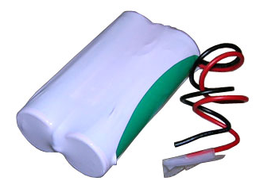
Power- Battery
Lithium Nickel Manganese Cobalt Oxide
7.4V Voltage (Operating)
4.4Ah (32.6Wh) Capacity
Cycle Life of about 1000 cycles
5.5A Protection IC
Charging rate of 4.4A (max)

Slide 7
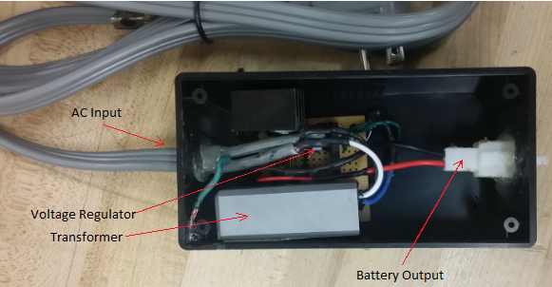
Power- AC to DC Charger
Inputs from standard 120 V 60Hz AC power source
Charges main battery
Delivers 400 mA of current
Full charge in 10 hours

Slide 8
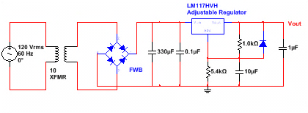
Power- AC to DC Charger Schematic

Slide 9
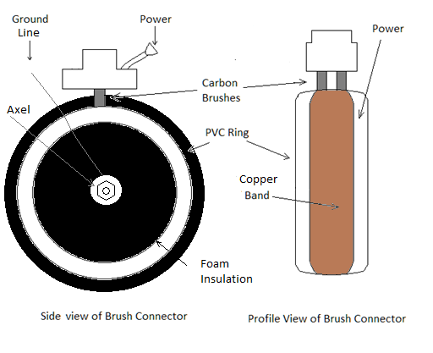
Power- Brush Connector

Slide 10
Power- Brush Connector
3 distinct parts:
  Spring loaded carbon brushes mounted to the bike’s frame
    Constant spring pressure ensures electrical contact
  Rotating ring connector attached to the bike’s rim
    PVC core and foam insulation for electrical isolation
    Copper ring provides a continuous low resistance electrical contact
  Grounding point attached to bike’s axle.
    Replaced original bike grease with conductive graphite lubricant to increase conductivity

Slide 11
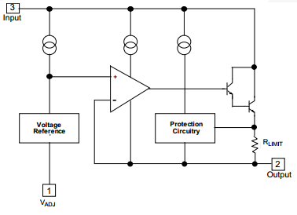
Power- LM317 Adjustable Voltage Regulator
1.5A output current
1.2-37V output adjustable Voltage
Thermal shutdown
1 per bank of LEDs

Slide 12
Power-Generator
Supplemental power- charges battery when drops below 5.5v
Can be engaged and disengaged
Rectifier to convert from AC to DC
Speed (mph) | Charging electric current (mA)
5.3 | 100
5.9 | 150
6.5 | 200
8.4 | 250
9.3 ≥ 12.4 | 300 ≥ 500

Slide 13
Power Testing- Battery
Battery Life Test
  Drained battery using 200mA load. Battery drained in ~20 hours
  Confirmed 4Amp-hour specification
Recharging Time Test
  Connected to 400mA charger hourly monitored until current flow =0
  From empty, battery recharges in ~10 hours
Internal Protection Testing
  Shorted leads, connected to high voltage

Slide 14
Power Testing- AC-to-DC Charger
Voltage output of the transformer viewed on the oscilloscope to confirm that the voltage was correctly stepped from 120V AC.
Voltage output of rectifier viewed to confirm full wave rectification
Voltage output on oscilloscope to confirm proper rectification and potential
Current Output
  Connected multimeter in series with battery and charger
  Determined current level to be 400mA output

Slide 15
Power Testing- Brush Connector
Connectivity test from ring to battery outlet while wheel was rotating to ensure connectivity across entire ring surface
Connectivity test from axle to ring and from spokes to ring to check for shorts
Connected to oscilloscope to ensure constant voltage on load without drops
Measured resistance from ring to end of wiring harness to confirm system resistance was at acceptable levels (<100 ohms)

Slide 16
Power
Hardware
Software

Slide 17
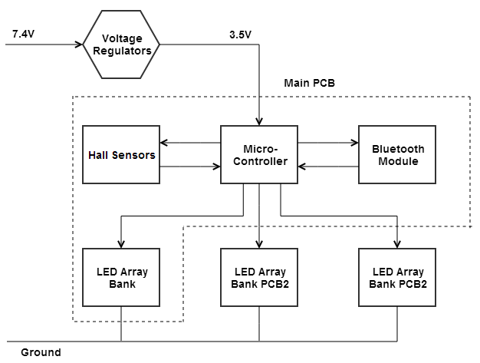
Hardware- Main PCB

Slide 18
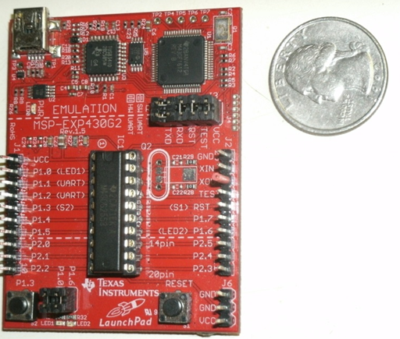
Hardware-Microcontoller
MSP430g2553IN20
16 MHz clock speed
16 channel pins
0.5 KB RAM
16KB Flash

Slide 19
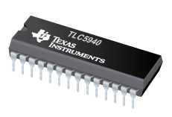
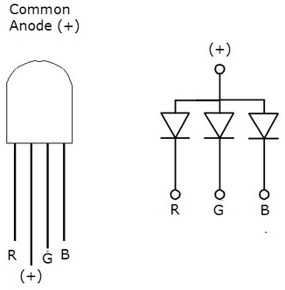
Hardware- LED Arrays
LED Drivers
Texas Instruments - TLC5940NT
16 Channels
3-5.5V Operating Voltage
30MHz Data transfer speeds
Pulse Width Modulation
Adjustable sink current (0-120mA)
LEDs
Common Anode
4 pin RGB
5mm
Diffused

Slide 20
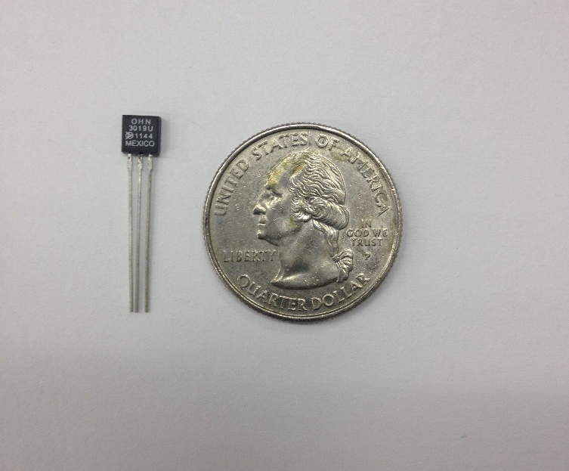
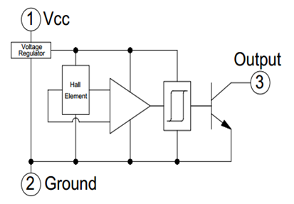
Hardware- RPM Sensor
OPTEK Technology OH090U Hall Effect Sensor
Acts as Reed Switch
In presence of magnetic field it switches LOW

Slide 21
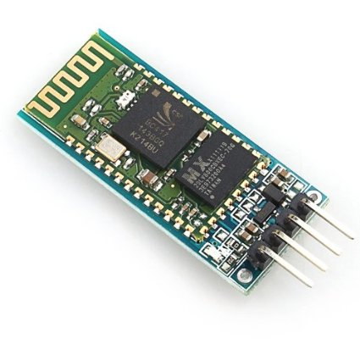
Hardware- Bluetooth Module
HC-06
Low Cost module designed for serial port based Bluetooth applications.
Integrated microcontroller with implemented Bluetooth stack and antenna
Image source: Amazon

Slide 22
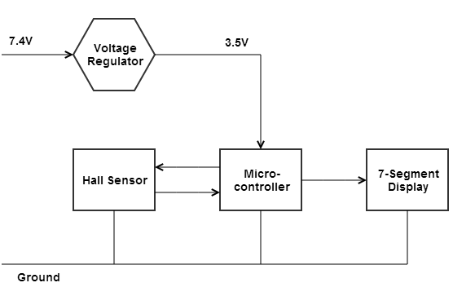
Hardware- Secondary PCB

Slide 23

Hardware- 7- Segment Display
On handlebar, connected to secondary PCB
Connected using time division multiplexing
Odometer displays distance traveled
$D=Revolution∗Wheel Circumference$
Reset button

Slide 24
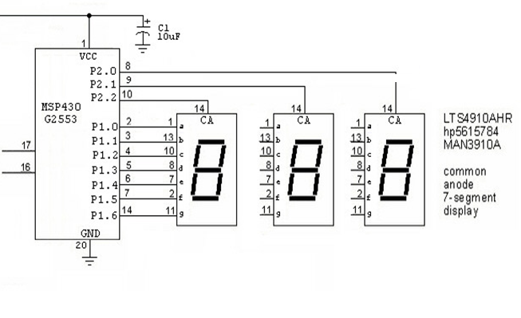
Hardware- 7- Segment Display
Image used with permission from All About Circuits

Slide 25
Hardware Testing- PCB
Pre-Fabrication Testing
  Breadboard prototype
  Perforated board prototype
Post-Fabrication Testing
  Connectivity tests to ensure proper fabrication
  Tested connectivity after soldering components onto board

Slide 26
Hardware Testing- RPM Sensor
Connected to oscilloscope in presence of magnetic field to ensure accuracy and precision of sensor readings
Configuration test
  To determine how to best wire and connect sensors
  Connected sensors in series- compromised accuracy of final RPM sensor
  Connected sensors to different I/O pins on microcontroller to regain accuracy

Slide 27
Power
Hardware
Software

Slide 28
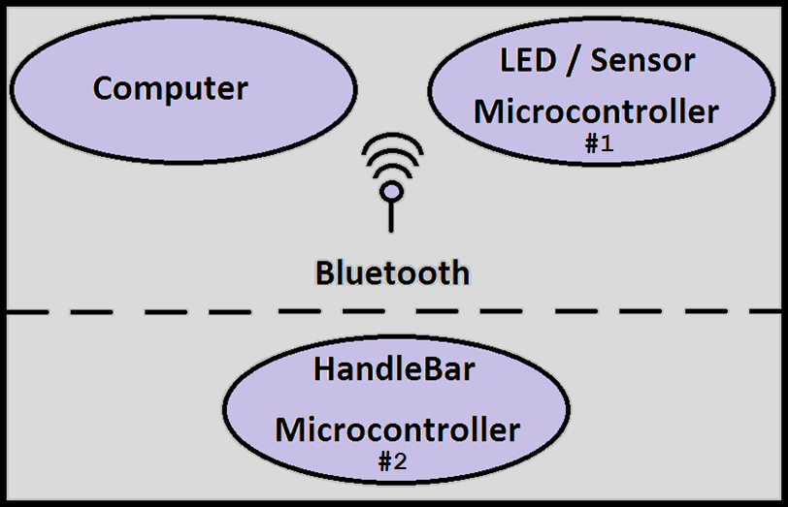
Software Overview

Slide 29
Software- Microcontroller #1
Three major components:
  LED Array
  Message Detection
  Sensor Detection

Slide 30
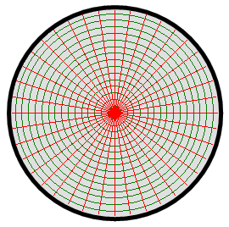
Software – LED Array
FOR EACH BIT
  SET SIN = (1 or 0)
  PULSE SCLK
DO THIS 4098 TIMES
  PULSE GSCLK
SET BLANK HIGH
PULSE XLAT
SET BLANK LOW

Slide 31
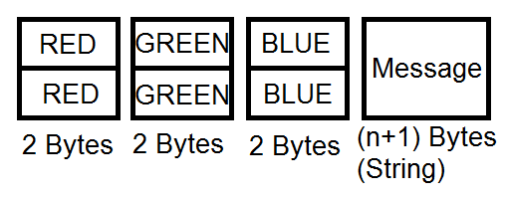
Software- Message Detection
UART Send/Receive
  9600 Baud
  One byte at a time
  Message ends with known character

Slide 32
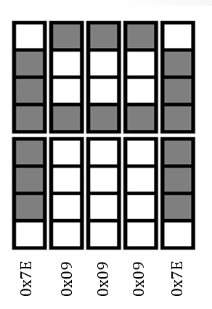
Software- Character Library
A predefined representation is stored for each ASCII character value
Permanently stored in Flash
Value of the letter ‘A’
Gray = 1, White = 0

Slide 33
Software- Message Timing
Three forms of timing :
  Message position
  Character spacing
  Character width

Slide 34

Software- Timing- Message Position
WHILE (1)
SENSOR TRIGGER
DELAY //Varying This delay changes //message position
DISPLAY MESSAGE

Slide 35

Software- Timing- Character Spacing
WHILE (1)
FOR EACH LETTER
DELAY //Varies Character Spacing
FOR EACH COLUMN
DISPLAY MESSAGE( LETTTER, COLUMN)

Slide 36

Software- Timing- Character Width
WHILE (1)
FOR EACH LETTER
FOR EACH COLUMN
DELAY //Varies Character WIDTH
DISPLAY MESSAGE( LETTTER, COLUMN)

Slide 37

Software- GUI
Components
  Graphical
  Bluetooth
Language: C#- Built in .Net library compliments Bluetooth implementation

Slide 38
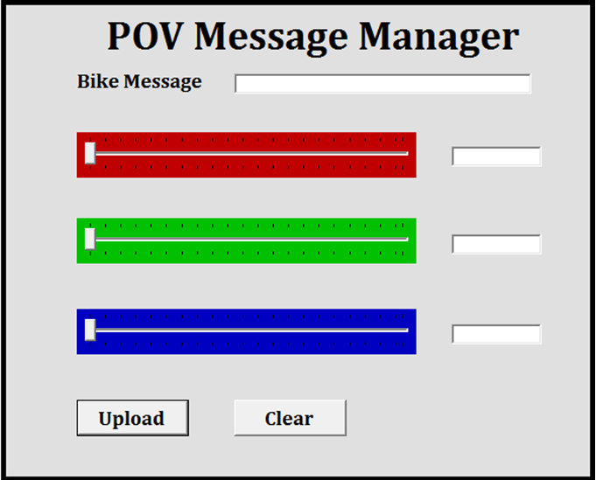
Software- GUI

Slide 39
Software- Testing
Features are tested independently if possible and then integrated into the system.
Only one feature may be integrated at a time.
Should a difficult error occur, reverting back to a previous version of the code may be necessary

Slide 40
Division of Labor
 | Matt | Sean | Gian | Nancy
Software Development | X | X
PCB Development |  |  | X | X
Power |  | X | X | X
Mechanical Design | X | X | X | X
Testing | X | X | X | X

Slide 41
Budget
Item | Quantity | Cost (each $) | Cost (total $)
LEDs | x100 | 00.15 | 15
LED Controllers | x5 | 05.00 | 25
Power Supply | x1 | 70.00 | 70
Bike | x1 | 00.00 | 0
Micro-controller | X2 | 50.00 | 100
PCB | x1 | 200.00 | 200
Bike RPM Sensor | X2 | 40.00 | 80
Bluetooth Module | x1 | 30.00 | 30
Battery | X2 | 40.00 | 80
Generator | X1 | 60.00 | 60
7-segment modules | X1 | 5.99 | 5.99
Mounting hardware |  | 20.00 | 20.00
Wiring |  | 10.00 | 10.00
 |  | Total: | 675.99

Slide 42
Questions?

