Slide 1
SPIDRONE
Group 2
Jonathan Obah - EE
Benjamin Atsu - EE
Daniel Camargo - CpE
Kyle Ferriss - CpE
Notes:
Add Picture of drone, replace solar panel one because our project is about the drone not the solar panels.

Slide 2
Motivation
Our motivation stemmed from a mutual interest in drones and advances in technology that is impacting our everyday life. The technologies that grabbed our attention was the use of wireless charging for appliances, solar power for green energy, and automation to minimize human interaction.
Notes:
We need to shorten this.

Slide 3
Project Description
The SPIDRONE (Solar Powered Inductive Drone) is an environmentally friendly UAV that can follow a user’s path autonomously, and land precisely land on a dock. The dock will be equipped with solar panels and capable of charging the SPIDRONE inductively, which minimizes human interaction.

Slide 4
Goals and objectives
Low operating and maintenance costs.
Environmentally friendly.
Autonomous user tracking and flight planning.
Autonomous landing and charging.
Wireless charging.
Failsafe for low battery.

Slide 5
Development Approach
Hardware | Software
Design Prototype | Acquire Necessary Software
Prototype Development and Testing | Code Development
Design PCB | Code Testing
Final Product Build | Prototype Integration
Final Product Testing | Final Product Integration

Slide 6
Project Overview

Slide 7
Design Constraints
Economic - Constructing a drone can be expensive.
Time - Scheduling.
Legal - FAA regulations and registration.
Environmental - Outdoor testing required, weather, and humans.
Safety - Chemicals, fire, propellers.
Social - Some people may think we’re using the drone for unethical purposes.

Slide 8
Specifications - Charging Dock
4W, 12V Solar panel
3V – 5.5V Wireless Receiver
5V input Wireless Transmitter
Rechargeable Lithium Polymer (Li-Po)- 5200 mAh
Notes:
Want overall project specifications before going into detail about the individual specis

Slide 9
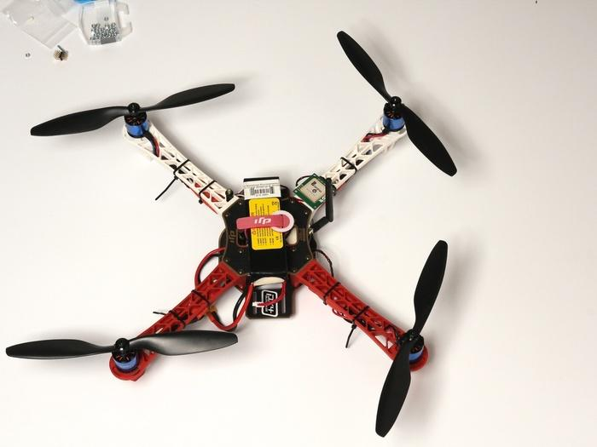
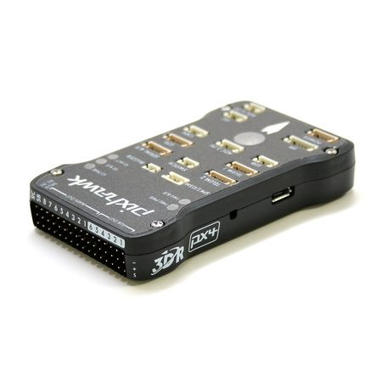
Specifications - Drone
Flamewheel F450 Frame
3S 3000 mAH Lithium Polymer Battery
Pixhawk Flight Controller
ESC: 20A
960 KV Motors
9.5x4.5 Propellers
Notes:
Want to see reason for choosing this drone framework, offer a comparison.

Slide 10
Flight Controller Software
ArduPilot’s Mission Planner
Open source, and supports Python scripting.
Built in battery failsafe.
Different flight sequences already included: Land, Follow Me, and Return to Launchpoint.
  While already included these flight modes need to be rewritten to support the features we outlined for the SPIDRONE.
Chosen over OpenPilot and PX4 for the large amount of information and resources available.

Slide 11
Optical Recognition And Automatic Landing

Slide 12
Design Approach - Automatic Landing
Heading will be adjusted to original home heading.
Mission Planner’s RTL mode will be activated as it allows inputs to control the drone during its descent
Camera is mounted to bottom of drone.
Video feed is processed by a PC utilizing OpenCV.
PC calculates and issues commands to align the drone.
When the drone is disarmed, the image processing terminates

Slide 13
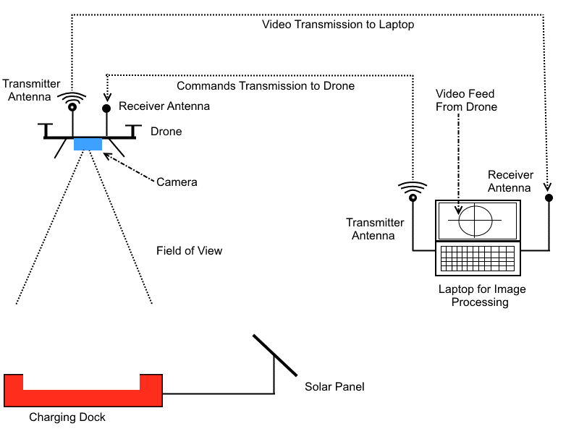
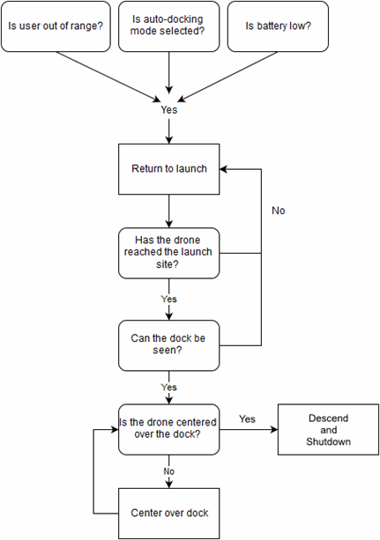
Design Approach -Automatic Landing
Notes:
Good illustration, these illustrations can be put onto first page.

Slide 14
Design Approach - Interface
Mission Planner “supports” Python importing external libraries and modules, but does not work that well.
Needed a way for an external program to have access to the drone
Two scripts were made, one to run inside of Mission Planner, and one outside.
The scripts are able to communicate with each other via TCP/IP Sockets locally.

Slide 15
User Tracking

Slide 16
Design - User Tracking
Majority of the population own a smartphone capable of transmitting data and GPS coordinates.
Using Android Studio, developed an app that tracks a user’s GPS coordinates and create a path.
Upload those coordinates to a server for the drone to download and follow.

Slide 17
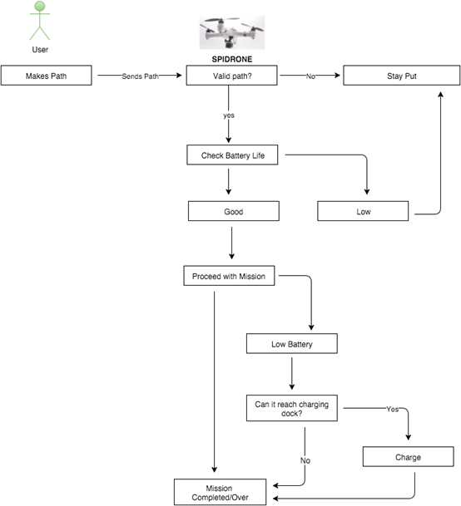
Design - User Tracking

Slide 18
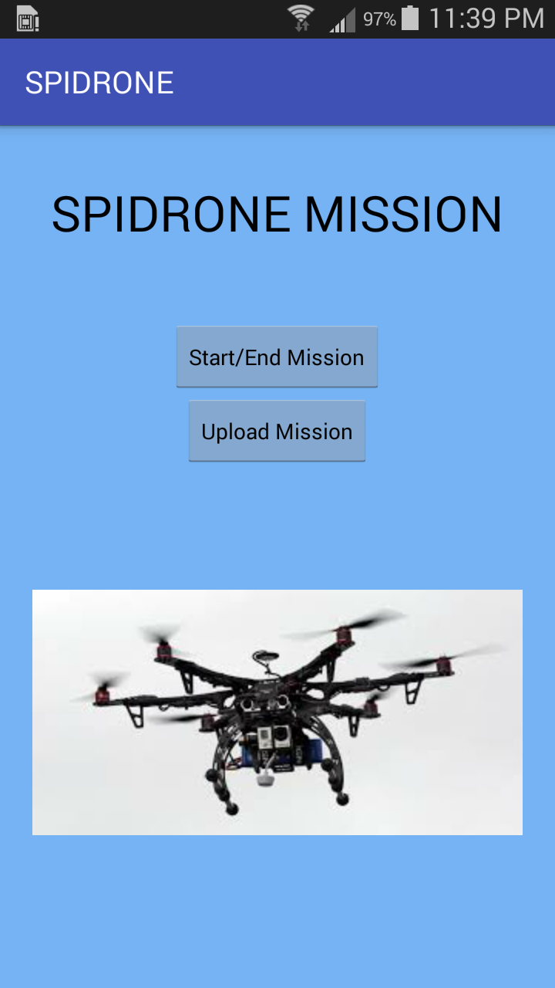
Android “SPIDRONE” Application
User friendly
Application consists of two buttons
  “Start/End Mission” button –
      Connects to GPS, Saves coordinates as text.
  “Upload Mission” button.
      Saves Text File to phone’s storage.
      To be sent to the drone.
Phone connects directly to computer to Upload
Mission to the SPIDRONE.

Slide 19
Solar Panel And DC-DC Conversion

Slide 20
Solar Panel
Durability/ Longevity
  Estimated life span of up to 50 years
Footprint(area Per Kw)
  Requires least area for a given power usually 6-9 square meters
Efficiency
  Best research cell efficiency of 25 percent and a typical module efficiency of 15-20 percent

Slide 21
Specifications - Power Source : Solar Panel
•Mono-crystalline silicon 18V,5W
•No-load voltage: 18-23V DC
•Load voltage: 18V
•Output current: 250-280mAh (0.2A-0.28A)
•Size: 320x120x5mm/12.6*4.7*0.19inch
•Weight: 0.323kg/ 11.4oz.

Slide 22
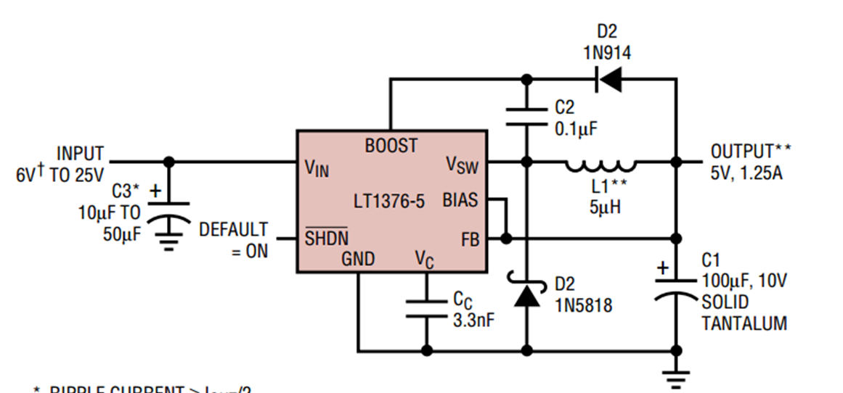
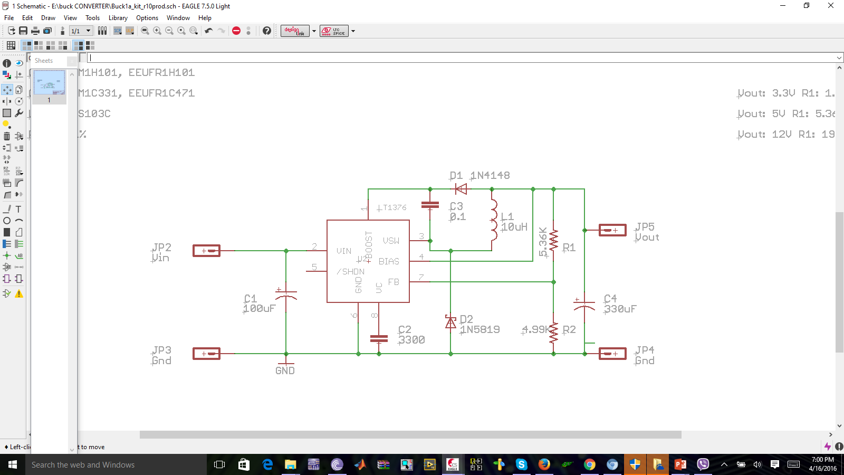

DC- DC Converter- Design Approach
R2 fixed =4.99k
$$\frac{R1}{R2}=\frac{Vout−2.42}{2.42}$$
R1=19.6K, Vout =12V
R1= 1.82K,Vout = 3.3V
R1= 5.36K,Vout = 5V

Slide 23
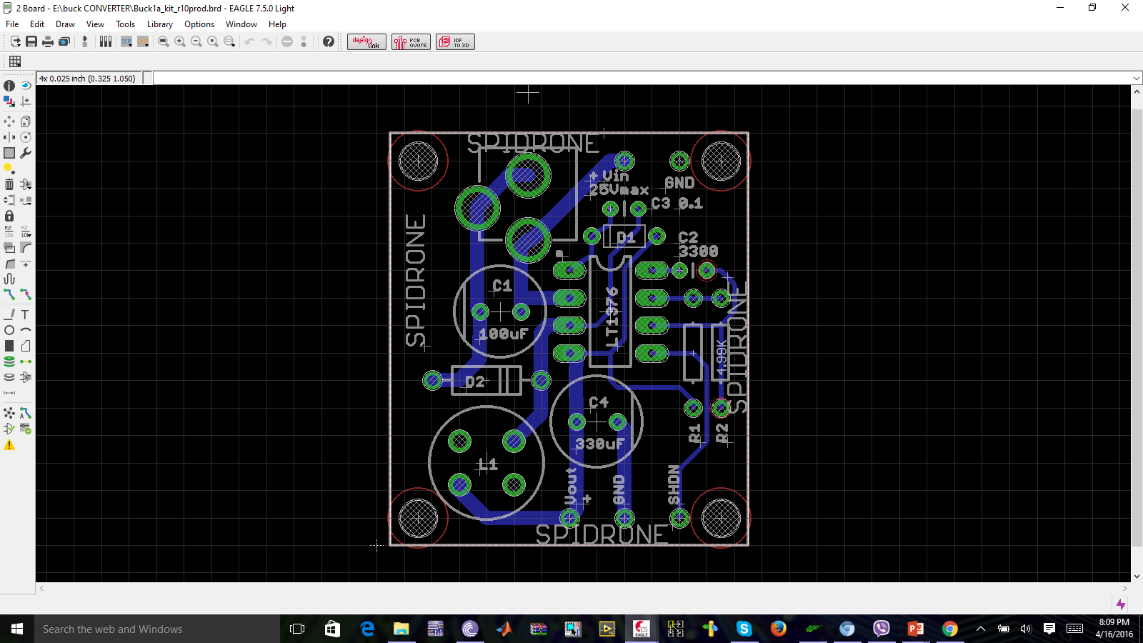
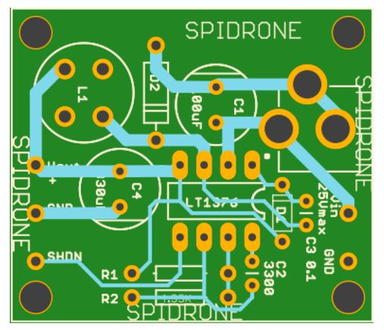


Printed Circuit Board

Slide 24
Wireless Charging

Slide 25
Design of Wireless Charging Station
Input Voltage | 3.3V – 5.5V
Output Voltage | 11.1V
Output Current | 0.658A
Wireless Resonant Frequency | 129.5kHz

Slide 26
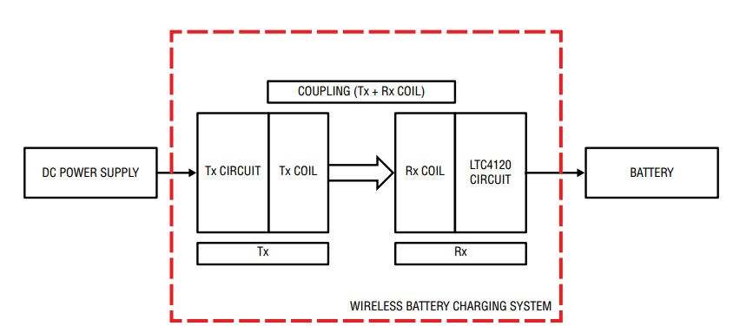
Wireless Battery Charging System

Slide 27
Transmitter circuit parameters 10.5mm Gap
SPECIFICATION | WITH RECEIVER (NO LOAD) | WITH RECEIVER (1.535W LOAD)
Operational Frequency | 130.2kHz | 128.8kHz
Input Voltage | 4.99V | 4.95V
Input Current | 0.156A | 0.658A
RMS Value of Tx Output AC Voltage | 10.8V | 10.5V
Peak Value of Tx Output AC Voltage | 15.2V | 15.2V
Receiver Output DC Voltage | 17.4V | 13.9V
Standby Loss | 0.777W | N/A
Efficiency | N/A | 46.9%

Slide 28
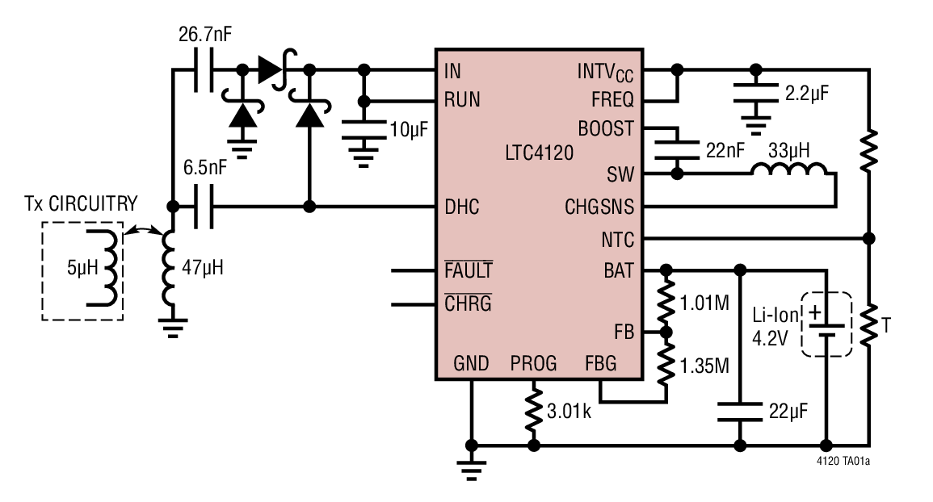
Wireless Receiver and 400mA Buck Battery Charger (LTC4120)
Schematic of LTC4120

Slide 29
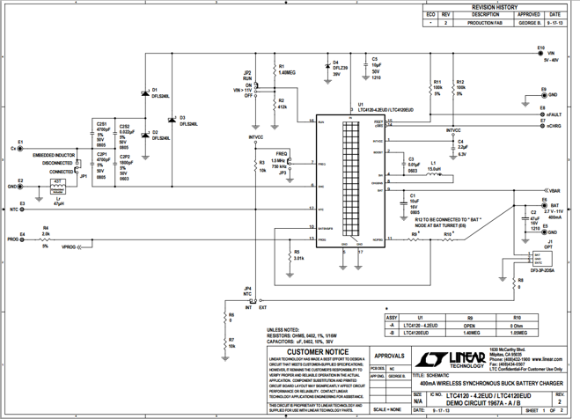
Schematic for 400mA Wireless Synchronous Buck Battery Charger (Connect Drone Battery to E6)

Slide 30
Battery Charger Specifications
Battery Parameter | Minimum | Typical | Maximum | Units
Charge Current | 383 | 402 | 421 | mA
Standby Current | - | 2.5 | 4.5 | uA
Shutdown Current | - | 1100 | 2000 | nA
Regulation Voltage | 2.370 | 2.400 | 2.407 | V
Recharge Threshold Voltage | –38 | –50 | –62 | mV
Low Battery Linear Charge Current | 6 | 9 | 16 | mA
Low Battery Threshold Voltage | l 2.15 | 2.21 | 2.21 | V

Slide 31
Final Product Testing
Software testing for both the Landing system and the tracking system.
  Landing precision on the charging station.
  Loading user coordinates to drone.
The solar panel was tested outdoors
DC-DC converters were tested in the lab for voltage and current requirements.

Slide 32
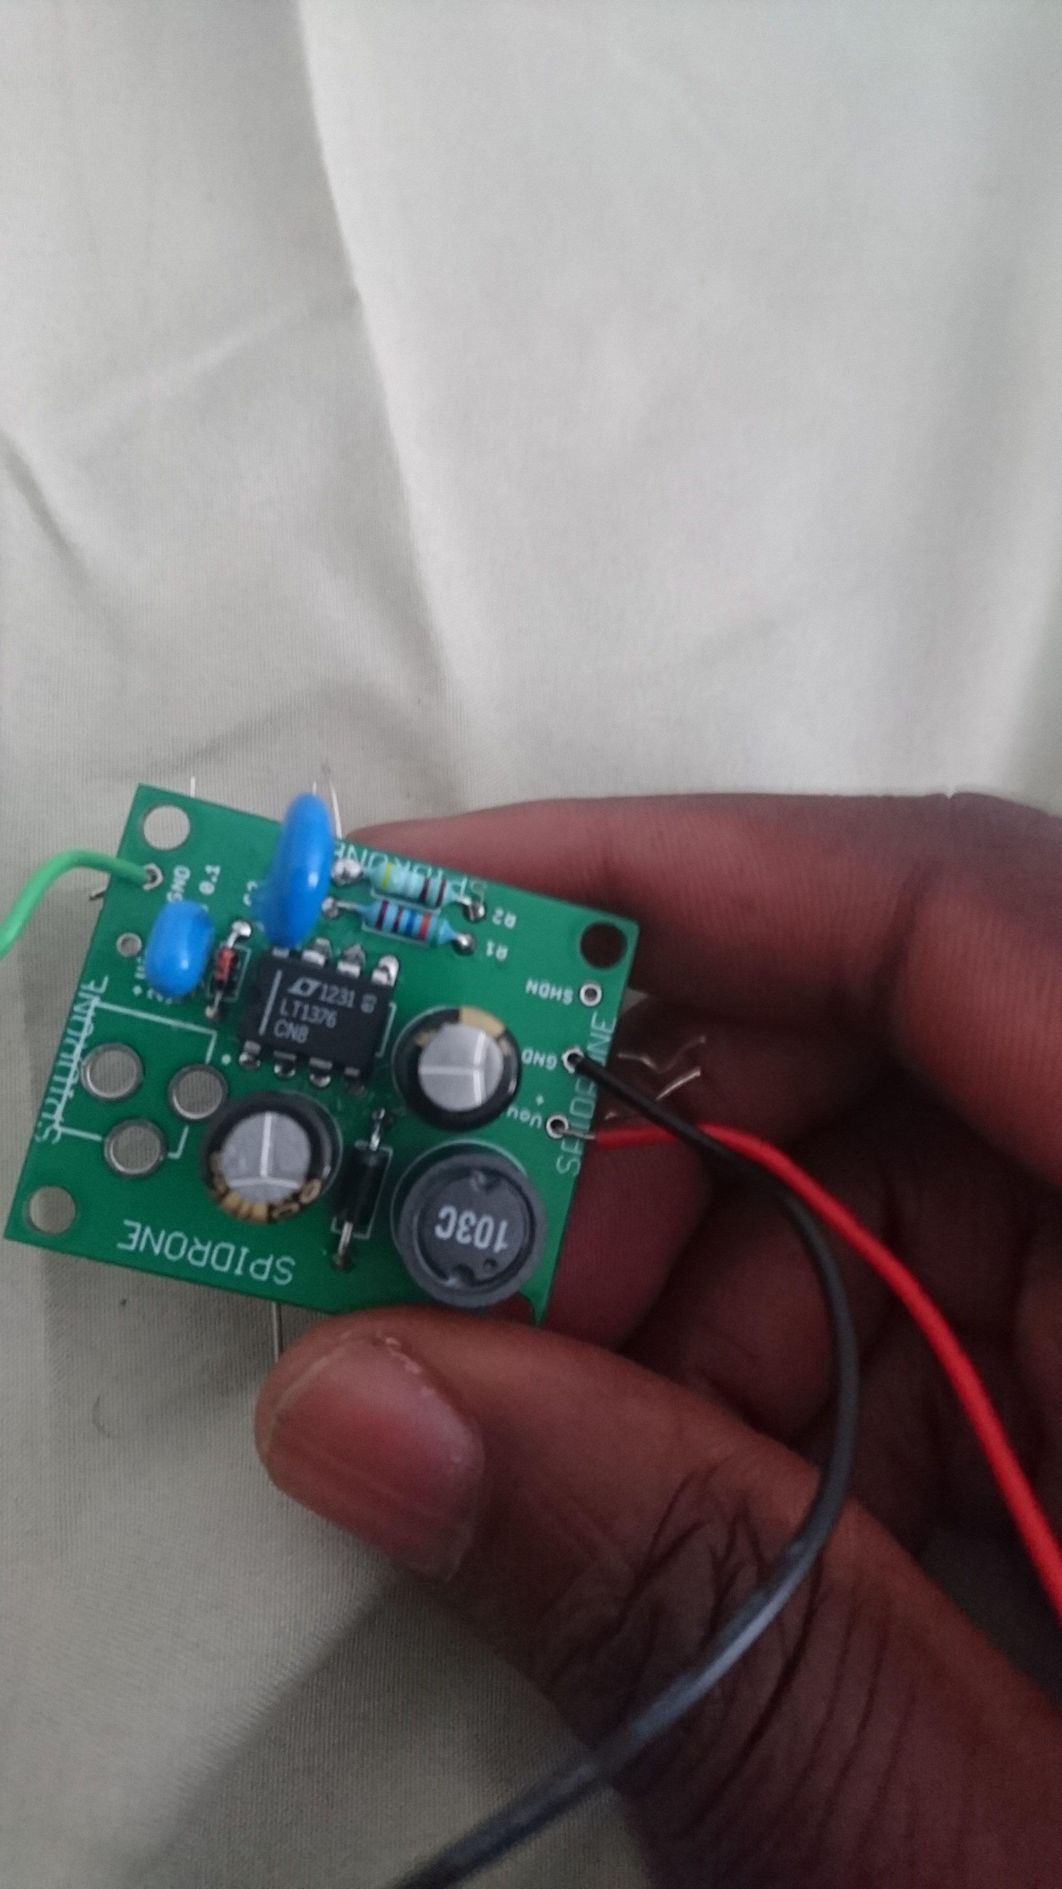
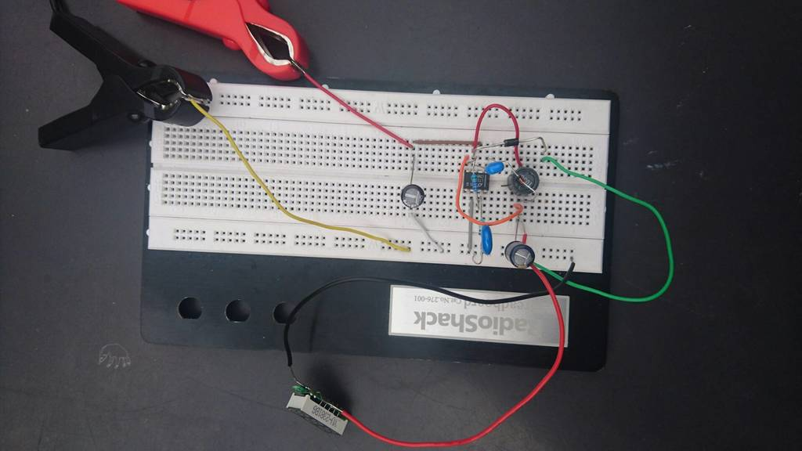
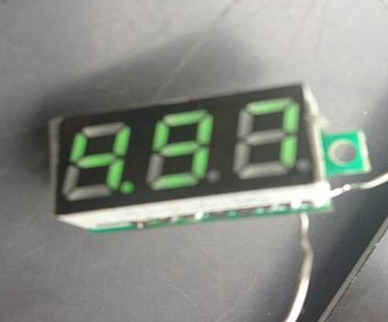
Prototype and Testing

Slide 33
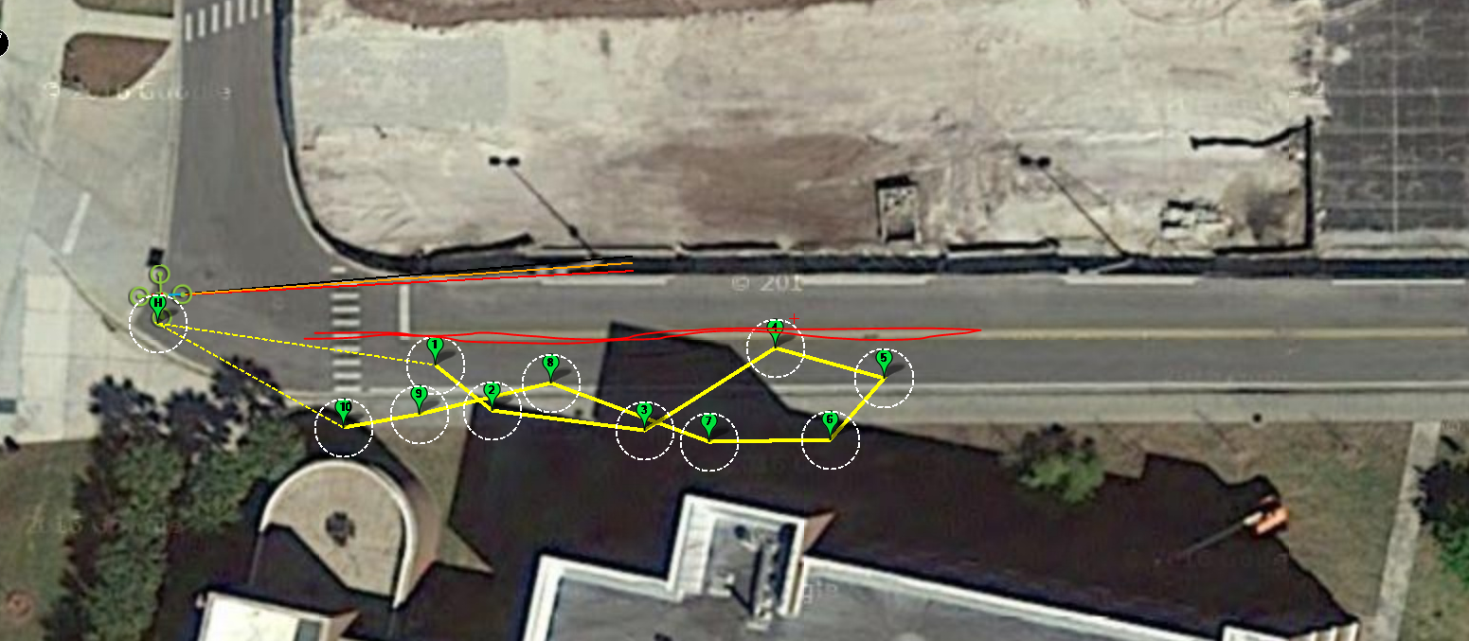
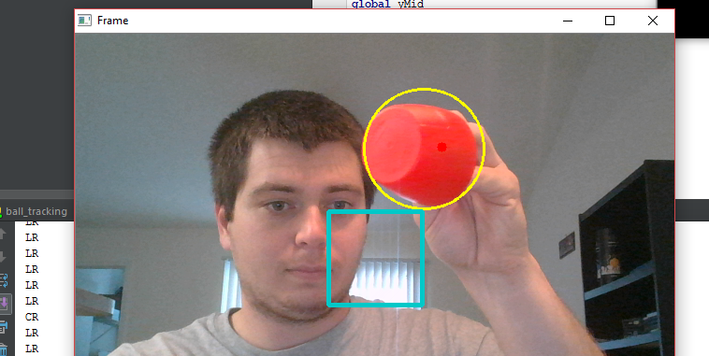
Prototype and Testing

Slide 34
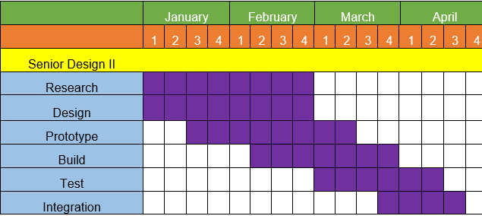
Milestones
Notes:
Finish by April 1. March 15 is midterm demonstration. Show rough demo. Can convert project to be a rover as a backup plan. David Douglas can activate our UCF ID’s for senior design lab

Slide 35
Work Distribution
Name | Auto-Landing | User-Tracking | Power and DC-DC Conversion | Wireless Charging | Budget Management
Benjamin Atsu
Daniel Camargo
Kyle Ferriss
Jonathan Obah

Slide 36
Progress Report

Slide 37
Financing
Most of our project is sponsored by Boeing and Leidos,
The upfront costs and reimbursement is Kyle Ferriss’s responsibility, and any costs not covered by the sponsorship will be divided evenly amongst the group.

Slide 38
Budget
Item | Cost
Microcontroller | $20.00
PCB Manufacturing | $100.00
Induction Coil | $10.00
Document Printing | $50.00
Camera | $50.00
Servo | $10.00
Propellers | $20.00
DC Motors | $40.00
Wiring | $10.00
Controller | $20.00
Solar Panels | $20.00
Wireless Transmitter and Receiver | $225
Accelerometer | $20.00
Drone Frame | $30.00
Materials (wood, plastic) | $50.00
GPS | $50.00
Altimeter | $15.00
Misc. | $300.00
Total | $1034.00
Sponsorship from Boeing/Leidos | -$745.65
Estimated Out of Pocket Costs | $288.35

Slide 39

Questions

